Slide 1

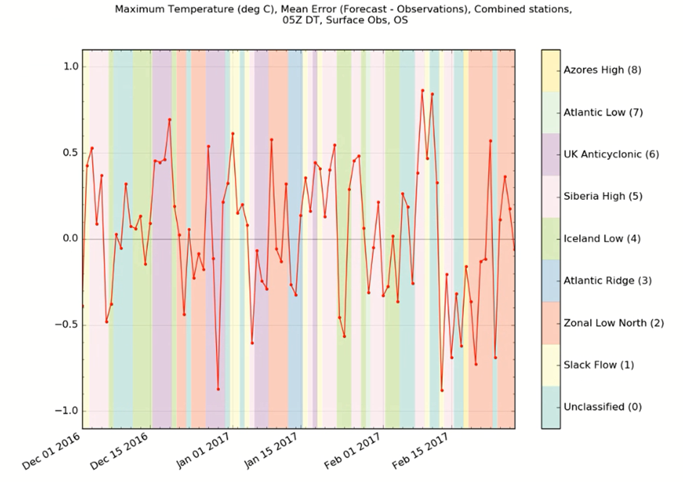
Assessing model performance by weather regime transitions
Chris Steele, Ben Perryman, Phil Gill, and Teresa Hughes
Assessing model performance under different weather regimes highlights areas for improvement and is a measure of model success.
We aim to build on the existing method by stratifying on flow regime transitions.
Are large changes in error, e.g. A→B, characteristic of transition periods?
A
B

Slide 2
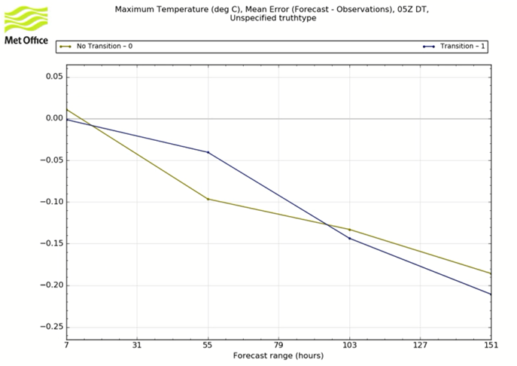
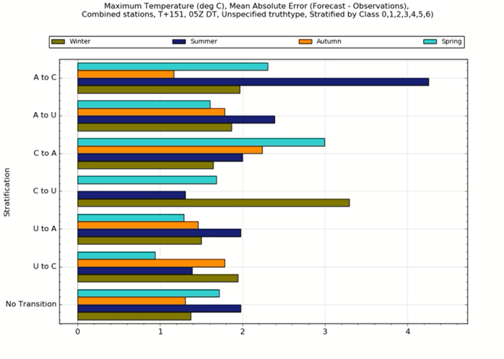
Assessing model performance by weather regime transitions
Chris Steele, Ben Perryman, Phil Gill, and Teresa Hughes
Stratification by transitions between cyclonic (C), anticyclonic (A), and unbiased (U) verified over the UK
Stratification by ‘transition’, or ‘no transition’
Mean error of maximum temperature (°C)
Stratification
Forecast range (hours)
Mean absolute error of maximum temperature (°C) at the 6 day forecast range

