Slide 1



PROJECTED CHANGES IN ATMOSPHERIC CIRCULATION TYPES INDUCING HIGH INTENSITY OF THE URBAN HEAT ISLAND IN IASI CITY
Lucian SFÎCĂ*, Robert HRIȚAC*, Vlad-Alexandru AMIHĂESEI*/**, Pavel ICHIM*
*Department of Geography and Geology, Alexandru Ioan Cuza University of Iași, Romania
** Meteo Romania, National Meteorological Administration, Bucharest, Romania
UP 3.3
Tuesday, 6.09
Synoptic climatology
15:00–15:15/EMS2022-124

Slide 2
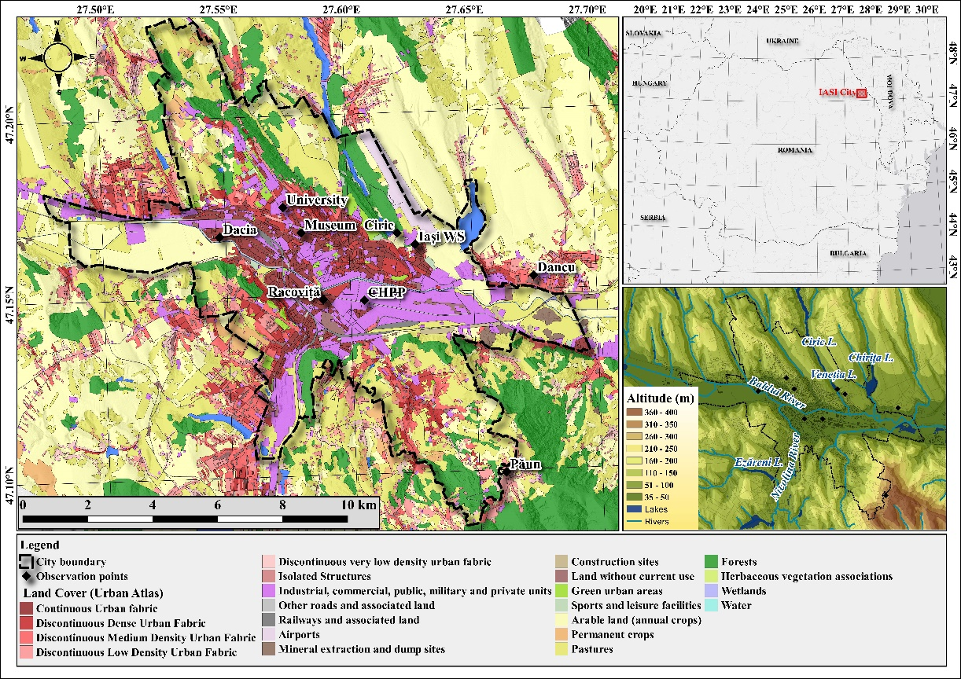
INTRODUCTION
General features of the study area
Aims and scope:
Assessing the intensity of urban heat island based on
in situ monitoring network functioning between 2013
and 2020.
2. Identifying the synoptic patterns associated to extreme
weather conditions and also to high intensities of urban
heat island. Analyzing their synchronous occurrence.
3. Exploring climate scenarios for air temperature over the
study region.
4. Spotting atmospheric circulation changes in the light of
climate scenarios and assessing their impact on the intensity
of urban heat island.
Physico-geographical position, hypsometric characteristics of the city of Iași and observation points
An urban heat island (UHI) estimated at 0,7-0,8°C in our previous studies;
Maximum intensity of UHI during the summer night (up to 3°C);
Recent residential development of the city that does not take into account the climate impact.

Slide 3
DATA:
Urban air temperature monitoring network
Air temperature hourly data from an urban monitoring network
consisting in 9 observation points covering the 2013-2020 interval.
Air temperature
(monitoring network)
Sea level pressure
(ERA 5)
2. Data for sea level pressure to assess atmospheric circulation
Sea level pressure, 500hPa and 700hPa wind at continental scale
from ERA-5 data base.
HISTORICAL
3. Climate scenario data
In this study 10 bias corrected regional climate models (RCMs), freely available via an open-access repository in netCDF CF-1.4-compliant file format (Dumitrescu and Amihaesei, 2021). The data is based on daily climate projections over the 21st century at 0.11° spatial resolution (about 12.5 km × 12.5 km), from the EURO-CORDEX initiative (Kotlarski et al., 2017; Mezghani et al., 2017, Dumitrescu and Amihaesei, 2021).
Sea level pressure at continental scale from EURO-CORDEX data base until 2100.
Projected changes of urban heat island
induced by atmospheric circulation
CLIMATE SCENARIOS
Air temperature
(RoClib)
Sea level pressure
(EURO-CORDEX)

Slide 4
METHODOLOGY: FLOW CHART
AIR TEMPERATURE
MONITORING DATA
HIGH URBAN HEAT ISLAND
INTENSITY
HIGH AIR TEMPERATURE
ATMOSPHERIC CIRCULATION
CLASSIFICATION
ATMOSPHERIC CIRCULATIONS
INDUCING HIGH/LOW
AIR TEMPERATURE
ATMOSPHERIC CIRCULATIONS
INDUCING HIGH/LOW
UHI INTENSITY
CLIMATE SCENARIOS
FUTURE ATMOSPHERIC CIRCULATIONS
INDUCING HIGH/LOW
AIR TEMPERATURE
FUTURE ATMOSPHERIC CIRCULATIONS
INDUCING HIGH/LOW
AIR TEMPERATURE
TREND ANALYSIS
FILTERING
TREND ANALYSIS
Identification of amospheric circulations types leading to high air temperature in summer and low air temperature in winter and to inense urban heat island
BETTER WINTER CONDITIONS
WORSE SUMMER CONDITIONS

Slide 5
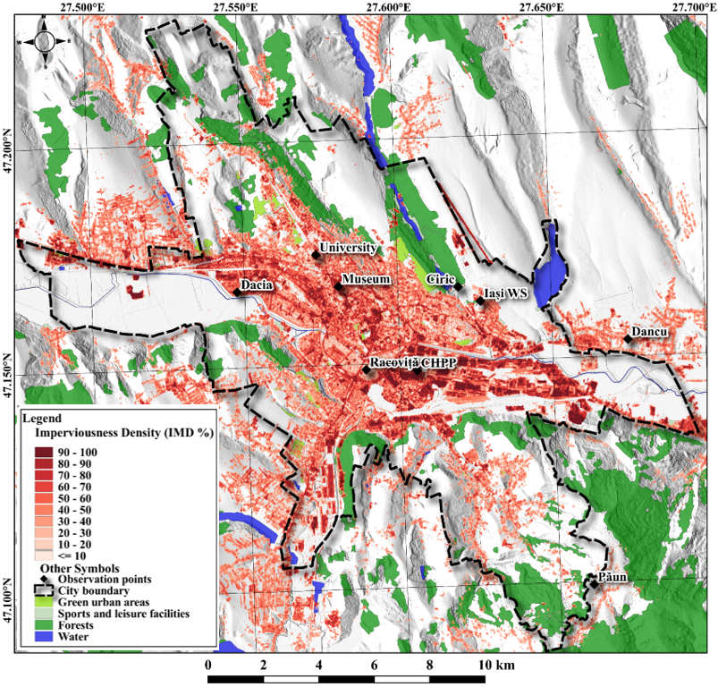
METHODOLOGY: DEFINING THE URBAN HEAT ISLAND INTENSITY
Imperviousness density (IMD) for Iași city and the location of in situ monitoring points for air temperature and relative humidity
1. Difference between monitoring points at the same altitude inside (Museum mp) and outside the city (Dancu mp).
0.60°C; 0.53°C; 0.66°C
2. Difference between the most central monitoring points (CHPP- Racovita-Museum mp) and those outside the city (Dancu-Ciric mp).
0.67°C; 0.67°C; 0.67°C

Slide 6
METHODOLOGY: ASSESSING ATMOSPHERIC CIRCULATION TYPES
1. Gross Wetter Typen classification (GWT)
2. Wetter Lage Klassifikation (WLK)
Gross Wetter Typen (GWT) atmospheric circulation method (Beck et al., 2007).
Based on sea level pressure, 18 types of atmospheric circulation:
- cyclonic (types 1–8 and 17) and
- anticyclonic (types 9–16 and 18) conditions.
Based on 700 hPa wind and 500 hPa geopotential height with 14 atmospheric circulation types (Bissolli and Dittmann, 2003; Philipp et al., 2010):
- anticyclonic (types 1-7) and
- cyclonic (types 8-14) conditions.
The classifications were conceived for historical time series (1981-2020) and GWT also for climate scenarios (RCP4.5, RCP8.5) using only sea level pressure data.

Slide 7
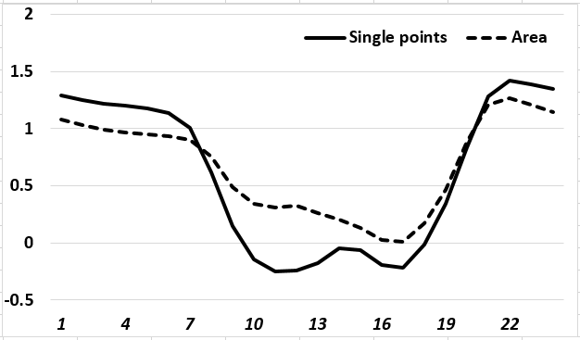
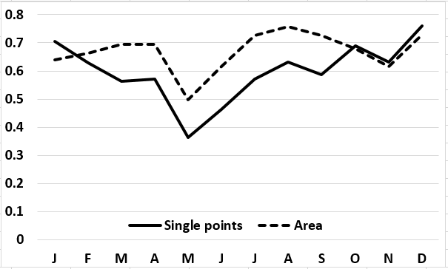
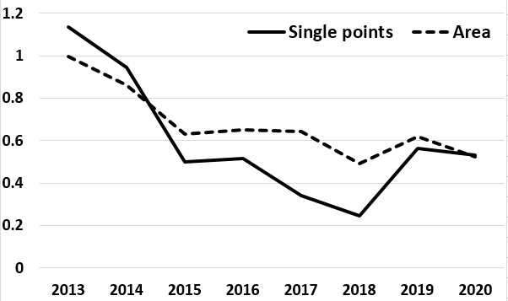
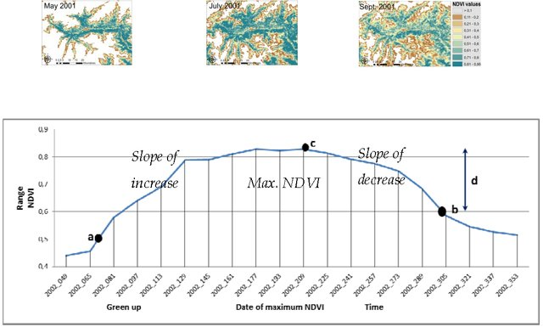
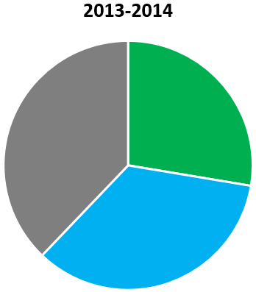
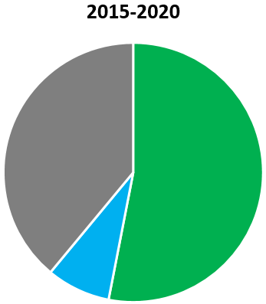





RESULTS: 1. INTENSITY OF URBAN HEAT ISLAND (2013-2020)
Daily variation of UHI intensity
Annual variation of UHI intensity
Multi-annual variation of UHI intensity
Sky view factors
NDVI Annual cycle
Atmospheric circulation
Museum: 68% Dancu: 84%
Westerly
circulations
Easterly
circulations
Others

Slide 8
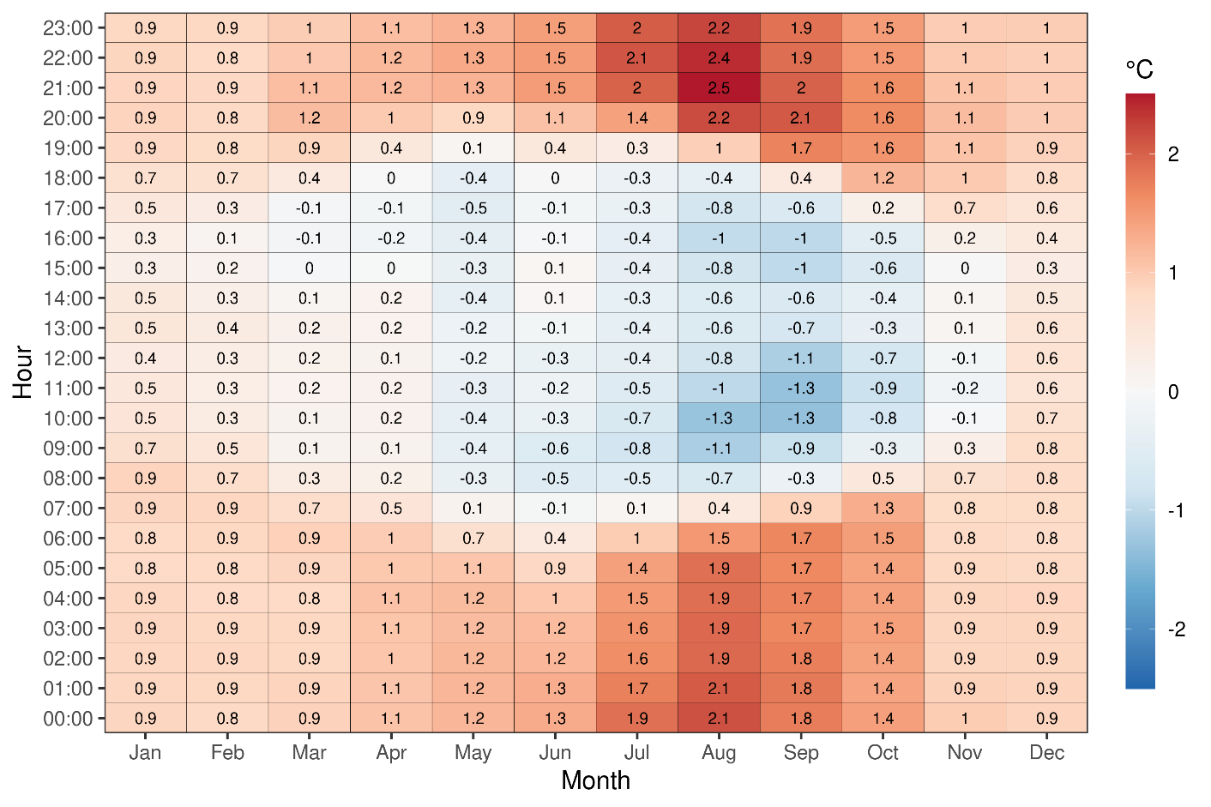
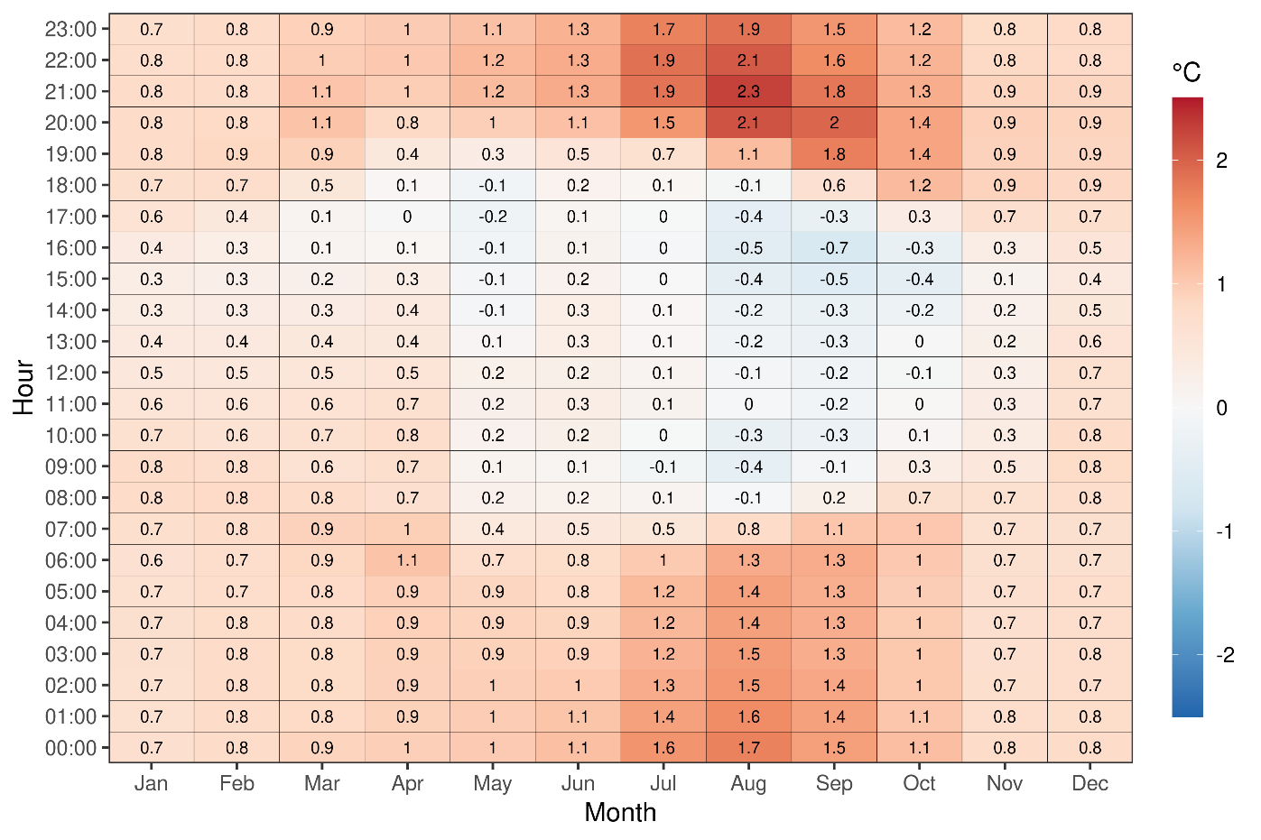
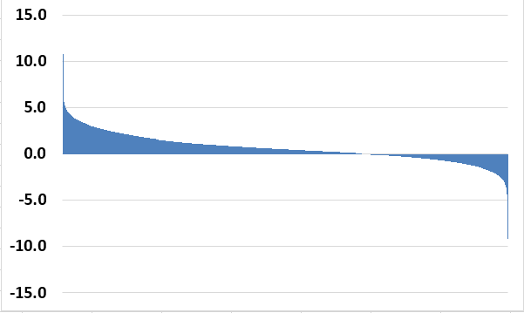
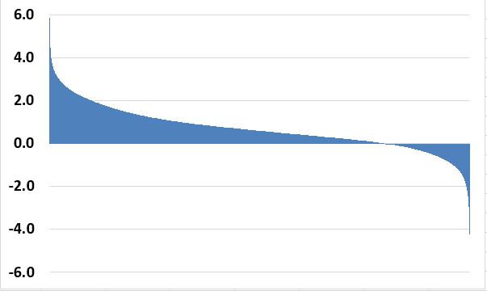
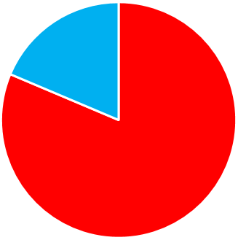
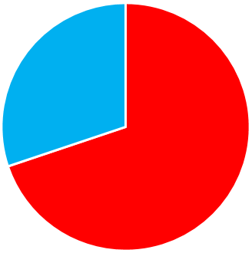
RESULTS: 1. INTENSITY OF URBAN HEAT ISLAND (2013-2020)
Single points assessment of UHI
Area-based assessment of UHI
18.6%
30.2%
69.8%
81.4%

Slide 9
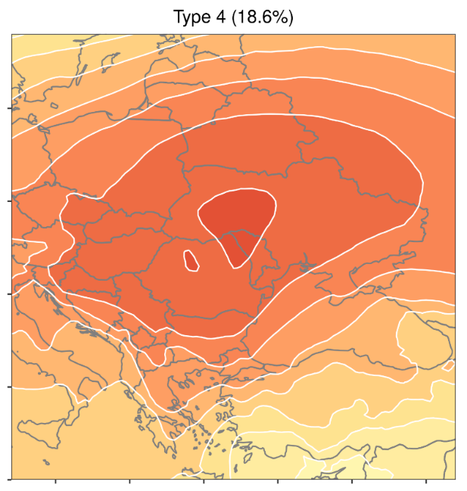



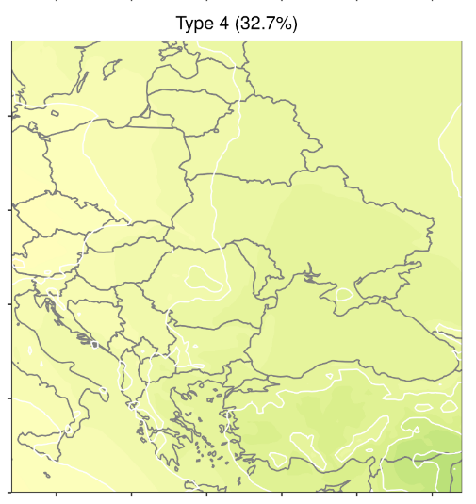

RESULTS: 2. SELF ORGANIZED MAPS FOR HIGH AIR TEMPERATURE AND INTENSE UHI
Main SOM of upper third
values of daily mean air temperature
Main SOM of upper third
values of urban heat island intensity

Slide 10
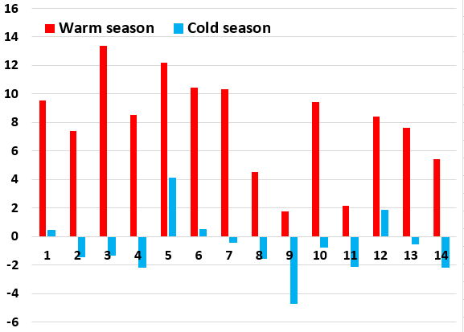
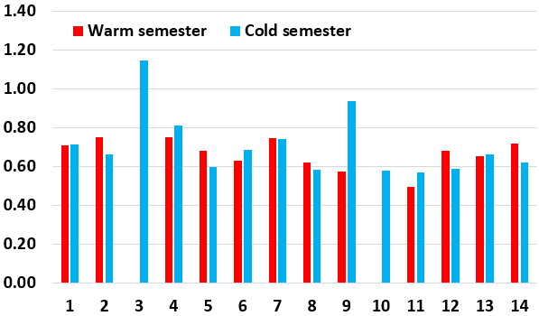
RESULTS: 3. WLK CIRCULATIONS LEADING TO HIGH TEMPERATURE AND INTENSE UHI
Daily maximum (WS) and minimum (CS) air temperature (Tmax)
Urban heat island intensity (UHII)
Warm season
WLK Types | 1 | 2 | 3 | 4 | 5 | 6 | 7 | 8 | 9 | 10 | 11 | 12 | 13 | 14
Tmax mean | 28.8 | 26.3 |  | 30.2 | 28.1 | 26.4 | 25.6 | 23.4 | 22.2 |  | 26.0 | 24.5 | 21.4 | 24.0
UHII | 0.71 | 0.75 |  | 0.75 | 0.68 | 0.63 | 0.75 | 0.62 | 0.57 |  | 0.50 | 0.68 | 0.65 | 0.72
Cold season
WLK Types | 1 | 2 | 3 | 4 | 5 | 6 | 7 | 8 | 9 | 10 | 11 | 12 | 13 | 14
Tmin mean | 0.4 | -1.4 | -1.3 | -2.1 | 4.1 | 0.5 | -0.4 | -1.5 | -4.7 | -0.8 | -2.1 | 1.8 | -0.5 | -2.2
UHII | 0.71 | 0.66 | 1.15 | 0.81 | 0.60 | 0.68 | 0.74 | 0.58 | 0.93 |  | 0.57 | 0.59 | 0.66 | 0.62

Slide 11
RESULTS: 3. WLK CIRCULATIONS LEADING TO HIGH TEMPERATURE AND INTENSE UHI
Warm season
 | 1 | 2 | 3 | 4 | 5 | 6 | 7 | 8 | 9 | 10 | 11 | 12 | 13 | 14
Tmax mean (2013-2020) | 28.8 | 26.3 |  | 30.2 | 28.1 | 26.4 | 25.6 | 23.4 | 22.2 |  | 26.0 | 24.5 | 21.4 | 24.0
UHI Intensity (2013-2020) | 0.71 | 0.75 |  | 0.75 | 0.68 | 0.63 | 0.75 | 0.62 | 0.57 |  | 0.50 | 0.68 | 0.65 | 0.72
Man-Kendall trend
Impact on UHII
WLK Types
+
-
-
-
Cold season
 | 1 | 2 | 3 | 4 | 5 | 6 | 7 | 8 | 9 | 10 | 11 | 12 | 13 | 14
Tmax mean (2013-2020) | 0.4 | -1.4 | -1.3 | -2.1 | 4.1 | 0.5 | -0.4 | -1.5 | -4.7 | -0.8 | -2.1 | 1.8 | -0.5 | -2.2
UHI Intensity (2013-2020) | 0.71 | 0.66 | 1.15 | 0.81 | 0.60 | 0.68 | 0.74 | 0.58 | 0.93 | 0.58 | 0.57 | 0.59 | 0.66 | 0.62
Man-Kendall trend
Impact on UHII
WLK Types

Slide 12
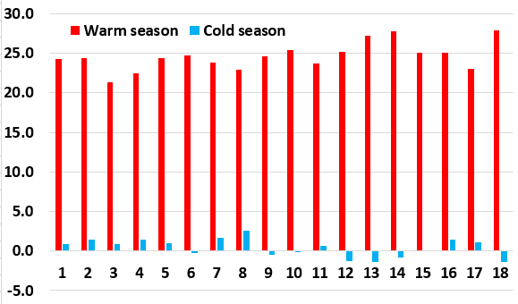
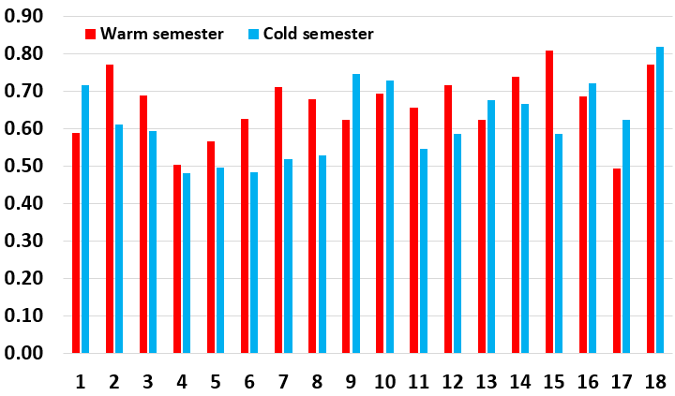
RESULTS: 4. GWT CIRCULATIONS LEADING TO HIGH TEMPERATURE AND INTENSE UHI
Daily maximum (WS) and minimum (CS) air temperature (Tmax)
Urban heat island intensity (UHII)
Warm season
GWT Types | 1 | 2 | 3 | 4 | 5 | 6 | 7 | 8 | 9 | 10 | 11 | 12 | 13 | 14 | 15 | 16 | 17 | 18
Tmax | 24.2 | 24.4 | 21.4 | 22.5 | 24.4 | 24.7 | 23.9 | 22.9 | 24.6 | 25.4 | 23.7 | 25.2 | 27.2 | 27.8 | 25.0 | 25.0 | 23.0 | 27.9
UHII | 0.59 | 0.77 | 0.69 | 0.50 | 0.57 | 0.63 | 0.71 | 0.68 | 0.62 | 0.69 | 0.66 | 0.72 | 0.62 | 0.74 | 0.81 | 0.69 | 0.50 | 0.77
Cold season
GWT Types | 1 | 2 | 3 | 4 | 5 | 6 | 7 | 8 | 9 | 10 | 11 | 12 | 13 | 14 | 15 | 16 | 17 | 18
Tmax | 0.9 | 1.4 | 0.8 | 1.5 | 0.9 | -0.2 | 1.7 | 2.5 | -0.5 | -0.1 | 0.7 | -1.2 | -1.3 | -0.8 | 0 | 1.4 | 1.2 | -1.4
UHII | 0.72 | 0.61 | 0.59 | 0.48 | 0.50 | 0.48 | 0.52 | 0.53 | 0.75 | 0.73 | 0.55 | 0.59 | 0.68 | 0.67 | 0.59 | 0.72 | 0.62 | 0.82

Slide 13
RESULTS: 4. GWT CIRCULATIONS LEADING TO HIGH TEMPERATURE AND INTENSE UHI
Warm season
 | 1 | 2 | 3 | 4 | 5 | 6 | 7 | 8 | 9 | 10 | 11 | 12 | 13 | 14 | 15 | 16 | 17 | 18
T max mean (2013-2020) | 24.2 | 24.4 | 21.4 | 22.5 | 24.4 | 24.7 | 23.9 | 22.9 | 24.6 | 25.4 | 23.7 | 25.2 | 27.2 | 27.8 | 25.0 | 25.0 | 23.0 | 27.9
UHI Intensity (2013-2020) | 0.59 | 0.77 | 0.69 | 0.50 | 0.57 | 0.63 | 0.71 | 0.68 | 0.62 | 0.69 | 0.66 | 0.72 | 0.62 | 0.74 | 0.81 | 0.69 | 0.50 | 0.77
Impact on UHII
Man-Kendall trend
-
+
-
Cold season
 | 1 | 2 | 3 | 4 | 5 | 6 | 7 | 8 | 9 | 10 | 11 | 12 | 13 | 14 | 15 | 16 | 17 | 18
T max mean (2013-2020) | 0.9 | 1.4 | 0.8 | 1.5 | 0.9 | -0.2 | 1.7 | 2.5 | -0.5 | -0.1 | 0.7 | -1.2 | -1.3 | -0.8 | 0 | 1.4 | 1.2 | -1.4
UHI Intensity (2013-2020) | 0.72 | 0.61 | 0.59 | 0.48 | 0.50 | 0.48 | 0.52 | 0.53 | 0.75 | 0.73 | 0.55 | 0.59 | 0.68 | 0.67 | 0.59 | 0.72 | 0.62 | 0.82
Impact on UHII
Man-Kendall trend
+

Slide 14
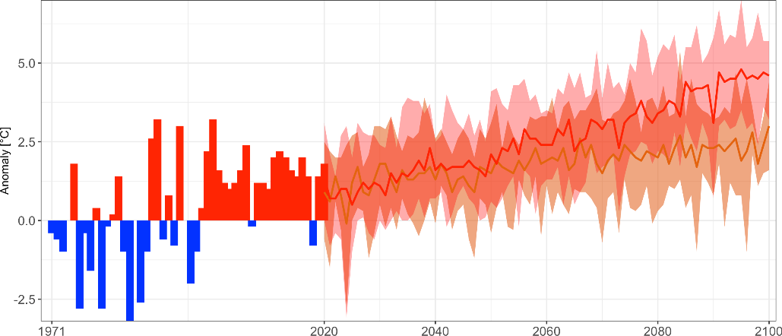
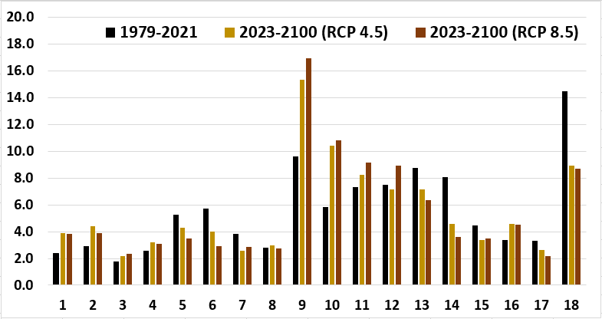
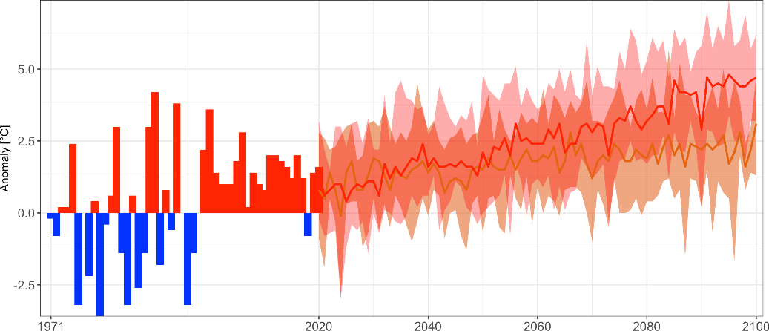
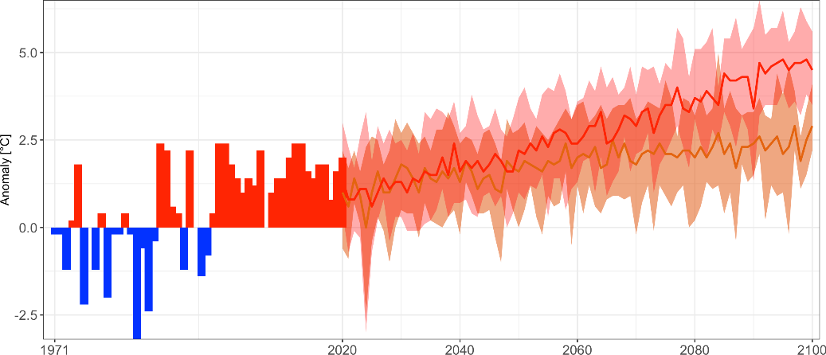
RESULTS: 5. CLIMATE SCENARIOS
Air temperature scenarios for Iași city
Annual mean frequency of GWTs for 1971-2021 and their projections according to RCP 4.5 and RCP 8.5
Mean air
temperature
%
Maximum air
temperature
Higher annual GWTs frequency:
- 9, 10, 11, 12 (westerly circulations in anticyclonic pattern)
- 1, 2, 3, 4 (westerly circulations in cyclonic patterns)
Lower annual GWTs frequency:
- 18 (pure anticyclonic) and 17 (pure cyclonic);
- 5, 6, 7(easterly cyclonic) and 13, 14, 15 (easterly anticyclonic),
Minimum air
temperature

Slide 15
RESULTS: 6. CHANGES IN ATMOSPHERIC CIRCULATION IMPACTING URBAN HEAT ISLAND
Mann-Kendall trend analysis indicated significant trends in atmospheric circulation types only for RCP8.5 and during the warm season.
GWT Types | 1 | 2 | 3 | 4 | 5 | 6 | 7 | 8 | 9 | 10 | 11 | 12 | 13 | 14 | 15 | 16 | 17 | 18
Tmax mean (2013-2020) | 24.4 | 24.4 | 21.3 | 22.7 | 24.5 | 24.9 | 23.8 | 22.9 | 24.9 | 25.5 | 23.8 | 25.2 | 27.6 | 28.4 | 25.4 | 25.2 | 23.2 | 28.4
RCP 8.5 Tmax changes (2090-2099) | +0.6 | +0.3 | +4.0 | +4.2 | +2.2 | -1.7 | -1.8 | +1.4 | +1.6 | +0.1 | +4.3 | +4.1 | +2.1 | -3.7 | -1.9 | -0.6 | +0.4 | -0.3
UHII | 0.59 | 0.77 | 0.69 | 0.50 | 0.57 | 0.63 | 0.71 | 0.68 | 0.62 | 0.69 | 0.66 | 0.72 | 0.62 | 0.74 | 0.81 | 0.69 | 0.50 | 0.77
Man-Kendall trend (p<0.05) |  | - |  |  |  |  | - | - |  |  |  | + |  |  | - |  |  | +
Impact on Urban Heat Island Intensity

Slide 16
RESULTS: 6. CHANGES IN ATMOSPHERIC CIRCULATION IMPACTING URBAN HEAT ISLAND
Changes in frequency of atmospheric circulation types presenting significant trends during warm season according to RCP8.5
Changes in air maximum temperature for atmospheric circulation types presenting significant trends in annual frequency for warm season according to RCP8.5

Slide 17
CONCLUSIONS
Climate change will lead to increased air temperature, but also to changes of atmospheric circulation leading to both high air temperature and high urban heat island intensity. In cases when the atmospheric circulation changes are leading to higher air temperature and higher UHI intensity this determines worse conditions during summer and better conditions during winter in term of thermal comfort.
The monitoring network should be extended to the western part of the city.
Changes in atmospheric circulation according to main climate scenarios are oriented towards an increase of westerly circulation types and a decrease in easterly circulation types.
The changes expected in atmospheric circulation types lead to an increase of urban heat island intensity, but only in RCP8.5 extreme scenario and only for warm season.
The changes in urban heat island intensity are expected to be less induced by changes in atmospheric circulation, but mostly by changes in urban land cover and climate change mitigation policies..
Acknowledgement: This work was supported by a grant of the Ministry of Research, Innovation and Digitization, CNCS - UEFISCDI, project number 32/10.05.2022, code PN-III-P1-1.1-TE-2021-0882, within PNCDI III (UCLAR)

