Slide 1
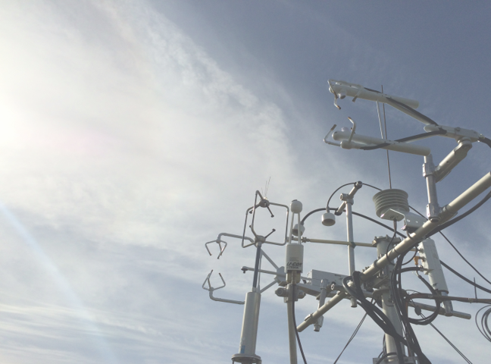
Quantifying Biases in Open-path Eddy Covariance CO₂ Flux Measurements Caused by Spectroscopic Effects in Broadband Non-dispersive Infrared Gas Analyzers
Ivan Bogoev
Campbell Scientific, UT, USA
EMS 2022, Bonn
Notes:
I would like to thank the organizers for the opportunity to present.

Slide 2

Motivation: controversial findings
Ma, J. et al. (2014). A downward CO₂ flux seems to have nowhere to go. Biogeosciences, 11: 6251-6262.
Is the desert a carbon sink? Where does the carbon go?
Schlesinger, W. (2016). An evaluation of abiotic carbon sinks in deserts. Global Change Biol., doi: 10.1111/gcb.13336

Slide 3
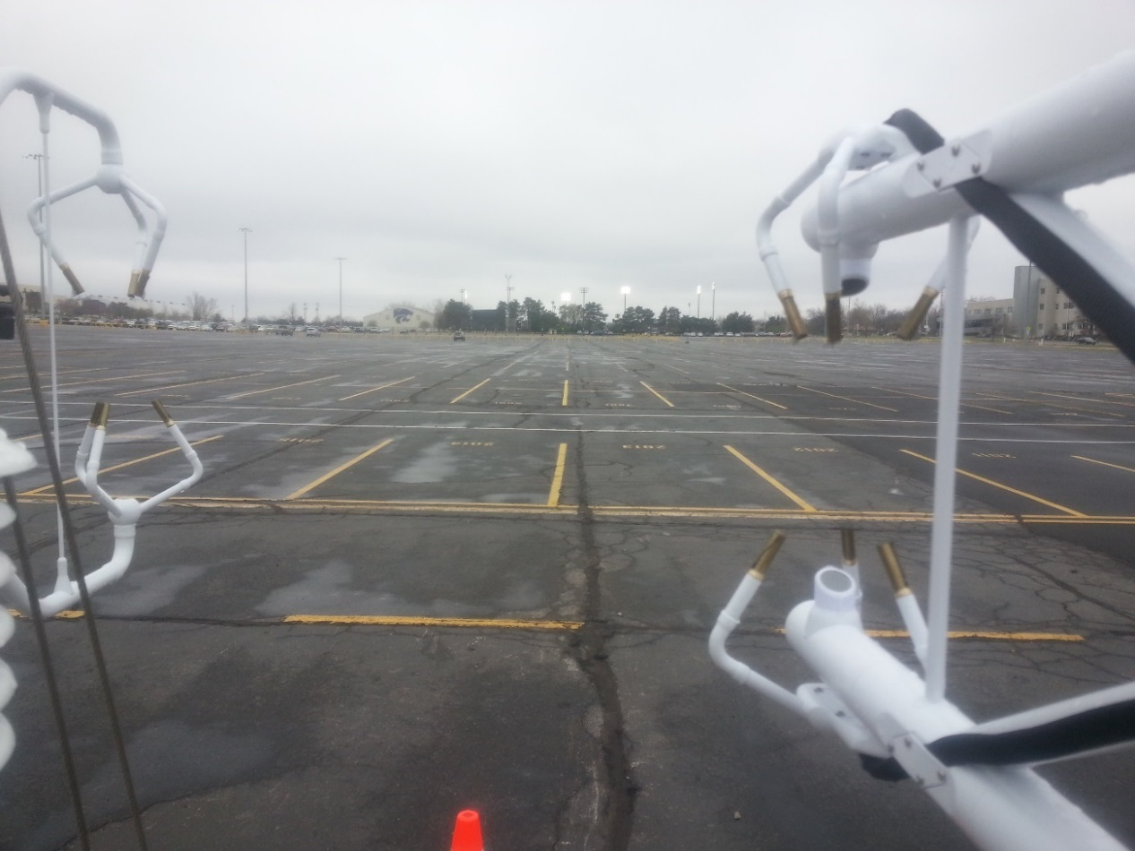
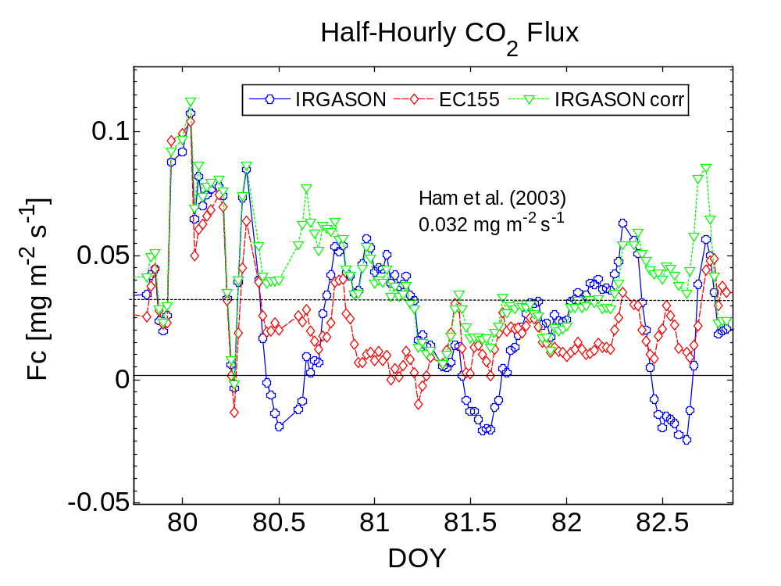
Motivation: unreasonable CO₂ uptake

Slide 4
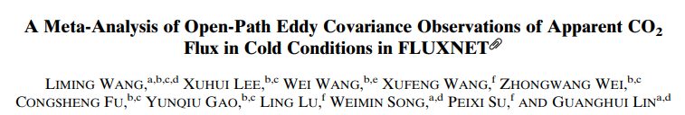
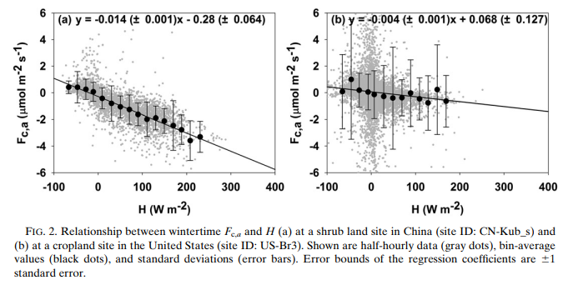
Motivation: unreasonable CO₂ uptake

Slide 5
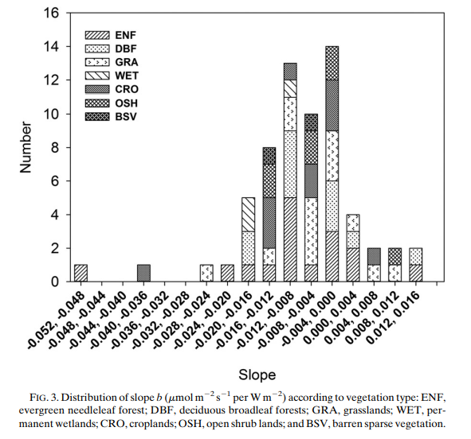
Motivation: unreasonable CO₂ uptake
64 total sites
37 sites
show bias

Slide 6
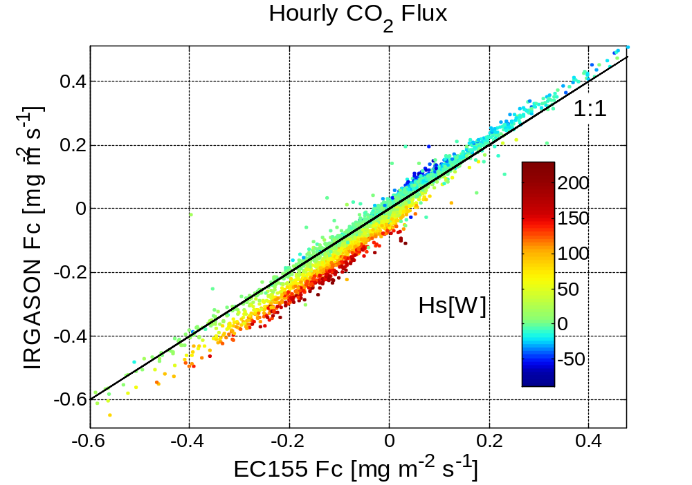
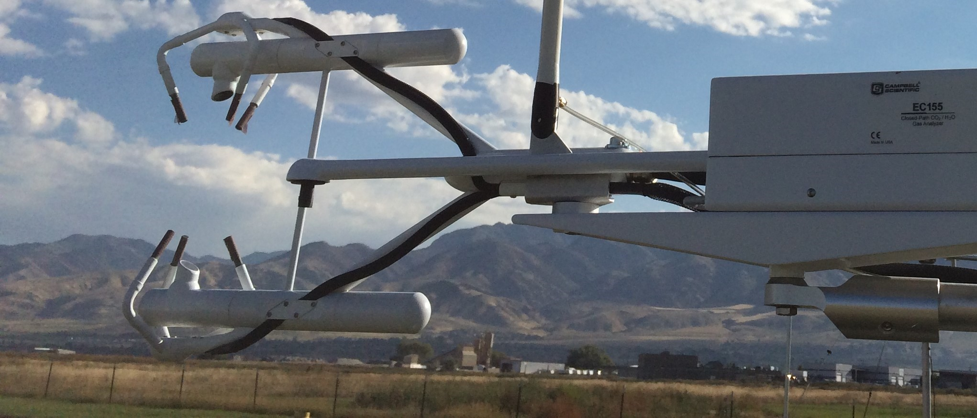
Motivation: poor comparisons between open- and closed-path analyzers

Slide 7
Biases in open-path sensor is driven by sensible heat flux

Slide 8
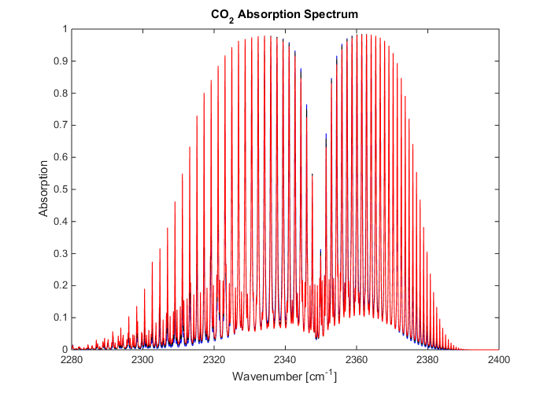
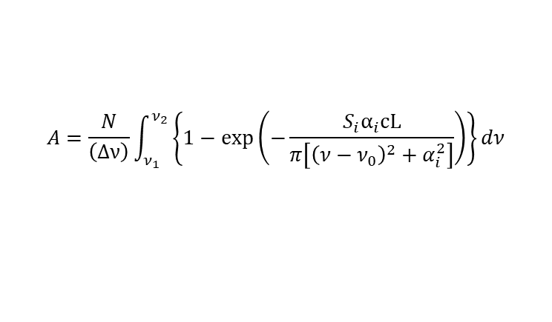
Background: broadband non-dispersive infrared spectroscopy
$$A=\frac{N}{\left(Δν\right)}\int_{ν_{1}}^{ν_{2}}{\left\{1−\exp\left(−\frac{S_{i}α_{i}cL}{π\left[{\left(ν−ν_{0}\right)}^{2}+α_{i}^{2}\right]}\right)\right\}}dν$$
A = Absorbed light energy in the spectral interval
N = Number of absorption lines in the spectral interval
ν = Wave number of the individual spectral line
c = Density of the absorbing gas
L = Path length
S_{i} = Strength of the individual line
α_{i} = Half-width of the individual line
S_{i} = f(T) α_{i} = f(T,P,)
T = Air temperature, P = barometric pressure
A = f(c,T)

Slide 9
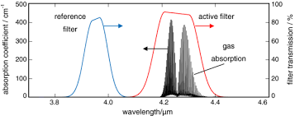
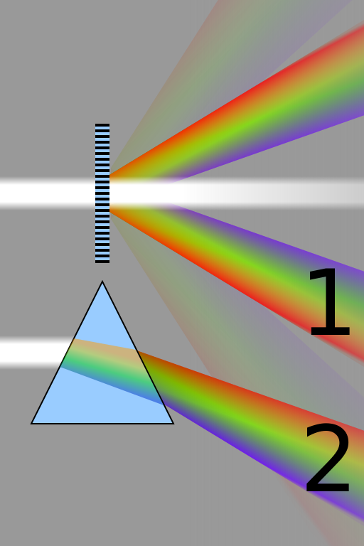
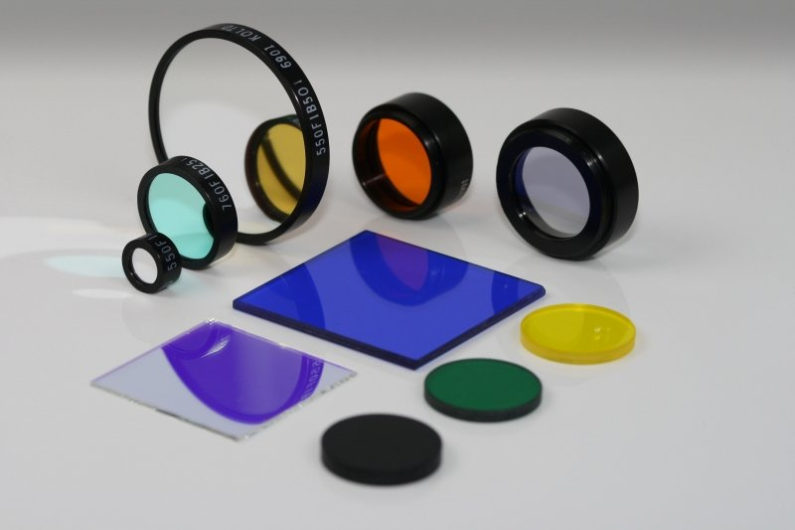
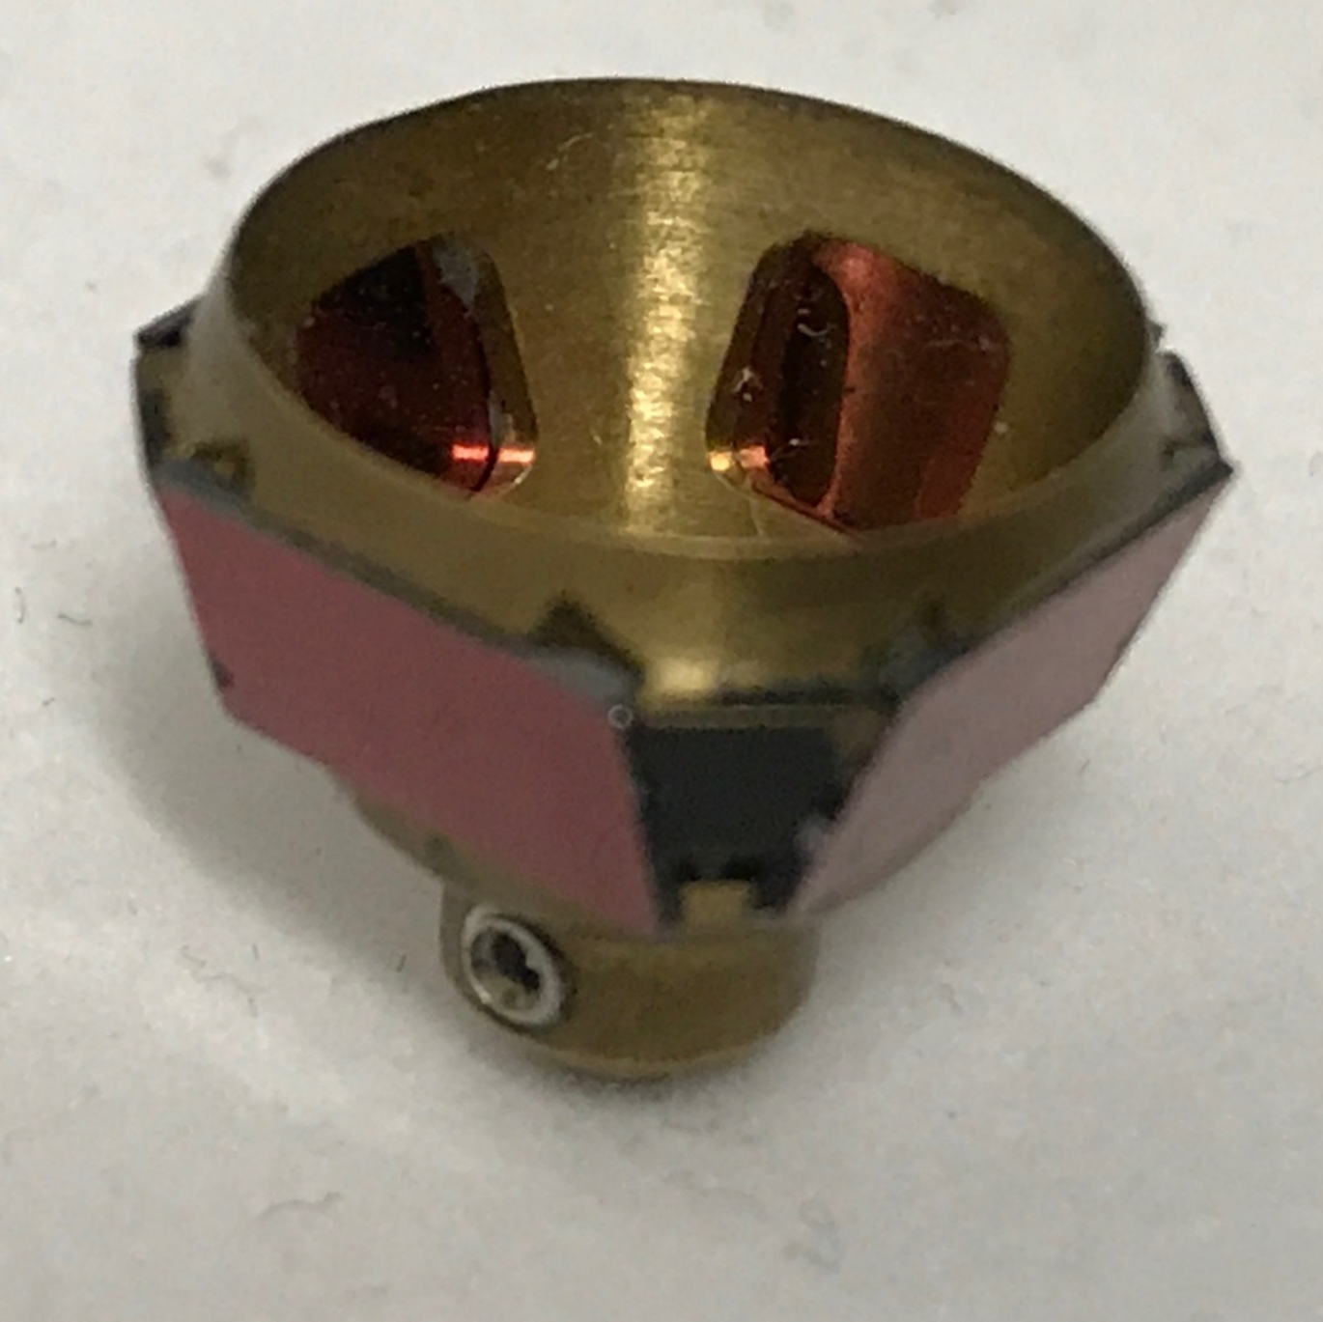
Non-dispersive infrared spectroscopy
After Infratek Gmbh
Non-dispersive: interference filters
Dispersive

Slide 10
Methods: HITRAN simulations
Same CO₂ density at different temperatures
600 ppm 244 K, 29.95 mmol m⁻³
700 ppm 285 K, 29.95 mmol m⁻³
700 ppm 326 K, 29.95 mmol m⁻³
710 ppm 285 K, 30.35 mmol m⁻³

Slide 11
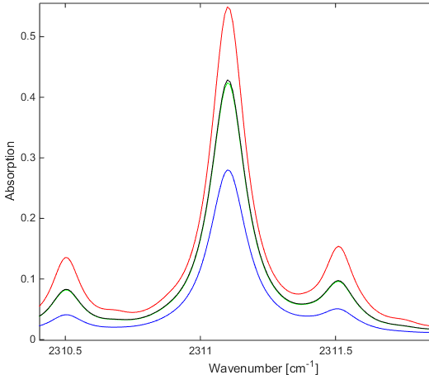
Collision broadening: weak lines
326 K
285 K
244 K
Doppler broadening of weak lines where line strength and line width increase with increase in temperature

Slide 12
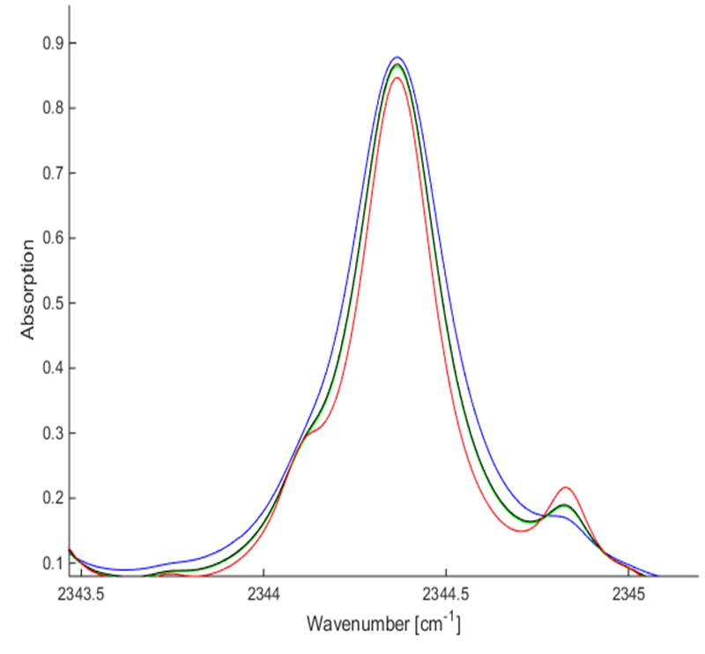
Collision broadening: strong lines
Doppler broadening of strong lines where line strength and line width decrease with increase in temperature
244 K
285 K
326 K

Slide 13
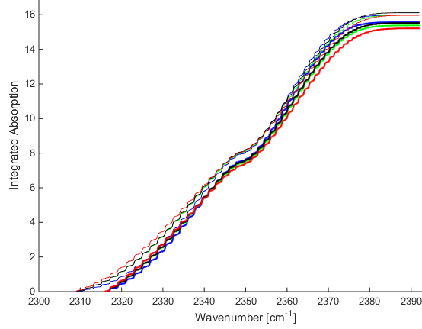
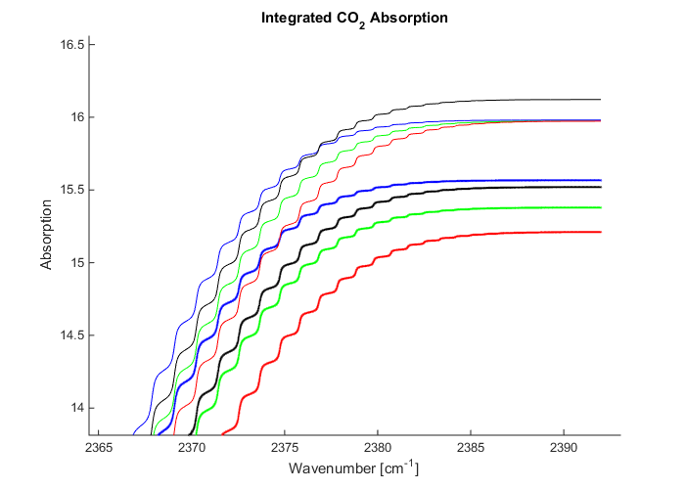

Methods: HITRAN integrated spectra
$$A=\frac{N}{\left(Δν\right)}\int_{ν_{1}}^{ν_{2}}{\left\{1−\exp\left(−\frac{S_{i}α_{i}cL}{π\left[{\left(ν−ν_{0}\right)}^{2}+α_{i}^{2}\right]}\right)\right\}}dν$$
2392 cm⁻¹
2309 cm⁻¹
Case A
A
Optimal
2316 cm⁻¹
Case B
B
Accounting for filter tolerances
Δ
2392 cm⁻¹

Slide 14
Results: HITRAN integrated spectra
Case A
Δ10 ppm CO₂
No temperature dependance
Case B
Δ10 ppm CO₂
Δ82 K
Temperature sensitivity approx. 0.25 ppm K⁻¹
or 0.0098 mmol m⁻³ K⁻¹
Warmer air will cause underestimation of CO₂

Slide 15
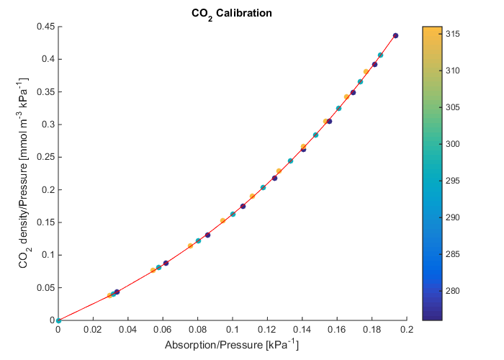
Methods: synthetic calibration HITRAN
Generated 33 CO₂ absorption spectra for spectral range case B
CO₂ concentrations: 0 to 1000 ppm
1000 ppm
Temperatures: 276, 295 and 316 K
Pressure: 101.4 kPa
T [K]
276 K
295 K
400 ppm
316 K
300 ppm
200 ppm
100 ppm

Slide 16
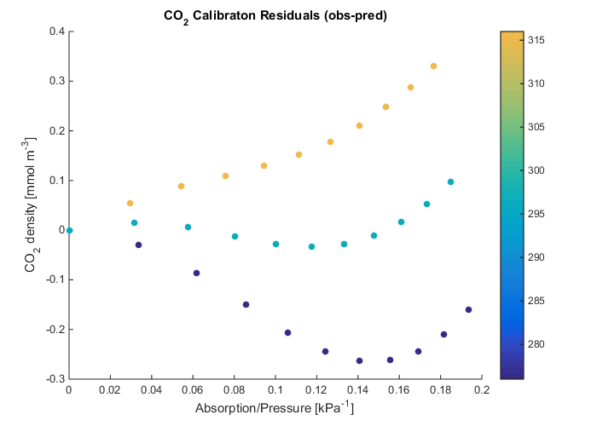

Results: synthetic calibration residuals
underestimation
$\frac{ΔCO2}{ΔT}=\frac{0.32}{316−276}=0.008 [mmol m−3K−1$]
Standard - measured
316 K
295 K
100 ppm
1000 ppm
200 ppm
overestimation
300 ppm
276 K
400 ppm

Slide 17

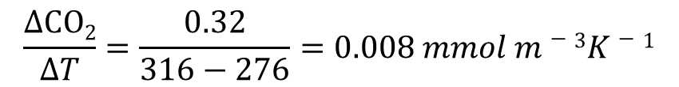
Discussion
$$\frac{ΔCO2}{ΔT}=\frac{0.32}{316−276}=0.008 mmol m−3K−1$$
μ$mol m−2 s−1 per Wm−2$

Slide 18
Conclusions
Case A
2309 cm⁻¹
2392 cm⁻¹
There is an optimal spectral band in the CO₂ absorption spectrum where line-broadening temperature effects are balanced
When the optimal CO₂ absorption band is properly sampled by the interference filter the temperature effects are negligible. Case A
A manufacturing tolerance of the filter pass-band can increase the sensitivity of the analyzer to air temperature changes and if not corrected can cause a systematic error in measured CO₂ concentrations. Case B
2316 cm⁻¹
Case B

Slide 19
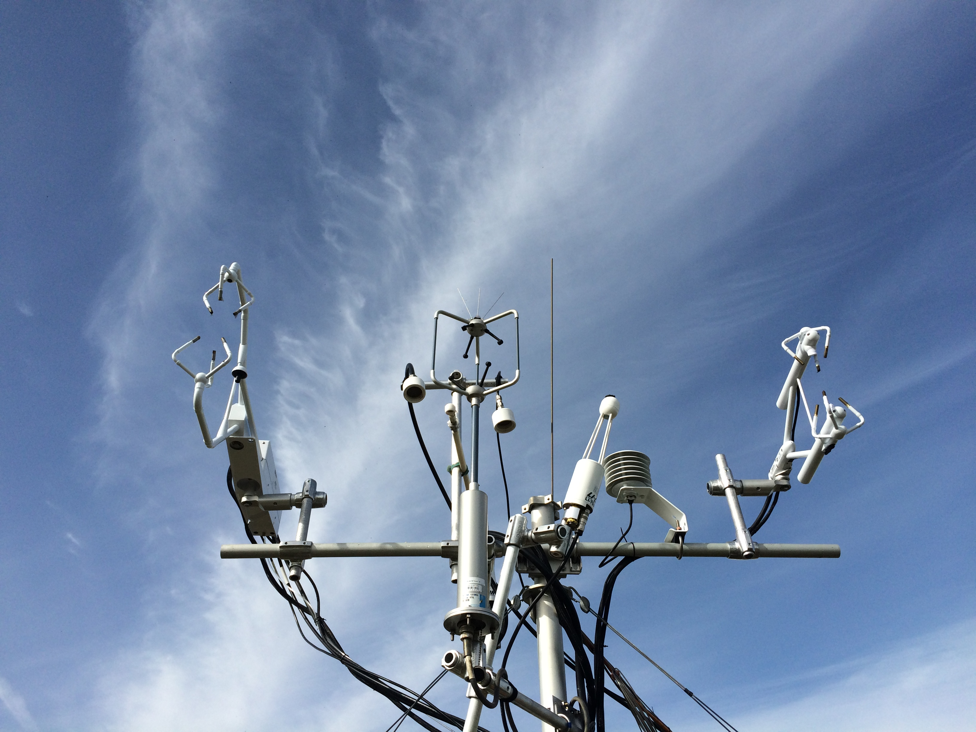

Conclusions
Open-path broad-band non-dispersive infrared CO₂ gas analyzers need a correction for temperature related spectroscopic effects
Accurate and fast-response air temperature measurements in the optical path of the analyzer are needed to properly apply the correction
T air
A = f(c,T)

Slide 20
References
Wang et al. (2017) A meta-analysis of open-path eddy covariance observations of apparent CO2 flux in cold conditions in FLUXNET
J. Atmos. Ocean. Technol., 34
Wang et al. (2017) Performance evaluation of an integrated open-path eddy covariance system in a cold desert environment
J. Atmos. Ocean. Technol., 33
Ono et al. (2008) Apparent downward CO2 flux observed with open-path eddy covariance over a non-vegetated surface
Theor. Appl. Climatol., 92, pp. 195-208
Russell et al. (2019) Adjustment of CO2 flux measurements due to the bias in the EC150 infrared gas analyzer
Agric. For. Meteorol., 276 Article 107593

