Slide 1
Study of a unique fog event in Israel during January 2021: from measured microphysics, ground-remote sensing and satellite imagery to mesoscale forecasts and synoptic analysis
Dorita Rostkier-Edelstein^{1,2}, Eyal Agassi¹, Pavel Kunin³, Tamir Tzadok¹, Rong-Shyang Sheu⁴, Adam Pitrkowski, and Ayala Ronen¹
¹Department of Environmental Physics, Environmental Sciences Division, Israel Institute for Biological Research, Ness-Ziona, Israel
²Fredy and Nadine Herrmann Institute of Earth Sciences, the Hebrew University of Jerusalem, Edmond J. Safra Campus, Jerusalem, Israel
³Life Sciences Research Institute, Ness-Ziona, Israel
⁴Research Applications Laboratory, National Center for Atmospheric Research, Boulder, Colorado, USA

Slide 2
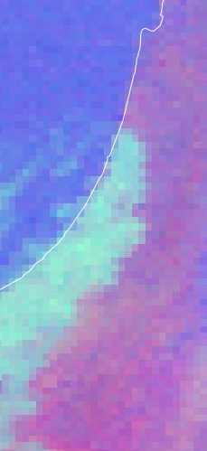
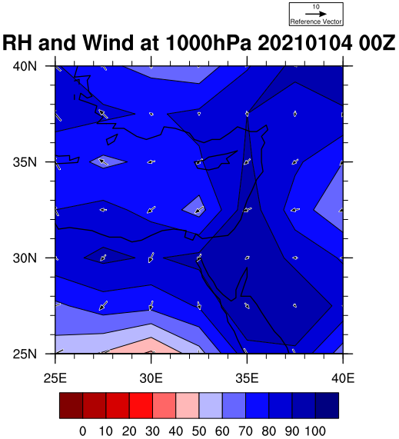
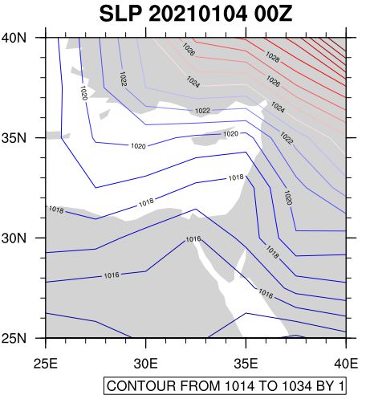
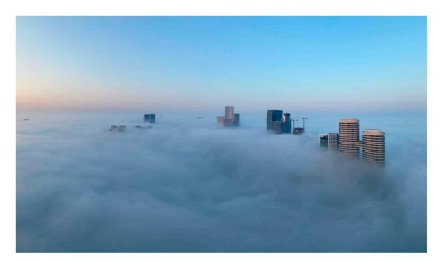
The event
Meteosat
Regional-scale radiation fog event that occurred in Israel's central and southern areas in January 2021.
Not observed in decades (~50 years), very dry soil after long dry period, very efficient radiative cooling
Synoptic flow: Red Sea Trough with eastern to western axis, available moisture (conditions prone to radiation fog)

Slide 3
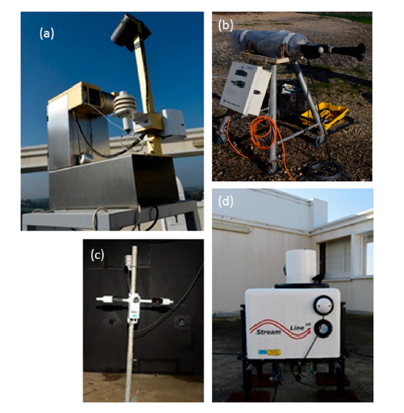
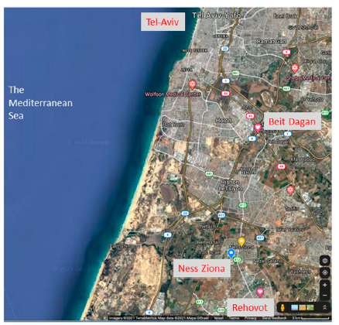
Measurements campaign
Field-campaign area map:
measurement site in Ness Ziona
nearby meteorological stations
Beit Dagan radionsondes site
(a) Sky imager [ASIS1i, SOLOMIRUS, Colorado
Springs, Colorado, USA].
(b) Droplet-sizes measurements [FSSP-100, PMS, Boulder, Colorado, USA].
(c) Visibility-range sensor [SWS250, Biral, Bristol, UK].
(d) Doppler Lidar [StreamLine XR, Halo photonics, Leigh, UK]
[Google maps]

Slide 4
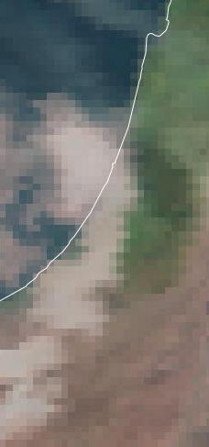
EUMETSAT imagery
Night time: a combination of the SEVIRI IR3.9, IR10.8 and IR12.0 channels.
Best color contrast between fog/low cloud and cloud-free area at night.
The thinner the low clouds/fog the more like the color of the ground (pinkish).
However, fog and low clouds are not separable from each other based only on their colors.
Day time: Natural Color RGB product, solar channels: NIR1.6, VIS0.8 and VIS0.6.
Water clouds with small droplets have large reflectance at all channels and appear whitish.

Slide 5
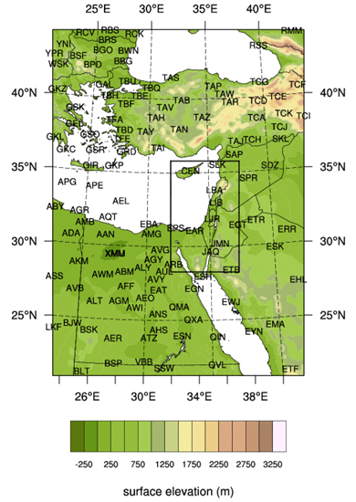
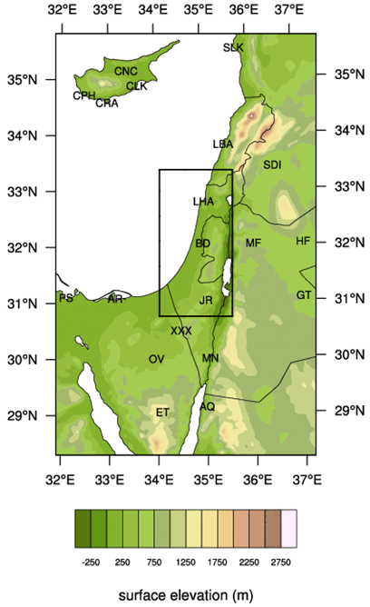
Operational WRF-RTFDDA mesoscale forecasts
WRF model (version 4.0) with the Advanced Research (ARW) WRF solver
3 nested domains 9, 3 and 1 km horizontal resolution and 57 vertical levels, operational output every 25 hPa
IC/BC from ECMWF’s Integrated Forecast System (IFS)
Initialization at 18 UTC
RTFDDA continuous assimilation (Newtonian relaxation) of surface observations, radiosounding and aircrafts observations
Process | Parameterization
Microphysics | WSM6
PBL | YSU
Surface layer | MM5 similarity
Short wave | RRTM
Long wave | Goddard
Land surface | Noah
Cumulus | Grell 3D ensemble

Slide 6
Algorithm for WRF-RTFDDA fog conditions evaluation
Simulation of radiation fog development is one the most difficult challenges in numerical weather prediction
It is common practice to forecast fog as a diagnostic variable, based on forecast conditions of temperature, relative humidity and wind speed.
The algorithm we used was based on a combination of three thresholds:
  2-m relative humidity > 90%
  10-m wind speed < 2 m/s
  dew point depression (difference between 2-m temperature and 2 m dew point temperature) < 2.2 of less.

Slide 7
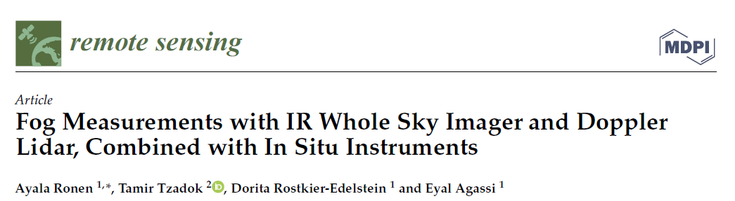
Results: remote sensing
Remote Sens. 2021, 13, 3320. https://doi.org/10.3390/rs13163320

Slide 8
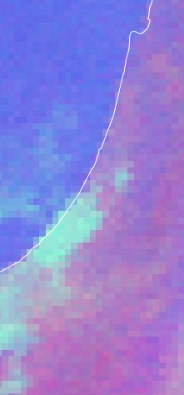
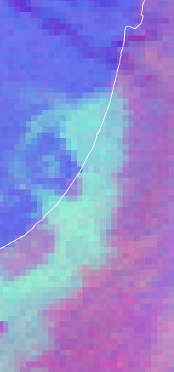
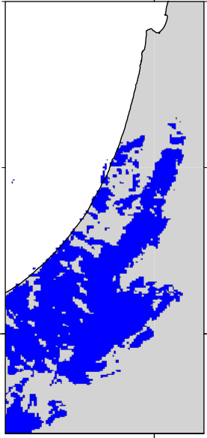
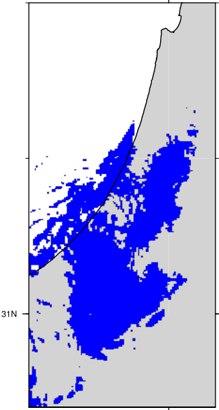
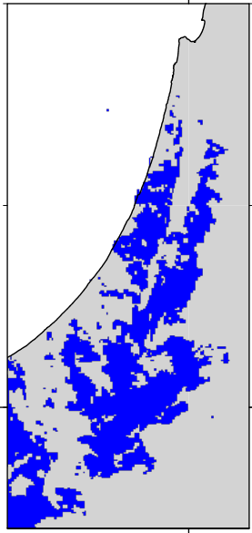
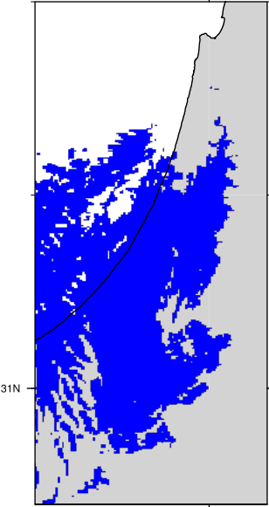
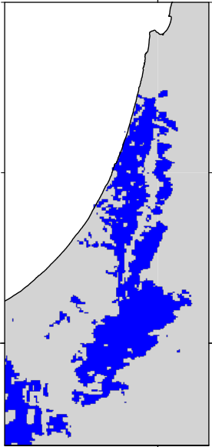
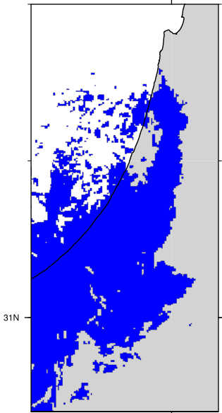
Results: satellite and model forecasts
Time (UTC) | 00 |  | 02 |  | 04
EUMETSAT
WRF-RTFDDA (diagnostic algorithm) | Surface | 975hPa | Surface | 975hPa | Surface | 975hPa
Whitish areas: warm, thick fog with small droplets.
Not possible to distinguish thin fog
Northward and seaward development (drier soil and land cover in the south lead faster cooling)
Clear patches (urban heat island?)

Slide 9
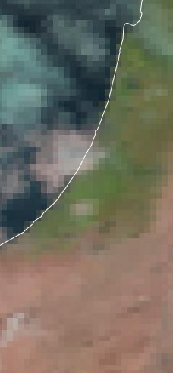
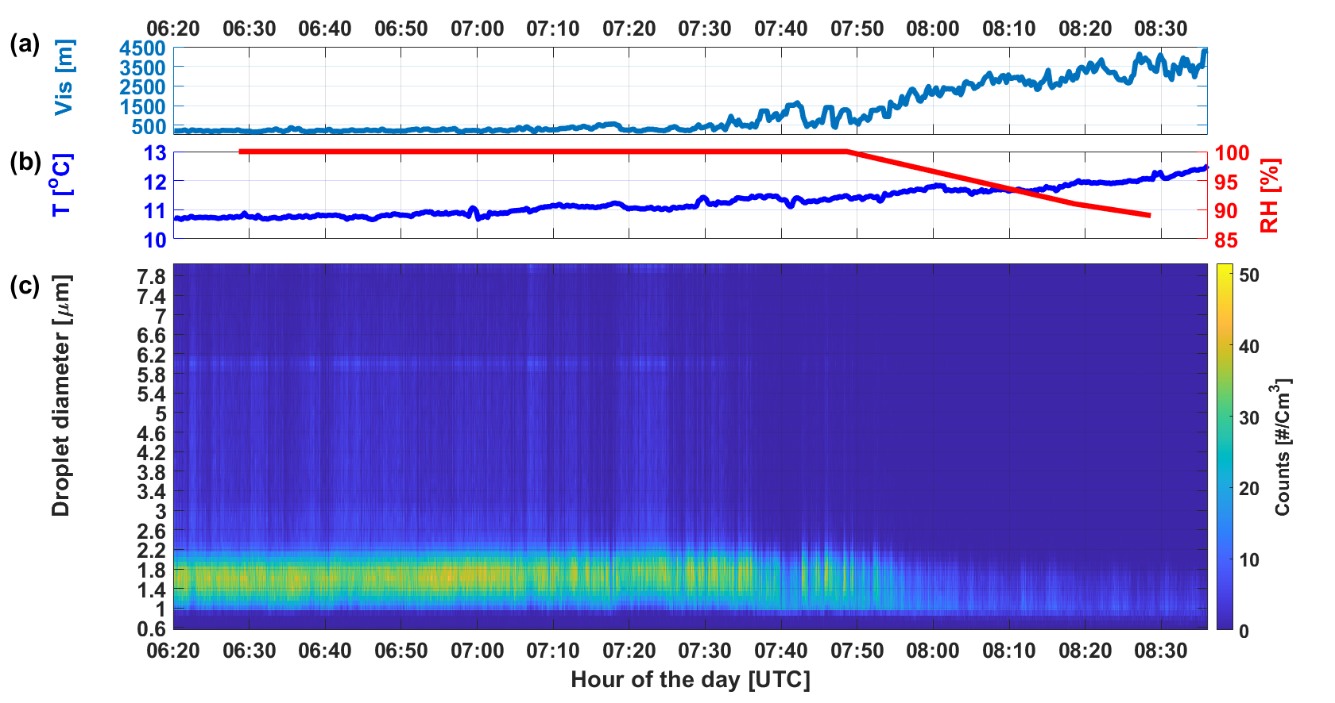
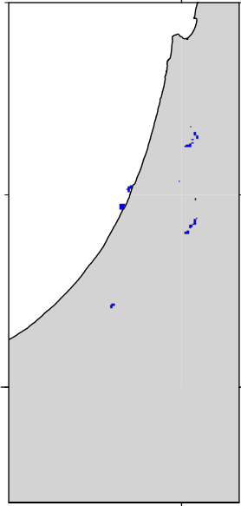
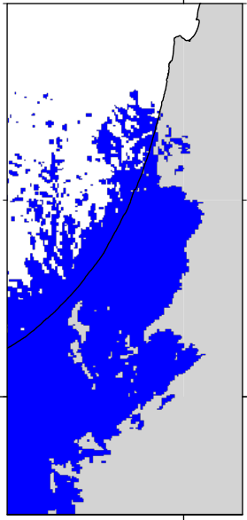
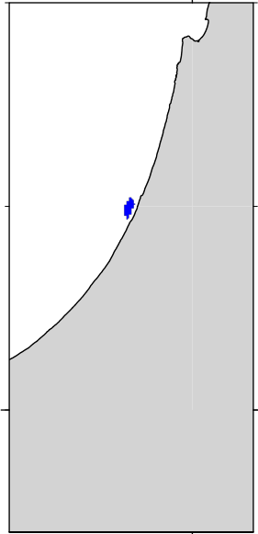
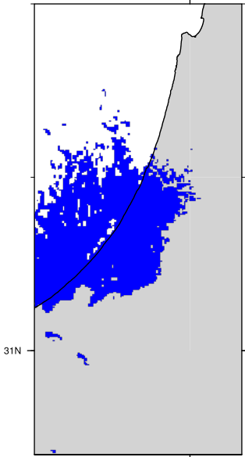
Results: satellite and model forecasts
Time (UTC) | 06 |  | 08
EUMETSAT
WRF-RTFDDA (diagnostic algorithm) | Surface | 975hPa | Surface | 975hPa
Model shows that as surface heats up fog just above it dissipates, but low level clouds still persist
In agreement with in-situ measurements of visibility at the surface

Slide 10
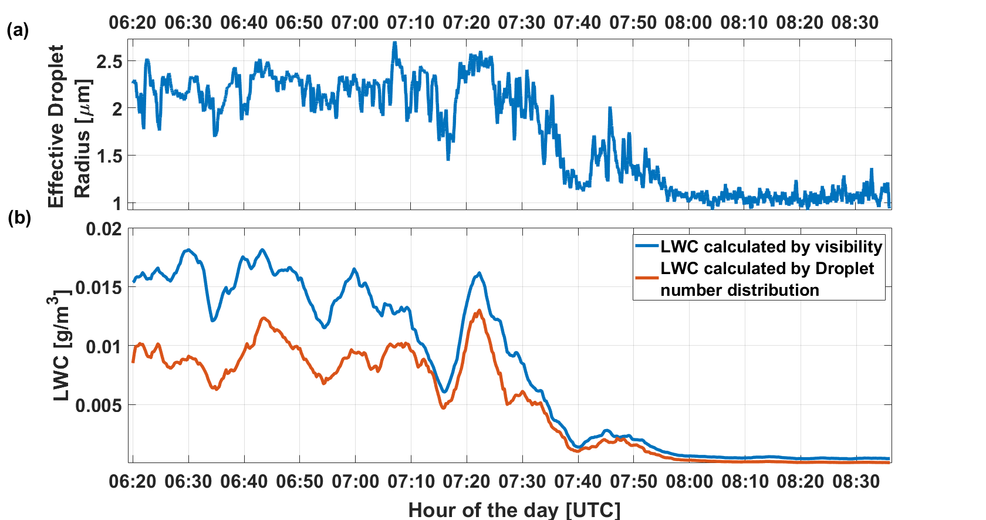
Microphysical properties
Fog droplets relatively small in agreement with EUMETSAT imagery,
very low LWC

Slide 11
Summary
A rare and dense regional-scale radiation fog event served as a case study for analyzing the fog in Israel.
EUMETSAT imagery enabled following the spatio-temporal development from south to central coastal areas and its dissipation at morning hours.
The in-situ measured droplets size agrees with the identification of the satellite images as small-drops fog.
WRF-RTFDDA forecasts at 1-km grid size overall predicted the temporal and spatial evolution of the dense fog.
Yet, differences are noted (landuse in the WRF model has not been updated for the past decades may affect accuracy)
WRF-RTFDDA forecasts distinguished between near-surface fog and elevated fog/low level clouds, that cannot be deduced from satellite images.
Future climate perspective: Increase in the frequency of such events as winters become drier and Red Sea troughs become more frequent?

