Slide 1

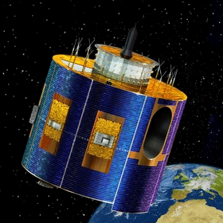
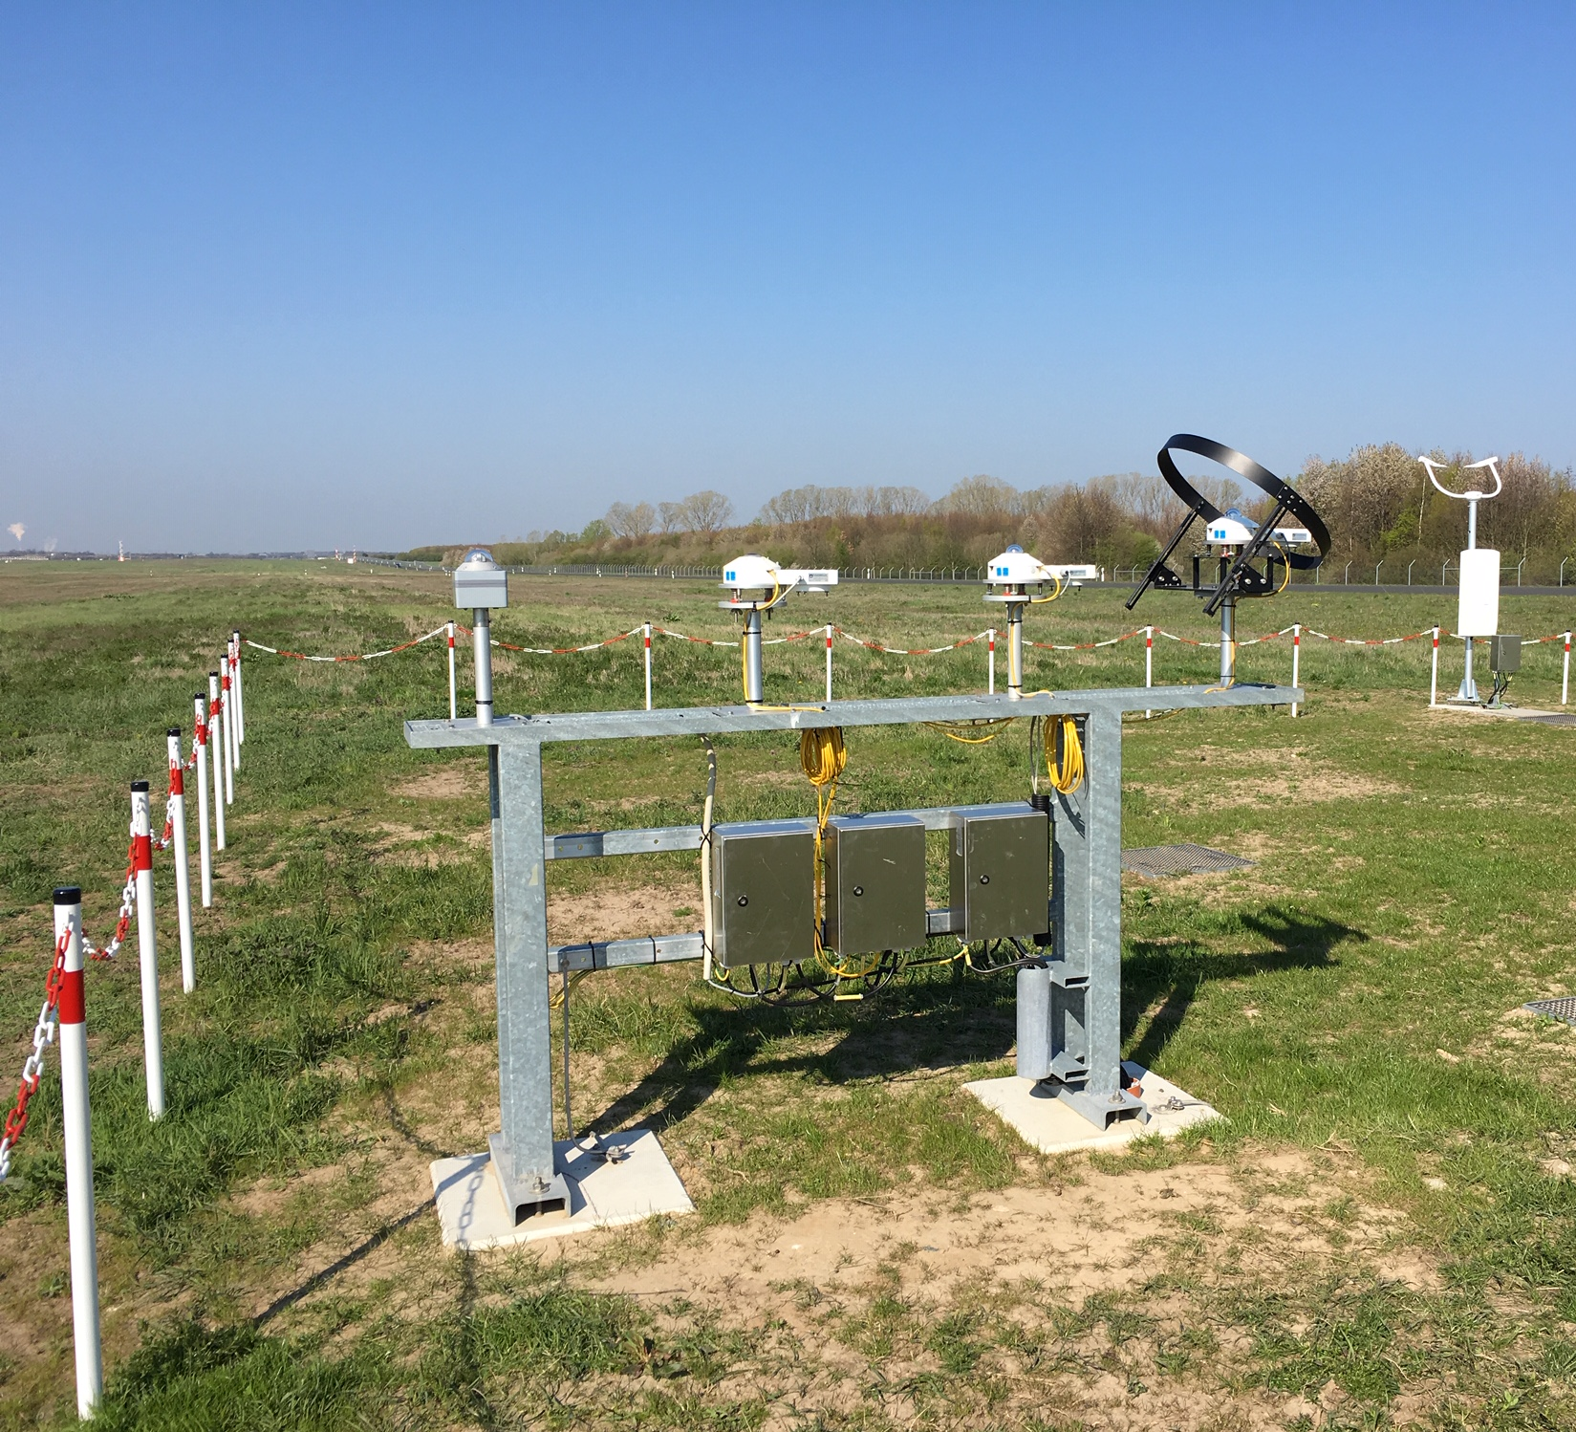

Towards the combination of in-situ and satellite-based solar radiation data in near-realtime - The project DUETT at DWD
Anna Klameth, Sven Brinckmann, Jörg Trentmann
UP1.5 Atmospheric measurements: Instruments, experiments, networks and long-term programs using in-situ and remote sensing techniques
Quelle: https://www.dwd.de/DE/forschung/atmosphaerenbeob/wettersatelliten/satelliten_meteosat_node.html
Bild: S. Wacker

Slide 2
Quelle: https://www.dwd.de/DE/forschung/atmosphaerenbeob/wettersatelliten/satelliten_meteosat_node.html
1
Introduction to DUETT
OUTLINE
2
Current status DUETT
3
Validation results DUETT
4
Summary and outlook

Slide 3
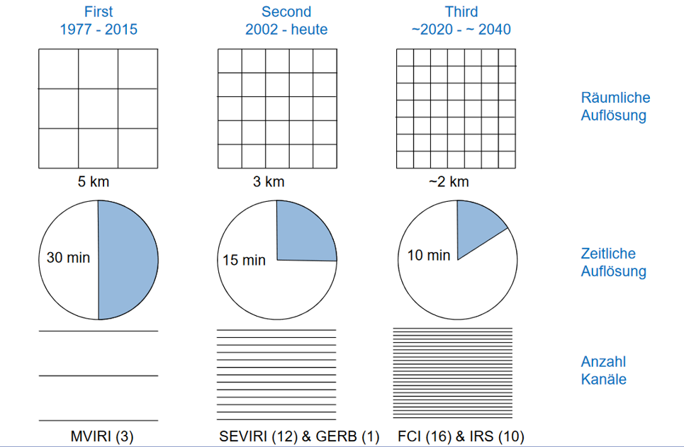
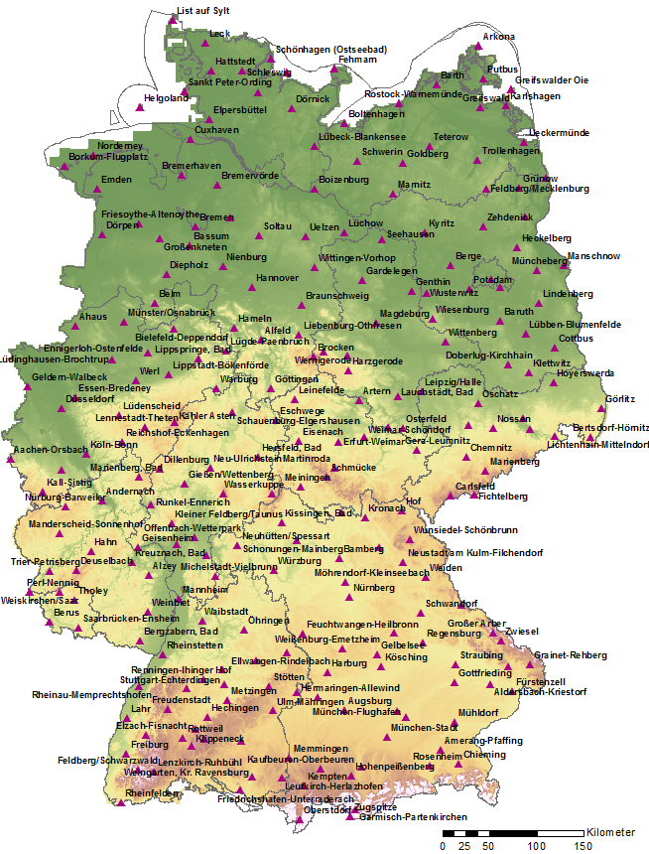
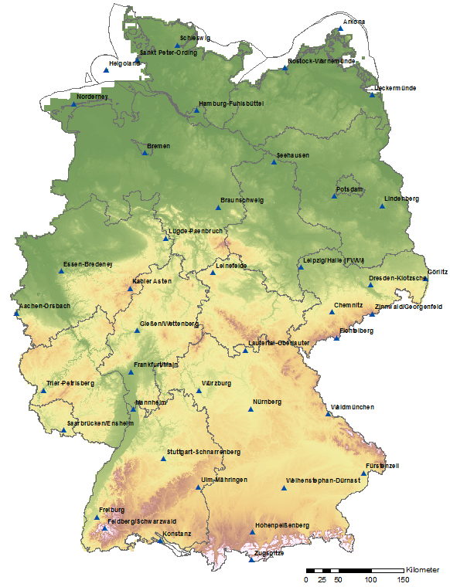
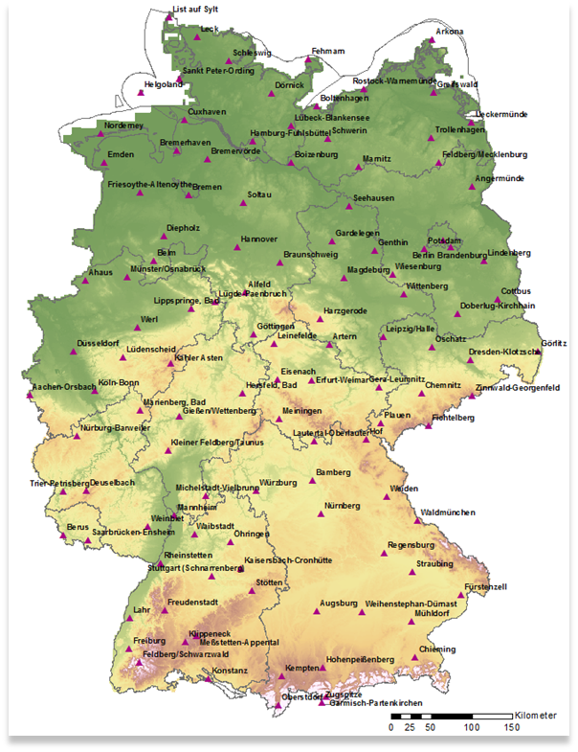
1 Introduction to DUETT
METEOSAT generations
new solar radiation measuring network at DWD
  automation
  high quality sensors (WMO)
  economic efficiency
improving quality and spatio-temporal resolution of satellite data
combination of both data sources in near-realtime = DUETT
PARAMETER SUNSHINE DURATION AT DWD STATIONS
TODAY
FUTURE
2023 ~
spatial
resolution
.
temporal
resolution
number of
channels

Slide 4
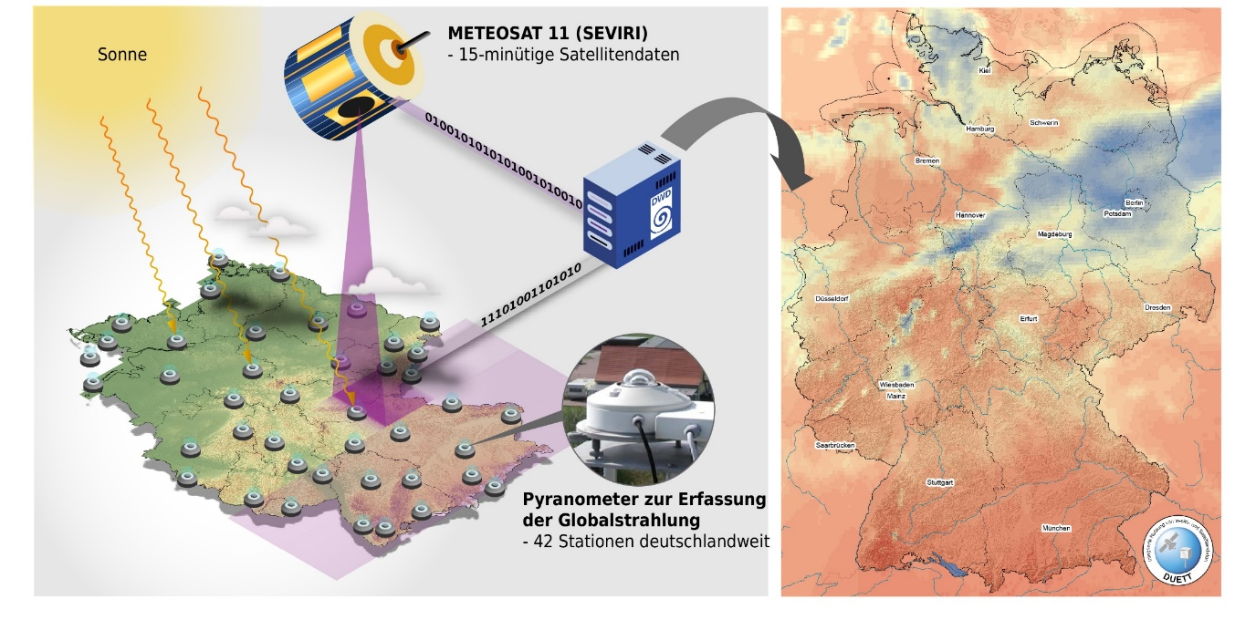
DUETT (10/2019 – 07/2023)
detailed collection of user requirements
development of merging algorithms global radiation /sunshine duration
operational near-realtime production
area-wide high-quality data sets for Germany
satellite data based on METEOSAT 11 (SEVIRI)
every 15 min
near-realtime
.
pyranometer data
future 42 stations (DWD)
every 10 min

Slide 5
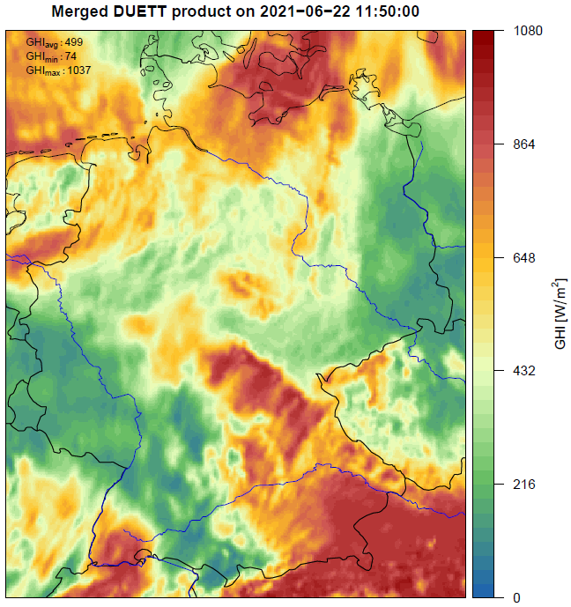
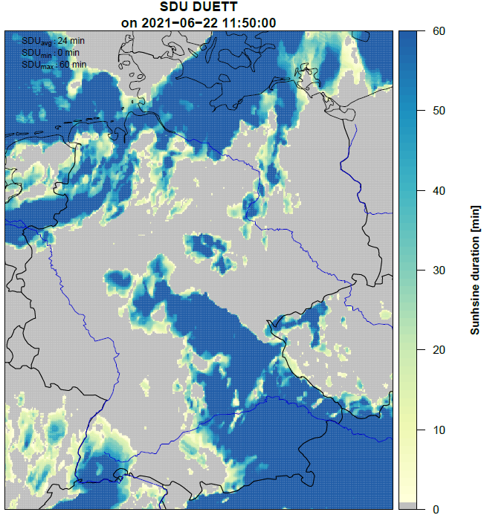
2 Current status DUETT
DUETT 1-h-mean
development of algorithms based on geostatistics completed (s. presentation S. Brinckmann, UP2.3 on 9th September, 09.45 am)
operational test phase started recently (until May 2023)
Product details:
  hourly data (HH:50 UTC)
  2x2 km raster; derived station data
  area of Germany
  available at HH+1:05 UTC
Global radiation
DUETT 1-h-sum
.
Sunshine duration

Slide 6
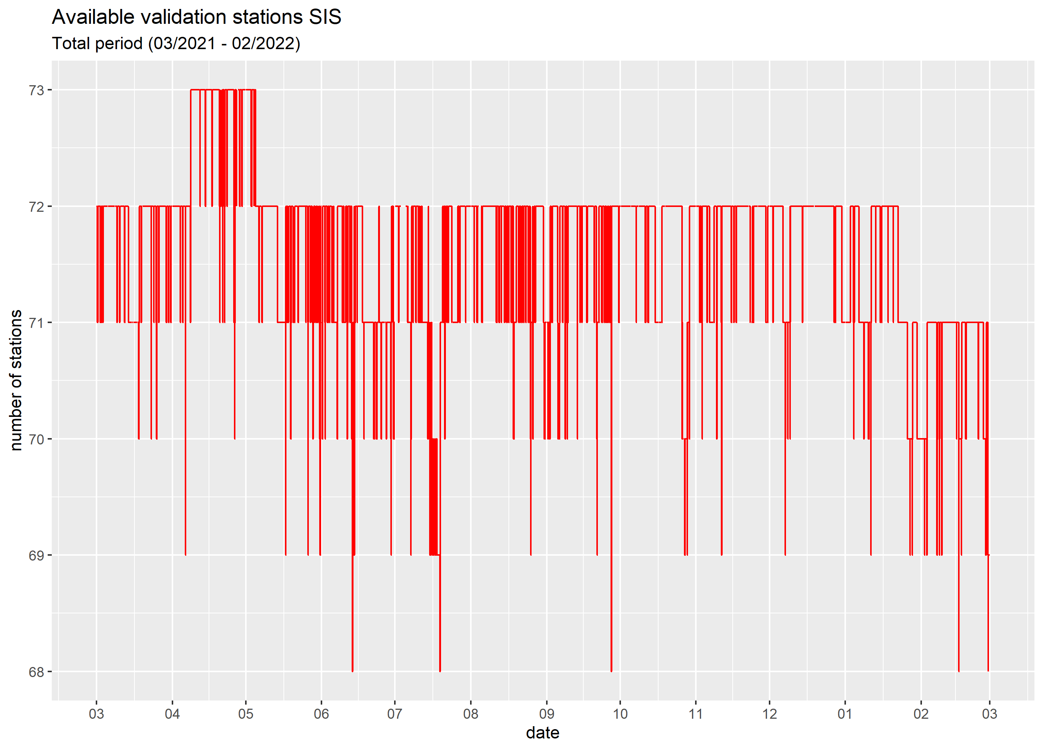
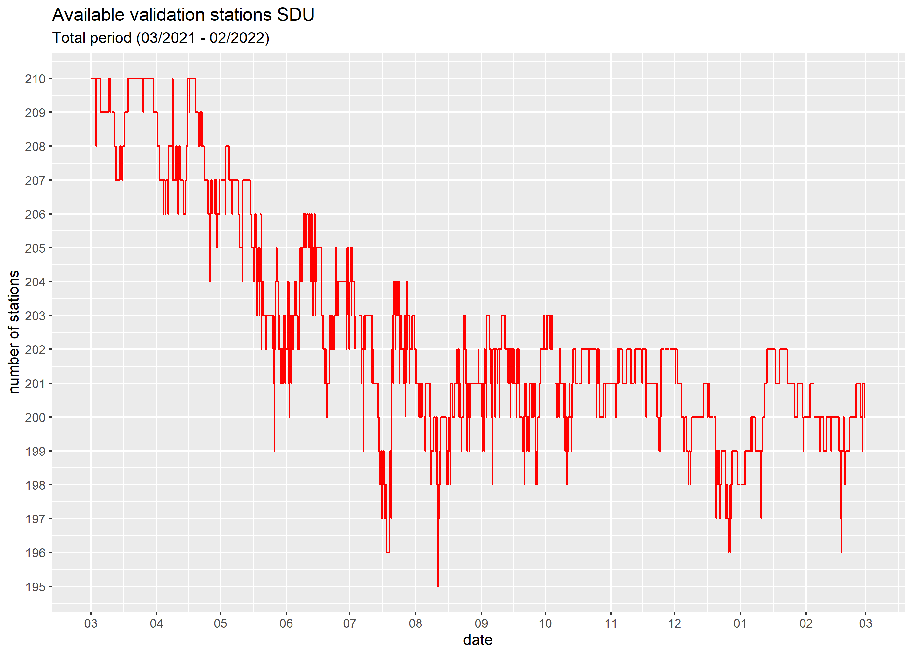
3 Validation results DUETT
available validation stations global radiation
validation period: 03/2021 – 02/2022
current software version 001 (reprocessed)
global radiation: ~ 70 independent validation stations
sunshine duration: ~ 200 independent stations
number of stations
available validation stations sunshine duration
.
number of stations

Slide 7
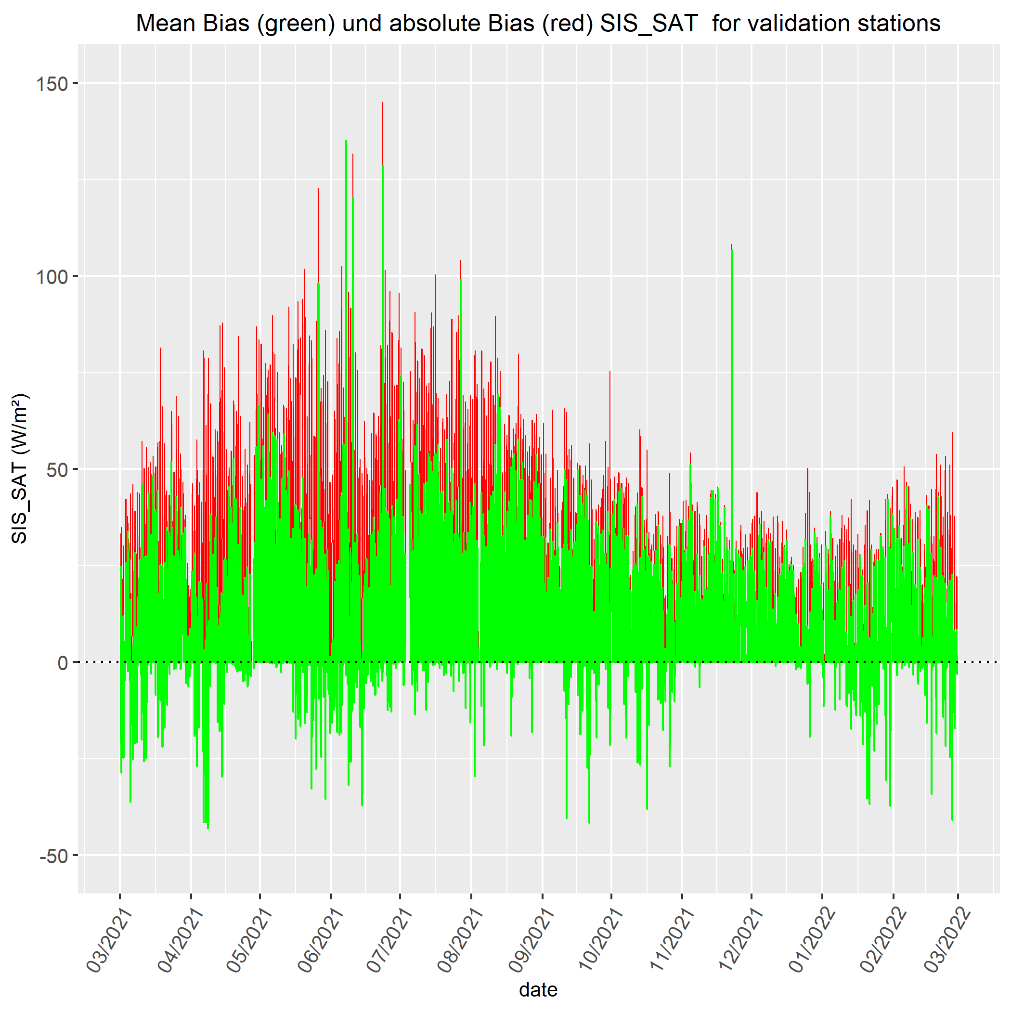
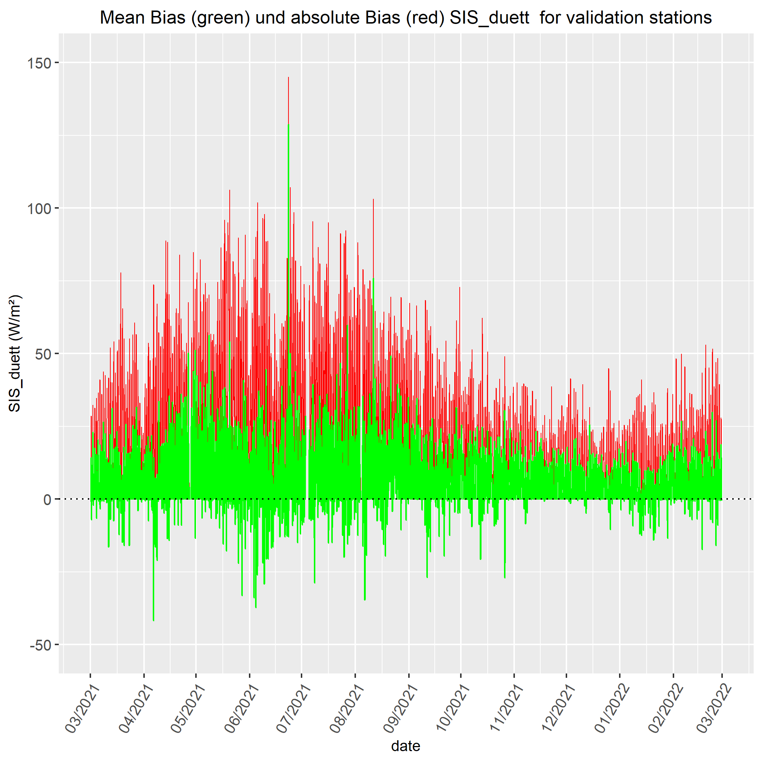
Global radiation: comparison SAT vs. DUETT for validation stations
mean bias: 5.9 W/m² (all day)
mean abs. bias: 18.8 W/m² (all day)
mean bias: 3.2 W/m² (all day)
mean abs. bias: 15.7 W/m² (all day)
SAT- station data
DUETT- station data
W/m²
W/m²
date
date

Slide 8
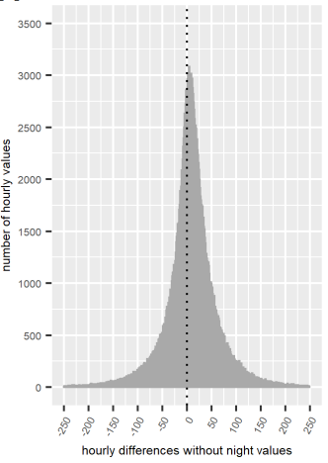
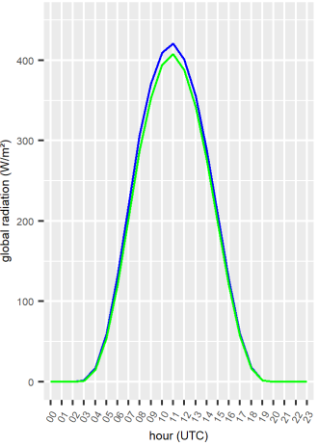
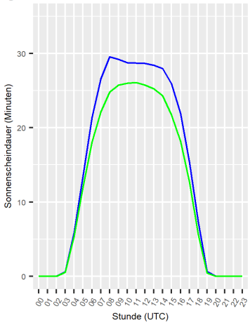
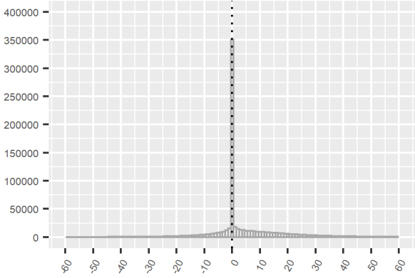
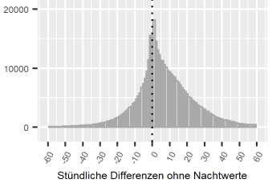
Results over all validation stations (03-12/2021)
green: station data blue: DUETT
global radiation
sunshine duration
hourly differences
mean day course
hourly differences
mean day course
mean bias: 9 W/m²
mean abs. bias: 38 W/m²
mean bias: 4 min
mean abs. bias: 7 min
number of hourly values
global radiation (W/m²)
number of hourly values
sunshine duration (min)
zoomed in
hourly differences (daytime) (UTC)
hour (UTC)
hourly differences (daytime) (UTC)
hour (UTC)

Slide 9

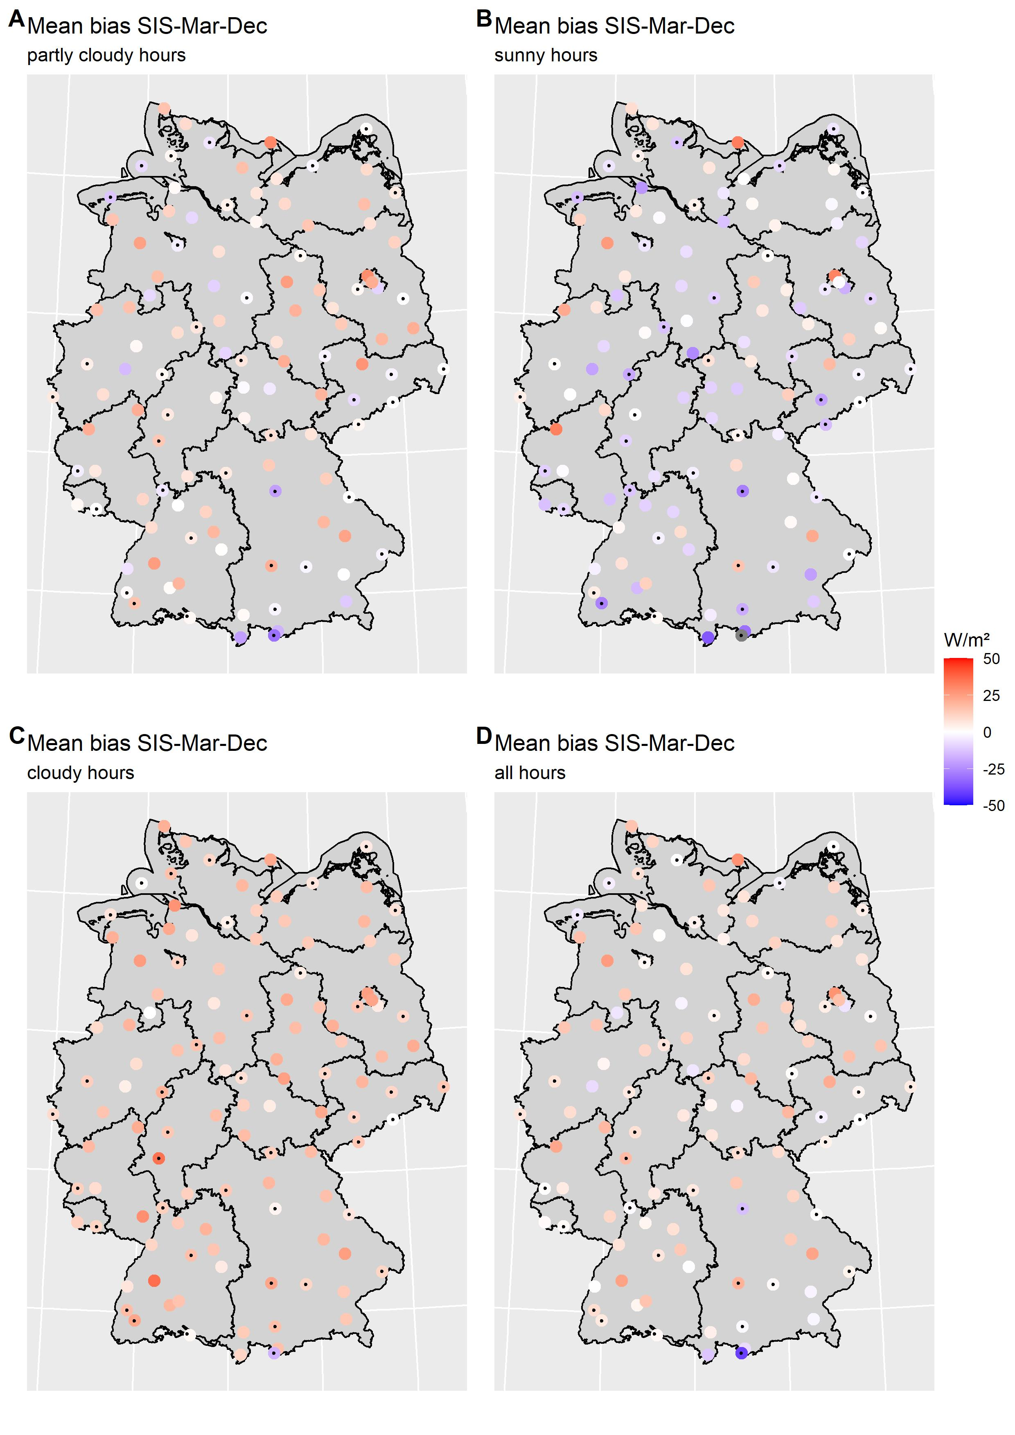
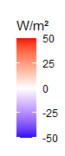
Spatial analysis – global radiation (03-12/2021)
.
sunny: SDU > 50 Min, partly cloudy: SDU 10-50 Min, cloudy: SDU < 10 Min

Slide 10
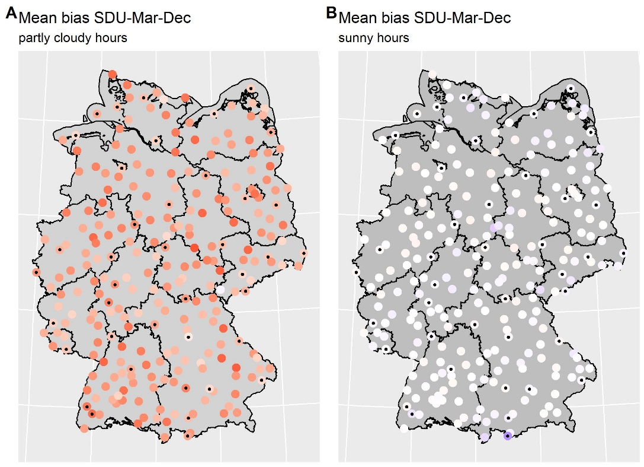
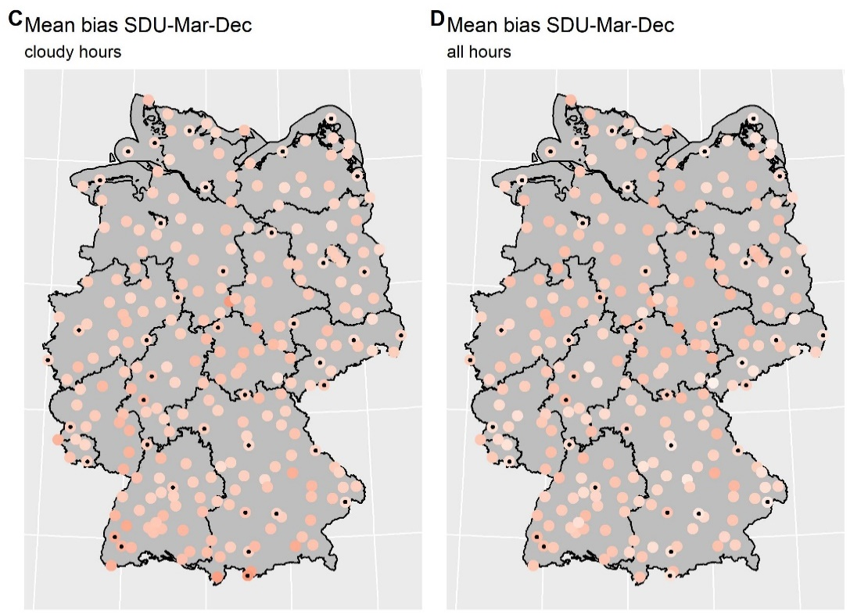
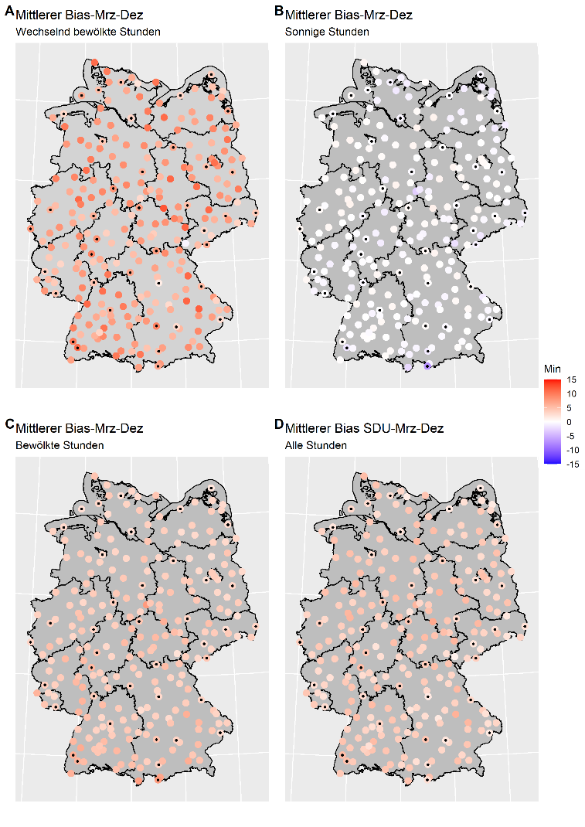
Spatial analysis – sunshine duration (03-12/2021)
.
sunny: SDU > 50 Min, partly cloudy: SDU 10-50 Min, cloudy: SDU < 10 Min

Slide 11
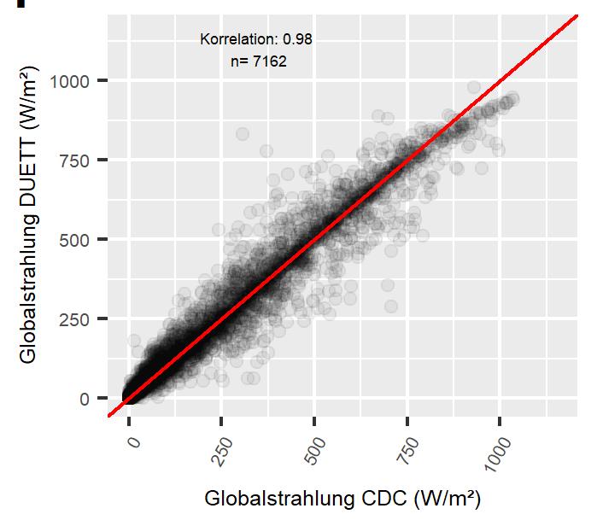
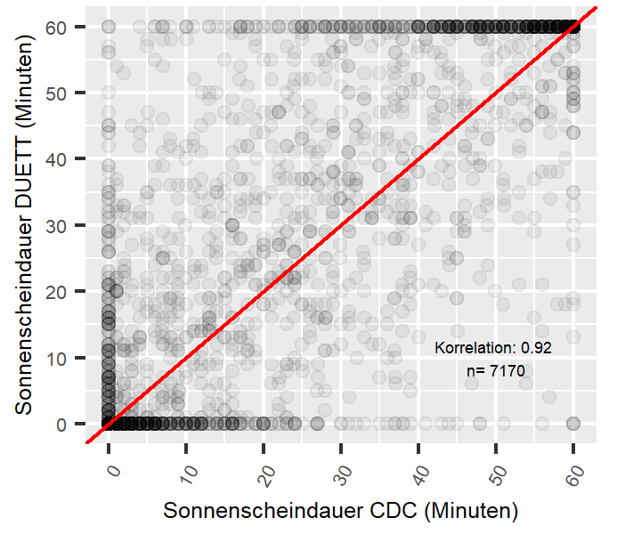
Station-based analysis – good examples
Global radiation
Sunshine duration
station Berus
station Elpersbuettel
correlation: 0.98
n = 7162
global radiation - DUETT (W/m²)
sunshine duration - DUETT (min)
.
correlation: 0.92
n = 7170
global radiation - station data (W/m²)
sunshine duration - station data (min)

Slide 12
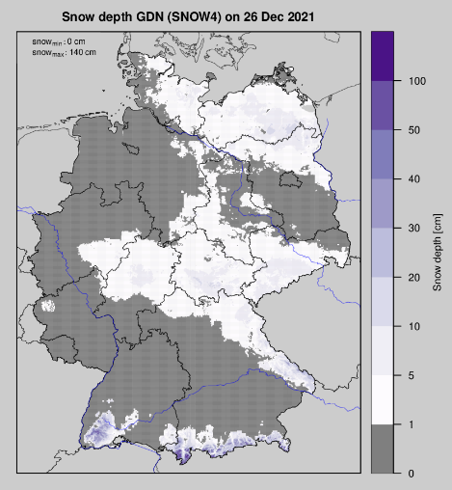
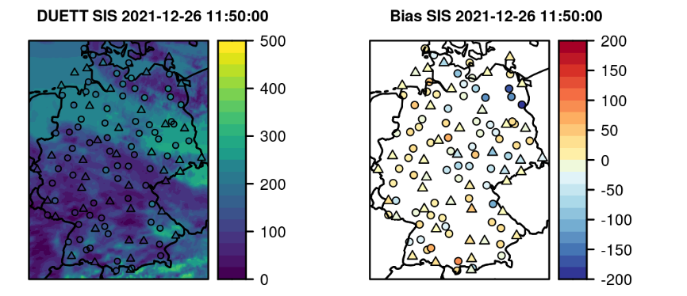
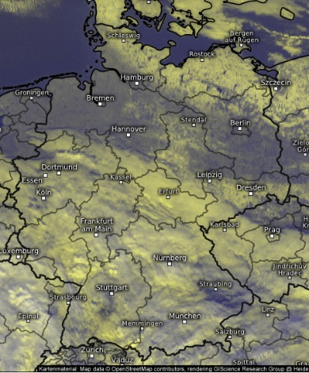
Station-based analysis – challenging examples
Global radiation
26th December 2021, 11:50 UTC
snow cover and clear sky
26th Dec 2021 11:30 UTC

Slide 13
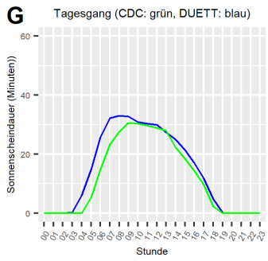
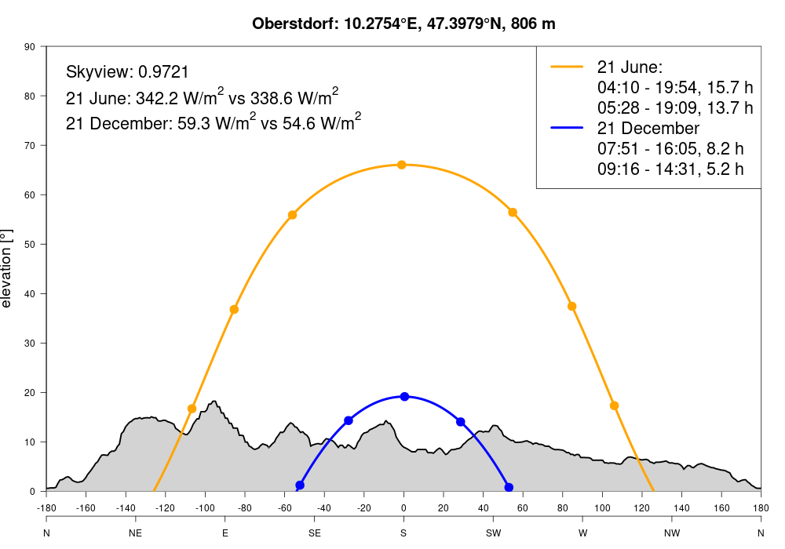
sunshine duration, Oberstdorf
topographic shadowing
mean day course
green: station data
blue: DUETT
Sunshine duration (min)
hour (UTC)

Slide 14
4 Summary and outlook
improvement of satellite data through operational combination with in-situ measurements in near-realtime
best performance of DUETT - algorithms with homogeneous conditions (sunny or overcast)
tendency towards overestimation of DUETT products
snow cover in clear sky conditions and topographic shadowing (at certain stations) challenging -> plans to integrate shadowing correction and snow mask
integration of METEOSAT Third Generation FCI data with higher spatio-temporal resolution in 2023
.

Slide 15
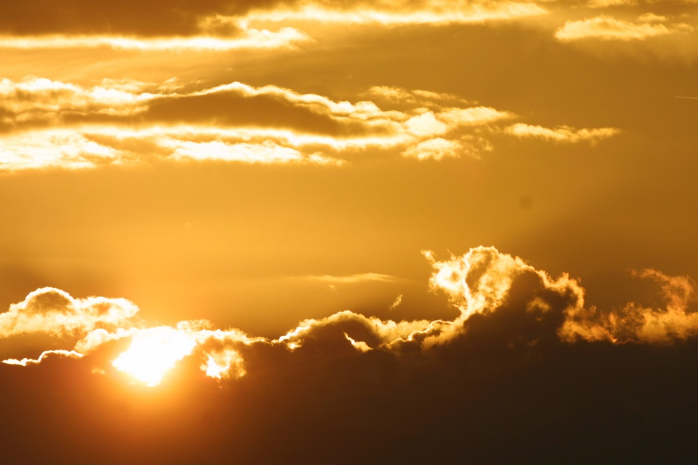
Thank you for your attention !
Contact DUETT:
Anna.Klameth@dwd.de
Sven.Brinckmann@dwd.de
More about in UP 2.3

