Slide 1
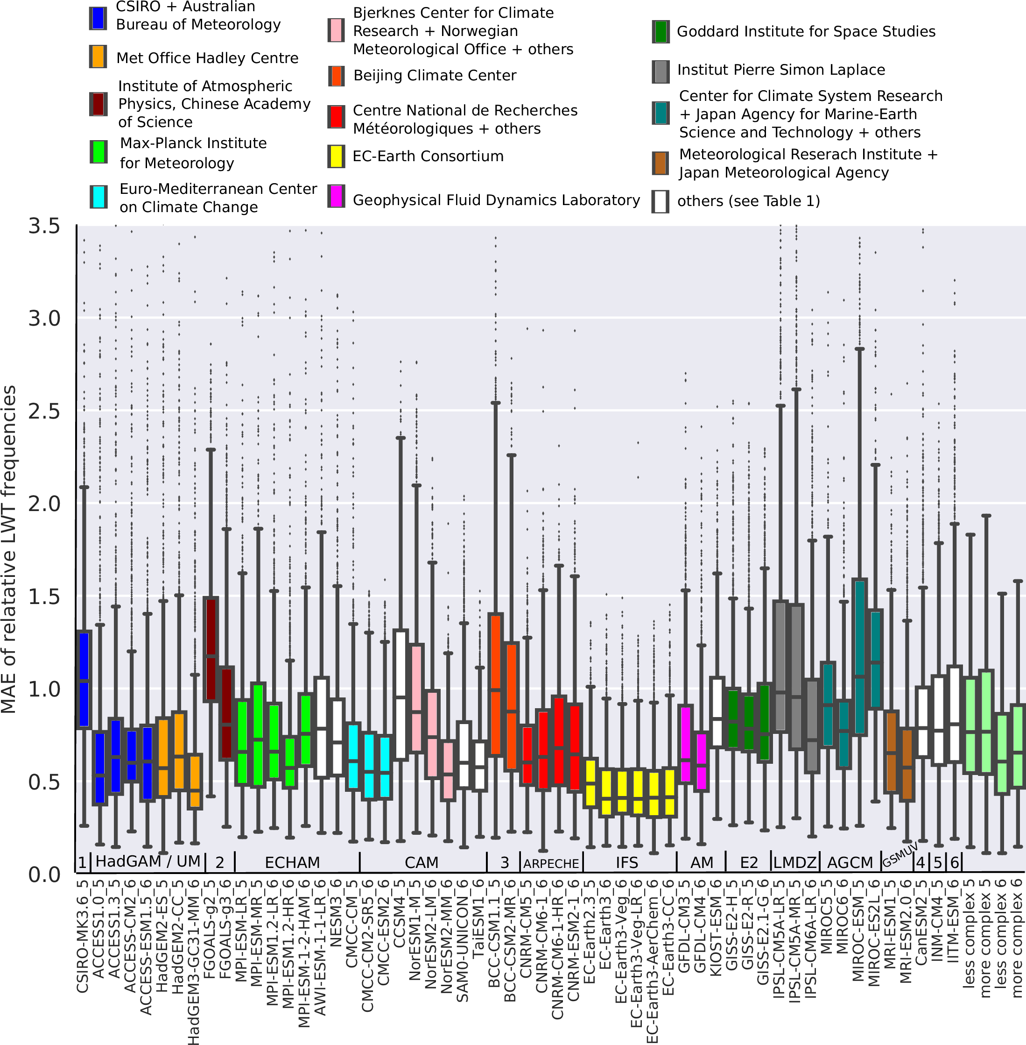
Model Performance Summary
Key Figure: GCM-specific northern hemisphere error samples displayed with a boxplot. One run per GCM is shown. The reference reanalysis is ERA-Interim.

