Slide 1
Simulating cold pools with ICON during the FESSTVaL period
Additional Material
Maike Ahlgrimm¹, Bastian Kirsch², and Mirjana Sakradzija^{1,} Frank Beyrich ^{3,} Ulrich Görsdorf ³
1 Deutscher Wetterdienst, Hans-Ertel-Zentrum
2 Universität Hamburg, Hans-Ertel-Zentrum
3 Deutscher Wetterdienst

Slide 2
Comparing FESSTVaL simulations to observations

Slide 3
Three „supersites“
Development of quick evaluation tools for ICON NWP–style simulations against observations
  Focus here: general boundary layer and cloud state
  To quickly answer the question: Is this a reasonable model simulation?
The FESSTVaL observational network contained three „supersites” with very comprehensive measurements, surrounded by a network of stations with more limited sensors
Options for comparing model to supersites:
x: supersites
o: nearest model grid point („meteogram“)
lat/lon: „area average“
model domain
o
x
x
o
o
x

Slide 4
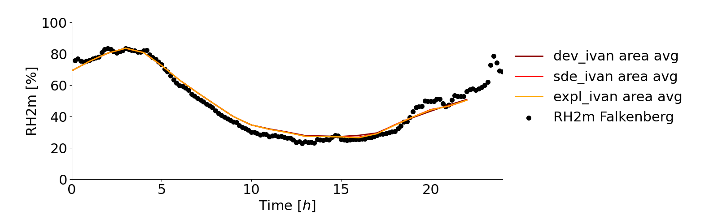
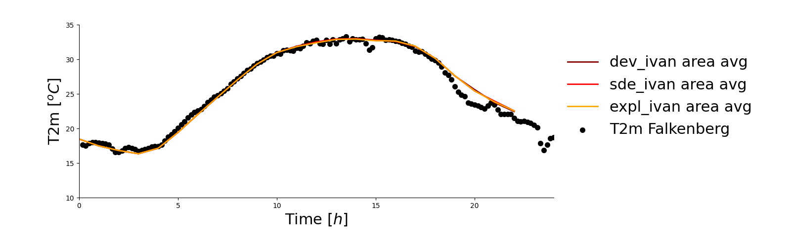
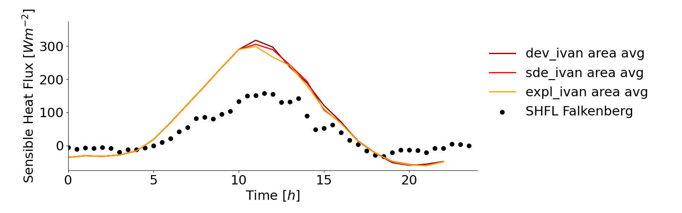
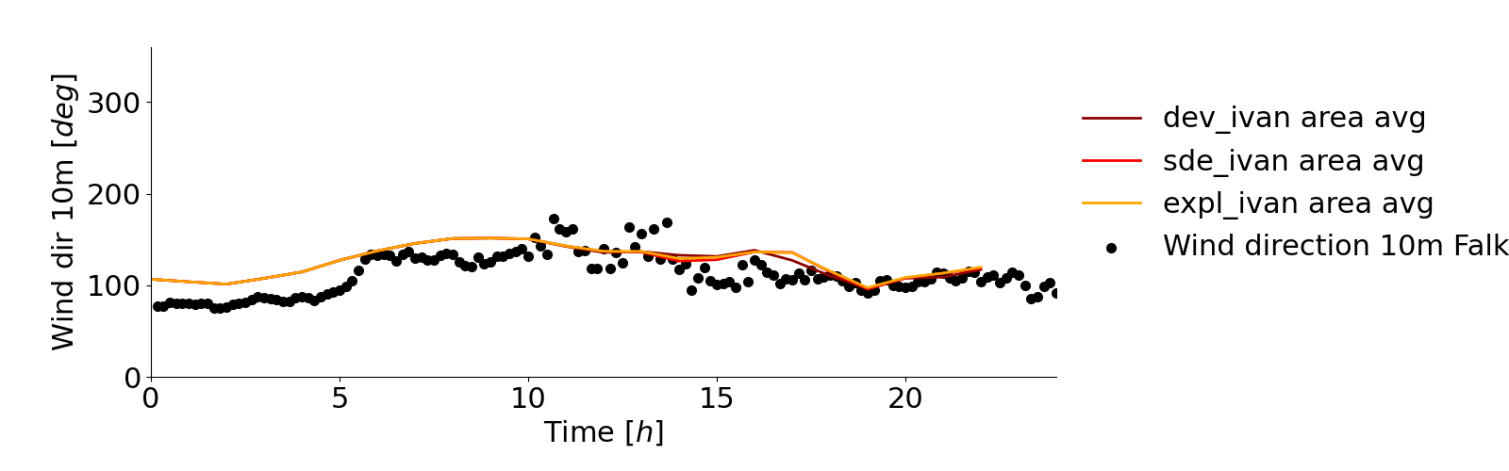
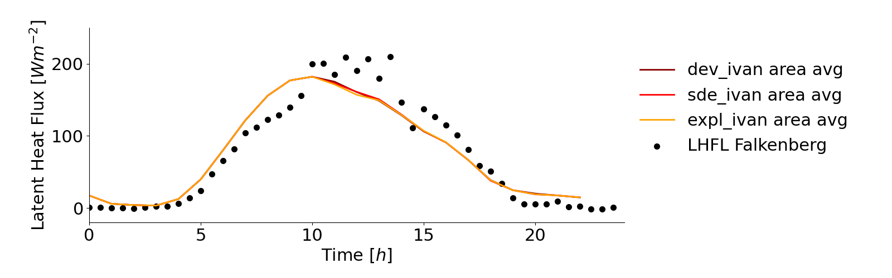
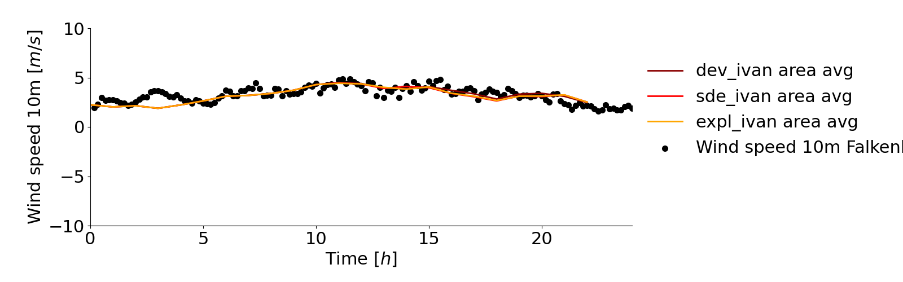
Model vs. surface observations
Time series plots
Example: 20210617, 2km LAM, comparing area average (specified area around 3 supersites) from three model versions with point observations from Falkenberg

Slide 5
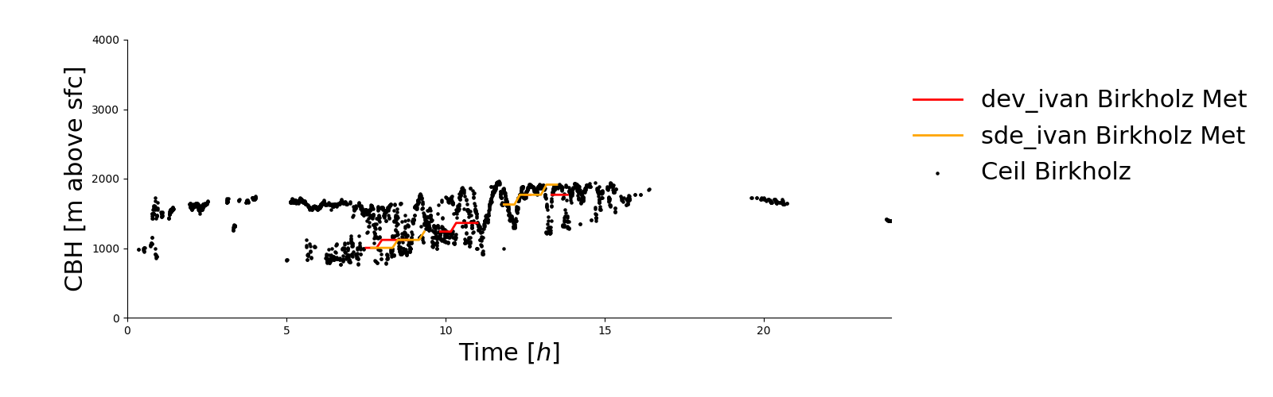
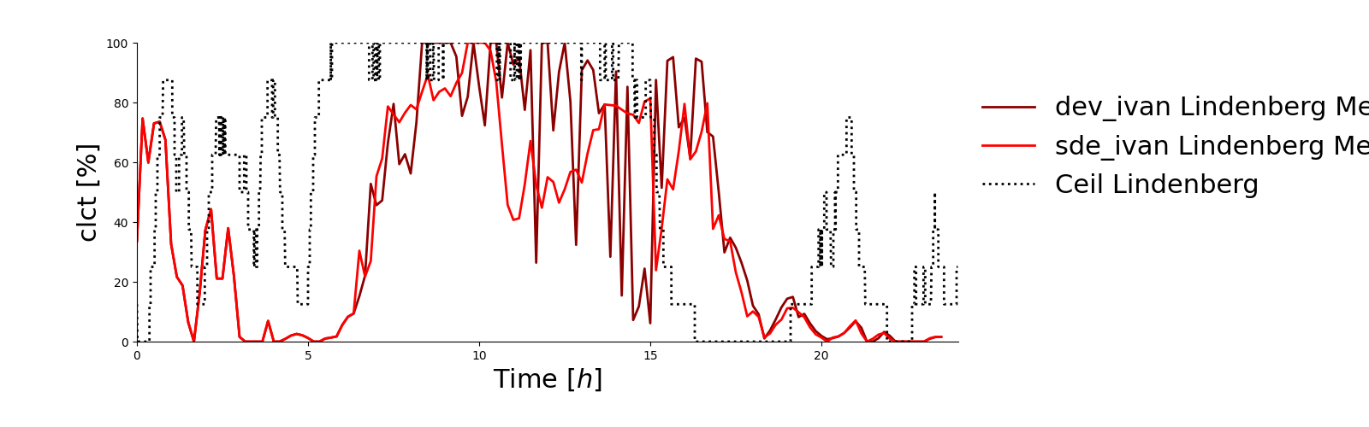
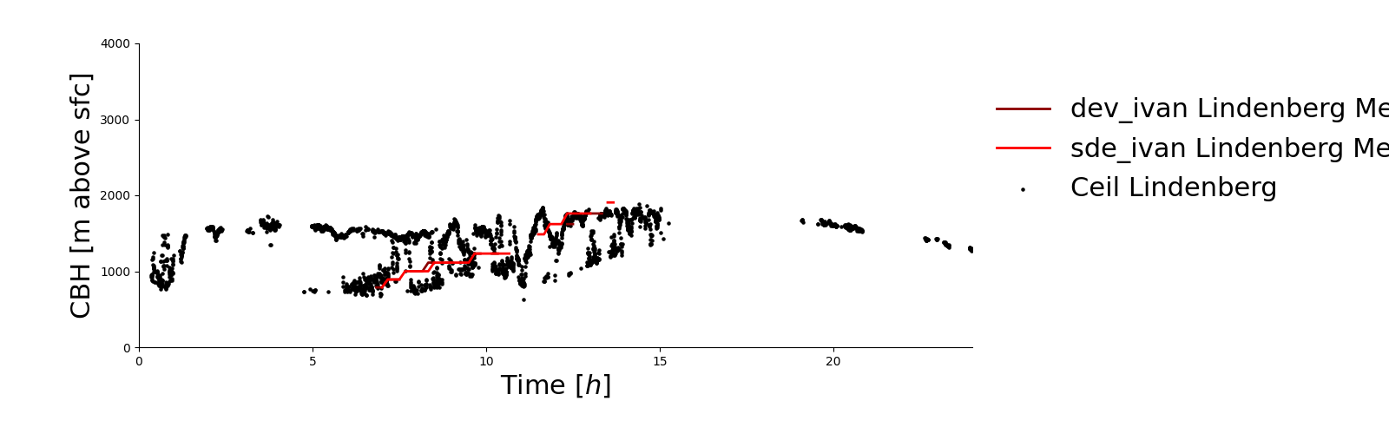
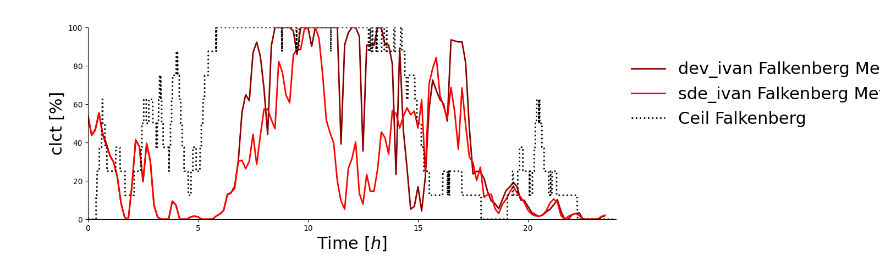
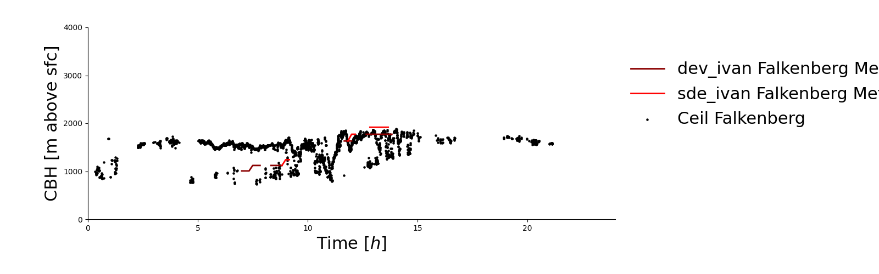
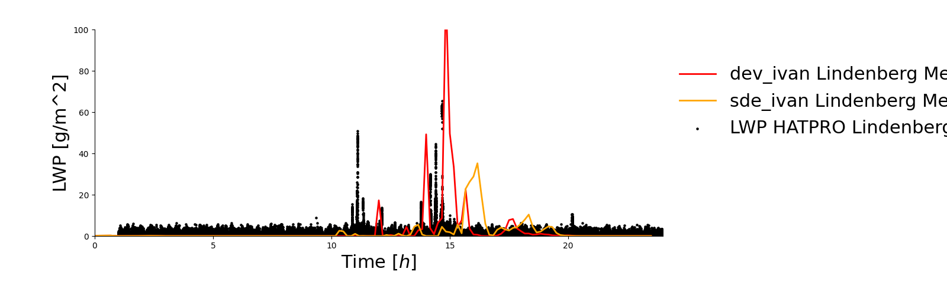
Model vs. cloud observations
Cloud base height from ceilometer at 3 supersites
20210613, 2km, 2 model versions (nearest grid point)
Total cloud cover (octa) from ceilometer at Falkenberg, Lindenberg vs. 2 model versions
HATPRO LWP

Slide 6
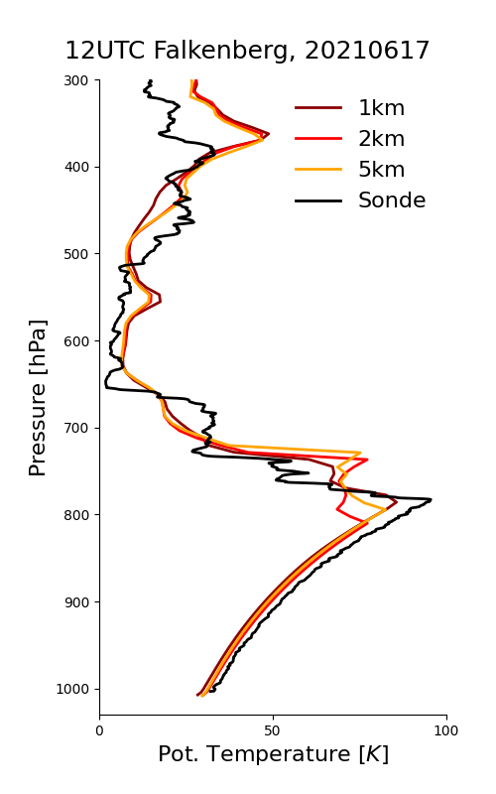
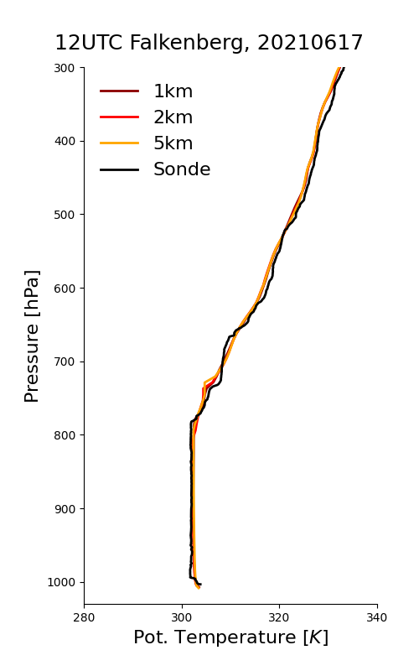
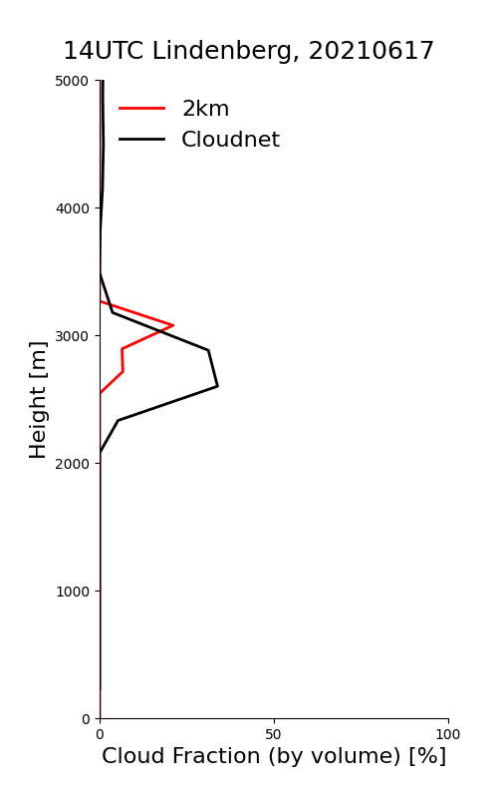
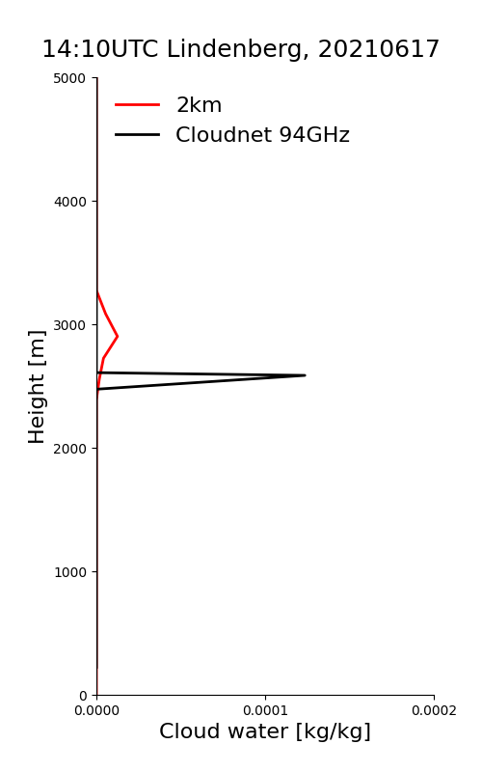
Model vs. vertically resolved obs
Radiosonde profiles
Hourly cloudnet product
RH
Theta
cloud fraction
cloud condensate
From 94GHz Cloudnet
Very shallow cloud from retrieval – cloud top not really well-constrained

Slide 7
Cross section of cold pool evolution in ICON simultation

Slide 8
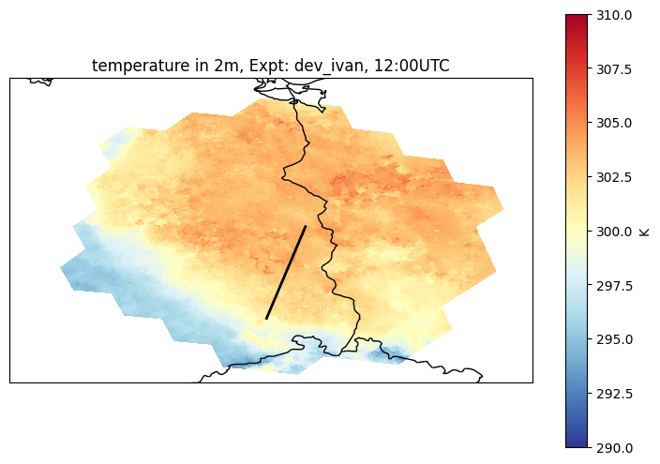
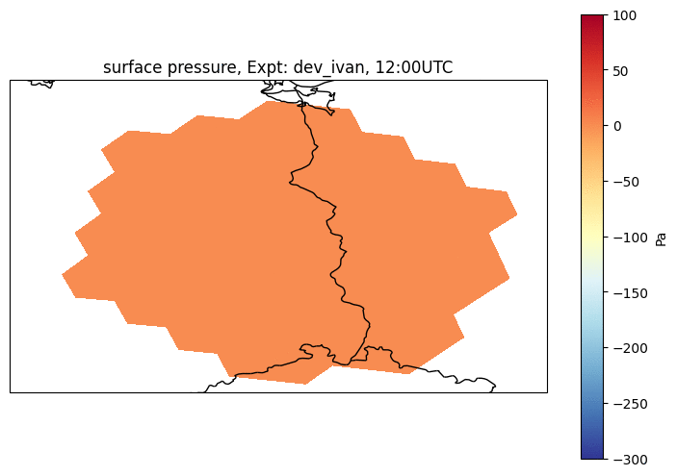
Cold pool simulations
2021-06-29, ICON LAM 2km
“dev” (reference version)
Loop starting at 12UTC
Good news: the model produces CPs
Interesting features: fast/slow pressure perturbations
Surface pressure perturbation (vs. state at 12UTC)
2m Temperature
cross section on next slide
Notes:
pressure perturbations – fast gravity waves, slower CP boundaries
temperature perturbation

Slide 9
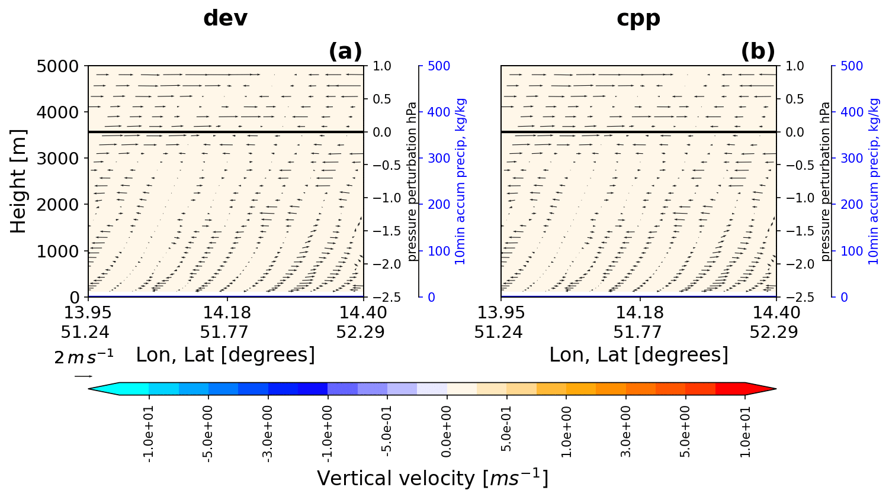
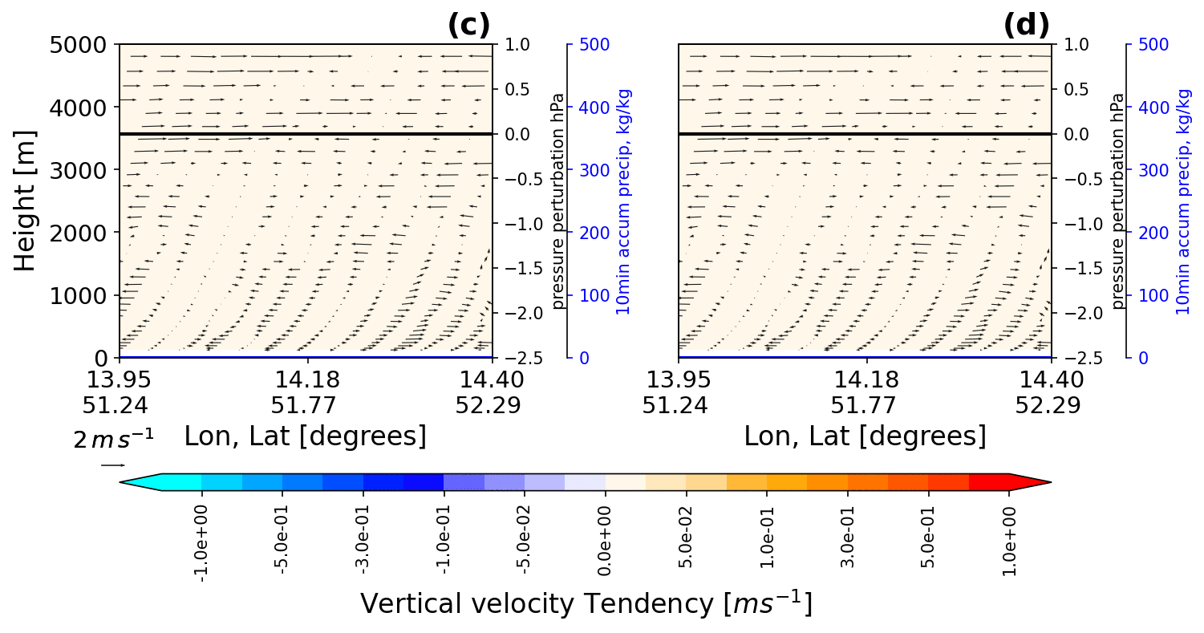
Cross section from CP origin to Lindenberg
Animation: Propagation of CP boundary
cpp
added by the CPP Scheme
Factor 10 different scales!
Black curve: surface pressure perturbation (relative to surface pressure at 12UTC)
Blue curve: 10min accumulated precipitation
CPP: ICON with cold pool perturbations scheme to enhance VV along CP boundary (developed at LMU, M. Hirt)
Notes:
VV enhancement where expected

Slide 10
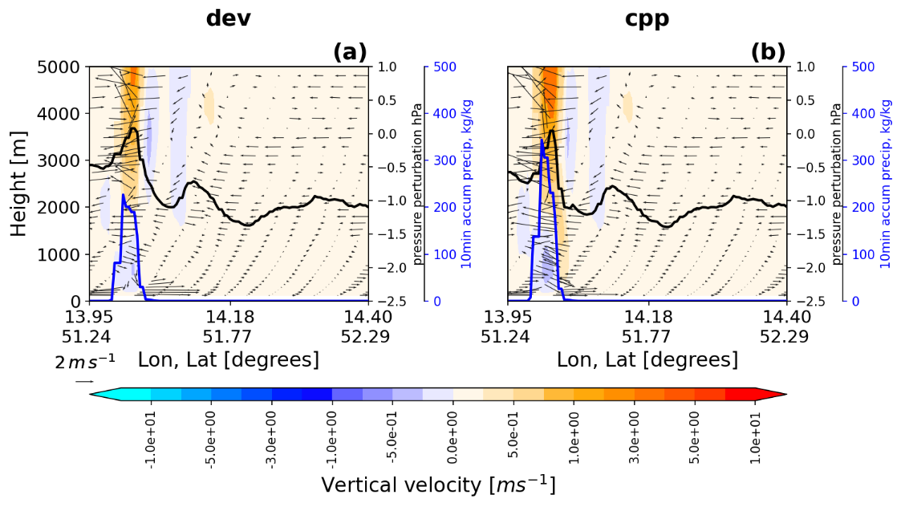
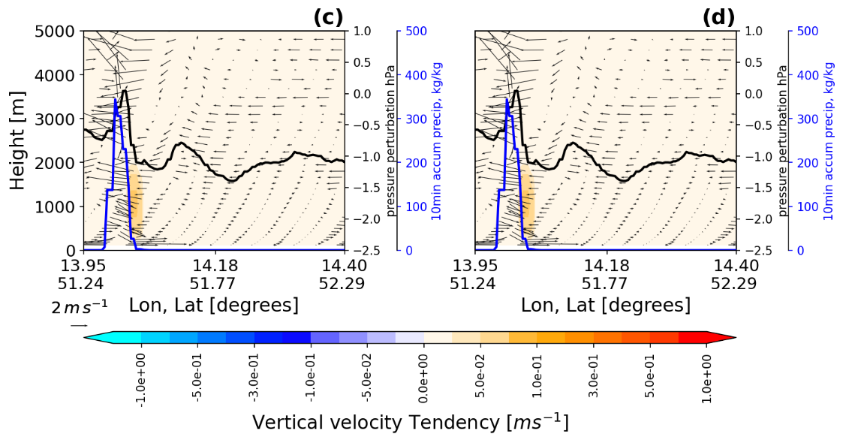
Snapshot – CP initialization
ICON LAM 2km, 13:20UTC
CCP enhancement of VV at the right place, more intense precip

