Slide 1
IMPROVER
A probabilistic, multi-model postprocessing system for meteorological forecasts
Overview and updates
Paul Abernethy, Josh Apps, Meyrick Almeida, Ben Ayliffe, Laurence Beard, Tim Bonin, James Canvin, Rob Coulson, Neil Crosswaite, Gavin Evans, Ben Fitzpatrick, Tom Gale, Roger Harbord, Leigh Holly, Katie Howard, Teresa Hughes, Timothy Hume, Katharine Hurst, Simon Jackson, Daniel Mentiplay, Stephen Moseley, Ken Mylne, Ben Owen, Carwyn Pelley, Fiona Rust, Chris Sampson, Anja Schubert, Michael Sharpe, Marcus Spelman, Belinda Trotta, Bruce Wright
Simon Backhouse, Mark Baker, Anna Booton, Dan Brierley, Clare Bysouth, Rob Coulson, Sean Coultas, Ric Crocker, Zhiliang Fan, Jonathan Flowerdew, Roger Harbord, David Hardy, Aaron Hopkinson, Caroline Jones, Lucy Liu, Marion Mittermaier, Tim Pillinger, Nigel Roberts, Caroline Sandford, Victoria Smart, Tomek Trzeciak, Mark Worsfold
Notes:
This presentation attempts to provide an overview of IMPROVER, a probabilistic, multi-model postprocessing system for meteorological forecasts, that has been developed by the Met Office and others.
Many people, both Met Office and others, have been involved in the development of IMPROVER so far and there has been an attempt to capture their names on the title slide.

Slide 2
Overview
Notes:
The first part of the presentation aims to provide a better idea of what IMPROVER is. Some of the information is specific to the Met Office implementation, but should serve to illustrate how IMPROVER can be used. There’s a lot of content here – you can download the slides later to read those details I don’t have time for.

Slide 3
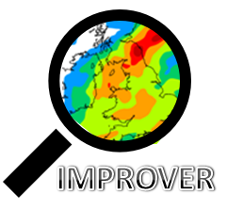

Integrated Model Post Processing & Verification
Vision: Provide [the Met Office organisation with]
a single source of blended, probabilistic forecast information for the UK and globe out to 14 days ahead.
NWP
models
Post
Processing
Users
Products
Notes:
IMPROVER stands for Integrated model post processing and verification, and as a capability, is probably best summed up by the Met Office project vision statement: Provide (the Met Office organisation with) a single source of blended, probabilistic forecast information for the UK and globe out to 14 days ahead.
Post processing is undertaken to make NWP model forecast outputs better and more useful for users and downstream product generation.

Slide 4





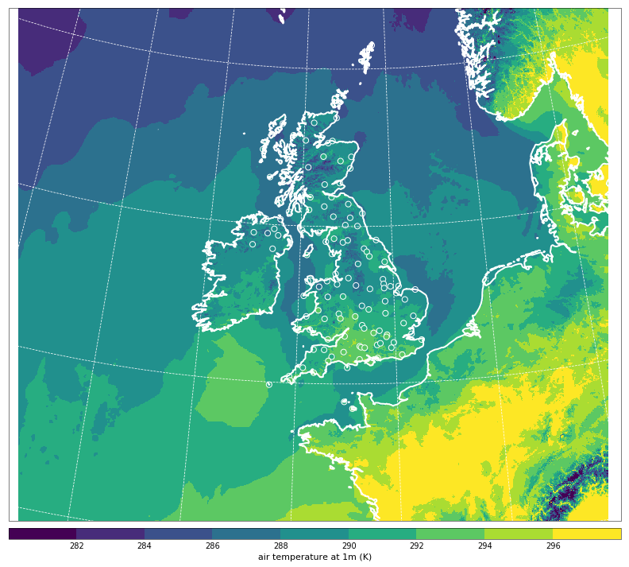
Principles
Iris
Single, integrated, modular processing chain,
grid-based and probabilistic
Probabilistic at the core – forecasts blended using probabilities
Sequential application of ‘physical’, ‘statistical’
and ‘neighbourhood’ processing
Consistent spot and gridded forecasts:
  Process each variable separately on the grid
  Extract site-specific forecasts at end of the processing chain
Fully integrated verification to measure the
benefits of each stage of processing
Allows for time-lagging and blending between models/ensembles
A modular software framework following modern
professional software development practices
Air temperature at 1m (K)
Notes:
[Only time for three of these]
IMPROVER processes probabilistic data with verification of each module allowing us to monitor the scientific impact and to produce consistent spot and gridded forecasts.

Slide 5
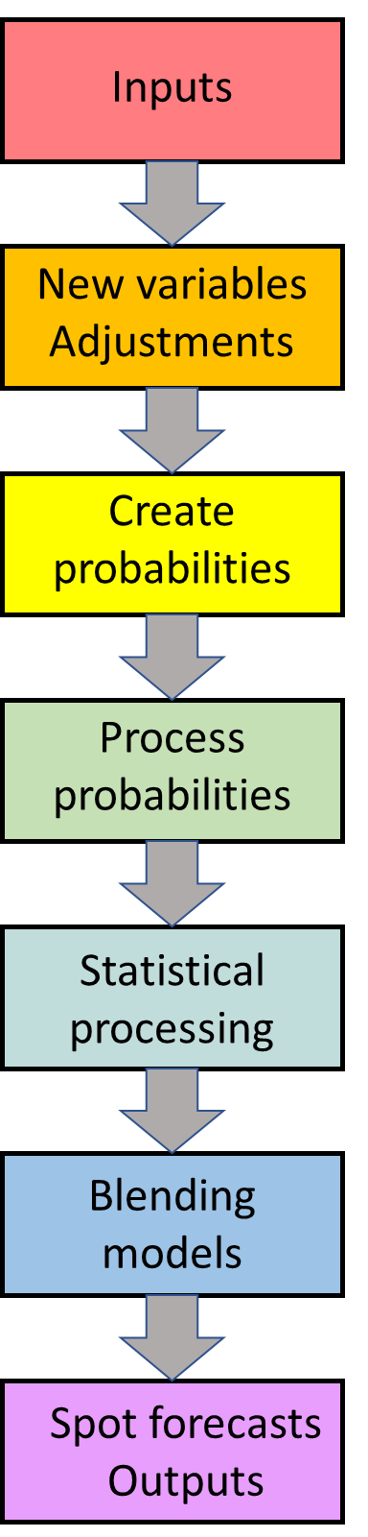
Post-processing chains
Separate processing chains for each variable
At the Met Office, before post-processing, the NWP forecast data is re-gridded onto standard grids:
  UK = 2km
  Global ~ 20 km
Notes:
IMPROVER is comprised of a series of post-processing chains - one for each variable. The diagram shows the generic sequence of steps that are applied at the Met Office, and these will be described in more detail on the following slides. Most processing steps are applied to gridded data, with spot forecasts extracted at the end, to maintain consistency.
At the Met Office, before post-processing, the NWP model forecast data are re-gridded on standard grids, either a 2km UK or 20 km global grid.

Slide 6
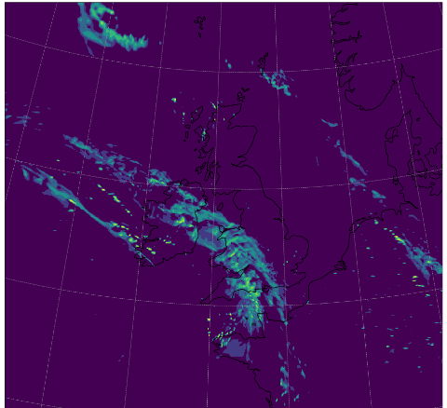
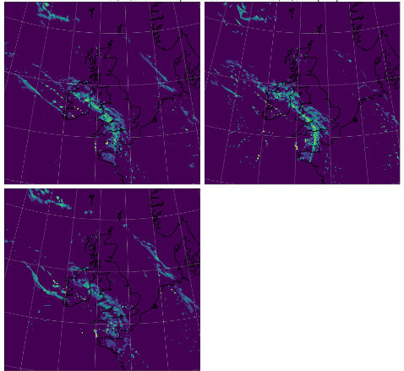
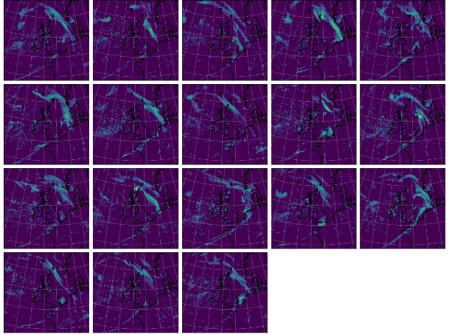
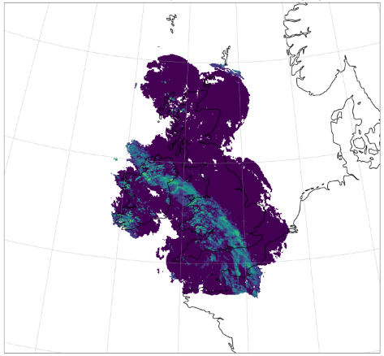
Input forecasts from individual NWP model runs
UKV 1.5km
UK hi-res model to 12 hours,
every hour
MOGREPS-UK 2.2km
UK hi-res Ensemble
to 5 days,
3 forecasts every hour
MOGREPS-G ~20km
Global ensemble
to 7 days,
18 forecasts every 6 hours
Precipitation only: Radar Extrapolation Nowcast
Out to 6 hours, every 15 minutes
Notes:
For the Met Office UK forecast, the prime input is the MOGREPS-UK ensemble model, but use of MOGREPS-G allows the forecast range to be extended to 7 days, and the deterministic UKV model adds value at the start. For precipitation, a nowcast generated by extrapolating radar data provides an important contribution in the first few hours.

Slide 7
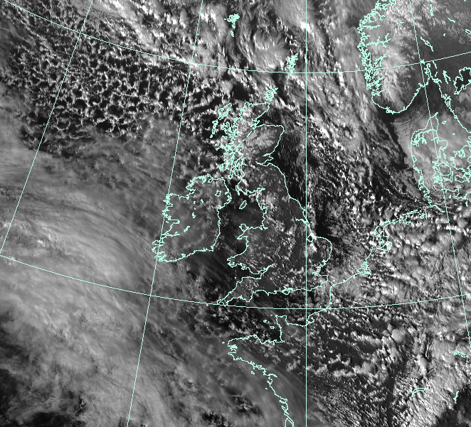
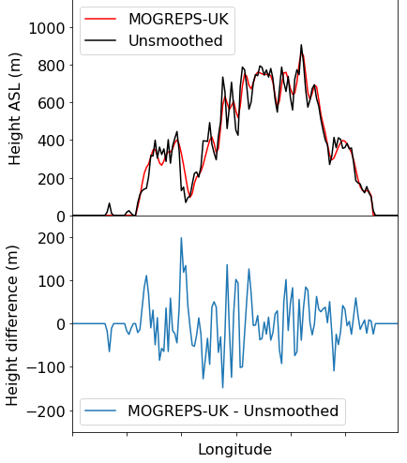
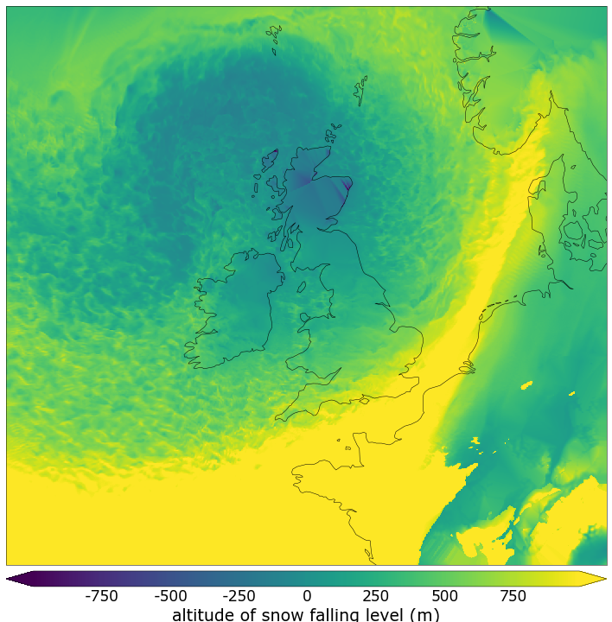
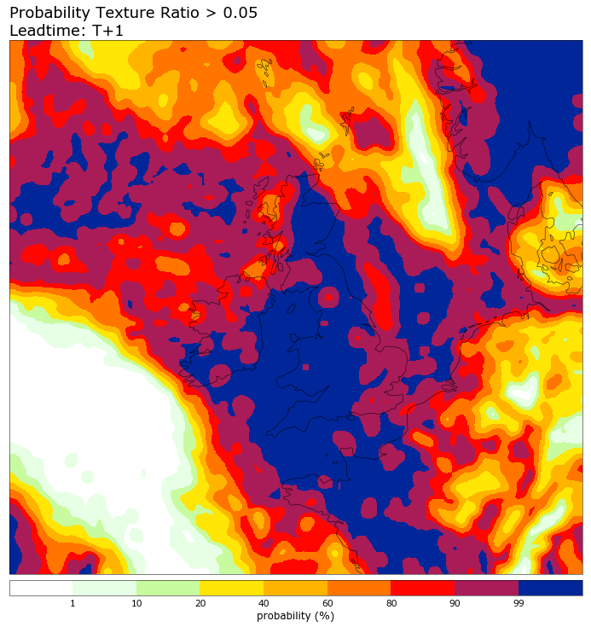
Calculate new variables Apply physical adjustments
Cloud texture
determines showers
Altitude difference
for
temperature lapse rate adjustment
Snow melting level
for precipitation type probabilities
Frontal
cloud
Frontal
cloud
OSA1.3 Tuesday 17:00 Tuning the precipitation phase discriminator
Continuous
Broken
Notes:
Initially, any new variables that are required are calculated. Many of these, such as altitude difference, cloud texture and snow melting level are to support physical adjustments such as a lapse rate-based temperature correction or the diagnosis of other quantities such as showers and, wintry precipitation.
Advertise the phase talk!

Slide 8
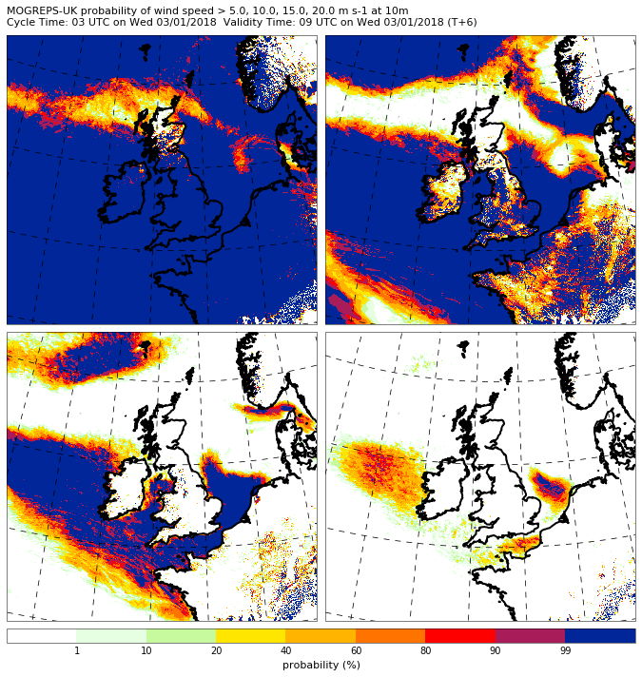
Convert to binary probabilities
Combine members
MOGREPS-UK
3 members
Probabilities of exceeding wind speed thresholds
5 m s⁻¹
10 m s⁻¹
P > Thresh 1
P > Thresh 2
P > Thresh n
…
Mean probability
Mean probability
Mean probability
…
15 m s⁻¹
20 m s⁻¹
1 10 20 40 60 80 90 99
probability (%)
Notes:
Binary probabilities of exceeding a range of thresholds are calculated and combined to generate mean probabilities. The example shows the probability of exceeding four different wind speed thresholds. All subsequent processing steps are applied to the probabilities.

Slide 9
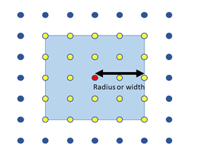
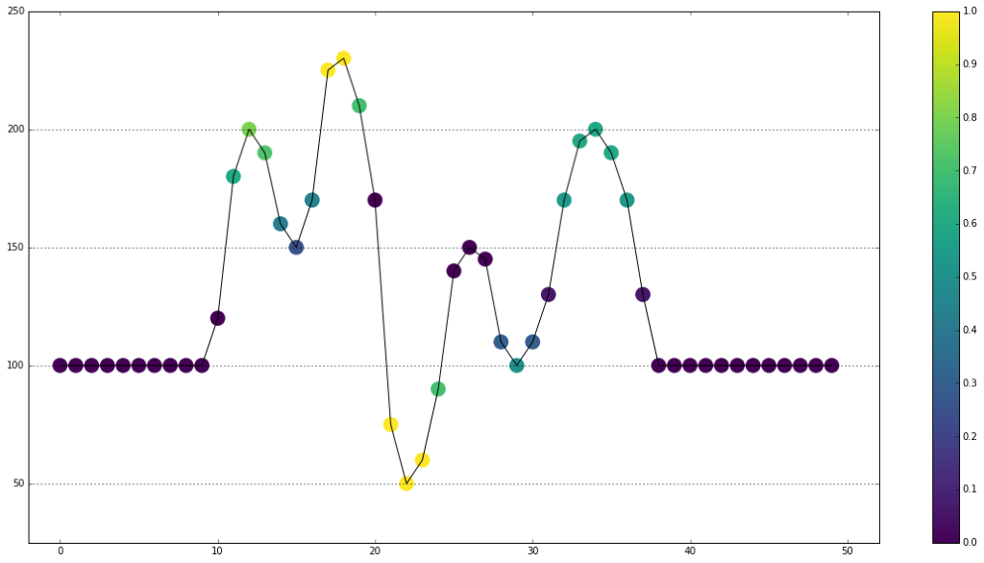
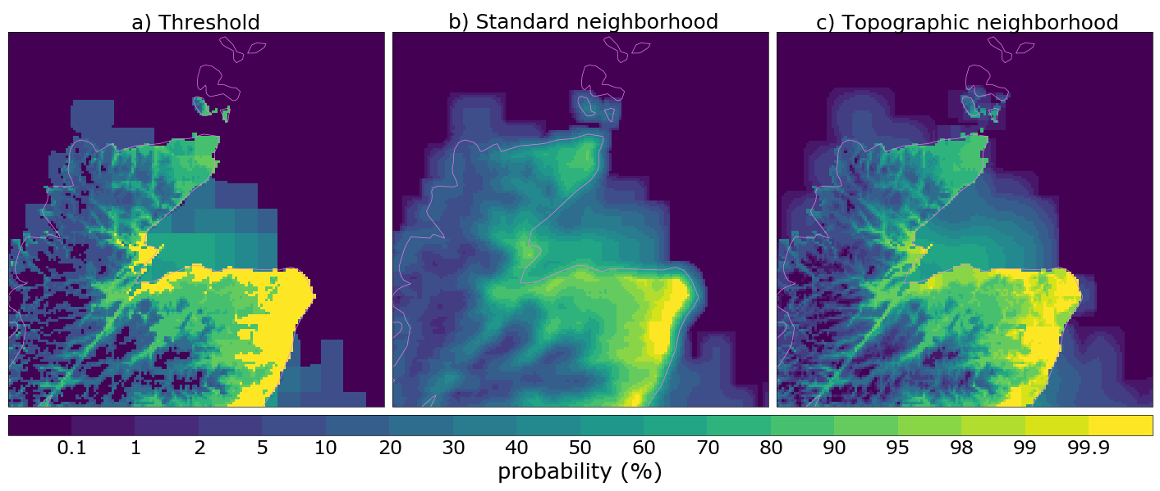
Apply spatial post-processing methods
Include older forecasts
Time lagging
(cycle blending)
Neighbour processing
Topographic neighbour
UKV
x 4
MOGREPS-UK
x 6
MOGREPS-G
x 2
Notes:
Neighbourhood processing - the use of other values in a neighbourhood as though they were valid at the point under consideration - effectively increases the ensemble size, providing smoother, more realistic probabilities. Time lagging or cycle blending has a similar effect by including forecasts from previous model runs.

Slide 10
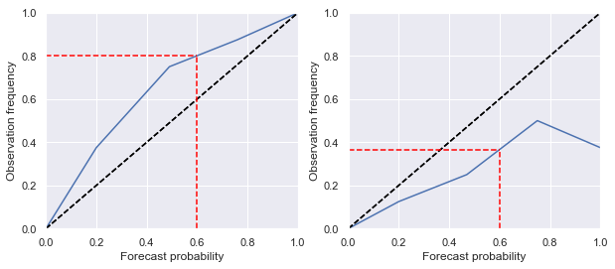
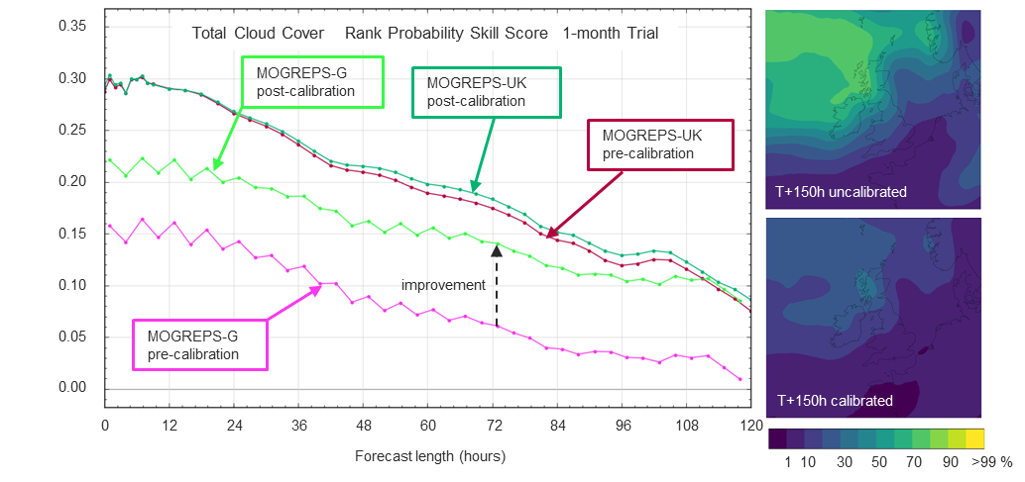
Apply statistical post-processing methods
Reliability Calibration
for precipitation and cloud
Improve forecast quality
(in a statistical sense)
Align different models
to improve model transitions
Gridded EMOS
(Ensemble Model Output Statistics)
Notes:
Statistical methods are used both to correct the probability distribution, improving the forecast quality in a statistical sense, and to align different models to improve model transitions in the forecast. Reliability calibration adjusts the probabilities to be more reliable, that is to say that an event forecast X percent of the time should be observed to occur X percent of the time. This provides a large improvement in MOGREPS-G cloud forecast, removing a jump that occurs at the transition between MOGREPS-UK and MOGREPS-G in the uncorrected data. Gridded EMOS or Ensemble Model Output Statistics is the second method of statistical correction we use.

Slide 11
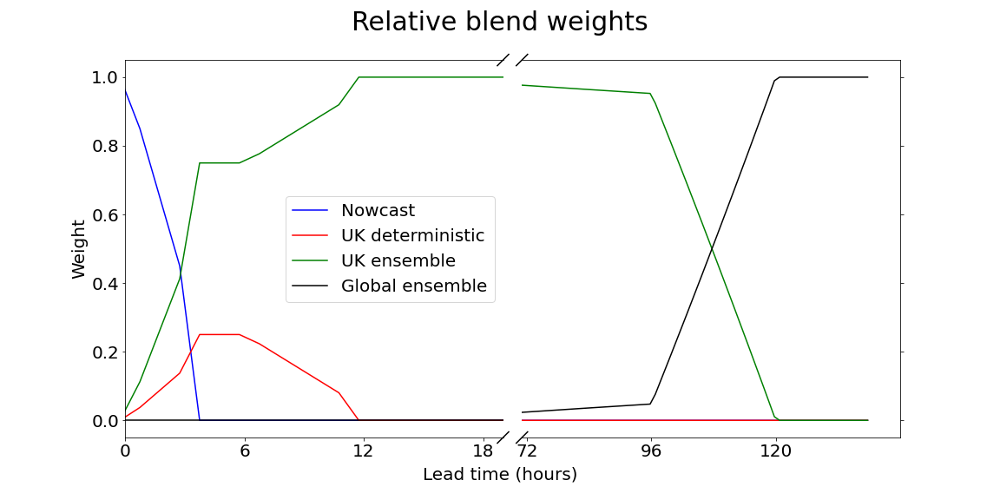
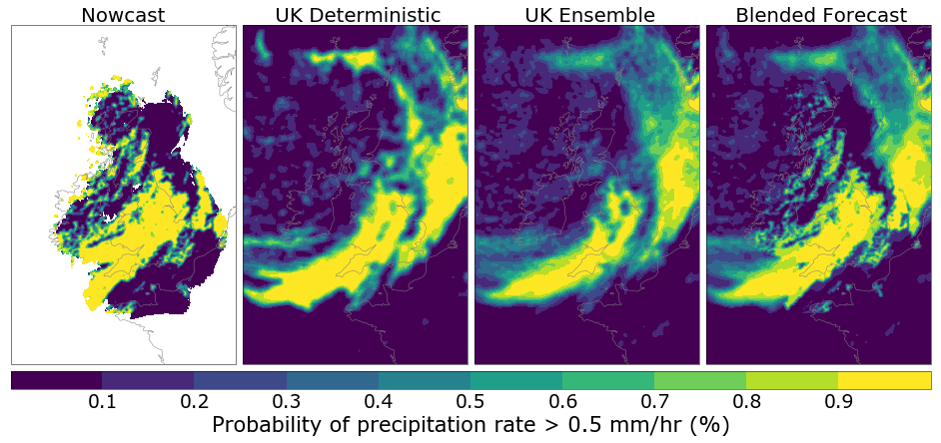
Blend probabilities from different models
0
6
12
18
72
96
120
168
hours
15 min
<1 hour
1 hour
6 hours
Notes:
The probabilities from the different models are blended using the fixed weights shown in the top diagram. For much of the forecast there will only be a single model contributing, but multiple runs of that model. However, at the start and at 4 to 5 days there will be two models and for precipitation there will be a third contribution at the start from the nowcast.

Slide 12
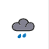
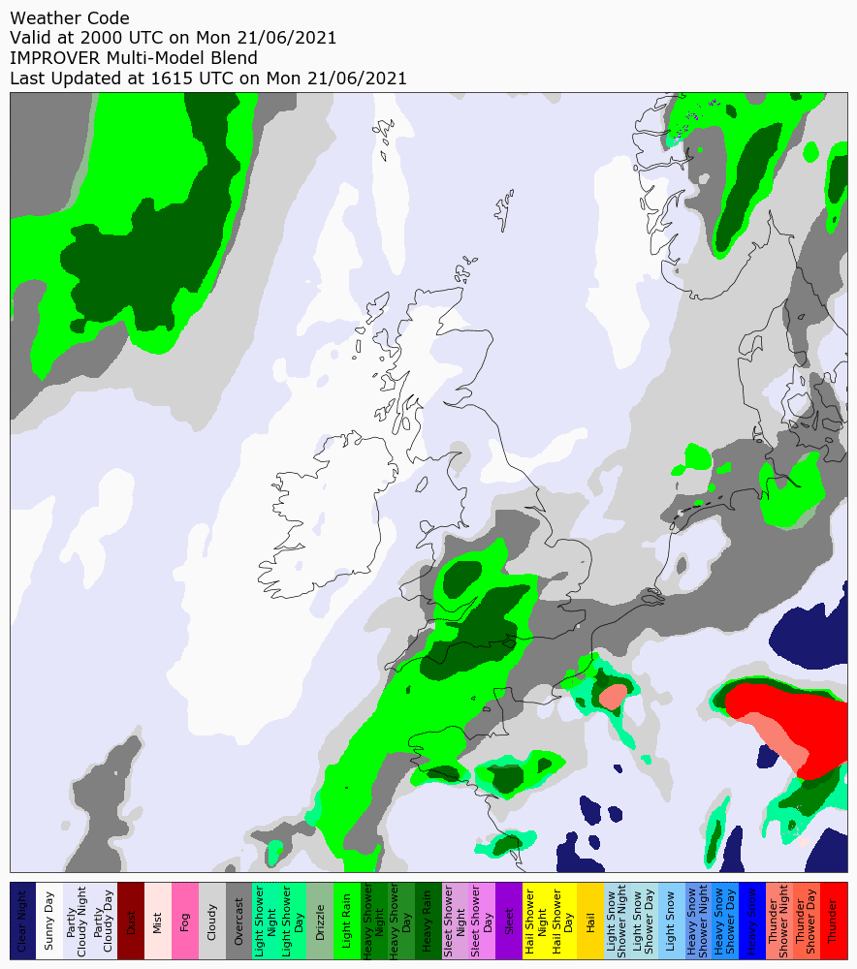
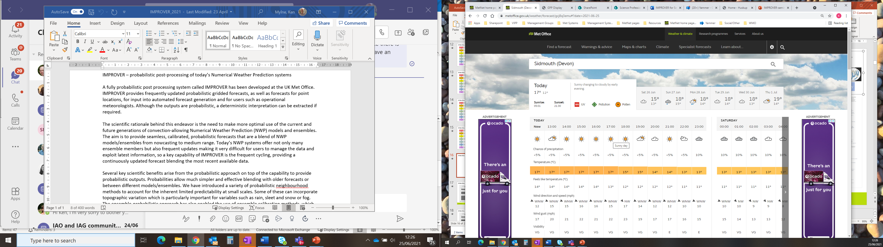
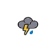
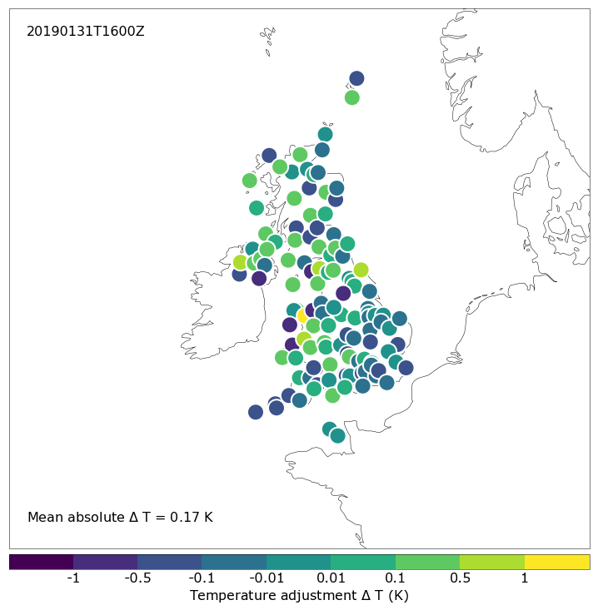
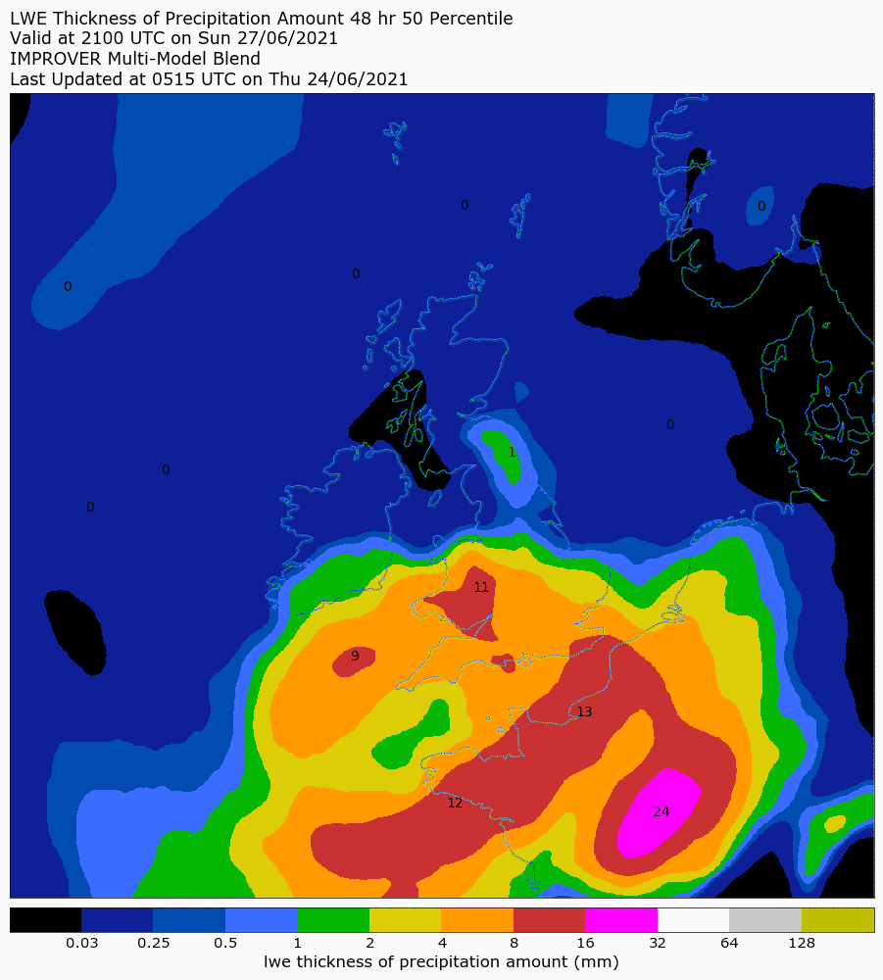
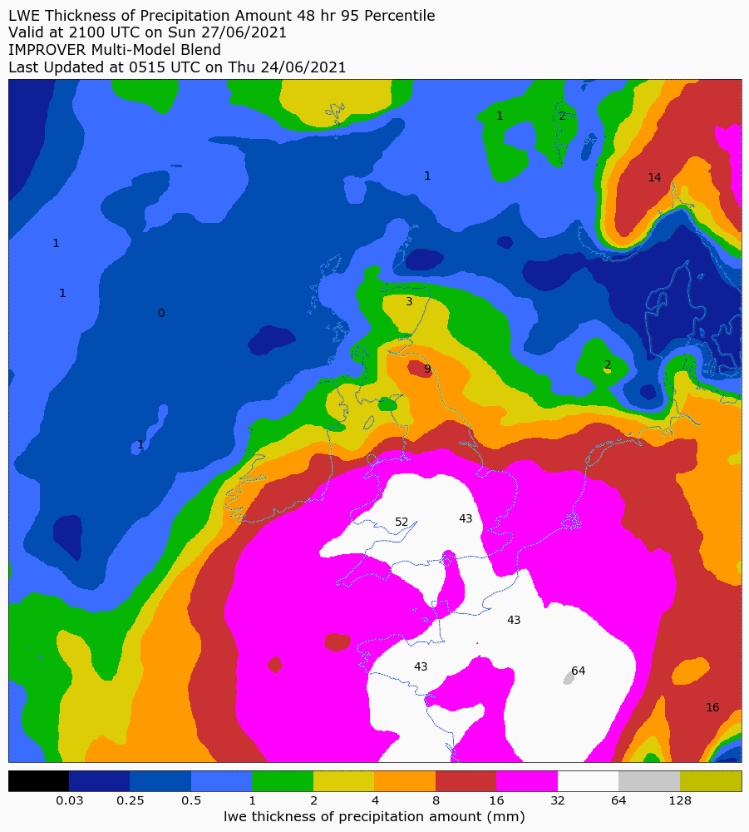
Generate spot forecasts Output gridded and spot
Lapse-rate temperature correction
EMOS site calibration
fog
rain
hail
thunder
clear
cloud
sleet
snow
Notes:
A key difference from the previous post-processing systems at the Met Office, is that both gridded and spot forecasts are provided from this one system. So, one of the final steps is to generate spot probabilities from the gridded blend, with further corrections applied to fine-tune the forecasts to the specific sites, including both physical corrections such as a lapse-rate based temperature correction and a third calibration method, EMOS site calibration. As well as probabilities, both gridded and spot percentile values also are generated for most variables. These can be helpful in assessing the potential extremes, as the example of a 48 hour precipitation accumulation with both the 50th and 95th percentile shows. We also produce gridded and spot weather symbol codes.

Slide 13
Range of diagnostics provided
Precipitation rate: total, rain, sleet, snow (total in vicinity)
Precipitation accumulation: total (1, 3, 6, 12, 24, 48 hour), rain, sleet, snow (1 hour)
Temperature: instantaneous, day max, night min (and feels-like temperature)
Wind: speed, direction, gust (highest in 1 or 3 hours)
Visibility
Cloud cover: low, low + medium, total
Relative humidity
UV index: instantaneous, day max
Weather types (codes)
ES2.1 Thursday 11:15 Generating Weather symbol data in IMPROVER
Lightning: at point, in vicinity
Pressure at mean sea level
Notes:
This is an attempt to give some idea of the range of diagnostics that IMPROVER generates.
Advertise Weather Symbol talk!

Slide 14
Data and metadata
dimensions:
threshold = 41 ;
projection_y_coordinate = 970 ;
projection_x_coordinate = 1042 ;
bnds = 2 ;
variables:
float probability_of_wind_speed_above_threshold(threshold, projection_y_coordinate, projection_x_coordinate) ;
probability_of_wind_speed_above_threshold:long_name = "probability_of_wind_speed_above_threshold" ;
probability_of_wind_speed_above_threshold:units = "1" ;
probability_of_wind_speed_above_threshold:grid_mapping = "lambert_azimuthal_equal_area" ;
probability_of_wind_speed_above_threshold:coordinates = "blend_time forecast_period forecast_reference_time height time" ;
int lambert_azimuthal_equal_area ;
lambert_azimuthal_equal_area:grid_mapping_name = "lambert_azimuthal_equal_area" ;
lambert_azimuthal_equal_area:longitude_of_prime_meridian = 0. ;
lambert_azimuthal_equal_area:semi_major_axis = 6378137. ;
lambert_azimuthal_equal_area:semi_minor_axis = 6356752.31414036 ;
lambert_azimuthal_equal_area:longitude_of_projection_origin = -2.5 ;
lambert_azimuthal_equal_area:latitude_of_projection_origin = 54.9 ;
lambert_azimuthal_equal_area:false_easting = 0. ;
lambert_azimuthal_equal_area:false_northing = 0. ;
float threshold(threshold) ;
threshold:units = "m s-1" ;
threshold:standard_name = "wind_speed" ;
threshold:spp__relative_to_threshold = "greater_than_or_equal_to" ;
float projection_y_coordinate(projection_y_coordinate) ;
projection_y_coordinate:axis = "Y" ;
projection_y_coordinate:bounds = "projection_y_coordinate_bnds" ;
projection_y_coordinate:units = "m" ;
projection_y_coordinate:standard_name = "projection_y_coordinate" ;
float projection_y_coordinate_bnds(projection_y_coordinate, bnds) ;
float projection_x_coordinate(projection_x_coordinate) ;
projection_x_coordinate:axis = "X" ;
projection_x_coordinate:bounds = "projection_x_coordinate_bnds" ;
projection_x_coordinate:units = "m" ;
projection_x_coordinate:standard_name = "projection_x_coordinate" ;
float projection_x_coordinate_bnds(projection_x_coordinate, bnds) ;
int64 blend_time ;
blend_time:units = "seconds since 1970-01-01 00:00:00" ;
blend_time:long_name = "blend_time" ;
blend_time:calendar = "gregorian" ;
int forecast_period ;
forecast_period:units = "seconds" ;
forecast_period:standard_name = "forecast_period" ;
int64 forecast_reference_time ;
forecast_reference_time:units = "seconds since 1970-01-01 00:00:00" ;
forecast_reference_time:standard_name = "forecast_reference_time" ;
forecast_reference_time:calendar = "gregorian" ;
float height ;
height:units = "m" ;
height:standard_name = "height" ;
height:positive = "up" ;
int64 time ;
time:units = "seconds since 1970-01-01 00:00:00" ;
time:standard_name = "time" ;
time:calendar = "gregorian" ;
// global attributes:
:institution = "Met Office" ;
:mosg__model_configuration = "gl_ens uk_det uk_ens" ;
:source = "IMPROVER" ;
:title = "IMPROVER Post-Processed Multi-Model Blend on UK 2 km Standard Grid" ;
:Conventions = "CF-1.5"
On disk:
NetCDF format files (NetCDF-4 Classic)
Follow CF metadata standards and guidance wherever possible
Keep custom metadata minimal
One variable and validity time per file
In memory:
Iris “cubes” (uses CF data model)
Notes:
We follow CF-metadata standards and store data as NetCDF.
[next slide]
By default, IMPROVER reads and writes NetCDF files – NetCDF-4, but conforming to the Classic (NetCDF-3) data model.
The CF Metadata Convention is followed wherever possible, with some custom extensions to handle probabilities.
A single NetCDF will hold a single variable and validity time.
In memory, IMPROVER operates on Iris “cubes”.

Slide 15
History & Recent Developments

Slide 16
Project history
Australian Bureau of Meteorology join
US Air Force join
BoM
prod-live
2017
2018
2019
2020
2021
2022
Starting out
Met Office
Alpha release
Real-time capability
UK and globe
Introduced nowcasting
MOGREPS-G in UK blend
Hourly-cycling MOGREPS-UK
Met Office
Operational beta demo
Web & App focus
Suite & verification upgrades
Science upgrades
Nowcast porting & enhancements
Statistical calibration
More variables
Visualisation
Met Office
Fully Operational
Further Web and App focus
Suite resilience improvements
Site calibration
Weather Symbol enhancement
Conda pack, logging
More variables
Notes:
The Met Office IMPROVER project started in 2016, with the first alpha release in 2019, and a beta release in 2021. The system gained operational acceptance in 2022, going operational in May. The aim is for this to allow the other gridded and site-specific post-processing systems that are run to be retired within a few years.

Slide 17
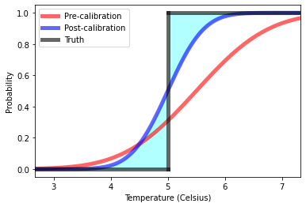
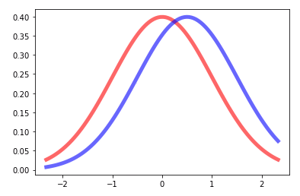
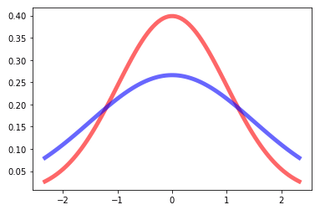

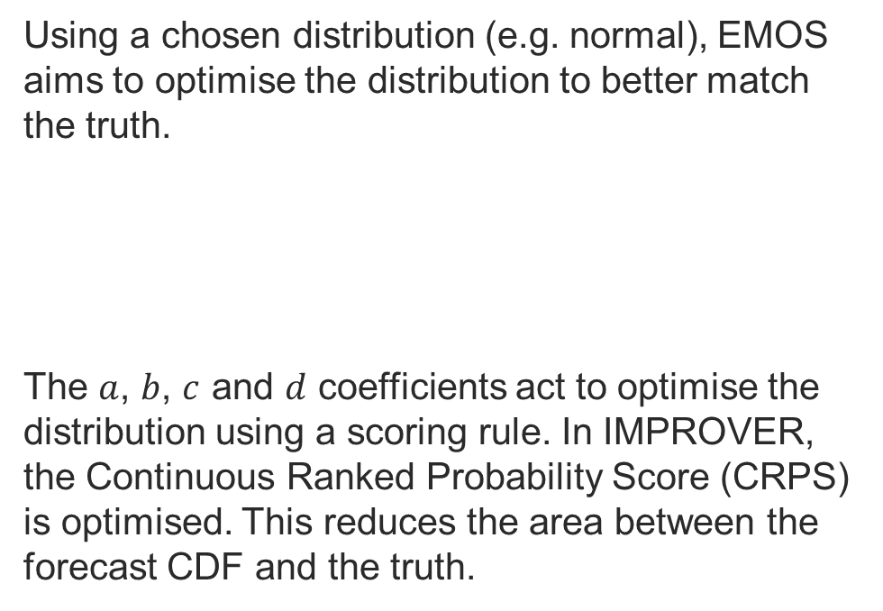
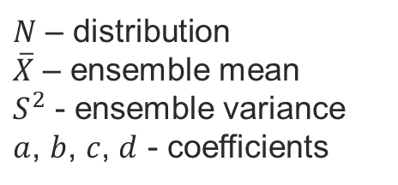


EMOS Calibration
Pre-calibration forecasts
Estimate EMOS coefficients
Using a chosen distribution (e.g. normal), EMOS aims to optimise the distribution to better match the truth.
The $a$, $b$, $c$ and $d$ coefficients act to optimise the distribution using a scoring rule. In IMPROVER, the Continuous Ranked Probability Score (CRPS) is optimised. This reduces the area between the forecast CDF and the truth.
Truths
$N$ – distribution
$\overline{X}$ – ensemble mean
$S^{2}$ - ensemble variance
$a$, $b$, $c$, $d$ - coefficients
$$N\left(a+b\overline{X}, c+dS^{2}\right)$$
Change location parameter
Change scale parameter
Post-calibration
$$μ=a+b\overline{X}$$
$$σ^{2}=c+dS^{2}$$
Apply to:
screen temperature
daytime max temperature
night-time min temperature
10m wind speed
Constraint:
Prefer techniques that calibrate all sites, rather than just sites with observations, as this can lead to large differences between neighbouring sites.
Notes:
One of our recent developments is to extend the EMOS calibration applied to our final spot forecasts of temperature and wind. EMOS aims to optimise the distribution to better match the truth. It derives two pairs of coefficients which act on the ensemble mean and variance in future forecasts. As we want to deliver equivalent skill for both our observed and non-observed spot forecasts, we use a non-localised EMOS scheme.
We use ensemble mean because literature shows little benefit in using all members over mean; more efficient (reduced data volumes)
The coefficients are optimised to minimise the CRPS.
We ran experiments with different static and dynamic predictors and alternative distributions.
[CRPS is graphically shown as the shaded blue area in the image to the right of the main slide]

Slide 18
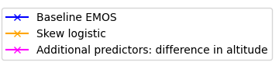
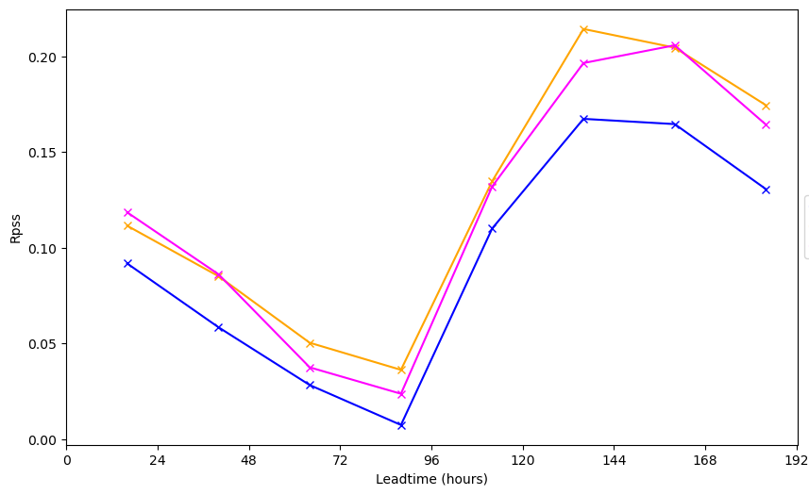
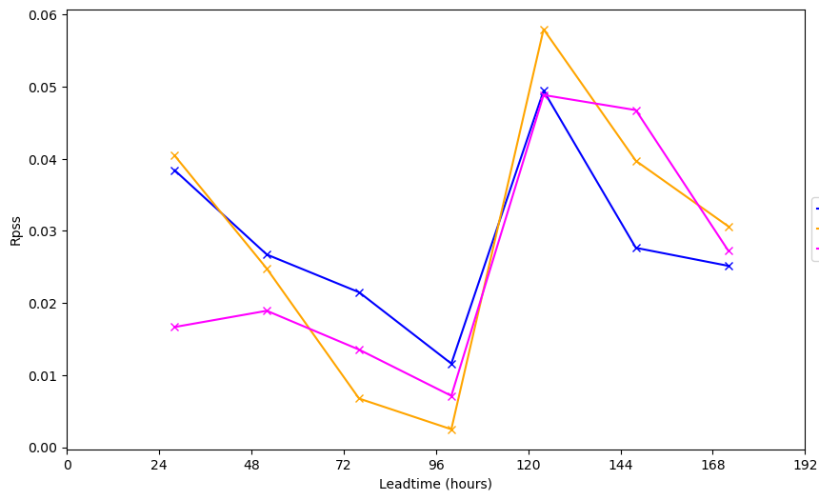
Results – EMOS – preferred non-local
RPSS relative to pre-calibrated data
Daytime max temperature
Night-time min temperature
Higher is Better
Notes:
The Blue line is the simplest EMOS experiment (Normal Distribution, Ensemble Mean is the only predictor) and is our baseline here. Orange shows the result of the Skew Logistic EMOS and Pink shows the Normal Distribution EMOS with the additional altitude-offset predictor.
On the left is the Daytime maximum temperature which shows a definite gain in skill for the two experiments shown.
On the right is the night-time minimum temperature, which shows a very small change in skill and no obvious signal for which of the three trials performs best. We believe there are significant local-scale effects that non-localised EMOS cannot capture.

Slide 19
Verification
IMPROVER spot forecasts assessed against current Met Office “BestData”
Want to do better than BestData at ~14,000 non-observation sites and get close to BestData at ~100 observed sites
Notes:
Since we’ve drifted into the realm of verification, I’ve included a couple of slides showing the performance of IMPROVER.

Slide 20
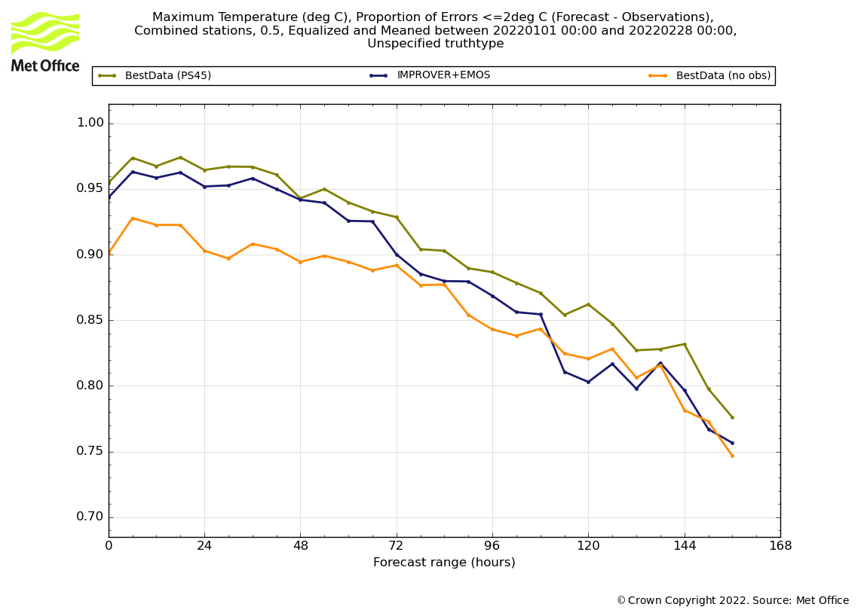
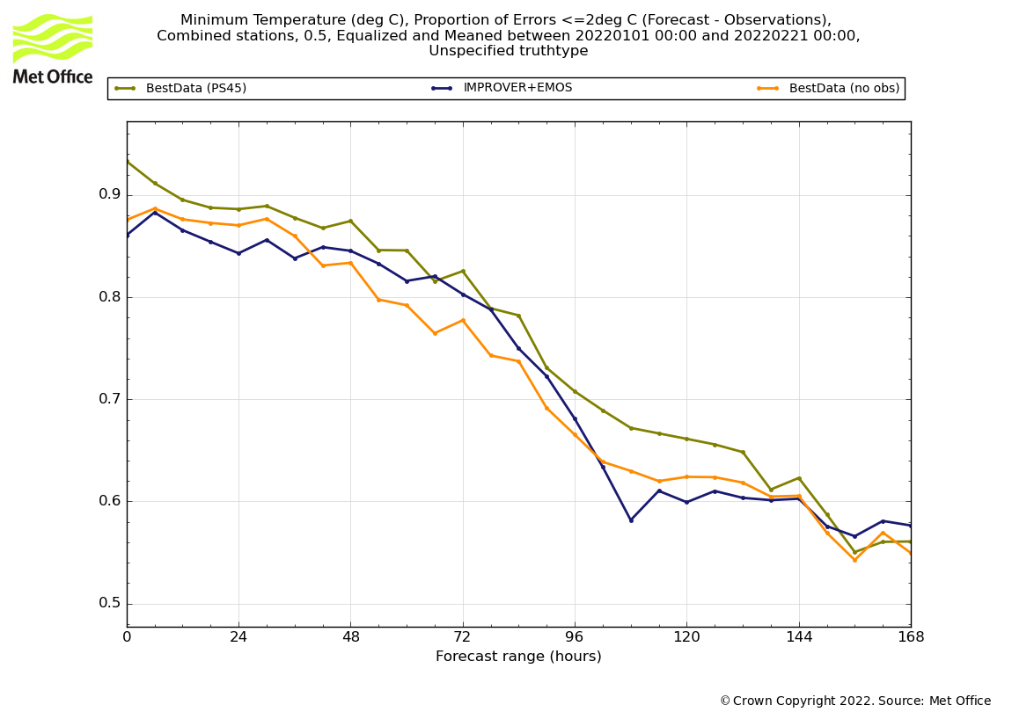
Verification
Proportion of forecasts within 2degC of observations
Maximum temperature
IMPROVER close to BestData at obs sites
And better at non-observing locations
Minimum temperature
IMPROVER generally close to BestData at obs sites
And (apart from first 36 hours) slightly better non-observing locations
Higher is Better
Higher is Better
Notes:
This slide looks at maximum and minimum temperatures again, and compares the verification metric “proportion of forecasts within 2 degrees of observations” (where 1 is a perfect score) from three sources. The top-most line, brown, shows the current Met Office operational forecast performance at observation sites where recent observations are used to improve the forecast. The orange line is the same system, but without that statistical correction, so represents the current operational forecast at non-observing sites. The dark blue line is the IMPROVER forecast. While it doesn’t beat the operational forecast at observing sites, it is comparable with the much larger number of forecasts at non-observing sites.

Slide 21
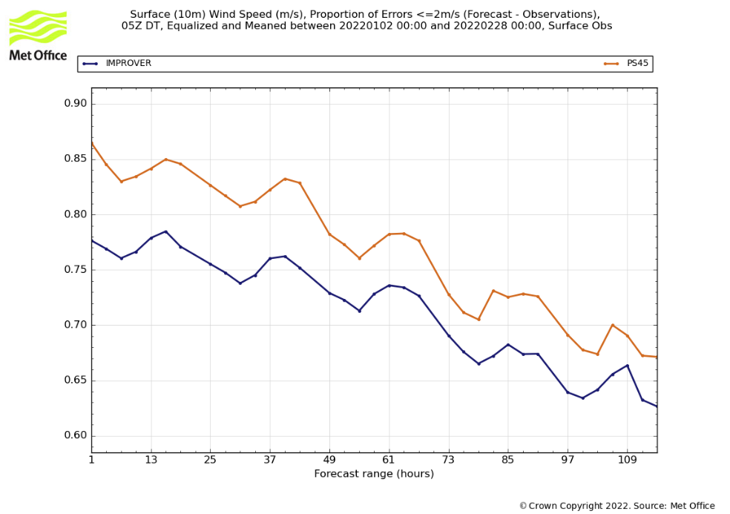
Verification
Wind speed
proportion within 5knts
PWS metric is ~5% worse than BestData
But has a similar performance to BestData at non-obs sites)
Higher is Better
Notes:
Hidden slide
This shows verification for wind speed, where IMPROVER is not as good as BestData at observing sites, but we know that IMPROVER’s performance at non-observing sites is similar to BestData (not shown) which improves the consistency of the data.

Slide 22
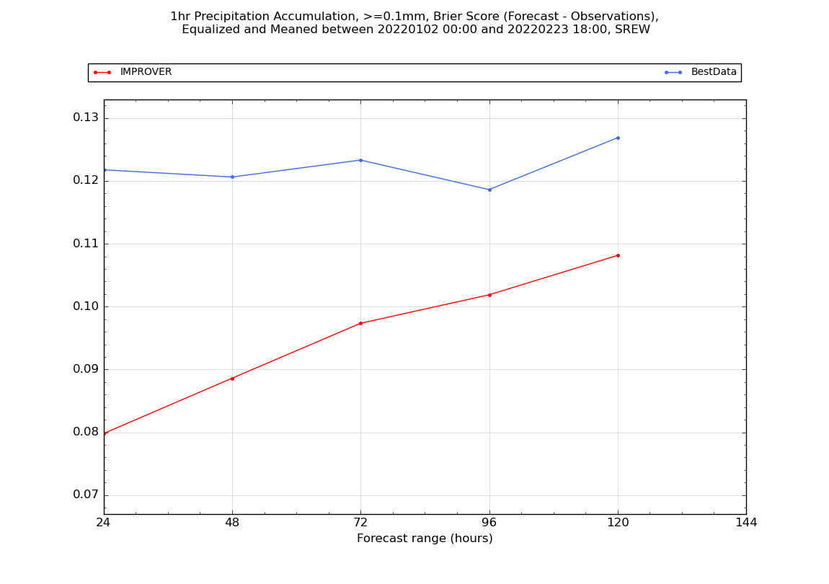
Verification
Probability of precipitation (PoP)
Brier Score (accm>=0.1mm/hr)
Performance much better than BestData
In particular, reliability is much improved
Lower is Better
Notes:
Here we have a similar comparison for probability of precipitation. In this case, IMPROVER, red, is significantly better.

Slide 23
Technical Aspects
Met Office implementation
Notes:
The Met Office IMPROVER project goes beyond just an open source code base, with many other technical, process and people aspects.

Slide 24
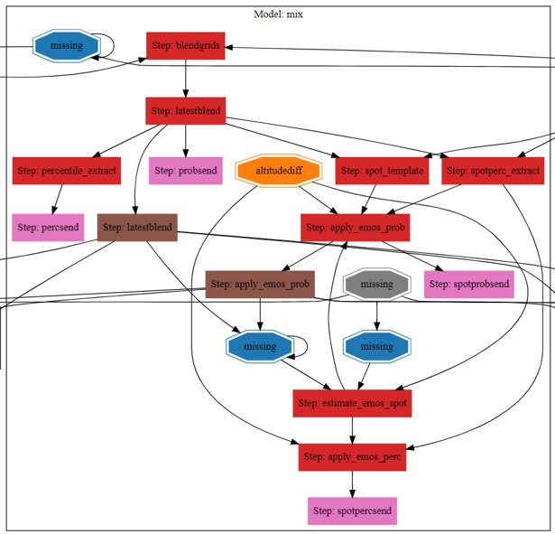

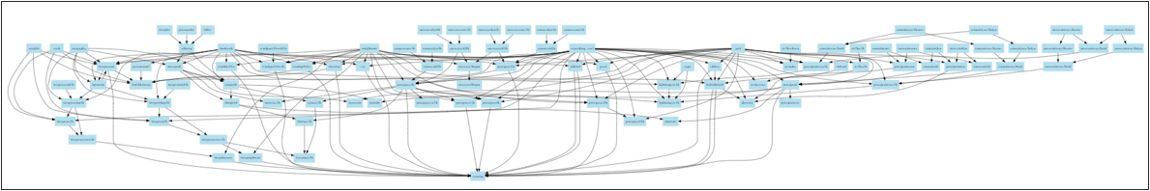
Workflow infrastructure
Not just a science code base, but also the workflow infrastructure to run this:
Suite Infrastructure (rose/cylc)
Environment management (conda)
Notes:
As much work has gone into the technical running of IMPROVER as into the science. A very large number of tasks require scheduling and running in a timely manner, which I don’t have time to do justice to in this talk.

Slide 25
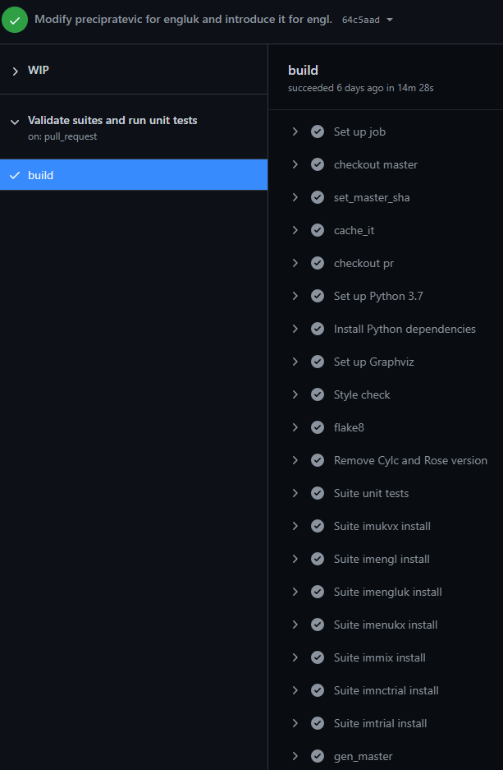
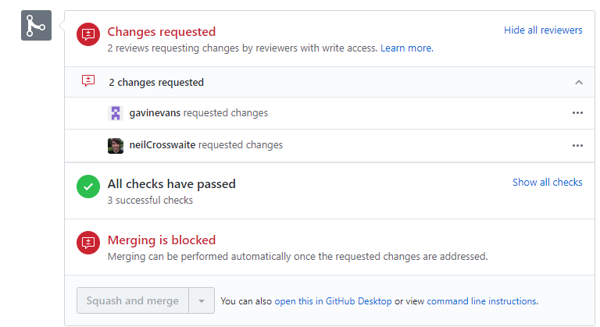
Technology aspects
Automation of tests and checks where possible:
Code style, black
Unit tests
Code coverage checks
Complexity tracking
Security checks
Documentation building
Suite validation
Suite generated files comparison
Nightly testing of codebase and
suite using representative real data
Protected branches
Notes:
Hidden slide
There are a whole host of technology aspects to the process of developing and running the IMPROVER code that make it more robust and easier to work with.

Slide 26
Collaboration & Initial Customers

Slide 27
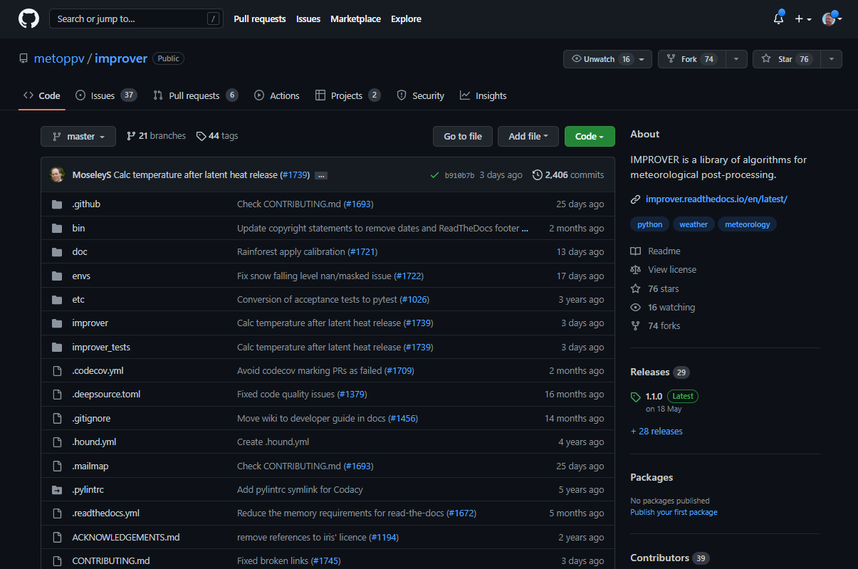
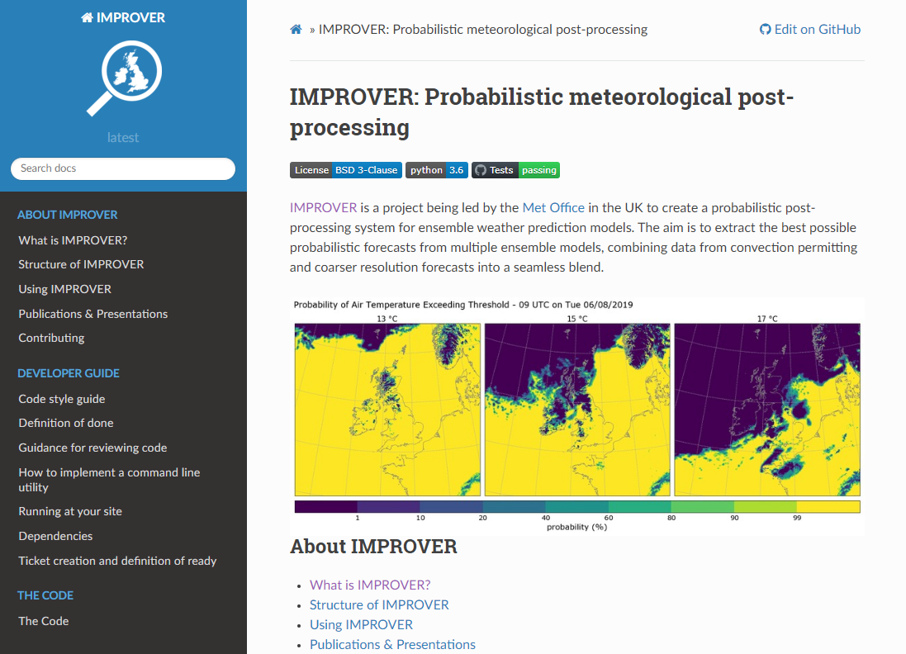
Shared code
All the IMPROVER code is open Source (GitHub)
Documentation is available on Read the Docs
https://github.com/metoppv/improver
https://improver.readthedocs.io/en/latest/
Notes:
All IMPROVER code is open source and can be viewed on GitHub, along with documentation to go with each process step on Read the Docs.

Slide 28



Formal collaborations
Bureau of Meteorology, Australia
Collaborating since 2019
Team of ~10 people working on IMPROVER
IMPROVER has technical acceptance and is now running under operations
US Air Force
Collaborating since 2021
Spinning up to team of 3 people working on IMPROVER
Meteorological Service Singapore
Starting to collaborate in 2022
Notes:
The Met Office has also established a number of more formal collaborations, where we work more closely with organisations, having regular catch-up and sharing some of the closed source aspects of the Met Office IMPROVER system (e.g. source execution and workflow infrastructure).

Slide 29
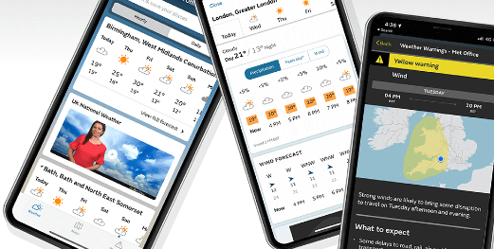



Initial customers
Met Office Digital – Website and App
Will use site specific IMPROVER for Web & App forecast tables later this year and gridded IMPROVER to generate maps next year
Met Office Hazard Manager
Will also start to use site specific UK IMPROVER data later this year and gridded IMPROVER to generate maps next year
Network Rail
Are currently evaluating the use of IMPROVER during proof of concept trial
Met Office Operational Meteorologists
Online Weather demo tool
Evaluated the use of IMPROVER forecasts in the Winter Testbed this year
UK Royal Navy
Have evaluated the use of trial IMPROVER data via Online Weather
Notes:
These are our initial customers which will make use of IMPROVER data for the general public and for expert users.
[more details]
Our users take our data via The Service Hub service, this service serves our data in the relevant format users require it in. Via SH, users can take IMPROVER variables from the UK and/or globe in site specific and/or gridded format.
- Digital and Hazard Manager are working to the same timelines to ensure consistency. This ensures customers accessing both services will see the same source of data.
Digital teams will use our UK & Global data to populate forecast tables on the public website and in the app
Hazard Manager will use our UK data for their service which is designed to help authorities prepare for and respond to emergency incidents caused or influenced by the weather.
Initially, they are working with site specific information to replace their current data feeds in a similar way to transition their downstream users effectively at the end of this year. This will pave the way for the next phase (2023) which will see users utilising probabilistic information informed by user insight to transition users away from a fully deterministic offering.
Network Rail – have been using our probabilistic gridded UK data for several months as a proof of concept trial, we are working with them to gather their requirements for future use once trial has concluded.
Op Mets – Have been exposed to IMPROVER data via Online Weather demonstrator tool which was a product of the ensemble exploitation project. This tool has allowed them to visualise IMPROVER data in the same way as they would via visual weather product they have now. They have more recently been involved in the IMPROVER testbed where over a 4 week period they used IMPROVER to make decisions on hazards and impactful weather. We have captured their feedback and observations and fed these into our product backlog.
Ministry of defence, specifically the Royal Navy have been equipped with laptops on board their carrier ships with secure access to online weather tool I have just mentioned above. They have used our forecast data to inform decisions upon entry and exit to ports and we have received some really positive feedback from them. We are continuing to work with them to understand their future requirements.

Slide 30
Planned Future Work

Slide 31

New diagnostics
Freezing rain
precipitation scenarios that are meteorologically consistent, suitable to drive hydrological models.
Global hail
Indicate the likelihood of hail using the Miller and Fawbush and Will Hand CDP approach.
Notes:
Finally, here are a sample of what we are currently working on: Freezing Rain, Diagnosing hail from the global ensemble model,…

Slide 32
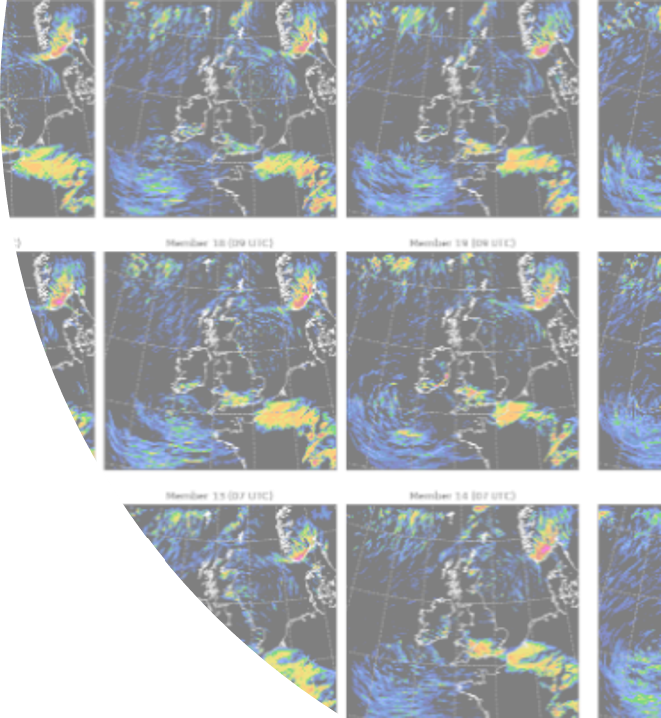
Enhanced capabilities
Week 2 predictions
Extend IMPROVER forecasts out to 14 days using inputs from ECMWF Ensemble forecasts and MOGREPS-G model.
Improved visibility
Upgrade our existing visibility diagnostic by incorporating inputs from the new model VERA scheme developed within the Met Office.
Notes:
… Extending forecasts to 14 days, pulling through new visibility data from the VERA scheme…

Slide 33

New capabilities
Precipitation realizations
Recover precipitation ‘pseudo ensemble members’ that are meteorologically consistent, suitable to drive hydrological models.
Notes:
We need to derive precipitation realizations for use in hydrology

Slide 34

Technical enhancements
Improved compute efficiency
Investigation into feasibility of hosting IMPROVER on the cloud
Infrastructure for gridded machine learning
Researching future verification options
Notes:
And we have some technical enhancements in the pipeline too.

Slide 35
Thank you

