Slide 1


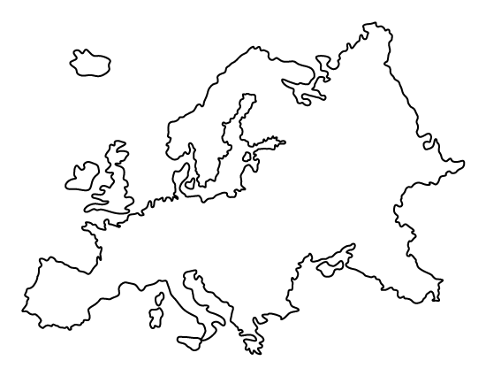
Urban meteorological networks in Europe: A review
Jelena Dunjić, Stevan Savić, Dragan Milošević, Ivan Šećerov
University of Novi Sad, Faculty of Sciences

Slide 2

Why are UMNs important?
More than half of the world’s population now lives in urban areas, which puts large pressure on urban environment in terms of building intensity
Assessment of climate in urban environments strongly relies on the good quality and resolution of meteorological data
Monitoring of urban climate via traditional national/global networks do not provide enough data on complex and heterogeneous urban environemnts
According to the IPCC in-situ observations from climate networks have provided the most important basis for understanding the dynamics and causes of climate change

Slide 3

Our objectives for this research
To make an inventory of the urban meteorological networks and available data in Europe
To assess the purpose of the networks and data
To obtain detailed information on:
  scale of UMNs,
  spatial distribution and density of sensors,
  data resolution,
  data collection, communication and availability
  main barriers and challenges in development and maintenance of UMNs
To contribute to establishment of KSP

Slide 4


Methods for data collecting
Two sources:
  Literature review - urban meteorological networks whose characteristics or data are reported in scientific journals referred in the Web of Science database
  Questionnaire form - networks reported during the data collection of urban and rural networks from partners participating in FAIRNESS COST Action

Slide 5
Literature review process
Keywords selection
OR
sensor
temperature
“urban meteorological network”
AND
AND
“urban climate network”
WoS database
Initial screening
II round full text screening
Content analysis and classification

Slide 6



Literature review preliminary outcomes
Network establishment procedure
Sensor characteristics
Purpose
  Remotly sensed data validation
  land use / surface cover assessment
  LCZ assessment
  UHI assessment
  human outdoor thermal comfort assessment
  air quality assessment
Gaps and barriers (funding, measurement methods, data assimilation, etc.)

Slide 7
Questionnaire survey
COST Action CA20108 - FAIR NETwork of micrometeorological measurements
Part of the activities of WG 1 (Networking and communication)
Creation of the questionnaire with 22 questions regarding urban/rural meteorological networks in order to make an inventory of available micrometeorological data and their structure in Europe
Questionnaire was disseminated through e-mails among the WG1 members, climatology/meteorology experts and institutions that are dealing with various urban or rural micrometeorological networks/stations/data portals
By now 41 micrometeorological urban or rural networks/stations, from 15 European countries are identified

Slide 8
Questionnaire survey
The networks obtained through questionnaire differe in:
  number of stations in the network (up to 273),
  sensor type (e.g. Davis, General electric, HOBO, Campbell etc.)
  communication protocol (ftp, http, etc.)
  measurement period (1998 - present)
  frequency of measurements (1-60 min)
  measurement parameters (air temperature, humidity, wind speed and direction, precipitation, surface temperature, air pressure, global radiation, aerosols, CO₂, etc.)

Slide 9
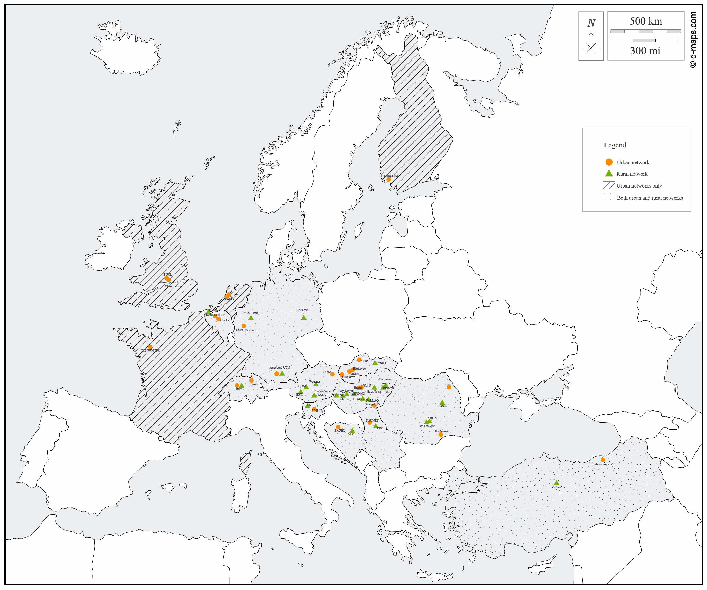
Urban networks:
Austria: BOKU-Met urban,
Belgium: MOCCA and Vlinder,
Bosnia and Herzegovina: PMFBL,
Finland: TURCLIM,
France: ICU-RENNES,
Germany LMSS and Augsburg UCN,
Hungary: Fog_Bp, BpArt, Szeged UN;
The Netherlands: AAMS;
Romania: Bucharest network, Iasi network;
Serbia: NSUNET;
Slovakia: Trnava, Zilina, Bratislava and Hlohovec;
Slovenia: UNI-LJ;
Switzerland: Zurich UHI MN;
Turkey: Trabzon net;
United Kingdom: BUCL and Birmingham Urban Observatory.
The list will be regularly updated with new micrometeorological networks/stations during the project implementation, so that the final number of networks will be known by 2025.

Slide 10
Thank you for your attention ☺

