Slide 1


The dynamic of extreme precipitation events in Berlin and Brandenburg in the context of wireless communication performance
Frederik Bart, Fred Meier, Dieter Scherer and David Hellmann
Chair of Climatology | Institute of Ecology | Technische Universität Berlin

Slide 2






Introduction
Analysis in the context of AI-NET-PROTECT (since November 2021)
Investigation of weather influence on THz-Links (100 GHz - 10 THz)
Terahertz link
Antenna gain
Thermal noise
Transmit power
Incident radiation
Attenuated radiation
Absorption and scattering
Transmission distance
Signal loss due to rain specific attenuation during extreme precipitation events (EPE)
Regionally varying positive trend of EPEs in recent decades (Barbero et al., 2019)
Spatial and temporal dynamic of daily EPE in Berlin/ Brandenburg (30 years)
Impact of hourly rain specific attenuation on link availability (10 years)
Notes:
Analysis based on hourly and daily rain gauge measurements in Berlin/ Brandenburg (DWD):
Dynamic of ERE based on peak-over-threshold approach
Trends in spatial distribution of ERE (1991-2020)
Influence of the selected threshold/ method on these results
Conversely attenuation data can be used to gain rainfall data along the transmission path
Attenuation of microwave (MW) radiation due to scattering and absorption effects
Impact depends on multiple factors (i.e. wavelength or transmission distance)

Slide 3
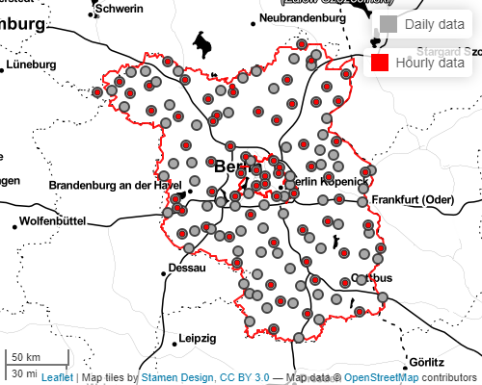
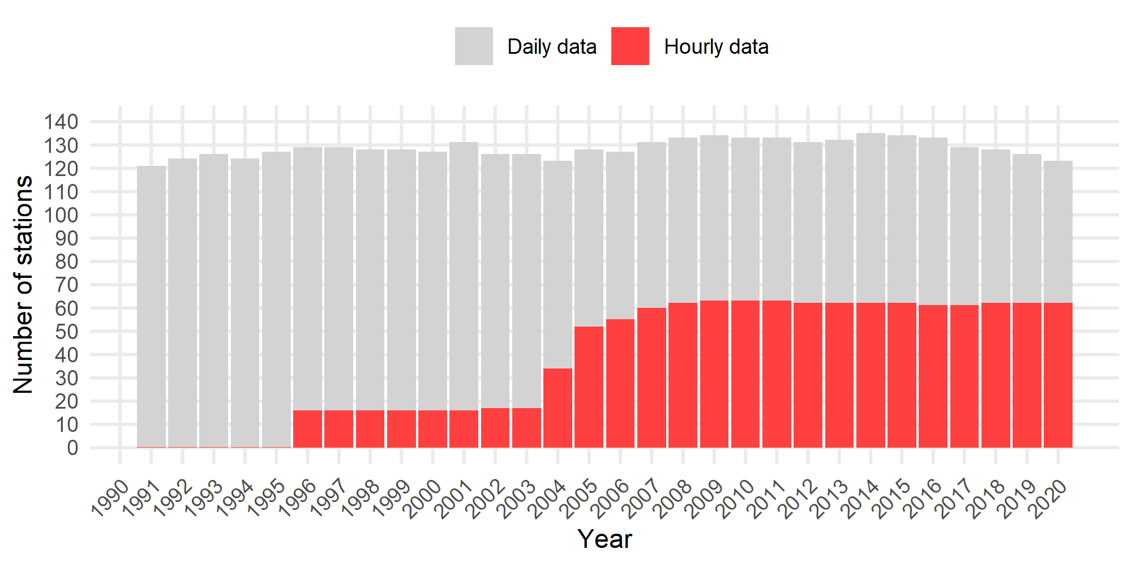
Raingauge data of the German Meteorological Service¹ (DWD)
Peak over threshold analysis
¹ DWD Climate Data Center (CDC), 2021
DWD stations in Berlin and Brandenburg
Threshold values ² | Description
PN10 | Days with prec. amount ≥ 10 mm
PNL95 | Days with prec. amount ≥ the 95th percentile of wet days (≥ 1mm) between 1960-1990 → mean of all stations = 14.5 ± 0.8 mm
PN20 | Days with prec. amount ≥ 20 mm
PNL99 | Days with prec. amount ≥ the 99th percentile of wet days (≥ 1mm) between 1960-1990 → mean of all stations = 26.1 ± 1.8 mm
² Based on climate change indices by the WMO CCl/CLIVAR working group (Peterson et al., 2001)
Notes:
Analysis based on hourly and daily rain gauge measurements in Berlin/ Brandenburg (DWD):
Filter:
Days >75% of hours
Seasons >75% of days
Years >75% of seasons
Werte für Berlin nicht extra kennzeichnen

Slide 4
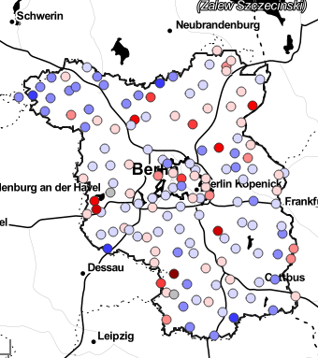
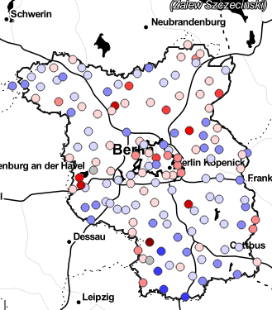
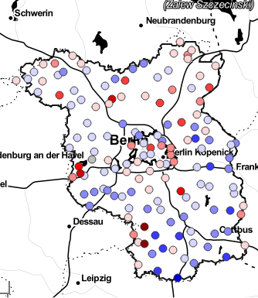
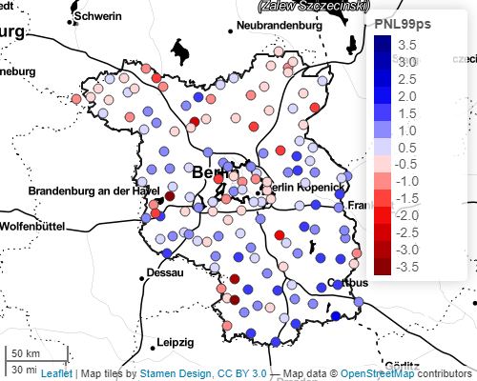


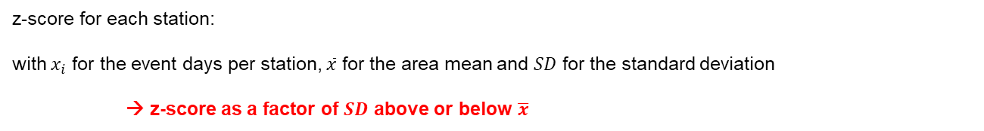
Standardized total number of event days (1991 – 2020)
$$z_{i}=\frac{x_{i}−\overline{x}}{{SD}_{x}}$$
z-score for each station:
with $x_{i}$ for the event days per station, $\overline{x}$ for the area mean and $SD$ for the standard deviation
→ z-score as a factor of $SD$ above or below $\overline{x}$
PN10 (10 mm)
^{͞x = 341 SD = 91}
PNL95 (14.5 mm)
^{͞x = 159 SD = 42}
PN20 (20 mm)
^{͞x = 74 SD = 21}
PNL99 (26.1 mm)
^{͞x = 35 SD = 11}
z-score

Slide 5
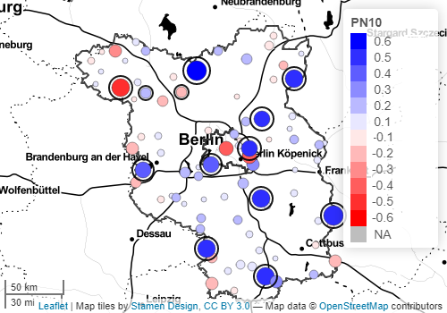
Spatial analysis of linear Trend (1991-2020)
Annual extreme event days per station
Selection only stations with 30 years of data (1991-2020)
Mann-Kendall trend test (Mann, 1945; Kendall, 1975)
Magnitude of Trend using Sen’s slope (Sen, 1968)
Black circle = significant trend (p < 0.05)
Size of the dots = magnitude of trend
Trend of annual PN10 event days from 1991-2020
→Higher threshold values resulted in similar direction of trend but significantly lower magnitude
Notes:
→Manfred Kendall with K-means clustering
Intensity? Prec / no of events?
-> prewhitening ist eventuell nicht notwendig (testen)

Slide 6
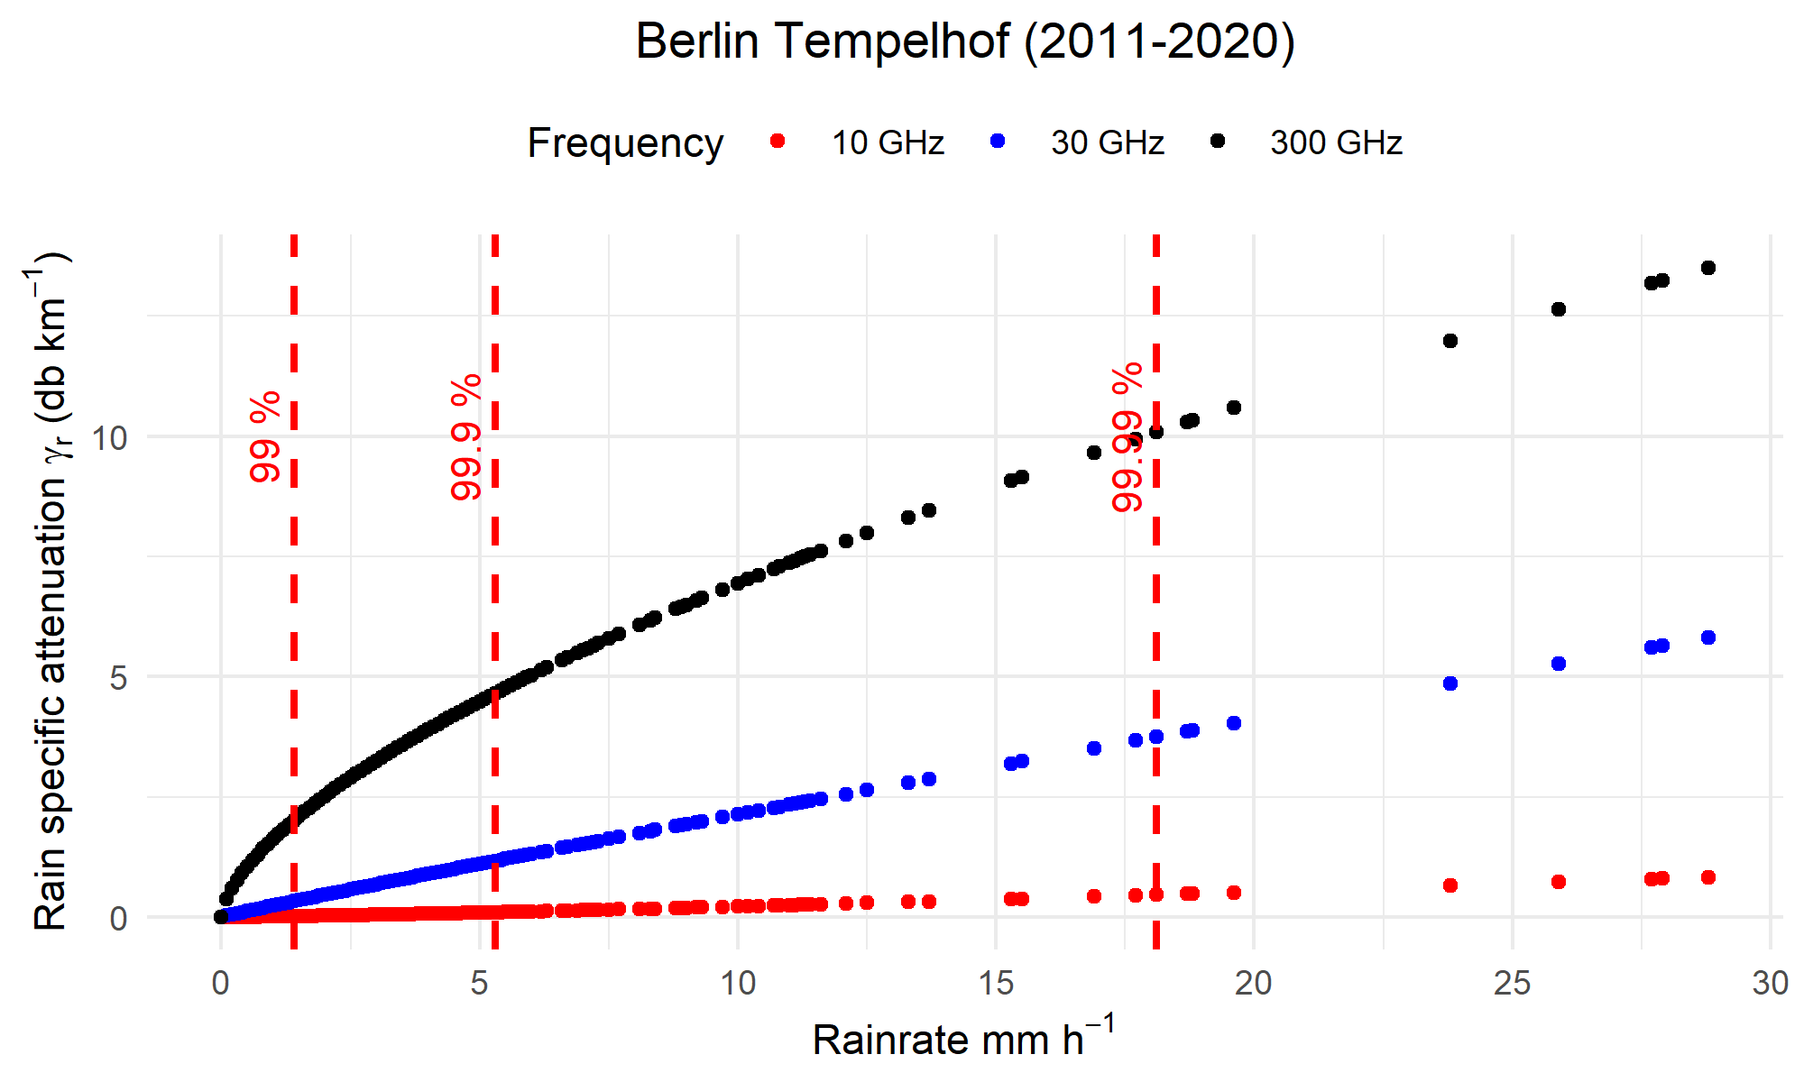


Rain specific attenuation (hourly data)
Recommendation of the International Telecommunications Union (ITU-R P.838-3)
$$γ_{R}=kP^{a}$$
With $P$ for the rain rate (mm h⁻¹) and coefficients $k$ and $a$ as functions of the frequency (GHz)
Link parameters:
Transmission distance = 1 km
Path elevation angle = 0° (Horizontal path)
Polarization tilt angle = 45°
Link availability (%) | Rain spec. attenuation (db km⁻¹)
 | 10 GHz | 30 GHz | 300 GHz
99 | 0.02 | 0.1 | 0.46
99.9 | 0.33 | 1.17 | 3.7
99.99 | 2.01 | 4.65 | 10
Notes:
Hier sollen eher Richtfunkfrequenzen zwischen den Antennen betrachtet werden. (10-30 GHz, Paper von Chwala und co.)
Scatterplot zwischen Dämpfung und Regenrate (für alle Regentage) erstellen Schwellenwerte als Linien einfügen
Mittelwerte eignen sich nicht für Niederschlagsdaten (zu viele 0-Werte)→ einzelne Ereignisse betrachten
Eventuell 99% perzentilkarte (CER) in den Ausblick
Polarization tilt angle = 45° for circular polarization

Slide 7
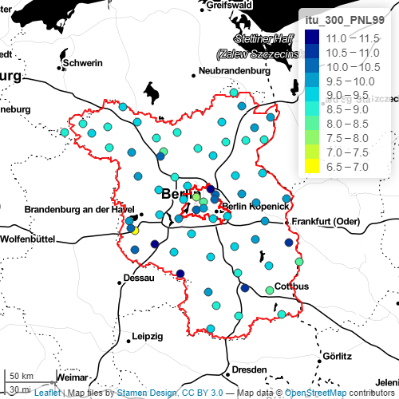
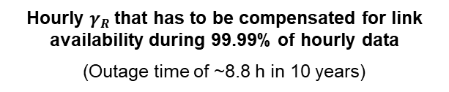

Percentile analysis for hourly station data (2011-2020)
Hourly data for DWD stations (n=66)
10-year timeframe (2011-2020)
99.99th percentile of attenuation data
$γ_{R}$ (db km⁻¹)
Hourly $γ_{R}$that has to be compensated for link availability during 99.99% of hourly data
(Outage time of ~8.8 h in 10 years)
Link parameters:
Frequency = 300 GHz
Transmission distance = 1 km
Path elevation angle = 0° (Horizontal path)
Polarization tilt angle = 45°
99.99th percentile of hourly $γ_{R}$ data (300 GHz)

Slide 8
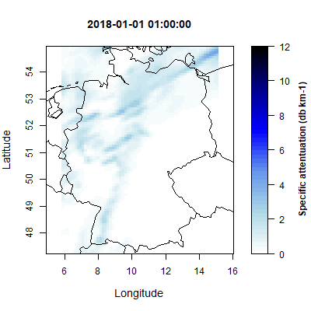
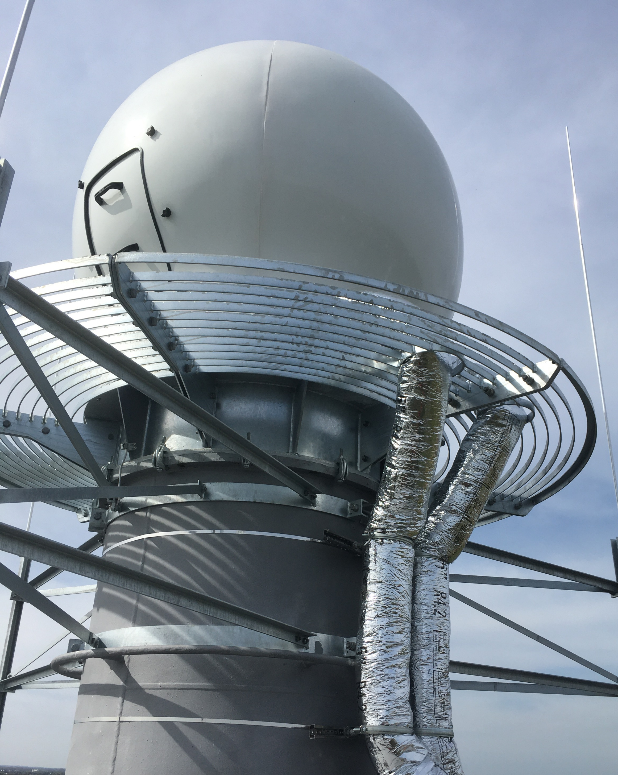

Outlook
Evaluation of the Central European Refined analysis¹ (CER) data set (Jänicke et al., 2017)
Investigation of extreme events over Berlin using the new x-band weather radar of the Urban Climate Observatory² (UCO)
Optical fiber pair
Heinrich Hertz institute lab
Rainrate and attenuation measurements during operation of the AI-NET-PROTECT THz-link testbed
Heinrich Hertz institute
THz-link (500 m)
THz-link (500 m)
Weather station
Weather station
¹ https://www.klima.tu-berlin.de/index.php?show=observatorium_start&lan=de
² https://www.klima.tu-berlin.de/index.php?show=daten_cer&lan=de
THz-link (500 m)
Telefunken building
TU Berlin main building
Weather station

Slide 9






Thank you for your attention
Twitter: @CELTIC_AI_NET
@AI_NET_PROTECT
Web: https://ai-net.tech/protect
The CELTIC-NEXT project AI-NET-PROTECT (Project ID C2019/3-4) is partly funded by the German Federal Ministry of Education and Research, the Swedish Governmental Agency for Innovation Systems Vinnova, Business Finnland, BGE France, and the Polish National Center for Research and Development (NCBR).

Slide 10
References
Barbero, R., Fowler, H.J., Blenkinsop, S., Westra, S., Moron, V., Lewis, E., Chan, S., Lenderink, G., Kendon, E., Guerreiro, S., Li, X.-F., Villalobos, R., Ali, H., Mishra, V., 2019. A synthesis of hourly and daily precipitation extremes in different climatic regions. Weather and Climate Extremes 26, 100219. https://doi.org/10.1016/j.wace.2019.100219
DWD Climate Data Center (CDC): Historische tägliche Stationsbeobachtungen (Temperatur, Druck, Niederschlag, Sonnenscheindauer, etc.) für Deutschland, Version v21.3, 202
DWD Climate Data Center (CDC): Historische stündliche Stationsmessungen der Niederschlagshöhe für Deutschland, Version v21.3, 2021
International Telecommunication Union (ITU) (Ed.), 2005. Recommendation ITU-R P.838-3 - Specific attenuation model for rain for use in prediction methods.
Jänicke, B., Meier, F., Fenner, D., Fehrenbach, U., Holtmann, A., Scherer, D., 2017. Urban–rural differences in near-surface air temperature as resolved by the Central Europe Refined analysis (CER): sensitivity to planetary boundary layer schemes and urban canopy models. International Journal of Climatology 37, 2063–2079. https://doi.org/10.1002/joc.4835
Kendall, M.G., 1975. Rank correlation methods, 4th ed., 2d impression. ed. Griffin, London.
Mann, H.B., 1945. Nonparametric Tests Against Trend. Econometrica 13, 245–259. https://doi.org/10.2307/1907187
Sen, P.K., 1968. Estimates of the Regression Coefficient Based on Kendall’s Tau. Journal of the American Statistical Association 63, 1379–1389. https://doi.org/10.1080/01621459.1968.10480934

Slide 11
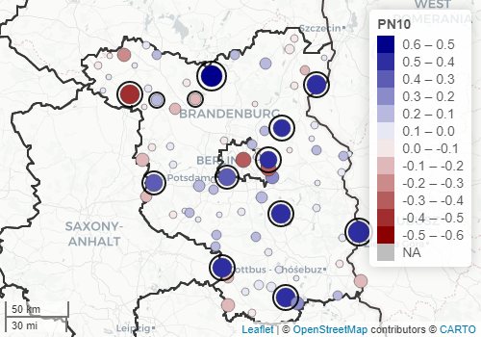
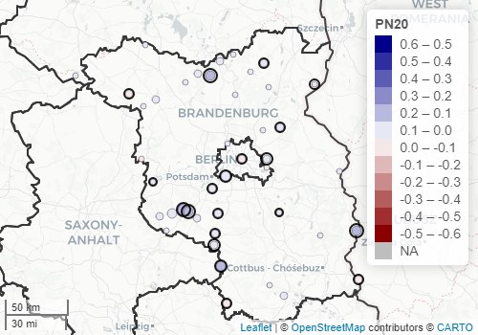
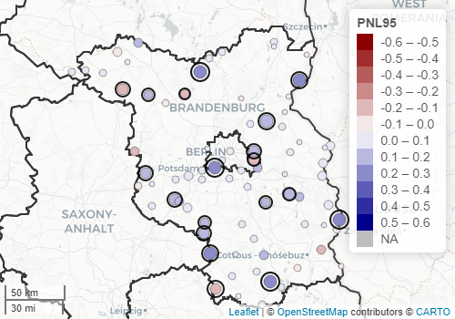
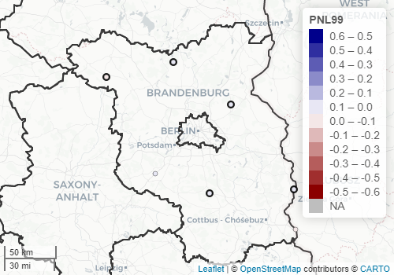
Trend analysis annual event days (1991-2020)

Slide 12
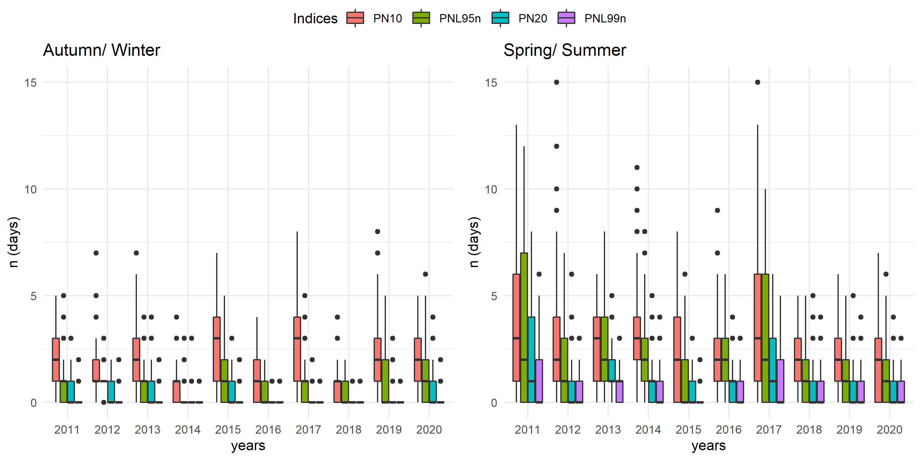
Peak over threshold analysis (2011-2020)
Notes:
Influence of the selected threshold value/ method
Isoplethendiagram für ein Jahr?

Slide 13
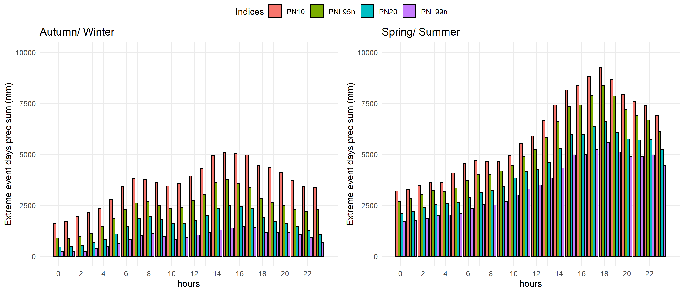
Hourly prec. sum during extreme event days (2011-2020)
Notes:
Kann so auch verwentet werden um tageszeitliches Muster zu zeigen

Slide 14
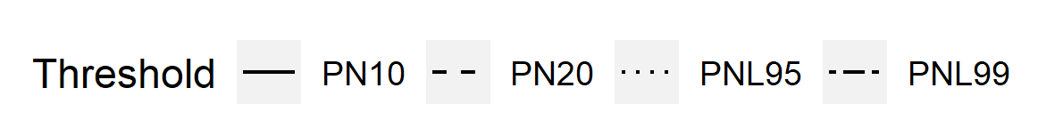
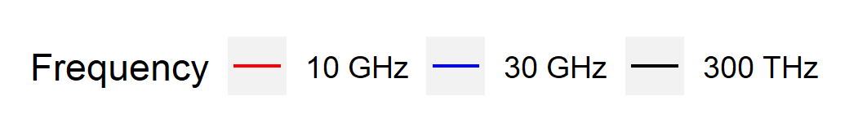
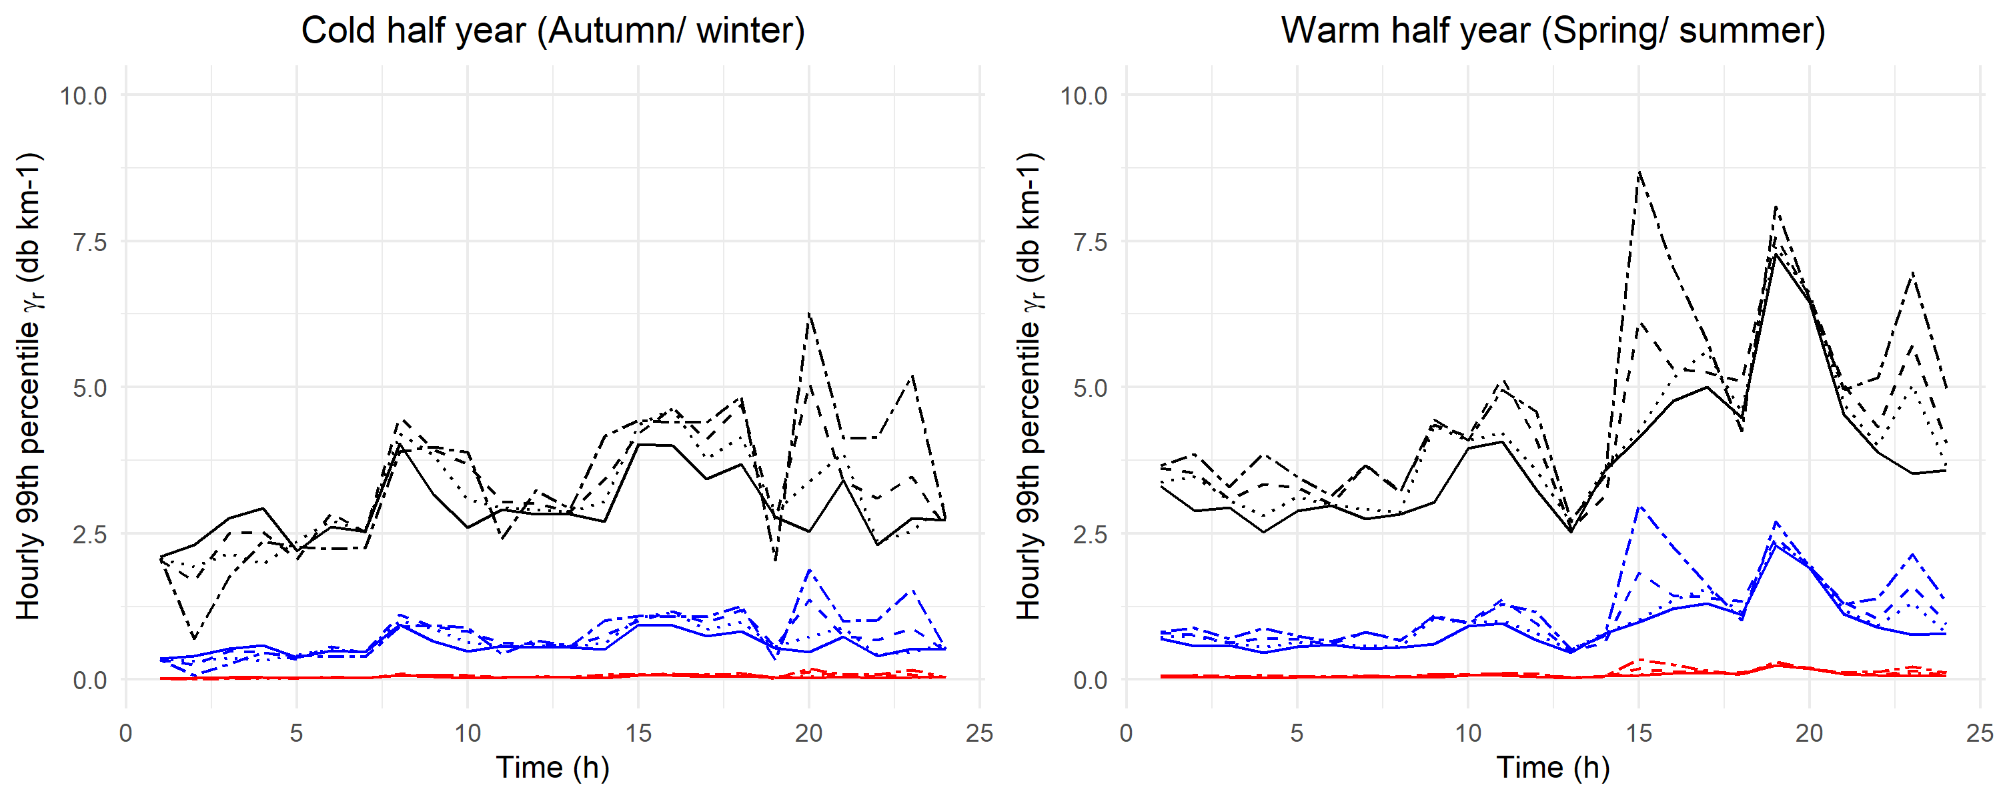
Dynamic of diurnal attenuation during extreme event days
Station at Berlin Tempelhof (2011-2020)
→ Hourly attenuation that has to be compensated for link availability during 99% of EPE days

