Slide 1
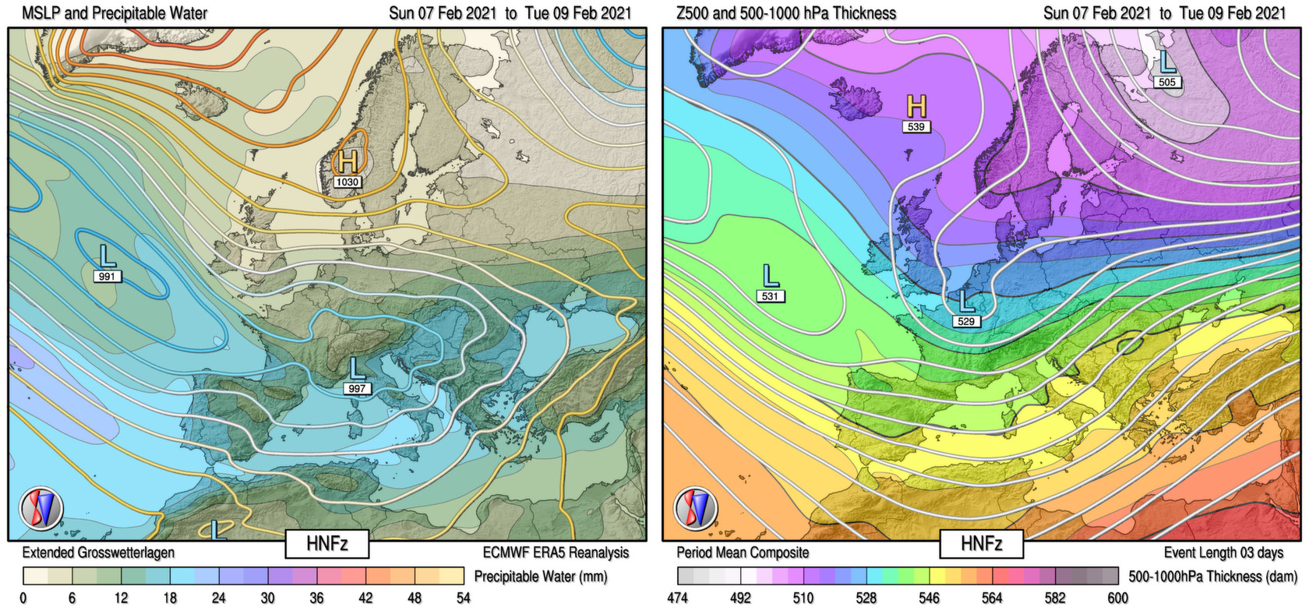
GWL-REA
An improved method for classifying Hess-Brezowsky Grosswetterlagen based on pattern correlations in combination with Lamb Weather Type statistics
Paul James and Jennifer Ostermöller / Deutscher Wetterdienst
Synoptic Climatology Session / EMS, Bonn, Germany, 6th September 2022

Slide 2
Grosswetterlagen
Introduction
  Grosswetterlagen: 29 characteristic synoptic circulation patterns over C. Europe
    Developed by Baur, Hess and Brezowsky (1940s/50s)
    Work continued in recent decades at DWD and PIK-Potsdam
      Daily catalogue from 1881 to present (manual classification)
    Capture a significant fraction of synoptic variability
    Discriminate local weather better than many other classifications (COST733)
  Nomenclature very easy to understand
    Anticyclonic-Cyclonic distinction, and/or location of steering High or Low
  Used widely in synoptic climatology and to describe current weather patterns
  However, homogeneity is an important factor for climate applications
    Manuel classification is quite inhomogeneous over the decades
  An automatic algorithmic classification method is required
P. James / DWD - Synoptic Climatology Session, EMS, 06.09.2022
Notes:
Aufgaben, die von ihrem Wesen her Vorlaufforschung benötigen

Slide 3
Grosswetterlagen Classification
Original method
  Weighted pattern correlations based on 2 meteorological fields
    Developed at UK Met Office (James, 2006, 2007)
    Used MSLP and 500 hPa Geopotential
    Each synoptic situation correlated against 29 climatological GWL patterns
      Over domain 30°W to 60°E and 20°N to 80°N (with centre weighting)
    Highest correlating GWL was taken on each day
    Temporal filter – each GWL event should last 3 days or more
    Daily GWL catalogue created with well-known reanalyses (e.g. ERA5)
  Method produced a homogeneous catalogue, but had 3 specific weaknesses:
    Poor response to within-type variability (only used 29 climatological patterns)
    Classified type sometimes inconsistent with type nomenclature
    Arbitrary implementation of temporal filter
  A strongly modified method is required to address these problems…
P. James / DWD - Synoptic Climatology Session, EMS, 06.09.2022
Notes:
Aufgaben, die von ihrem Wesen her Vorlaufforschung benötigen

Slide 4
GWL-REA
A new algorithmic GWL classification method
  GWL-REA (Grosswetterlagen for Reanalyses), DWD 2022
  Addresses the three aforementioned problems as follows:
  (1) Improve capability for capturing within-type variability:
    Each GWL surface pattern can be associated with several meteorologically consistent mid-tropospheric circulation patterns
      Having just one single climatological composite per GWL, with fixed MSLP and Z500 components, is insufficient and leads to large regions of phase-space being poorly captured.
      Require several patterns per GWL with combination rules to map onto the 29 final GWLs, decoupling the surface and mid-troposphere.
      GWL-REA uses 268 GWL patterns in total (9 per GWL on average)
      Correlation coefficients for each final GWL are averaged from the top third of coefficients from the respective base patterns.
      Add Thickness field (500-1000 hPa) to further improve correlation method
P. James / DWD - Synoptic Climatology Session, EMS, 06.09.2022
Notes:
Aufgaben, die von ihrem Wesen her Vorlaufforschung benötigen

Slide 5
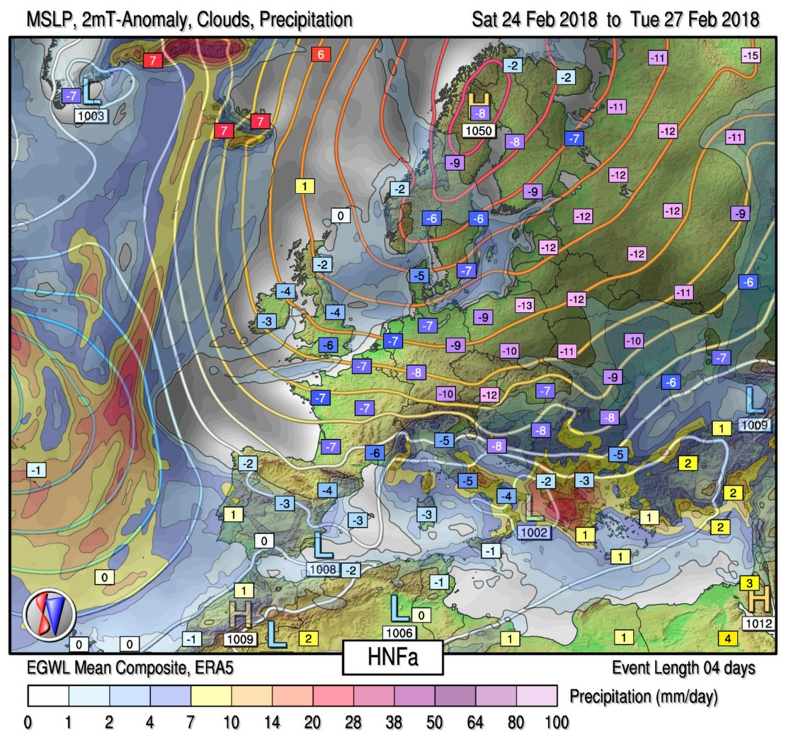
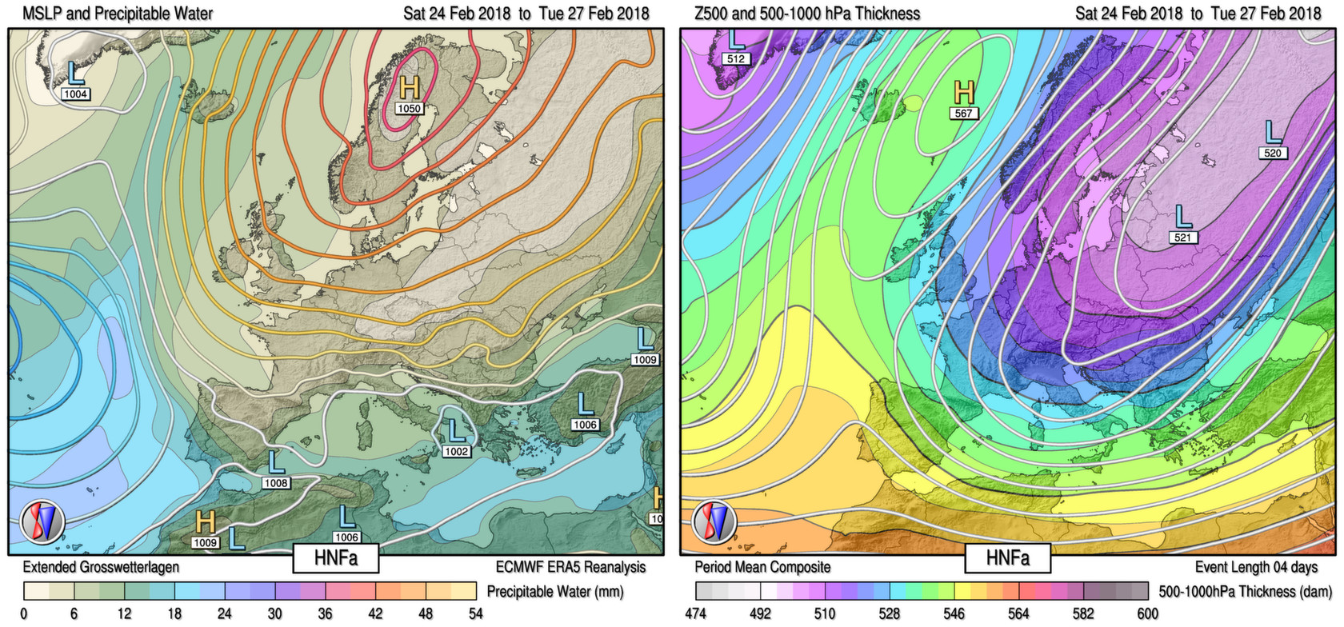
Different mid-tropospheric situations:
Example: Anticyclonic Easterly (HNFa) Type 1
  High over Norwegian Sea and Fennoscandinavia, anticyclonic over C. Europe (Feb. 2018)
  Very cold polar-continental air mass spreads westwards
  Mid troposphere strongly cyclonic
P. James / DWD - Synoptic Climatology Session, EMS, 06.09.2022
Notes:
Aufgaben, die von ihrem Wesen her Vorlaufforschung benötigen

Slide 6
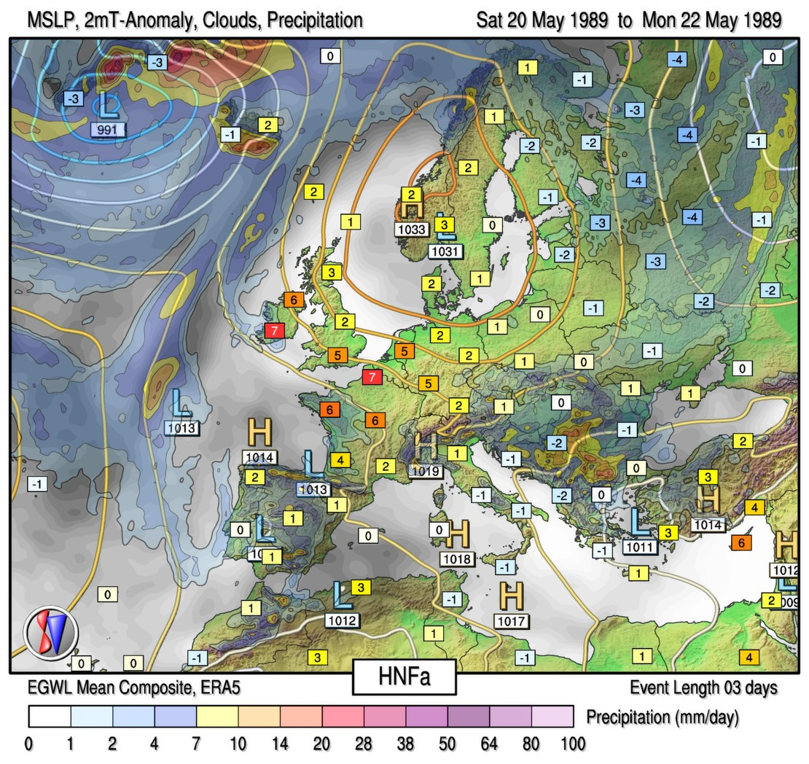
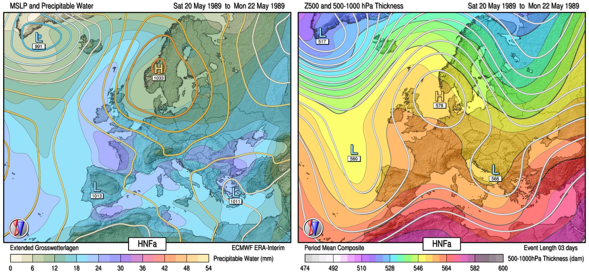
Different mid-tropospheric situations:
Example: Anticyclonic Easterly (HNFa) Type 2
  High over Norwegian Sea and Fennoscandinavia, anticyclonic over C. Europe (May 1989)
  Surface pattern similar to previous
  Mid-troposphere is completely different, however – warm with upper ridge
P. James / DWD - Synoptic Climatology Session, EMS, 06.09.2022
Notes:
Aufgaben, die von ihrem Wesen her Vorlaufforschung benötigen

Slide 7
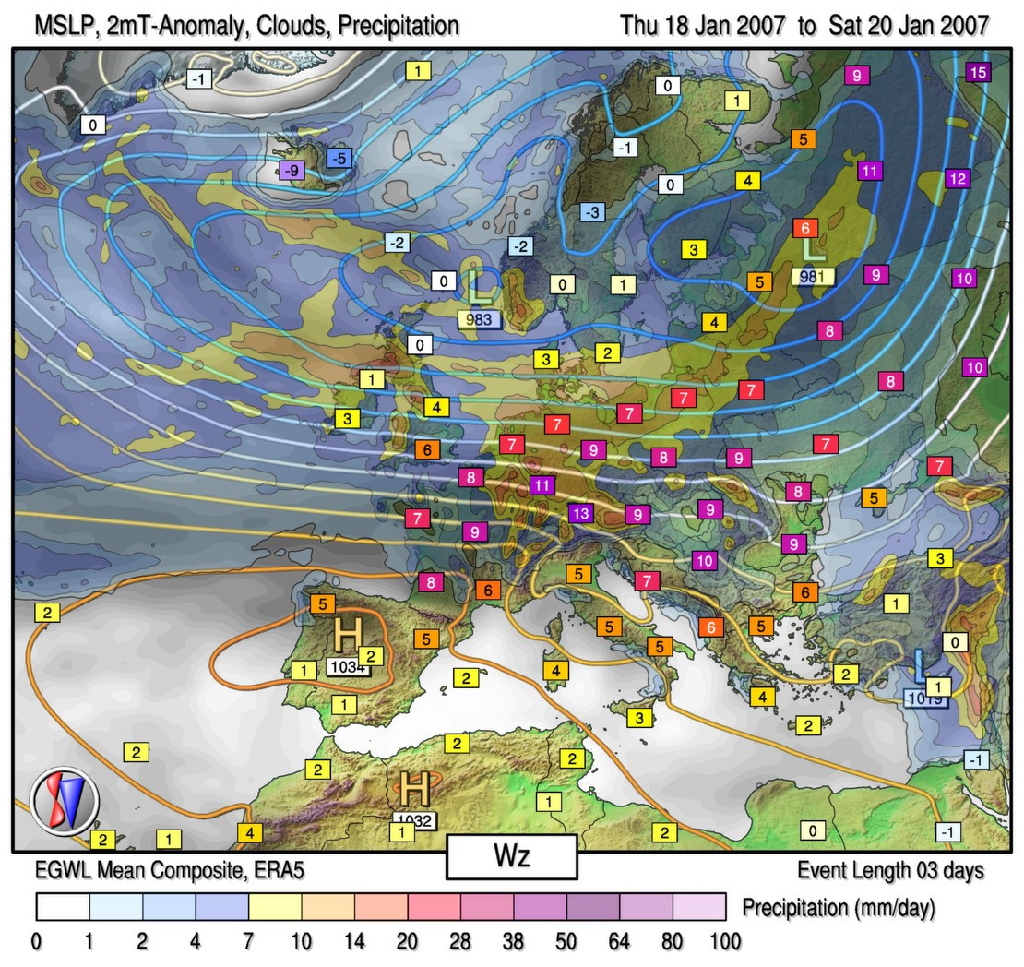
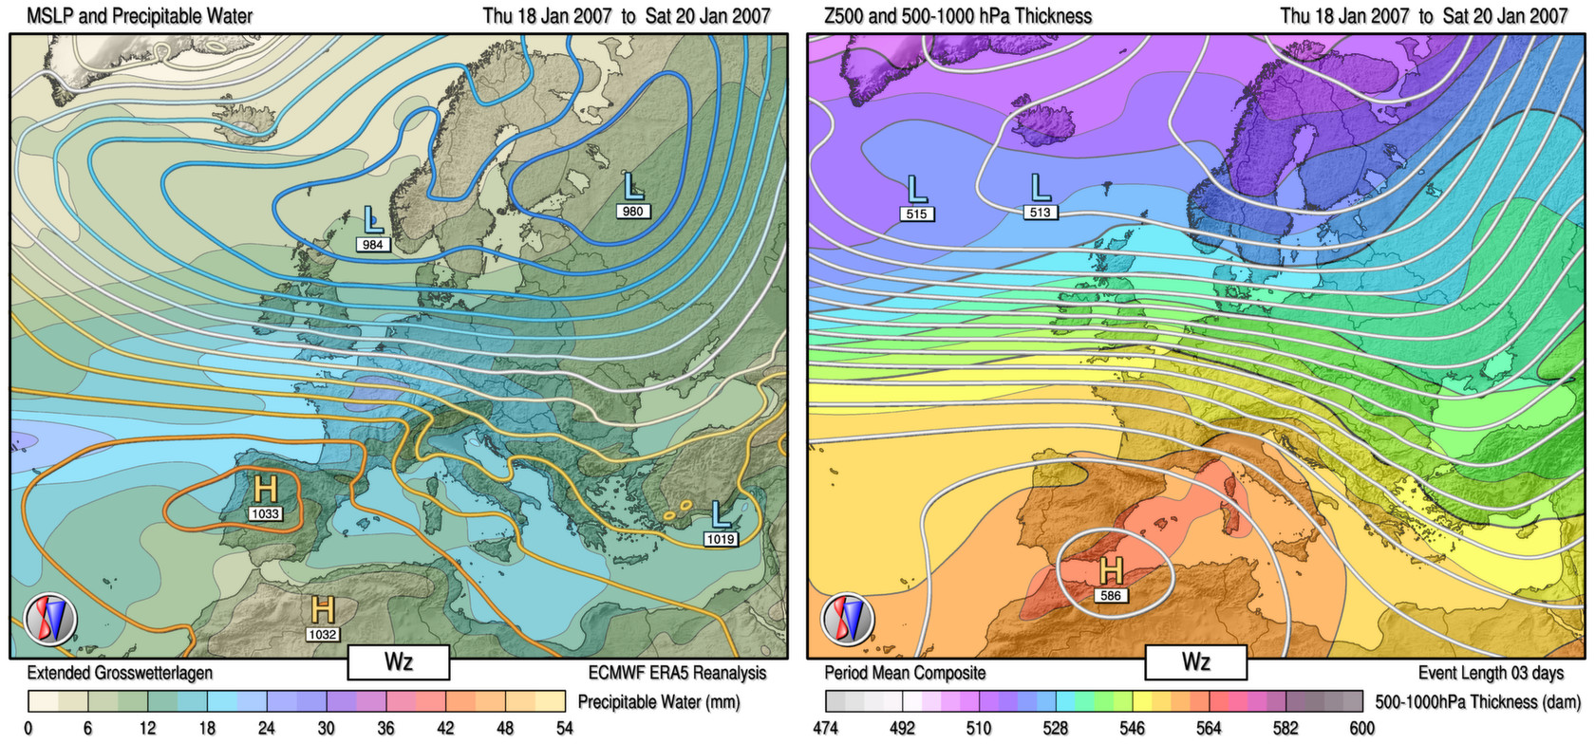
Different mid-tropospheric situations:
Example: Cyclonic Westerly 1
  Cyclonic Westerly (January 2007)
  Quasi straight surface flow with widespread, significant rainfall
  Very stormy, exceptionally warm air mass (slightly anticyclonic at 500 hPa)
P. James / DWD - Synoptic Climatology Session, EMS, 06.09.2022
Notes:
Aufgaben, die von ihrem Wesen her Vorlaufforschung benötigen

Slide 8
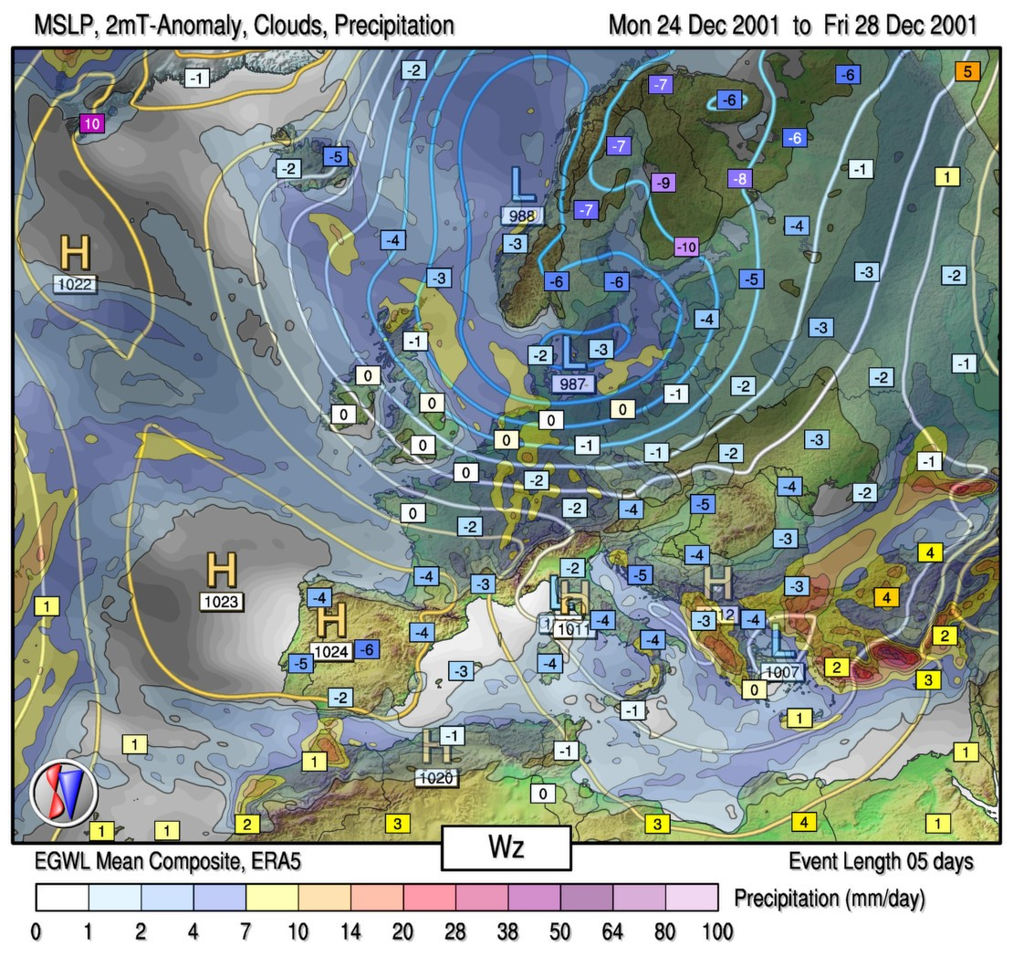
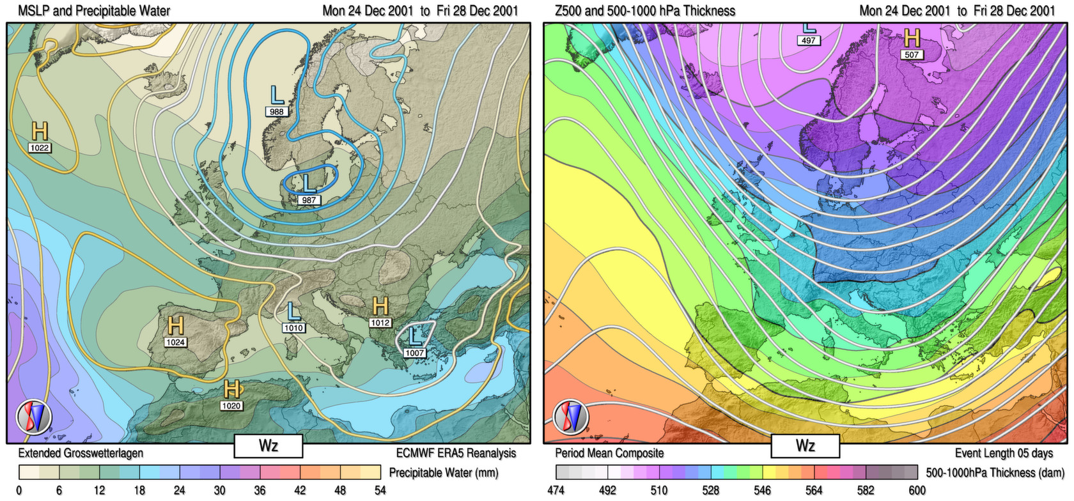
Different mid-tropospheric situations:
Example: Cyclonic Westerly 2
  Also a windy, cyclonic westerly situation with showery precipitation (December 2001)
  Much colder (polar maritime) air masses, however
  Mid tropospheric flow is cyclonic in this case
P. James / DWD - Synoptic Climatology Session, EMS, 06.09.2022
Notes:
Aufgaben, die von ihrem Wesen her Vorlaufforschung benötigen

Slide 9
GWL-REA
A new algorithmic GWL classification method
  (2) The nomenclature problem
    Each GWL has a name that has a specific meaning
    The original method only captured the large-scale characteristics of synoptic patterns, but ignored the specific meanings
    Sometimes the synoptic situation did not match locally to the nomenclature of the chosen GWL (cyclonicity over C. Europe, position of High / Low)
    A poor nomenclature correspondence will make it hard for the method to find widespread acceptance, especially amongst synoptic meteorologists, no matter how good the method is in a technical sense!
    GWL-REA uses specific statistics based on the well-known automatized „Lamb Weather Types“ (LWT) method of Jenkinson and Collison (1993), centred on 7 different European regions
    Measures local cyclonicity, flow strength and direction (surface and 500 hPa)
    Correlation coefficients modified with these LWT statistics as appropriate
      Penalties applied to specific GWLs whenever LWT statistics suggest a nomenclature mismatch according to a given set of rules
    Yields a strong reduction in frequency of problematical classifications
P. James / DWD - Synoptic Climatology Session, EMS, 06.09.2022
Notes:
Aufgaben, die von ihrem Wesen her Vorlaufforschung benötigen

Slide 10
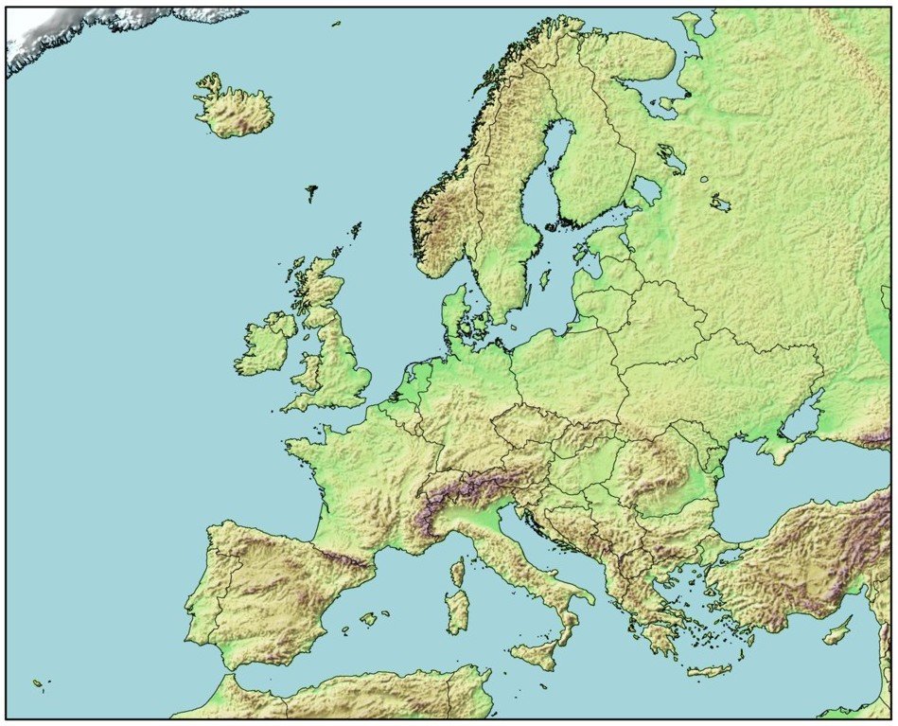
GWL-REA
LWT regions
  LWT statistics from the following 7 regions are required at the surface and 500 hPa to wholly capture the meanings of the GWL names. The respective domain centres are:
Norwegian Sea
N-F
Fennoscandinavia
British Isles
Central Europe
Western Europe
Eastern Europe
P. James / DWD - Synoptic Climatology Session, EMS, 06.09.2022
Notes:
Aufgaben, die von ihrem Wesen her Vorlaufforschung benötigen

Slide 11
GWL-REA
A new algorithmic GWL classification method
  (3) Arbitrariness of the temporal filter
    The classic Hess-Brezowsky GWL concept requires each GWL event to last at least 3 days
    This is sometimes too strict, since some significant events can occur that only last 2 days but need to be captured in the GWL catalogue
    An automatic method produces far too many short-lived events if 2 day events are allowed all the time
      Many such events are irrelevant and insignificant. Leaving these in the catalogue makes it more confusing and harder to assimilate
    GWL-REA only allows some 2 day events – when certain strict conditions with respect to the neighbouring GWLs are obeyed
    Average GWL length is then around 3.4 days, which is an optimum between accuracy and readability
P. James / DWD - Synoptic Climatology Session, EMS, 06.09.2022
Notes:
Aufgaben, die von ihrem Wesen her Vorlaufforschung benötigen

Slide 12
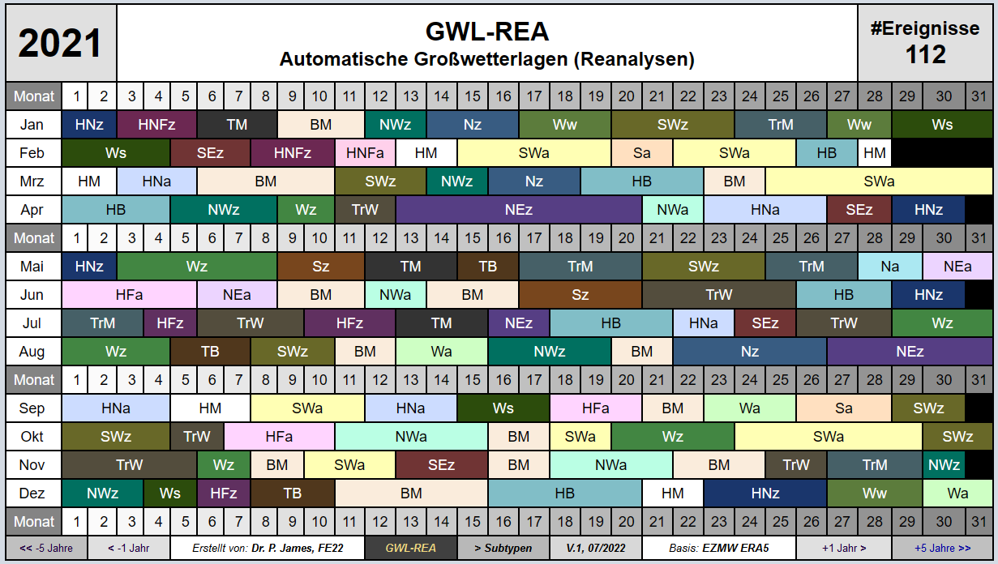
GWL-REA
Example catalogue for 2021 (ERA5)
P. James / DWD - Synoptic Climatology Session, EMS, 06.09.2022
Notes:
Aufgaben, die von ihrem Wesen her Vorlaufforschung benötigen

Slide 13
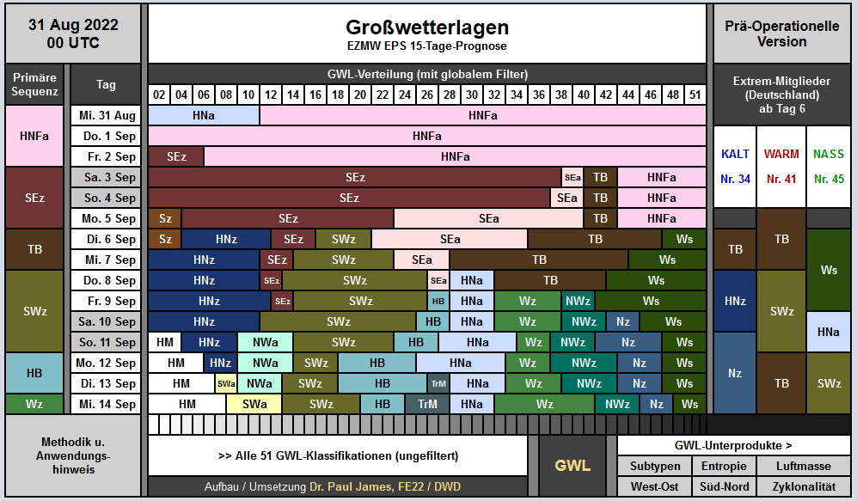
GWL-EPS
Application in medium range ensemble forecasting
  GWL method also deployed operationally at DWD in classifying the 51 ensemble members of the ECMWF EPS15 system
  Useful for rapidly assimilating and summarizing such ensemble forecasts
P. James / DWD - Synoptic Climatology Session, EMS, 06.09.2022
Notes:
Aufgaben, die von ihrem Wesen her Vorlaufforschung benötigen

Slide 14
GWL-REA
Summary
  A new improved method for automatically classifying GWL from reanalysis data has been developed
  In addition to extended pattern correlations, LWT statistics are deployed to improve the nomenclature consistency of the results
  First complete classifications with reanalyses for 1851 to 2022 (NOAA-20CR, ERA40, ERA5) show promising results
    Good results for many specific case studies and homogeneous over long time scales with respect to use in climate research
  GWL-REA can be used on reanalysis data, on climate modelling scenarios as well as in medium- and long-range forecasting
  A historical GWL catalogue will be published soon
  Improved capacity for capturing within-type variability also allows for the definition and classification of experimental GWL subtypes
    60 subtypes currently defined in total (1 to 4 per GWL)
    Capture air mass characteristics of synoptic type – very useful for climatological studies focussed on air temperature
P. James / DWD - Synoptic Climatology Session, EMS, 06.09.2022
Notes:
Aufgaben, die von ihrem Wesen her Vorlaufforschung benötigen

Slide 15
GWL-REA
A new algorithmic GWL classification method
Thanks for your attention !

