Slide 1
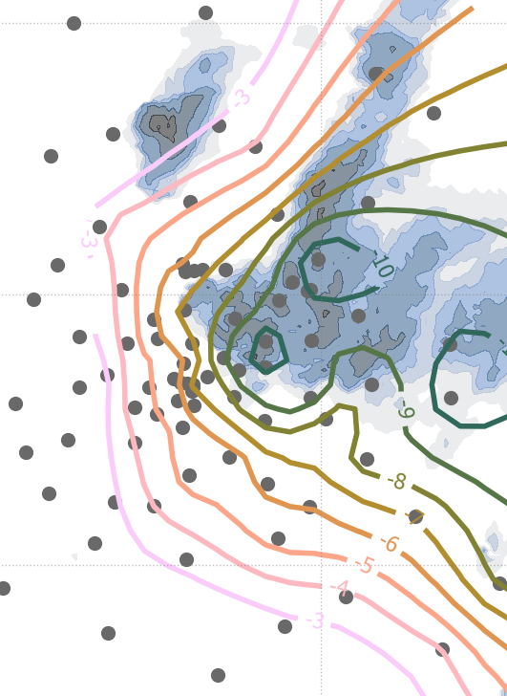

The morphology of convective cold pools in a dense station network during FESSTVaL
Bastian Kirsch^{1,3},
Cathy Hohenegger^{2,3}, and Felix Ament^{1,2,3}
¹ Meteorologisches Institut, Universität Hamburg, Hamburg, Germany
² Max-Planck-Institut für Meteorologie, Hamburg, Germany
³ Hans-Ertel-Zentrum für Wetterforschung – Bereich Modellentwicklung Konvektion
EMS Annual Meeting, Bonn, 7. September 2022

Slide 2
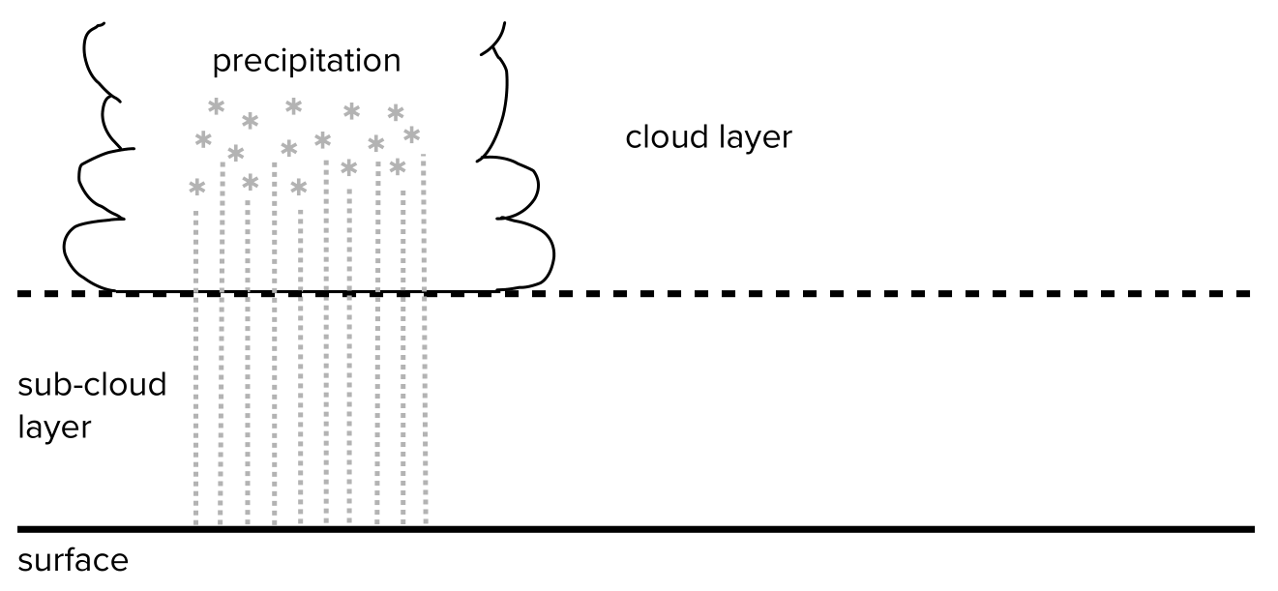
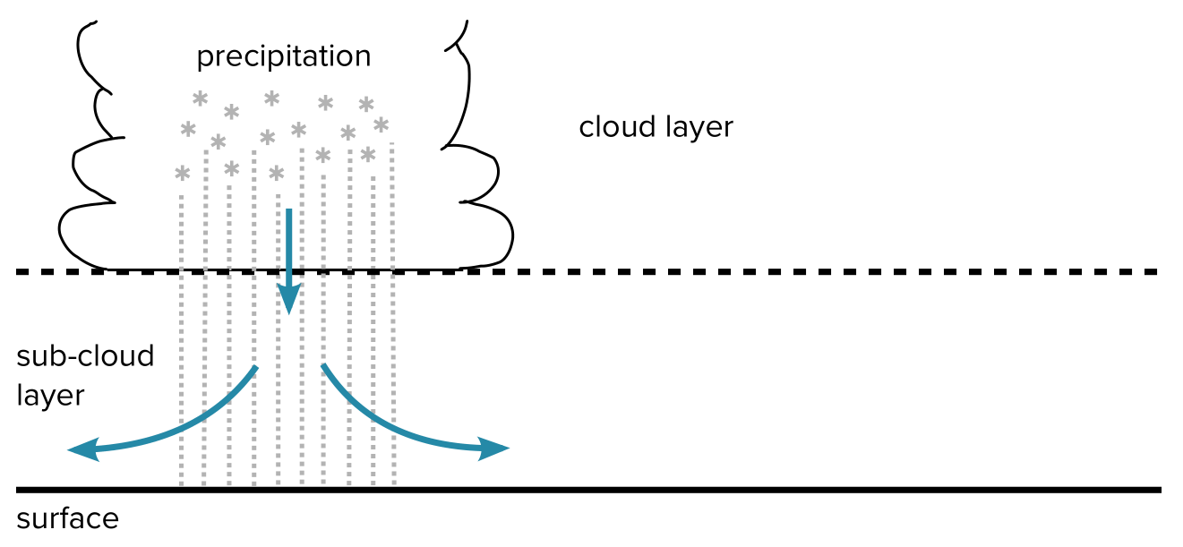
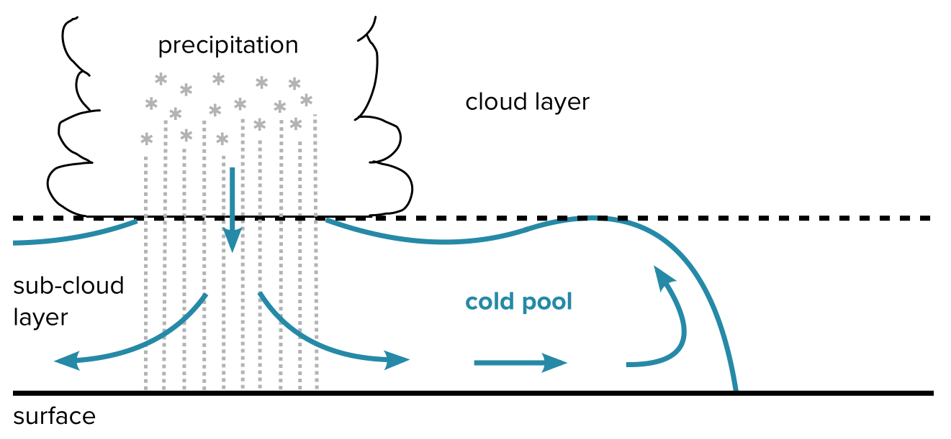
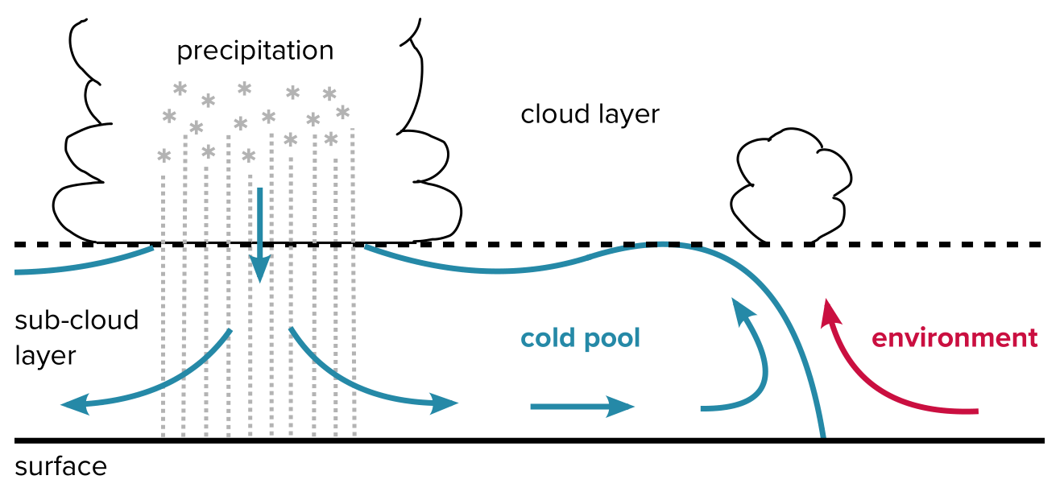
Why are cold pools relevant?
Crucial factor to understand organization of convection
Khairoutdinov and Randall (2006), Schlemmer and Hohenegger (2014), Torri et al. (2015)
Notes:
brief reminder what CPs are and why they are relevant.
mesoscale bodies of cold and dense air that form underneath precipitating clouds and spread on the Earth‘s surface
The leading edge of a CP front is a region of preferred initiation of secondary convection
Many studies have shown that CPs are…

Slide 3
The observational blind spot
Evidence of spatial cold pool properties only from high-resolution numerical simulations
Conventional observation systems usually miss the sub-mesoscale (100 m — 10 km) structure of cold pools
New data set of FESSTVaL experiment allows to address the observational blind spot with in-situ measurements:
  What are the basic morphological properties of cold pools?
    How large are cold pools?
    Are cold pools circularly shaped?
  Which factors control the size and strength of growing cold pools?
Notes:
However, much of our knowlegde on the spatial properties of CPs (size, shape, structure) is based on high-resolution numerical simulations

Slide 4
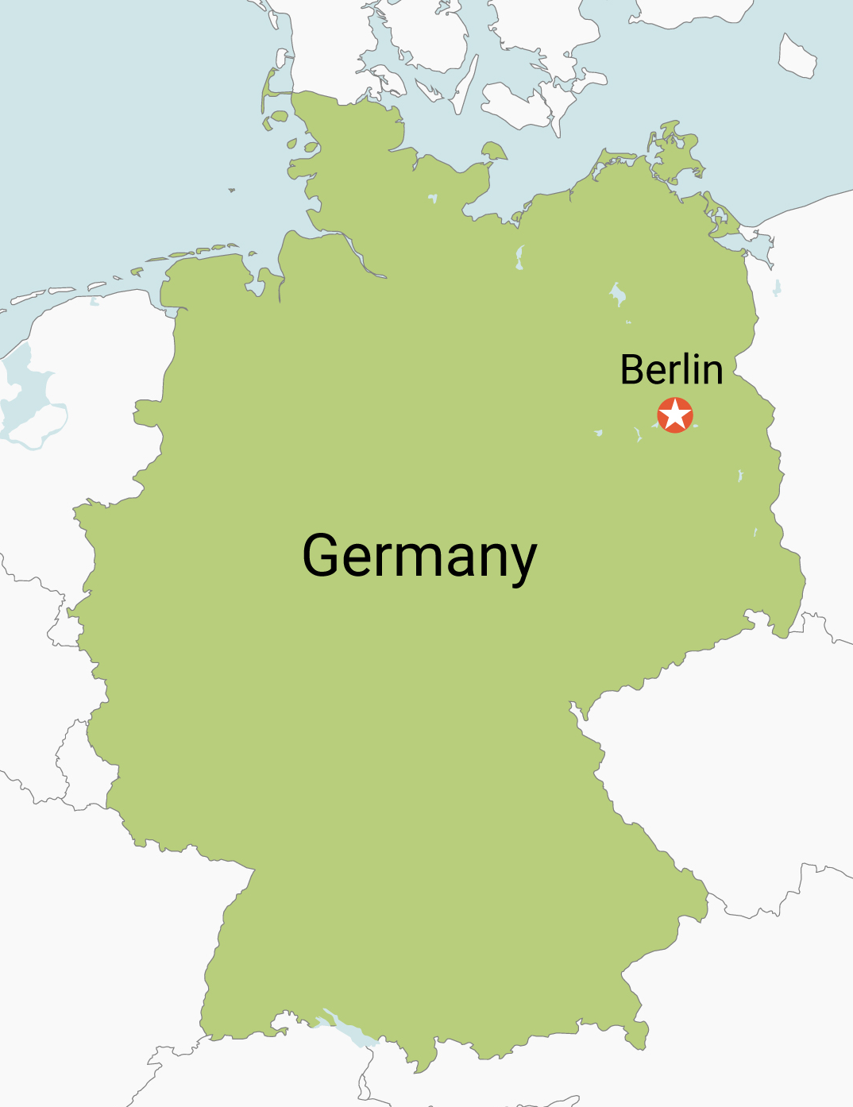
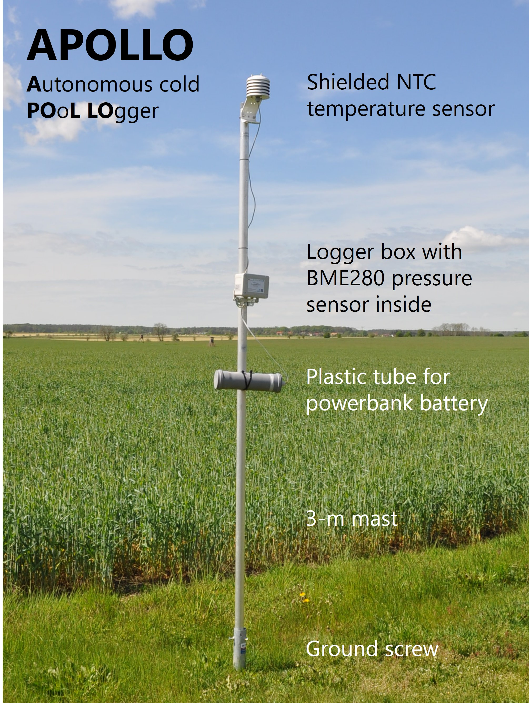
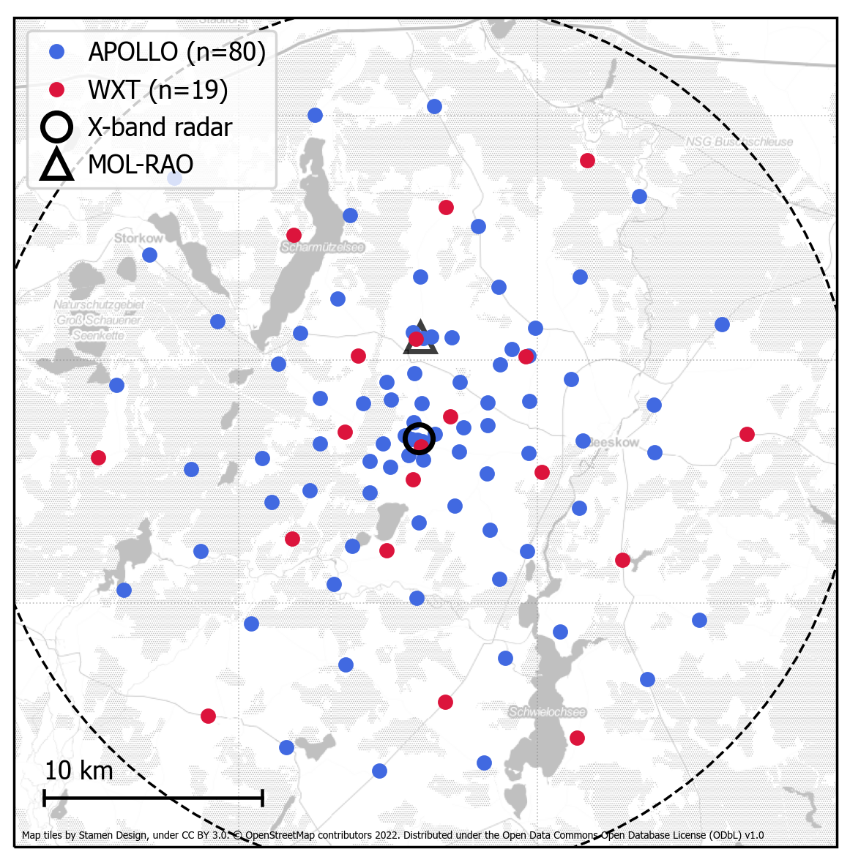
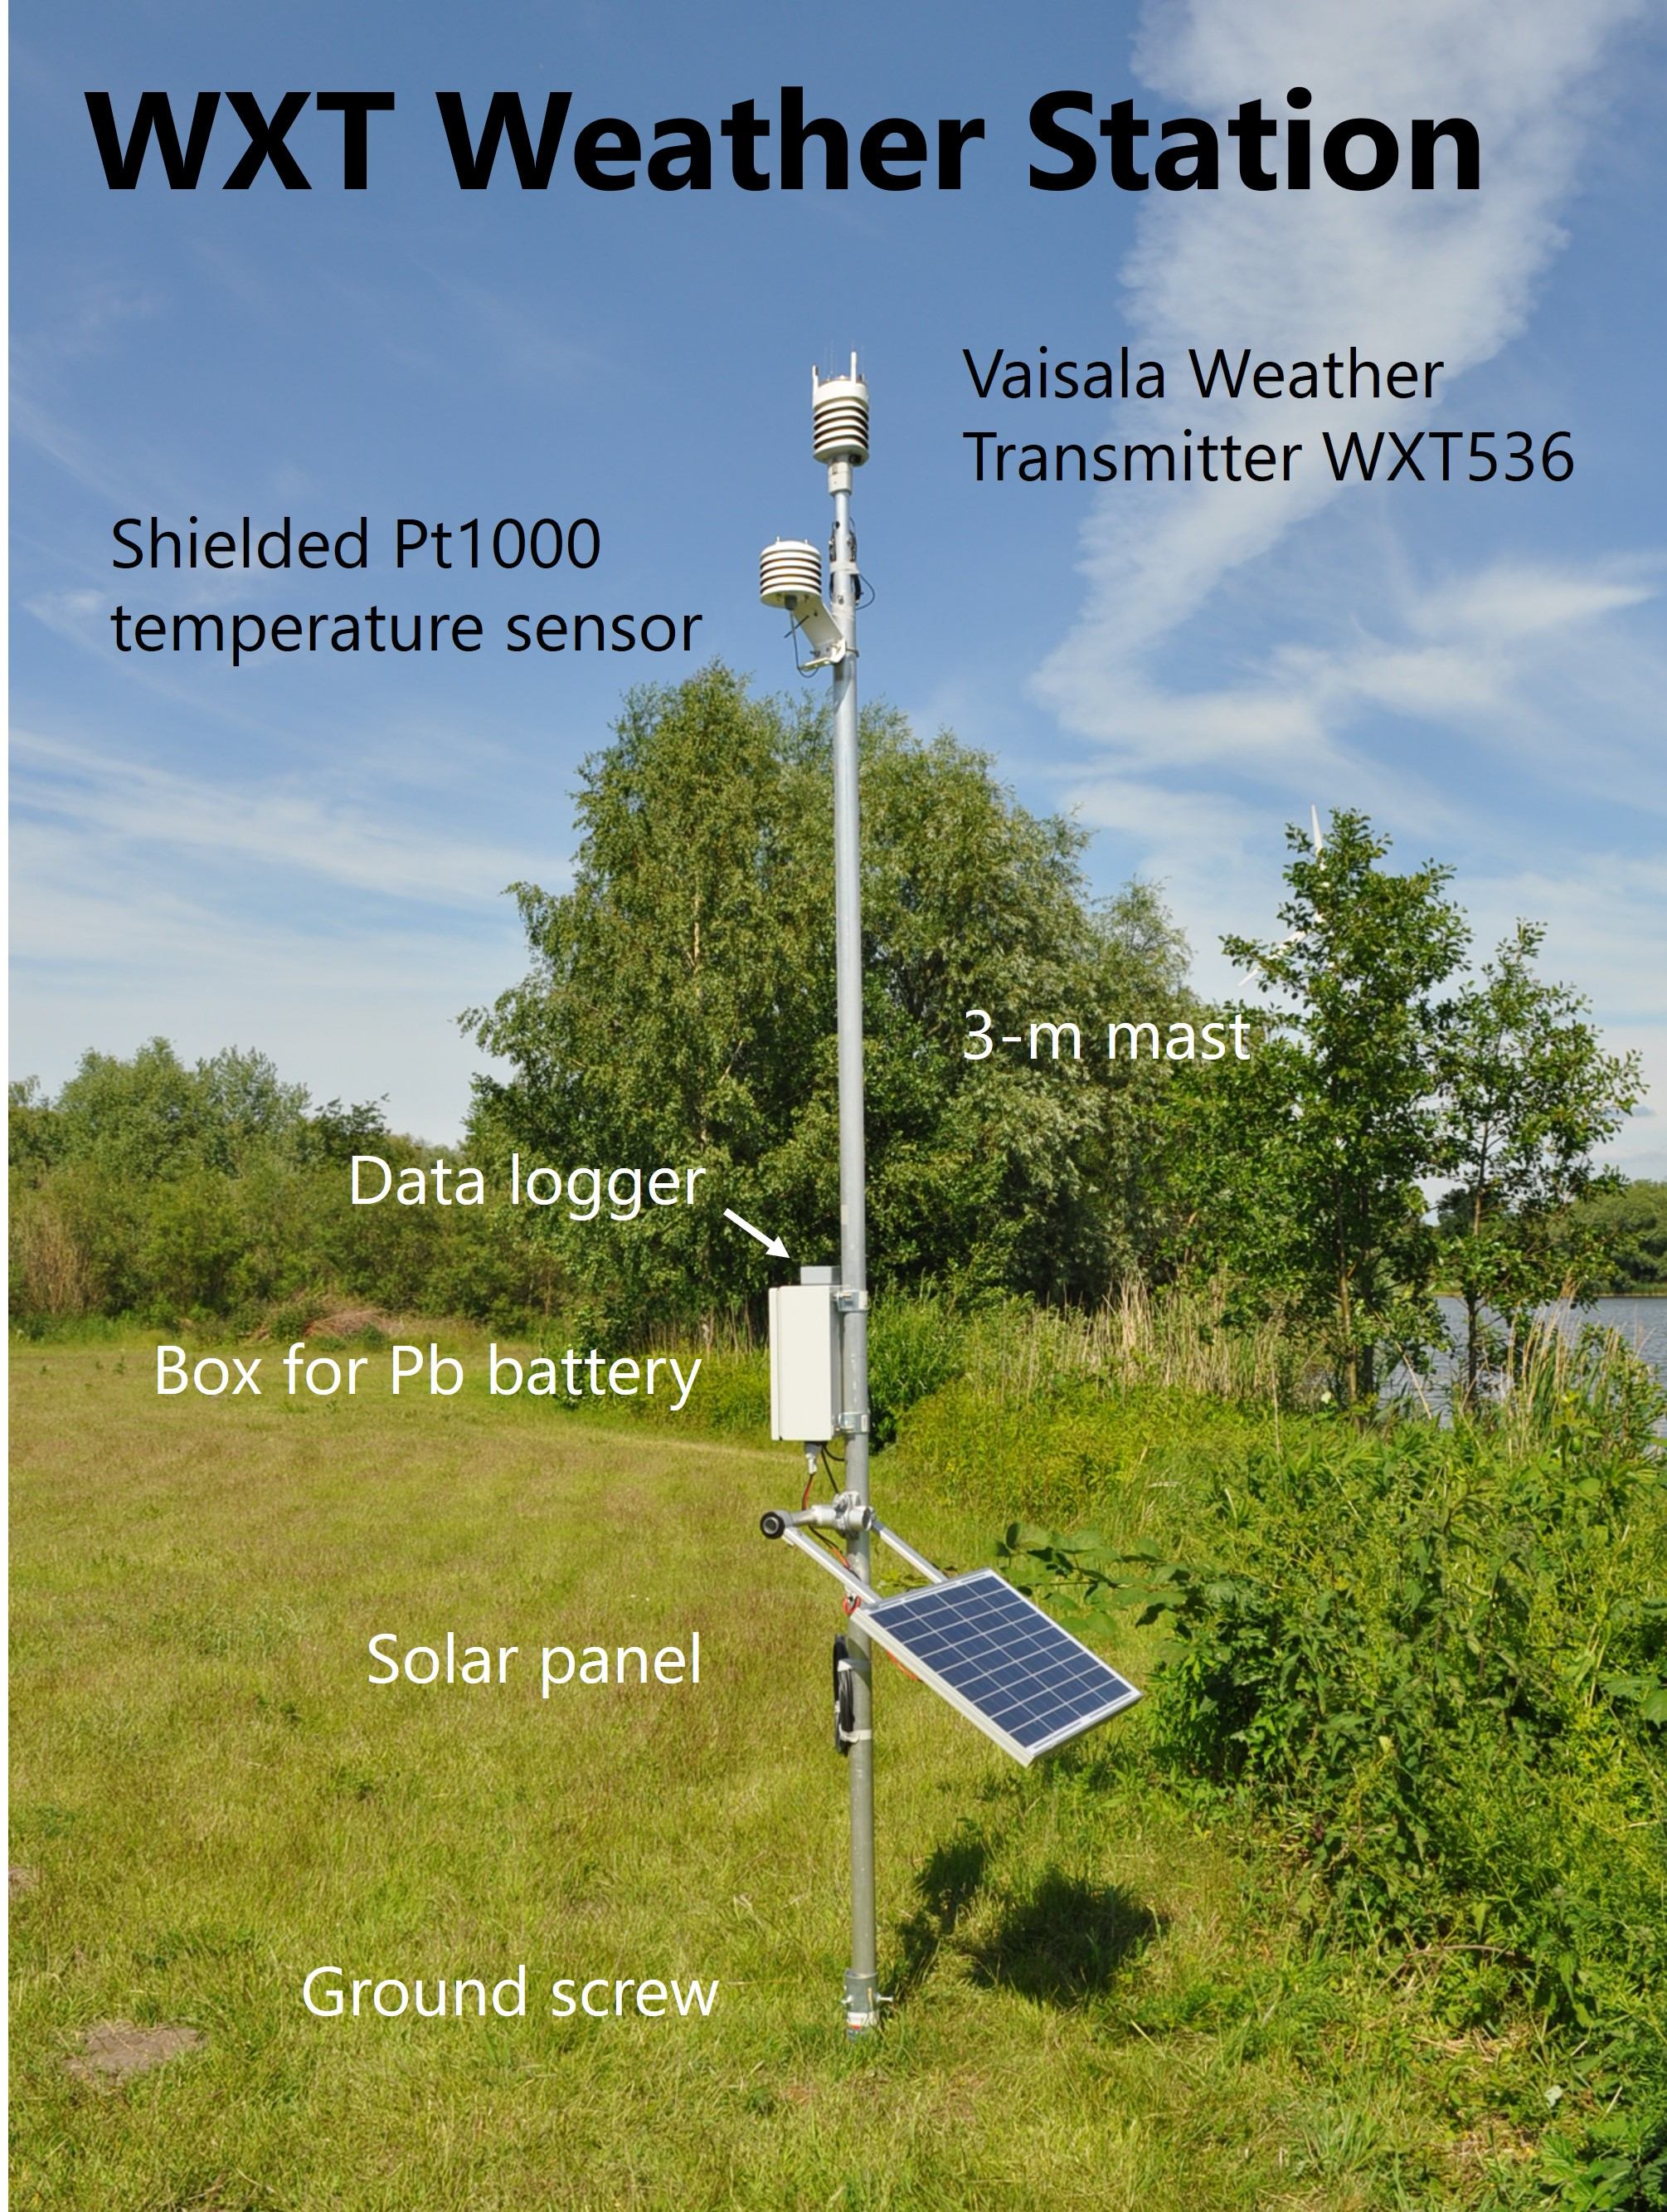
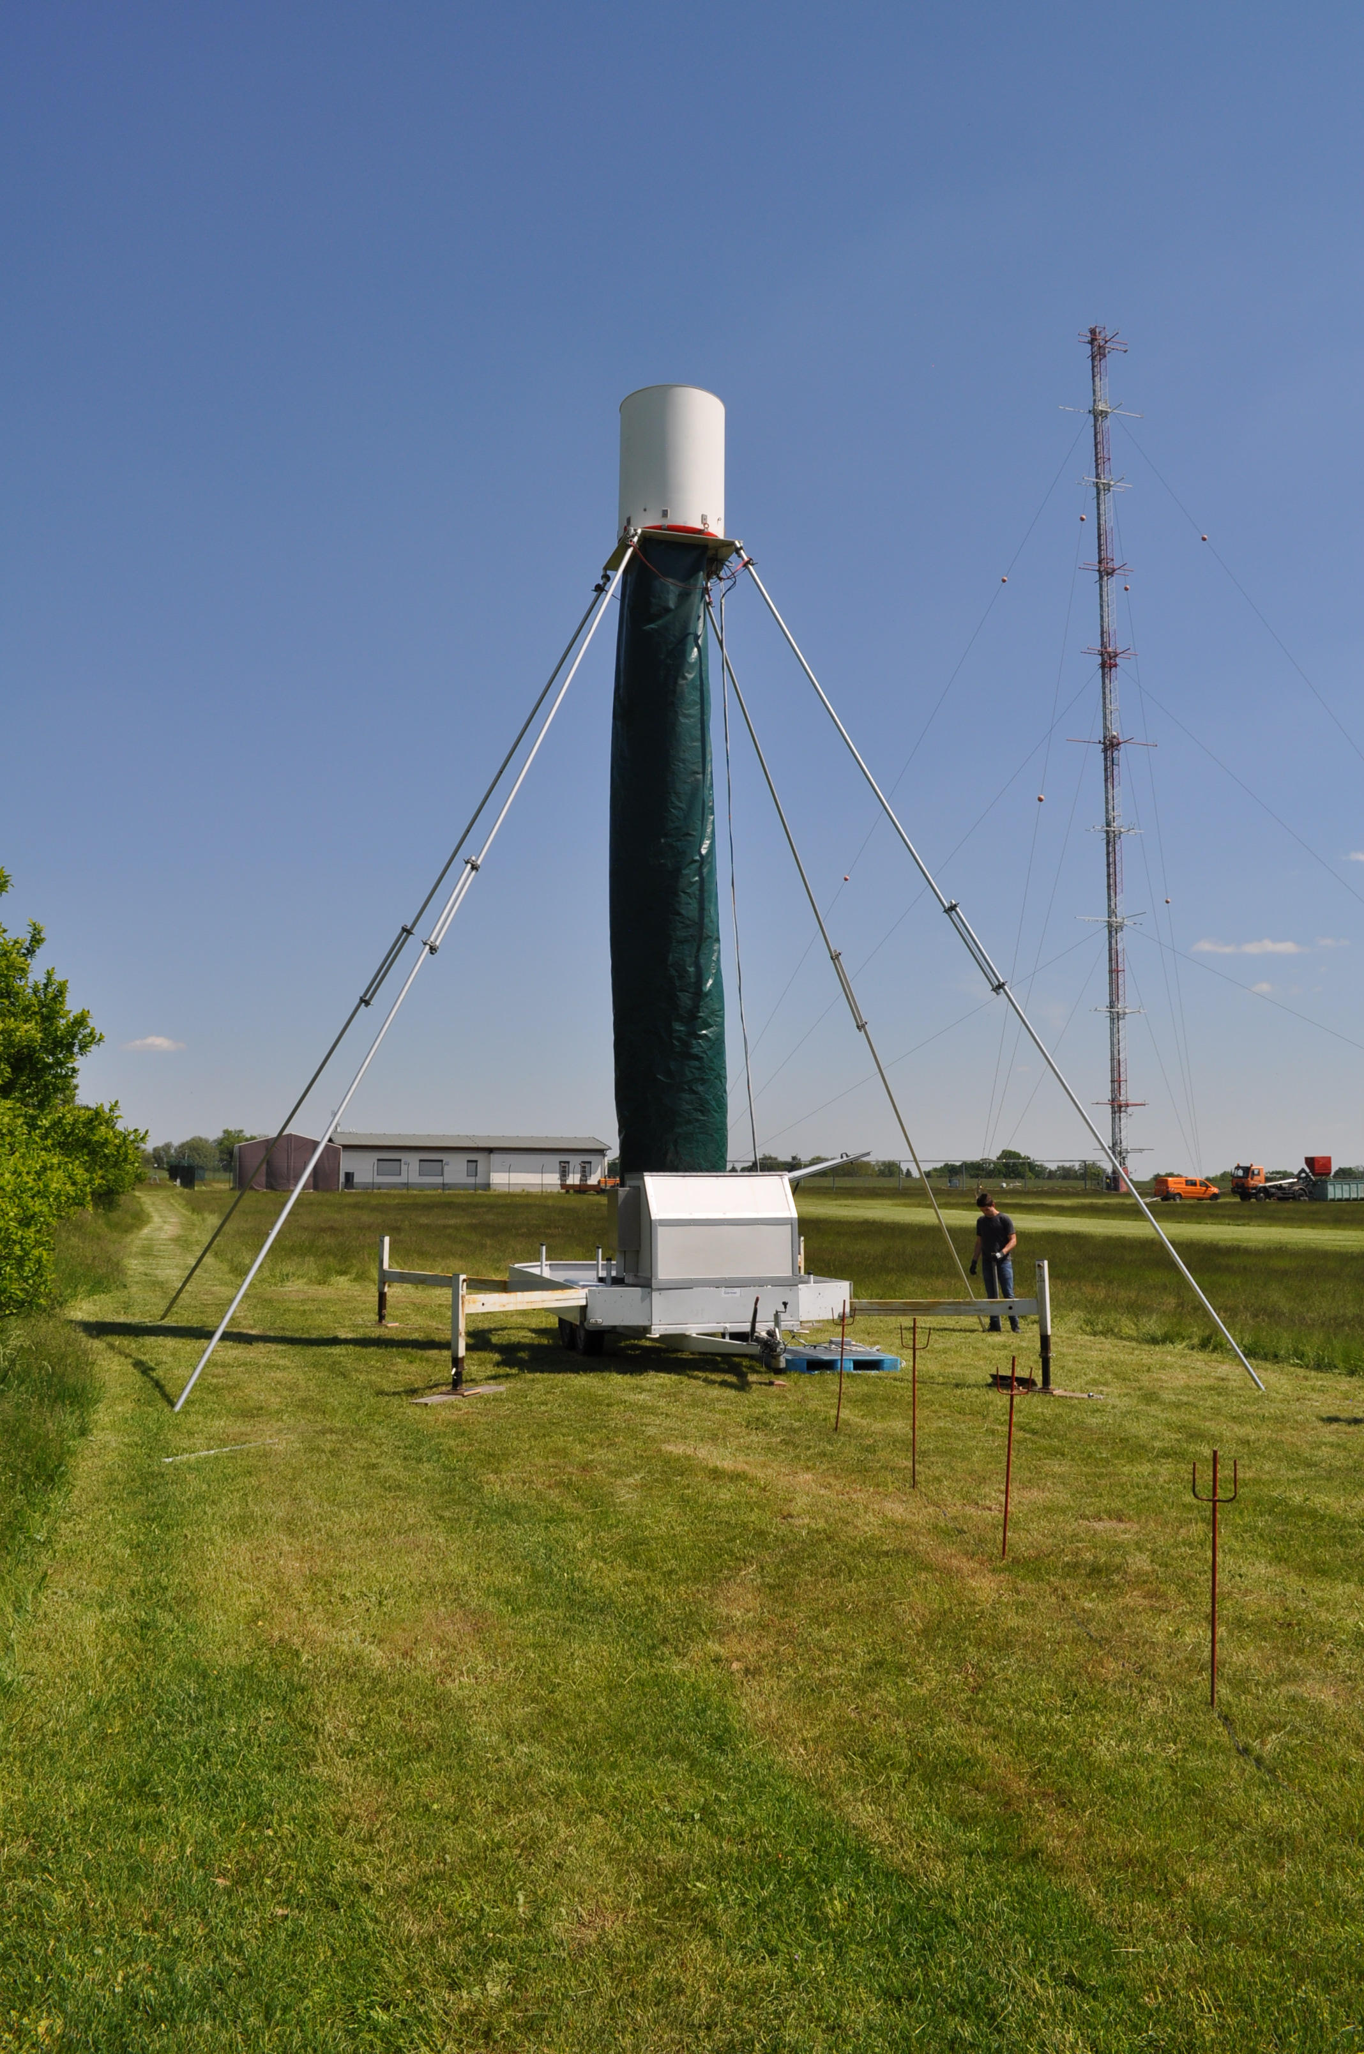
FESSTVaL experiment, May ─ Aug 2021
80 ×
T, p @ 1 s
vemaps.com
X-band radar
RR @ 30 s
19 ×
T, p, RH, wind, RR
@ 10 s
Notes:
F took place in eastern Germany last summer
Core of F was an dense network of 99 custom-designed measurement stations covering an area of ~30 km diameter
APOLLOs T and P, WXTs more…
High-resolution rainfall obs from X-band radar
Many other groups with drones, wind lidars and other remote sensing

Slide 5
1. Cold pool morphology

Slide 6
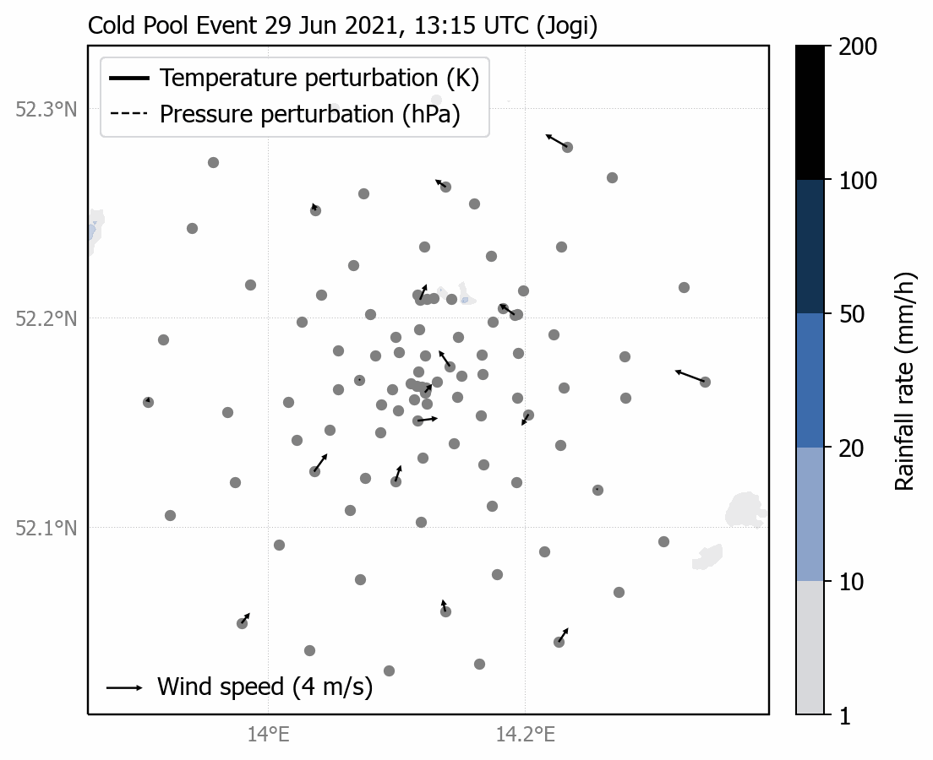
Spatio-temporal analysis of cold pools
Define temperature perturbation ∆T as deviation from a time-dependent reference state
Spatially interpolate ∆T on a regular grid via kriging
Define CP objects as four-connected clusters of ∆T ≤ -2 K
Radar data: Burgemeister et al. (2022)
Notes:
how to extract information on CP props from network obs
dT ref state per CP event
Derive properties like size, shape, and dT structure per object
Example animation of signficant CP event called Jogi (dT, radar)

Slide 7
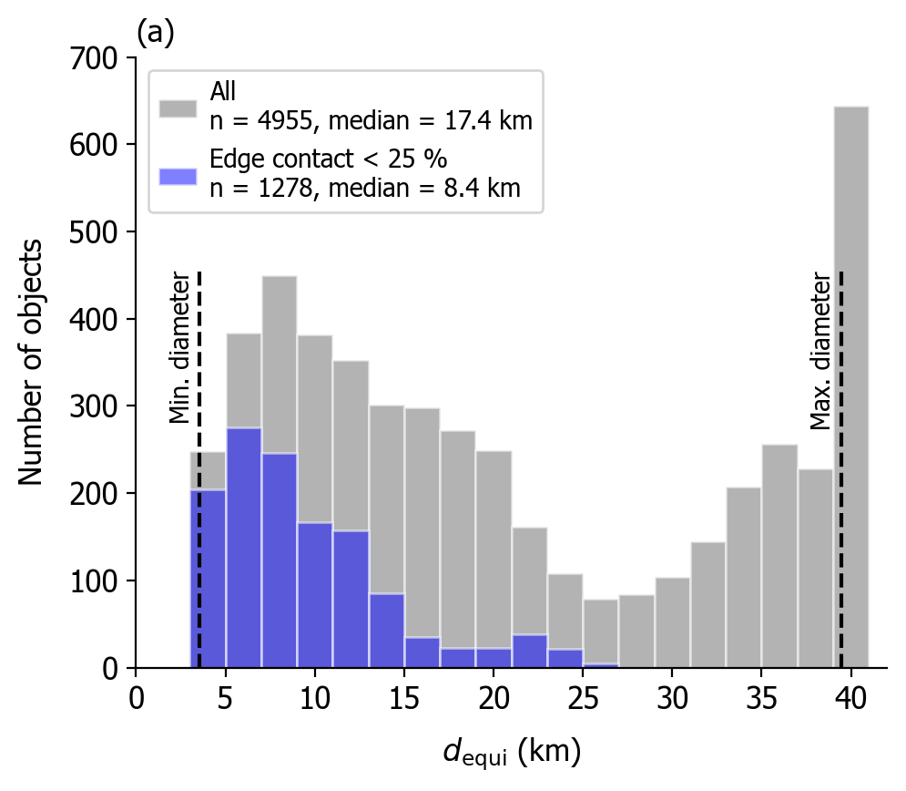
Sampling of cold pool objects
4955 CP objects from 39 events analyzed at 1-min intervals
Use only objects that are mostly inside the network
  Contact with boundary of network lower than 25 %
1278 CP objects remain for analysis
Detection threshold
Network size
Notes:
- Statistically analyze the CP morph, apply method to all 39 events observed (multiple objects per scene; grey histogram)
- rarely see the entire CP inside the network
- Right peak = accumulation of CPs that cover entire network
- Use proportion of object perimeter that touches the network boundary as filter criterion (blue histogram)

Slide 8
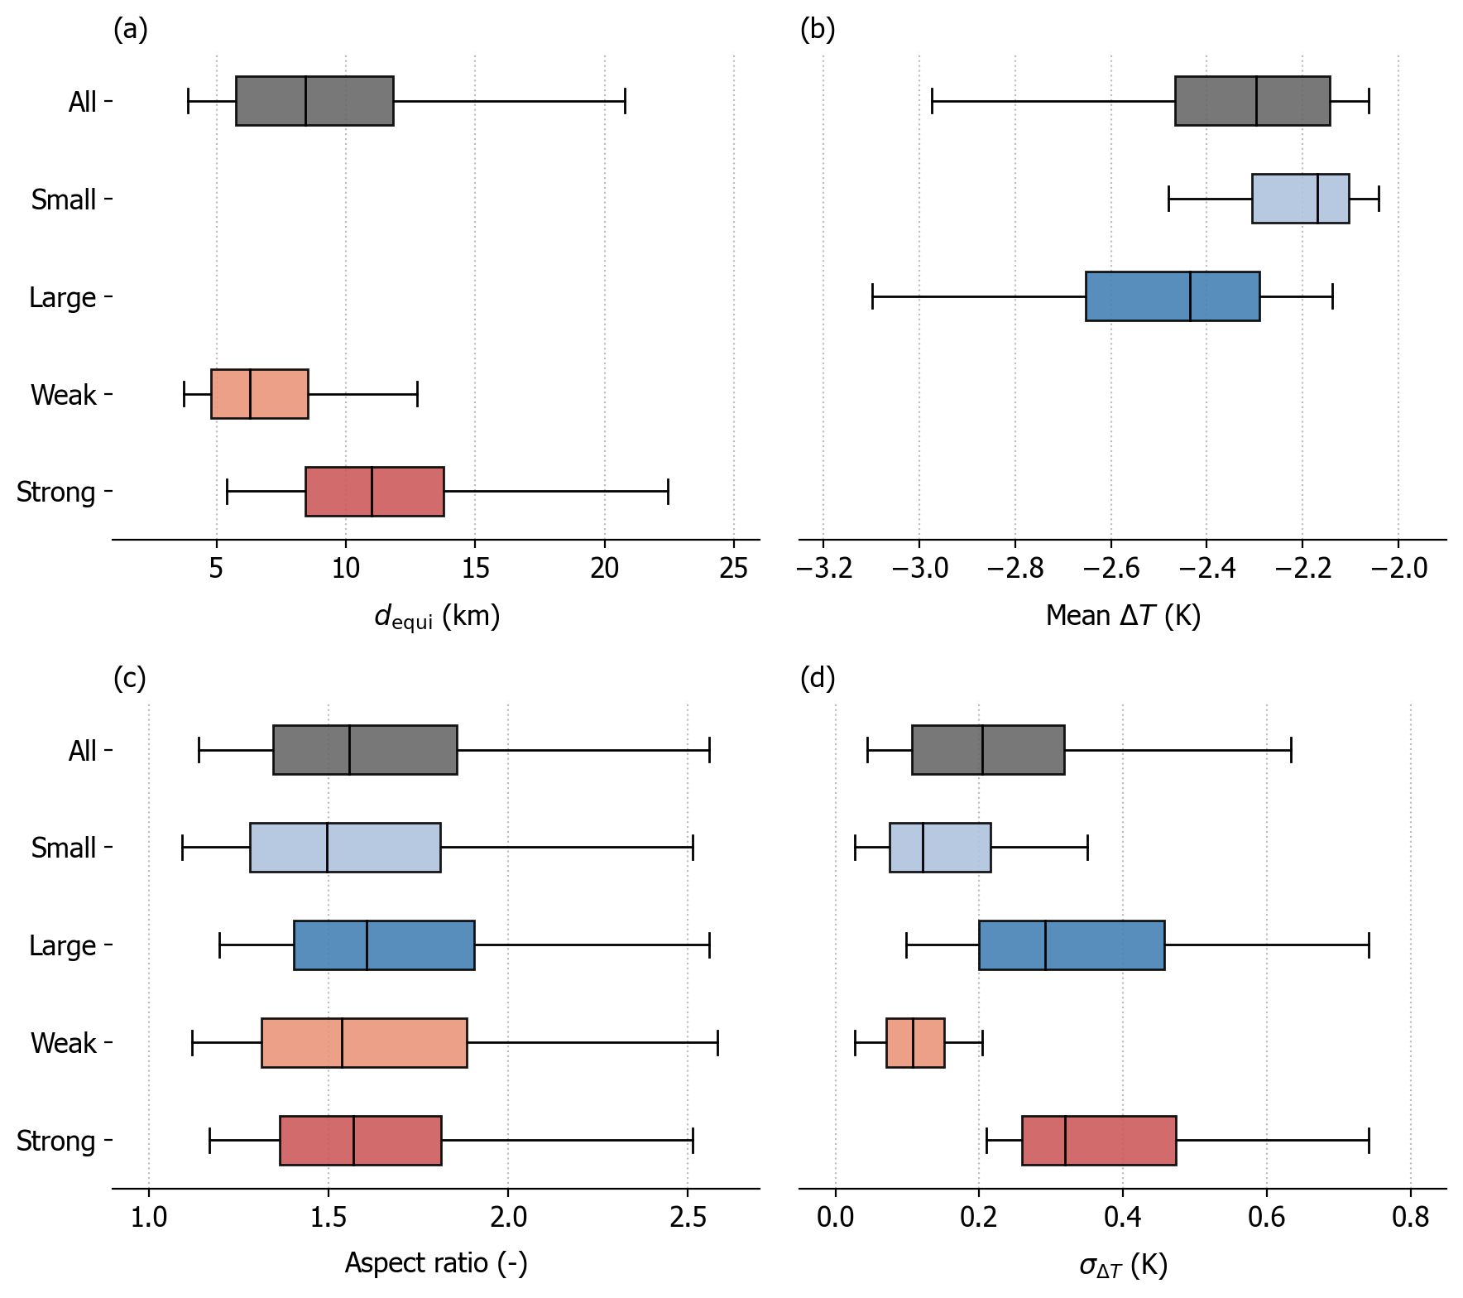
How large and round are cold pools?
Median equivalent diameter 8.4 km (strongly depends on filtering)
Stronger CPs are larger (and vice versa).
CPs are not round, independent on their size and strength.
  Merging into larger clusters
Notes:
closer look into the filtered sample
Smaller/larger and weaker/stronger half of sample (in terms of mean dT)
Aspect ratio around 1.5 (1=round)
Possible reasons for non-circularily shaped CPs? Merging into larger clusters

Slide 9
2. Cold pool growth

Slide 10
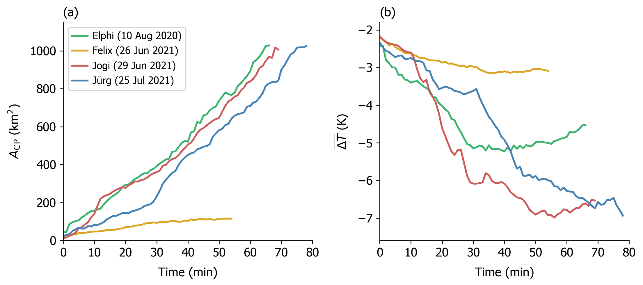
Definition of growth phase
Selection of four events that are initiated and grow inside the network
End of growth phase: maximum area reached or boundary contact ≥ 2/3
Cold pool area
Mean strength ∆T
Notes:
For this analysis concentrate on 4 events, where we can see the beginning of life cycle

Slide 11
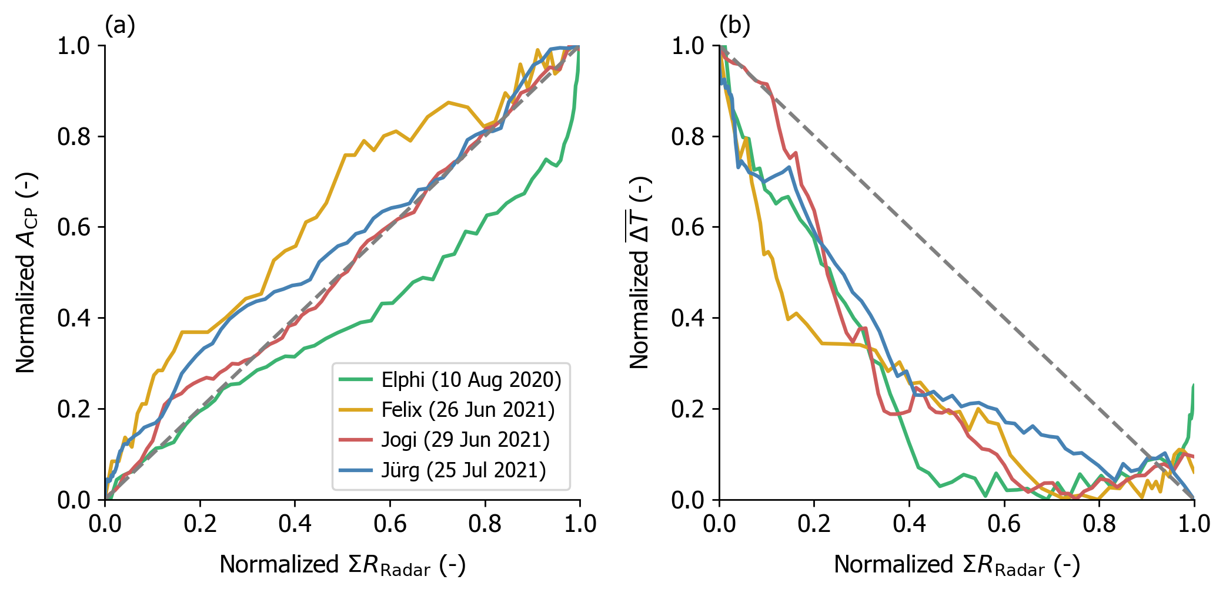
How does rainfall control the cold pool growth?
Cold pool area scales with area-integrated rainfall amount
Cold pools cool most efficiently early in their life cycle
Cold air production by rainfall evaporation
Time
Notes:
We know that CPs form by precipitation, but how do the CP props quantitatively relate to rainfall?
a: Normalized area-integrated rainfall amount over the domain measured by radar vs. normalized CP area for the four cases
b: Also for mean dT relative relative relationship very similar among the cases, showing most efficient cooling in early stages (80% cooling for 50% rainfall)
This argues for…
Other factors: Evaporation efficiency?

Slide 12
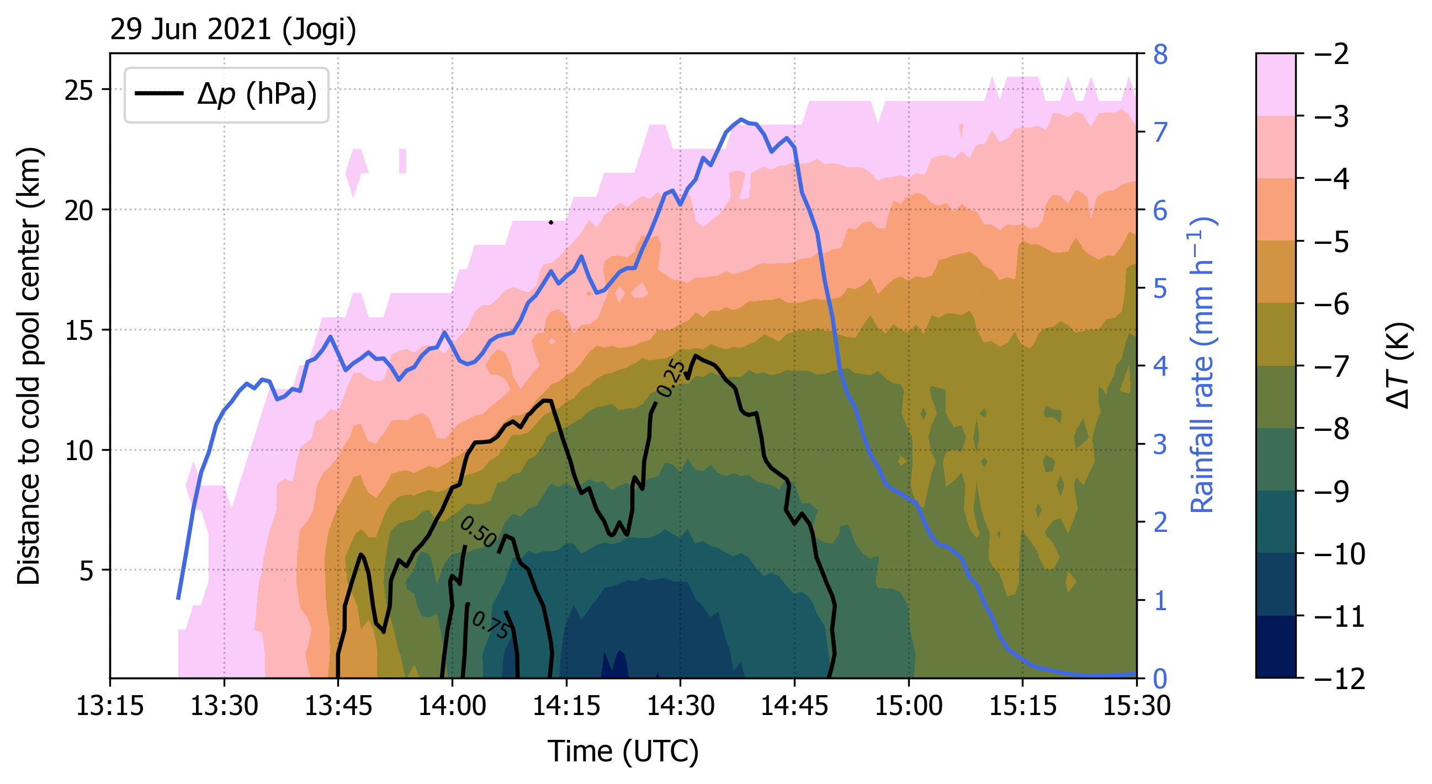
View into the horizontal cold pool structure
Growth according to area-mean rainfall
Nearly linear radial temperature gradient
Non-hydrostatic pressure perturbation
Notes:
Plot of Jogi: Time vs. Distance to center for dT and dp + Mean RR over area
Grows to about 40 km diameter in about one hour, confims visually that rainfall controls growth
Allows view into structure, strongest dT at center, nearly linear radial gradient, not confined to leading eadge
dp peak precedes dT -> non-hydrostatic -> downdrafts -> import of upper-level air additional factor for growth (in line with evidence in point measurements)

Slide 13
Take-home messages
Median diameter of cold pool objects sampled during FESSTVaL experiment is 8.4 km, however, this number is biased by the limited network size.
Cold pools are not circularly shaped, independent of their size and strength.
Cold pool area scales linearly with total rainfall amount due to evaporative cooling and downward transport of upper-level air.
  Today at 17:30h: Keynote talk by Cathy Hohenegger on FESSTVaL
  Tomorrow at 15:15h: Talk by Maike Ahlgrimm on “Simulating cold pools with ICON during the FESSTVaL period”

