Slide 1




Risk assessment of frost occurrence in a changing climate
Zala Žnidaršič¹, Andreja Sušnik², Gregor Gregorič², Tjaša Pogačar¹
¹Biotechnical faculty, University of Ljubljana, Slovenia
²Slovenian Environment Agency, Slovenia
EMS Annual Meeting 2022
UP3.1 Climate change detection, assessment of trends,
variability and extremes
4-9 September 2022, Bonn, Germany

Slide 2
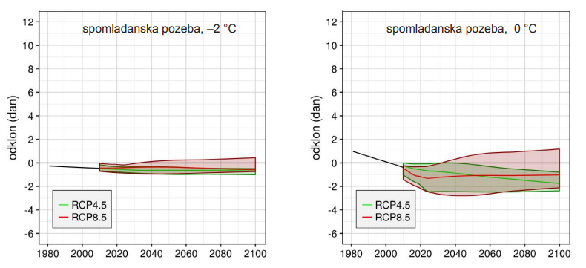
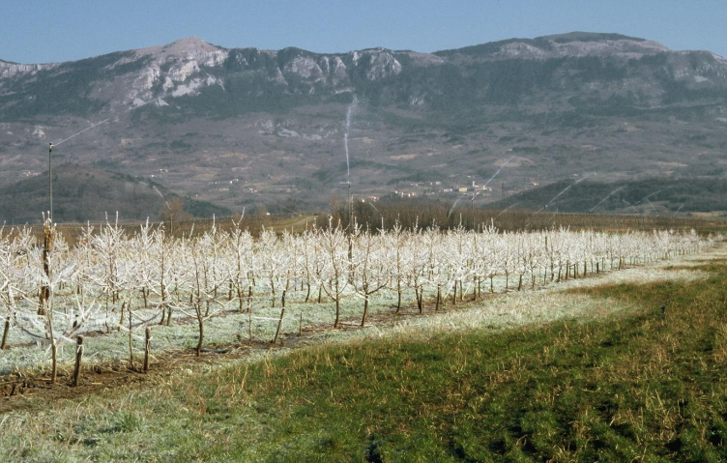
OVERVIEW
UP3.1 Climate change detection, assessment of trends, variability and extremes 2
  Attempts to model frost risk projections for the 21th century in Slovenia - no change in frost risk due to climate change
  An alternative climatological analysis of frost risk in Slovenia
Spring frost, -2 °C
Spring frost, 0 °C
Anomaly (days)
Anomaly (days)
Source: Bertalanič, R. & Dolinar, M., Slovenian Environment Agency (2018).
Z. Žnidaršič, A. Sušnik, G. Gregorič, T. Pogačar

Slide 3
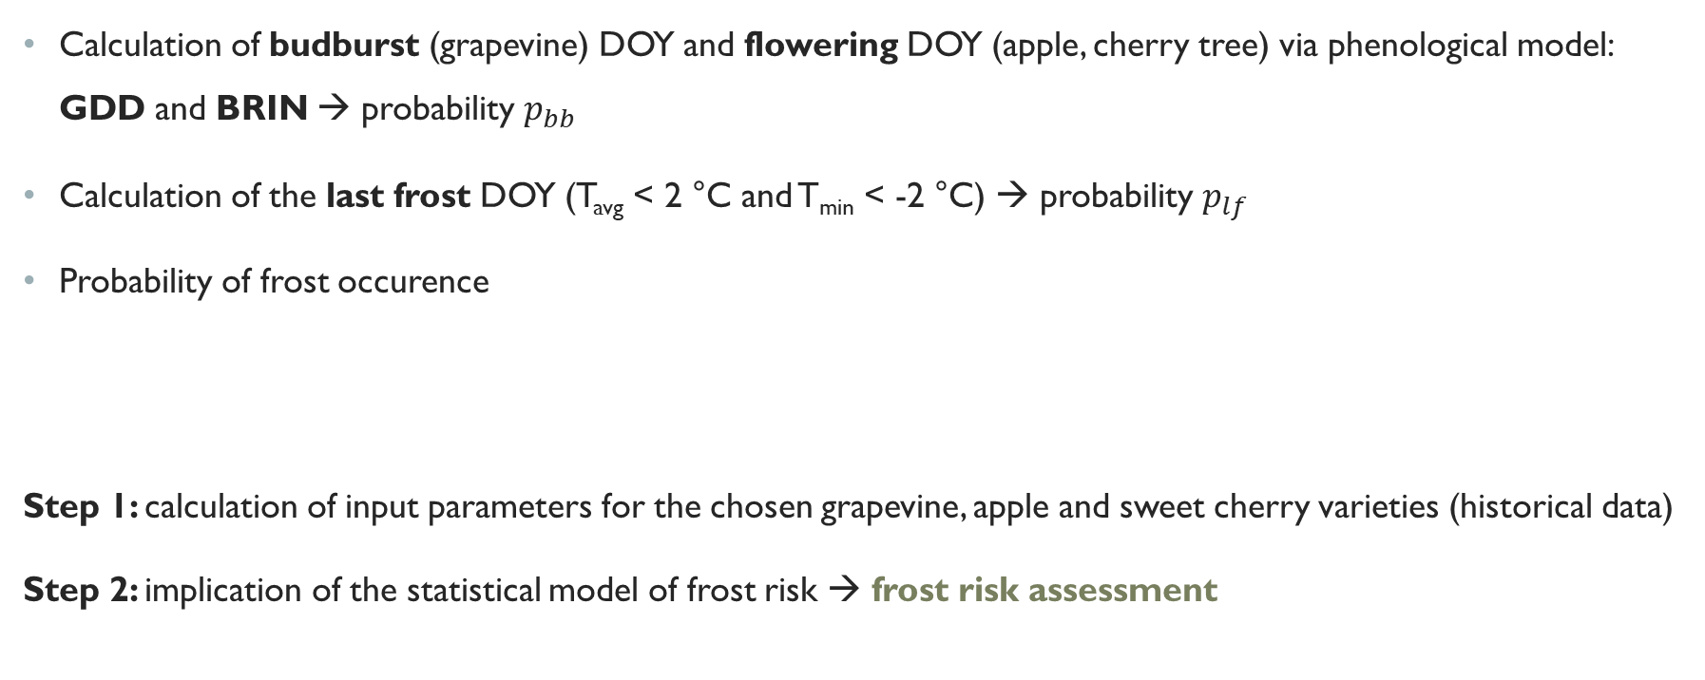

methodology
UP3.1 Climate change detection, assessment of trends, variability and extremes 3
Calculation of budburst (grapevine) DOY and flowering DOY (apple, cherry tree) via phenological model: GDD and BRIN → probability $p_{bb}$
Calculation of the last frost DOY (T_{avg} < 2 °C and T_{min} < -2 °C) → probability $p_{lf}$
Probability of frost occurence
Step 1: calculation of input parameters for the chosen grapevine, apple and sweet cherry varieties (historical data)
Step 2: implication of the statistical model of frost risk → frost risk assessment
$$P_{tf}=\sum_{t^{∗}=t_{0}}^{t_{f}}{\left\{p_{bb}\left(t^{∗}\right)\left[1−\sum_{t=t_{0}}^{t^{∗}}{p_{lf}\left(t\right)}\right]\right\}.}$$
Methodology as proposed by: Sgubin et al. (2018), Garcia de Cortazar-Atauri et al. (2009)
Z. Žnidaršič, A. Sušnik, G. Gregorič, T. Pogačar

Slide 4
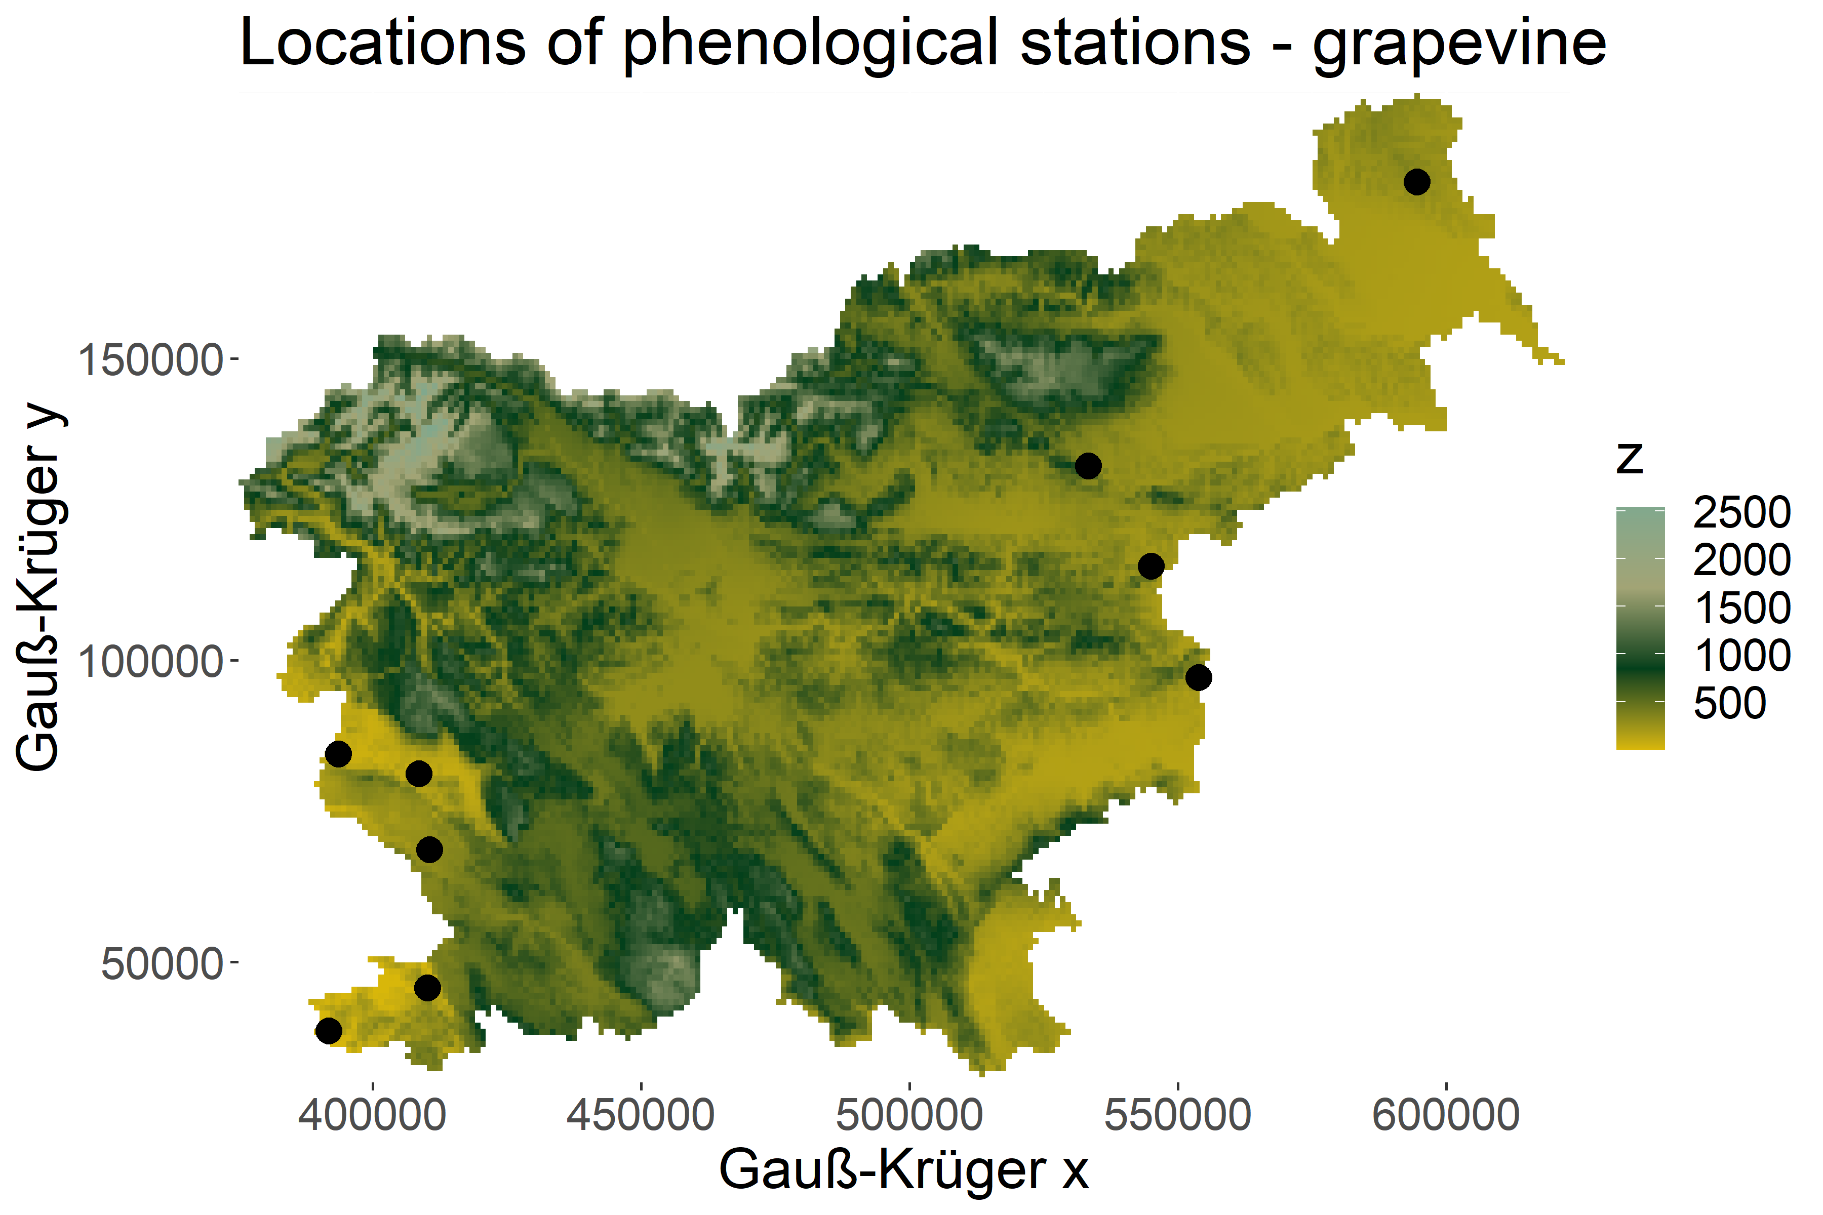
Phenological Data
UP3.1 Climate change detection, assessment of trends, variability and extremes 4
Fruit tree | Variety | Location (period) | Climate type
Grapevine (Vitis vinifera L.) | Refošk - Teran | Rižana (1981–2020) | Submediterranean
 |  | Tomaj (1981–1983, 1985–2012, 2020) | Submediterranean
 | Malvasia | Portorož (1985–2006) | Submediterranean
 |  | Rižana (1981–2020) | Submediterranean
 | Merlot | Bilje (1990, 1994–2008, 2011–2020) | Submediterranean
 |  | Slap (1984–2006, 2018–2020) | Submediterranean
 | Laški Rizling | Bizeljsko (1982–2012, 2014–2020) | Subcontinental
 |  | Slovenske Konjice (1981–2008, 2010–2015) | Subcontinental
 |  | Zibika (1982–1984, 1986, 1988–1993, 1995–2020) | Subcontinental
 | Chardonnay | Šalovci (2002–2018, 2020) | Subcontinental
→ Apple tree (Malus domestica), cherry tree (Prunus avium L.)
Z. Žnidaršič, A. Sušnik, G. Gregorič, T. Pogačar

Slide 5


… Data
UP3.1 Climate change detection, assessment of trends, variability and extremes 5
Fruit tree | Variety | Location (period) | Climate type
Apple tree (Malus domestica) | Jonathan | Bizeljsko (1986–2012) | Subcontinental
 |  | Kadrenci pri Cerkvenjaku (1981–2021) | Subcontinental
 |  | Bukovžlak (1982–2021) + 5 locations | Subcontinental
 |  | Lesce (1982–1984, 1986–2015) | Moderate c. of the hilly region
 | Jonagold | Bizeljsko (2014–2021) | Subcontinental
 | Bobovec | Brod (1981–2021) | Subcontinental
 |  | Dobliče (1981, 1989–2020) | Subcontinental
 |  | Podlehnik (1981, 1982, 1984–1987, …) | Subcontinental
 |  | Šmartno pri Slovenj Gradcu (1981, …) | Moderate c. of the hilly region
 | Golden Delicious | Bukovci (1996–2008) | Subcontinental
 |  | Rakičan (1992, 1999–2012, 2014–2018) | Subcontinental
 | Elstar | Bukovci (2008–2021) | Subcontinental
 | Idared | Portorož (2001–2021) | Submediterranean
Cherry tree (Prunus avium L.) | Germersdorf | Portorož (1989–1993, 1999–2020) | Submediterranean
 |  | Rižana (2001–2015, 2017–2020) | Submediterranean
 |  | Bilje (1981–1982, 1987–1988, …) | Submediterranean
 | Early Bigi | Tomaj (1996–2012) | Submediterranean
 | Unknown | Tomaj (1981–1995) + 2 locations | Submediterranean
 | Van | Slap (1992–2006, 2018–2019) | Submediterranean
Z. Žnidaršič, A. Sušnik, G. Gregorič, T. Pogačar

Slide 6
Meteorological Data
UP3.1 Climate change detection, assessment of trends, variability and extremes 6
E-OBS historical climate data for the period 1980–2020, interpolated to a 1 × 1 km regular grid over Slovenia; provided by the Slovenian Environment Agency
In progress: Climate projections for the period 2010–2100 (RCP 4.5, RCP 8.5)
Z. Žnidaršič, A. Sušnik, G. Gregorič, T. Pogačar

Slide 7
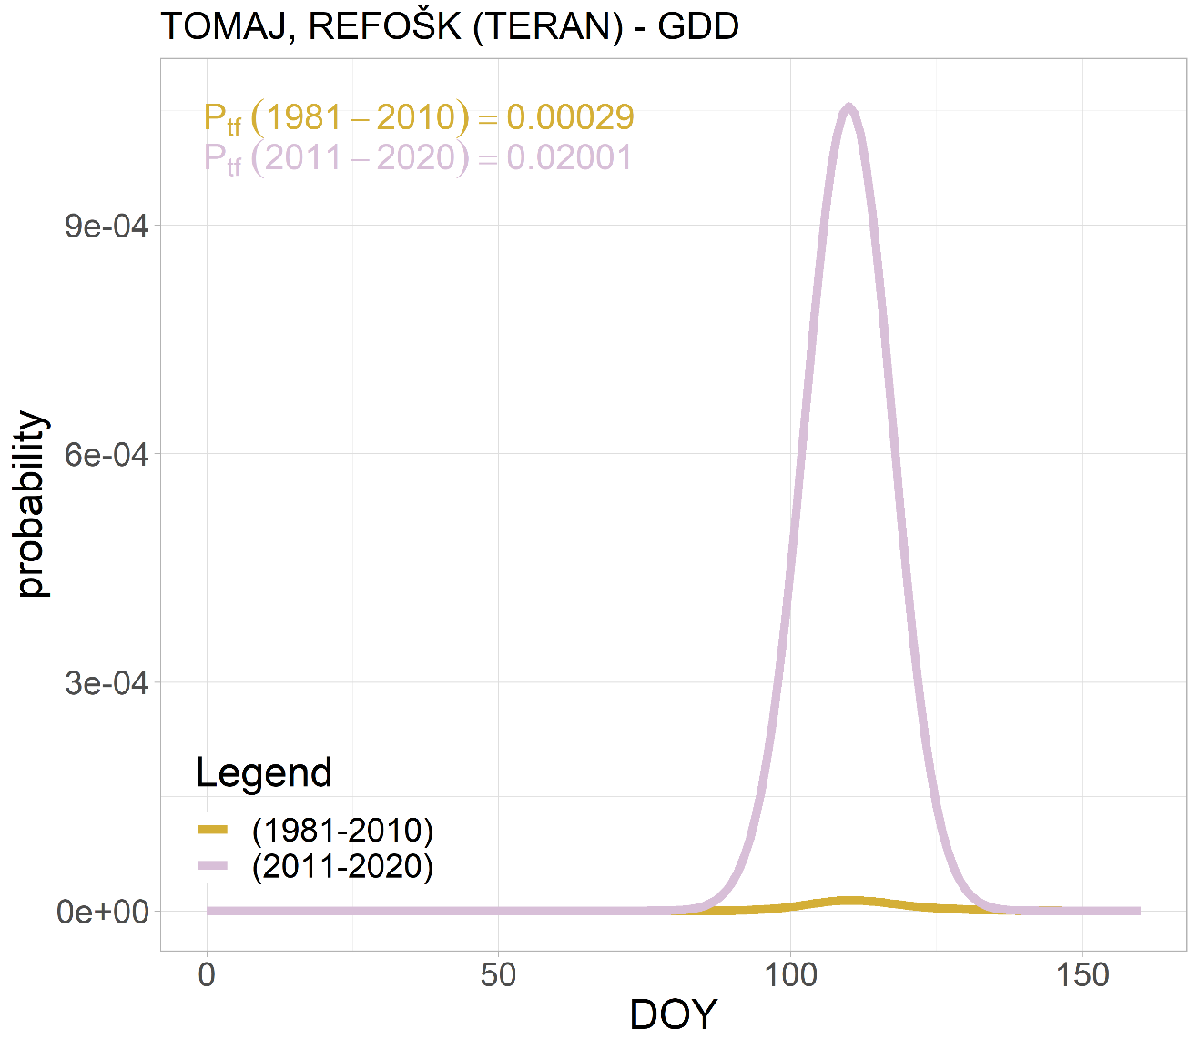
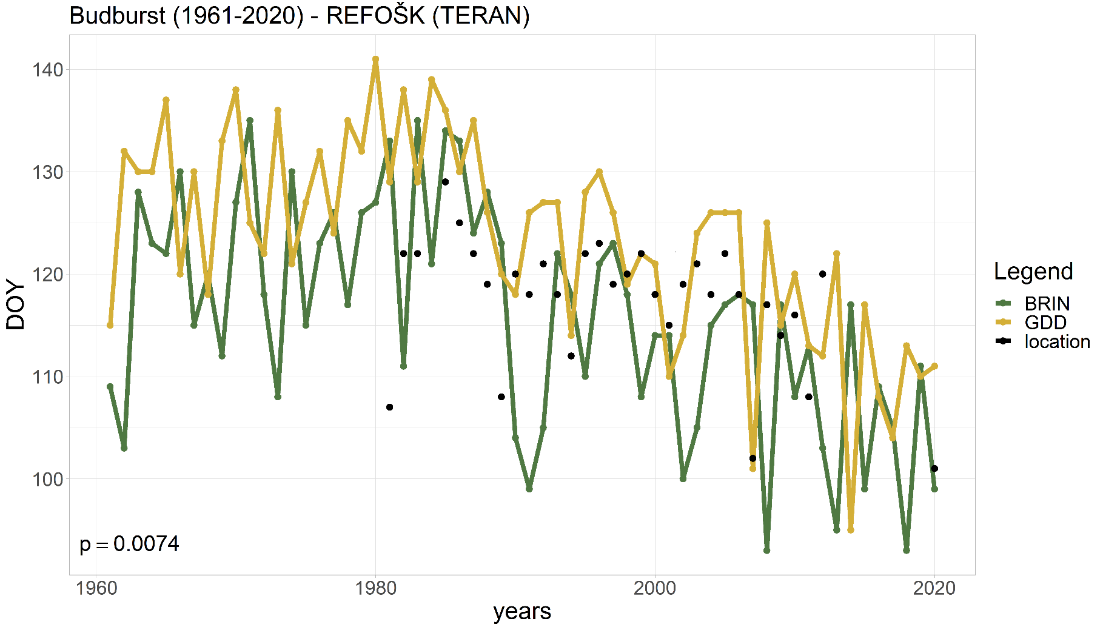
Frost risk – grapevine
UP3.1 Climate change detection, assessment of trends, variability and extremes 7
Majority of grapevine varieties → downward trend of budburst DOY (p < 0.05)
Submediterranean climate of Slovenia (Merlot, Malvasia, Refošk-Teran): frost risk up to 70 times greater in 2011–2020 vs. 1981–2010
Subcontinental climate of Slovenia: frost risk 2-4 times greater in 2011–2020 vs. 1981–2010 (Laški Rizling, Chardonnay)
Z. Žnidaršič, A. Sušnik, G. Gregorič, T. Pogačar

Slide 8
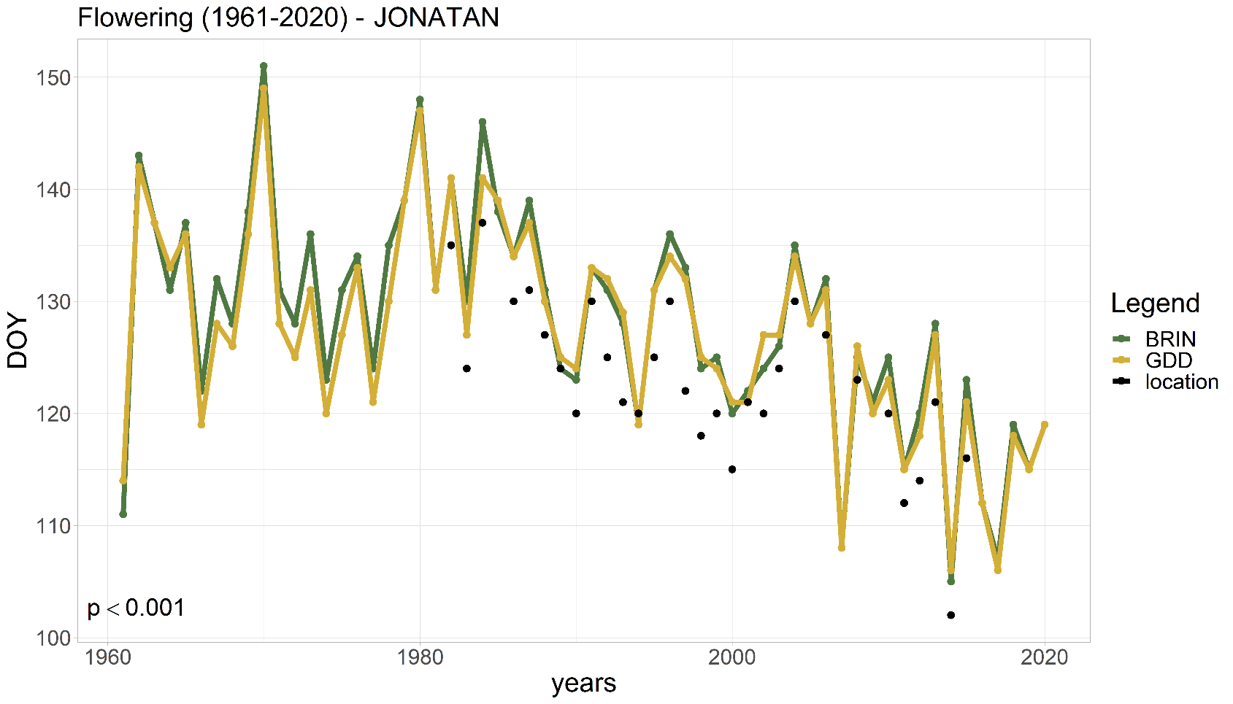
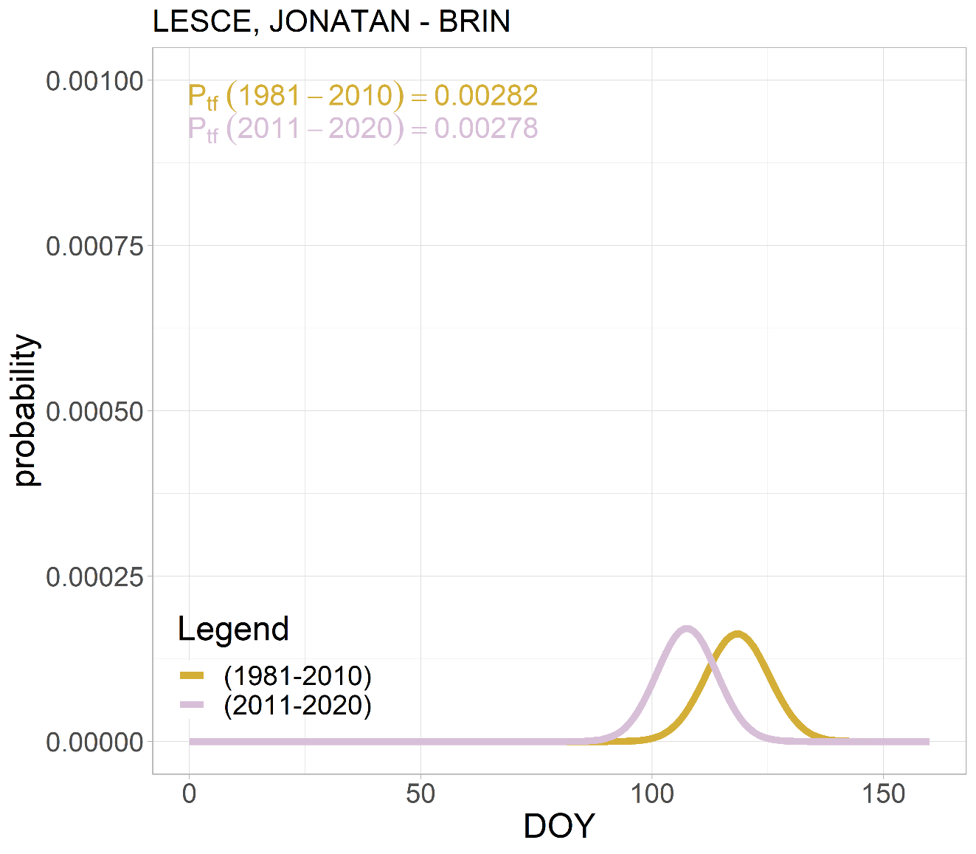
Frost risk – apple tree
UP3.1 Climate change detection, assessment of trends, variability and extremes 8
Majority of apple tree varieties → downward trend of flowering DOY (p < 0.05)
Submediterranean climate of Slovenia (Idared): frost risk 5 times greater in 2011-2020 vs. 1981-2010
Subcontinental climate of Slovenia (Jonathan, Jonagold, Bobovec, Golden Delicious, Elstar, Idared): frost risk up to 10 times greater in 2011-2020 vs. 1981-2010
Moderate climate of the hilly region: frost risk decreases or equal (Jonathan, Bobovec)
Z. Žnidaršič, A. Sušnik, G. Gregorič, T. Pogačar

Slide 9
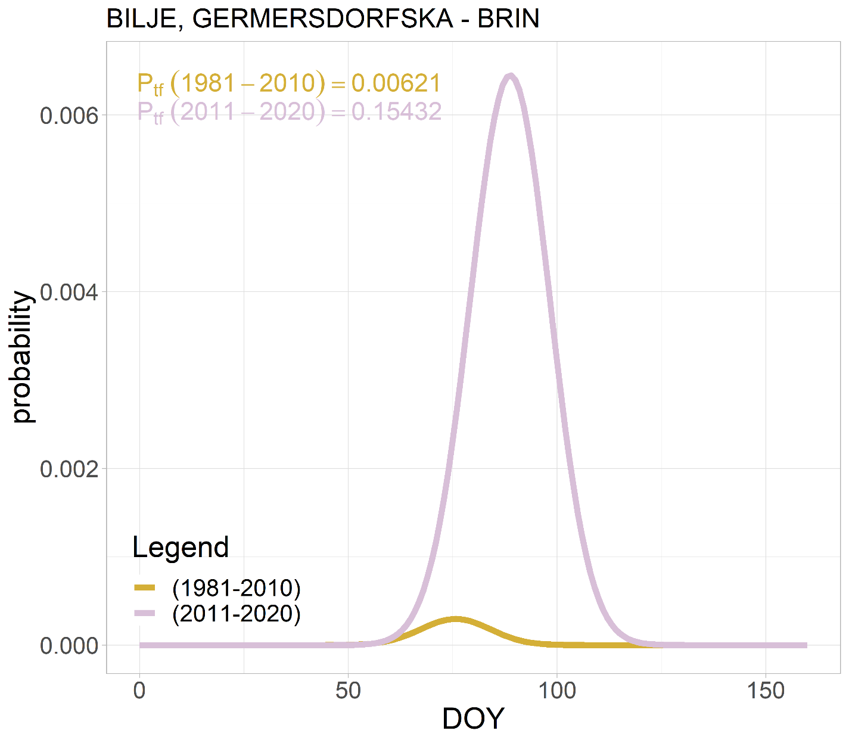
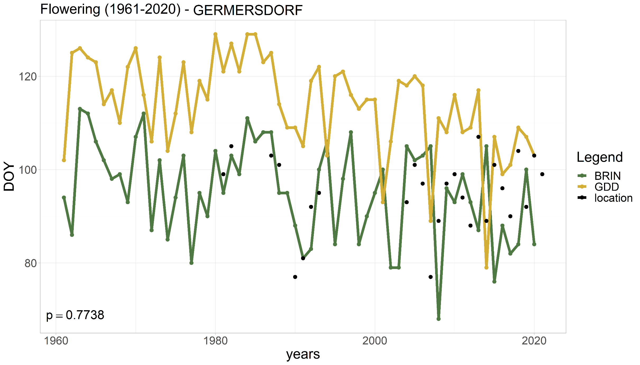
Frost risk – Cherry tree
UP3.1 Climate change detection, assessment of trends, variability and extremes 9
50 % of cherry tree varieties → divergent results
Submediterranean climate of Slovenia: 3-10x (Early Bigi, Van) up to 25 times greater frost risk (Germersdorf) in 2011-2020 vs. 1981-2010
Lack of data
Z. Žnidaršič, A. Sušnik, G. Gregorič, T. Pogačar

Slide 10
To be continued…
UP3.1 Climate change detection, assessment of trends, variability and extremes 10
Analysis of frost occurrence based on climate projections data (RCP4.5, RCP8.5), 6 climate models, period 2010–2100
Expanding the phenological observations database
Z. Žnidaršič, A. Sušnik, G. Gregorič, T. Pogačar

Slide 11
CONCLUSIONS
UP3.1 Climate change detection, assessment of trends, variability and extremes 11
  Frost events occurring after the beginning of the growing season = great risk for fruit trees, especially after budburst
Increased frost risk in analysed varieties of grapevine, apple and cherry trees grown in Slovenia for the period 2011–2020 in comparison to reference period 1981–2010
  Downward trend of budburst for the majority of grapevine varieties/flowering for the majority of apple tree varieties, divergent results for cherry tree varieties
Z. Žnidaršič, A. Sušnik, G. Gregorič, T. Pogačar
Notes:
We have observed increased frost risk for virtually all grapevine and cherry tree varieties whilst only for the apple tree varieties grown in the Submediterranean climate type. Among the least impacted will be the region with Moderate climate of the hilly region where Jonathan and Bobovec apple tree varieties are grown, for which we have calculated no change in frost risk.

Slide 12
Acknowledgments
UP3.1 Climate change detection, assessment of trends, variability and extremes 12
This work was supported by the Slovenian Research Agency, Research Program P4−0085.
                THANK YOU FOR YOUR ATTENTION!
Z. Žnidaršič, A. Sušnik, G. Gregorič, T. Pogačar

