Slide 1
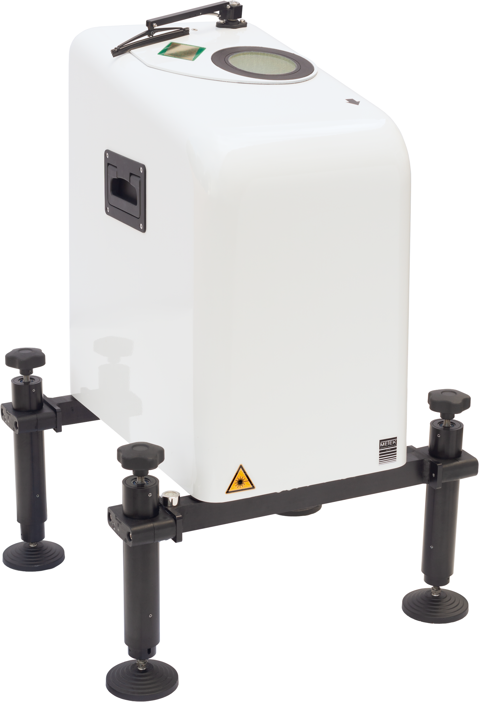
A Doppler Lidar Technique for Monitoring the
„Whole“ Boundary Layer
UP 1.5
Hans-Jürgen Kirtzel, Dr. Gerhard Peters
Metek GmbH

Slide 2
A Doppler Lidar Technique for Monitoring the
„Whole“ Boundary Layer
Hans-Jürgen Kirtzel, Dr. Gerhard Peters
Metek GmbH
Monitoring: Routine unattended observation with automatic online QA / reliability proof of
data
Boundary Layer: No unique definition, can be identified by profiles of wind, temperature,
turbulence, aerosol, or by range availability of remote profilers
Whole: From near ground heights (≈10 m, height of small masts) up to geostrophic wind field
Our Target: Wind and turbulence, Lidar

Slide 3
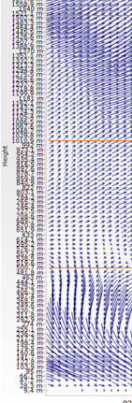
Motivation
How much information yields a wind profile?
The strongest gradients are typically observed near the surface.

Slide 4
Motivation
1500 m -
How much information yields a wind profile?
The strongest gradients are typically observed near the surface.
1000 m -
500 m -
70 m -

Slide 5
Motivation
1500 m -
Environmental applications: Air quality
Dispersion of released materials
Cold outflows
Heated metropols
1000 m -
Engineering tasks: Wind and ghust loads
Wind energy (ultra high wind
turbines, > 250 m, sail systems)
Weather forecast: Modelling
500 m -
Aviation: Flight safety
Airport management
Reduction of environmental impact
tbc
70 m -

Slide 6
Doppler Lidar System s
(Based on aerosol scattering)
Pulsed Lidars: Ranging by simple time counting High peak pulse power
Unambiguos range determination Limited range resolution
High SNR for a given mean power Limited minimum measuring height
CW Lidars: Ranging by optical focal setting Data affected by low hanging clouds
Relatively small emission peak power Unknown sign of radial wind
Fine range resolution in low ranges Blind zone around zero
Low minimum measuring height Limited to max. ranges of 200/300 m
Consecutive measurements in different heights
FM-CW Lidars: Ranging by optical focal setting Data affected by low hanging clouds
Relatively small emission peak power Unknown sign of radial wind
Fine range resolution in low ranges Blind zone around zero
Very low minimum measuring height Limited to approx. 200/300 m ranges
Determination of effective Consecutive measurements in different heights
measuring height

Slide 7
FM CW Doppler Lidar Wind Ranger 100/200
VAD scans at 80° elevation at a rate of 0.5 … 2 rps
Sample rate 100 Hz
Narrow scan angle 10 °, in favor of vertical wind measurements
Measuring heights 7 … 200 m, range resolution 0.05 … 32 m
Up to 20 measuring heights available (typ. 6 … 10)
Wind Ranger
100/200
No 180° ambiguity, no blind zero zone
Determination of the effective measuring range
Compact and light weight, 30 cm x 40 cm x 50 cm w/o feet, 45 kg

Slide 8
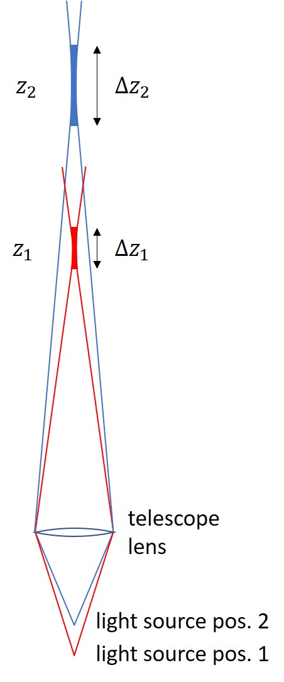
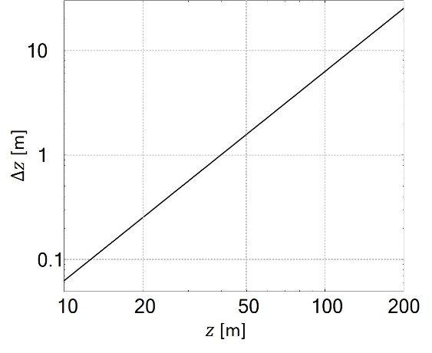
CW Doppler Lidar Systems
Ranging and Range Resolution
3 “ lens diameter
Height / Lens diameter | 2“ lens | 3“ lens
10 m | 0,16 m | 0,08 m
20 m | 0,64 m | 0,32
100 m | 16 m | 8
200 m | 64 m /NA | 32 m

Slide 9
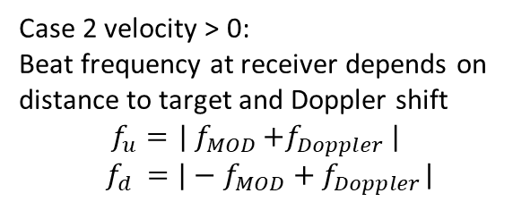

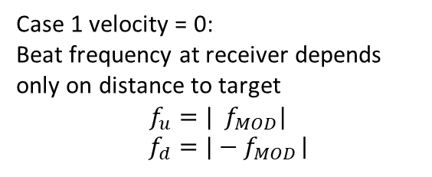
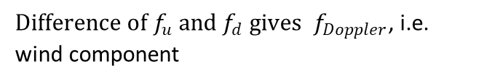

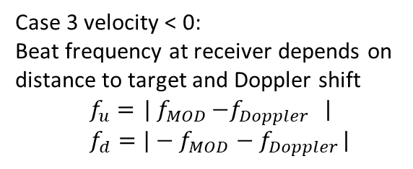
FM CW Doppler Lidar Wind Ranger 100/200
Principle of triangular frequency modulation
Case 1 velocity = 0:
Beat frequency at receiver depends only on distance to target
$$f_{u}=| f_{MOD}|$$
$f_{d}=|−f_{MOD}$|
f_{u} and f_{d} are the frequency shift between transmitted and received signal
f_{u}
f_{d}
Optical Frequency
${Sum of f}_{u} and f_{d} gives{ f}_{MOD}$, i.e. height
Time
Case 2 velocity > 0:
Beat frequency at receiver depends on
distance to target and Doppler shift
$$f_{u}={ | f}_{MOD}+f_{Doppler }|$$
${ f}_{d} =|−f_{MOD}+f_{Doppler}$|
f_{u}
f_{d}
Optical Frequency
${Sum of f}_{u} and f_{d} gives{ f}_{MOD}$, i.e. height
Time
${Difference of f}_{u} and f_{d} gives{ f}_{Doppler}$, i.e. wind component
Case 3 velocity < 0:
Beat frequency at receiver depends on
distance to target and Doppler shift
$f_{u}={ | f}_{MOD}−f_{Doppler }$|
$f_{d}=|−f_{MOD}−f_{Doppler}$|
f_{u}
f_{d}
Optical Frequency
Time

Slide 10
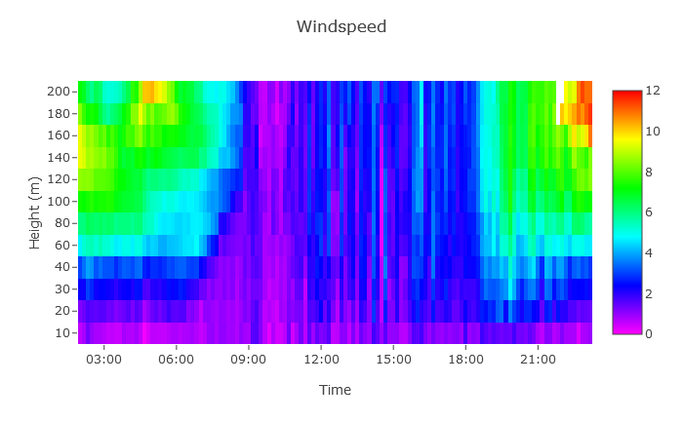
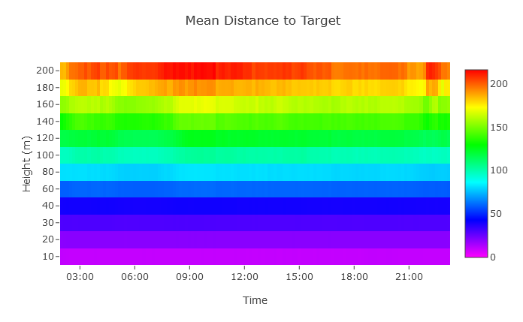
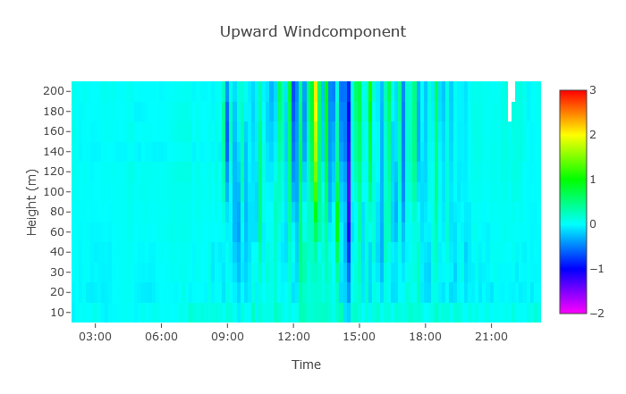
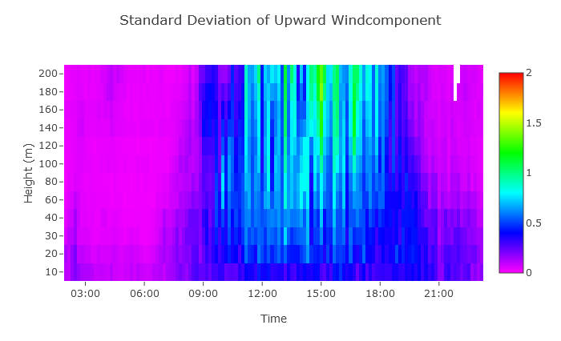
FM CW Doppler Lidar Wind Ranger 100/200
11.08.2022 00:00 – 23:50

Slide 11
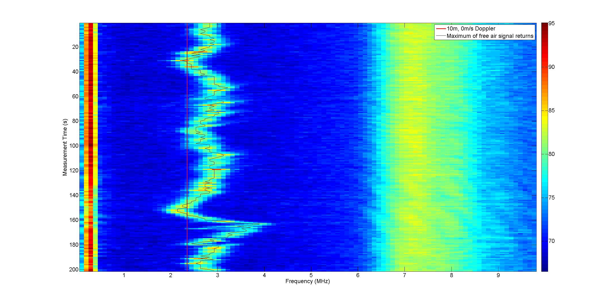
FM CW Doppler Lidar Wind Ranger 100/200
Discrimination between hard target and atmospheric signal
Internal reflection,
≈ 2 m distance
Wind signal,
10 m distance
Reflection from hard target, 20 m distance

Slide 12
Pulsed Doppler Lidar Systems
Variants
Available for different applications and corresponding ranges and heights
Short range (N beams or 2D scanner) | Range 40/60 … 200/350 m Compact (60 x 60 x 60 cm) Light weight (50 … 80 kg) Low power (< 170 W + 170 W) | Wind siting Urban areas Dispersion Wind systems in low heights
Long range (2D Scanner) | Range 70/100 … 2500/10000 m Height 70/100 … 2500 (PBL) Partly compact (60 x 60 x 60 cm / 90 x 90 x 90 cm) Partly light weight (80 kg/ >200 kg) Partly low power (< 170 W + 170 W / 1600 W) | Wind field investigation under low elevation Airports (glide pathwind measurements) Investigation of wind systems

Slide 13
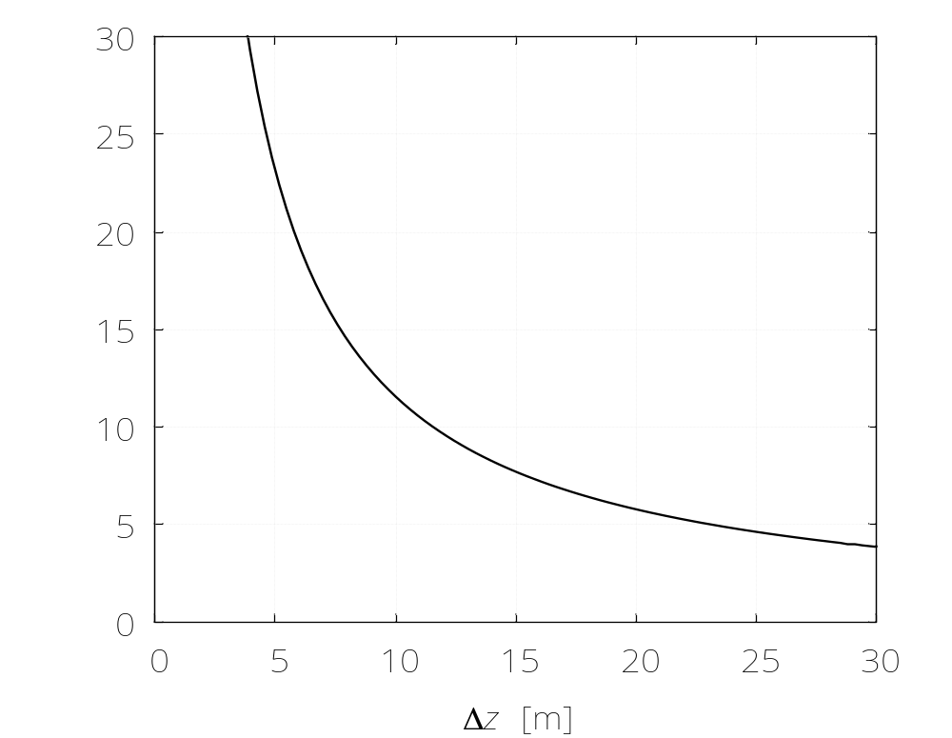
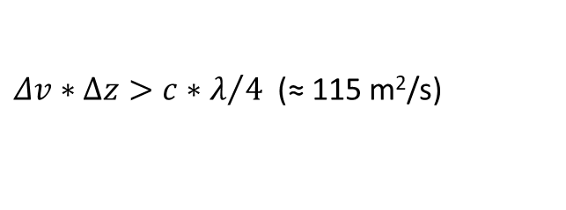
Pulsed Doppler Lidar Systems
Range Resolution vs Velocity Resolution
The relation between range resolution and velocity resolution is given by
$Δv∗Δz>{c∗λ}/4$ (≈ 115 m²/s)

Slide 14
Pulsed Doppler Lidar Wind Ranger BL
VAD scans at 80° elevation at a rate of 0.1 rps
Pulse rate 10 kHz, pulse length 320 ns, i.e. 100 m
Narrow scan angle 10 °, in favor of vertical wind measurements
Measuring heights 80 … 2500 m
Up to 100 measuring heights available
Wind Ranger
BL
Compact and light weight, 30 cm x 40 cm x 50 cm w/o feet, 45 kg

Slide 15
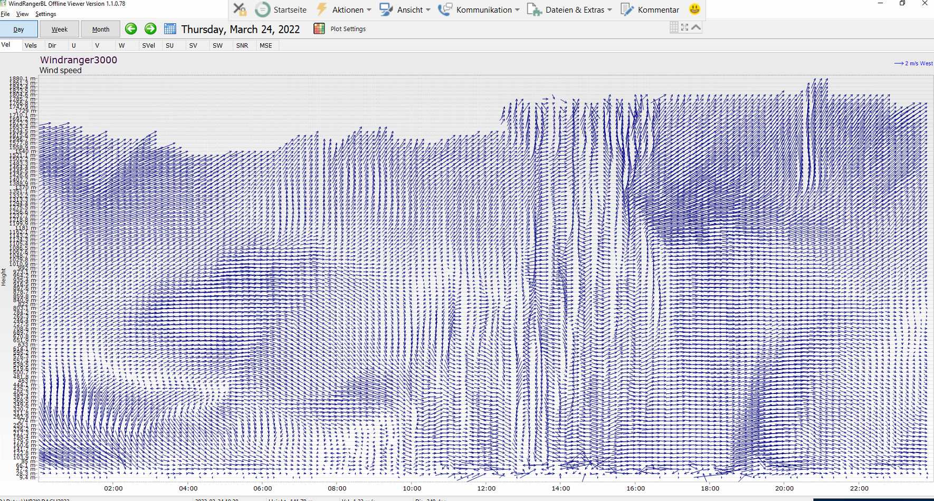
Pulsed Doppler Lidar Wind Ranger BL, 24.03.2022
Wind Ranger BL Messungen, Wind vectors, D-A-CH 2022 Leipzig,
Ideal conditions (red lines indicate 500/1000/1500 m)

Slide 16
Pulsed Doppler Lidar Wind Ranger BL, 24.03.2022
Wind Ranger BL Messungen, Wind vectors, D-A-CH 2022 Leipzig,
Ideal conditions (red lines indicate 500/1000/1500 m)
Red area indicate blind zone up to 85 m due to pulse length of Lidar system (320 ns)

Slide 17
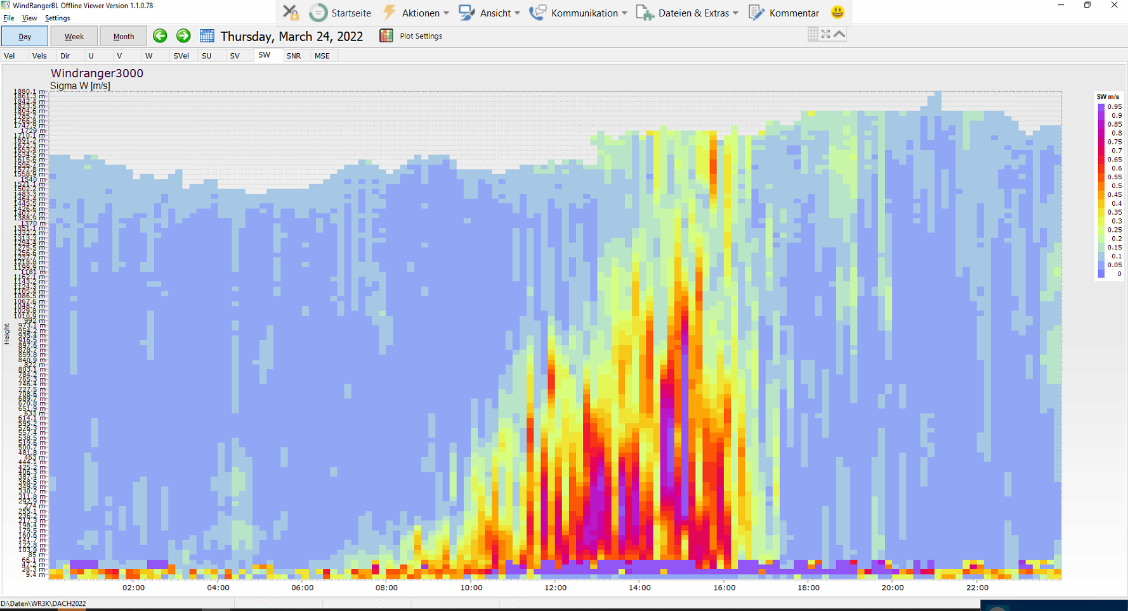
Pulsed Doppler Lidar Wind Ranger BL, 24.03.2022
Wind Ranger BL Messungen, std.dev. of vertical wind, D-A-CH in Leipzig,
Ideal conditions (red lines indicate 500/1000/1500 m)
Red area indicate blind zone up to 85 m due to pulse length of Lidar system (320 ns)

Slide 18
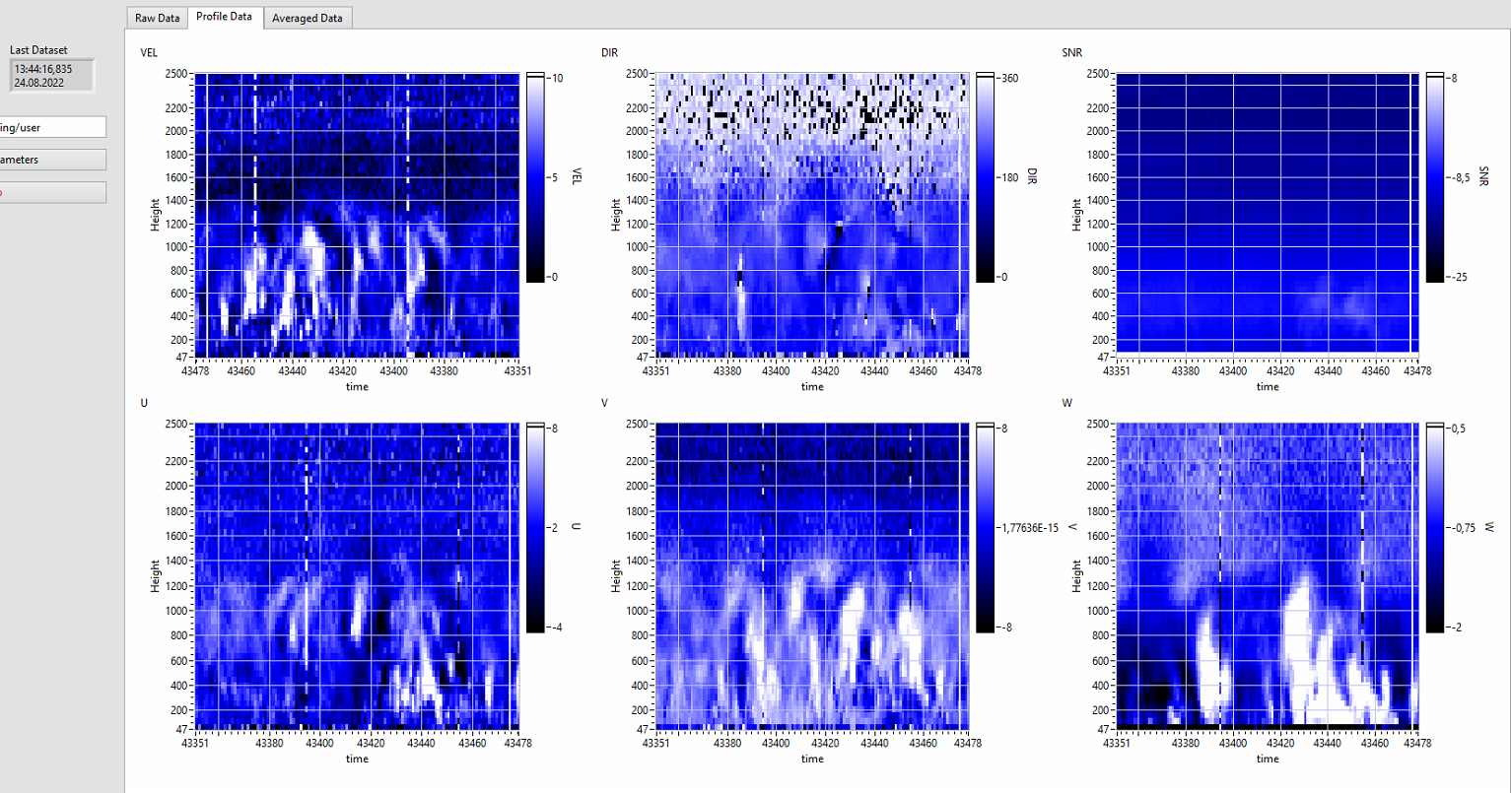
Pulsed Doppler Lidar Wind Ranger BL, 24.08.2022, 13:44 UTC, 10 s Averages
white_ estimated BL red available Lidar data
Velocity
Direction
SNR
all 20 minutes
U-Comp.
V-Comp.
W-Comp.

Slide 19
Wind Ranger 100/200 + Wind Ranger BL = Wind Ranger XM
+
=
Wind Ranger
100/200
Wind Ranger
BL
Wind Ranger
XM
VAD scans at 80° elevation at a rate of 0.5 … 2 rps
VAD scans at 80° elevation at a rate of 0.1 rps
Combined staggered mode of both techniques
Sampe rate 100 Hz
Pulse rate 10 kHz, pulse length 320 ns, i.e. 100 m
Narrow scan angle 10 °, in favor of vertical wind
Typ. 4/8 minutes low mode,
1/2 minutes high mode
Narrow scan angle 10 °, in favor of vertical wind
Measuring heights 7 … 200 m
Measuring heights 80 … 2500 m
Up to 20 measuring heights available (typ. 6 … 10)
Up to 100 measuring heights available
No 180° ambiguity, no blind zero zone
Determination of the effective measuring range

Slide 20
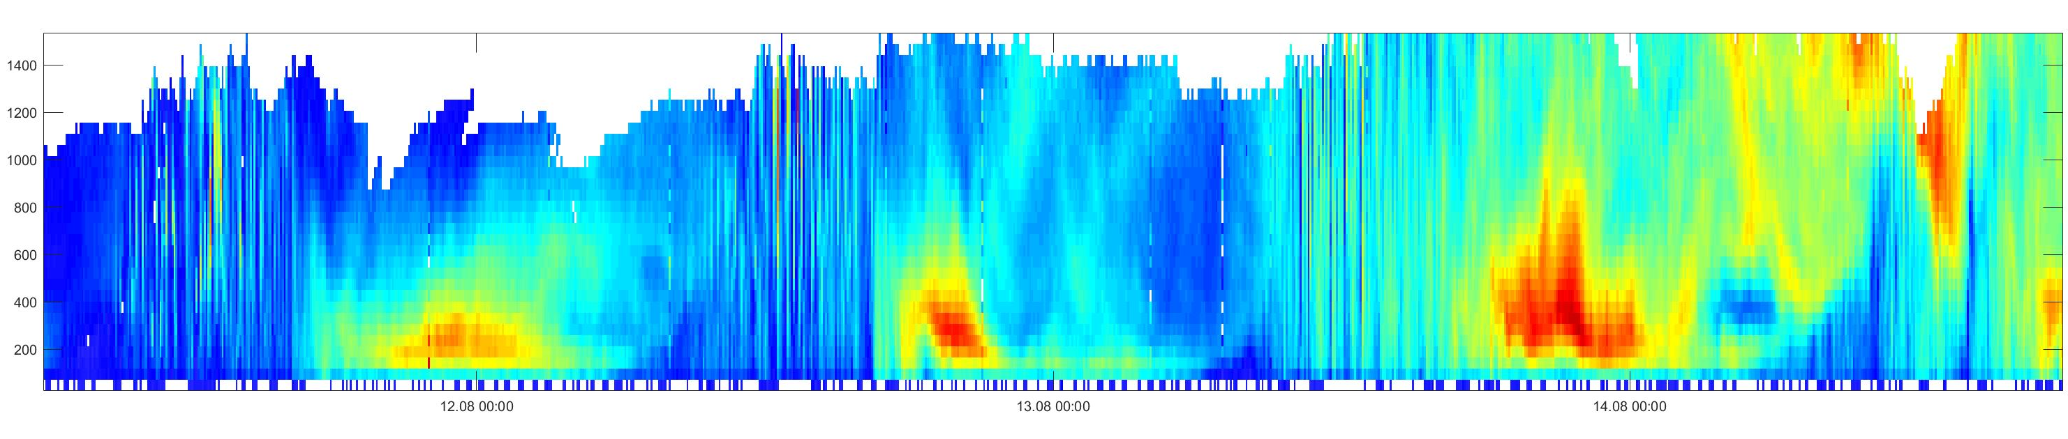
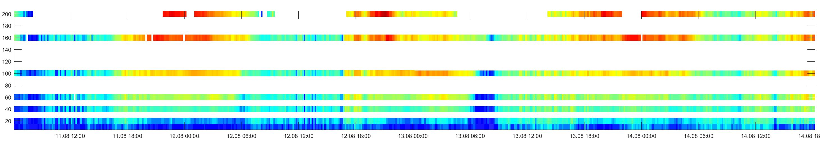
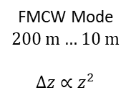
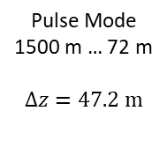
Capability of Wind Ranger XM
Data samples of combined modes
Pulse Mode
1500 m … 72 m
$$Δz=47.2 m$$
15
10
Height (m)
Wind Speed (m/s)
5
0
FMCW Mode
200 m … 10 m
$$Δz∝z^{2}$$
15
Height (m)
10
Wind Speed (m/s)
5
10
0
11.08 12:00
12.08 00:00
12.08 12:00
13.08 00:00
13.08 12:00
14.08 00:00
14.08 12:00
Pls. regard the different color scaling

Slide 21
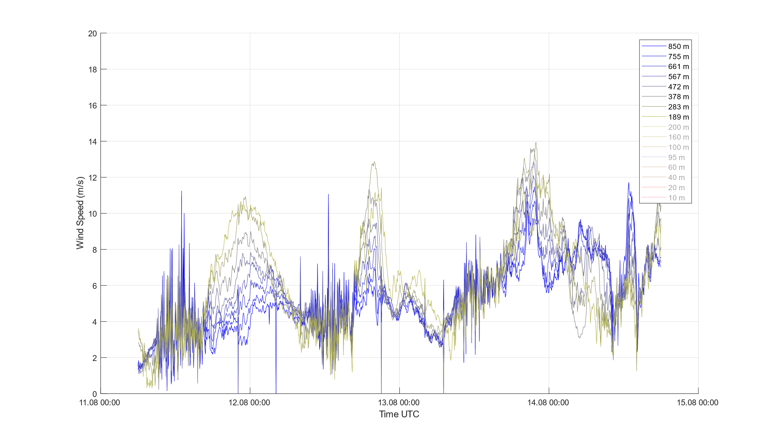
Capability of Wind Ranger XM
Data samples of combined modes, WR BL data
(850 … 189 m)
10

Slide 22
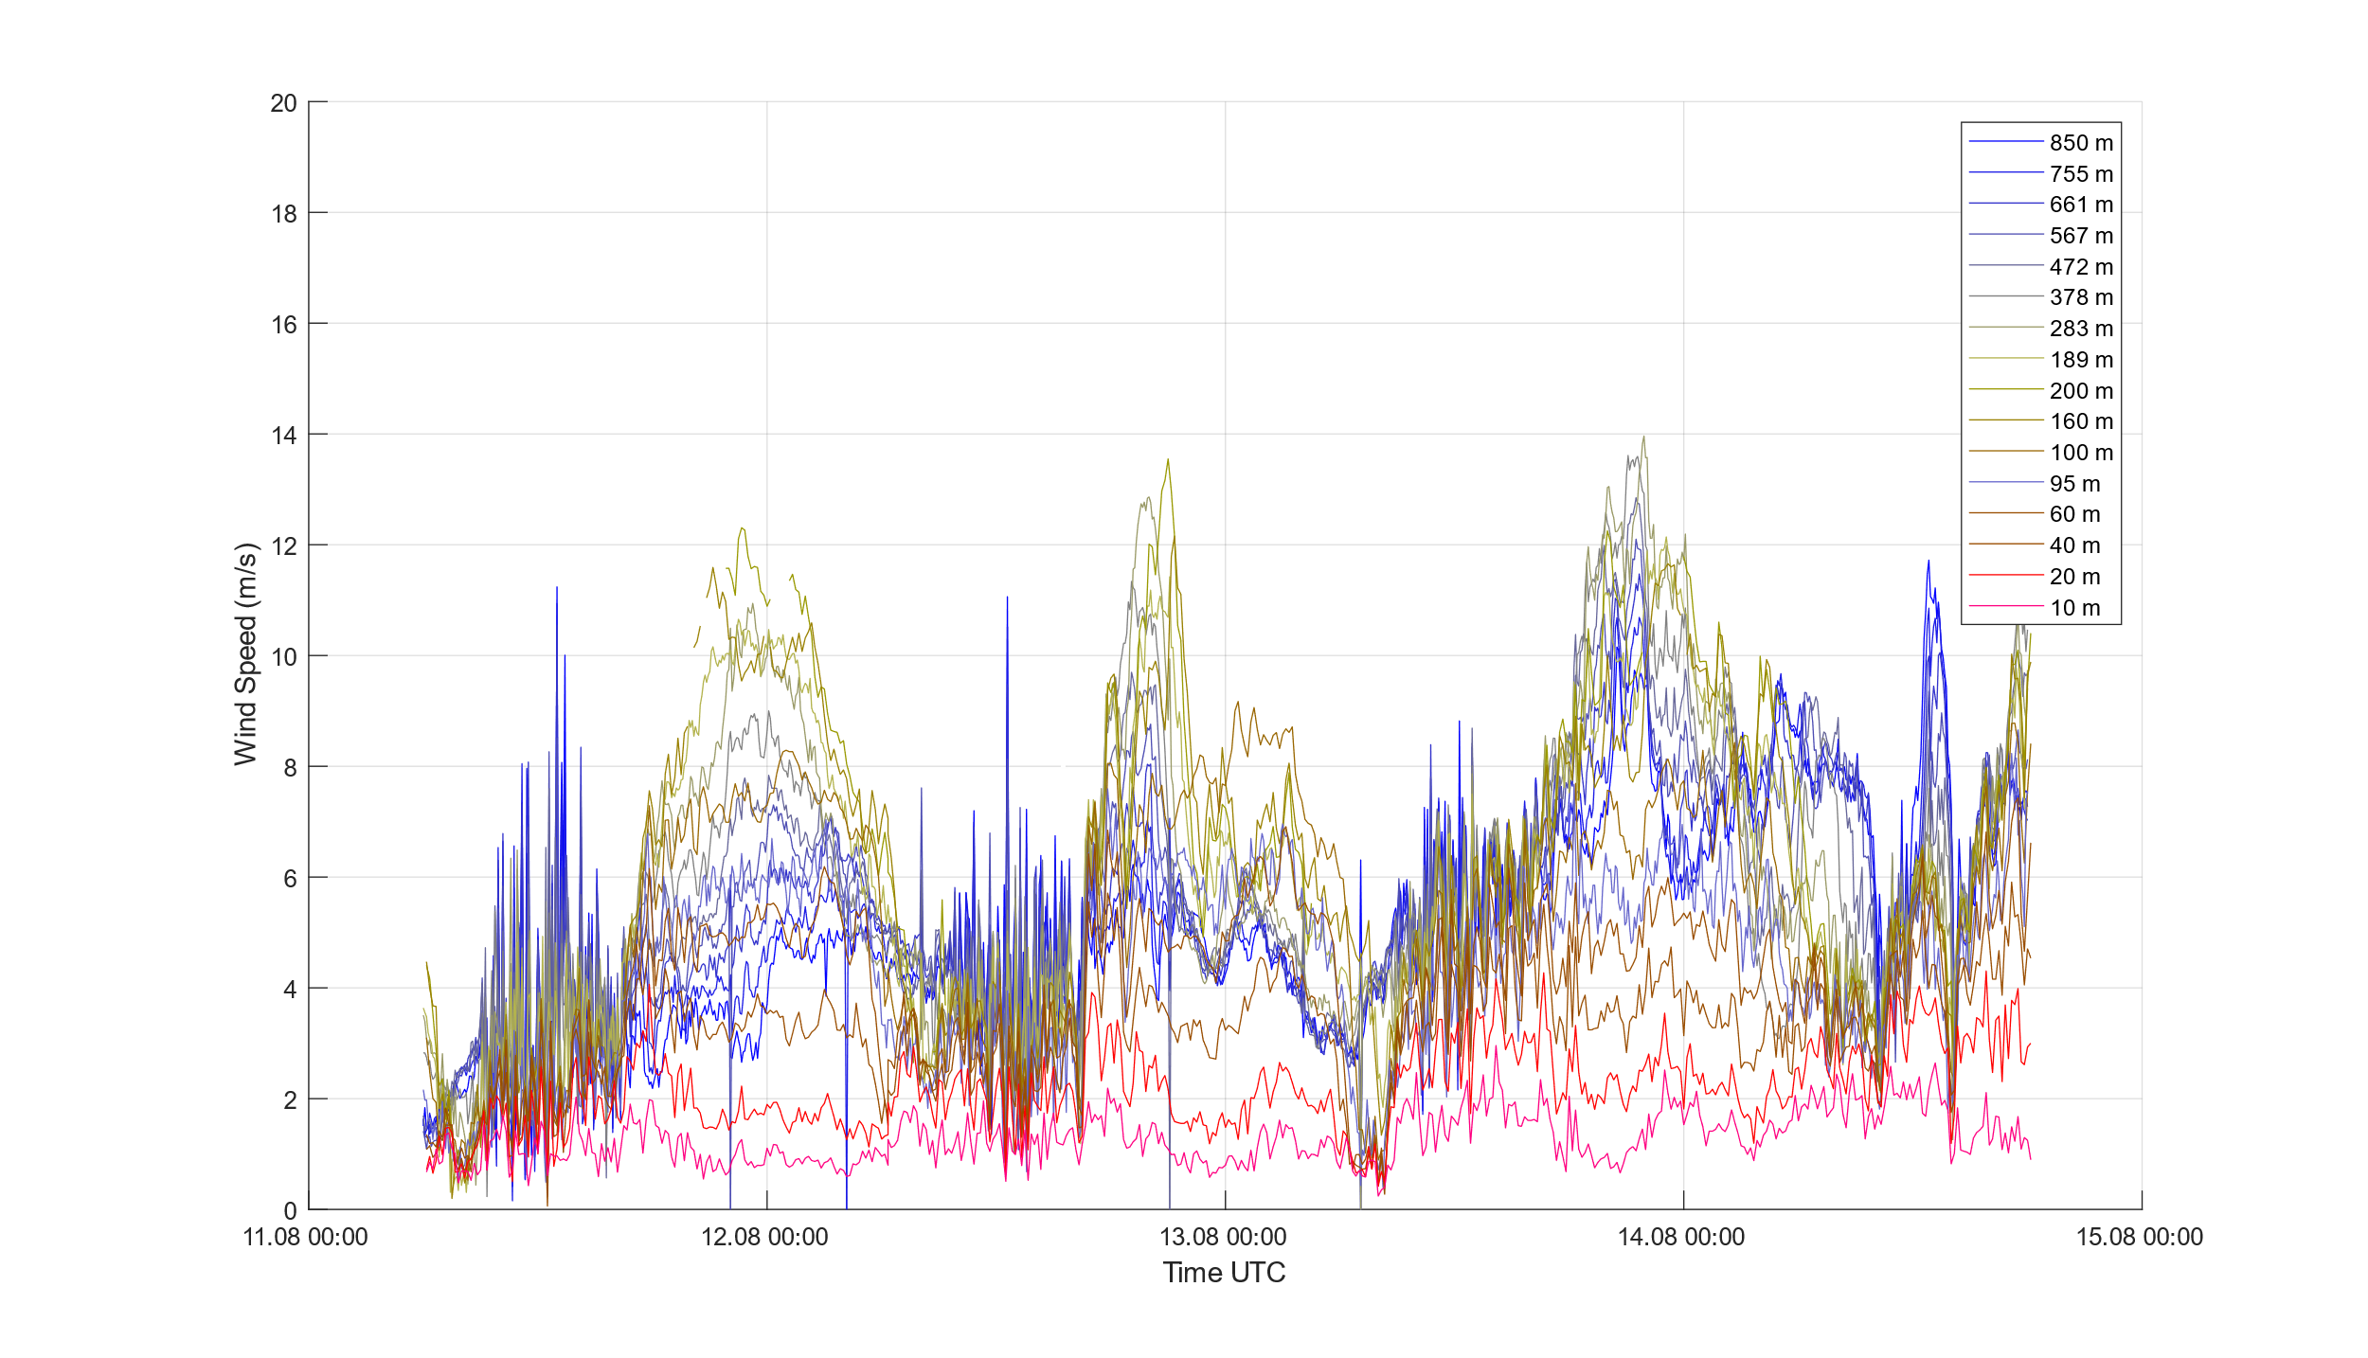
Capability of Wind Ranger XM
Data samples of combined modes, WR 200 data
(850 … 189 m)
(200 … 10 m)
10

Slide 23
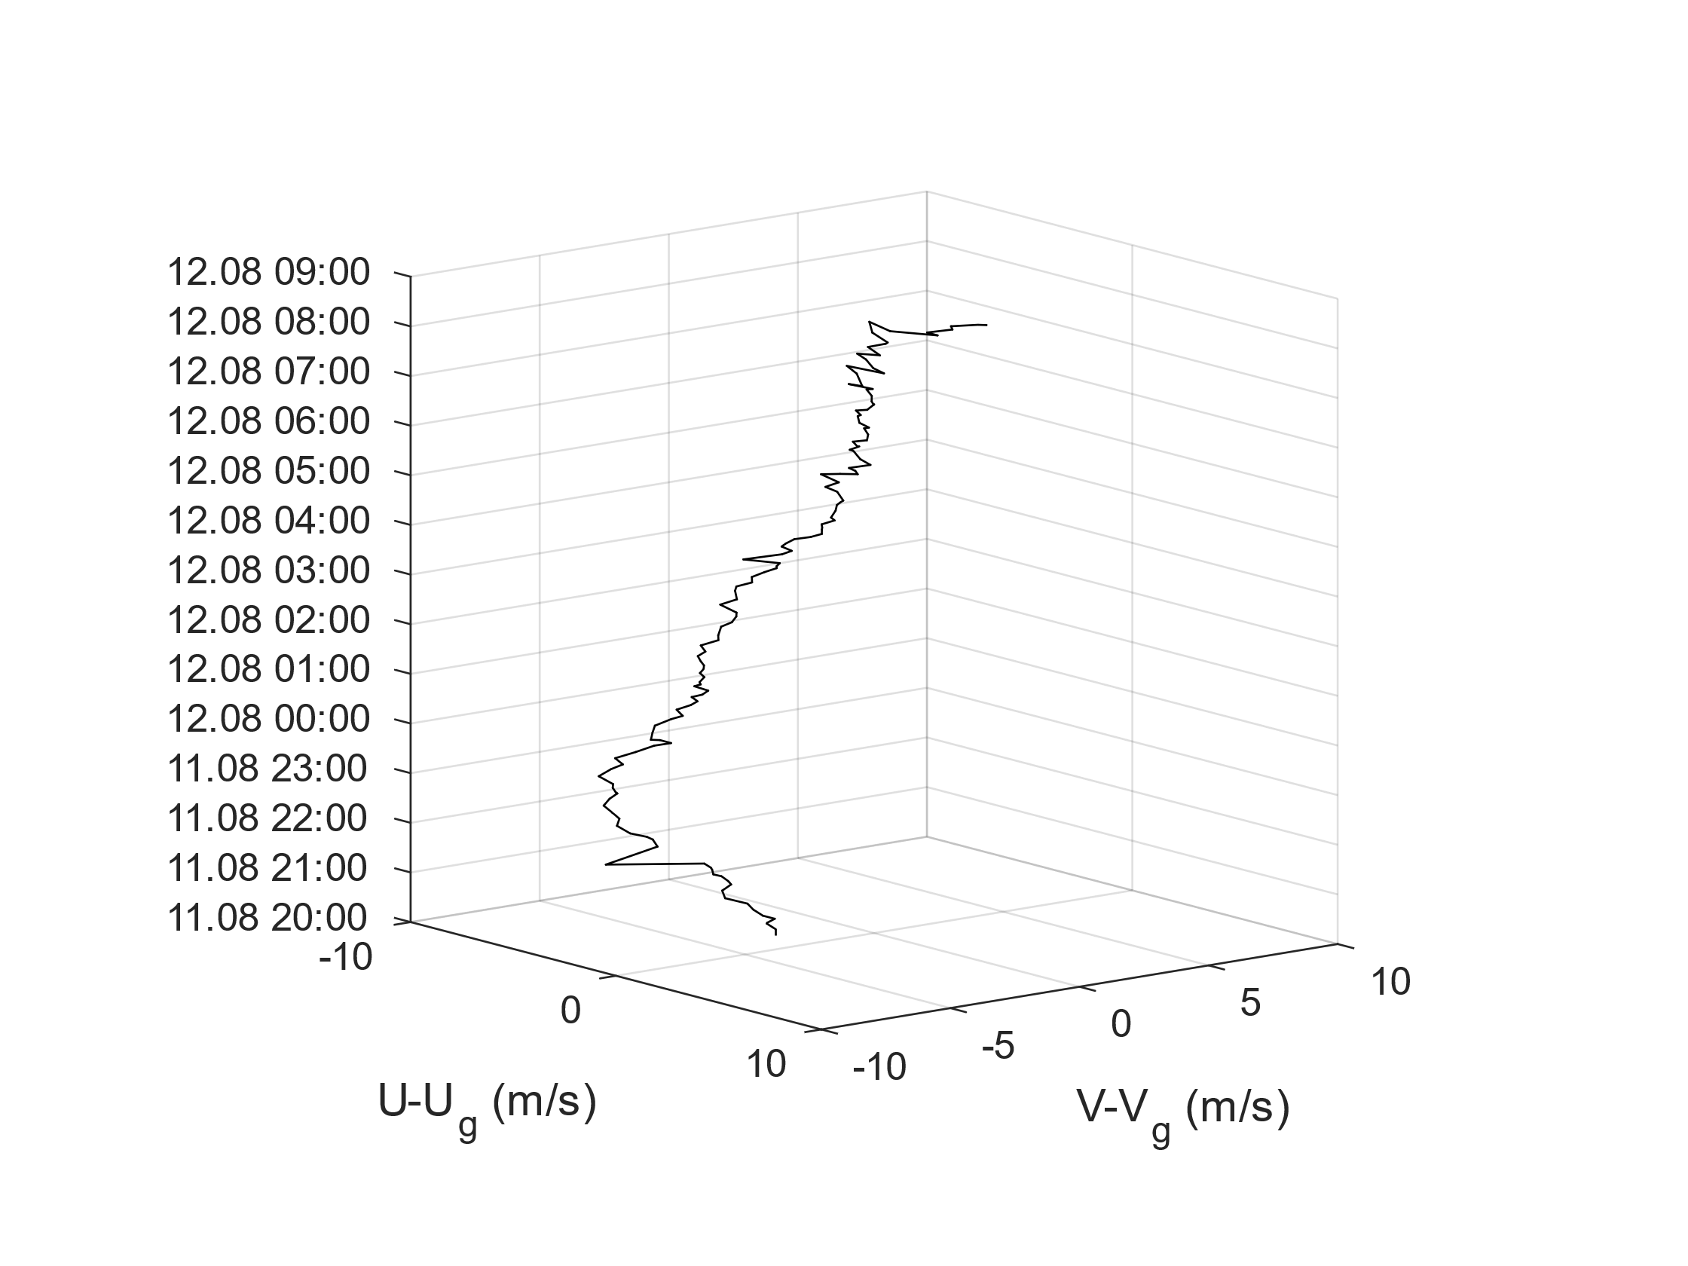
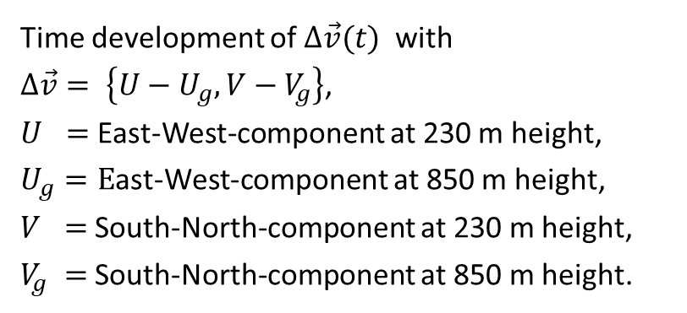
Capability of Wind Ranger XM
Data samples of combined modes, Low Level Jet 1
Time development of $Δ\vec{v}(t)$ with
$Δ\vec{v}= \left\{U−U_{g}, V−V_{g}\right\}$,
$U =$ East-West-component at 230 m height,
$U_{g}=E$ast-West-component at 850 m height,
$V =$South-North-component at 230 m height,
$V_{g} =$South-North-component at 850 m height.
10
5
(m/s)
g
0
10
V-V
11-12.08.2022
-5
-10
-10
-5
0
5
10
U-U
(m/s)
g

Slide 24
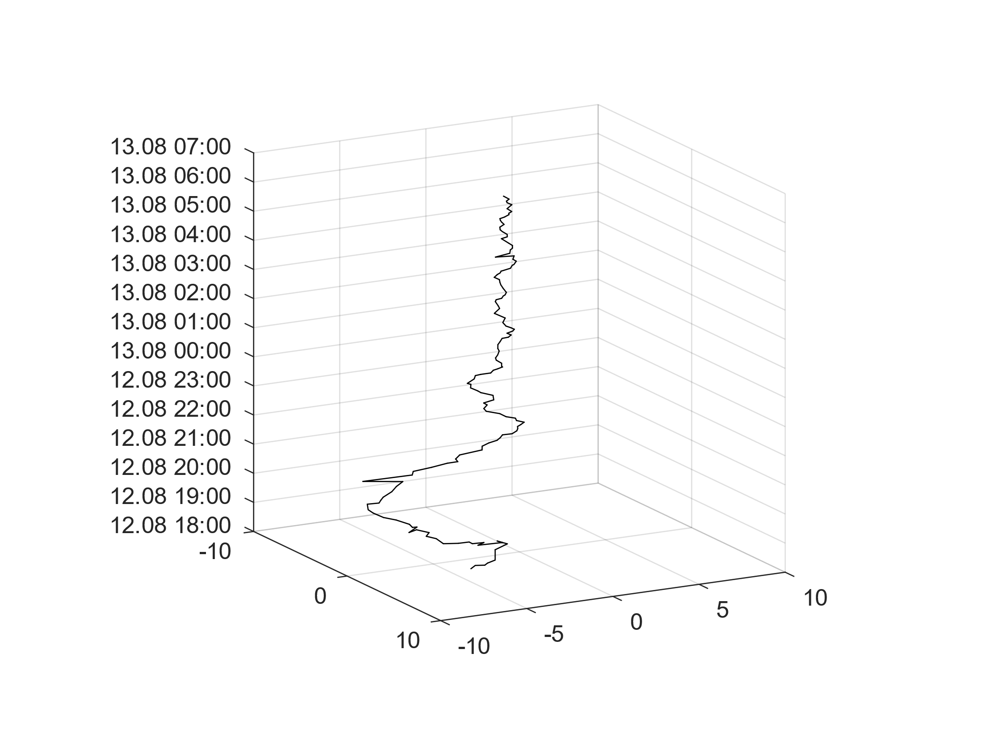
Capability of Wind Ranger XM
Data samples of combined modes, Low Level Jet 2
10
5
(m/s)
g
0
V-V
12-13.08.2022
-5
10
-10
-10
-5
0
5
10
U-U
(m/s)
g

Slide 25
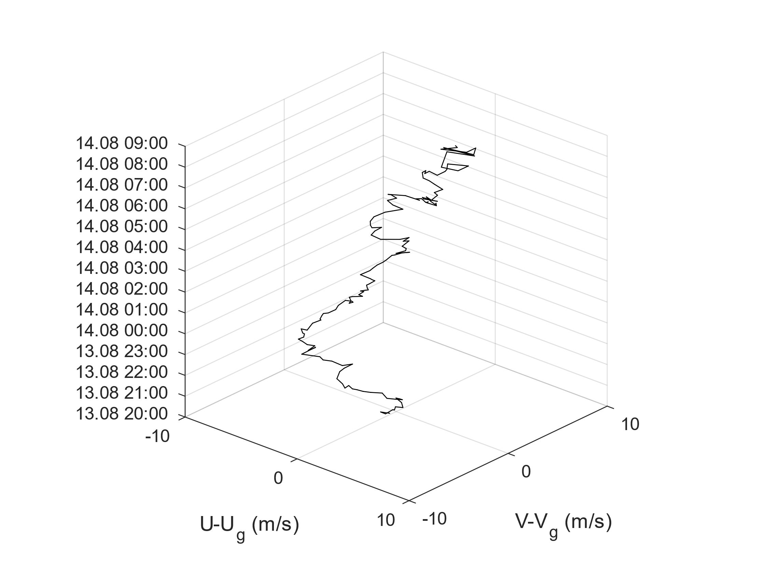
Capability of Wind Ranger XM
Data samples of combined modes, Low Level Jet 3
10
5
(m/s)
g
0
V-V
-5
10
13-14.08.2022
-10
-10
-5
0
5
10
U-U
(m/s)
g

Slide 26
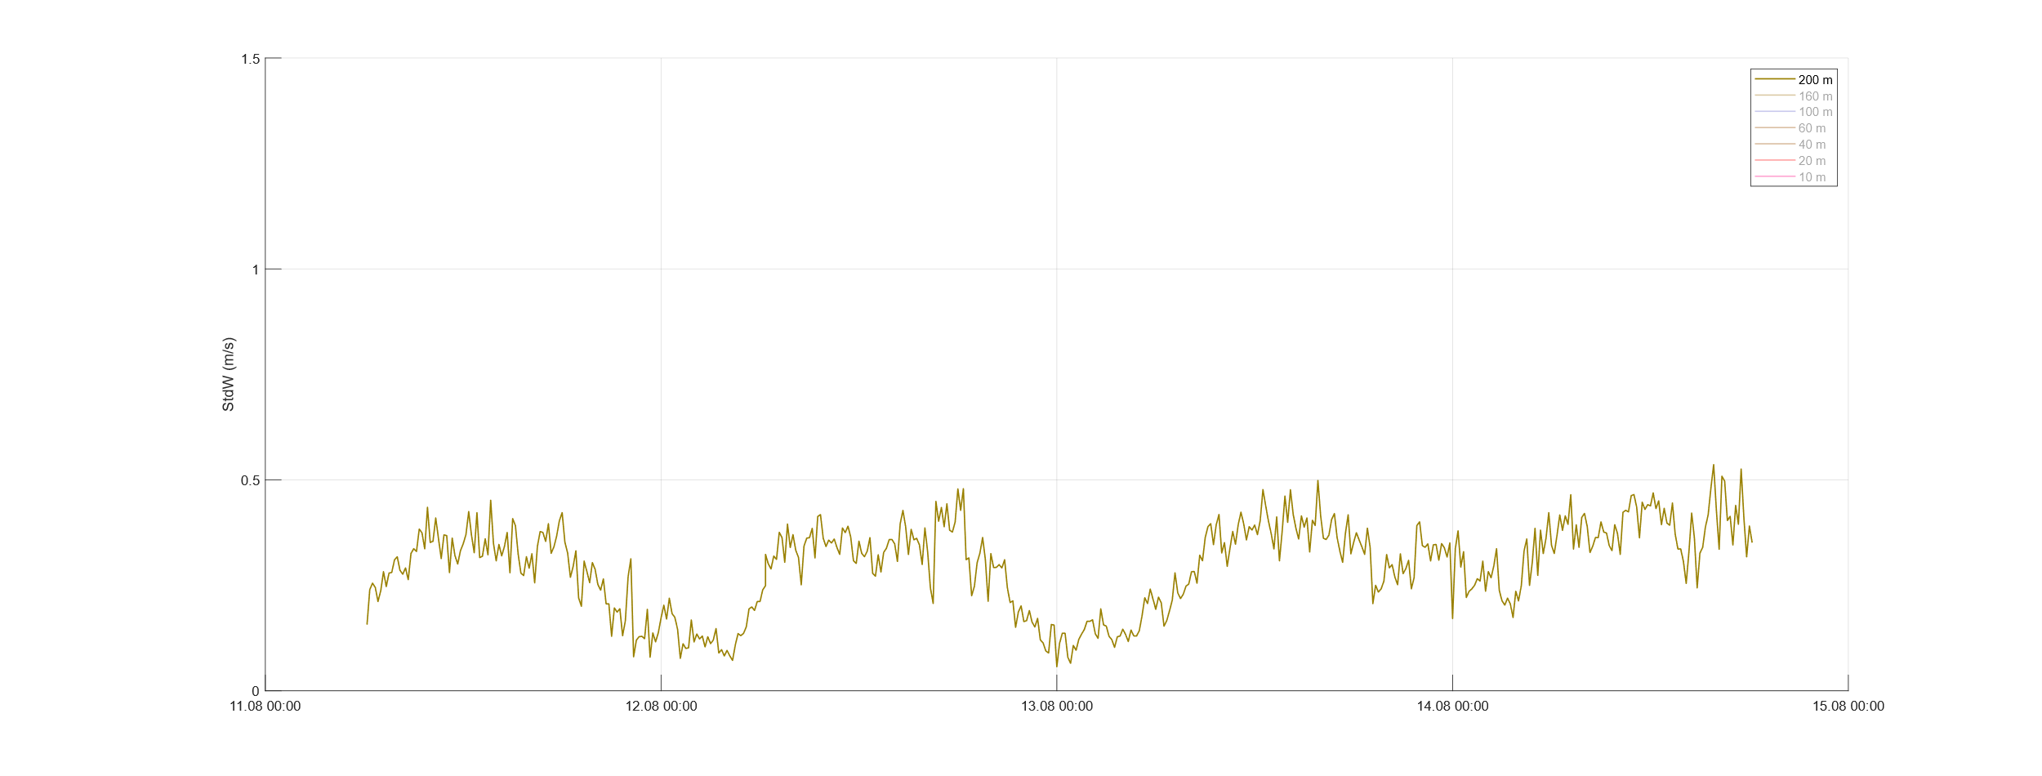
Capability of Wind Ranger XM
Standard deviation of vertical wind, 200 m

Slide 27
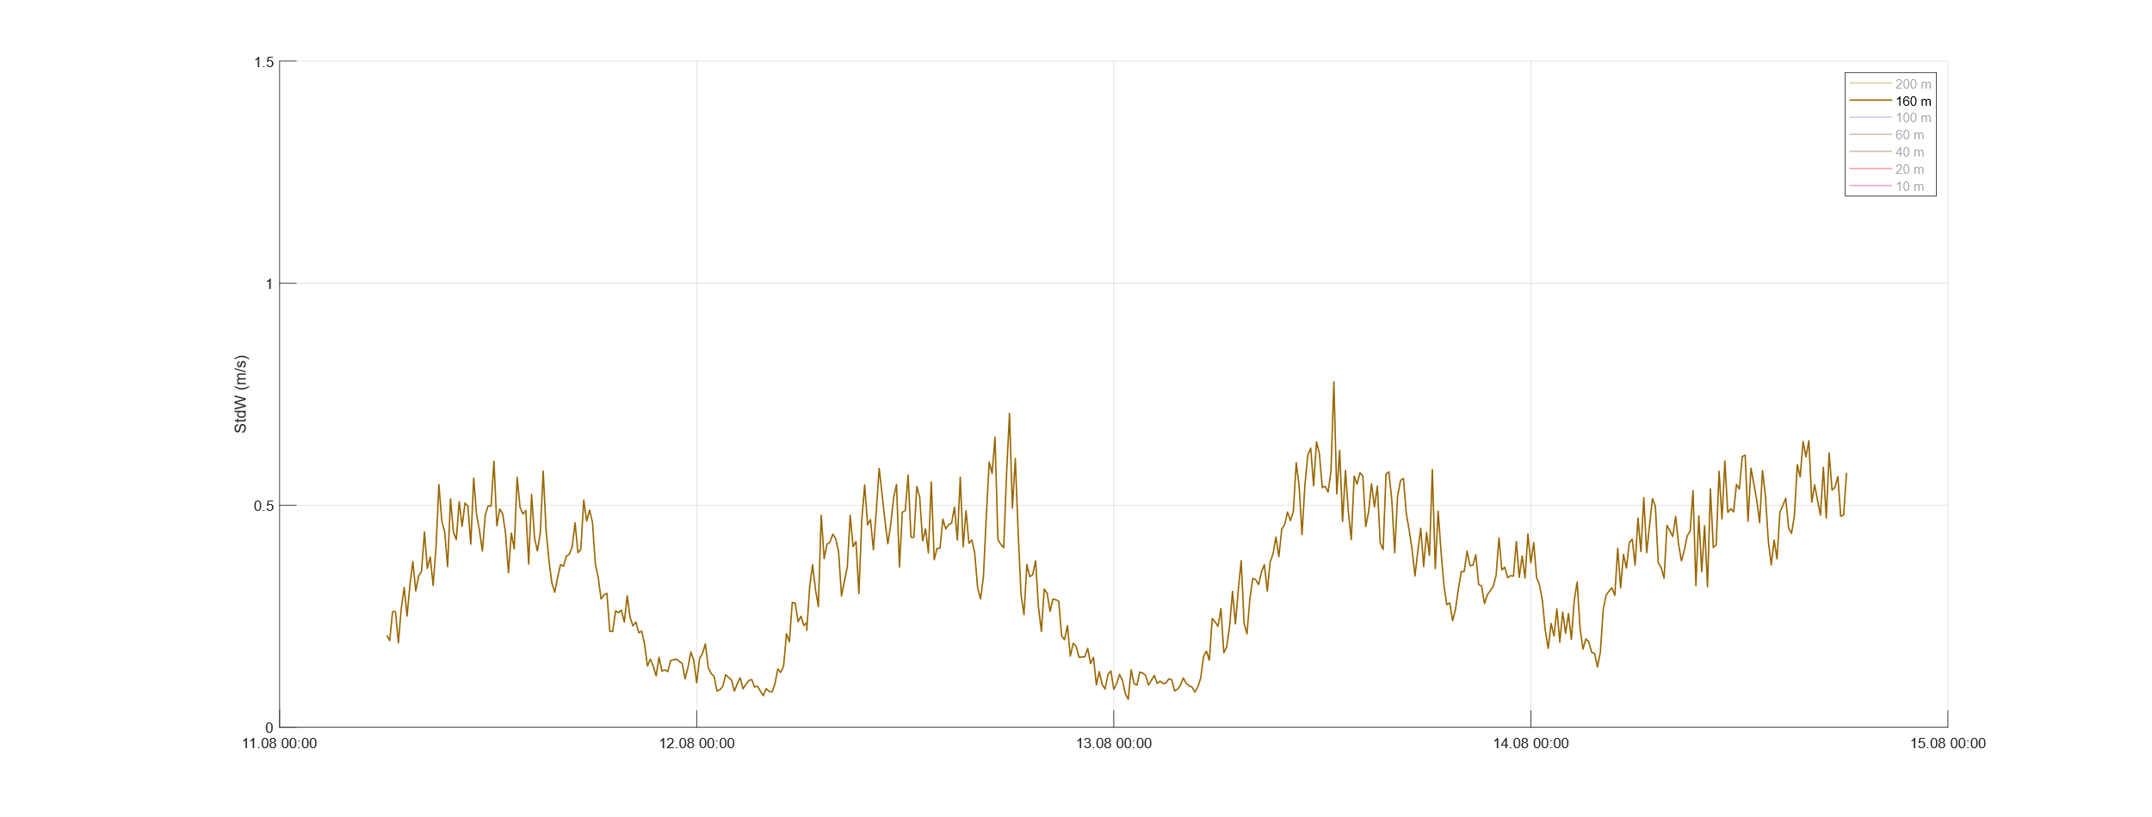
Capability of Wind Ranger XM
Standard deviation of vertical wind, 160 m

Slide 28
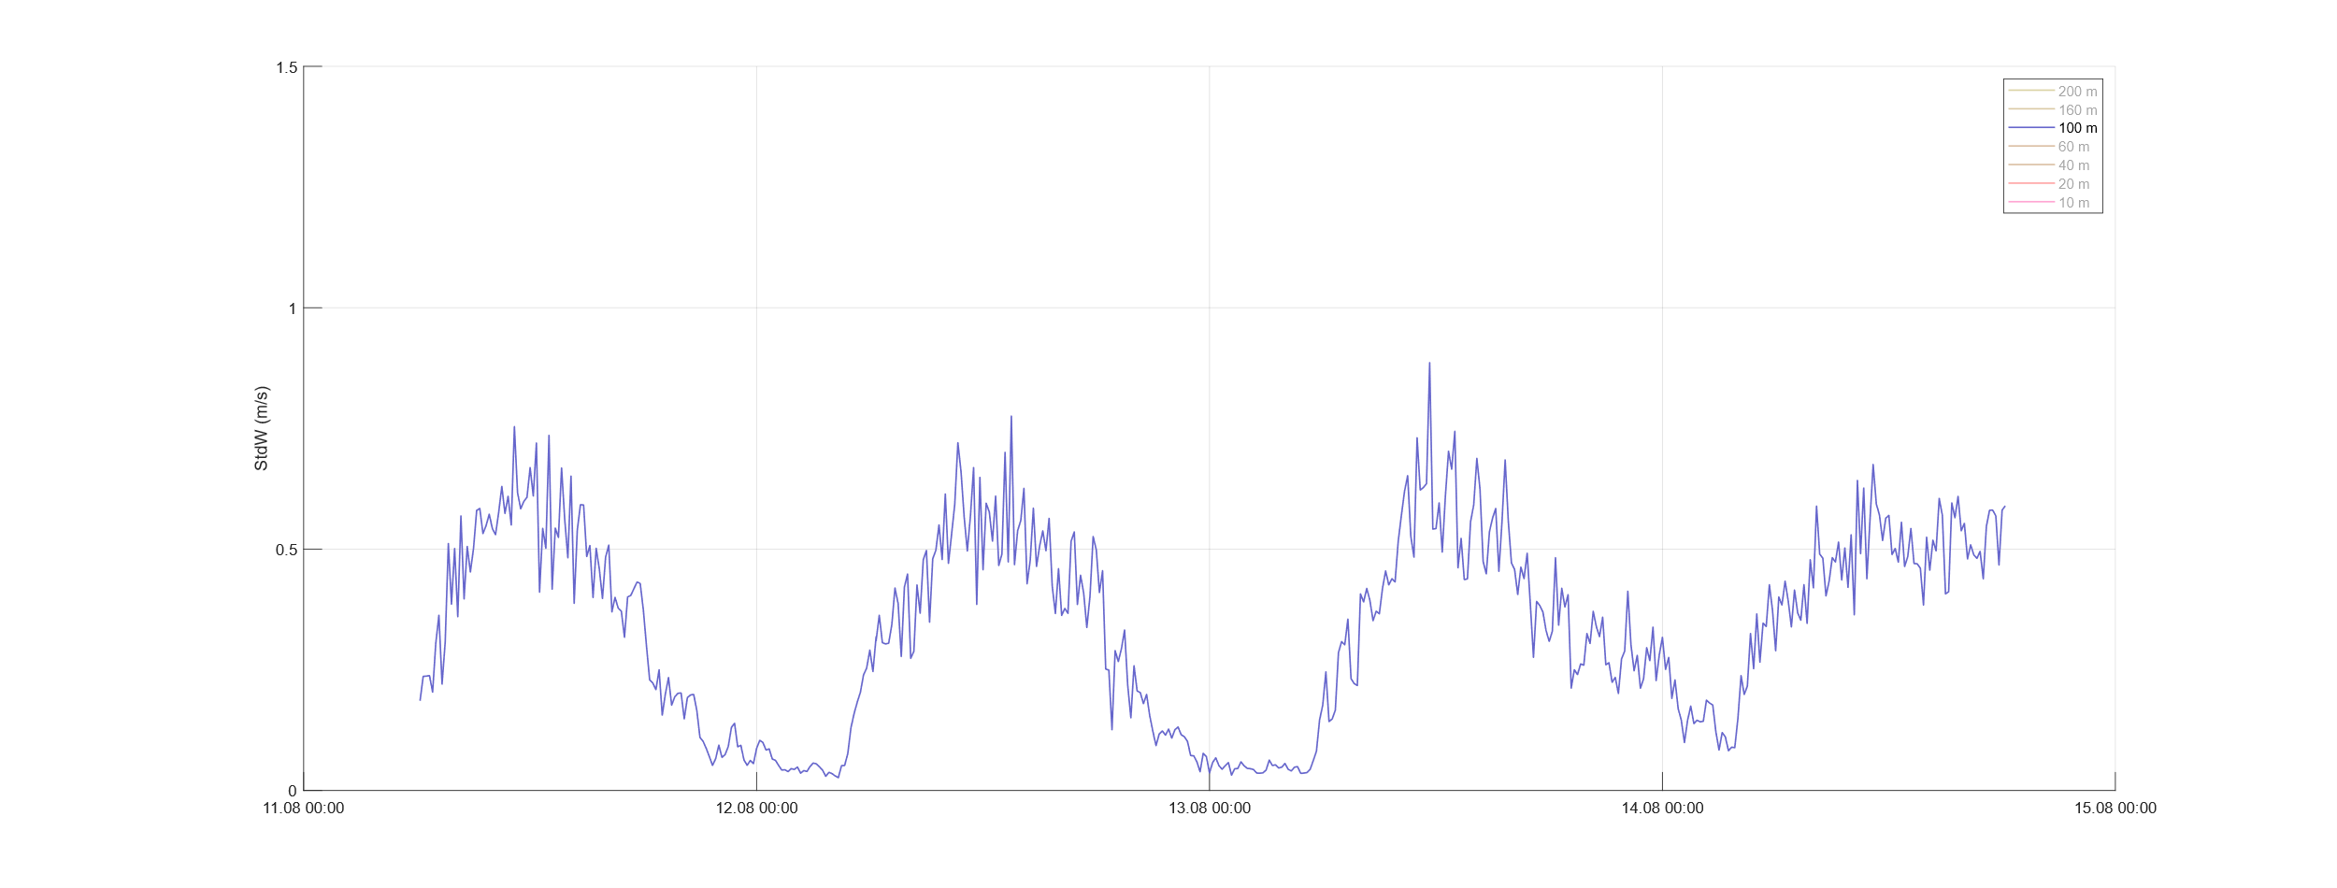
Capability of Wind Ranger XM
Standard deviation of vertical wind, 100 m

Slide 29
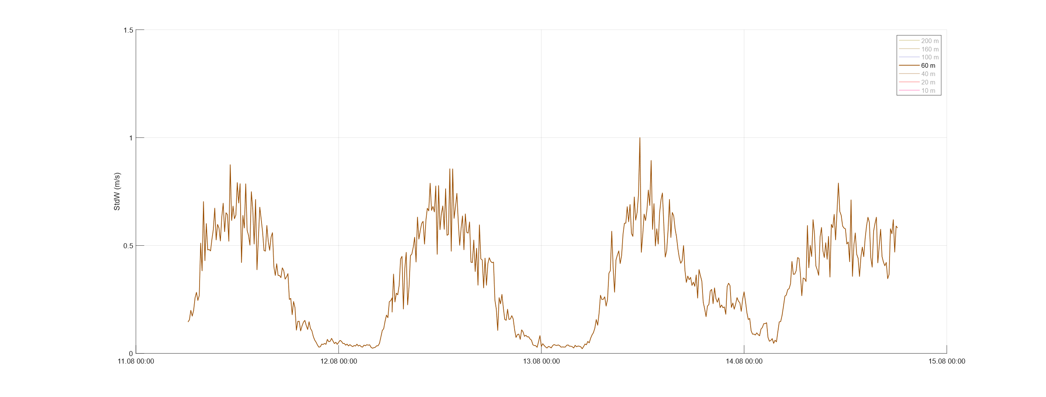
Capability of Wind Ranger XM
Standard deviation of vertical wind, 60 m

Slide 30
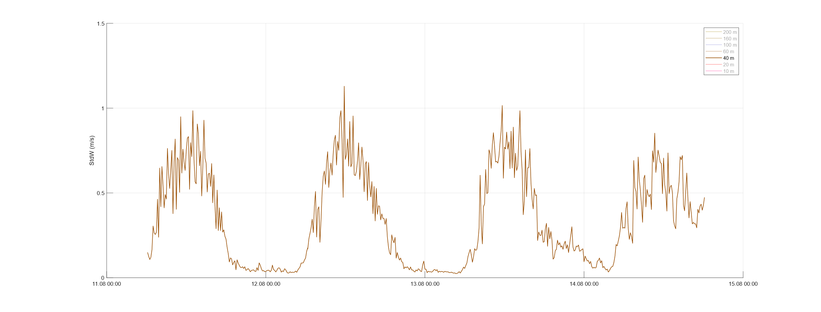
Capability of Wind Ranger XM
Standard deviation of vertical wind, 40 m

Slide 31
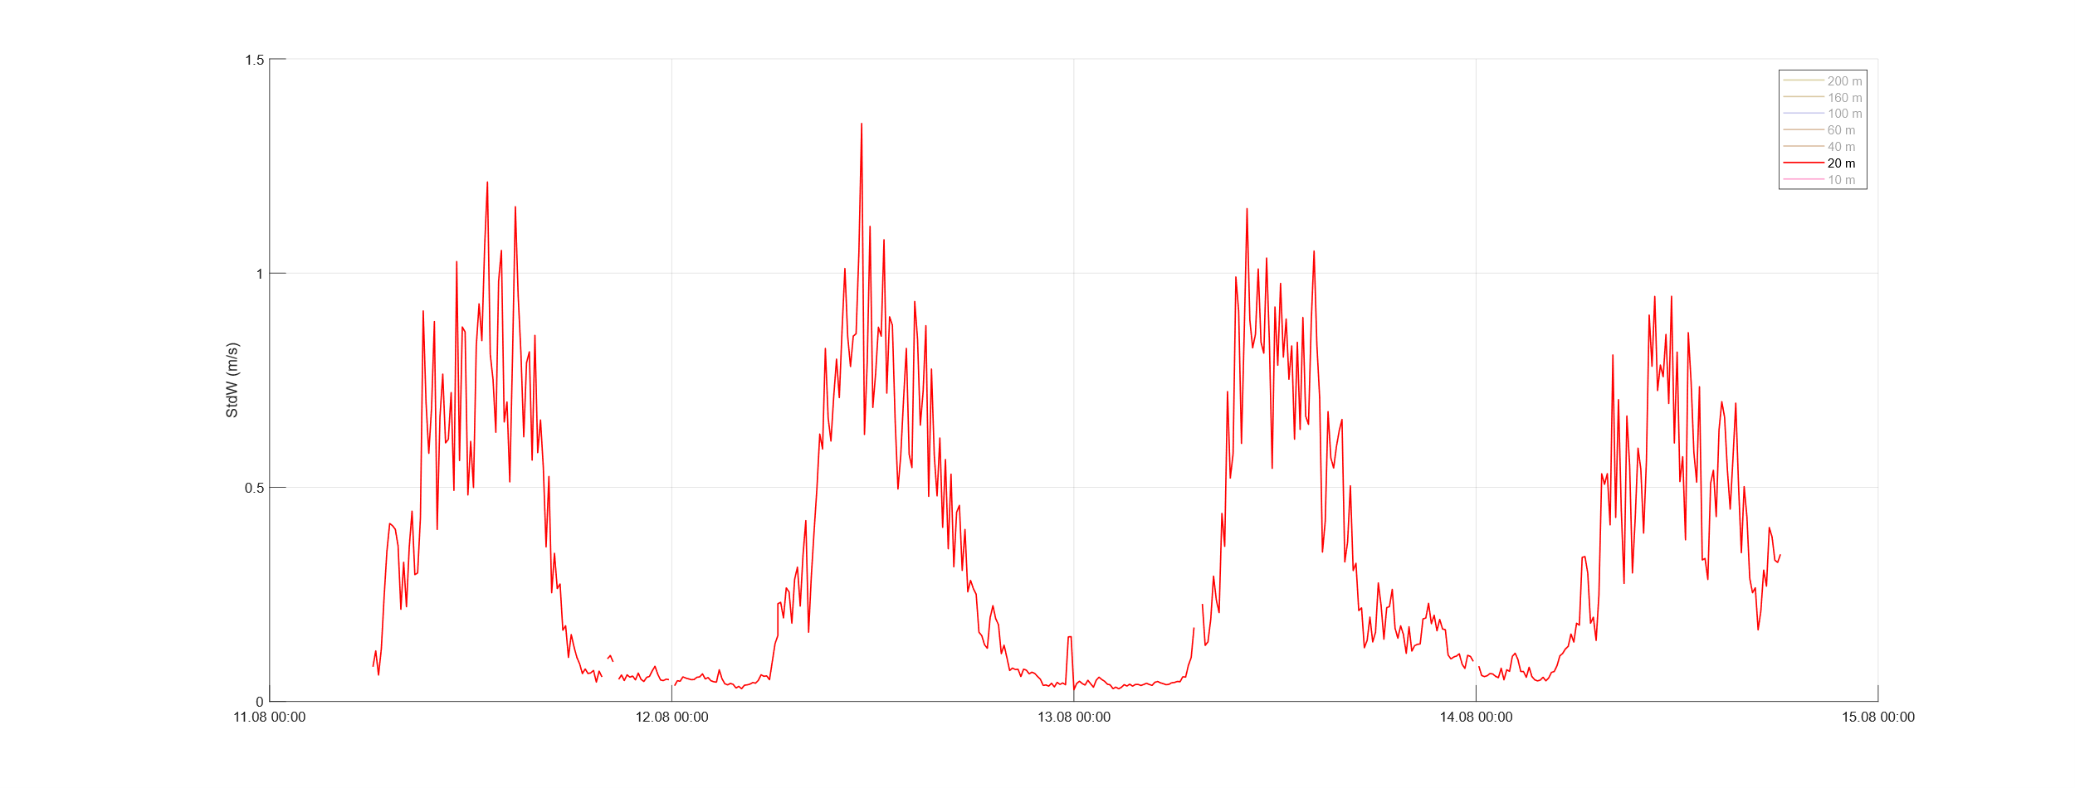
Capability of Wind Ranger XM
Standard deviation of vertical wind, 20 m

Slide 32
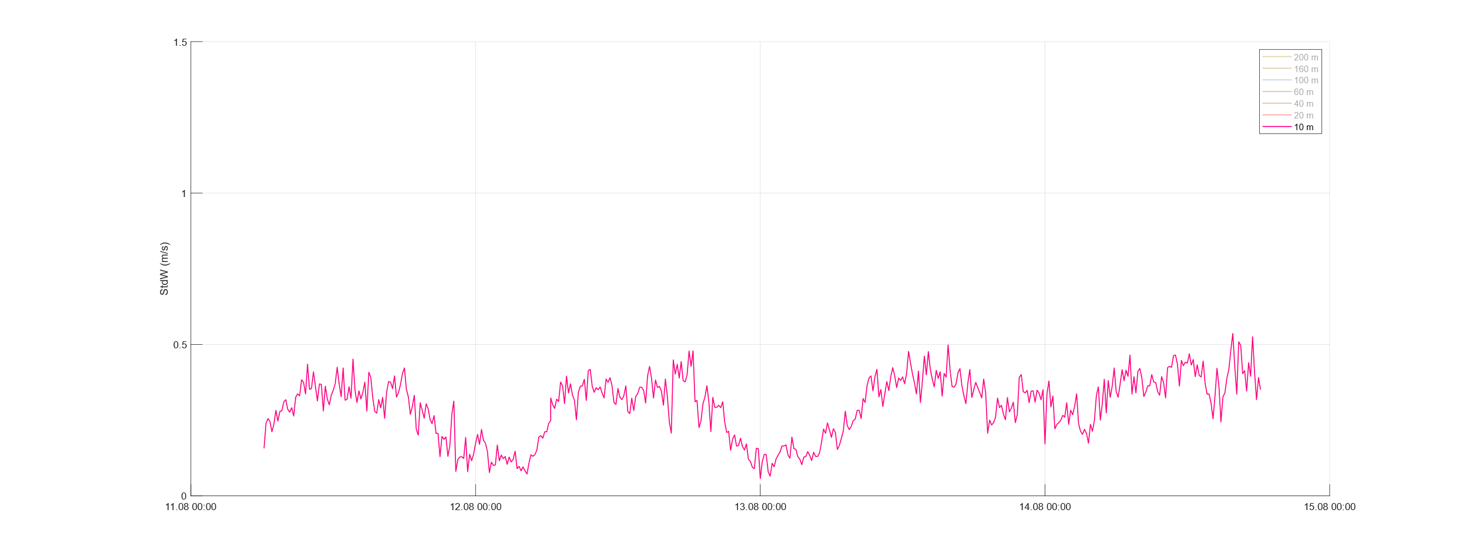
Capability of Wind Ranger XM
Standard deviation of vertical wind, 10 m
Decrease in 10 m height because measuring site is surrounded by 10 m high buildíngs !

Slide 33
Conclusions and Outlook
Compact and light weight Lidar systems can combine low range/ long range measurements
Fine resolution in low ranges, 8 cm in 10 m height
Lowest heights down to 10 m
In long range mode (100 m pulse length) measurements covering the upper limit of observed PBL are possible
Turbulence measurements look quite promising for WR 100/200, WR XM still open
Monitoring the „whole“ PBL in good weather conditions seems feasible
Verifications with masts and short range/long range lidars are next topics

Slide 34
Thank you for your attention

