Slide 1

Large-eddy Simulation of Surface Heterogeneity Induced
Secondary Circulation with Ambient Winds
Lijie Zhang¹, Stefan poll^{1,2}, Stefan kollet ^{1,2,3}
CONTACT: L.ZHANG@FZ-JUELICH.DE
Institute for Bio- and Geosciences: Agrosphere (IBG-3), Research Centre Jülich, Jülich, Germany
SimDataLab Terrestrial Systems, Jülich Supercomputing Centre (JSC), Jülich, Germany
Centre for High-Performance Scientific Computing in Terrestrial Systems, Geoverbund ABC/J, Jülich, Germany

Slide 2
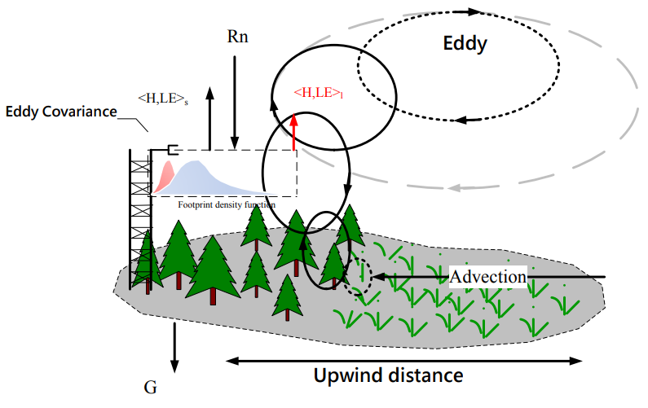
Introduction
Background
Land surface heterogeneity affects the surface energy distribution and induces secondary circulations at a certain scale. (Avissar and Schmidt 1998; Raasch and Harbusch 2001)
Ambient wind may influence the formation of secondary circulation. (Lee et al., 2019)
Transport by the secondary circulations can lead to an underestimation of energy fluxes by 10%-30% as measured by Eddy-Covariance, and leading to the energy balance closure problem. (Mauder et al.2020; Wanner et al.2022)
Sketch of the generation of secondary circulation (Chen 2012; Mauder et al., 2007; Foken, 2008; Foken et al., 2010)

Slide 3
Methodology
Simulation Setups
Coupled ICON-LES and TERRA-ML.
The model domain consists of 96 x 96 x 84 pixels with
the size of 50 m X 50 m X 50m.
The simulation last 24 hours with constant incoming radiation of
700 W/m².
Cross River (CR)
Mixed wind (CR+PR)
Table 1. Ambient winds setting
Parallel River (PR)
Simulations | PR wind speed (m/s) | CR wind speed (m/s)
Reference simulation (No-wind condition) | PR=0 | CR=0
PR wind simulation | PR=0, 0.25, 0.5, 1, 2, 4, 8, 16 | CR=0
CR wind simulation | PR=0 | CR=0, 0.5, 1, 2, 4, 8, 16
Mixed wind simulation | PR=CR= 0.35, 0.70, 1.41, 2.83, 5.66, 11.3
PR wind simulation with a fixed minor CR wind | PR = 2, 4, 8 , 16 | CR=0.75
Idealized model setting (Flat river corridor mimicked by continued soil moisture distribution)
Decomposition
We use a scale decomposition scheme to separate the atmospheric variables into ensemble average <f>(z), mesoscale f_{m}(y, z), and the turbulence f’(x,y,z,t).

Slide 4
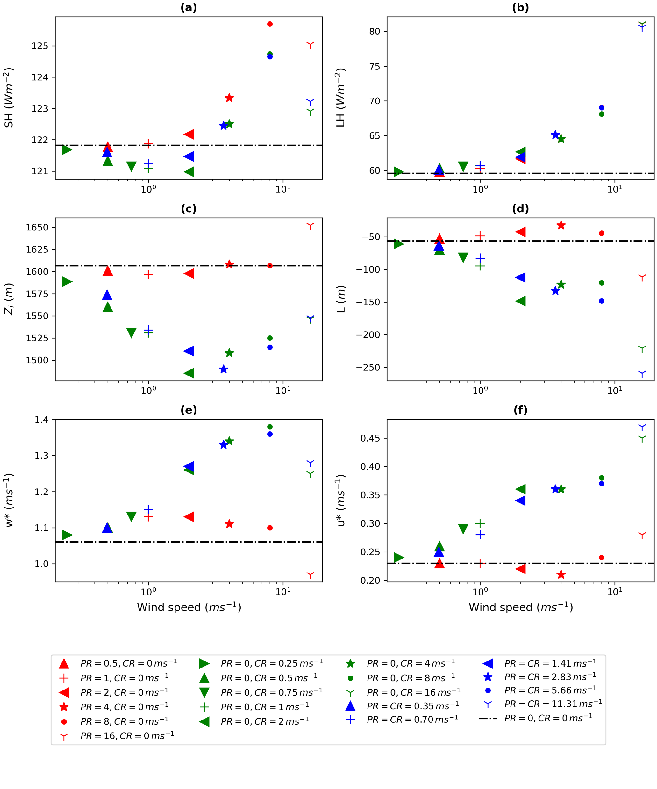
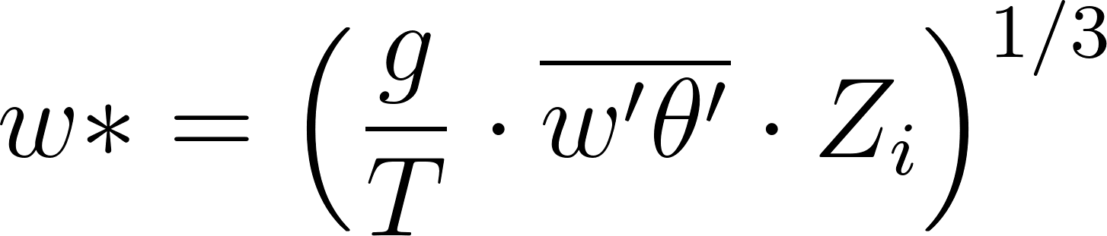
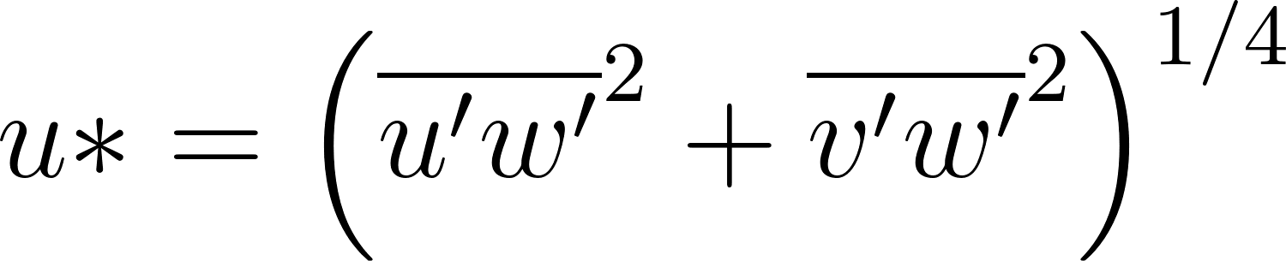
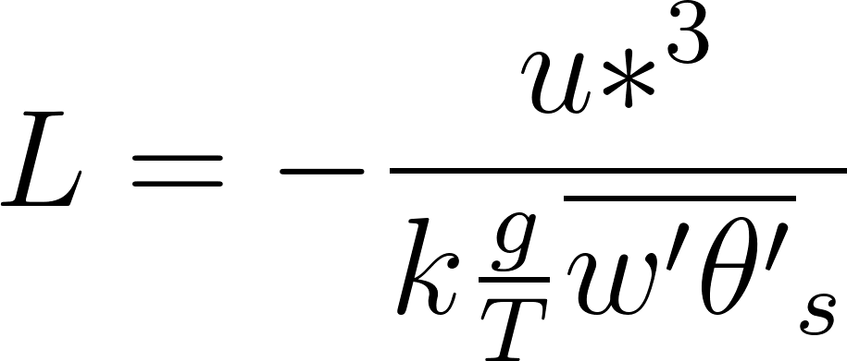
Results
Scaling Parameters
Vertical velocity scale
Friction velocity
Obukhov length
The boundary layer height (Zi) is determined as the height at which the turbulent heat flux has a negative maximum.
Essential bulk properties
Domain-averaged bulk properties for all simulations over the period of 1-12 h. The dot-dashed black line represents the reference simulation (PR = CR = 0 m/s).
The positive value of heat flux indicates the direction from the ground to the overlying atmosphere.

Slide 5
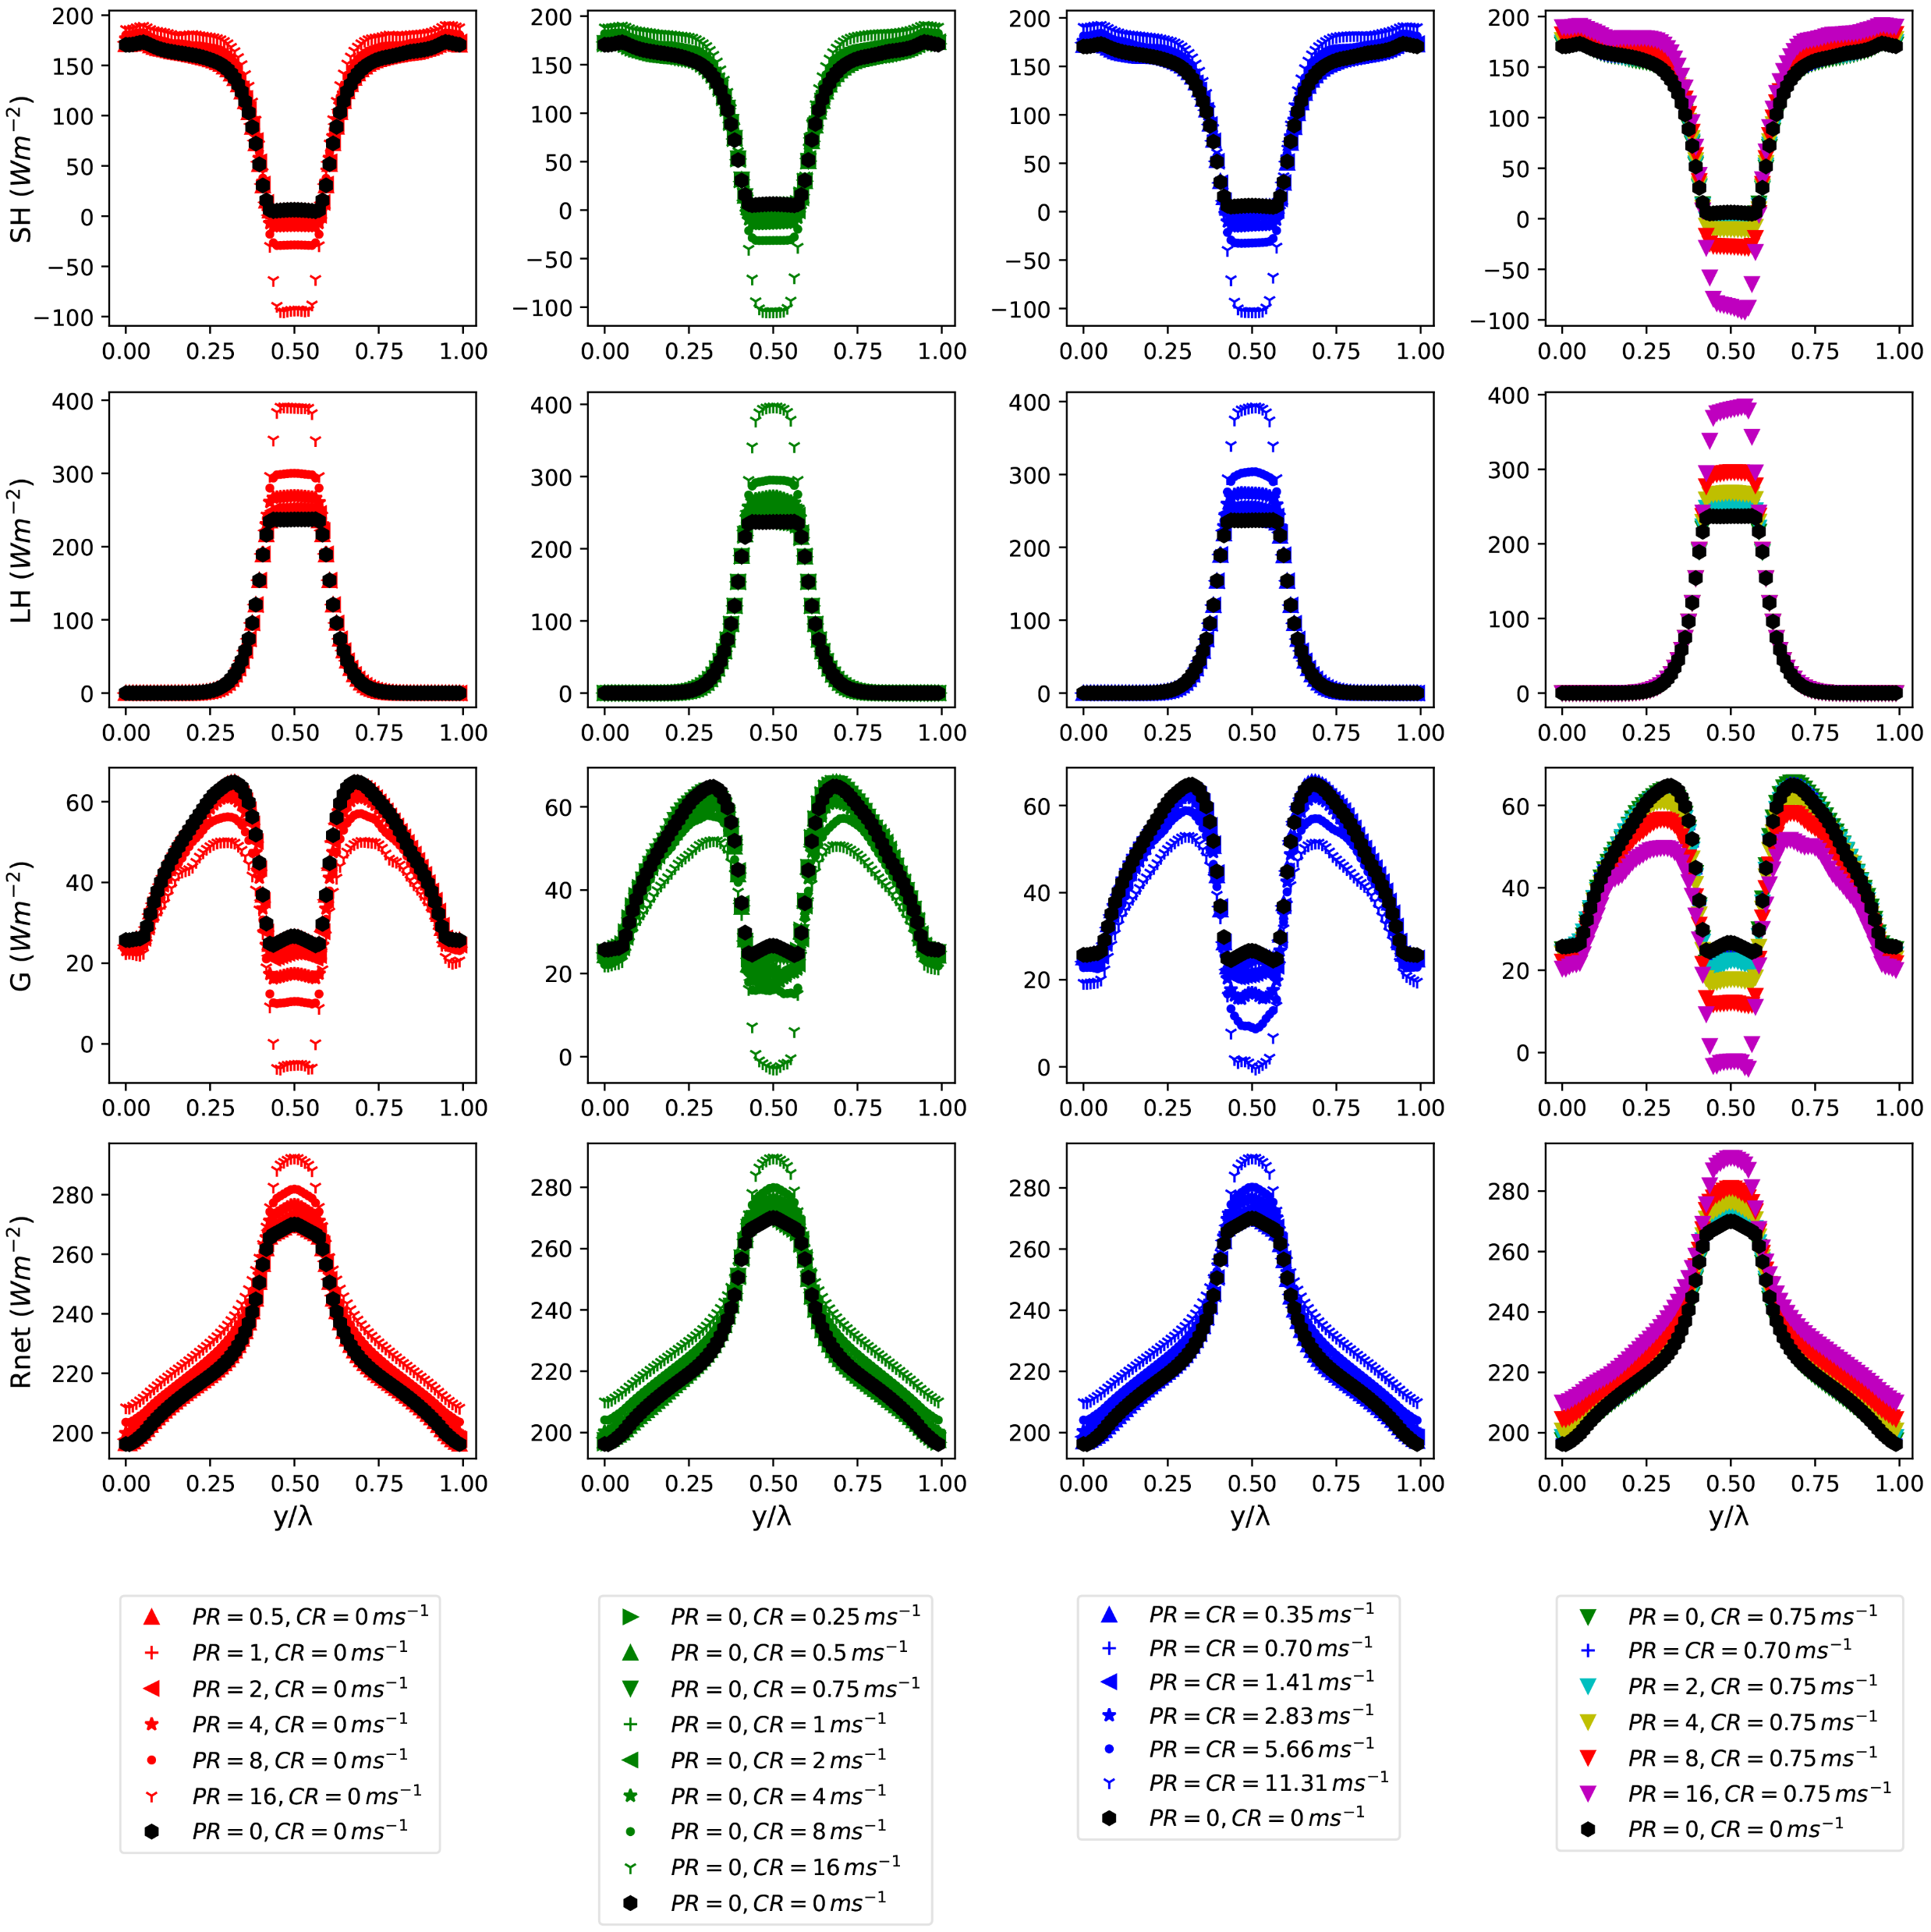
Parallel River wind
(PR)
Cross River wind
(CR)
Mixed wind
(CR+PR)
Results
Heat flux distribution
SH
LH
Both SH and LH increase with increasing wind speed, which is more pronounced for LH.
G
Combined wind speed and soil moisture dominate the energy distribution independent of the wind direction.
Rnet
Cross-river energy flux distribution over 1-12 h

Slide 6
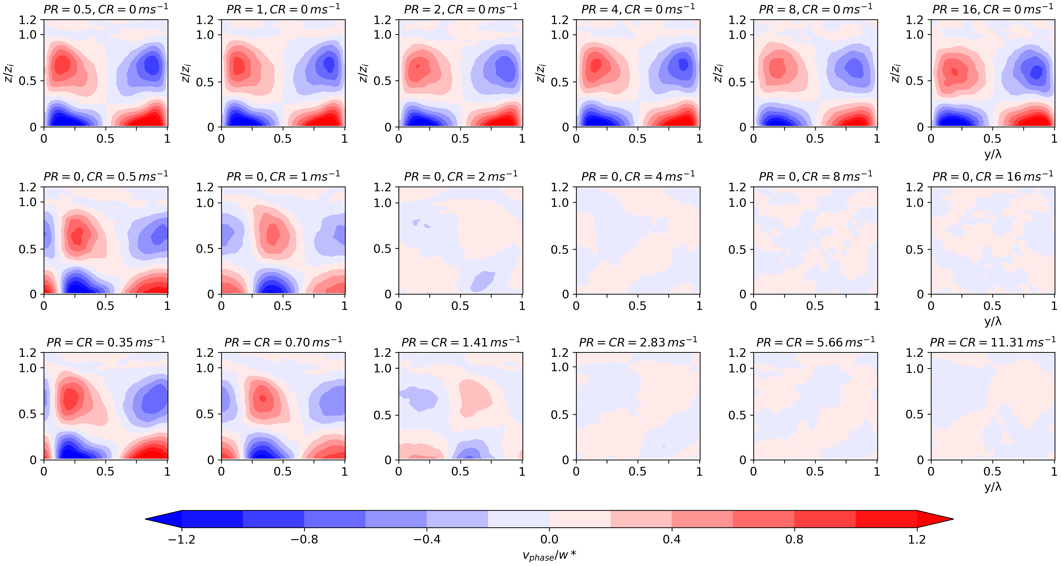
Results
Secondary circulation structure
0.5 m/s
1.0 m/s
2.0 m/s
4.0 m/s
8.0 m/s
16 m/s
Parallel River wind
(PR)
Cross River wind
(CR)
Mixed wind
(CR+PR)
Secondary circulation structure - mesoscale horizontal wind

Slide 7
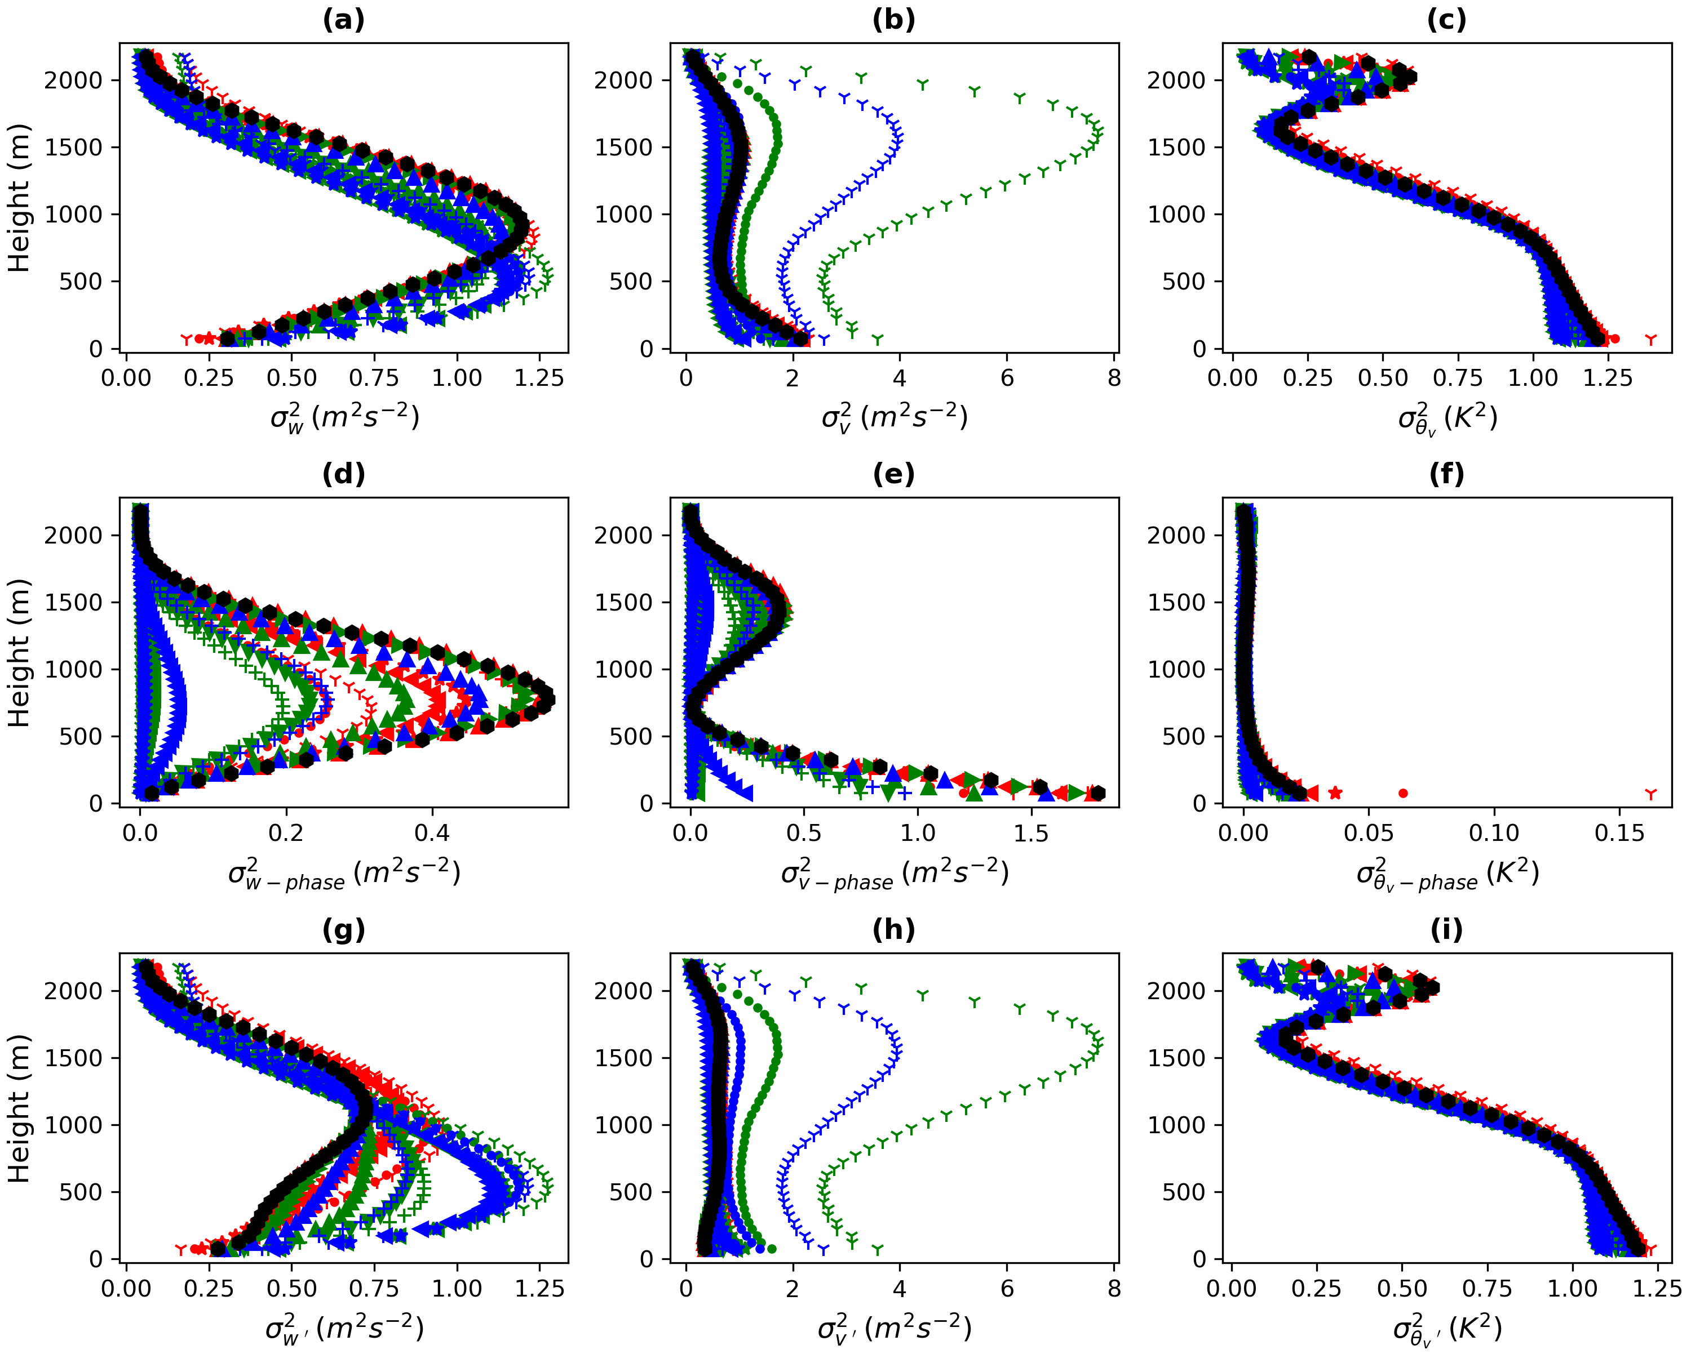
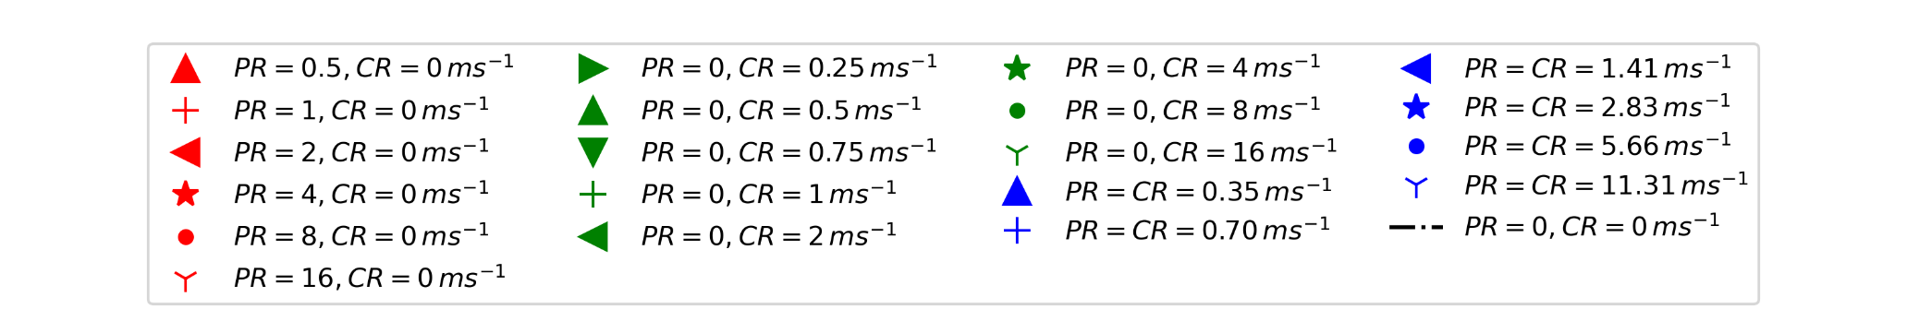
Vertical Wind
Horizontal Wind
Potential temperature
Results
Total
Variance
Vertical Profile
Total vertical and horizontal wind variances are affected under a well-formed secondary circulation conditions.
Mesoscale
Variance
The mesoscale variance of vertical wind represent the secondary circulation strength.
Turbulence
Variance
Ambient wind only slightly affects the profile of potential temperature variance.
Vertical profile of variance over 1-12 h for vertical wind horizontal wind and potential temperature
Notes:
7

Slide 8
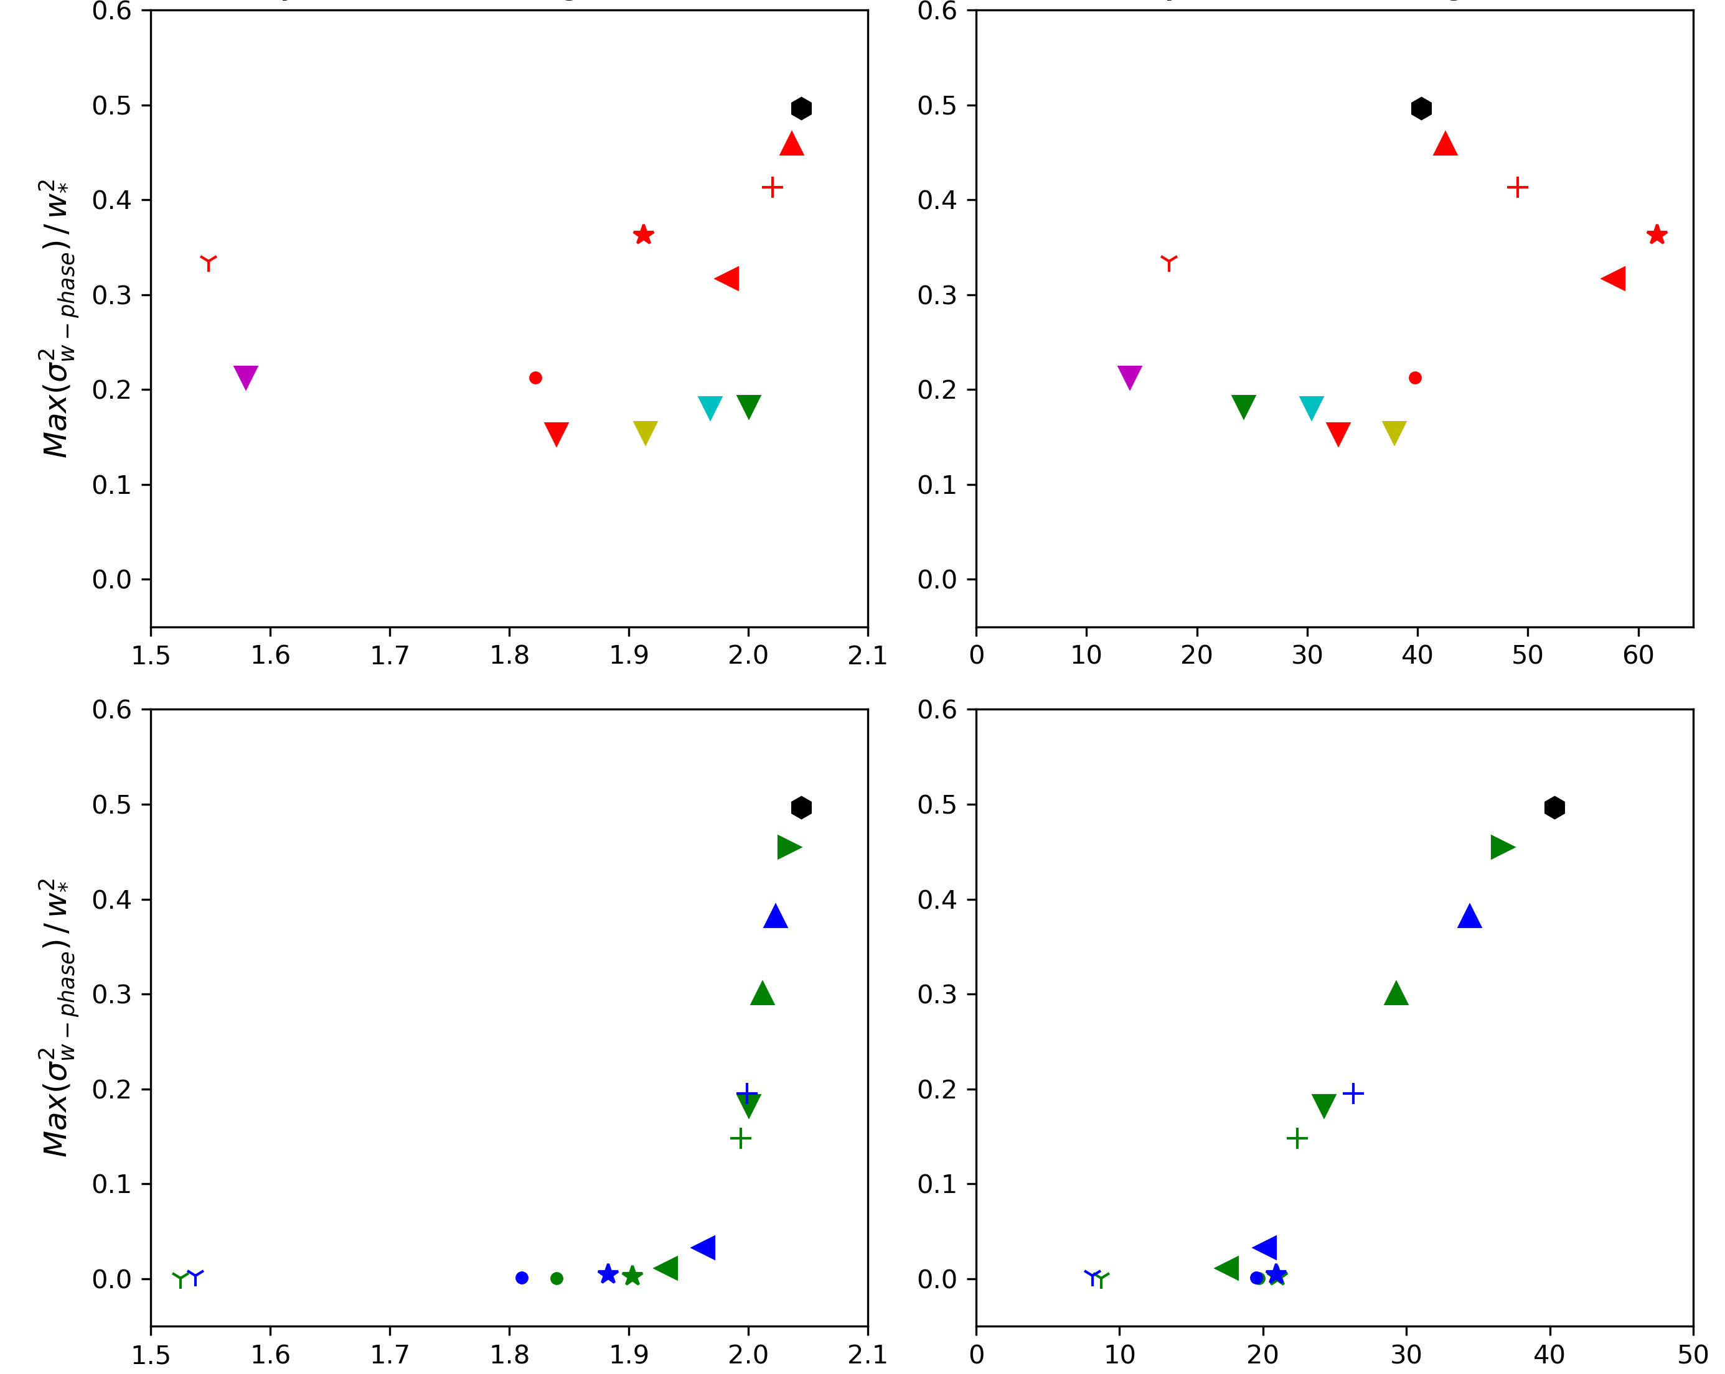
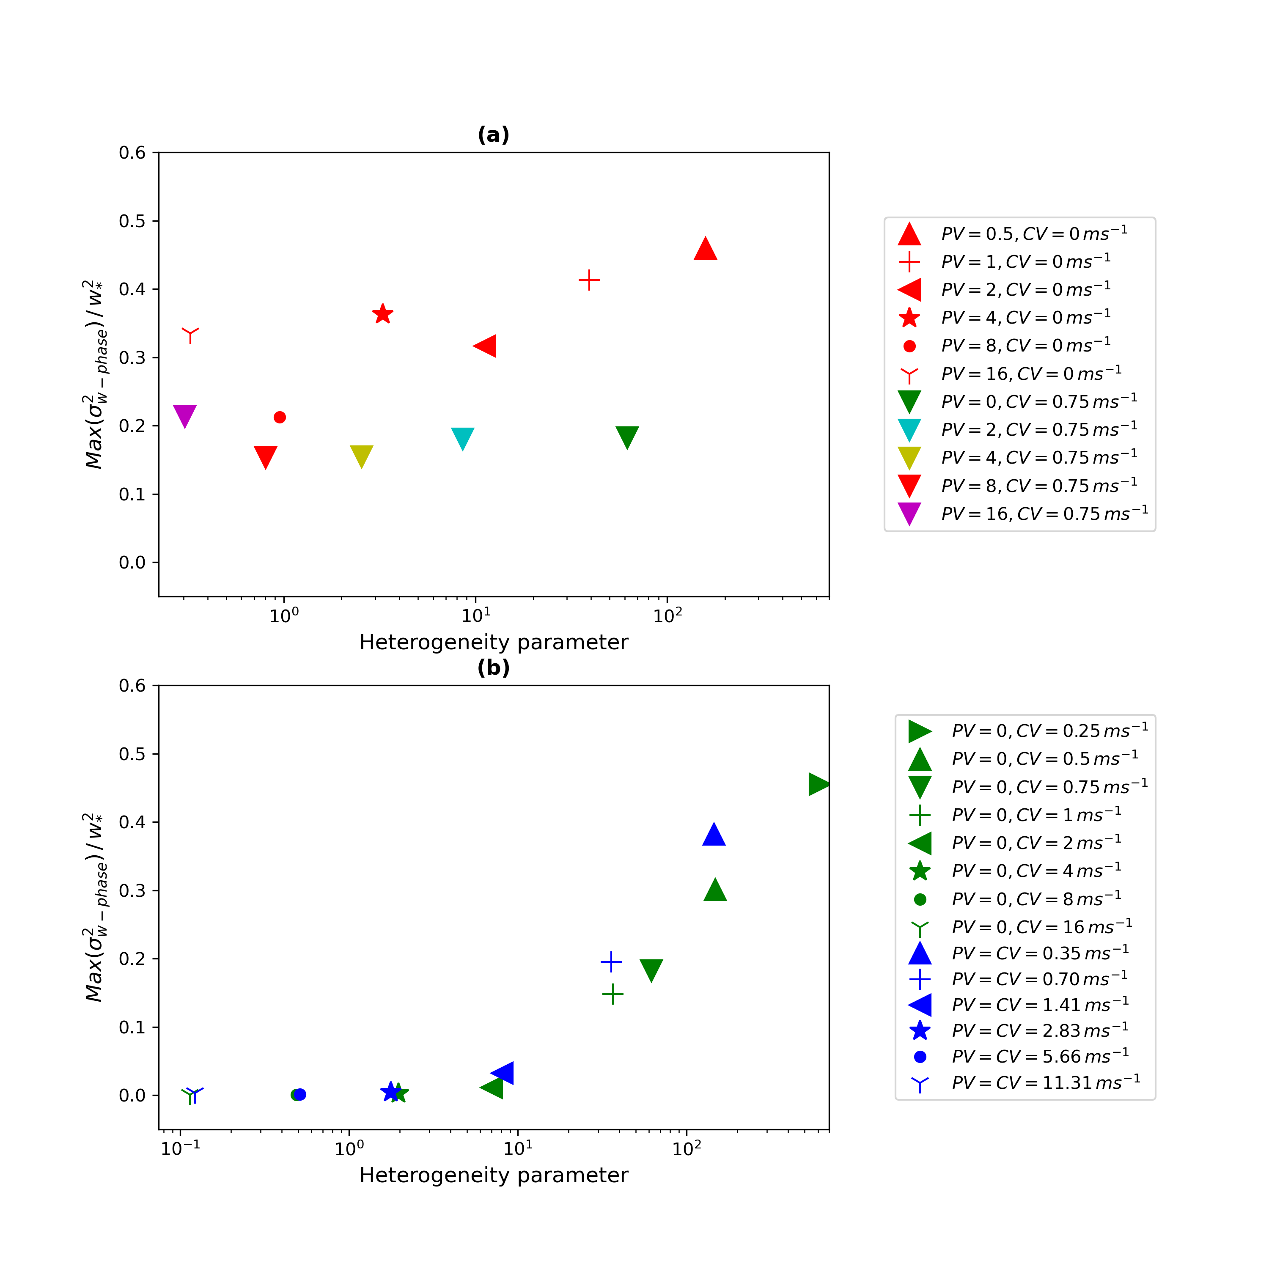
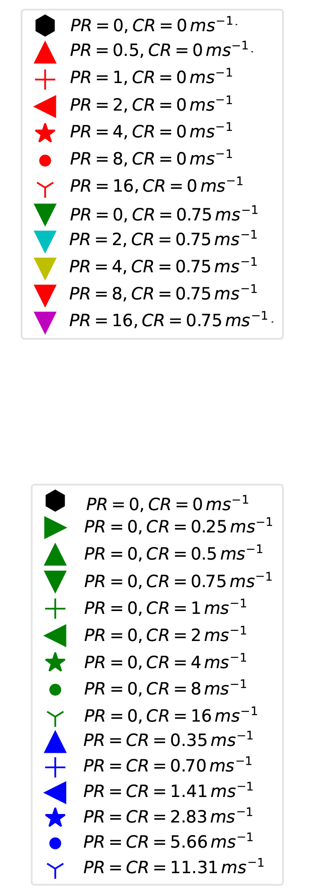
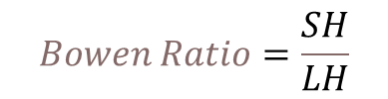
PR wind
Results
Similarity Analysis
No relationship between Bowen Ratio and the PR winds; any dependence comes from the CR winds only.
CR wind + Mixed
Secondary circulation structure vanished when CR > 2 m/s
Positive relationship between secondary circulation and Bowen ratio, –Zi/L under CR winds.
$$Bowen Ratio=\frac{SH}{LH}$$
Bowen Ratio
-Zi/L
Relationship between the secondary circulation strength and (left) Bowen Ratio, (right) Stability parameter (-Zi/L).

Slide 9
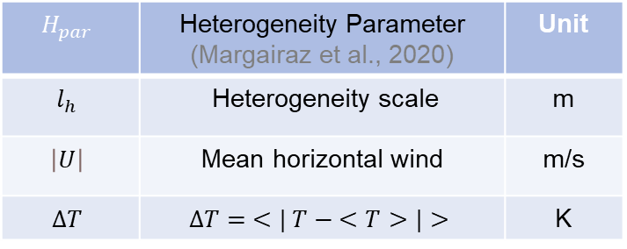
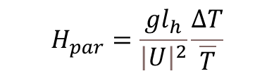
Results
PR wind
Similarity Analysis (Heterogeneity parameter)
$$H_{par}=\frac{gl_{h}}{{\left|U\right|}^{2}}\frac{ΔT}{\overline{T}}$$
CR wind + Mixed
$$H_{par}$$ | Heterogeneity Parameter (Margairaz et al., 2020) | Unit
$$l_{h}$$ | Heterogeneity scale | m
$$\left|U\right|$$ | Mean horizontal wind | m/s
$$ΔT$$ | $$ΔT= <| T − <T>|>$$ | K
Heterogeneity Parameter
Relationship between the secondary circulation strength and Heterogeneity parameter.

Slide 10
Summary and Conclusion
Combined wind speed and soil moisture dominate the energy distribution independent of the wind direction.
Secondary circulation structure persists under the parallel river (PR) wind independent of the wind speed but is destroyed when the cross river (CR) wind is stronger than the mesoscale horizontal wind speed.
Secondary circulation strength positively correlates with the Bowen ratio, Stability parameters (-Zi/L) and Heterogeneity parameter under the cross-river (CR) wind.

Slide 11

Thanks!
Questions and comments?
Contact me: l.zhang@fz-juelich.de

