Slide 1
Spatial structures in atmospheric boundary-layer flow – wind tunnel modeling
EMS Annual Meeting 2022
Klára Jurčáková and Radka Kellnerová
Institute of Thermomechanics of the Czech Academy of Sciences, Prague

Slide 2
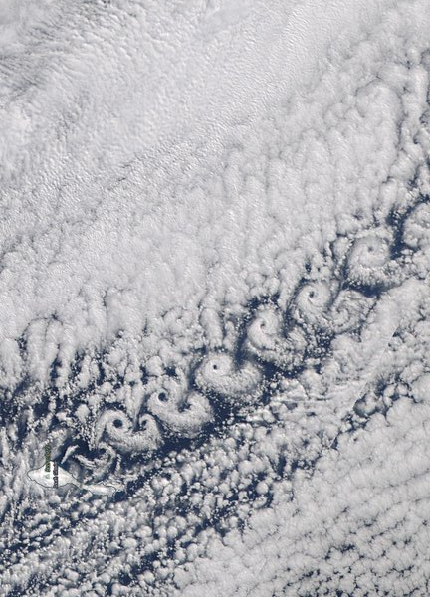
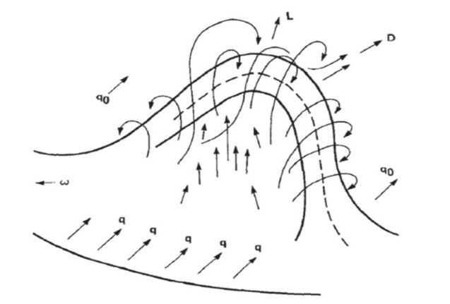
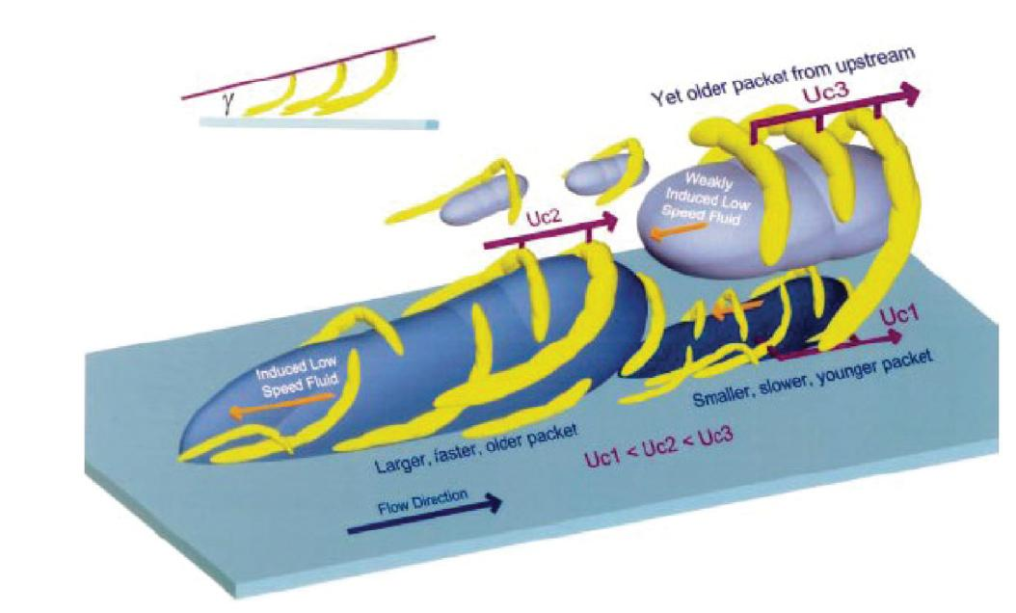
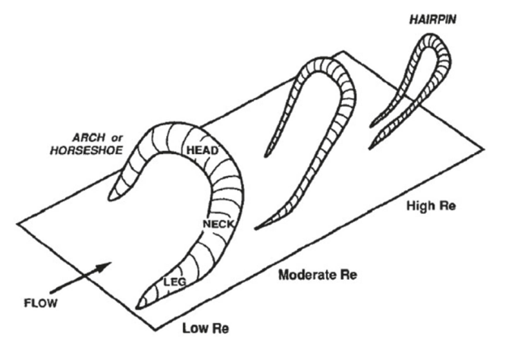
Motivation
Coherent structures = the building-blocks of turbulent ﬂow
What are the characteristics of these building-blocks and how are they organized?
Horseshoe and hairpin vortices
Adrian RJ, Meinhart CD and Tomkins CD. 2000. Vortex organisation in the outer region of the turbulent boundary layer. J Fluid Mech 422: 1-54.

Slide 3
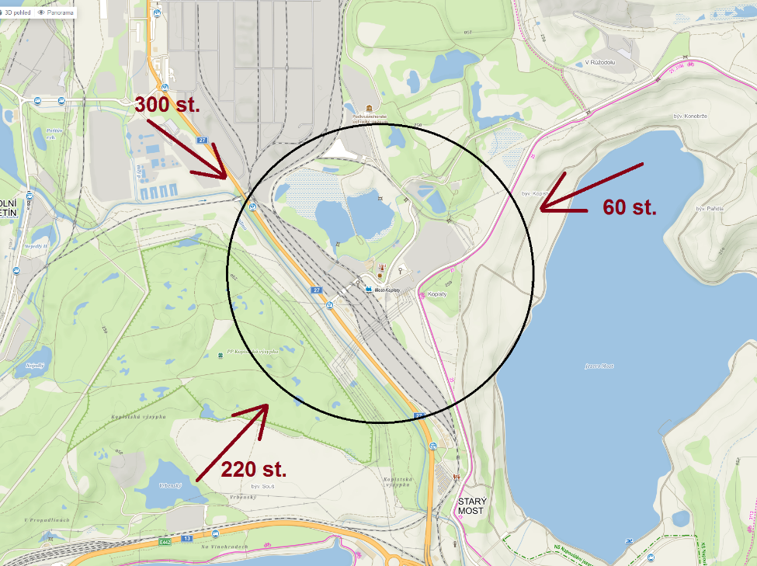
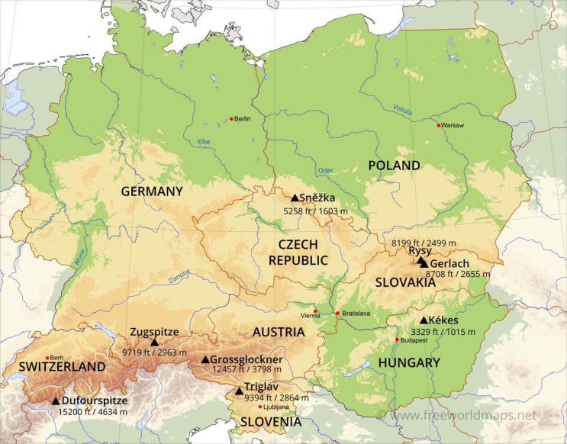
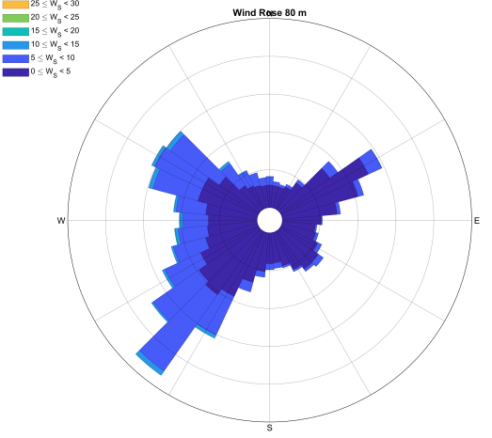
Field site – Kopisty observatory
Industrial area
lake
hilly forested area
Wind rose
at 80 m

Slide 4
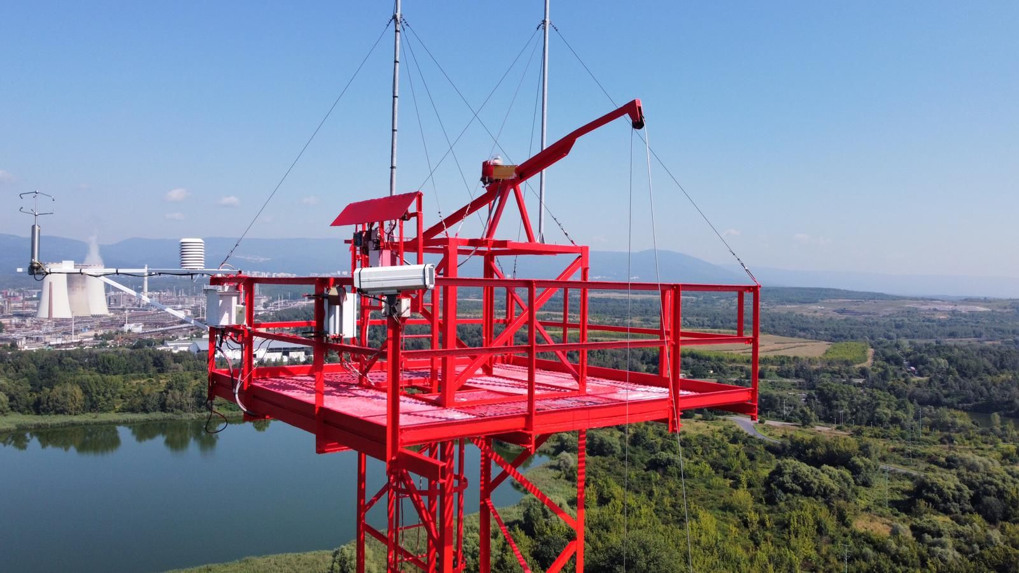
Field site – Kopisty observatory
Meteorological tower
80 m high
Coherent structures in turbulent flow are of interest basic research
3D sonic anemometers
at heights 20, 40, 60, and 80 meters
Operated by the Institute of Atmospheric Physics of the Czech Academy of Sciences

Slide 5
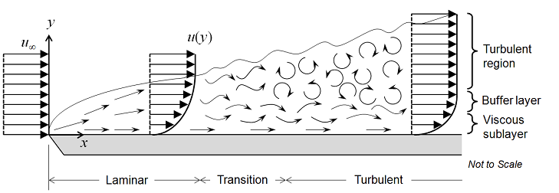
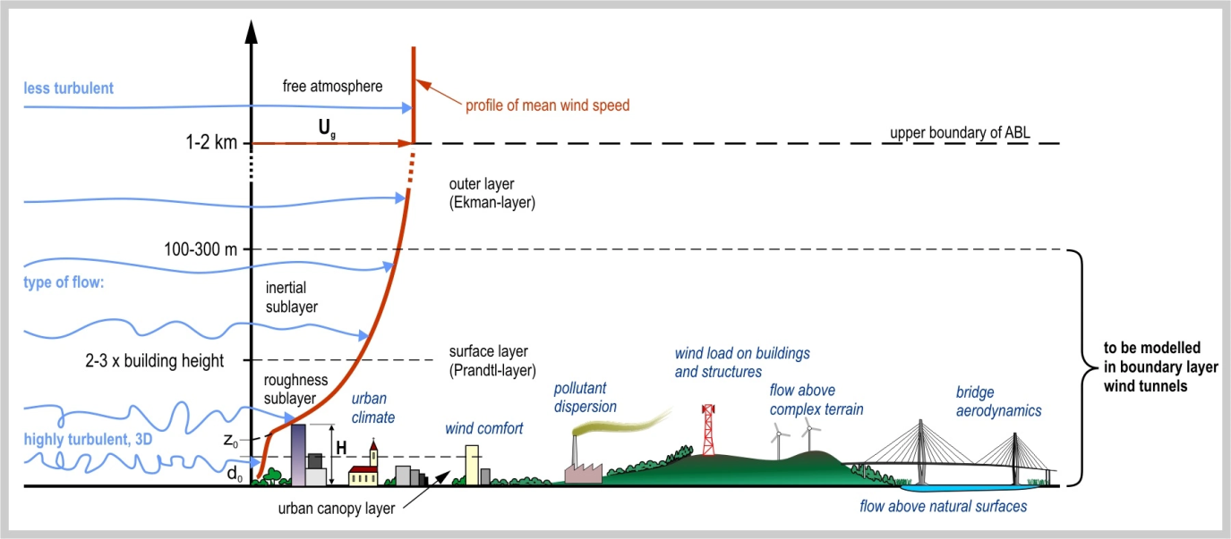
Wind tunnel modelling of ABL
The aerodynamic boundary layer was first defined by Ludwig Prandtl in 1904.
Theory of turbulence, thermal effects, similarity theories
ABL is a special case of aerodynamic boundary layer.
Turbulence self-similarity, similarity numbers – Reynolds number
Outer scales are limited by the wind-tunnel dimensions, inner scales are limited by viscous dissipation

Slide 6
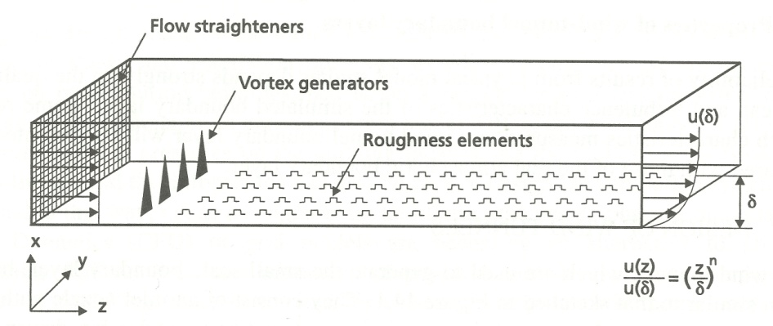
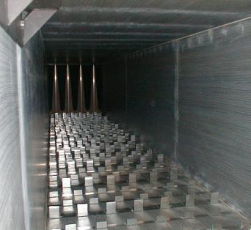
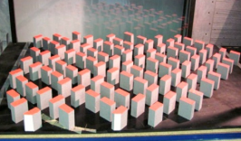
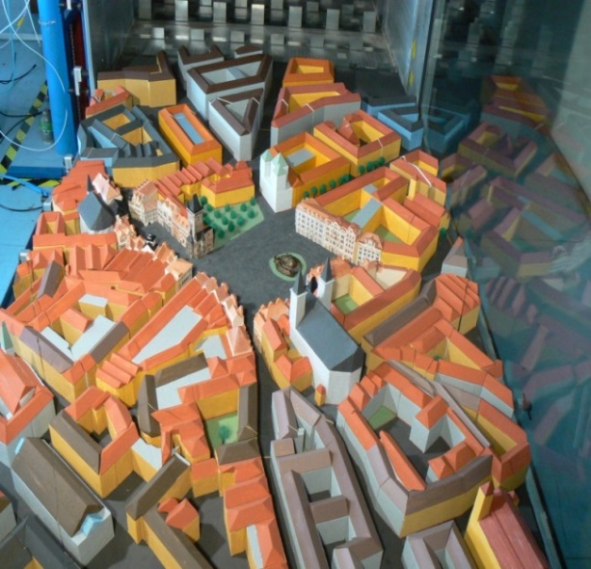
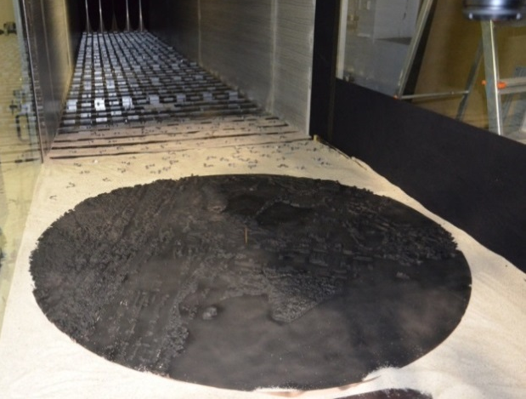
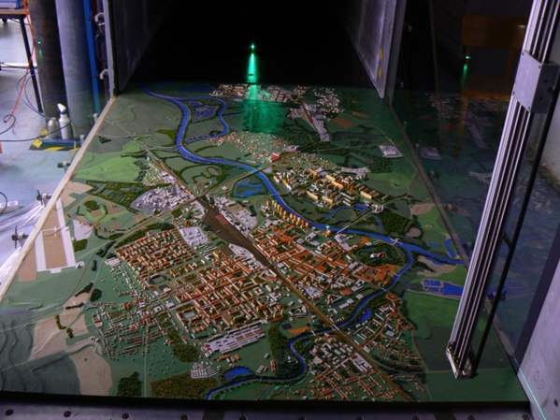
Wind tunnel modelling of ABL
Scaled models (1:100 to 1:1000), time runs faster (100:1 to 1000:1)
Scaled model of ABL in wind tunnel, using vortex generators and roughness
Characteristics as roughness length, intensity of turbulence, integral length scale, power spectra, etc., must match in the given scale.

Slide 7
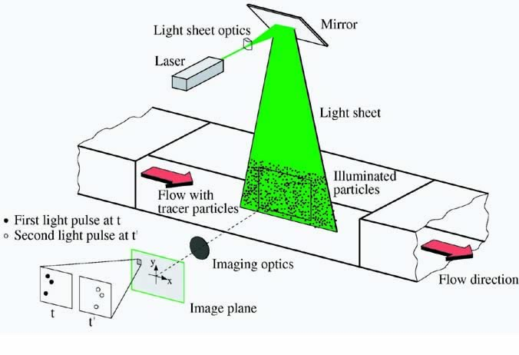
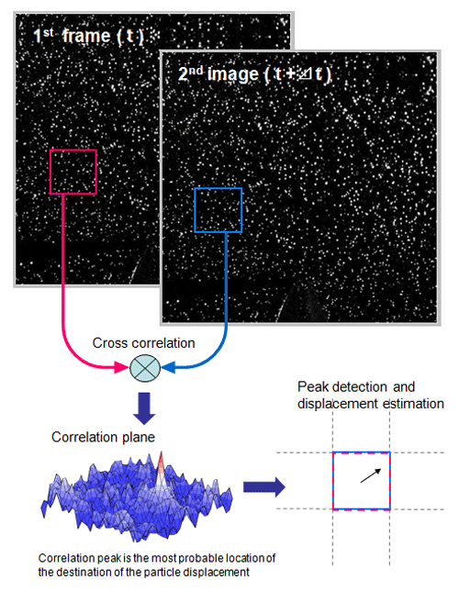
Particle Image Velocimetry - PIV
Correlation of two consecutive images
2 velocity components in 2D plane
Time- resolved PIV – analysis of flow dynamics

Slide 8
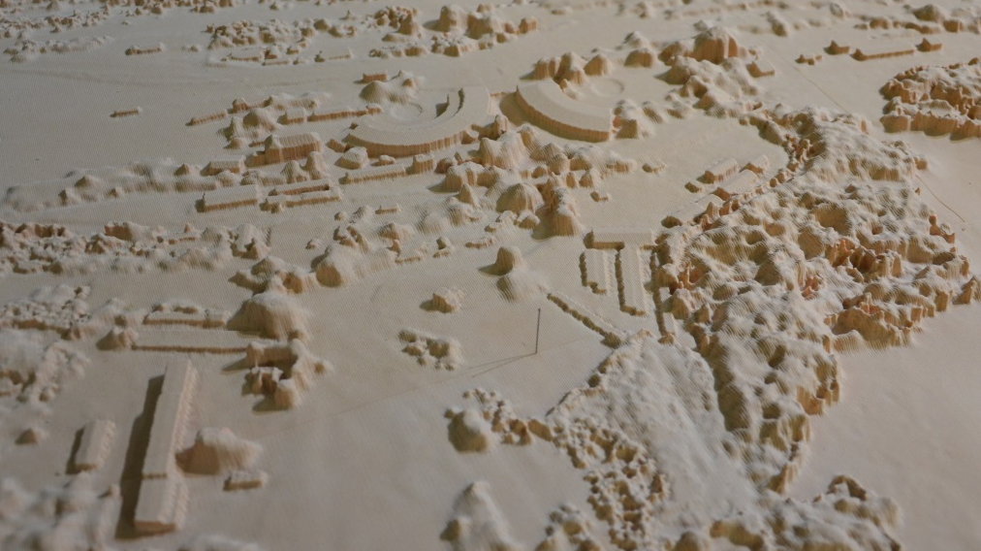
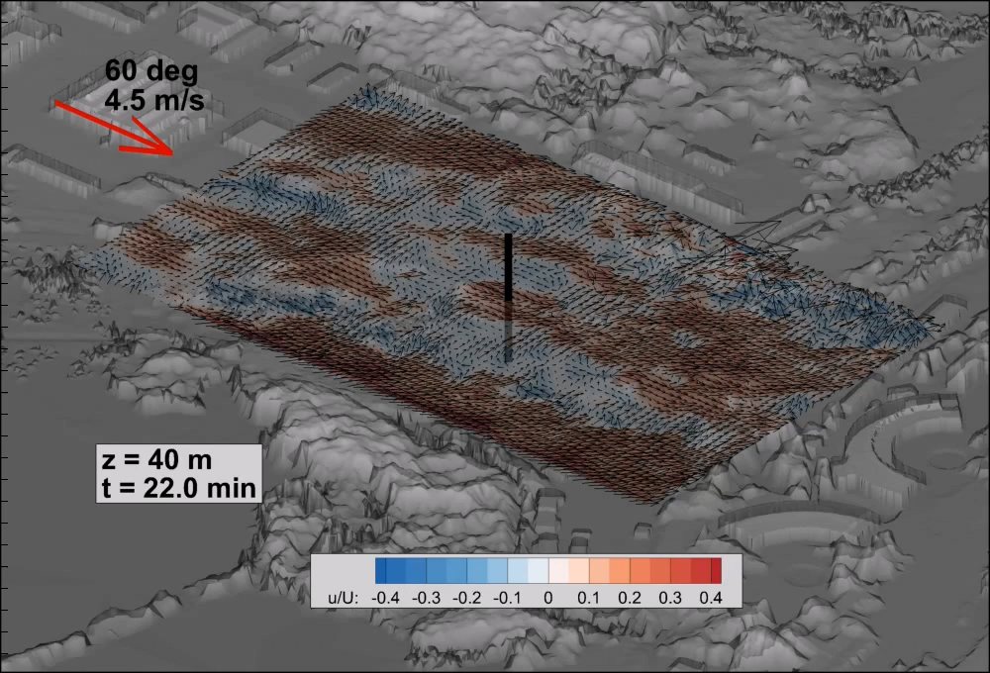
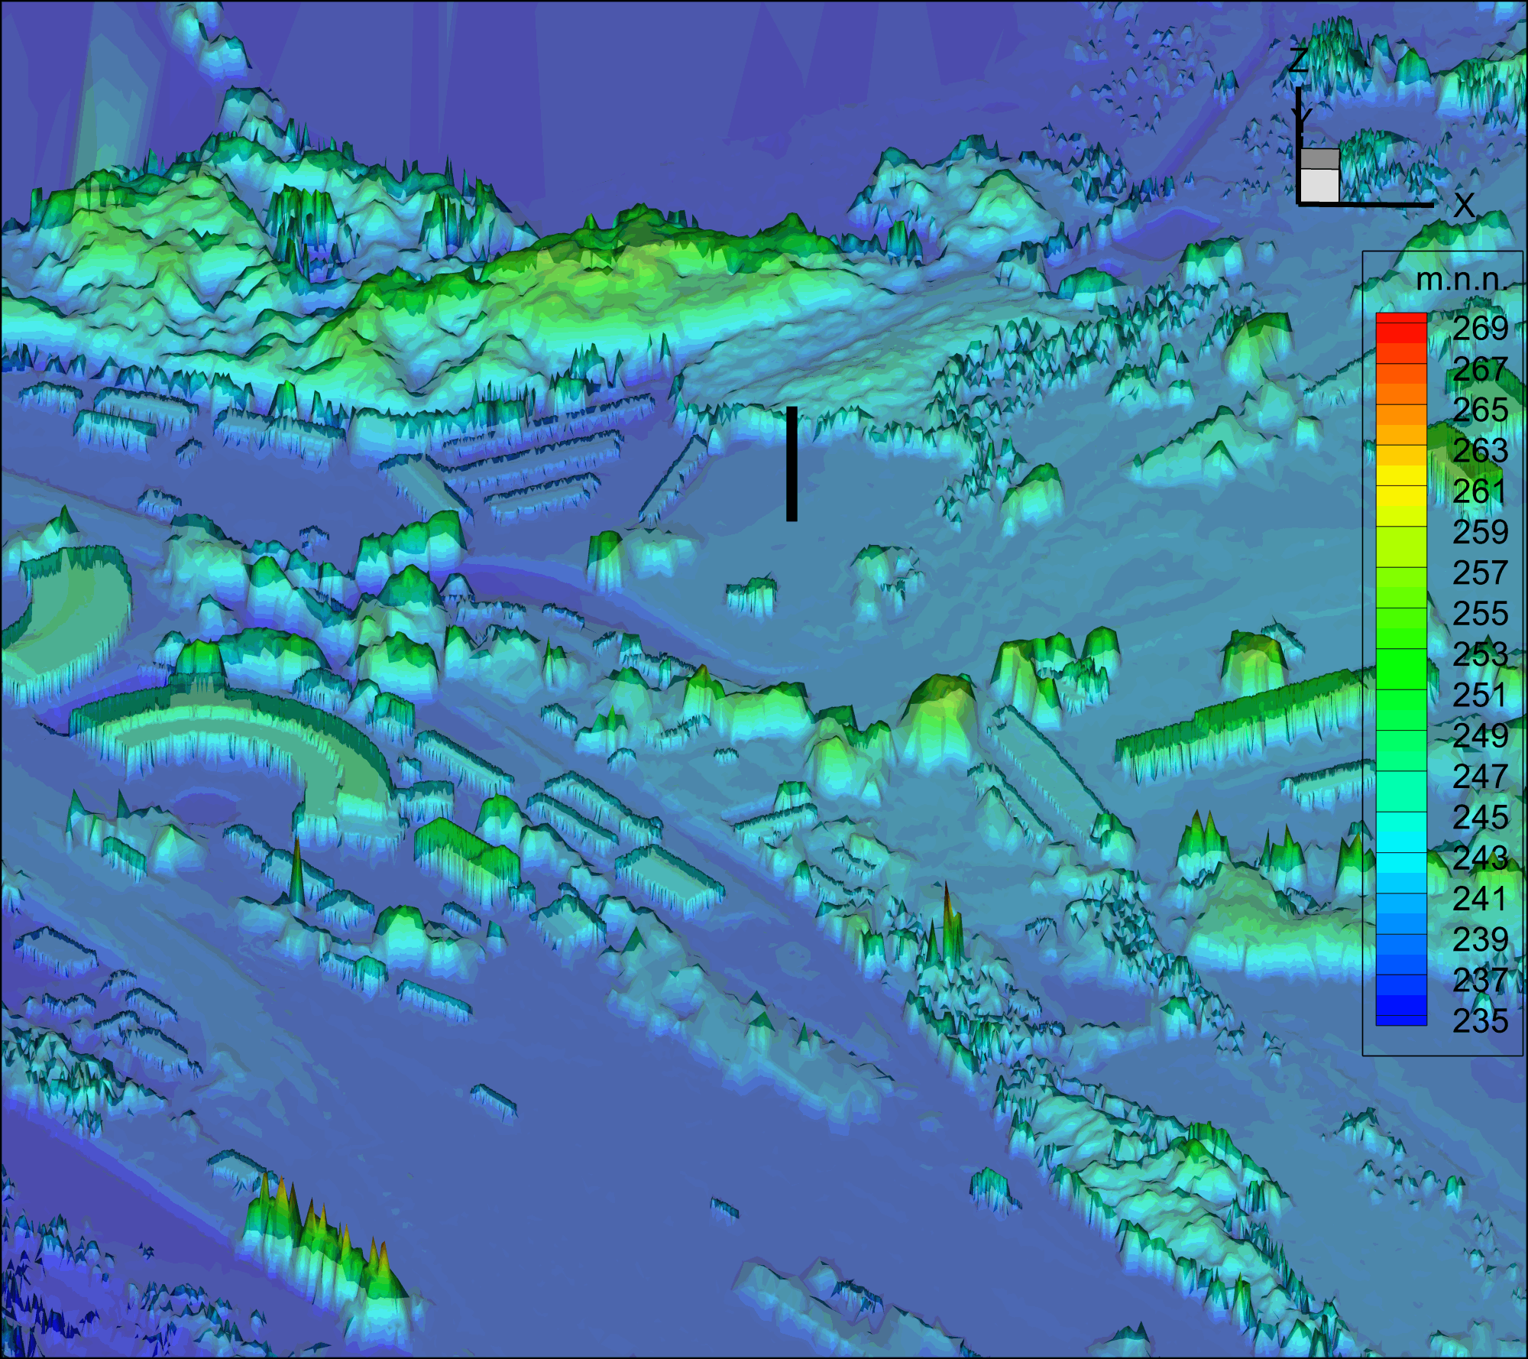
Kopisty Observatory model
Time is rescaled to the full scale
Along-wind velocity fluctuations:
  Blue – low-momentum regions
  Red – high-momentum regions

Slide 9
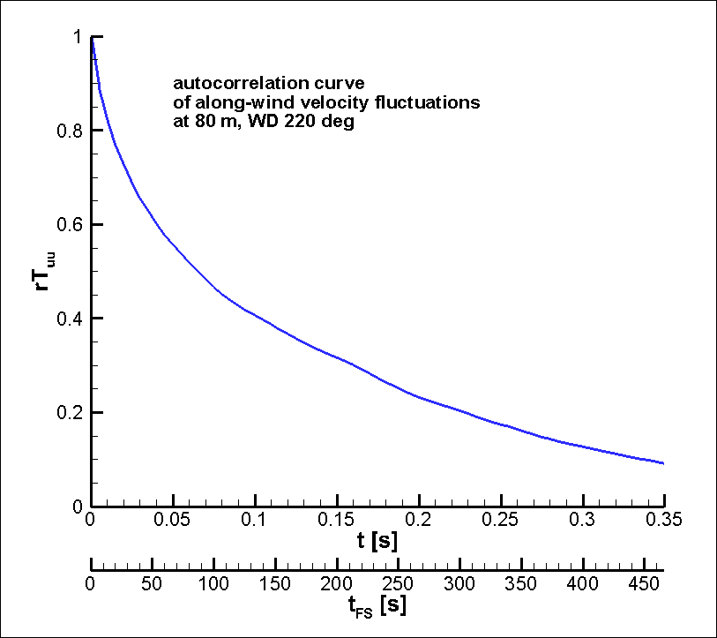
Temporal correlation - autocorrelation
Velocity time series
Autocorrelation function

Slide 10
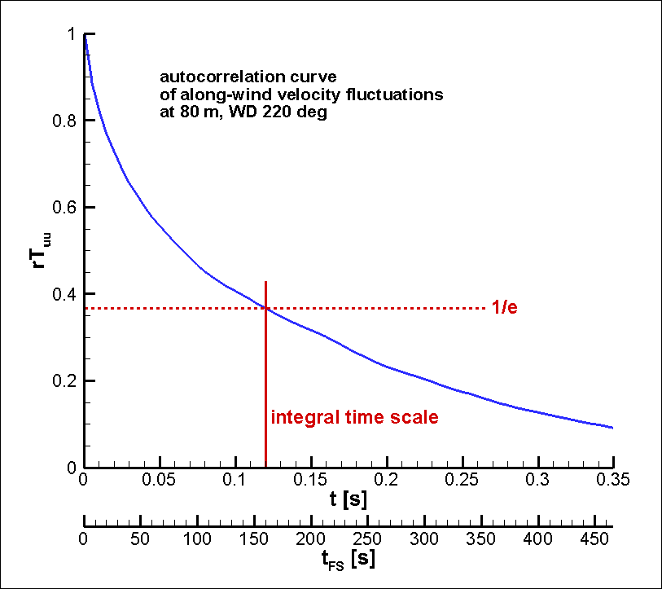
Temporal correlation - autocorrelation
Velocity time series
Autocorrelation function
Integral time scale
Integral length scale
L=t·U
Taylor hypothesis of frozen turbulence

Slide 11
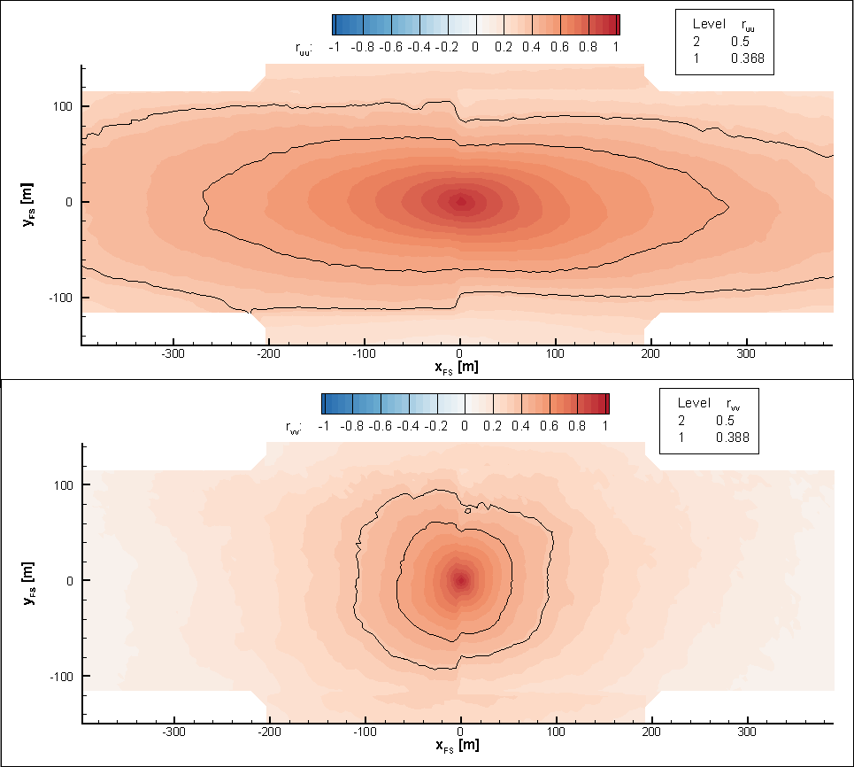
Two-point correlations – spatial corr.
Correlations of Along-wind velocity fluctuations at two points
1/e value larger than field of view
Lateral velocity component

Slide 12
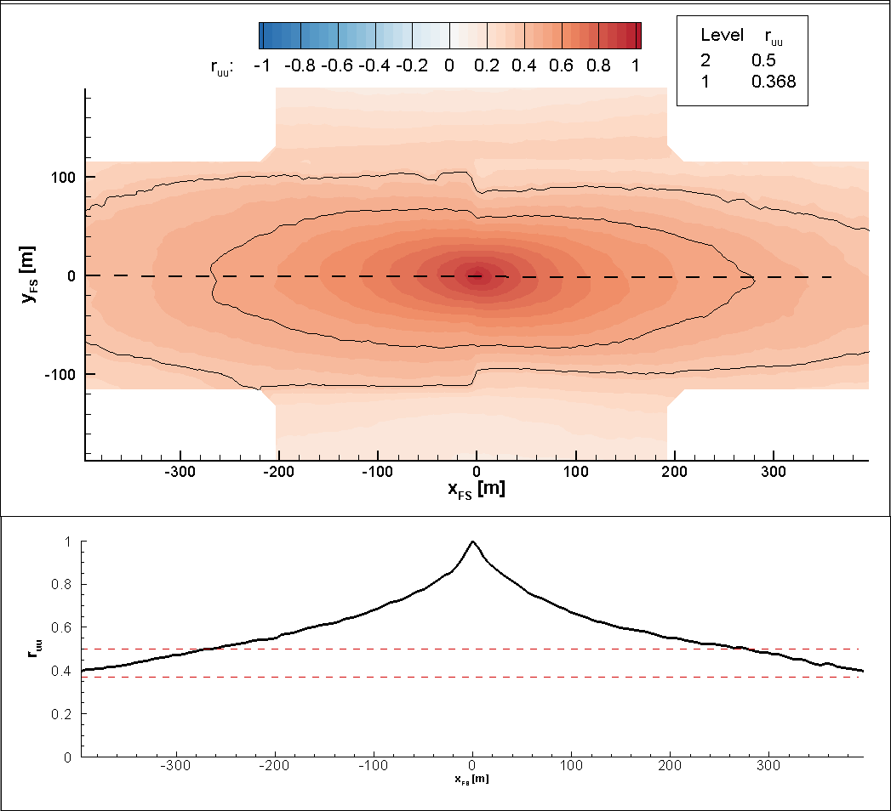
Two-point correlations – spatial corr.
Correlations of Along-wind velocity fluctuations at two points
1/e value larger than field of view

Slide 13
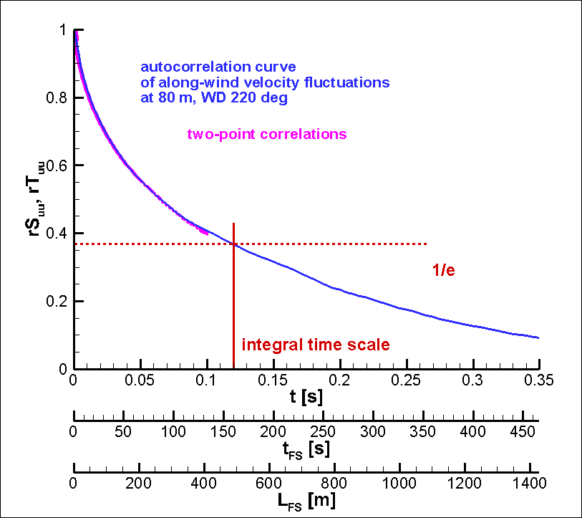
Two-point correlations – spatial corr.
Correlations of Along-wind velocity fluctuations at two points
1/e value larger than field of view

Slide 14
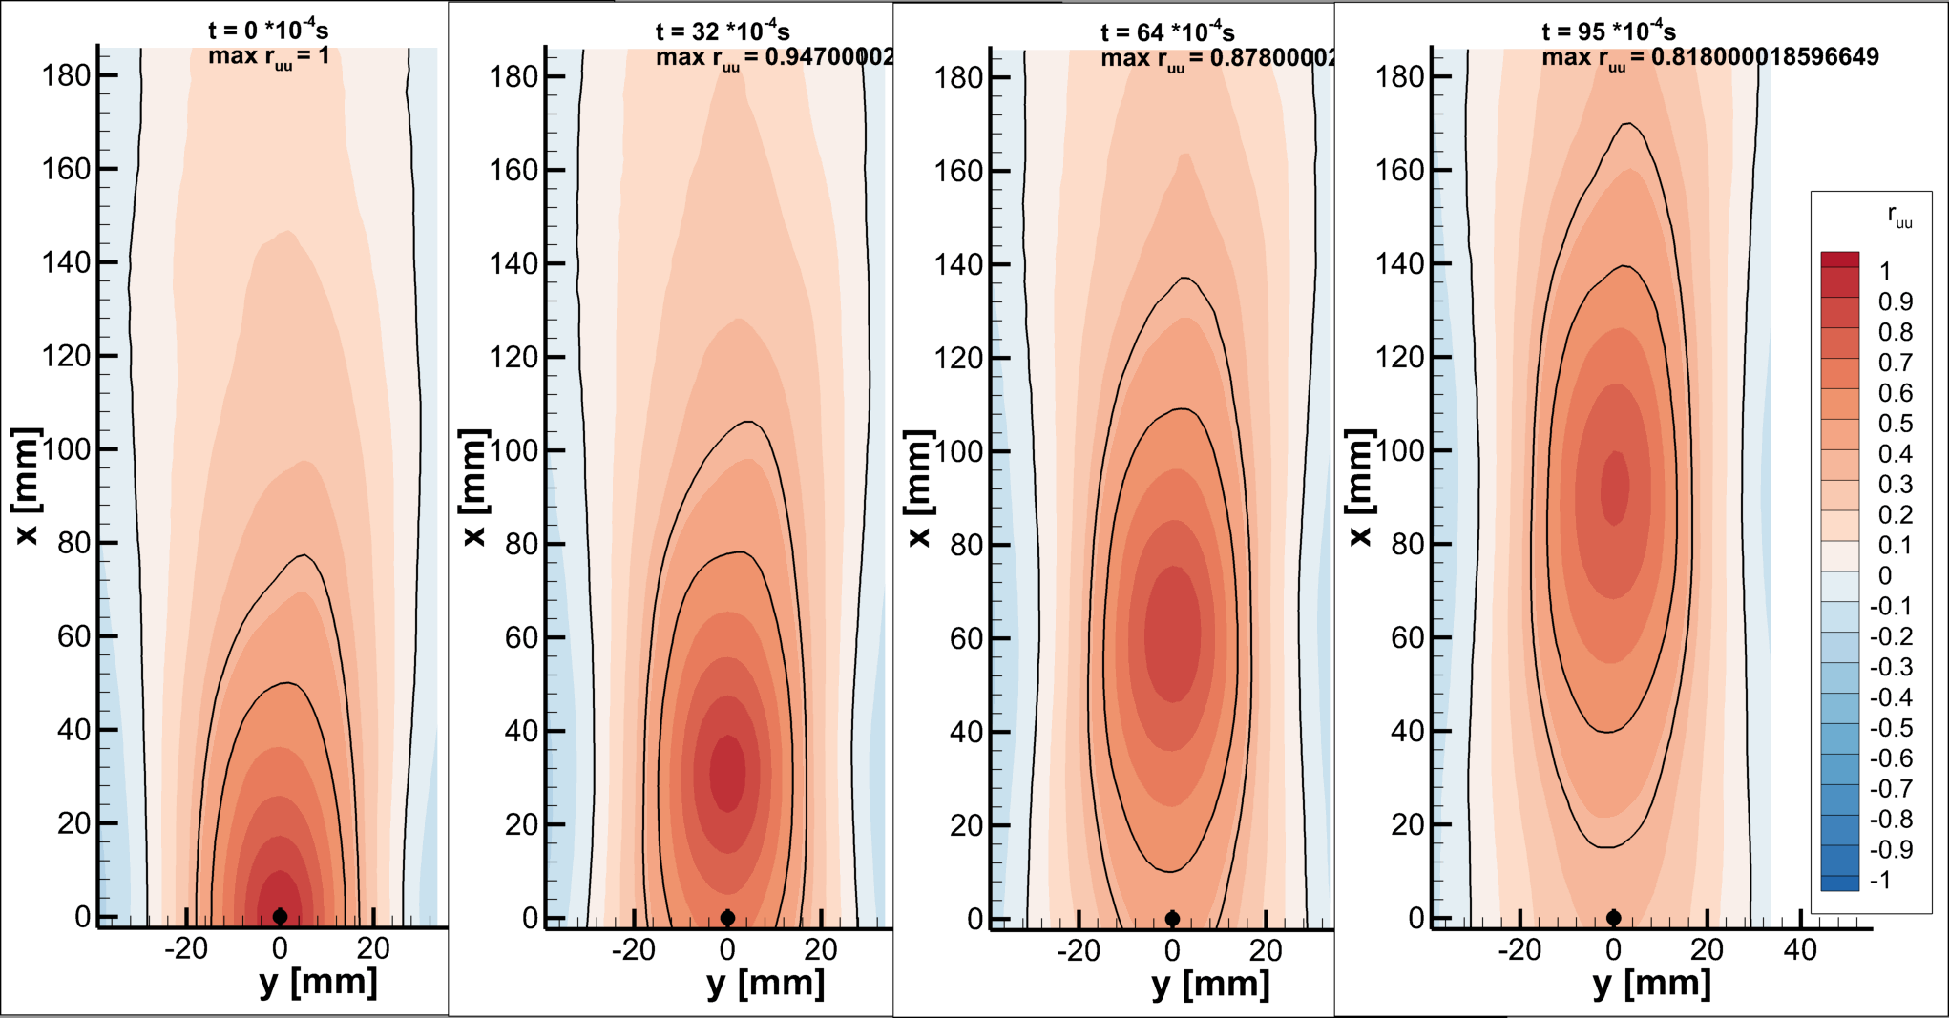
Spatio-temporal correlations
Two-point correlations with a time lag
Drift of the maximal correlation ≈ average advective velocity of coherent structures

Slide 15
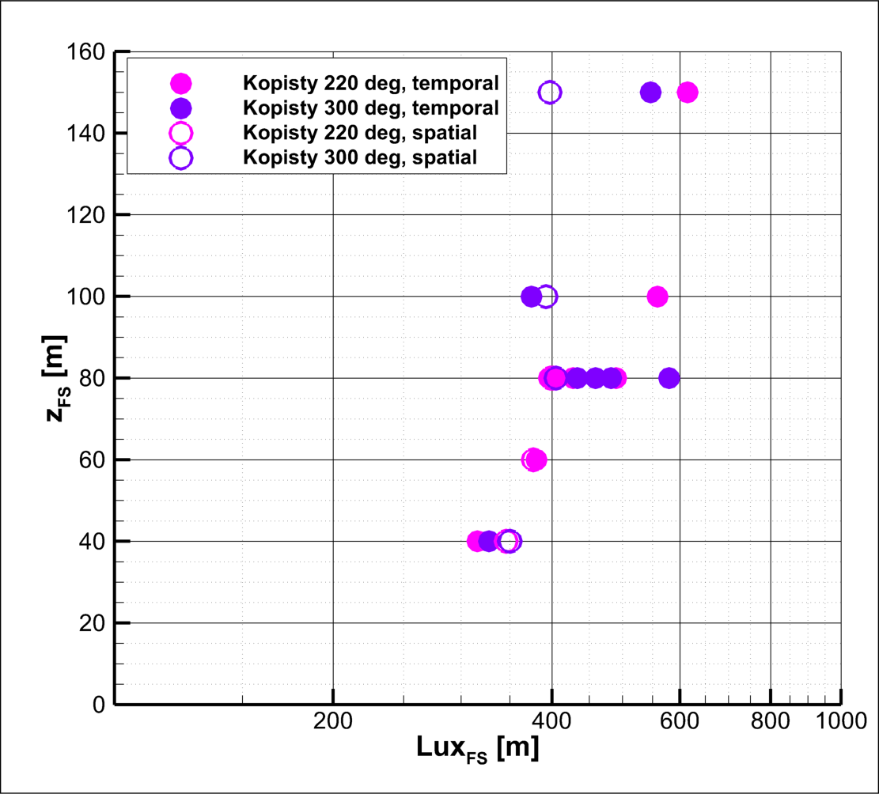
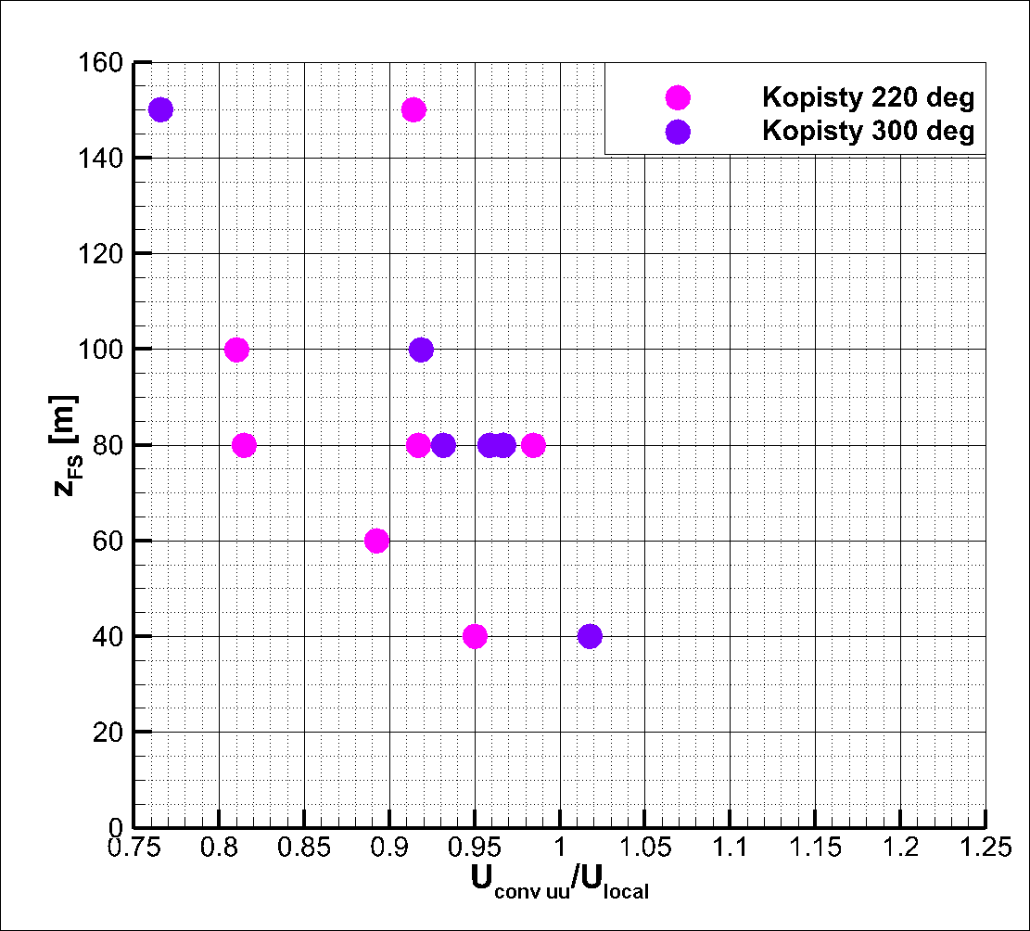
Further processing
Other velocity components, cross-moments
Quadrant analysis – sweep and ejection events, conditional sampling
Measurement in vertical
Extreme value statistics
Critical points of comparison between wind-tunnel results and observations
Averaging time
Thermal stability

Slide 16
Take away
Wind tunnel modelling is a tool to help us understand spatio-temporal connections important for boundary layers dynamics
Taylor hypothesis of frozen turbulence is applicable in fully developed turbulence further from the surface
Thank you for your attention!
Acknowledgement
This work was carried out thanks to the support of the Czech Ministry of Education, Youth, and Sports (project no. LTC 20056), and the institutional support RVO 61388998.

