Slide 1

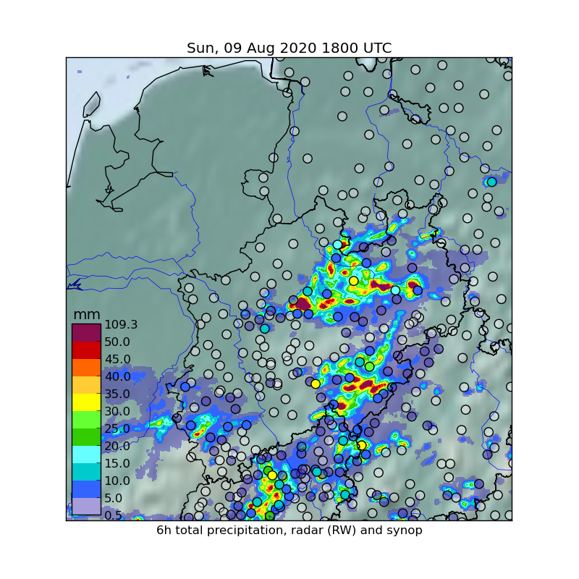
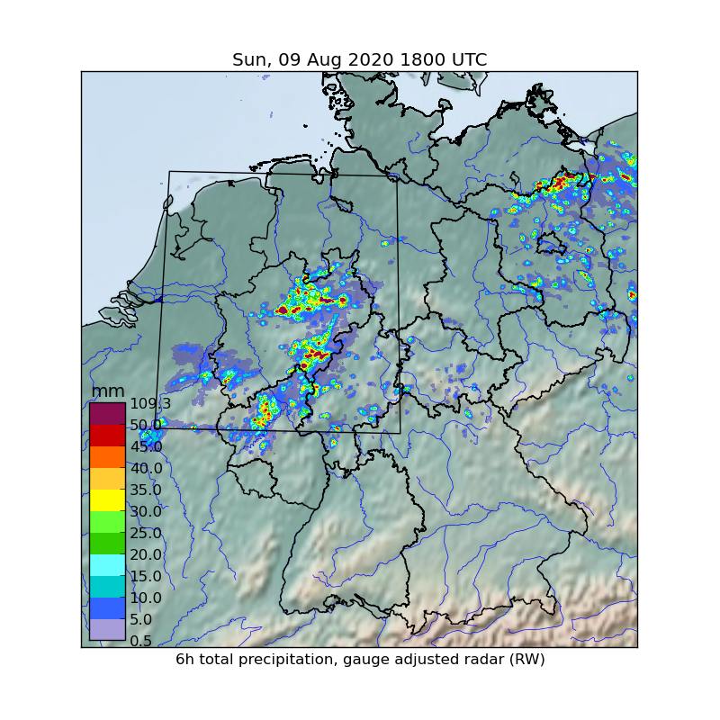
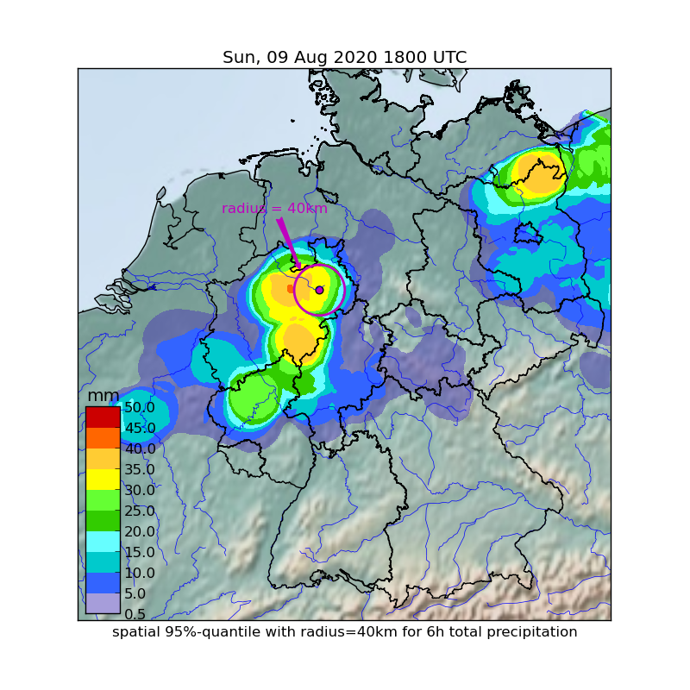
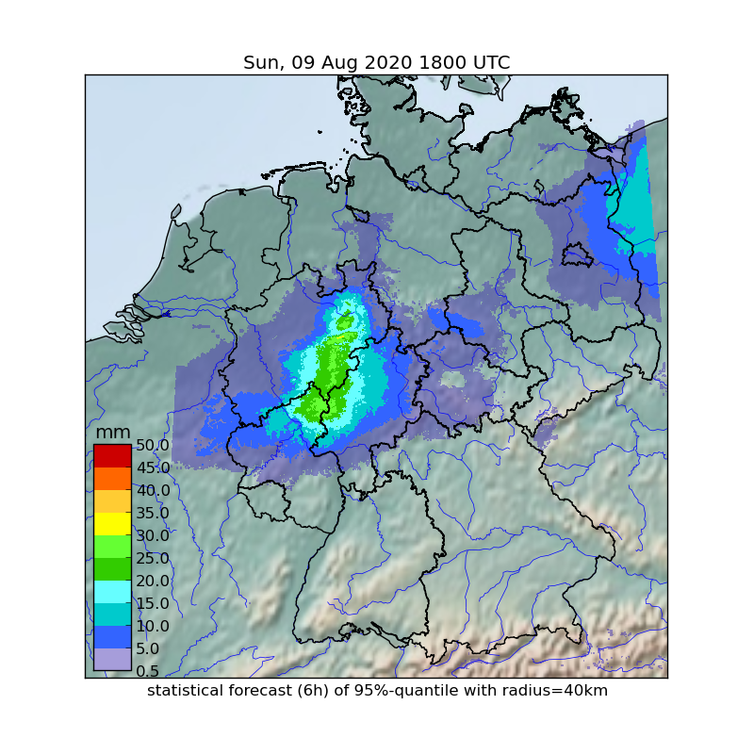
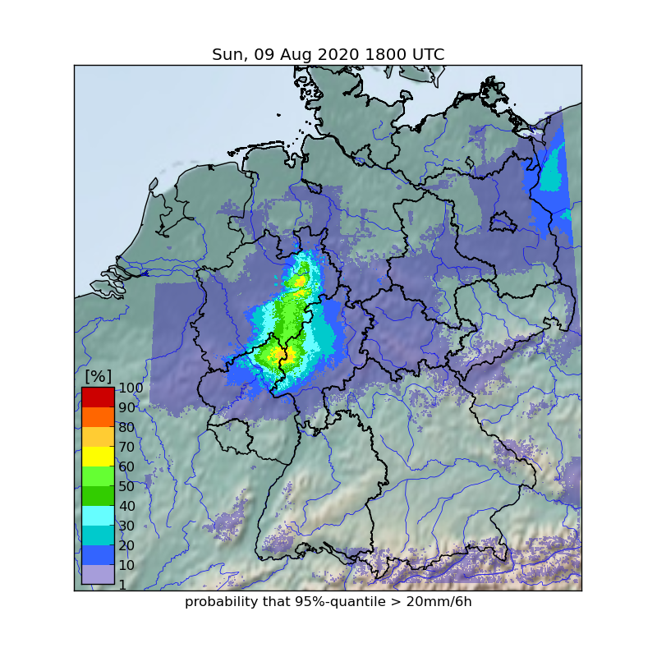
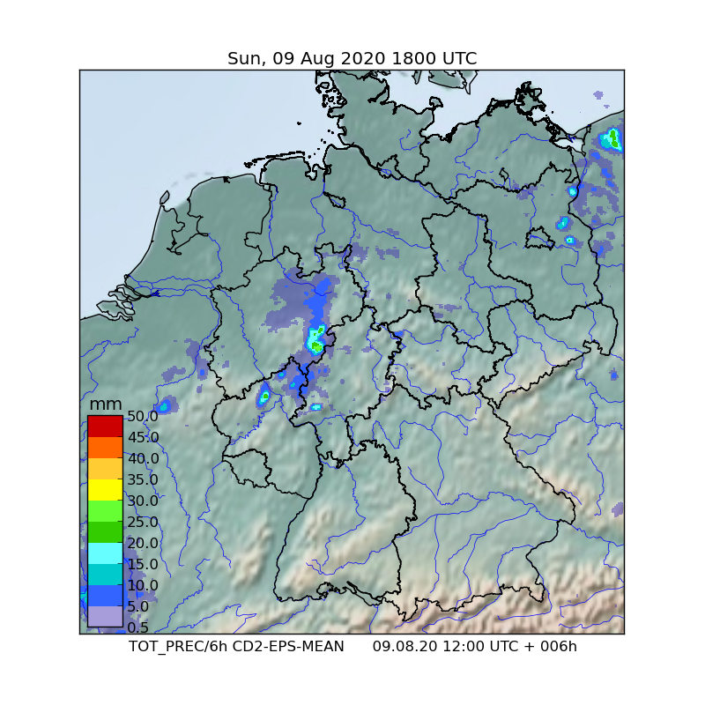
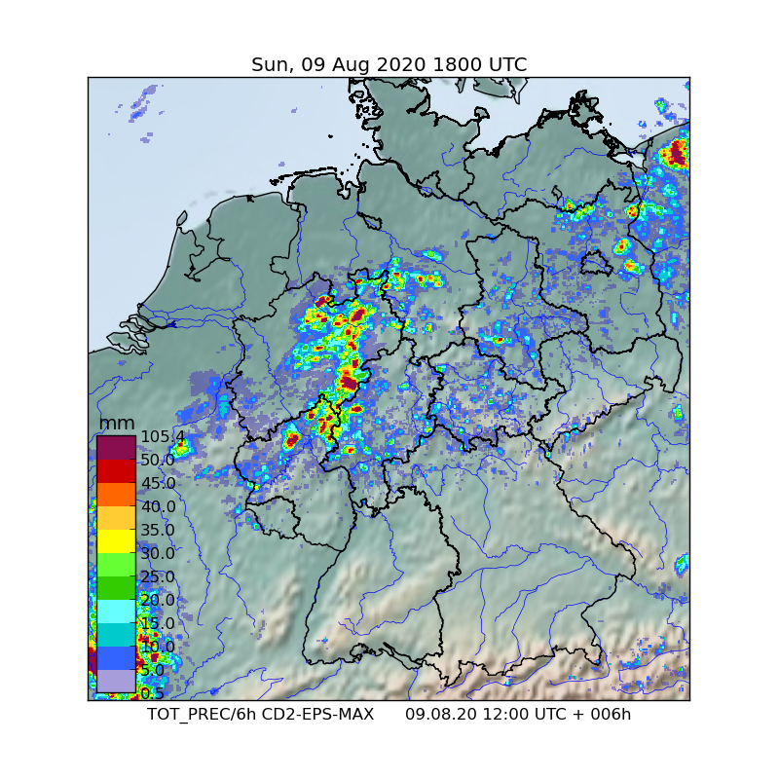
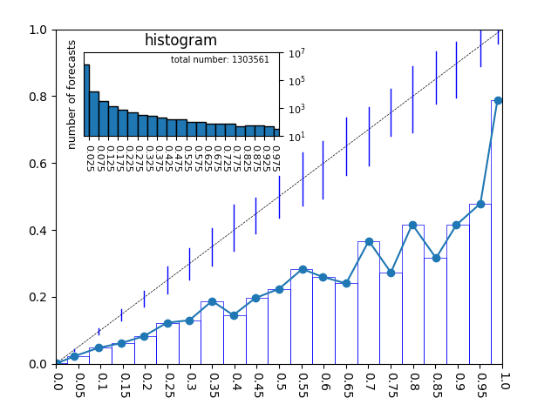
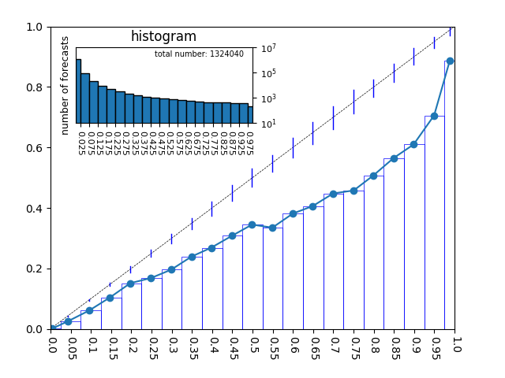
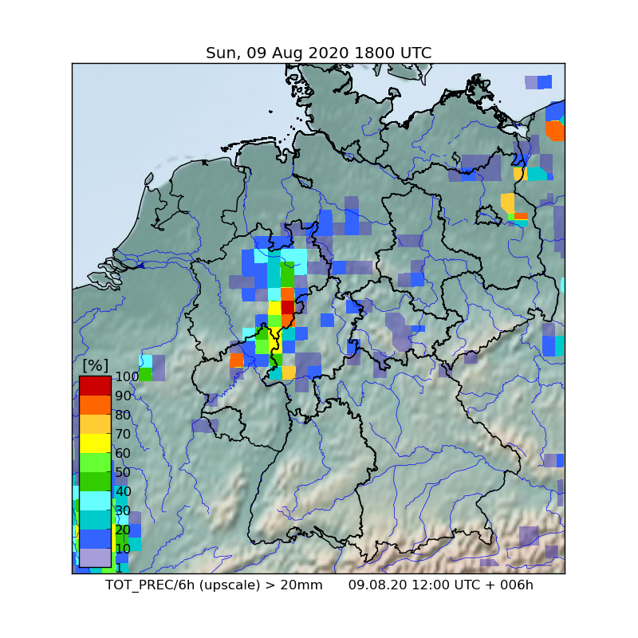
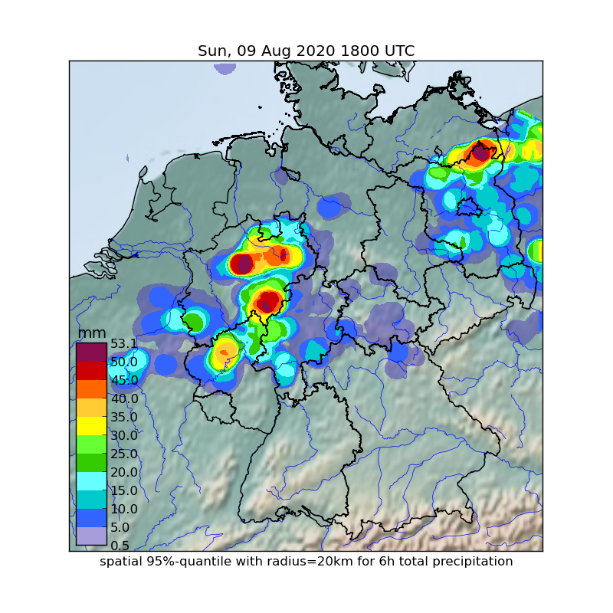
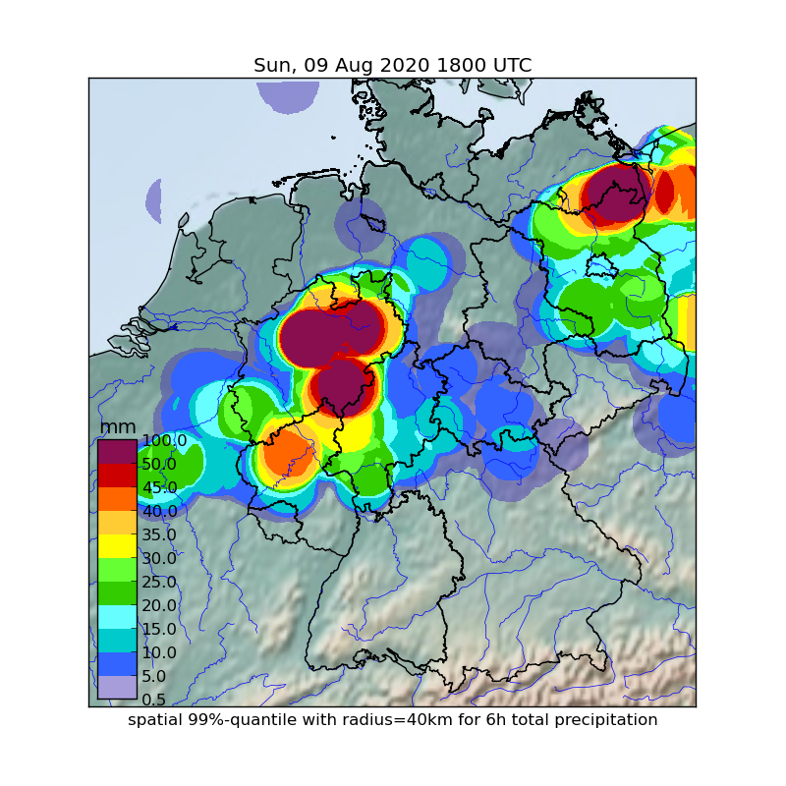

EMS Annual Meeting 2022
Bonn, Germany
4-9 September 2022
OSA1.1 Forecasting, nowcasting and warning systems
A radar based statistical forecast product for heavy precipitation
Reinhold Hess
Spatial Representativity of Precipitation Observations
Spatial 95%-Quantile of Precipitation Amounts
Reliable forecasts of heavy precipitation are one of the most difficult challenges in weather forecasting. Highest precipitation rates of convective events usually realise more likely in the surrounding of rain gauges rather than exactly above their small funnels and are therefore rarely detected by synoptic observations.
The spatial coverage of DWD’s radar network allows to detect local precipitation events in the vicinity of synoptic stations and increases representativity and predictive skill of statistical forecasts of heavy convection.
The suggested approach derives spatial 95%-quantiles in circular surroundings of 40km radius as an innovative forecast product in order to support forecasters to rate upcoming heavy precipative events.
95%-quantiles of rain gauge adjusted radar precipitation are chosen in order to estimate the maximum precipitation amount in the circular surroundings, whilst they are robust against spurious spikes in the radar data.
6h precipitation amounts from DWD’s radar network and corresponding synoptic observations. Rain gauge adjusted radar estimations show thunderstorm cells with precipitation amounts of more that 100mm/6h, whereas synoptic measurements detect rain rates only below 35mm/6h.
Statistical forecasts of quantiles and probabilities
Statistical forecasts of these point observations often underestimate maximum rain rates and result in low probabilities for heavy precipitation at a given location.
What would be a relevant forecast product with regard to weather warnings?
Ensemble forecasts of COSMO-D2-EPS show realistic scenarios
Deterministic forecasts of convective events are usually dislocated. As a result, maximal precipitation rates are reduced for the ensemble mean of total precipitation (left) and the signal for heavy events is weakened.
Using a model output statistics (MOS) approach, forecasts of the 95%-quantiles and threshold probabilities are computed. 95%-quantiles (left) and probabilities that 20mm/6h are exceeded (right) show meaningful signals for heavy precipitation. 10 years of model and radar data have been used for training.
Reference: Hess, R. (2020). Statistical postprocessing of ensemble forecasts for severe weather at Deutscher Wetterdienst. Nonlinear Processes in Geophysics, 27(4), 473-487.
Ensemble mean of 6h forecast of CD2-EPS
Reliability Diagrams of SYNOPS and Radar
Pointwise maximal values of the ensemble members (right) show overforecasting of precipitation in total. Areas with maximal rain rates remain dislocated (compare with radar data above).
Reliability diagrams of training data for conventional statistical forecasts based on synops (left) and for the proposed 95%-quantiles (right) show many more cases of heavy precipitation and a significant improvement of statistical calibration for the new radar product.
Pointwise maximum ensemble values of 6h forecasts of CD2-EPS
Reliability diagram of synoptic precipitation > 20mm/6h
Reliability diagram of
95%-quantiles > 20mm/6h
The “upscaled precipitation” product is based on the spatial maximal precipitation of 10*10 grid points for each ensemble member. The relative frequencies of the ensemble members that exceed 20mm/6h show a clear signal for heavy precipitation at the costs of spatial resolution.
Different sizes of surroundings and quantiles are possible
Larger spatial scales provide higher representativity and accuracy, but reduce spatial resolution and sharpness. The radius can be set to define the spatial scale and the used quantile may be selected accordingly.
Reference: Ben Bouallègue, Z. and Theis, S.E. (2014), Spatial techniques applied to precipitation ensemble forecasts: from verification results to probabilistic products. Met. Apps, 21: 922-929.
Relative frequencies of ensemble members with total precipitation > 20mm/6h on a 22km grid
What is the most useful spatial scale (radius of surrounding)?
DWD, Research and Development
Email: Reinhold.Hess@dwd.de

