Slide 1

A Case Study on the Soil Temperature Cooling Mechanism by Convective Cold Pools using Observation Network Data
EMS Annual Meeting 9th Sep 2022
Jaemyeong Mango Seo^{1,2}, Cathy Hohenegger^{1,2},
Nima Shokri³, and Hannes Nevermann³
¹Max-Planck Institut for Meteorology
²Hans-Ertel-Zentrum für Wetterforschung
³Hamburg University of Technology

Slide 2
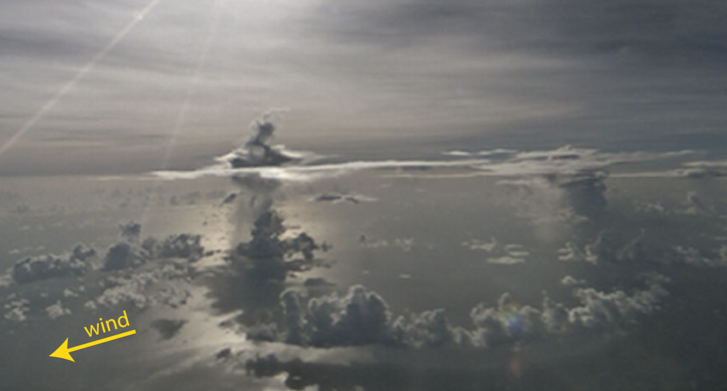
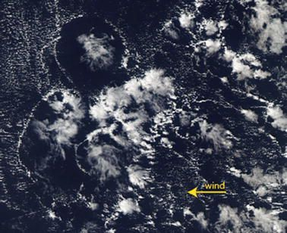
Cold pools
Zuidema et al. (2017)
“A region or pool of relatively cold air surrounded by warmer air”
“Any large-scale mass of cold air; a cold air mass or cold dome”
AMS Glossary

Slide 3
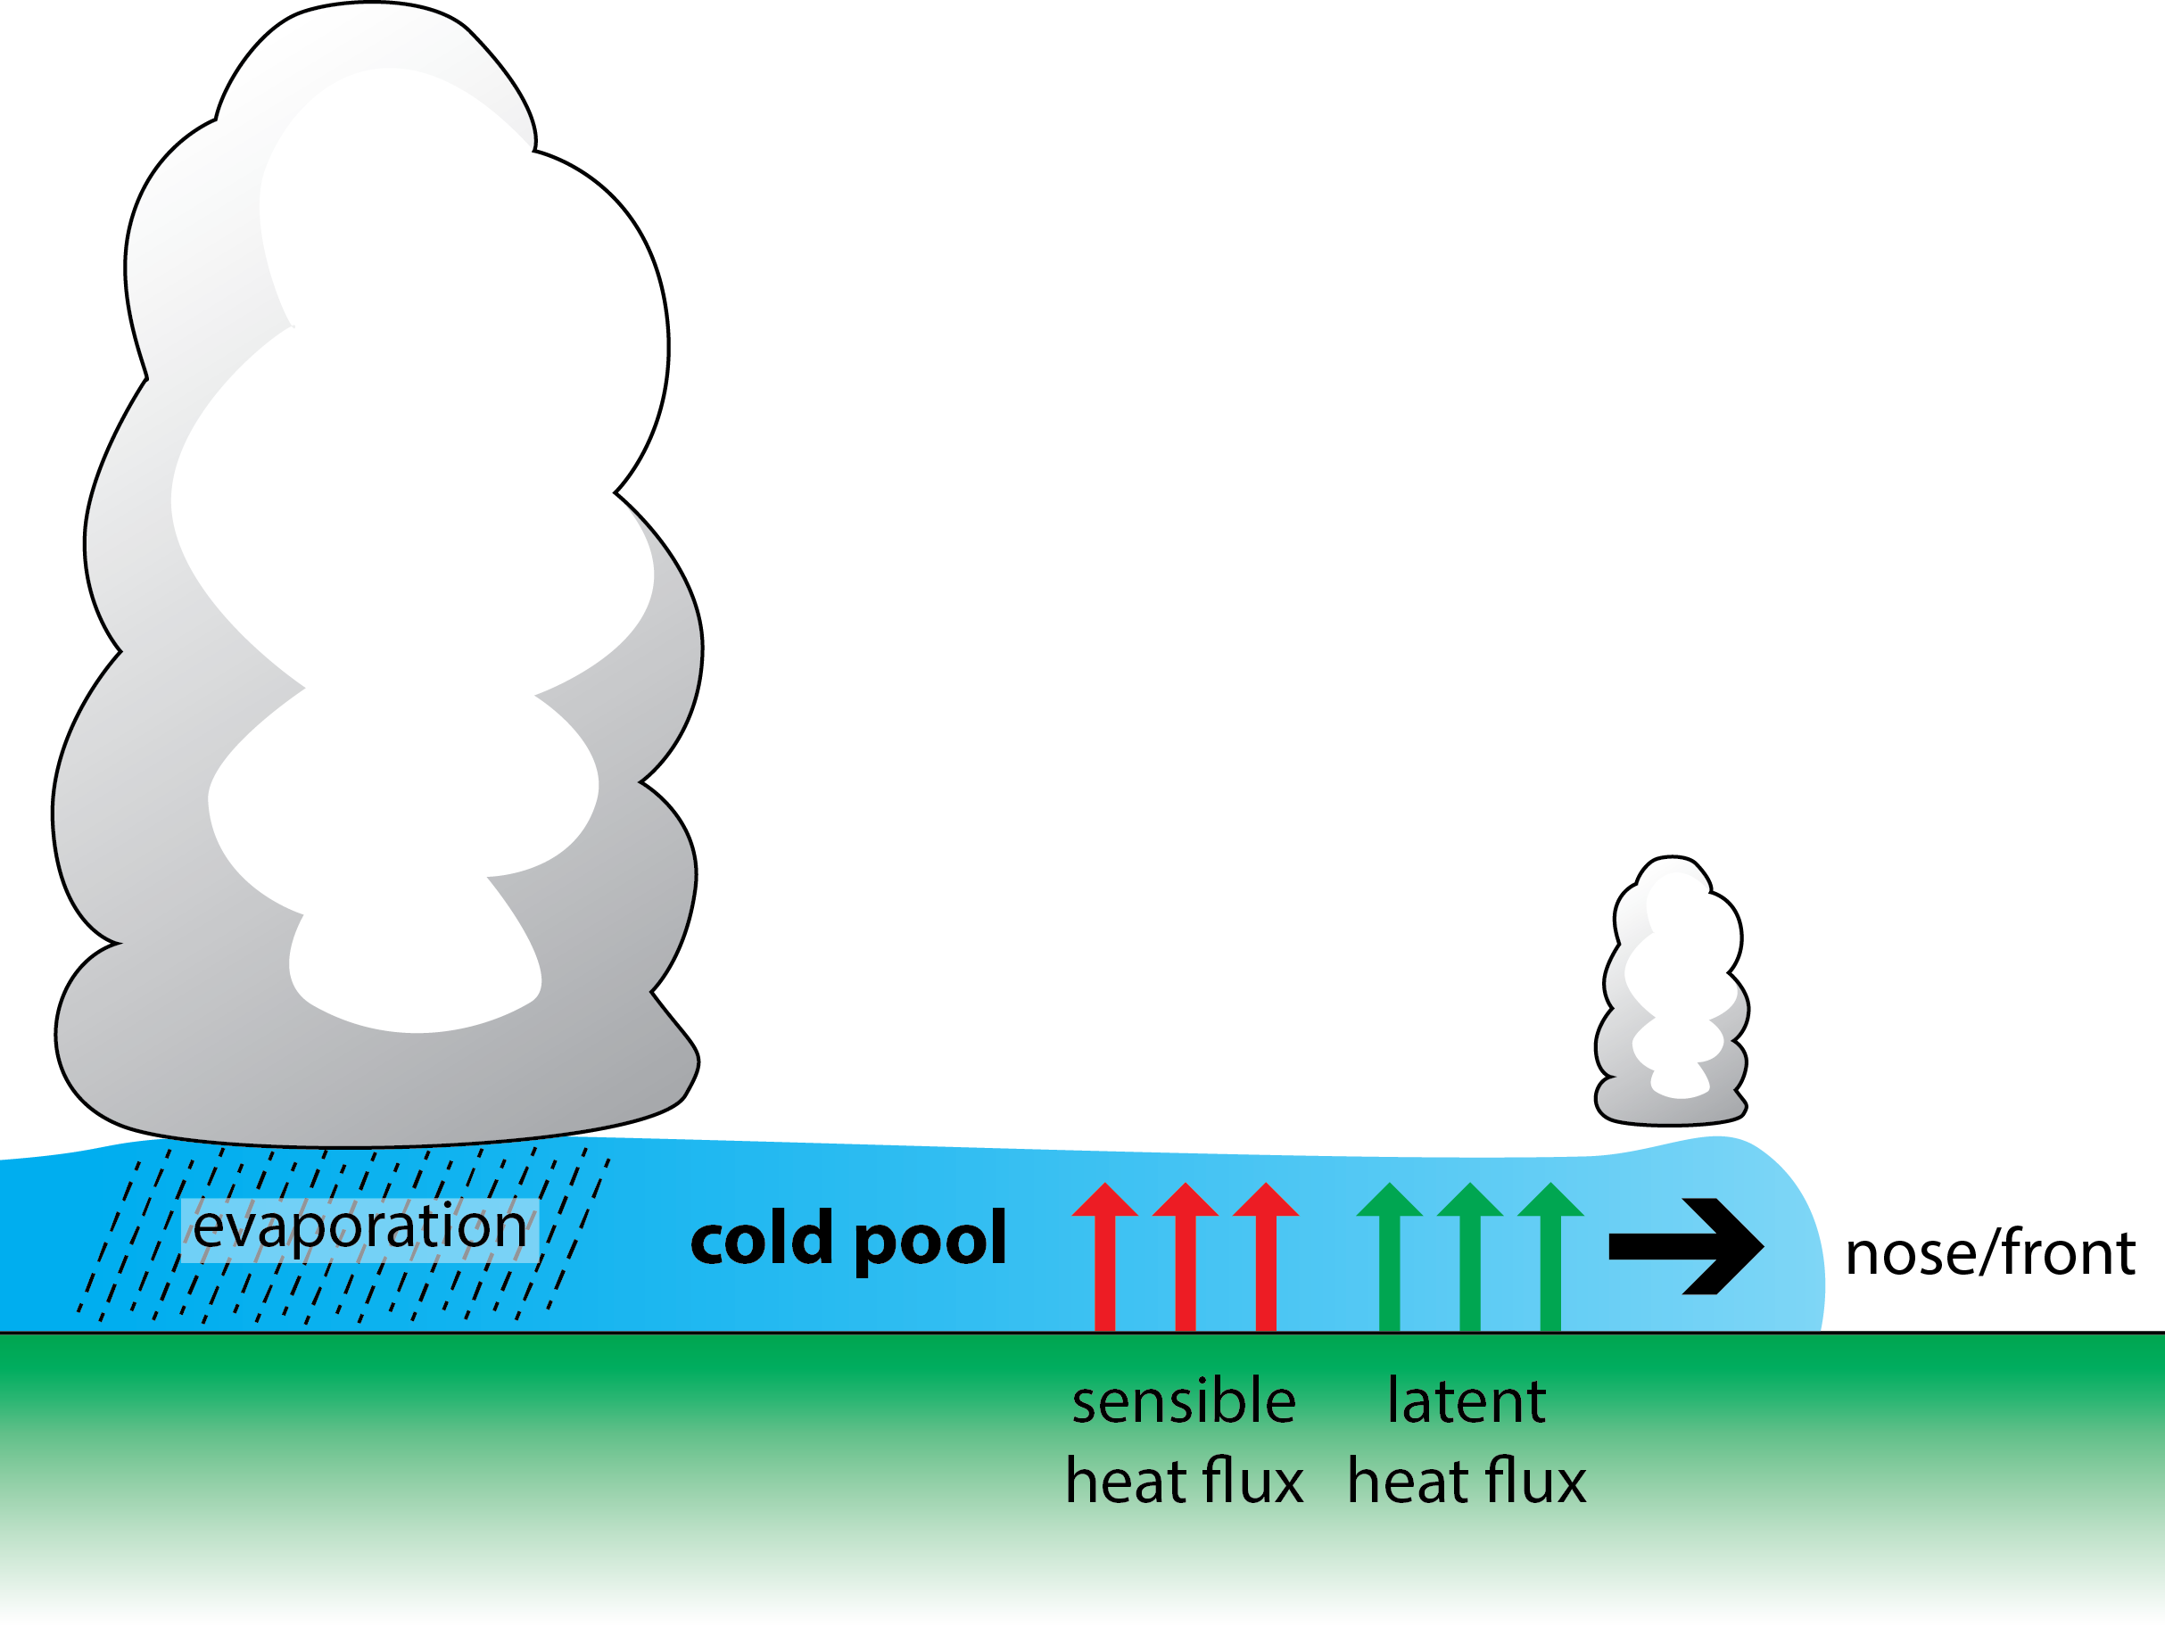
Cold pools and suface
Cold pool generated by evaporative cooling propagates outward
Cold pool strength is determined by the density difference to the environment
Thermal and moisture fluxes between the cold pool and the surface can weaken the cold pool strength and propagation
surface
friction

Slide 4
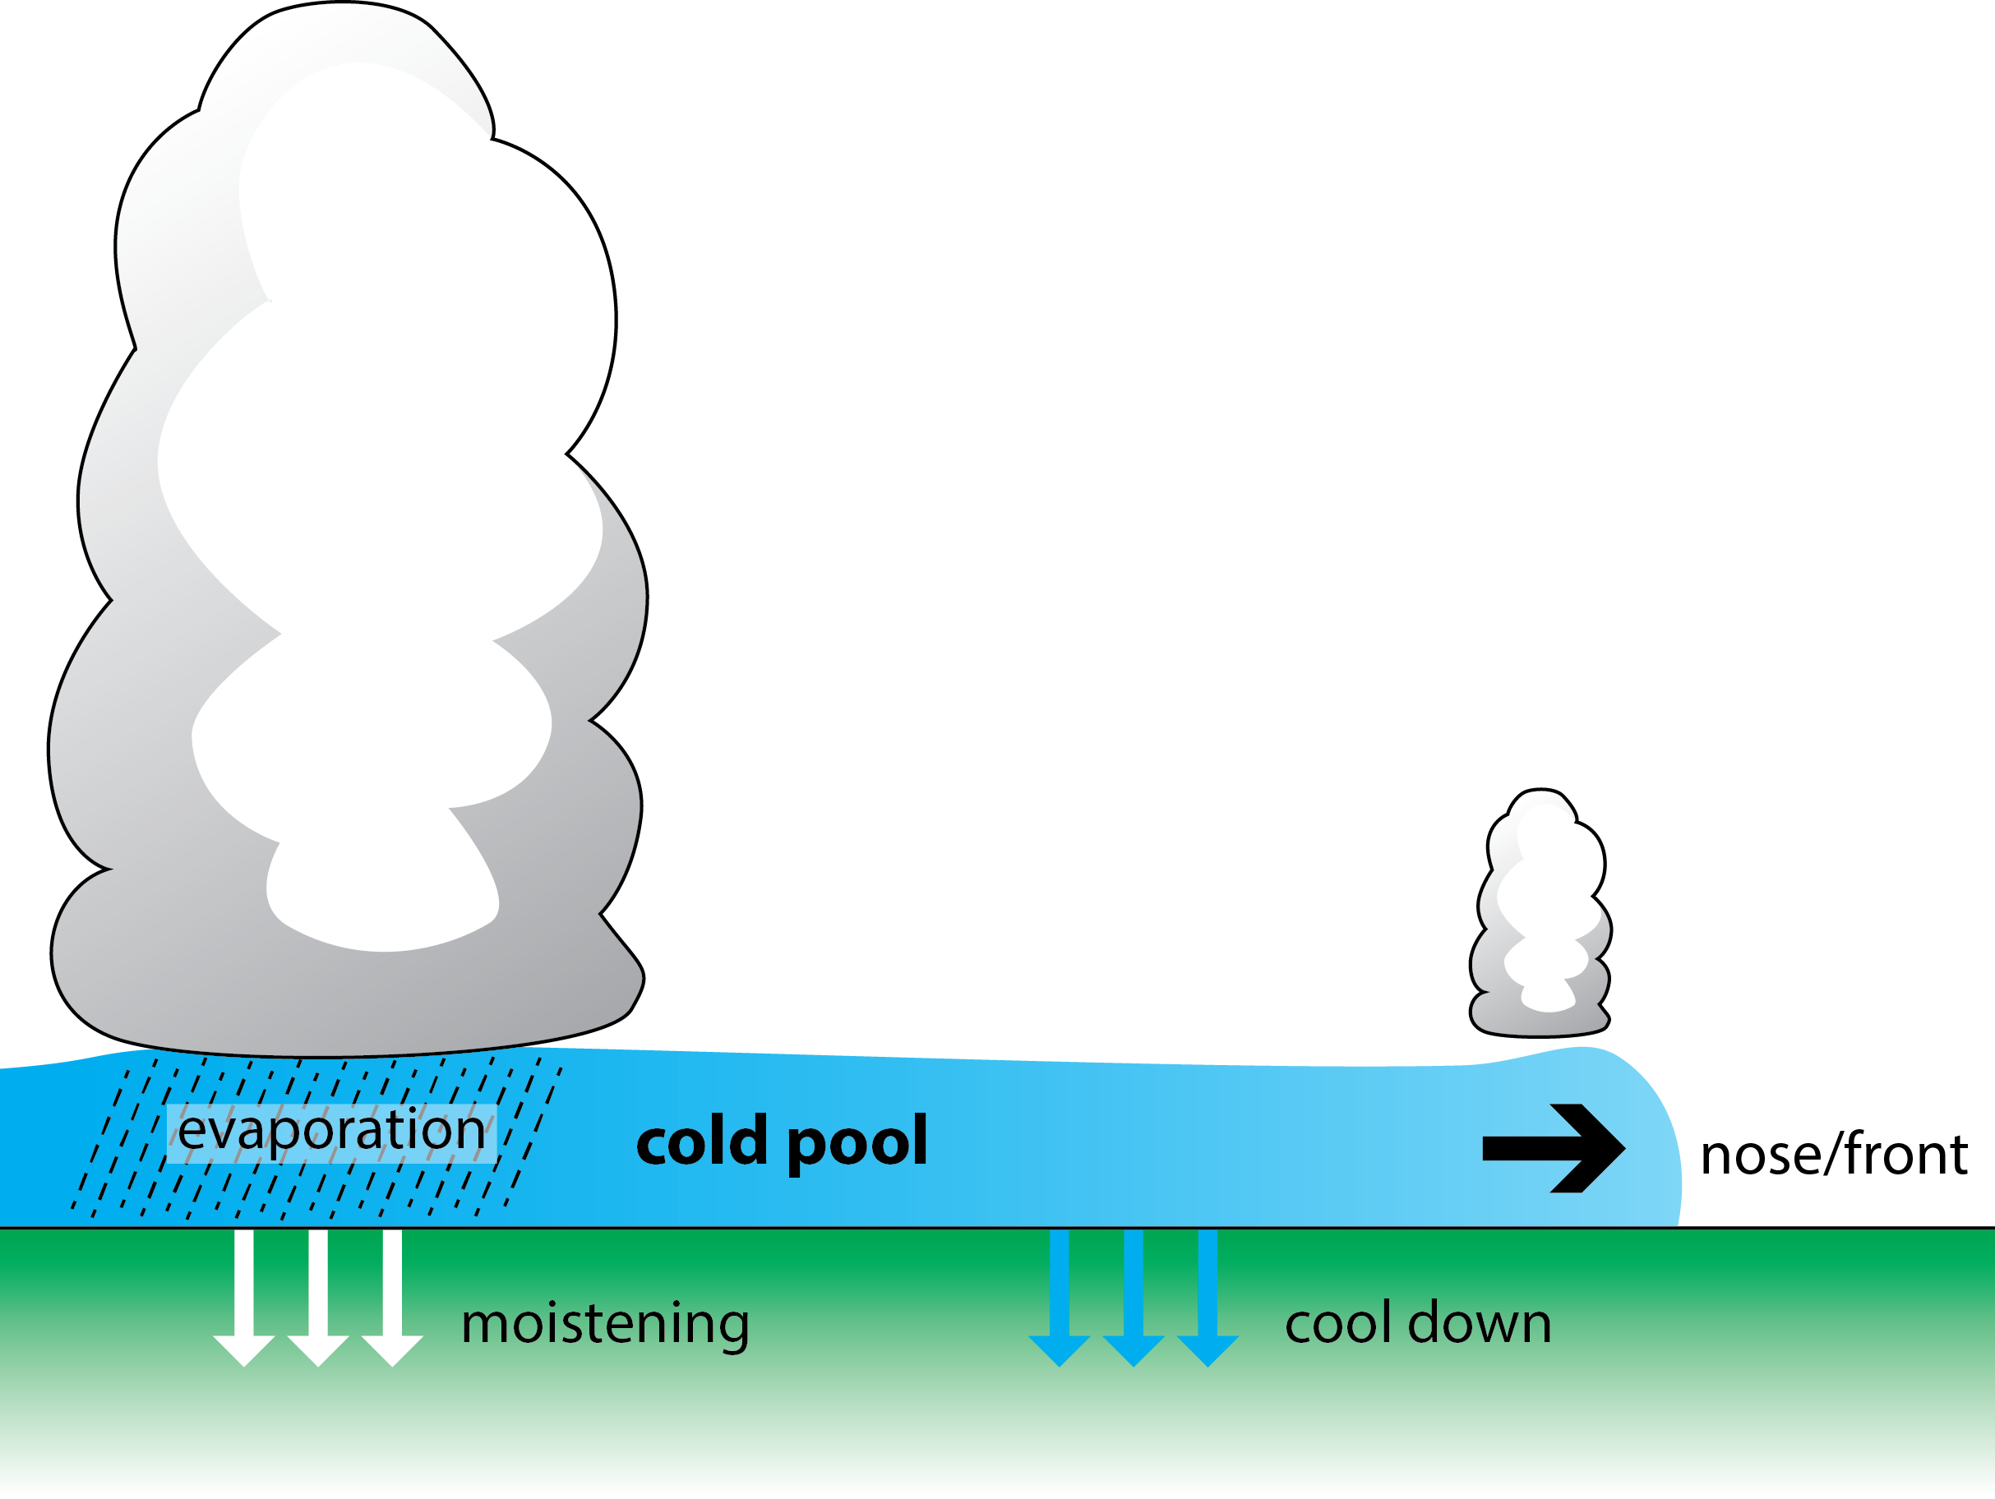
Cold pools and suface
Precipitation moistens the surface and the underlying soil layer
Cold pool can directly cool down the temperature of the surface and the underlying soil layer
How do precipitation and cold air mass of the cold pool cool down the temperature of soil layer?

Slide 5
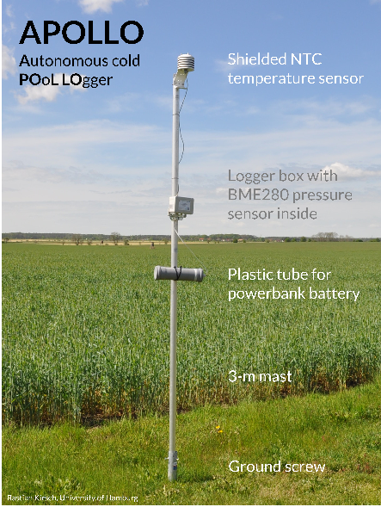
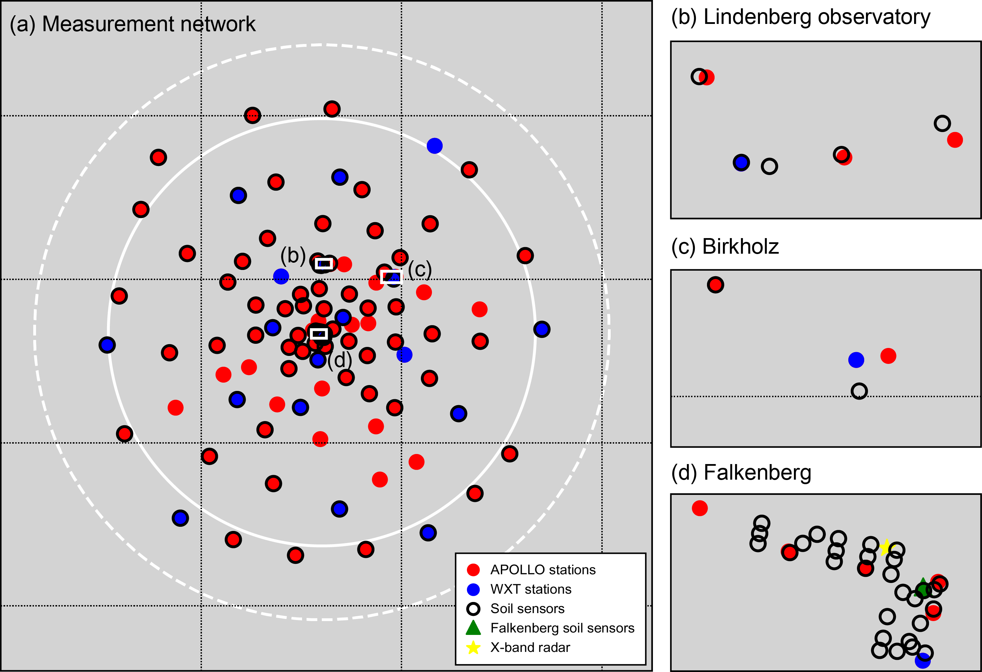
FESSTVaL campaign
Field Experiment on Submesoscale Spatio-Temporal Variability in Lindenberg
Period: 17.05.2021 - 27.08.2021 (summer)
Focuses on atmospheric boundary layer, cold pools and gust of wind
To observe various aspects of the targets, various instruments including X-Band radar, doppler lidars, energy balance and soil instruments, and more than 100 of near-surface stations were operated.

Slide 6
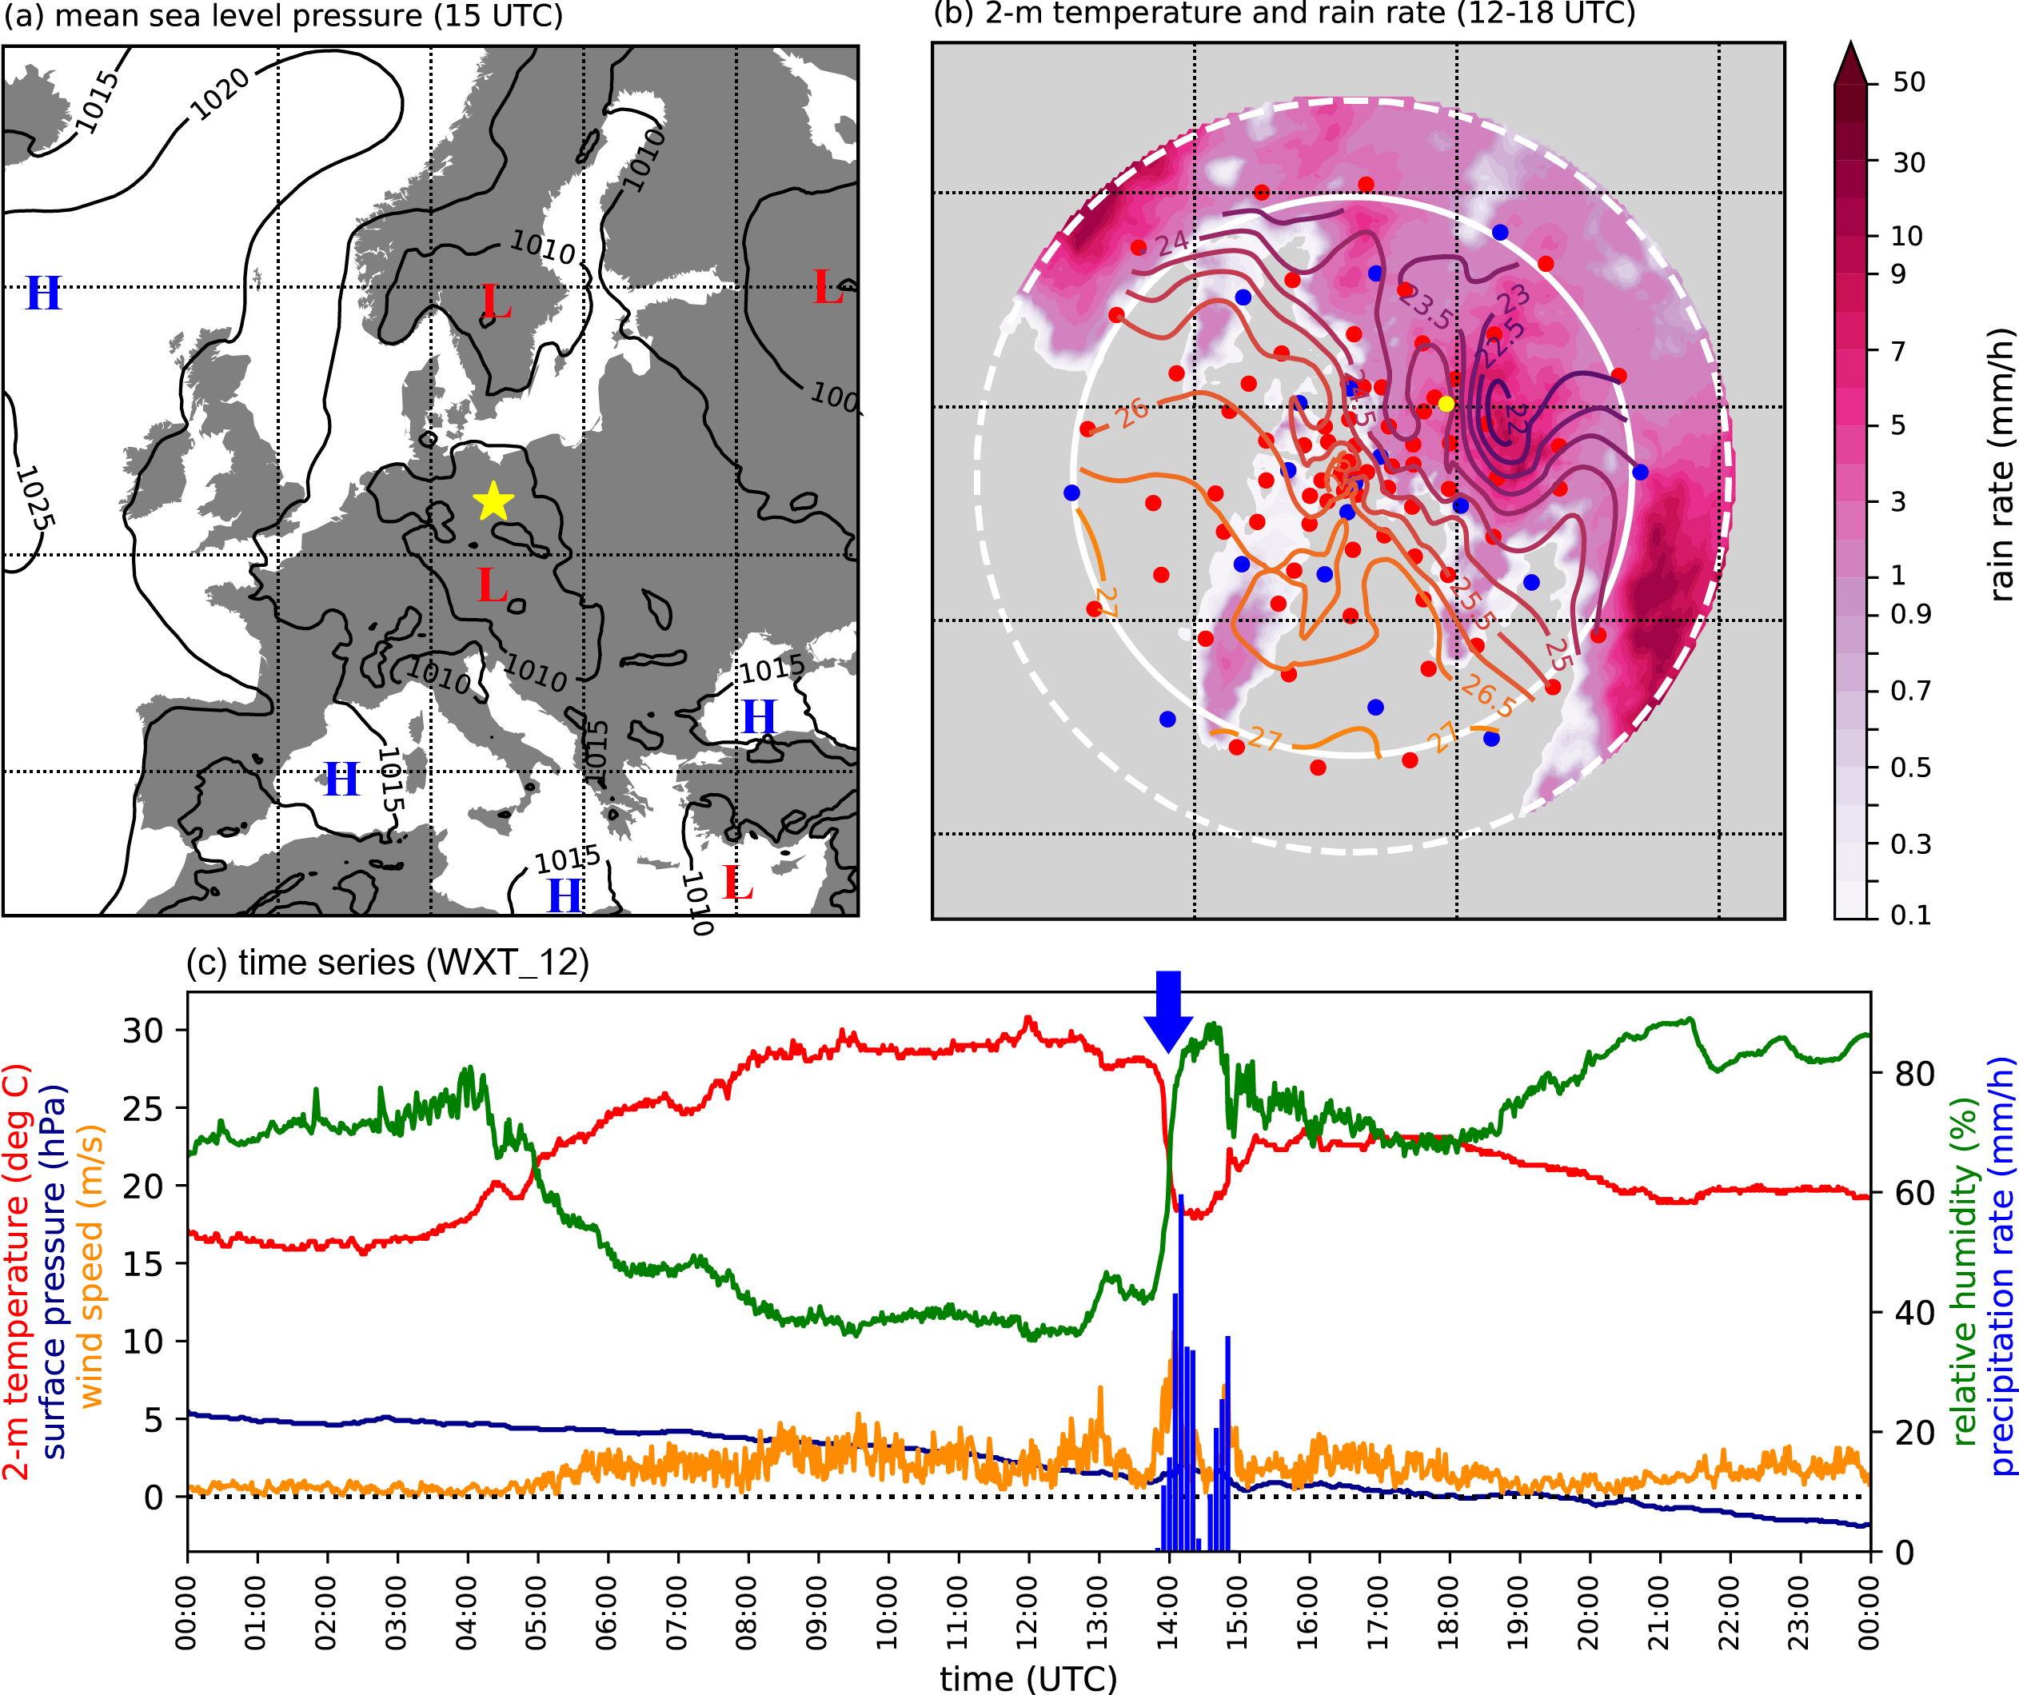
Jogi case – 29th Jun 2021
Strong cold pool event with |ΔT_{2m}|_{max} = -11.12K occurred at ~1400UTC by clustered convective cells mainly over the eastern and northern part of the domain.

Slide 7
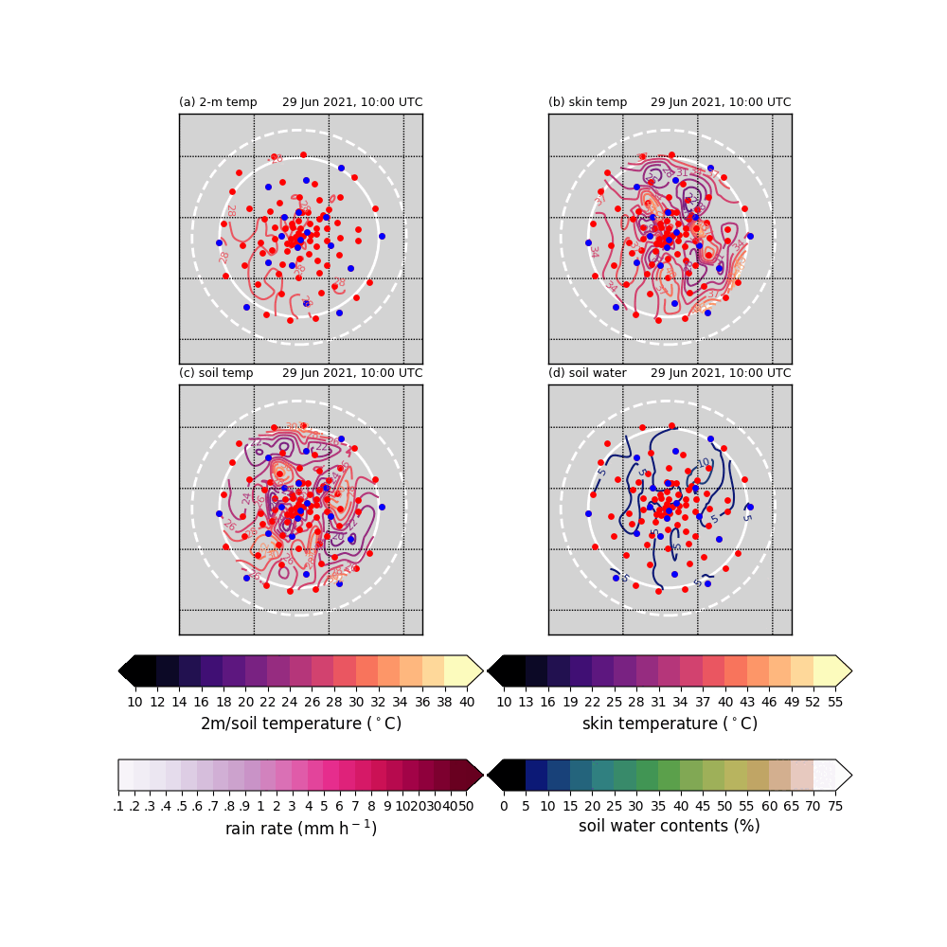
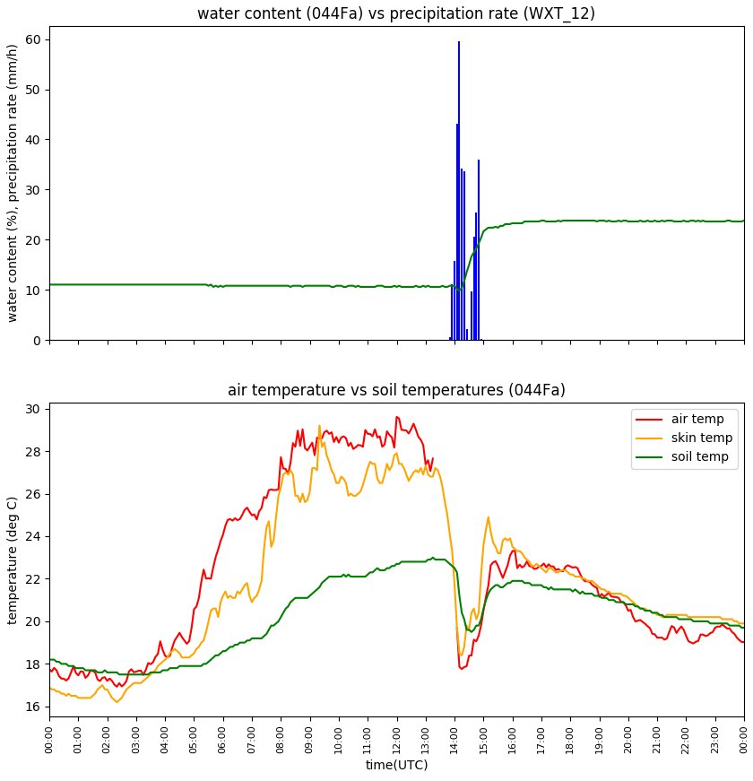
Jogi case – 29th Jun 2021
Strong cold pool event with |ΔT_{2m}|_{max} = -11.12K occurred at ~1400UTC by clustered convective cells mainly over the eastern and northern part of the domain.

Slide 8
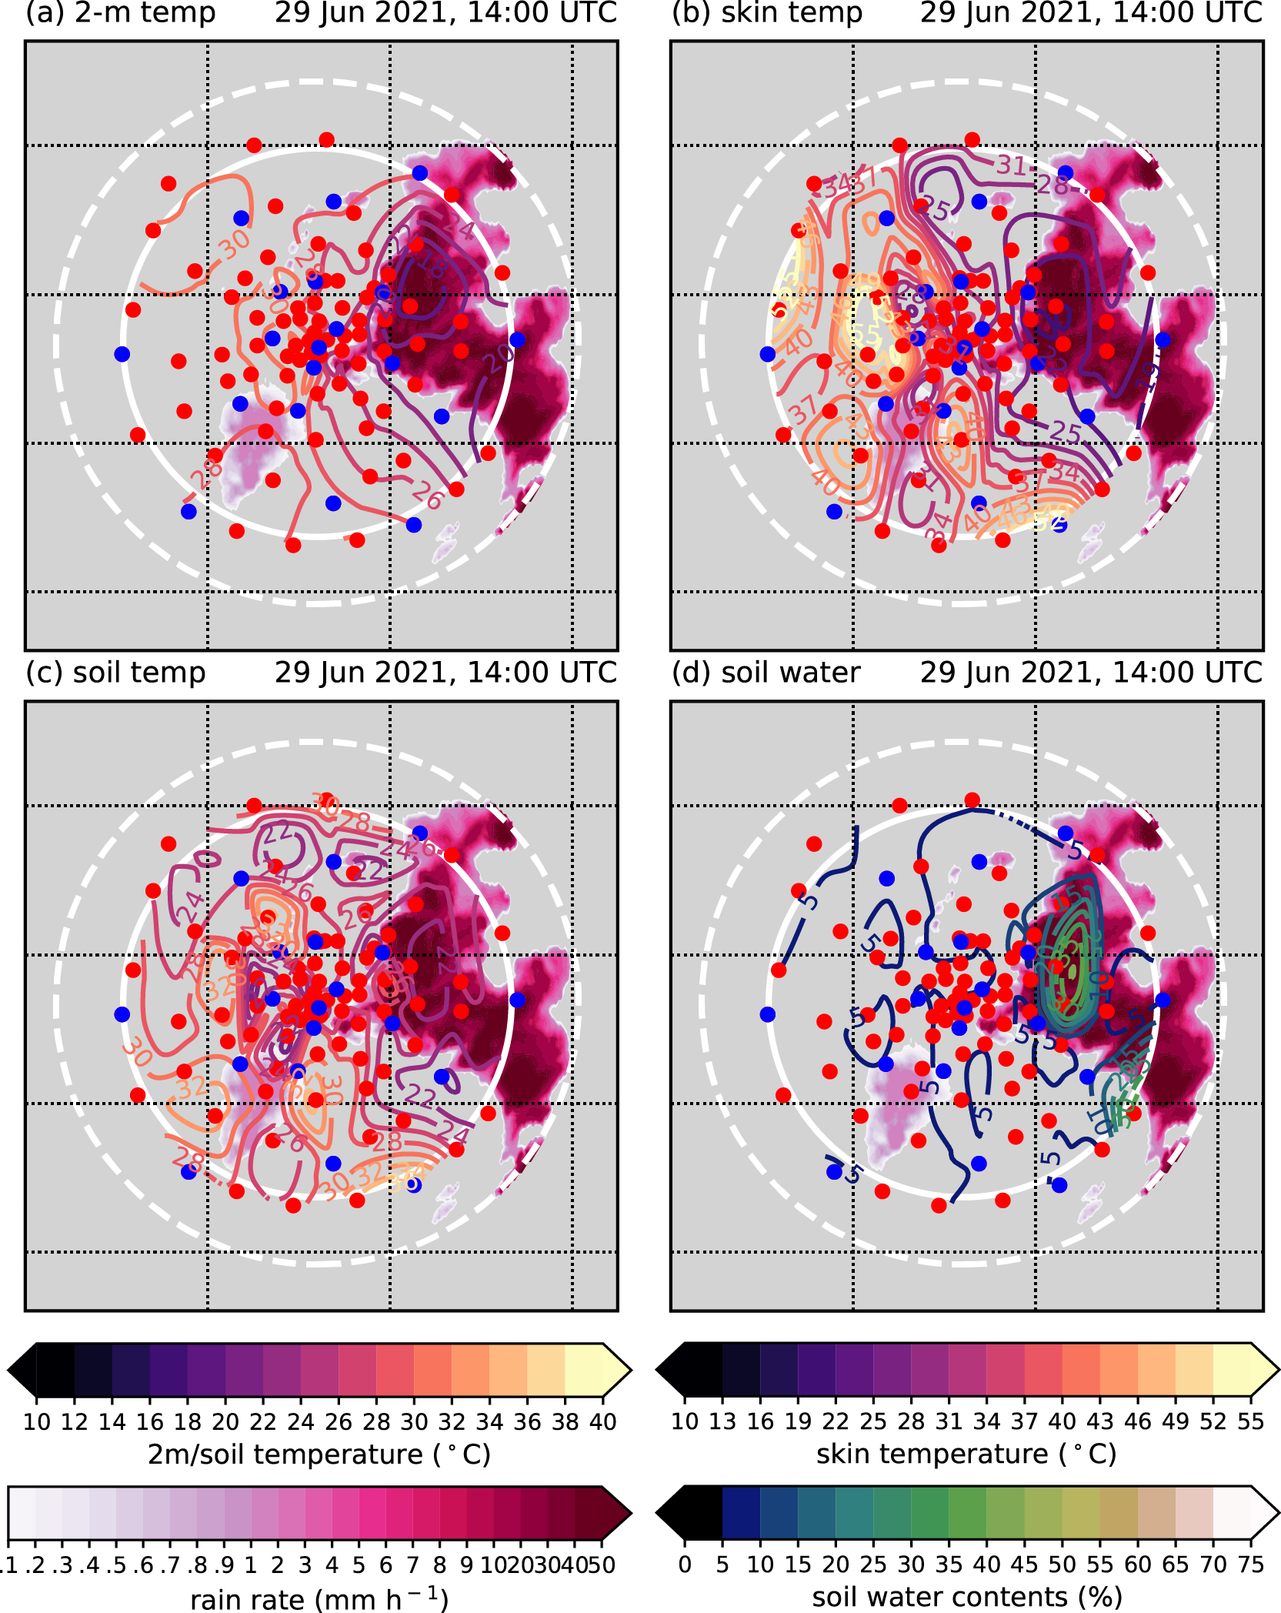
Jogi case – 29th Jun 2021
Clear decrease in T_{2m}, T_{skin}, and T_{soil}.
During precipitation, soil water content is accordingly increased.

Slide 9
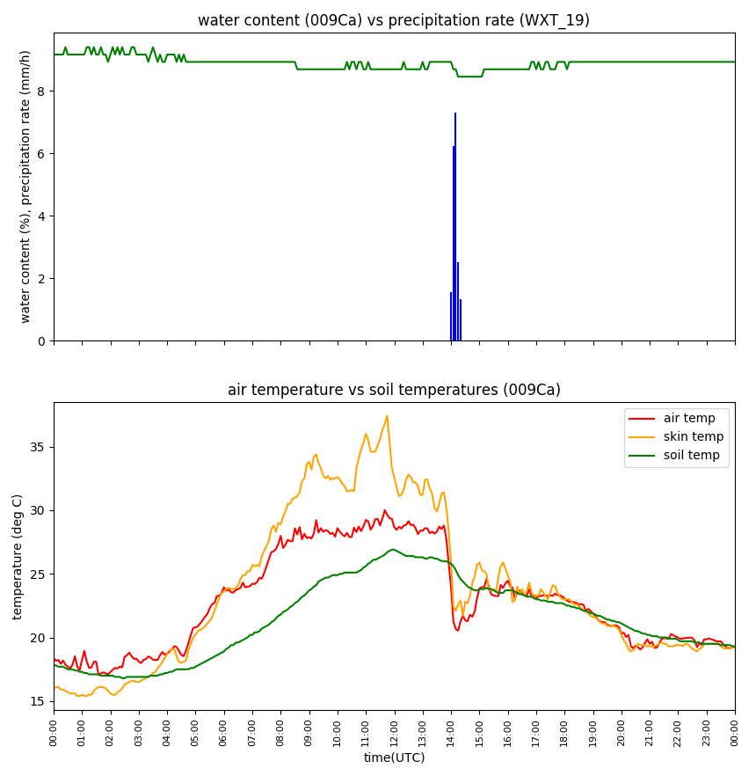
Jogi case – 29th Jun 2021
Clear decrease in T_{2m}, T_{skin}, but T_{soil} does not clearly decrease.
At this station, the soil water content increase is not observed.

Slide 10
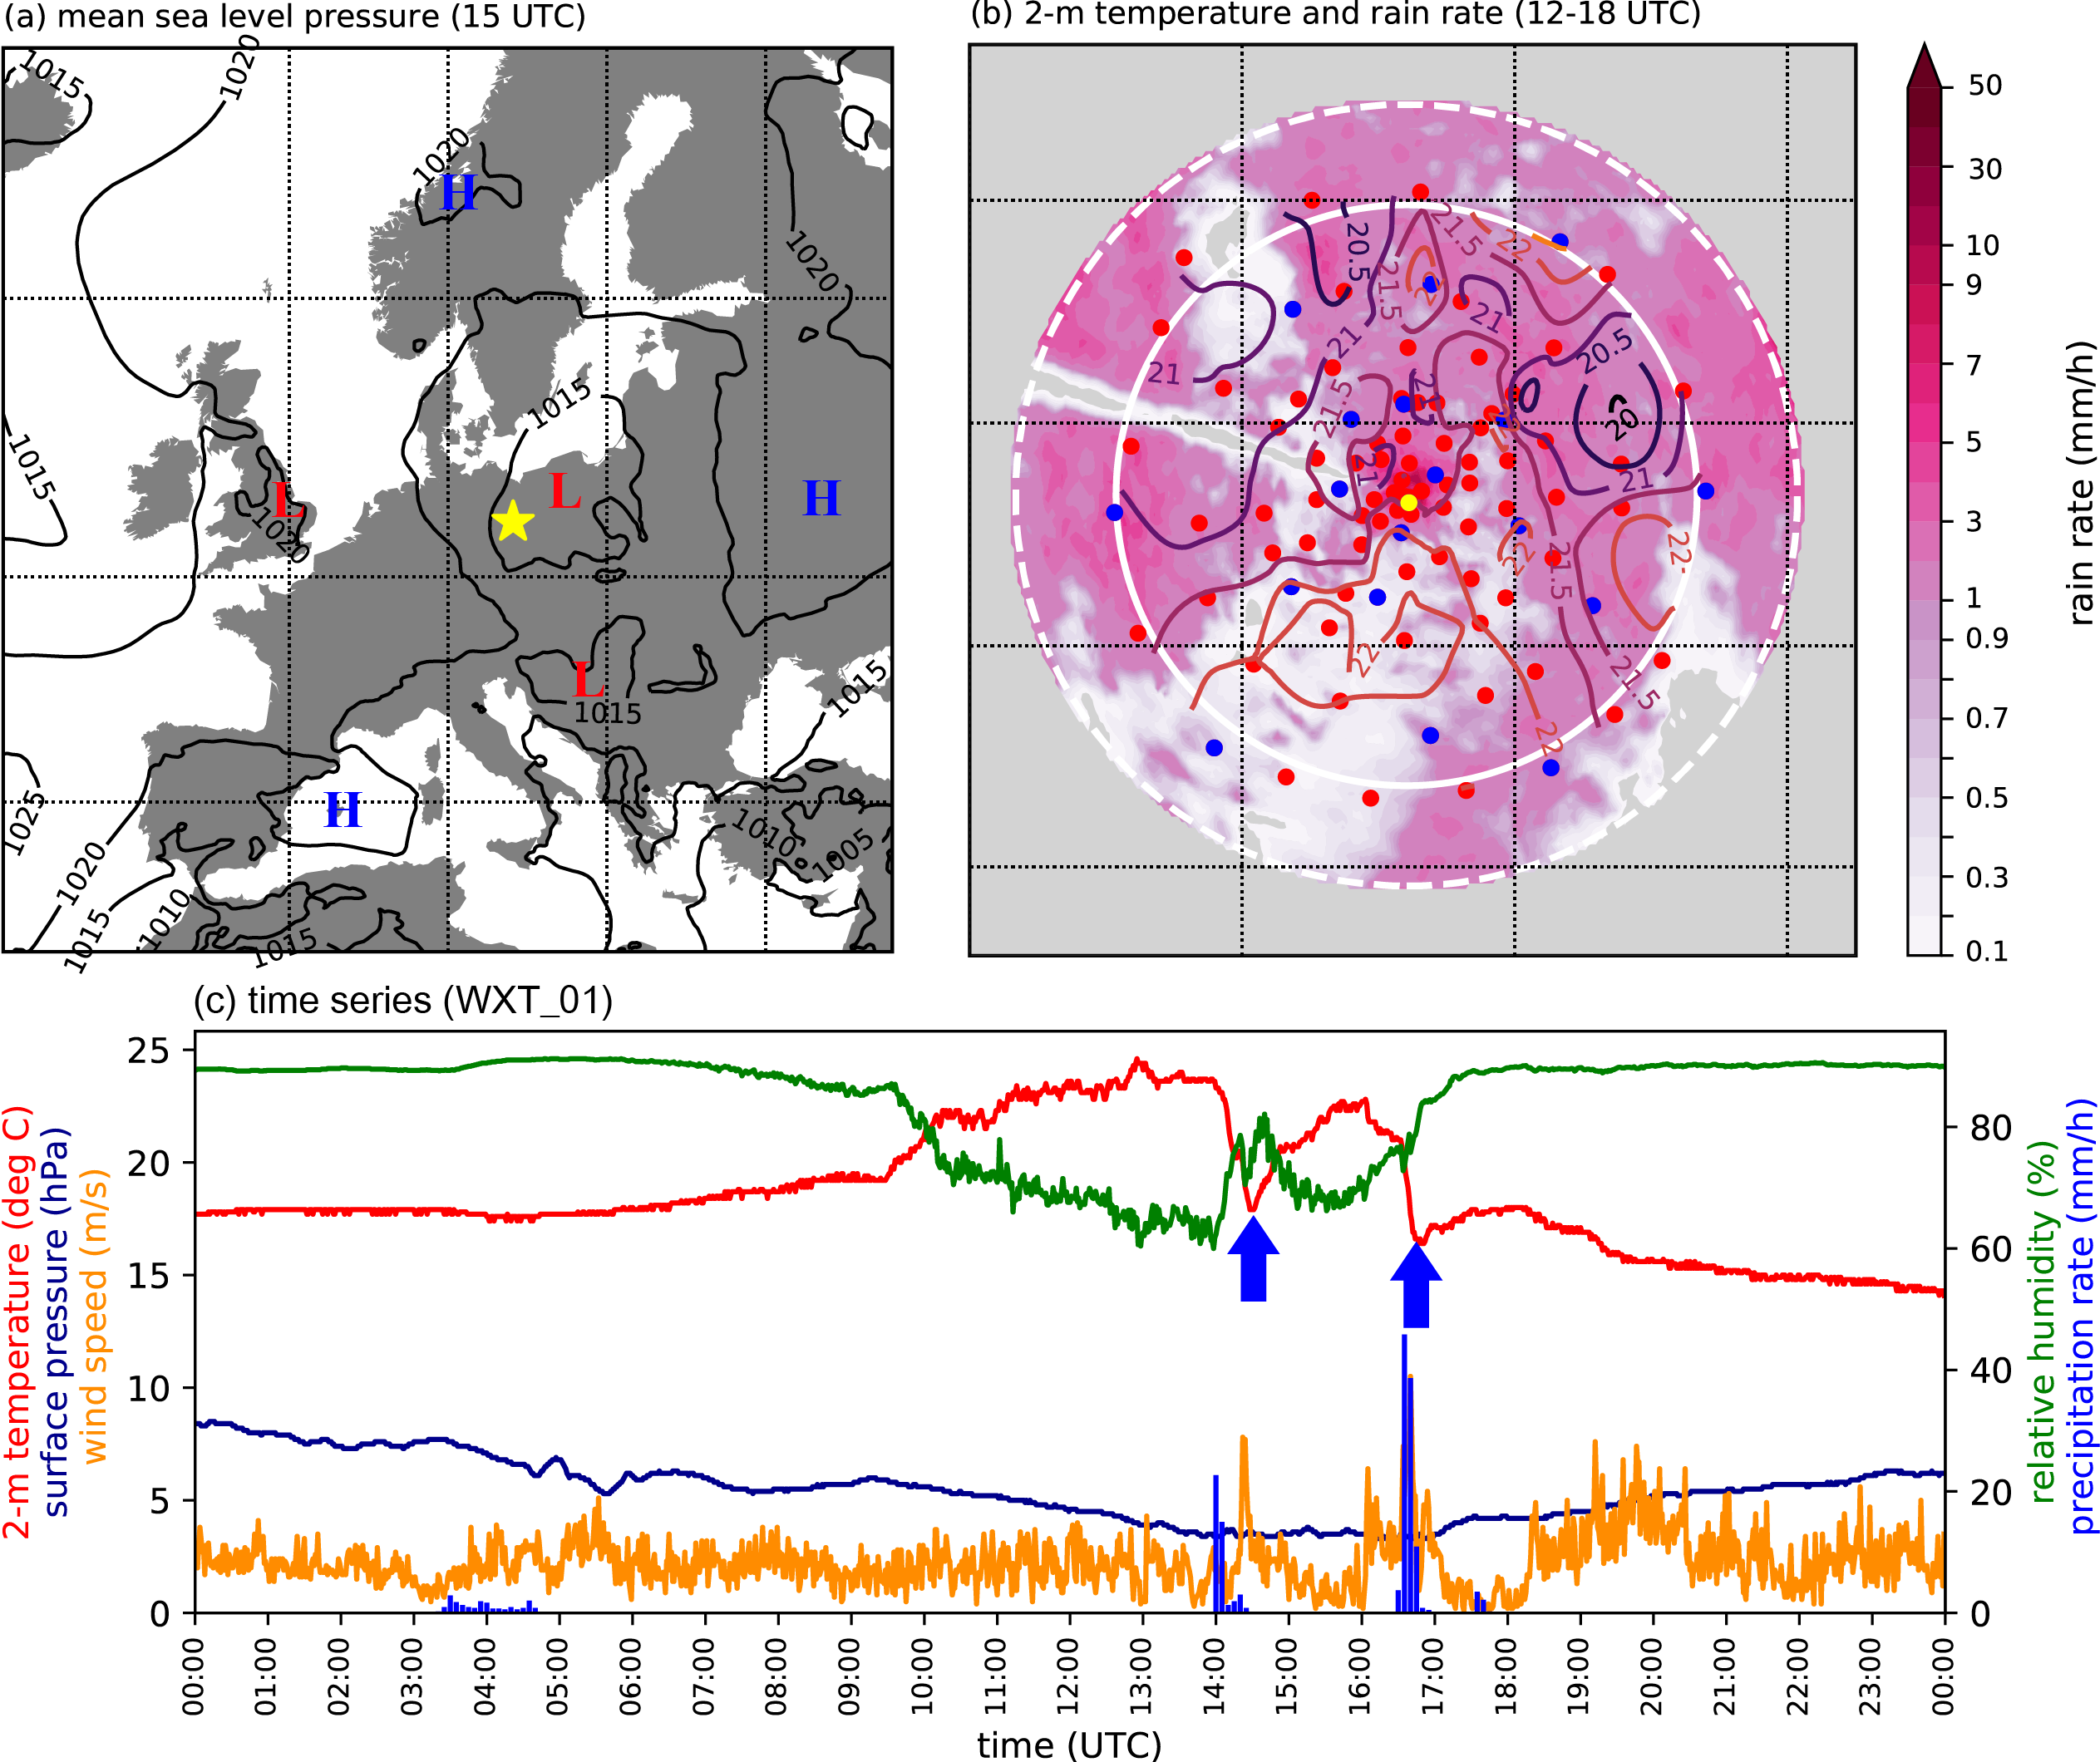
Robinson & Freitag cases – 9th Jul 2021
Several convective cells induce clear temperature decrease two times (1: Robinson at ~1400 UTC, |ΔT_{2m}|_{max} = -9.78K; 2: Freitag at ~1700 UTC |ΔT_{2m}|_{max} = -6.33K ).

Slide 11
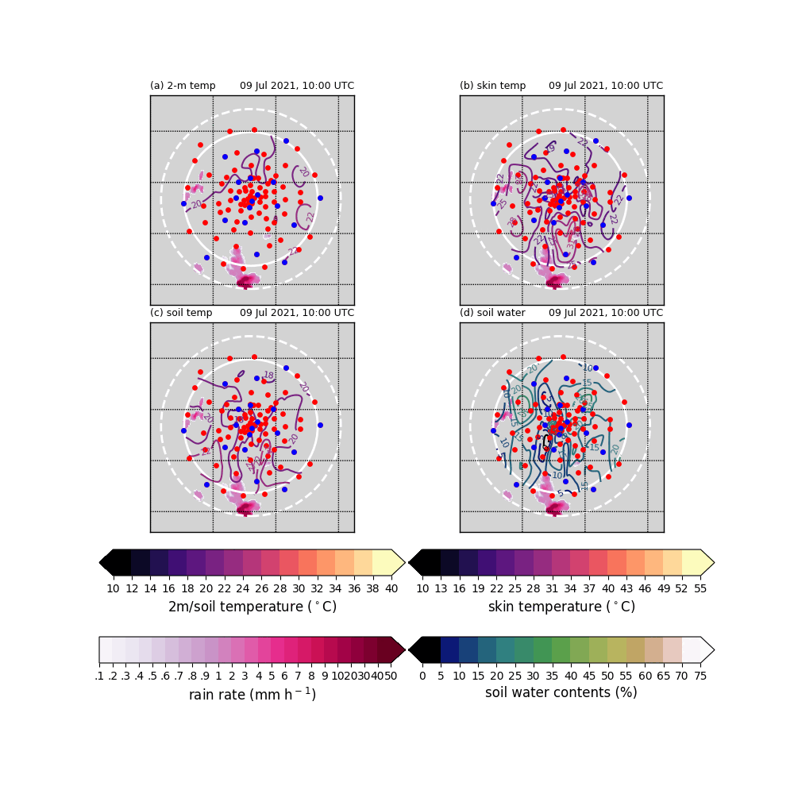
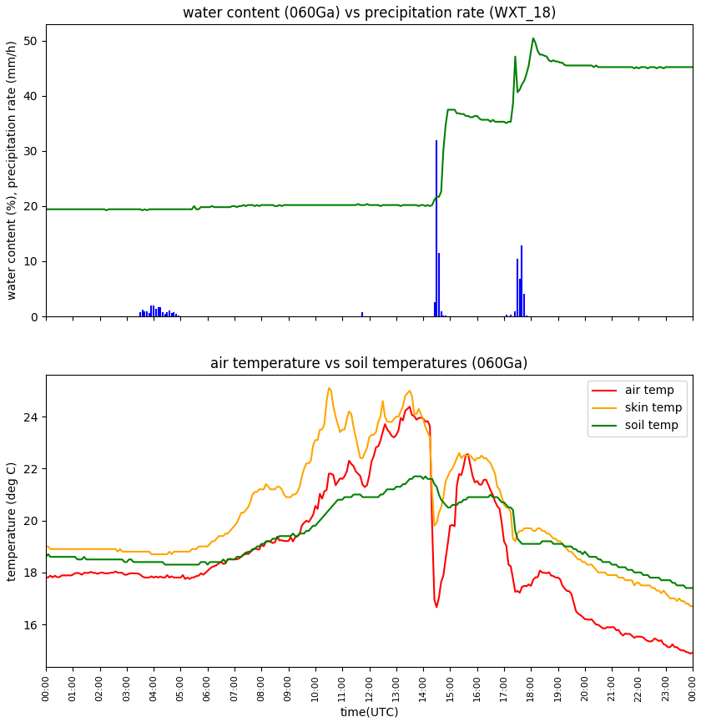
Robinson & Freitag cases – 9th Jul 2021
Several convective cells induce clear temperature decrease two times (1: Robinson at ~1400 UTC, |ΔT_{2m}|_{max} = -9.78K; 2: Freitag at ~1700 UTC |ΔT_{2m}|_{max} = -6.33K ).

Slide 12
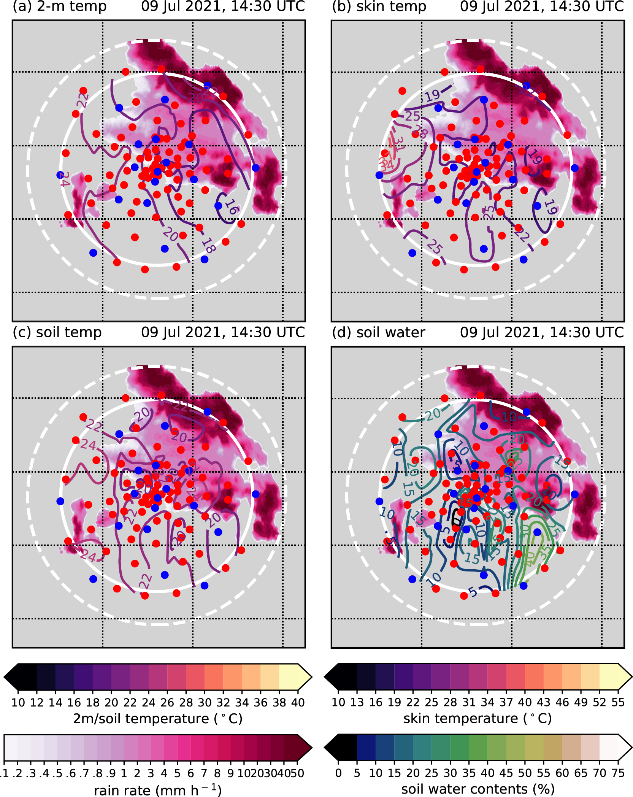
Robinson & Freitag cases – 9th Jul 2021
At north-eastern part of the domain affected twice by the precipitation and according temperature drops.
Two clear soil water content jumps are observed.

Slide 13
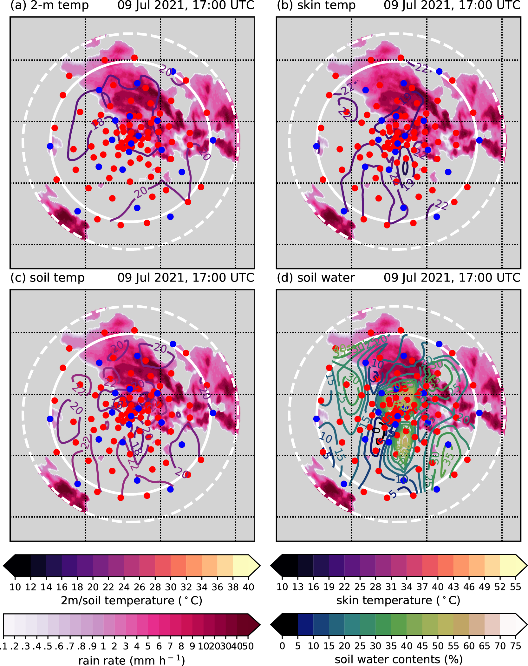
Robinson & Freitag cases – 9th Jul 2021
At north-eastern part of the domain affected twice by the precipitation and according temperature drops.
Two clear soil water content jumps are observed.

Slide 14
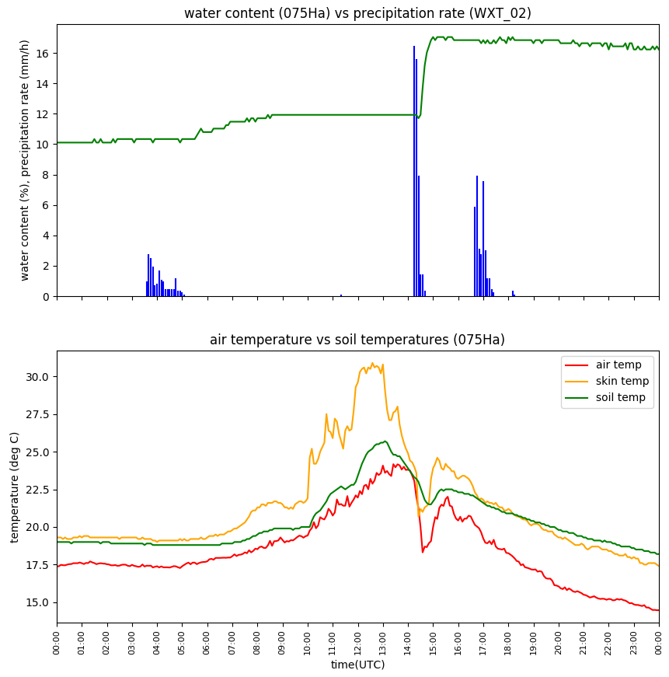
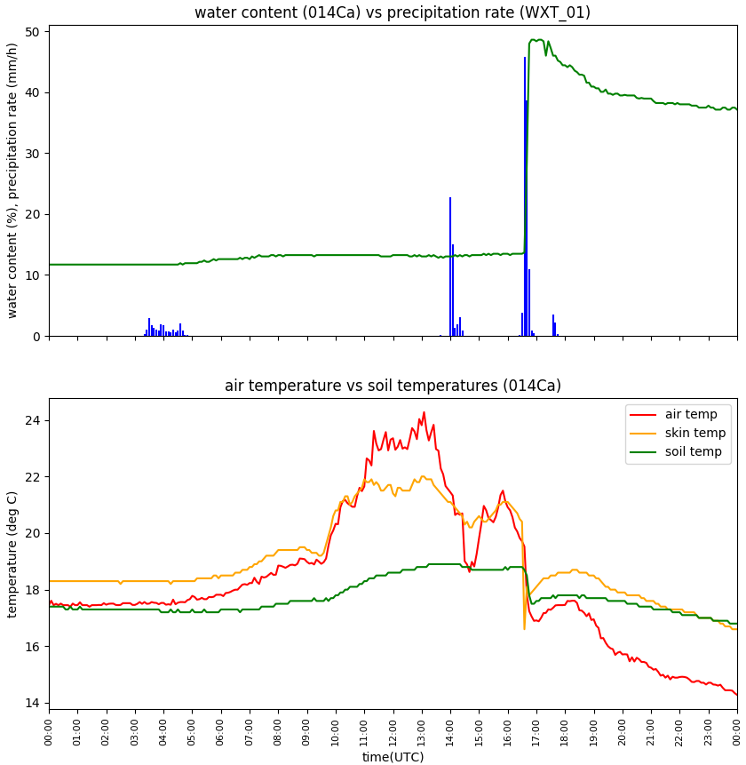
Soil tempearature and soil water content – 9th Jul 2021
Many stations observed precipitation without the soil water contents jump.
Mostly, the soil temperature drop follows the soil water contents jump.

Slide 15
Cold pool statistics

Slide 16
Cold pool statistics
T2↓ | Ts↓ | θs↓
Y | Y | Y | 13/21 (62%) | 7/13 (54%)
 |  | N |  | 6/13 (46%)
Y | N | Y | 8/21 (38%) | 0/8 (0%)
 |  | N |  | 8/8 (100%)
Jogi
T2↓ | Ts↓ | θs↓
Y | Y | Y | 24/37 (65%) | 15/24 (63%)
 |  | N |  | 9/24 (37%)
Y | N | Y | 13/37 (35%) | 1/13 (8%)
 |  | N |  | 12/13 (92%)
Robinson
T2↓ | Ts↓ | θs↓
Y | Y | Y | 10/25 (40%) | 8/10 (80%)
 |  | N |  | 2/10 (20%)
Y | N | Y | 15/25 (60%) | 5/15 (33%)
 |  | N |  | 10/15 (67%)
Freitag

Slide 17
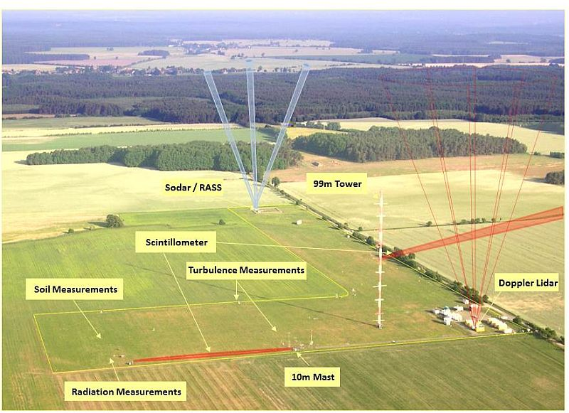
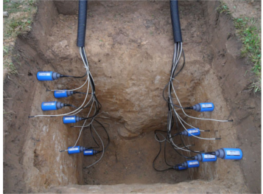
Soil measurement – Falkenberg supersite
At Falkenberg supersite, soil temperature at 12 levels (.05, .1, .15, .2, .3, .45, .5, .6, .9, 1, 1.2, and 1.5 m) and soil water contents at 6 levels (.08, .15, .3, .45, .9, and 1.05 m) are measured.

Slide 18
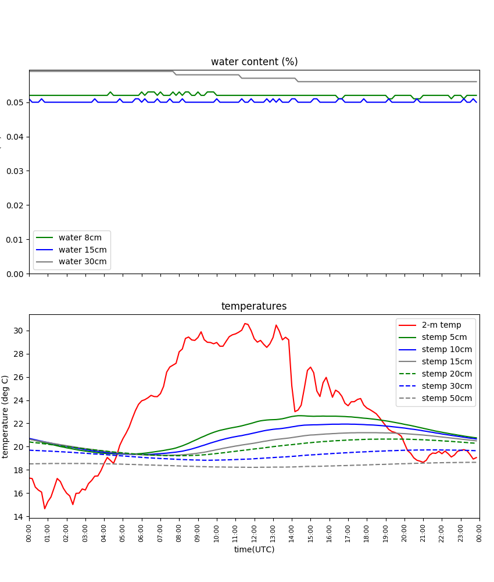
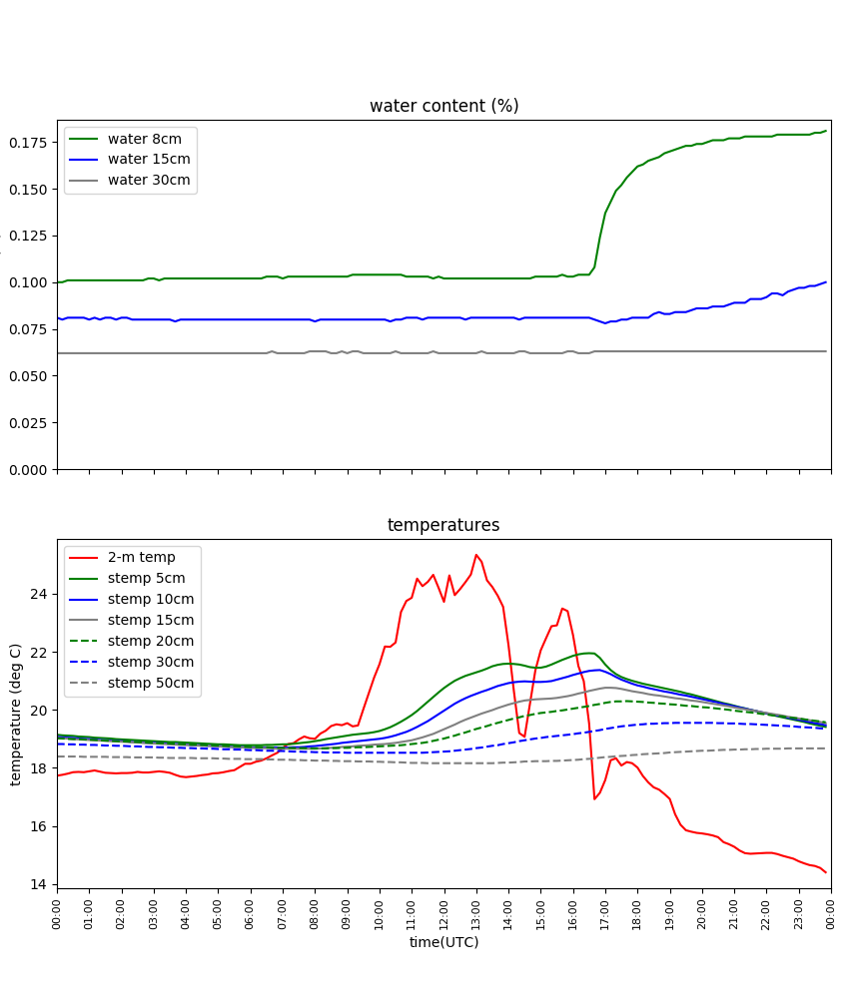
Soil tempearature and soil water content – Falkenberg site
Jogi
Robinson & Freitag
Soil water content increase vs. Soil temperature decrease

Slide 19

Conceptual temperature diffusion model
$$c_{soil}\frac{∂T}{∂t}=λ_{soil}\frac{∂^{2}T}{∂z^{2}}$$
c_{soil}: the soil heat capacity (J m⁻³ K⁻¹)
λ_{soil}: the thermal conductivity (J m⁻¹ K⁻¹ s⁻¹)
Idealized initial surface temperature (BC): T(t,z = 0) = T_{mean} + T_{diurnal}cos[Ω_{diurnal}(t – T_{max,diurnal})]
Idealized initial surface temperature profile:
T(t,z) = T_{mean} + T_{diurnal}exp[z/H_{diurnal}]cos[Ω_{diurnal}(t – T_{max,diurnal}) + z/H_{diurnal}]
H_{diurnal}: Diurnal e-folding depth
of the thermal forcing (m)
= sqrt(2k/Ω_{diurnal})
c_{soil} and λ_{soil} considering soil water content θ:
c_{soil} = ρ_{b}c_{soil} + ρ_{b}c_{w}θ
λ_{soil} = b₁ + b₂θ + b₃θ^{1/2} (from Chung and Horton 1987)
All parameters are determined using soil information, temperature statistics, and observation data of Falkenberg supersite.

Slide 20
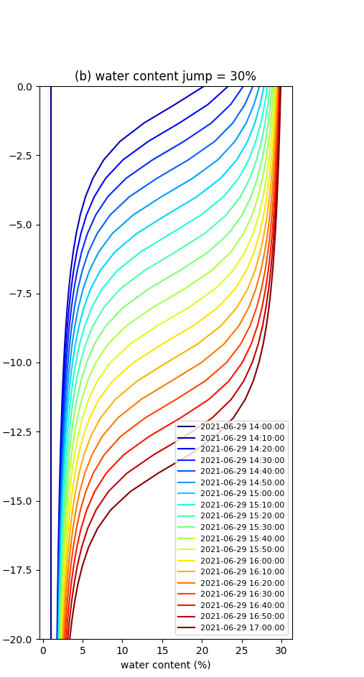

Conceptual temperature diffusion model
$$\frac{∂T}{∂t}=κ_{soil}\frac{∂^{2}T}{∂z^{2}}$$
κ_{soil}: the thermal diffusivity (m² s⁻¹)
The diffusion equation is numerically solved considering the linearly decreasing surface temperature during the first 10 minute and continuous moistening from the surface (4.58 cm h⁻¹).

Slide 21
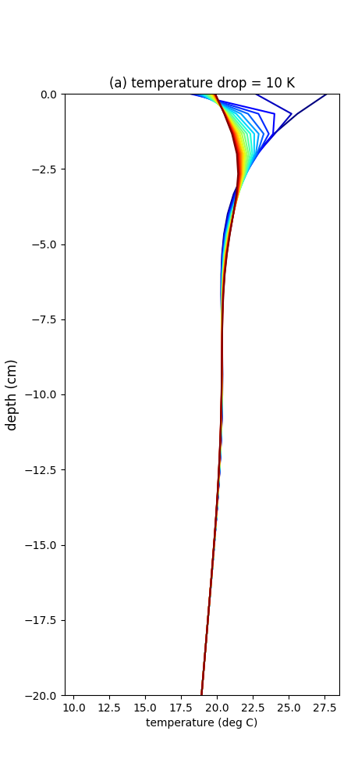
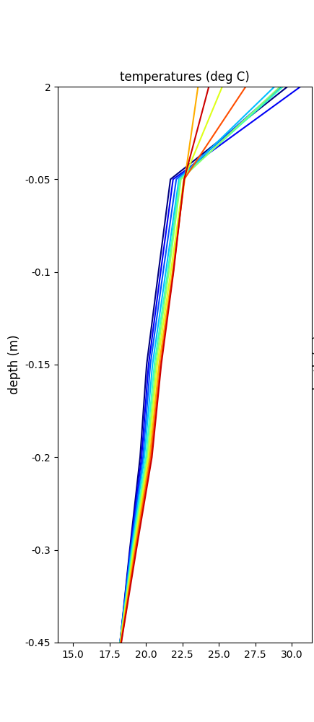
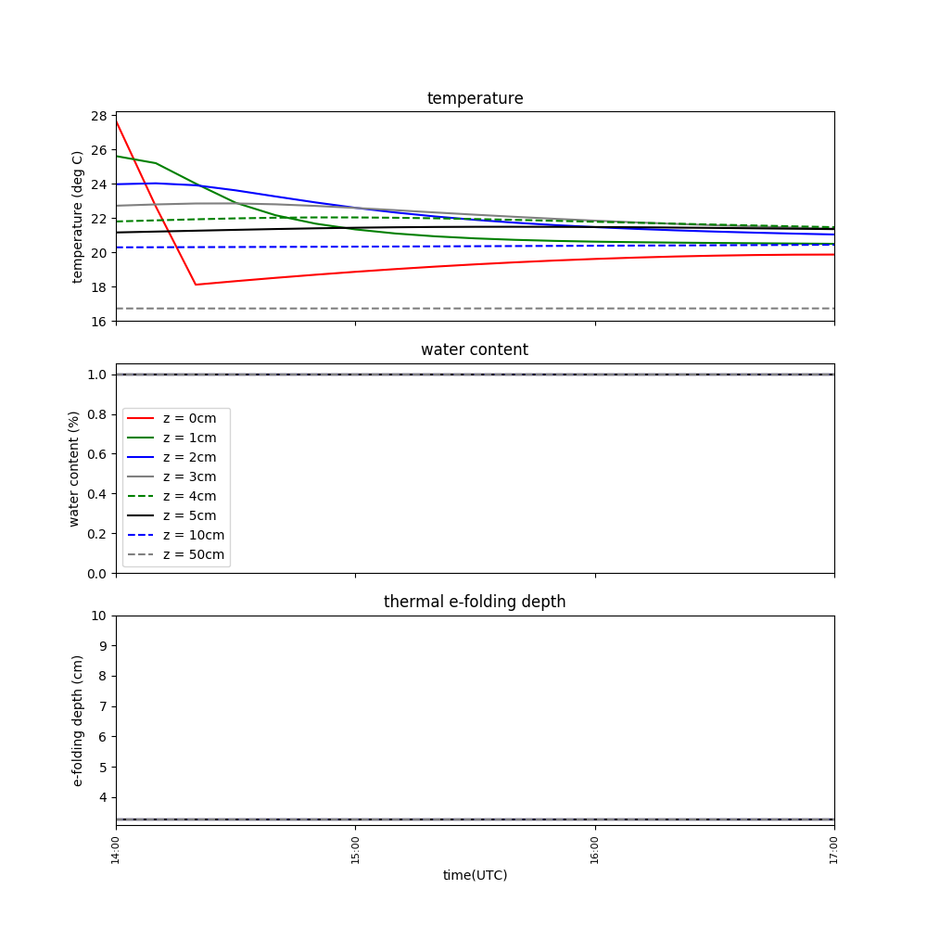
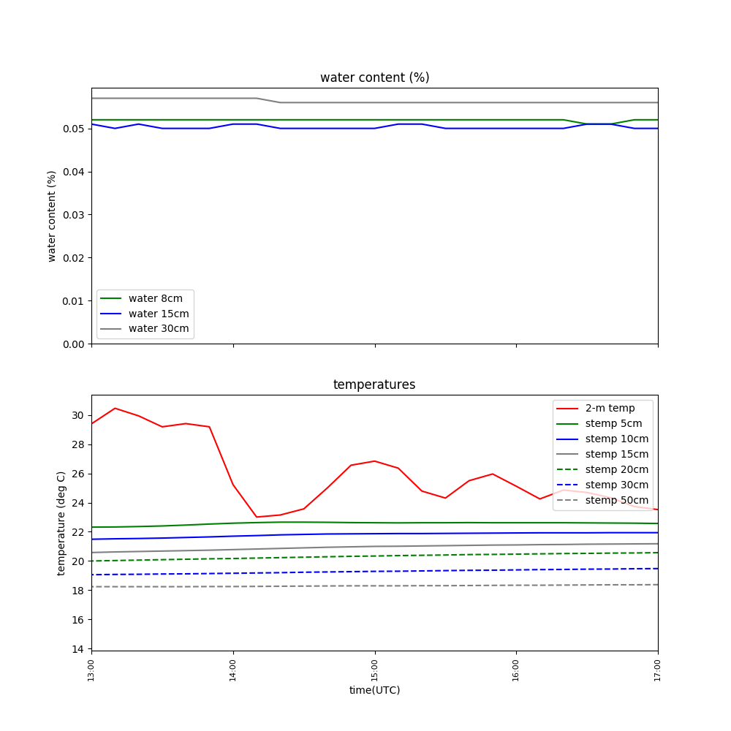
Temperature drop without water content jump
diffusion model
diffusion model
Jogi case
Jogi case

Slide 22
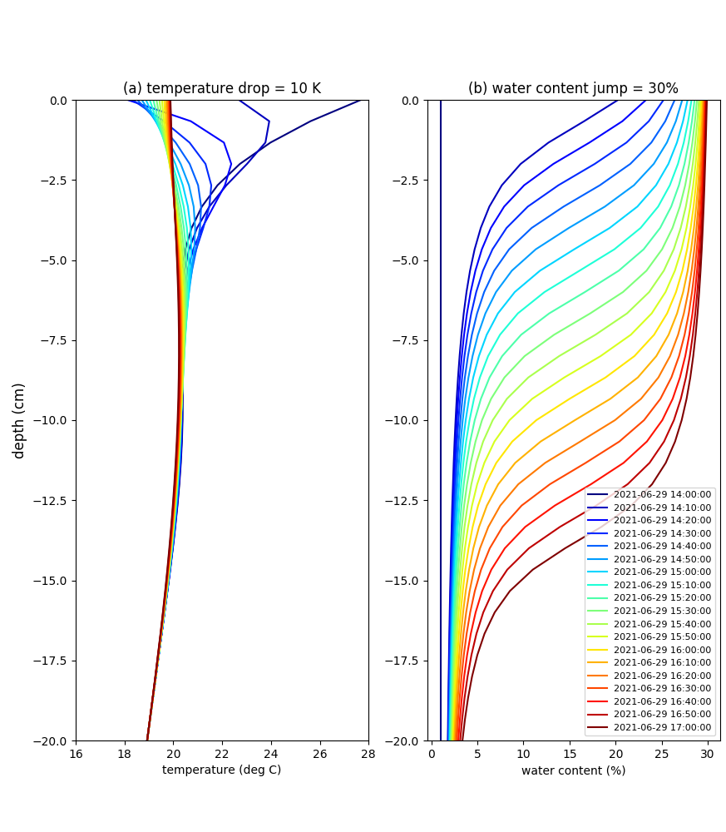
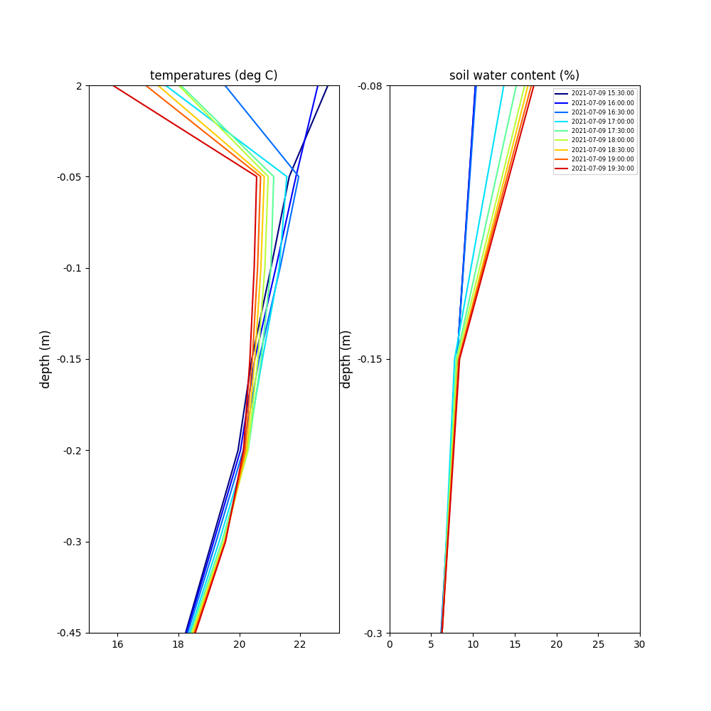
Temperature drop with water content jump
diffusion model
Freitag case

Slide 23
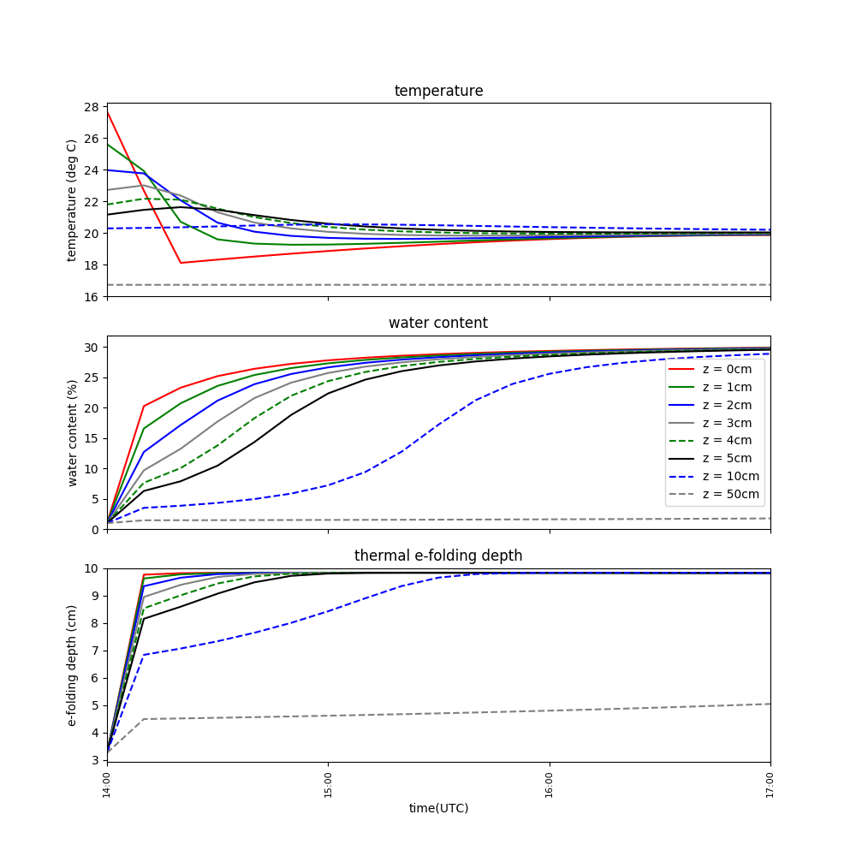
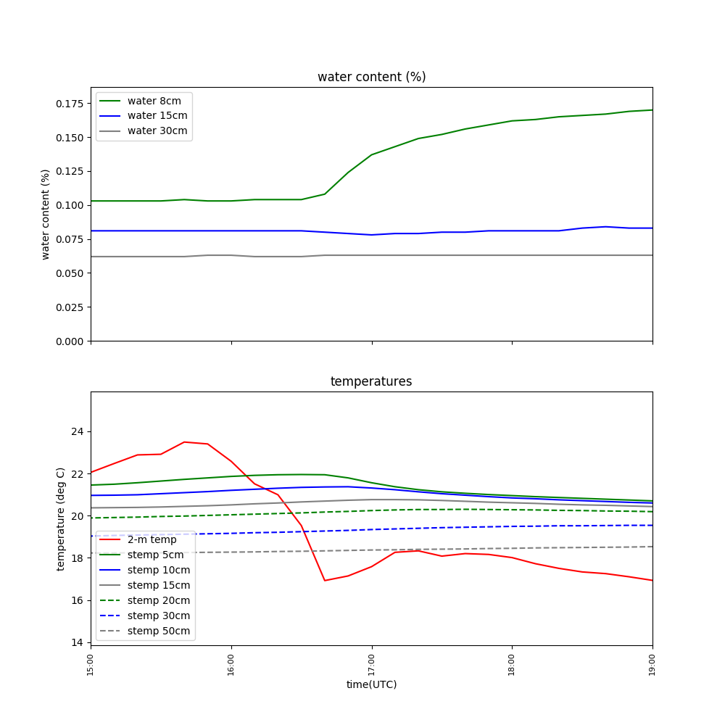
Temperature drop with water content jump
diffusion model
Freitag case

Slide 24
Summary
To examine how soil temperature is affected by air temperature decrease in cold pool events, the measurement data during FESSTVaL are analysed and an ideal thermal diffusion model is conducted.
Many observed soil temperatures are decreased during cold pool events when the soil water contents are accordingly increased.
Thermal diffusion model results suggest that one possible reason is thermal diffusivity increase due to the increase of the soil water content from very low (~ 5%) level to certain threshold level (~20% here).
Further studies are still necessary to explain many exceptional cases.

