Slide 1
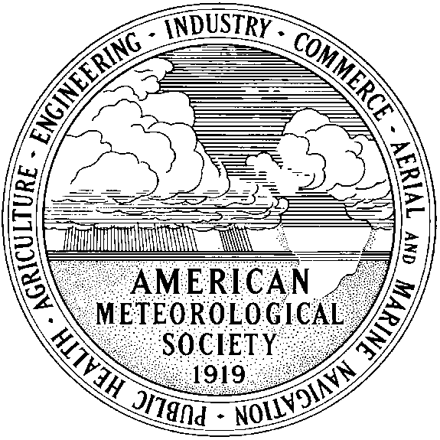
Improving Communication Between Meteorologists and Oceanographers: The American Meteorological Society’s Committee on Oceans, Coasts and the Blue Economy
Pamela Emch
Emch & Associates, Redondo Beach, CA, USA
Chair, AMS COCBE
2023 Annual Meeting of the European Meteorological Society
Bratislava, Slovakia
Session ES2.1 Communication and Media
6 September 2023

Slide 2
American Meteorological Society (AMS) Membership
Over 13,000 professionals in the atmospheric, oceanic, hydrologic, and related sciences and areas
~1/3 academic, 1/3 public/government, 1/3 private sectors
Among scientific disciplines likely higher percentage in atmospheric science
~ 3,000 students
~ 1,000 Associate Members — individuals outside the atmospheric and related sciences, such as weather enthusiasts, K-12 teachers, etc.

Slide 3
AMS Volunteer Commissions
Council
(elected)
Education and
Human Resources
Scientific and
Technological Activities (STAC)
Publications
Professional Affairs
Commissions
Planning
Weather, Water and
Climate Enterprise (CWWCE)
Under the six commissions there are over 140 boards and committees on which over 1000 volunteers serve

Slide 4
AMS and Oceanographers
AMS leadership has wanted to strengthen interactions and ties between AMS and the oceanographic community
The AMS Scientific & Technological Activities Commission (STAC) includes at least three committees partially focused on ocean-related topics
Committee on Air-Sea Interactions, Committee on Atmospheric and Oceanographic Fluid Dynamics, Committee on the Coastal Environment
Organize sessions at AMS Annual Meeting, etc.
Oceanographers have commented: “Typically these committees tend to be very atmospheric science centric.”

Slide 5
In Fall 2020 AMS Initiated the Committee on Oceans, Coasts and the Blue Economy (COCBE)
Resides in the AMS Commission on the Weather, Water, and Climate Enterprise (CWWCE)
CWWCE’s broad charter includes outreach to user community, communication, policy, economics and AMS strategic objectives
COCBE Key Goals
Strengthen ties with oceanographic community above and beyond those engendered in existing AMS committees
Increase sessions and speakers related to the nexus between oceanography and atmospheric science
Include wide-ranging topics: outreach to broader maritime user community, maritime transportation, decision support, economic factors, policy, and weather, water, climate, & environmental strategic initiatives

Slide 6
COCBE Members’ Institutions Span Sectors
Public / Gov’t
Integrated Ocean Observing System, NOAA (US National Oceanic and Atmospheric Administration)
Ocean Applications Branch, NOAA/NWS Ocean Prediction Center
Nat’l Ocean Service Ctr for Oper. Oceanographic Prod. & Serv., NOAA
Northwest Fisheries Science Center, NOAA Fisheries
Office of the Oceanographer of the Navy, US Navy / Pentagon
Private
ArcVera Renewables; Lynker Technologies; Jupiter Intelligence; Sonardyne International
Academic
London School of Economics
Dept. of Marine Sciences, University of Georgia
Scripps Institution of Oceanography, California
After three years the committee now has a full membership of 12 individuals

Slide 7
Accomplishments
Organized sessions at AMS Annual Meeting
Healthy Oceans: Sustainability, Economics, and Environmental Security
How Ocean Data, Information and Knowledge Delivers Societal and Economic Benefits in US Coastal Waters and Regions
Extreme Maritime Weather, including talks on
Container ship roll
Public-private partnership to ensure super tankers move safely in and out of port (Ports of Los Angeles & Long Beach)
Public weather services for ports
Modernized forecasts and warnings for the high seas
Extra tropical and tropical cyclones
Ship tracking analyses
Organized sessions at AMS Washington Forum (science & policy)
Data and information needs/gaps for offshore wind energy capture in US waters & lessons to be learned from Europe
Secured keynote speakers representing oceanographic community

Slide 8
Future Plans
Continue organizing and leading meeting sessions
Work with AMS and other entities on education / workforce of the future
Span meteorology, oceanography, changing environment, coastal areas, +
Increase international membership, topics, meeting attendance
Attract members from, and increase collaboration with, other societies and organizations, such as the Marine Technology Society (MTS)
Improve committee social media profile and outreach

Slide 9
Review of Goals and Challenges
Have We Achieved Our Goals?
Increase sessions related to oceanography/meteorology nexus
Strengthen ties with oceanographic community
Good communication within our committee, which includes meteorologists and oceanographers
Challenges
Our AMS meeting sessions are only moderately well attended
Meteorologists gravitate to other sessions that they typically attend
Many oceanographers don’t generally think of AMS & AMS meetings as being a home for oceanography – they go to other meetings/societies
Need to improve awareness of our committee within and outside of AMS
Our committee has had good momentum for a new, growing committee.
It’s now at a “critical mass” membership that should help us move forward.

