Slide 1
Is poor communication a reason for why we still are moving in the wrong direction?
The emission of greenhouse gases has not yet abated
EMS 2023-106, Bratislava, Sept. 6.
Notes:
Abstract: Past measurements of atmospheric CO2-concentrations indicate a steady annual increase since 1958 when the observations started. In the meanwhile, there have been numerous reports published on the state of the climate, climate change and its consequences (e.g. The Charney Report in 1979 and six assessment reports from the Intergovernmental Panel on Climate Change, IPCC, in 1990, 1995, 2001, 2007, 2013, and 2021). The track-record for scientific communication in the past can be described as a failure since the CO2-levels have kept increasing in spite of the warnings from the IPCC and the scientific community. In 2022, the emission of CO2 from coal, oil and gas was higher than ever.
On the other hand, the media has become more climate literate, and there are today almost daily news headlines on climate-related stories. There are also some advances towards a more sustainable future, such as renewable energy sources and carbon trading. The question is nevertheless whether the message from the scientific community has been too difficult or too vague for those policymakers who influence the extraction of coal, oil and gas. An example of the message not being loud and clear is the IPCC’s sixth summary for policy-makers (SPM) of the synthesis report. There seem to be two communication problems: (1) relevant and important policy-makers don’t seem to understand the IPCC’s summary meant for them, and (2) those writing the SPM don't seem to learn from feedback from scientists who try to convey an understanding of our challenges regarding climate change. It’s important to takestock and learn from both mistakes and successes.
So what can the EMS do? Write a joint statement together with the AMS or offer the IPCC some advice?
1)https://www.carbonbrief.org/analysis-global-co2-emissions-from-fossil-fuels-hit-record-high-in-2022/
2)https://www.realclimate.org/index.php/archives/2023/04/the-summary-for-policymakers-of-the-intergovernmental-panel-on-climate-change-sixth-assessment-reports-synthesis/
How to cite: Benestad, R.: Is poor communication a reason for why we still are moving in the wrong direction?, EMS Annual Meeting 2023, Bratislava, Slovakia, 4–8 Sep 2023, EMS2023-106, https://doi.org/10.5194/ems2023-106, 2023.

Slide 2
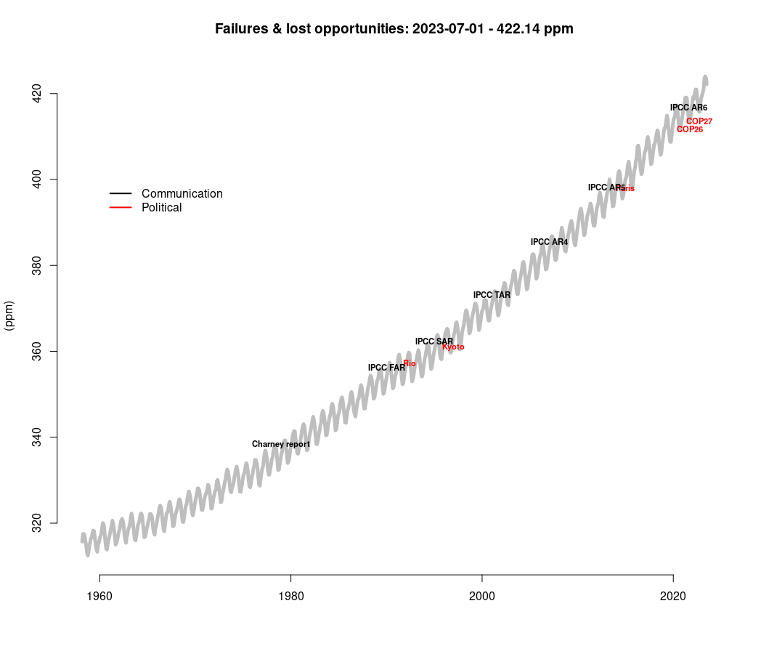
What’s the story?
Why, despite scientific reports and climate summits?
No single answer?
Notes:
https://www.theguardian.com/science/2023/jul/27/scientists-july-world-hottest-month-record-climate-temperatures

Slide 3
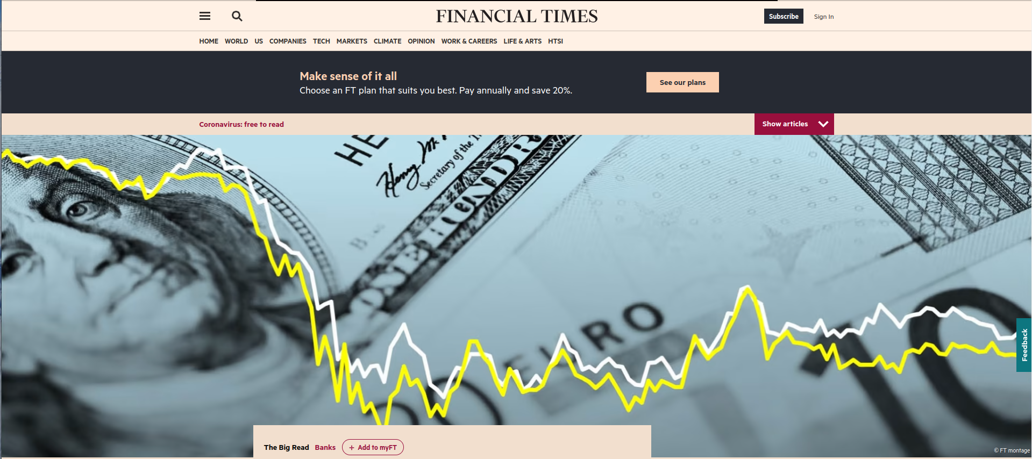

Slide 4
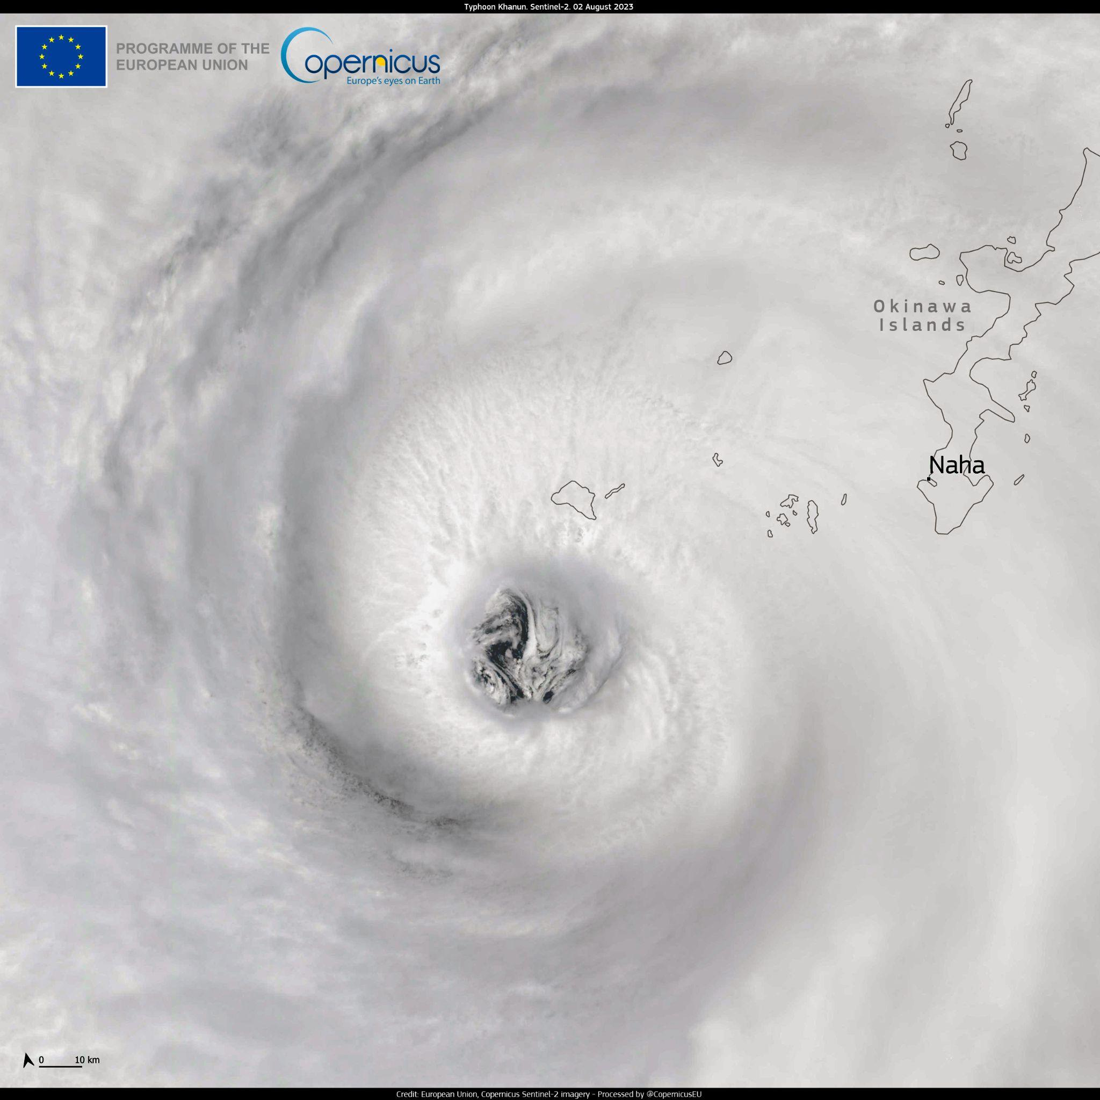
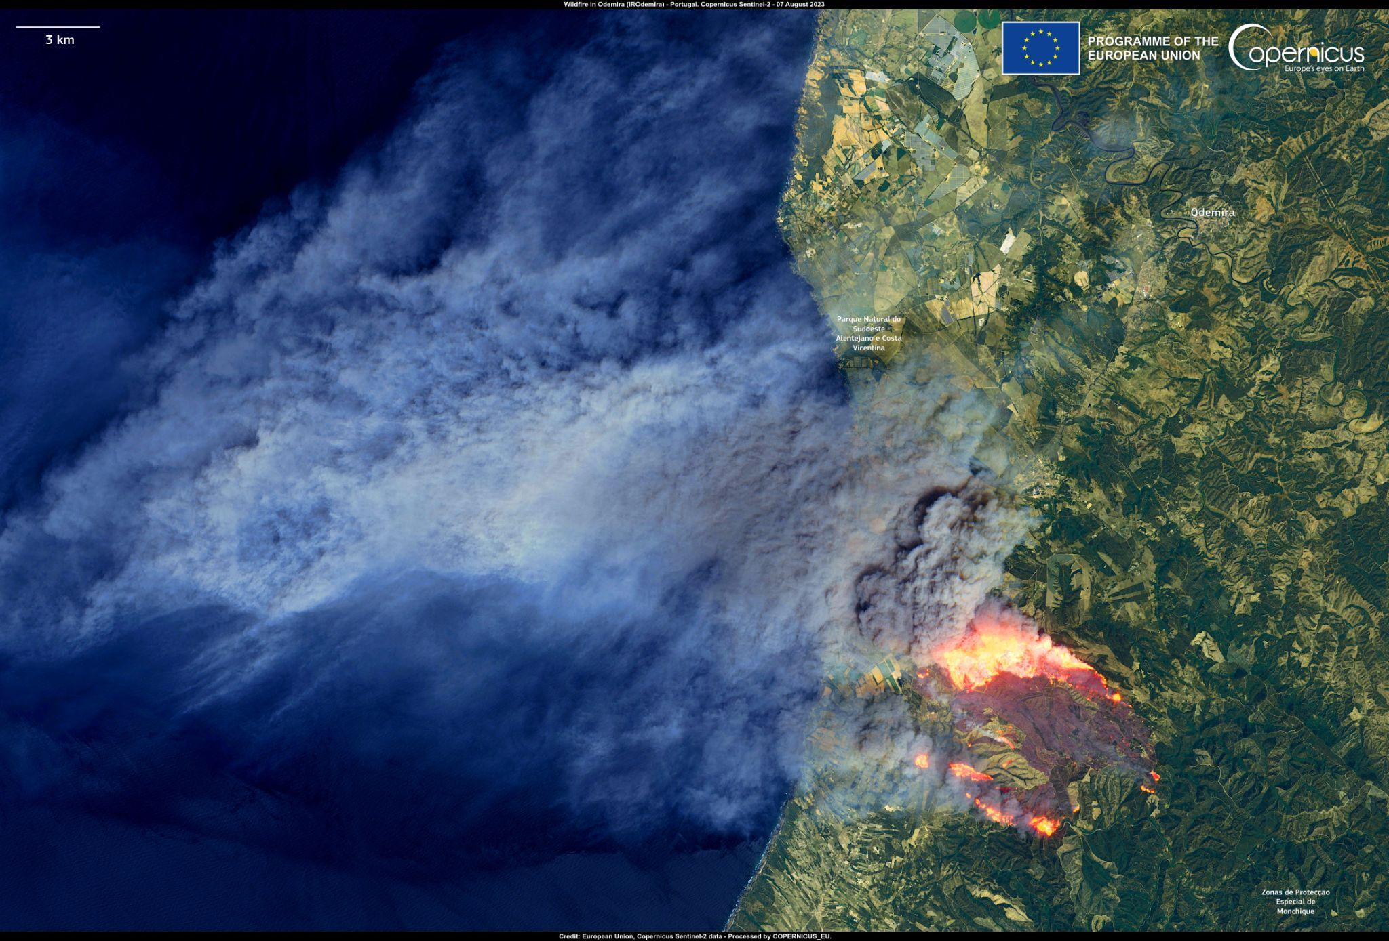
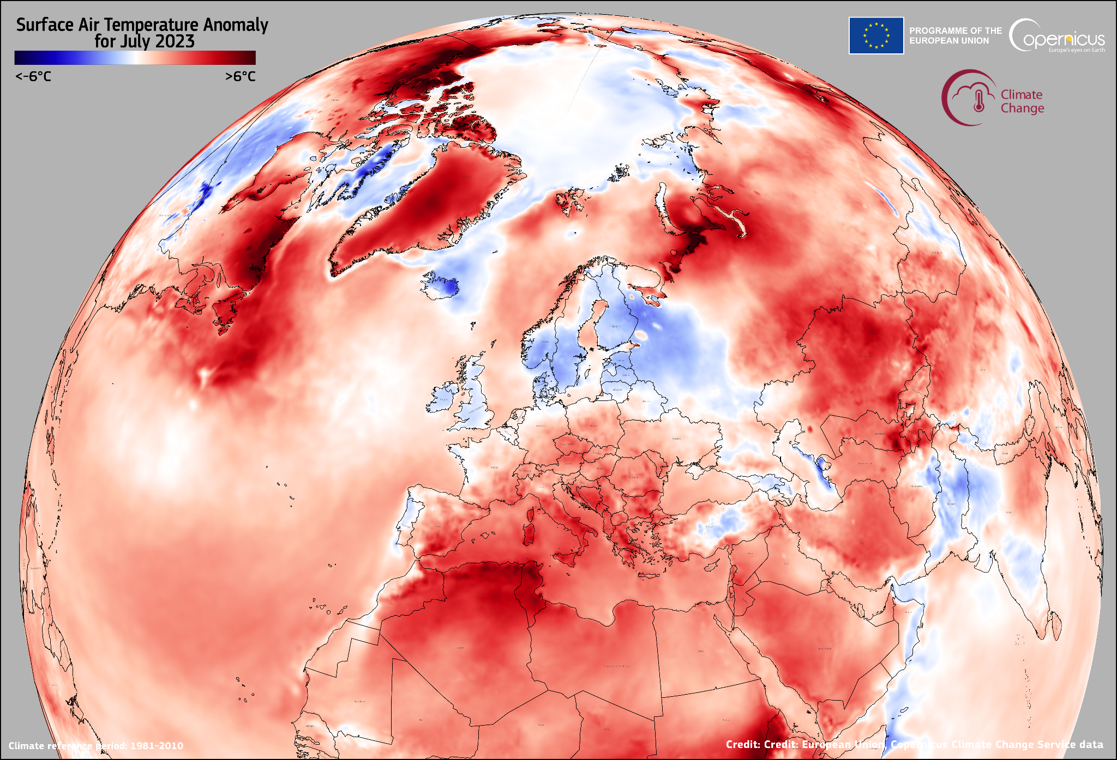
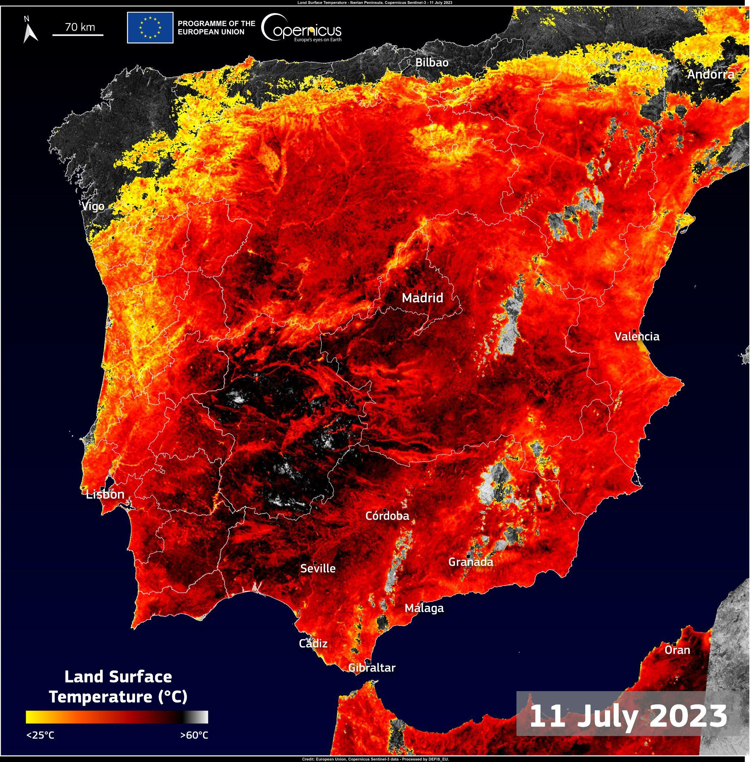
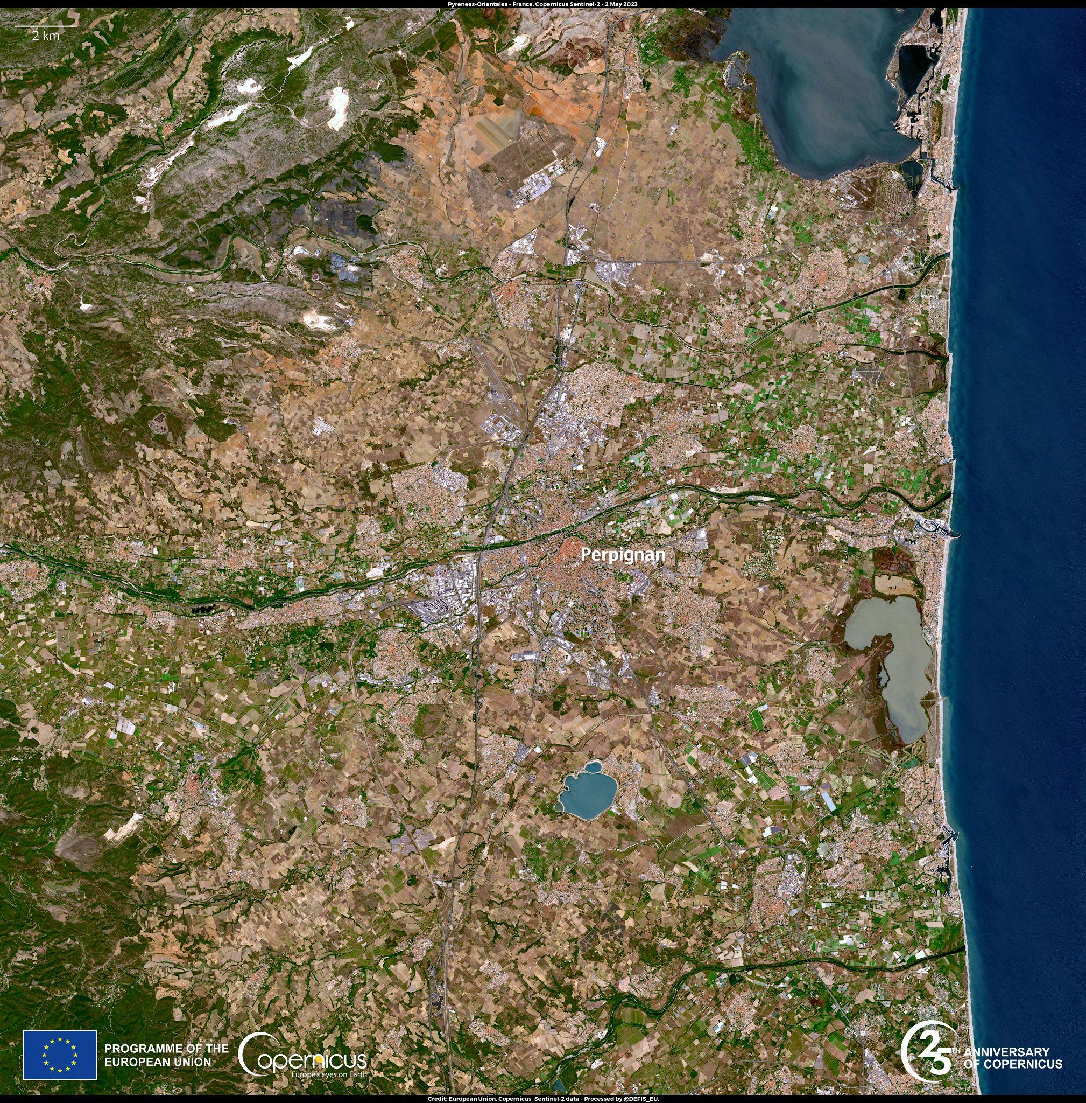
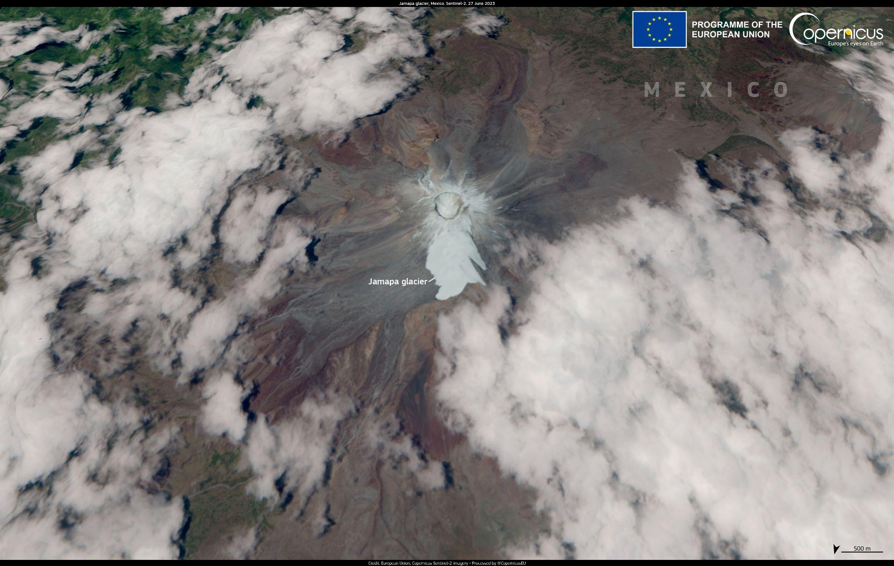
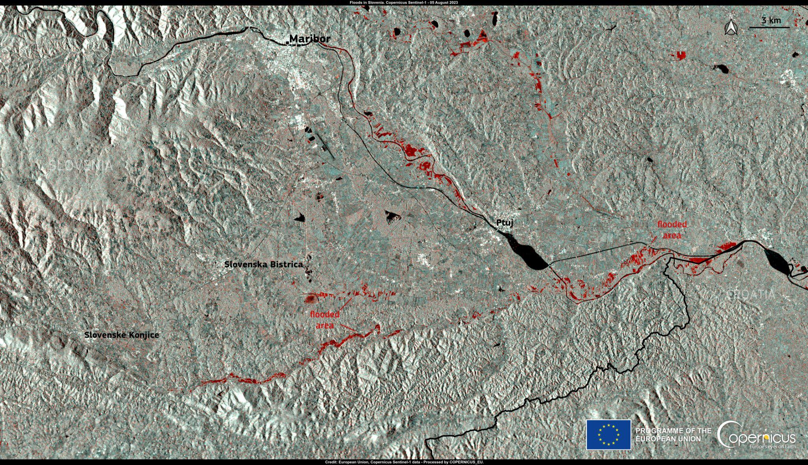
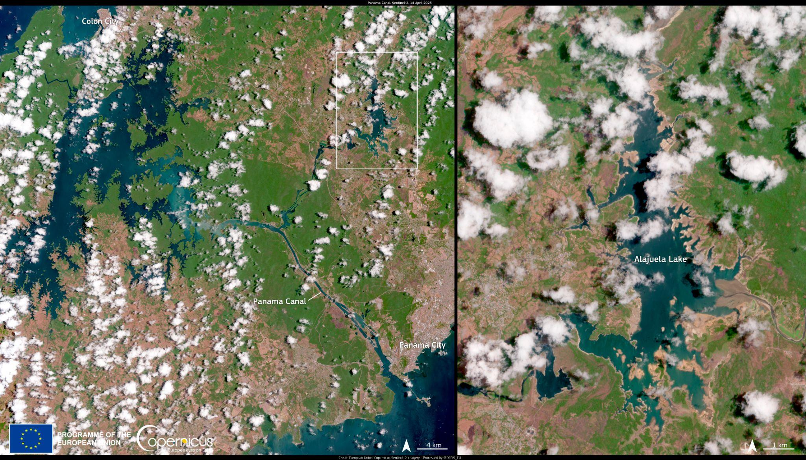
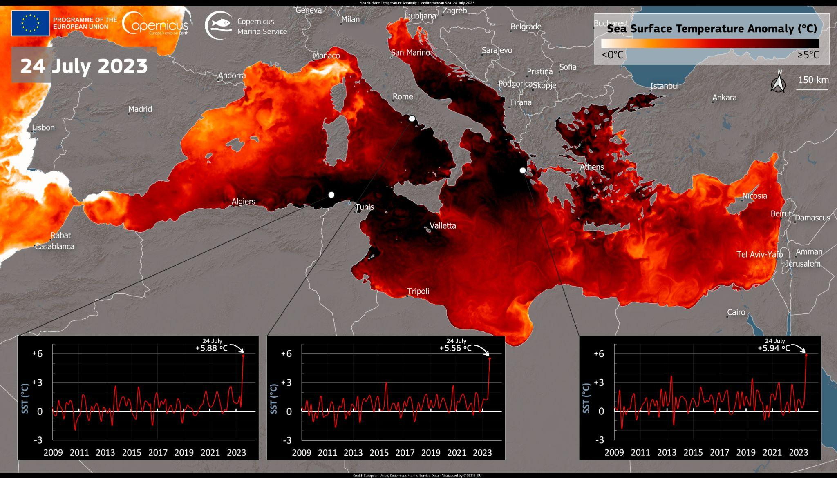

Slide 5
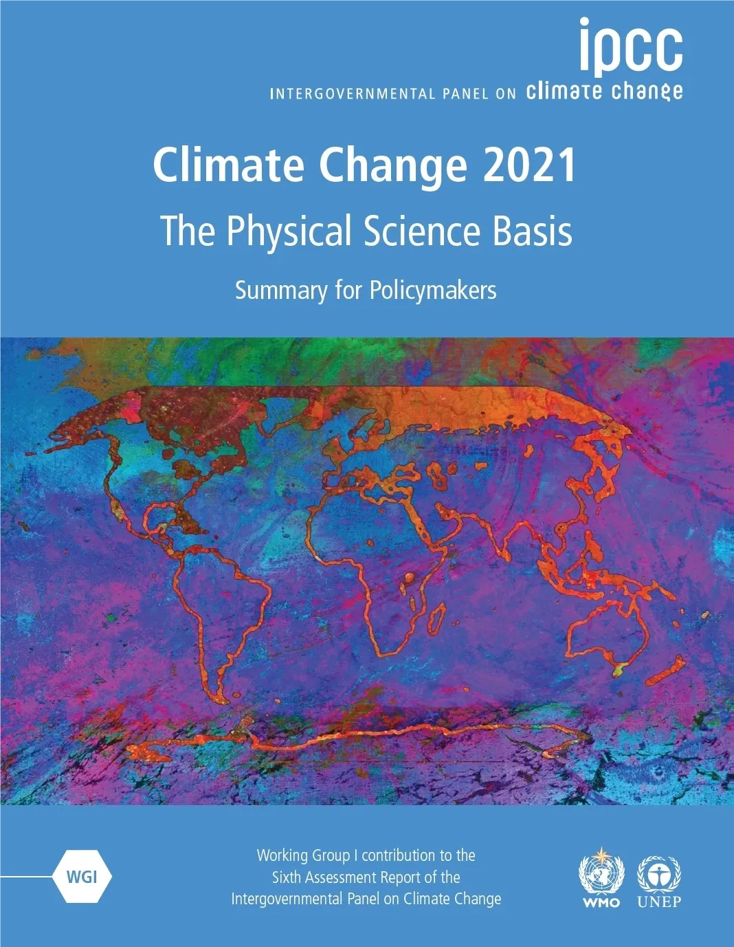
A likely outcome, after all?
Efforts spent on increasing the CO₂-concentrations in the atmosphere.
Repeated alerts which weren’t heeded?

Slide 6
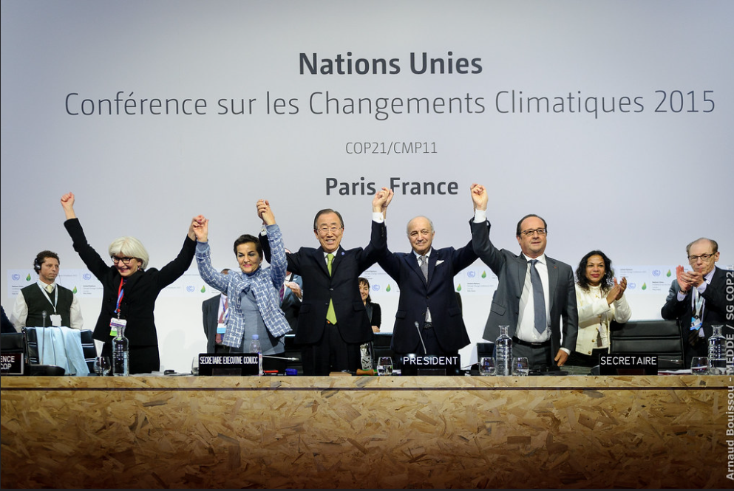
What hasn’t & has changed within last decades?
Little change within climate science
Our CO₂-emissions continue to grow.
The same people in power the last decades.
Nice speeches from leaders.
Good progress regarding renewables.
Media is more aware about climate change.
The younger generation has woken up.

Slide 7
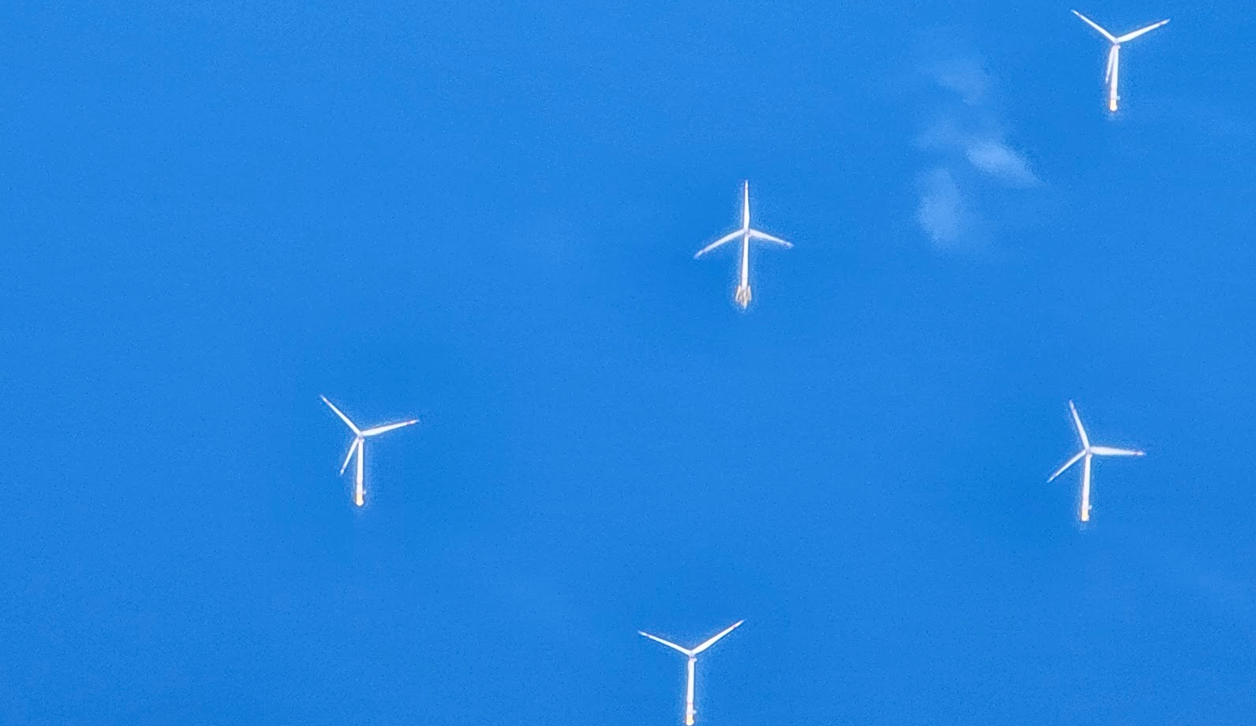
Different business opportunities & different forces for renewable & fossils

Slide 8
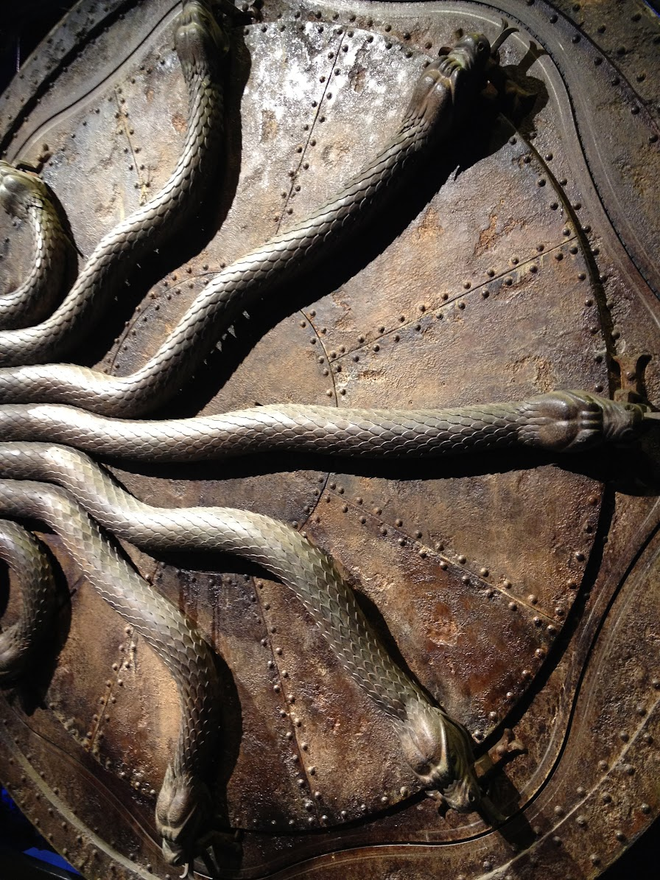
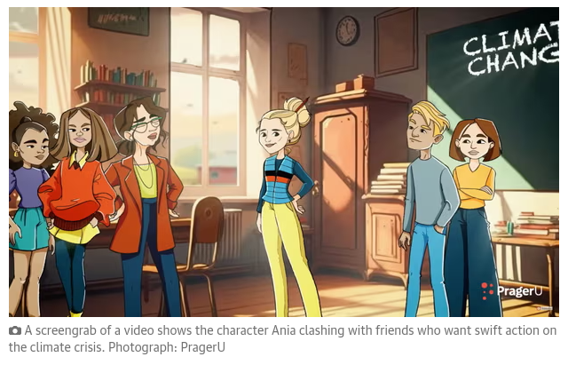
Climate disinformation?
Facsimile the Guardian, August 10, 2023
Denial
Conspiracy theories
“Greenwash”
“Inevitable”
Captured by the past
Invisible forces?
Notes:
https://www.theguardian.com/us-news/2023/aug/10/florida-ron-desantis-climate-vidoes-school-curriculum

Slide 9
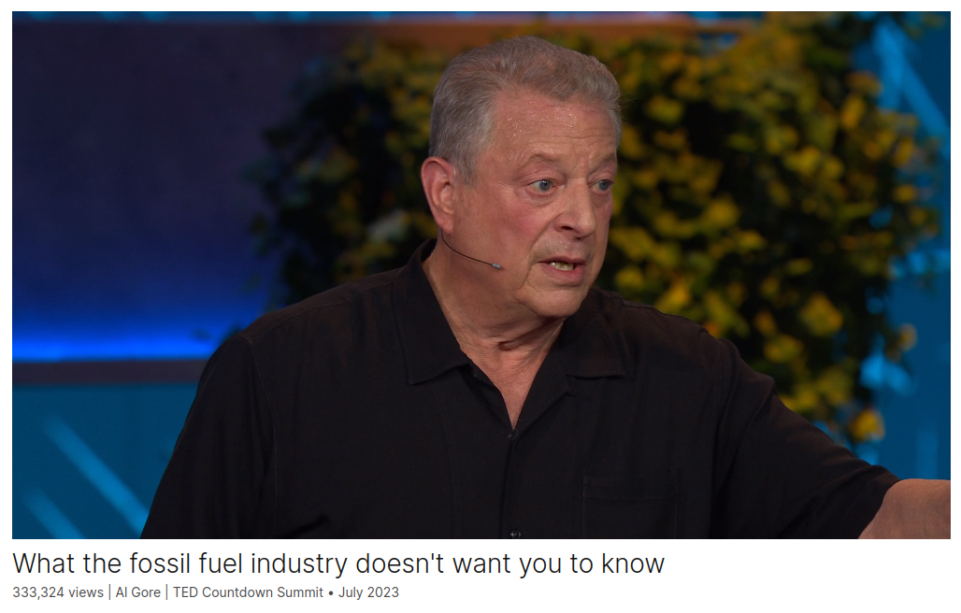
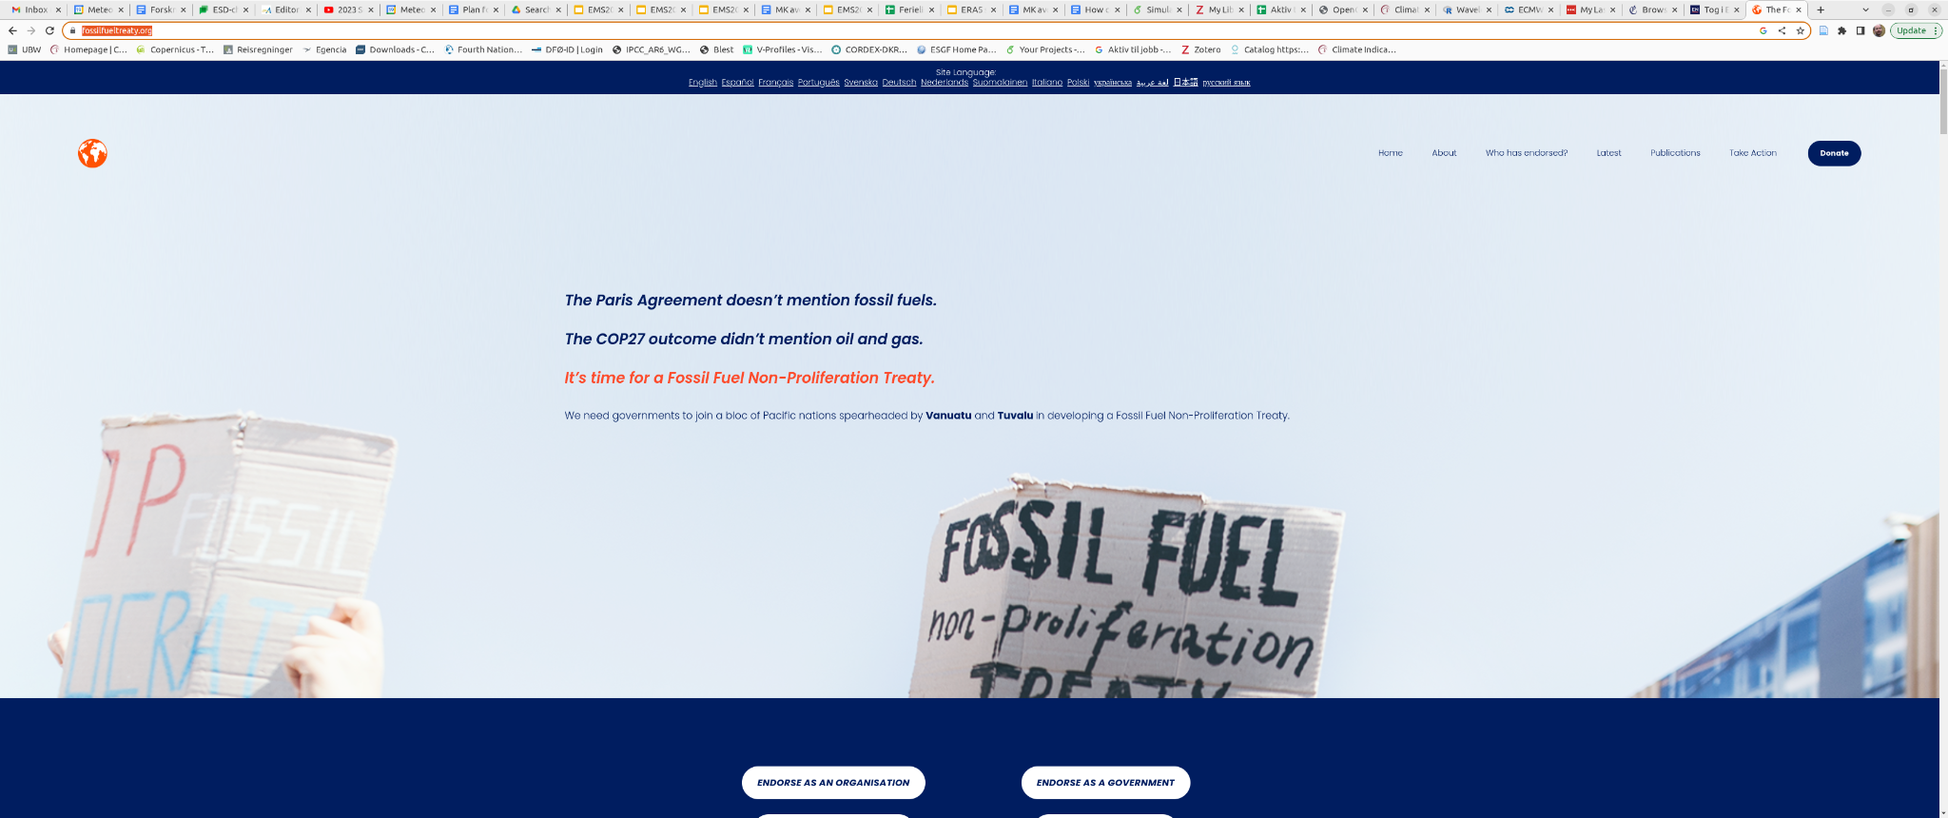
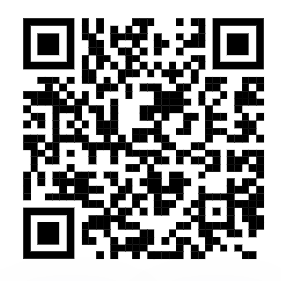
https://shorturl.at/wHPR4
https://fossilfueltreaty.org/
Notes:
https://www.ted.com/talks/al_gore_what_the_fossil_fuel_industry_doesn_t_want_you_to_know

Slide 10
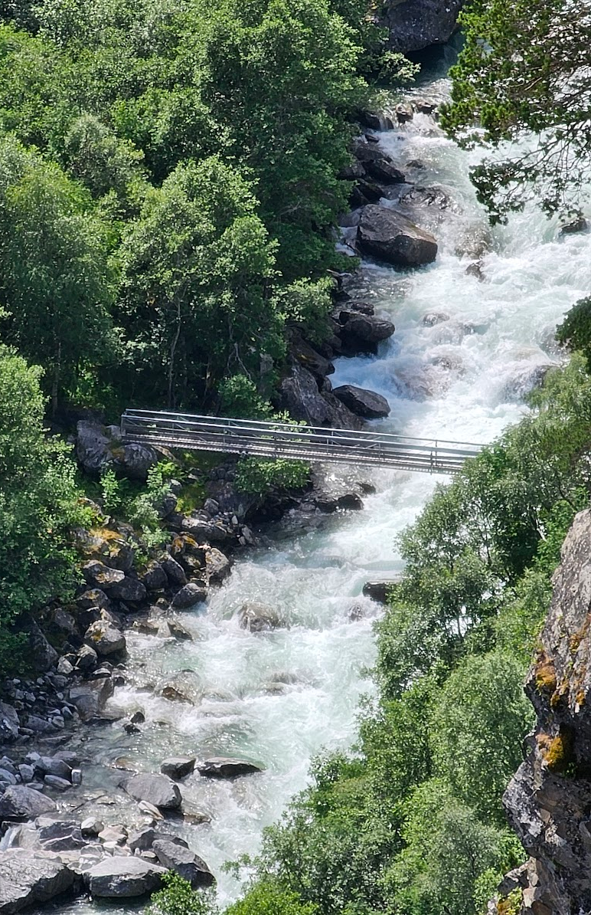
Bridge between science and society
How much real effort and resources have been devoted?
How many of us scientists have talked to politicians, policymakers, people in the oil or the financial sectors?

Slide 11
Invisible climate change adaptation?
?

Slide 12
What’s our story?
Who did what when & where?
Villains, heroes, threats, & drama.
Science is made for resolving disputes.
Stages: boardrooms, Climate summits.
Props: CO₂, weather reports, calamities, technology, science.
Fossil monster

Slide 13
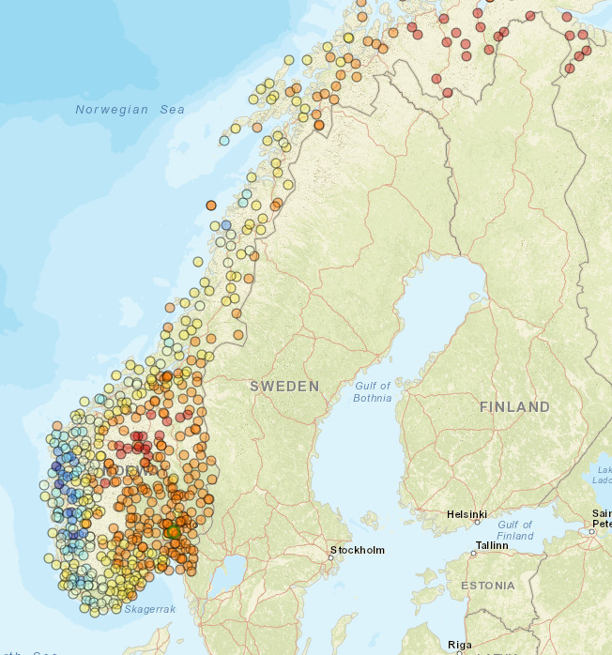
Lesson from YR
Information about climate change where you live?
Easily available open data on local environment/climate.
Which web portals?
https://ocdp.met.no/

Slide 14
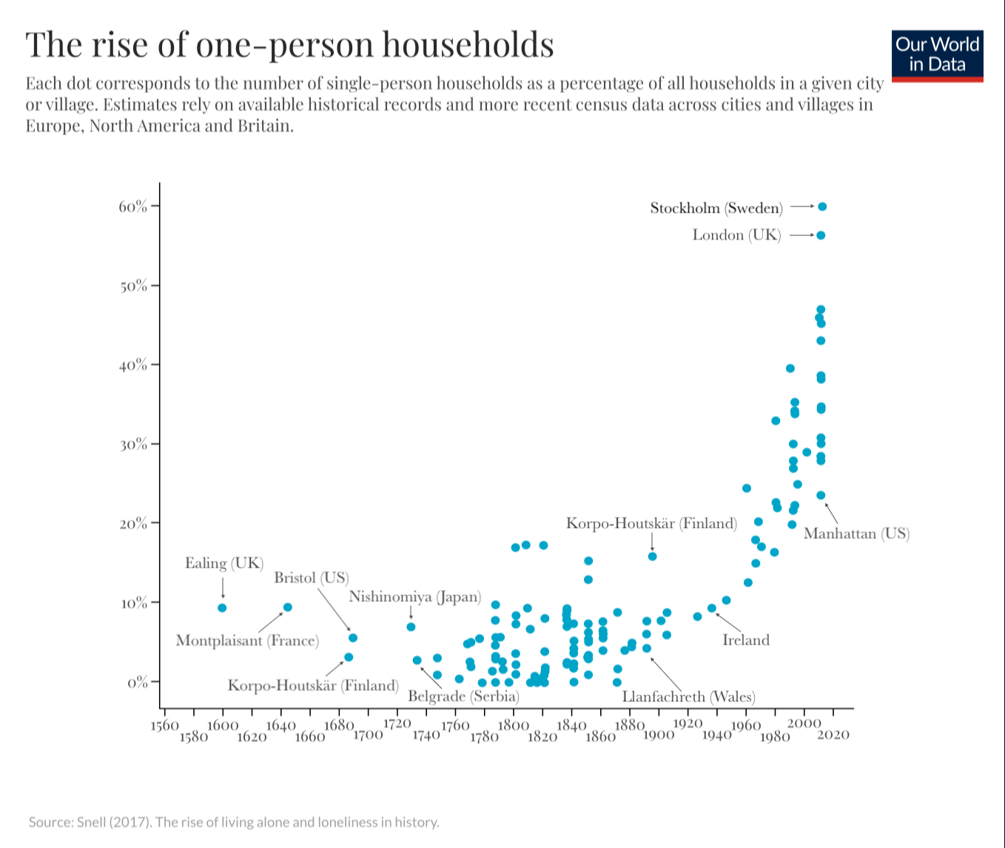
Other factors?
Mass madness
Notes:
https://ourworldindata.org/living-alone

Slide 16
All in the same boat
We have knowledge & information
We have technology
We can change our course
We also have fakes & madness…
Thank you for your attention!

