Slide 1


Interdisciplinary approach to include the effect of weather and climate in models for the spread of airborne infectious diseases
A collaboration between the Meteo Service and the Public Health Institute of the Netherlands
Dutch National Institute
for Public Health and the environment
Ministry of Health, Welfare and Sport
Royal Netherlands
Meteorological Institute
Ministry of Infrastructure and
Water Management

Slide 2
Overview
Problem definition
Risk factors
Mathematical framework
Results so far
Next steps

Slide 3
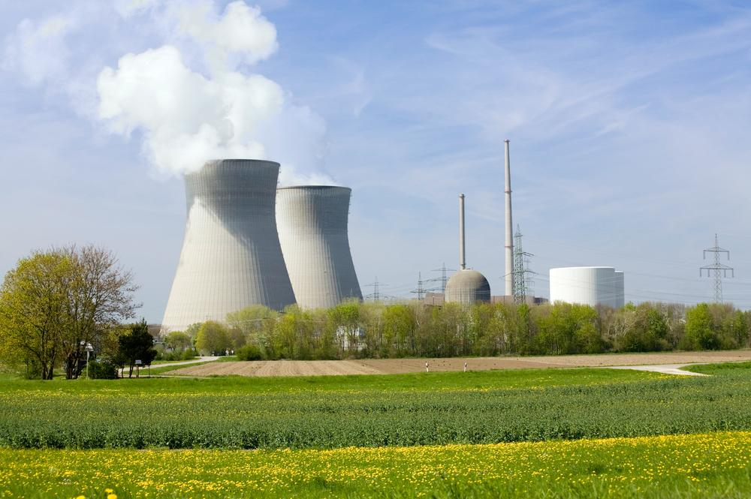
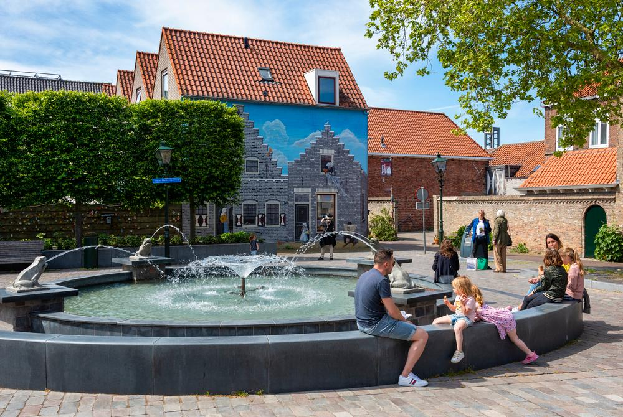
Problem of airborne legionellosis
Spread through the air
Many potential sources
Outbreaks around a source
Goal: Finding sources
Solution: Fit outbreak data
Loenenbach, et al.
(2018)
Notes:
Since outbreaks happen in a patern we can recover them
To best fit the location we need to account for different factors

Slide 4

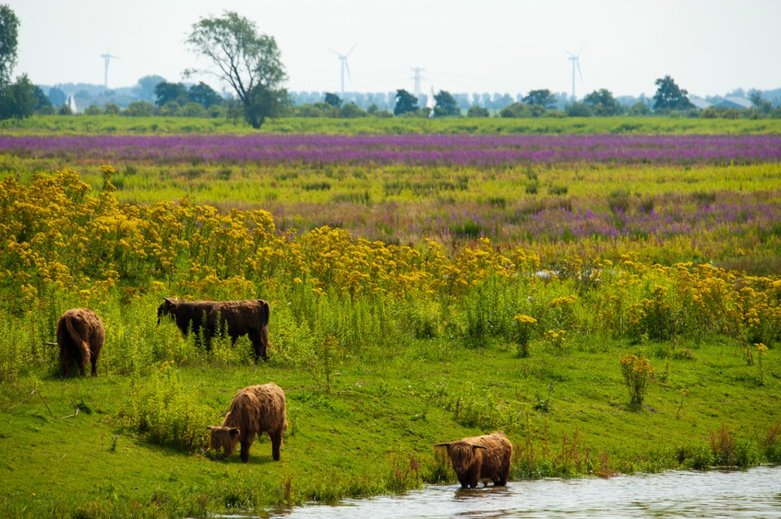


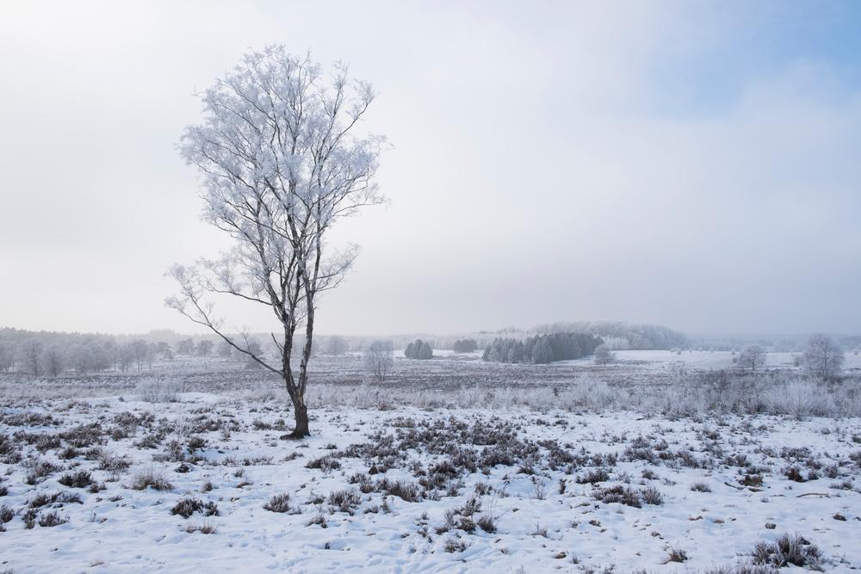
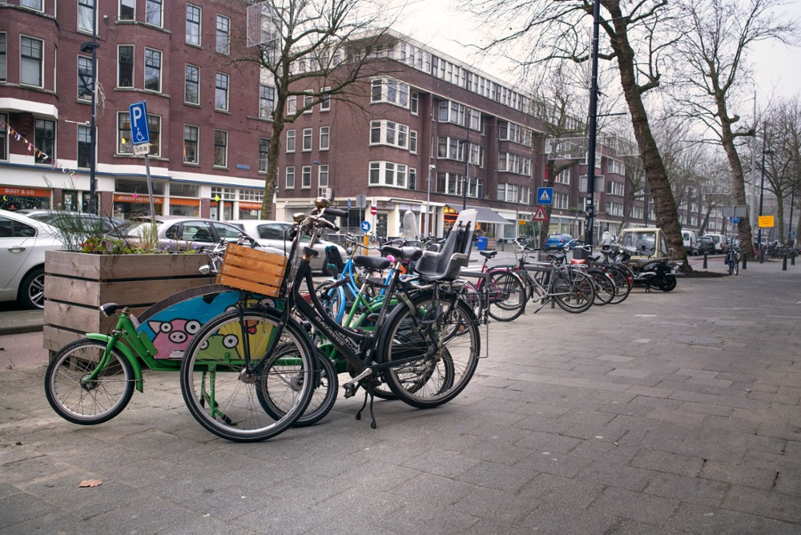

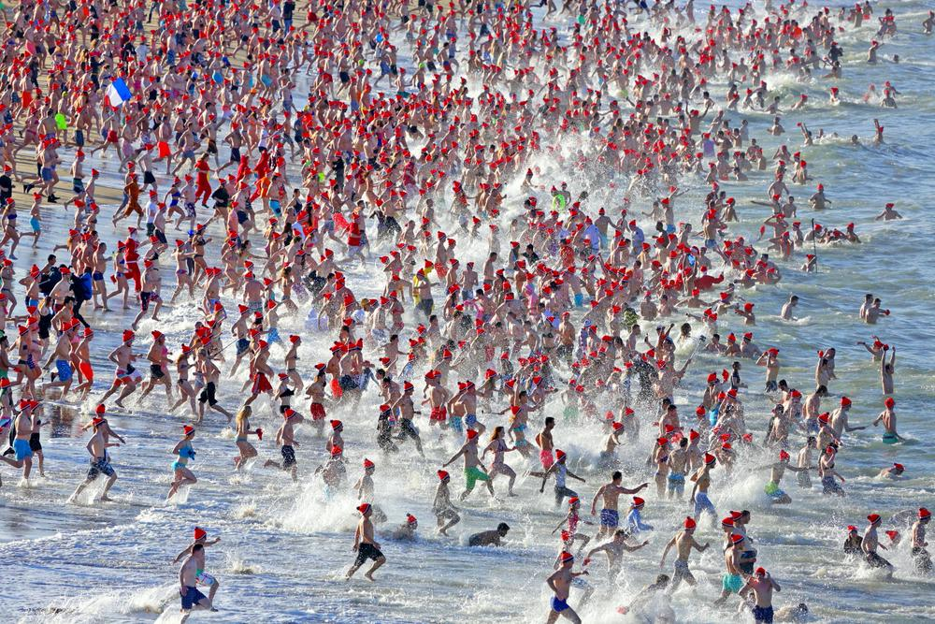
Risk Factors
Factors that influence risk of illness
Categories:
  Human
  Organism
  Weather/Climate
  Environment
van Leuken, et al. (2015)
Notes:
Human: Age, health, behavior
Organism: Survival, growth
Weather: Temperature, rainfall, wind
Environment: Land-use
Weather and environment particularly influence the spread of the pathogen.
So let’s discuss how we define this spread.

Slide 5
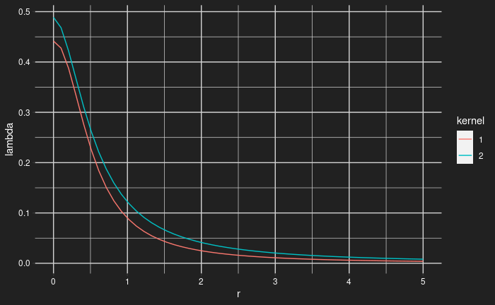

Mathematical framework
Kernel
  r ; distance
  h0 ; infectiousness at source
  r0 ; half-distance
  α ; shape-parameter
λ $=\frac{h_{0}}{1+{(r/r_{0})}^{α}}$
Boender, et al.
(2007)

Slide 6
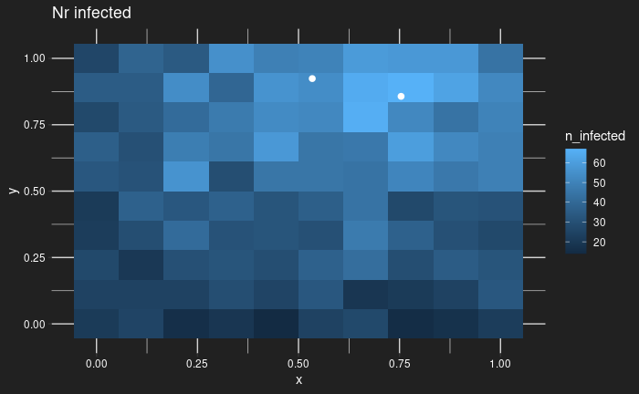
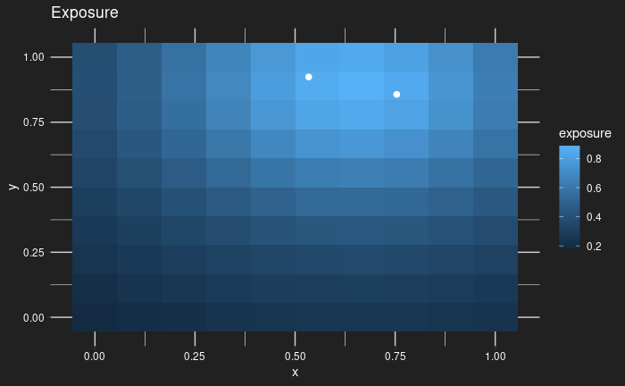
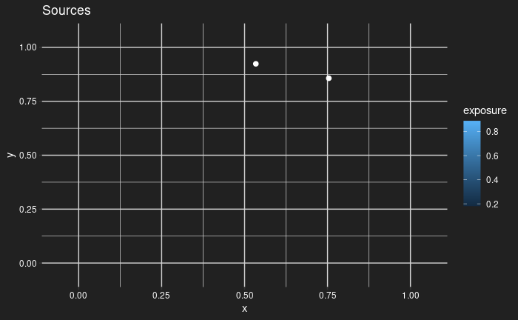
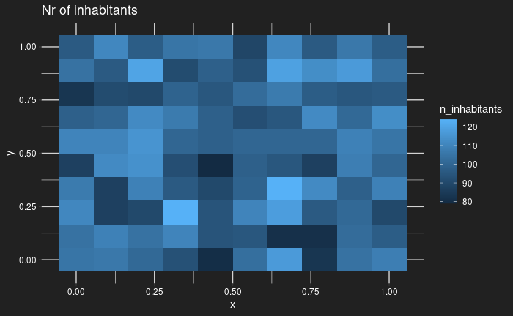


Results
Trial set-up
Creating the inhabitants
Setting exposure points
Describing point properties
Determining the exposure
Modeling infections
λ $=\frac{h_{0}}{1+{(r/r_{0})}^{α}}$
$$P^{inf}=1 −e^{−\sum_{k∊K}{λ_{k}}}$$

Slide 7
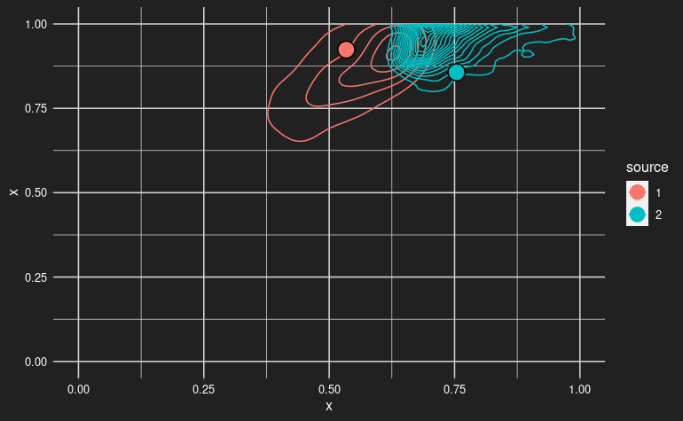
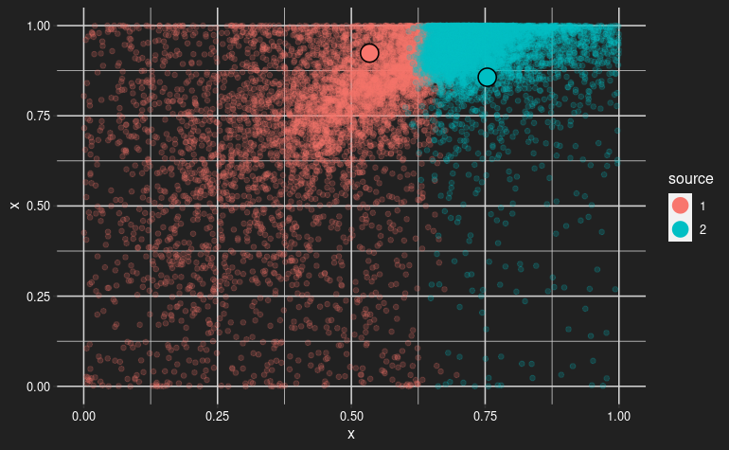
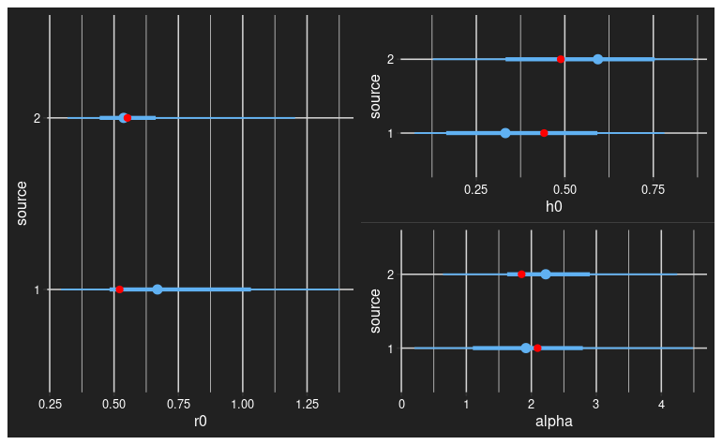
Results
Fit on simulation
r0, h0, alpha fit
Locations found

Slide 8
Next steps
Full implementation using actual map data
Creating an anisotropic kernel
Use high quality weather data for covariates and anisotropy

Slide 9
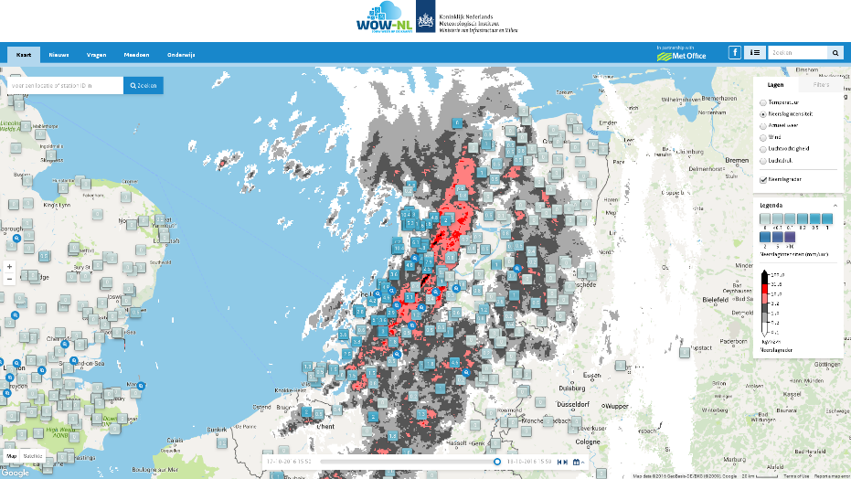
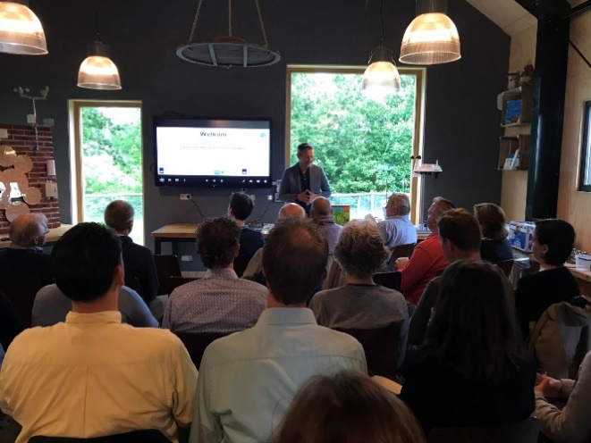
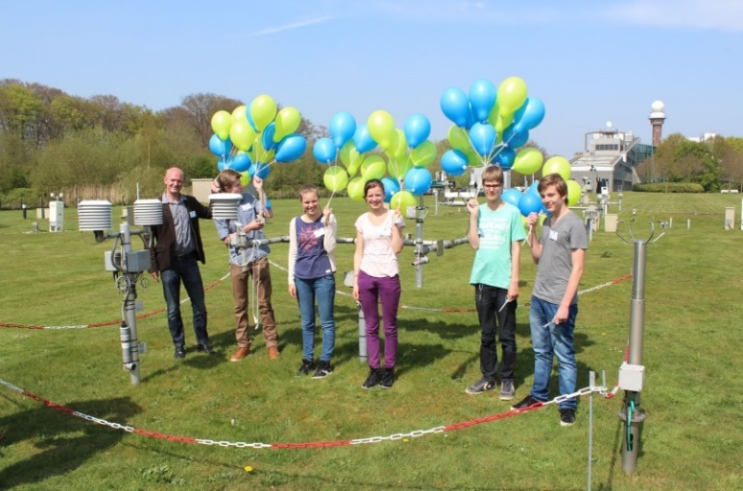
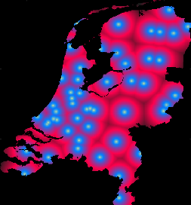
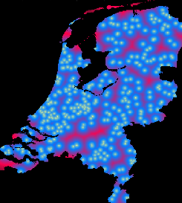
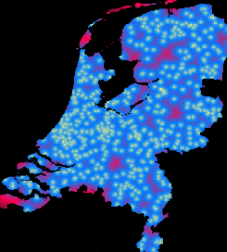
WOW citizen network
Initiated by UK Met Office
WOW-NL portal launched 2015
Teaching Material and Outreach
Smart Cities – Senshagen Zwolle
User support by back office
Exchange of best practices with other WOW partners
We are very grateful for all the efforts from the WOW community in providing data!

Slide 10
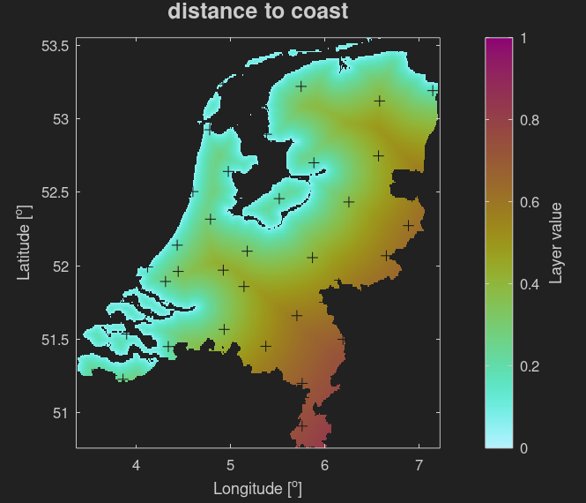
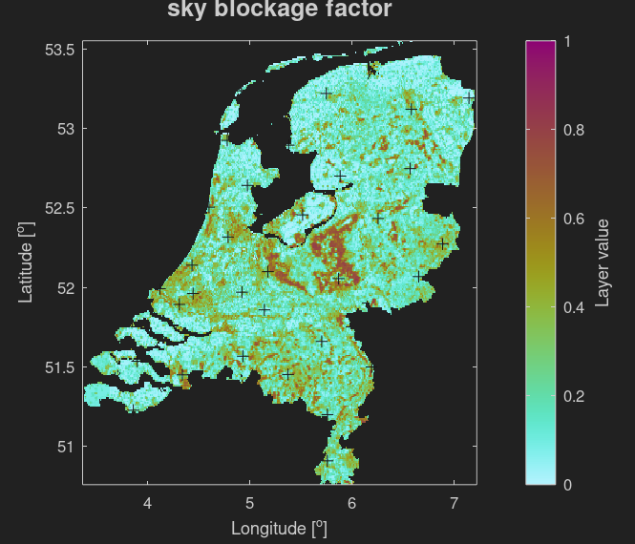
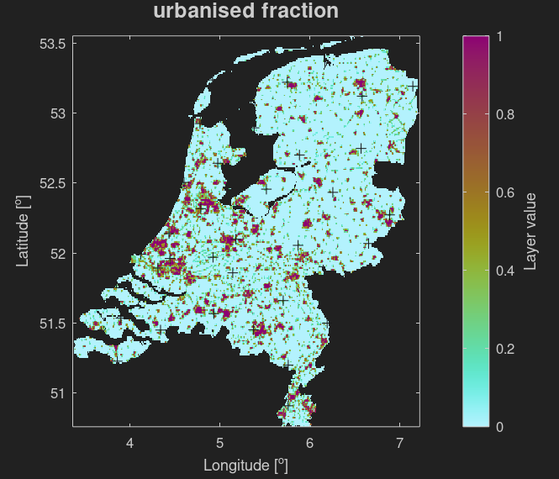
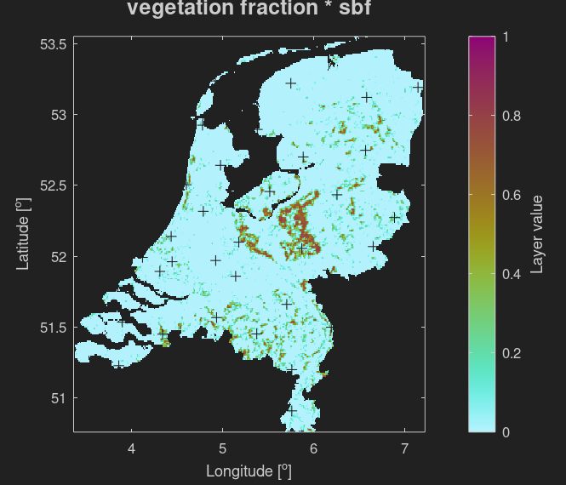

Covariates
KNMI
KNMI
CORINE
CORINE
CORINE

Slide 11
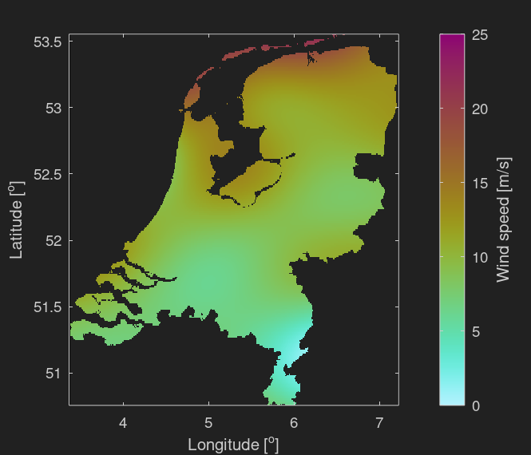

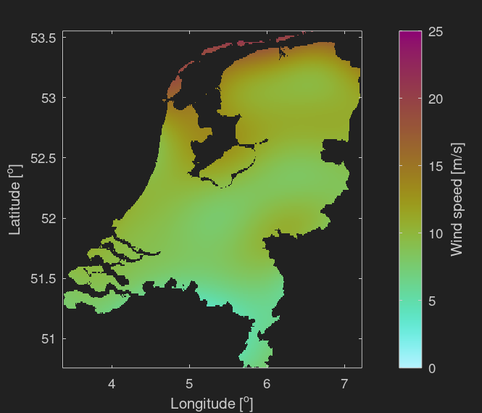
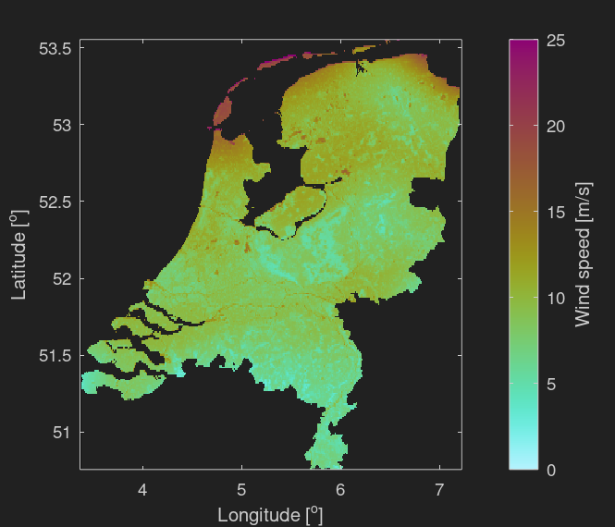
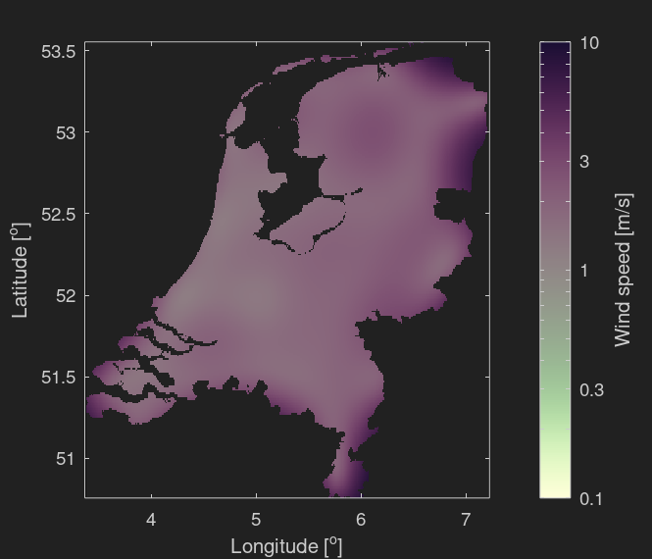
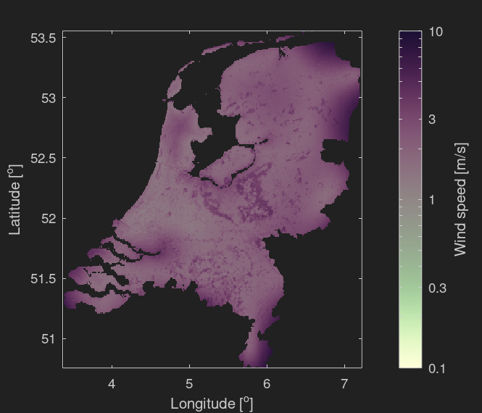
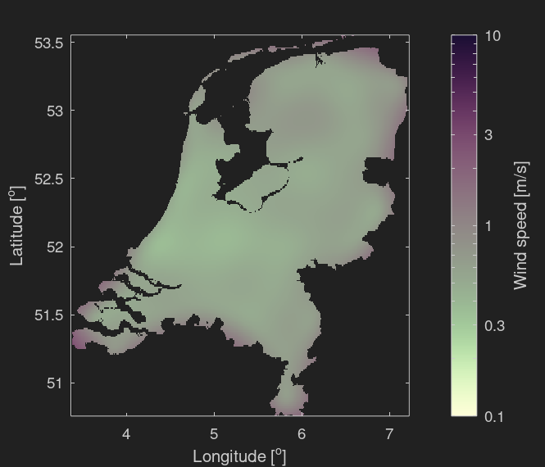
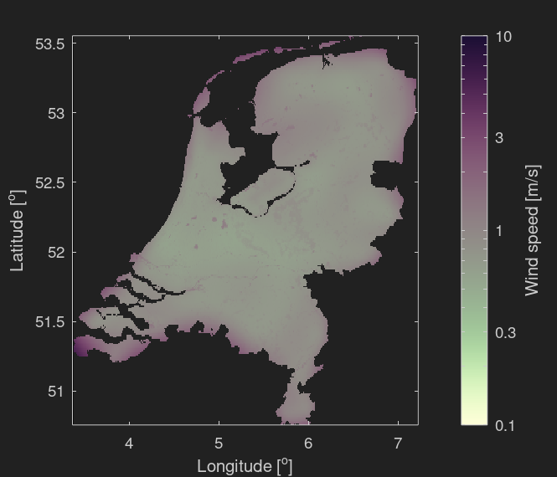
High-resolution climatological data set
8 February 2021, 12UTC (storm “Darcy”)
KNMI
KNMI
cov
KNMI
WOW
KNMI
WOW
cov

Slide 12
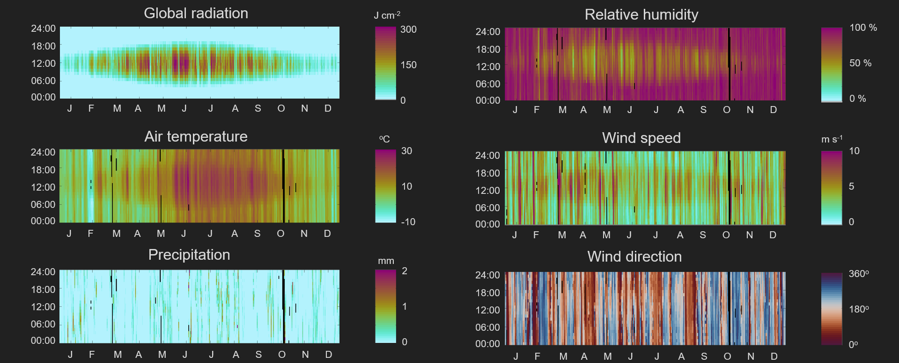
Prototype data set for 2021

Slide 13
Outlook
Creating an anisotropic kernel for the infection model
Use high-resolution climate/weather data for covariates and anisotropy
  Improve and complete climate data sets
  Keep discussing which data is relevant and how it should be delivered

Slide 14
Thank you very much for your kind attention!
Jouke de Baar
Gerard van der Schrier
Contact: jouke.de.baar@knmi.nl
Dutch National Institute
for Public Health and the environment
Ministry of Health Welfare and Sport
Royal Netherlands
Meteorologial Institute
Ministry of Infrastructure and
Water Management
Arno Swart
Elisa Benincà
Dante Spekken
Jesse Limaheluw
Lucie Vermeulen
Contact: arno.swart@rivm.nl

Slide 15
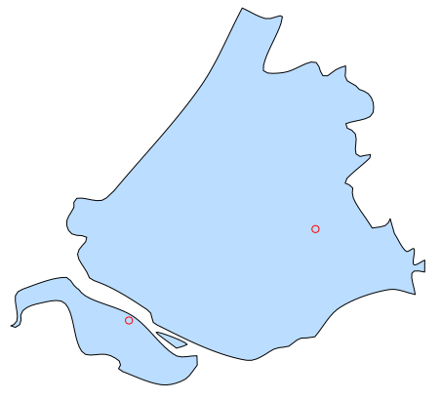
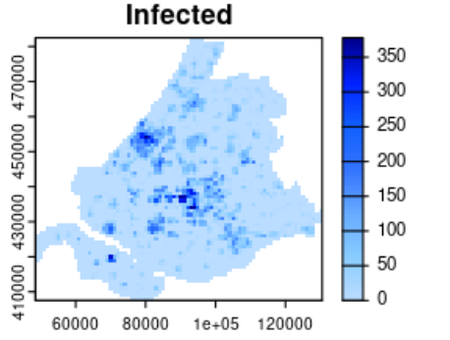
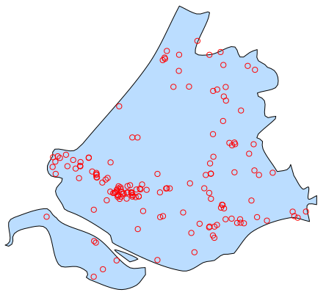
What is risk mapping?
Source tracing
Risk mapping
van Leuken, et al.

