Slide 1
An improved E-OBS pan-European gridded data set for global radiation
based on in situ observations
J.H.S. de Baar, G. van der Schrier, W. H. Knap &
E.J.M. van den Besselaar

Slide 2
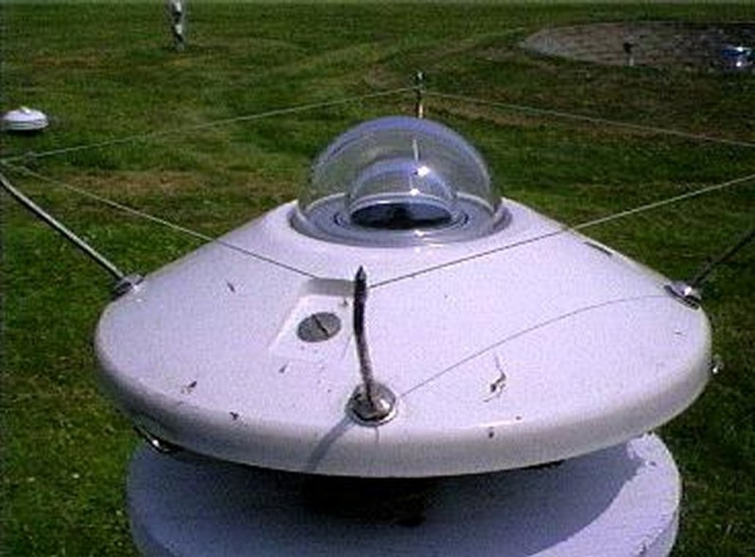
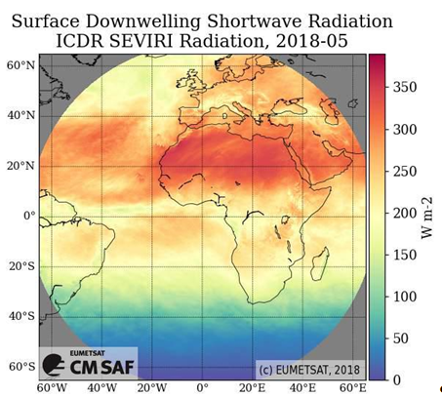
Introduction
Aim is to provide a global radiation gridded dataset based on in-situ observations, going back to 1950
There are excellent satellite-based products available, but the historic perspective is limited

Slide 3
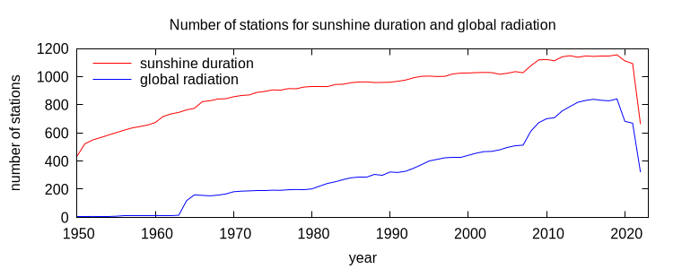
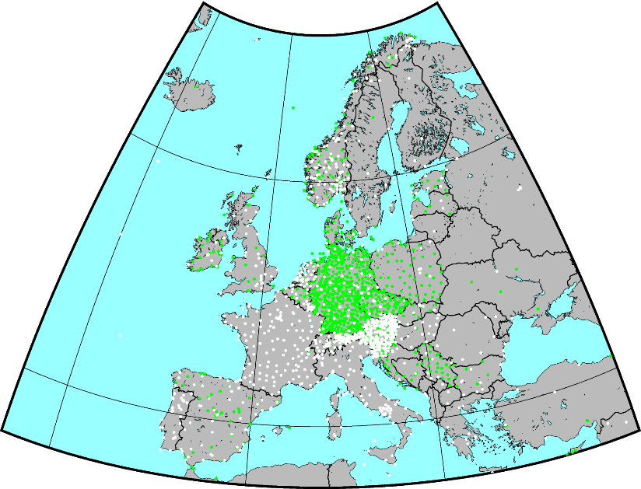
Data sources
# global radiation stations low
# sunshine duration stations much higher
…. but inhomogeneous over Europe
Data provided by
European NMHSs
WRDC
BSRN
QQ
SS

Slide 4
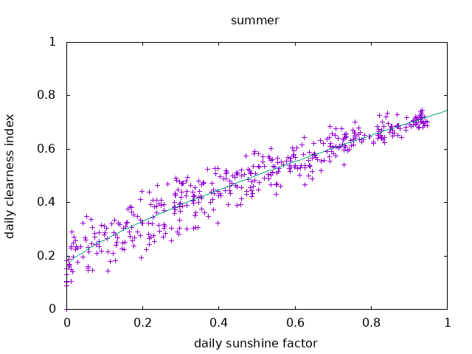

How to convert SS to QQ?
Standard approach is to use the linear Ångstöm-Prescott relation
Here: Suehrcke et al. (2013) non-linear relation
Clearness index for a cloudless day
Parameters of the model
Time fraction of bright sunshine
$$γ=1$$
Ångstöm-Prescott relation
Suehrcke et al. (2013) doi:10.1016/j.solener.2013.02.026.
De Bilt (NL)

Slide 5
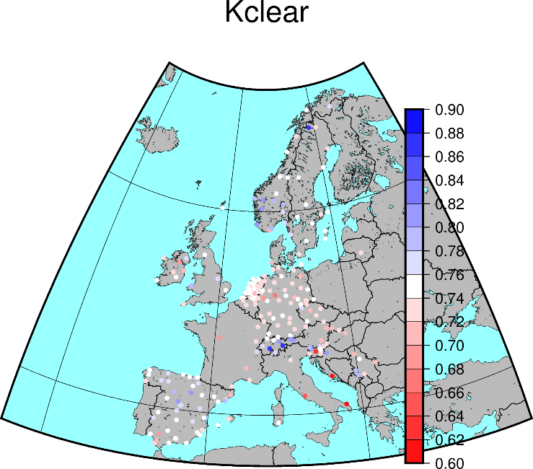

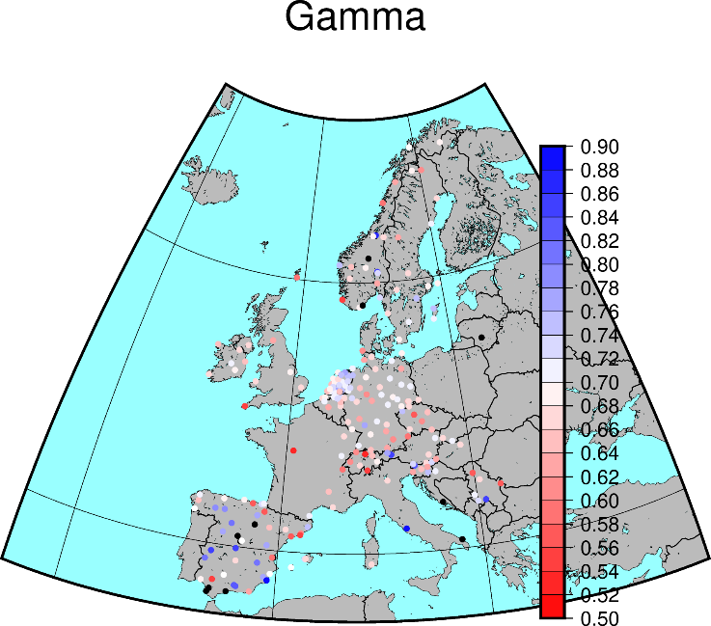

How to convert SS to QQ?
Use stations with overlapping QQ-SS series to optimize the parameters
Parameters will have a seasonal cycle and will vary across Europe
(summer)
Distinctly non-linear $γ≠1$
Variations in Europe – Alps, Iberia, Ireland

Slide 6




Quality Control
Quality Control based on checks of the physical limits (Allen et al. 1994)
$R_{so}$ = $\left(\text{0.75 + 2 }∙ {10}^{−5} z\right)$ $R_{a}$
$R_{so}$ :
Radiation received at the surface of the earth on a clear day
$R_{a}$ :
Top of Atmosphere radiation
$z$:
Elevation of the station
The relation with station altitude:
linearizing Beer's radiation extinction law
assuming sun’s average angle above the horizon is about 50° (Allen et al. 1994)
Allen et al. 1994. An update for the definition of reference evapotranspiration
ICID Bulletin 43 (2):1-34

Slide 7
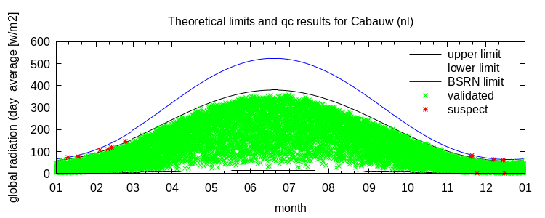
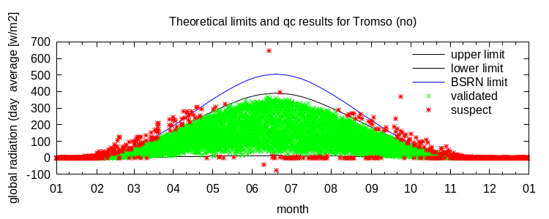
Quality Control
Lower limit: 3% of TOA (Geiger et al. 2002)
BSRN limit: integration of 1-minute ‘Extremely Rare Limit’
(Garcia et al. 2019)
Geiger et al. 2002. Solar energy 73 (6) 475-480
Garcia et al. 2019. doi:10.5194/gi-8-77-2019

Slide 8
Gridding procedure
Collect station data
Use forward selection linear regression to fit monthly background grids as function of covariates:
  Topography
  PCA modes of ERA5-Land global radiation
Kriging regression to grid daily anomalies
Sum background grids and gridded anomalies
Ensemble Dispersion Improvement auto-Tune (EDIT) to improve ensemble dispersion

Slide 9
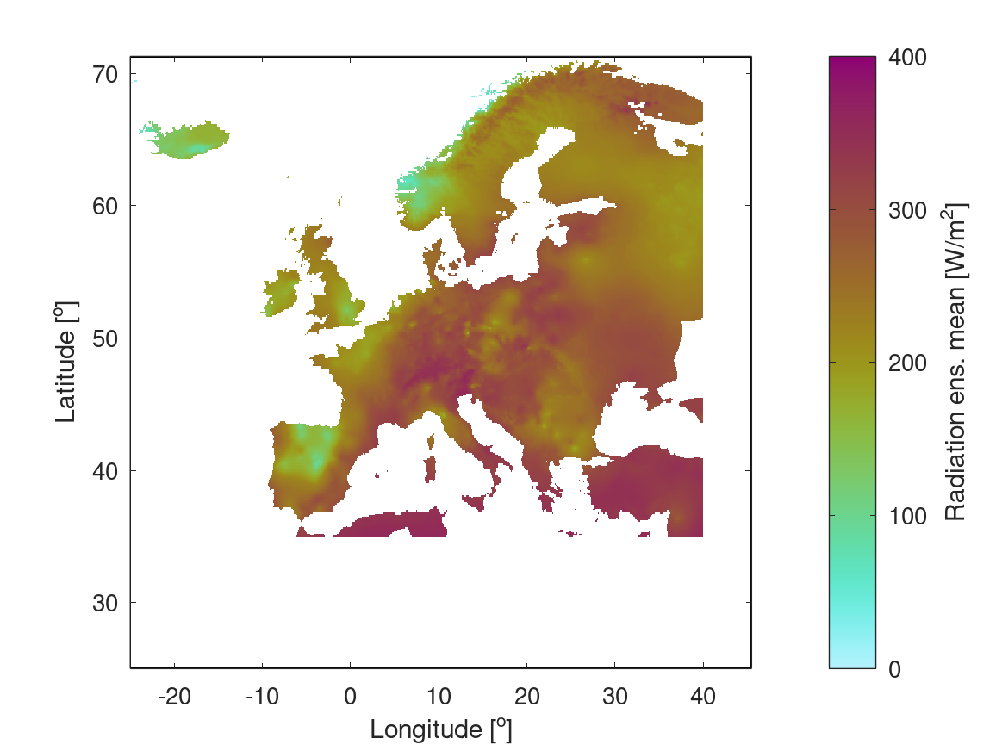
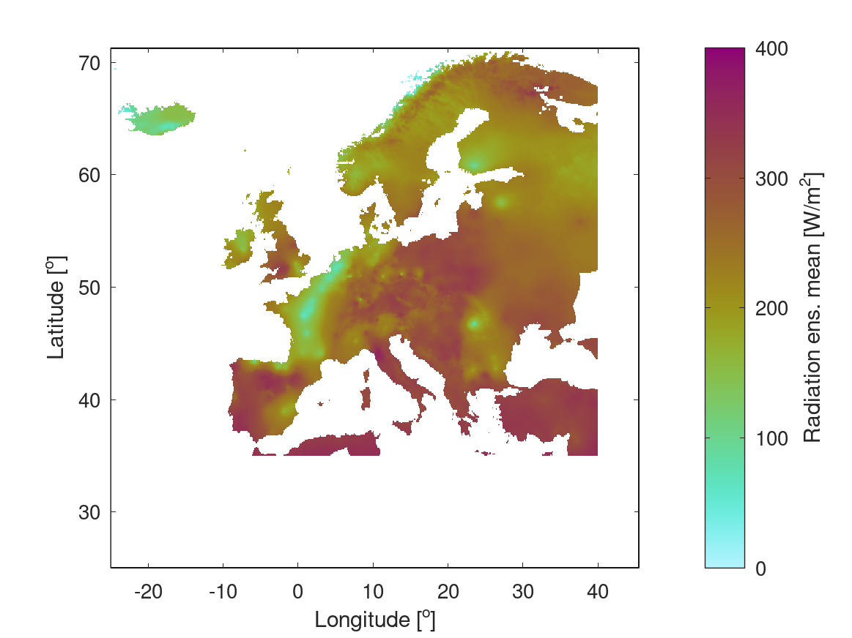
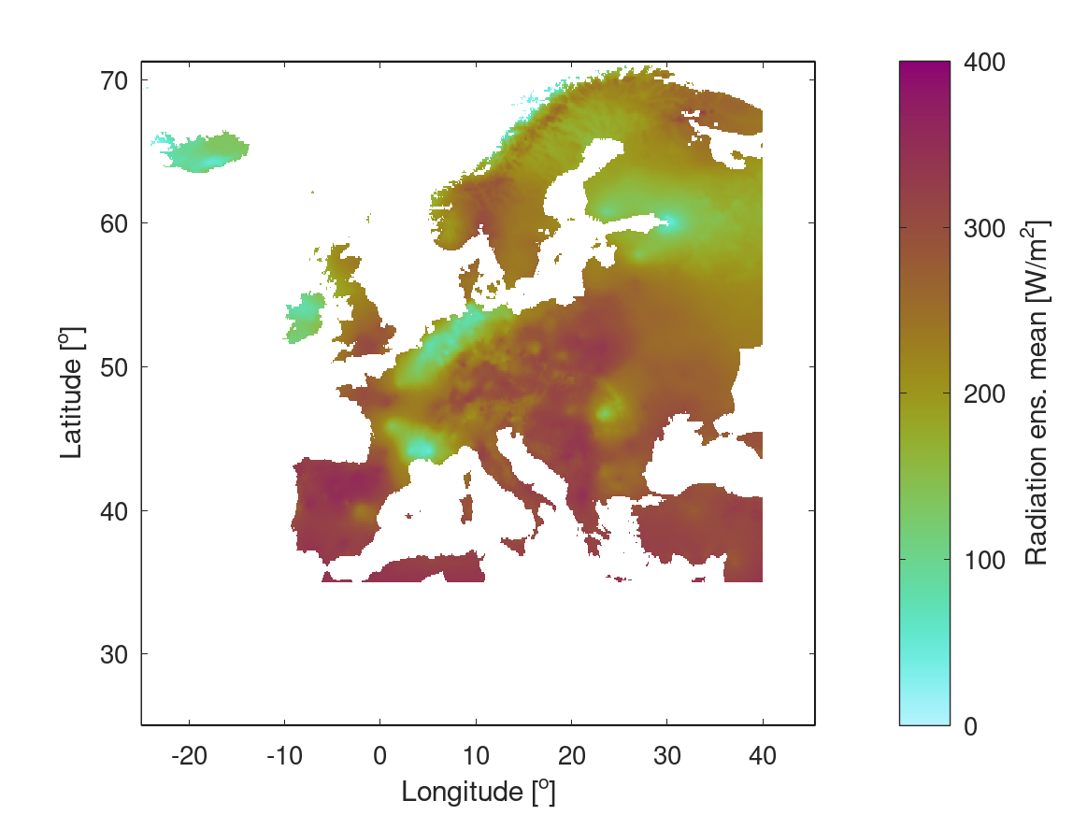
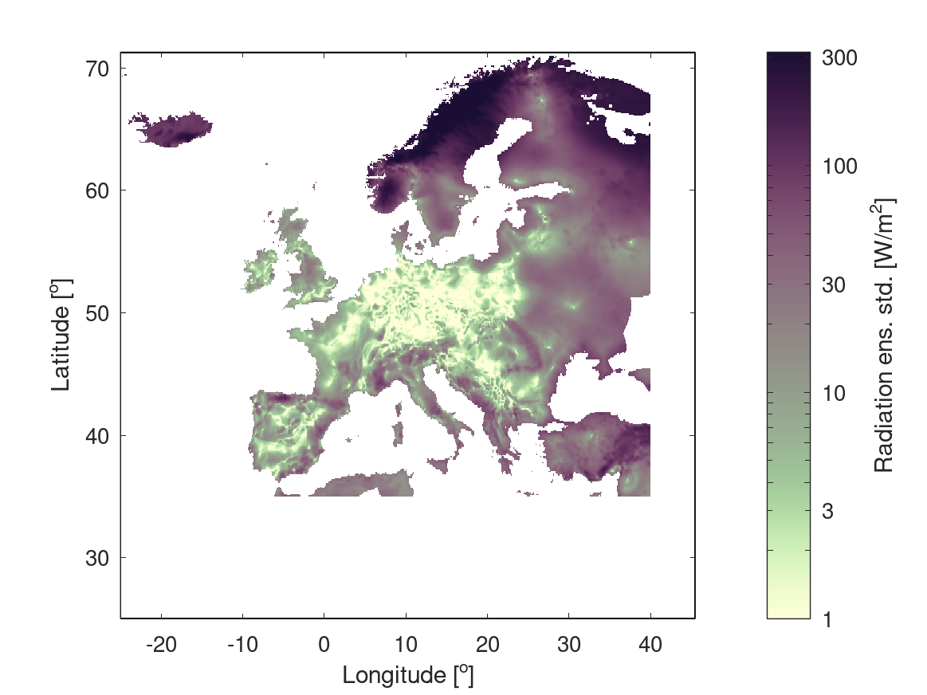
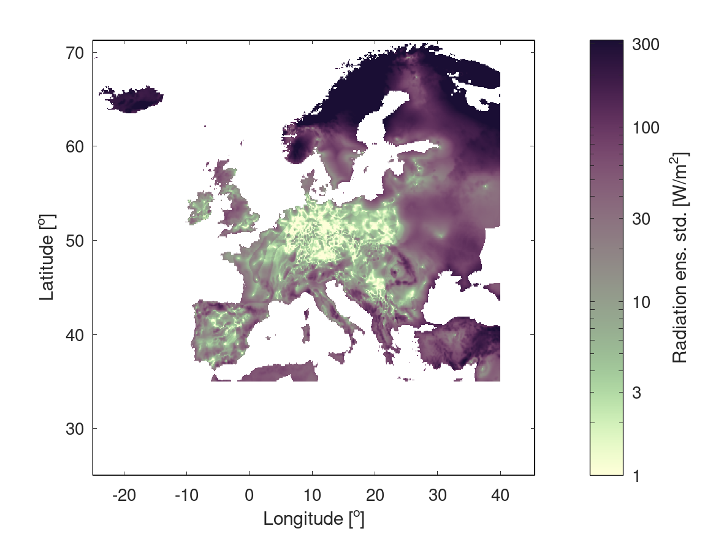
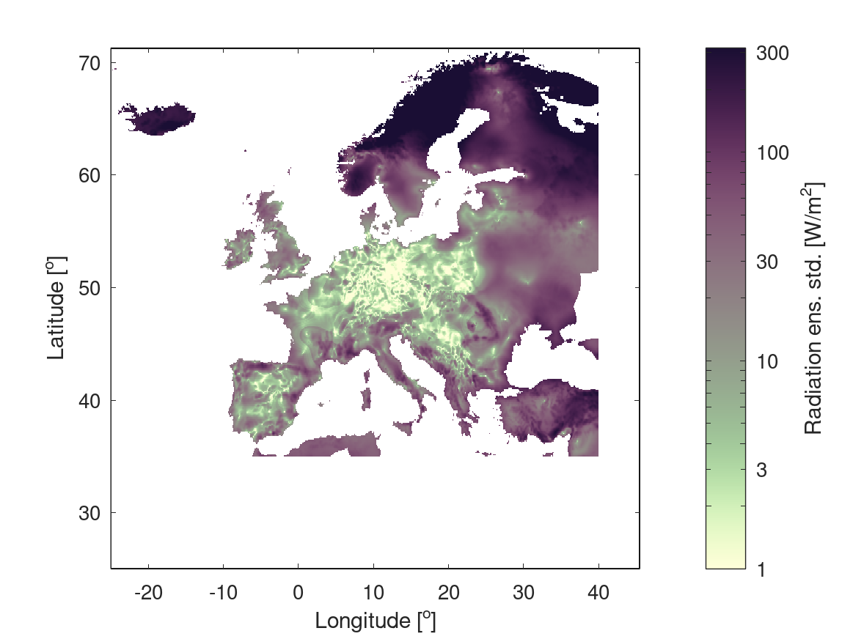
Results: example grid
16 July 1976
17 July 1976
18 July 1976
ens. mean
ens. mean
ens. mean
ens. std.
ens. std.
ens. std.

Slide 10
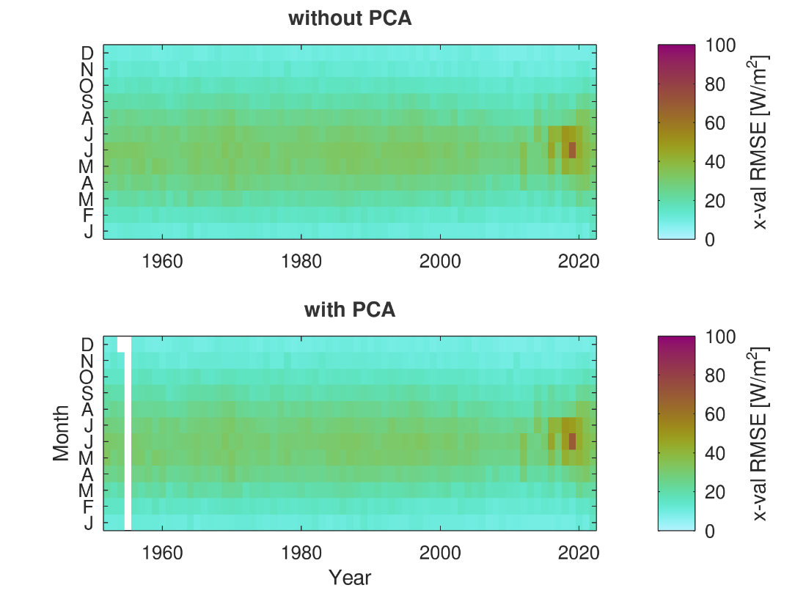
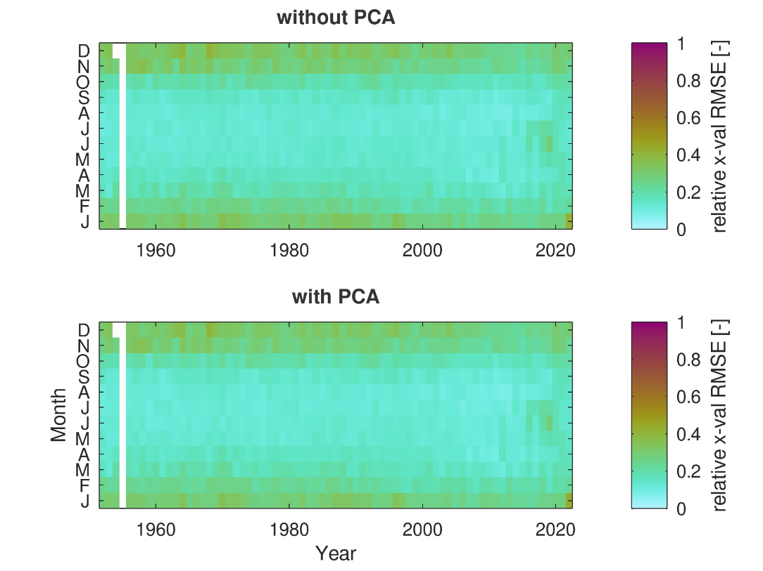
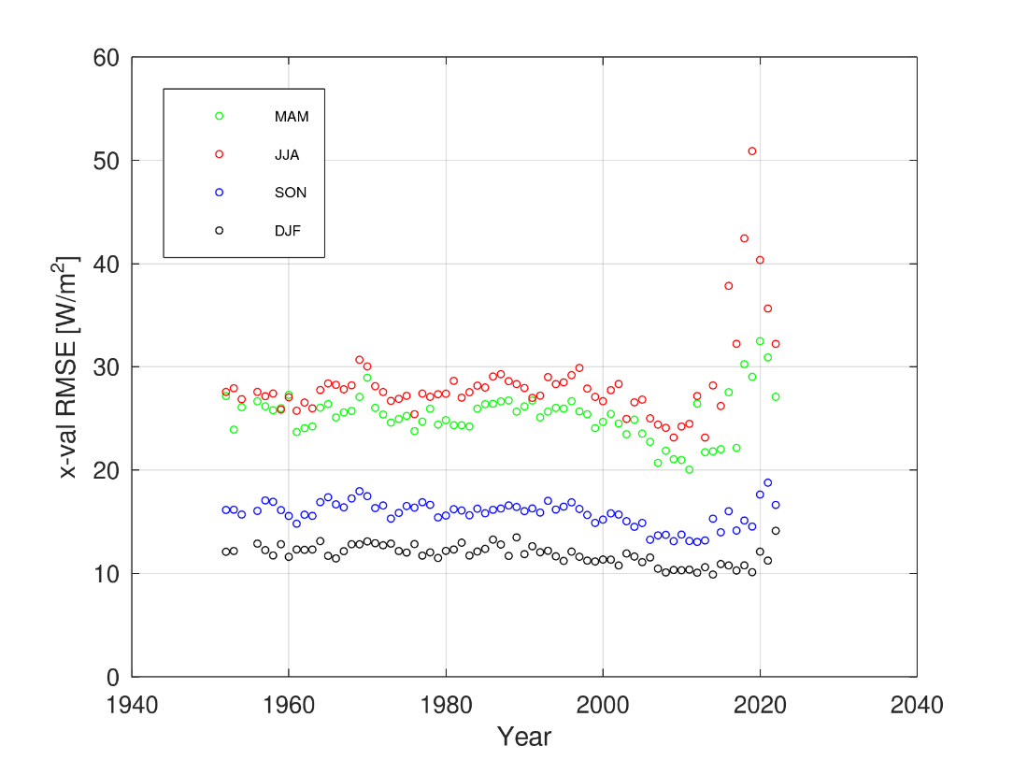
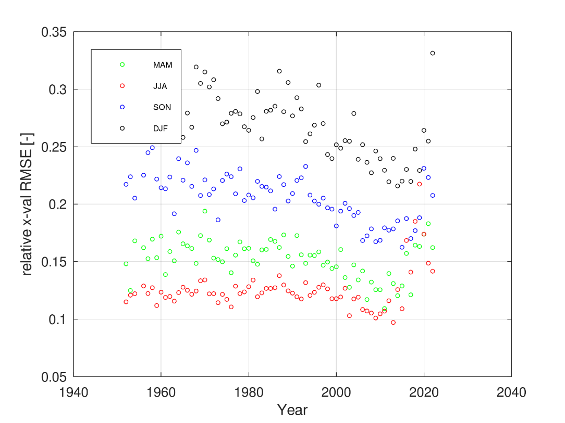
Results: cross-validation of ens. mean

Slide 11
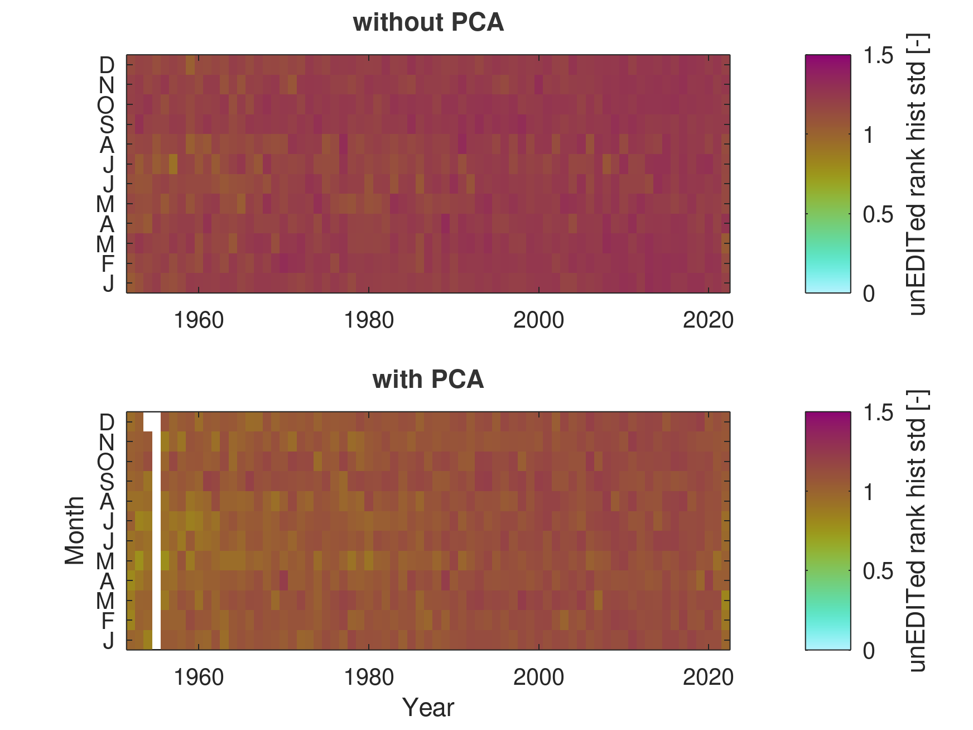
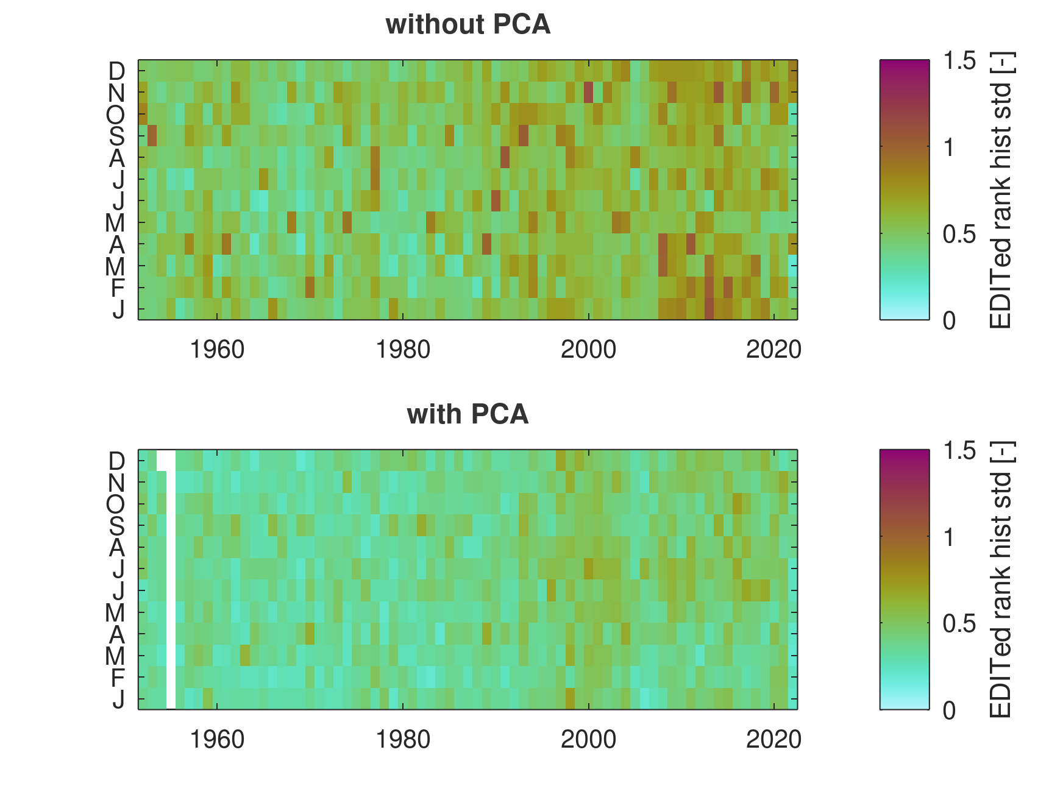
Results: cross-validation of ens. dispersion
Ensemble Dispersion Improvement auto-Tune (EDIT)

Slide 12
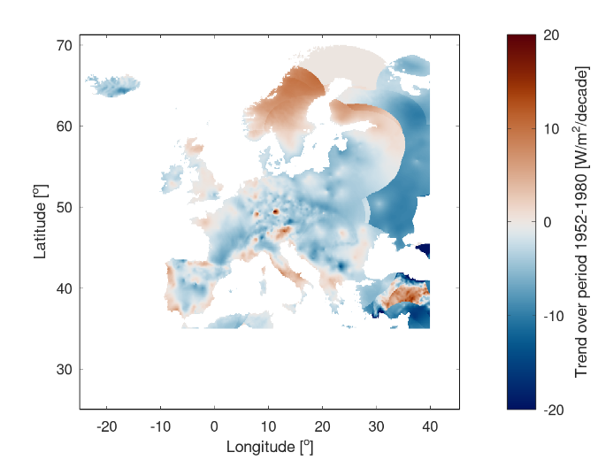
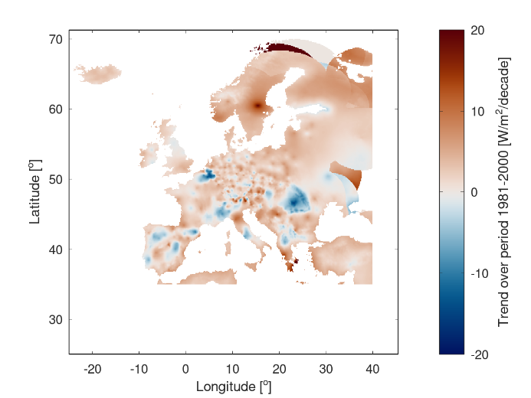
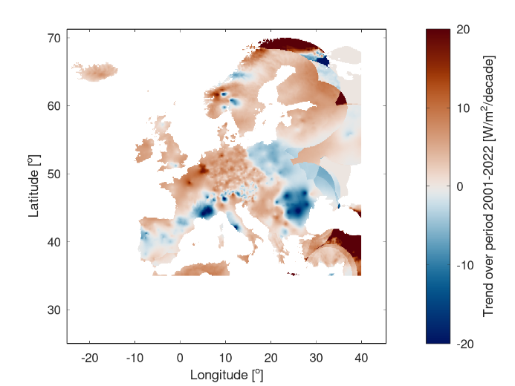
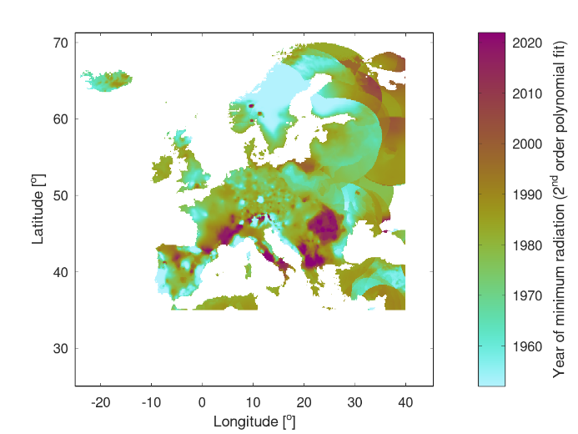
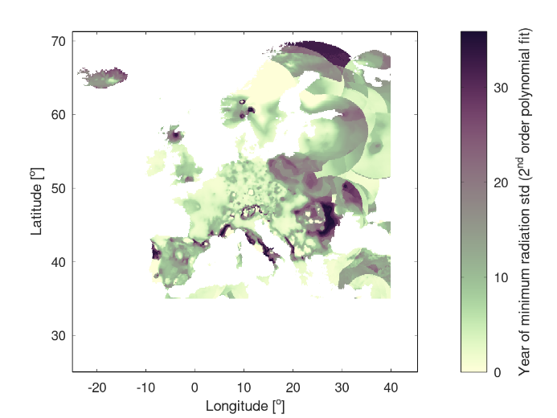
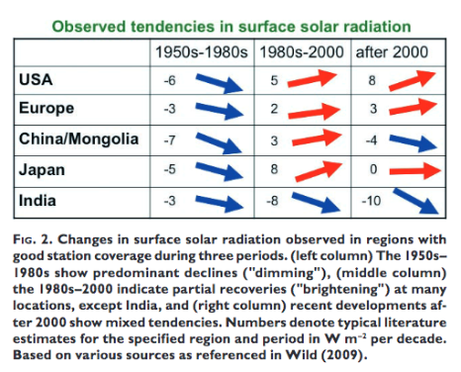
Results: dimming/brightening
Wild (2012)
http://dx.doi.org/10.1175/BAMS-D-11-00074.1
1952-1980
1981-2000
2001-2022
Year of minimum
Year of minimum std

Slide 13
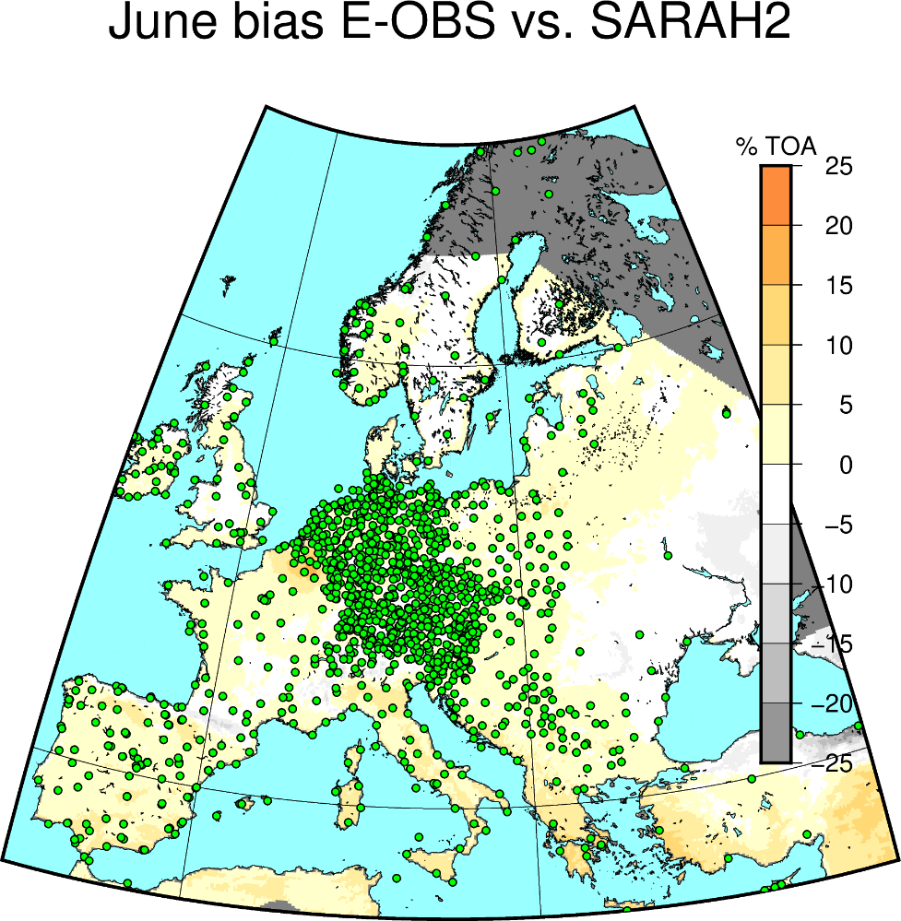
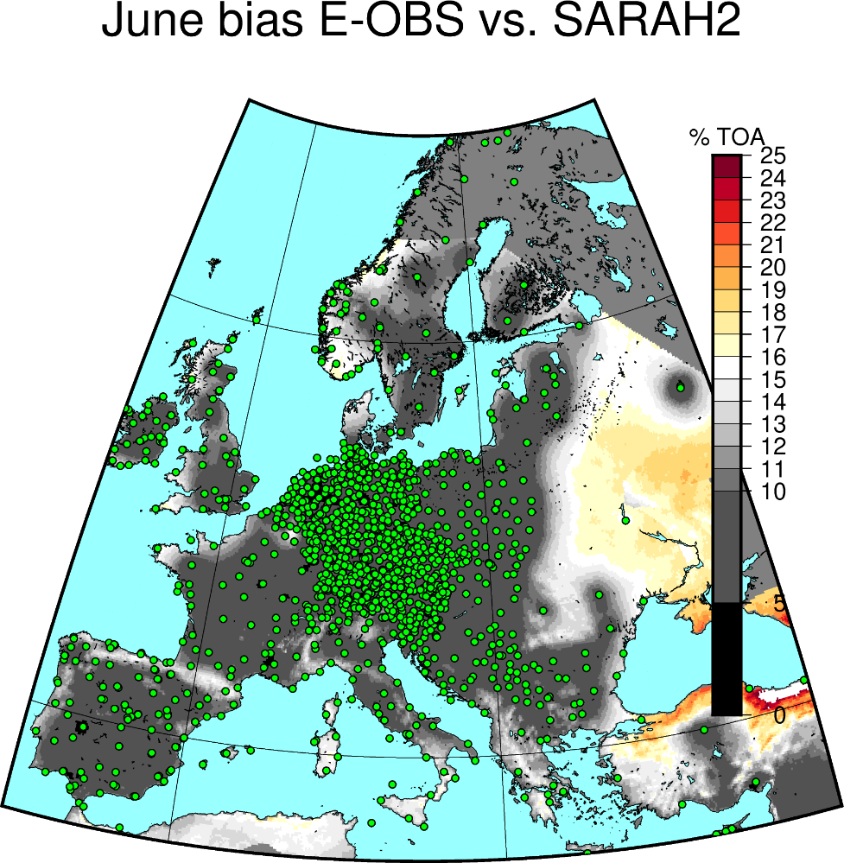
Comparison with SARAH2 – 1984-2001

Slide 14
Thank you very much for your kind attention!
J.H.S. de Baar, G. van der Schrier, W. H. Knap &
E.J.M. van den Besselaar
gerard.van.der.schrier@knmi.nl
jouke.de.baar@knmi.nl

