Slide 1
Community climatology
Towards a new social contract in climate research?
Royal Netherlands
Meteorological Institute
Ministry of Infrastructure and
Water Management
Jouke de Baar, Irene Garcia-Marti, Gerard van der Schrier, Theo Brandsma (KNMI)
EMS 2023, Bratislava

Slide 2

New social contract?
Conventional social contract?
Results & Advice
Society
Science
Society
Science
Society
Understand each other?
Share ownership of future issues in weather and climate?
Funding & Autonomy

Slide 3
Society
Society
Knowledge-value chain
VALUE
IMPLEMENT
ACTION
Public Health Inst.
FORMULATE
DECISION
Public Health Inst.
APPLY
INTELLIGENCE
COMMUNICATE
KNOWLEDGE
Met Service
Met Service
ANALYZE
INFORMATION
Society
PROCESS
DATA
ACQUIRE

Slide 4
Introduction
Approach
Results
Next steps
Royal Netherlands
Meteorological Institute
Ministry of Infrastructure and
Water Management

Slide 5
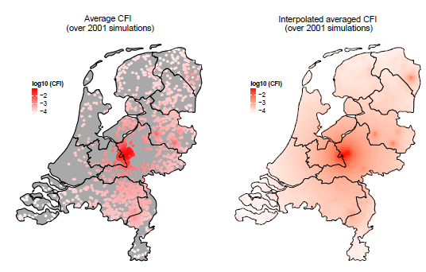
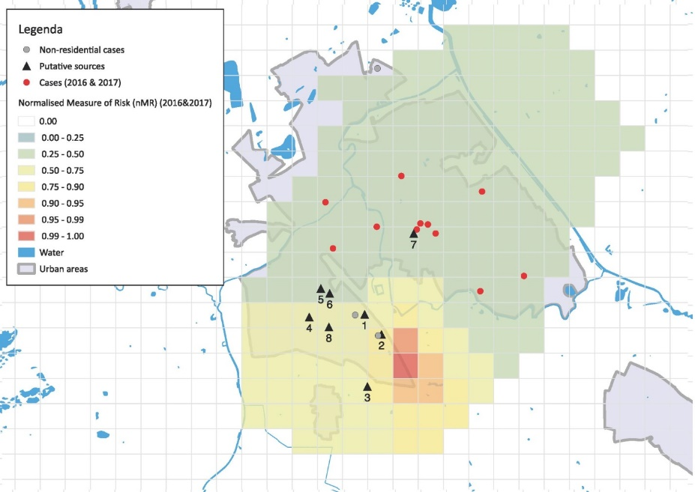
Question
Question from: National Institute for
Public Health and the Environment
Can KNMI provide historical weather maps at
1 km X 1 km X 1 hour
resolution?
Risk mapping for
airborne infectious diseases
Source detection of
airborne infectious diseases
Source: RIVM, https://doi.org/10.3201%2Feid2410.180906

Slide 6
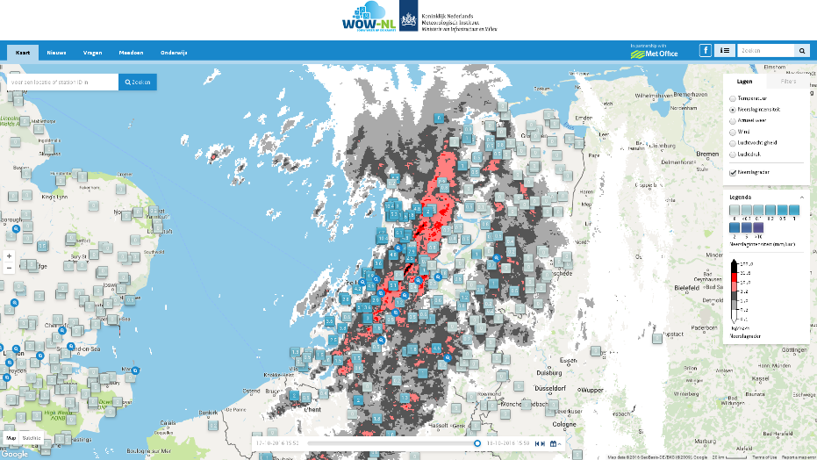
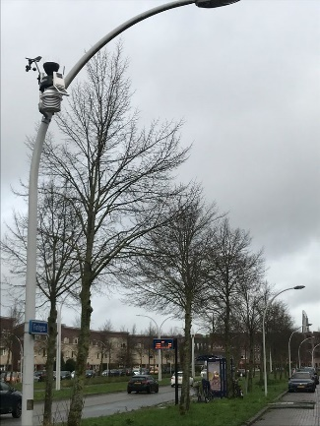
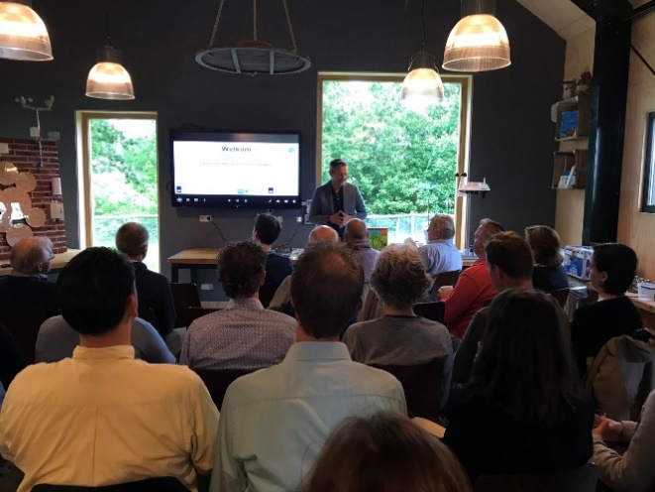
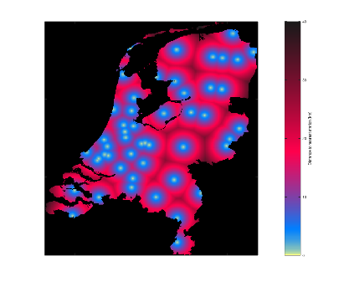
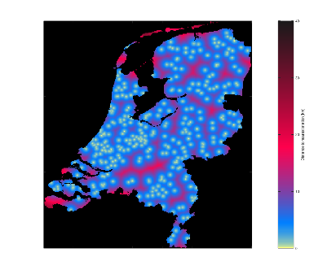
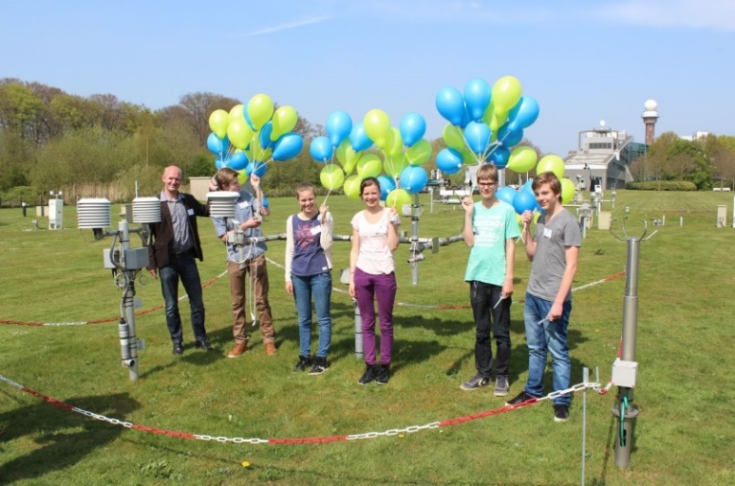
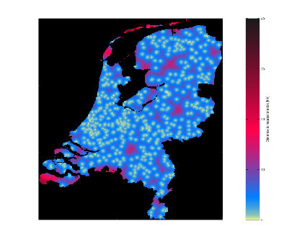
Methodology
Weather Observation Website: WOW
Initiated by UK Met Office
WOW-NL portal launched 2015
Teaching Material and Outreach
Smart Cities – Senshagen Zwolle
User support by back office
Exchange of best practices with other WOW partners
We are very grateful for all the efforts from the WOW community in providing data!

Slide 7
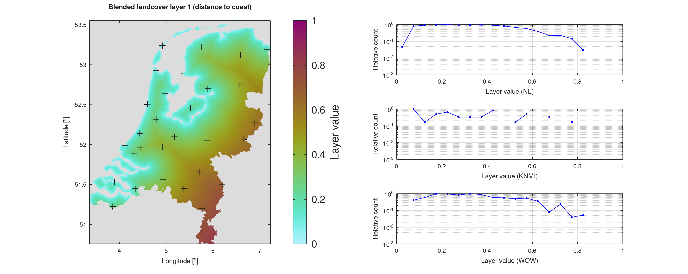
Methodology
Covariates
distance to coast

Slide 8
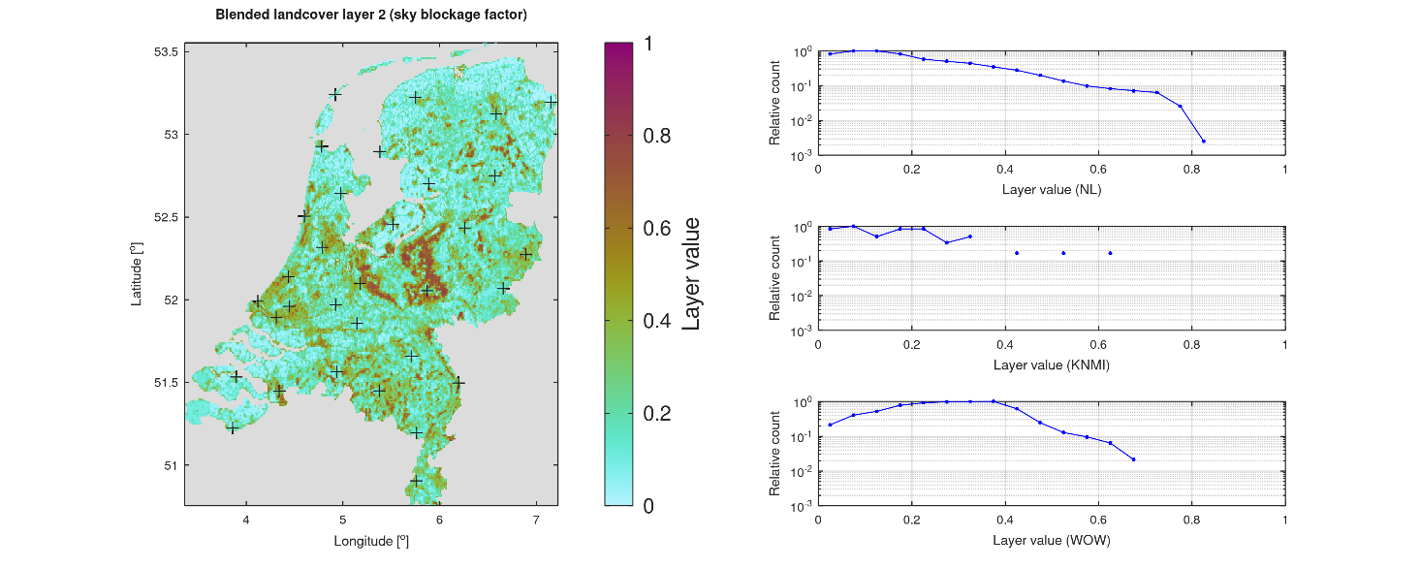
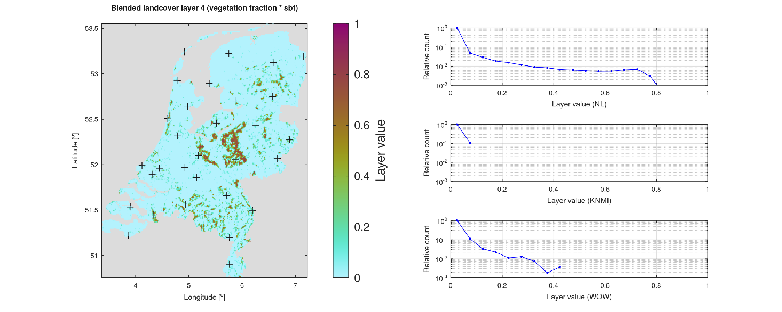
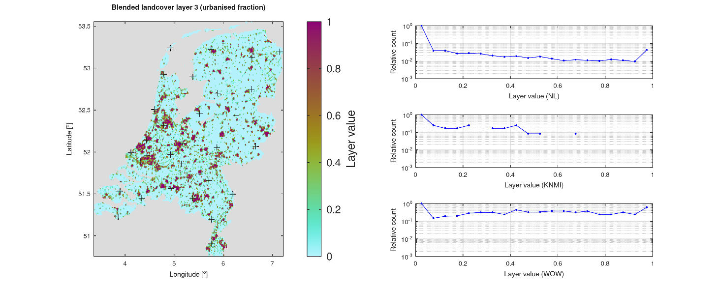
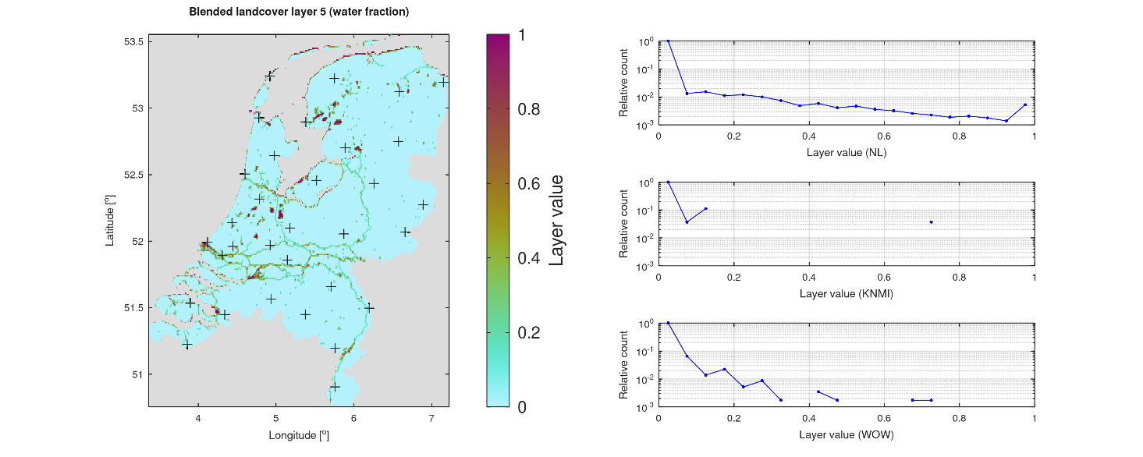
Methodology
Copernicus CORINE Land Cover
sky blockage factor
vegetation fraction
urbanization fraction
water fraction

Slide 9
Introduction
Approach
Results
Next steps
Royal Netherlands
Meteorological Institute
Ministry of Infrastructure and
Water Management

Slide 10
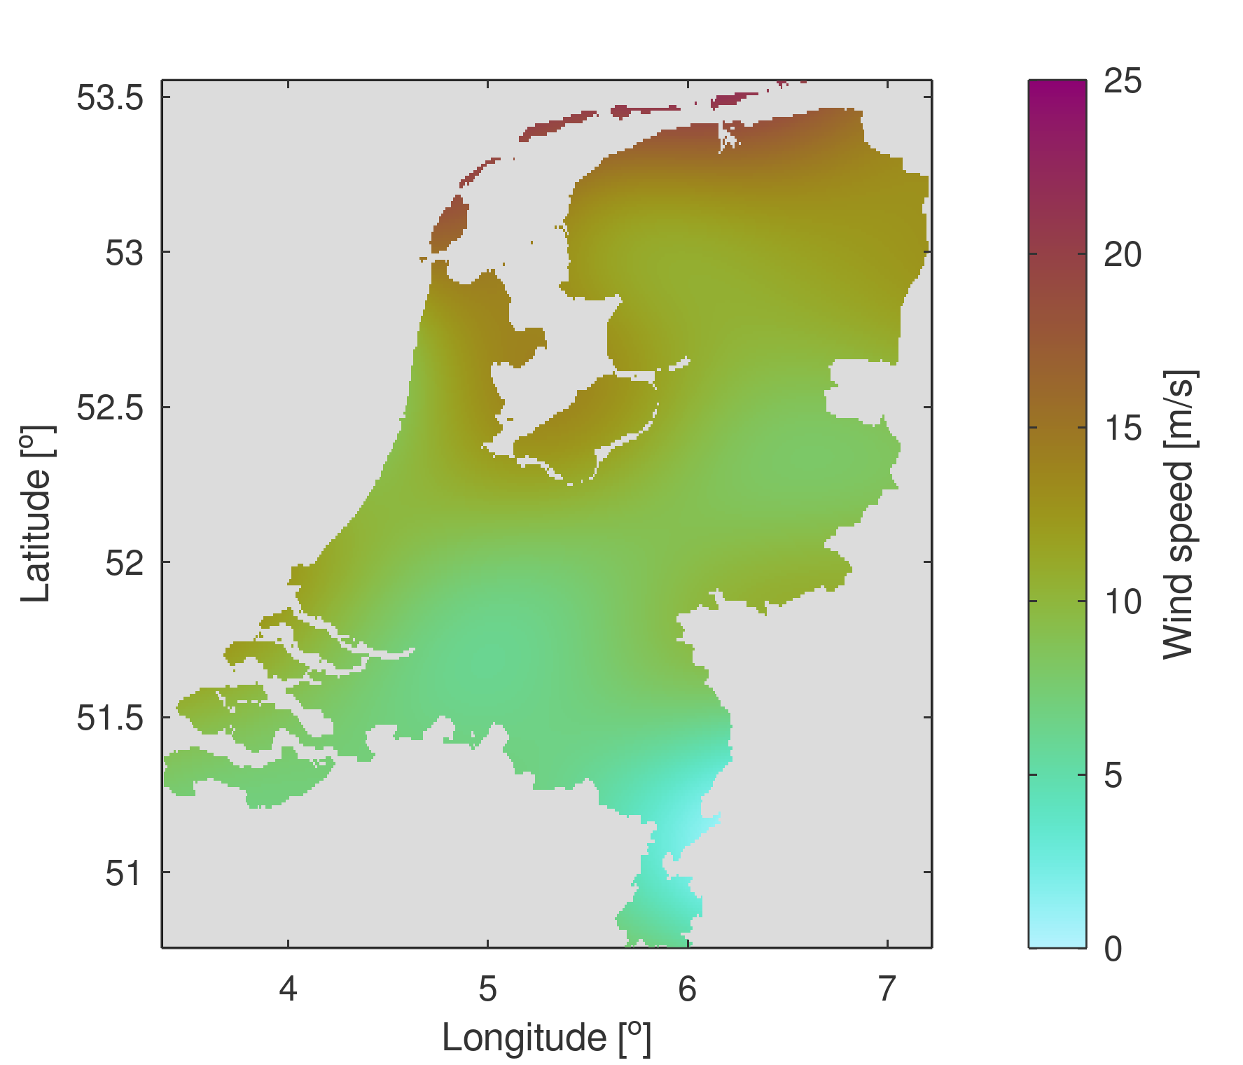
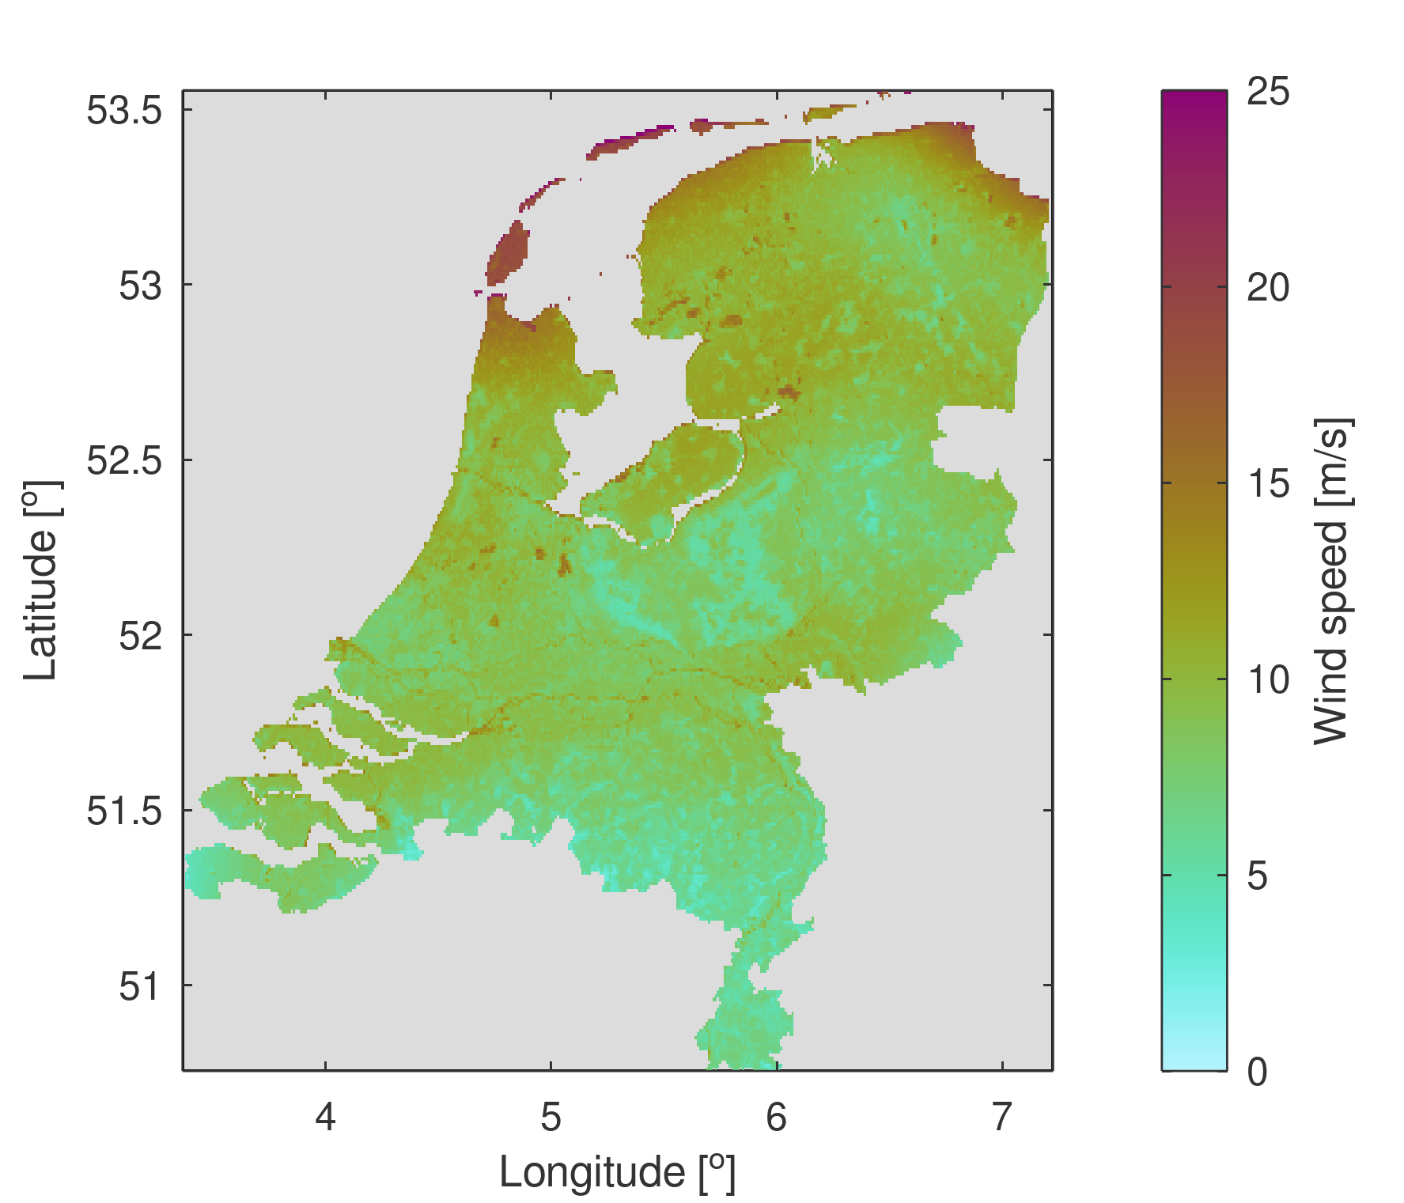
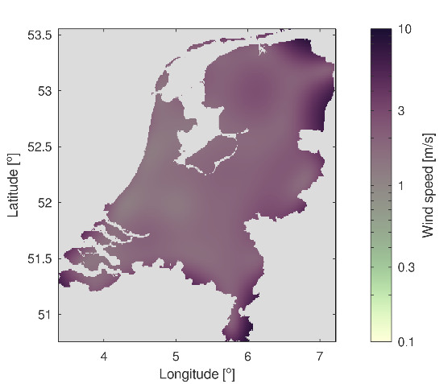
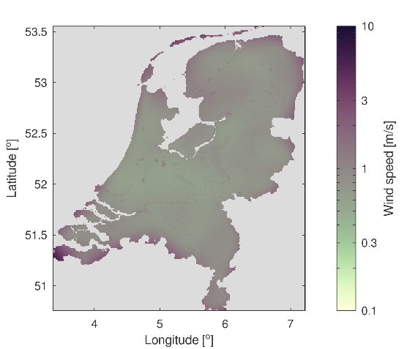
Results
7 February 2021, 11:00-12:00 (“Darcy”)
KNMI
KNMI + WOW + cov

Slide 11
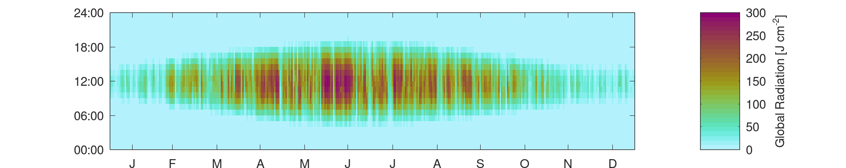
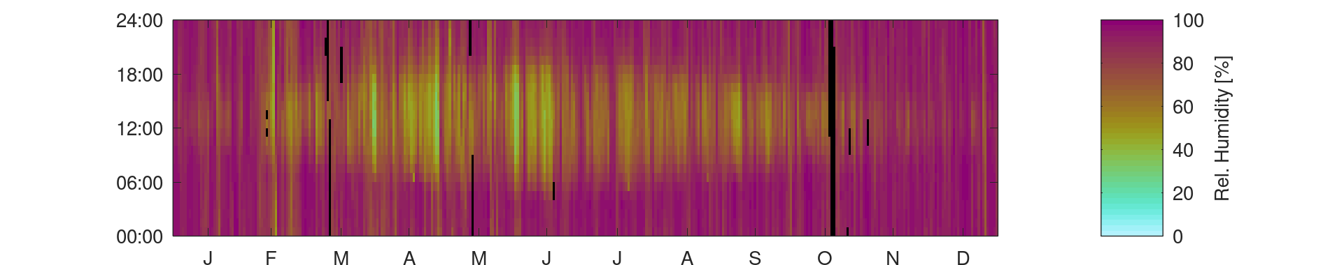
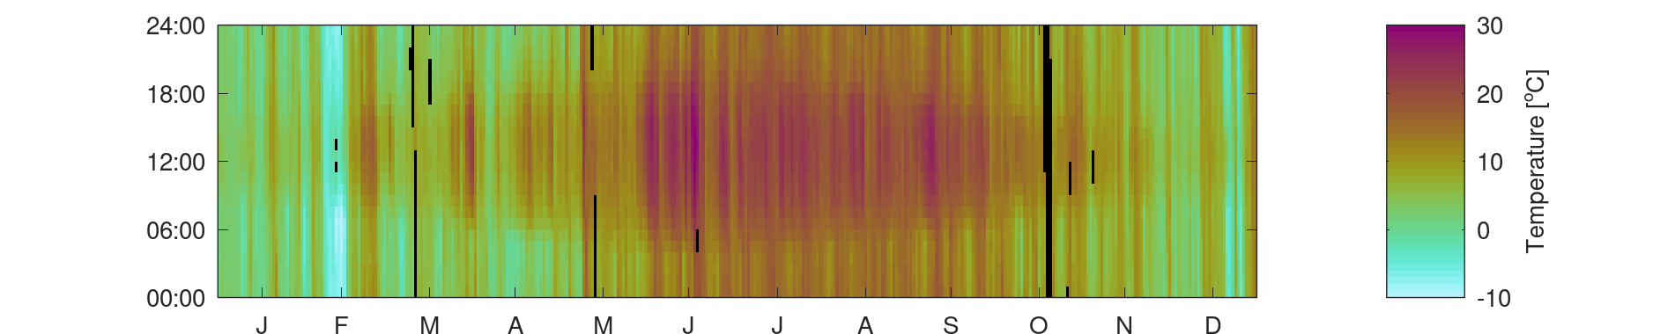
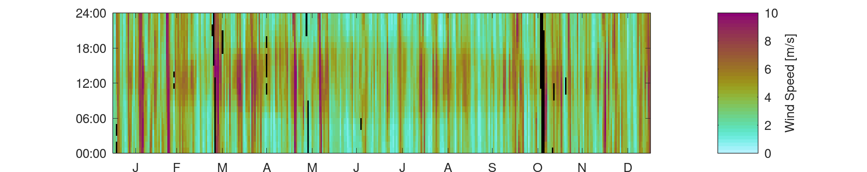
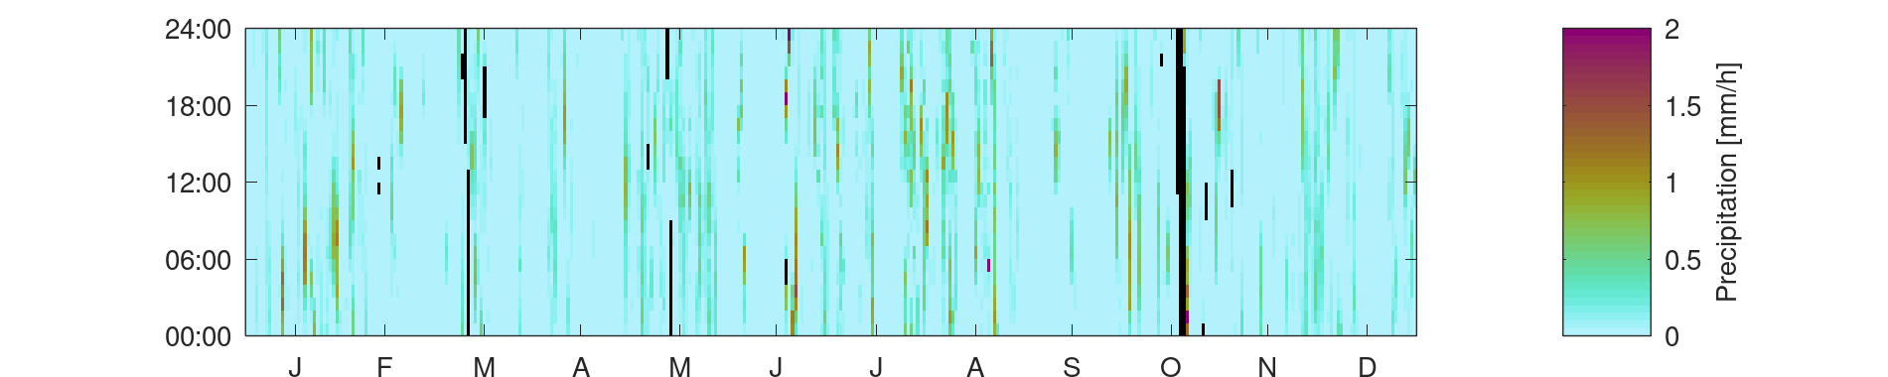
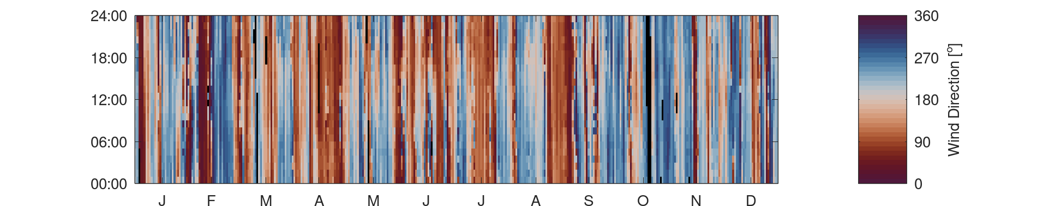
Results
Prototype data set: Year 2021
Global radiation
Relative humidity
Air temperature
Wind speed
Precipitation
Wind direction

Slide 12
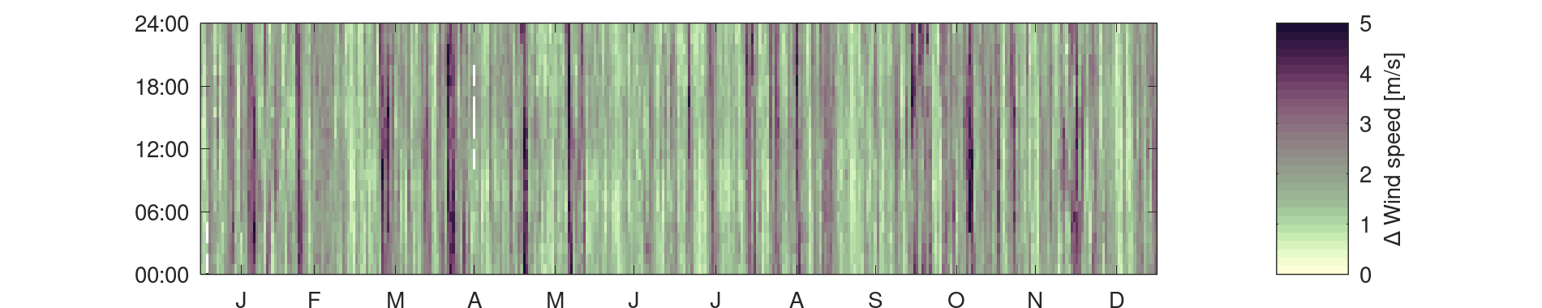
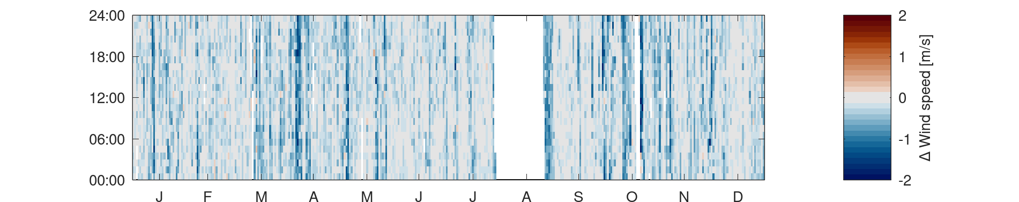
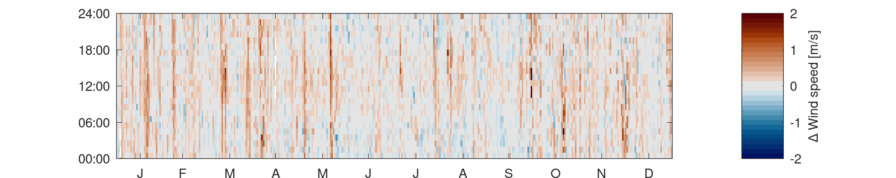
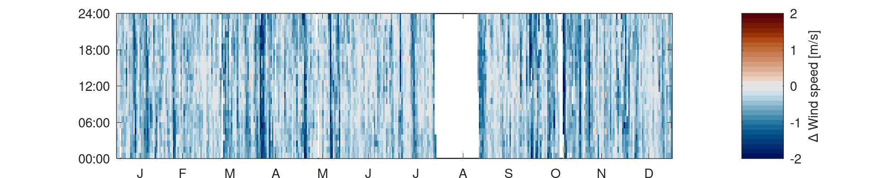
Results: cross-validation
Prototype data set: Year 2021
Wind speed
Blue? Error is reduced!
KNMI
KNMI + WOW
KNMI + cov
KNMI + WOW + cov

Slide 13
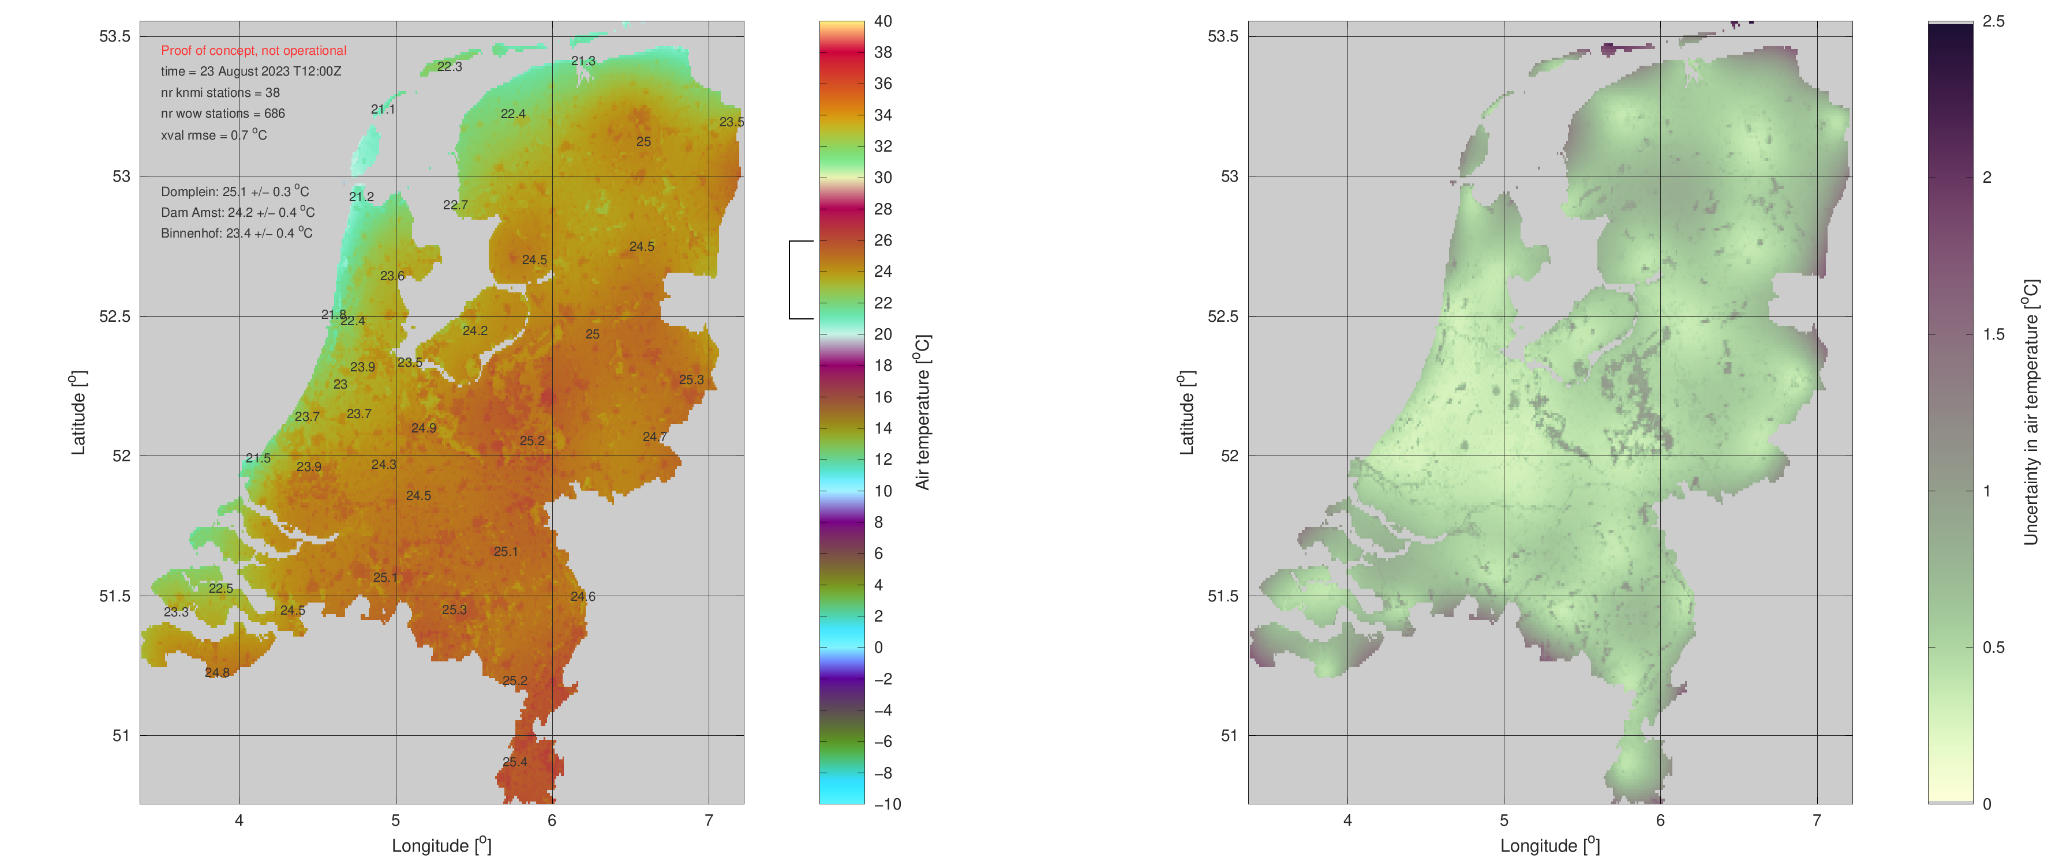
Proof-of-concept for KNMI weather room
Spin-off

Slide 14
Next steps
- Take new steps in reaching out to WOW community
- Collect & implement feedback from user group
- Think about verification & validation
- Provide data set for full period (2015-2022)
Royal Netherlands
Meteorological Institute
Ministry of Infrastructure and
Water Management

Slide 15
Thank you very much for your kind attention
Royal Netherlands
Meteorological Institute
Ministry of Infrastructure and
Water Management
Jouke de Baar, Irene Garcia-Marti, Gerard van der Schrier, Theo Brandsma (KNMI)
jouke.de.baar@knmi.nl
OSA2.5 Human biometeorology
Wednesday 16:00–16:15
Interdisciplinary approach to include the effect of weather and climate in models for the spread of airborne infectious diseases

Slide 16
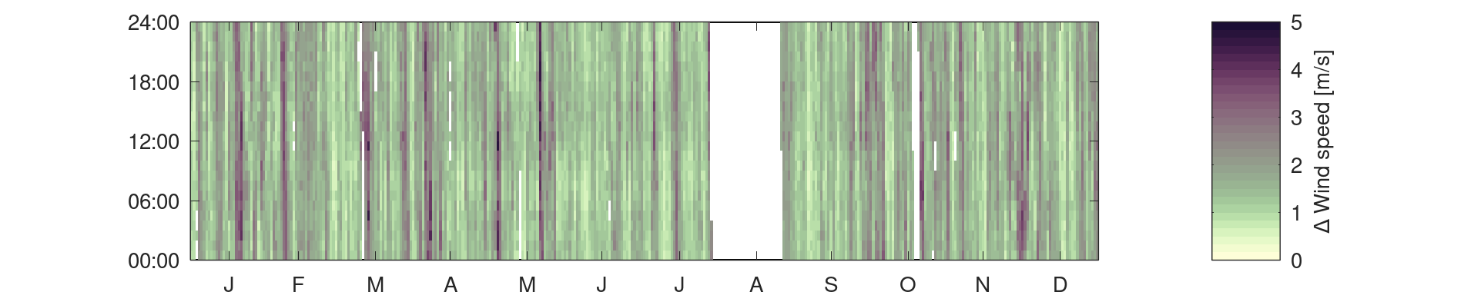
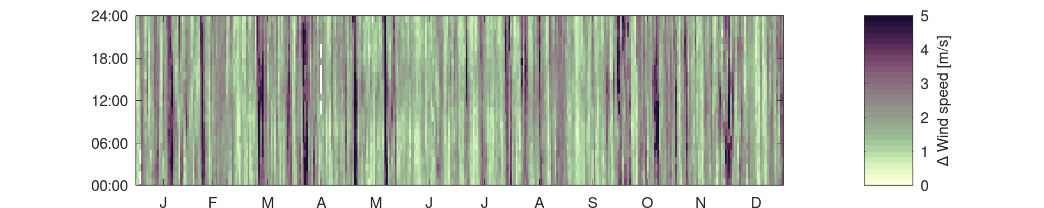
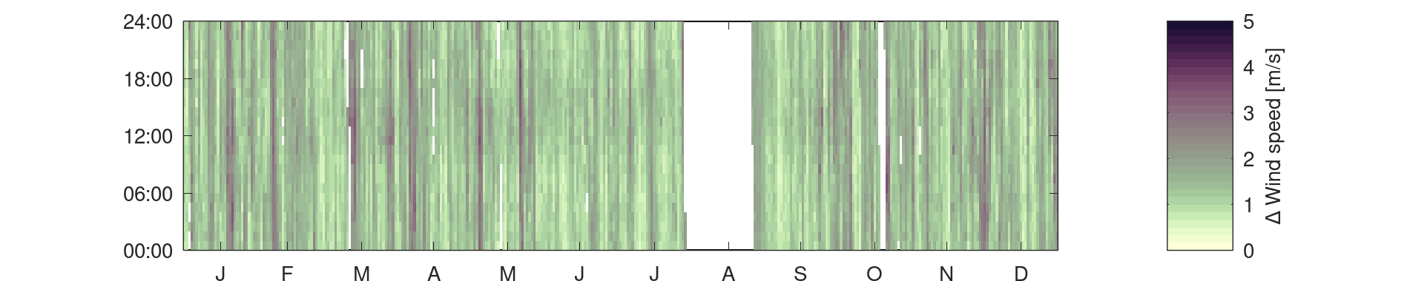
Q & A slide
Prototype data set: Year 2021
Wind speed
KNMI
KNMI + WOW
KNMI + cov
KNMI + WOW + cov

Slide 17
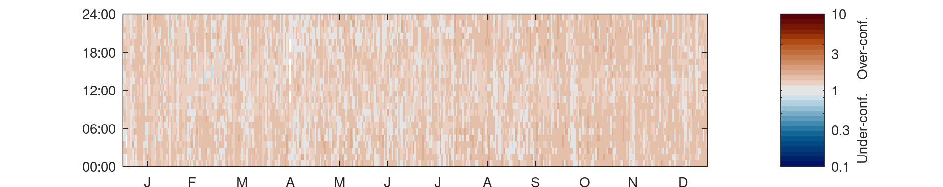
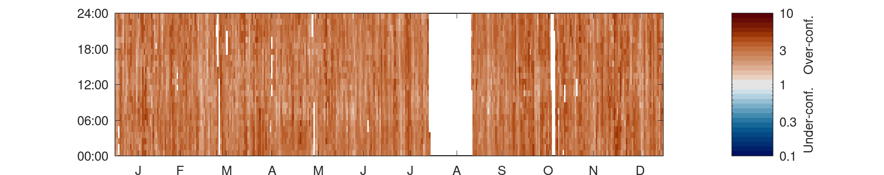
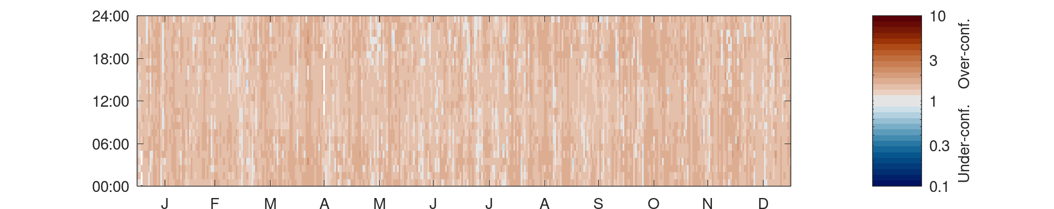
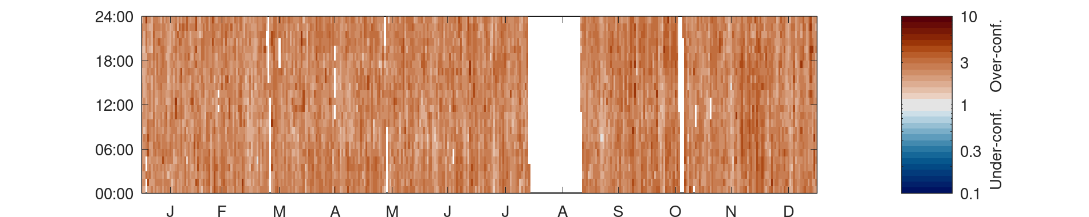
Prototype data set: Year 2021
Q & A slide
Wind speed
KNMI
KNMI + WOW
KNMI + cov
KNMI + WOW + cov

Slide 18


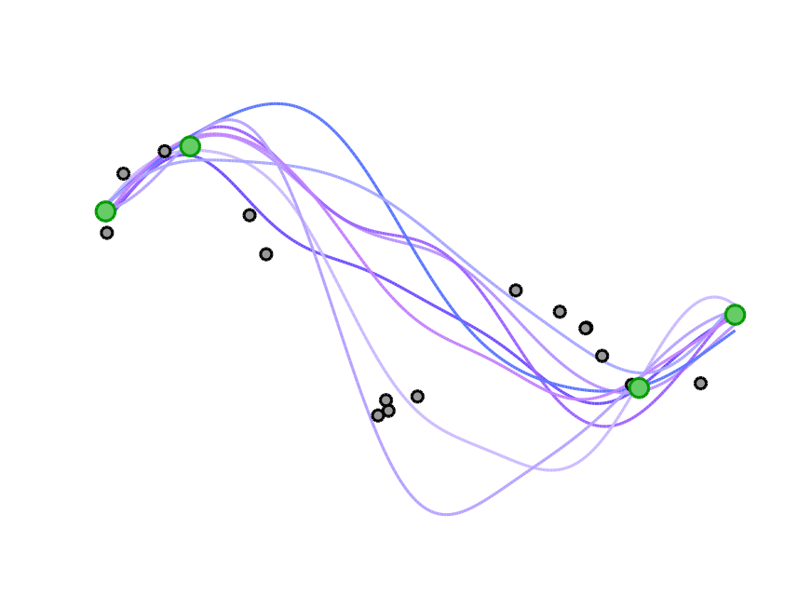
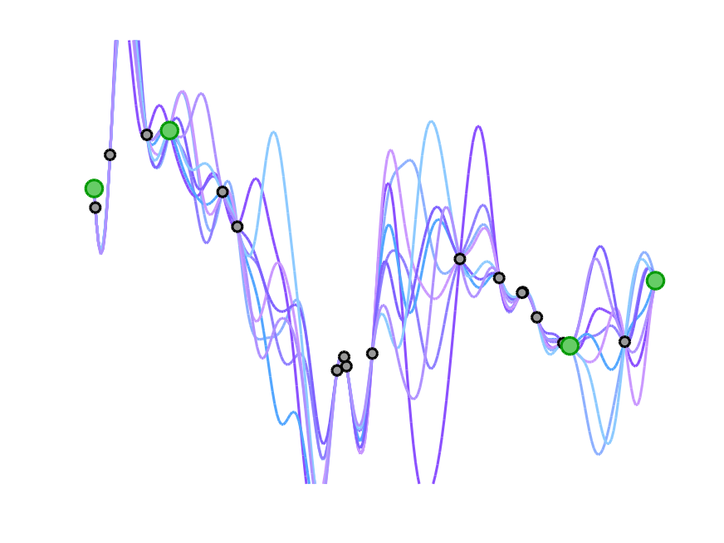
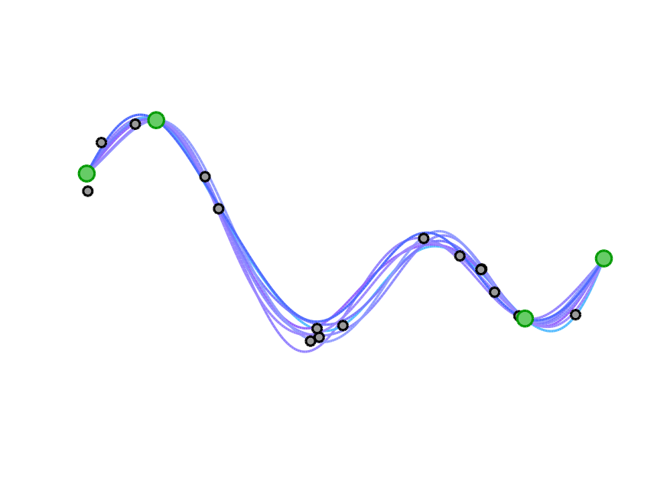
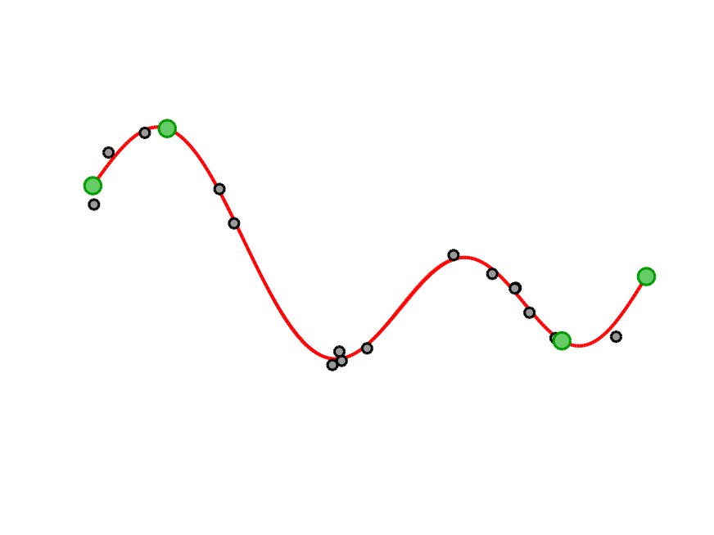
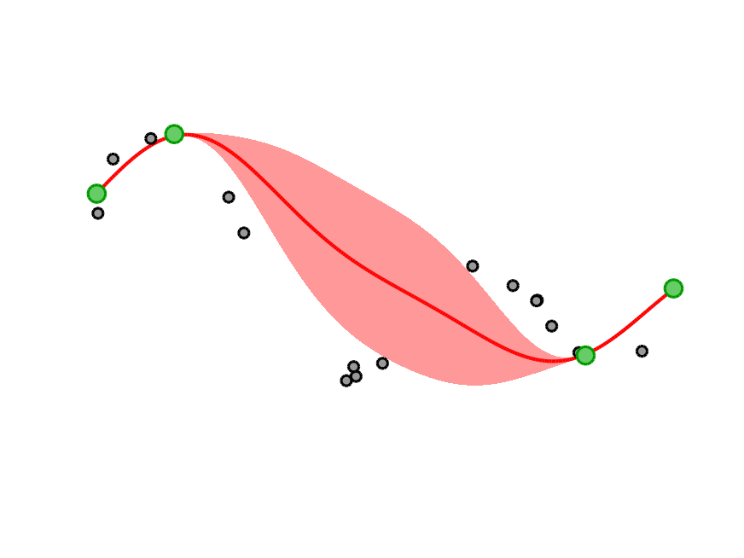
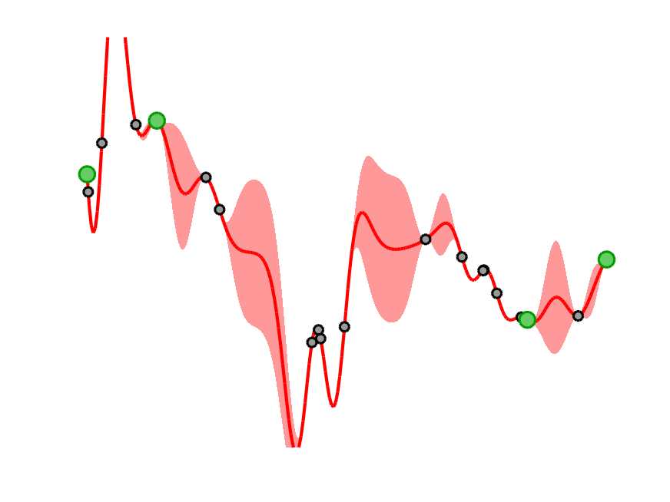
Q & A slide
Multi-fidelity Gaussian process regression
high-fidelity data
low-fidelity data
ignoring low-fi data
exact interpolation
regression with noise treatment

Slide 19
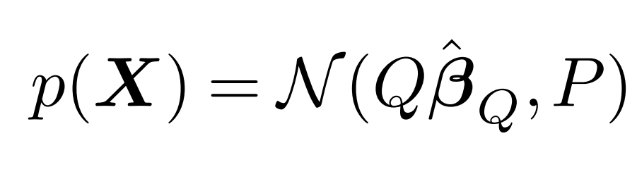
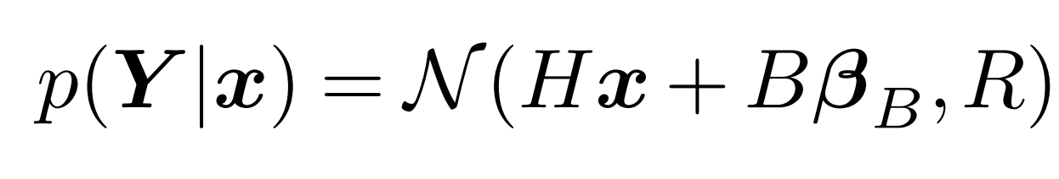
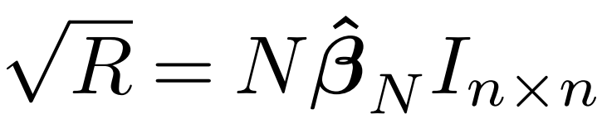
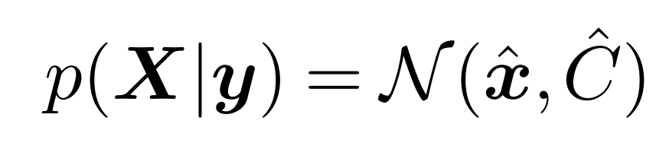
Q & A slide
Equations
Prior
Likelihood
regression with noise treatment
Posterior

Slide 20
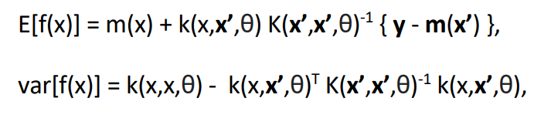
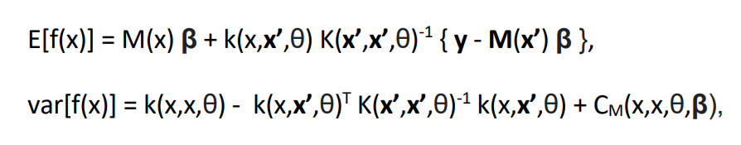
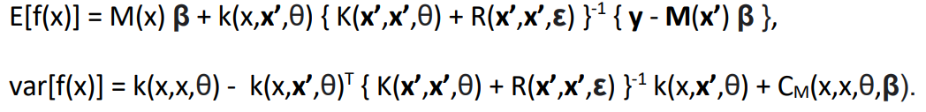
Q & A slide
Equations
Standard GPR
With external drift
With bias and noise
regression with noise treatment

