Slide 1
The dynamic of precipitation extremes in Berlin and Brandenburg based on a generalized Pareto distribution
Frederik Bart, Jana Ulrich, Dieter Scherer, Fred Meier, David Hellmann
Chair of Climatology | Institute of Ecology | Technische Universität Berlin

Slide 2
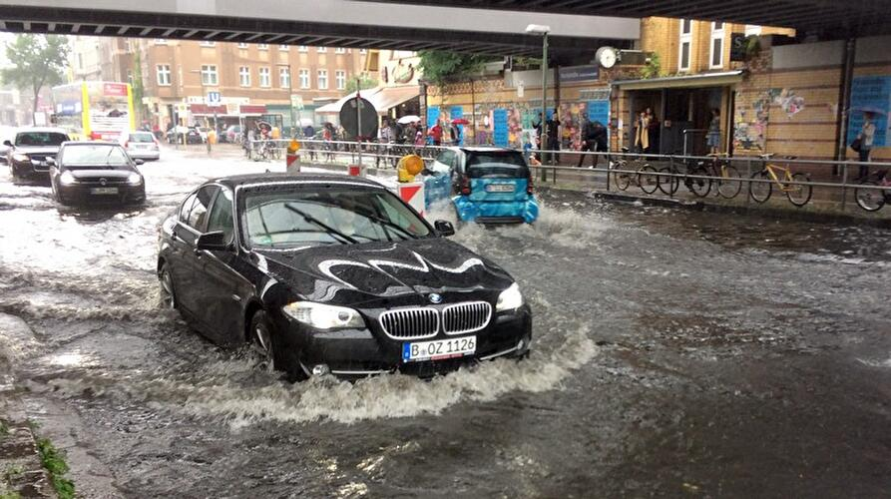
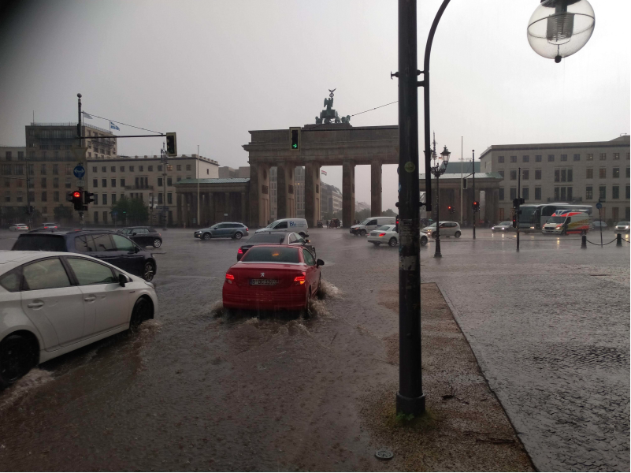
Precipitation extremes in Berlin and Brandenburg
Why study extreme events in this region?
Yorckstraße, June 2017
Pariser Platz, June 2019
Foto: www.berlin.de
Foto: Dr. Benjamin Creutzfeldt
Damages: Ca. 60 million € in insurance services (GDV)
Damages: Ca. 50 million € in insurance services (GDV)
Estimated return period of the 2017 event of 200 years (Berghäuser et al., 2020)
Is there a significant trend in return levels in this region?
What spatial and seasonal patterns can be identified?
Notes:
Introduction and Motivation (2 min)

Slide 3
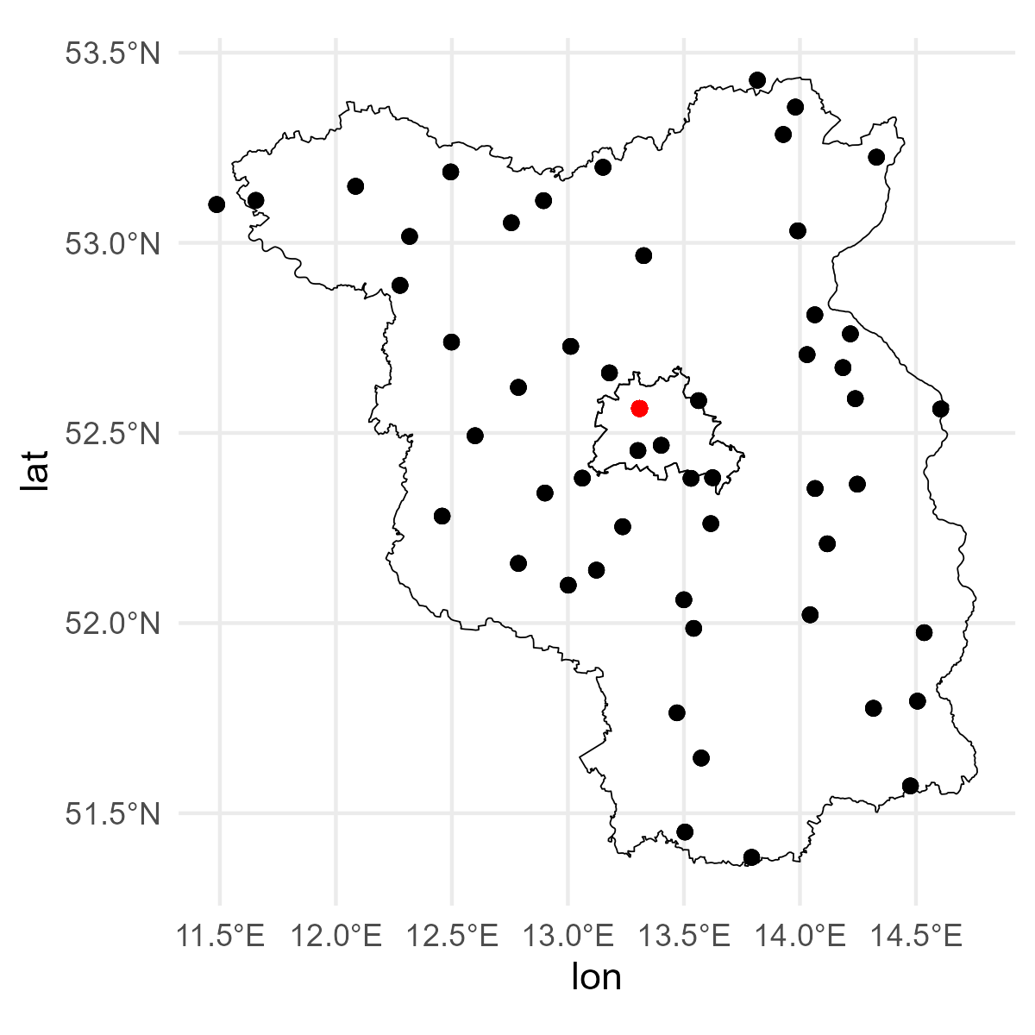
Data and Methods
Precipitation data (1991 – 2020)
Daily Raingauge measurement network of the German Weather Service (DWD)
Filtered based on data availability per season (~ 54 stations)
Regional climate model data (Central Europe Refined Analysis v2)
Berlin Tegel
(DWD Climate Data Center (CDC), 2023)
Notes:
Data and Methodology (2 min)

Slide 4
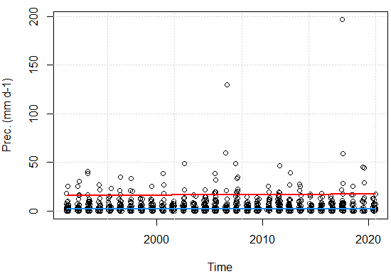
Data and Methods
Precipitation data (1991 – 2020)
Daily Raingauge measurement network of the German Weather Service (DWD)
Filtered based on data availability per season (~ 54 stations)
Regional climate model data (Central Europe Refined Analysis v2)
Berlin Tegel
Peak Over Threshold approach (POT)
Seasonal time dependent POT (Coelho et al., 2008)
$${u_{s}\left(t\right)\text{ = }\text{m}}_{s}\left(t\right)+ α_{s}$$
m_{s}(t) = long term seasonal trend of rain days (annual)
α_{s} = constant value to ensure α% of observed values above u_{s}(t)
(DWD Climate Data Center (CDC), 2023)
Station Berlin Tegel (JJA 1991-2020)
m_{s}(t) + a_{s}
m_{s}(t)
Notes:
Data and Methodology (2 min)

Slide 5
Data and Methods
Precipitation data (1991 – 2020)
Daily Raingauge measurement network of the German Weather Service (DWD)
Filtered based on data availability per season (~ 54 stations)
Regional climate model data (Central Europe Refined Analysis v2)
Berlin Tegel
Peak Over Threshold approach (POT)
Seasonal time dependent POT (Coelho et al., 2008)
$${u_{s}\left(t\right)\text{ = }\text{m}}_{s}\left(t\right)+ α_{s}$$
m_{s}(t) = long term seasonal trend of rain days (annual)
α_{s} = constant value to ensure α% of observed values above u_{s}(t)
(DWD Climate Data Center (CDC), 2023)
Station Berlin Tegel (JJA 1991-2020)
m_{s}(t) + a_{s}
m_{s}(t)
Probability distribution model
Generalized Pareto Distribution (GPD): $GPD(μ, σ\text{, }\text{ξ}\text{)}$
Parameter estimation via Maximum Likelihood Estimation (MLE)
Time dependent scale parameter: $ln\text{σ}$(t) = ${\text{σ}}_{0}$ +${\text{σ}}_{1}$t, ξ(t) = ξ
Temporal variation for 2-, 10- and 20-year return level
(Coles, 2001)
Notes:
Data and Methodology (2 min)

Slide 6
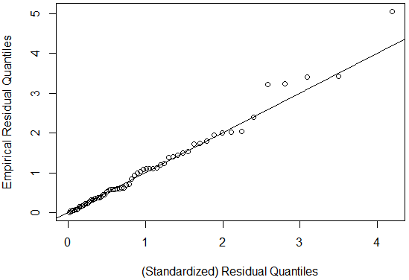
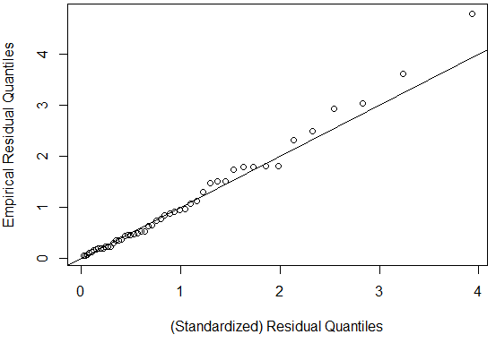
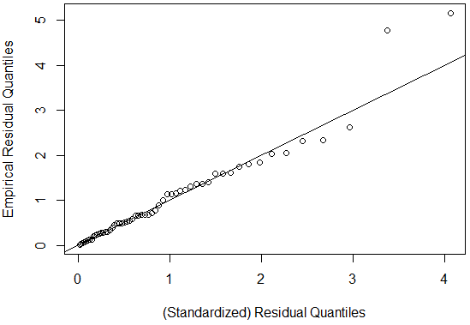
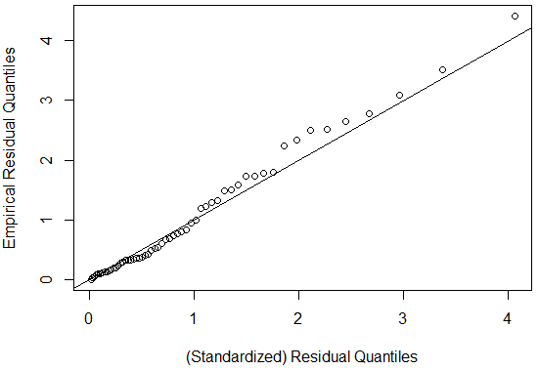
Goodness of fit (GOF)
QQ-plots
Deviation of standardized residual quantiles
$MSE= \frac{1}{n}\sum_{i=1}^{n}{{(Y_{i}−{\tilde{Y}}_{i})}^{2}}$
$Y_{i}$= Empirical quantiles
${\tilde{Y}}_{i}$ = Model quantiles
Average MSE:
DJF: 0.034
MAM: 0.032
JJA: 0.044
SON: 0.038
Typically lowest GOF for Summer months
DJF
MAM
Empirical residual quantiles
MSE = 0.024
MSE = 0.027
JJA
SON
Empirical residual quantiles
MSE = 0.063
MSE = 0.026
Model residual quantiles
Model residual quantiles
QQ-Plots for station Berlin Tegel
Notes:
Goodness of fit of the Pareto distribution (1 min)
Abweichungen kennzeichnen
Formel einfügen

Slide 7
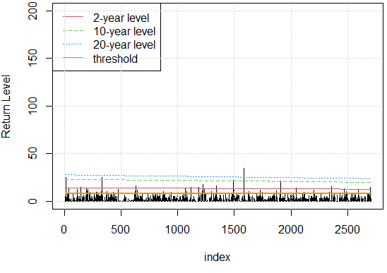
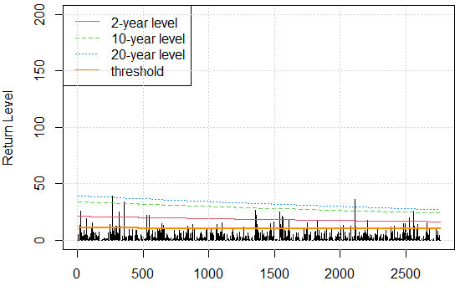
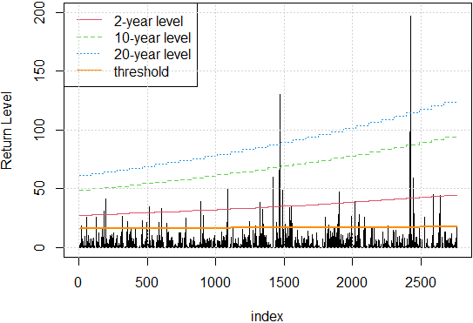
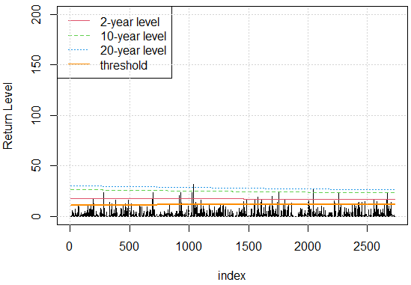
Results - Return levels
Seasonal return level for station Berlin Tegel
DJF
MAM
(mm d-1)
JJA
SON
(mm d-1)
Days
Days
Notes:
Result 1 (1 min)
Jahre auf Zeitachse einfügen

Slide 8
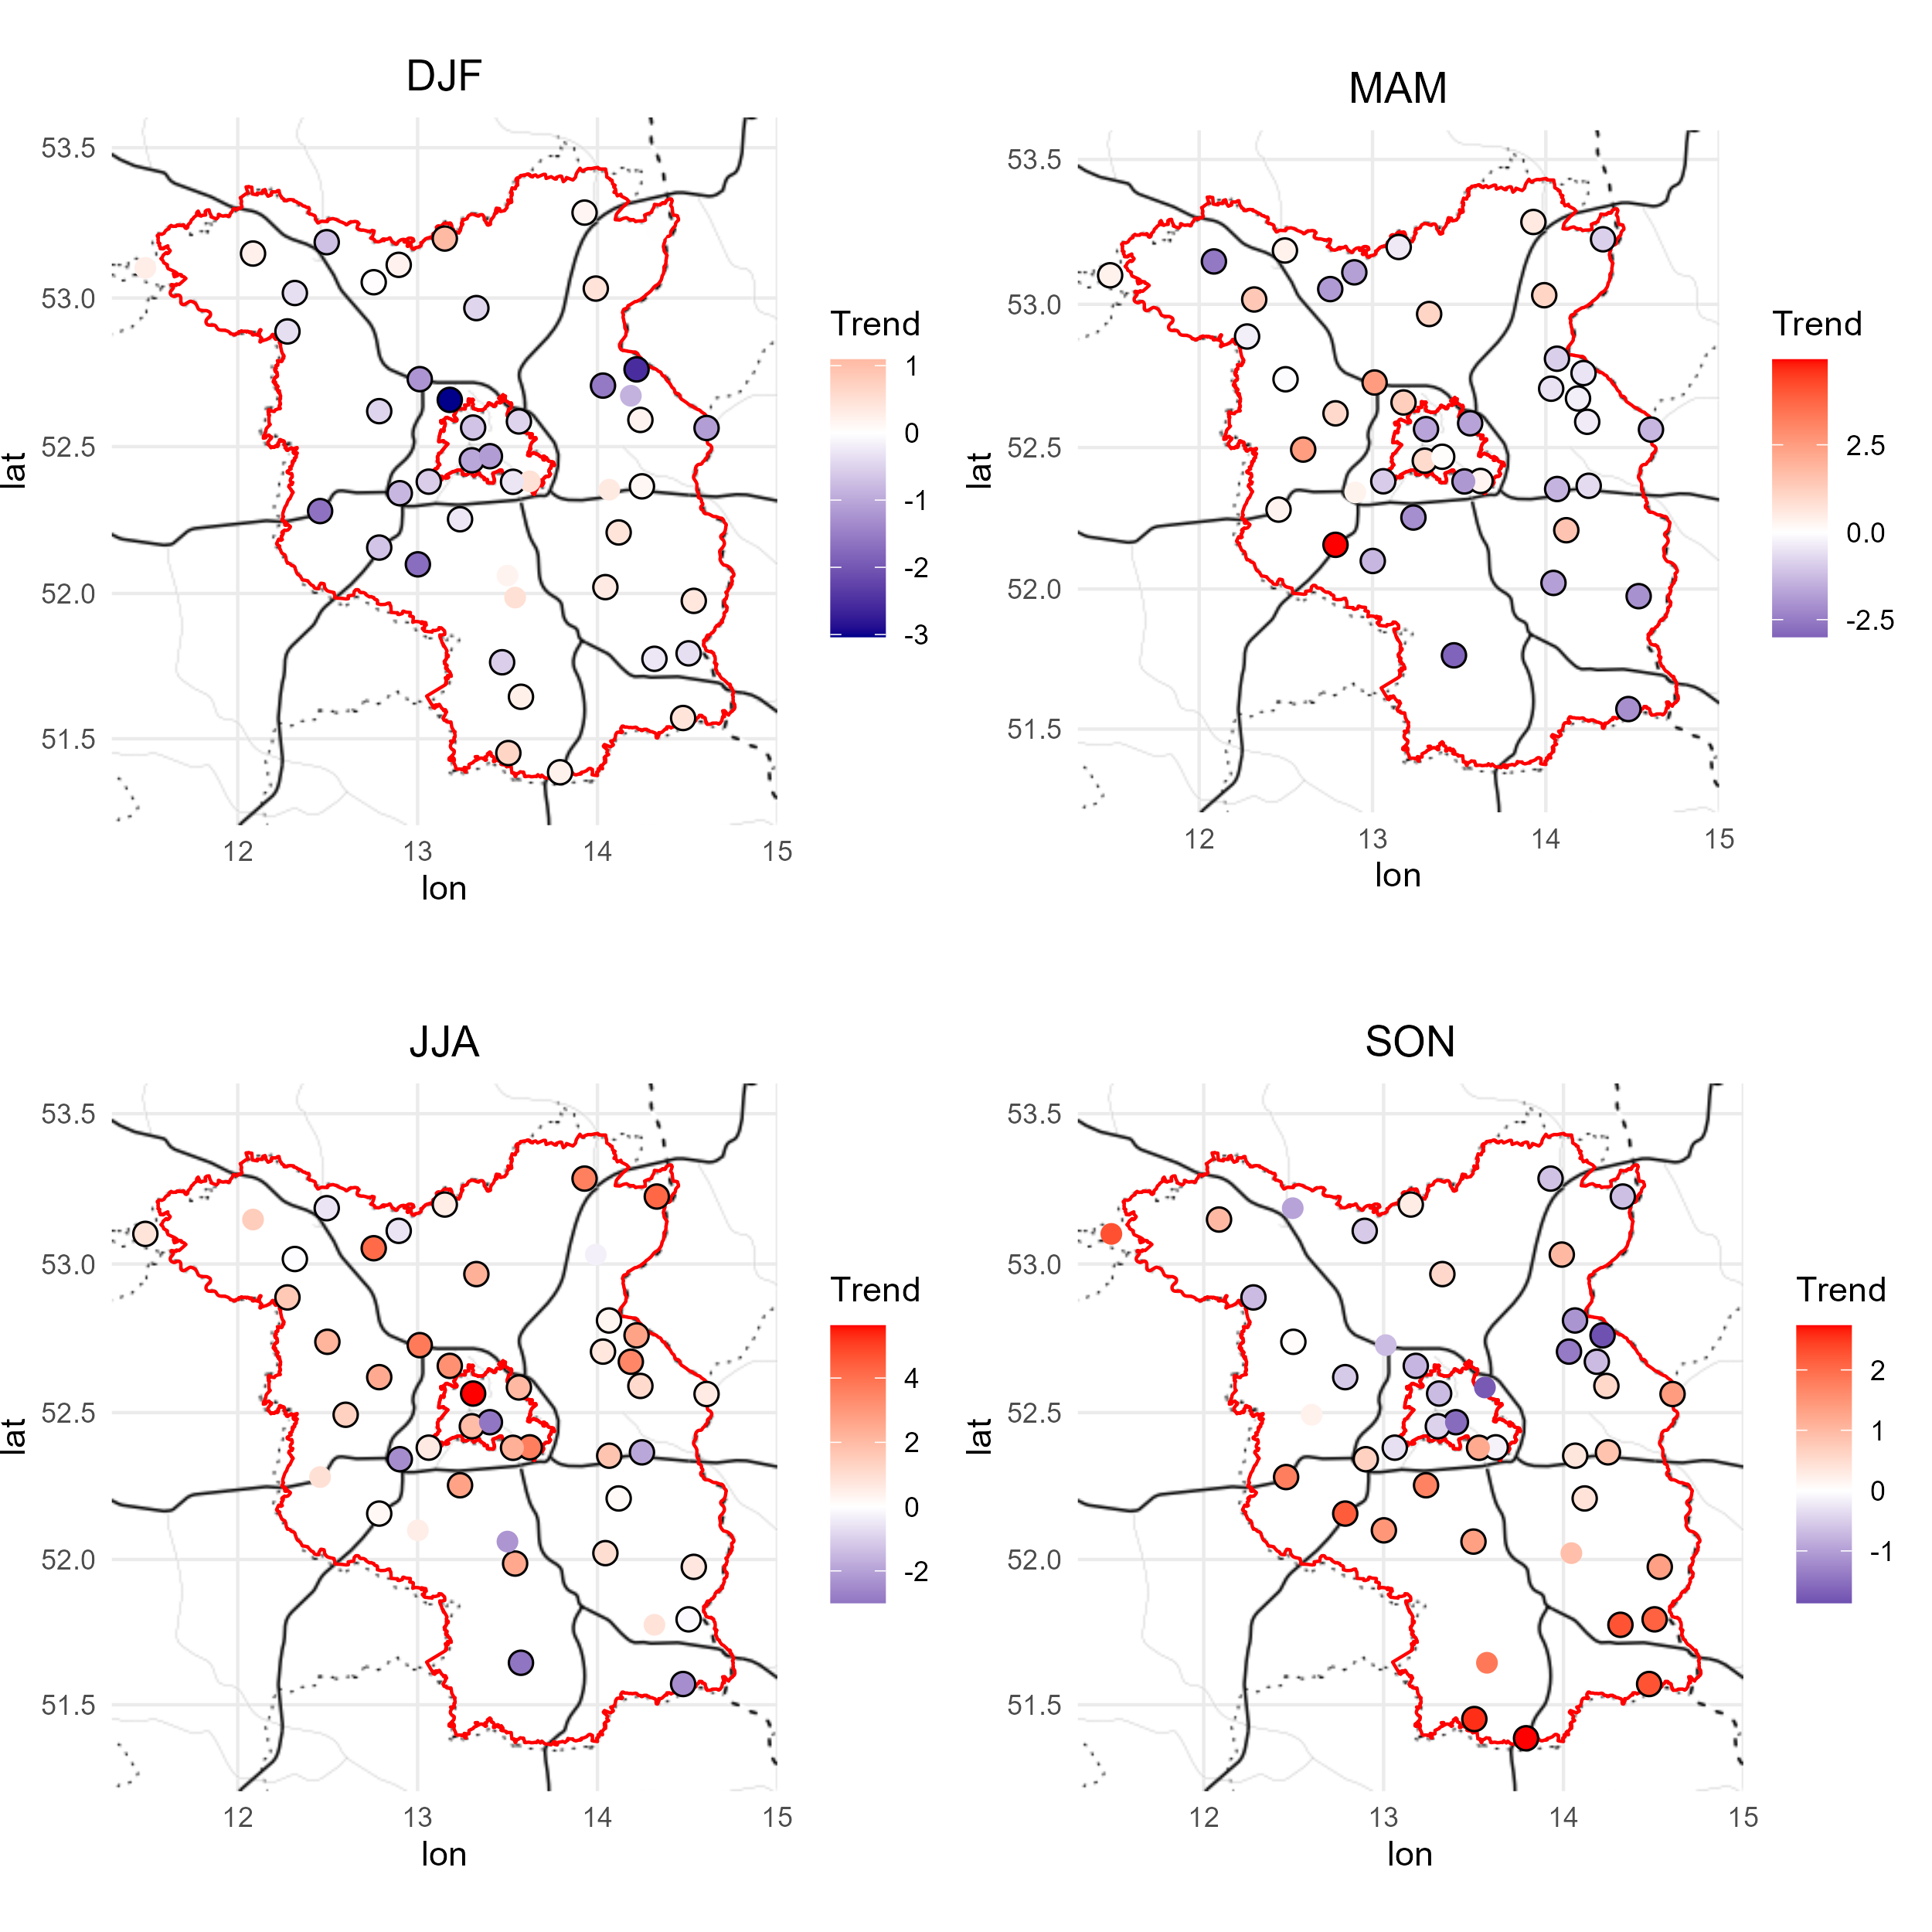
Results - Return level trend
Estimation the trend of the N-return level (Acero et al., 2011)
Mainly influenced by the slope of m_{s}(t) and ${\text{σ}}_{1}$(t)
Positive trend in the area of Berlin during the Summer
Higher trend in the south of Brandenburg in autumn
Possible influence of warmer continental climate
→ Preliminary results
*Black circle = significant slope m_{s}(t)
Seasonal 2yr Return level trend (mm decade -1)*
Notes:
Result 2 (2 min)

Slide 9
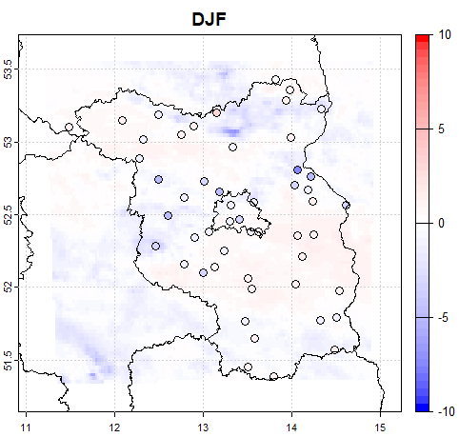
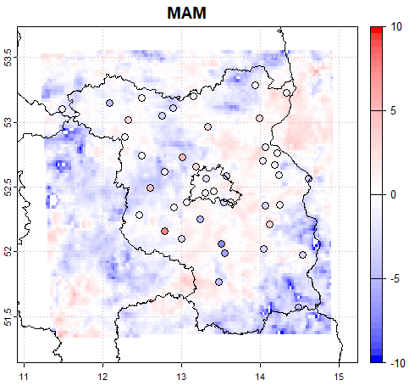
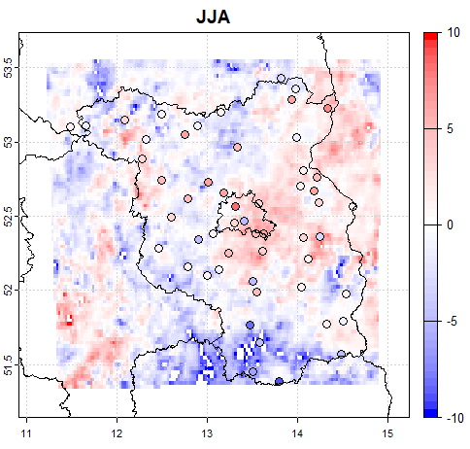
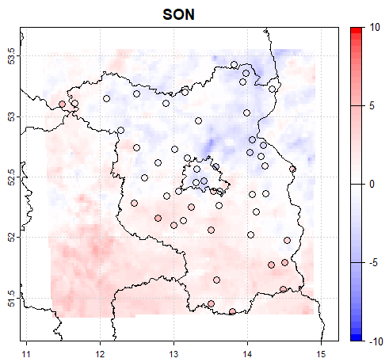
Results - Comparison with CER v2 data
mm decade -1
Stations can miss local events
Possible benefit by usage of high-resolution datasets
Central Europe Refined Analysis (CER v2) with 2 km grid spacing
WRF dynamical downscaling of ERA5 for Berlin and Brandenburg
Adjusted simulation setup based on CER (Jänicke et al., 2017)
Relatively good agreement for winter and autumn
→ Preliminary results
mm decade -1
Seasonal 2yr Return level trend (mm decade -1)*
Notes:
Result 3 (2 min)

Slide 10
Conclusions and outlook
Evaluation of trends in the return levels for daily precipitation extremes
Highest positive trend in 2-year return levels during summer months in Berlin
Discrepancy in return level trends between north and south of Brandenburg
Relatively high degree of uncertainty for higher return periods
Further experiments with different levels of model complexity
Inclusion of longer time series
CER v2 data shows good agreement for return level trends with station data especially for winter and autumn
Further evaluation of the dataset currently in progress
Notes:
Summary and conclusions (1 min)

Slide 11
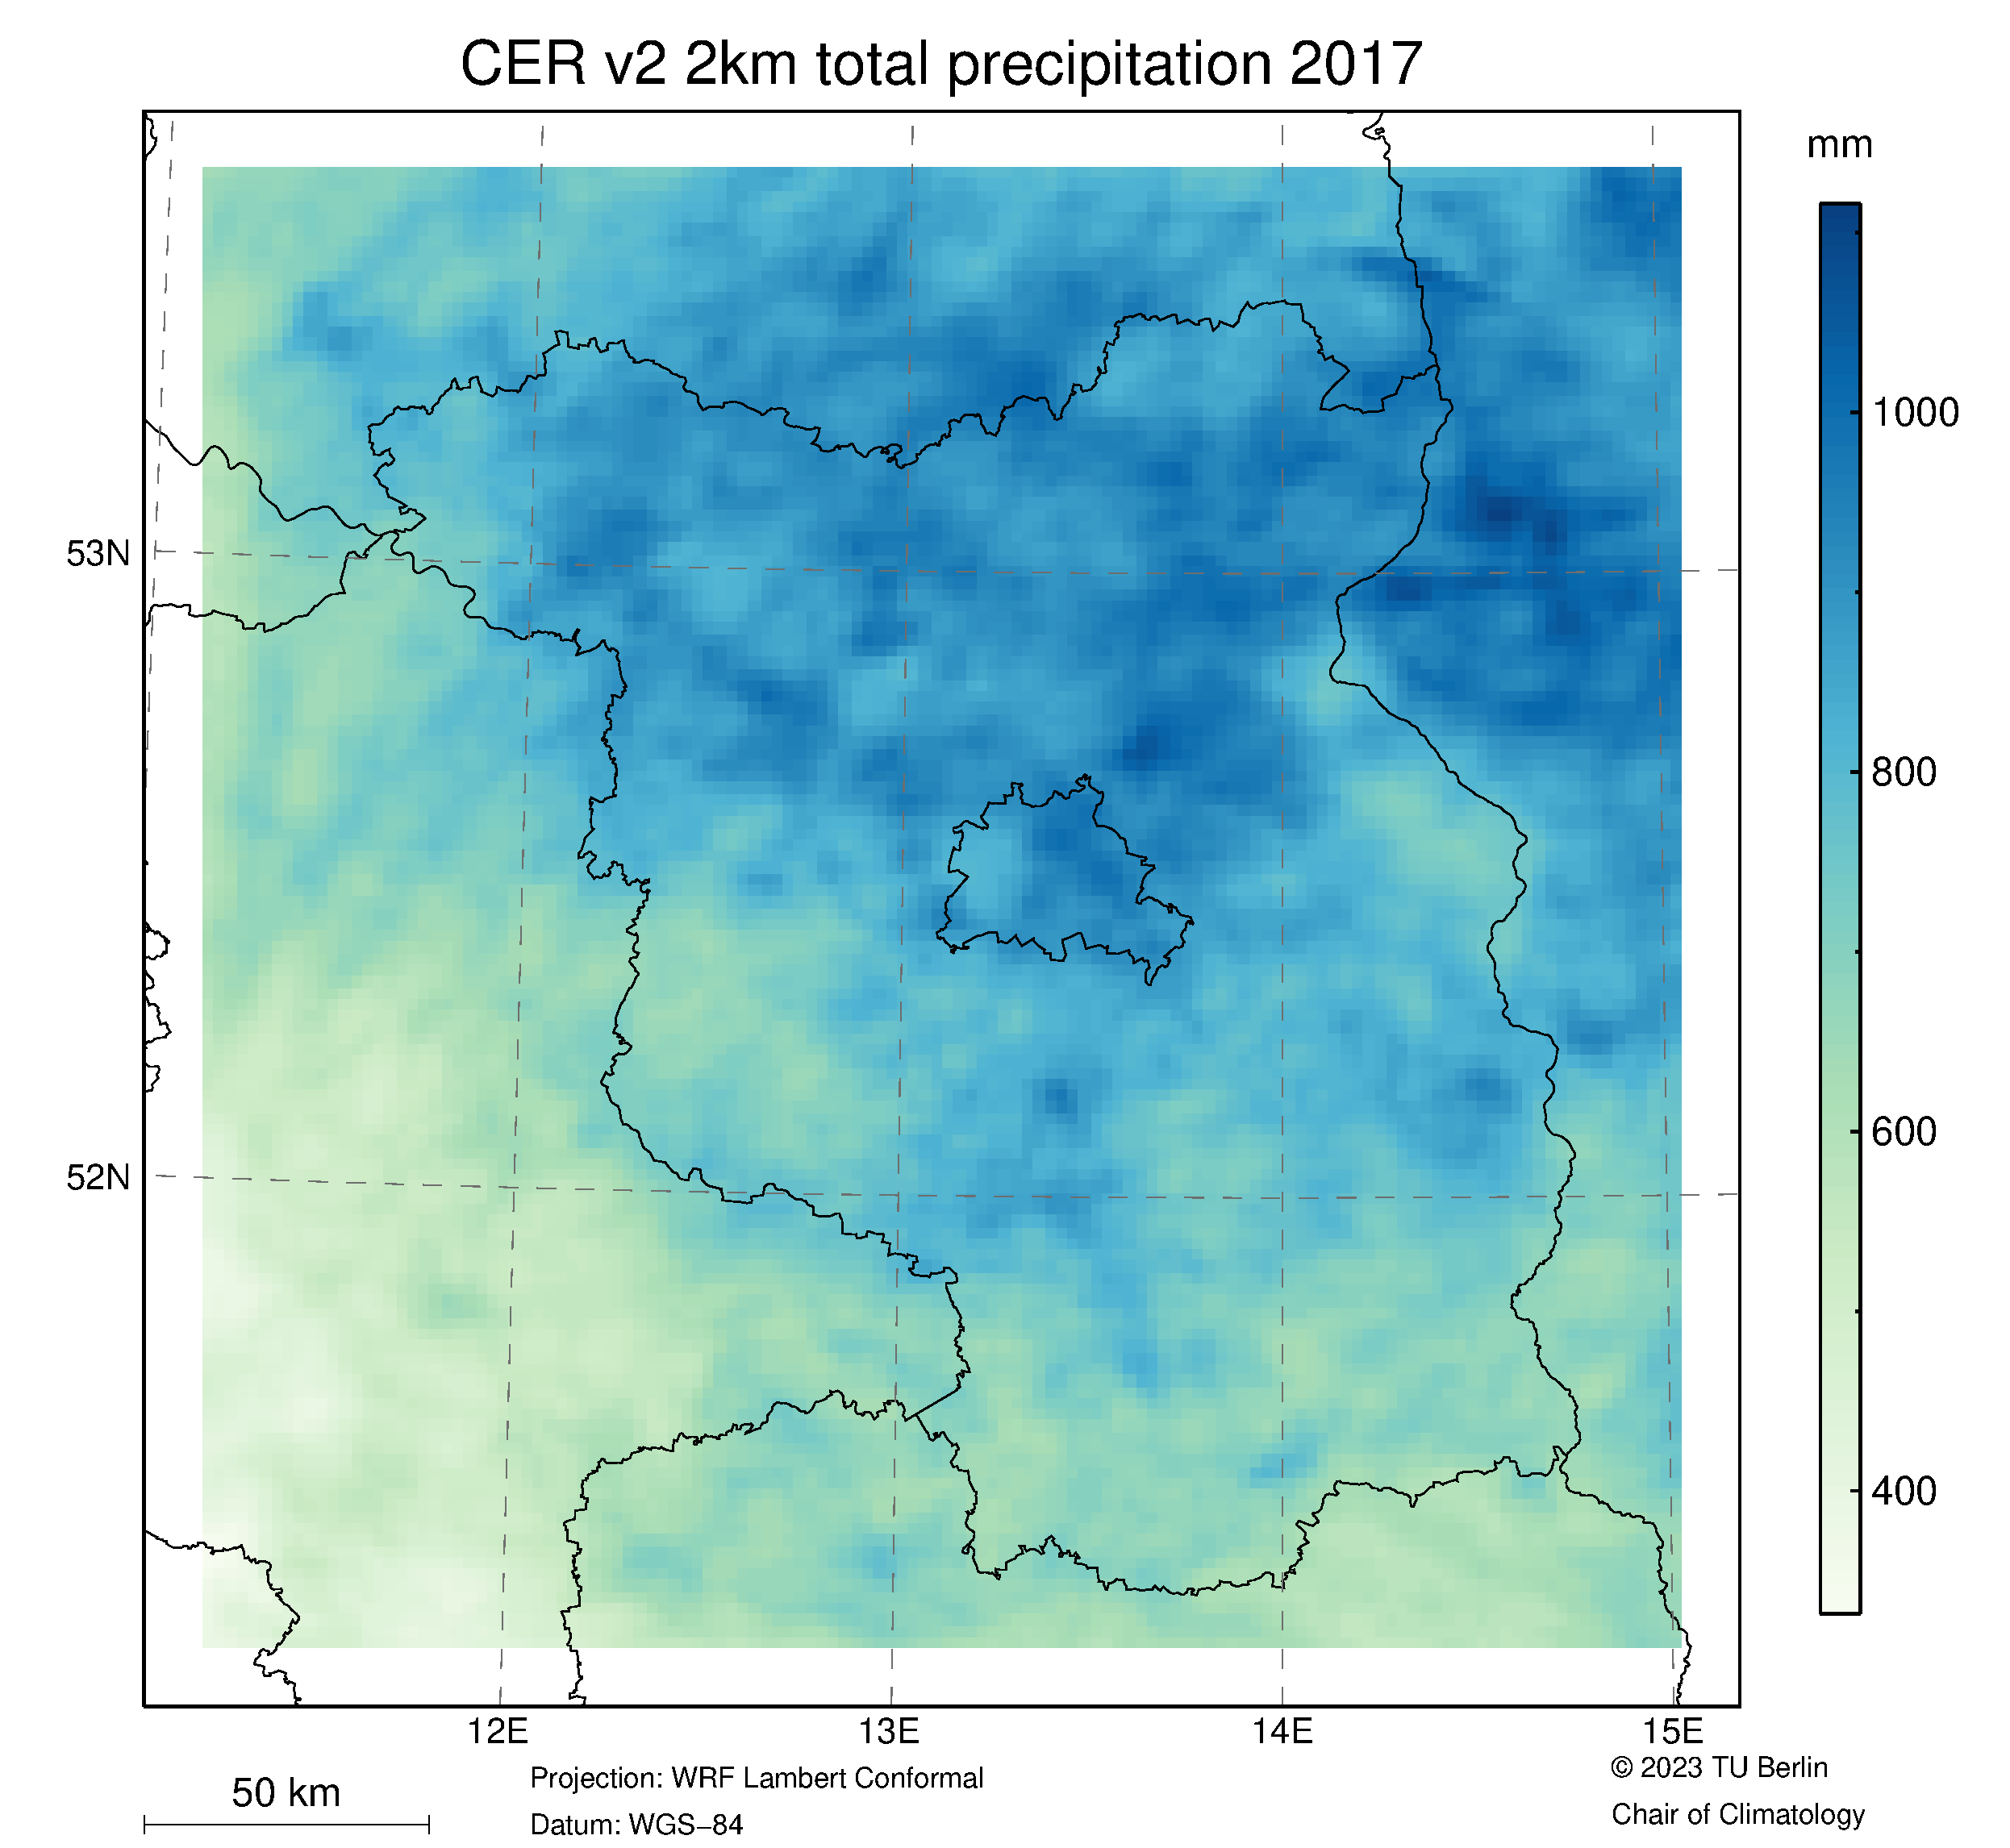
Contact
Are you interested in our dataset?
CERv2 Website: https://www.tu.berlin/en/klima/research/regional-climatology/central-europe/cer
Domain Berlin-Brandenburg (2 km horizontal grid spacing)
33 years of data available (1990-2022)
2D and 3D products of various atm. variables
For any further questions, please contact:
Frederik Bart (frederik.bart@tu-berlin.de)
Dr. Marco Otto (marco.otto@tu-berlin.de)
Prof. Dr. Dieter Scherer (dieter.scherer@tu-berlin.de)
Thank you for your attention!
Notes:
Contact information and end of Presentation (1 min)

Slide 12
References
Coles, S. An Introduction to Statistical Modeling of Extreme Values. (Springer, 2001). doi:10.1007/978-1-4471-3675-0.
Coelho, C. a. S., Ferro, C. a. T., Stephenson, D. B. & Steinskog, D. J. Methods for Exploring Spatial and Temporal Variability of Extreme Events in Climate Data. Journal of Climate 21, 2072–2092 (2008).
Acero, F. J., García, J. A. & Gallego, M. C. Peaks-over-Threshold Study of Trends in Extreme Rainfall over the Iberian Peninsula. Journal of Climate 24, 1089–1105 (2011).
Berghäuser, L. et al. Starkregen in Berlin : Meteorologische Ereignisrekonstruktion und Betroffenenbefragung. (2021) doi:10.25932/publishup-50056.

Slide 13
Slope of scale parameter ${\text{σ}}_{1}$
Likelihood-ratio test compared to stationary conditions (scale parameter constant):
Black circle = p < 0.05
Black square = p < 0.1
Scale ${\text{σ}}_{1}$
Scale ${\text{σ}}_{1}$
Scale ${\text{σ}}_{1}$
Scale ${\text{σ}}_{1}$

Slide 14
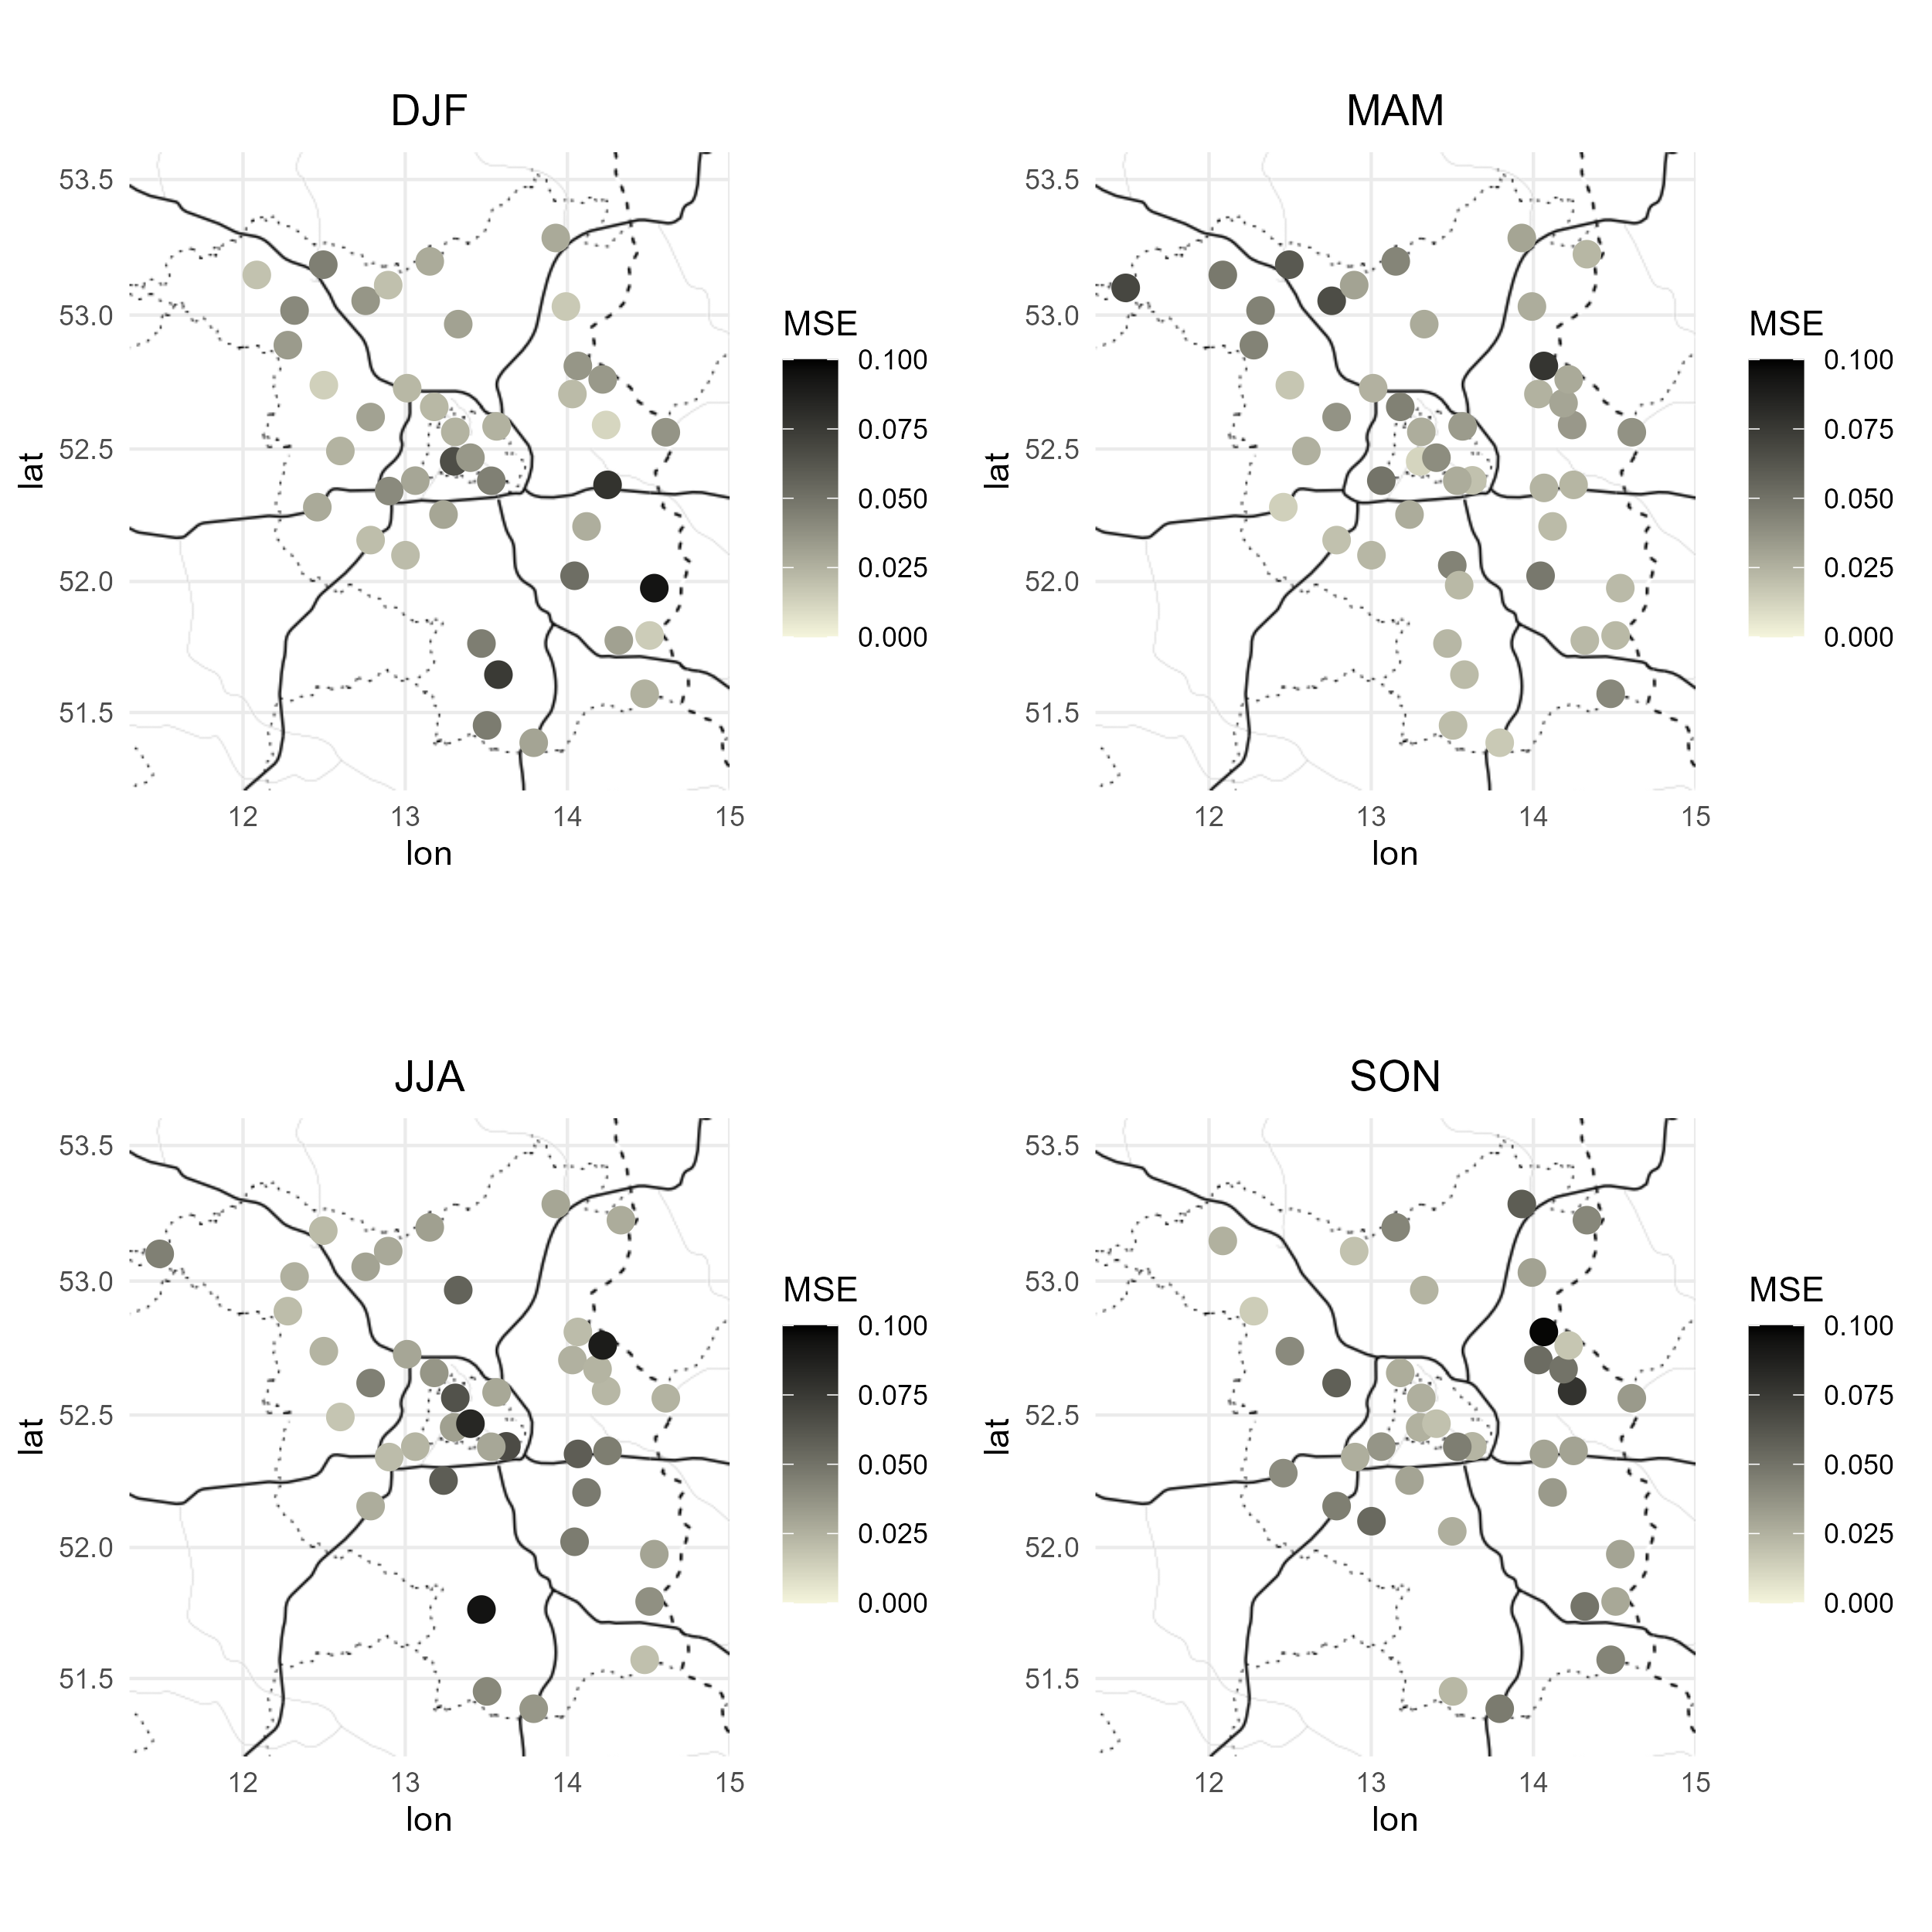
MSE for all Stations

Slide 15
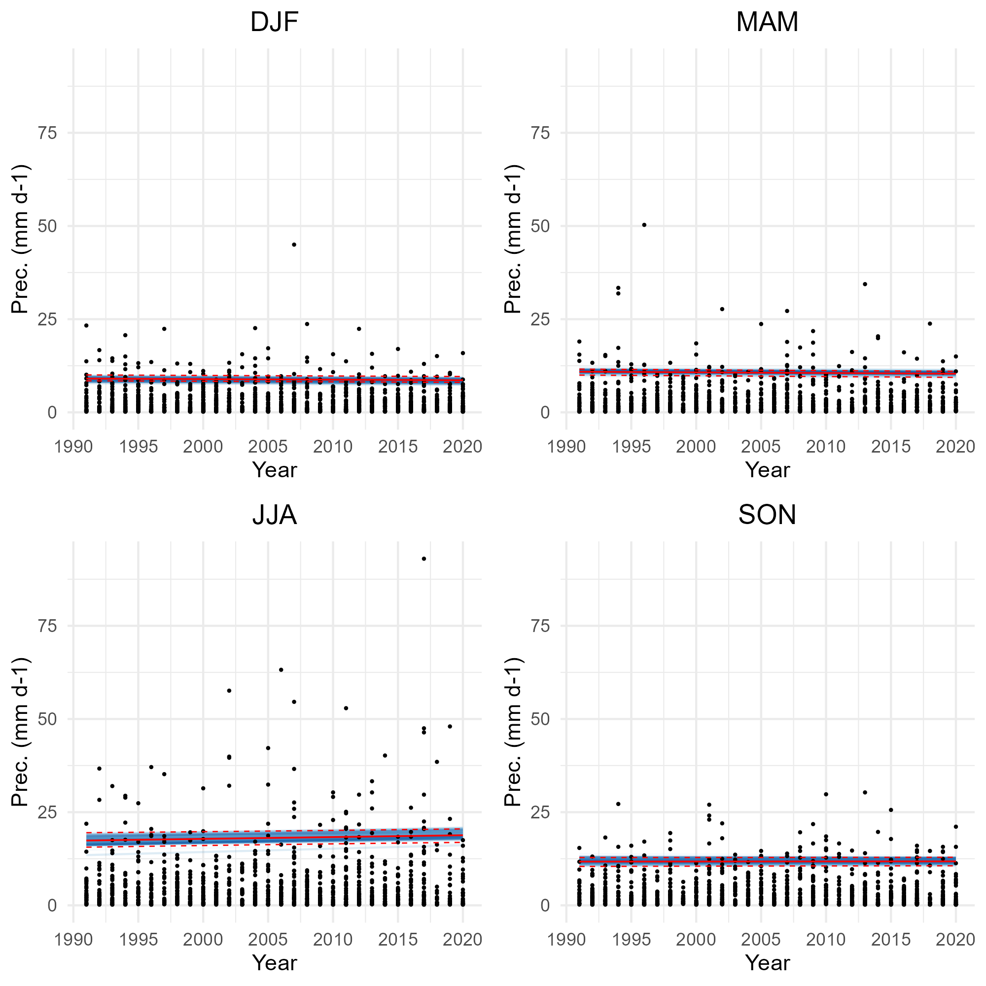
threshold uncertainties
Station Berlin Dahlem (1991-2020)
Estimation of 95% confidence intervals via Bootstrapping

Slide 16
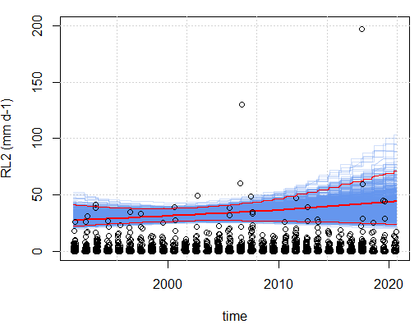
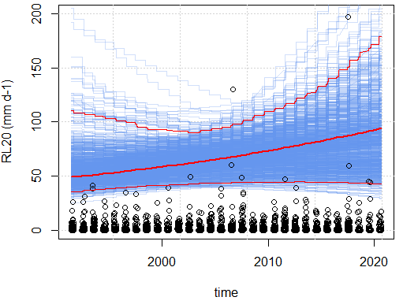
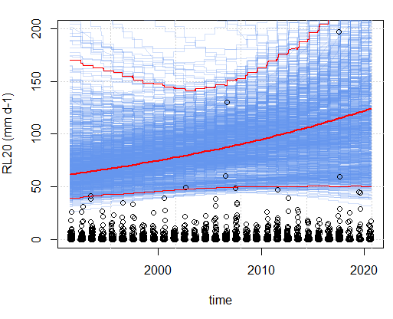
Uncertainty estimates (bootstrapping)
Station Berlin Tegel (JJA)
Bootstrapping with 1000 samples
95% confidence interval
2 year return level
10 year return level
20 year return level

Slide 17
Threshold selection
shape
scale
Percentile
Estimation of shape and scale based on different percentiles for α_{s}
Results are given the spatial average for the whole domain

Slide 18
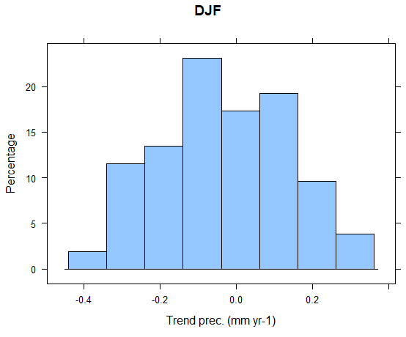
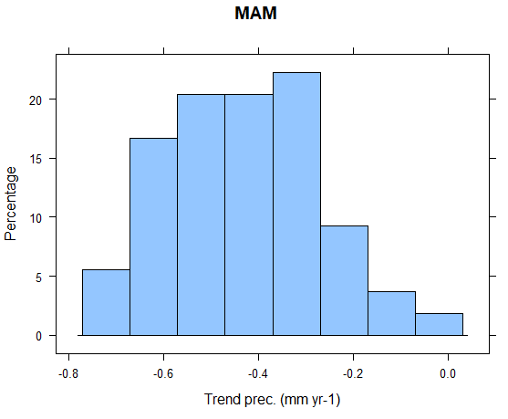
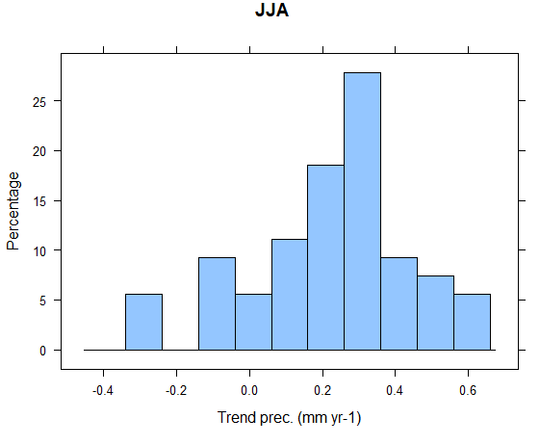
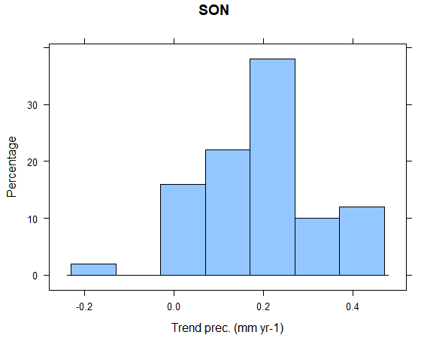
Slope of seasonal mean rainfall

