Slide 1

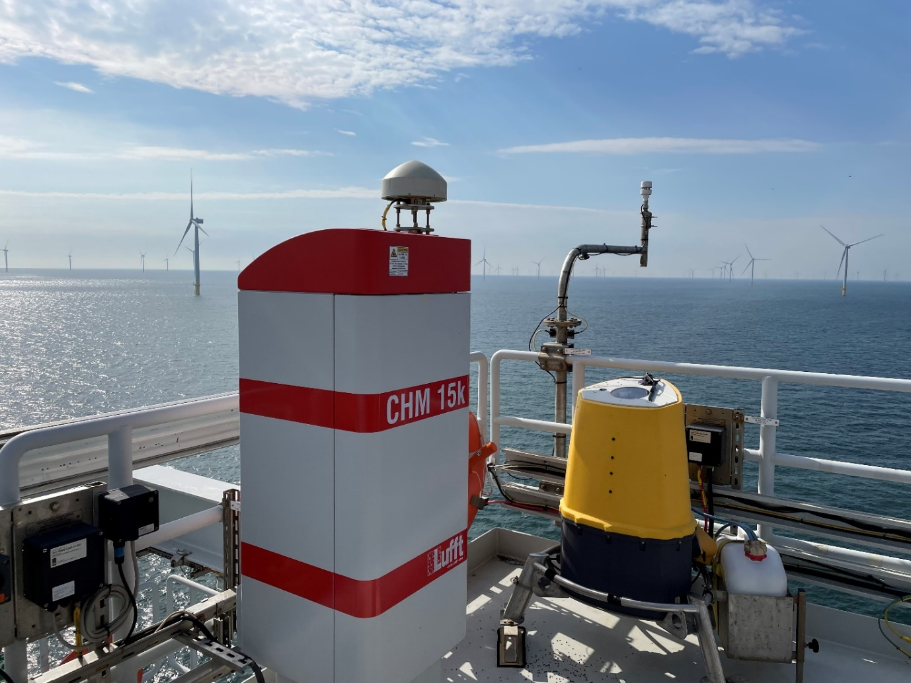
Wind lidars within Dutch offshore wind farms
Steven Knoop¹, Mando de Jong²
KNMI, The Netherlands
1) R&D Observations and Datatechnology
2) Observation Operations
Borssele Alpha, Damian Napoles Soto (KNMI)
EMS 2023

Slide 2
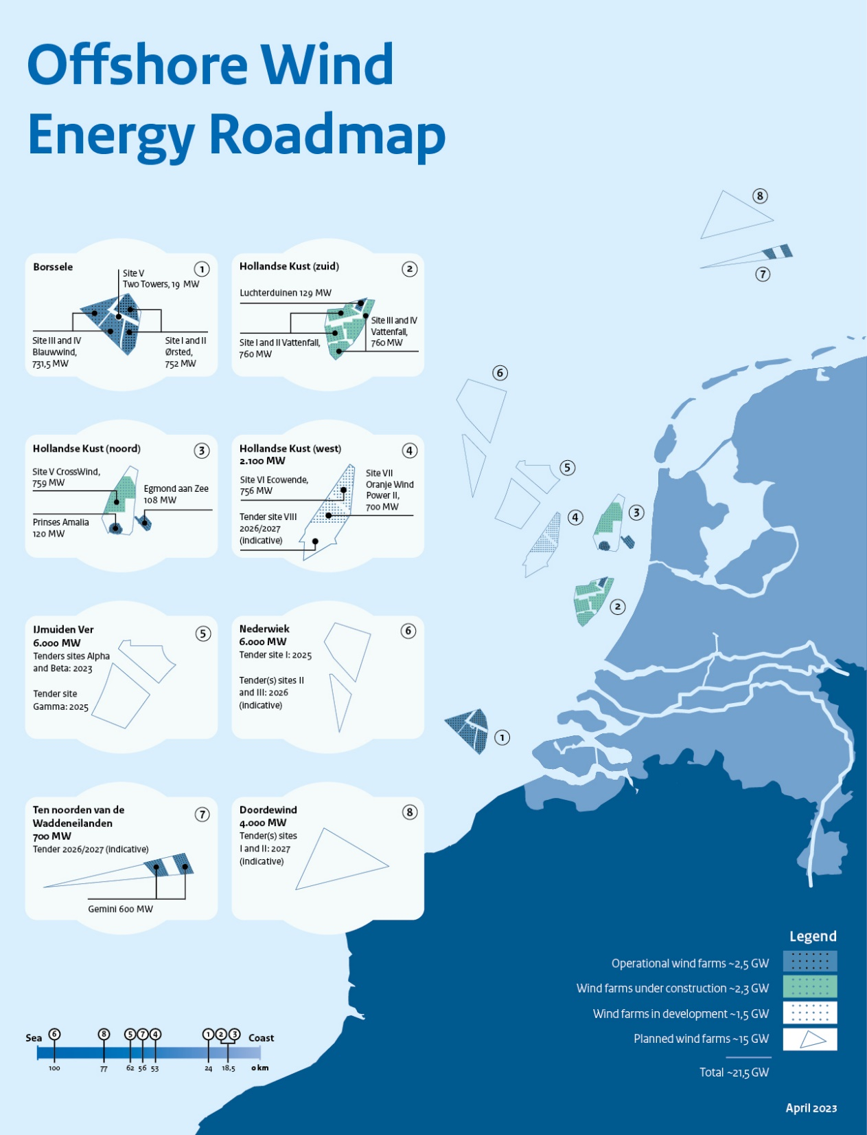
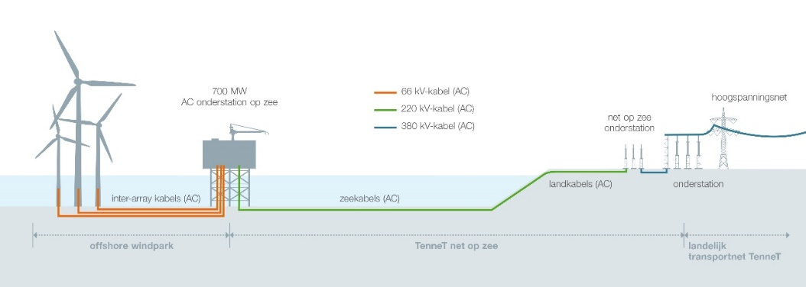
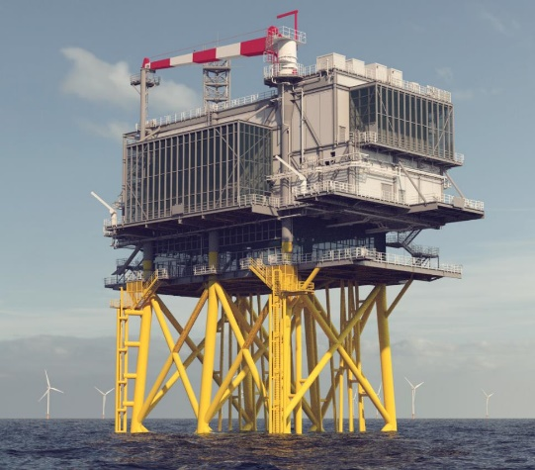

Introduction
Notes:
https://www.noordzeeloket.nl/en/functions-and-use/offshore-wind-energy/
https://www.tennet.eu/projects/offshore-projects-netherlands
1) Borssele: 94x 8 MW + 77x 9.5 MW + 2x 9.5 MW
2) Hollandse Kust Zuid : 139x 11 MW
3) Hollandse Kust Noord : 69x 11 MW

Slide 3
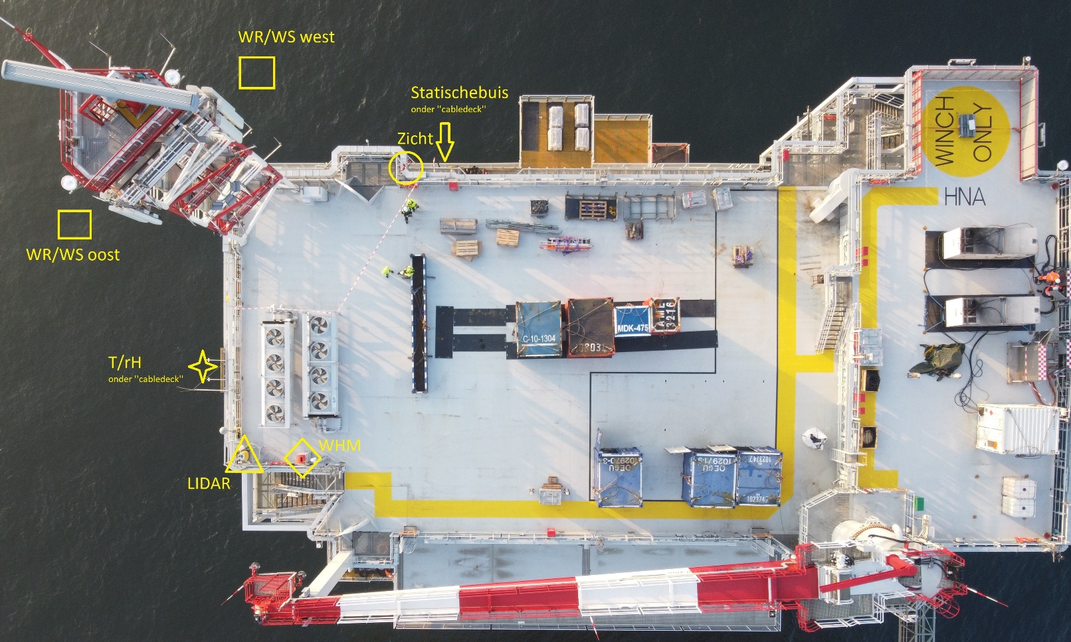
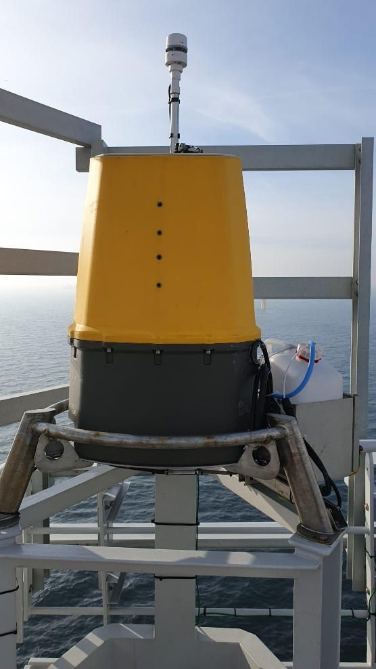
ZX300M wind lidar
Hollandse Kust Noord, Damian Napoles Soto (KNMI)
Notes:
KNMI deploys meteorological instruments on top of those platforms

Slide 4
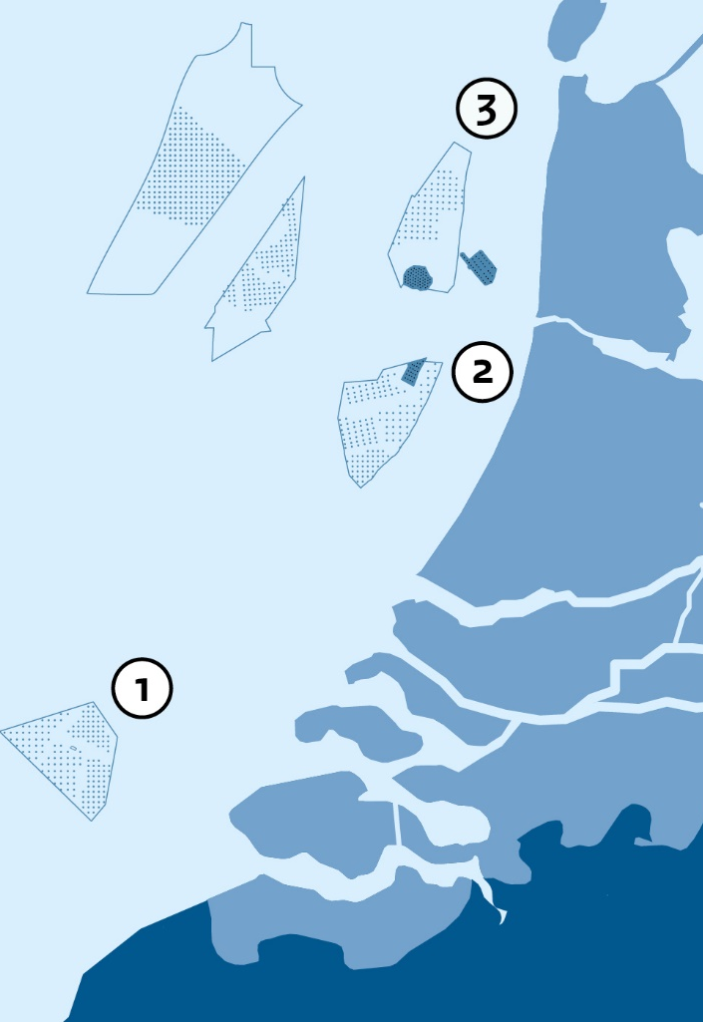
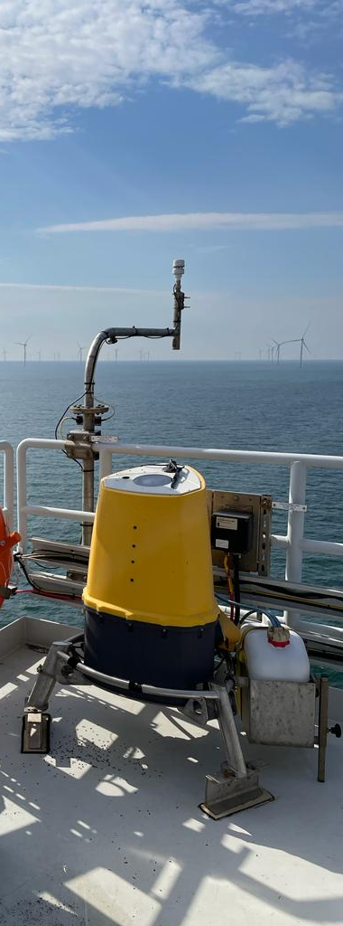
Wind lidars
Borssele
Hollandse Kust Zuid
Hollandse Kust Noord
(short-range) wind lidar on each substation
Official role: part of compensation scheme
Instrument: ZX300M (ZX lidars)
Data is publicly available
 | Start WL | Start WF* | Offline WL
Borssele Alpha | 2019-7 | 2020-4 | 2021-3 -> 2021-7 2023-4 -> now
Borssele Beta | 2020-6 | 2020-4 | 2023-8 -> now
Hollandse Kust Zuid Alpha | 2022-4 | 2023-6? | 2022-5 -> now
Hollandse Kust Zuid Beta | 2022-8 | 2023-6?
Hollandse Kust Noord | 2022-12 | 2023-6
Hollandse Kust West Alpha | 2023?
….

Slide 5
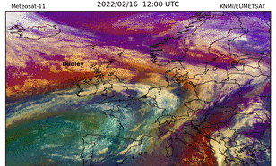
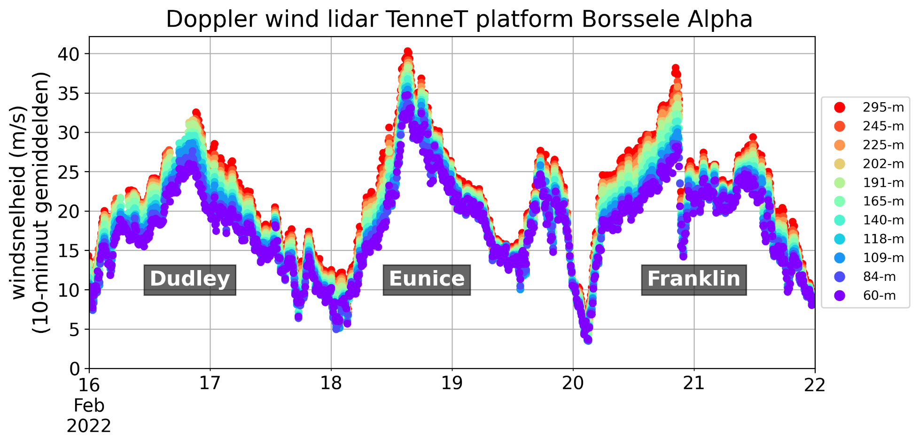
Triplet storm 2022
wind speed (m/s)

Slide 6
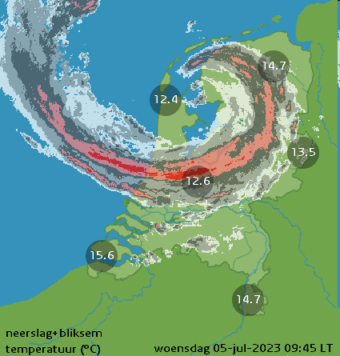
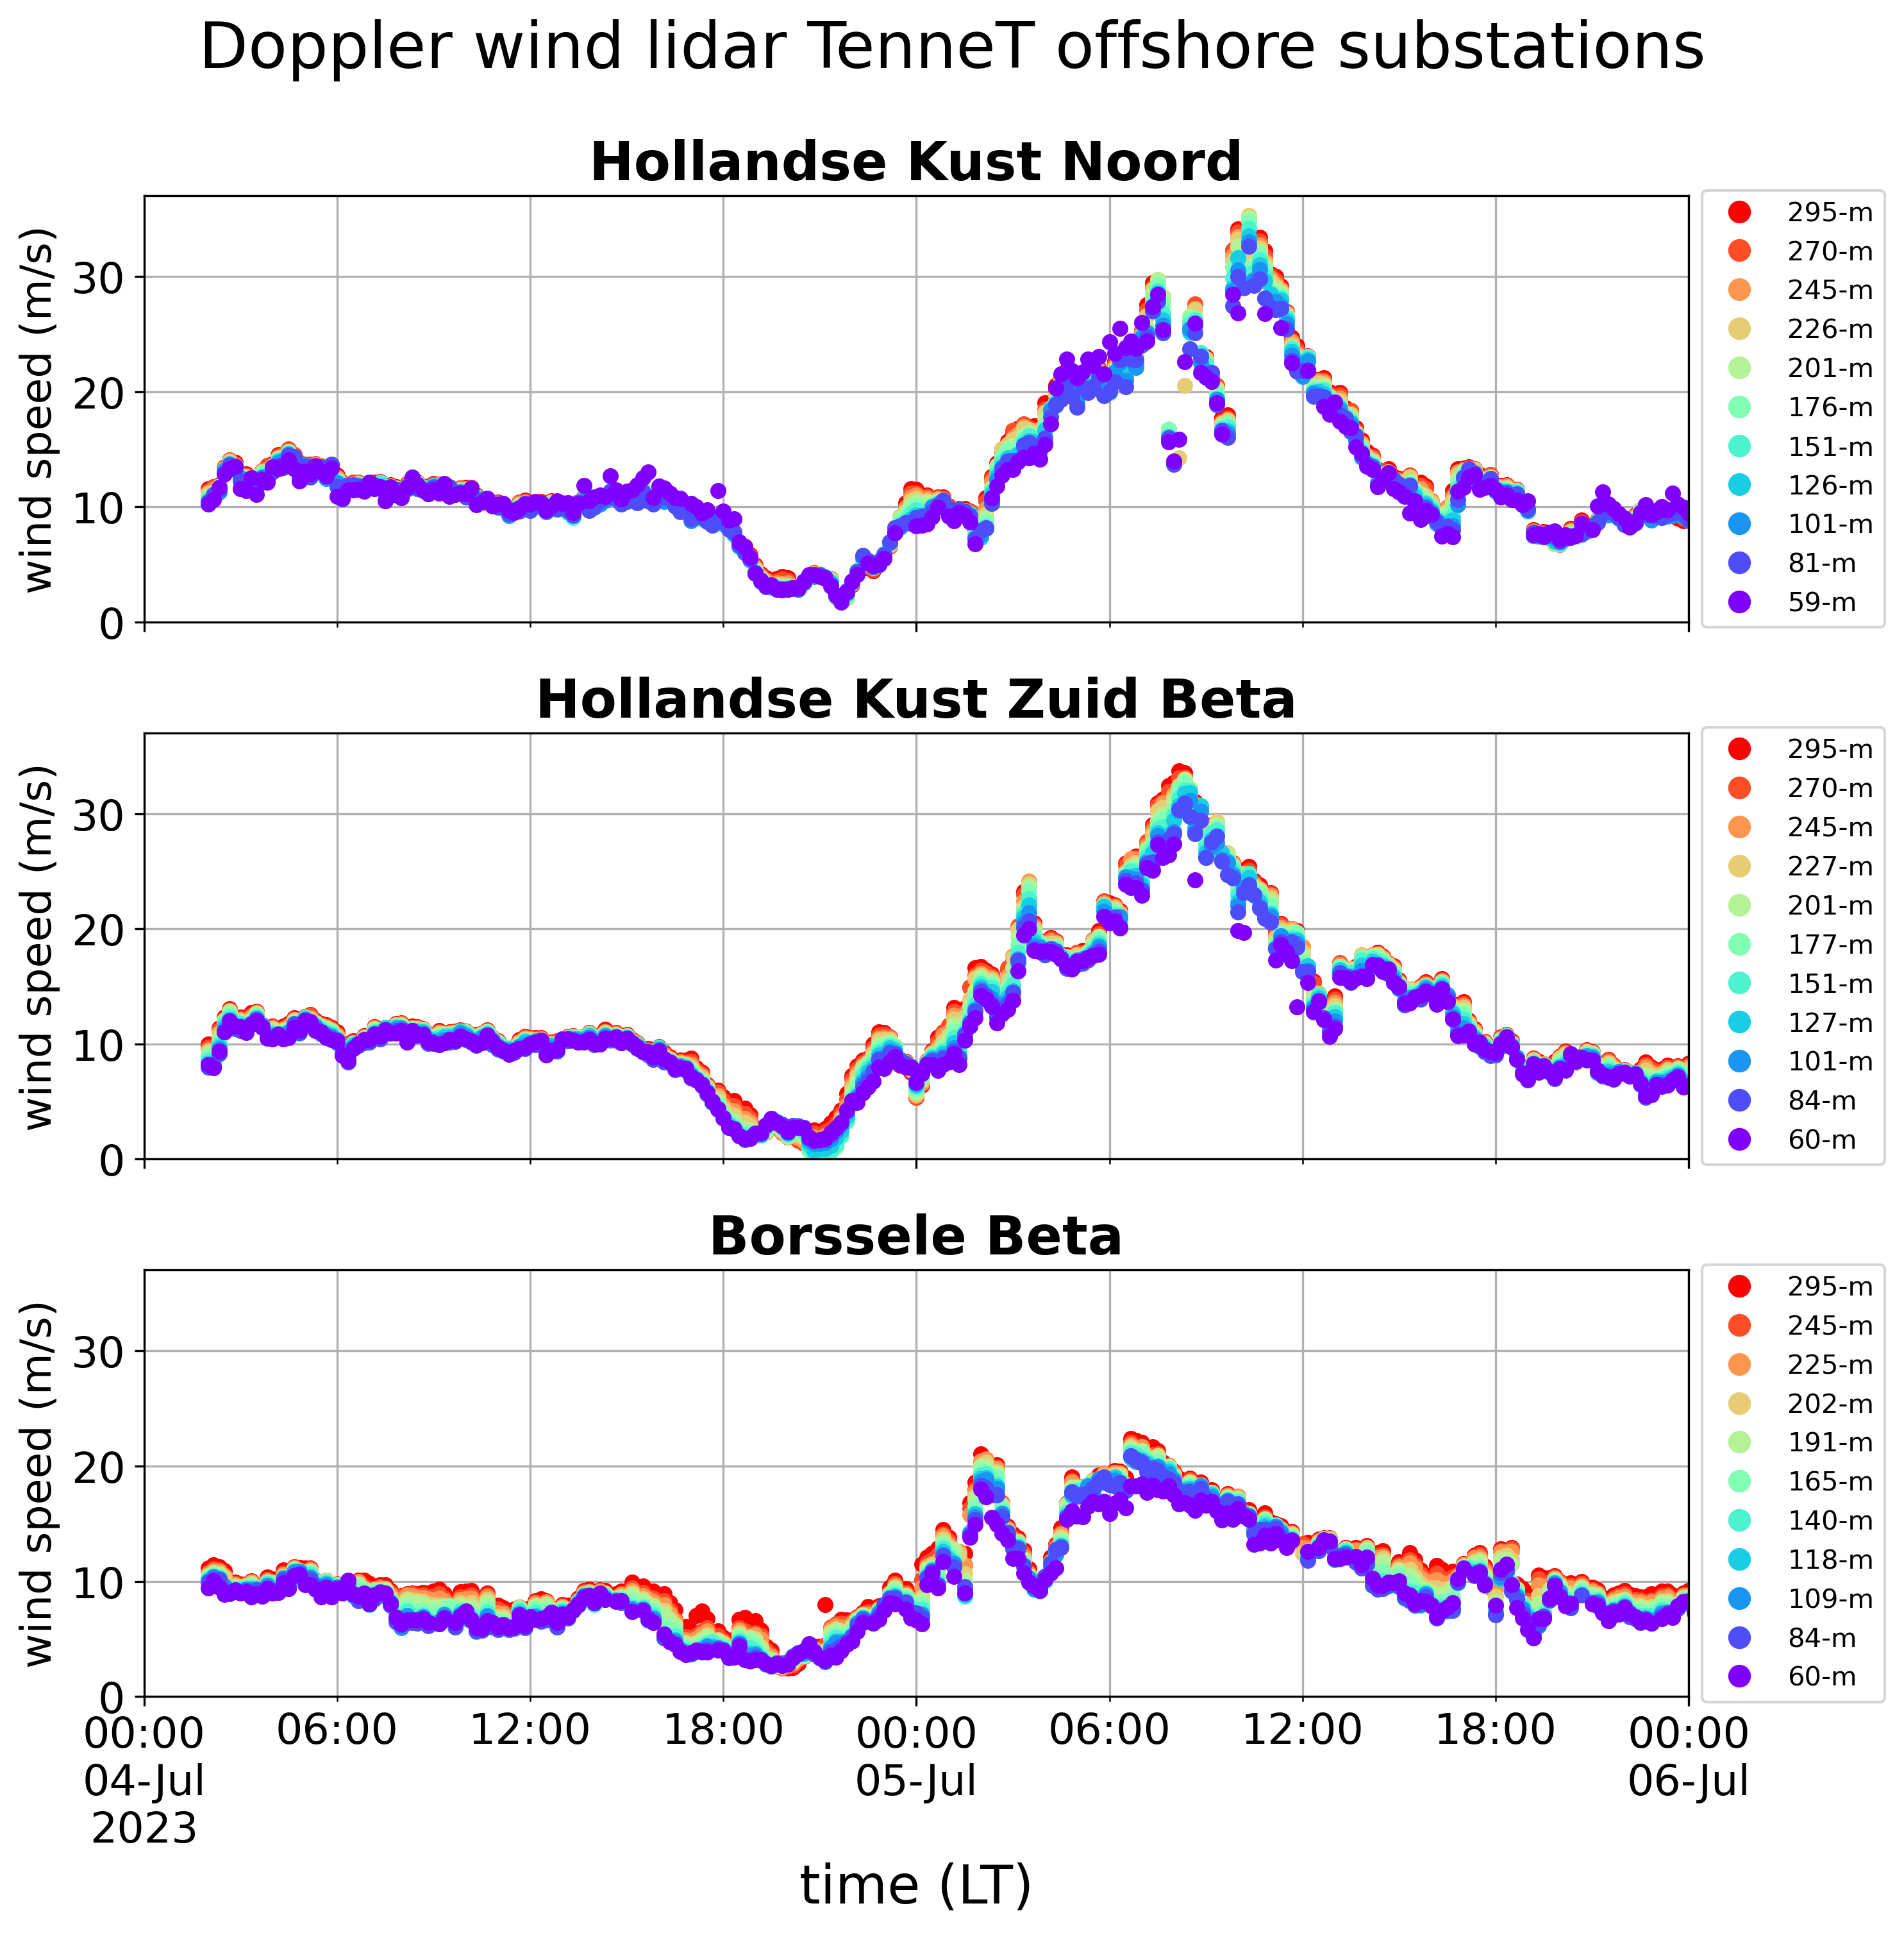

Storm Poly, July 2023

Slide 7
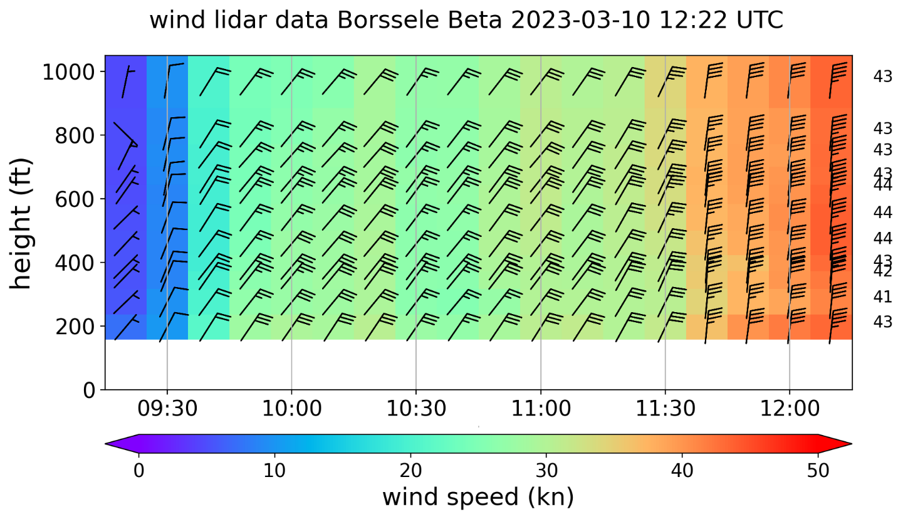
Weather room

Slide 8
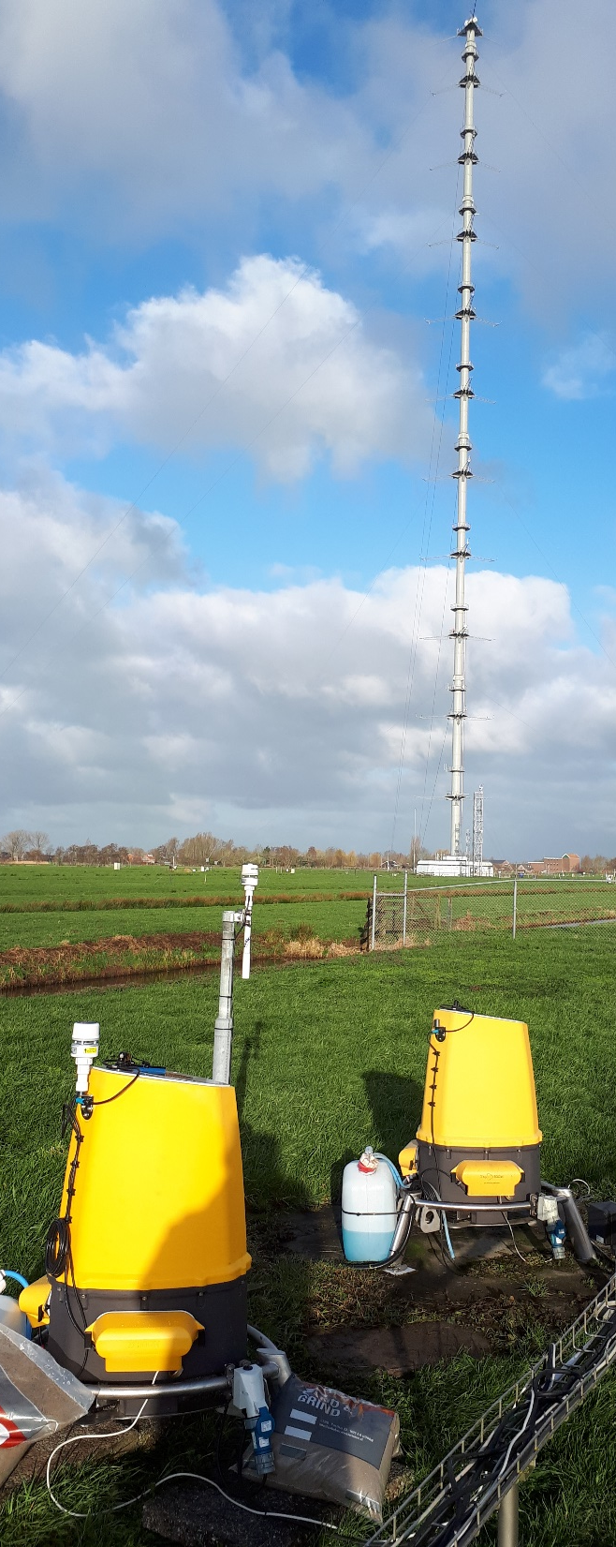
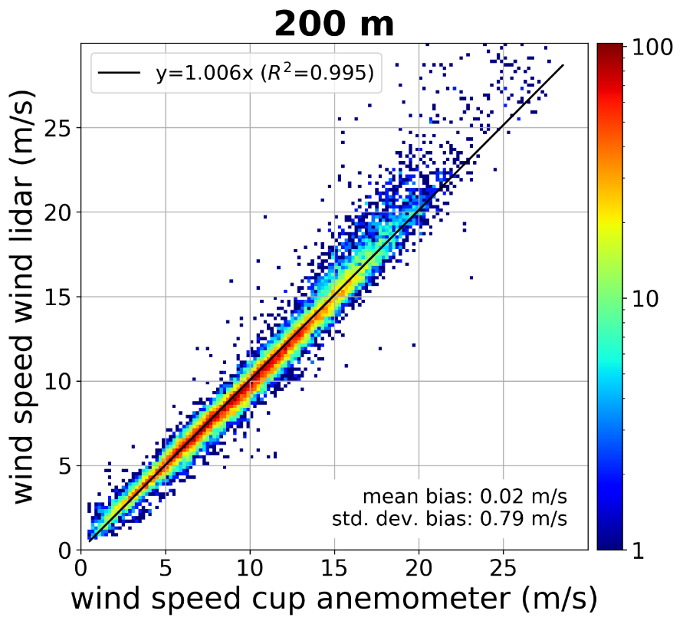
ZX300M wind lidar
CW focusing, conical VAD scan 1s, measuring heights subsequently
10 user configurable measuring height between 10m and 200m (300m) above instrument (+1 fixed at 38m)
Data output: 10-min. averages (QC), and “1s” data (QC since ZX firmware)
Variables: horizontal wind speed (HWS), vertical wind speed, wind direction, stand. Dev. HWS, turbulence intensity, max. HWS (only in 10-min. data)
180° ambiguity issue
Knoop, Bosveld, de Haij, Apituley: A 2-year intercomparison of continuous-wave focusing wind lidar and tall mast wind measurements at Cabauw, AMT 14, 2219, 2021, https://doi.org/10.5194/amt-14-2219-2021
Knoop: ZephIR 300M wind lidar firmware intercomparison, KNMI Internal report IR-2021-01, https://cdn.knmi.nl/knmi/pdf/bibliotheek/knmipubIR/IR2021-01.pdf

Slide 9
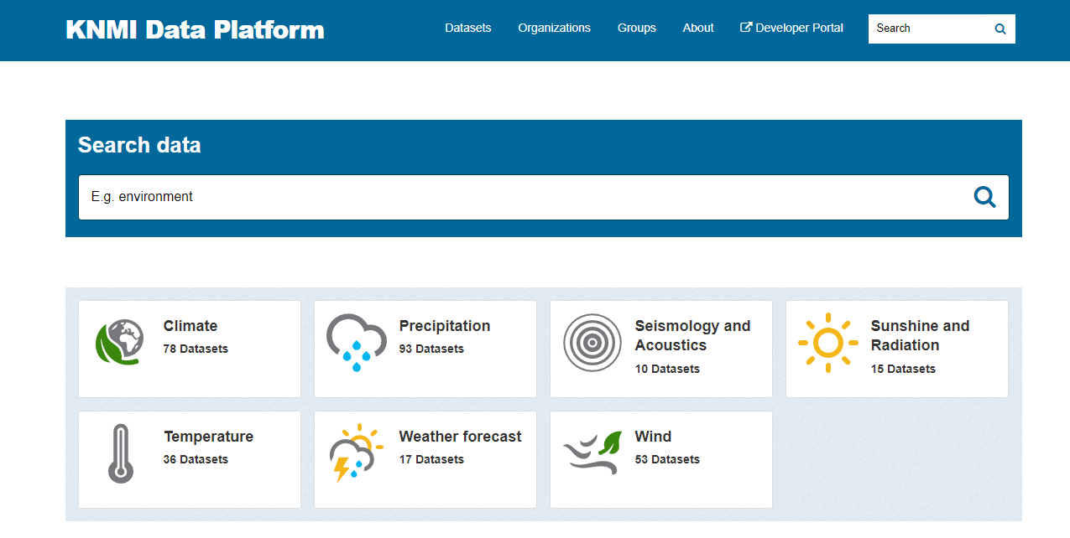
Data
https://dataplatform.knmi.nl/dataset/windlidar-nz-wp-platform-10min-1
https://dataplatform.knmi.nl/dataset/windlidar-nz-wp-platform-1s-1
Native ZX300 Wind@... and Wind10@... CSV files (L2 data)
Height configuration varies with wind farm
Available on daily basis
Missing metastable (height instrument, firmware version, …): available upon request

Slide 10
Impact substation
25°
285°
115°
205°

Slide 11
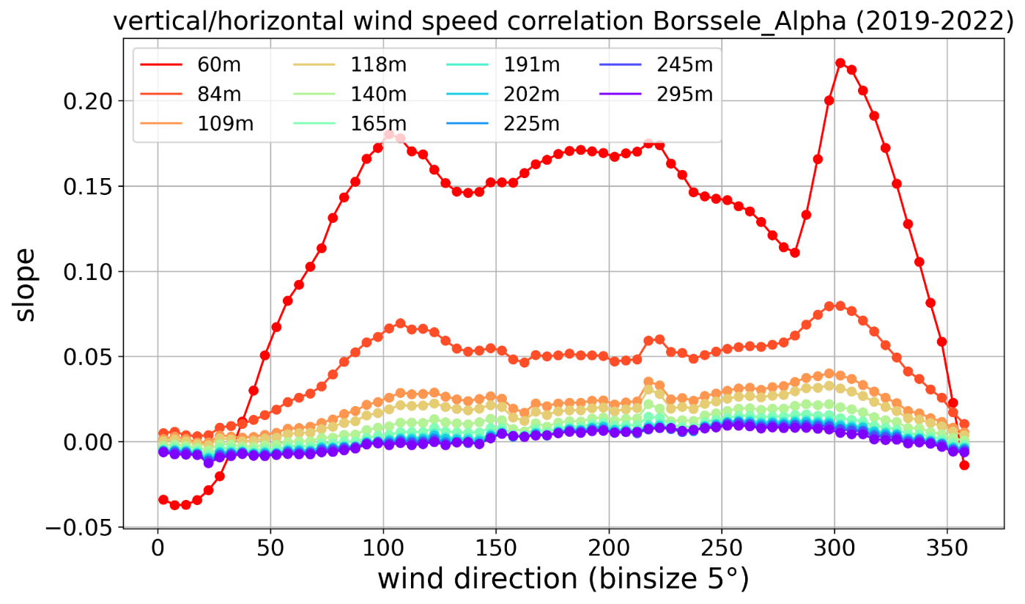
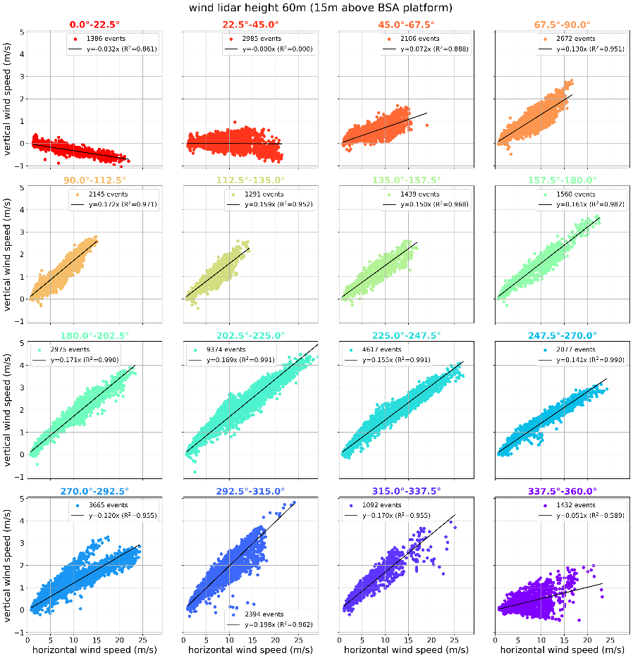
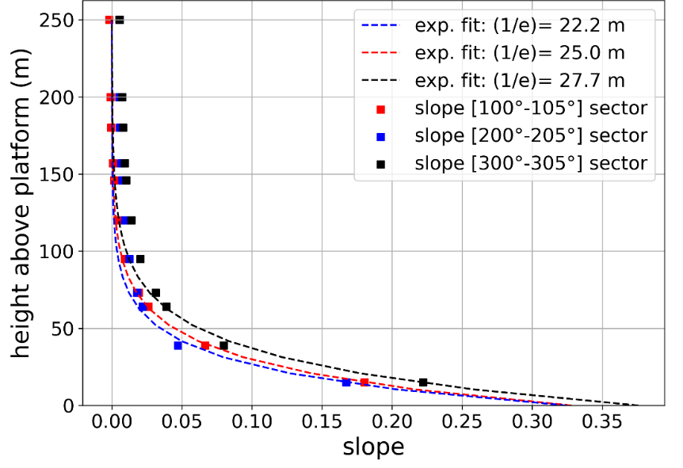
Vertical wind speed

Slide 12
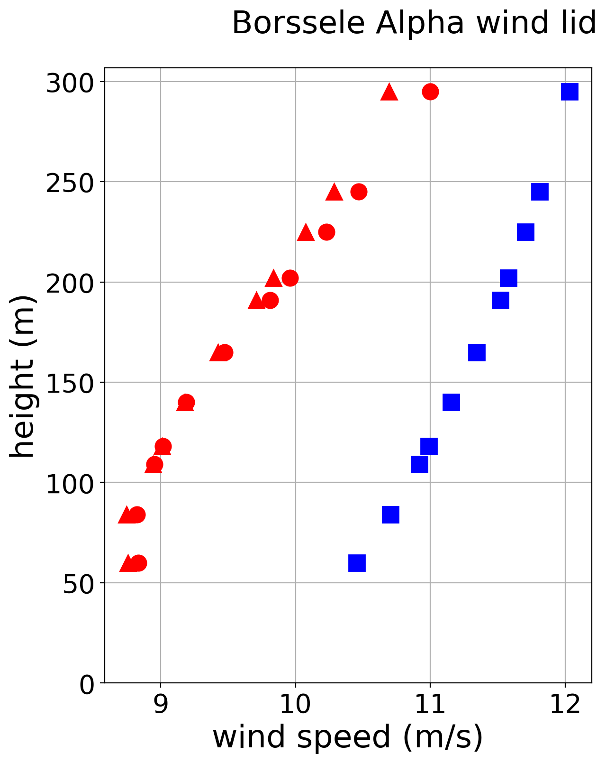
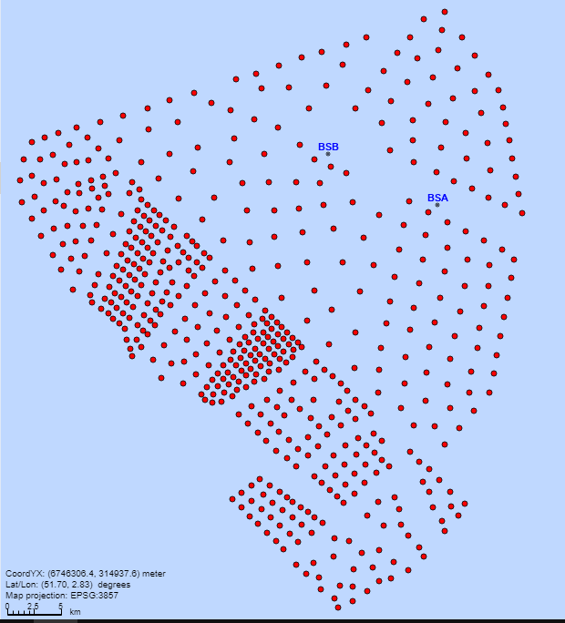



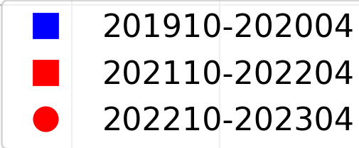
Impact wind farm
Borssele

Slide 13
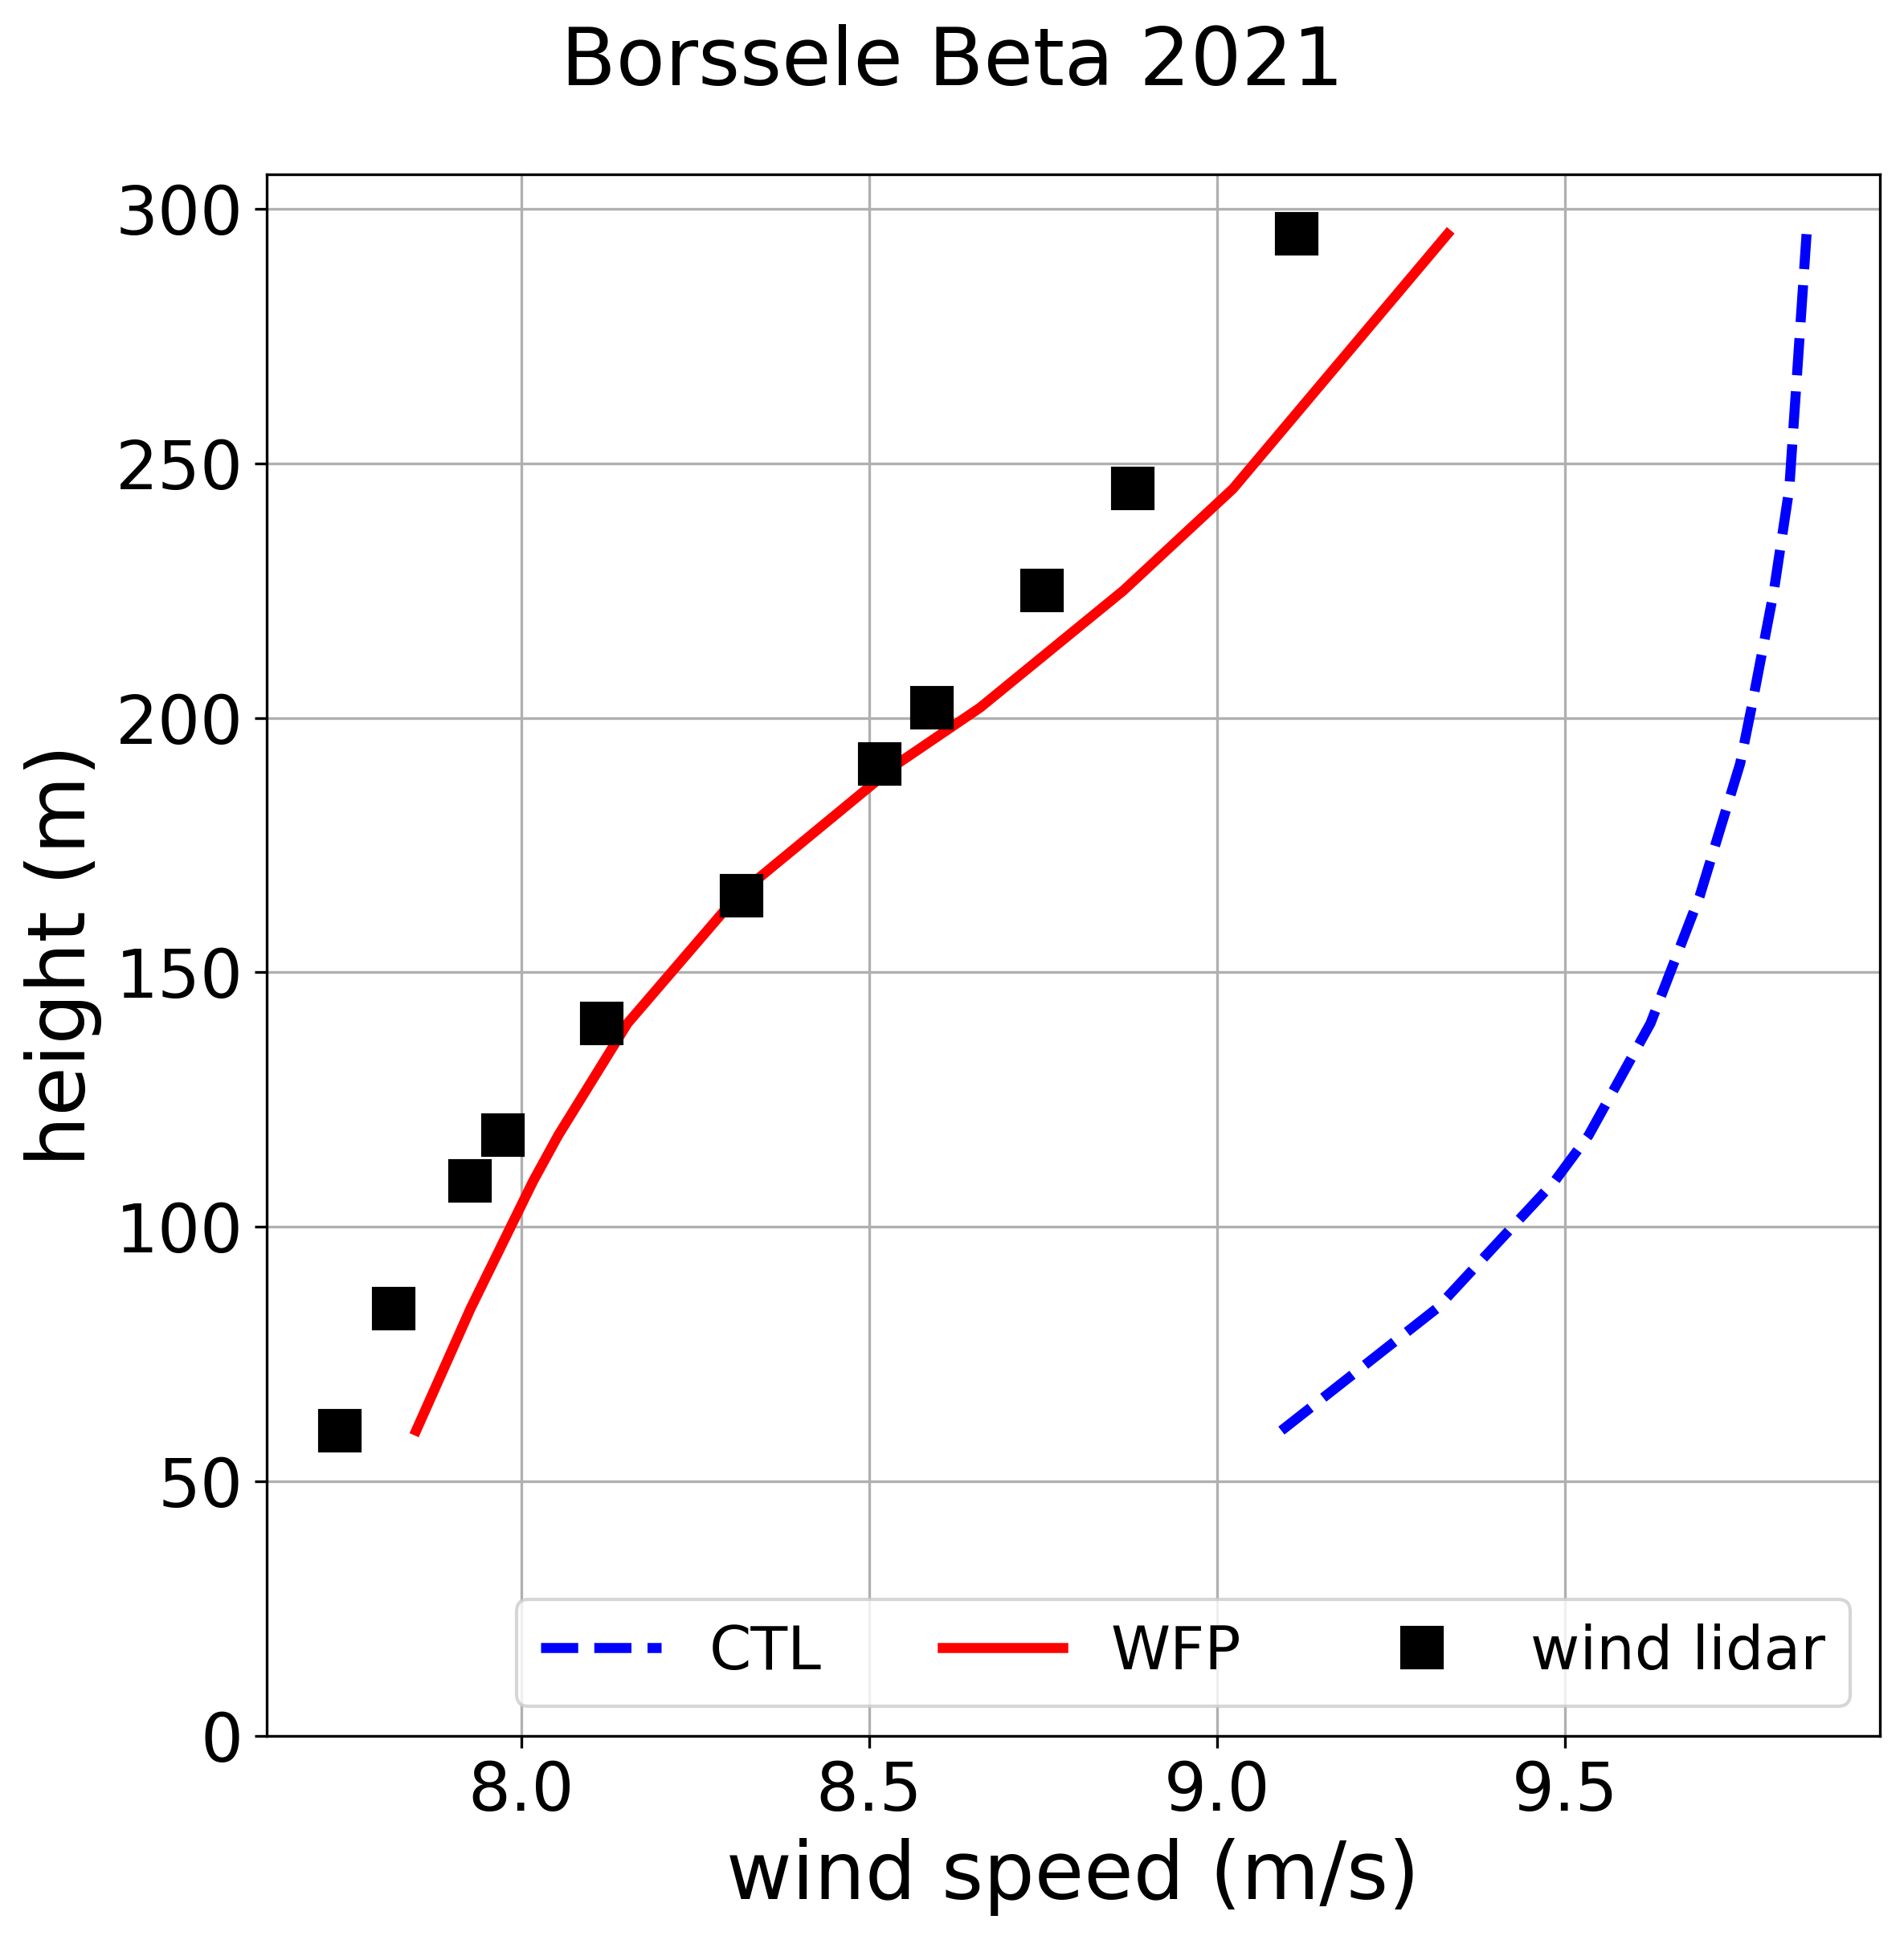
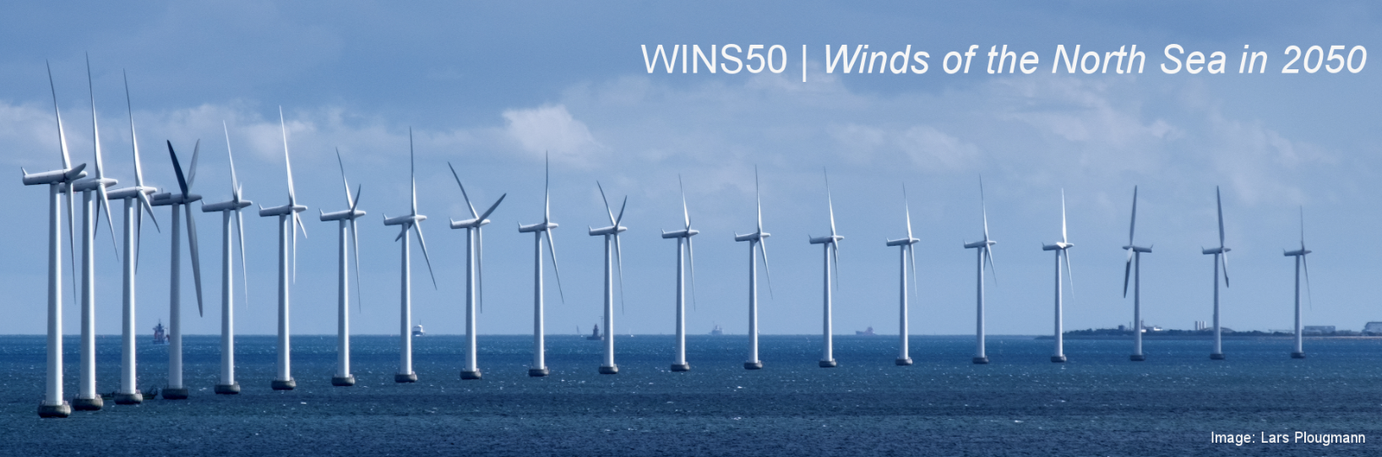
HARMONIE re-analysis 2019-2021
with wind farm parameterization (WFP)
without wind farms (CTL)
https://wins50.nl/
KNMI, TU Delft, Whiffle
Borssele

Slide 14
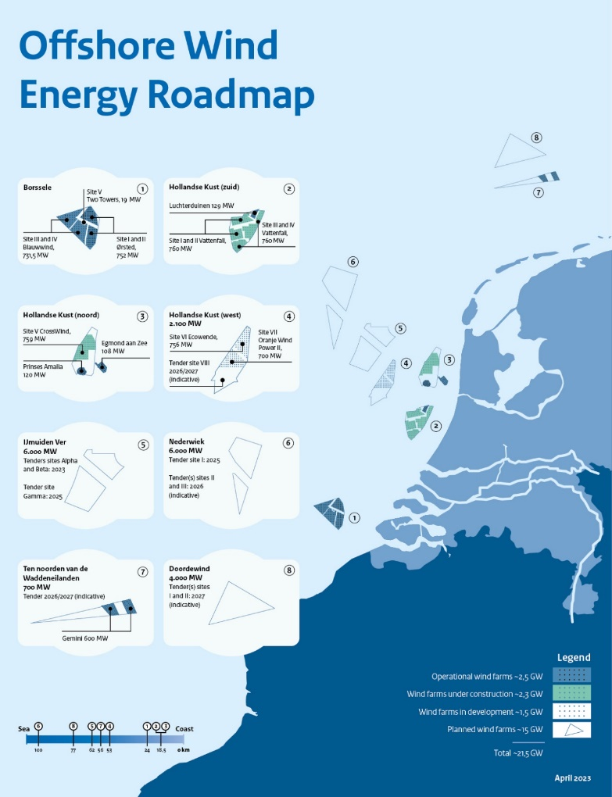

Conclusions
KNMI/RWS wind lidar network Dutch North Sea
TenneT substation within offshore wind farms
Data available on dataplatform.knmi.nl
Network is still growing!
Impact substation
Impact wind farm
steven.knoop@knmi.nl

