Slide 1
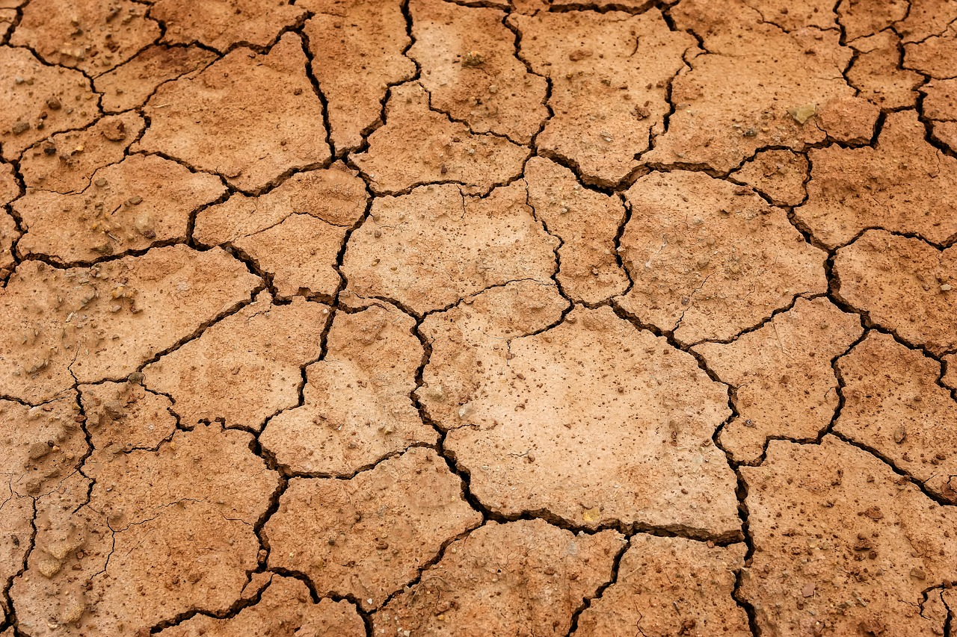


Are heatwaves and drought more likely to occur simultaneously
with warming?
Joanna Wibig, Joanna Jędruszkiewicz
Department of Meteorology and Climatology
The work was supported from the Polish National Science Centre (grant 2019/33/B/ST10/01136).
https://pixabay.com

Slide 2

Motivation
Data & methods
Warm & dry days variability and changes
Potential evaporation & water balance variability and changes
Potential factors
Summary

Slide 3
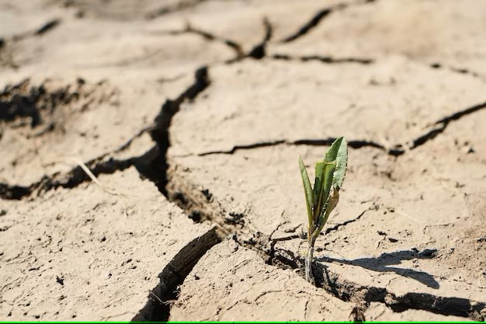
MOTIVATION
In public perception warm and dry days appear more and more often
There are such opinion of scientists from European countries, but in Poland research on compound extreme events have not been conducted so far.
We wanted to answer three questions:
Do warm&dry events appear throughout the whole year?
Does their frequency change over time?
What factors are responsible for these changes?

Slide 4
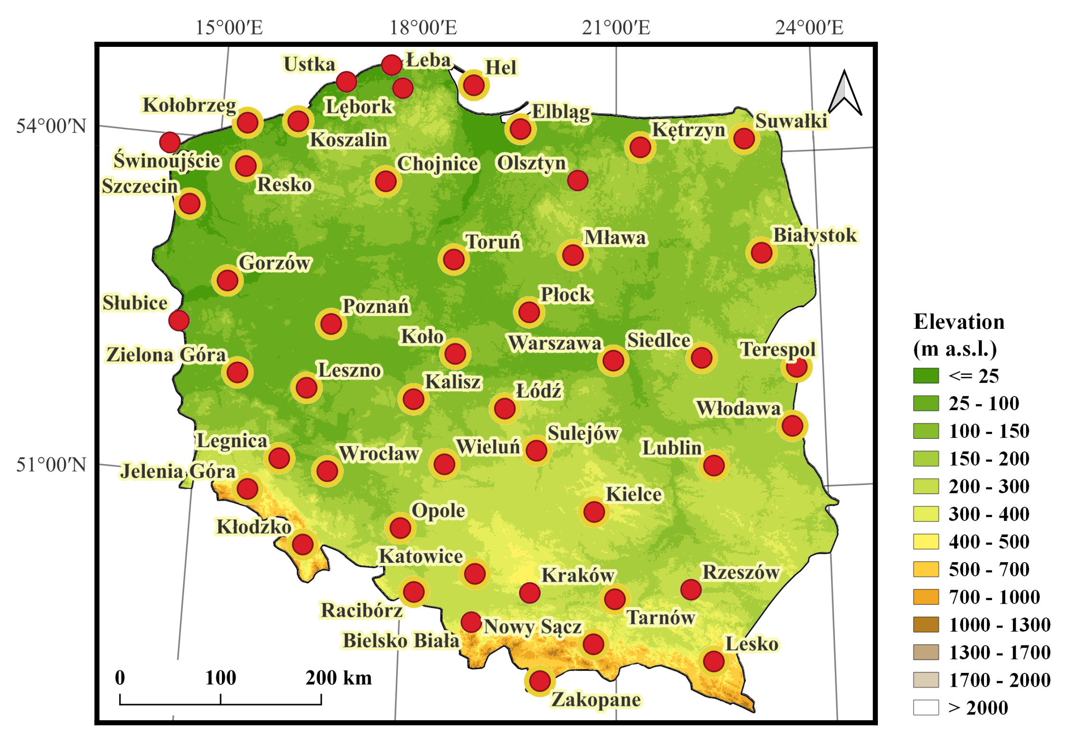
Daily data from 48 meteorological stations from the period 1966-2022:
(from IMWM-PSI)
maximum temperature,
minimum temperature,
mean temperature,
precipitation total.
Circulation indices, monthly values from the period 1966-2022
GBI from the University of Lincoln Hanna, E., et al. (2016)
NAO index from CRU https://crudata.uea.ac.uk/nao/nao.dat
AO index from NOAA NCEP/CPChttps://www.cpc.ncep.noaa.gov/products/precip/CWlink/daily_ao_index/monthly.ao.index.b50.current.ascii
DATA

Slide 5
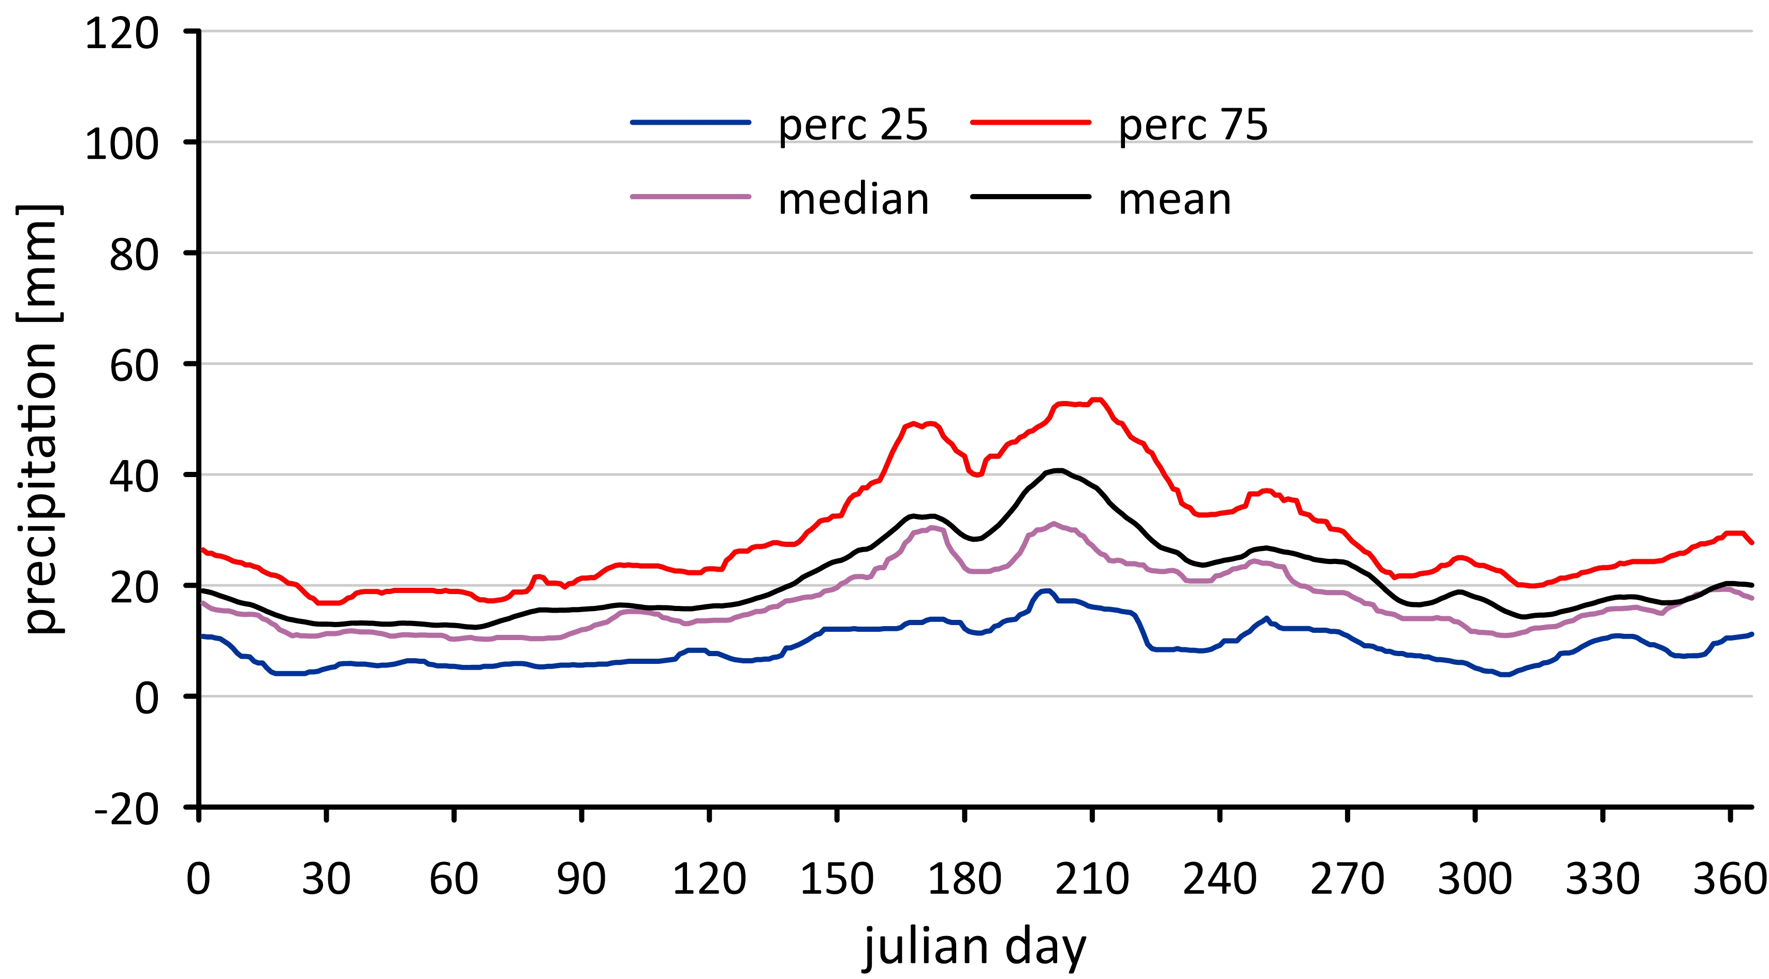
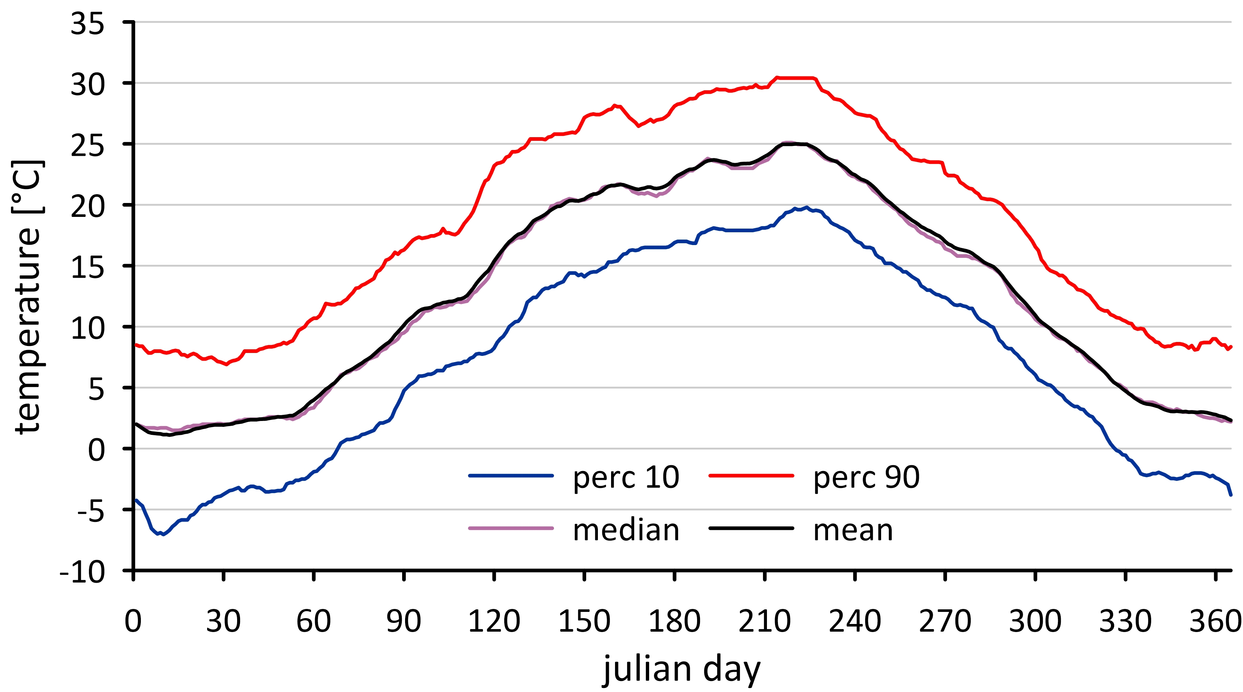
warm&dry days identification
For each station:
Mean, median and 90th percentile of daily tmax for each julian day, based on 15-days window centred on the day under consideration
Mean, median and 75th percentile of sum of 15 day precipitation total for each julian day, based on 15-days window centred on the day under consideration
Reference period: 1971-2000
Warm & dry day : temperature above threshold (90th percentile) & precipitation below threshold (25th percentile)
Temperature
Precipitation
Precipitation
Precipitation

Slide 6

METHODS
Monthly frequency of warm & dry days were calculated.
Values in two 20-year periods were compared: 1966-1985 and 2001-2020
Potential evaporation (PET) was calculated using Hargreave formula
Trends of PET were estimated using SEN’s method and their significance was checked by Mann-Kendall test
Large scale circulation impact was analyse by correlation of monthly values of three circulation indices NAO (North Atlantic Oscillation), AO (Arctic Oscillatio) and GBI (Greenland Blocking Index) with monthly sum of warm&dry days in the whole area of Poland.
Impact of local factors, like precipitation, temperature, snow cover duration were taken into account

Slide 7
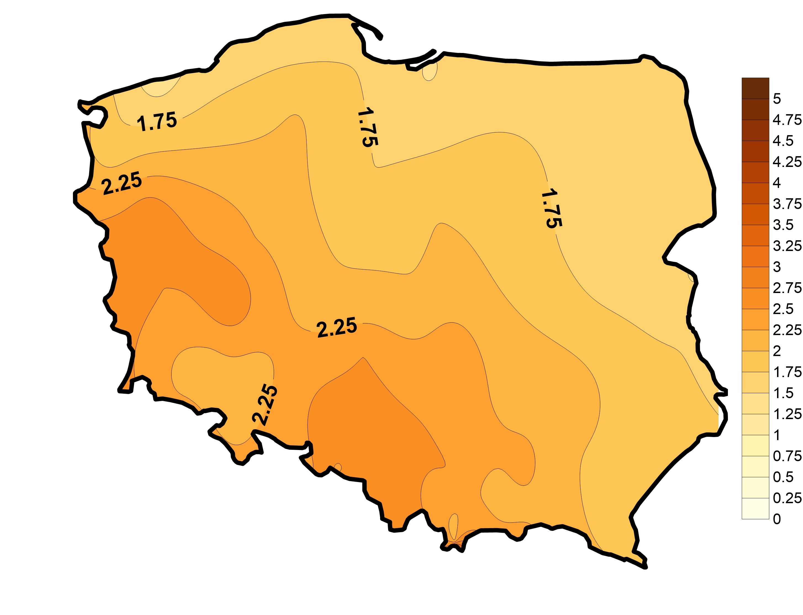
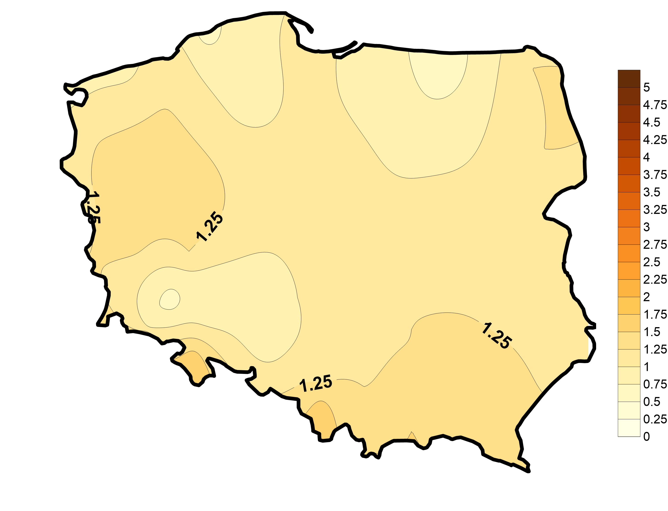
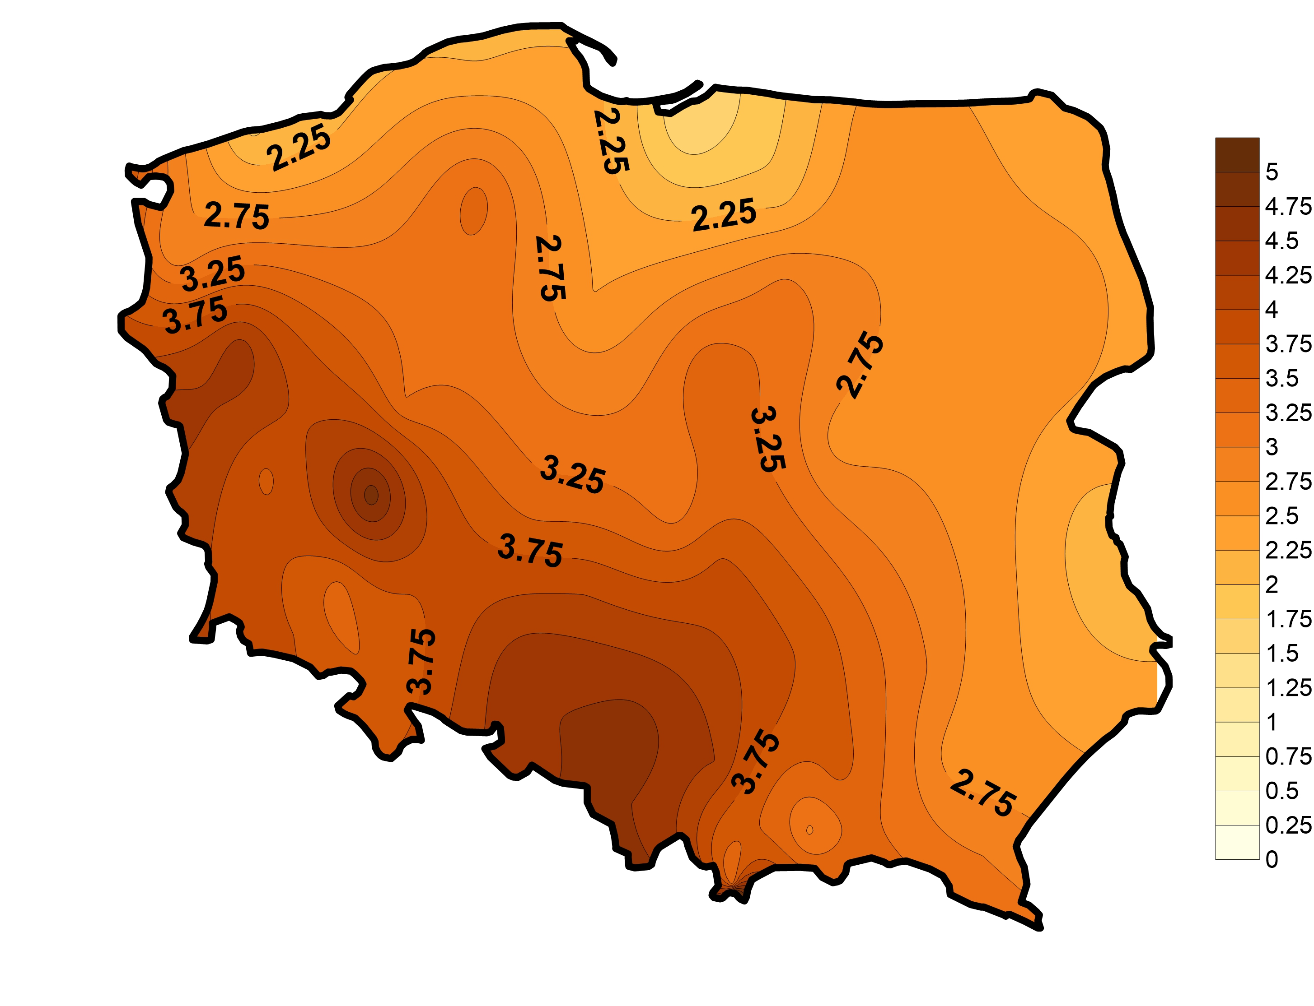
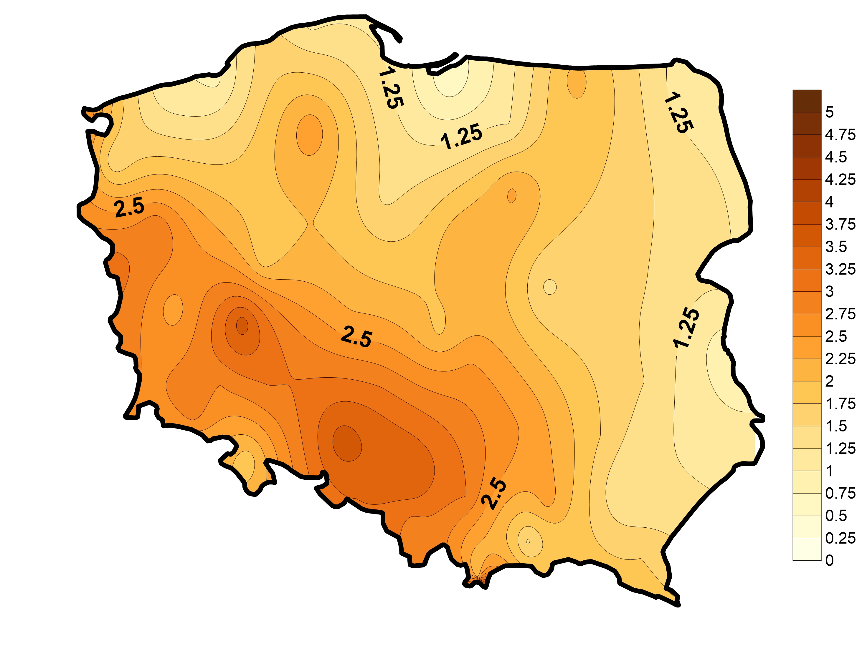
Average
1966-2022
APRIL
Frequency of warm&dry days
Difference
(2001-2020)-(1966-1985)
Average 1966-1985
Average 2001-2020

Slide 8
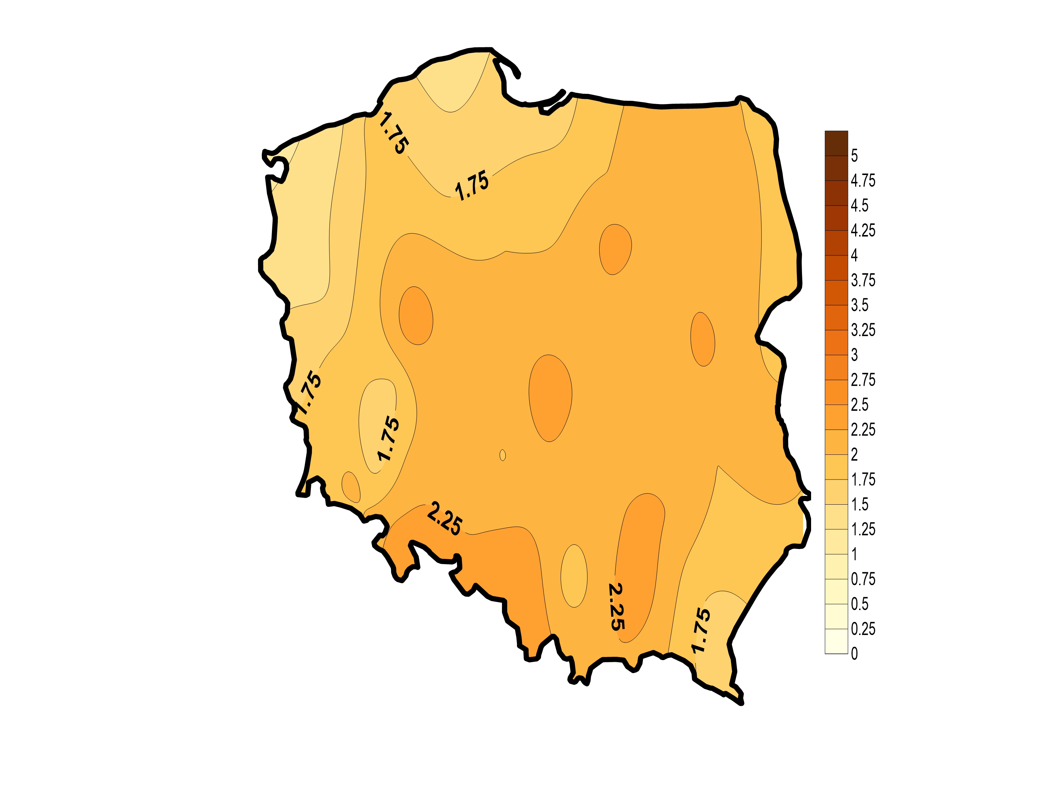
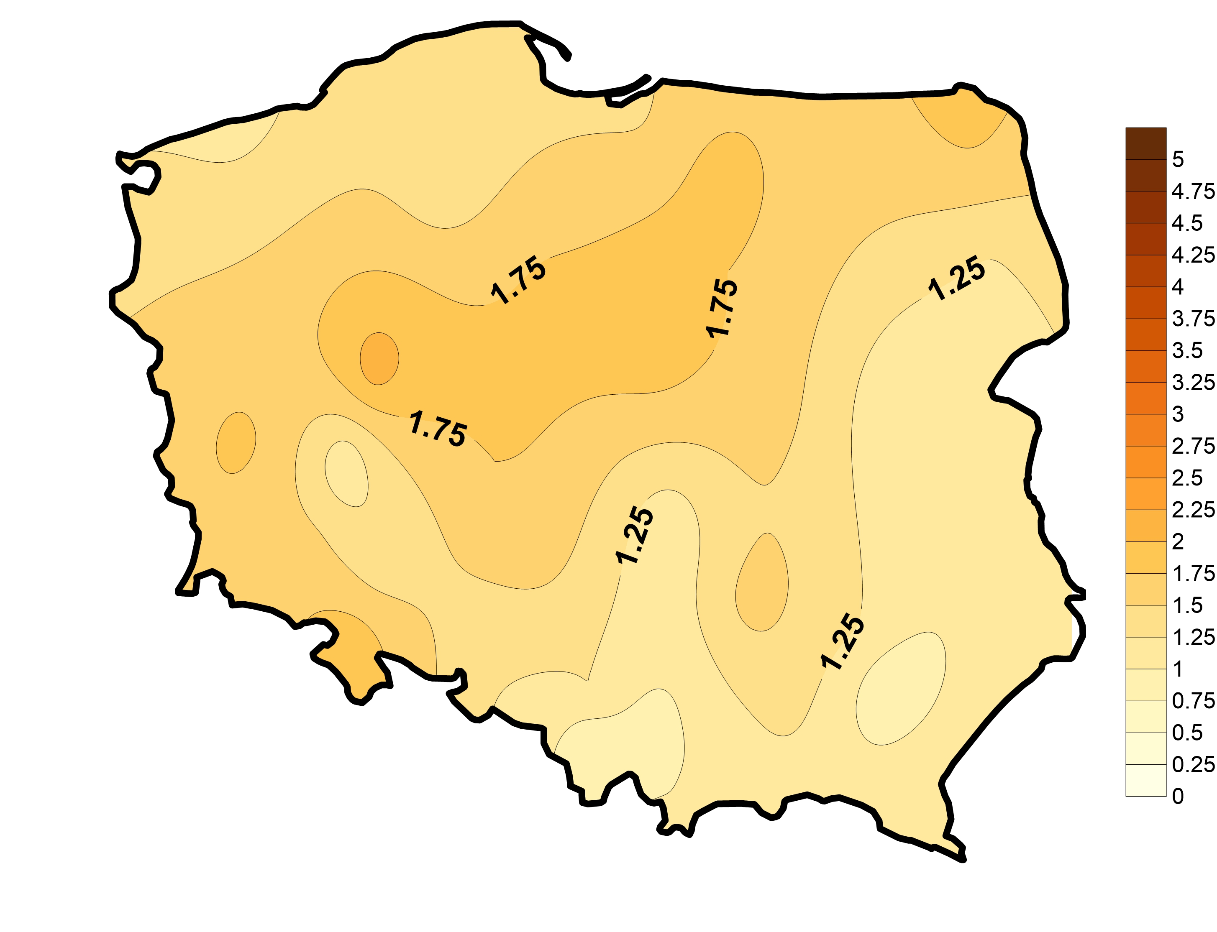
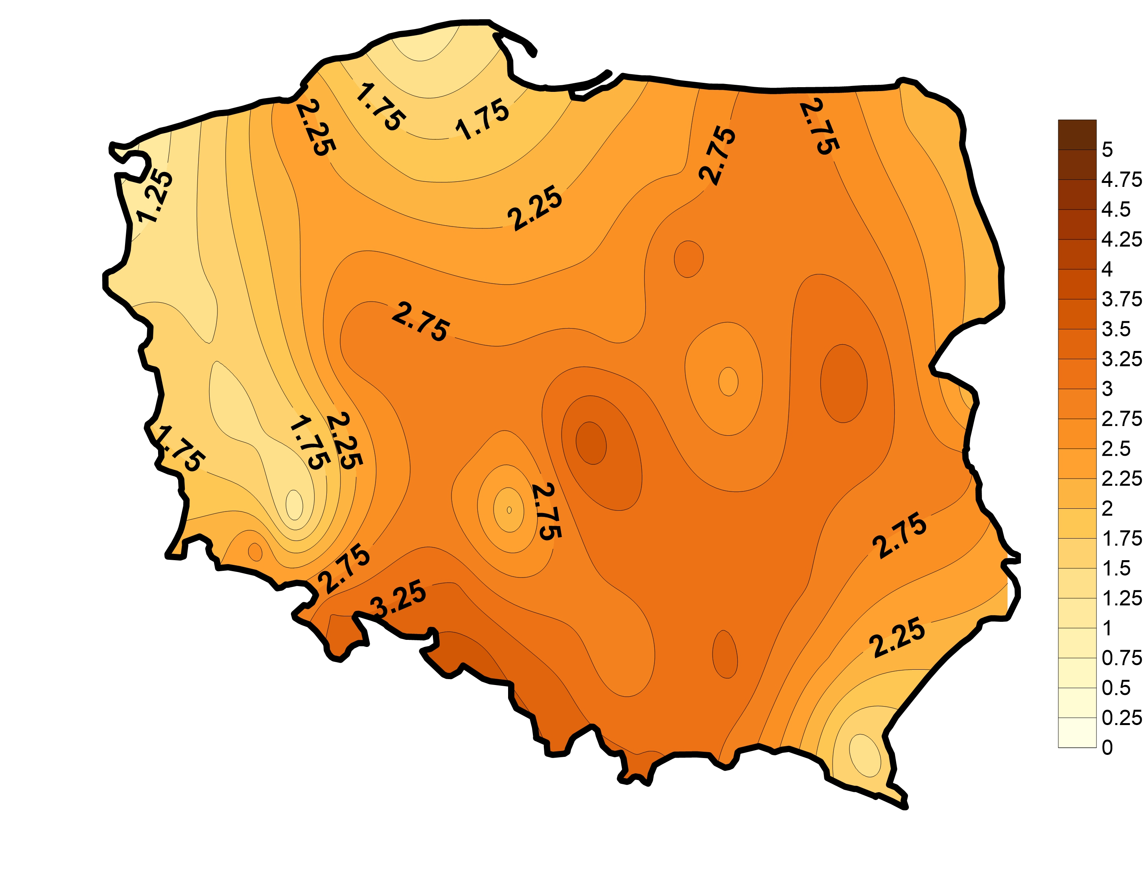
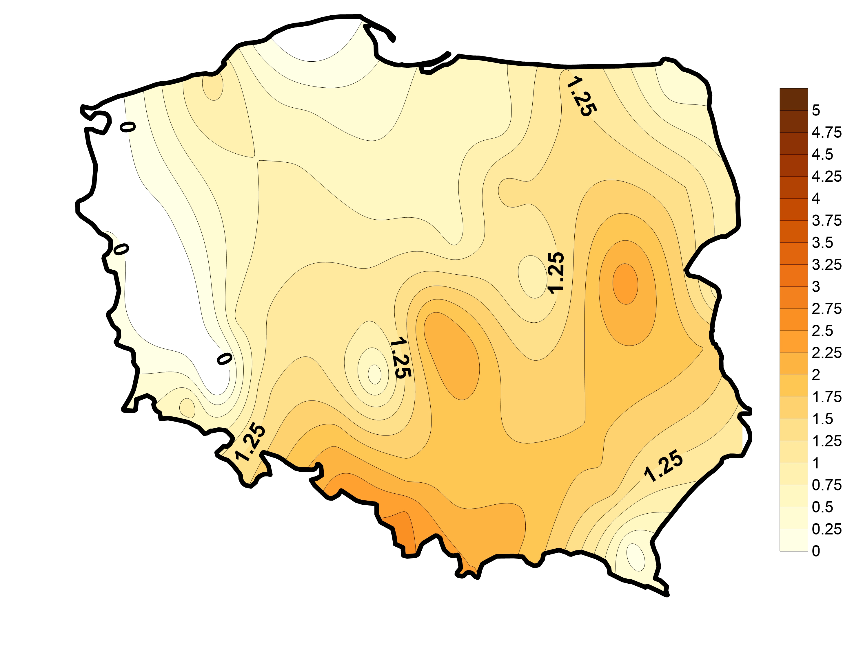
Average
1966-2022
JULY
Frequency of warm&dry days
Difference
(2001-2020)-(1966-1985)
Average 1966-1985
Average 2001-2020

Slide 9
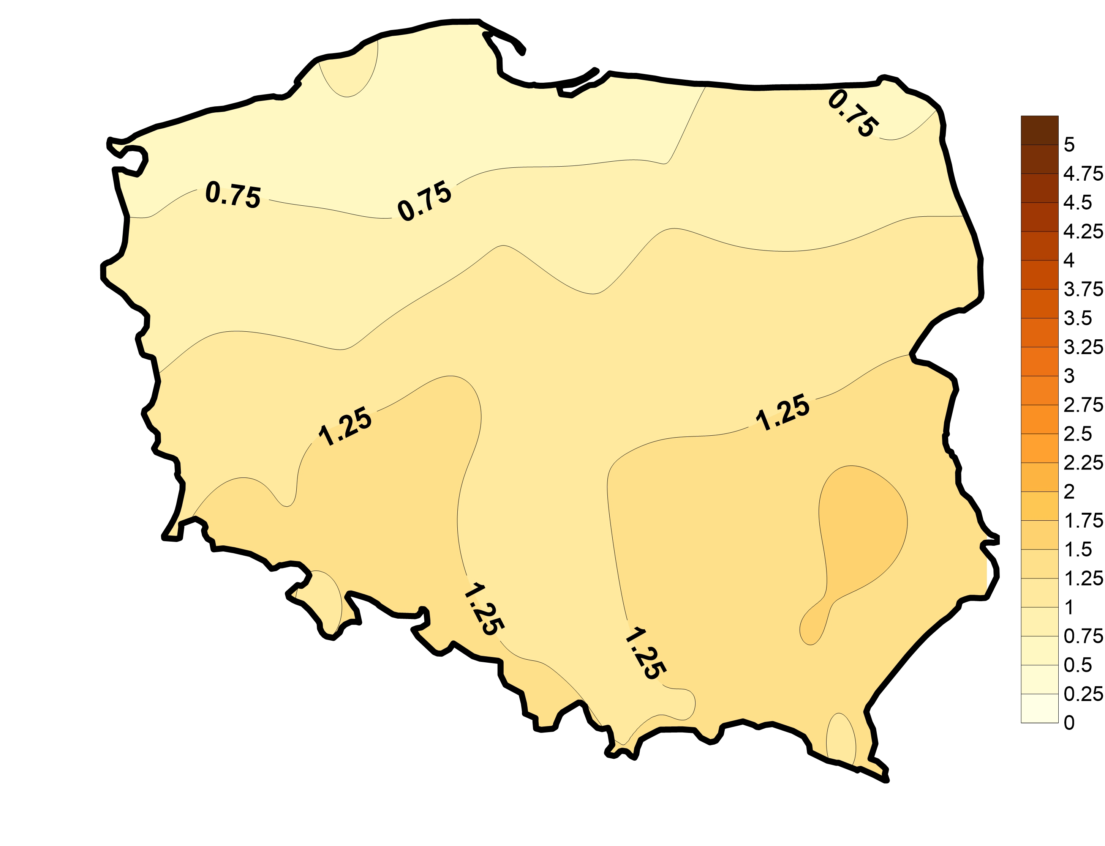
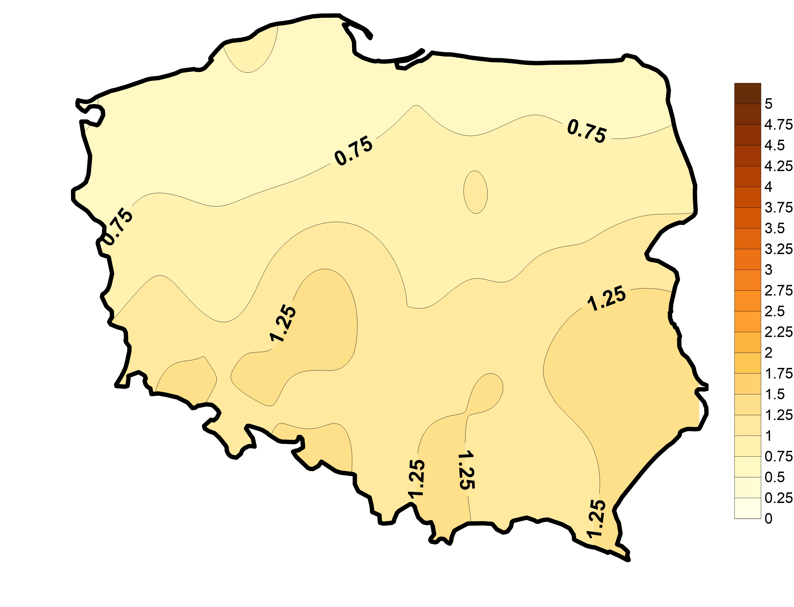
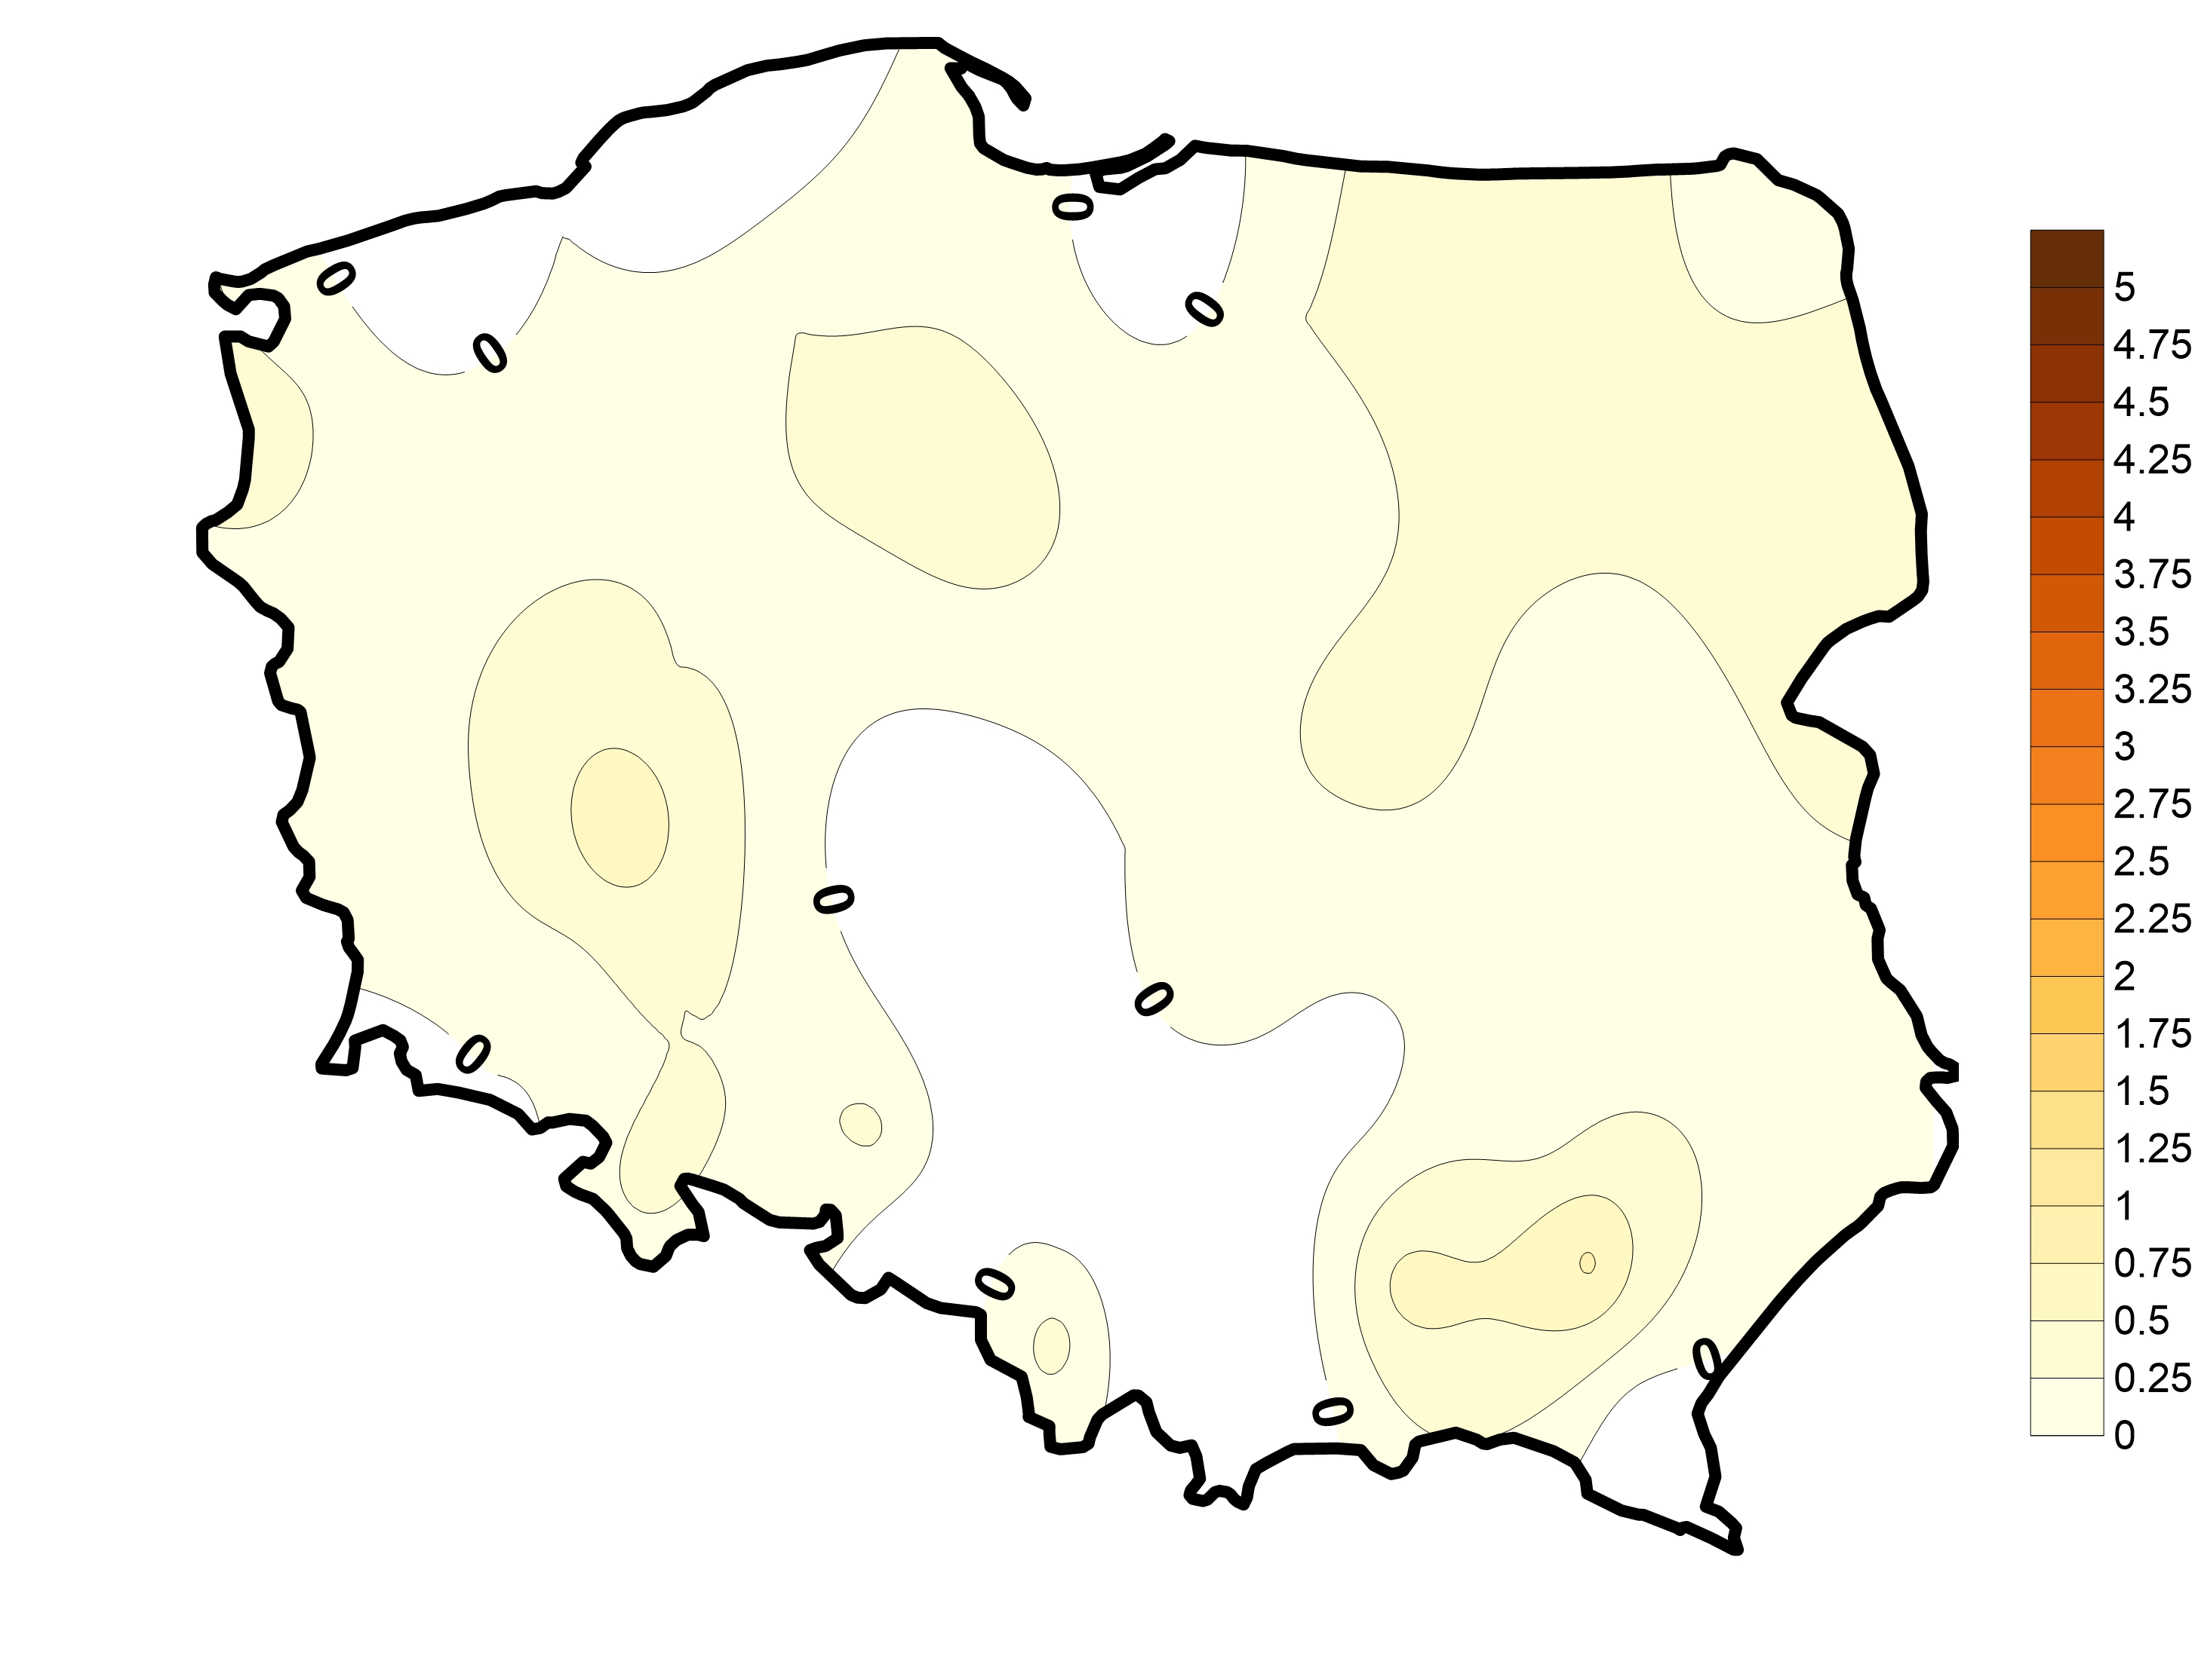
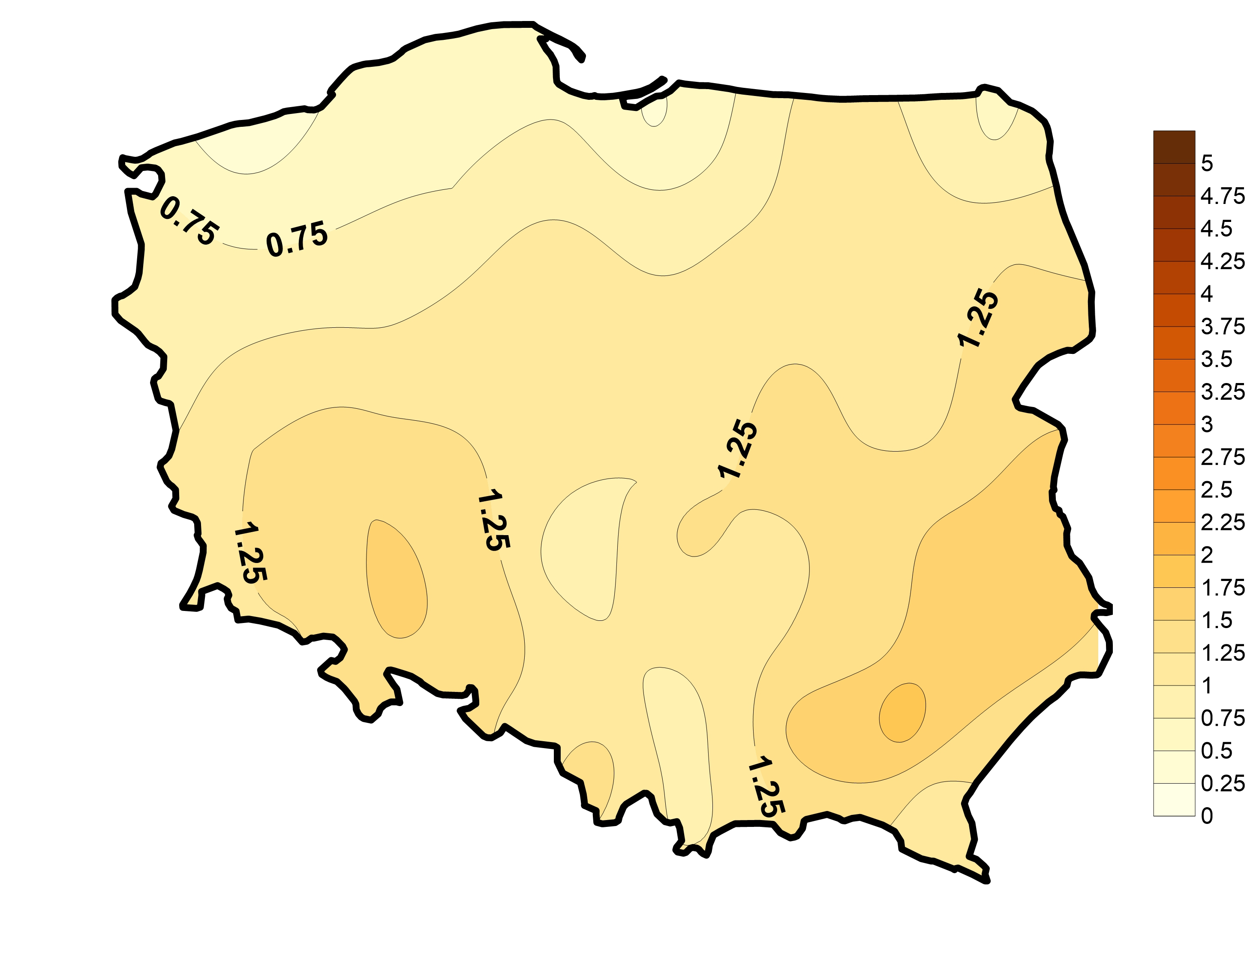
Average
1966-2022
OCTOBER
Frequency of warm&dry days
Difference
(2001-2020)-(1966-1985)
Average 1966-1985
Average 2001-2020

Slide 10
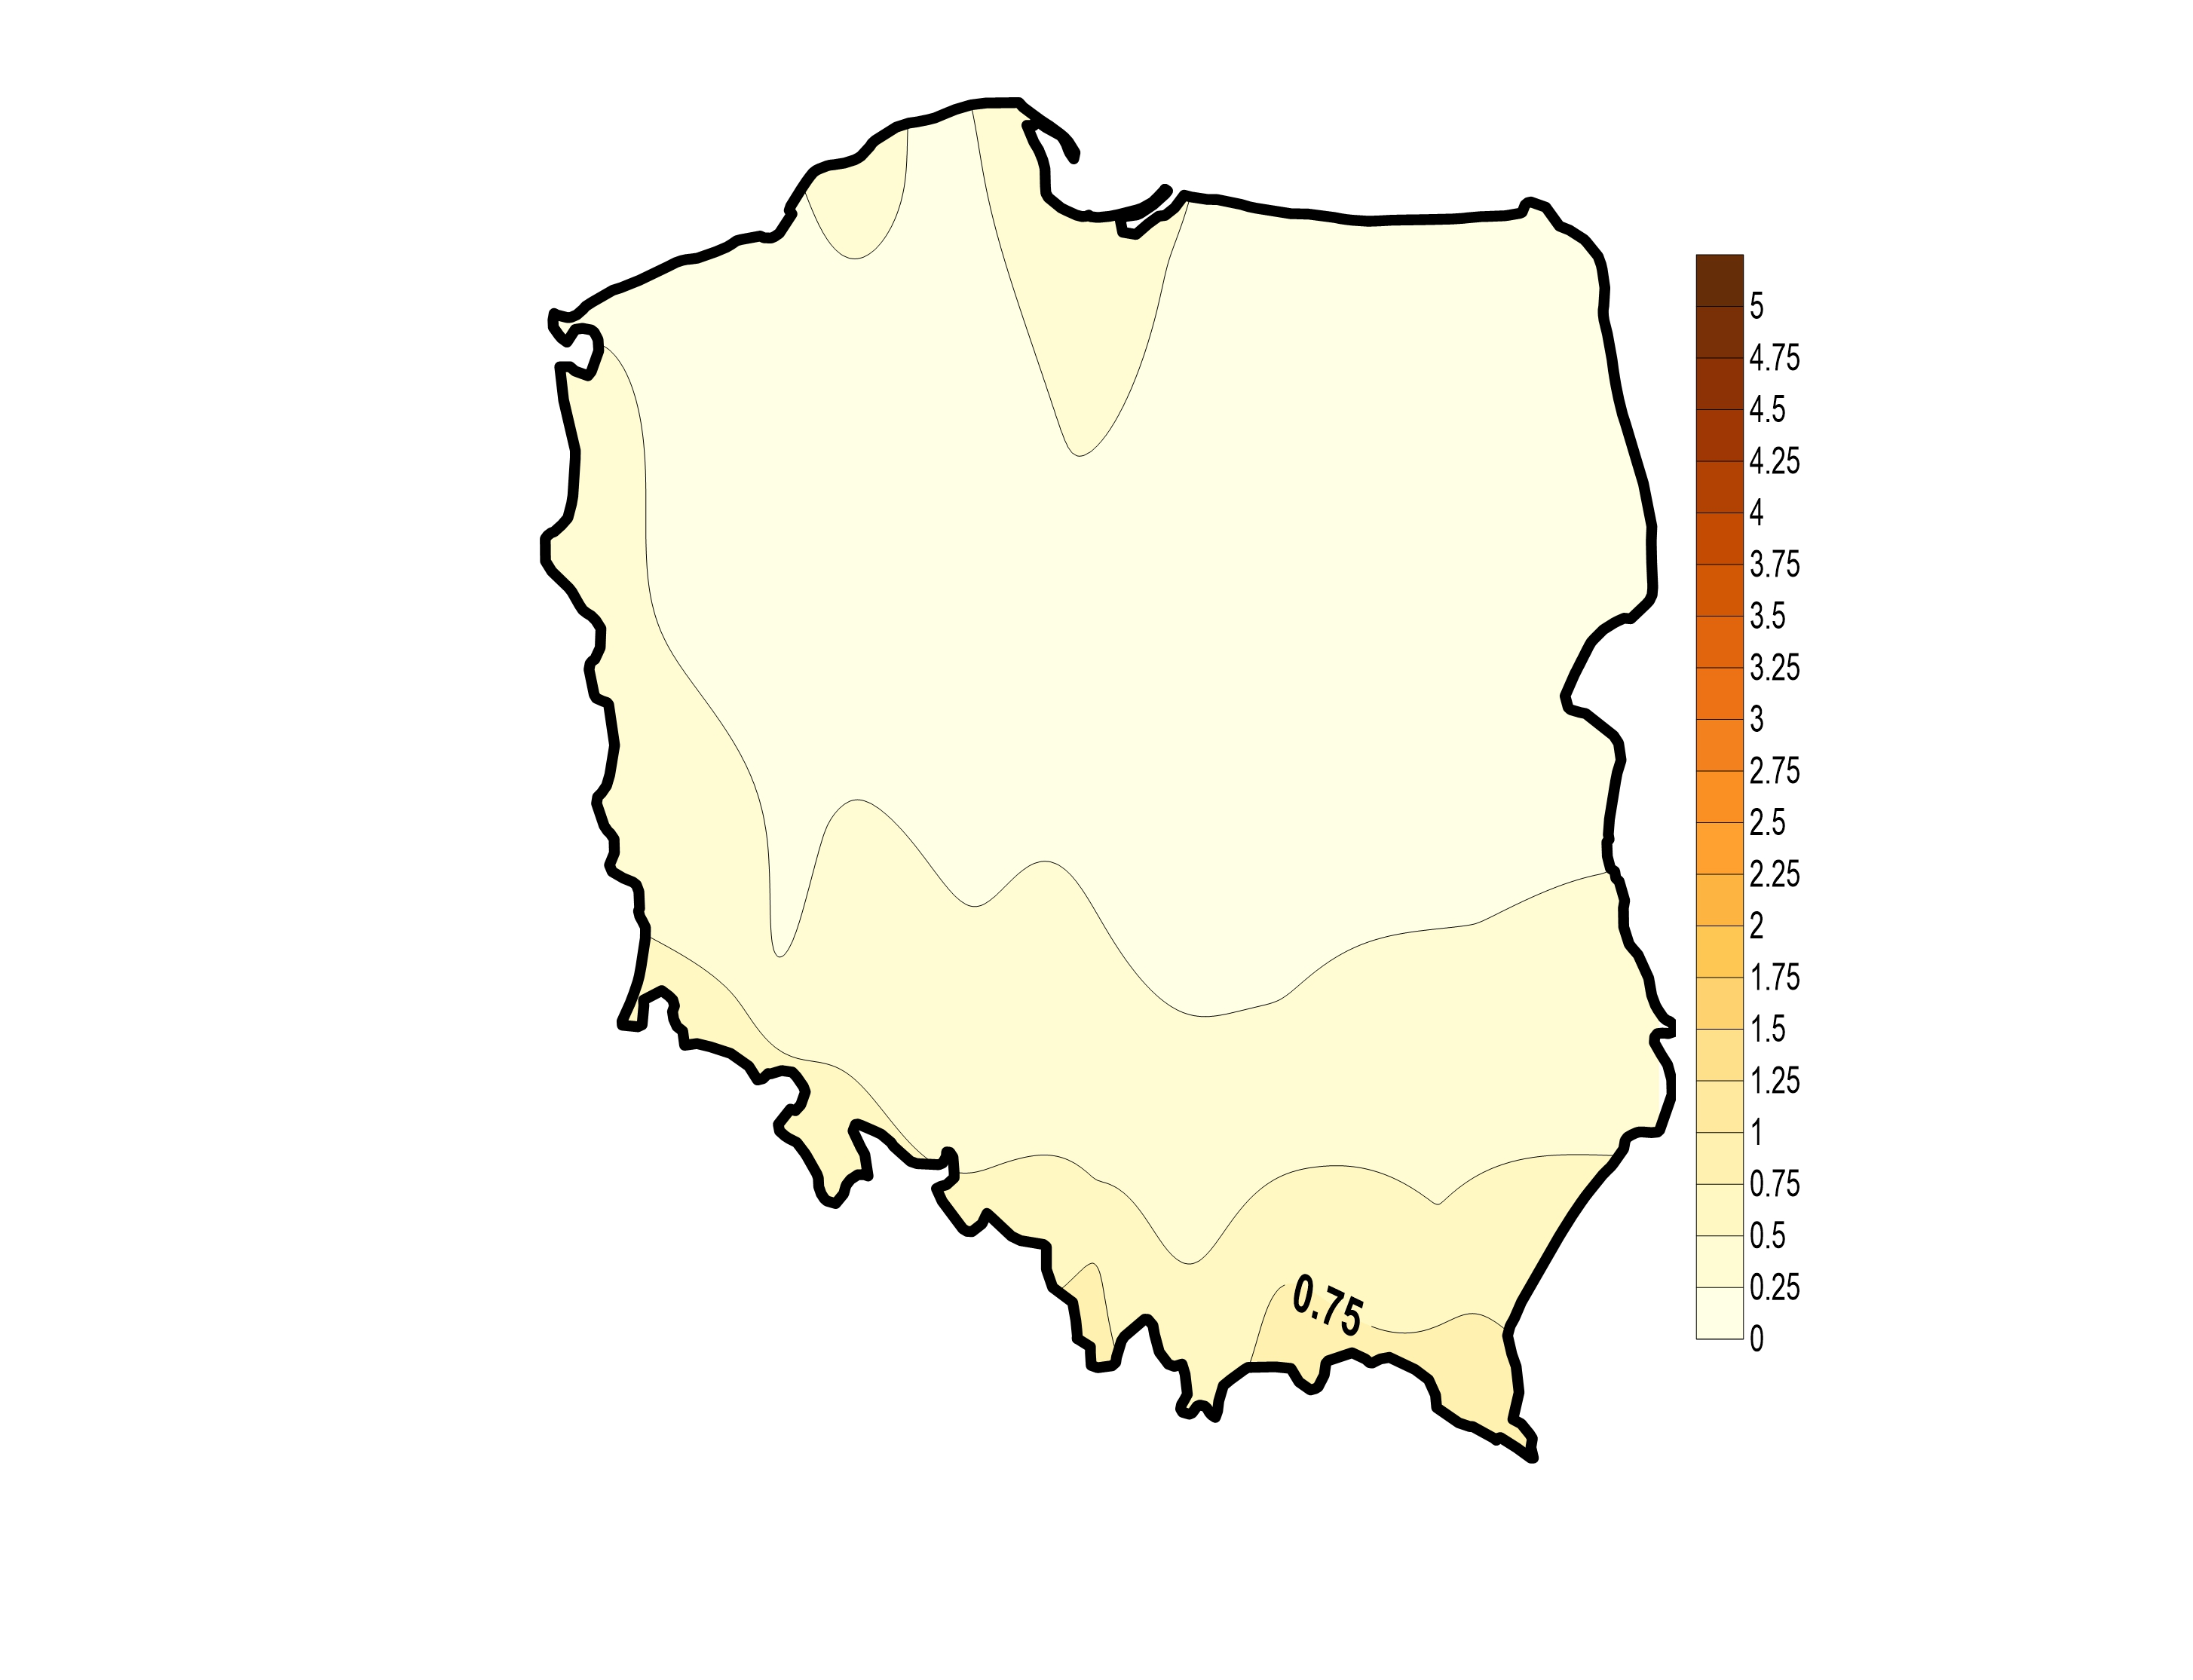
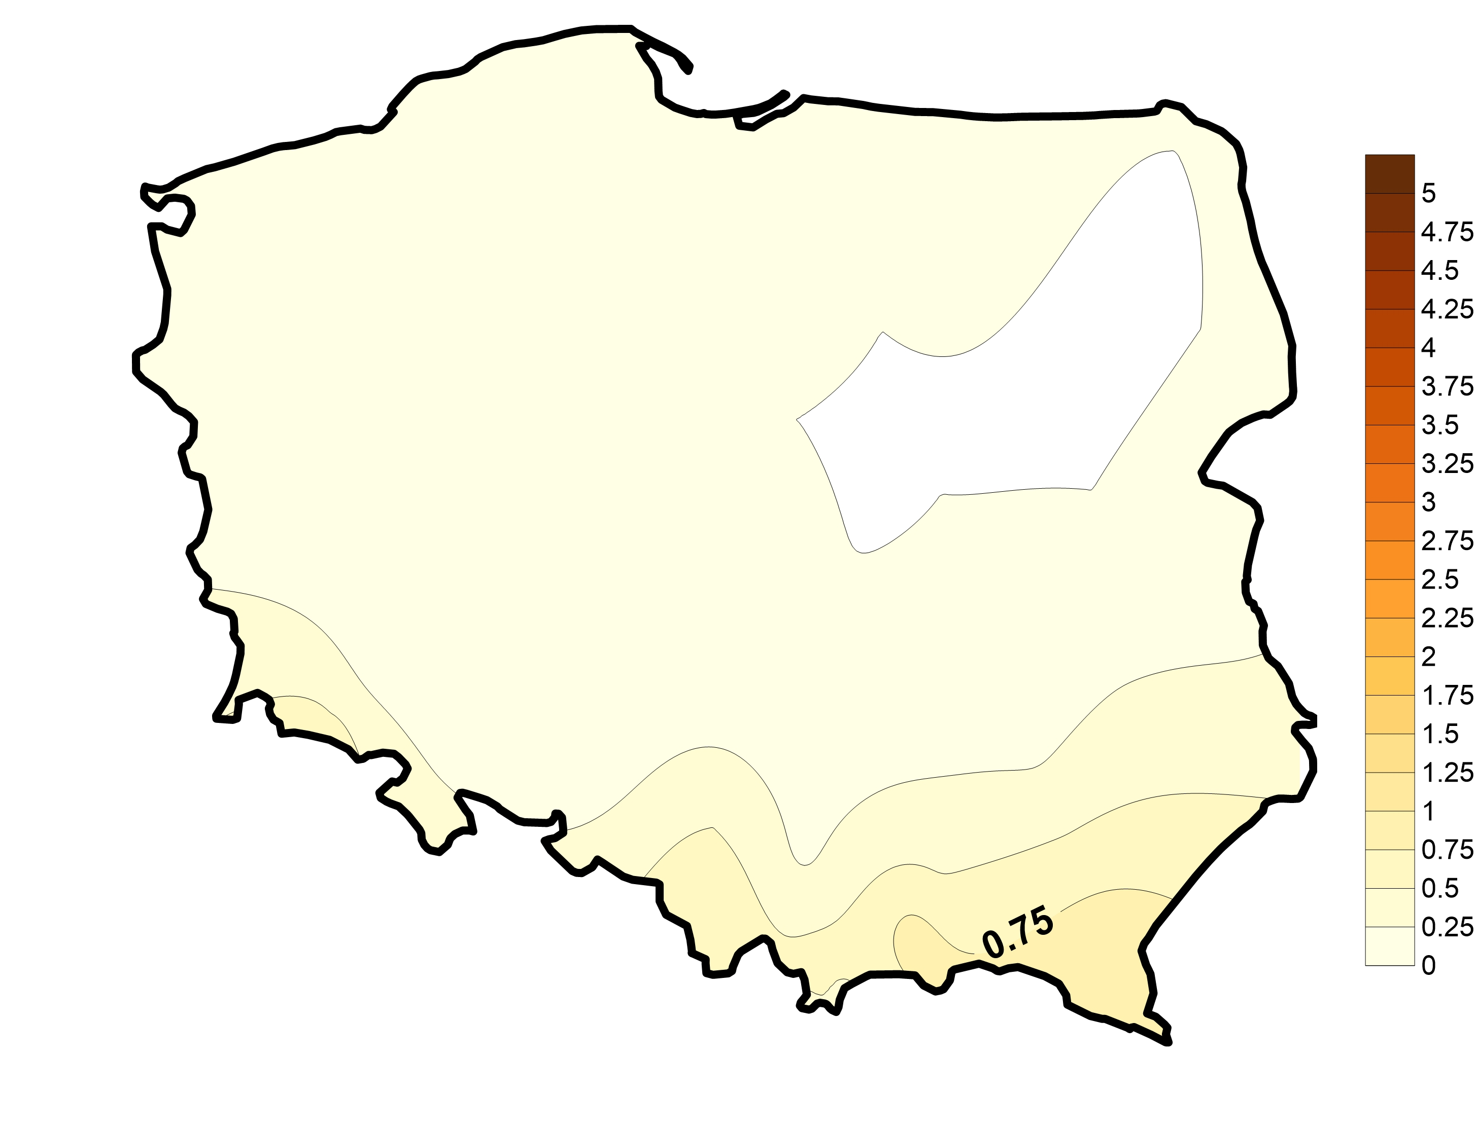
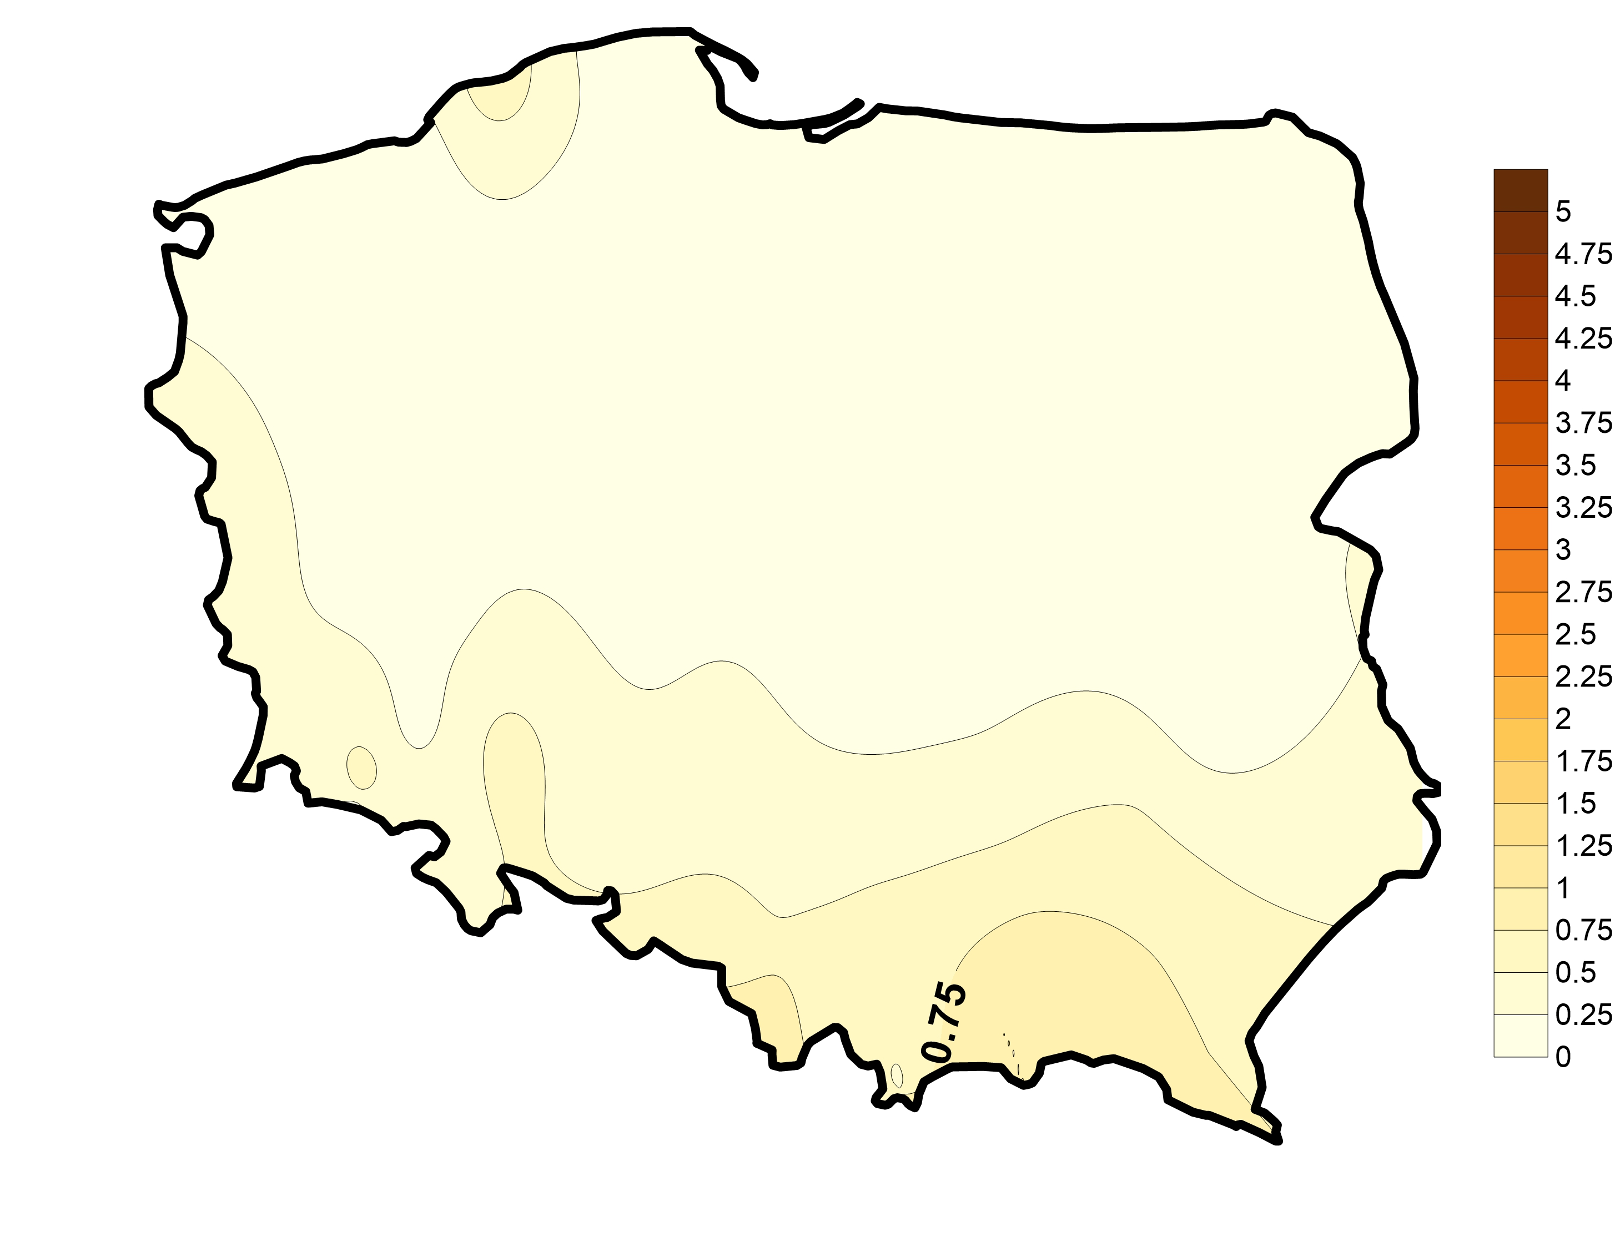
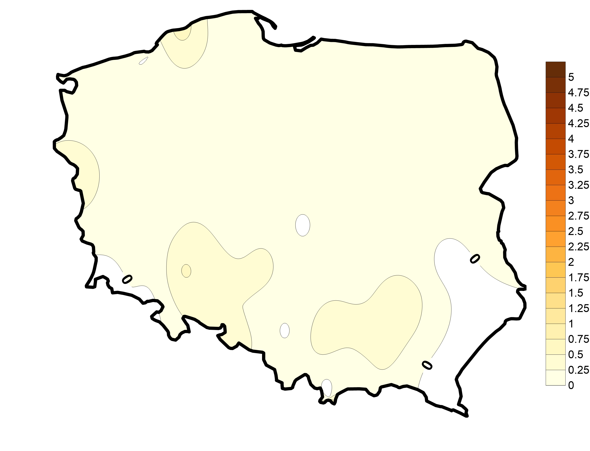
Average
1966-2022
JANUARY
Frequency of warm&dry days
Difference
(2001-2020)-(1966-1985)
Average 1966-1985
Average 2001-2020

Slide 11
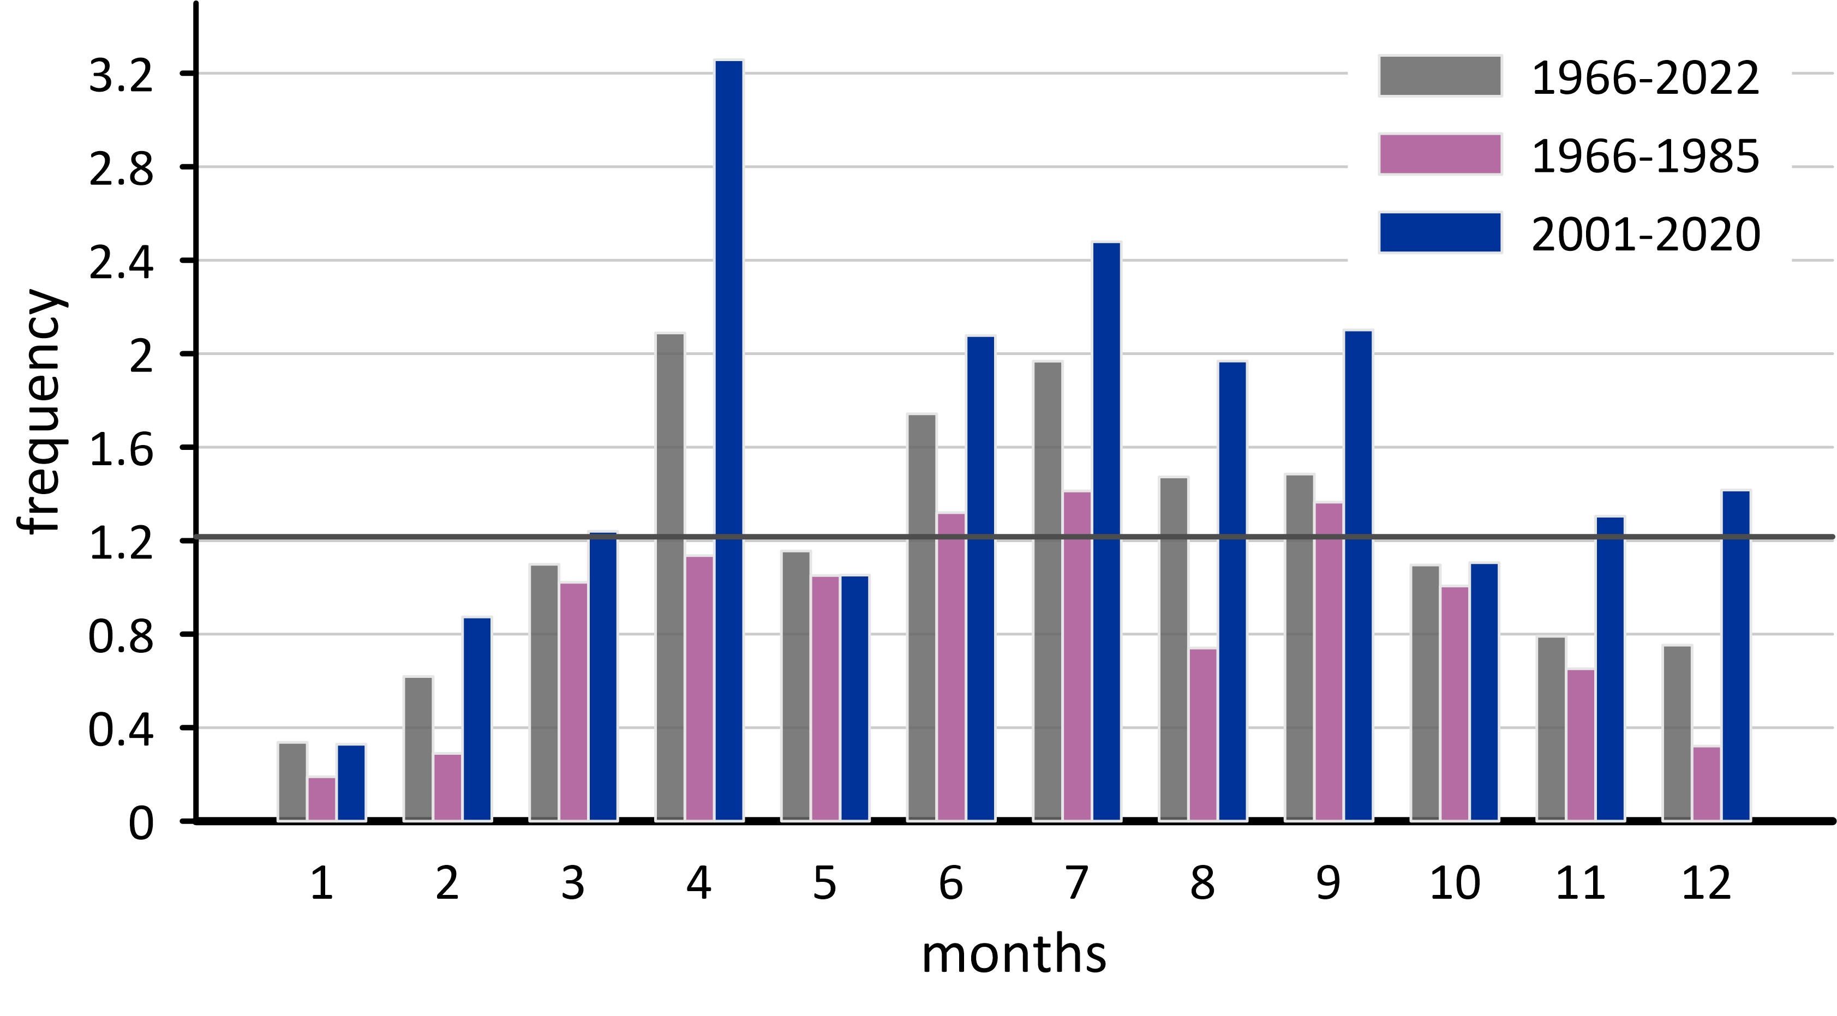
Frequency of warm&dry days

Slide 12
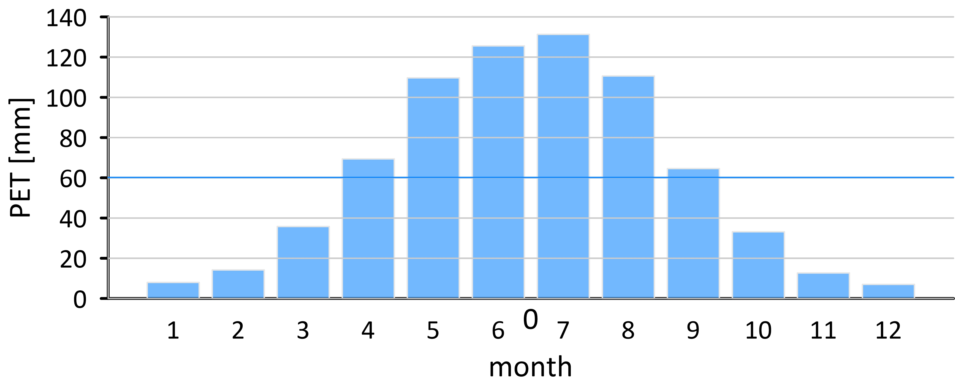
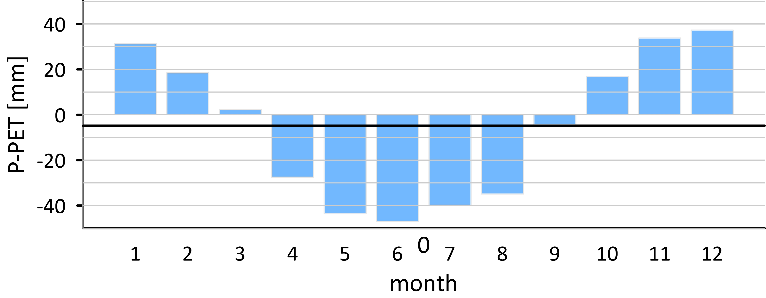
Mean annual course of potential evaporation
Mean annual course of water balance (P-PET)

Slide 13
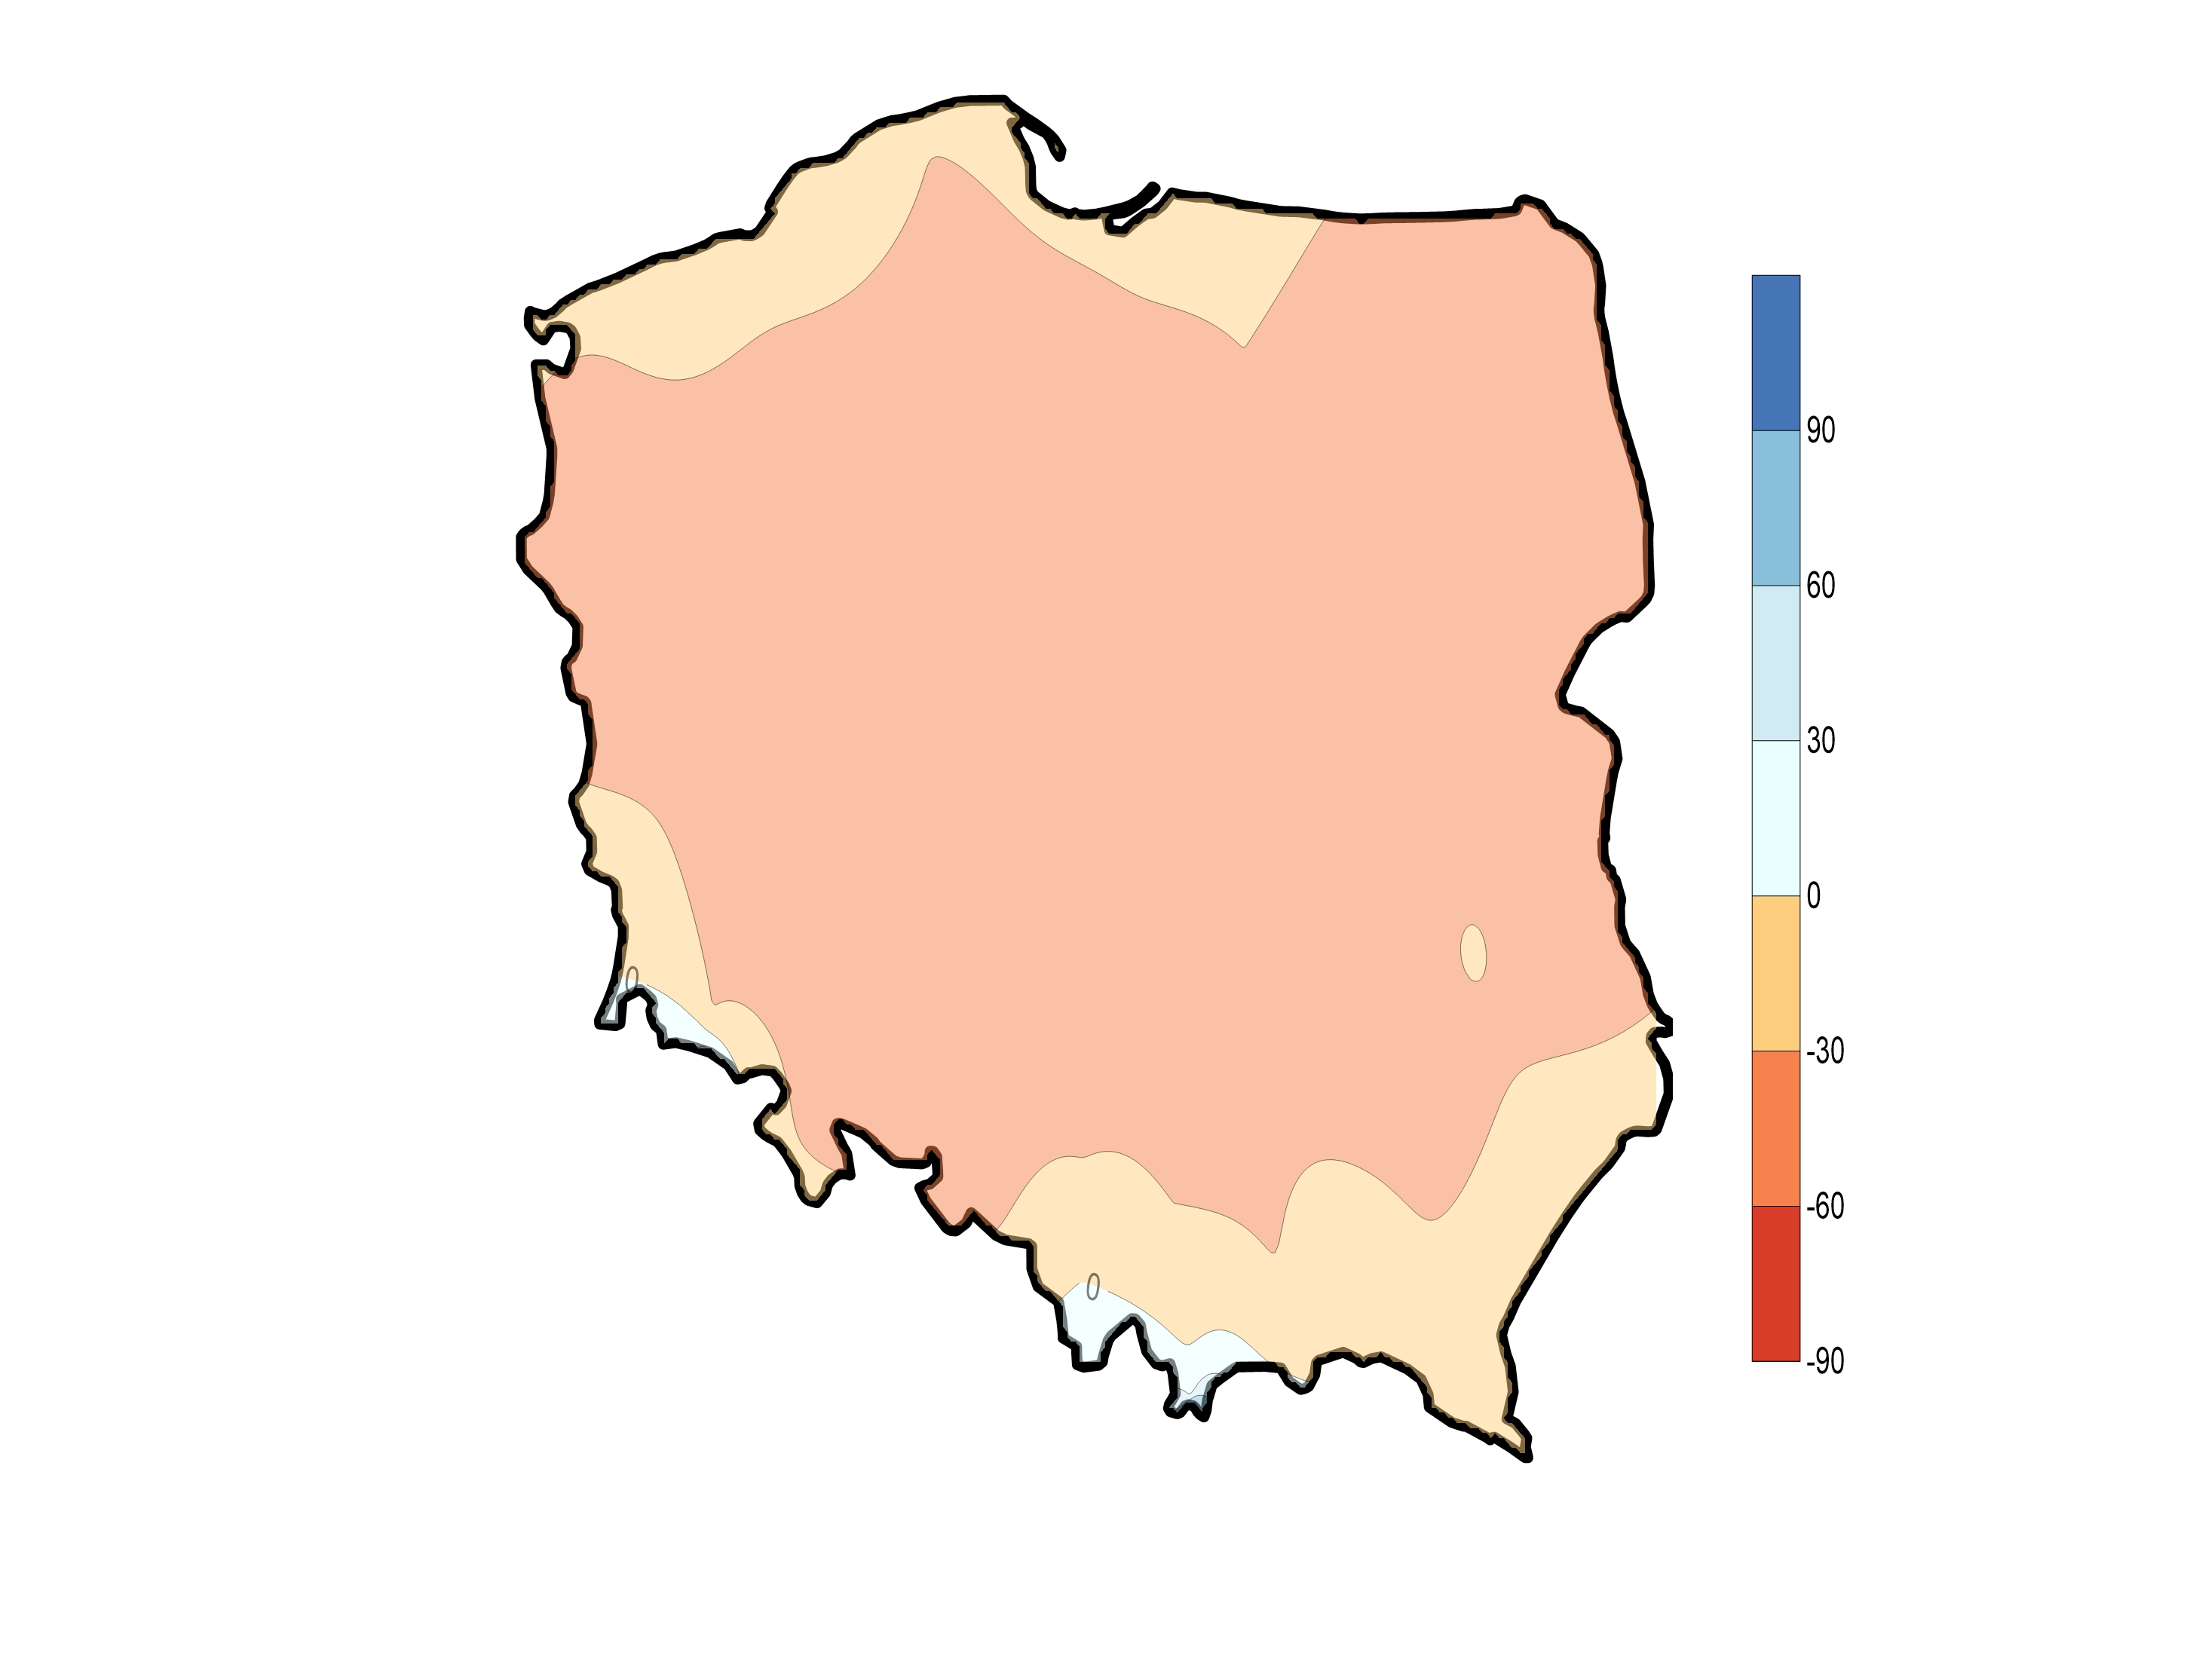
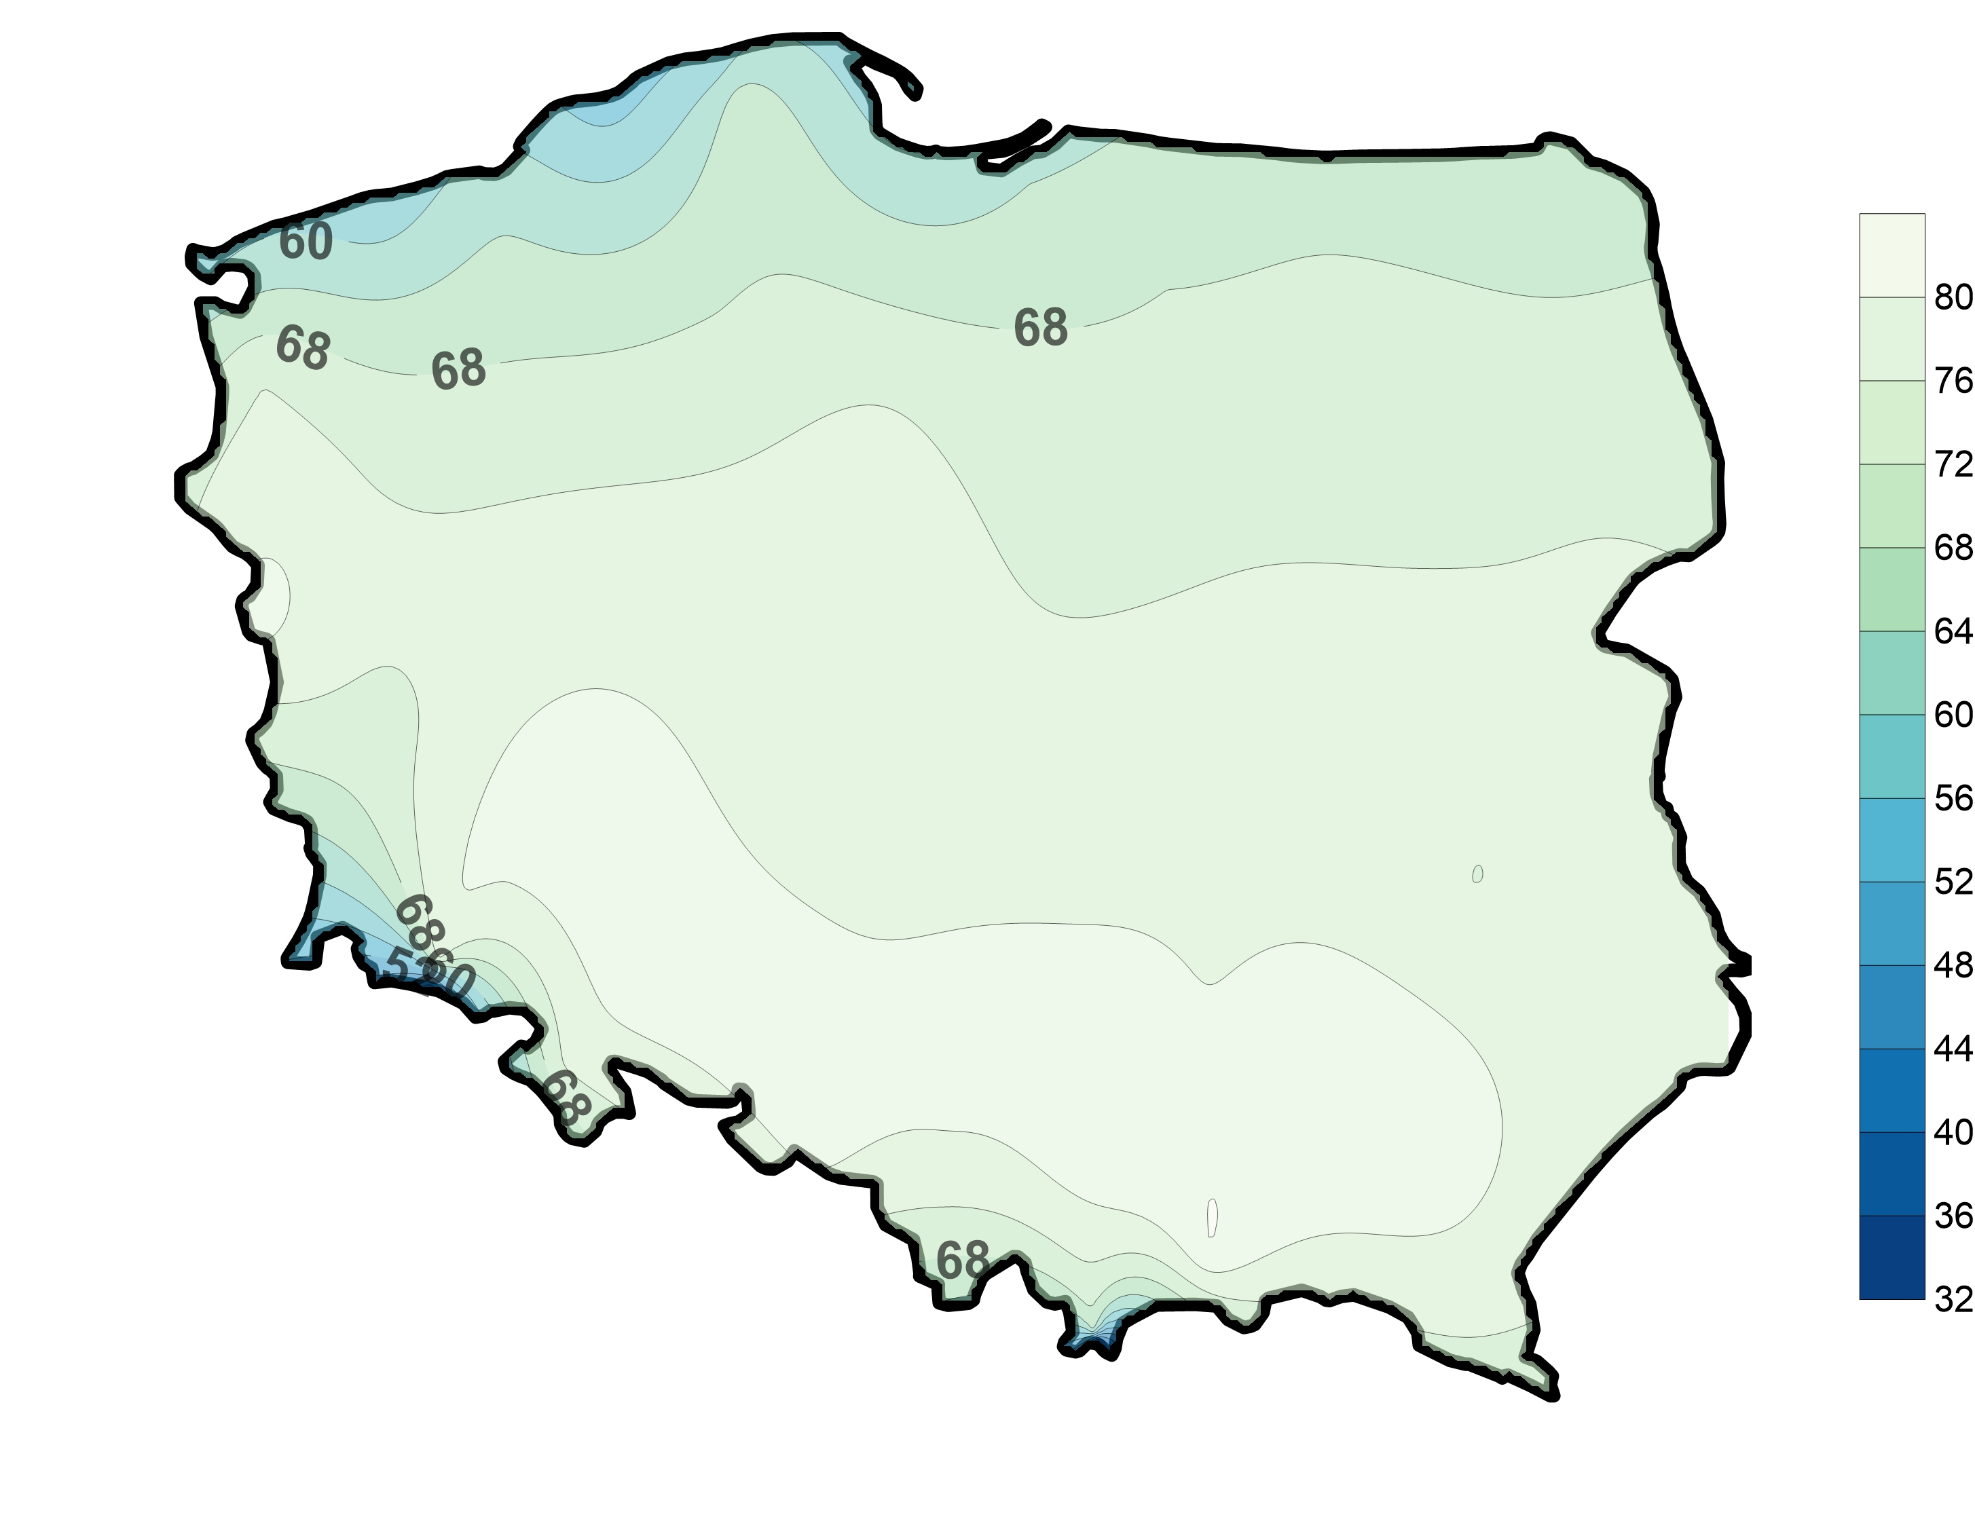
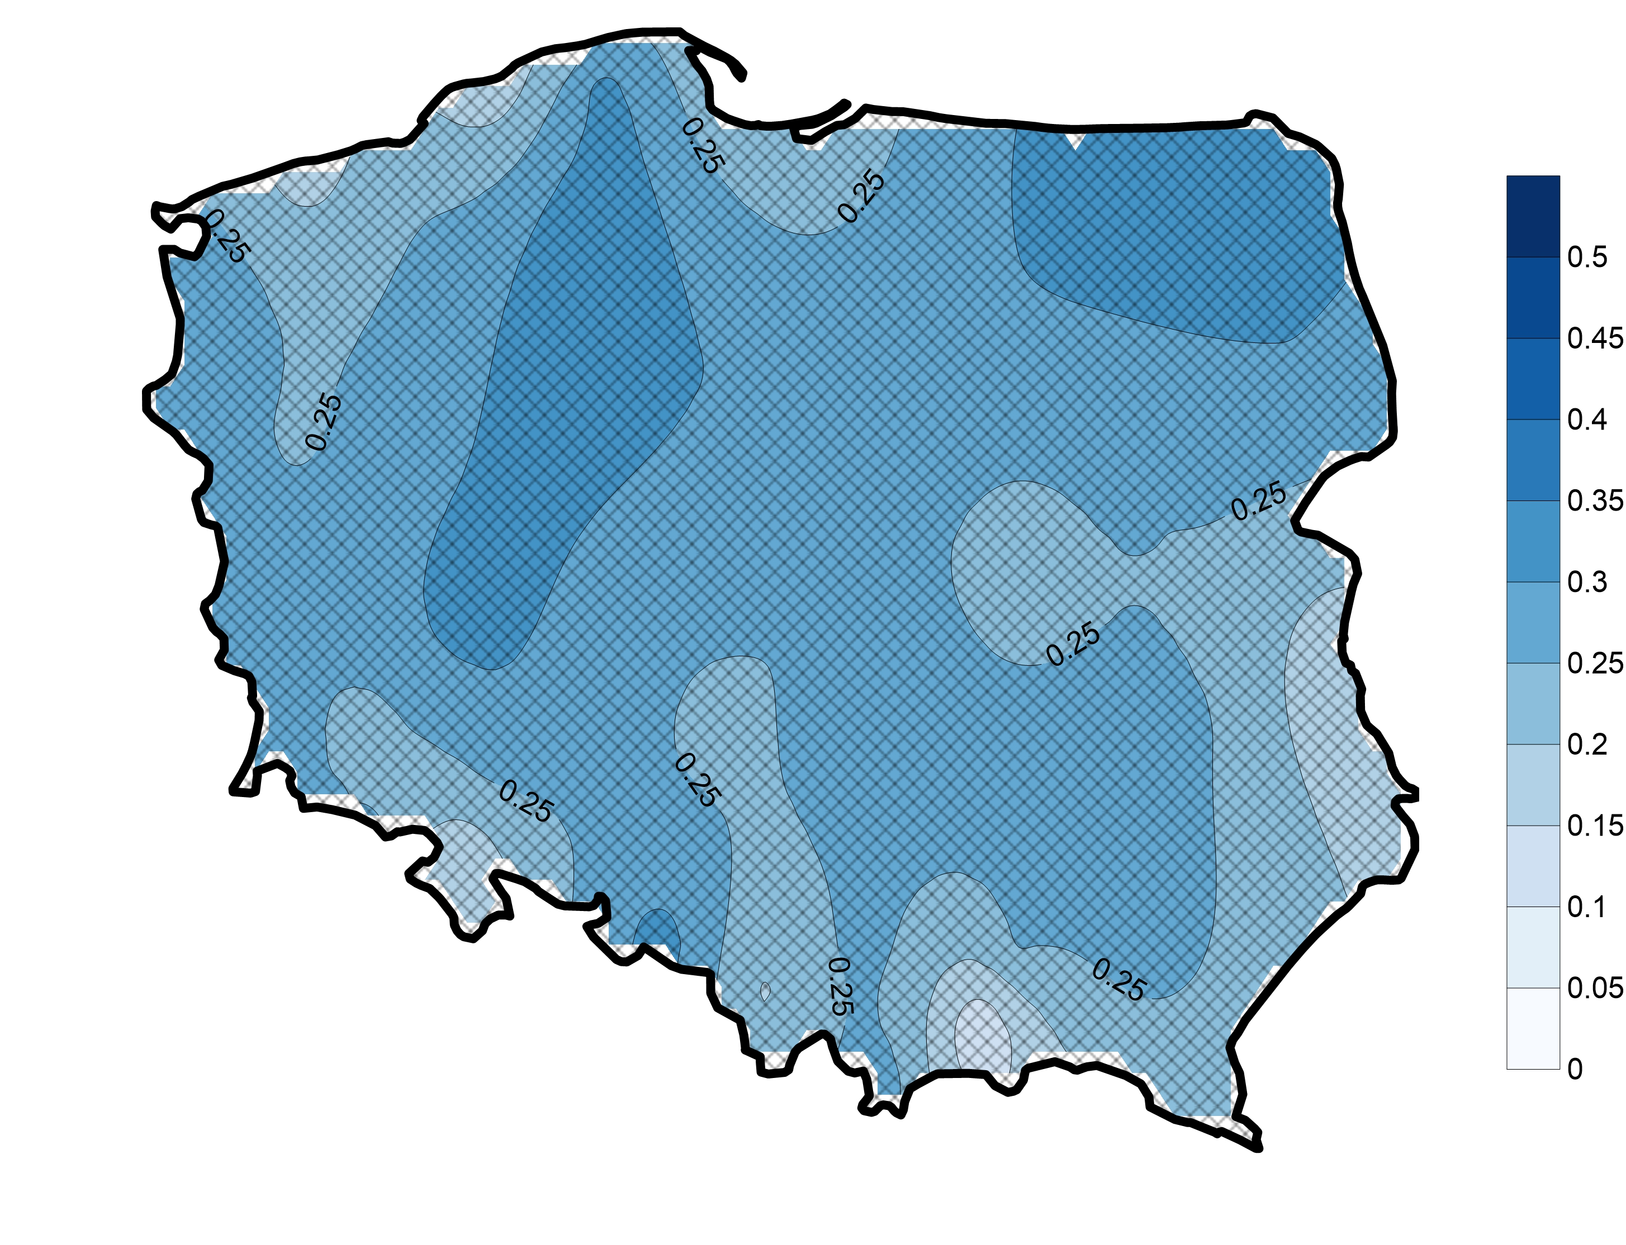
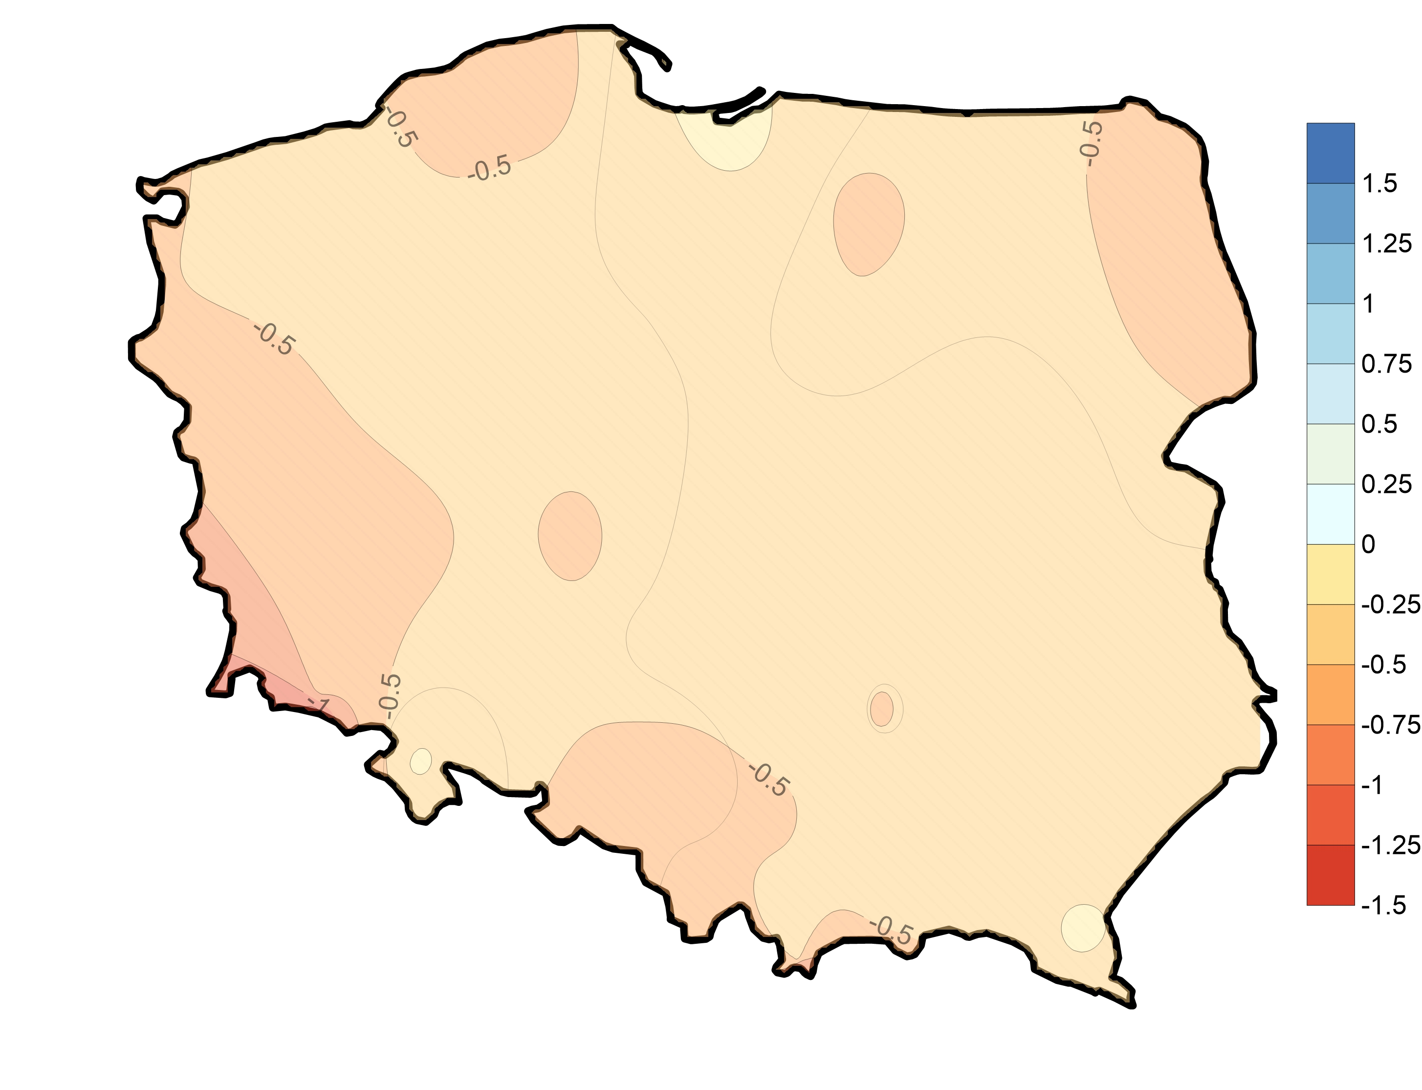
APRIL
PET
mean
P-PET
mean
Hargreave
formula
P-PET
trend
mm y⁻¹
PET
trend
mm y⁻¹

Slide 14
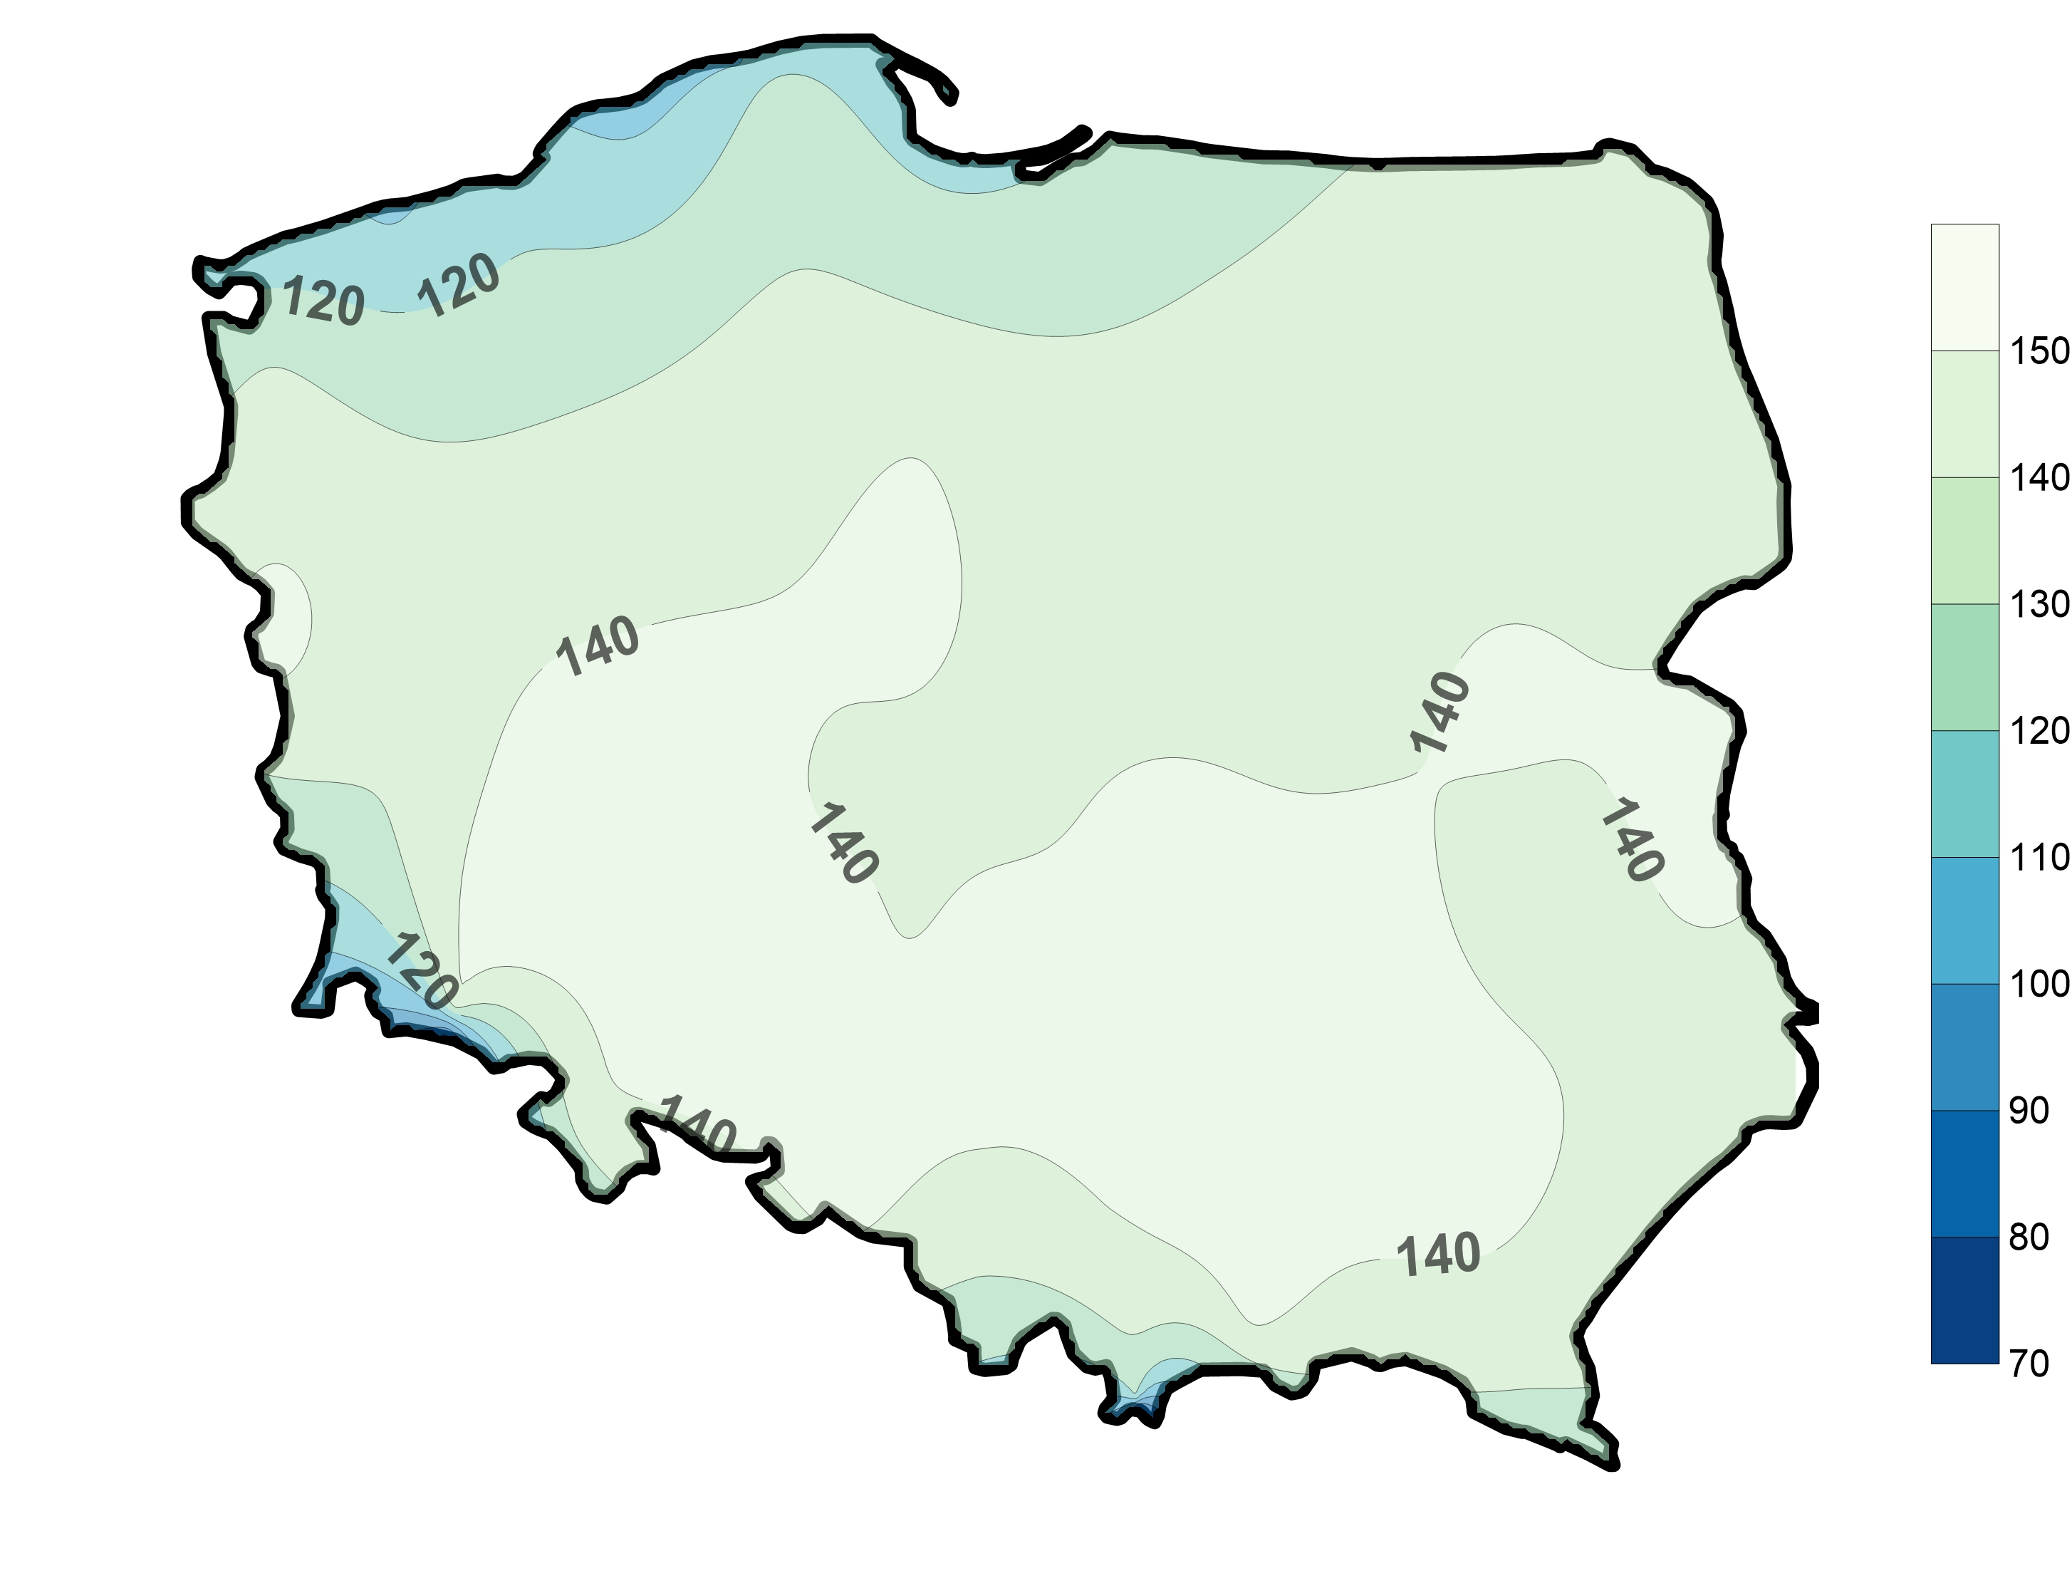
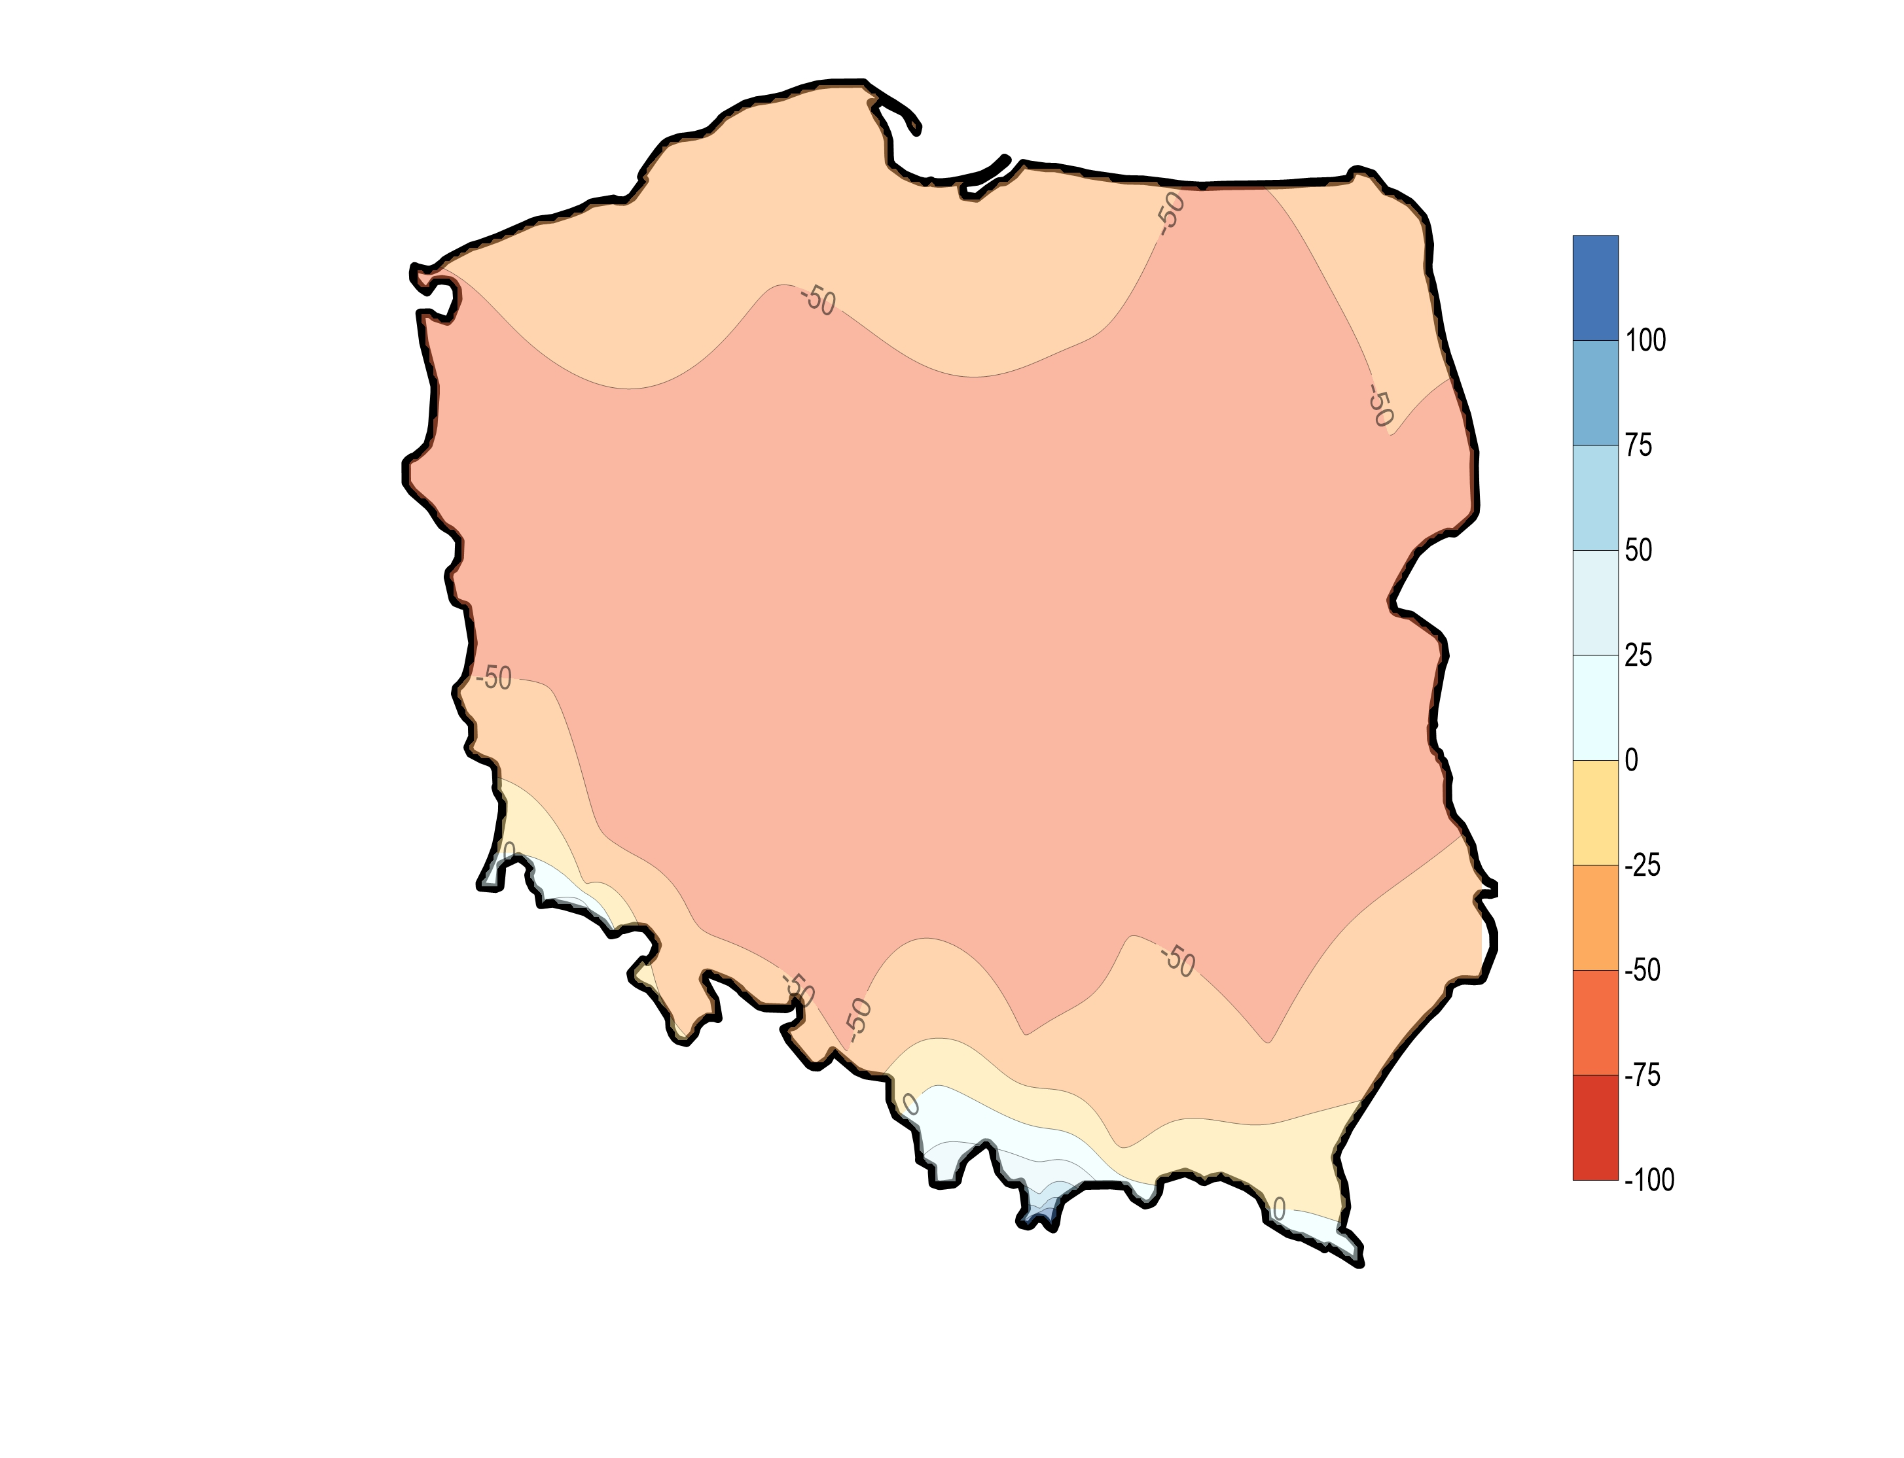
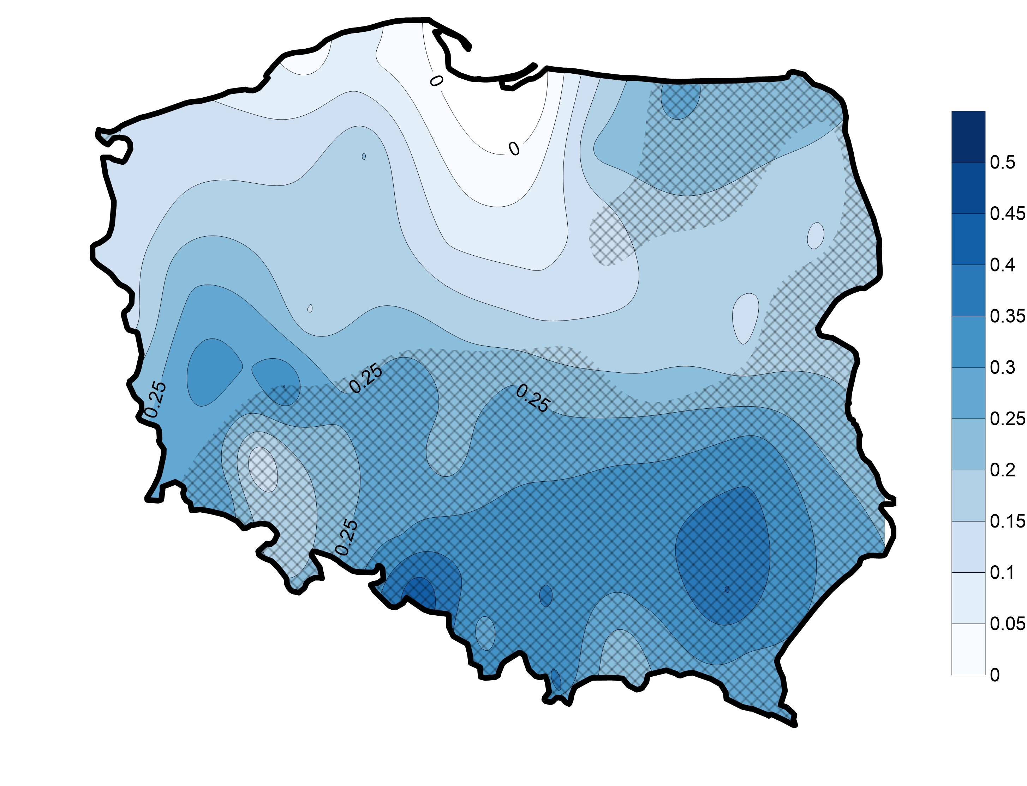
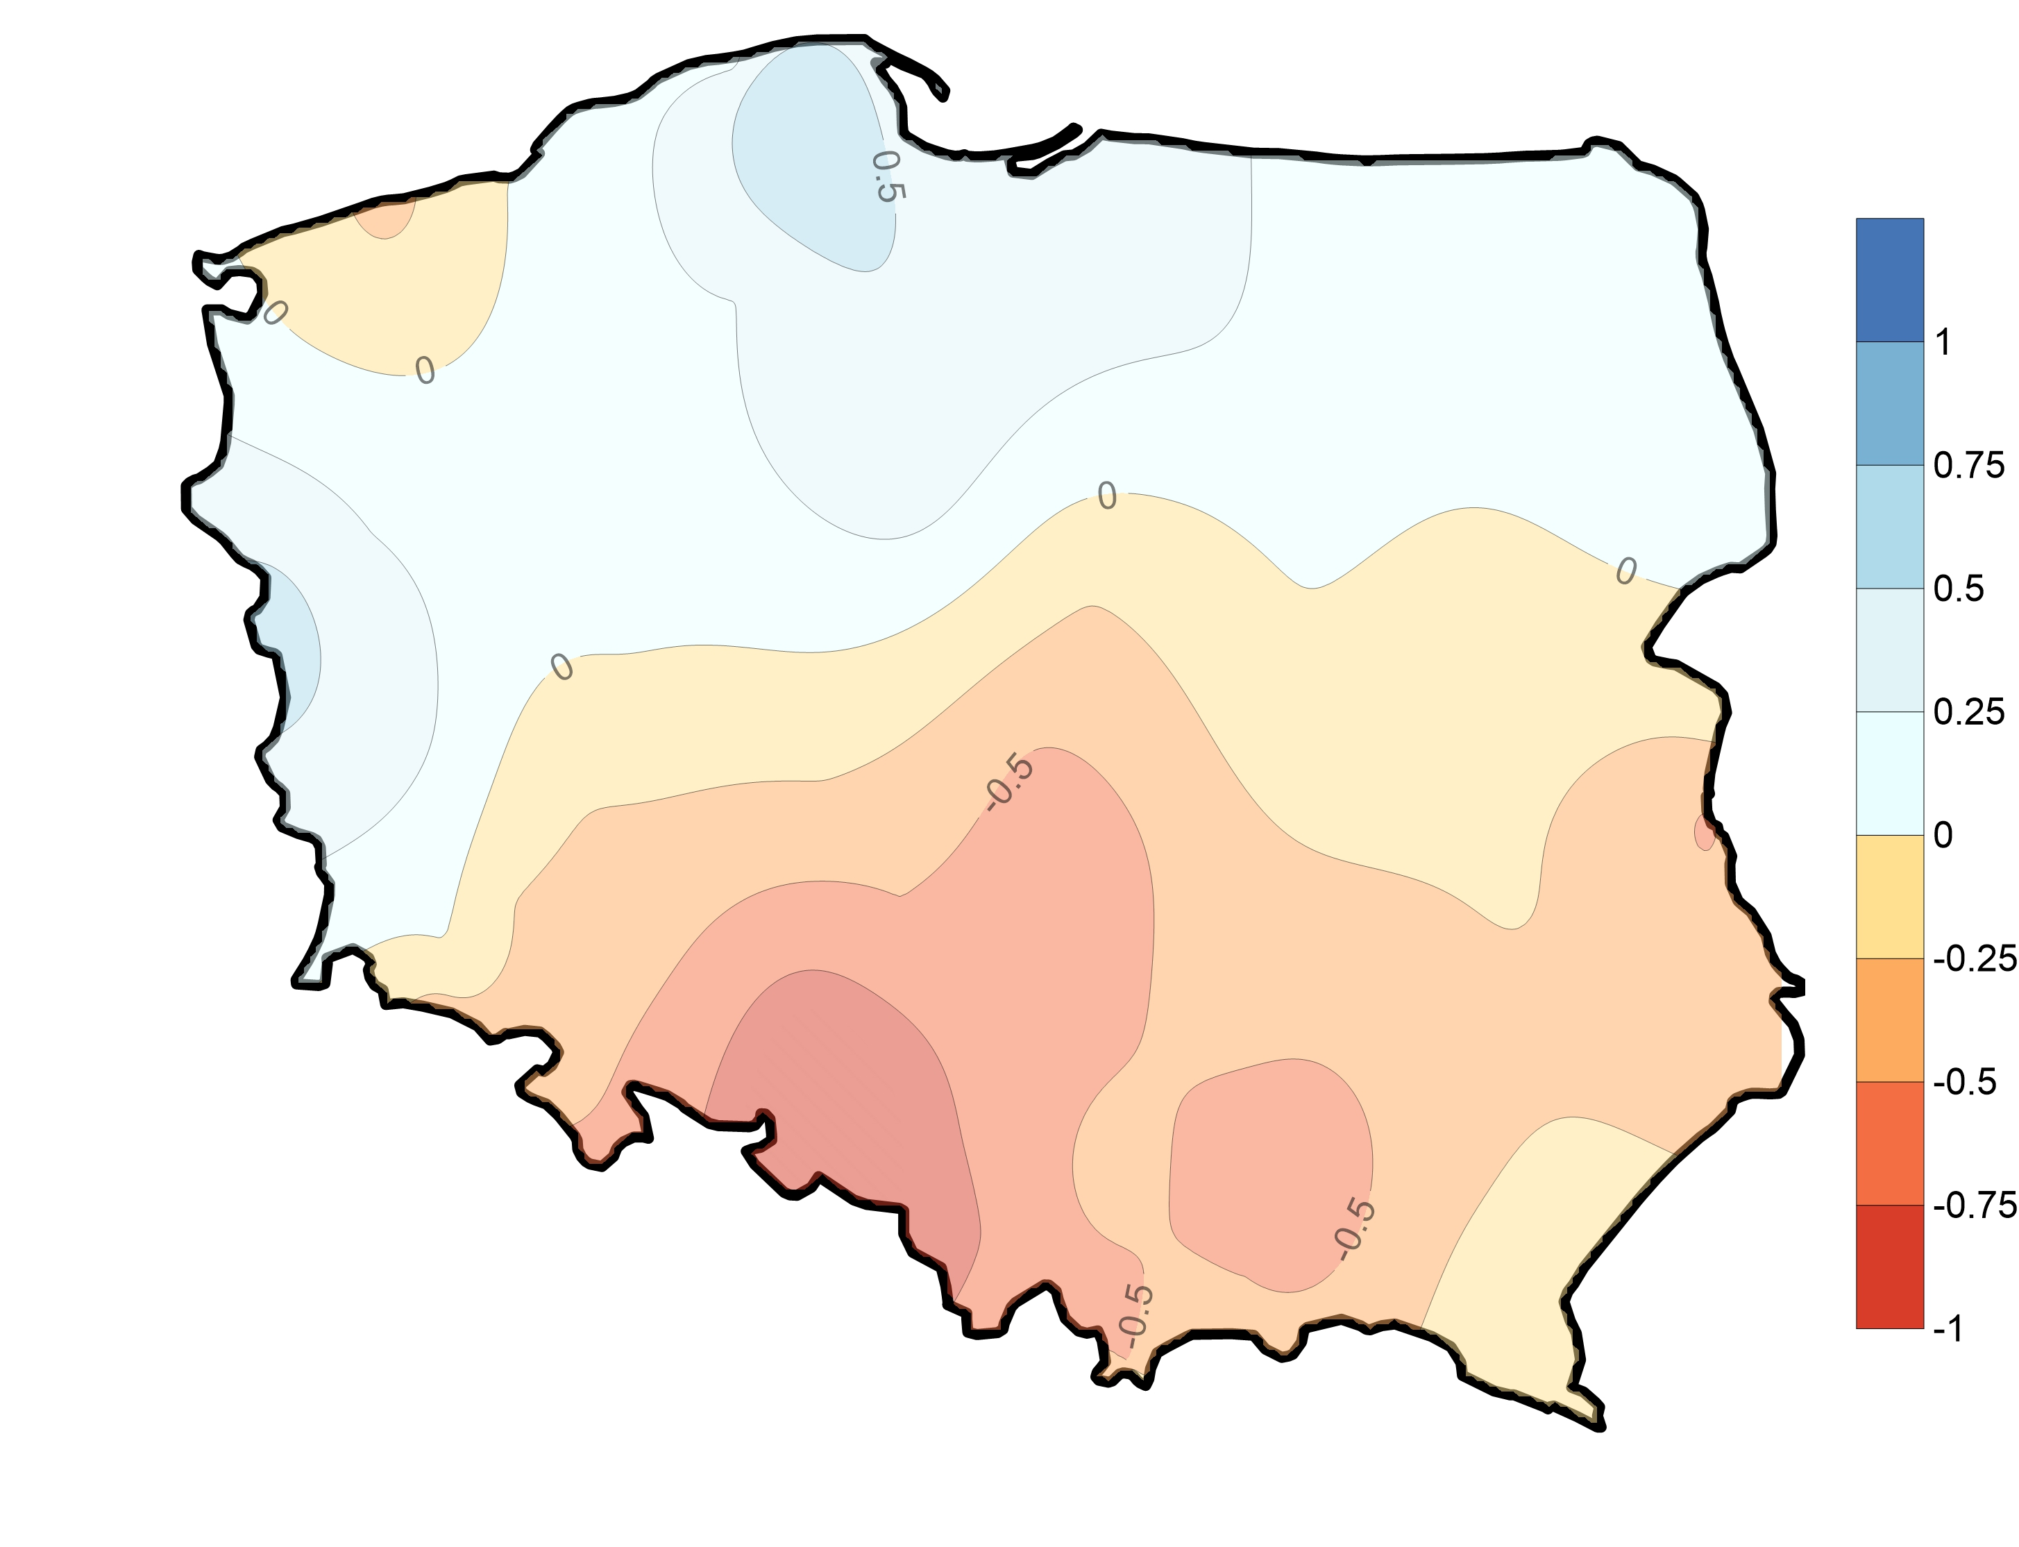
JULY
PET
mean
P-PET
mean
Hargreave
formula
P-PET
trend
mm y⁻¹
PET
trend
mm y⁻¹

Slide 15
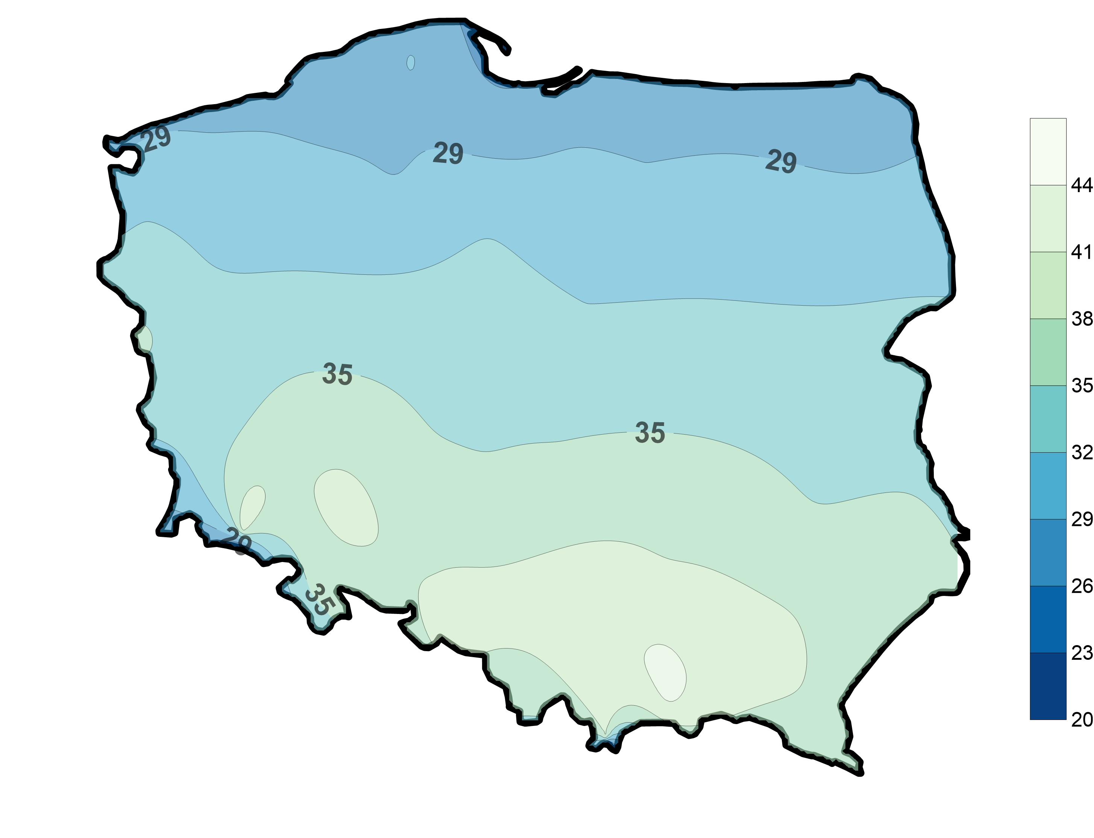
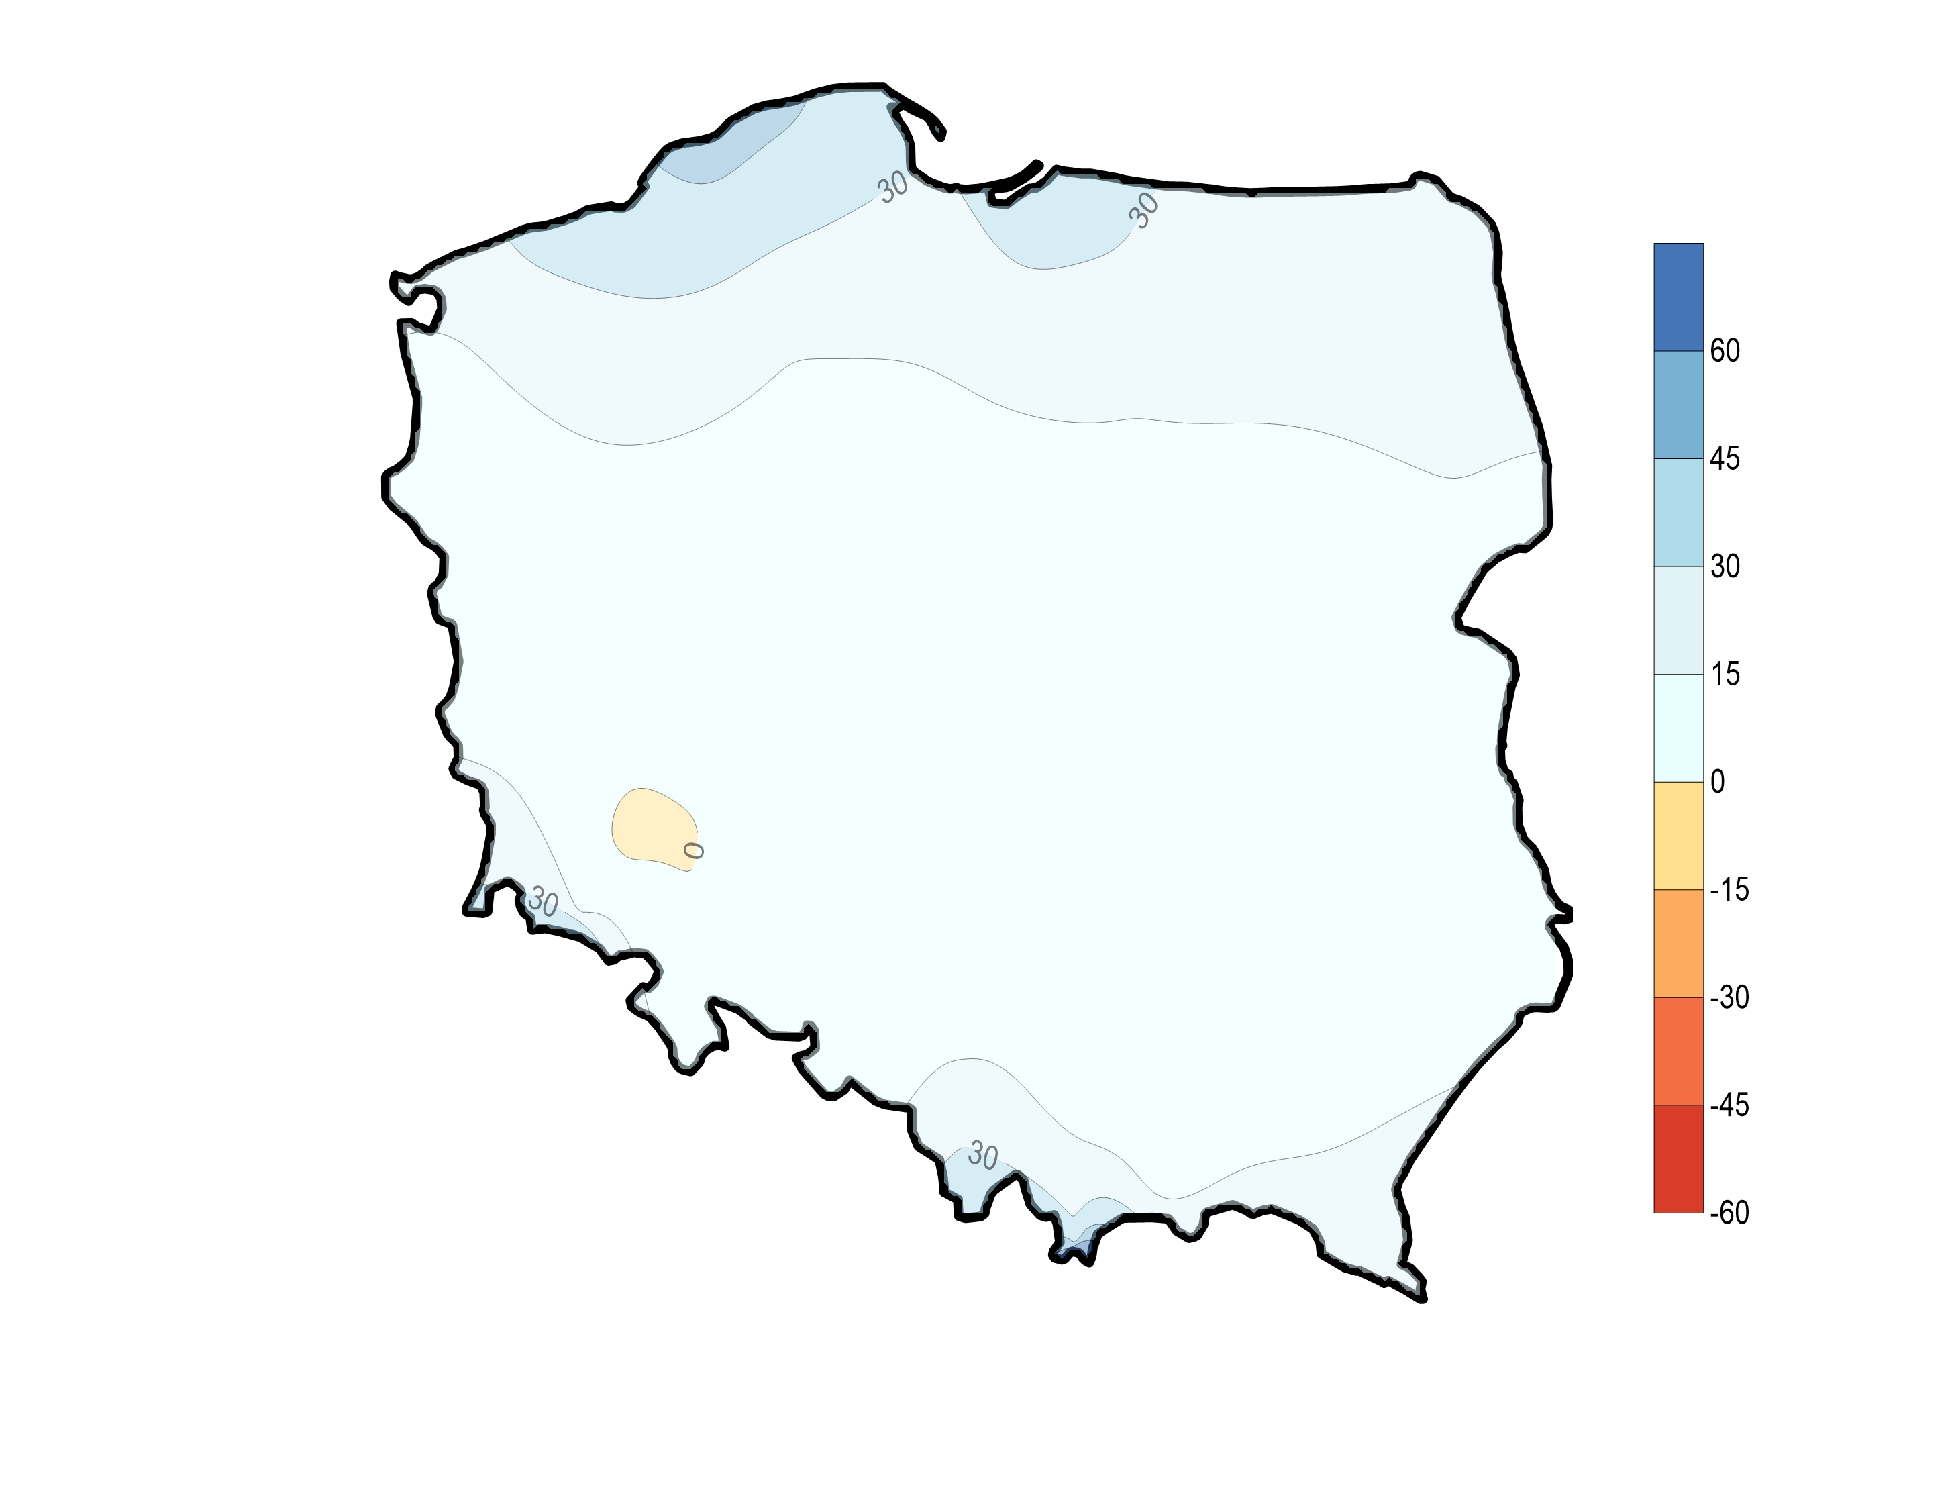
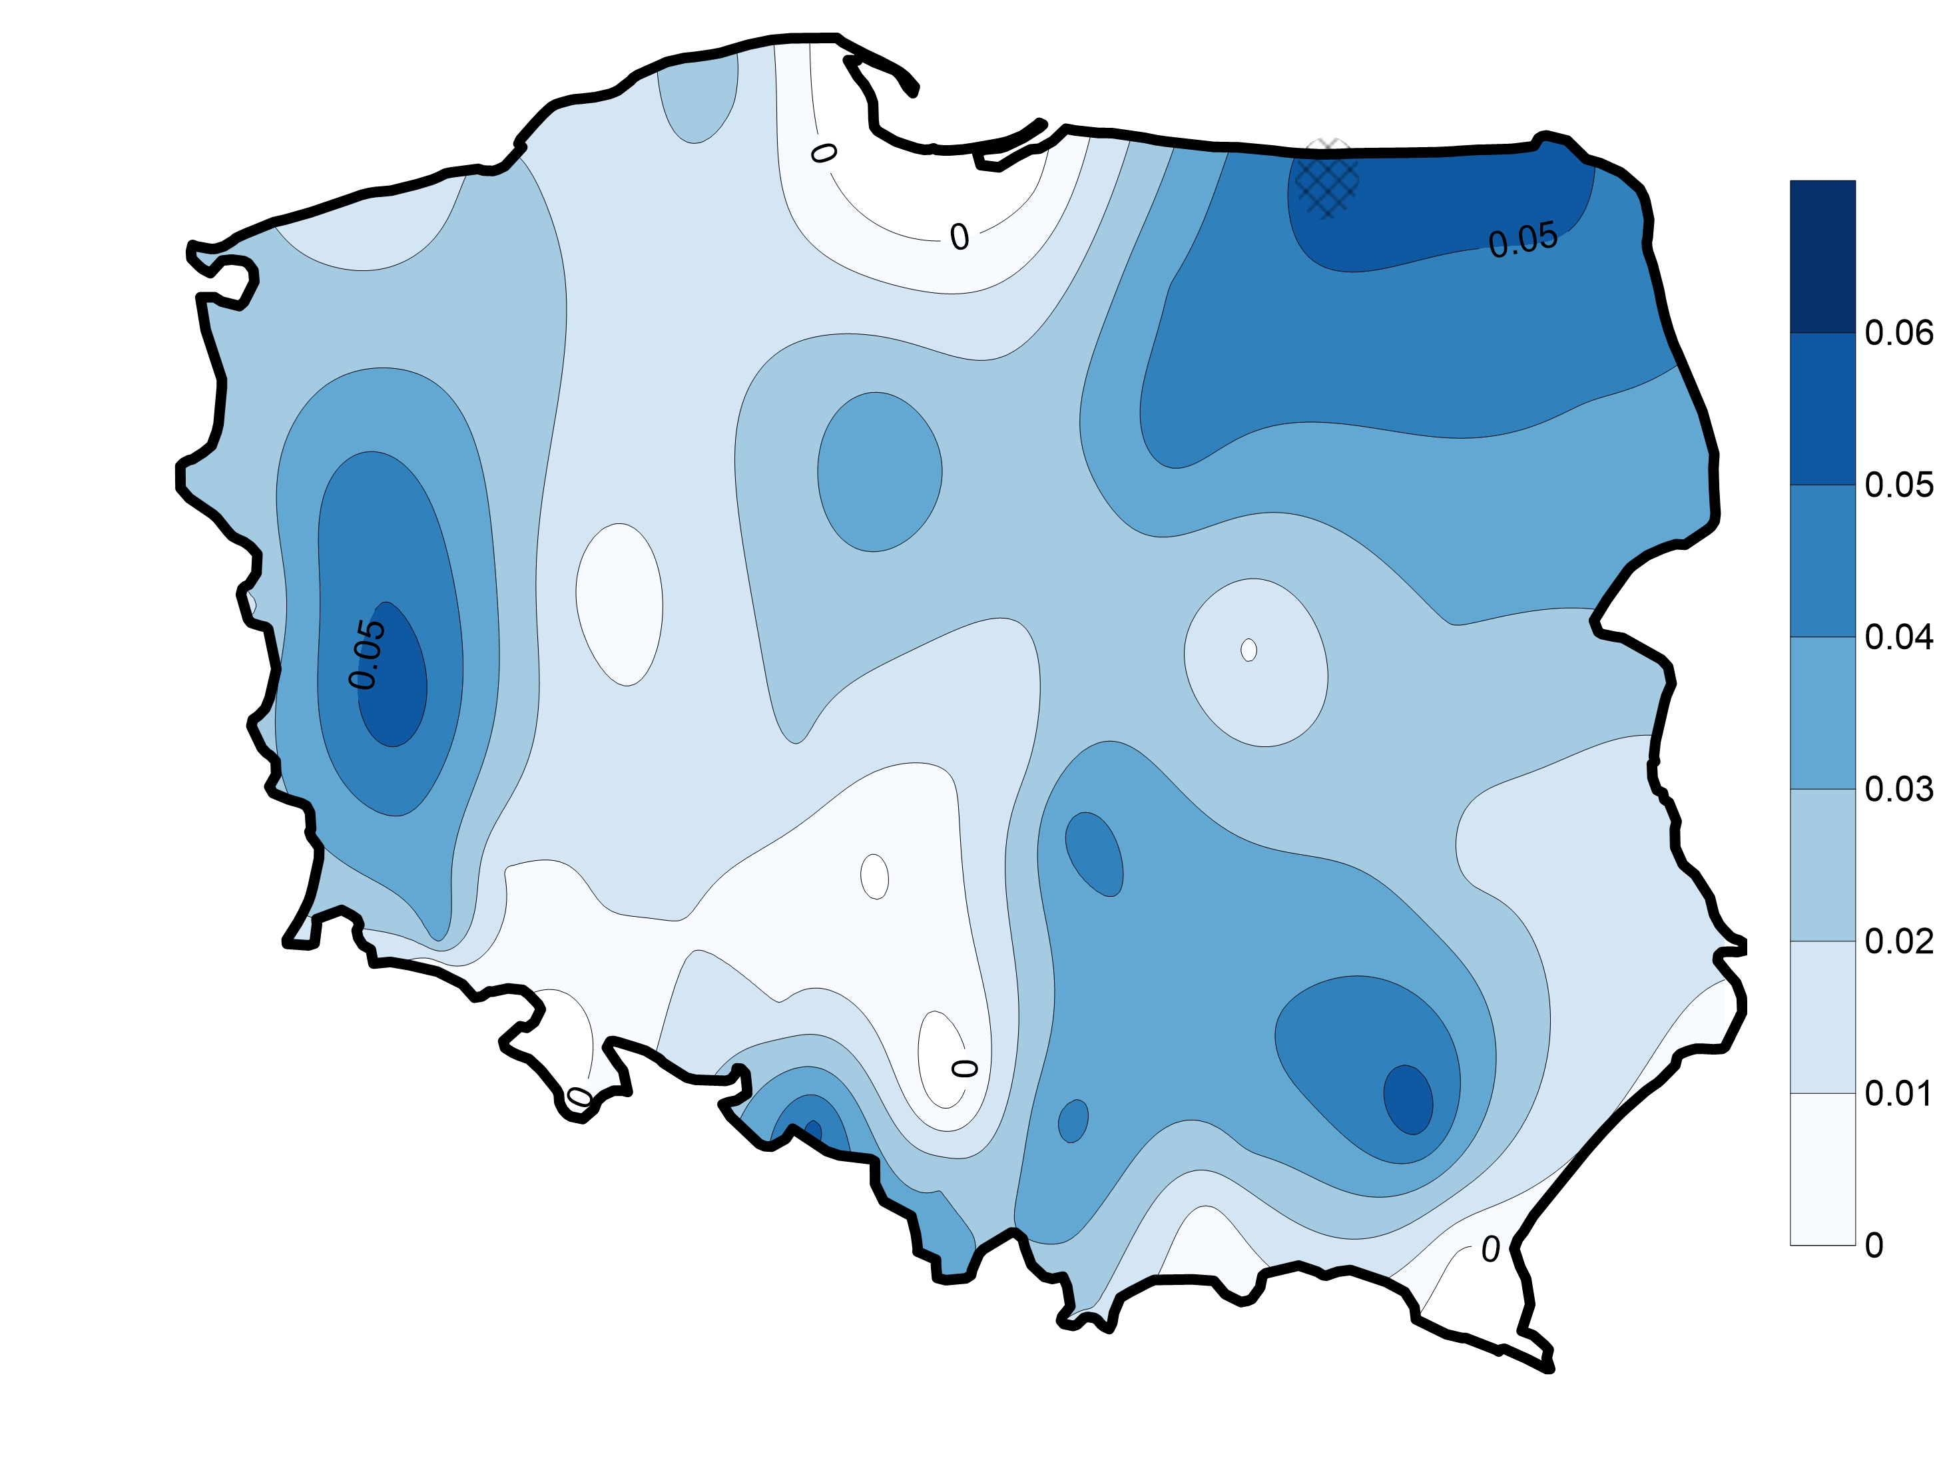
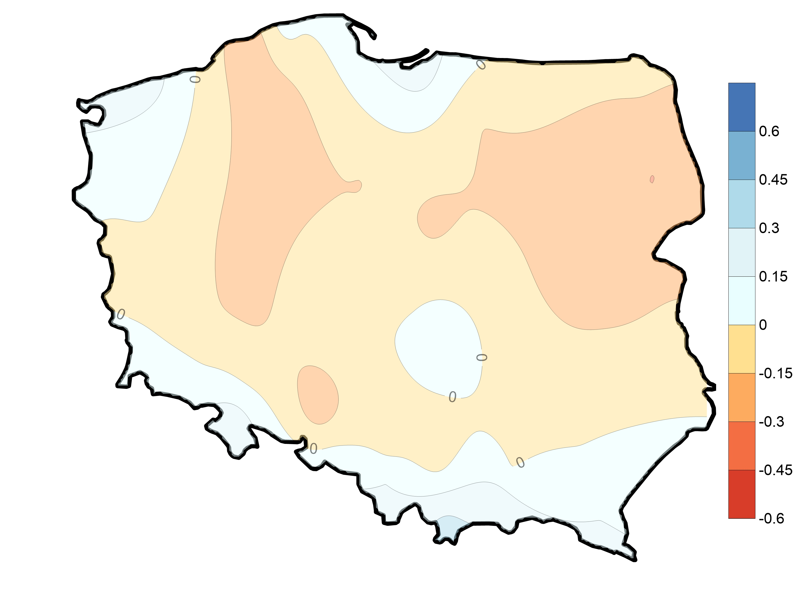
OCTOBER
PET
mean
P-PET
mean
Hargreave
formula
P-PET
trend
mm y⁻¹
PET
trend
mm y⁻¹

Slide 16
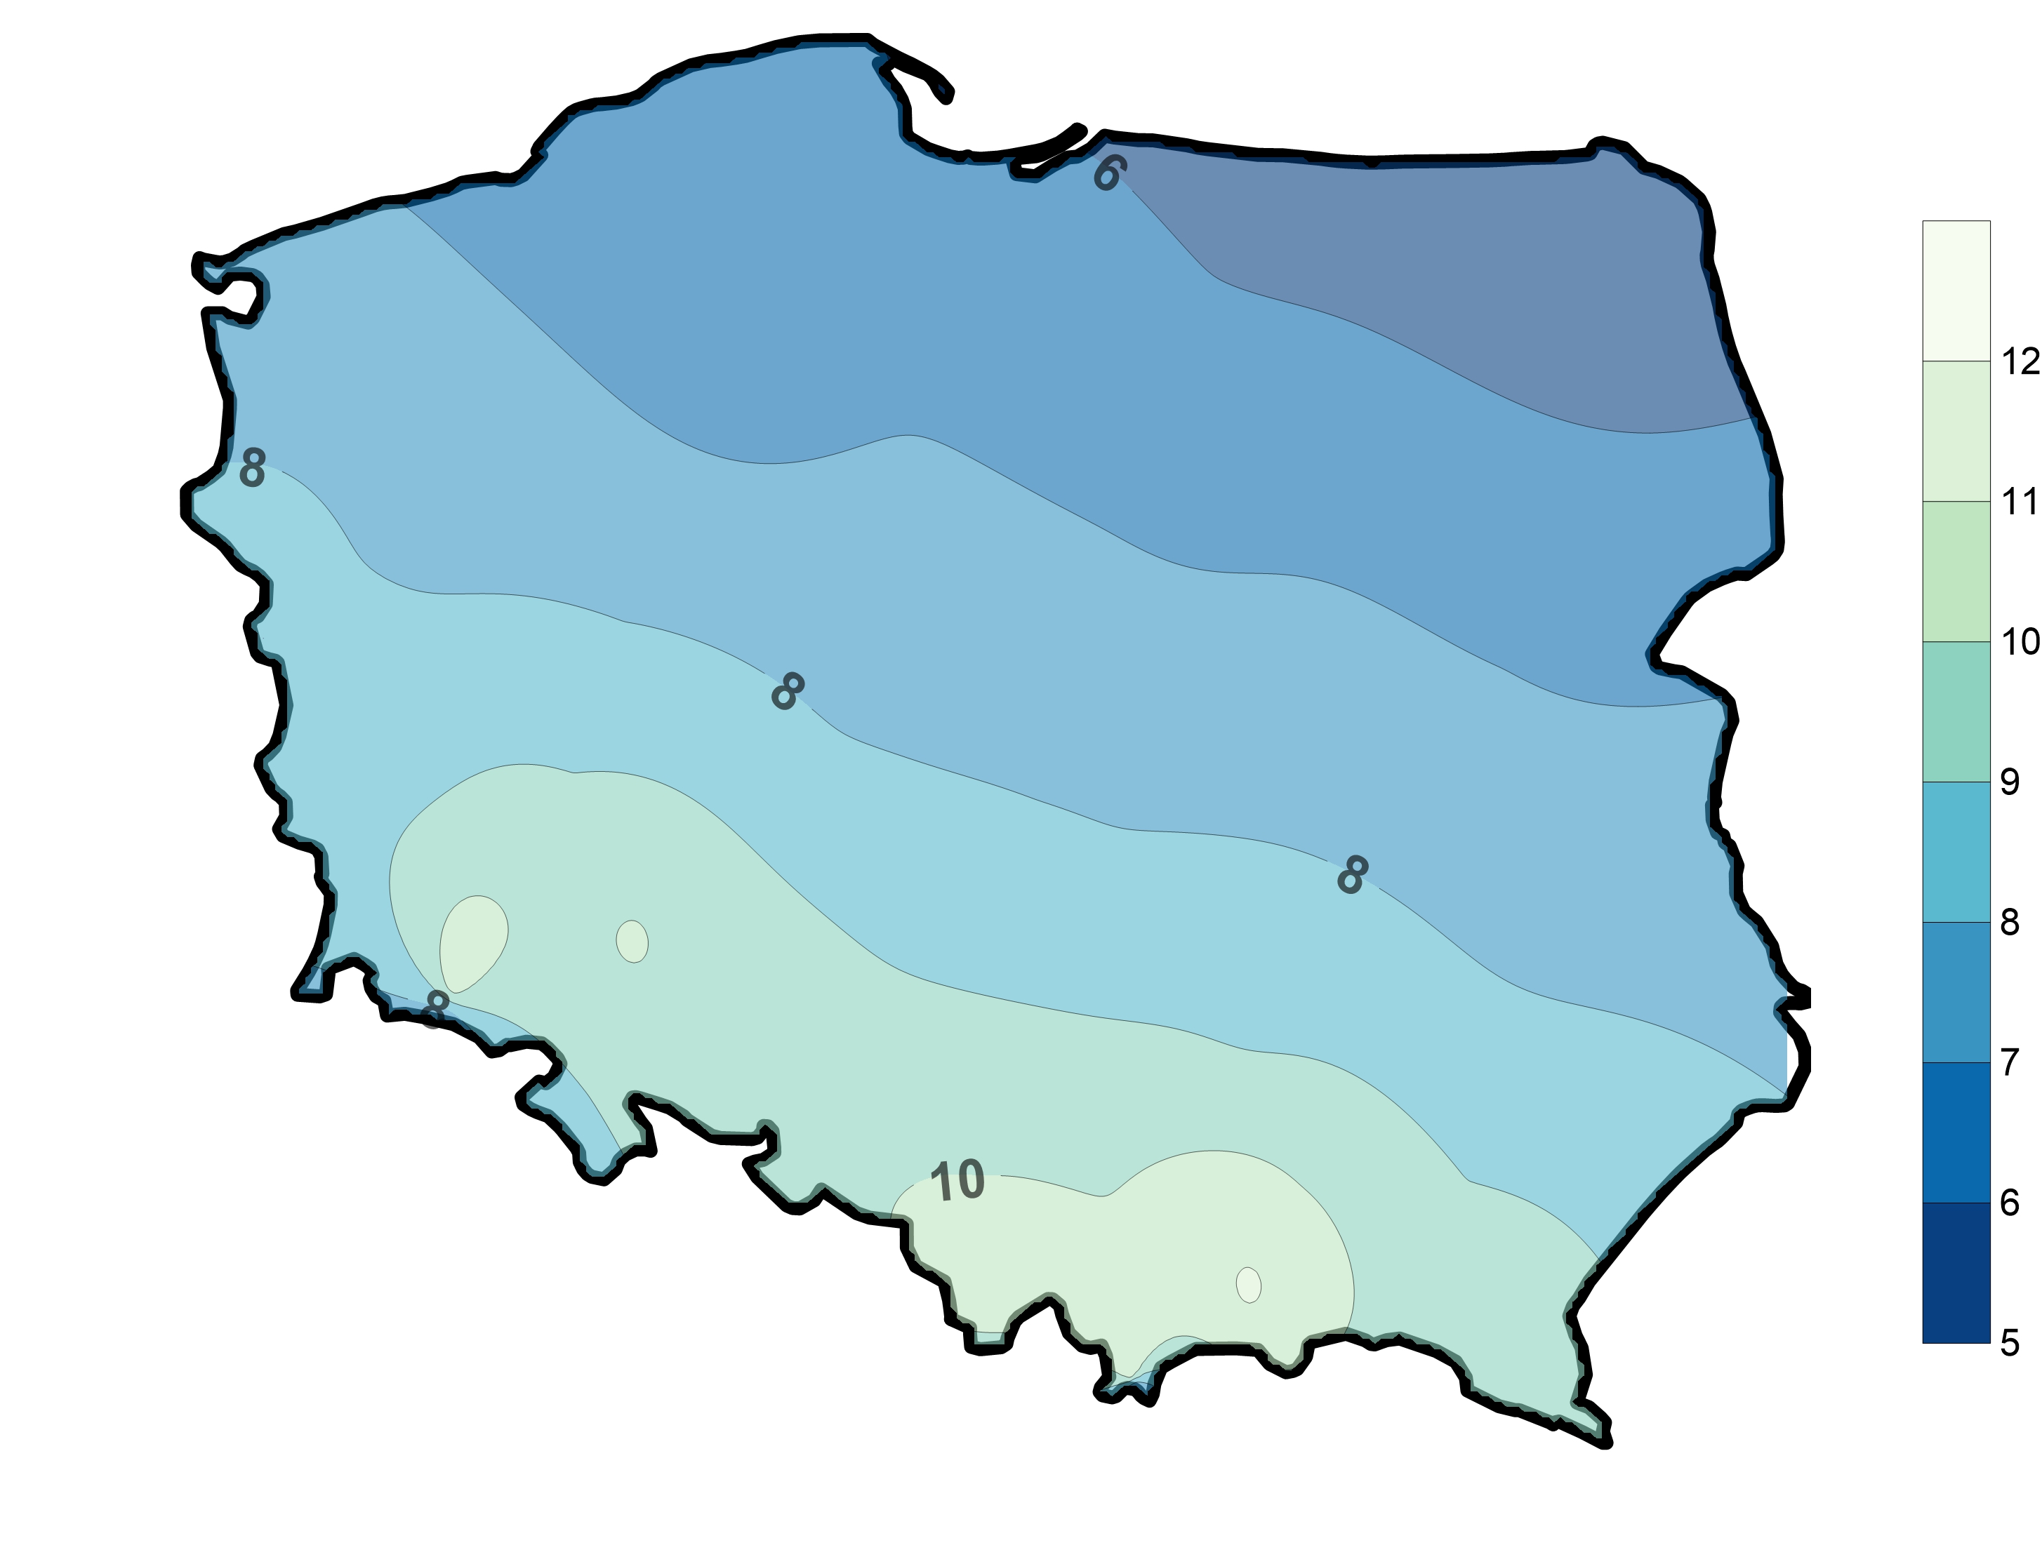
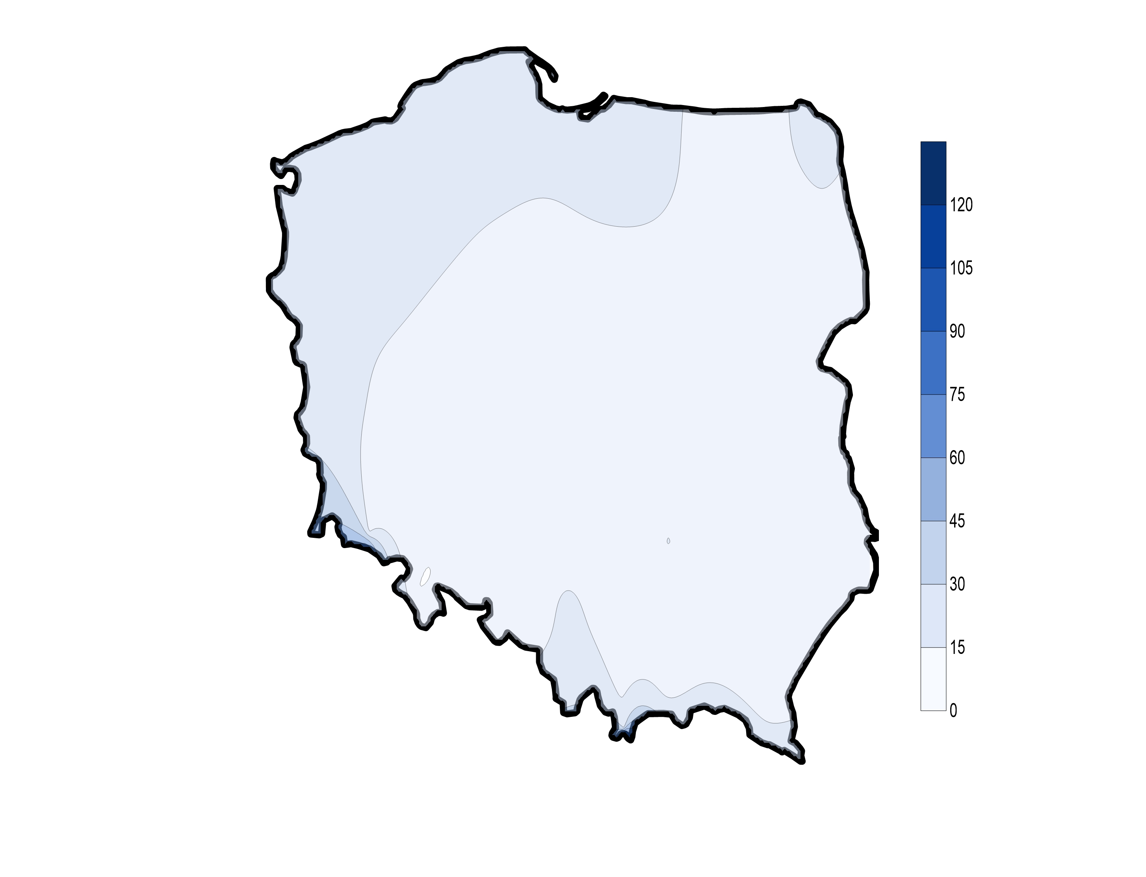
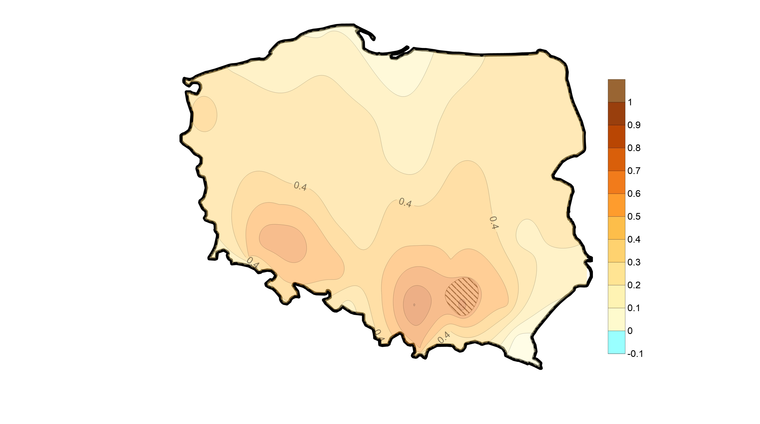
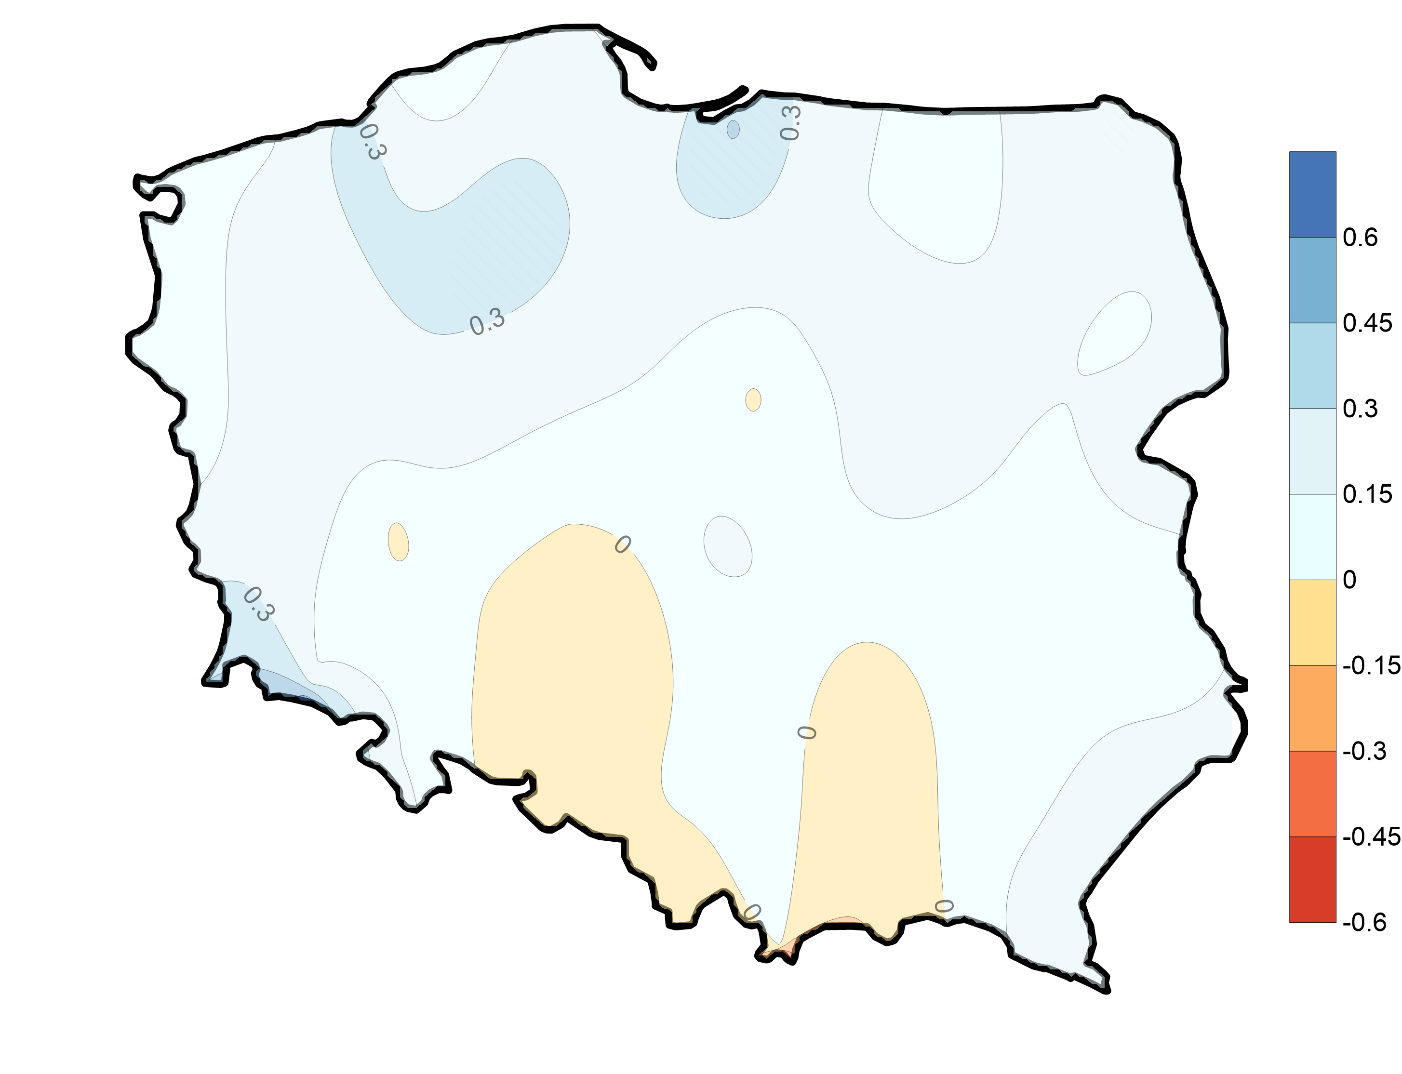
JANUARY
PET
mean
P-PET
mean
Hargreave
formula
P-PET
trend
mm y⁻¹
PET
trend
mm y⁻¹

Slide 17
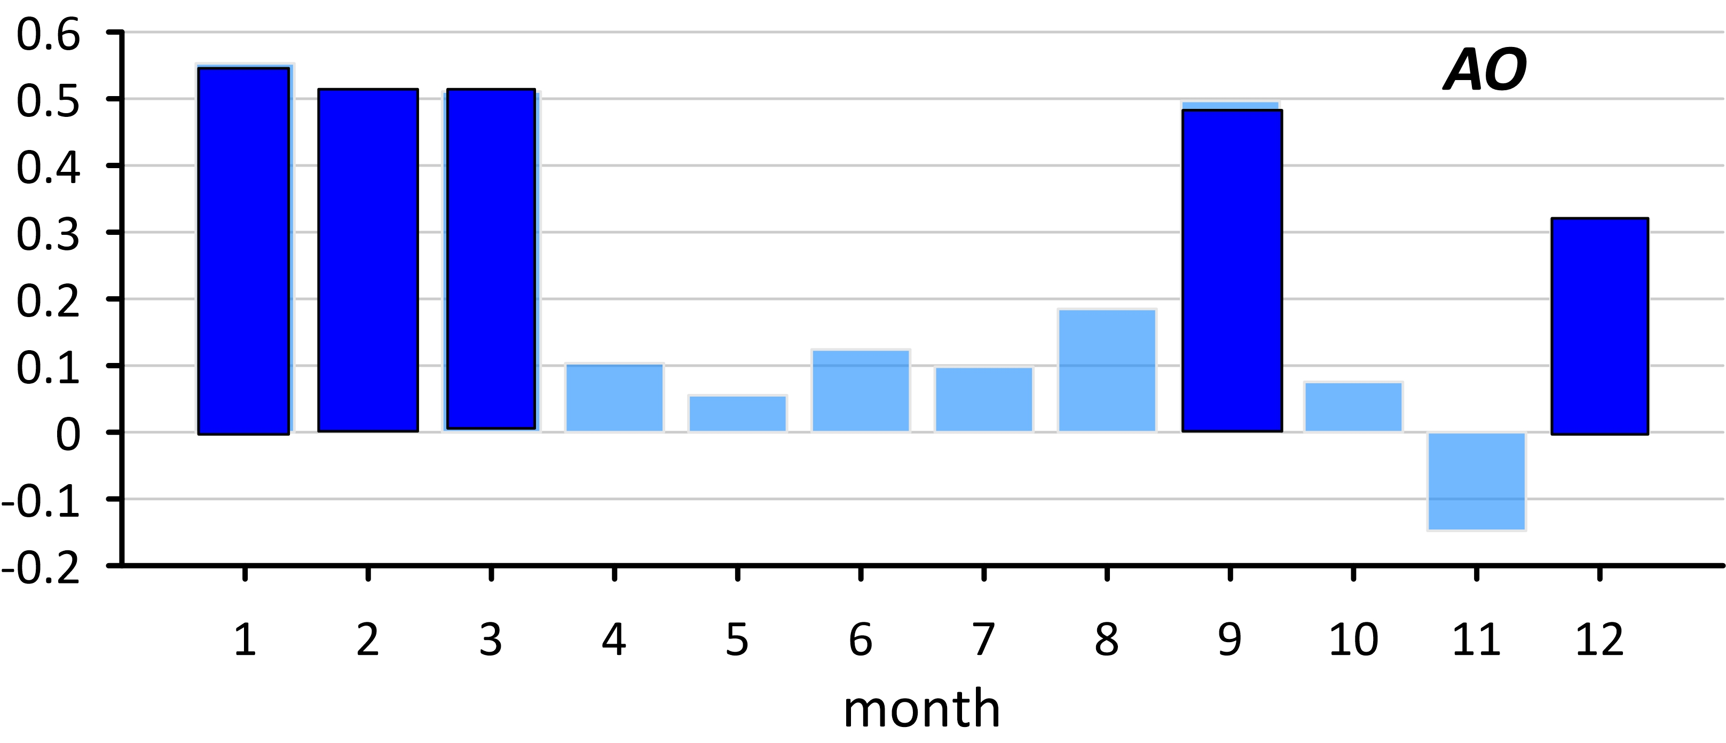
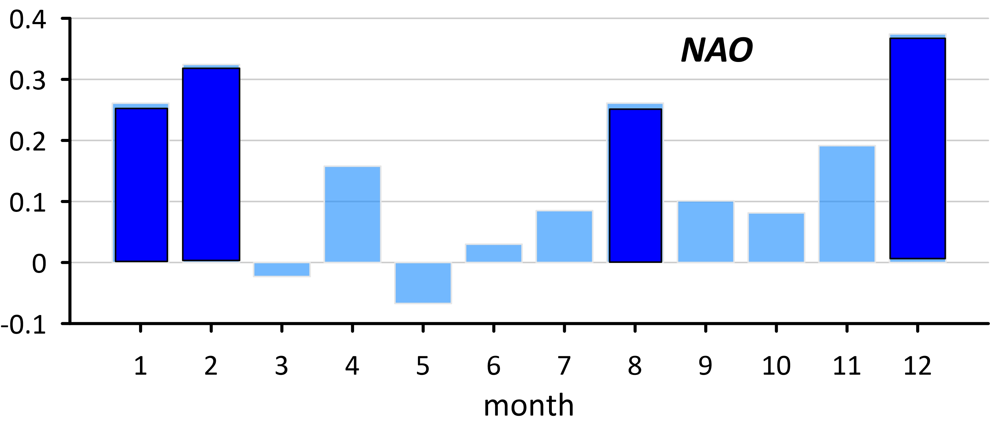
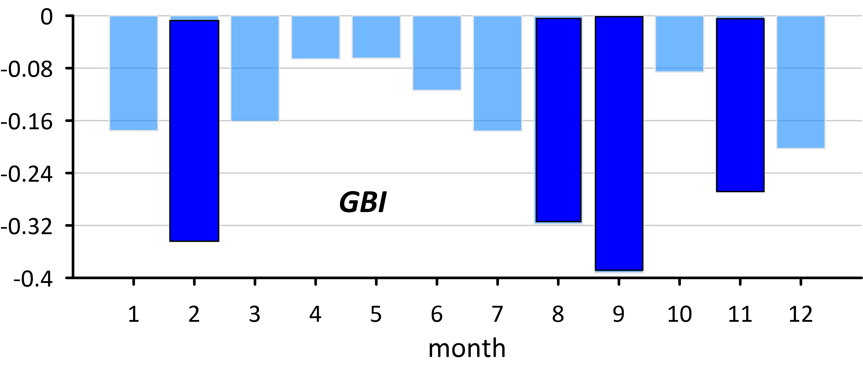
Large scale circulation indices
Correlations with warm&dry days in Poland summarized on all stations
Significant correlation are in winter and at the turn of summer and autumn, not in the season were the trend in frequency of warm&dry days is significant.

Slide 18
Temperature and precipitation trends (1951-2018)
Spring
Summer
Autumn
Winter
precipitation: E. Łupikasza, Ł. Małarzewski, 2021; temperature: Z. Ustrnul et al., 2021

Slide 19
Snow cover indices:
Snow cover duration (number of days with snow cover during the year – from 1st August to 31st July)
First day with snow cover
Last day with snow cover
Snow cover: J. Wibig, J. Jędruszkiewicz, 2023

Slide 20
SUMMARY
Warm&dry days appear during the whole year, but they are most frequent in summertime
Their frequency have increased, the strongest increase is observed in April, than in summer months. In autumn the trends are insignificant
Large scale factors are not responsible for tyrends in warm part of the year, when they are significant
Among local drivers trends in temperature, precipitation and snow cover were analysed
Precipitation trends are small, and increases alternate with decreases, however increase in spring in southwestern Poland corresponds well with the highest increase in warm&dry days in April.
Snow cover decrease and its almost complete absent in April results in increase in temperature and dry days.
Temperature has the strongest impact, directly on warm days frequency and indirectly through impact on evaporation and snow cover changes.

