Slide 1
Hourly reference evapotranspiration analysis using synoptic meteorological measurements and ERA5 reanalysis data from Kenyan Counties
Peter K. Musyimi ^{1, 2}, Abderrahmane Mendyl³, Agustiyara Agustiyara⁴, Balázs Székely^{1,4}, and Tamás Weidinger³
¹ ELTE Eötvös Loránd University, Department of Geophysics and Space Science, H-1117 Budapest Pázmány Péter stny 1/C, Hungary.
²Karatina University, Department of Humanities and Languages, P.O BOX 1957-10101, Karatina, Kenya. E-mail: pemusyimi@gmail.com ; musyimipeter@student.elte.hu
³ELTE Eötvös Loránd University, Institute of Geography and Earth Sciences, Department of Meteorology, H-1117 Budapest Pázmány Péter stny 1/A, Hungary.
⁴ELTE Eötvös Loránd University, Doctoral School of Environmental Sciences, Department of Geophysics and Space Science, Budapest, Hungary

Slide 2
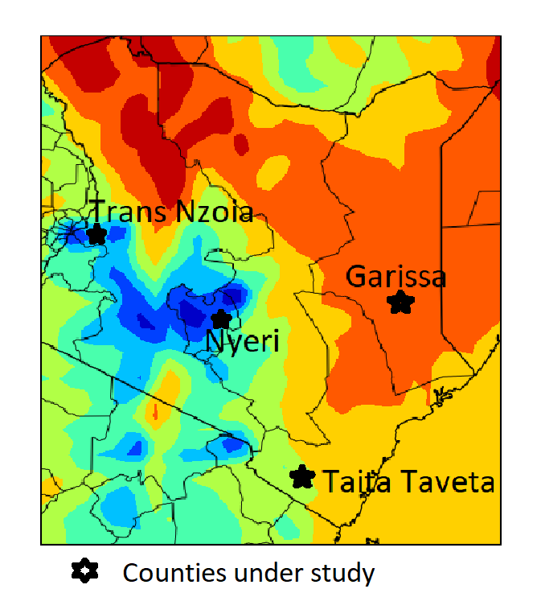
Objective
Study Area
Analyze and compare hourly reference evapotranspiration from ERA5 reanalysis data in Kenya counties of diverse climatology and compare with daily synoptic meteorological measurements
Humid Kenya Highlands
Nyeri County
falls in between Mount Kenya (5199m above sea level) and Aberdare ranges (approximately 3350 m above sea level).
Trans-Nzoia County
is mountainous and climatically characterized by humid conditions,
Highland equatorial, mild, and generally warm and temperate
Arid, And Semi-arid Savannah Tropical Conditions Regions
Garissa County
climate classification varies from a Semiarid climate (Bsh) to a hot desert climate (Bwh)
Taita-Taveta County
89 percent arid and semi-arid
experiences a bimodal rainfall characterization
Characterized by a tropical savannah climate (Aw)
Figure 1: Study area’s geographic location

Slide 3
DATA
ERA5 data
ERA5 hourly dataset from 2000 to 2022 was downloaded fromhttps://cds.climate.copernicus.eu/cdsapp#!/dataset/reanalysis-era5-single-levels?tab=form
Synoptic data
hourly(main parameters), and daily (day by day) sought Meteomanz website http://www.meteomanz.com/
Duration- from 2000 to 2022 for Garissa, Voi, Nyeri, and Kitale stations of the counties under study
The synoptic data was used to analyze daily reference evapotranspiration(ET₀) and compare results with ERA5
Meteorological variables downloaded include;
10 m u-component (zonal) of wind speed [m s⁻¹]
10 m v-component (meridional) of wind speed [m s⁻¹]
2 m dew point temperature [K]
2 m air temperature [K]
surface net solar radiation [J m⁻²]
surface net thermal radiation [J m⁻²]
atmospheric surface pressure [Pa]

Slide 4
METHODOLOGY
Wind speed of 10 m height above the land surface was converted to 2m value using a logarithmic velocity profile of short grass surface(Equation 2)
$$u_{2}=u_{z }[\frac{4.87}{\ln\left({67.8}_{z}−5.42\right)}]$$
Where; $u_{z}$ is the wind speed at z height above the surface (Equation 3). wind speed data is at (z= 10 m)
$u_{z}$=$\sqrt{u^{2}+v^{2}}$
$e_{s}$and $e_{a}$ were computed using Tetens equation( Equation 4 & 5 ) as a function of hourly air temperature($T_{a}$) and dew point temperature ($T_{dew}$) in °C after converting from Kelvin
$e_{s}$=$0.61078exp.$ ($\frac{17.27∗T_{a}}{T_{a }+237.3})$
$e_{a}=0.61078exp.(\frac{17.27∗T_{dew}}{T_{dew}+237.3}$)
$${hET}_{0,x,t}=\frac{0.408∆(R_{n}−G)+γ\frac{37}{Ta+273}u_{2}(e_{s}−e_{a})}{∆+γ(1+0.34u_{2})}$$
${ET}_{0}$ was analysed on hourly basis for each hour (t) and for grid cell point location (x) of the station.
Equation 1
where R_{n} is hourly net radiation (MJ m⁻²),
G the soil heat flux (MJ m⁻²),
γ is the psychrometric constant (kPa°C⁻¹),
∆ is slope of saturation vapour pressure curve (kPa °C⁻¹),
T_{a} is hourly air temperature (°C) after converting from ERA5 temperature in K,
e_{s} is hourly saturation vapour pressure (kPa),
e_{a} is actual hourly vapour pressure (kPa),
u₂ is the hourly wind speed (m s⁻¹) at 2 m above the surface

Slide 5
slope of saturation vapour pressure curve (∆) (Equation 6)
$$∆=\frac{4098e_{s}}{(T_{a}+237.3)^{2}}$$
Psychrometric constant ( $γ)$(Equation 7)
$γ=\frac{C_{p}∗P}{ε∗λ}$
where P is atmospheric pressure,
Cp is the air’s specific heat at constant pressure based on the ideal gas law(1.013×10⁻³ MJ kg⁻¹ per °C)
ε is the ratio of the molecular weight of water vapor to that of dry air(0.622)
λ is the latent heat of vaporization(2.45 MJ kg⁻¹)
Net radiation in MJ m⁻², $R_{n}$, is estimated from net solar radiation and net thermal radiation $R_{t} \left(Equation 8\right)$
$$R_{n}=R_{s }− R_{t}$$
$R_{t}$ is negative , therefore ${, R}_{n}=R_{s }+ R_{t}$
Soil heat flux, G is estimated for daytime and nighttime (Equation 9)
$$G=\left\{{\begin{aligned}G_{day}=0.1∗R_{n} \\ G_{night}=0.5∗R_{n}\end{aligned}}_{ }\right\}$$
G is 10 % of the net radiation (Rn) during the day and 50 % during the night
Net solar radiation (Rs) was used to define daytime and night-time periods for each day
Daily ${ET}_{0}$ was aggregated by summation to hourly timescales to obtain the daily ${ET}_{0}$.

Slide 6
Results
Houry ET0 variability and influence by climate variables

Slide 7
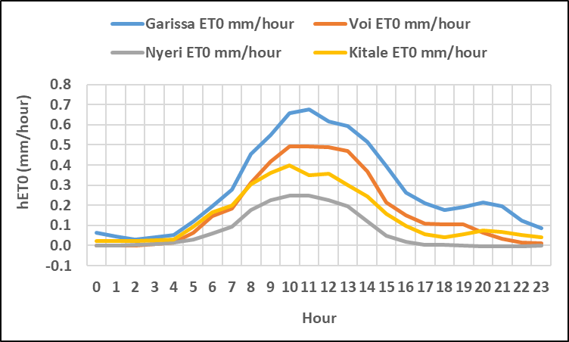
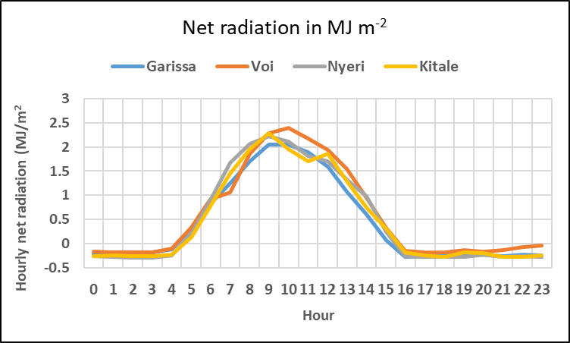
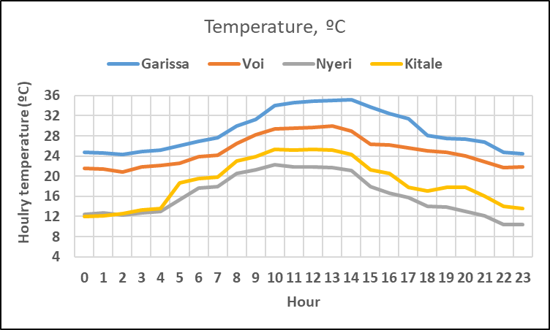
(a)
(b)
(c)
The hourly ET₀ gave a gaussian distribution shape ( Figure 2a). The same pattern was also demonstrated by temperature, net radiation and wind speed.
The highest values of hourly ET₀ occurred between 10.00 am and 1.00 pm concurring with hourly temperature and net radiation (Figure 2 b &c)
The highest values of hourly ET₀ occurred at savannah tropical, arid and semi-arid climate (Aw, Bsh and Bwh climate) i.e. Garissa and Taita Taveta counties
7

Slide 8
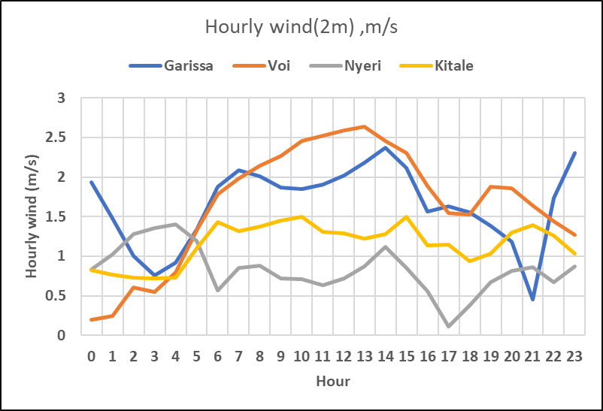
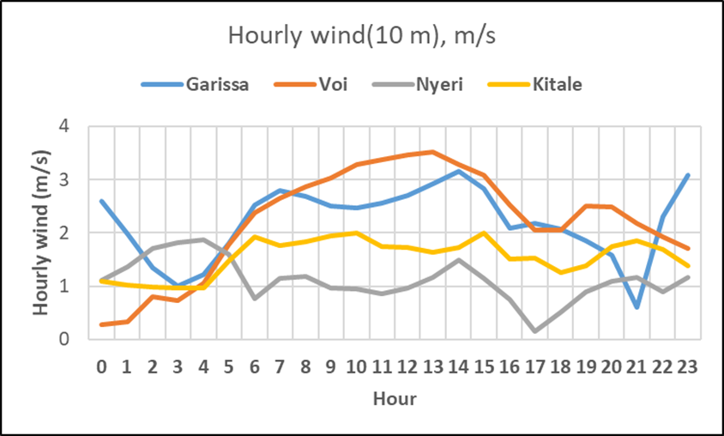
(a)
Figure 3: a) Houlry wind speed at 2 m, b) at 10 m
Wind speed at 2m and 10 m through out the day demonstrated variability with high values from 7.00 am to 3.00 pm ( Figure 3)
The highest values of hourly wind occurred for for savannah tropical, arid and semi-arid climate (Aw, Bsh and Bwh climate) i.e. Garissa and Taita Taveta counties (Figures 3 a & b)
The trends and patterns observed for ET₀ are evident, due to the reliance and dependence of evapotranspiration on the climatic variables T, Rs, u₂ and RH.
(b)
8

Slide 9
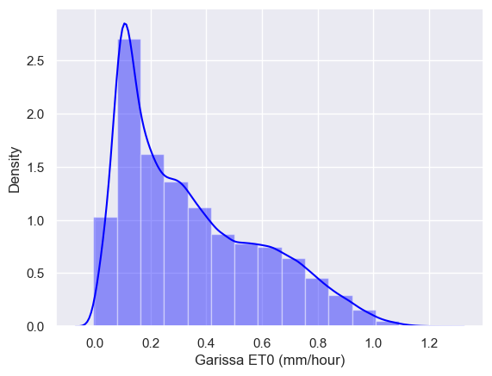
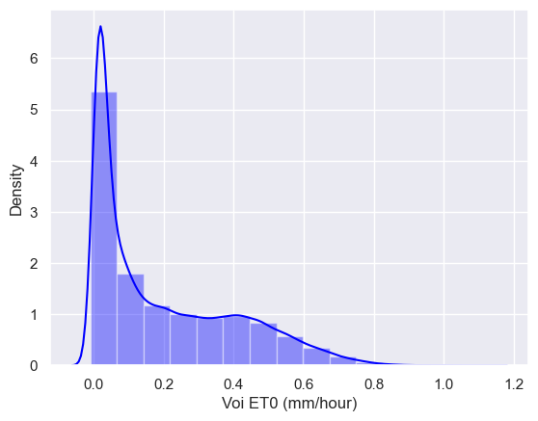
(a)
(b)
Arid, And Semi-arid Savannah Tropical Conditions Regions(Aw, Bsh and Bwh climate )
Garissa County
Mean hourly ET₀ ranged from 0.32±0.2 mm/hour in 2002 t0 0.37±0.3 mm/hour in 2017.
Standard Error of Mean(SEM) ranged from 0.002385 in 2022 to 0.002795 in 2019.
Taita-Taveta County, Voi station
Mean hourly ET₀ ranged from 0.174±0.2 mm/hour in 2020 to 0.218±0.3 mm/hour in 2022.
SEM ranged from 0.001961 in 2020 to 0.002314 in 2003.
Figure 4: a) hourly ET0 distribution in Garissa County, b) hourly ET0 distribution at Taita Taveta County, Voi station
9

Slide 10
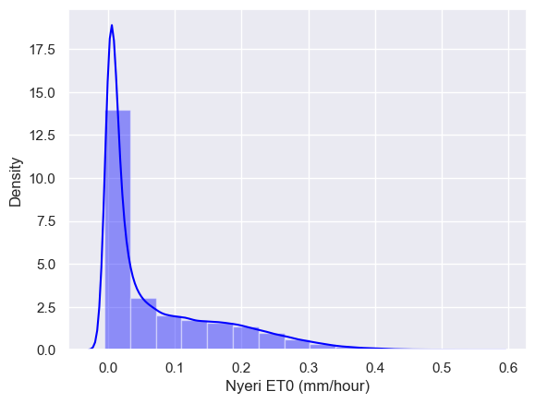
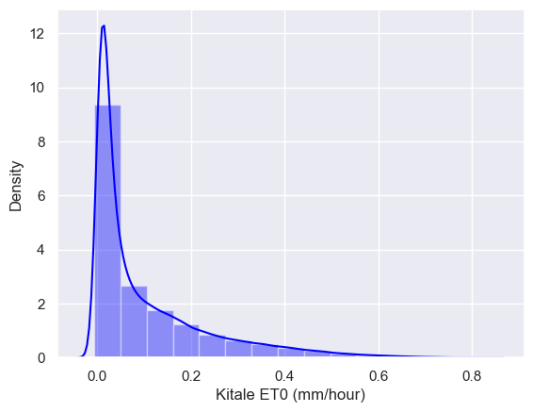
Humid Conditions Regions (Cfa, Cwa climate)
Nyeri County
Mean hourly ET₀ ranged from 0.066±0.08 mm/hour in 2020 to 0.081±0.09 mm/hour in 2000.
Standard Error of Mean(SEM) ranged from 0.0008 in 2014 to 0.001 in 2000.
Trans Nzoia County, Kitale station
Mean hourly ET₀ ranged from 0.0844±0.11 mm/hour in 2001 to 0.119±0.14 mm/hour in 2017.
SEM ranged from 0.0011 in 2020 to 0.015 in 2019.
Figure 5: a) hourly ET₀ distribution in Nyeri County, b) hourly ET₀ distribution at Trans Nzoia County, Kitale station
10

Slide 11
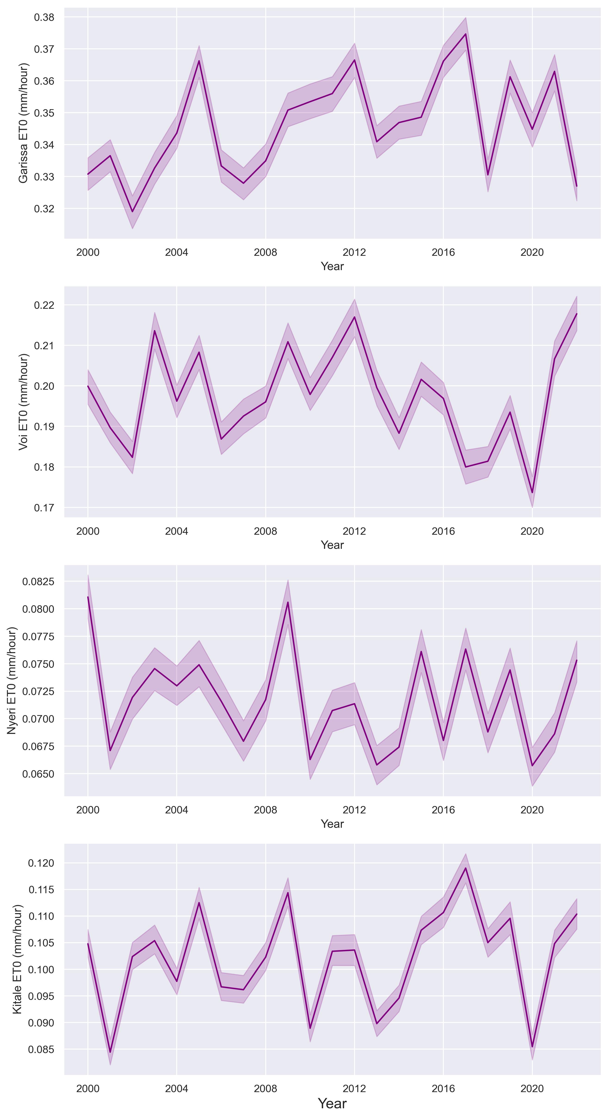
Figure 6: Hourly ET₀ trends in the four counties under study
11

Slide 12
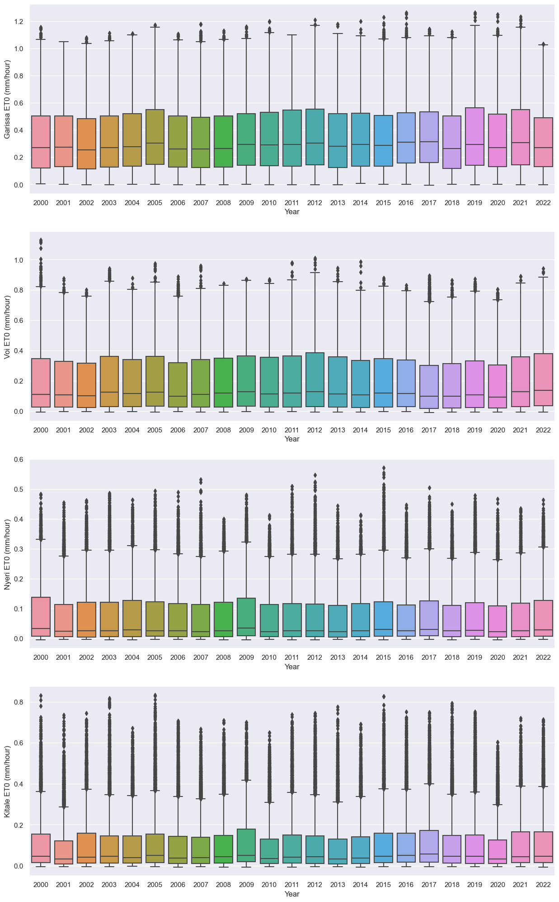
Figure 7: Hourly ET₀ range and variability among the four counties under study
12

Slide 13
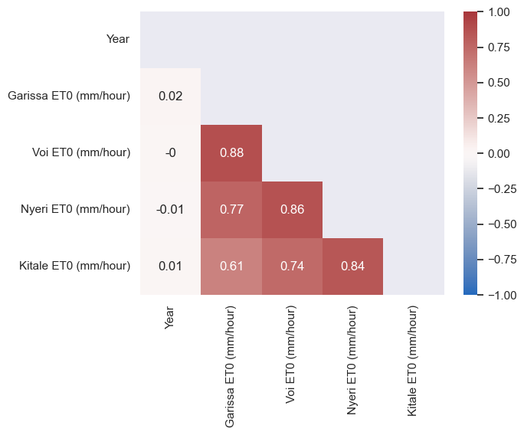
Figure 8: Correlation of Hourly ET₀ between Arid and semi arid and Humid climatic regions under study

Slide 14
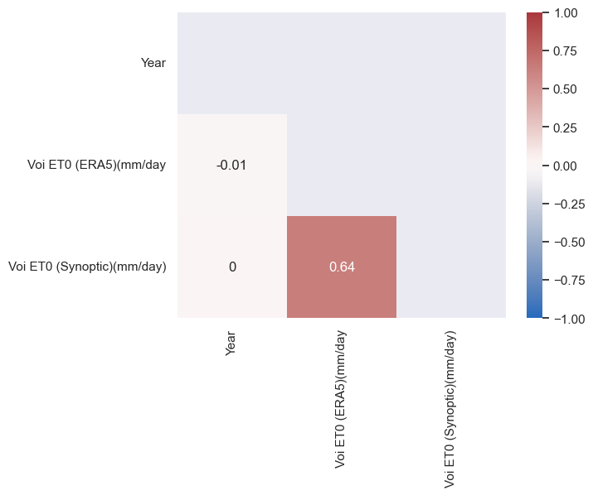
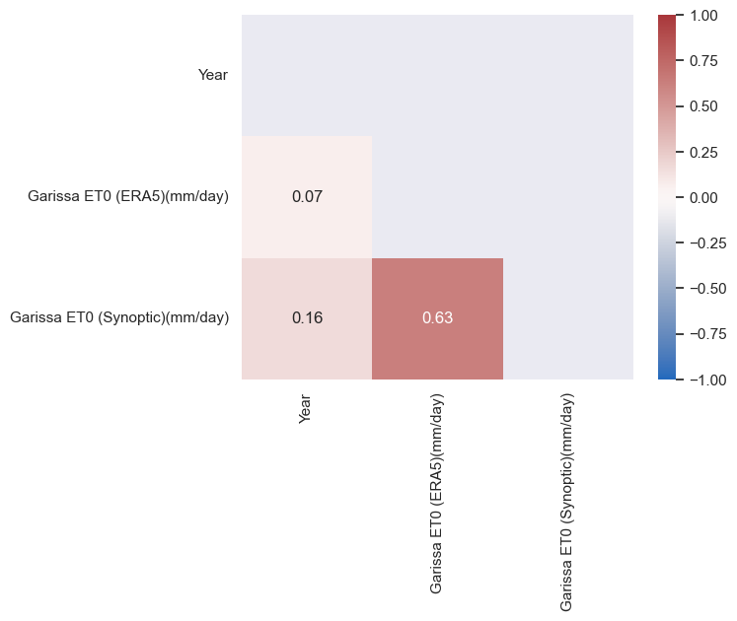
COMPARISON:
Figure 9: Correlation of daily ET₀ from ERA5 and synoptic data in Arid and Semi arid (Aw, Bsh and Bwh climate) counties of Kenya under study

Slide 15
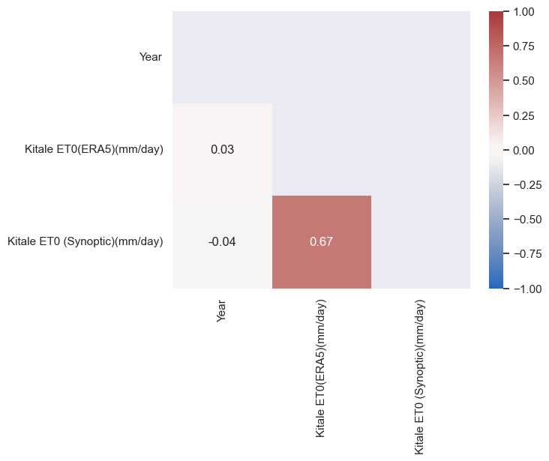
Figure 10: Correlation of daily ET₀ from ERA5 and synoptic data Humid climatic(Cfa, Cwa climate) counties of Kenya under study
15

Slide 16
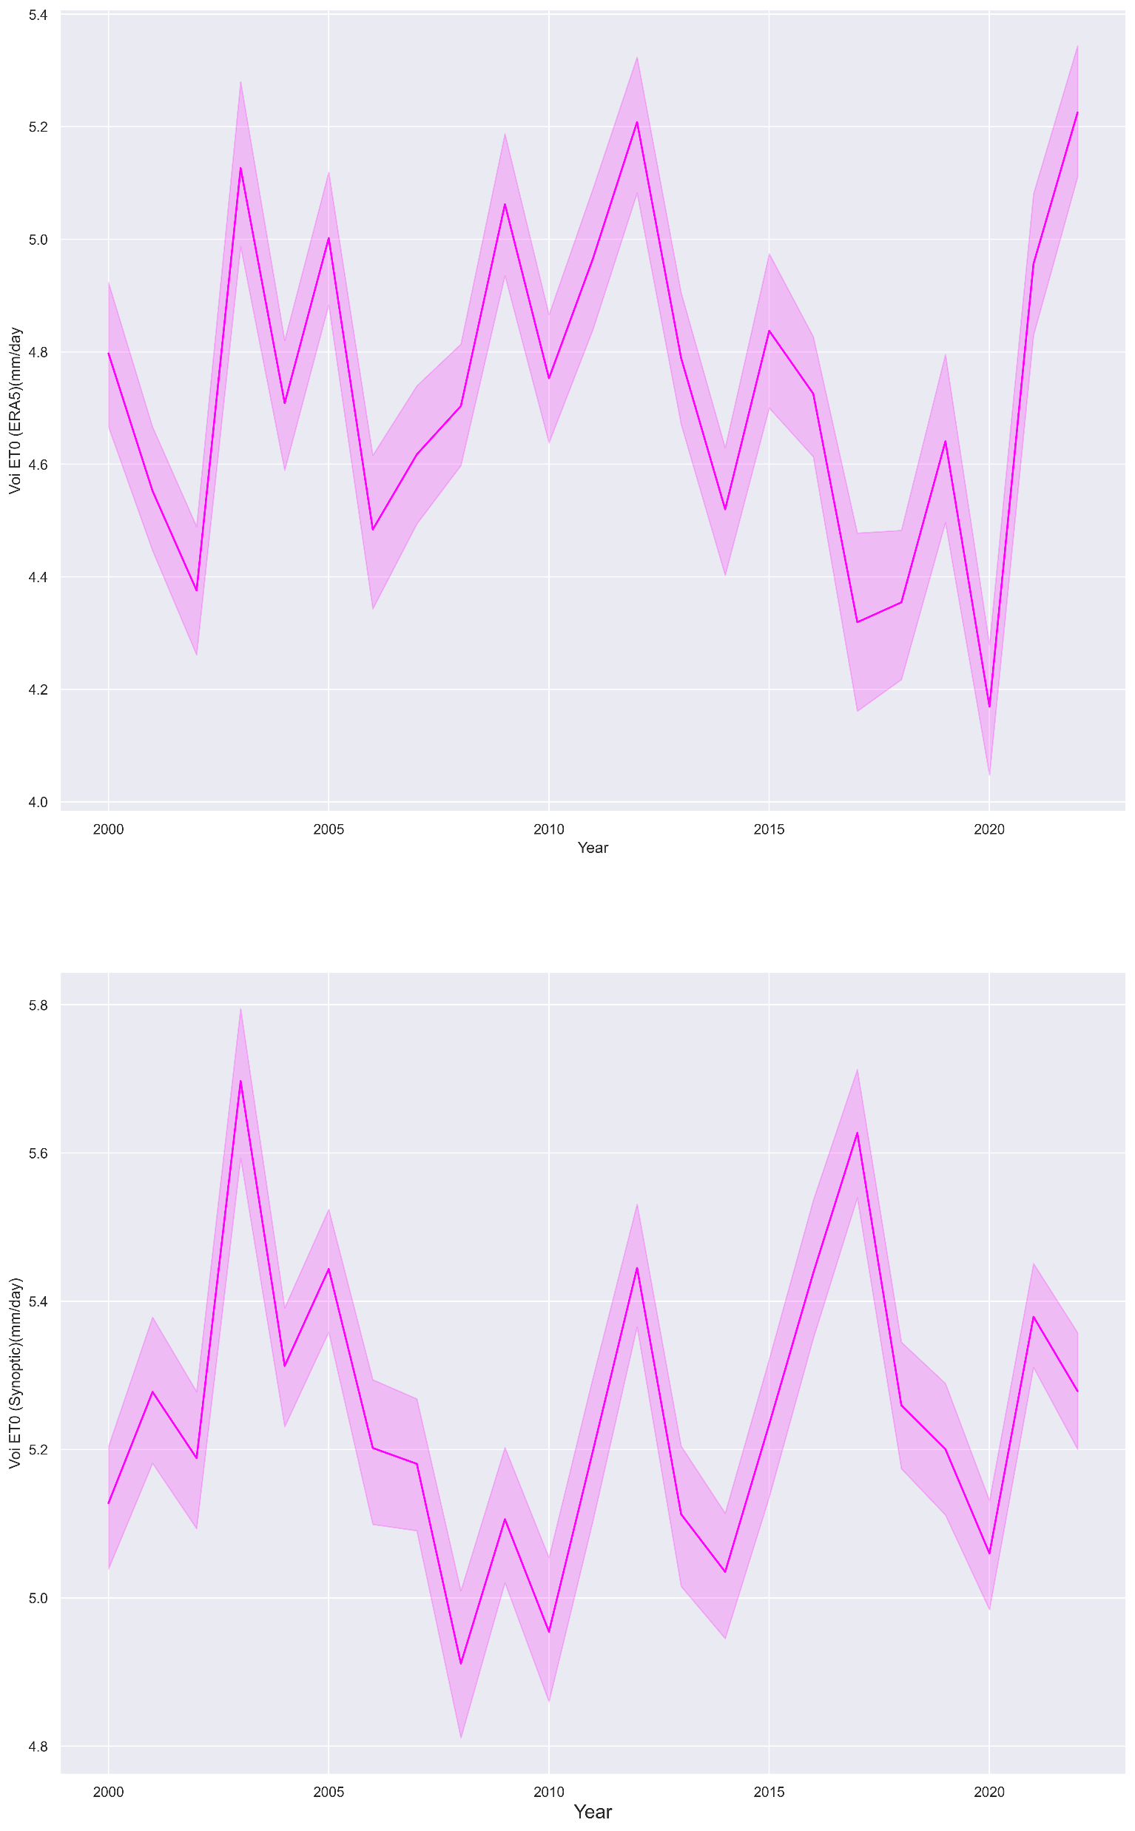
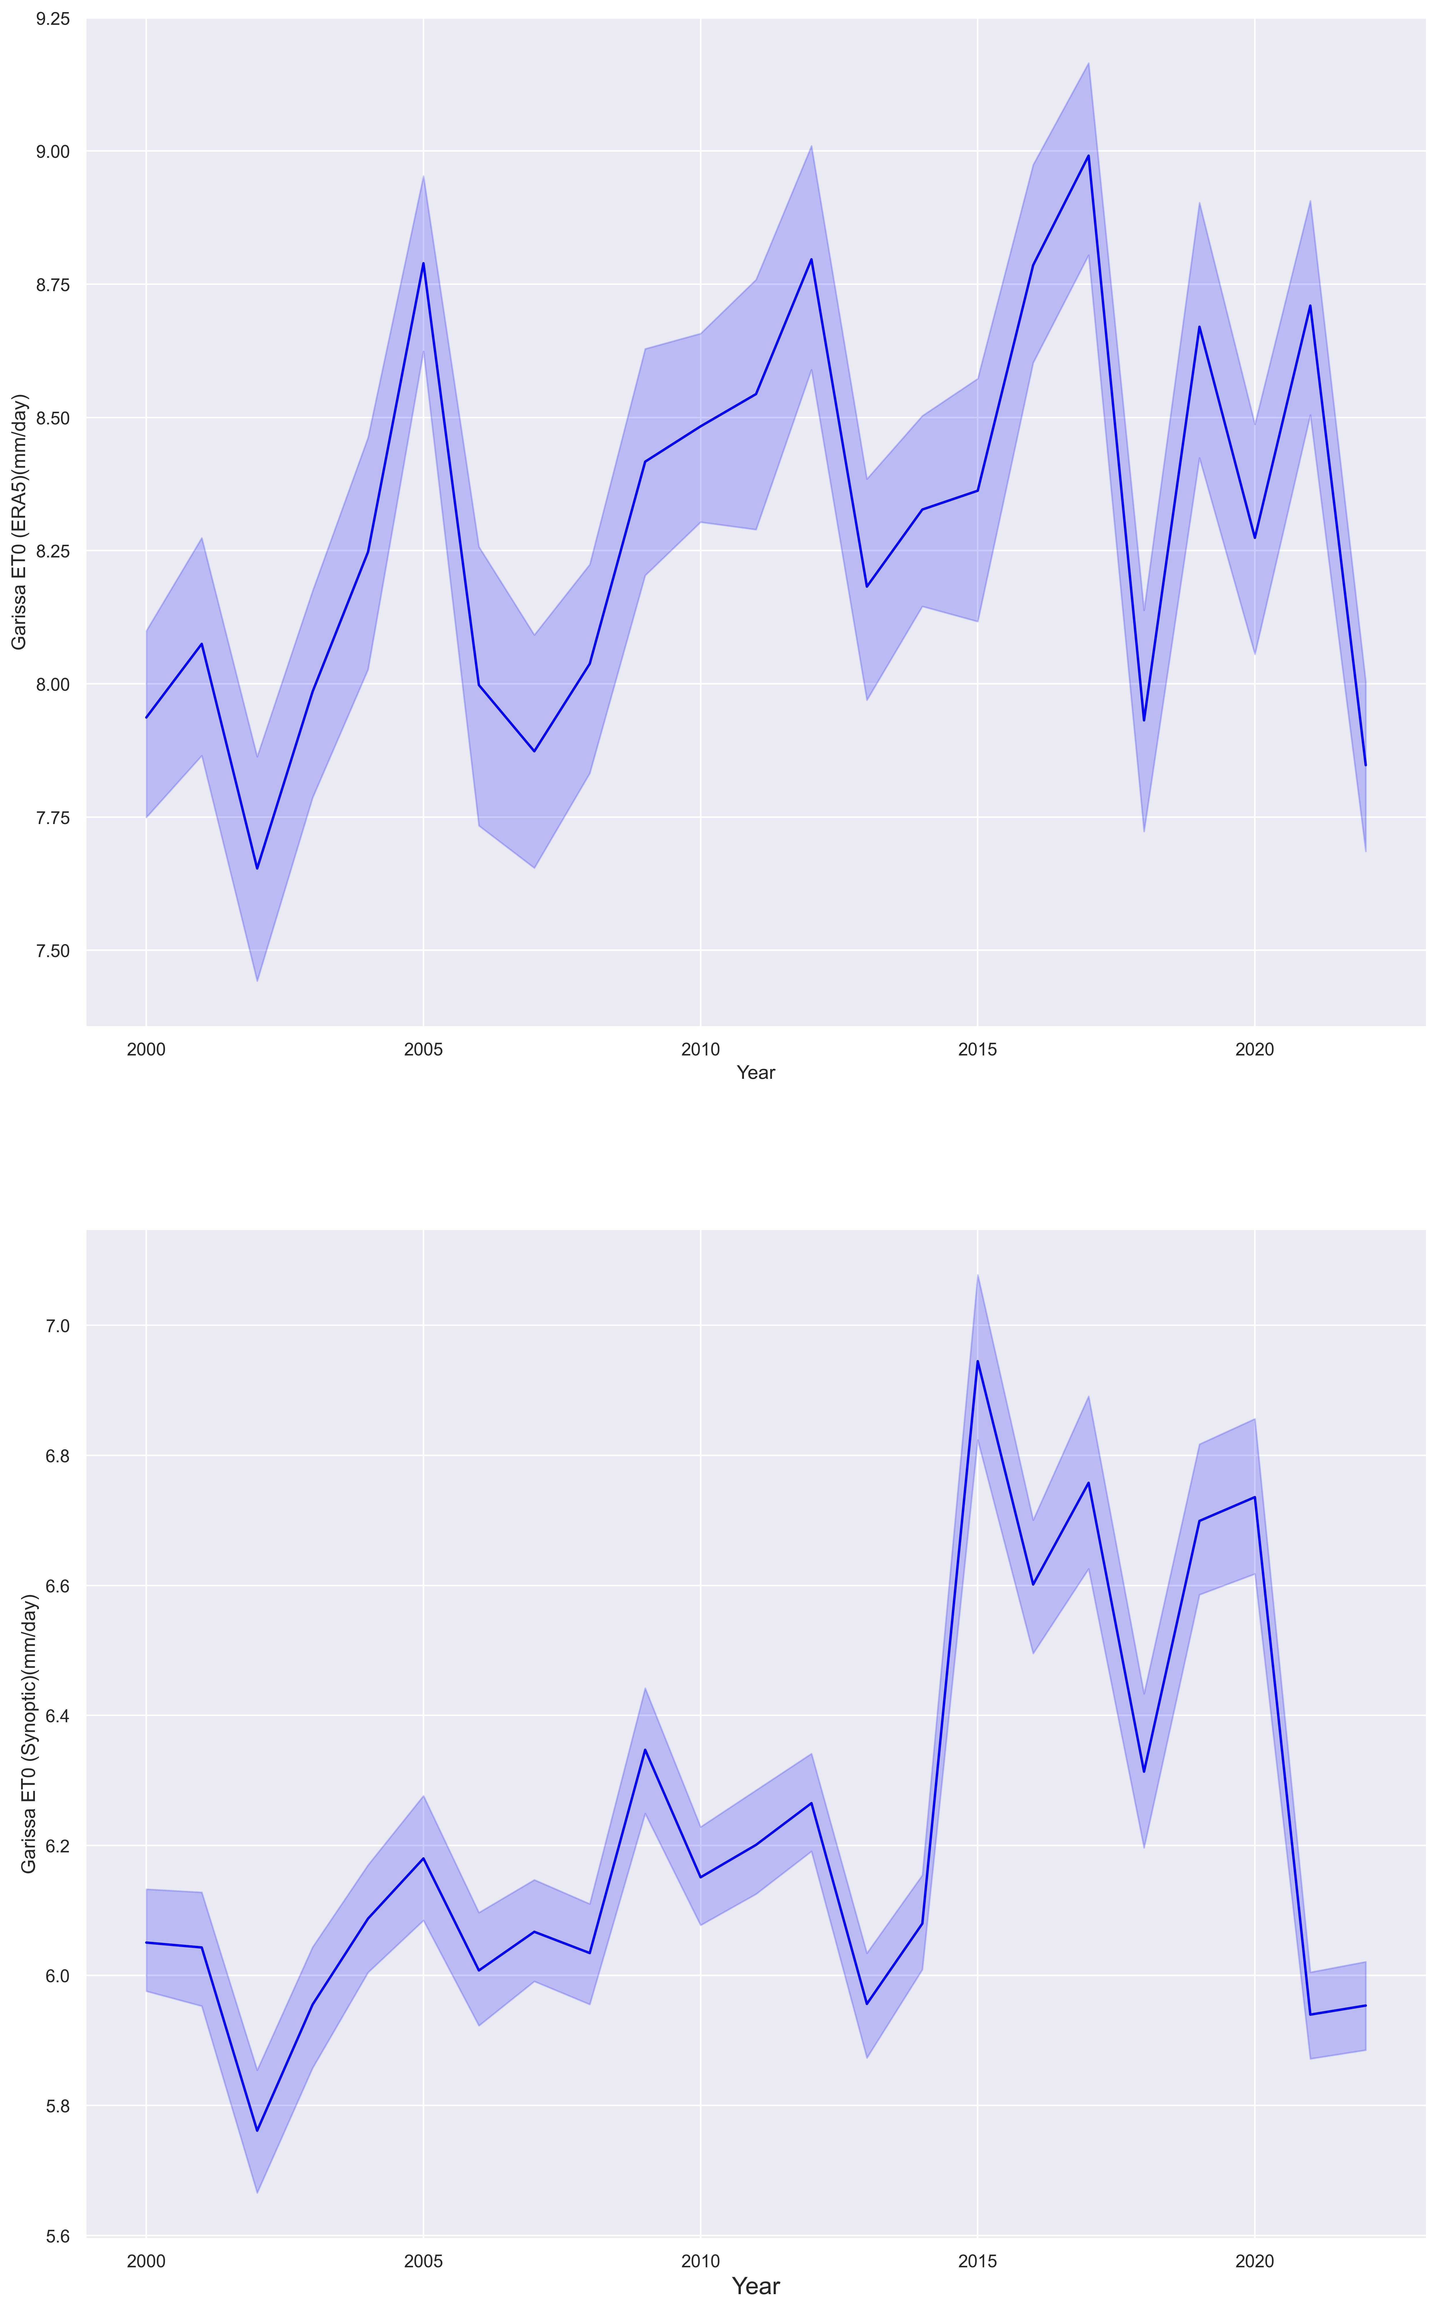
a) Voi,ERA5 daily ET₀
c) Garissa, ERA5 daily ET₀
Figure 11: Daily ET₀ trends and variability using two datasets in the ASALs counties( Aw and Bsh climates) under study
b) Voi, Synoptic daily ET₀
d) Garissa, Synoptic daily ET₀
16

Slide 17
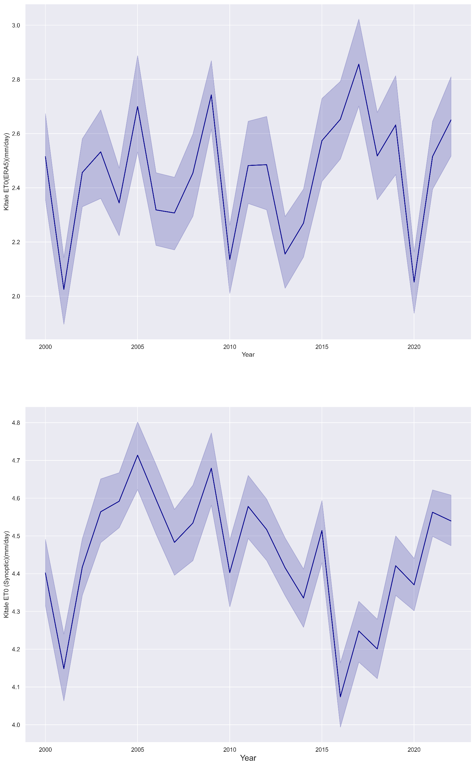
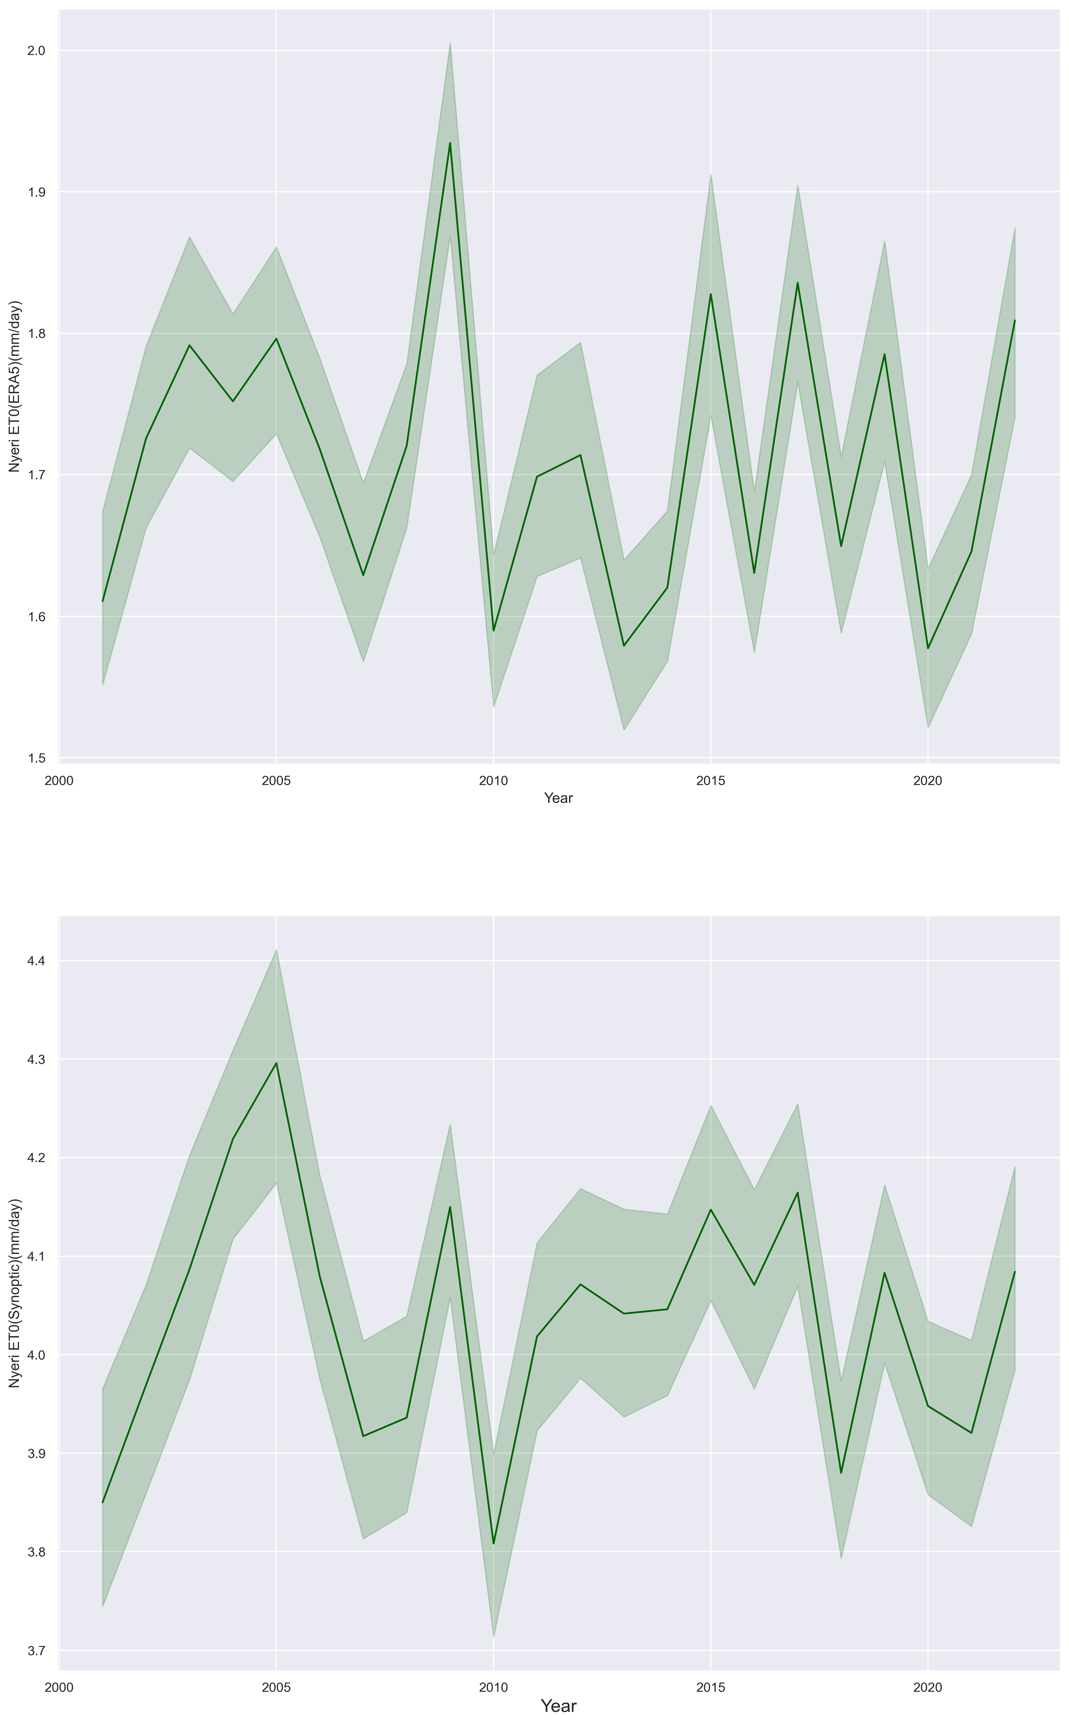
a) Kitale, ERA5 daily ET₀
d) Nyeri, ERA5 daily ET₀
Figure 12: Daily ET₀ trendsand variability using two datasets in Humid counties (Cfa, Cwa climate) under study
b) Kitale Synoptic daily ET₀
e) Nyeri, synoptic daily ET₀
17

Slide 18
IMPORTANCE
For agrometeorology and agricultural planning processes in different climatic regions of Kenya
For food security preparedness in climate change and variability regimes
Important in investigating variability and uncertainties of various datasets in analysis of ET₀ in Kenya
Understanding and monitoring water loss in hourly ET₀ periodicity is critical in determining quantity of water lost and planning irrigation mechanisms and management
CONCLUSION
The hourly ET₀ demonstrated a gaussian distribution shape with highest values between 10.00 am and 1.00 pm, and was directly influenced by temperature, solar radiation and windspeed.
The average hourly ET₀ was 0.07±0.09 in Nyeri ,0.1±0.09 in Trans Nzoia (Cfa, Cwa climate) and 0.35 ±0.2 in Garissa , 0.2±0.2 in Taita Taveta (Aw, Bsh and Bwh climate)
The pattern of hourly ET₀ concurred well with the patterns of daily ET₀
There existed a moderate correlation between hourly ET₀ from different climates( Cfa,Cwa and Aw,Bsh,Bwh) and a very strong correlation between houly ET₀ from same climates(Cfa and Cfa or Aw,and Bsh)
There existed a moderate correlation between ET₀ from synoptic data and ERA5 reanalysis data in Arid and semi arid climatic regions (0.64 in Voi, Taita-Taveta county and 0.63 in Garissa, Garissa County)
There existed a strong correlation between ET₀ from synoptic data and ERA5 reanalysis data in humid climatic regions (0.68 in Nyeri County and 0.67 in Kitale, Trans Nzoia County)
18

Slide 19
Thank You!

Slide 20
References
Allen, R.G., Pereira, L.S., Raes, D., and Smith, M., 1998: Crop evapotranspiration: FAO Irrigation and drainage paper 56. FAO - Food and Agriculture Organization, United Nations Rome, Italy. http://www.fao.org/3/X0490E/X0490E00.htm. ISBN 92-5-104219-5
Lakatos, M., Weidinger, T., Hoffmann, L., Bihari, Z., and Horváth, Á., 2020: Computation of daily Penman-Monteith reference evapotranspiration in the Carpathian Region and comparison with Thornthwaite estimates. Advances in Science and Research, 16, 251-259. https://doi.org/10.5194/asr-16-251-2020
Musyimi,P. K., Székely,B., Gandhi,A., WeidingerT. (2022). Palmer-type soil modelling for evapotranspiration in different climatic regions of Kenya. Hungarian Geographical Bulletin, 71(4), 365-382. https://doi.org/10.15201/hungeobull.71.4.4
Peel, M.C., Finlayson, B.L., and McMahon, T.A., 2007: Updated world map of the Köppen-Geiger climate classification. Hydrology and Earth System Sciences Discussions, European Geosciences Union, 11, 1633-1644. https://doi.org/10.5194/hess-11-1633-2007
Singer, M.B., Asfaw, D.T., Rosolem, R., Cuthbert, M.O., Miralles, D.G., MacLeod, D., Quichimbo, E.A. and Michaelides, K., 2021: Hourly potential evapotranspiration at 0.1 resolution for the global land surface from 1981-present. Scientific Data, 8(1), p.224. https://doi.org/10.1038/s41597-021-01003-9
Tetens, O.1930: Uber einige meteorologische Begriffe. Z. geophys 6, 297–309 (1930)
Zotarelli, L., Dukes, M. D., Romero, C. C., Migliaccio, K. W., Morgan, K. T., 2010: Step by step calculation of the Penman-Monteith evapotranspiration (FAO-56 method). Institute of Food and Agricultural Sciences. The University of Florida
20

