Slide 1



Rapid assessment template
The Value Chain Project is a joint WWRP¹ HIWeather² Flagship Project with the WWRP Societal and Economic Research Applications (SERA) Working Group
The World Meteorological Organisation (WMO) World Weather Research Program
High Impact Weather (HIWeather)

Slide 2
Contents
Introduction to the warning value chain
Rapid assessment template
Essential information
Observations
Weather forecasts
Hazard forecasts
Impact forecasts
Warning communication
Warning response
Analysis of the warning chain
Subjective scoring (could be done as a group activity)
Add key evidence for the different value chain components (e.g., copy and paste content from observations, forecast displays and warnings) and include any comments or thoughts you have on this evidence.

Slide 3
Introduction to the warning value chain
This section covers a brief introduction to the warning value chain and warning value chain questionnaire.

Slide 4
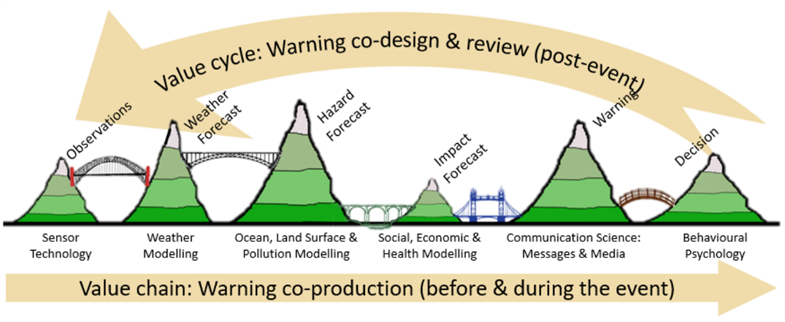
The warning value chain
This simplified view of the value chain for high impact weather warnings shows the capabilities and outputs (green "mountains“) where value is added, and information exchanges (bridges crossing the “valleys of death” where value is lost) linking the capabilities and their associated communities. From Golding (2022).

Slide 5
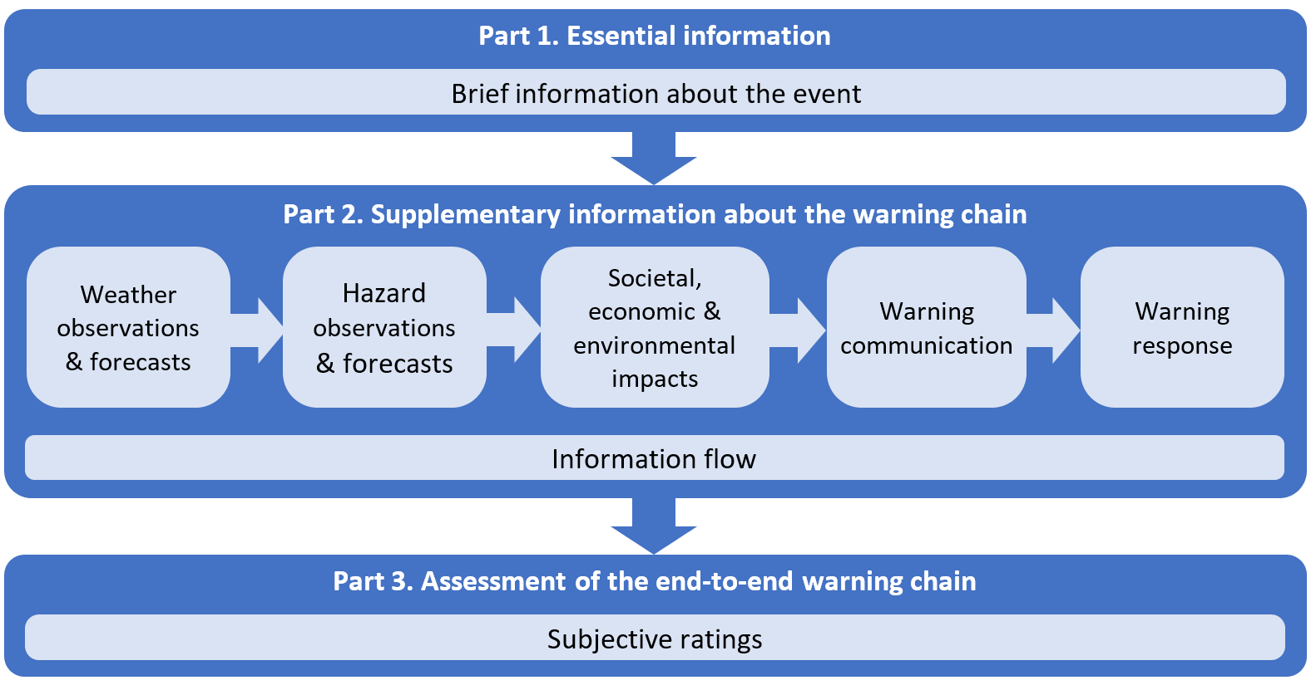
Full questionnaire
First developed by WMO/WWRP’s HIWeather Warning Value Chain Flagship Project in 2021.
Designed to help capture the end-to-end production and flow of information and decision making along the warning chain.
Completed questionnaires add to a global database of hazardous weather events.
Supports learning from past events to:
  Help understand effective practices.
  Identify improvements that would enhance future warnings.
Full questionnaires can be downloaded from Google Drive
Google doc - https://docs.google.com/document/d/1tWx9TrMols0BUPwHzBmVynJIWx31Vgo5fMLe23OCRvw/edit?usp=drive_link
MS Word (zip) - https://drive.google.com/file/d/1PGRxIRtC976lscDcbMezFV366suZ0xhB/view?usp=drive_link

Slide 6

Rapid assessment questionnaire
The rapid assessment template contained in the following slides is not designed to replace the full questionnaire template, but instead may help with:
Rapid assessments where there is not time to complete a full questionnaire.
Storing perishable and/or key information until a time comes to complete a full questionnaire.
Presenting key results from a fully completed questionnaire.

Slide 7
1. Essential information
Brief facts about the particular event:
What happened?
When?
Where?
Overview of warnings, responses and impacts

Slide 8
Essential information

Slide 9
2. Observations
For example:
Observational data used in the weather forecasts
Weather observations and analysis charts
How did the observed weather relate to climatology and/or previous extreme events
Successes/issues/challenges experienced

Slide 10
Observations

Slide 11
3. Weather forecasts
For example:
Weather forecast models used in this event
Post-processing/calibration applied to weather model output
Weather forecast outputs and examples
Interpretation/guidance for forecast users
Level of agreement between the different forecasts
How reliable and accurate were weather forecasts at different lead times?
When was the potential event first detected in the models?
Successes/issues/challenges experienced

Slide 12
Weather forecasts

Slide 13
4. Hazard forecasts
For example:
Hazard forecast outputs and examples
How reliable and accurate were the hazard forecasts
What process identified the event as hazardous and started the warning process?
Hazard observations and analyses
How was the hazard(s) made worse by pre-existing conditions?
Successes/issues/challenges experienced

Slide 14
Hazard forecasts

Slide 15
5. Impact forecasts
For example:
Impact prediction models/tools (if used)
Informal rules/tools used to predict impacts
Impact forecast outputs and examples
Who and what were exposed and vulnerable to the hazards?
Observed impacts e.g health/social, property/business, infrastructure, environmental
Comparison of predicted/expected and actual impacts
Successes/issues/challenges experienced

Slide 16
Impact forecasts

Slide 17
6. Warning communication
For example:
Brief overview of the communication “story”
What warnings were provided to emergency responders, stakeholders and the public?
Communication of warning information by other organizations including media
Warning outputs and examples, including uncertainty information
Were communication systems in place and operating effectively?
To what extent were warning messages received and understood by the public?
Communication success/issues/challenges experienced

Slide 18
Warning communication

Slide 19
7. Warning response
For example:
Overview of response to warnings by emergency services, the public, and institutions?
How did the response compare to similar previous events?
Were disaster preparedness and response plans used?
How did key decision makers and institutions interact before, during and after event?
How knowledgeable was the community about the hazard and its associated risks?
What capacity did the community have to respond to warnings?
Success/issues/challenges experienced

Slide 20
Warning response

Slide 21
8. Analysis of the warning chain
For example:
Evidence that warning chain was effective in reducing impacts
What were the strongest links (information flow) in the warning chain?
What were the weakest links (information flow) in the warning chain?
Are there any key lessons learned from this event?

Slide 22
Analysis of the warning chain

Slide 23
9. Scoring
How successful were the forecasts, warnings and responses?

Slide 24
Scoring
Scale of 1 (poor) to 5 (excellent). Score individually and then take a group average. Note any justification for your scores on the subsequent slides.
 | Person A | Person B | Person C | Person D | Person E | Average
How well do you think the event was observed?
How well do you think the weather was forecast?
How well do you think the hazards were forecast?
How well do you think the impacts were predicted?
How well do you think warnings were communicated?
How well do you think the warnings were used?
How well do you think the entire warning chain performed overall?

Slide 25
Person A score justification
 | Scores | Justification
How well do you think the event was observed?
How well do you think the weather was forecast?
How well do you think the hazards were forecast?
How well do you think the impacts were predicted?
How well do you think warnings were communicated?
How well do you think the warnings were used?
How well do you think the entire warning chain performed overall?

Slide 26
Person B score justification
 | Scores | Justification
How well do you think the event was observed?
How well do you think the weather was forecast?
How well do you think the hazards were forecast?
How well do you think the impacts were predicted?
How well do you think warnings were communicated?
How well do you think the warnings were used?
How well do you think the entire warning chain performed overall?

Slide 27
Person C score justification
 | Scores | Justification
How well do you think the event was observed?
How well do you think the weather was forecast?
How well do you think the hazards were forecast?
How well do you think the impacts were predicted?
How well do you think warnings were communicated?
How well do you think the warnings were used?
How well do you think the entire warning chain performed overall?

Slide 28
Person D score justification
 | Scores | Justification
How well do you think the event was observed?
How well do you think the weather was forecast?
How well do you think the hazards were forecast?
How well do you think the impacts were predicted?
How well do you think warnings were communicated?
How well do you think the warnings were used?
How well do you think the entire warning chain performed overall?

Slide 29
Person E score justification
 | Scores | Justification
How well do you think the event was observed?
How well do you think the weather was forecast?
How well do you think the hazards were forecast?
How well do you think the impacts were predicted?
How well do you think warnings were communicated?
How well do you think the warnings were used?
How well do you think the entire warning chain performed overall?

Slide 30
Scoring summary

Slide 31
Key notes / recommendations

Slide 32
More information
HIWeather warning value chain project website (June 2023)
Full warning value chain questionnaire (July 2023)
Golding (2022) Towards the “Perfect” Weather Warning: Bridging Disciplinary Gaps through Partnership and Communication. Available from https://link.springer.com/book/10.1007/978-3-030-98989-7.
Hoffmann, D., E.E. Ebert, C. Mooney, B. Golding and S. Potter (2023) Using value chain approaches to evaluate the end-to-end warning chain. Adv. Sci. Res., 20, 73–79, https://doi.org/10.5194/asr-20-73-2023.
WMO WWRP website (July 2023)
Email: valuechain@bom.gov.au

