Slide 1











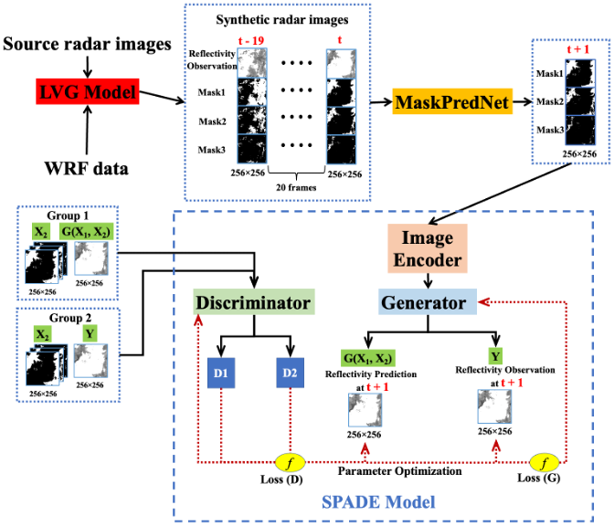
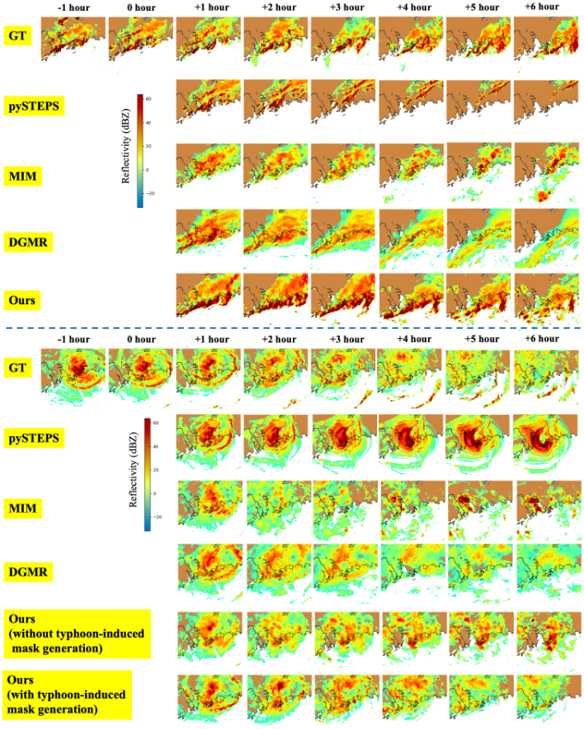
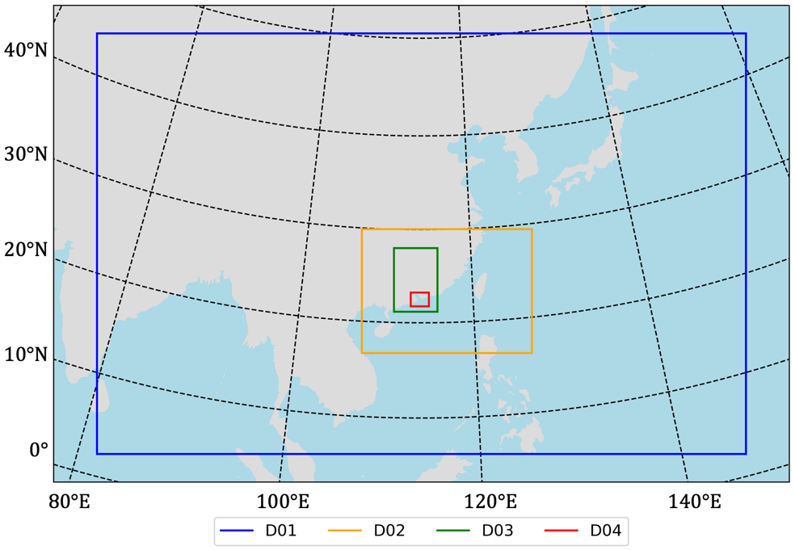
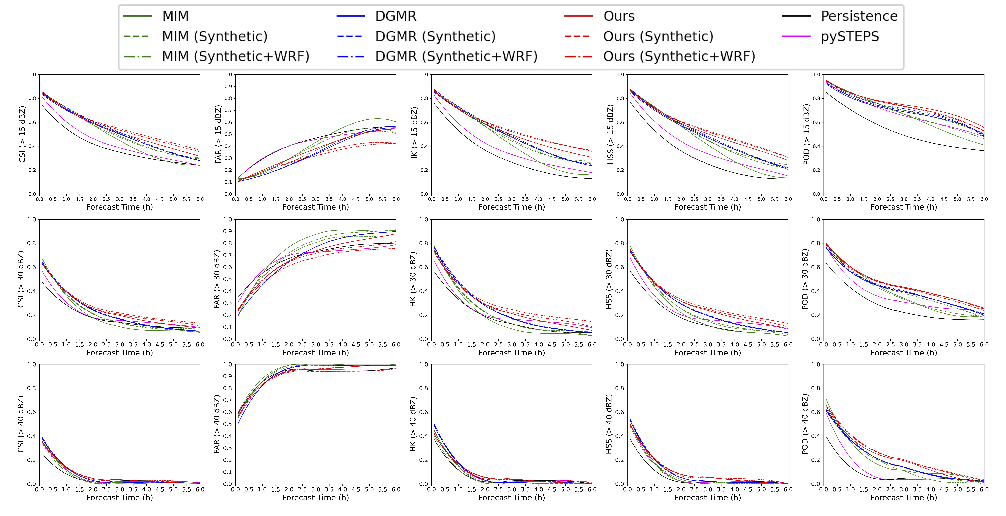
Project No.: AOE/E-603/18
Physical-dynamic-driven AI-Synthetic Precipitation Nowcasting using Task-segmented Generative Model
PhD Student: Rui Wang | Supervisor : Prof. Jimmy Fung & Prof. Alexis Lau
1. Background
Accurate and timely rainfall nowcasting is important for protecting the public from heavy rainfall-induced disasters. In recent years, deep-learning models have been demonstrated to significantly outperform traditional methods in heavy rainfall nowcasting. However, the performance of existing deep-learning-based nowcasting models is still limited by short effective prediction time (< 3 hours) and the rapid growth of blurriness increases in forecast time.
3. Main highlights
Innovative Physical-dynamic-based AI-Synthetic Task-segmented Architecture
The STGM encompasses three key components: the Long Video Generation (LVG) model generating synthetic radar data from observed radar images and data provided by the Weather Research and Forecasting (WRF) model, MaskPredNet predicting the spatial coverage of various rainfall intensities, and SPADE determining rainfall intensity based on the coverage provided by MaskPredNet. (Fig. 3)
2. Skillful 6-hour rainfall nowcasting
We present the Synthetic-data Task-segmented Generative Model (STGM), an innovative physical-dynamic-driven heavy rainfall nowcasting model. The STGM can produce a high spatiotemporal resolution skillful forecast for heavy rainfall events over coastal South China for up to 6 hours. (Fig. 1 and 2)
Fig. 3 Architecture of our approach
Physical-Dynamic-Driven Mechanism
We employ the Advanced Research WRF (ARW) model with four nested domains. Meteorological variables are extracted from the third domain of the WRF output dataset, including zonal wind, meridional wind, temperature, Qvapor, and relative humidity extracted at 850 hPa pressure level. (Fig. 4)
Fig. 1 6-hour precipitation nowcasting comparison by our model, DGMR, MIM, and pySTEPS. on non-typhoon (Up) and typhoon (Bottom) rainfall events. GT refers to ground truth.
Fig. 4 WRF data domain configuration.
Fig. 2 6-hour precipitation nowcasting of mean skill scores at different reflectivity thresholds on 20 precipitation events by our model, DGMR, MIM, pySTEPS, and Persistence model.
Submitted paper:
Wang, R., J.C.H.* & Lau, A.K.H (2023). Physical-dynamic-driven AI-Synthetic Precipitation Nowcasting using Task-segmented Generative Model. Geophysical Research Letters, under revision.

