Slide 1


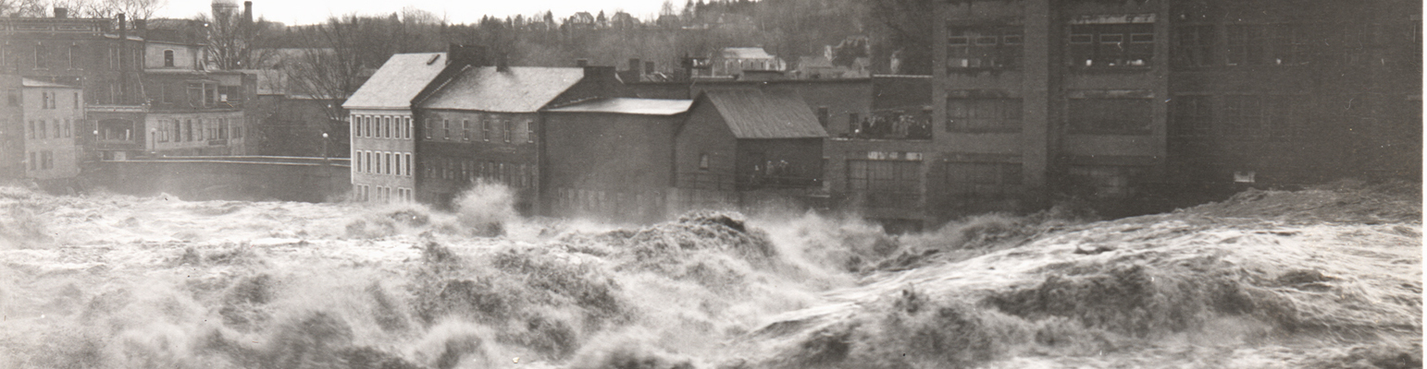

The EMS Annual Meeting
Bratislava, Slovakia & Online, 3–8 September 2023
Documentary evidence of past floods in Poland in the 11th–15th centuries
Babak Ghazi ª, Rajmund Przybylak ^{a, c}, Piotr Oliński ^{b, c}, Katarzyna Bogdańska ^{b}, Aleksandra Pospieszyńska ^{a, c}
ª Department of Meteorology and Climatology, Faculty of Earth Sciences and Spatial Management, Nicolaus Copernicus University, Toruń, Poland
^{b} Department of Medieval History and Auxiliary Sciences of History, Faculty of Historical Sciences, Nicolaus Copernicus University, Toruń, Poland
^{c} Centre for Climate Change Research, Nicolaus Copernicus University, Toruń, Poland
Babak.ghazi@doktorant.umk.pl
License: Creative Commons
The work was supported by the National Science Centre, Poland project No. 2020/37/B/ST10/00710.

Slide 2

Documentary evidence of past floods in Poland in the 11th–15th centuries
Babak Ghazi
Overview
Motivation
Climate change impacts on extreme events
Catastrophic social and economic effects of floods
Fill the knowledge gap for historical floods before the 16th century

Slide 3
Documentary evidence of past floods in Poland in the 11th–15th centuries
Babak Ghazi
How?
Historical and documentary evidence:
Documentary evidence are reliable sources
Covering a long time span
Provide comprehensive and detailed information regarding changes in the frequencies and intensities of flood events.
Objectives
There is a clear knowledge gap in flood studies based on the documentary evidence prior to the 16th century.
Therefore, the main aim of the present paper is to improve the existing knowledge about floods in medieval Poland based on documentary evidence.

Slide 4
Documentary evidence of past floods in Poland in the 11th–15th centuries
Babak Ghazi
Study area
Baltic Coast and Pomerania,
Masuria-Podlasie,
Greater Poland,
Masovia,
Silesia,
Lesser Poland
Poland*

Slide 5
Documentary evidence of past floods in Poland in the 11th–15th centuries
Babak Ghazi
Method

Slide 6
Documentary evidence of past floods in Poland in the 11th–15th centuries
Babak Ghazi
Classifications
Classification of floods based on intensity (source: Sturm et al., 2001; modified by Brázdil et al., 2006)
Index | Index classification | Description
0 | flood | no additional reports
1 | smaller, regional flood | little damage, e.g. riverside fields and gardens, wood supplies; short duration
2 | above-average, or supra-regional flood | damage to water-related buildings and structures; average duration; severe damage to riverside fields and gardens; loss of animals, and sometimes human lives
3 | above-average, or supra-regional flood on a disastrous scale | severe damage to water-related buildings and structures; some buildings completely destroyed or washed away; longer duration (days or weeks); severe damage to riverside fields and gardens; extensive loss of animals and human lives

Slide 7
Documentary evidence of past floods in Poland in the 11th–15th centuries
Babak Ghazi
Classification of floods based on intensity (Barriendos & Coeur, 2004)
Index | Index classification | Description
0 | ordinary | in-bank flow; no damage; water discharge may increase but without overflowing
1 | extraordinary | overflowing of river bed; damage but no destruction.; flood without destruction
2 | catastrophic | overflowing of river bed; destruction of permanent infrastructure; flood with general damage and destruction.
Classification of floods based on origin (Lambor, 1954, modified)
Index | Description
1 (1a, 1b, 1c) | Rain 1a – torrential, 1b – frontal, 1c – long-lasting, territorially widespread
2 | snowmelt
3 | storm
4 (4a, 4b) | Winter 4a – ice jam, 4b – shuga
5 | Anthropogenic

Slide 8
Documentary evidence of past floods in Poland in the 11th–15th centuries
Babak Ghazi
Results
Numbers of floods in 20-year periods in Poland from 1001 to 1500

Slide 9
Documentary evidence of past floods in Poland in the 11th–15th centuries
Babak Ghazi
Number of floods in various geographical regions of Poland during 11th–15th centuries

Slide 10
Documentary evidence of past floods in Poland in the 11th–15th centuries
Babak Ghazi
Total number of different categories of flood intensities in Poland in the period 1001–1500 based on classifications of (a) Brázdil et al. (2006) and (b) Barriendos and Coeur (204); and (c) categories of origin of floods based on Lambor (1954). Key: N/A means information is not available.

Slide 11
Documentary evidence of past floods in Poland in the 11th–15th centuries
Babak Ghazi
Comparison of extreme floods in Poland, Germany and Czech Republic, 11th–15th centuries
Century | Poland (current research) | Poland* | Germany* | Czech Republic*
11th |  | 1097
12th |  | 1118 |  | 1118, 1141
13th | 1219, 1253, 1270 | 1221, 1235, 1253, 1270, 1299 |  | 1257, 1272, 1273, 1281
14th | 1304, 1310, 1316, 1320, 1337, 1351, 1370, 1372, 1374, 1376, 1385, 1387, 1388, 1393, 1396 | 1310, 1342, 1347, 1368 | 1315, 1316, 1342 | 1315, 1316, 1321, 1342, 1359, 1364, 1367, 1370, 1373, 1374, 1387, 1392
15th | 1403, 1405, 1410, 1415, 1426, 1427, 1428, 1432, 1433, 1434, 1445, 1449, 1450, 1456, 1460, 1462, 1464, 1465, 1466, 1467, 1468, 1470, 1475, 1476, 1477, 1488, 1491, 1493, 1496, 1497, 1500 | 1404, 1414, 1438, 1451, 1456, 1459, 1468, 1475, 1493, 1500 | 1434, 1496 | 1432, 1445, 1481
*Normal font for flood category 3 (Above-average, or supra-regional flood on a disastrous scale) based on Brázdil et al. (2006) classification; Italic font for flood category 2 (catastrophic) based on Barriendos and Coeur (2004) classification; and bold font for years that are common to both of classifications.
*Poland (Kowalewski, 2006), Germany (Mudelsee et al., 2003), Czech Republic (Elleder, 2015)

Slide 12
Documentary evidence of past floods in Poland in the 11th–15th centuries
Babak Ghazi
Comparison of flood occurrences in Poland and some Central European countries, 11th–15th centuries
Century | Current research (Poland) | Mudelsee et al. (2003) (Germany) Elbe | Brázdil et al. (2005) (Czech Republic) Vltava, Ohře, Elbe | Kiss (2019) (Hungary)
11th | 1097(2) | 1059 |  | 1051
12th | 1118(2), 1125(2), 1151, 1152, 1179 | 1118, 1141, 1163 | 1118, 1118, 1121/22, 1126, 1126, 1141 | 1147, 1154
13th | 1219 (2), 1220 (2), 1221 (2), 1235 (2), 1253 (2), 1269, 1270 (2), 1281 (2) | 1275 | 1250, 1257, 1257, 1264, 1264, 1270, 1272, 1273, 1281 | 1229, 1235, 1245, 1260, 1267, 1268 (2), 1270, 1285, 1294, 1296, 1300

Slide 13
Documentary evidence of past floods in Poland in the 11th–15th centuries
Babak Ghazi
Comparison of flood occurrences in Poland and some Central European countries, 11th–15th centuries
Century | Current research (Poland) | Mudelsee et al. (2003) (Germany) Elbe | Brázdil et al. (2005) (Czech Republic) Vltava, Ohře, Elbe | Kiss (2019) (Hungary)
14th | 1304, 1310 (2), 1312 (2), 1316 (2), 1320, 1328, 1333?, 1337, 1342?, 1347, 1349?, 1350, 1351, 1359, 1360, 1366, 1367, 1368, 1370, 1371, 1372, 1374, 1376, 1379, 1381, 1385, 1387 (2), 1388 (3), 1393?, 1394, 1395, 1396, 1398, 1400, | 1306, 1315, 1316, 1342 (2), 1343, 1367, 1400 | 1315, 1315, 1316, 1316, 1321, 1321, 1327, 1342, 1342, 1359, 1359, 1359, 1364, 1367, 1367, 1370, 1370, 1373, 1374, 1374, 1387, 1392, 1392 | 1316, 1325, 1328, 1334, 1333(2), 1335 (2), 1338 (2), 1341 (2), 1342 (3), 1343 (3), 1344 (2), 1345, 1346, 1347, 1348, 1349 (2), 1355, 1357 (2), 1358, 1359, 1362, 1363, 1364, 1366 (2), 1367 (2), 1372, 1373, 1374, 1377 (2), 1378, 1382, 1383, 1389, 1393, 1396 (3), 1399 (3), 1400

Slide 14
Documentary evidence of past floods in Poland in the 11th–15th centuries
Babak Ghazi
Comparison of flood occurrences in Poland and some Central European countries, 11th–15th centuries
Century | Current research | (Germany) | (Czech Republic) | (Hungary)
15th | 1403 (2), 1404, 1405, 1407, 1408, 1409, 1410, 1412, 1413, 1414,1415 (2), 1416, 1417, 1421, 1426, 1427(3), 1428 (2), 1430 (2), 1432, 1433, 1434 (2), 1437, 1440 (2), 1441, 1444, 1445, 1446, 1449, 1450, 1451 (3), 1452 (2), 1453, 1454 (2), 1455, 1456 (4), 1457, 1458, 1459, 1460, 1461?, 1462 (2), 1463, 1464 (2), 1465 (2), 1466 (2), 1467 (3), 1468 (3), 1469, 1470 (2), 1472 (3), 1473, 1474 (2), 1475 (2), 1476, 1477 (2), 1479, 1480, 1481, 1482, 1486, 1488, 1491 (2), 1493 (2), 1495 (2), 1496 (2), 1497 (2), 1500 (2) | 1404, 1413, 1422, 1428 (2), 1431, 1432 (2), 1433 (2), 1434, 1435, 1437, 1443, 1445, 1446, 1449, 1451, 1457, 1480, 1481, 1488, 1491, 1493, 1495, 1496, 1497, 1498 (2) | 1405, 1405, 1432 (3), 1432, 1432 (2), 1433, 1433, 1434, 1434, 1437, 1445, 1445, 1454, 1457, 1459, 1461, 1464, 1464, 1464, 1481, 1491, 1491, 1496, 1496 | 1400, 1402 (3), 1405, 1406, 1408, 1409, 1410, 1411, 1412, 1413 (2), 1414, 1416, 1417, 1419, 1421 (2), 1422 (2), 1423, 1424 (3), 1426 (2), 1432 (2), 1433, 1434, 1435, 1436 (2), 1437 (2), 1439 (2), 1440 (2), 1442, 1443 (2), 1444 (2), 1445, 1446, 1447, 1454 (3), 1458 (2), 1465, 1466 (2), 1468, 1469 (2), 1472, 1476, 1478 (2), 1480 (2), 1481, 1482, 1484, 1485 (2), 1486, 1487, 1488, 1489, 1490, 1491 (2), 1493 (2), 1495 (2), 1496 (2), 1498, 1499 (3), 1500

Slide 15
Documentary evidence of past floods in Poland in the 11th–15th centuries
Babak Ghazi
Number of floods in Poland, Germany, Czech Republic and Hungary, 1001–1500

Slide 16
Documentary evidence of past floods in Poland in the 11th–15th centuries
Babak Ghazi
Conclusions
The main results of the present paper can be summarized as follows:
A total of 166 floods were recorded in the study period. The greatest number (102, i.e. 61.4%) was noted in the 15th century, and the second greatest in the 14th century (40, 24.1%)
Floods were registered most often for the Vistula River basin (84 cases). Significantly fewer floods (69) were observed in the Oder River basin.
The most 11th–15th-century floods occurred in the Baltic Coast and Pomerania (57, 34.3%) and in Silesia (55, 33.1%).

Slide 17
Documentary evidence of past floods in Poland in the 11th–15th centuries
Babak Ghazi
Conclusions
The main results of the present paper can be summarized as follows:
The "above average or supra-regional floods" category was most common (77 cases) in Poland in the period 1001–1500 according to the classification of Brázdil et al. (2006)
The flood events indexation according to the Barriendos and Coeur (2004) classification shows that “extraordinary” floods (category 1) occurred more often (99 cases) than other distinguished flood categories. The “catastrophic” floods category was also quite common (62 cases)
The main reason for floods in Poland in the 11th–15th centuries was the three sub-types of rain (47.6%, 79 cases).

Slide 18
Documentary evidence of past floods in Poland in the 11th–15th centuries
Babak Ghazi
Conclusions
The main results of the present paper can be summarized as follows:
Analysis shows that about 63% and 60% of floods that occurred in the Czech Republic and Germany, respectively, were also noted in the area of Poland.
Smaller spatial correlation was found for the extreme floods category than for all floods. It seems that this phenomenon is caused mainly by large biases related to differences in the criteria used to define extreme floods.

Slide 19
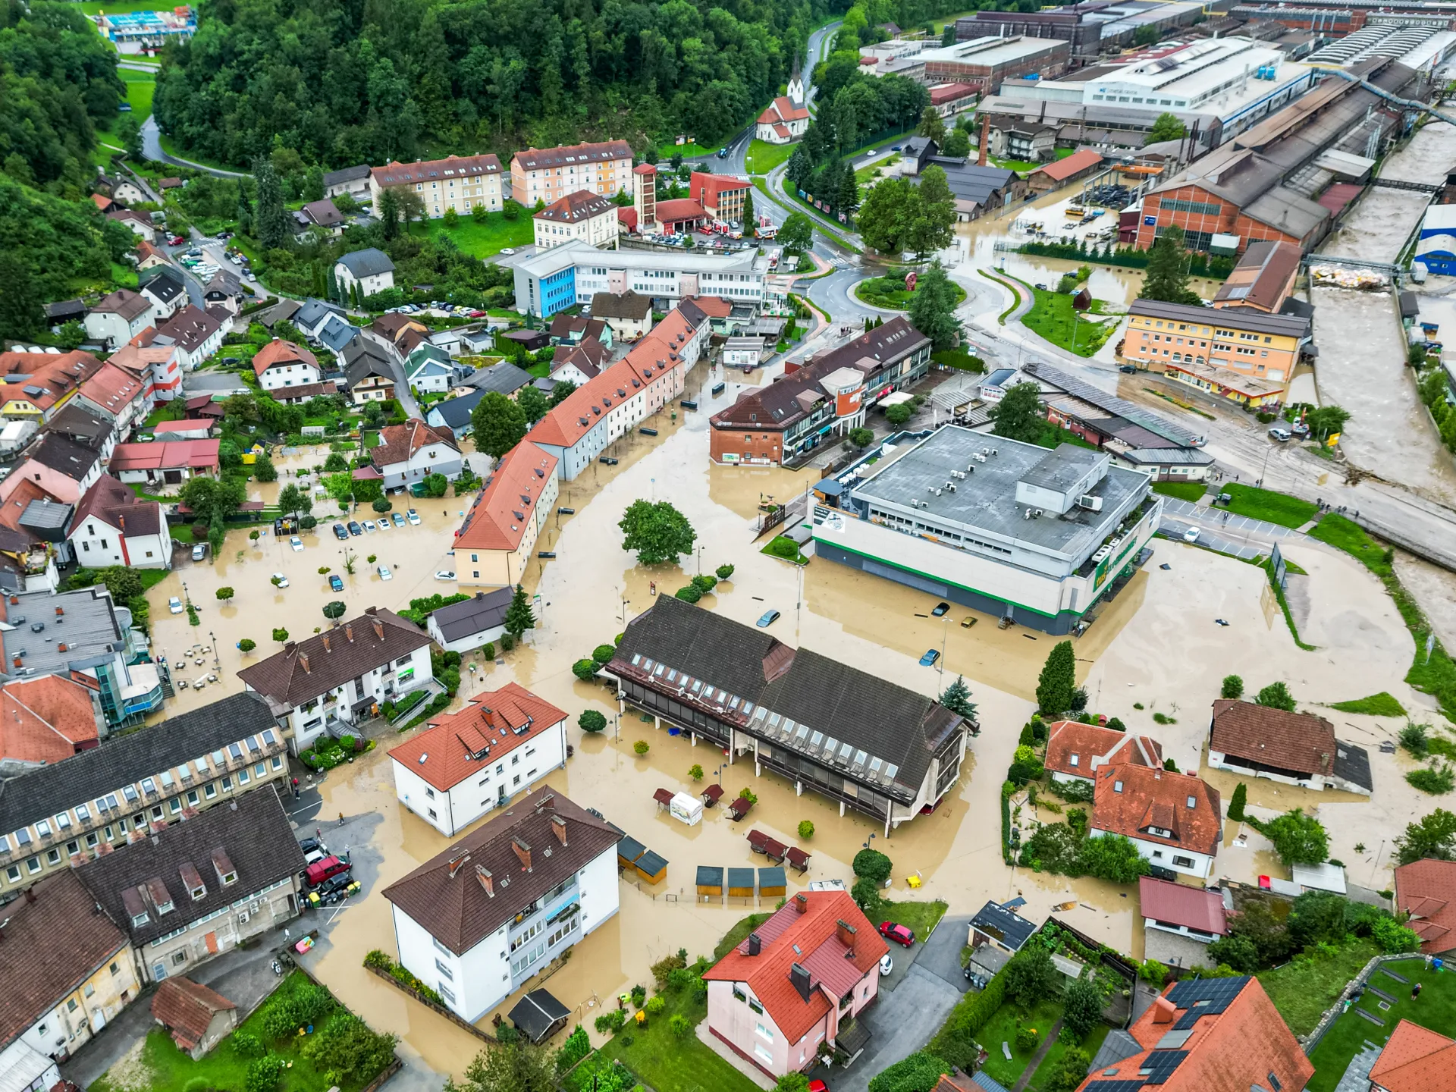
Documentary evidence of past floods in Poland in the 11th–15th centuries
Babak Ghazi
Thank You for your attention!
Photo: Creator: Anadolu Agency | Credit: Getty Images
Photo: Creator: Anadolu Agency | Credit: Getty Images
For more details: https://doi.org/10.1016/j.jhydrol.2023.129778
babak.ghazi@doktorant.umk.pl
The work was supported by the National Science Centre, Poland project No. 2020/37/B/ST10/00710.

Slide 20
Documentary evidence of past floods in Poland in the 11th–15th centuries
Babak Ghazi
References
Barriendos, M., Coeur, D. Flood data reconstruction in historical times from non-instrumental sources in Spain and France. Systematic, Palaeoflood and Historical Data for the Improvement of Flood Risk Estimation. Methodological Guidelines, edited by: Benito, G. and Thorndycraft, VR, Centro de Ciencias Medioambientales, Madrid, Spain, pp. 29-42.
R. Brázdil, Z.W. Kundzewicz, G. Benito, Historical hydrology for studying flood risk in Europe, Hydrol. Sci. J., 51 (5) (2006), pp. 739-764, 10.1623/hysj.51.5.739
Elleder, L. Elleder, Historical changes in frequency of extreme floods in Prague, Hydrol. Earth Syst. Sci., 19 (10) (2015), pp. 4307-4315, 10.5194/hess-19-4307-2015
Grześ, M., 2008. Historia powodzi na Wiśle w świetle tablic wielkich wód, unpublished conference paper, http://www.wielkawoda.umk.pl/czym_sa_znaki/index.html.
Kasprzak, M., 2010. Wezbrania i powodzie na rzekach Dolnego Śląska. In: Piotr Migoń (Ed.), Wyjątkowe zdarzenia przyrodnicze na Dolnym Śląsku i ich skutki. Rozprawy Naukowe Instytutu Geografii i Rozwoju Regionalnego Uniwersytetu Wrocławskiego, 14, Instytut Geografii i Rozwoju Regionalnego Uniwersytetu Wrocławskiego, pp. 81–140.
Kiss, A. 2019 Floods and Long-term Water-level Changes in Medieval
Kowalewski, Z. Powodzie w Polsce-rodzaje, występowanie oraz system ochrony przed ich skutkami Woda-Środowisko-Obszary Wiejskie, 6 (2006), pp. 207-220
Lambor, J. 1954. Klasyfikacja typów powodzi i ich przewidywanie
M. Mudelsee, M. Börngen, G. Tetzlaff, U. Grünewald, No upward trends in the occurrence of extreme floods in central Europem Nature, 425 (6954) (2003), pp. 166-169, 10.1038/nature01928

