Slide 1
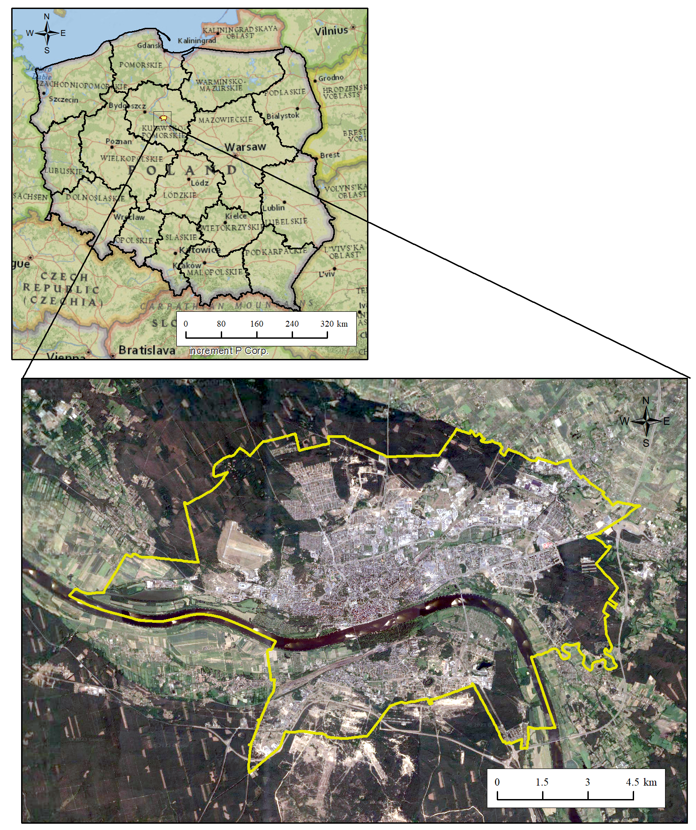
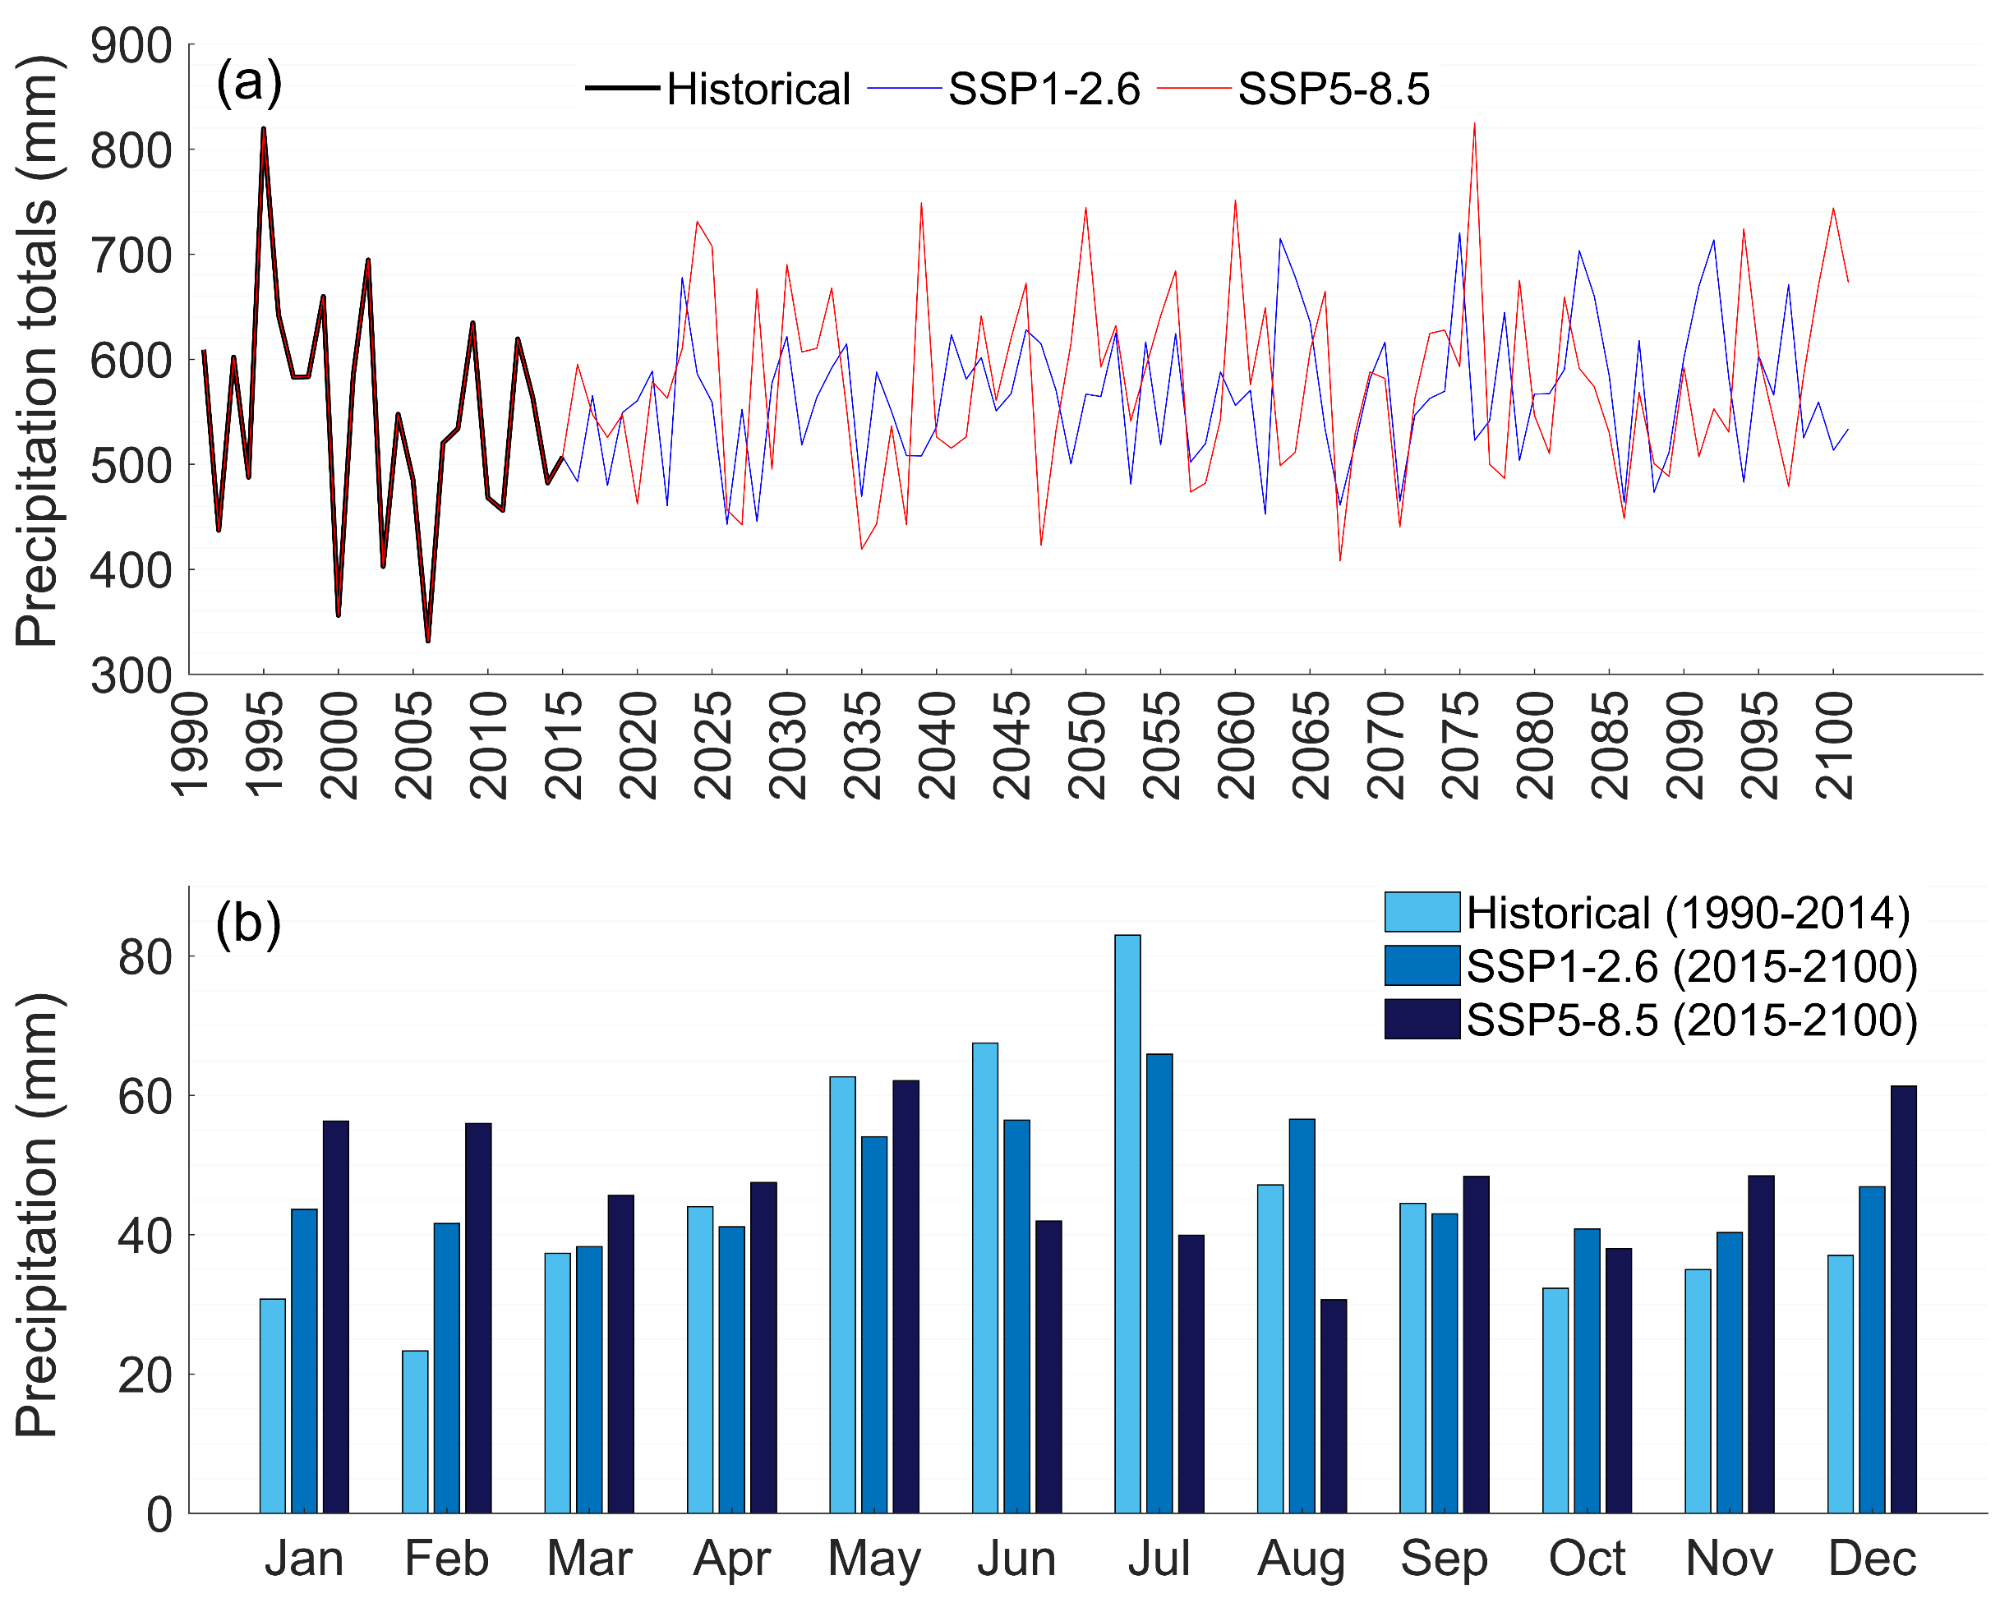
The EMS Annual Meeting
Bratislava, Slovakia & Online, 3–8 September 2023
Estimation of droughts and floods occurrences in central Poland
under climate change scenarios
Babak Ghazi¹, Rajmund Przybylak^{1,2}, and Aleksandra Pospieszyńska^{1,2}
¹ Faculty of Earth Sciences and Spatial Management, Nicolaus Copernicus University, Toruń, Poland (babak.ghazi@doktorant.umk.pl)
² Centre for Climate Change Research, Nicolaus Copernicus University, Toruń, Poland
Overview
In this research, we studied the impact that climate change in central Poland (Fig. 1) on the frequency of meteorological droughts and the risk of flood occurrence, based on the standardised precipitation index (SPI 12) (Table 1). First, by an average mean ensemble of six general circulation models (GCMs) from CMIP6 dataset (Table 2), precipitation for a future period (2026–2100) in central Poland was projected under two climate change socio-economic pathway scenarios (SSPs), SSP1-2.6 and SSP5-8.5 (Fig. 2). Then, based on the projected precipitation for the future period, the SPI–12 values were calculated.
Study area, data and methods
Study area
Table 1. Details and definitions of SPI values (McKee et al., 1993)
Table 2. Detailed features of used GCMs
Color | SPI Class | Values
Extremely wet | extremely wet | SPI ≥ 2.0
Very wet | very wet | 1.50 ≤ SPI < 1.99
Moderately wet | moderately wet | 1.00 ≤ SPI < 1.50
Near normal | near normal | −0.99 ≤ SPI <1
Moderately dry | moderately dry | −1.0 ≤ SPI < −1.50
Severely dry | severely dry | −1.50 ≤ SPI < −2.0
Extremely dry | extremely dry | SPI ≤ −2.0
GCM model | Research center
CMCC-ESM2 | The Euro-Mediterranean Centre on Climate Change/ Italy
EC-Earth3 | EC-EARTH European consortium/ Europe
INM-CM4-8 | Institute for Numerical Mathematics/ Russia
IPSL-CM6A-LR | Institute Pierre-Simon Laplace / France
MPI-ESM1-2-HR | Max Planck Institute for Meteorology/ Germany
NorESM2–LM | Norwegian Climate Centre / Norway
Fig. 1. Location of the study area
Datasets sources
1. The observation precipitation dataset for Toruń, Poland, 1990–2014: Institute of Meteorology and Water Management—National Research Institute. 2. The precipitation datasets of GCMs: NASA Center for Climate Simulation (NEX-GDDP CMIP6). The GCMs datasets for historical and future periods are from 1990–2014 and 2015–2100, respectively. In this research, we also selected equal 25–year periods for the historical reference period (1990–2014), the near-future (2026–2050), mid-term (2051–2075), and far-future (2076–2100) periods (https://registry.opendata.aws/nex-gddp-cmip6).
Results and conclusions
Table 3. The frequency of SPI for historical and future periods
Projection of future precipitation
in central Poland
SPI (12) | Historical |  | SSP1-2.6 |  |  | SSP5-8.5
 | 1990–2014 | 2026–2050 | 2051–2076 | 2076–2100 | 2026–2050 | 2051–2076 | 2076–2100
Extremely wet | 8 | 10 | 9 | 6 | 5 | 8 | 17
Very wet | 5 | 16 | 17 | 20 | 19 | 16 | 22
Moderately wet | 27 | 26 | 15 | 24 | 20 | 19 | 21
Near normal | 205 | 190 | 202 | 194 | 198 | 186 | 180
Moderately dry | 20 | 28 | 27 | 28 | 21 | 39 | 41
Severely dry | 16 | 13 | 14 | 12 | 15 | 18 | 7
Extremely dry | 7 | 5 | 4 | 4 | 10 | 2 | 0
Summary:
Central Poland will experience an increase in precipitation by the end of the 21st century. Mean annual precipitation totals will increase by 2–7.5%.
The frequency of “Extremely dry” and “Severely dry” will decrease under SSP1-2.6 and SSP5-8.5 scenarios.
The frequency of “Moderately dry” will increase for future scenarios in comparison with the historical period.
The frequency of “Extremely wet” and “Very wet” will increase for SSP1-2.6 and SSP5-8.5 scenarios in comparison with the historical period.
The frequency of “Moderately wet” and “Near normal” will slightly decrease for the projected period (2026–2100) relative to the historical reference period (1990–2014).
In general, the occurrence of “floods” in the study area is more probable than “droughts” in the future period.
Fig. 2. Comparison of (a) annual and (b) monthly precipitation totals for historical period (1990–2014) with their projections under scenarios SSP1-2.6 and SSP5-8.5 for future period (2015–2100)
The work was supported by the National Science Centre, Poland project No. 2020/37/B/ST10/00710.
Reference
McKee, T.B., N.J. Doesken, and J. Kleist. The relationship of drought frequency and duration to time scales. in Proceedings of the 8th Conference on Applied Climatology. 1993. California

