Slide 1
ERA5-ecPoint
What it is and its power in the contextualization of severe temperature and rainfall
Fatima Pillosu
PhD candidate, University of Reading
^{Visiting Scientist, ECMWF}
EMS, Thursday 5th September 2024, Barcelona

Slide 2
Extreme events in August 2024
Heatwave and high temperatures sparked wildfires across Ireland, Turkey, Spain, Portugal, Italy & Scandinavia peninsula.
Severe flooding affected central and southern China, and it has been the hottest August on record in many regions.
7043 acres of forest on fire in Siberia.
Extreme wildfires in parts of USA (Montana, Wyoming, Dakotas). Extreme wildfires in Canada. Extreme rainfall, hail, and flash floods in Guadalajara (Mexico) and Long Island (New York) causing $10 million in damage.
Rain lashed parts of Spain, France, Italy and Turkey.
Shanshan typhoon cause the death of 4 people and the evacuation of millions
Thunderstorm, heavy rain, and severe flooding lashed parts of Saudi Arabia. 33 people killed in Yemen.
In many regions of the Gulf countries, temperatures exceeded 50 degrees Celsius.
Extreme monsoon season in Bangladesh (52 deaths). Severe flooding and landslides in India. In Thailand, 22 people died. Extreme flooding also in the Philippines.
Heavy rain and floods across Sahel, and emerging droughts in Ghana. Southern Africa is affected by extreme temperatures and severe droughts that will likely carry on through early 2025.
Heatwaves, droughts and extreme wildfires in the Amazon.
Australia is experiencing a persisting record winter extreme heat. In the north ( in Yampi Sound), it observed its highest wintertime temperature ever (41,6 degrees Celsius).

Slide 3
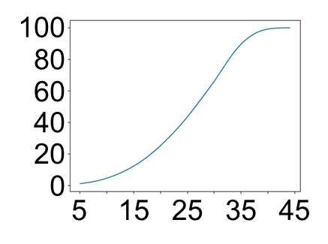
Examples of extreme temperatures in ERA5
Probabilities [%]
0
0.1
1
2
3
4
5
6
7
8
9
10
20
30
40
50
60
70
80
90
100
26th August 2024
Probabilities of maximum t2m in 24h (ending at 00 UTC) exceeding 40 degrees Celsius
18th August 2024
Probabilities of maximum t2m in 24h (ending at 00 UTC) exceeding 40 degrees Celsius
Probabilities of maximum t2m in 24h (ending at 00 UTC) exceeding 45 degrees Celsius
Yampi Sound
41.6 degrees Celsius
Al-Jahra, Kuwait
52 degrees Celsius
Distribution of ERA5’s maximum t2m in 24h between 2000 and 2024 in the Arabian Peninsula

Slide 4
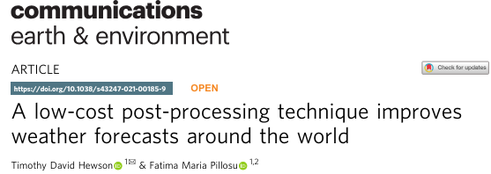
Global models can significantly underrepresent the frequency of big totals (e.g., those conducive to flash floods)
Global models underrepresent the frequency of small totals (e.g., zero rainfall)
Global models do not represent adequately the distribution of extreme (localized) rainfall & temperature events.
How can global predictions be improved?
ecPoint
Rain gauge
observations
Raw
global model forecasts
ecPoint post-processed
global model forecasts
ecPoint improves the representation of extreme (localized) rainfall.
Frequency
0
Short period rainfall total
ecPoint is a statistical post-processing system that generates probabilistic rainfall forecasts at point-scale.

Slide 5
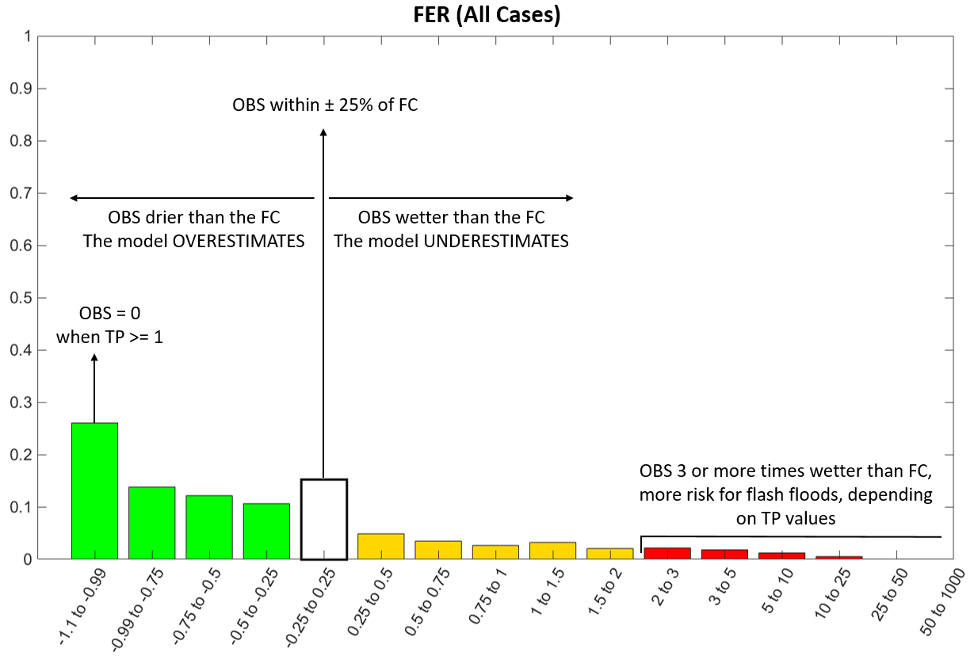
ecPoint and the concept of “remote-calibration”
It provides a huge training dataset (~10⁶ of data points instead of ~10³) from a short training period (~1 year instead of ~20).
Errors at those “remote sites” provide a good guide to assess the model reliability for a specific weather condition.
It facilitates the creation of point-based rainfall forecasts at global scale and any lead time.
It does not raise non-stationary issues in the observational data thanks to the shorter training period.
Let’s forecast rainfall for Louisiana. The weather conditions are mainly convection, light winds, in summer, flat area. How has the model performed, at a short range, in other sites with similar conditions?
Errors distribution:
MAPPING FUNTION (MF)
1
One can define one MF or multiple MFs that describe different error distributions for different weather conditions or GRID-BOX WEATHER TYPES (WTs) to capture different degrees of rainfall sub-grid variability and model biases at grid scale.
Errors:
FORECAST ERROR RATIO (FER)
0.9
MAPPING FUNCTION FOR ALL ERROR CASES IN THE TRAINING PERIOD
0.8
O_{point} within 25% of F_{gridCAL}
0.7
0.6
O_{point} drier than F_{gridCAL}
The model OVERESTIMATES
O_{point} wetter than F_{gridCAL}
The model UNDERESTIMATES
0.5
Relative Frequencies [-]
O_{point} = 0
when F_{gridCAL} >= 1mm
O_{point} : point rainfall observations (typically synop)
F_{gridCAL}: calibration rainfall forecasts (short range, tp >= 1 mm/acc)
0.4
0.3
O_{point} 3 or more times wetter than F_{gridCAL}
Higher risk of flash floods, depending on the prediction of rainfall values
0.2
0.1
FER [-]
0
-1
-1 to -0.75
-0.75 to -0.5
-0.5 to -0.25
-0.25 to 0.25
0.25 to 0.5
0.5 to 0.75
0.75 to 1
1 to 2
2 to 3
3 to 5
5 to 10
10 to 25
25 to 50
>50
FER [-]

Slide 6
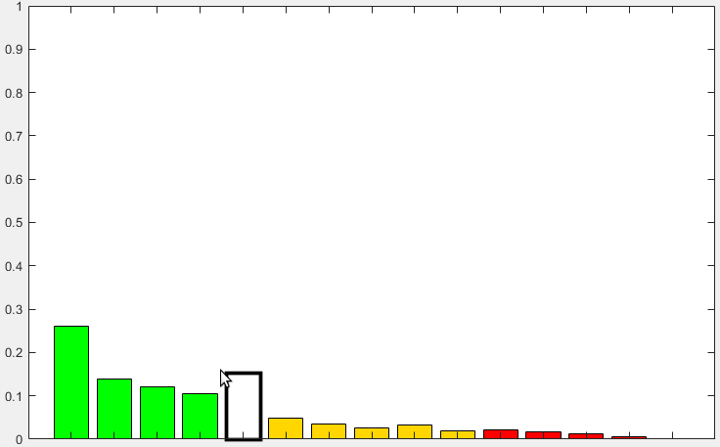
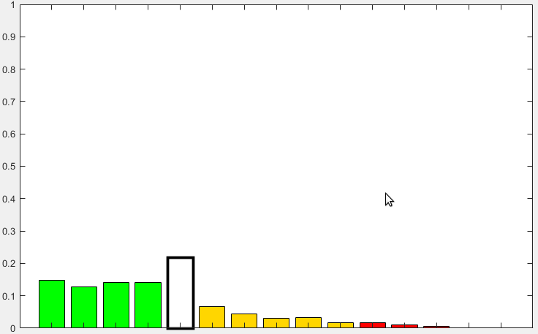
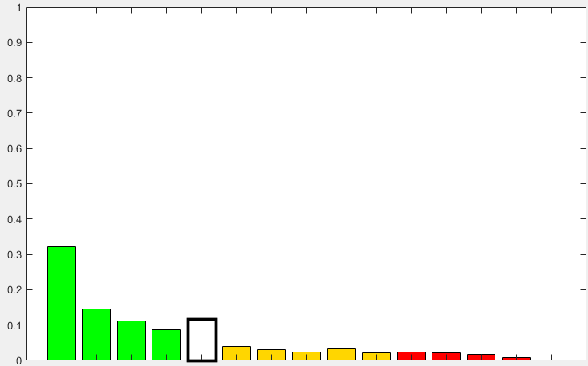
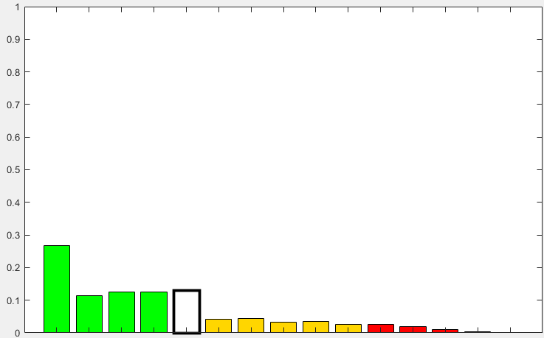
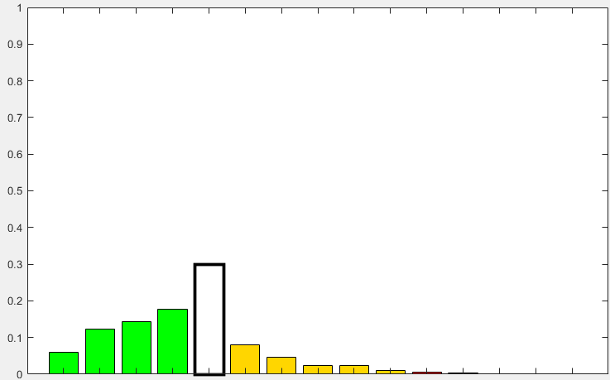
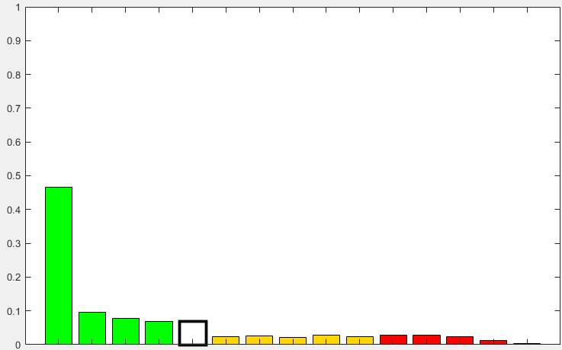
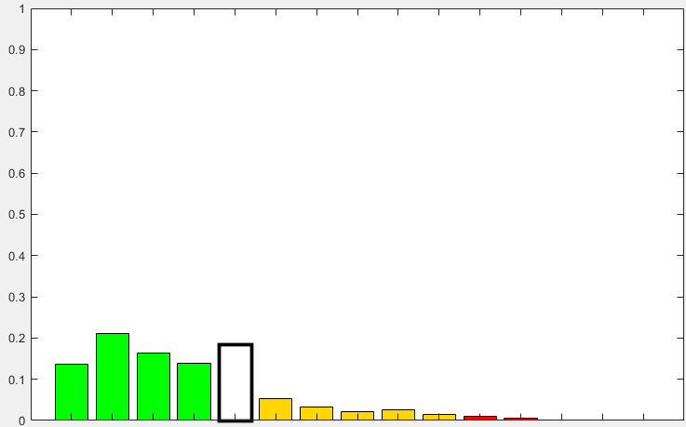
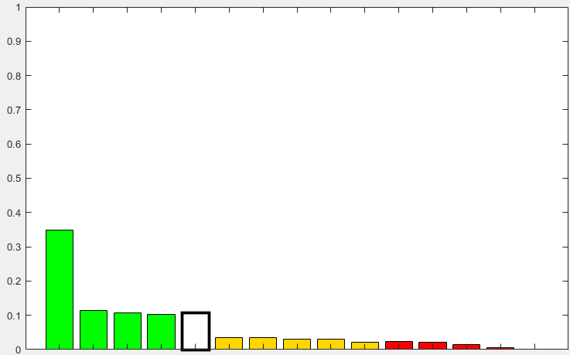
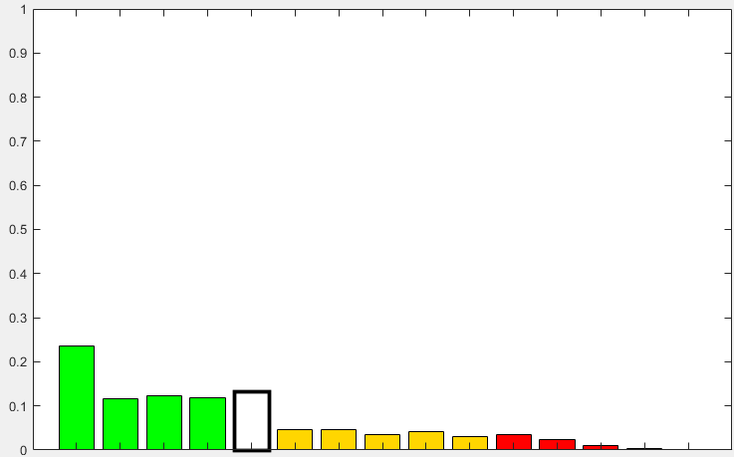
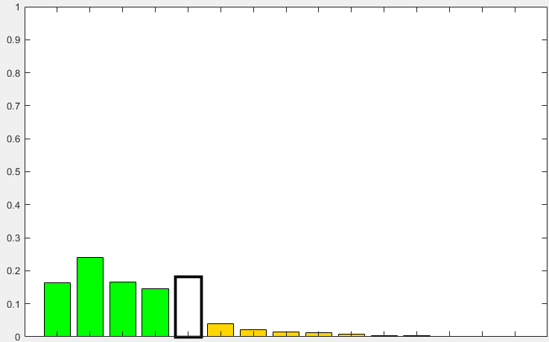
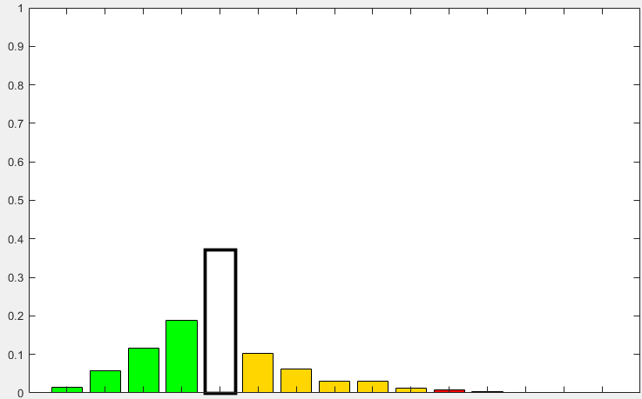
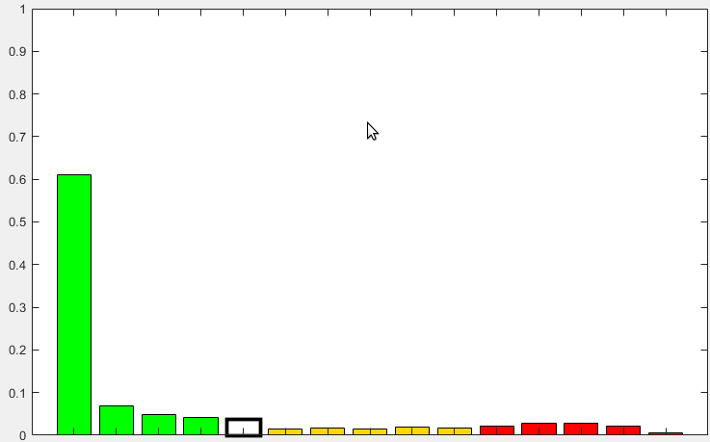
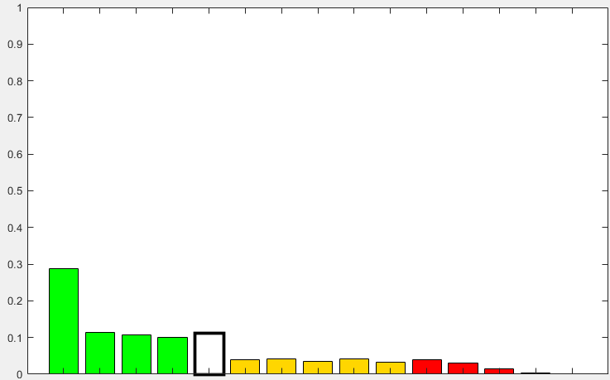
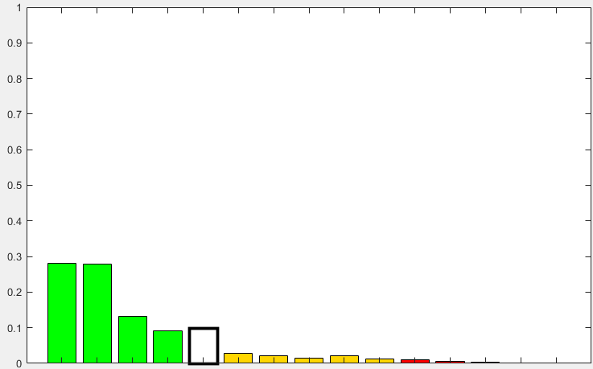
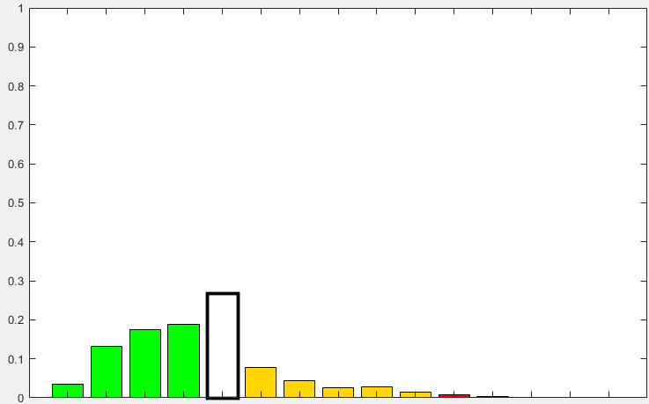
Single-WT vs. Multi-WTs
All cases
Single-WT ecPoint
Mainly large-scale rainfall
Mainly convective rainfall
Multi-WTs ecPoint
Low rainfall totals
High rainfall totals
Low rainfall totals
High rainfall totals
Low steering wind speed
High steering wind speed
Low steering wind speed
High steering wind speed
Low steering wind speed
High steering wind speed
Low steering wind speed
High steering wind speed
A
B
CAPE &
Daily solar radiation
CAPE &
Daily solar radiation
CAPE &
Daily solar radiation
CAPE &
Daily solar radiation
CAPE &
Daily solar radiation
CAPE &
Daily solar radiation
CAPE &
Daily solar radiation
CAPE &
Daily solar radiation
Pillosu et al.: Does the use of additional variables add value to grid-box-to-point-scale post-processed rainfall forecasts? A comparative analysis (under preparation)

Slide 7
ERA5-ecPoint was created within the project thanks to colleagues at
Reanalysis data between 1950 to 2021 for:
Rainfall, 24h and 12h
Temperature, min/mean/max in 24h
Fields available for Italy at https://dds.highlanderproject.eu/app/datasets/era5-ecpoint
The computations of ERA5-ecPoint have now been brought at ECMWF:
Rainfall, 24h and 12h -> 1950 to near real-time
Temperature, min/mean/max in 24h -> in progress to have data near real-time
Global fields available under request but they will also be available on the CDS in the autumn/winter.

Slide 8
Comparison of ERA5 and ERA5-ecPoint
Probabilities [%]
0
0.1
1
2
3
4
5
6
7
8
9
10
20
30
40
50
60
70
80
90
100
23rd August 2020
Probabilities of maximum t2m in 24h (ending at 00 UTC) exceeding 40 degrees Celsius
Roebuck
41.2 degrees Celsius

Slide 9
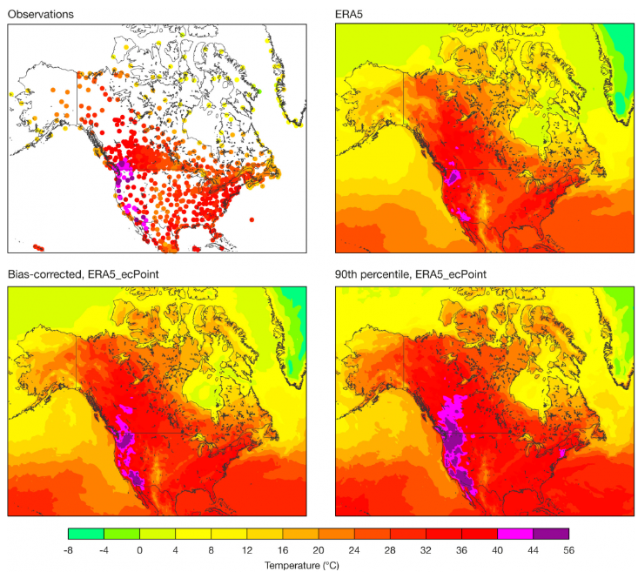
Comparison of ERA5 and ERA5-ecPoint
29th June 2021
Maximum t2m in 24h, ending at 00 UTC

Slide 10
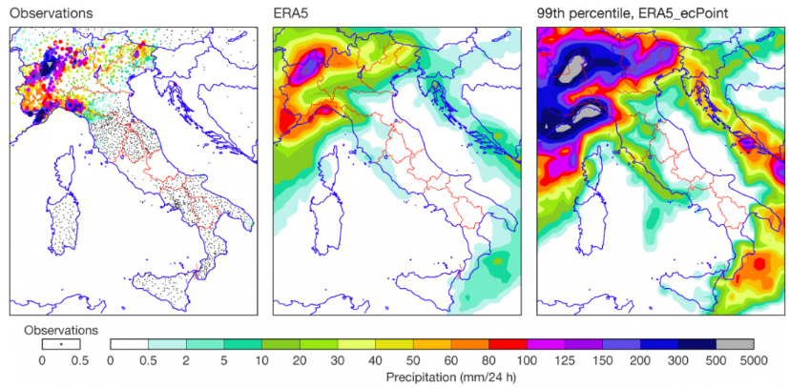
Comparison of ERA5 and ERA5-ecPoint
30th October 2020
24-hourly precipitation, ending at 00 UTC

Slide 11
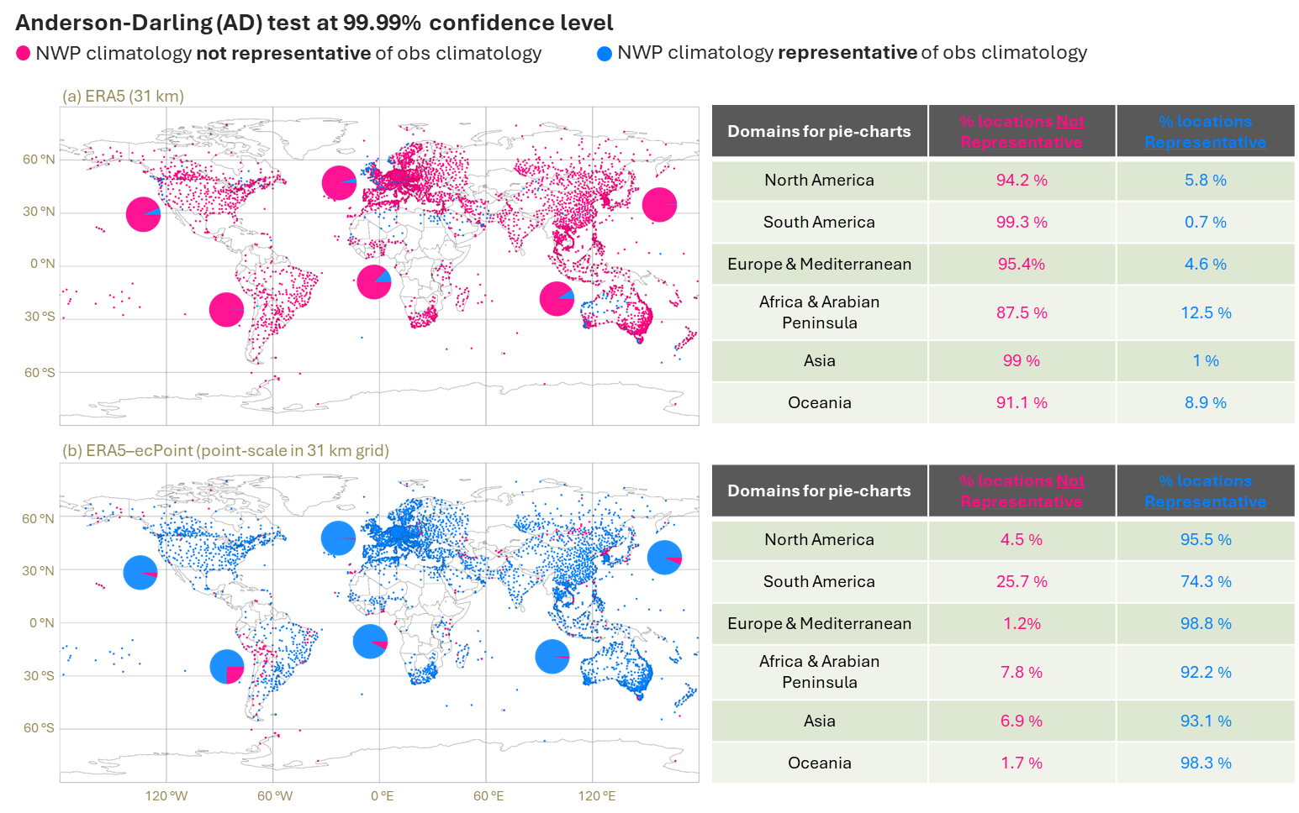
Verification of ERA5-ecPoint Rainfall
Pillosu et al.: Post-processed modelled rainfall climatology represents well observational point-rainfall climatologies (under preparation)

Slide 12
Conclusions
ERA5-ecPoint represents better than ERA5 extreme (localized) rainfall events (there is no reason to think it would not be the case also for temperature, but this needs to be tested).
ERA5-ecPoint could be used to contextualize the past climate of extreme (localized) events, and how it might have been changing in recent years.
Due to the high number of realization per day, we can represent events with high return periods (up to 1000 years) to understand the rarity of current extreme events.
ERA5-ecPoint can be used in down-stream applications where the representation of the absolute values of extreme events are vital (see presentation in UP2.2 for the creation of a historical dataset of probability of flash floods over a continuous global domain).

Slide 13
Thank you!
Any questions?
fatima.pillosu@ecmwf.int
@PillosuFatima
Fatima Pillosu
EMS, Thursday 5th September 2024, Barcelona

