Slide 1

Ensemble Classes of
Use Cases – examples of use cases in action
Ken Mylne
Science Fellow in Exploitation of Ensembles
EMS Conference 2024, Barcelona
EMS2024-143
Notes:
This presentation summarises the performance of IMPROVER and BestData for the record-breaking UK heatwave of 19th July 2022

Slide 2
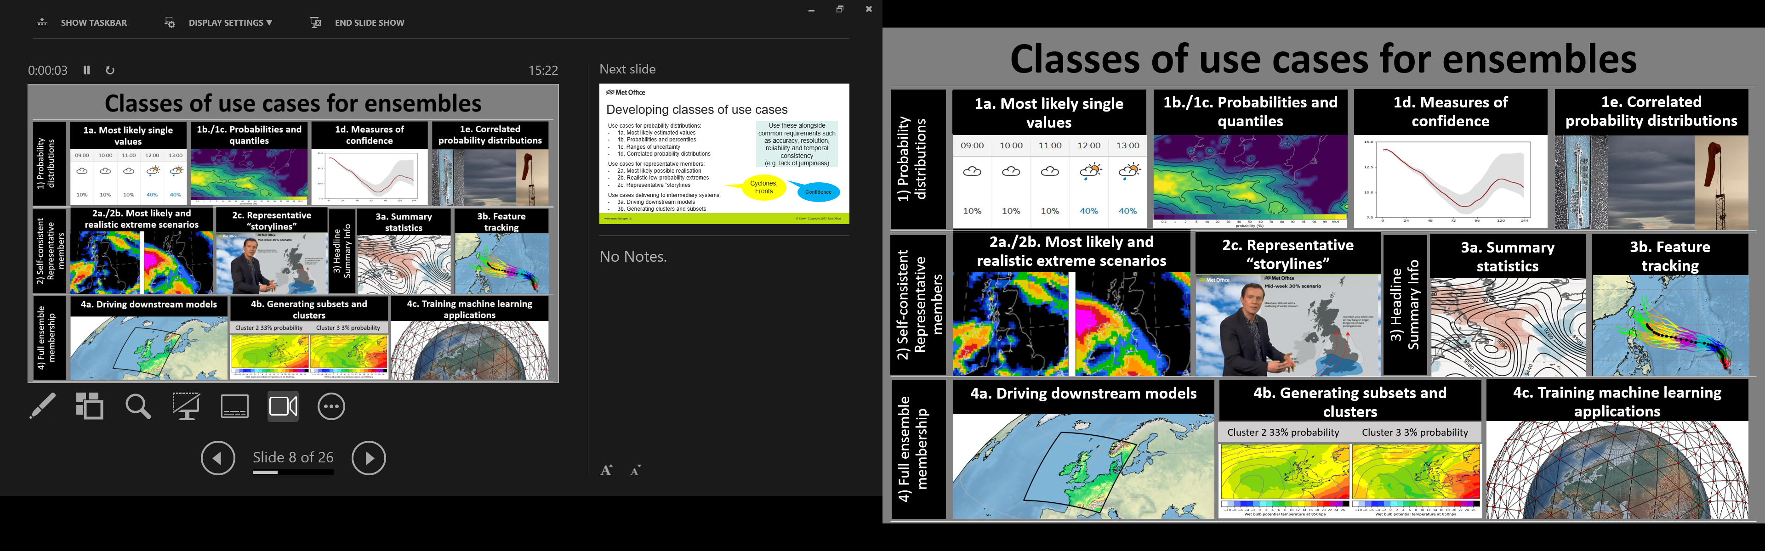
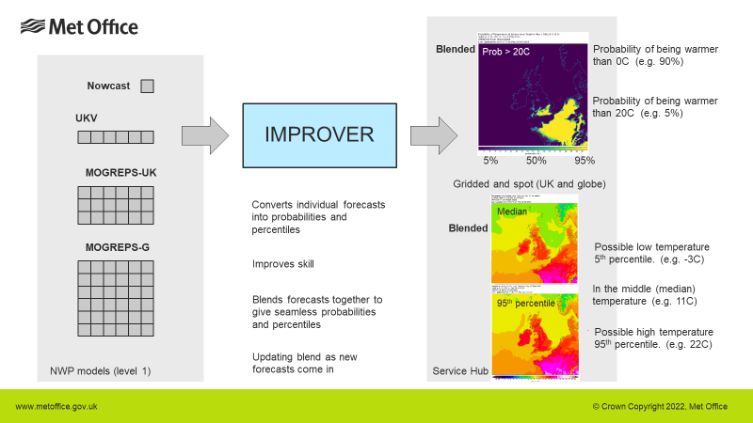
IMPROVER serves use case 1 – ensemble stats
Includes:
most likely
Extremes
Reasonable worst case
…but on a local point-by-point basis

Slide 3
IMPROVER serves use case 1 – ensemble stats
Includes:
most likely
Extremes
Reasonable worst case
…but on a local point-by-point basis
p(0.01mm/h)
p(4mm/h)
p(4mm/h within 10km)
50th
95th

Slide 4
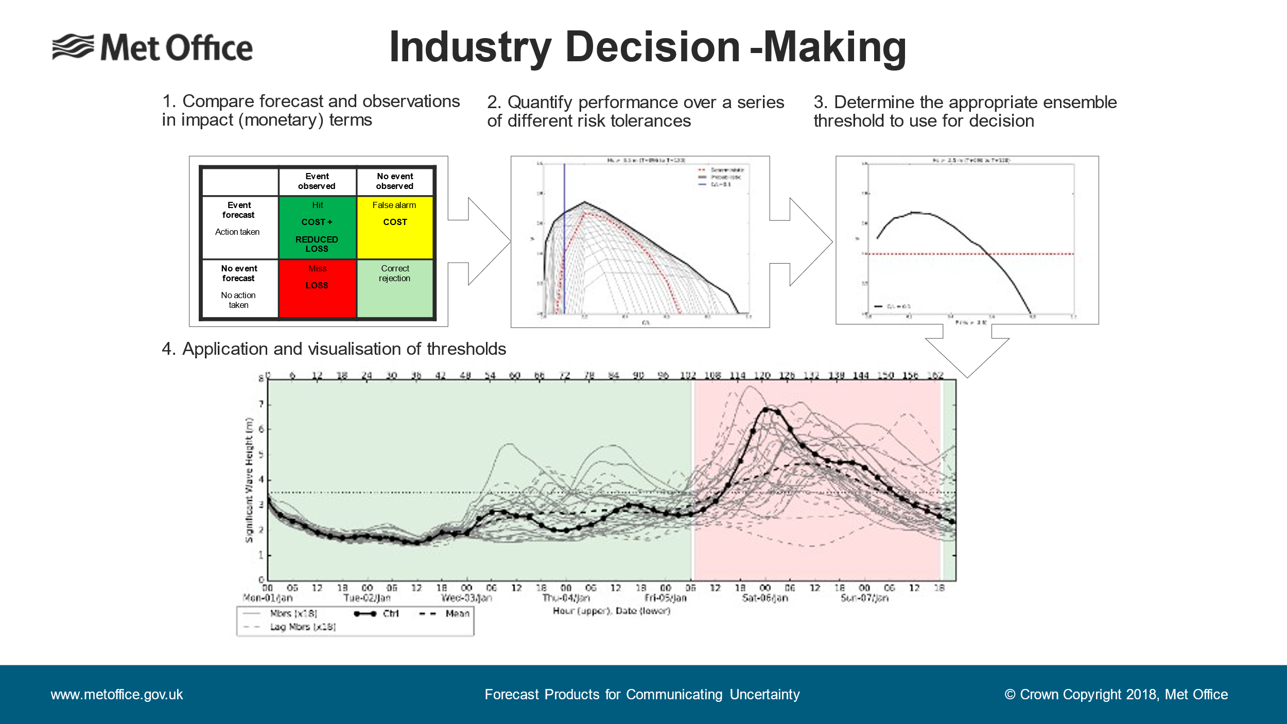

Slide 5
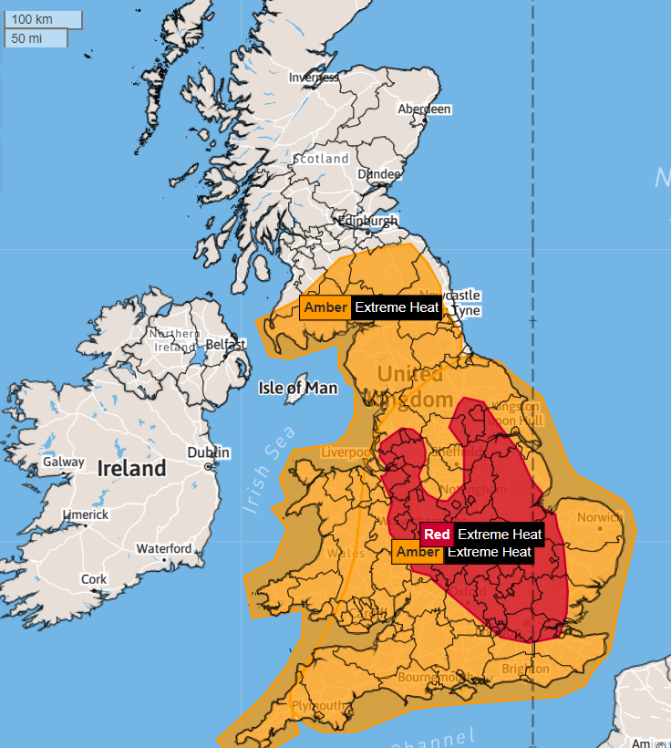
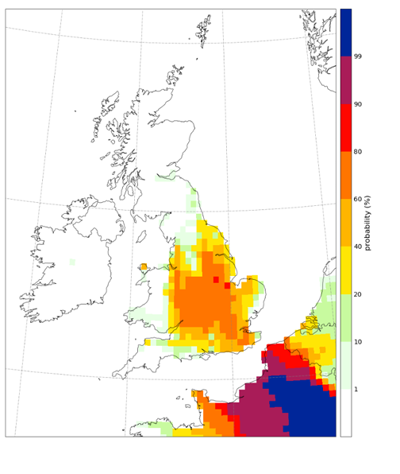
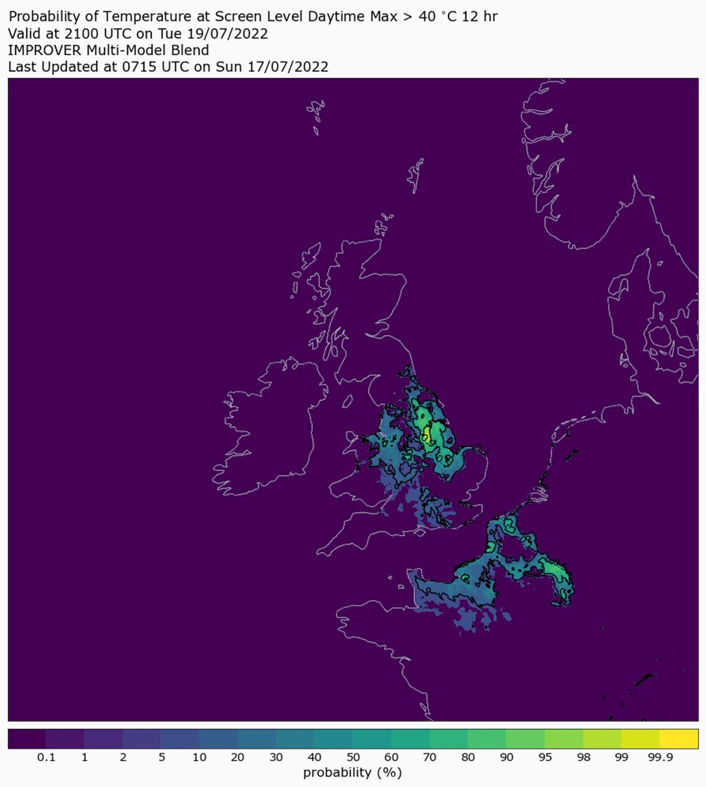
Heatwave Warnings
UK temperature record of 40.3C set 19 Jul 2022
Ensemble p(T>38C) issued 4 days ahead
IMPROVER 2 days ahead p(T>40C)
© Crown Copyright 2024, Met Office
Notes:
In a climate unaffected by human-induced climate change, it would be virtually impossible for temperatures in the UK to reach 40°C but climate change is already making UK heatwaves more frequent, intense and long-lasting
The chances of seeing 40°C days in the UK could be as much as 10 times more likely in the current climate than under a natural climate unaffected by human influence

Slide 6
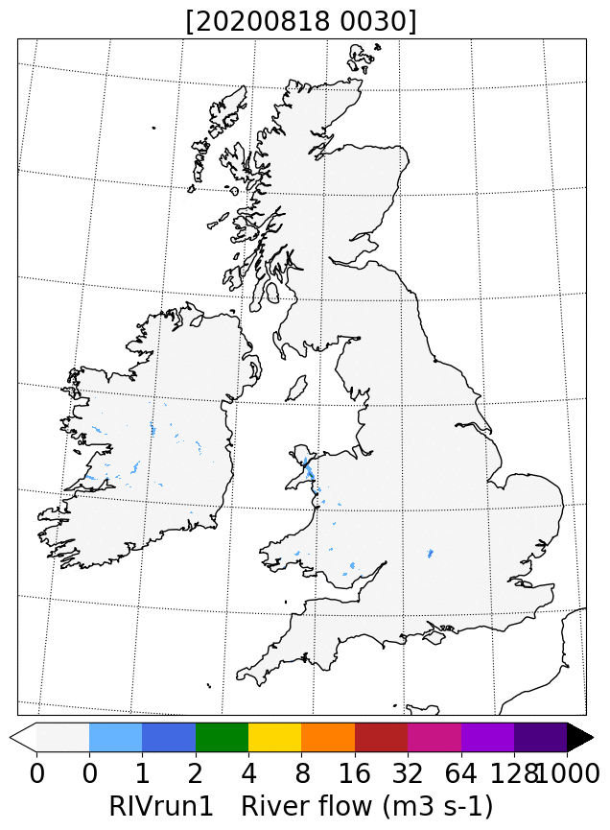
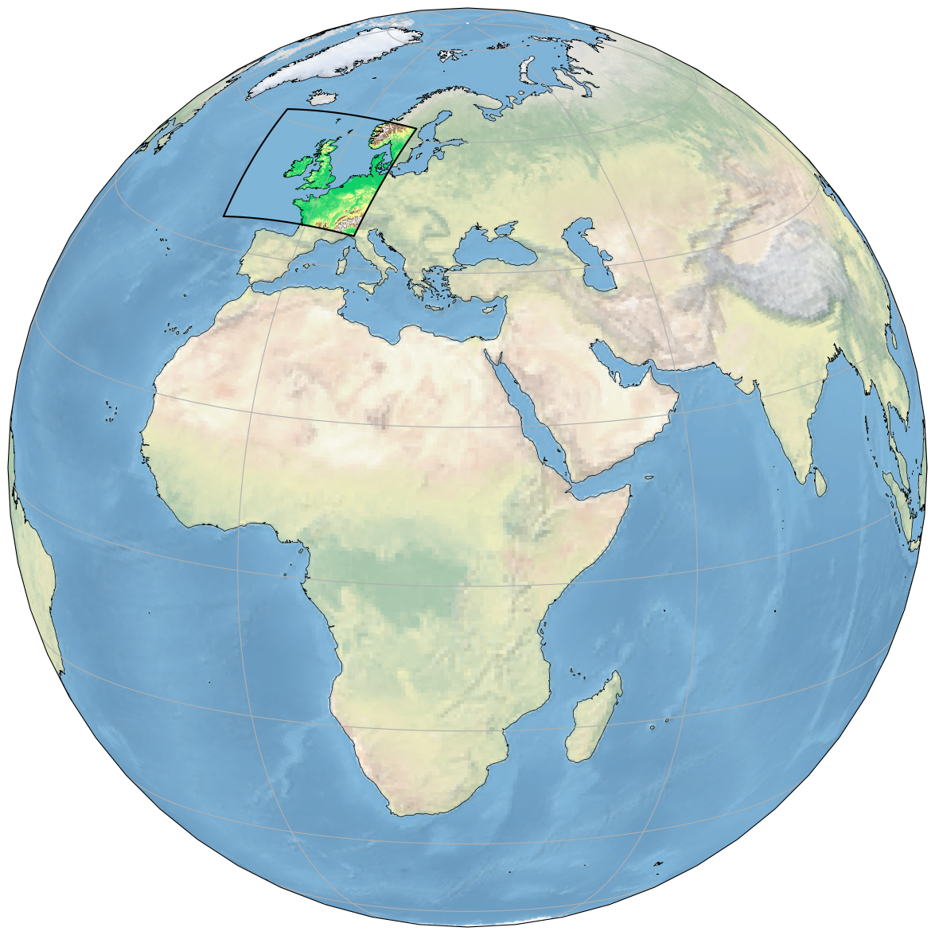
Hydrological Modelling
Animation of hydrological run-off from different ensemble members, driven from MOGREPS-UK
- Good example of use case 3 where we must use every ensemble member
4a. Driving downstream models

Slide 7
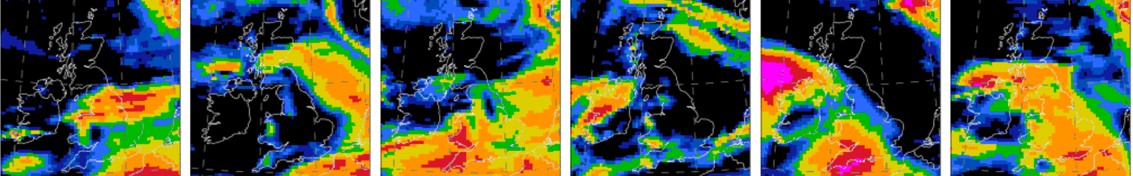
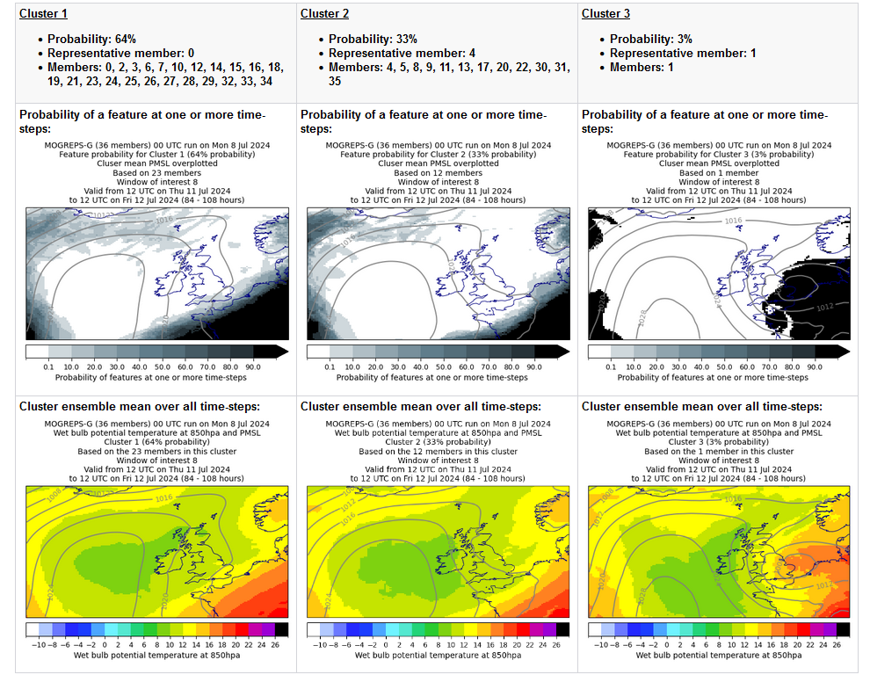
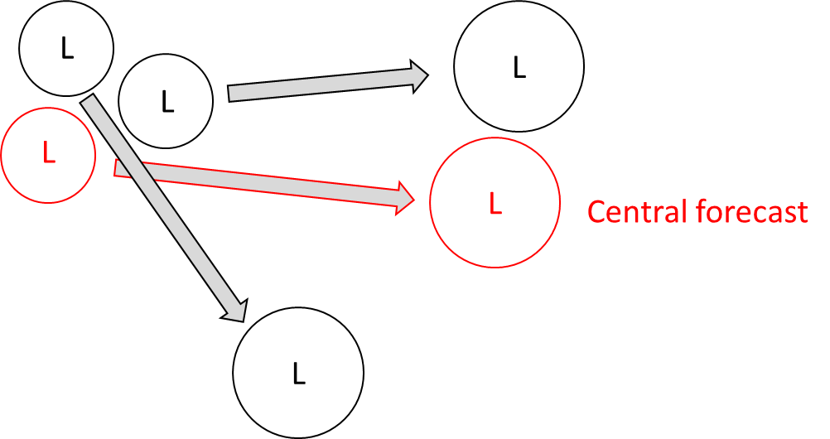
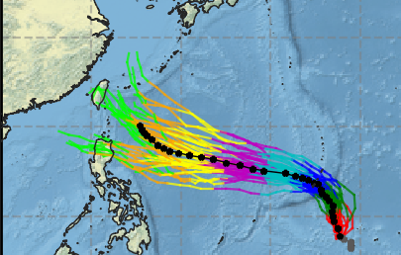
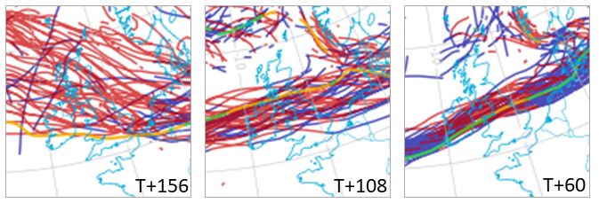
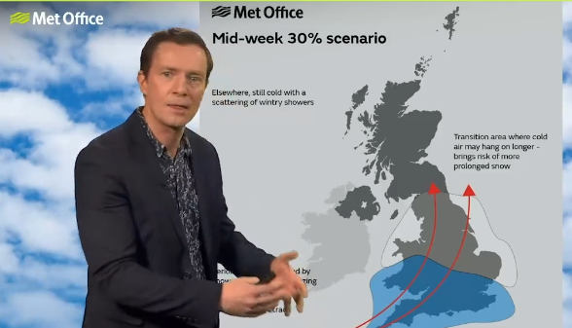
Representative members and Storylines
2a./2b. Most likely and realistic extreme scenarios
3b. Feature tracking
2c. Representative “storylines”
Feature-based clustering
Following PhD work of Kris Boykin
Feature tracking – cyclones, fronts
© Crown Copyright 2024, Met Office

Slide 8
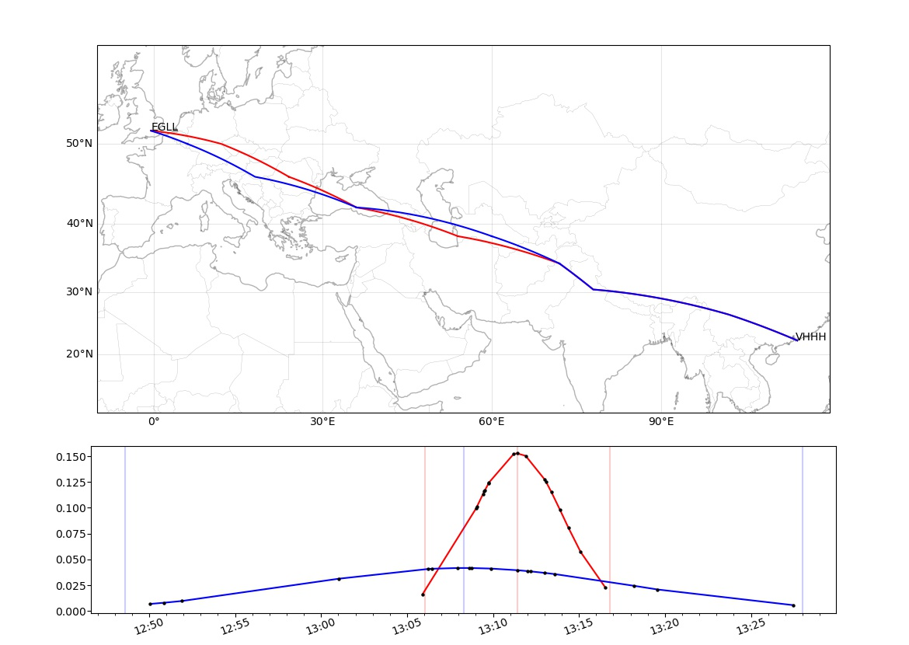
Aviation arrival times
4a. Driving downstream models
time-optimal trajectories
02/03/2024
31/03/2024
Aviation route planning Hong Kong to London
First calculate (deterministic) optimal route from control forecast (Use case 2a)
Use ensemble to predict probability distribution of arrival time (Use case 4a):
Allows airport to plan for arrivals and reduce congestion:
Most likely arrival time (use case 1a)
Range of uncertainty (use case 1d)
Flight time ensemble PDFs
02/03/2024
31/03/2024
© Crown Copyright 2024, Met Office

Slide 9
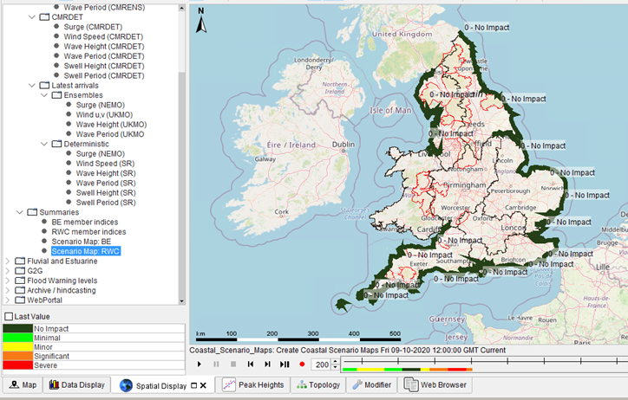
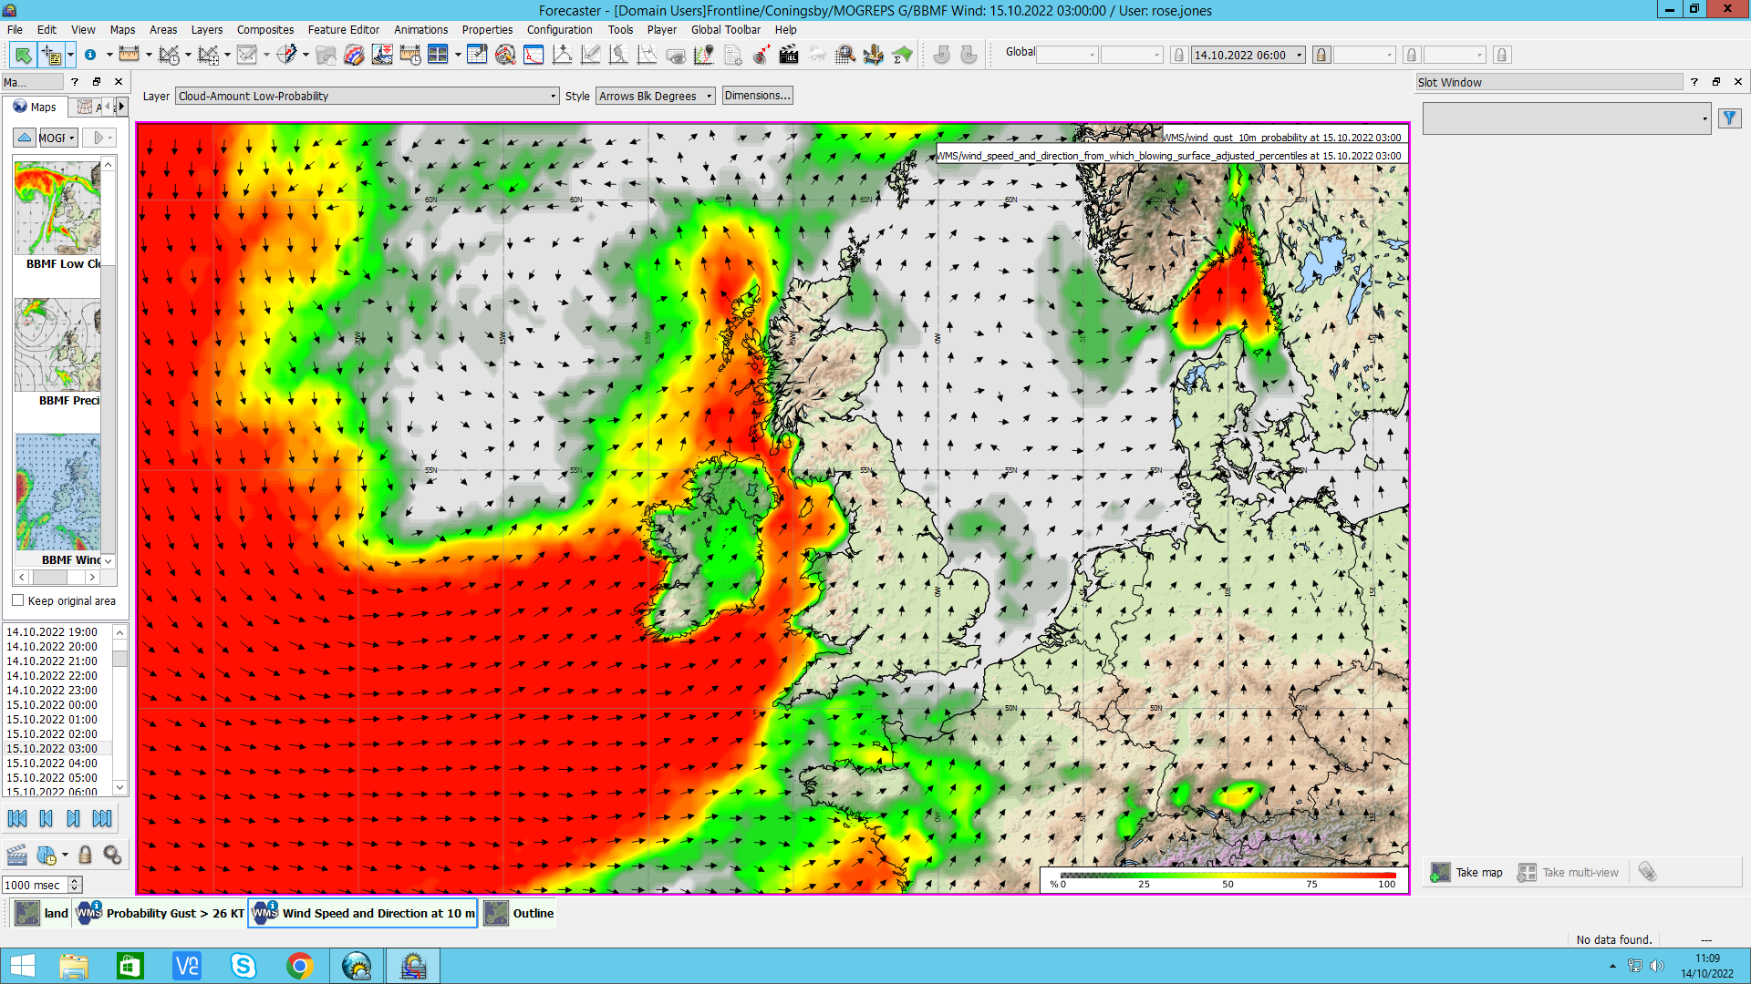
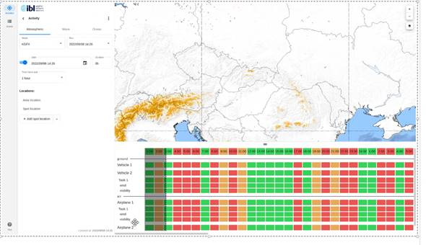
Examples of user cases
Some early success
Ensemble-driven flood impacts decision tools.
We are able to show likelihood and impact of coastal flooding across a 7 day period, using MOGREPS-G & Nemo Surge (driven by MOGREPS G) data. This helps us alert local authorities with increased notice, to trigger action to keep the public safe.
Ensemble-driven planning products.
This example shows a Red Amber Green probability of occurrence of a customer specified threshold, used for planning military flying of fragile WW2 aircraft. This product was re-designed from a deterministic, manually created risk table, to an automated MOGREPS-UK feed with great success. [p(gust>26kt)]
Newly developed tools to exploit our ensembles.
The Military MetOc Visualisation Hub (MMVH) is a web-based tool developed for the British military to ensure access to meteorological data, no matter how big the data, even with bandwidth limitations. It has allowed us to developed novel ways to display and utilise ensemble data.
Notes:
Obviously words need removing...

