Slide 1
A series of major sudden stratospheric warming events in winter 2023/2024
Ekaterina Vorobeva (evor@nilu.no) and Yvan Orsolini
NILU, Norway
Notes:
12 min + 3 min Q&A

Slide 2
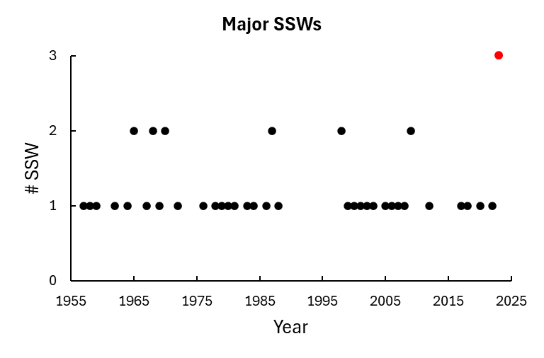
Sudden stratospheric warmings (SSWs)
SSWs: a disturbance of the stratospheric polar vortex associated with the significant temperature increase over the course of a few days.
Occurrence:
Typically, every 2 years.
One / two events per winter.
Type:
zonal wind: minor (weakening) or major (reversal).
spatial structure: split, displacement or mixed-type.
Duration:
Range from short (few days) to canonical long (up to 30 days) events.
?
Figure. Occurrence of SSWs per winter based on the Sudden Stratospheric Warming Compendium data set by A. Butler using the Charlton and Polvani (2007) definition.
Notes:
Add which definition

Slide 3
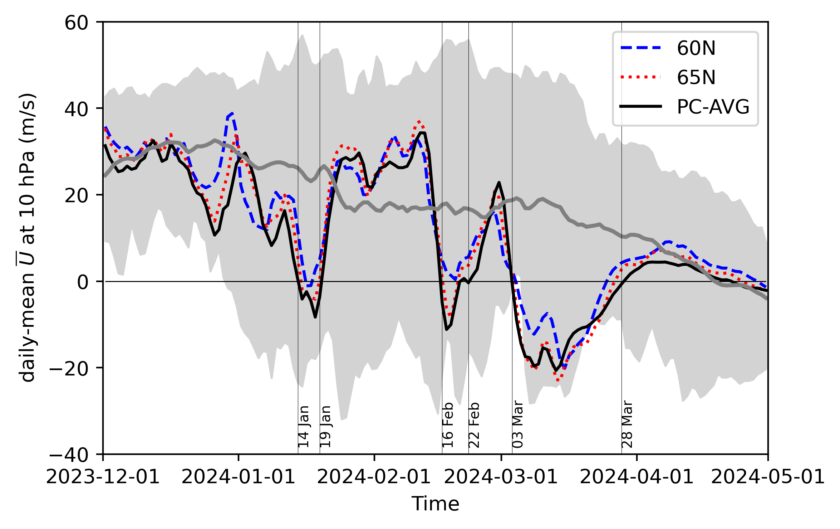
Multiple SSWs in winter 2023/2024
Why events in January and February were so short?
5 days
6 days
2 major SSWs
3 major SSWs
3 major SSWs
Figure. Daily-mean zonal-mean U at 10 hPa and different latitudes as a function of time. Gray line - climatological mean 2000 – 2022. Shading – min/max values.
Figure. Daily-mean zonal-mean T and U at 10 hPa as a function of latitude and time using ERA5 (hereafter).
Notes:
March SSW can be considered a major warming rather than the final warming as winds returned to westerly for more than 10 days prior to April 30.
February SSW can be argued upon due to different definitions showing different wind values as well as the event being close to the March SSW.
Standard definition of the major SSW date is based on the daily-mean zonal-mean zonal winds at 60N and 10 hPa following Charlton and Polvani (2007). Winds must return to westerly for 20 consecutive days between events, and for at least 10 days prior to April 30.

Slide 4
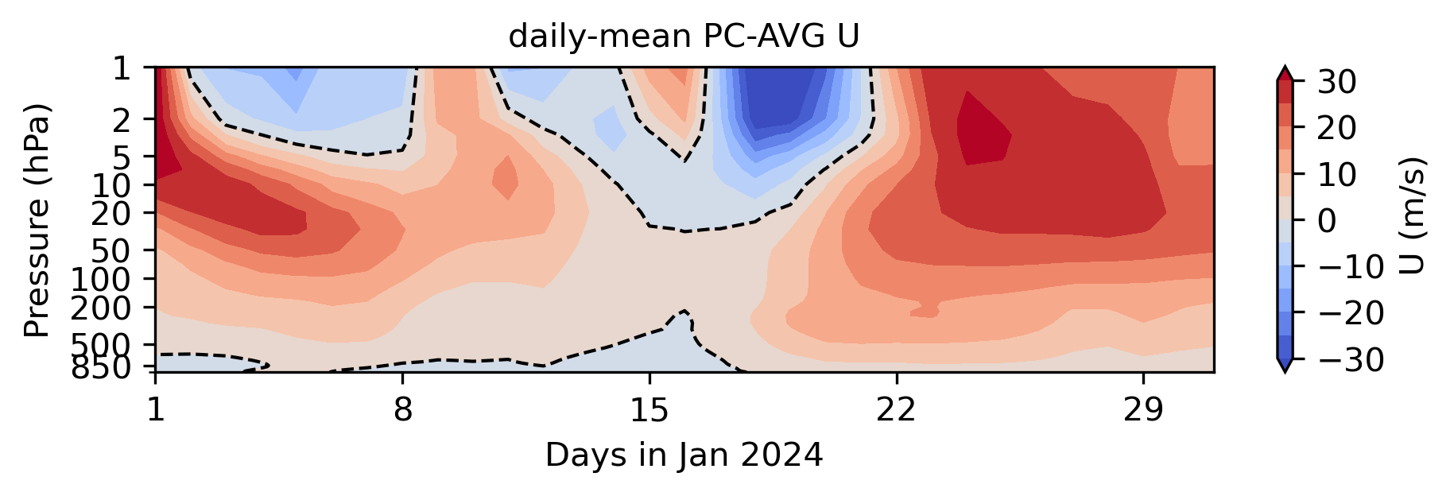
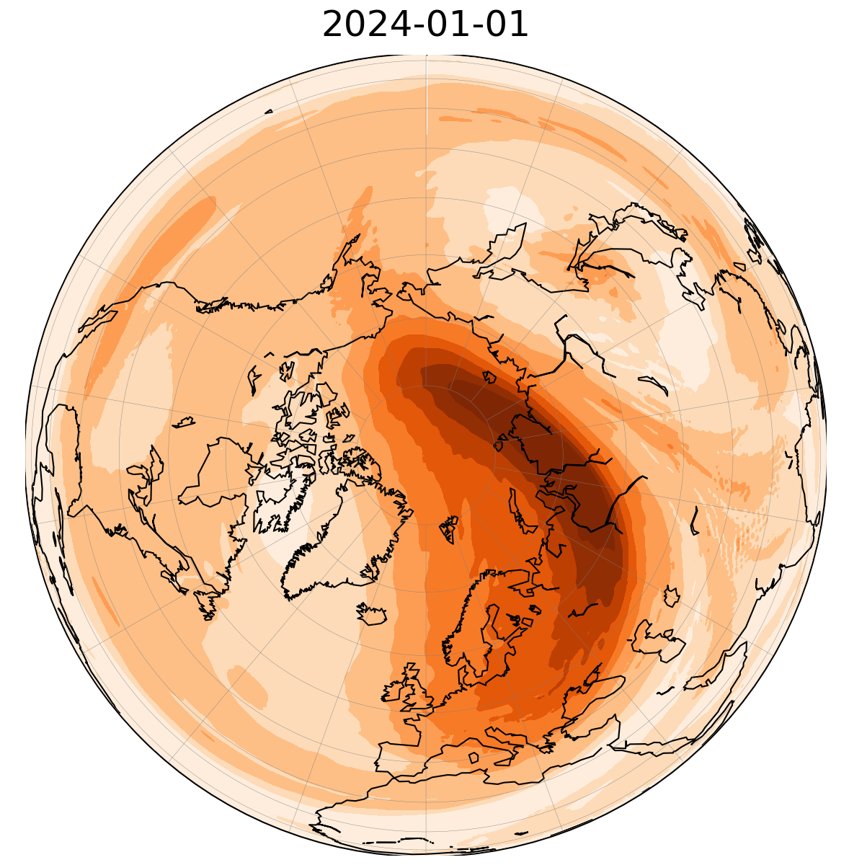
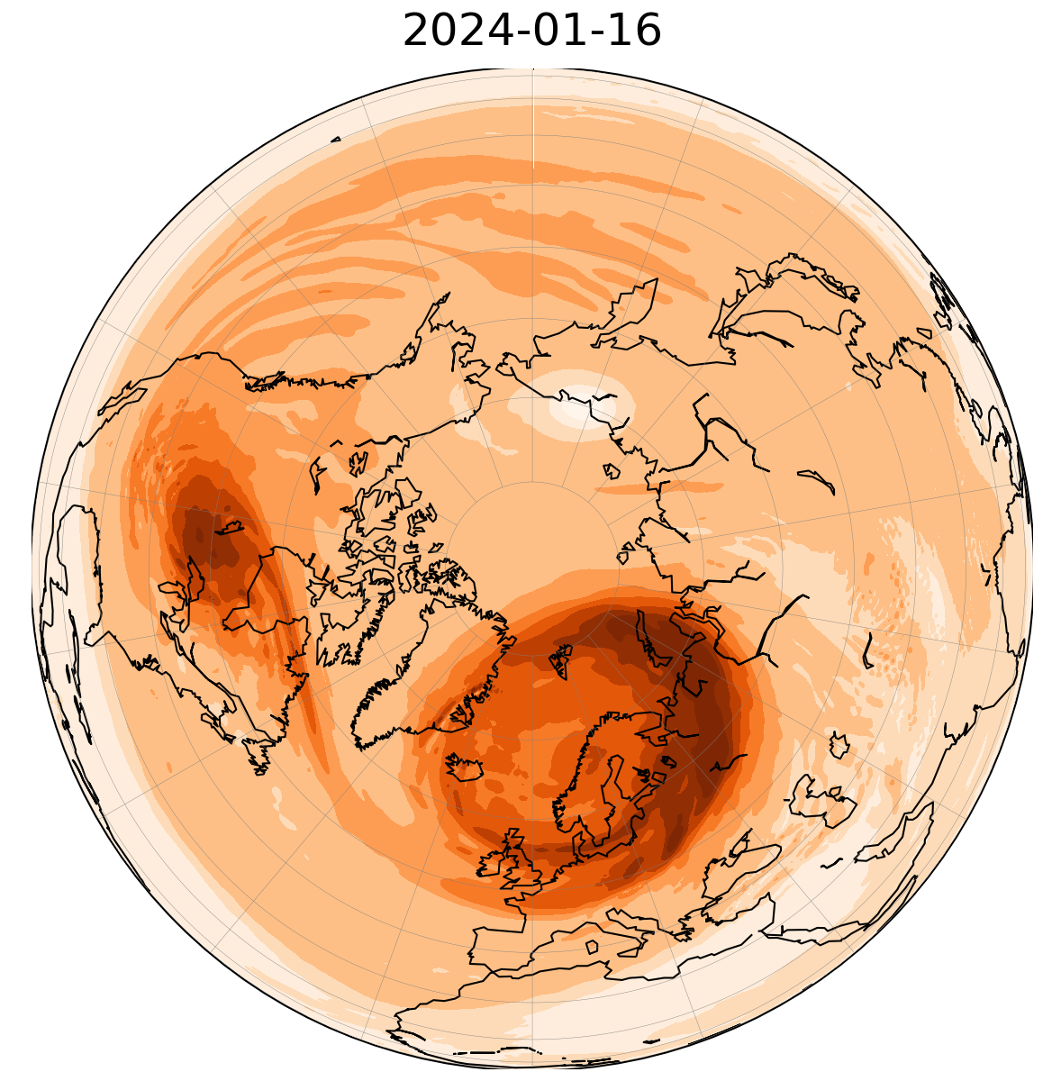
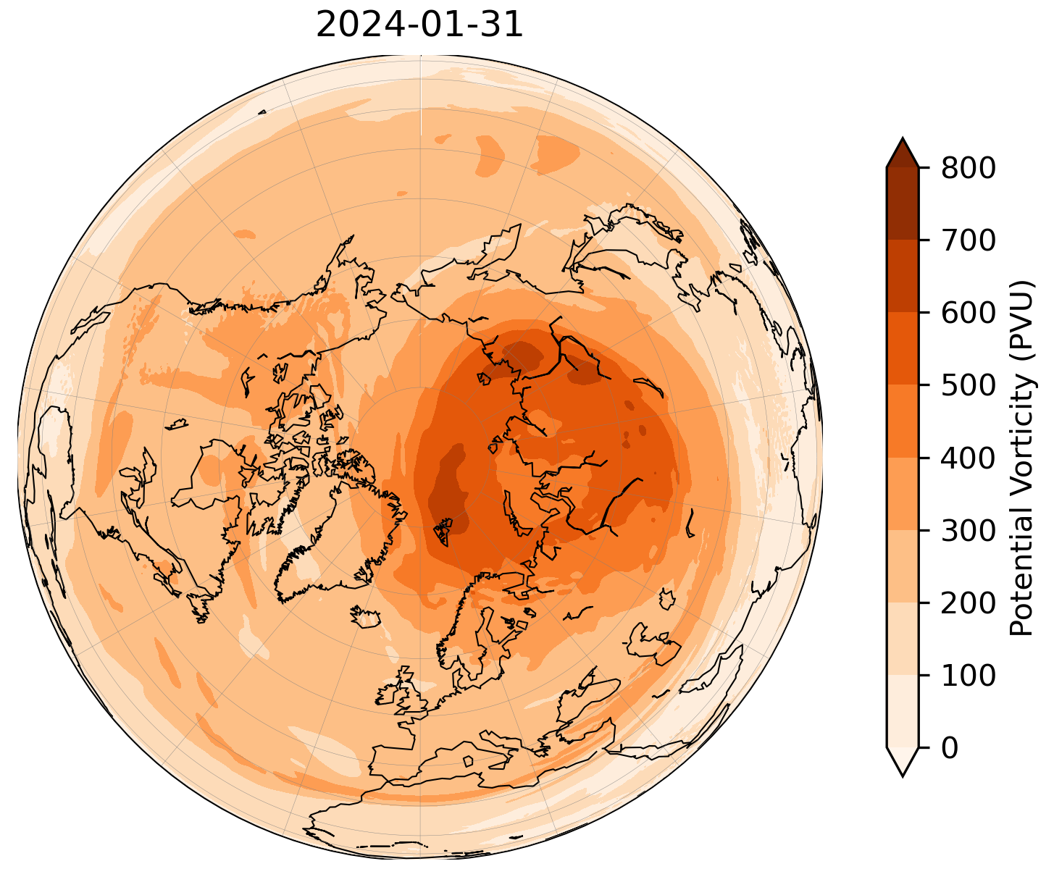
January SSW
At 10 hPa: wind reversal between 14 – 19 January.
Duration: 5 days.
Event type: major, split (16th January).
Timeline:
Early January: deformed polar vortex centered over the Barents Sea.
Mid-January: deformed vortex, splitting in two circulation cores located over the USA/Canada and Norway.
Late January: displaced polar vortex centered over the Kara sea.
Note: At 1 hPa, unstable vortex with three episodes of wind reversal (January 2 – 8, 11 – 14, 17 - 21).
Figure. Daily-mean polar-cap averaged U as a function of pressure and time.
10 hPa Potential Vorticity
Notes:
Minor SSW at 10 hPa on 5 January is the delayed impact from the higher up winds.
Major SSW at 10 hPa on 14 January is a combination of two events from 1 hPa.

Slide 5
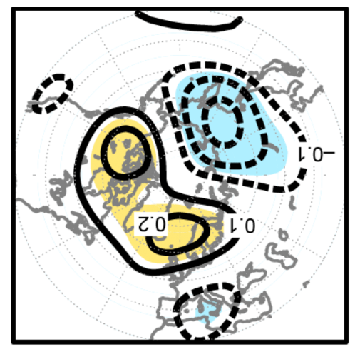
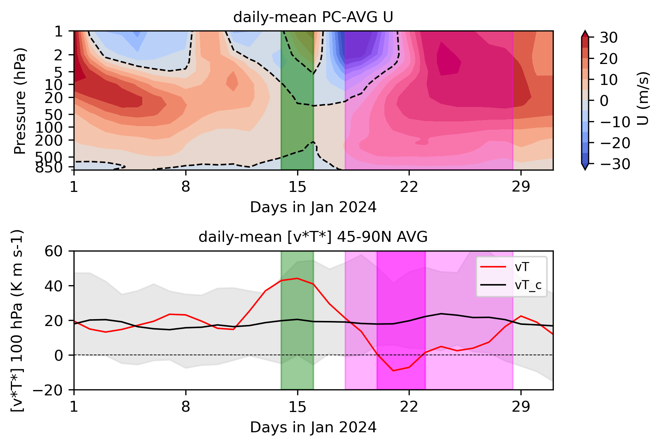
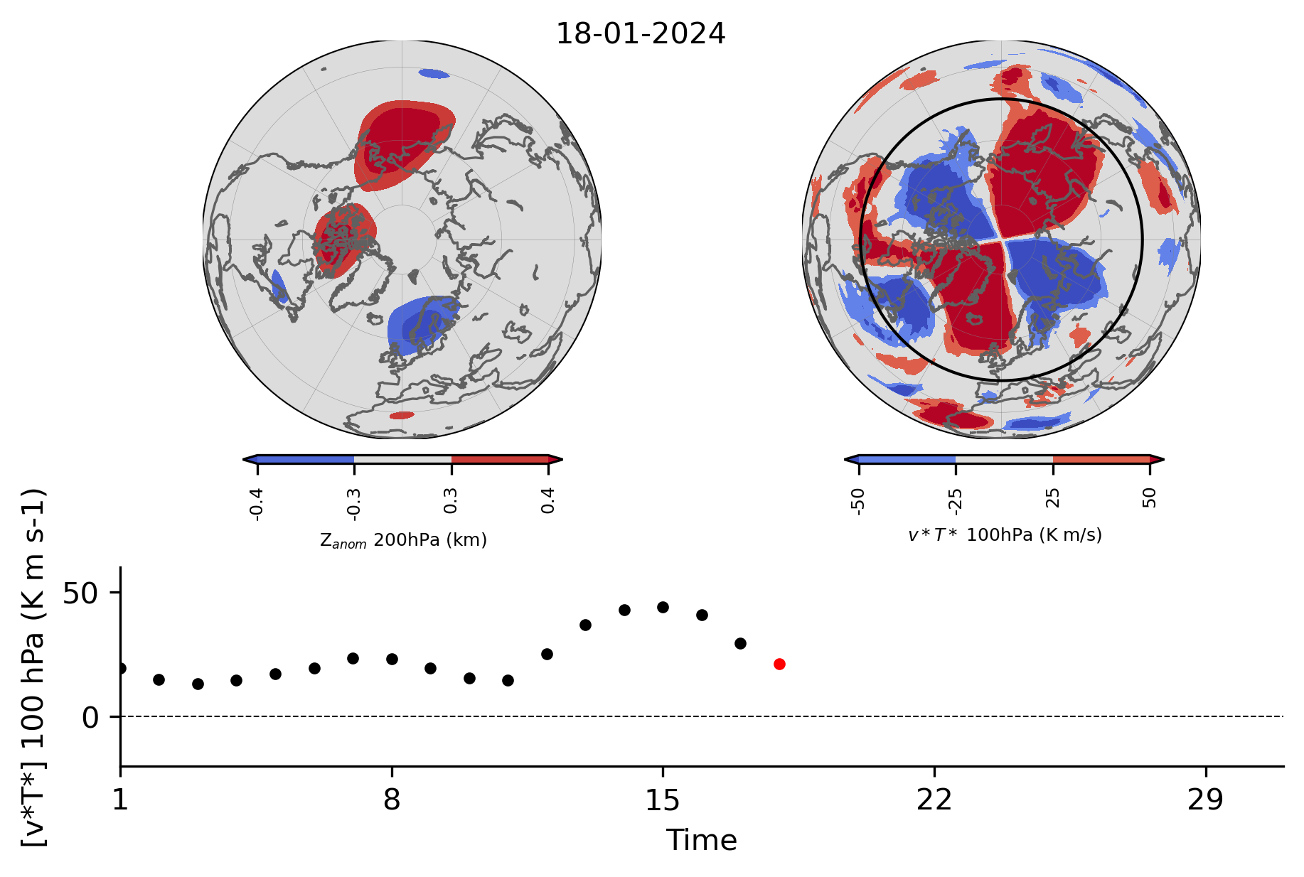
January SSW. Why short?
Previous studies: persistent high-pressure systems (BH) over Euro-Atlantic region increase upward PW activity, whereas BH over the Pacific and Far East suppress upward PW activity (e.g. Nishii et al., 2011; Orsolini et al., 2018).
Zonal-mean meridional eddy heat flux, [v*T*], is proportional to the upward planetary-wave (PW) activity (Andrews et al., 1987).
Increased [v*T*] → polar vortex disturbance; decreased [v*T*] → polar vortex intensification.
Figure. Correlation map of 200hPa geopotential with 100-hPa eddy heat flux [45N,90N]. Credit: Orsolini et al. (2018).
January 2024 – textbook case:
Figure. Daily polar-cap averaged U and zonal-mean eddy heat flux as a function time. Black curve - climatological mean of the eddy heat flux for 2000 - 2022.
Notes:
[v*T*] is often considered as a precursor to extreme stratospheric events (Polvani and Waugh, 2004).

Slide 6
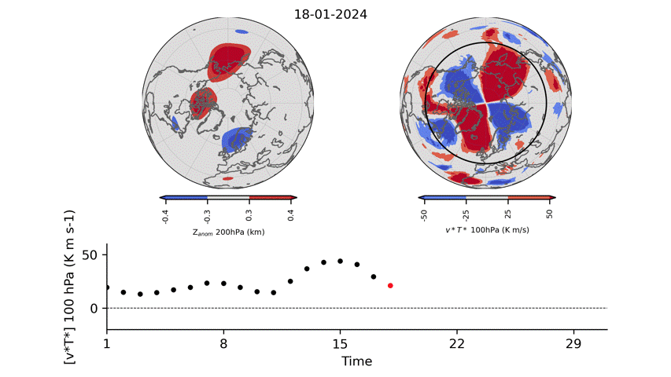
January SSW. Why short?
Previous studies: persistent high-pressure systems (BH) over Euro-Atlantic region increase upward PW activity, whereas BH over the Pacific and Far East suppress upward PW activity (e.g. Nishii et al., 2011; Orsolini et al., 2018).
Zonal-mean meridional eddy heat flux, [v*T*], is proportional to the upward planetary-wave (PW) activity (Andrews et al., 1987).
Increased [v*T*] → polar vortex disturbance; decreased [v*T*] → polar vortex intensification.
Figure. Correlation map of 200hPa geopotential with 100-hPa eddy heat flux [45N,90N]. Credit: Orsolini et al. (2018).
January 2024 – textbook case:
What’s next? Polar vortex recovery → quick termination of SSW event.
Figure. Daily polar-cap averaged U and zonal-mean eddy heat flux as a function time. Black curve - climatological mean of the eddy heat flux for 2000 - 2022.

Slide 7
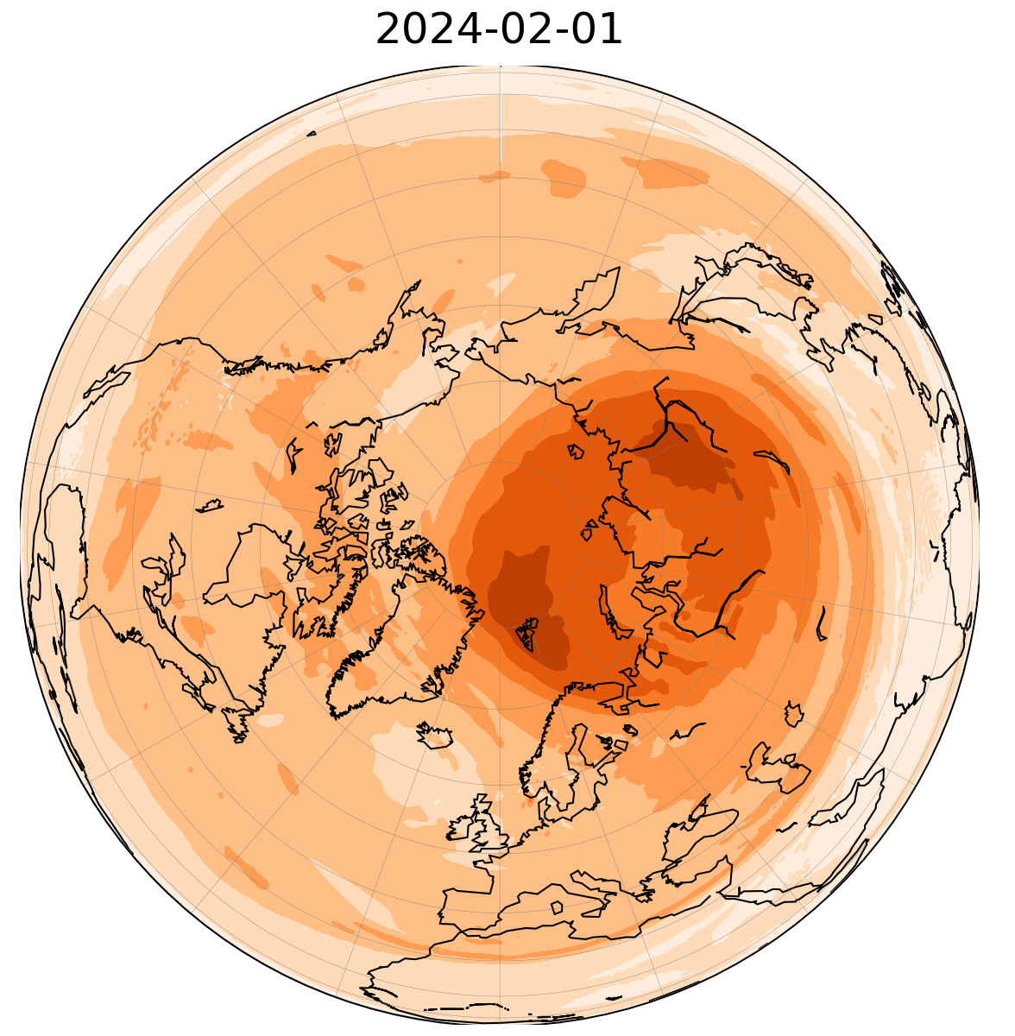
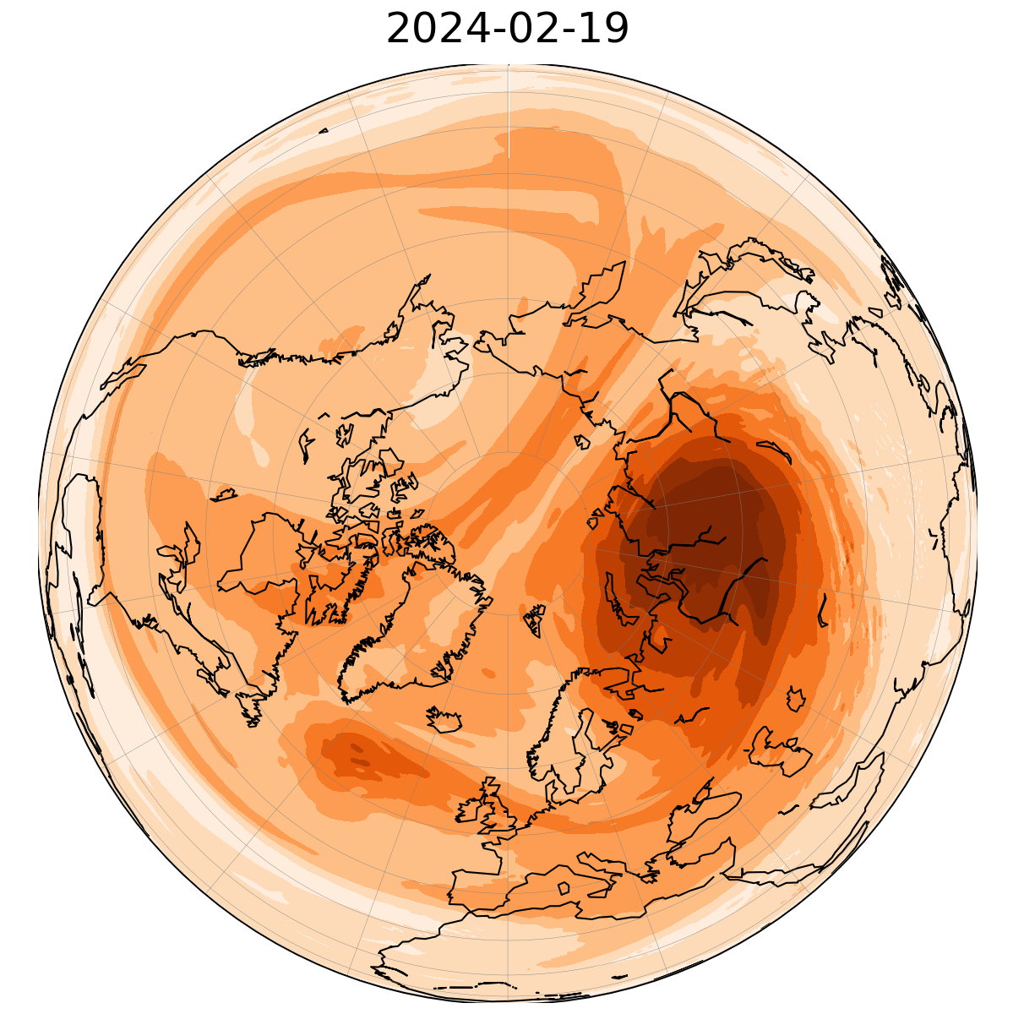
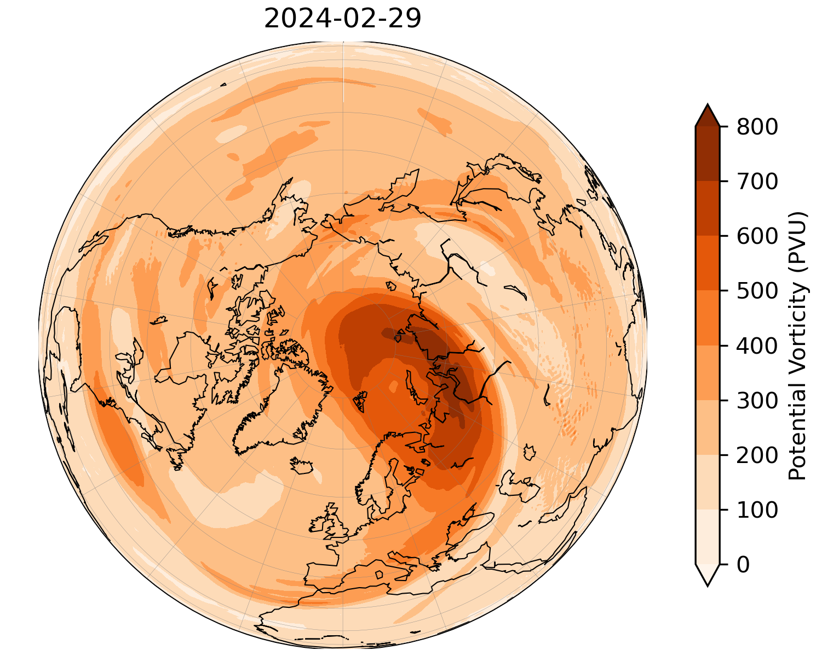
February SSW
At 10 hPa: wind reversal between 16 – 22 February.
Duration: 6 days.
Event type: major, displacement.
Timeline:
Early February: displaced polar vortex centered over the Kara sea.
Mid-February: deformed “comma-shape” polar vortex.
Late February: displaced polar vortex centered over the Barents sea.
Figure. Daily-mean polar-cap averaged U as a function of pressure and time.
10 hPa Potential Vorticity

Slide 8
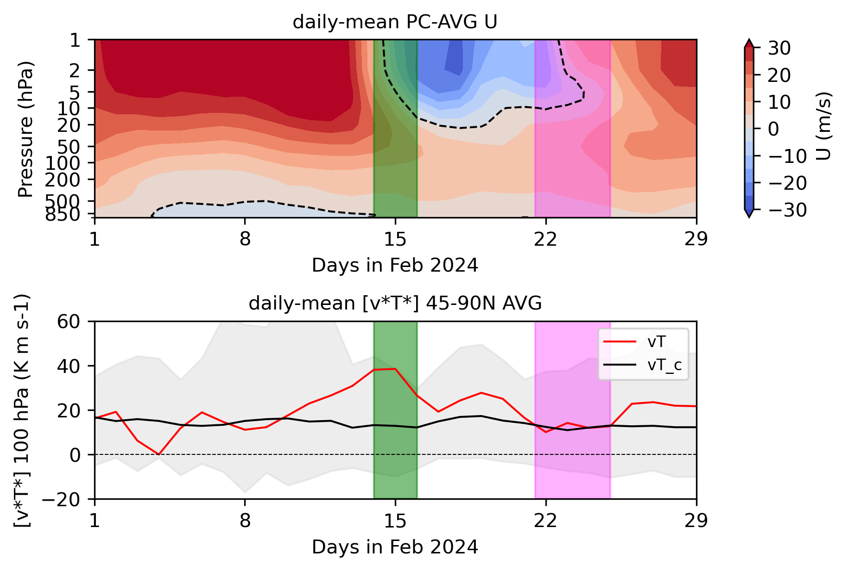
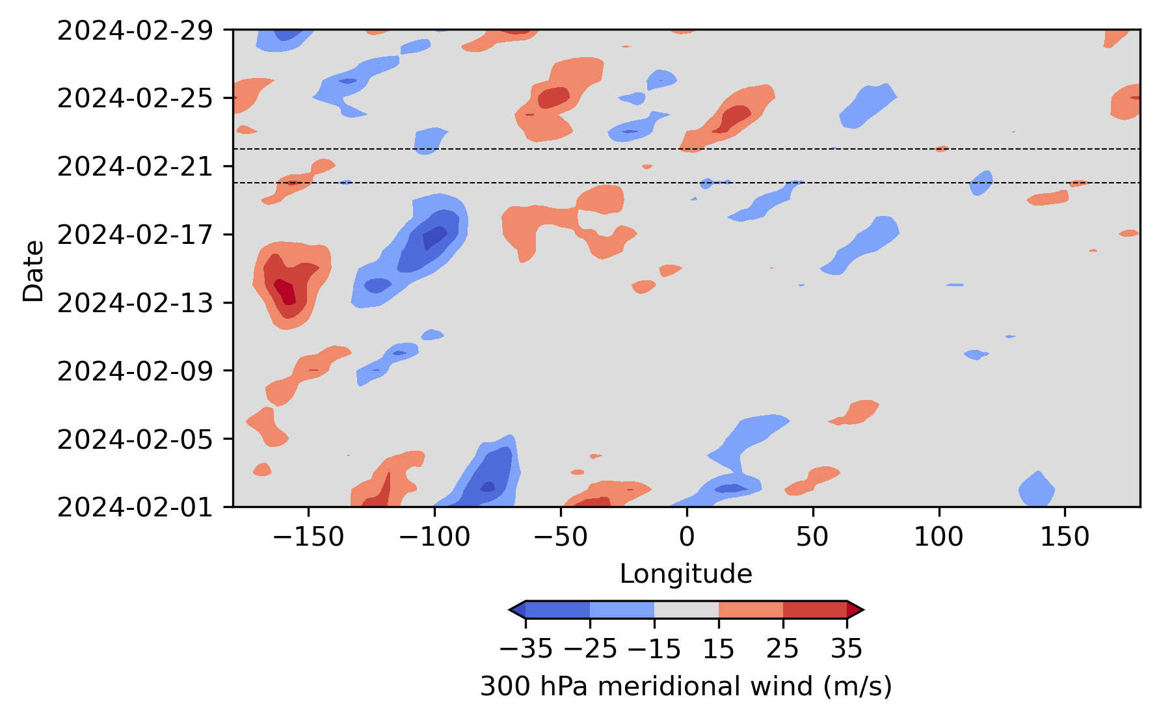
February SSW. Why short?
Reduced upward PW activity around 20 – 22 February.
Want to look at the meridional wind in the higher troposphere.
Hovmöller diagram reveals a relatively “quiet” period with no Rossby wave packets being generated.
Could this allow polar vortex to recover? To be explored.
Reduced PW activity around 20 – 22 February.
Figure. Daily-mean polar-cap averaged U and zonal-mean eddy heat flux as a function time. Black curve shows climatological values of the eddy heat flux for 2000 - 2022.
Figure. Daily-mean 300hPa V wind averaged within 45 – 90 N shown as a function time and longitude.

Slide 9
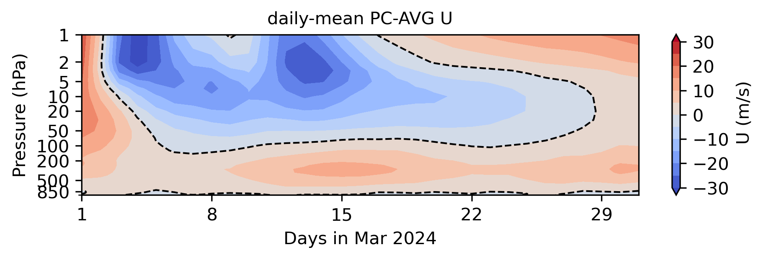
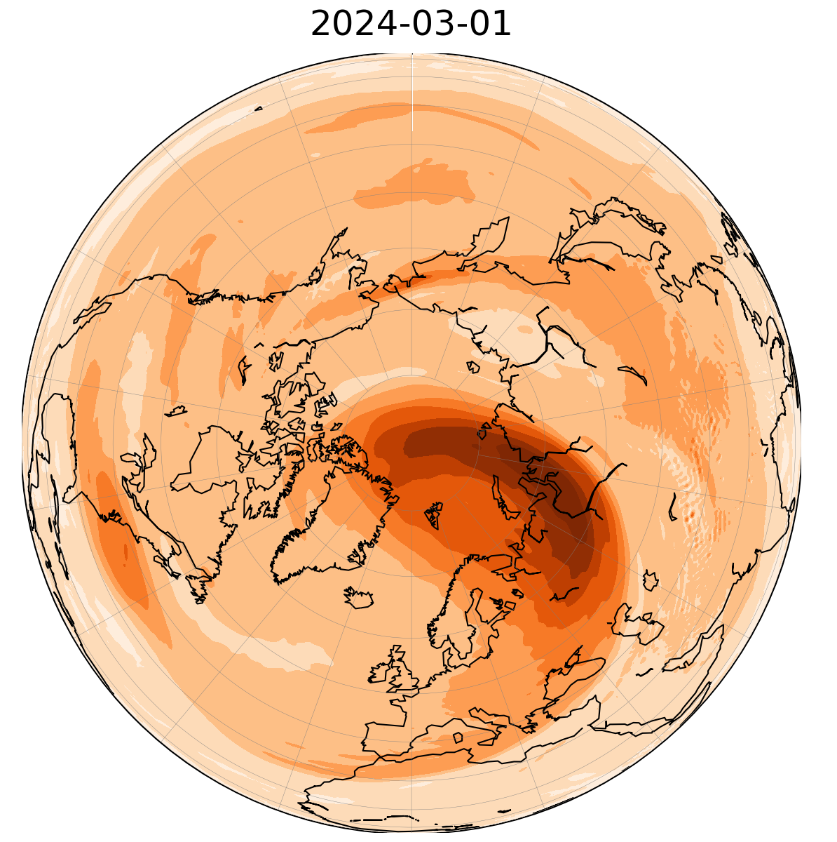
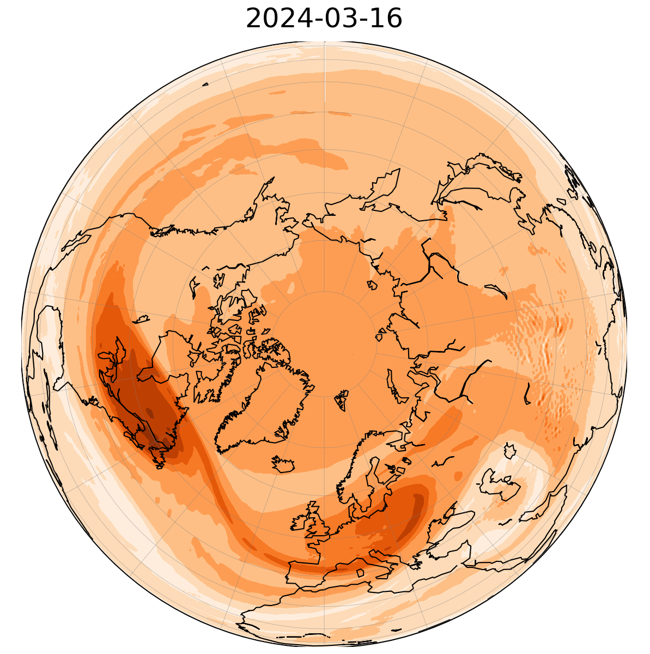
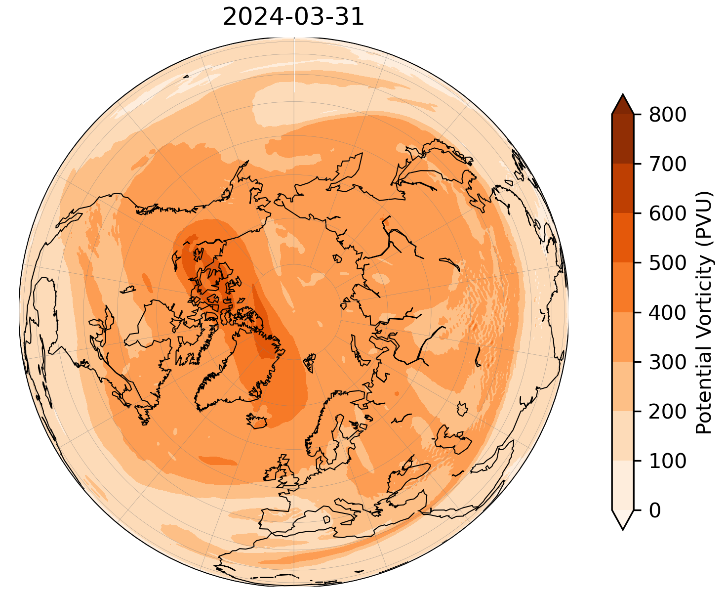
March SSW
At 10 hPa: wind reversal between 3 – 28 March.
Duration: 26 days.
Event type: major, split (15/16th March).
Timeline:
Early March: displaced polar vortex centered over the Barents sea.
Mid-March: deformed vortex, splitting in two circulation cores located over the Hudson Bay and central Europe.
Late March: weak and displaced polar vortex.
“Canonical event”: wind reversal in the entire stratosphere and below.
Figure. Daily-mean polar-cap averaged U as a function of pressure and time.
10 hPa Potential Vorticity

Slide 10
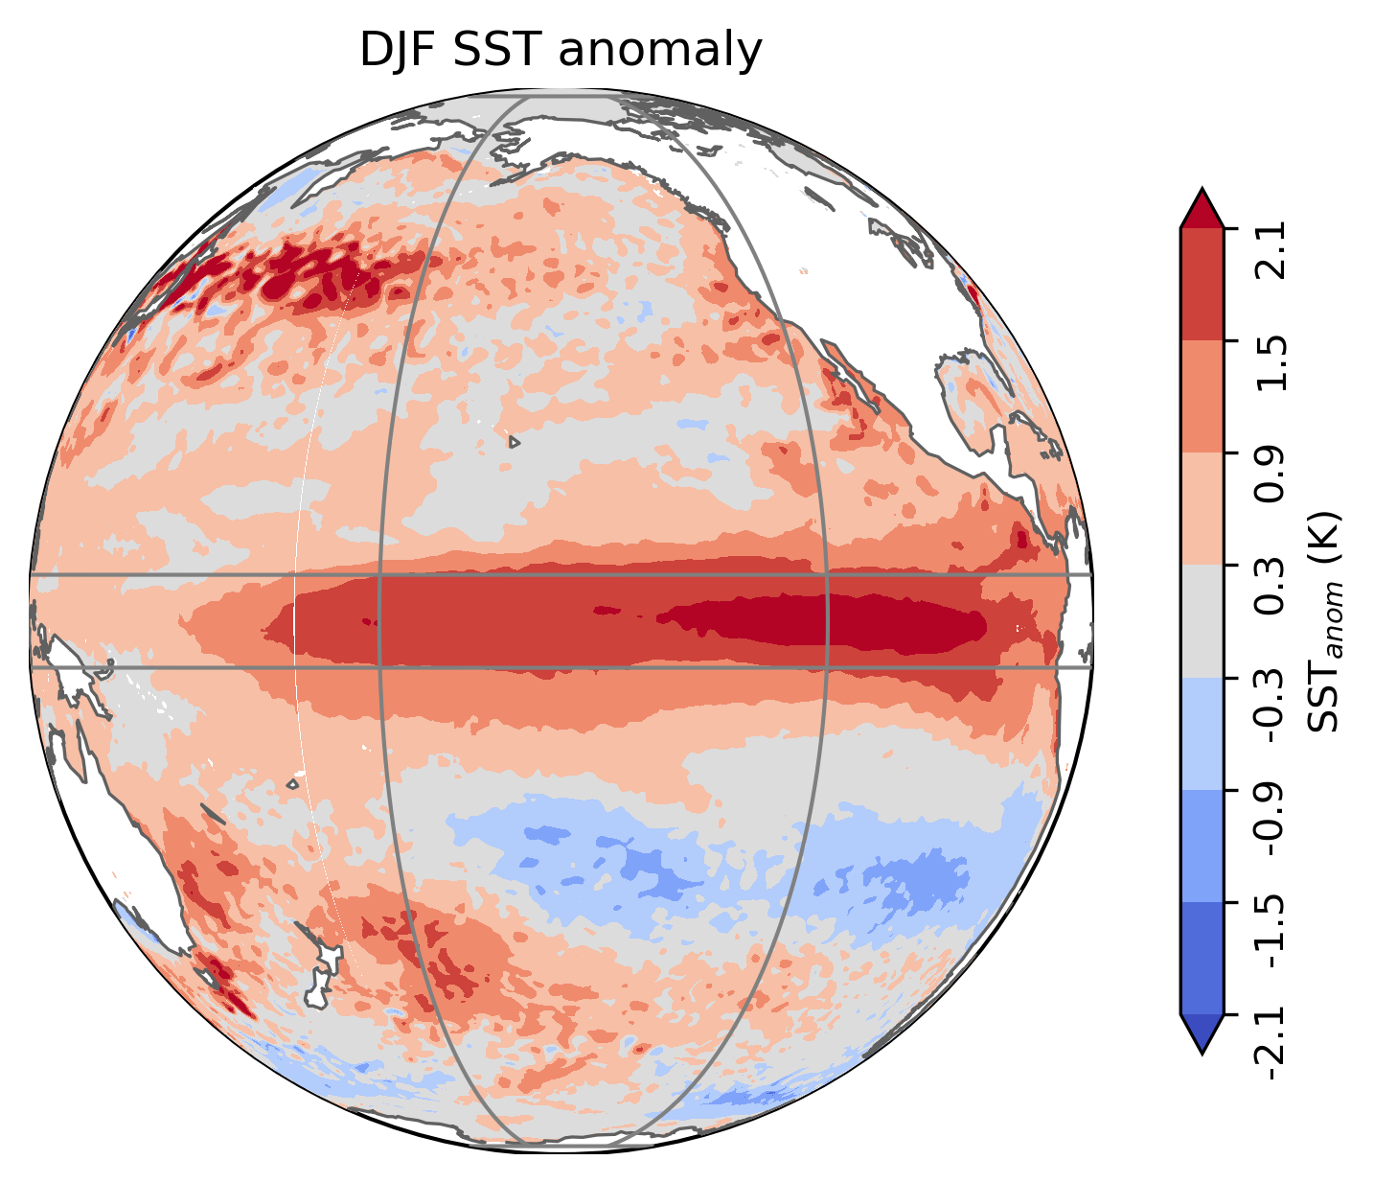
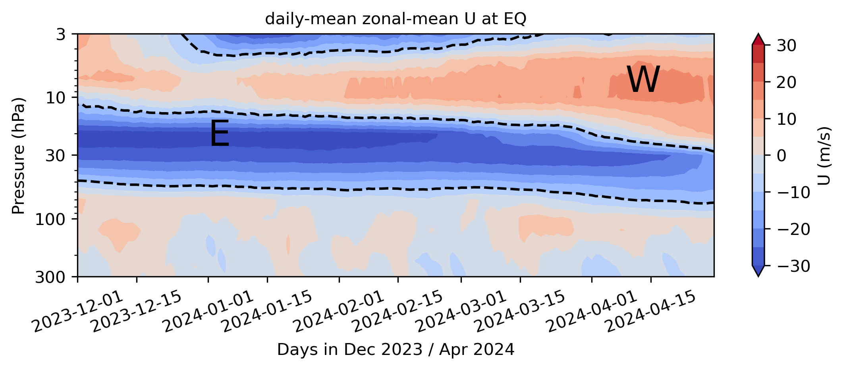
Other players
Table. External influences on SSWs according to Baldwin et al. (2021)
External influences | SSW frequency per winter
QBO | 0.9 (EQBO), 0.5 (WQBO)
ENSO | 0.77 (EN), 0.65 (LN)
Solar cycle | 0.67 (Max), 0.53 (Min)
October snow cover | 0.59
ENSO: El Niño in winter 2023/2024.
QBO: Esterly QBO in late 2023 / early 2024.
5N-5S, 120 – 170 W
Figure. DJF SST anomalies based on ERA5 and 1990 – 2023 climatology.
Figure. Daily-mean zonal-mean U wind at the EQ.

Slide 11
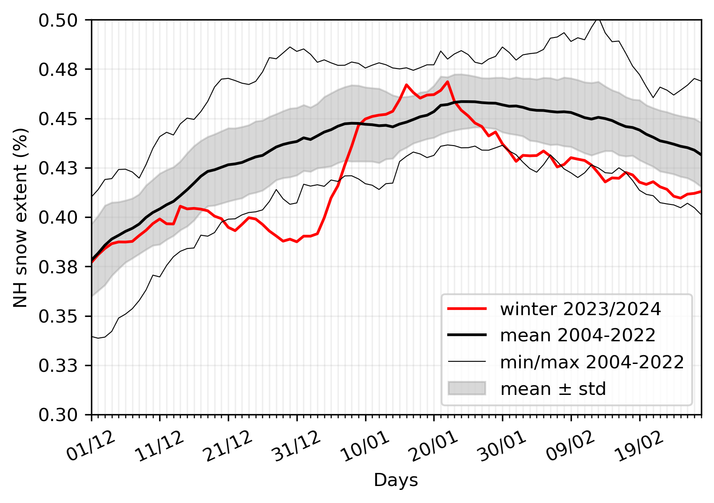
Other players
Table. External influences on SSWs according to Baldwin et al. (2021)
External influences | SSW frequency per winter
QBO | 0.9 (EQBO), 0.5 (WQBO)
ENSO | 0.77 (EN), 0.65 (LN)
Solar cycle | 0.67 (Max), 0.53 (Min)
Increased snow cover | 0.59
Northern Hemisphere snow cover extent:
Solar cycle: solar maximum, cycle 25.
Figure. Sunspot number 1957 – 2030. Observed (black) and predicted (red). Credit: Solar Cycle Progression | NOAA / NWS Space Weather Prediction Center
Figure. Northern Hemisphere snow cover extent in December 2023– February 2024 together with the climatological mean.
Notes:
Snow mechanisms is that changes in surface T horizontal gradients induced by snow presence across Eurasia, modulates PW forcing (Lu Z. et al., J Clim.,2020).

Slide 12
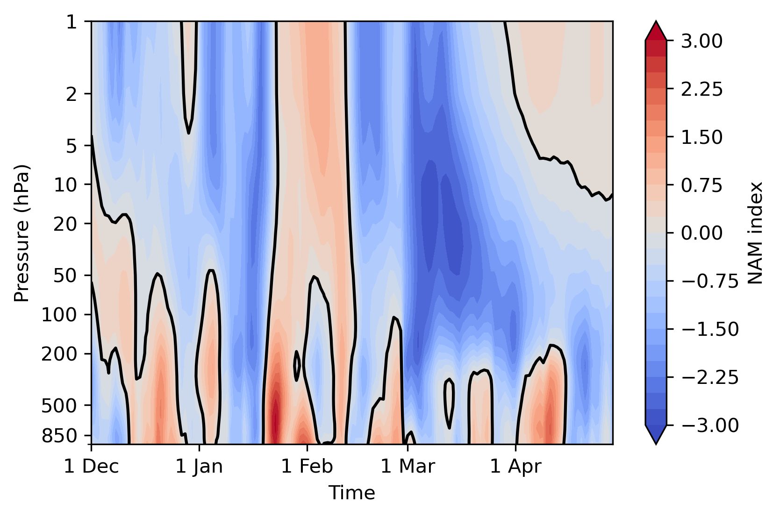
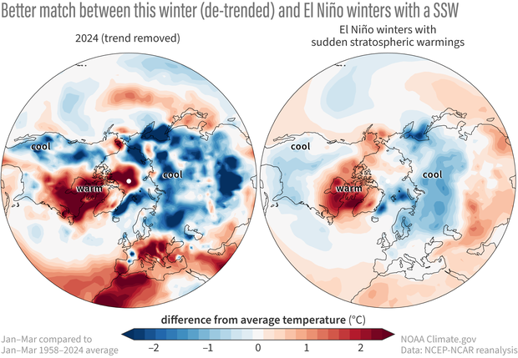
Tropospheric impact
The NAM index is used as an indicator of whether there was a downward migration of the mean circulation following the SSW.
In winter 2023 / 2024, multiple “drips” of the stratospheric signal to the troposphere and the surface.
The surface temperature anomalies is consistent with the pattern of the El Niño winters that had at least one major stratospheric warming event.
Main message: ENSO and the stratosphere had some impact on the January-March temperature pattern.
Figure. January-February-March temperature anomalies from the 1958-2024 average across with the linear temperature trend removed. Credit: Polar Vortex Blog by A. Butler and L. Ciasto.
Figure. NAM index in Dec – April 2023/2024.
Notes:
Tropospheric impact is often discussed in terms of the NAM index and surface temperature anomalies following the SSW.
Surface temperature anomalies: Warmer than average: North America, Alaska, Europe and northern Africa. Colder than average: Asia and the part of the United States.

Slide 13
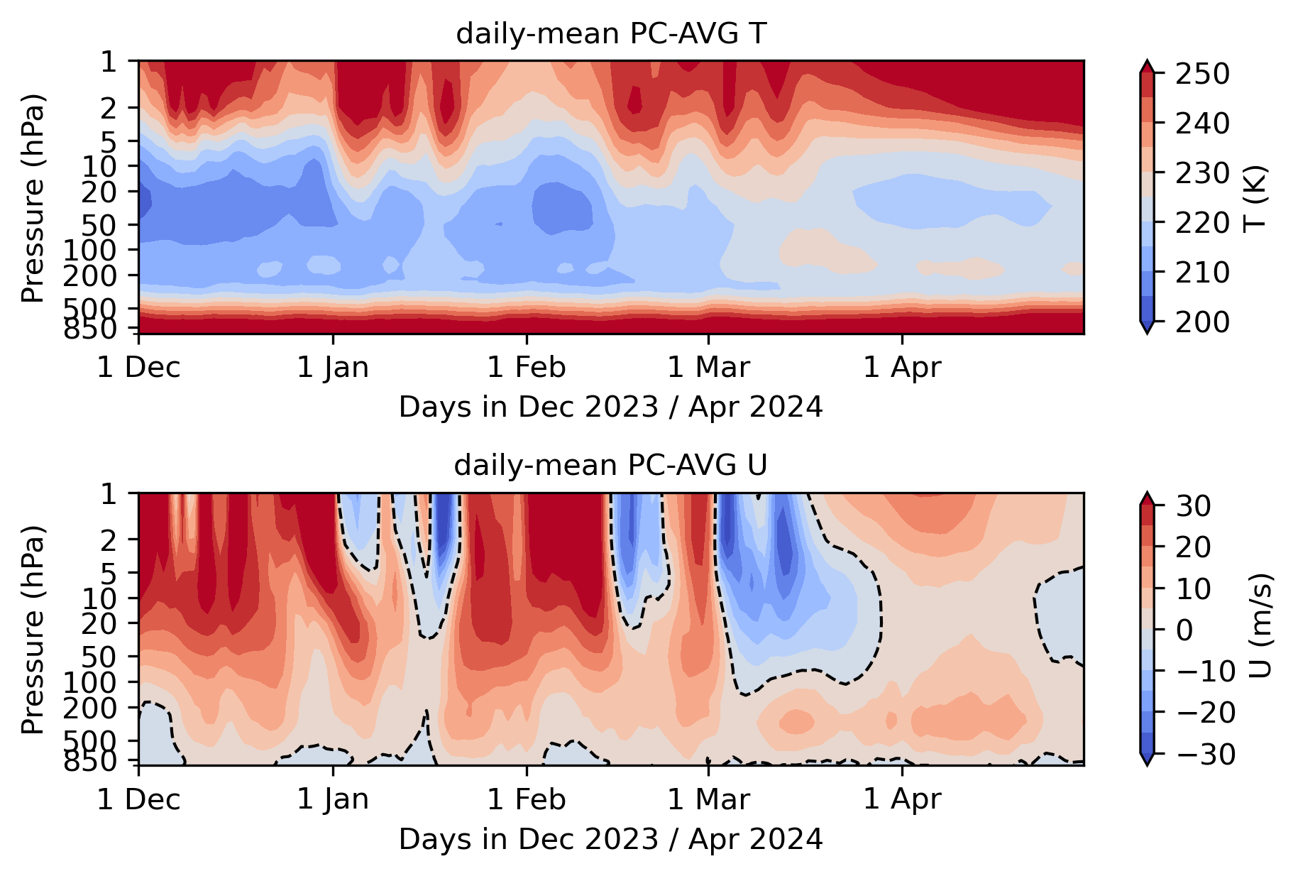
Conclusions
Fascinating stratospheric dynamics in winter 2023/2024.
Depending on the data source and SSW definition, one can identify either 2 or 3 major SSW events.
Having 3 SSWs in one winter is once in 250-years occasion (Ineson et al., 2024).
January SSW: short event (14 – 19 January) of split type. Proposed reason for a quick termination and polar vortex recovery is a persistent high-pressure system over the Pacific.
February SSW: short event (16 – 22 February) of displacement type. Proposed reason for a quick termination is the reduced PW activity, however further research is necessary to identify the exact mechanism.
March SSW: long event (3 – 28 March) of split type. Canonical event with the wind reversal in the entire stratospheric layer, as well as below 100 hPa.
Favorable conditions for SSW generation including external factors like Easterly QBO, El Nino ENSO and solar maximum.
(1)
(2)
(3)

Slide 14
Thank you for attention! Questions?

Slide 15
References
Ineson, S., Dunstone, N. J., Scaife, A. A., Andrews, M. B., Lockwood, J. F., & Pang, B. (2024). Statistics of sudden stratospheric warmings using a large model ensemble. Atmospheric Science Letters, 25(3), e1202.
Charlton, A. J., & Polvani, L. M. (2007). A new look at stratospheric sudden warmings. Part I: Climatology and modeling benchmarks. Journal of climate, 20(3), 449-469.
Nishii, K., Nakamura, H., & Orsolini, Y. J. (2011). Geographical dependence observed in blocking high influence on the stratospheric variability through enhancement and suppression of upward planetary-wave propagation. Journal of Climate, 24(24), 6408-6423.
Orsolini, Y. J., Nishii, K., & Nakamura, H. (2018). Duration and decay of Arctic stratospheric vortex events in the ECMWF seasonal forecast model. Quarterly Journal of the Royal Meteorological Society, 144(717), 2876-2888.
Baldwin, M. P., Ayarzagüena, B., Birner, T., Butchart, N., Butler, A. H., Charlton‐Perez, A. J., ... & Pedatella, N. M. (2021). Sudden stratospheric warmings. Reviews of Geophysics, 59(1), e2020RG000708.

