Slide 1
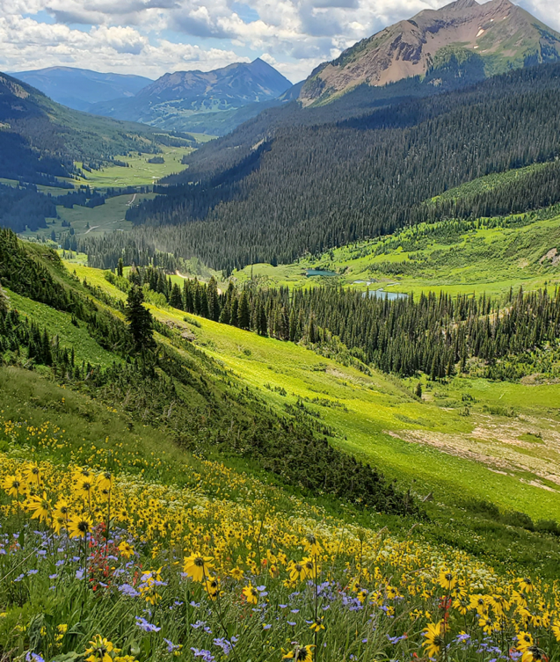
Cooperative Institute for Research in Environmental Sciences
UNIVERSITY OF COLORADO BOULDER and NOAA
Multi-season analysis of the boundary layer structure and evolution in a high-altitude valley in Colorado
Bianca Adler^{1,2} (bianca.adler@noaa.gov), Christopher J Cox², Janet Intrieri², Laura Bianco^{1,2}, Brian Butterworth^{1,2}, Gijs de Boer^{1,2}, Michael R. Gallagher^{1,2}, Ethan Gutmann³, Tilden Meyers⁴, Joseph Sedlar⁵, David D. Turner⁶, James M Wilczak², Vanessa Caicedo^{1,5}
¹CIRES, University of Colorado Boulder ²NOAA Physical Sciences Laboratory ³National Center for Atmospheric Research (NCAR) ⁴NOAA Air Resources Laboratory ⁵NOAA Global Monitoring Laboratory ⁶ NOAA Global Systems Laboratory
Q: What are the flow regimes in the East River Valley?
Main findings:
Thermally driven upvalley wind frequently stops in late morning during the warm season
Deep convective boundary layer grows above ridge height into upper-level flow layer
Depending on upper-level wind direction, flow is channeled in upvalley (long upvalley wind day) or downvalley wind direction (short upvalley wind day)
Approach:
Analyze comprehensive in situ and remote sensing observations from multi-year research initiative in high-altitude watershed in Rocky Mountains

Slide 2
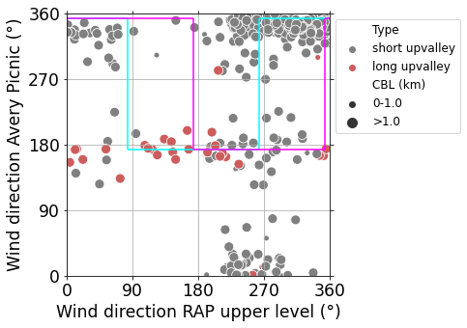
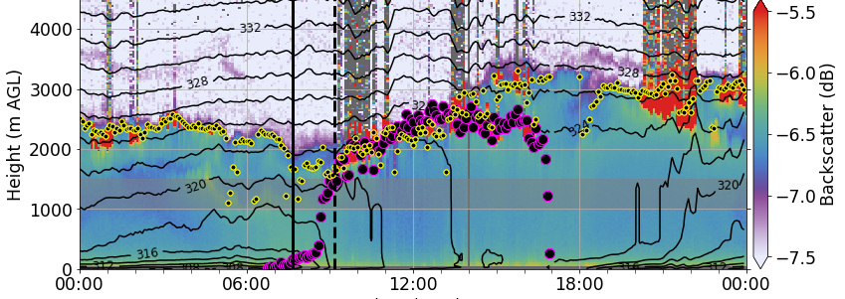
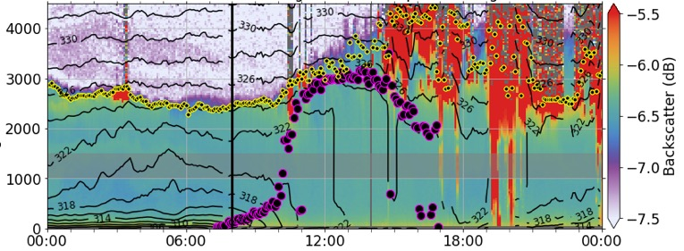
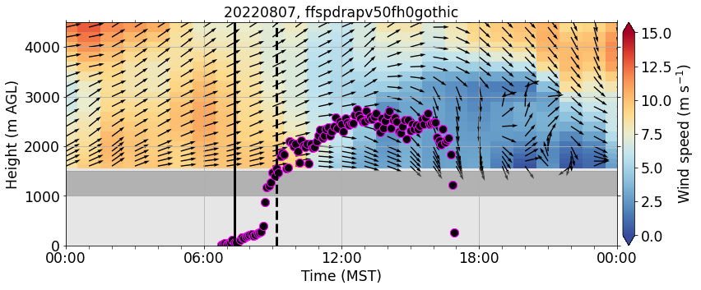
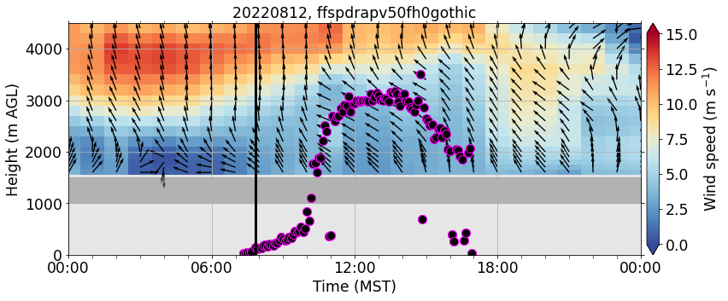
Relationship valley and upper level wind
24 –hr composites of mean wind direction during the warm season
Short upvalley wind day
Long upvalley wind day
Poster ID:
EMS2024-198
Display time:
Monday 08:30-
Tuesday 19:30
Attendance time:
Tuesday
18:00-19:30
Aerosol backscatter (HSRL)
AL
CBL
Start upvalley wind
Ridge height
Start upvalley wind
End upvalley wind
Upper level wind (RAP model analysis)

