Slide 1
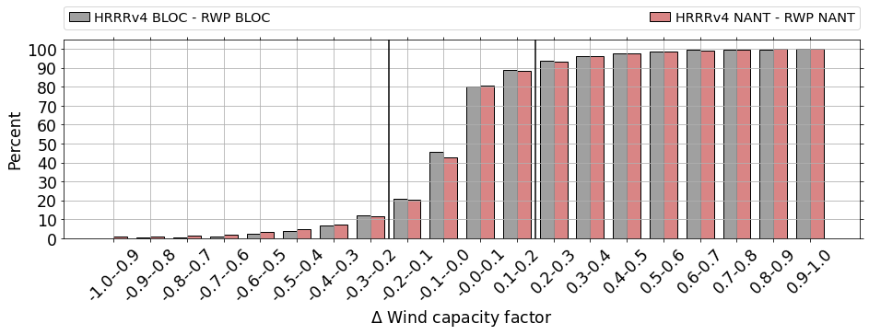
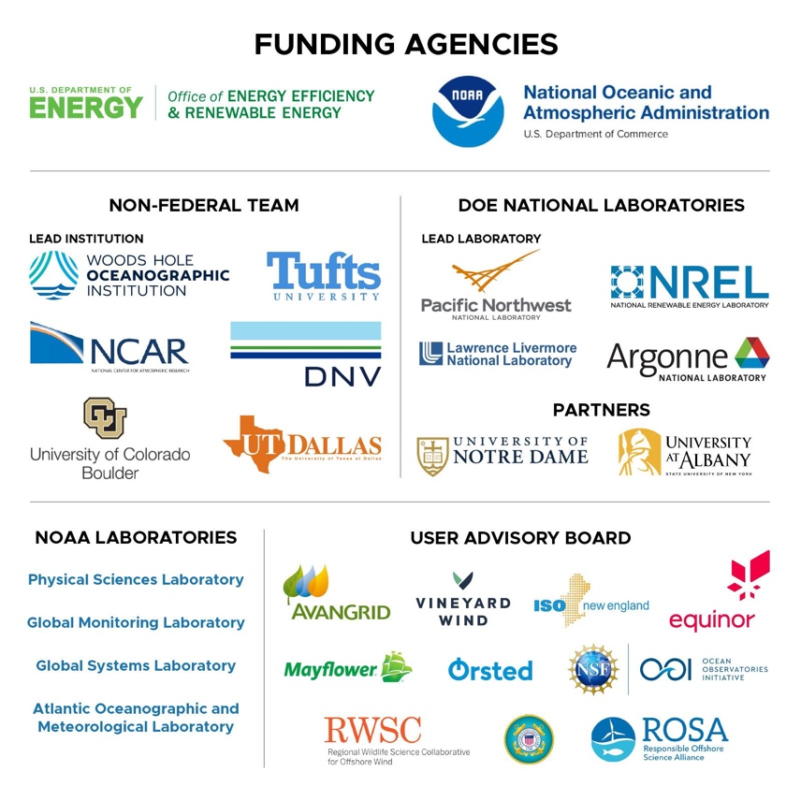
Improving offshore wind forecasts off the coast of New England in the United States - The Third Wind Forecast Improvement Project (WFIP3)
Cooperative Institute for Research in Environmental Sciences
UNIVERSITY OF COLORADO BOULDER and NOAA
Bianca Adler^{1,2} (bianca.adler@noaa.gov), James Wilczak², David D. Turner³, Raghavendra (Raghu) Krishnamurthy⁴, Anthony Kirincich⁵, Laura Bianco^{1,2} , Timothy Myers^{1,2}, Don Murray^{1,2}, Joseph B. Olson³
¹ CIRES, University of Colorado Boulder ² NOAA Physical Science Laboratory ³ NOAA Global Systems Laboratory ⁴ Pacific Northwest National Laboratory (PNNL) ⁵Woods Hole Oceanographic Institution (WHOI)
Ongoing multi-seasonal (18-month long) offshore field campaign off the coast of New England in the Eastern United States
Here: Evaluate NOAA’s operational High-Resolution-Rapid Refresh (HRRR) model for offshore wind forecasts
Approximately 80 % of wind capacity factor errors less than 0.2
..but error in wind capacity factor may be up to 100%

