Slide 1
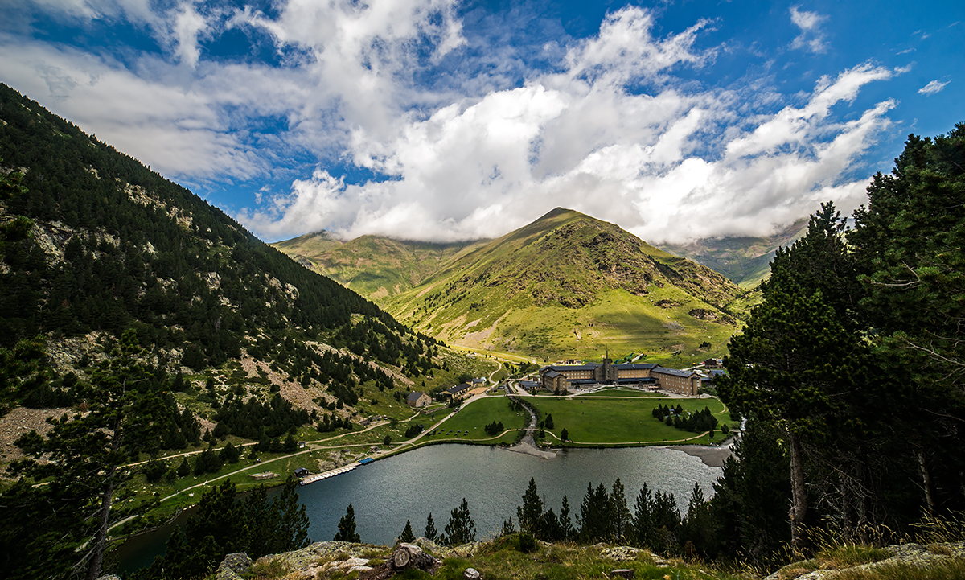
PYRENEES4CLIMA: A New Project to Provide More Reliable Climate Information for the Pyrenees Poster VB9
Marc Prohom and Jordi Cunillera (SMC)
Jean-Michel Soubeyroux (MF)
Sergio Vicente (CSIC)
Xabier Esteban-Alonso (NATURKLIMA)
Eva García-Balaguer and Juan Terrádez (PCCO/CTP)

Slide 2
PYRENEES4CLIMA project
The project addresses the need to implement the Pyrenean Climate Change Strategy: the first European cross-border strategy (in two phases 2030 and 2050).
46 entities involved, total budget of €19,8 million, and 7.5 years of duration.
Five fundamental pillars: Climate, Resilient Natural Areas, Adapted Mountain Economy, Population and Territory, and New Bioregion Climate Governance.
12 WPs.
WP2: Understanding climate impacts... More on that in the poster

