Slide 1
How should the anthropogenic heat be treated in the urban surface energy balance: revisit of the definition of Q_{F}
EMS2024-245
Yukihiro Kikegawa(kikegawa@es.meisei-u.ac.jp)*1,
Hirofumi Sugawara*2, Takuto Kobayashi*1, Naoya Maruyama*3
*1 Meisei University, Japan, *2 National Defense Academy of Japan,
*3 Meteorological Engineering Center, Inc., Japan

Slide 2
Motivation and aims
Amount of anthropogenic heat release from buildings is sometimes assumed to be equal to energy consumption (QF) in buildings (e.g. Oke, 1987).
However, this simple concept ignores the heat loads in rooms (incoming solar radiation through window) and the discharge of heat to the sewage (hot water of bath).
We evaluated heat budget on buildings to test this simplification.
We evaluated the full terms in heat budget on buildings by filed observation. With this results, we also tested the building energy model (BEM) and the heat storage parameterization.

Slide 3
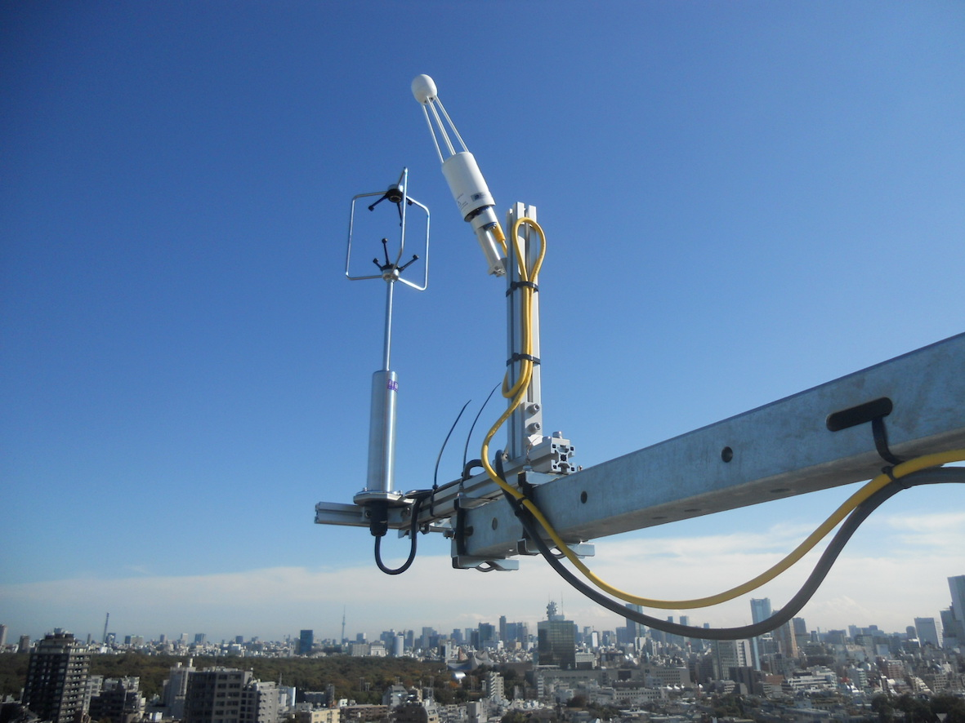
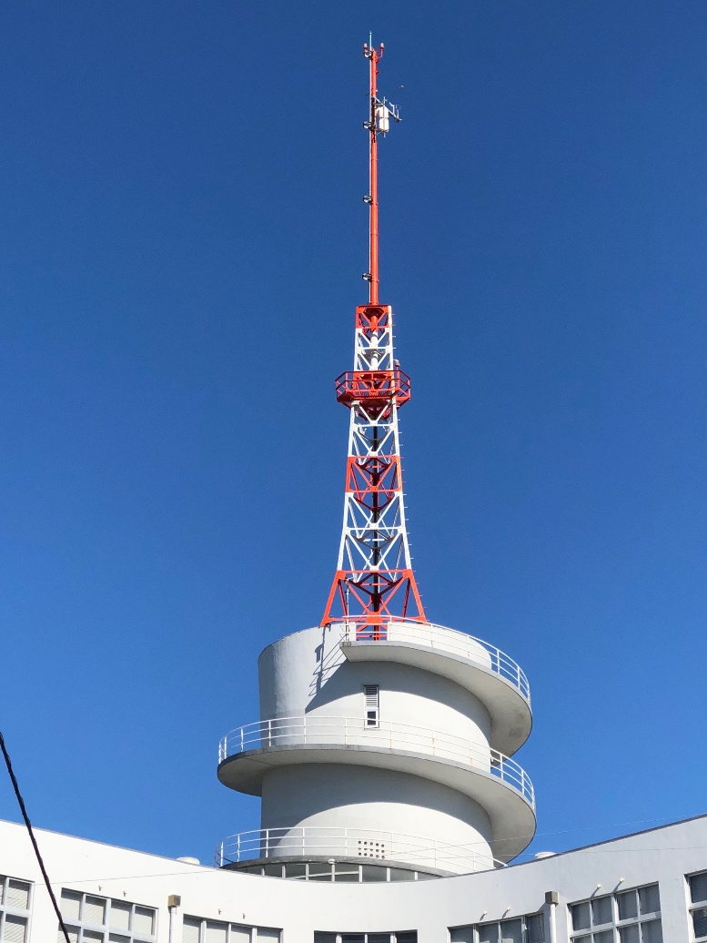
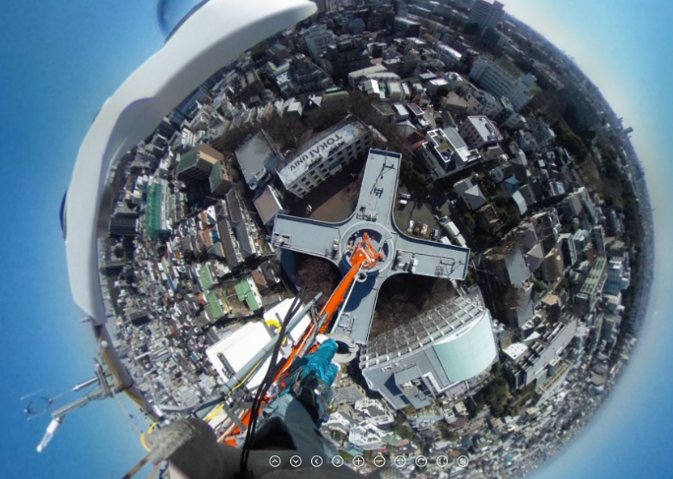
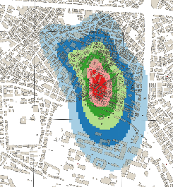
Observation (Yoyogi site, Tokyo)
52m→
radiation
eddy covariance
¹⁴CO₂ (flask)
37m→
O₂, CO₂
10%
26m→
aerosol
40%
50%
60%
JJA
FOV of radiometer

Slide 4
Observation (Yoyogi site, Tokyo)
Land cover : residential area with some office buildings and some green area
State of road traffic : two arterial roads at the east and the north of the site
Building morphology : λp = 0.35, λf = 1.56, building height H =11.1m, aspect ratio H/W = 1.3
Vegetation area : 25% in the flux footprint in JJA
Measurements : eddy covariance (heat, vapor, CO₂), radiation, O₂, ¹⁴CO₂, aerosol
FOV of down-facing radiometer: roof 29%, road 6%, wall 65%
Observation : since 2012 on going (more than 10 years!)
Analysis period in this poster: Jun – Aug in 2015 – 2019
Details: Hirano et al (2015, SOLA DOI:10.2151/sola.2015-024),
Sugawara et al (2021, GRL), Lipson et al (2022, Earth System Science Data),
Kaneyasu et al (2020, ACS Earth and Space Chemistry), Ishidoya et al (2011, ACP)

Slide 5
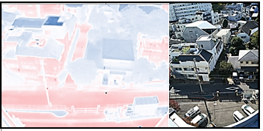
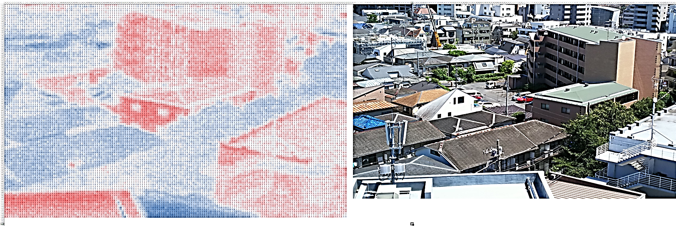
Observational evaluation of anthropogenic heat and heat budget
1) Surface temperature measurement
Two thermal imagers with different orientation (N and S).
Atmospheric correction by LOWTRAN
Pickup typical surface elements (roof, wall, road) and L↑-equivalent temperature was calculated.
Evaluate sensible heat flux from surface QHsfc (it does not include heat emission from car exhausts and ventilation flux through building windows)
$$QH_{sfc}=c_{p}ρC_{H}U\left(T_{S}−T_{a}\right)$$
$$C_{H}=\frac{k^{2}}{ln\left\{{\left(z−d\right)}/{z_{0}}\right\}ln\left\{{\left(z−d\right)}/{z_{T}}\right\}}$$
Zero plan displacement d : Sugawara et al (2014, doi.org/10.14887/kazekosymp.23.0_49)
Roughness length for momentum z0 : Hirano et al (2016 doi:10.14887/kazekosymp.24.0_85)
Roughness length for heat zT : Kanda et al (2007, JAMC)
Sensible heat from urban surface QH_{sfc}

Slide 6
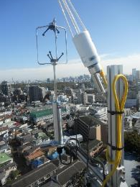
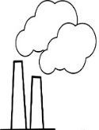
Observational evaluation of anthropogenic heat and heat budget
2) Evaluate anthropogenic heat from building QH_{building}
$$QH_{building}=QH_{ec}−QH_{sfc} −QH_{car}$$
Sensible heat from urban surface QH_{sfc}
Sensible heat flux measurement (eddy covariance) QH_{ec}
Anthropogenic heat from gasoline (QH_{car}) are evaluated based on the CO2 flux (Sugawara et al, 2021, GRL), where heat flux was calculated as
{coefficient of burning [J/mgCO2] } X {CO2 flux [mgCO2 m⁻² s⁻¹]} .
Breaking off for CO2 flux (gas, gasoline, respiration) were done with measured 14C and O2.
¹⁴C
1.95 molecules
1.44 molecules
¹²C
O₂
CO₂
O₂
CO₂
¹²C
¹²C
QH_{building}
fossil fuel respiration
town gas gasoline
Break off fossil fuel
and respiration
Oxygen molecules needed to make a molecule of CO₂
Break off gas and gasoline

Slide 7
Observational evaluation of anthropogenic heat and heat budget
3) Evaluate heat budget in buildings
Determined as residual
$$Q_{∗}+Q_{F}={QH}_{sfc}+{QH}_{building}+QE+ ∆Q_{S}$$
QF : Energy consumption in building (electricity and town gas)
$$Q_{F}(=Q_{elctricity}+Q_{gas})$$
Qelectricity : measured by local electricity provider
QH_{gas} : evaluated based on CO2 flux (Sugawara et al, 2021, GRL).
Full terms in heat budget are determined incl. heat storage in building ΔQs

Slide 8
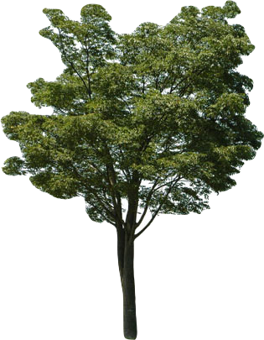
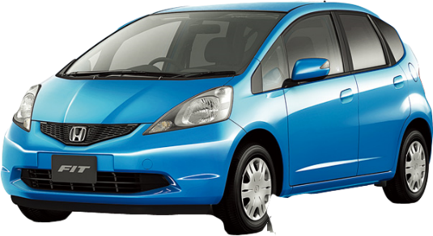
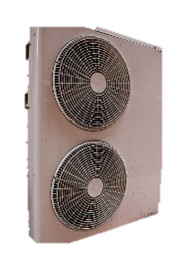
Result 1) Heat flux (Wm⁻², average 09-15 LST JJA)
QH_{ec} 180
Reflected solar
Longwave rad.
519
Q_{F_electricity} 15
Sensible heat from sfc.
Solar rad.
Atmos. rad.
QH_{building} 38
78
Electricity
1,036
QH_{car} 3
Ventilation
0.4
human
car
Latent
Solar rad.
Through windows
appliance
Air conditioner
～20
Heat from cooking & bath
Heat from cooking & bath
Heat storage
Town gas
12
Heat storage
Q_{F_gas} 2
Hot sewage
0.6
128
Anthropogenic heat exhaust from building (QH_building, 38) is not equal to energy consumption in building (electricity & gas, QF, 17).

Slide 9
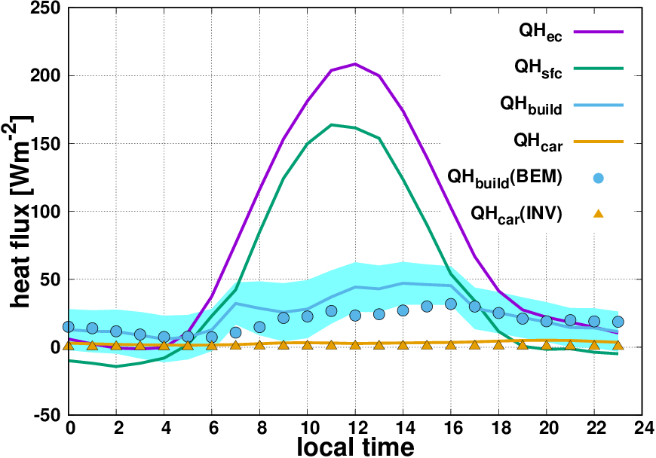
Result 2) Observation agrees with the inventory (INV) and Building Energy Model (BEM).
QHbuild(BEM) are calculated by BEM (Kikegawa 2003 Applied Energy) with meteorological inputs in Yoyogi site.
Shade range in QH_{building} corresponds to 1ºC of SFC temperature error.
QHcar (INV) are based on the car traffic amount around the Yoyogi site.

Slide 10
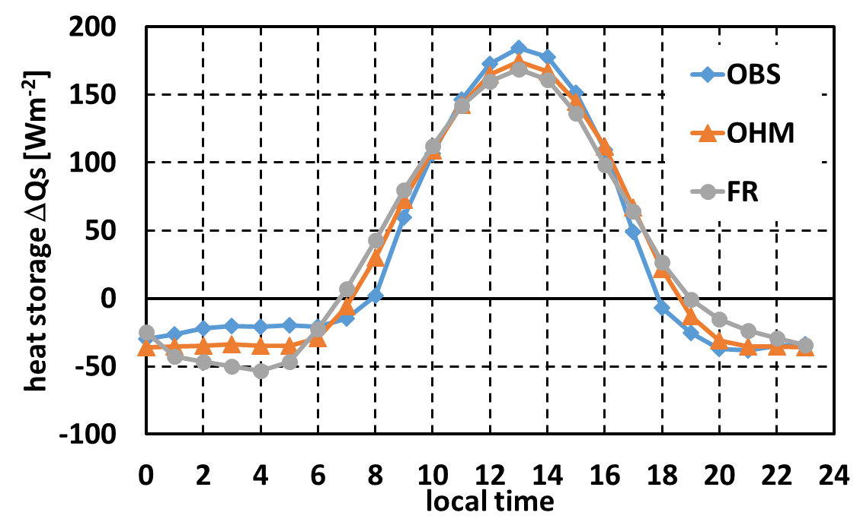
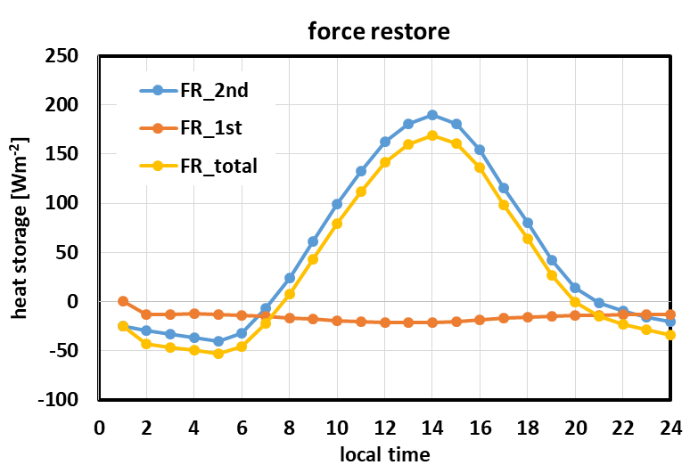
Result 3) Storage heat ΔQs parameterization are validated.
JJA
force
restore
Coefficients are best fitted to the observation.
OHM agrees with the observation better than the force restore.
Force restore result indicates that the surface layer storage (1st term) is much less than the deeper layer conduction (2nd).
OHM (Grimmond et al 1991): $ΔQs={0.37Q}_{∗}−0.25\frac{dQ_{∗}}{dt}−20.9$
Force restore (Deardorff, 1978): $ΔQs=−1.1\frac{dT_{s}}{dt}+15\left(T_{s}−25.6\right)$
Unit of dt is [hour], i.e. dTs/dt in [K h⁻¹] and dQ*/dt in [Wm⁻² h⁻¹]

