Slide 1
From deterministic forecasts to probabilistic impact-based forecasts in meteorology: Theory and practice
Filip Bukowski
Trinity College Dublin

Slide 2
Background
1/11
Hazardous Weather and Their Information Span
Understanding Uncertainty (Gill et al., 2008)
The Role of Perception in Weather Forecasts
The Need for a Shift to Probabilistic Impact-Based Forecasts (WMO, 2021)

Slide 3
Methodology
2/11
Interdisciplinary
Integrative
Review
(Galotti, 2024)
Theoretical
Framework
Establishment
Comparative
Visual
Research
1
2
3

Slide 4
ASTDSV Framework
Spatial
Abstract
Temporal
Dynamic
Verifiable
Sensorial
3/11

Slide 5
Current practice
4/11

Slide 6
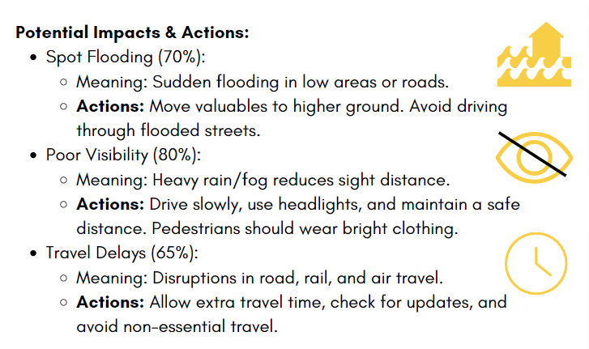
Practical application
5/11

Slide 7
Meteoalarm
6/11

Slide 8
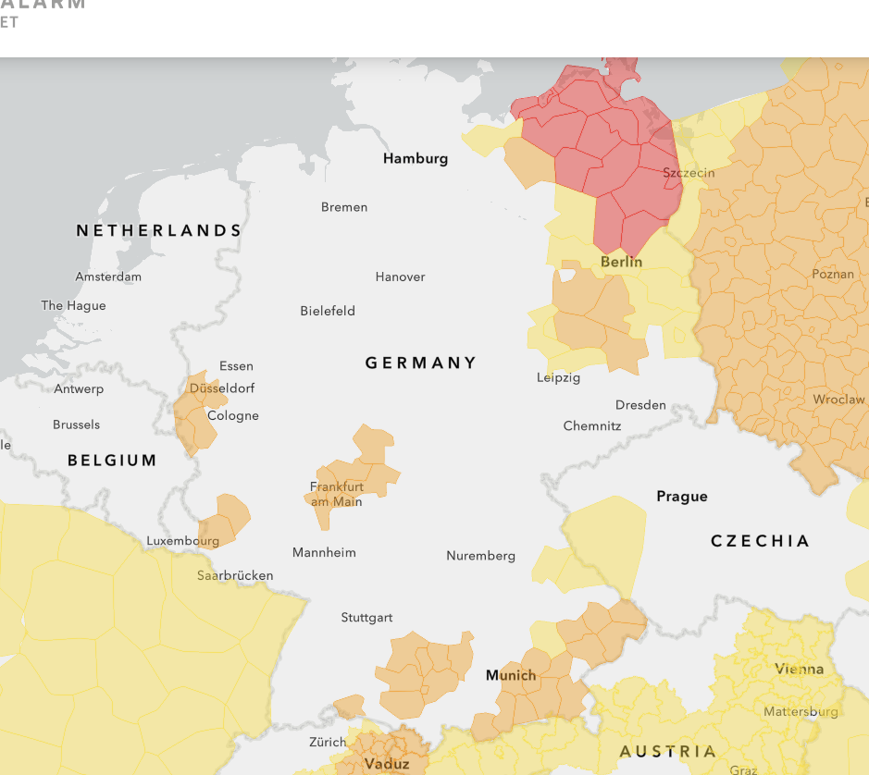
Meteoalarm inconsitencies
7/11

Slide 9
Good practices
8/11

Slide 10
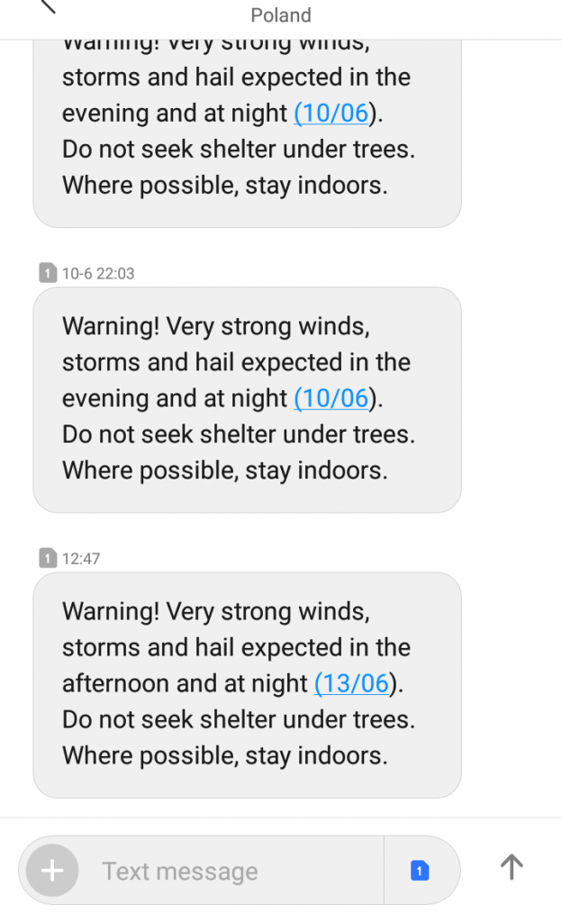
New ways of impact-based warnings
9/11

Slide 11
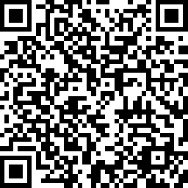
Thank you!
10/11
Questions?
The QR code leads to my current survey – please feel free to engage.
Contact at: bukowskf@tcd.ie

Slide 12
Bibliography
11/11
Bezprawnik (2019, June 13). Nieznany numer pisze po angielsku? Spokojnie, to tylko alert RCB; Bezprawnik.pl. https://bezprawnik.pl/alerty-rcb/
CHMI (2024). Alerts. (2024). Chmi.cz. https://www.chmi.cz/files/portal/docs/meteo/om/vystrahy/index.html
Galotti, M. (2024). Towards a Framework for Interdisciplinary Integrative Research, 6 May 2024 | Resilient and Just Systems | University of Helsinki. University of Helsinki. https://www.helsinki.fi/en/projects/resilient-and-just-systems/events/towards-framework-interdisciplinary-integrative-research-6-may-2024
MeteoAlarm | Early Warnings for Europe. (2024). Meteoalarm.org. https://www.meteoalarm.org/en/live/
Potuck, M. (2022, October 24). Carrot Weather gains support for Live Activities - 9to5Mac. 9to5Mac. https://9to5mac.com/2022/10/24/carrot-weather-live-activities/
Warnings & Advisories - Met Éireann - The Irish Meteorological Service. (2023). Www.met.ie. https://www.met.ie/warnings-today.html
Wetter und Klima - Deutscher Wetterdienst - Warnings. (2024). Www.dwd.de. https://www.dwd.de/EN/weather/warnings/warnings_node.html

