Slide 1
Session UP2.7 - Multi-scale transport and exchange processes
in the atmosphere over mountains
Comparison of wind profiles in the operational ICON-D2 analysis data with Doppler wind lidar observations in complex topography from the Swabian MOSES 2023 campaign
Nguyen, D., Thomas, J., Gasch, P., Oertel, A. (in cooperation with KITcube Team and DWD)
Institute of Meteorology and Climate Research Tropospheric Research
Karlsruhe Institute of Technology (KIT), Karlsruhe, Germany

Slide 2
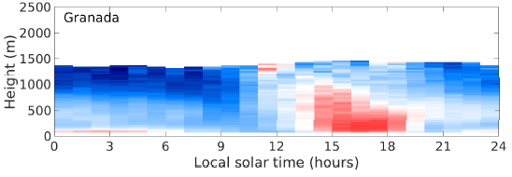
Introduction
Why do we need systematic validation of the regional convection-permitting analysis data
of German Weather Service (ICON-D2-analysis data)?
Forecasting convective summer-time conditions remains
a challenge Clark et al., 2016, Durran and Weyn, 2016
Systematic examination of the quality of analysis and
forecast data using observations over complex terrain is rare.
Forecasts/analysis data can be biased and/or have
large errors, especially in complex terrain
Pentikäinen et al. 2023, Bugnard et al., 2023
Convection is frequently initiated in Black Forest region
Kunz and Puskeiler, 2010, Fluck et al. 2021
Flat terrain
Wind speed bias
Complex terrain
(Pentikäinen et al. 2023).
Duc Nguyen

Slide 3
Introduction
Why do we need systematic validation of the regional convection-permitting analysis data
of German Weather Service (ICON-D2-analysis data)?
Forecasting convective summer-time conditions remains
a challenge Clark et al., 2016, Durran and Weyn, 2016
Systematic examination of the quality of analysis and
forecast data using observations over complex terrain is rare.
Forecasts/analysis data can be biased and/or have
large errors, especially in complex terrain
Pentikäinen et al. 2023, Bugnard et al., 2023
Convection is frequently initiated in Black Forest region
Kunz and Puskeiler, 2010, Fluck et al. 2021
What is research question?
How well is the mesoscale circulation represented
in ICON-D2 analysis data in the Black Forest region?
Flat terrain
Wind speed bias
Complex terrain
(Pentikäinen et al. 2023).
Duc Nguyen

Slide 4
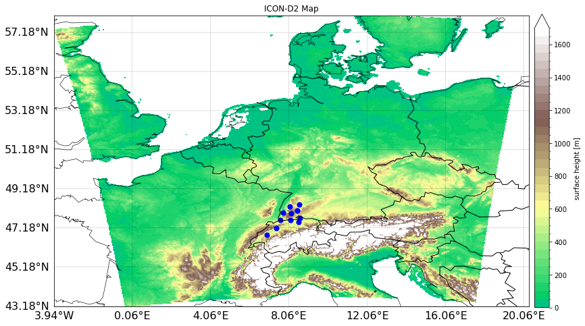
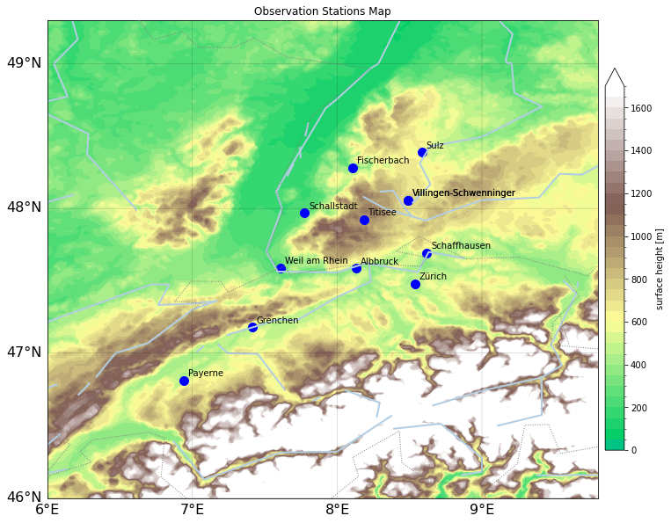
Data & Method - Analysis
What is the ICON-D2-analysis data?
Domain: 3.9W - 20.3E & 43.2N - 58.1N
Resolution: 2.2 km x 2.2 km x 65 vertical levels (R19B07)
Variables: Vertical profiles of zonal/meridional wind
Temporal resolution: 1h
ICON-D2 domain
Measurement region
Duc Nguyen

Slide 5
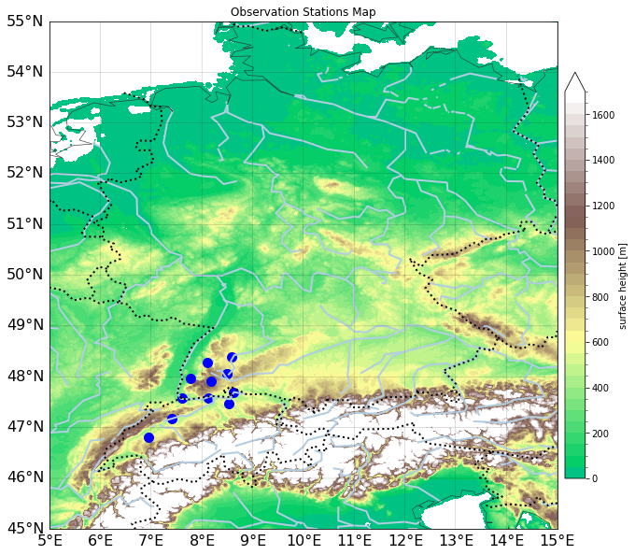
Data & Method - Observations
Swabian MOSES 2023 (JJA 2023)
Purpose:
Investigate the formation, development and impacts of convective storms
Observations will be combined with modeling and
data assimilation methods
Partners: German Universities, German Weather Service (DWD)
Study area: Southeastern Black Forest, Neckar Valley and
Swabian Alb
Dopper Wind Lidar (DWL)
12 DWLs in the Black Forest region and Switzerland
Vertical profiles of zonal/meridional wind
10-min profiles
Comparison to ICON-D2 analysis data retrieved from the nearest
neighbor grid point DWLs scans at each full hour
Blue points depict DWL sites
Duc Nguyen
Notes:
Tell audiences:
How many data, where they are, … measurements,….
Mention: what is

Slide 6
Data & Method
Verification metrics
Bias=$\frac{1}{N}\sum_{i=1}^{N}{\left(U_{O_{i}} −U_{A_{i}}\right)}$ (1)
Mean Absolute Error (MAE)
MAE= $\frac{\sum_{i=1}^{N}{|U_{O_{i}} −U_{A_{i}}|}}{N}$ (2)
Correlation coefficient (R)
R= $\frac{\sum_{i=1}^{N}{(U_{o_{i} }−\overline{U_{o}})(U_{a_{i} }−\overline{U_{a}})}}{\sqrt{{\sum_{i=1}^{N}{(U_{o_{i} }−\overline{U_{o}})}}^{2}{\sum_{i=1}^{N}{(U_{A_{i} }−\overline{U_{A}})}}^{2}}}$ (3)
Where:
N: number of data points
U_{o} : observed wind speed
U_{A} : analysis wind speed
$\overline{U_{O}}$ , $\overline{U_{A}}$ : mean of the values of the U_{o} -, U_{A} -variable
Duc Nguyen

Slide 7
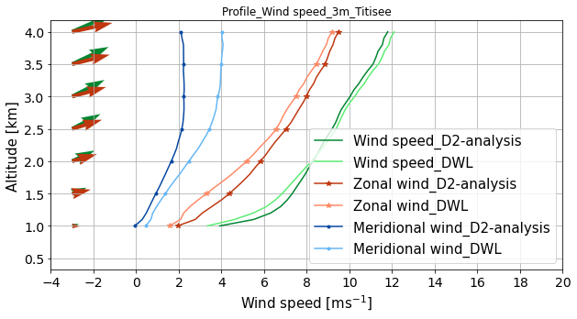
Mean wind characteristics during campaign
Vertical profile of horizontal wind
Complex
terrain
D2-analysis
DWL
7
Duc Nguyen

Slide 8
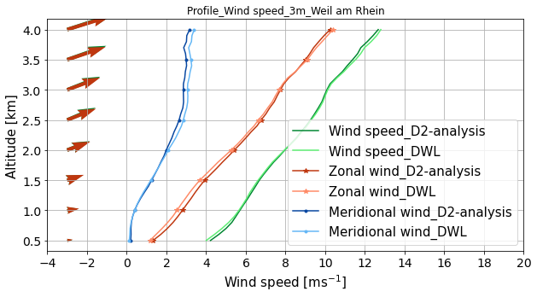
Mean wind characteristics during campaign
Vertical profile of horizontal wind
Complex
terrain
D2-analysis
DWL
Flat
terrain
Wind speed in ICON-D2 agrees relatively well with DWL
Differences are
small for the site in flat terrain,
and larger for the site in complex terrain
--> Systematically compare ICON-D2 with DWL all sites
D2-analysis
DWL
8
Duc Nguyen

Slide 9
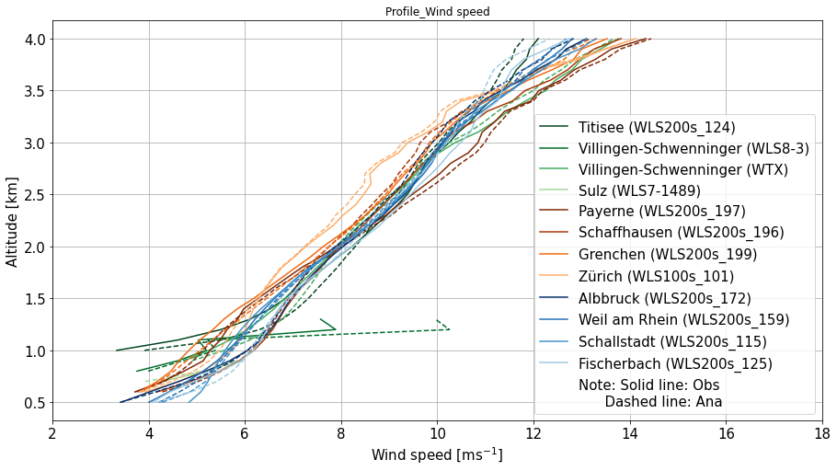
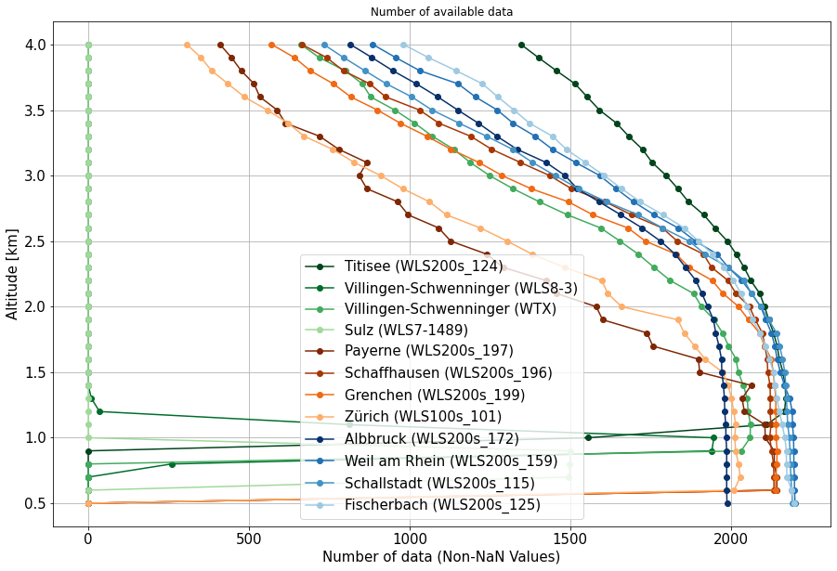
Mean wind characteristics during campaign
Vertical profile of horizontal wind
Wind speed
Number of observations
Solid line: Obs
Dashed line: Ana
Wind speed characteristics similar between all sites
ICON-D2 and DWL agree relatively well at all sites
9
Duc Nguyen

Slide 10
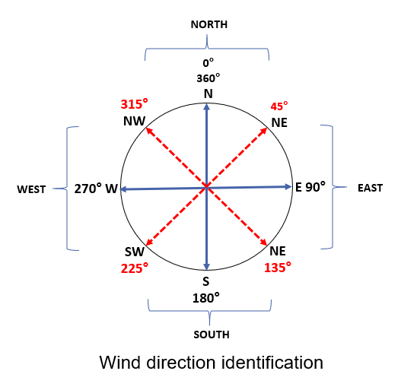
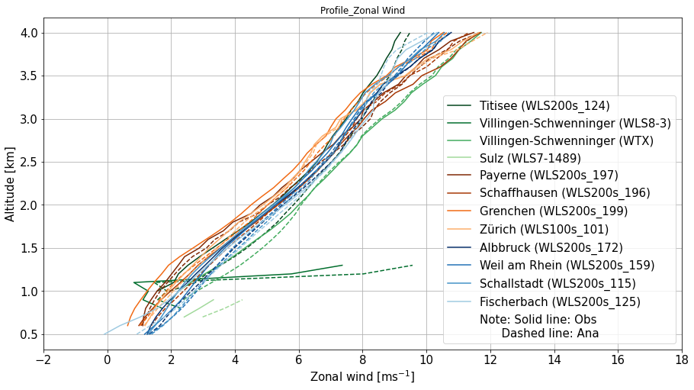
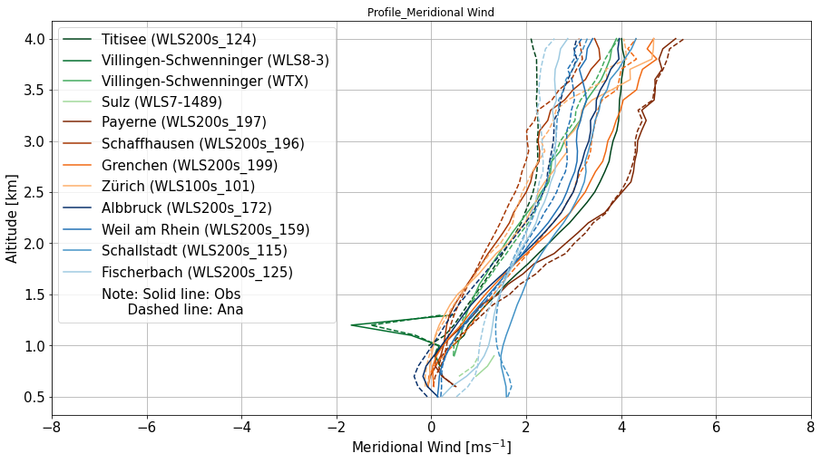
Mean wind characteristics during campaign
Vertical profile of horizontal wind
Zonal wind
Solid line: Obs
Dashed line: Ana
Meridional wind
Campaign period dominated by Southwesterly flow conditions
Wind direction agrees between sites
Wind direction more zonal at higher altitude
Solid line: Obs
Dashed line: Ana
10
Duc Nguyen

Slide 11
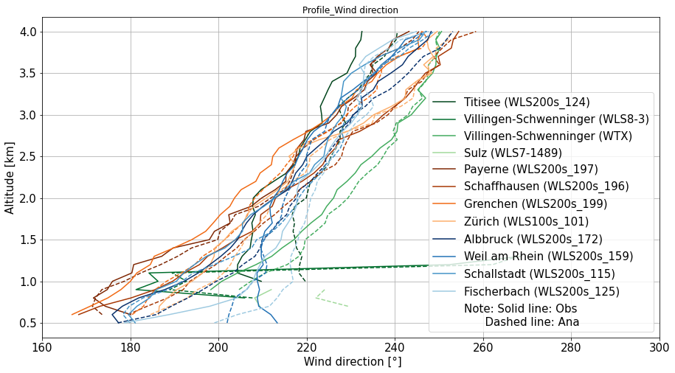
Mean wind characteristics during campaign
Vertical profile of horizontal wind
Wind direction
Number of observations
Solid line: Obs
Dashed line: Ana
Wind direction to be more zonal as attitude increases
Wind direction seems to agree between sites
11
Duc Nguyen

Slide 12
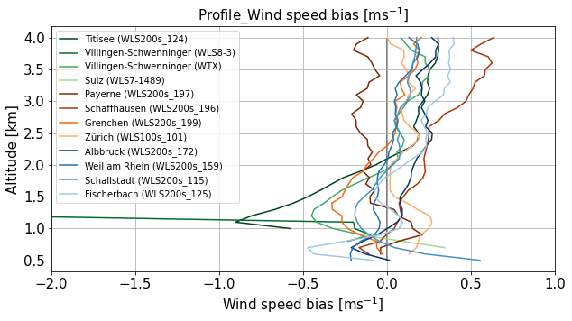
ICON-D2 analysis bias (Obs - Ana)
Wind speed bias (JJA 2023)
Wind speed bias<= |0.5 m/s|
Larger bias is observed at low altitude (<2 km)
Largest bias: Complex terrain
Smallest bias: Flat terrain
overestimation
underestimation
Duc Nguyen
Notes:
Put the formula in the method part
Zoom in PDF of AWVe

Slide 13
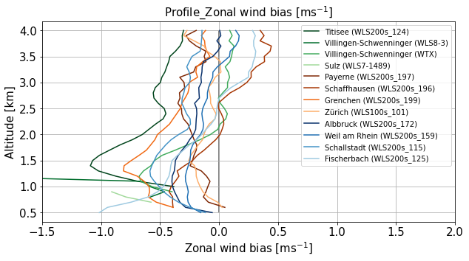
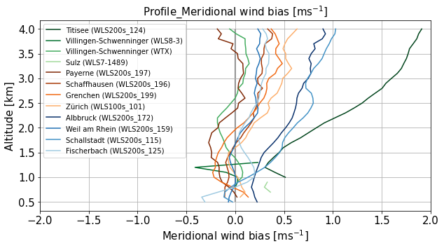
ICON-D2 analysis bias (Obs - Ana)
Zonal and meridional wind bias (JJA 2023)
Zonal wind
Meridional wind
Complex terrain
Flat terrain
overestimation
underestimation
overestimation
underestimation
Zonal wind:
ICON-D2 overestimates zonal wind
Larger bias at low altitude
Systematic overestimation at all sites, but most-pronounced at site in complex terrain
Meridional wind:
ICON-D2 underestimates meridional wind
Larger bias at higher altitude
Duc Nguyen
Notes:
Put the formula in the method part
Zoom in PDF of AWVe

Slide 14
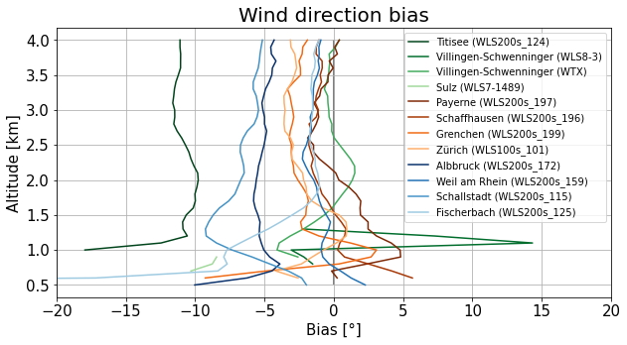
ICON-D2 analysis bias (Obs - Ana)
Wind direction bias (JJA 2023)
Wind direction bias <=| 10 degree| at most sites
Larger bias is observed at low altitude (<2 km)
Bias at (almost) all sites but with differing magnitude
Duc Nguyen
Notes:
Put the formula in the method part
Zoom in PDF of AWVe

Slide 15
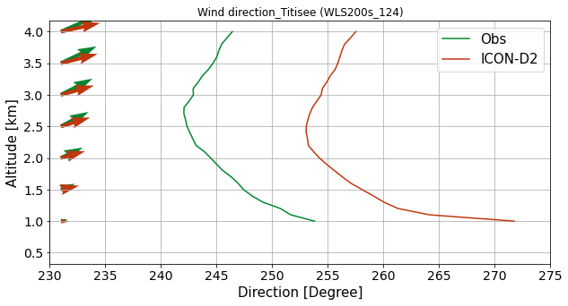
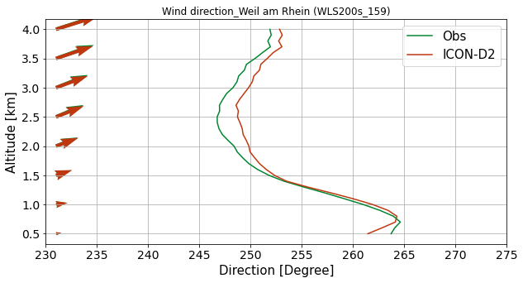
ICON-D2 analysis bias (Obs - Ana)
Wind direction (JJA 2023)
Complex
terrain
Flat
terrain
D2-analysis
DWL
D2-analysis
DWL
Direction [°]
Direction [°]
ICON-D2 analysis more zonal than DWL (Obs)
Duc Nguyen
Notes:
Put the formula in the method part
Zoom in PDF of AWVe

Slide 16
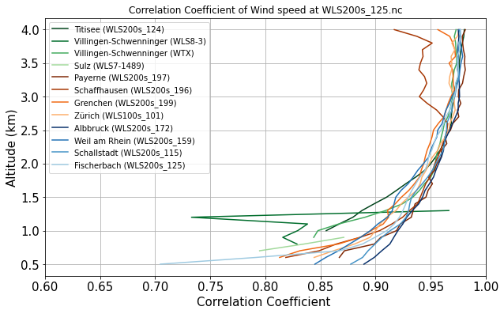
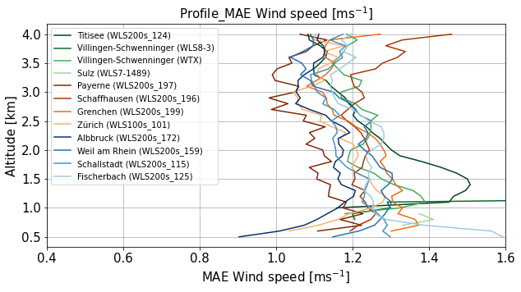
ICON-D2 analysis - other verification metrics
Wind speed (JJA 2023)
Correlation coefficient
Mean Absolute Error
Similar results for additional verification metrics
Duc Nguyen
Notes:
Put the formula in the method part
Zoom in PDF of AWVe

Slide 17
Summary and outlook
Flow characteristics during campaign period (JJA 2023) dominated by Southwesterly flow at all sites
Vertical profiles of horizontal wind relatively well represented in ICON-D2 analysis
ICON-D2 wind speed bias < |0.5 m/s|
largest bias in complex topography
Wind direction bias seems to be present in ICON-D2 (i.e., ICON-D2 overestimates zonal wind and underestimates meridional wind)
Bias differs between DWL sites and at different altitudes
Zonal wind bias is larger at lower altitude (<2 km) and meridional wind bias is larger at higher altitude (> 3 km)
Other verification metrics (e.g., MAE, correlation) show similar results

Slide 18
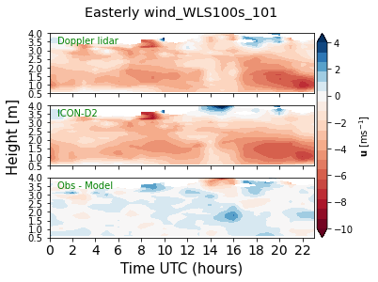
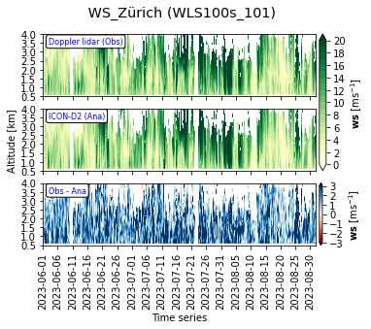
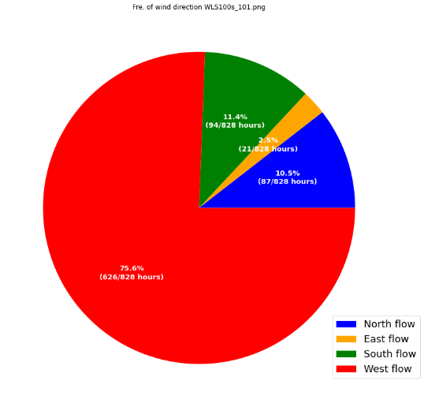
Outlook
Flow-dependent and site-dependent error characteristics
Link bias/error characteristics to topography and local mesoscale circulations
Comparison of observations to operational ensemble forecasts
Focus on selected case studies

Slide 19
References
Bugnard, A., Collaud Coen, M., Hervo, M., Leuenberger, D., Arpagaus, M., and Monhart, S.: Comparison between ground-based remote sensing observations and NWP model profiles in complex topography: the Meiringen campaign. EGUsphere [preprint], 2023.
Clark, P., Roberts, N., Lean, H., Ballard, S. P., and Charlton-Perez, C.: Convection-permitting models: a step-change in rainfall forecasting. Meteorol. Appl., 23, 165–181, 2016.
Durran, D., and Weyn, J. A.: Thunderstorms Do Not Get Butterflies. Bull. Am. Meteorol. Soc., 97, 237– 243, 2016.
Fluck, E., Kunz, M., Geissbuehler, P., and Ritz, S. P.: Radar-based assessment of hail frequency in Europe. Nat. Hazards Earth Syst. Sci., 21, 683–701, 2021.
Kunz, M. and Puskeiler, M.: High-resolution Assessment of the Hail Hazard over Complex Terrain from Radar and Insurance Data, Meteorol. Z., 19, 427–439, 2010.
Pentikäinen, P., O'Connor, E. J., and Ortiz-Amezcua, P.: Evaluating wind profiles in a numerical weather prediction model with Doppler lidar, Geosci. Model Dev., 16, 2077–2094,2023.

Slide 20
A campaign re-analysis for ‘Swabian MOSES 2023’: how do high-resolution observations change the analysis of a convective-scale data assimilation system?
Join Us for an Exciting Presentation!
Presented by: Julia Thomas
Date & Time: Friday, 06 Sep, 14:30–14:45 (CEST)
Venue: Lecture room B5

Slide 21
Thank you for your attention! Any question/suggestion? Contact: duc.nguyen2@kit.edu

Slide 22
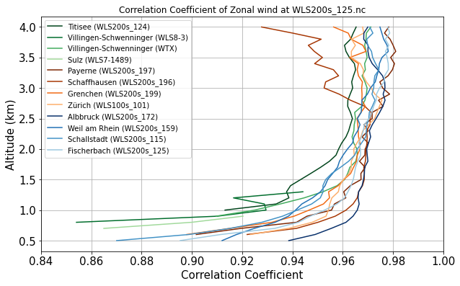
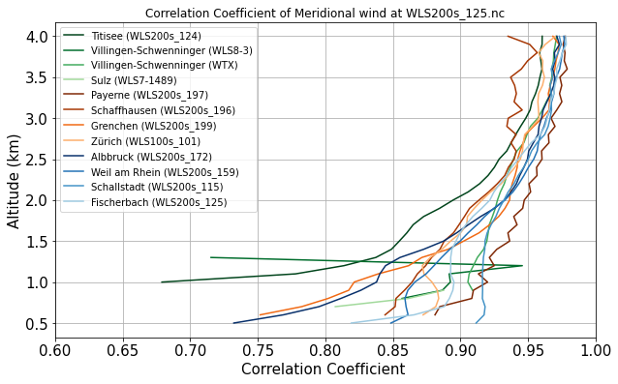
Correlation coefficient
Zonal wind
Meridional wind

Slide 23
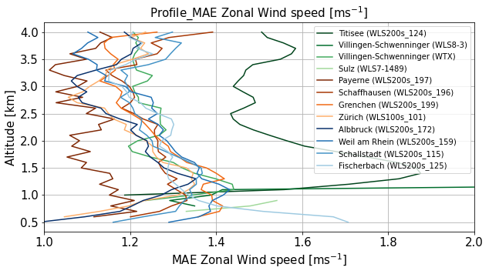
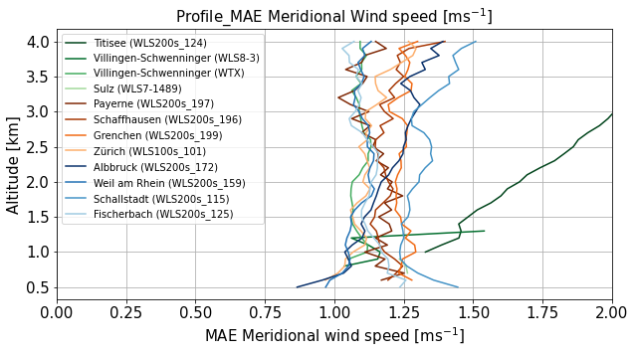
Mean Absolute Error
Zonal wind
Meridional wind

Slide 24
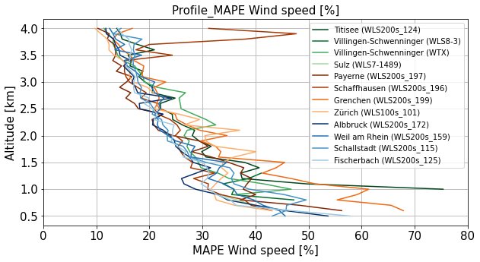
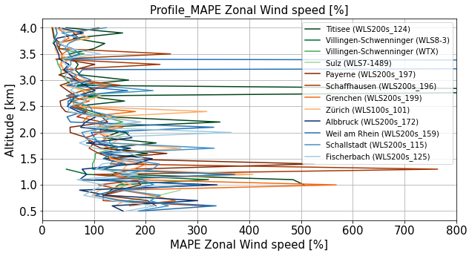
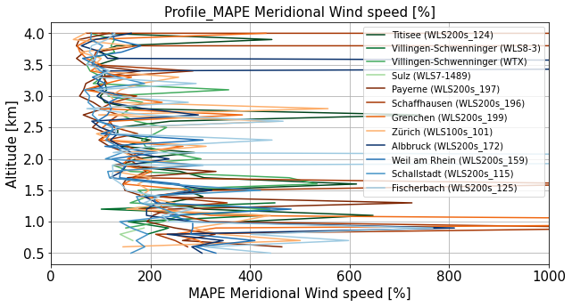
Mean Absolute percentage error
Wind speed
Zonal wind
Meridional wind

Slide 25
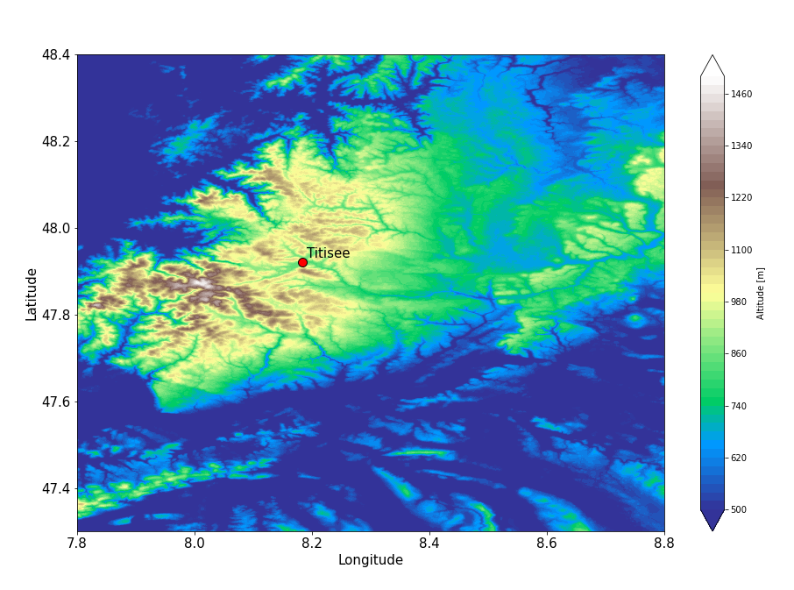
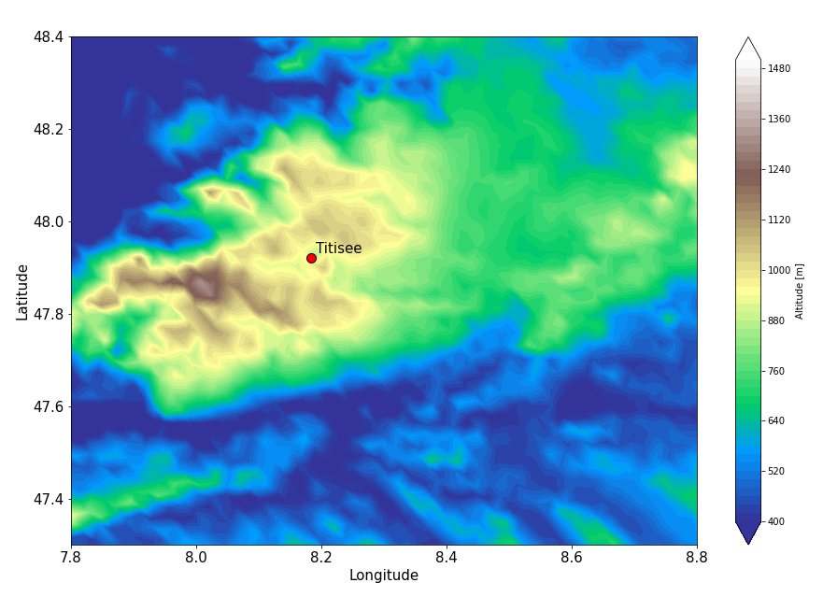
Topography
Code | Station Name | Doppler lidar height | Model height (Model height - DL height)
WLS200s_124 | Titisee | 833 | 873.568 (40)
WLS8-3 | Villingen-Schwenninger | 765 | 729.943 (-35)
WTX | Villingen-Schwenninger | 765 | 729.943 (-35)
WLS7-1489 | Sulz | 648 | 649.818 (1)
WLS200s_197 | Payerne | 492 | 452.193 (-40)
WLS200s_196 | Schaffhausen | 436 | 449.068 (13)
WLS200s_199 | Grenchen | 429 | 441.193 (12)
WLS100s_101 | Zürich | 423 | 423.818 (1)
WLS200s_172 | AIbbruck | 316 | 401.443 (85)
WLS200s_159 | Weil am Rhein | 252 | 257.818 (5)
WLS200s_115 | Schallstadt | 228 | 389.193 (161)
WLS200s_125 | Fischerbach | 219 | 302.443 (83)
Topography height

