Slide 1


Dry and Wet Spells in Poland in the Period 1966–2023
Joanna Wibig
Department of Meteorology and Climatology
University of Lodz

Slide 2

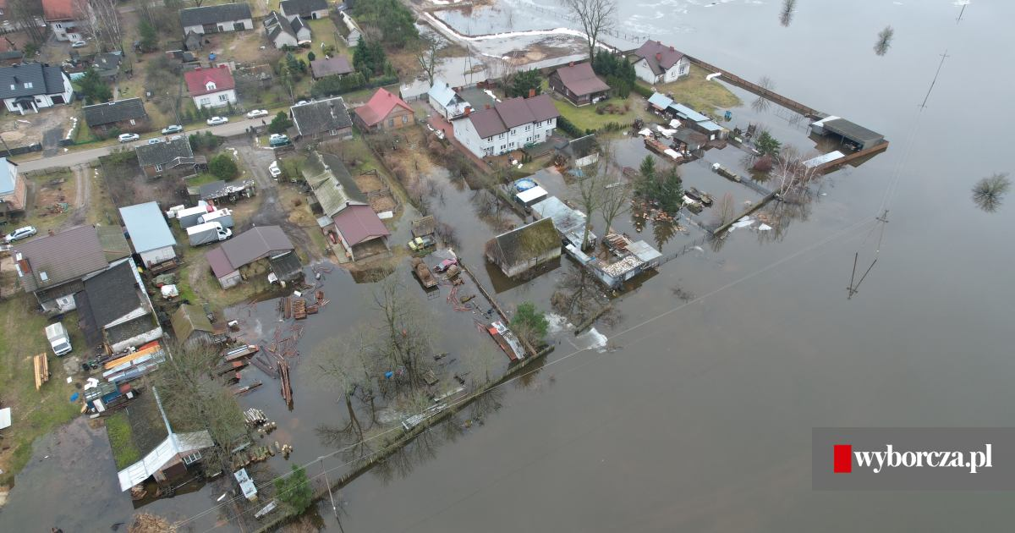
OUTLINE
Motivation
Data
Methods
Precipitation
Dry days and spells
Wet days and spells
Summary

Slide 3
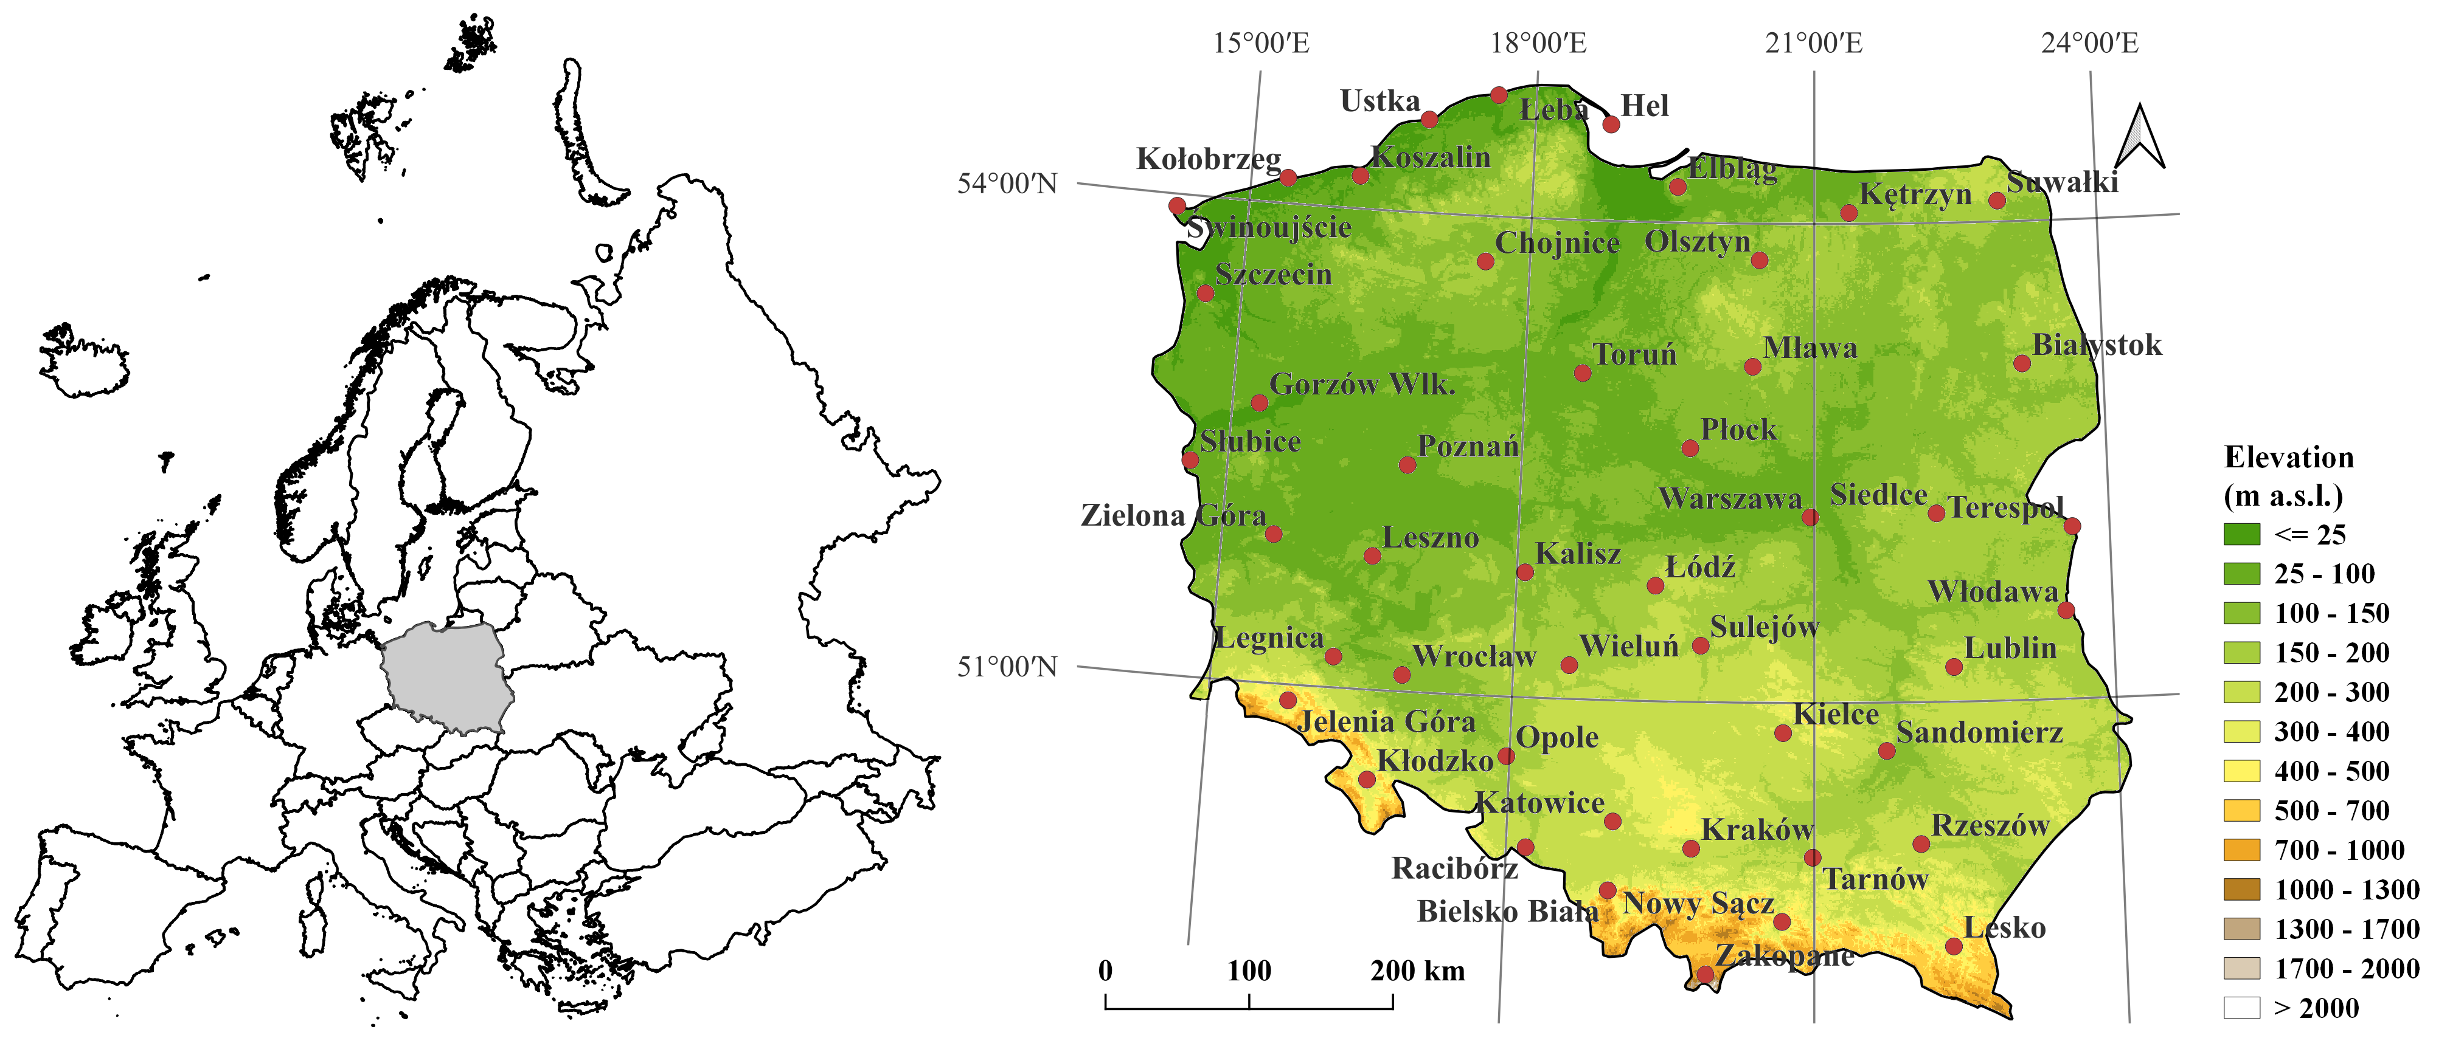
Data
Daily meteorological totals from 48 stations in Poland from the period 1966-2023 provided by provided by IMWM-PRI (Institute of Meteorology and Water Management – Polish Research Institute )
Data
Dodatkowe informacje

Slide 4
Methods
Dry days - days with precipitation below 0.1 mm,
Wet days - days with precipitation at least 1 mm
Dry spell at particular stations – a sequence of at least 7 consecutive dry days
Wet spell at particular stations – a sequence of at least 5 consecutive wet days
Dry spell in Poland - a sequence of at least 7 consecutive days in which dry spells continue on at least 12 stations
Wet spell in Poland - a sequence of at least 5 consecutive days in which wet spells continue on at least 9 stations
Trends in monthly and seasonal values of precipitation, dry and wet days at stations were calculated using the Sen-Theil estimator of slope and Mann-Kendall test

Slide 5
Annual totals
Average annual precipitation totals in Poland from 1966 to 2023 (A) and their long-term trends (A). Areas with statistically significant trends are dotted

Slide 6
January
April
July
October
Average monthly precipitation sums and their trends in the period 1966-2023

Slide 7
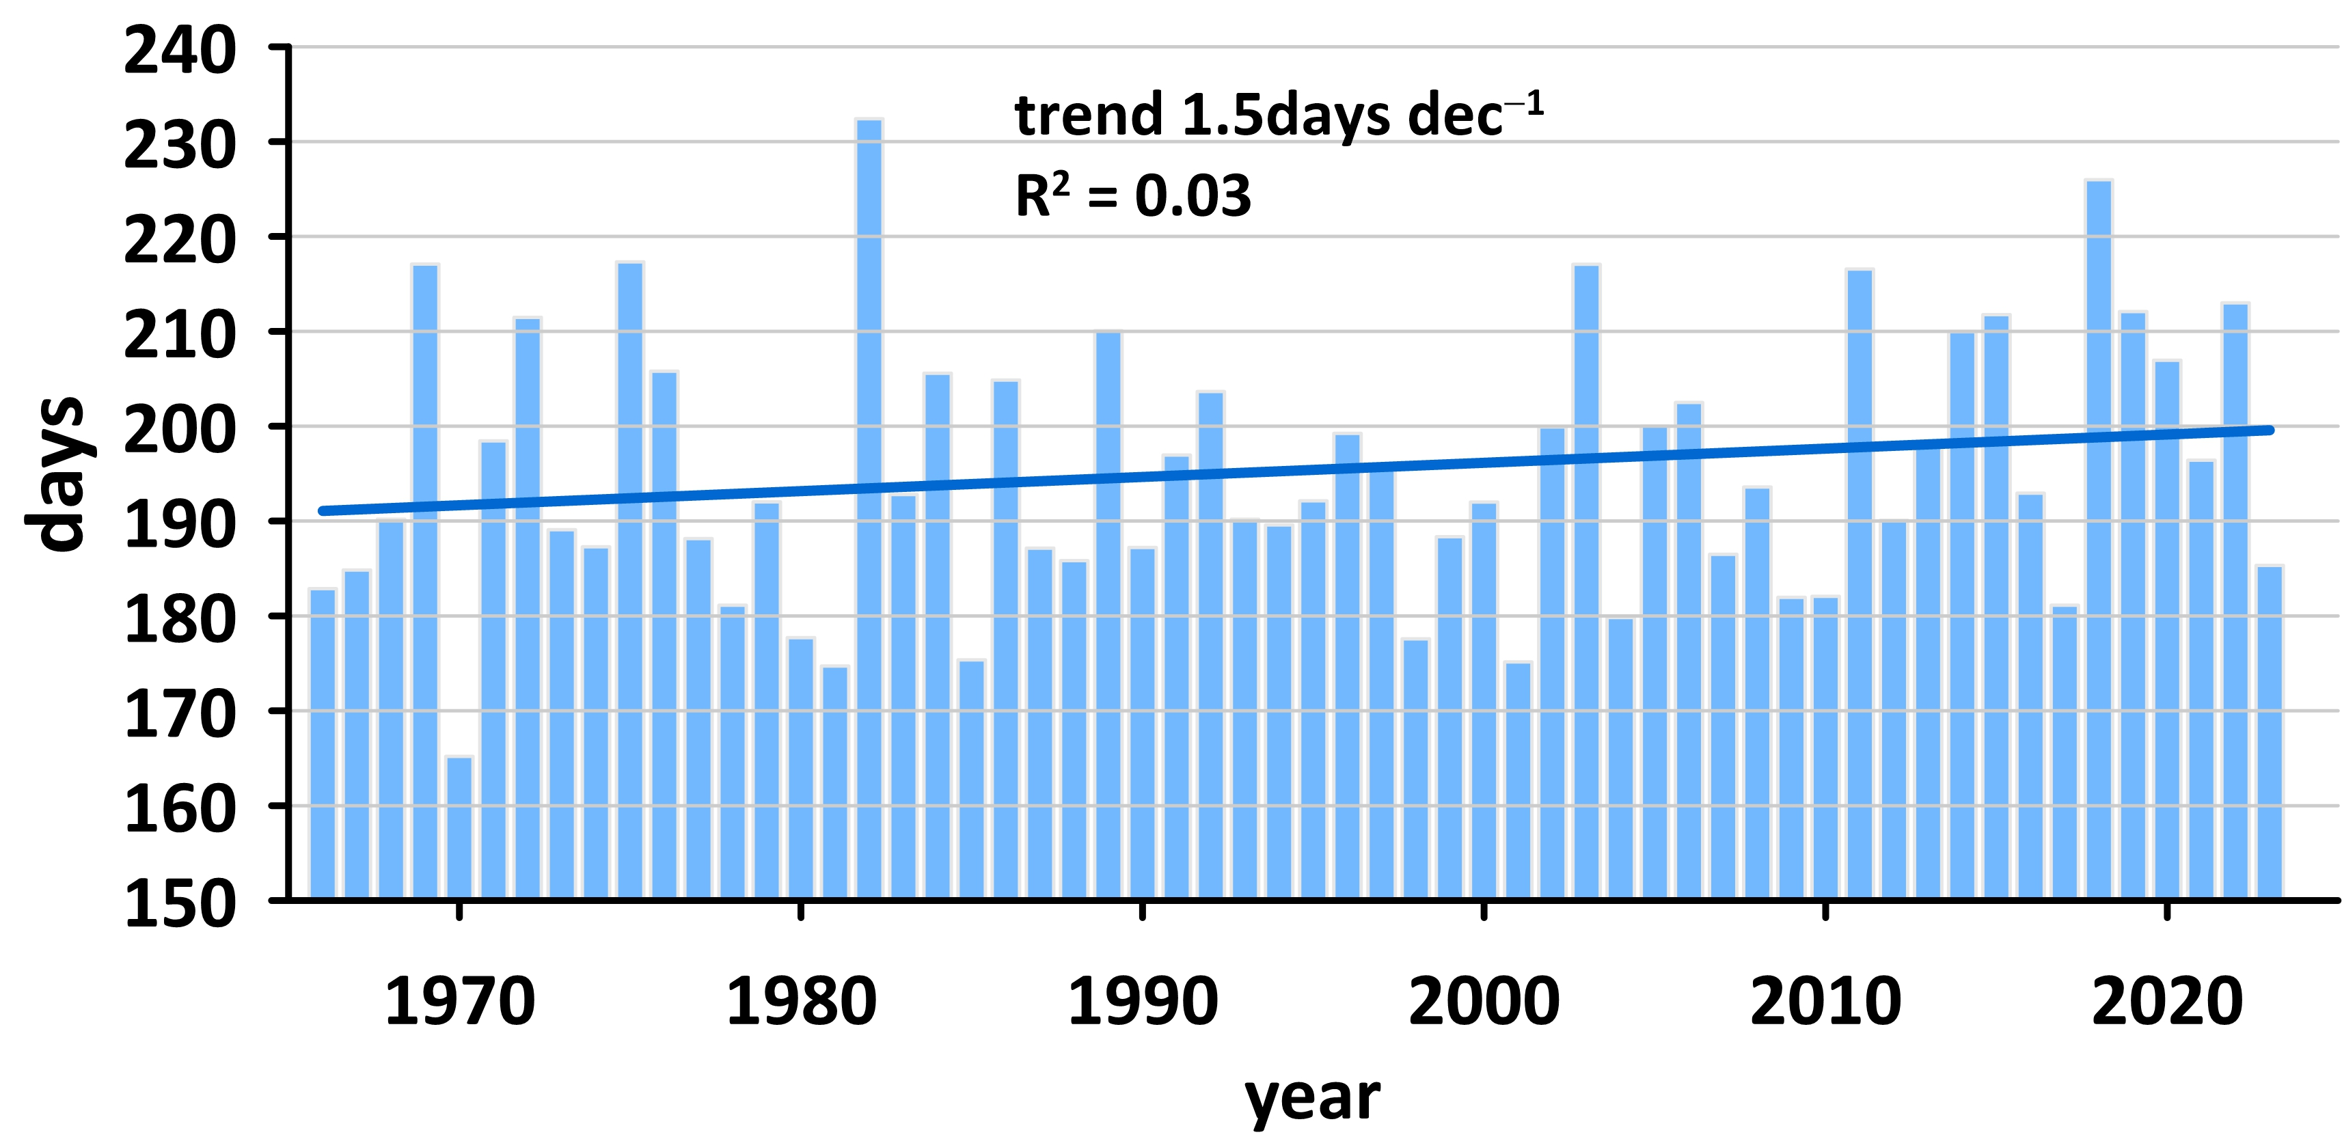
DRY DAYS
The annual numbers of dry days averaged in Poland in the period of 1966–2023 with linear trend

Slide 8
Trends in the number of dry days in six selected months in Poland in the period 1966-2023:
Jan
Apr
June
Aug
Nov
Dec

Slide 9
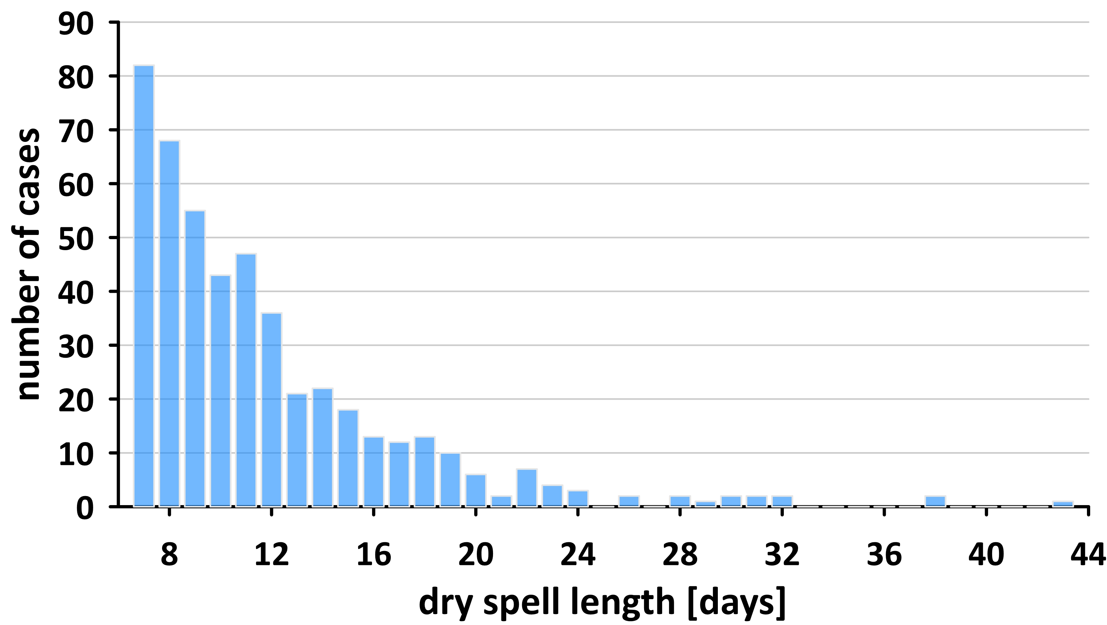
Ten of the longest-lasting dry spells in Poland
DRY SPELLS
Number | Begin | End | Length in days
1 | 21.10.2011 | 2.12.2011 | 43
2 | 29.03.2009 | 5.05.2009 | 38
3 | 24.02.2022 | 2.04.2022 | 38
4 | 19.03.1974 | 19.04.1974 | 32
5 | 28.06.2006 | 29.07.2006 | 32
6 | 17.04.2000 | 17.05.2000 | 31
7 | 28.03.2019 | 27.04.2019 | 31
8 | 15.08.2002 | 13.09.2002 | 30
9 | 7.02.2003 | 8.03.2003 | 30
10 | 12.05.1992 | 9.06.1992 | 29
The distribution of dry spells in relation to their length

Slide 10
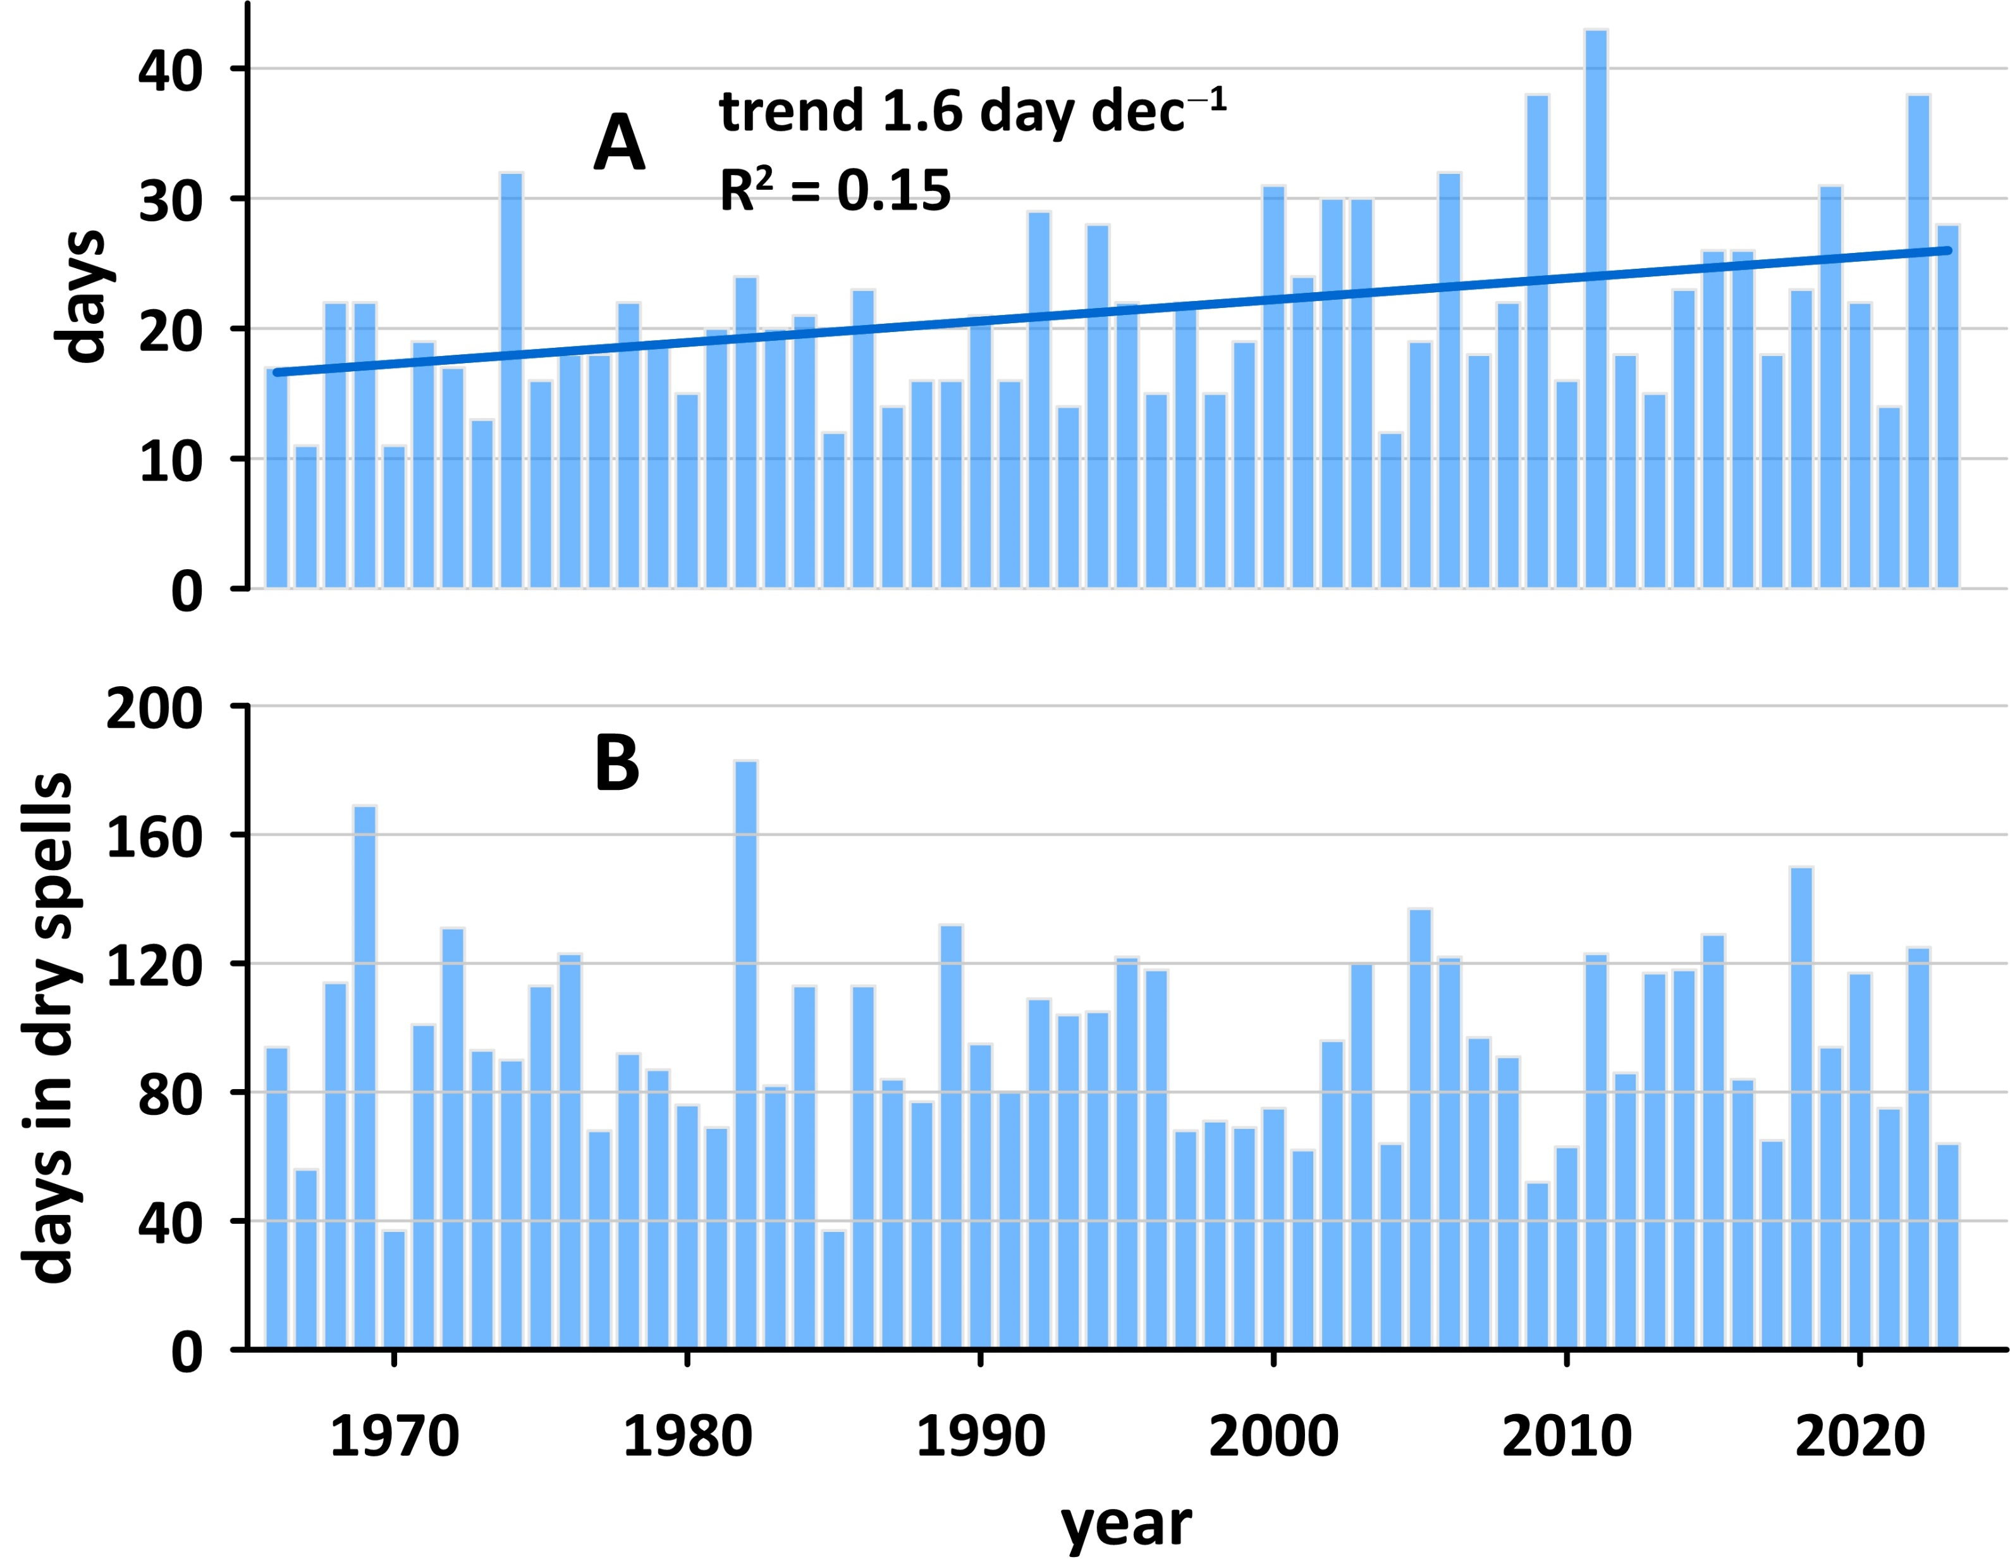
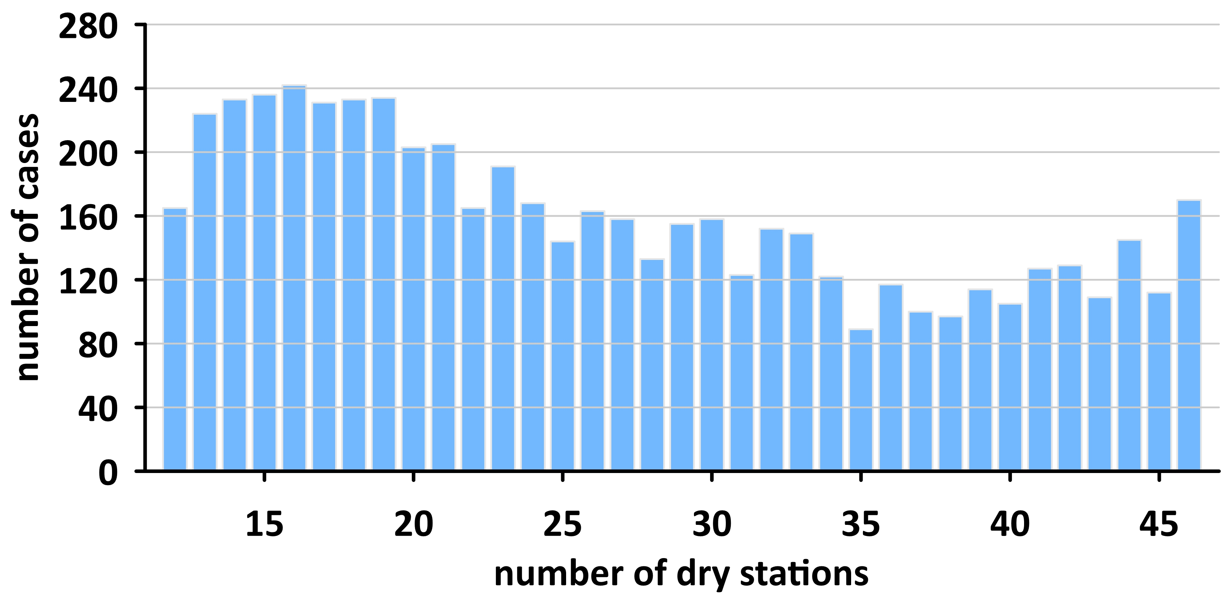
Number of dry spell days depending on the number of stations where no precipitation was recorded
The length of the longest spell in the year (A) and the annual number of dry spell days (B)

Slide 11
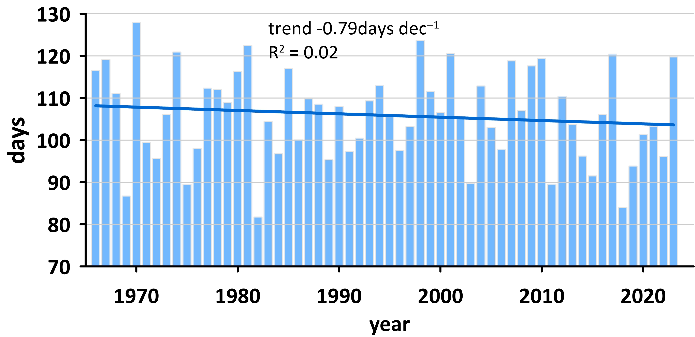
WET DAYS
The annual numbers of wet days averaged in the area of Poland in the period 1966-2023 with the linear trend line

Slide 12
Trends in the number of wet days in six selected months in Poland in the period 1966-2023:
Jan
Apr
June
Aug
Nov
Dec

Slide 13
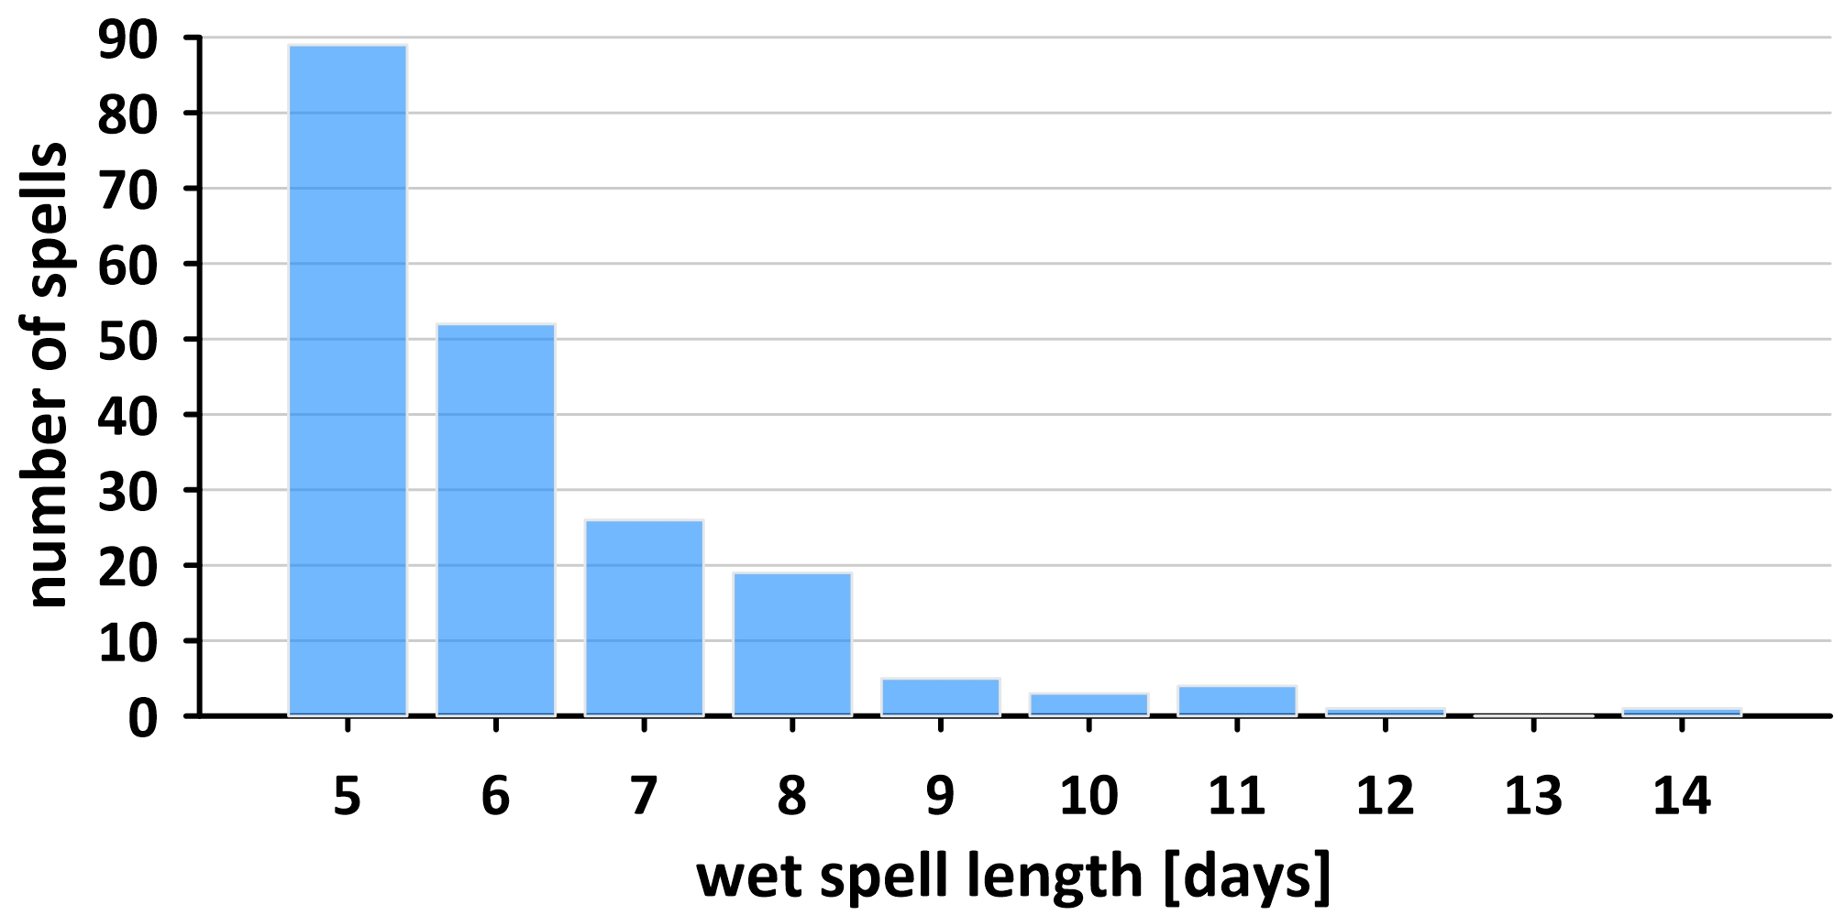
Nine of the longest wet spells in Poland
WET SPELLS
Number | Begin | End | Length in days | Precipitation in mm
1 | 29.06.1980 | 12.7.1980 | 14 | 121
2 | 19.10.2002 | 30.10.2002 | 12 | 60
3 | 4.12.1988 | 14.12.1988 | 11 | 43
4 | 26.08.1995 | 5.09.1995 | 11 | 128
5 | 25.10.1998 | 4.11.1998 | 11 | 60
6 | 7.09.2001 | 17.09.2001 | 11 | 87
7 | 28.02.1998 | 9.03.1998 | 10 | 38
8 | 27.05.2013 | 5.06.2013 | 10 | 91
9 | 8.05.2014 | 17.05.2014 | 10 | 117
The distribution of wet spells in relation to their length

Slide 14
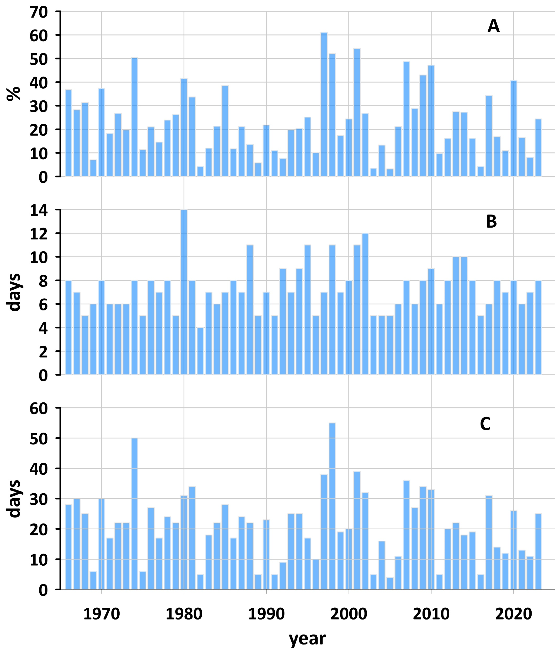
The total precipitation in wet spells expressed as a percentage of average annual precipitation (A),
the duration of the longest wet spell in the year (B),
the annual number of wet spell days (C).

Slide 15
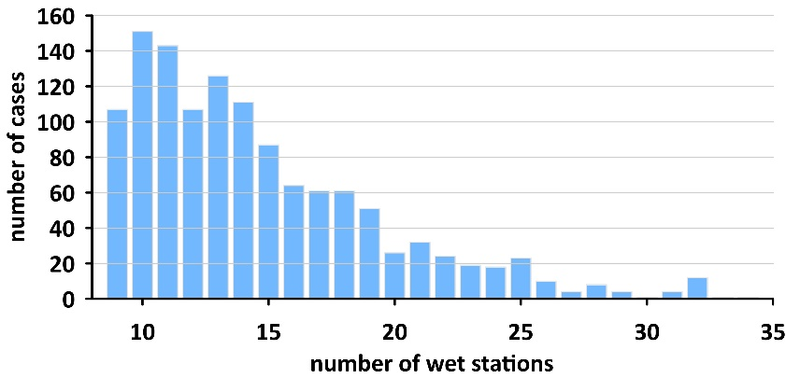
Number of wet spell days depending on the number of stations where at least 1mm of precipitation was recorded

Slide 16
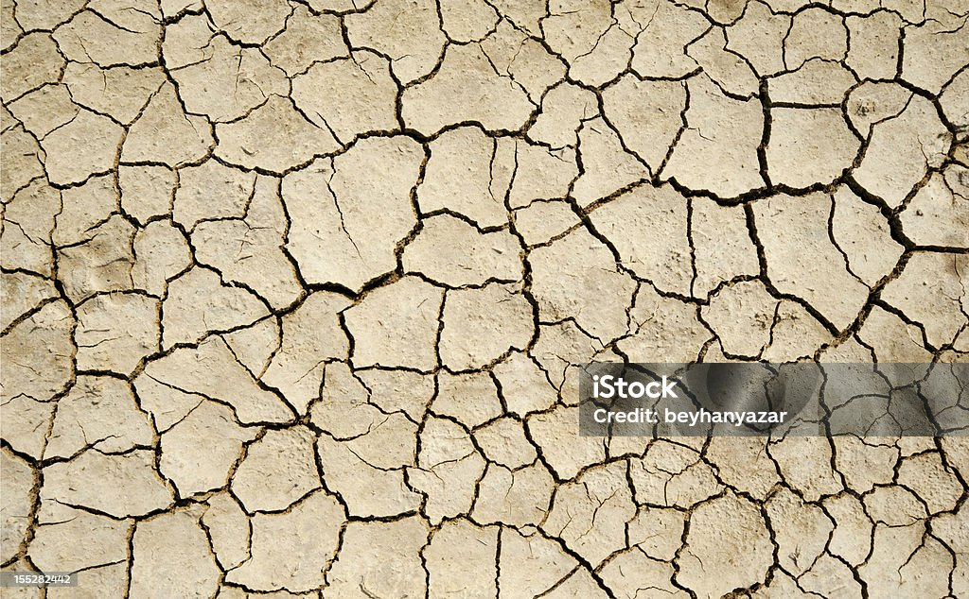
Summary
The average annual precipitation total has not been changing considerably in Poland, however its regime has changed
Winter: December is drier with more dry days, whereas In January and February, an increase in precipitation and the number of wet days is clearly visible, with a decrease in the number of dry days.
Spring: the most substantial changes are observed in April. Precipitation is decreasing in almost the entire country, significantly in the north and east. In the same regions, the number of dry days is increasing, and the number of wet days is decreasing,
Summer: During the summer, precipitation decreases in the south and increases in the north. A similar picture characterizes changes in the frequency of dry and wet days.
Autumn: September is drier in the north of the country, with more rainfall in the south. The number of wet days decreases significantly in the north and remains virtually unchanged in the south. In contrast, dry days increase throughout the country, but most strongly in the north. strong changes are recorded in November everywhere, except in the southeastern parts of Poland. Precipitation decreases and the number of dry days increases accordingly.

Slide 17
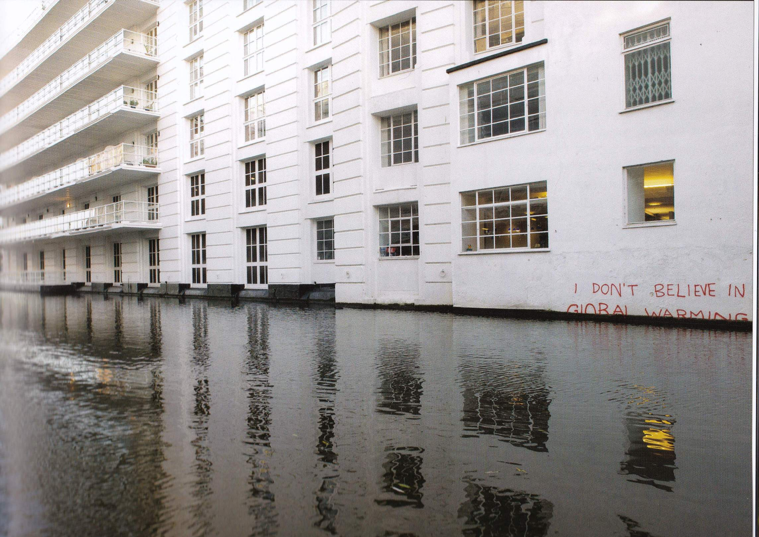
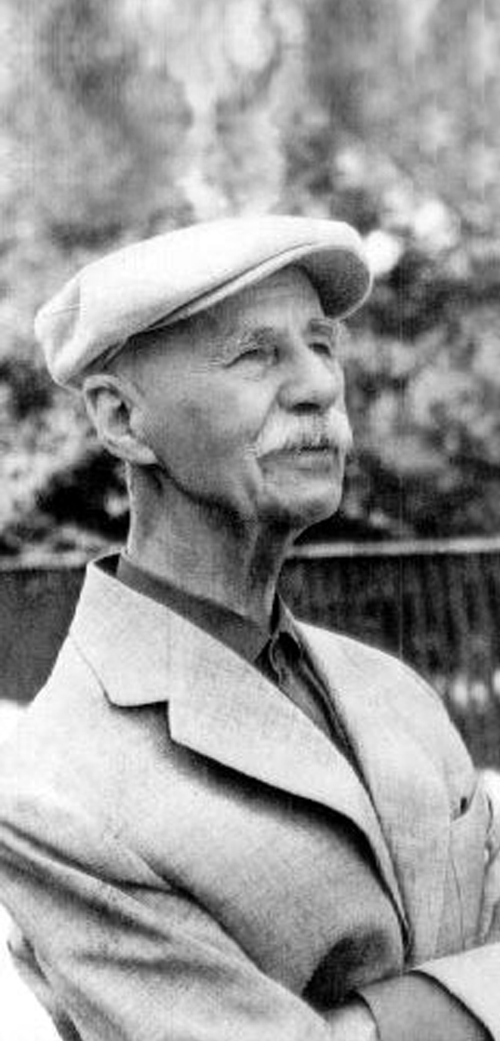
Thanks for your attention
This research was funded by National Science Center (NCN), grant number 2019/33/B/ST10/01136
BANKSY

