Slide 1
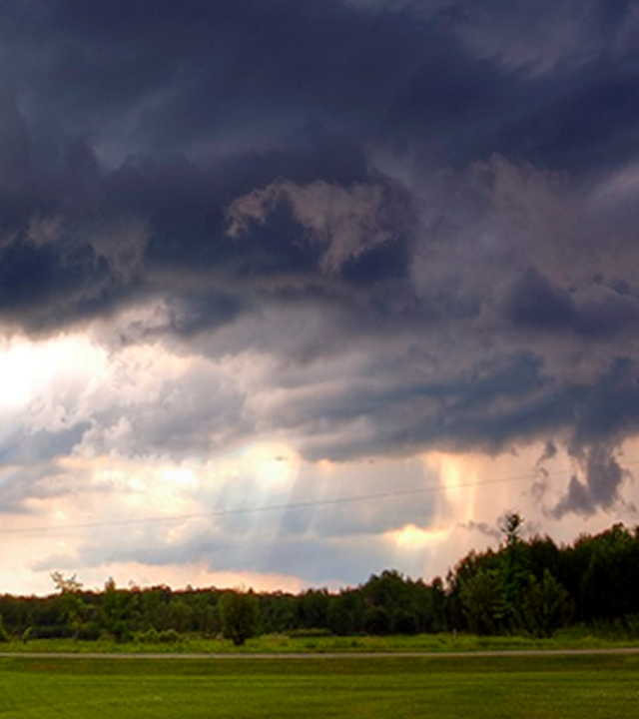
Using a value chain to develop a new warning service from scratch - epidemic thunderstorm asthma risk forecasts in Victoria, Australia
Beth Ebert¹, Danny Csutoros², Jim Black², Edwin Lampugnani^{3,4}, Usha Natala^{3,4}, Edward Newbigin^{3,4}
¹Bureau of Meteorology, ²Department of Health, Victoria, ³University of Melbourne, ⁴AirHealth Lab

Slide 2
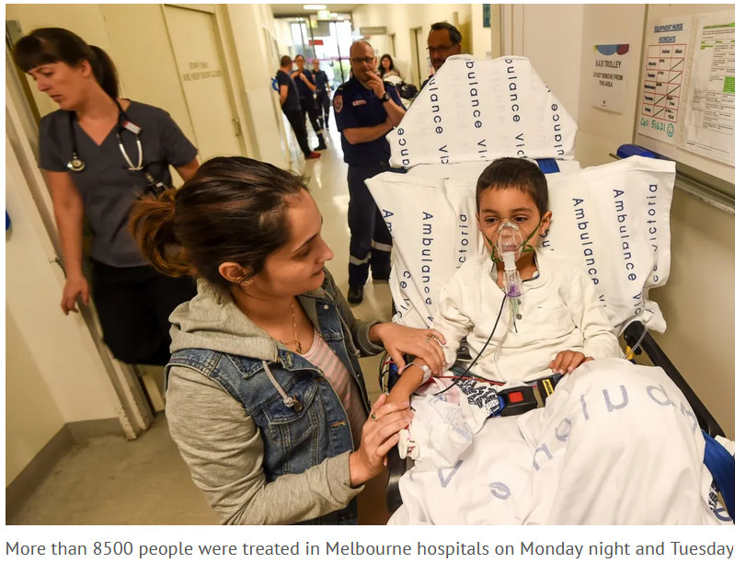
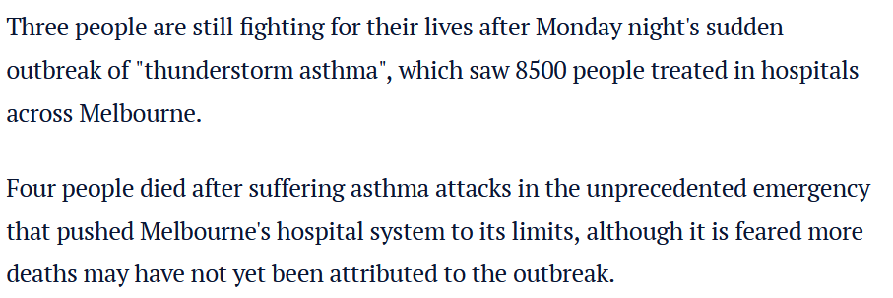
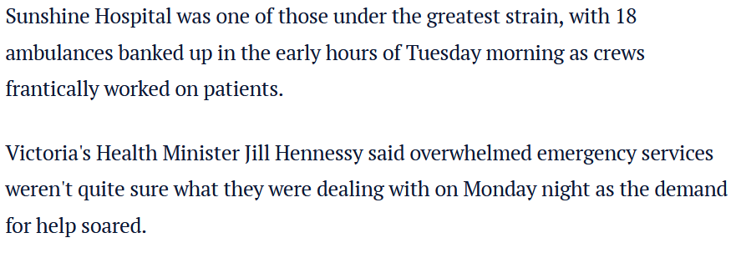
More than 8500 people were treated in Melbourne hospitals on Monday night and Tuesday: Rayann Zamani with mother Palli Zamani.
Notes:
Q: How many of you remember the big thunderstorm asthma event in November 2016?
Never before had ESTA 000, Ambulance Victoria or Victorian hospitals experienced this level of demand in such a condensed time period and dispersed over such a large geographical area.
Health Minister Jill Hennessy: "When we have one bomb go off, we know what we're dealing with," she said. "When we've had people calling for ambulances – one call every 4½ seconds at the peak – it was like having 150 bombs going off right across a particular part of metropolitan Melbourne. And that's something we've never really planned for."
Nearly 10,000 people visited emergency rooms, also a 7-fold increase in visits to GPs
10 deaths were ultimately attributed to this event.
Of those who died, the mean time from exposure to cardiorespiratory arrest was 80 minutes, but was as fast as 15 minutes
People from Asian backgrounds were more likely to be affected, poorer socioeconomic status. More men than women (though in the population 2/3 of people with asthma are women)
It seemed to hit younger and middle-aged adults harder than children and elderly people.
Many people who were affected had never experienced asthma, but almost all had hay fever.

Slide 3
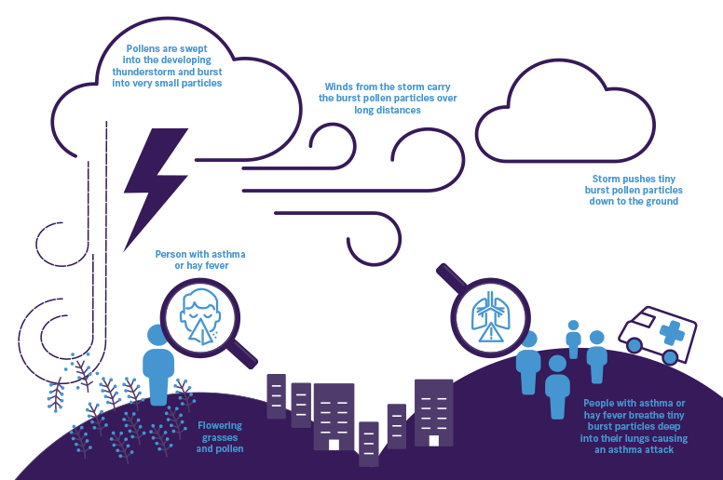
What causes thunderstorm asthma?
Asthma Australia
Notes:
You might have a higher chance of a sudden asthma flare-up triggered by a thunderstorm if you have:
seasonal hay fever
current asthma
a history of asthma
undiagnosed asthma.
The chance of having thunderstorm asthma is highest for adults who are sensitive to grass pollen and have seasonal hay fever (with or without known asthma). The worst outcomes are in people with poorly controlled asthma.
To lower the chance of having thunderstorm asthma when it is a known trigger for you, it is best to have good asthma management year-round. This means:
using your preventer especially during the spring thunderstorm season
keeping your hay fever under control and taking any necessary hay fever medication
checking pollen levels and where possible avoid being outside on these days.
being prepared. Have your scripts and supply of your asthma and hay fever medicines ready for the thunderstorm asthma and pollen seasons.

Slide 4
Users’ needs for an epidemic thunderstorm asthma warning
Past climate
Now
Hours
Seasonal
Days
1-week
1-month
Confidence boundary
Review
Respond
Prepare
Plan
Turn on early detection of impact
Enact thunderstorm asthma plan:
Stand up medical and emergency response staff
Inform vulnerable patients / community
Review / rapid update on training
Chief Health Officer and institutional responses
Post event impact analysis
Open hospital wards
Education campaign at start of season
Seasonal indicators of high pollen season informs longer term planning
Consider cancelling sports / outdoor events
Stay indoors
Take medication
Call Nurse On Call for advice
Symptoms – 000, NOC, GP, chemist
Advise people to switch air cond. on and close windows in cars
Change plans
Work from home
Work inside
Cancel sports / outdoor activities
Take medications as part of action plan
Community / individual
responses
Check medication
Asthma treatment plans
Visit GPs
Notes:
Critical responses occur on time scales from seasonal to minutes.

Slide 5
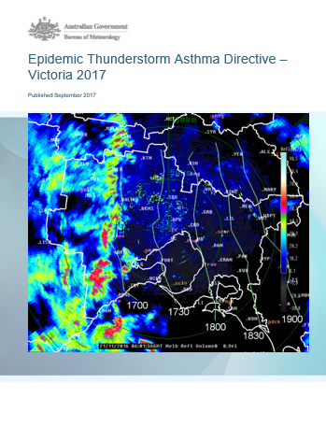
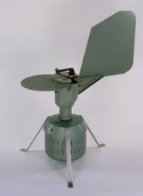
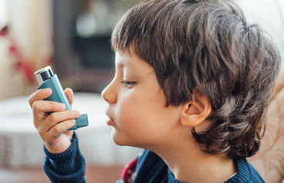
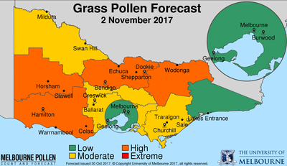
What is needed to deliver the outcomes?
1. Observations
Pollen counters, met observations, feedback from public, health indicators
2. Forecasting and data processing
Research and data integration
3. Operational service
Threshold tools, alerts and briefings
4. Enhanced decision making
Decision making process, response plans, training
Enhanced community safety and emergency response during thunderstorm asthma events
Feedback insight and learnings
Knowledge and capability gaps
Risk of epidemic thunderstorm asthma
L
M
H
L
L
M
Likelihood of convergence line
L
L
L
Grass pollen forecasts in 9 Victorian forecast districts
Source: Northwestern Melbourne Primary Health Network
Burkard pollen trap
Forecast grass pollen
Notes:
Consultation helped to understand the need, identify the necessary elements in the warning value chain, define the forecast process underpinning the new service, and monitor its performance

Slide 6
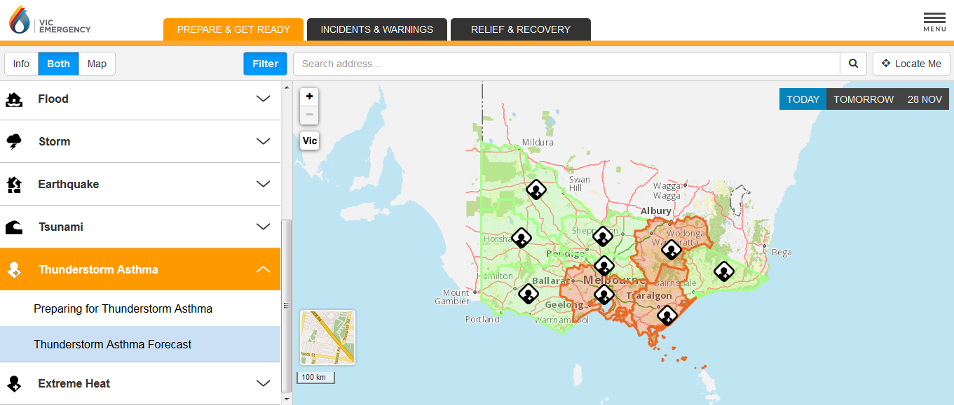
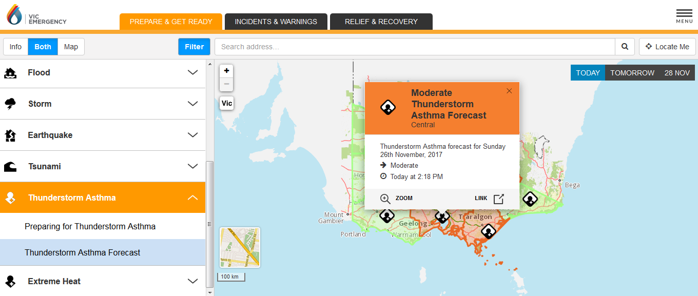
Daily thunderstorm asthma forecast on Vic Emergency website and app
Operates during October-December (Victorian grass pollen season)
Notes:
Thunderstorm asthma risk forecasts are available on the Vic Emergency website/app and the Melbourne Pollen website/app.

Slide 7
10 November 2020
Notes:
How many of you remember the Melbourne thunderstorm asthma event of November 11, 2020?

Slide 8
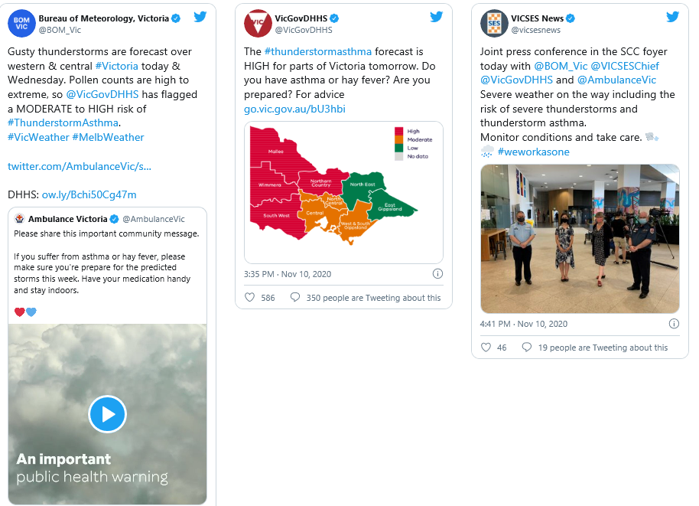
11 Nov 2020 – the health system was prepared
What happened?
One of Ambulance Victoria’s busiest days on record
1000+ cases for breathing problems, up 72% from normal
Could have been so much worse
Good communication and trusted partnerships are critical for a good outcome
Partner engagement with proactive, targeted, collaborative media
Simple, engaging 'impact first' style messaging with high-risk communities as the target audience.
Notes:
Good communication of the risk and also an understanding of human behaviour is essential for effective warnings.
Social science is very active in helping to develop effective warnings.
The Early Warnings For All Initiative was formally launched by the UN Secretary-General in November 2022 at the COP27 meeting in Egypt.

Slide 9
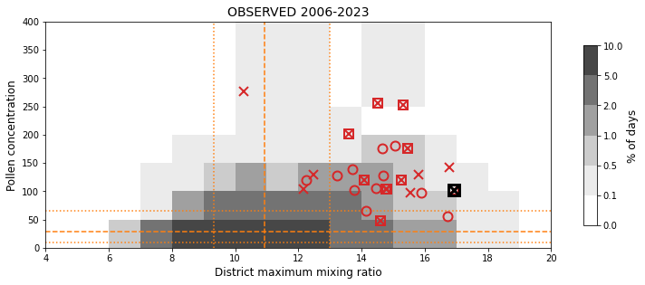
Scientific improvements informed by value-oriented metrics
Tested a large number of thunderstorm diagnostics from NWP to determine which could be most relevant for thunderstorm asthma events in Melbourne
Days with high asthma
BARRA atmospheric reanalysis 2009-2017
2016 event
Low level humidity
Downdraft energy
Thunderstorm asthma events are associated with high humidity and high grass pollen concentrations
Optimize the thresholds for forecasting high thunderstorm asthma risk using the FIRM score (Taggart et al. 2022, QJRMS)
Assume missed events are 10 x more costly than false alarms.
(Brown et al., 2022, Wea. Forecasting)

Slide 10
Forecast evaluation in all Victorian forecast districts 2017-2023
Risk of epidemic thunderstorm asthma
Risk of epidemic thunderstorm asthma
ORIGINAL forecast matrix
Used since 2017
L
M
H
NEW forecast matrix with low level moisture
Not yet implemented for operational use
L
M
H
L
M
Very moist
L
L
M
L
M
H
Likelihood of convergence line
Likelihood of convergence line
L
L
L
L
L
L
L
M
L
Forecast grass pollen
Forecast grass pollen
 |  | Asthma presentations at public hospitals
Day 0 |  | Not high | High
Forecast ETSA risk | Low | 4624 | 7
 | Mod | 228 | 9
 | High | 28 | 0
 |  | Asthma presentations at public hospitals
Day 0 |  | Not high | High
Forecast ETSA risk | Low | 4635 | 6
 | Mod | 171 | 4
 | High | 74 | 6
Day 1 |  | Not high | High
Forecast ETSA risk | Low | 4642 | 9
 | Mod | 221 | 7
 | High | 19 | 0
Day 1 |  | Not high | High
Forecast ETSA risk | Low | 4747 | 9
 | Mod | 94 | 4
 | High | 39 | 3
Day 2 |  | Not high | High
Forecast ETSA risk | Low | 4688 | 8
 | Mod | 178 | 8
 | High | 14 | 0
Day 2 |  | Not high | High
Forecast ETSA risk | Low | 4757 | 11
 | Mod | 90 | 2
 | High | 33 | 3
Notes:
The HAPD at individual hospitals were determined using the K-sums method used in SynSurv. As described by Jim Black at the Department of Health:
Whenever a new asthma-like presentation occurs at a hospital, the interval since the last is compared with the 5th percentile for that hospital.
If the interval is less than that, a counter is advanced to 1.
If a new sub-5th-percentile presentation occurs before an interval greater than the 25th percentile has passed, the counter advances by another 1.
If four such presentations are recorded, the hospital passes to ‘yellow alert’ status.
If six are recorded the hospital passes to ‘red alert’ status. If two or more hospitals reach yellow or red alert status, an automated email is sent to the State Duty Officer with details of the affected hospitals.

Slide 11
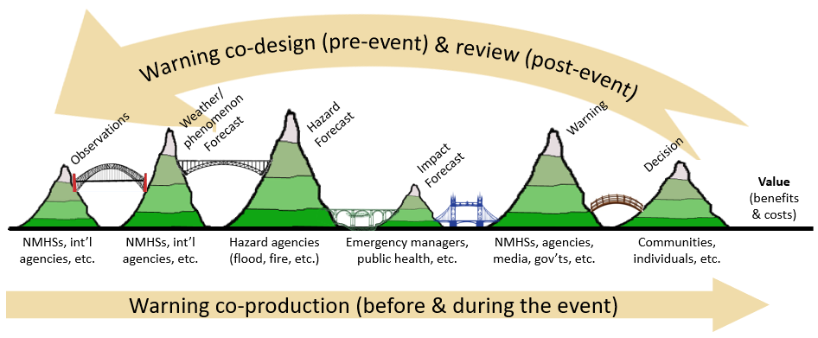
The value chain has been useful in all phases of this work
3. Describe the end-to-end warning process
4. Identify the knowledge and capability gaps
6. Post-event and post-season reviews
7. Use value-oriented metrics to guide improvements
1. Identify the relevant actors and partners
2. Identify the responses & outcomes
5. Operation of the warning system during pollen season
More/better grass pollen observations
Better TS forecasts
National ML-based pollen forecasts
Health studies of susceptible individuals
Syndromic surveillance at hospitals
Survey of people who experienced TS asthma
Socioeconomic evaluation of service
What else?

Slide 12
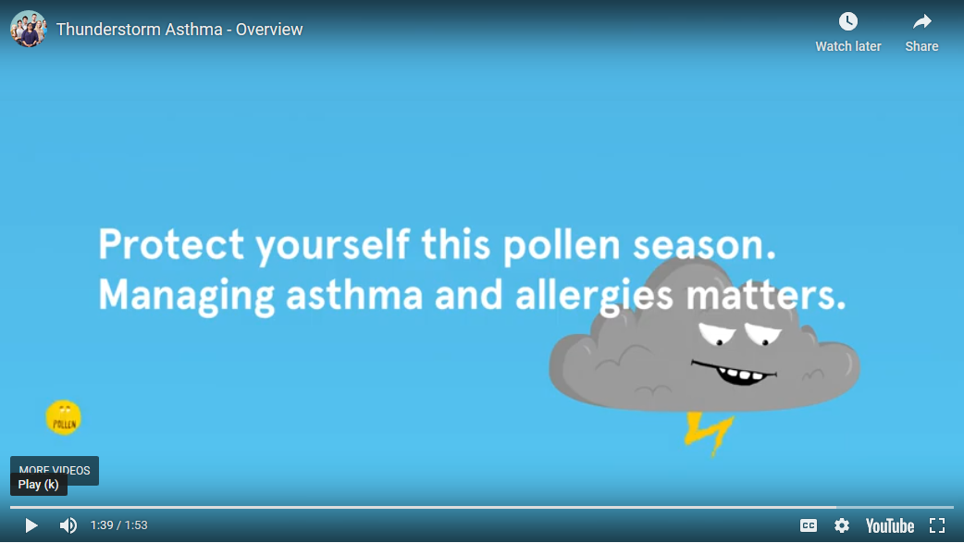
Thank you and questions
Notes:
Any questions

Slide 13
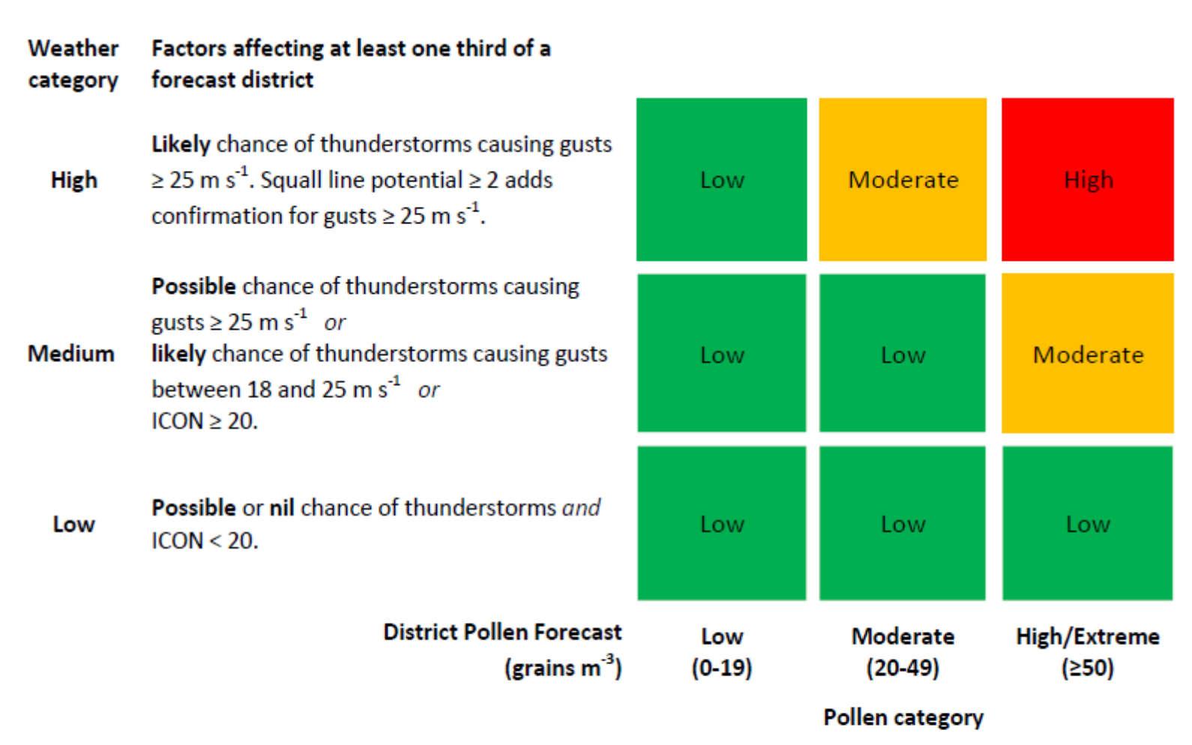
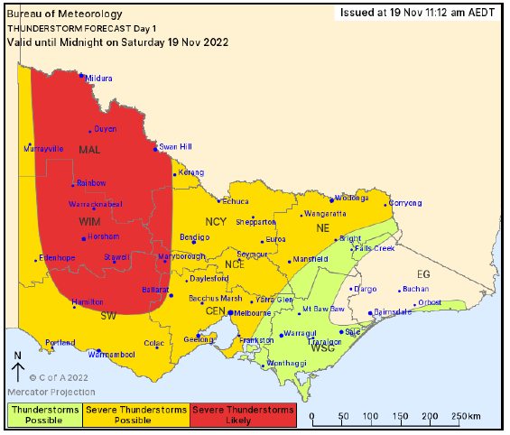
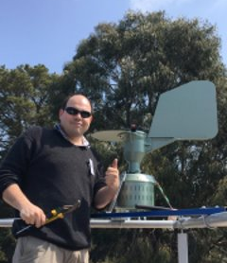
Thunderstorm asthma forecasting uses a simple risk matrix
Thunderstorm asthma risk
Bannister, T., and Co-Authors, 2021: A pilot forecasting system for epidemic thunderstorm asthma in south-eastern Australia. Bull. Amer. Meteorol. Soc., E399-E420, https://doi.org/10.1175/BAMS-D-19-0140.1
Notes:
The goal is to enhance community safety and emergency response during epidemic thunderstorm asthma events
Want to avoid another big event swamping the health system
Want everyone in the state to be able to access warnings
Co-designed the system with users in the Health Department, who "own" the warning.
Needed to be simple to meet the deadline
District-based service to align with existing thunderstorm warning service. Forecasts to be made 2 days ahead, next day, and on the morning for the afternoon. This meant we needed pollen forecasts, which we didn't yet have!
Department wants
Does not miss any truly large events and not too many false alarms
Sustainable, improving, robust
Integrated seamlessly into EM system
Highly visible and accessible, and high risk days become well known
Forecasts presence helps ETSA become part of our cultural knowledge and builds annual routine for preparedness and asthma /hay fever management
Does not induce fear or negative reputational impact on Melbourne

