Slide 1
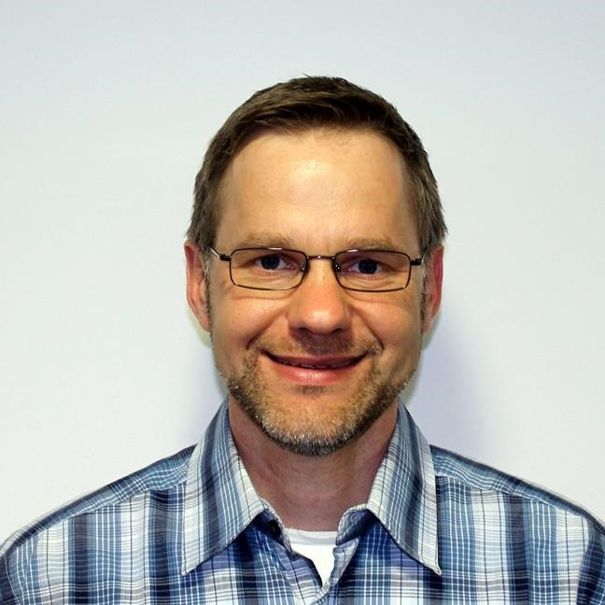
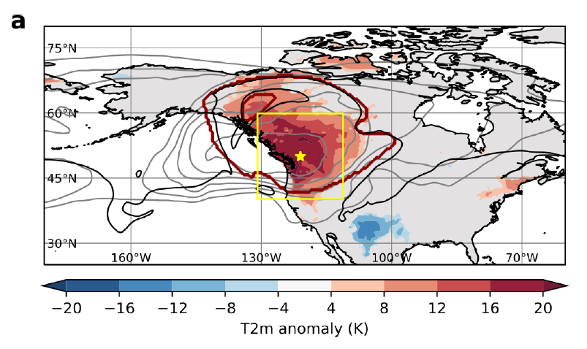
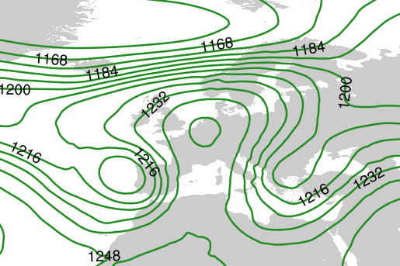
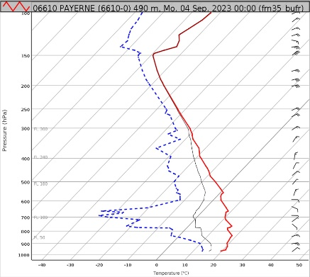
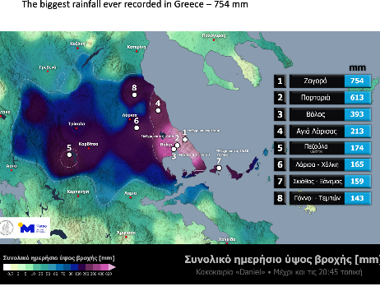
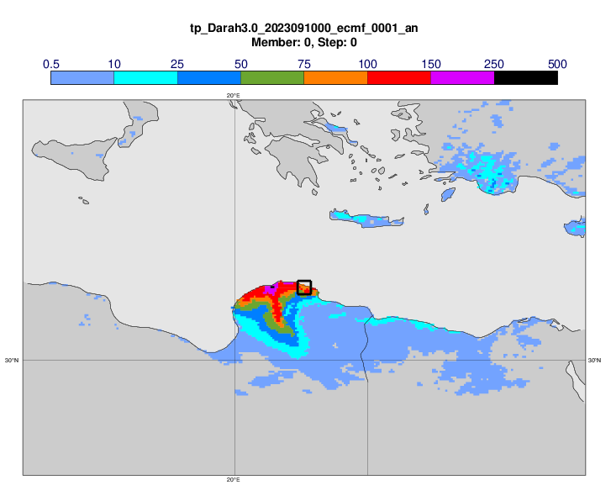
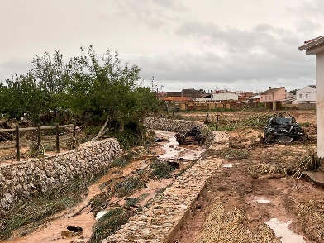




How synoptic weather activity and interaction with the extratropical wave guide matter for the prediction of blocking and extremes
Christian M. Grams¹, A. Oertel2², J. F. Quinting², L. Magnusson³, M. Deinhard (Pickl)², J. Dorrington², S. Hauser^{2,4}, J. Wandel⁵, M. Balmaseda³, and F. Vitart³
¹Federal Institute of Meteorology and Climatology, MeteoSwiss, Zürich-Flughafen, Switzerland, ²Institute of Meteorology and Climate Research (IMKTRO), Karlsruhe Institute of Technology (KIT), Germany, ³European Centre for Medium-Range Weather Forecasts (ECMWF), Reading, UK, ⁴School of Meteorology, University of Oklahoma, Norman, OK, ⁵Deutscher Wetterdienst (DWD), Offenbach, Germany
christian.grams@meteoswiss.ch
EMS2024-640
'Vestíbul' board VB24
Mon, 08:30-Tue, 19:30
Author in attendance time: Tue 18:00-19:30.
2023: Geopotential height at 200hPa
Heat wave and record high 0°-line in Central Europe
Severe Flooding in
Greece (4-7 Sep.)
and Libya (9-12 Sep.)
2021: T2m anomaly and blocking
MeteoSwiss,
https://www.meteoschweiz.admin.ch/ueber-uns/meteoschweiz-blog/de/2023/09/nullgradgrenze-ueber-5000m-vertikalprofile.html
Flash-floods in Iberia 3 September
Meteo.gr & ECMWF:
https://confluence.ecmwf.int/pages/viewpage.action?pageId=348806265 https://confluence.ecmwf.int/pages/viewpage.action?pageId=348807887
photo: Ayuntamiento Buenache de Alarcón https://floodlist.com/europe/spain-floods-september-2023
Oertel et al., 2023, Geophy. Res. Let. doi:10.1029/2022GL100958

Slide 2
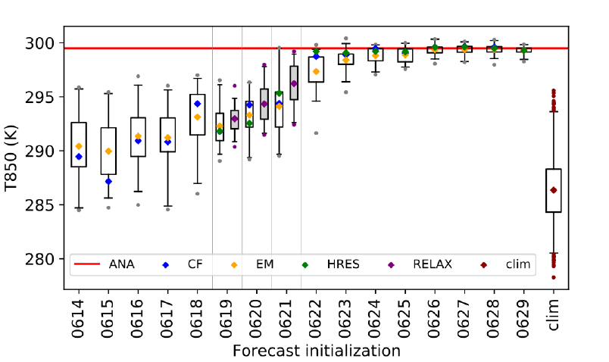
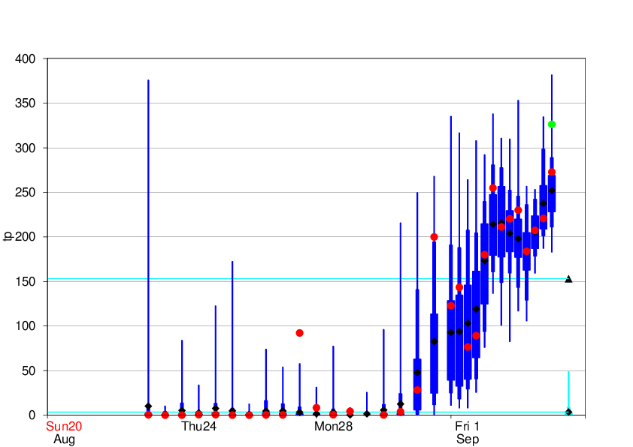
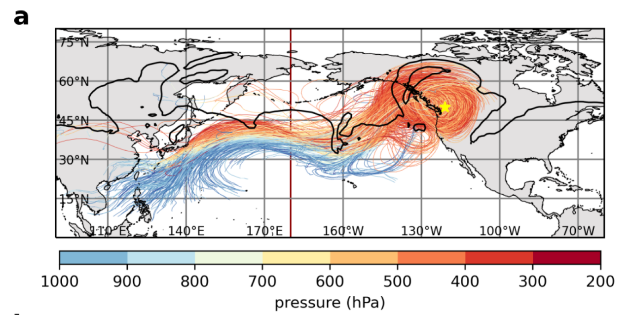
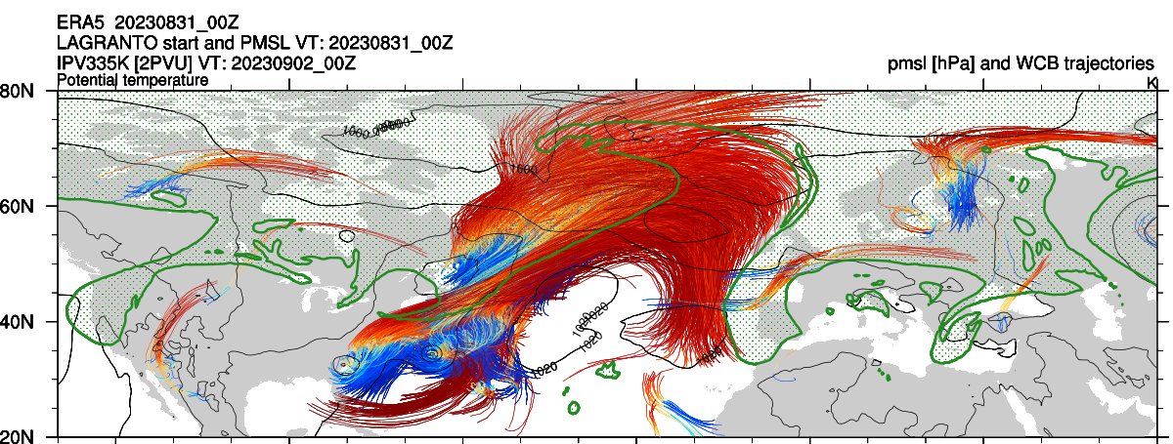
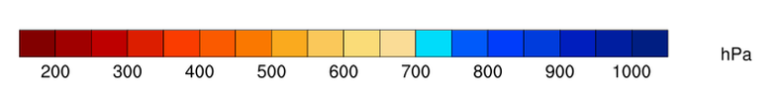
How synoptic weather activity and interaction with the extratropical wave guide matter for the prediction of blocking and extremes
Christian M. Grams¹, A. Oertel2², J. F. Quinting², L. Magnusson³, M. Deinhard (Pickl)², J. Dorrington², S. Hauser^{2,4}, J. Wandel⁵, M. Balmaseda³, and F. Vitart³
¹Federal Institute of Meteorology and Climatology, MeteoSwiss, Zürich-Flughafen, Switzerland, ²Institute of Meteorology and Climate Research (IMKTRO), Karlsruhe Institute of Technology (KIT), Germany, ³European Centre for Medium-Range Weather Forecasts (ECMWF), Reading, UK, ⁴School of Meteorology, University of Oklahoma, Norman, OK, ⁵Deutscher Wetterdienst (DWD), Offenbach, Germany
christian.grams@meteoswiss.ch
EMS2024-640
'Vestíbul' board VB24
Mon, 08:30-Tue, 19:30
Author in attendance time: 18:00-19:30.
IFS ENS for T850 on 29 June 2021
IFS ENS for 72h precip on 4-7 Sep 2023
IFS ENS for T850 on 29 June

