Slide 1

Online portal »Drought meter« for monitoring drought conditions in Slovenia
Anže Medved, Andreja Sušnik, Andreja Moderc, Živa Vlahović, Maja Žun
Anze.Medved@gov.si

Slide 2



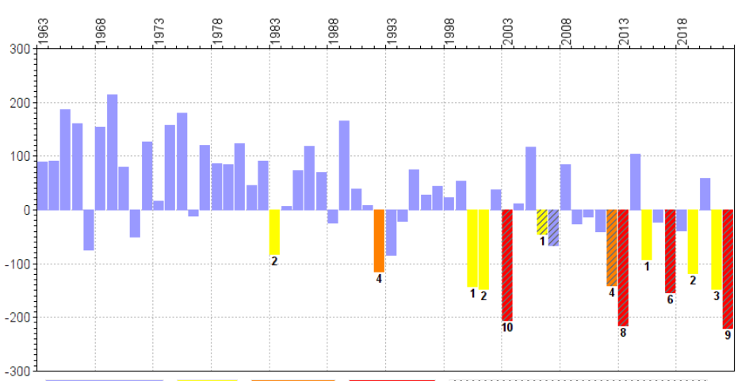

The frequency of droughts in Slovenia has been increasing in recent decades
In the last twenty years we have recorded 7 droughts that affected Slovenia on the scale of a natural disaster
For the purpose of detecting drought conditions in near real time and informing the public about these, Slovenian Environment Agency has developed the »Drought meter« online portal
on a weekly basis throughout the year drought conditions are estimated in three parts of the water cycle
Water balance [mm]
National
Regional
Local
No drought
Declared
natural disaster

Slide 3
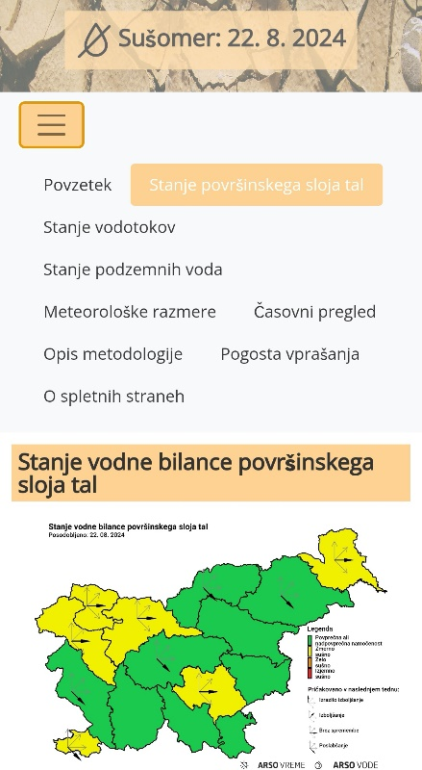
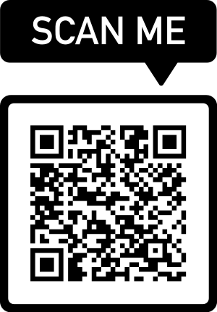
More info at:
Abstract: EMS2024-658
Poster area: 'Galaria Paranimf'
Poster board number: GP13
Display time: Wednesday, 4 September 2024, 08:00-Thursday, 5 September 2024, 13:00
Current state of „Drought meter“
(in Slovenian only)

