Slide 1
Mean Climate: Total Precipitation Rate Animation
Fig. S1. Animation of 6-hourly total precipitation rate in (a) CPCAM and (b) SPCAM, in common log. scale
More drizzle in CPCAM than SPCAM, especially at subtropics
ITCZ is more organized as an elongated band in CPCAM

Slide 2
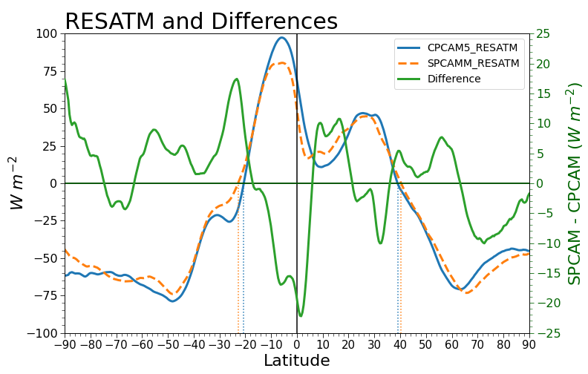
Mean Climate: Atmospheric Energy Balance
Fig. S2. Zonal averaged residual radiative flux of the atmosphere in (solid blue) CPCAM, (dashed orange) SPCAM, and (solid green) their difference.
Smaller atmospheric energy deficit in SPCAM than CPCAM (red rectangle) in the subtropics

Slide 3
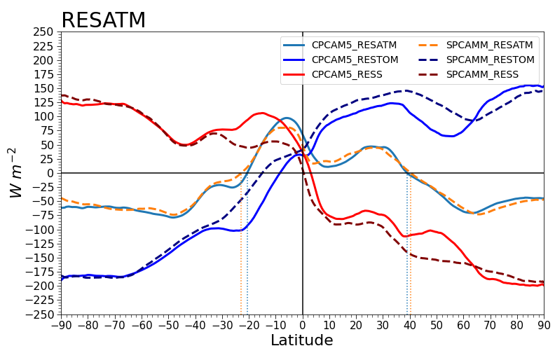
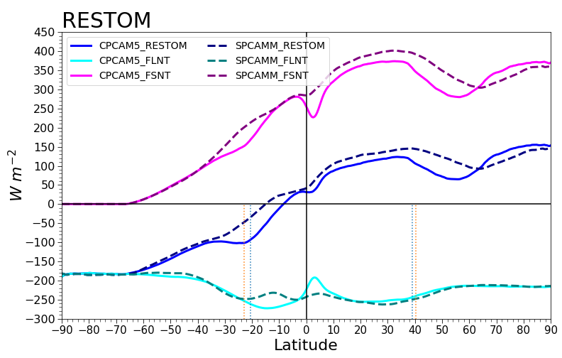
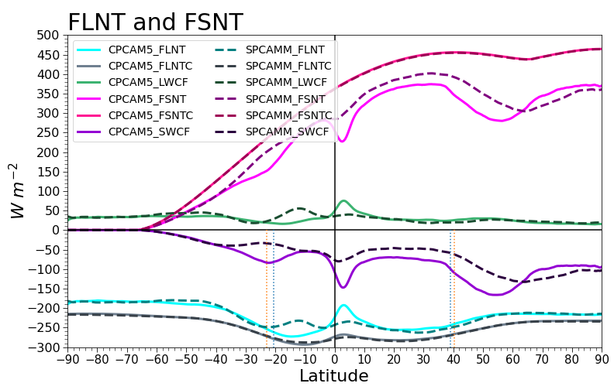
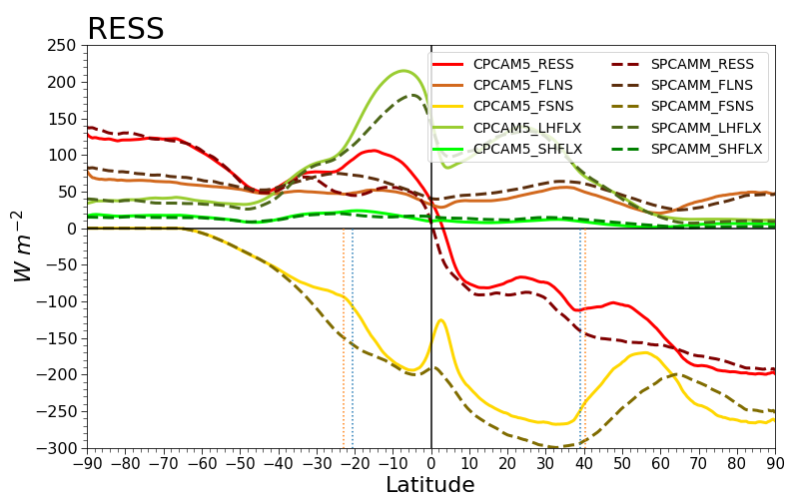
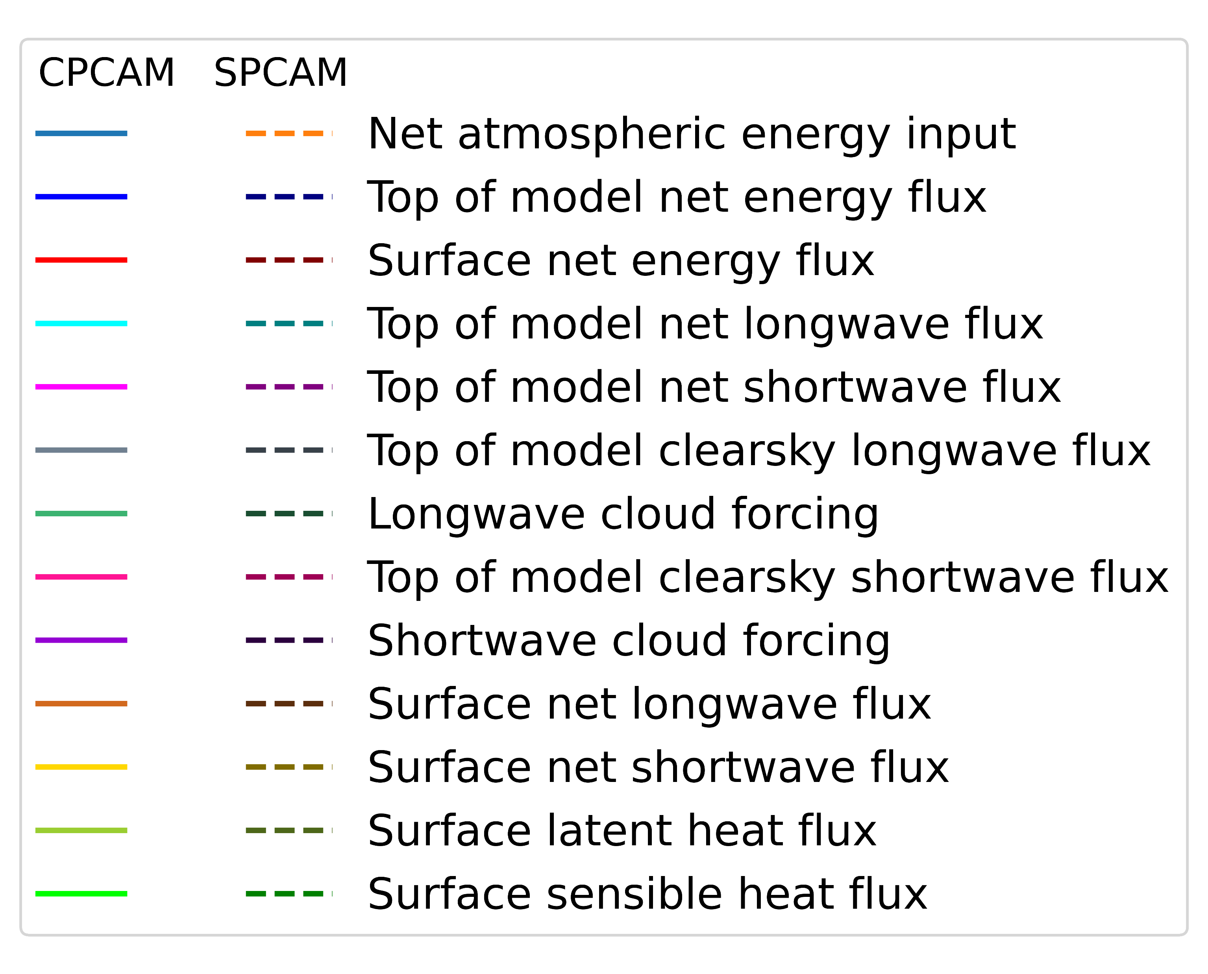
Mean Climate: Atmospheric Energy Budget
(a)
(b)
$$RES^{ATM}=F^{TOM}+F^{sfc}$$
$$F^{TOM}=F_{sw}^{TOM}−F_{lw}^{TOM}$$
(c)
(d)
$$F_{sw}^{TOM}=F_{swclear}^{TOM}+F_{swcf}^{TOM}$$
$$F_{lw}^{TOM}=F_{lwclear}^{TOM}+F_{lwcf}^{TOM}$$
$$F^{sfc}=F_{lw}^{sfc}−F_{sw}^{sfc}+H+E$$
Fig. S3. Zonal averaged atmospheric energy budget. Panel (a): net radiative flux at the top of model (TOM) and the surface, (b): individual terms at the TOM, (c): individual terms at the TOM with the cloud forcings, (d): individual terms at the surface.
Larger energy deficit at SH polar to subtropics region in CPCAM :
(a) larger top of atmosphere energy output (solid blue; more -ve) -> (b) smaller shortwave input at the subtropics (solid violet; less +ve) -> (c) larger shortwave cloud forcing in CPCAM (more shortwave reflection) (solid purple; more -ve)

Slide 4
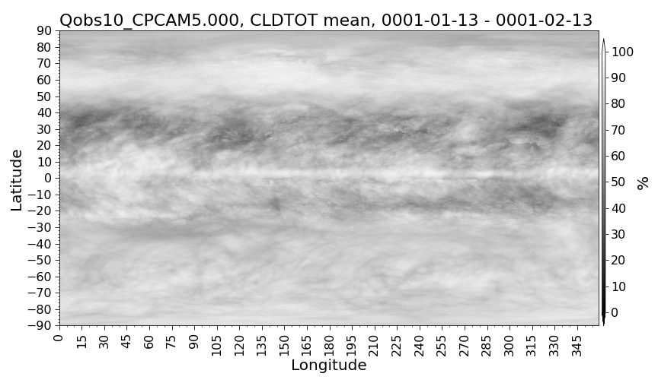
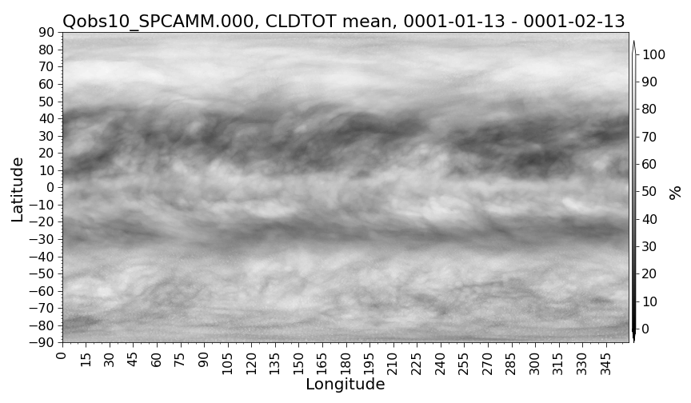
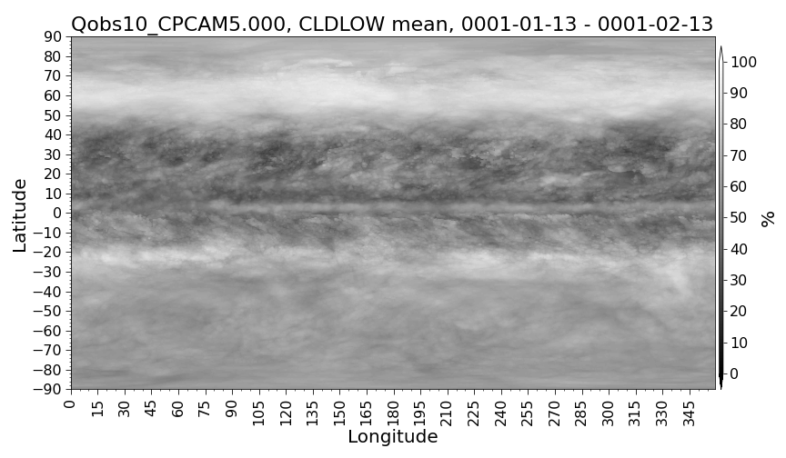
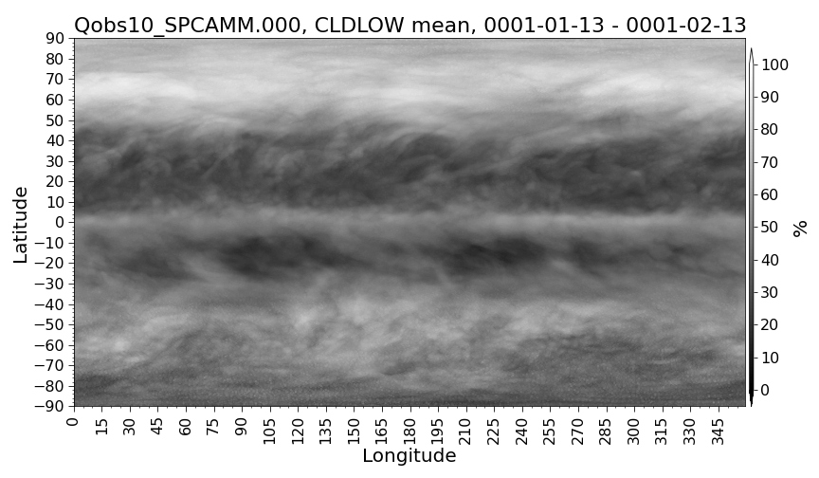
Mean Climate: Cloud Fraction
(a)
(b)
(c)
(d)
Fig. S4. Thirty-days averaged total cloud fraction in (a) CPCAM and (b) SPCAM, and low cloud fraction in (c) CPCAM and (d) SPCAM
CPCAM overestimate low cloud fraction at SH subtropics (red rectangles) -> more shortwave reflection

