Slide 1
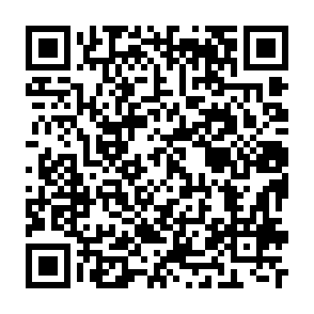
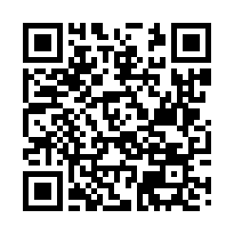
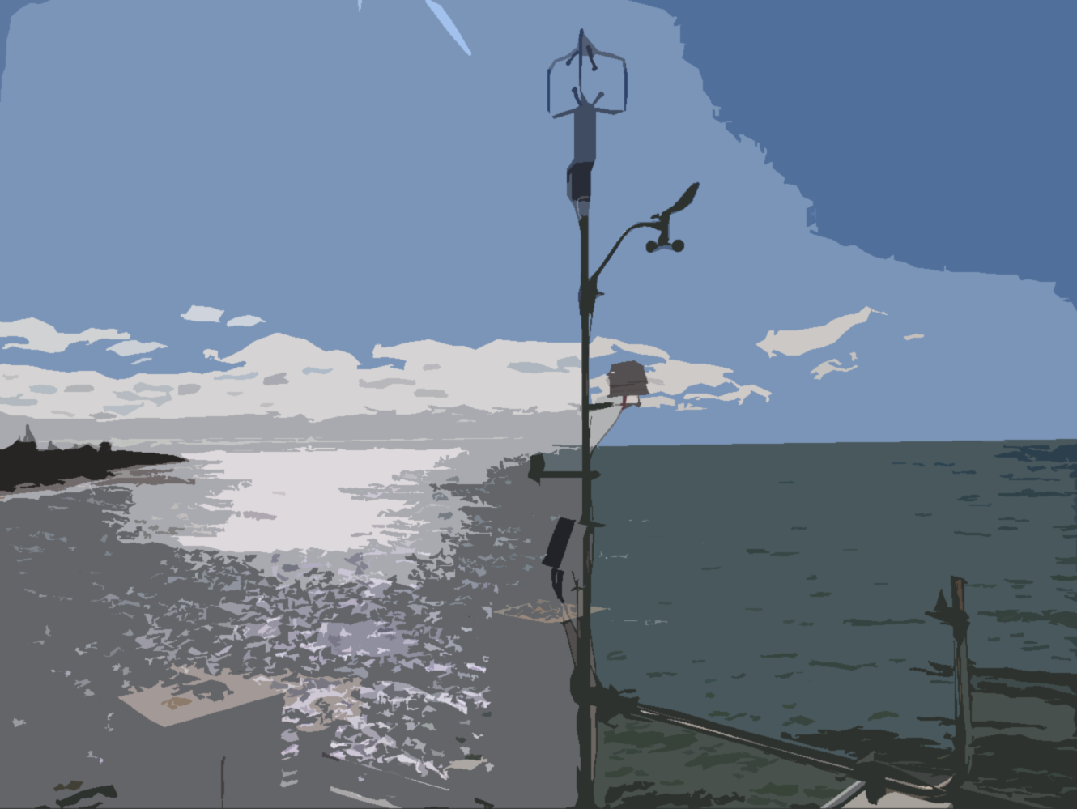
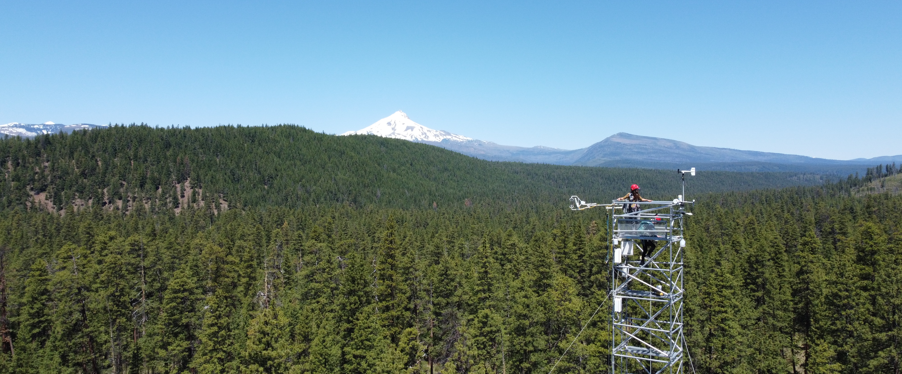
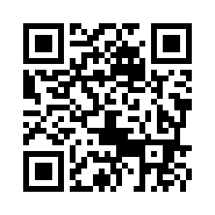
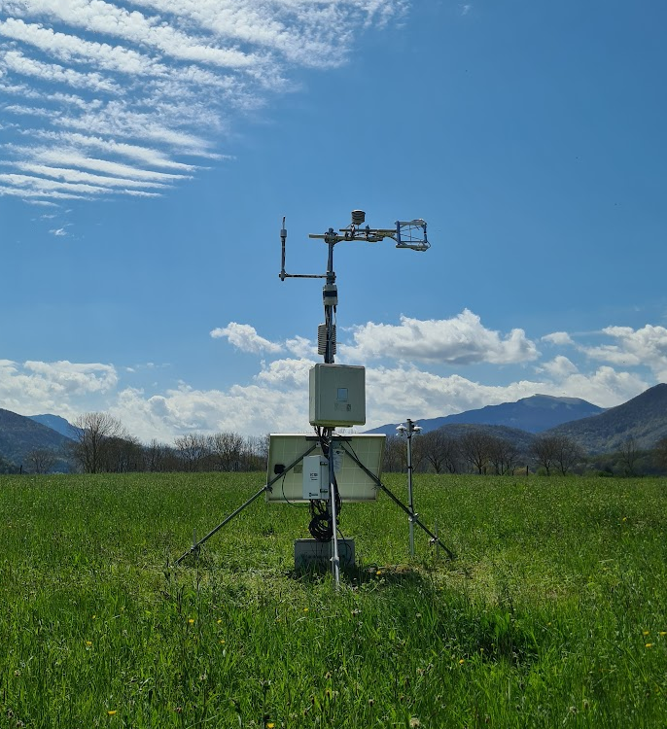
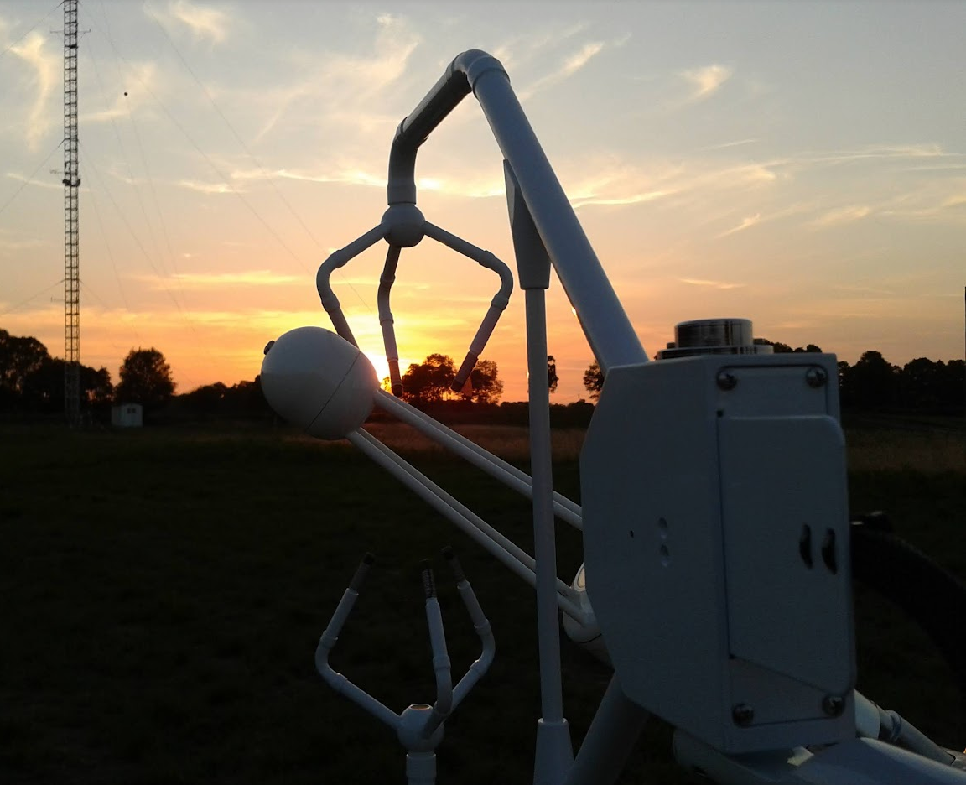
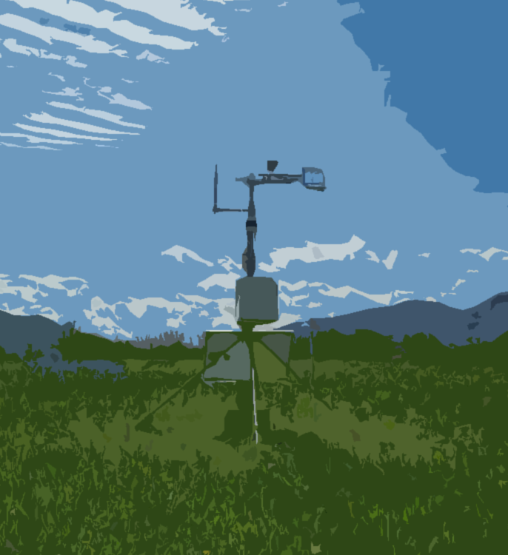
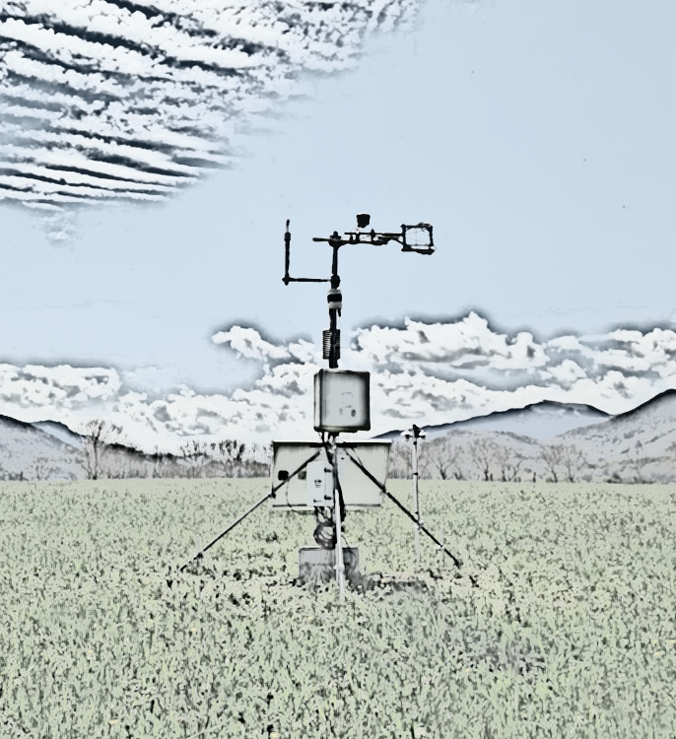
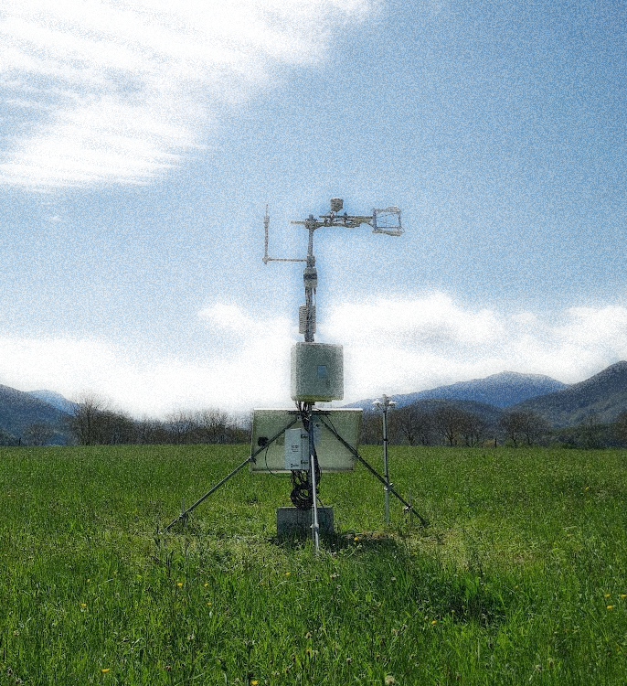
The FLUXNET Outreach Working Group
Communicating Flux Science to Society
Carlos Román-Cascón¹, Jason Kelley², Maoya Bassiouni³, Sung-Ching Lee⁴, Maricar Aguilos⁵,
and all the FLUXNET Outreach Committee members
¹University of Cádiz, INMAR, Applied Physics Department, Puerto Real, Spain (carlos.roman@uca.es); ²Asperatus Consulting, 30063 Beaver Creek Road, Corvallis OR 97333, US; ³Department of Environmental Science, Policy and Management, University of California Berkeley, Berkeley, CA, US; ⁴Max-Planck Institute for Biogeochemistry, Biogeochemical Integration, Jena, Germany; ⁵Department of Forestry and Environmental Resources, North Carolina State University, Raleigh, NC 27607, US
.
MAIN OBJECTIVES
To share flux science beyond typical research activities
To bridge gaps between flux scientists and the rest of the world!
(applied research, conservation of natural resources, government policies,
incentive programs, popular belief, society in general!)
SOME ACTIVITIES…
Facilitating flux-related communication beyond scientists!
Flux terminology glossary. Translation of audiovisual material into different languages.
Linking education and outreach.
Young scientist training in outreach.
Art to expand flux science
in our imagination!
Using emotions and creativity.
Collaborations between artist and researchers at flux tower sites to contemplate
the biosphere's breath.
@Alex Irving (Oregon State University)
Flux podcasts
Bridging the gap between eddy covariance flux scientists and stakeholders.
Interdisciplinary conversations between a diverse rotation of co-hosts, flux experts and stakeholders about flux science application.
Novel activities
Activities out of scope of traditional ones.
Testing new ways of science communication.
ACKNOWLEDGEMENTS
WIND4US project (Disentangling the complexity of the WIND systems in coastal areas FOR a better Understanding of their impacts on Society), funded by the 2023 Research Consolidation call for projects of the Ministry of Sciences and Innovation and the Spanish Research Agency inside “Plan de Recuperación, Transformación y Resiliencia” (NextGenerationEU funding).
OceanUCA project, funded by the 2023 call for Marine Sciences I+D+i projects in the frame of: “Plan Complementario de Ciencias Marinas of Junta de Andalucía” and “Plan de Recuperación, Transformación y Resiliencia” (NextGenerationEU funding).

