Slide 1






High-resolution temperature
profiling in the Pi Chamber
by Robert Grosz¹, Kamal Kant Chandrakar², Raymond A. Shaw³, Jesse C. Anderson³, Will Cantrell³,
and Szymon P. Malinowski¹
¹Institute of Geophysics, University of Warsaw, Poland
²Mesoscale & Microscale Meteorology Laboratory, NSF National Center for Atmospheric Research, USA
³Department of Physics, Michigan Technological University, USA
contact: rgrosz@fuw.edu.pl
SCREEN CAPTURE WELCOME

Slide 2
Motivation
From a microphysical perspective, which is the primary application of the chamber, understanding the spatial variability of scalar fluctuations within the chamber, including the properties of the large-scale circulation (LSC), is crucial. This understanding impacts not only the positioning of instruments inside the chamber but also the strategies for measurements, such as the lengths of measurement time series. Only with a comprehensive understanding of the physics involved can different phenomena be effectively linked together. This is why analyses aimed at addressing the full spectrum of scales are the focus of the present study.

Slide 3
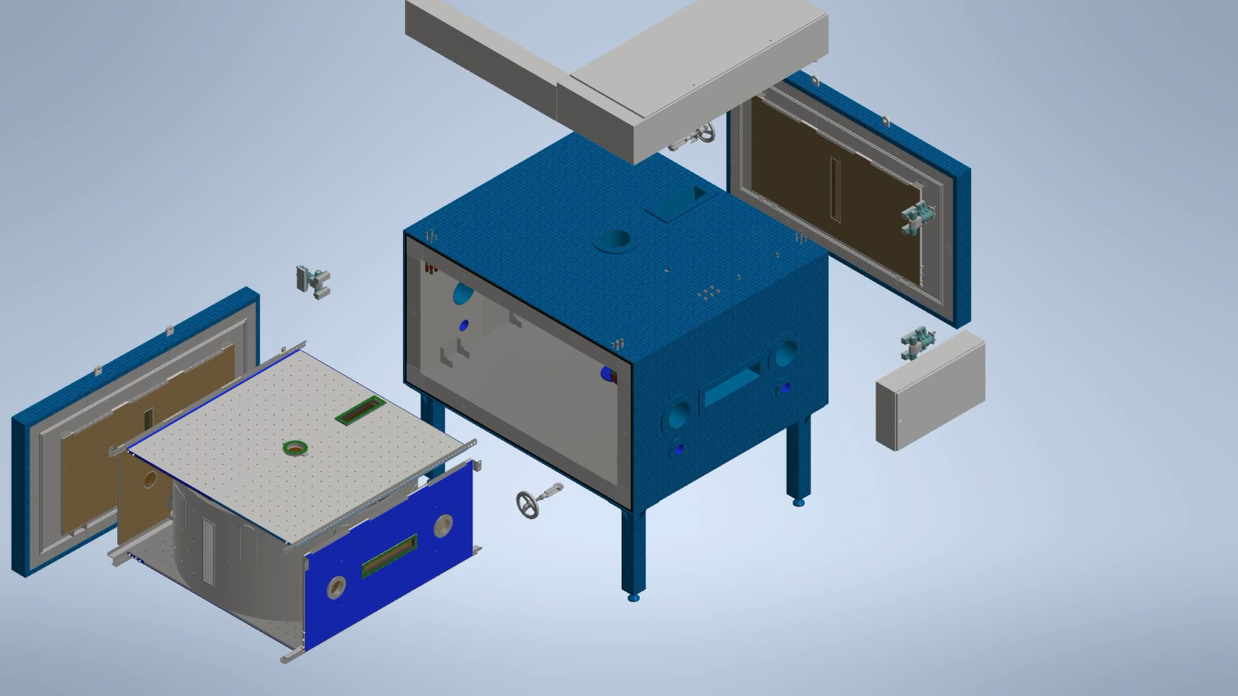
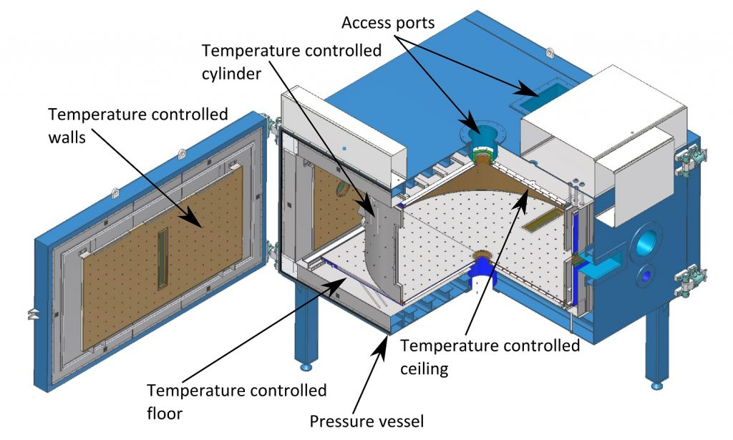

Pi Chamber
reproducible and controlled measurements across a wide range of temporal scales (minutes to days)
operates in two modes (pressure reduction and Rayleigh-Bénard convection)
Chang, K., et al., BAMS, 97, 2343–2358, (2016)
The established LSC period (single roll) for temeprature difference$ΔT=$12 K, was approximated to $τ12 ≈$ 72 s (moist convection with mixing ratio of 7.55 g kg⁻¹).
Anderson, J. C., et al., AMT, 14, 5473–5485, (2021)
Notes:
(Chang et al., 2016

Slide 4
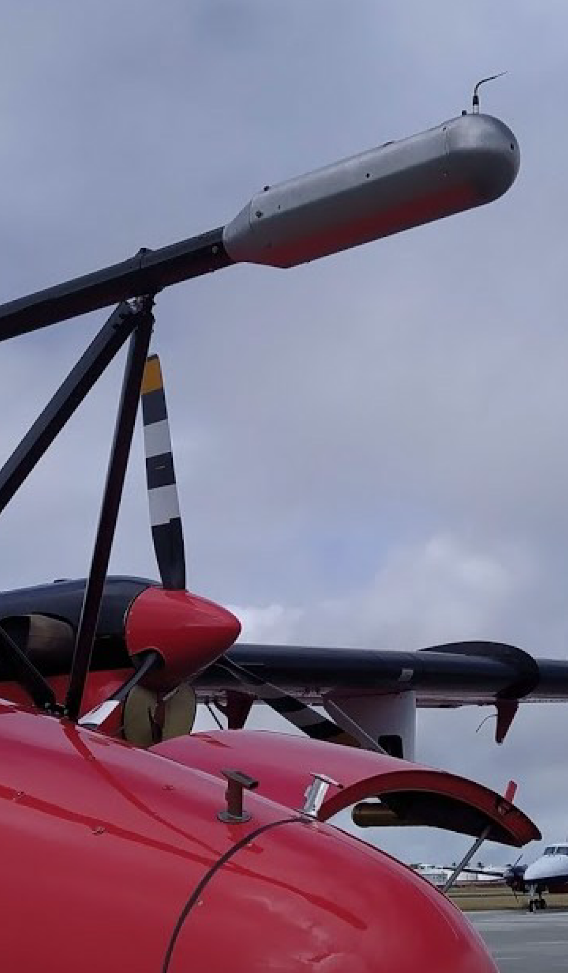

UltraFast Thermometer (UFT)
1992 – prototype, ∼ 50 µm thick thermocouple
1997 – UFT, resistive platinum-coated tungsten wire, 2.5 µm thick, 5 mm long, ∼50 Ω resistance, and time constant ∼10⁻⁴ s
UFT-M (POST, 2007), UFT-2-0 (ACORES, 2017),
UFT-2-A and UFT-2-B (EUREC⁴A, 2020)
The current version of UFT utilizes 3 mm long wire spanned on an industry miniature wire probe, right angle, parallel by DANTEC®
Haman, K. E., et al., J. Atmos. Oceanic Technol., 14, 217–227, (1997)
Kumala, W., et al., J. Atmos. Oceanic Technol., 6, 2043–2054, (2013)

Slide 5

Setup and strategy
high resolution (2 kHz) temperature time series at selected locations in a vertical profile near the axis of the chamber
investigation for three $∆T:$ 10 K, 15 K, and 20 K at Rayleigh number Ra ∼ 10⁹ and Prandtl number Pr ≈ 0.7
variable measurement time (3 min or 19 min)
less emphasized aspect – the surface topography, i.e. longitudinal stripes on the floor and ceiling (aluminum bars, 4 cm wide and 1.4 cm high, separated by 17 cm intervals)

Slide 6

Results
Temperature fluctuations T′ time series corresponding to different $∆T$
Experiments names explanation:
V20-S-L
V – vertical profiling
20 – $∆T$
S – type of boundaries (S for smooth
and R for rough)
L – 19 min measurement time

Slide 7
Standard deviation

Slide 8
Skewness

Slide 9


Power
Spectral
Density
vertical variability of the LSC period
grey regions describe +/- 1σ_{τ}
$τ12 ≈$ 72 s obtained by Anderson et al. (2021) for $∆T =$ 12 K
relationship between τ and $∆T$ modeled by exponential function
plot includes 95% simultaneous functional bounds, and root mean squared error (RMSE)

Slide 10

Power
Spectral
Density
scaling method proposed by Zhou and Xia (2001) – $f2P(f)$ – to collapse the PSD curves
high convergence across all curves around $f_{p}=$ 4 Hz
three spectrum regimes: inertial, transition, and dissipative
linearity of the slopes in log-log coordinates estimated with the Pearson correlation coefficient p

Slide 11
Power
Spectral
Density
– slopes

Slide 12
DNS vs experiment – standard deviation
Cloud Model 1 (CM1) (Bryan and Fritsch, 2002) with the computational domain size 960 × 960 × 500 grid cells. The model and setup are described in detail in Chandrakar et al. (2022, 2023)
temperature boundary conditions are consistent with the experiments, the Eulerian temperature time series are outputted at 0.0012–0.0015 s

Slide 13
DNS vs experiment – skewness
Mean vertical flow around the axis

Slide 14
Take away
basic characteristics – significant changes in the standard deviation, skewness, and the scaling exponents of the power spectrum of the distribution of temperature fluctuations near the top and bottom surfaces -> dynamics of local thermal plumes and their interaction with the LSC
topographic effects – no major differences were observed corresponding to topographic effects, likely due to insufficient time series
dynamic regimes – PSD analysis revealed periodicity of LSC with respect to the temperature differences, we identified three distinct dynamic regimes: inertial (∼ −7/5), transition (∼ −3), and dissipative (∼ −7). The scale break between the inertial and transition ranges was attributed to a dynamic transition from the LSC-dominated regime to the thermal plume regime. Our findings are consistent with other studies not directly related to RBC though
experiment versus DNS – experimental findings showed convincing agreement with DNS conducted under similar thermodynamic conditions, marking a rare comparative analysis in this field. Velocity profiles supported the argument for the nature of thermal plumes

