Slide 1
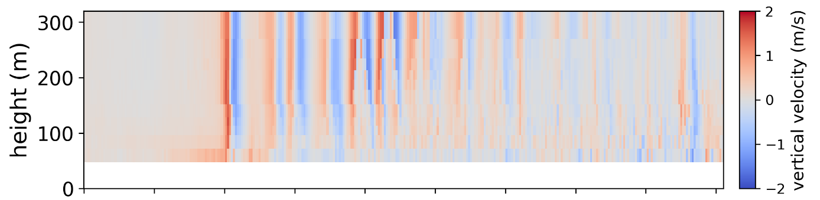

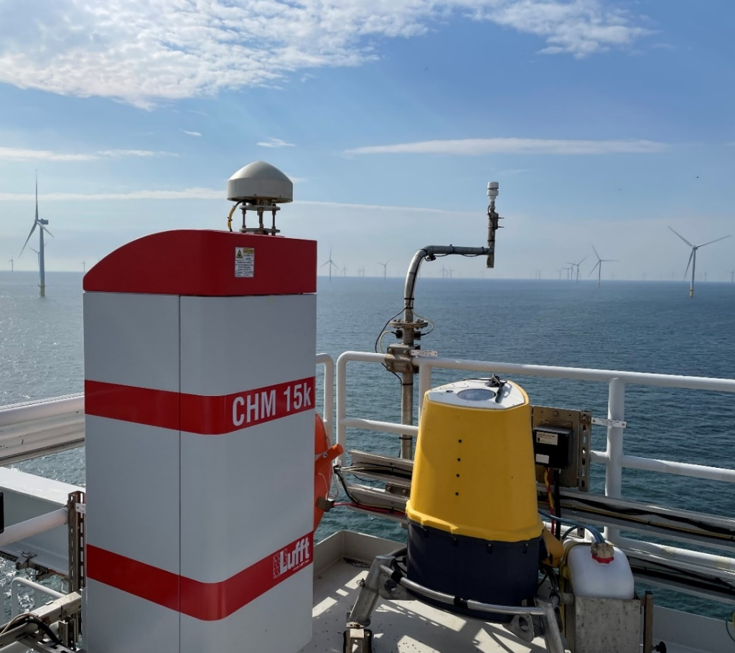

Doppler lidar gravity wave observations within North Sea wind farms
EMS2025-107
Steven Knoop, Mando de Jong and Jelle Assink
(KNMI)

Slide 2
Atmospheric gravity waves & (offshore) wind farms
WFIP2, AWAKEN, …

Slide 3
Wind-farm-induced gravity waves
HERE ONLY “EXTERNAL” GRAVITY WAVES!!!

Slide 4
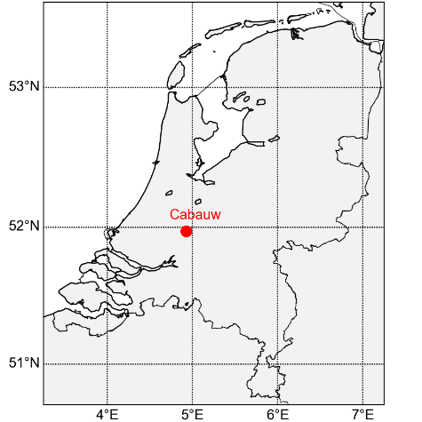

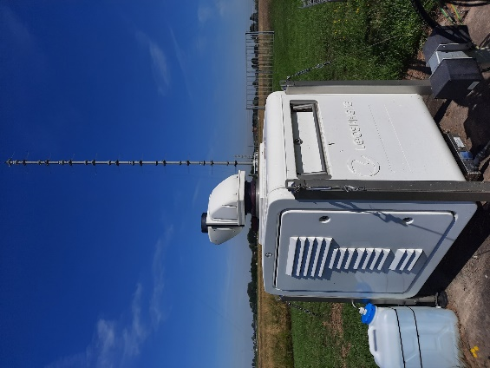
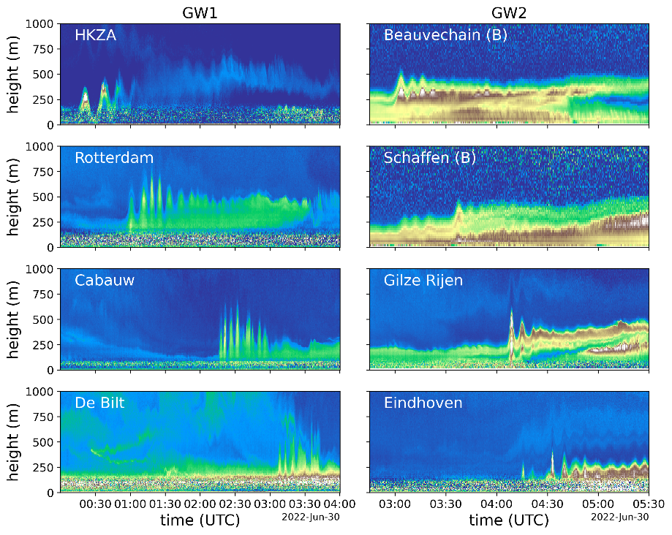
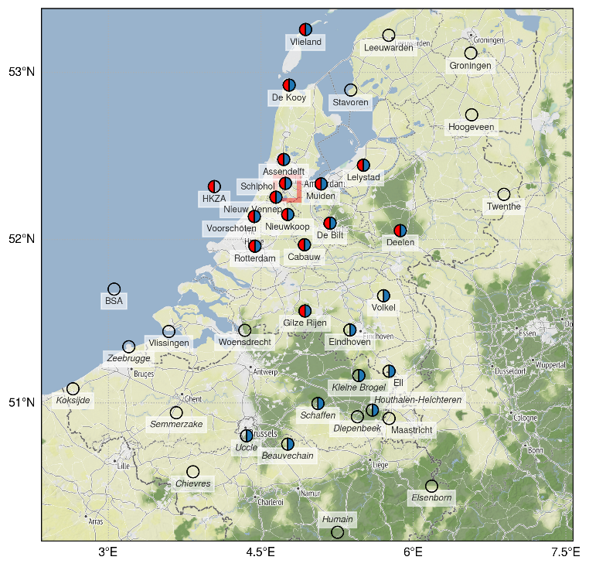
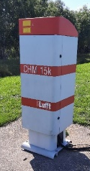
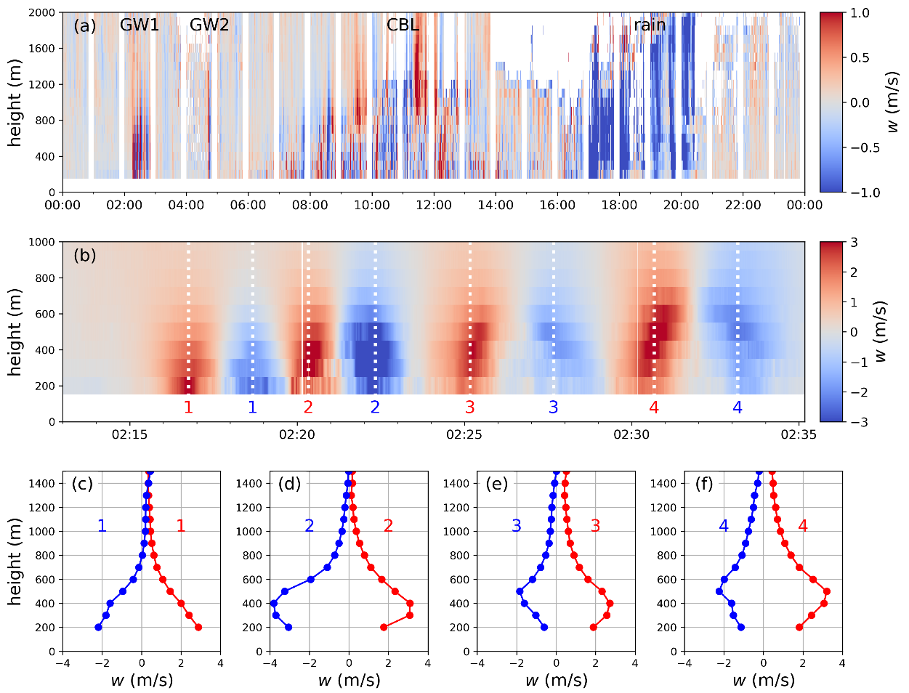
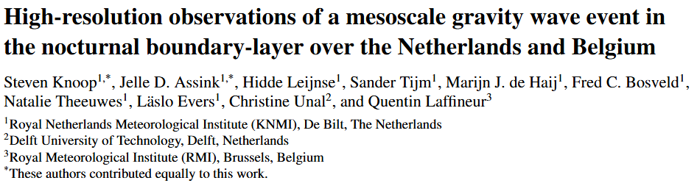
EMS2024 Barcelona
2022-06-30
w: vertical velocity

Slide 5
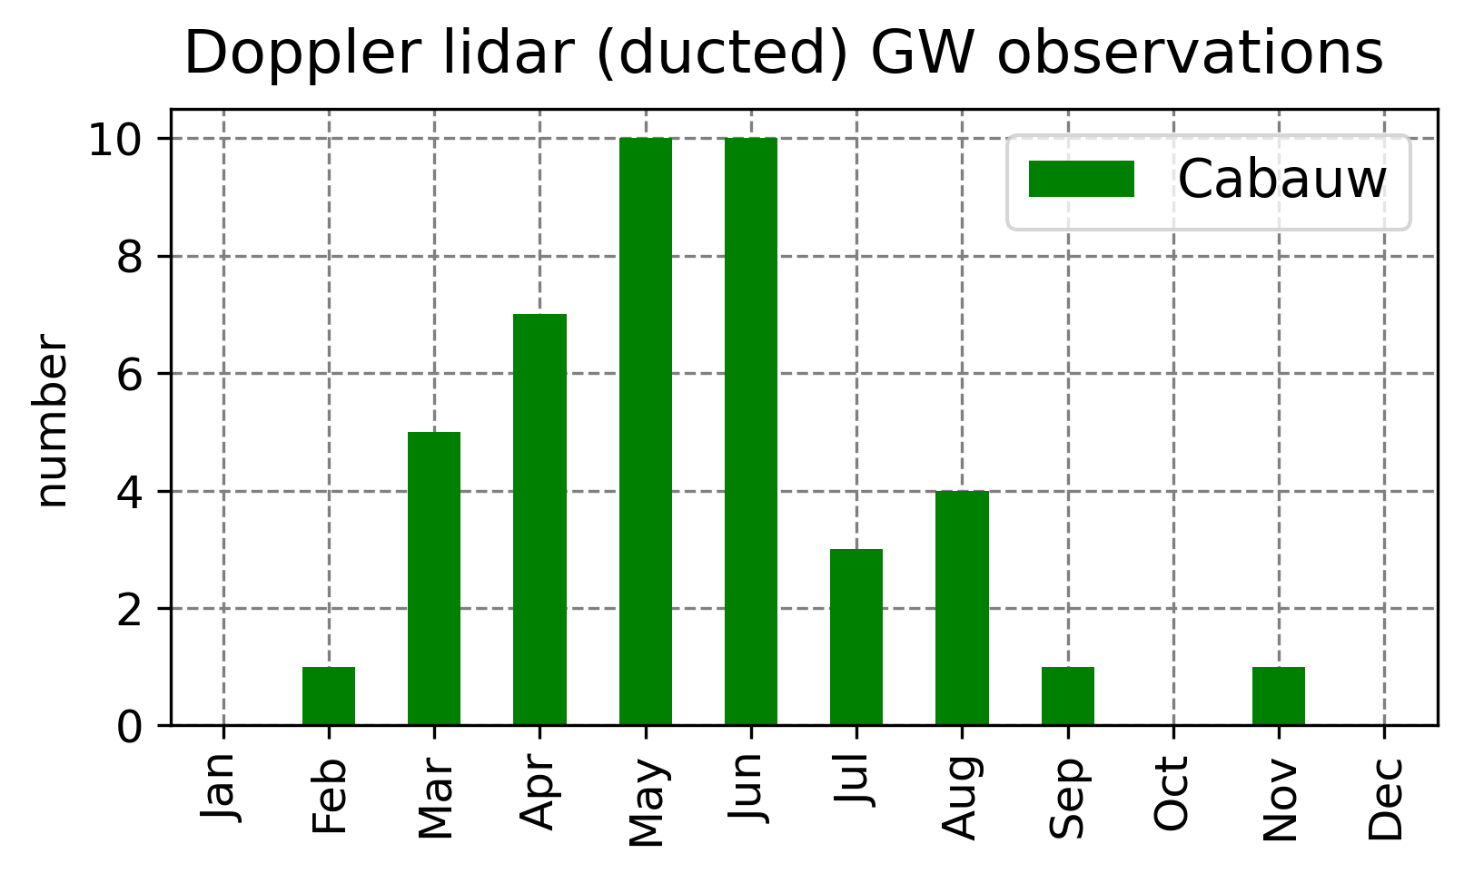
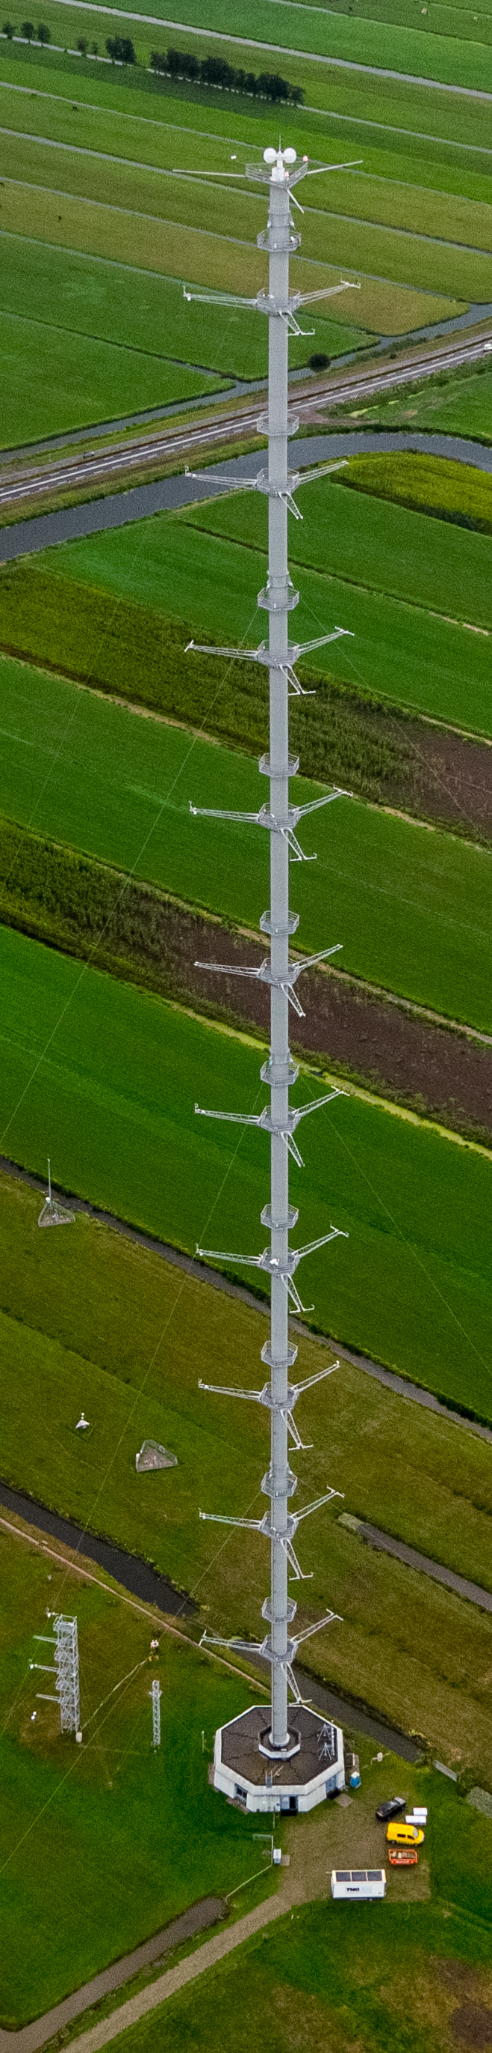
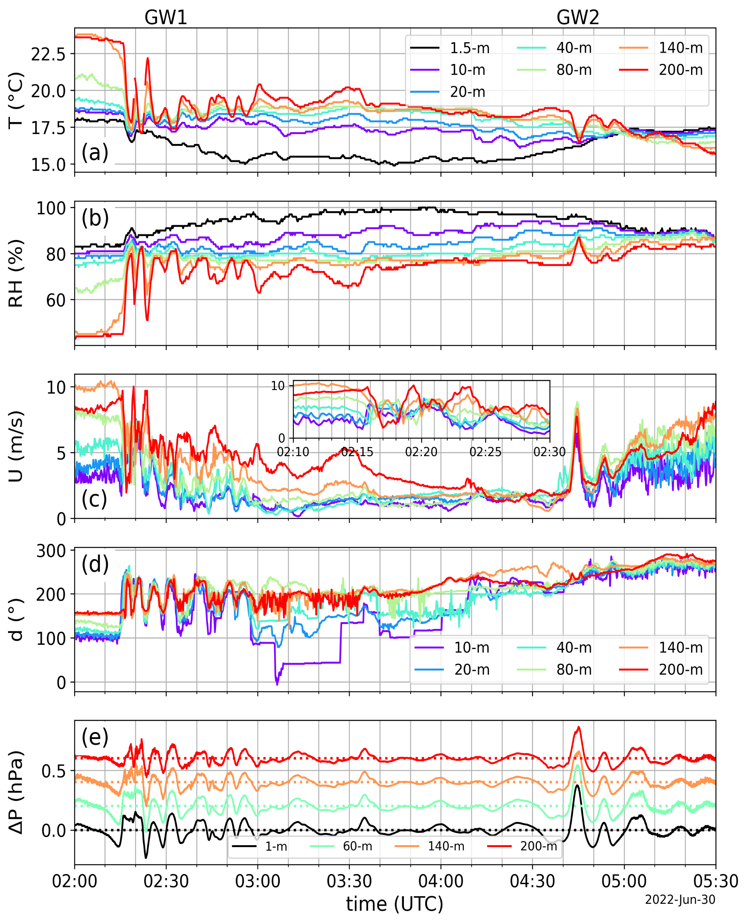
Impact on wind
EMS2024 Barcelona
~40 cases at Cabauw since 2018
Mostly spring/summer
Nocturnal boundary layer
Strong modulation on wind

Slide 6

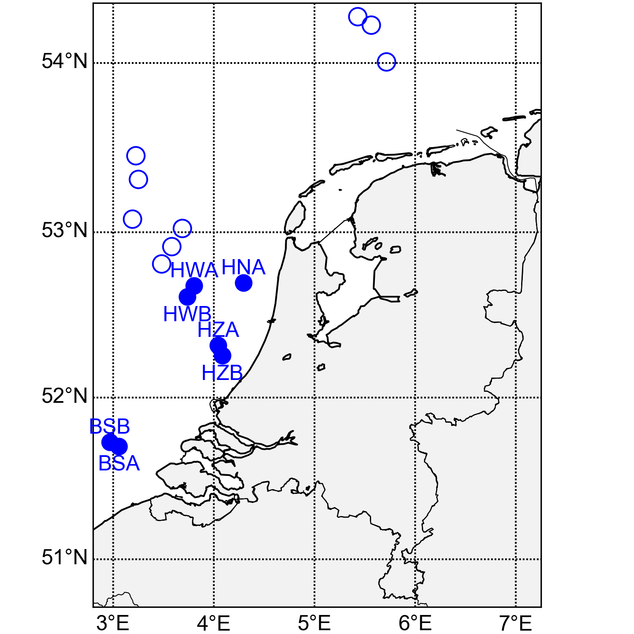
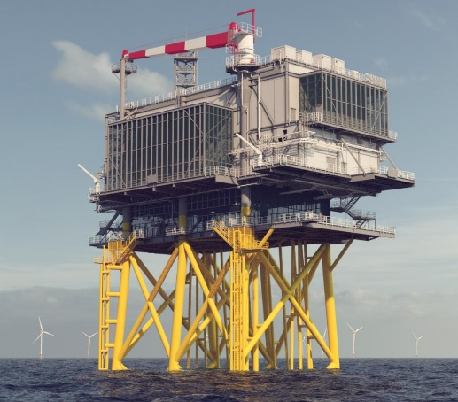

Borssele Alpha, Damian Napoles Soto (KNMI)
EMS2023 Bratislava
VAD
 | Start Doppler lidar | wind farm operational
BSA | 2019-7 | 2020-11
BSB | 2020-6 | 2020-11
HZA | 2022-4 | 2023-9
HZB | 2022-8 | 2023-9
HNA | 2022-12 | 2023-12
HWA | 2023-10 | -
HWB | 2025-07 | -
Doppler lidar:
ZX300M (ZX lidars)

Slide 7
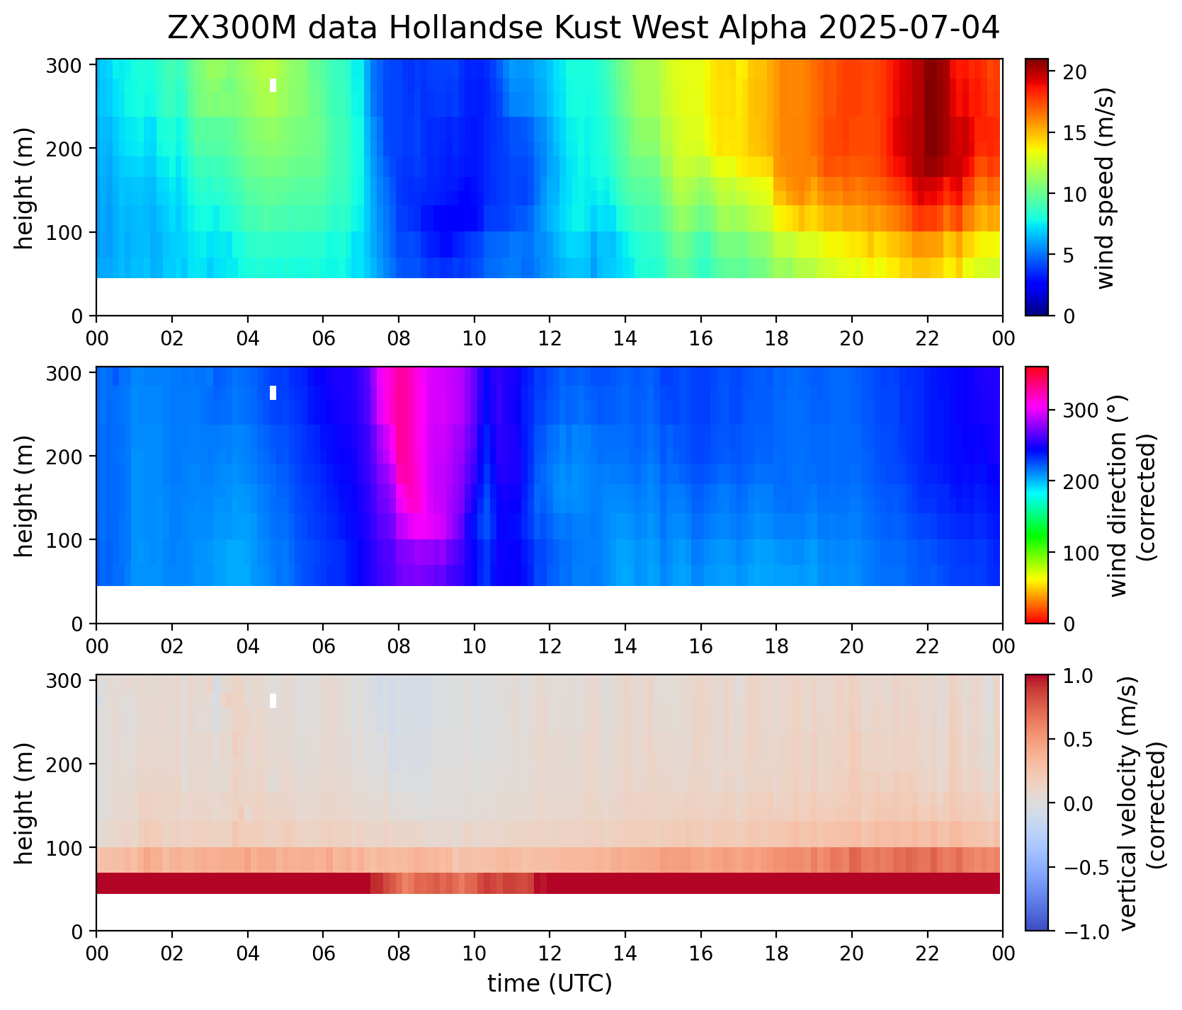
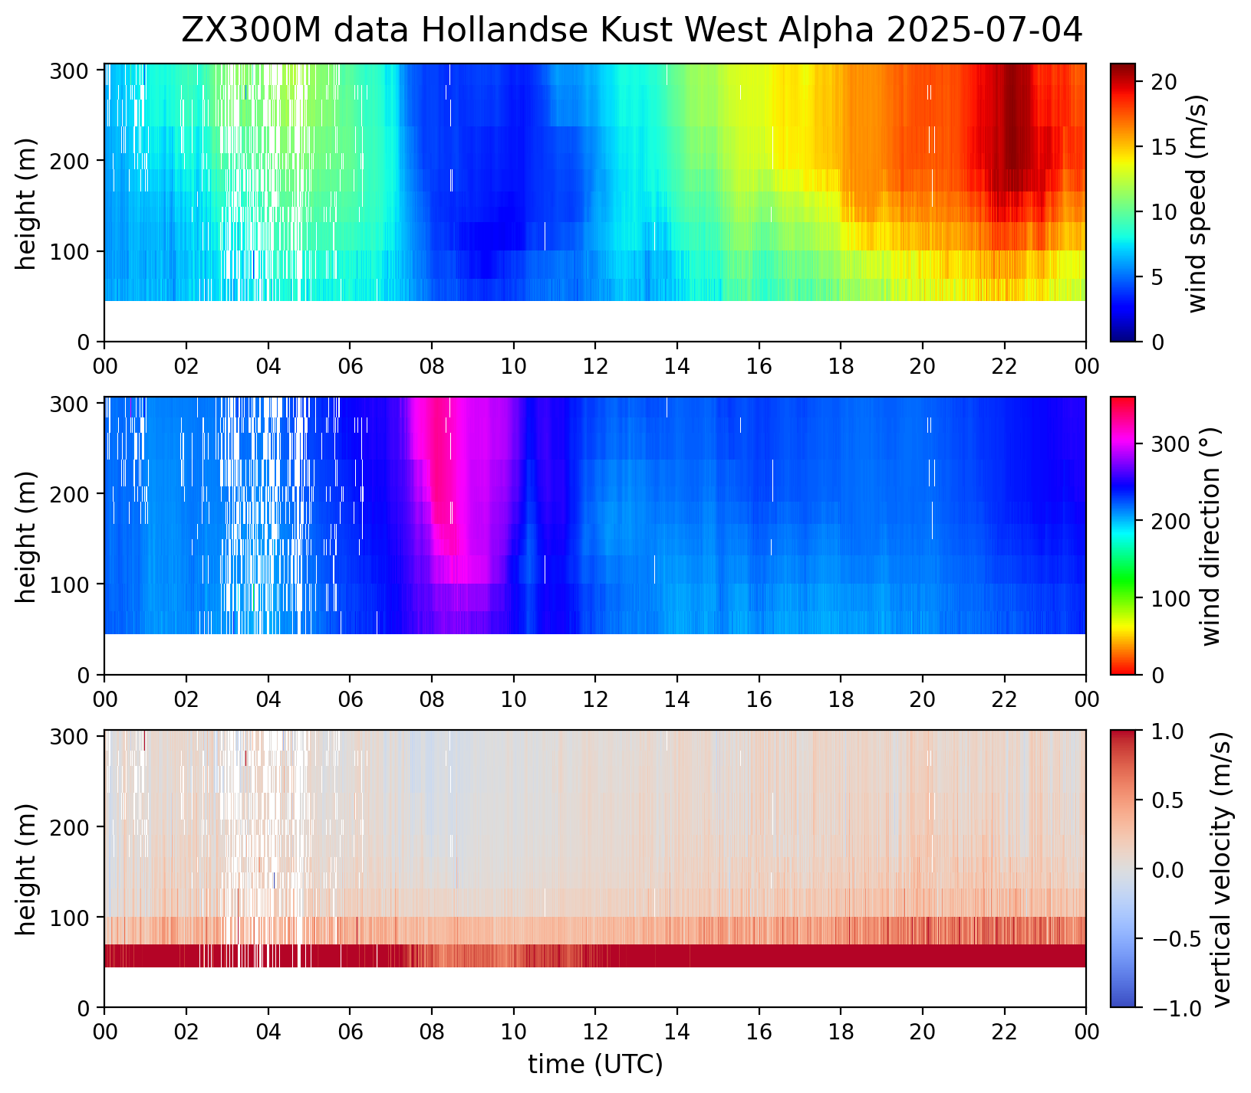
Example
10 min.
raw
45m
https://dataplatform.knmi.nl/dataset/windlidar-nz-wp-platform-10min-1
https://dataplatform.knmi.nl/dataset/windlidar-nz-wp-platform-1s-1

Slide 8
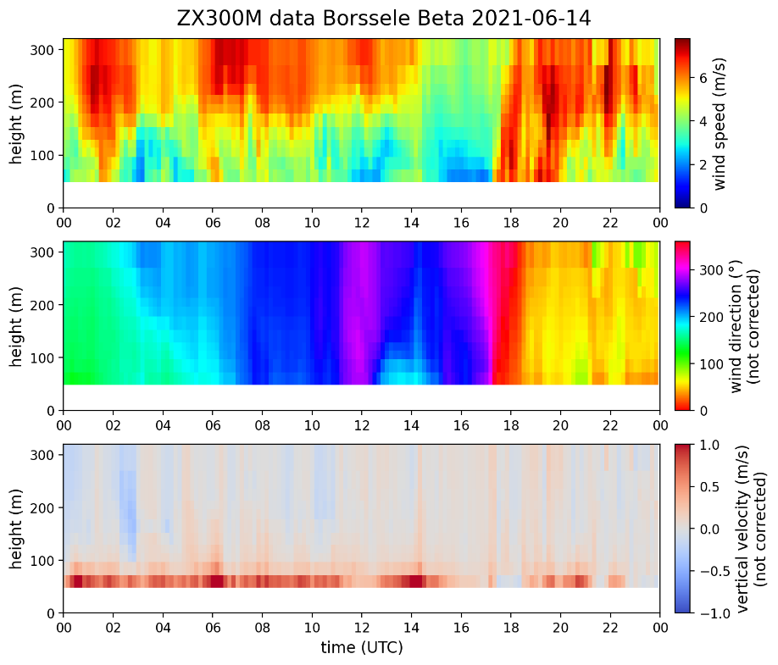
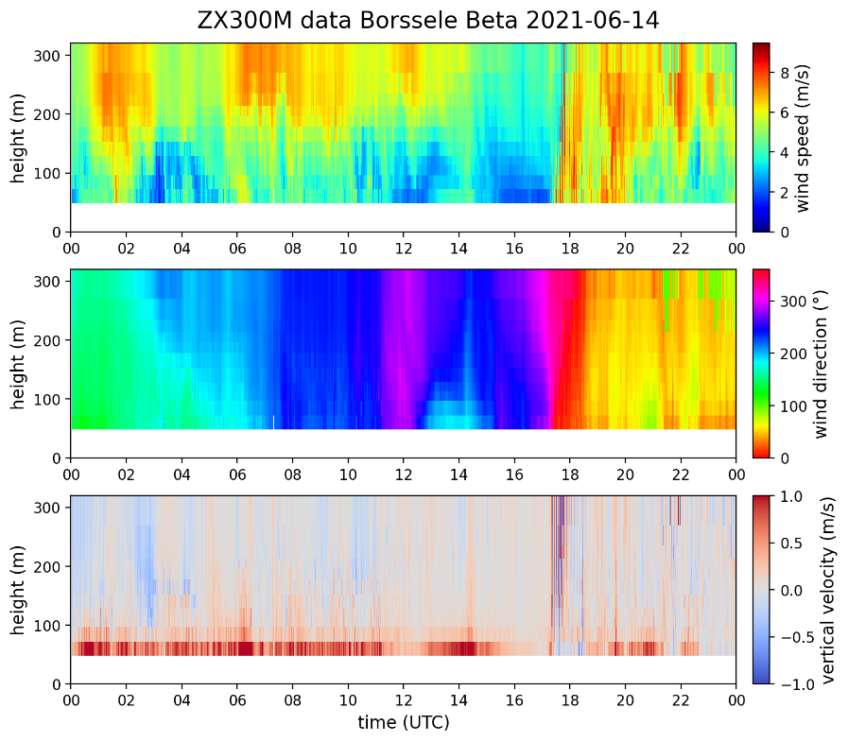

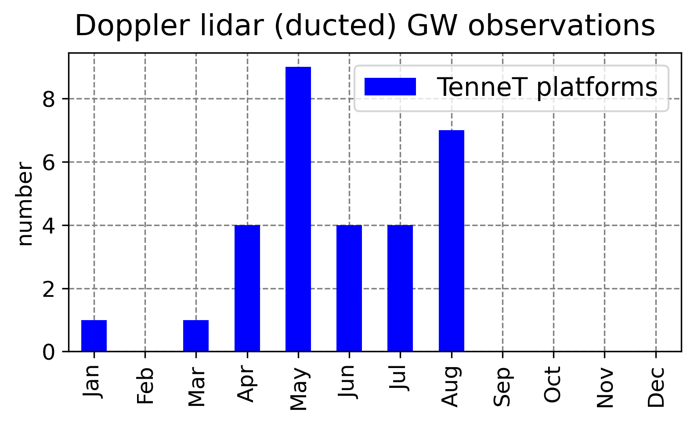
Example GW case
 | Start Doppler lidar | wind farm operational
BSA | 2019-7 | 2020-11
BSB | 2020-6 | 2020-11
HZA | 2022-4 | 2023-9
HZB | 2022-8 | 2023-9
HNA | 2022-12 | 2023-12
HWA | 2023-10 | -
HWB | 2025-07 | -
10 min. averaged
raw
visual inspection
w>1 m/s

Slide 9
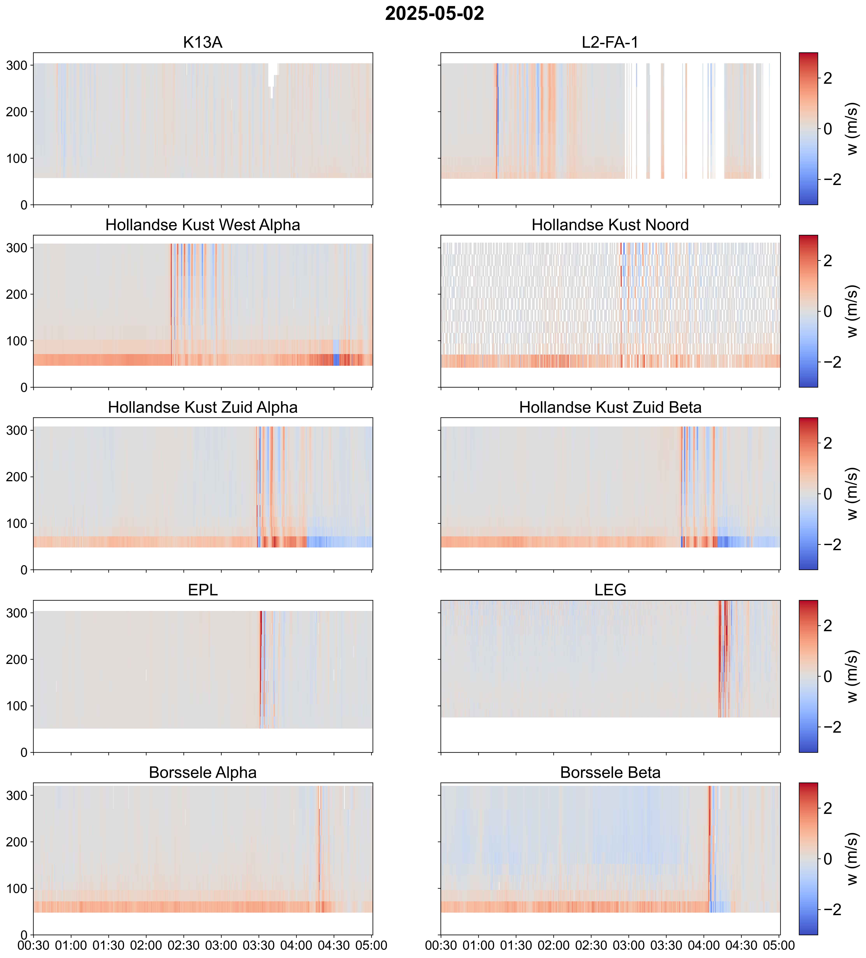
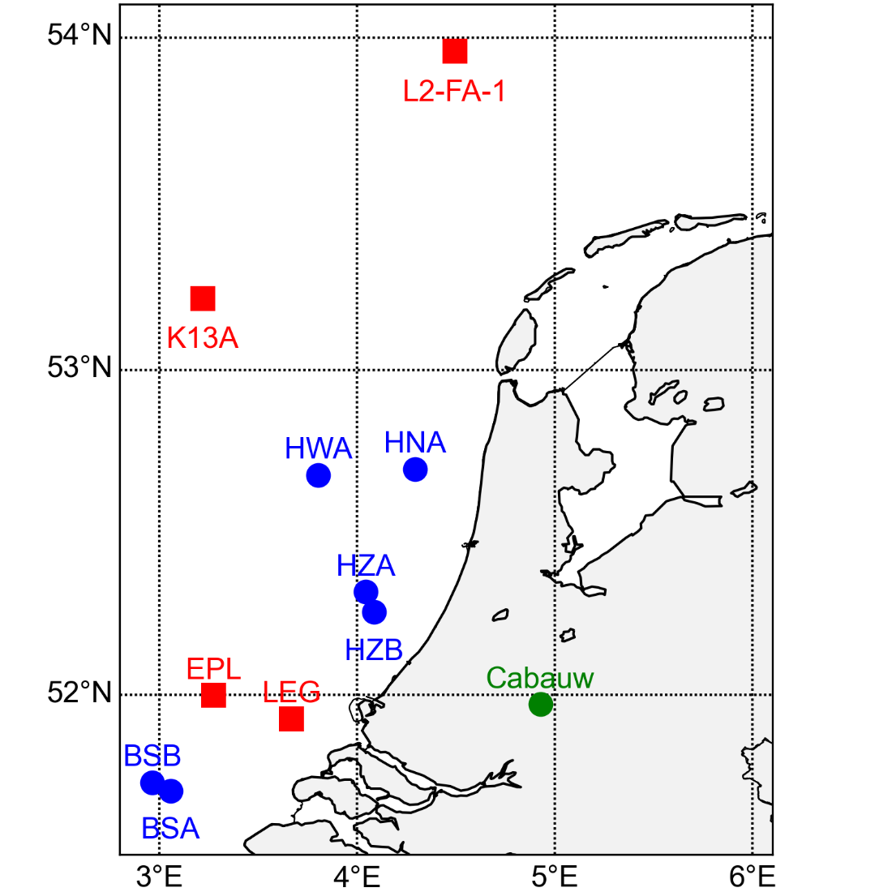
GW case
2025-05-02
HWA
HNA
HZA
HZB
Lag analysis:
direction φ ~ 320°
speed c ~ 10 m/s
BSA
BSB
TNO: EPL, LEG, K13A, L2-FA-1
https://offshorewind-measurements.tno.nl

Slide 10
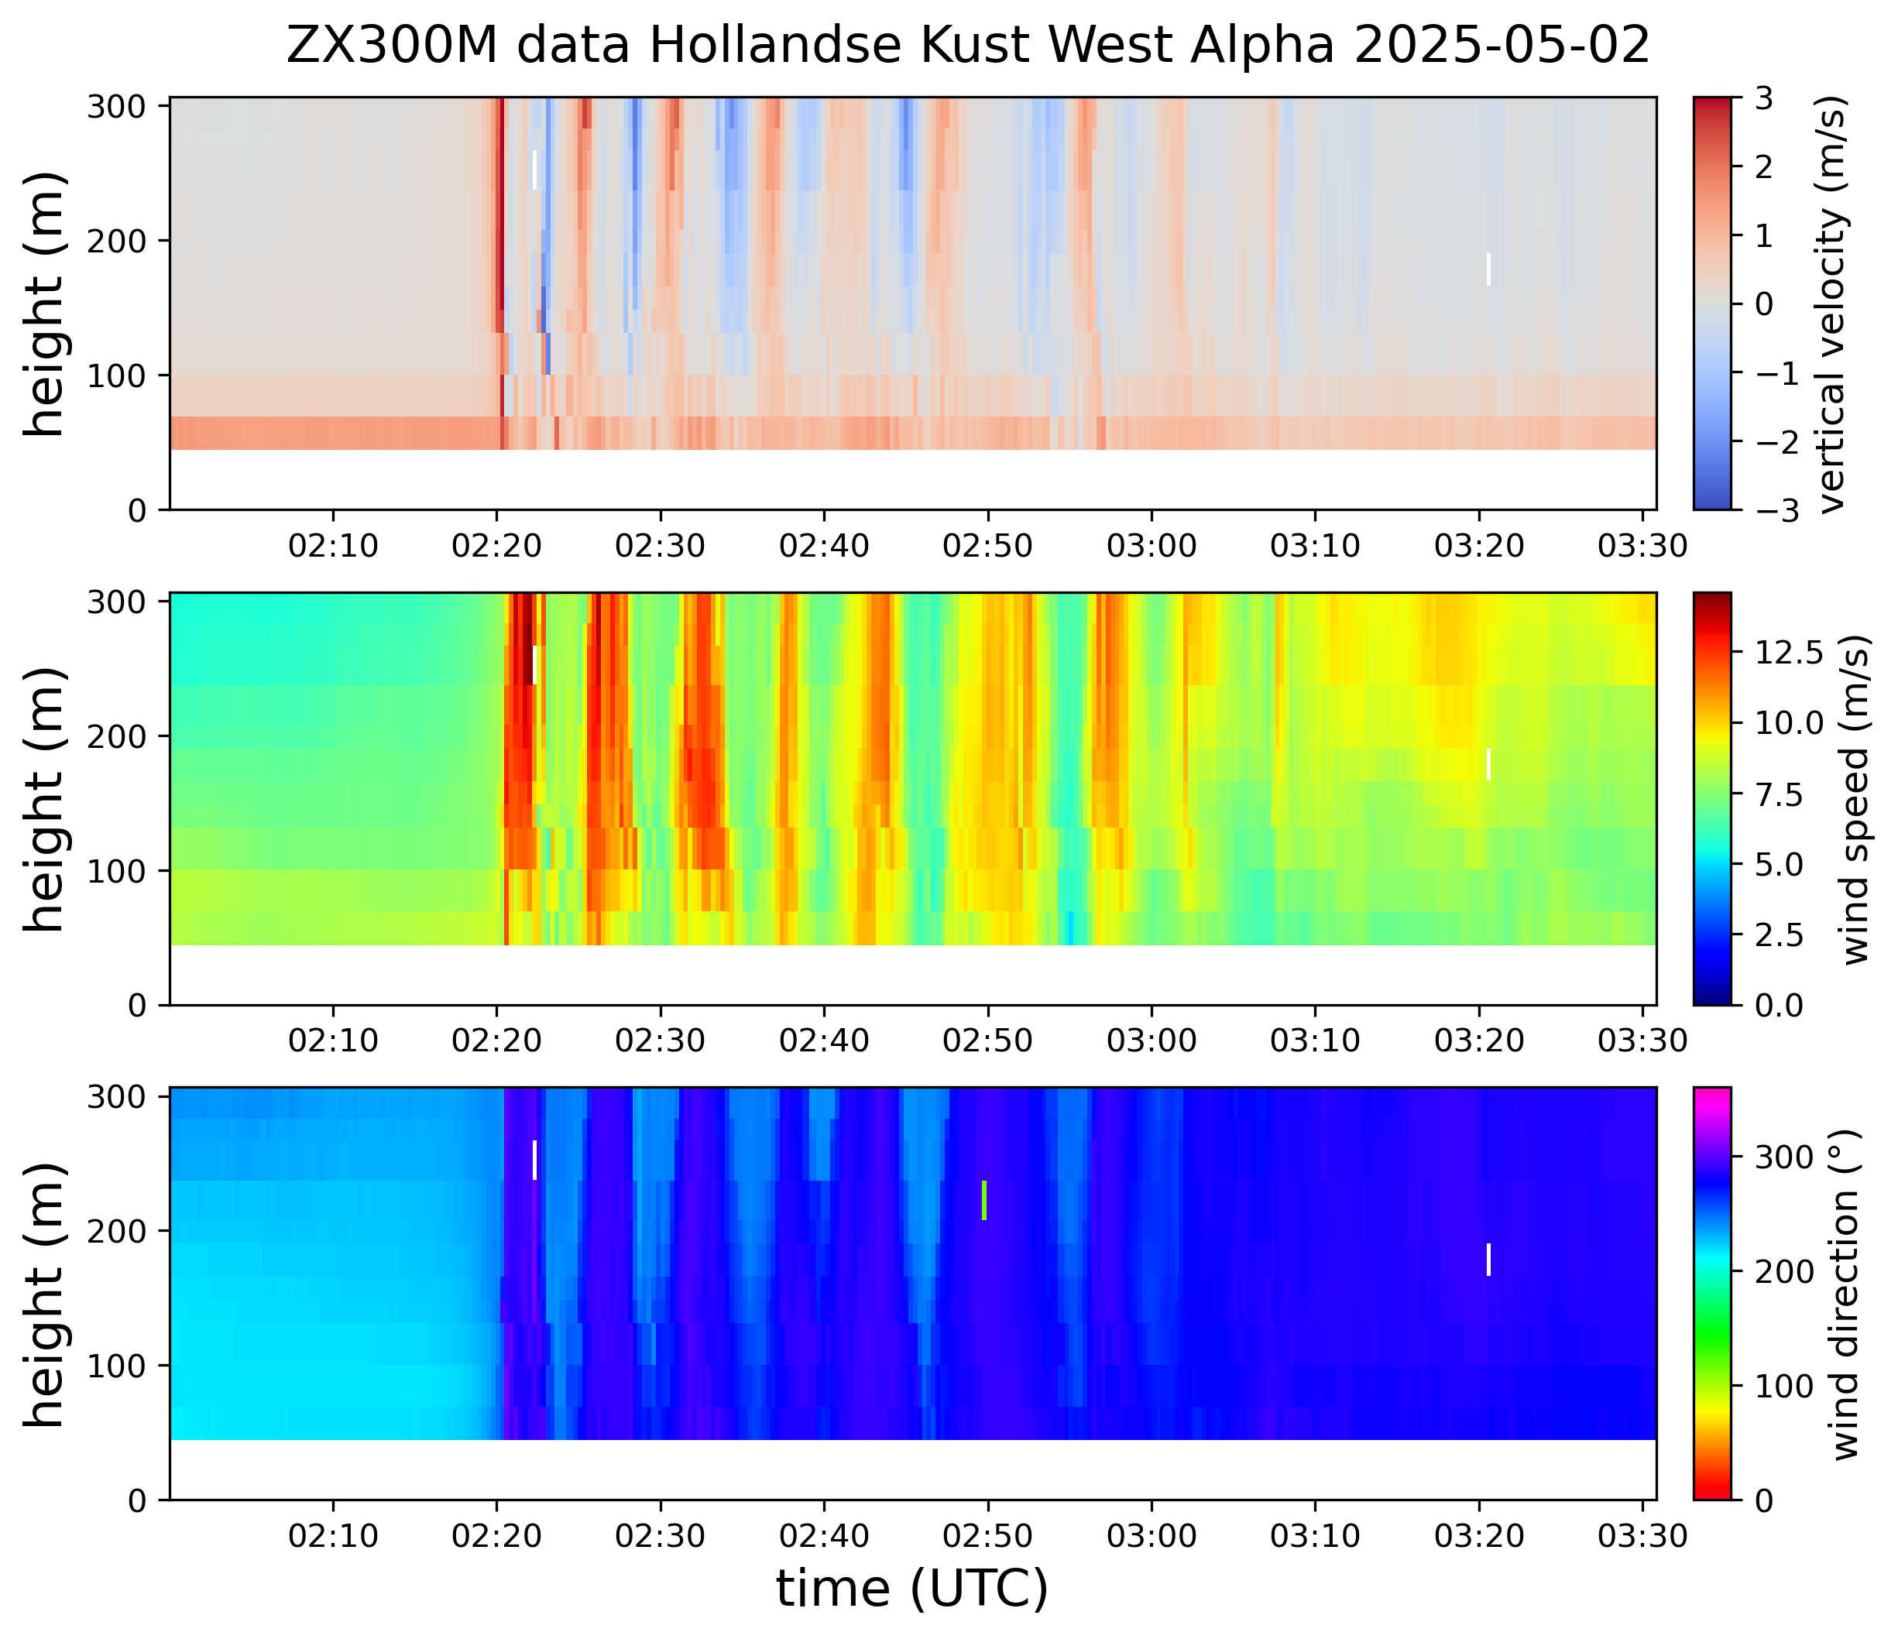
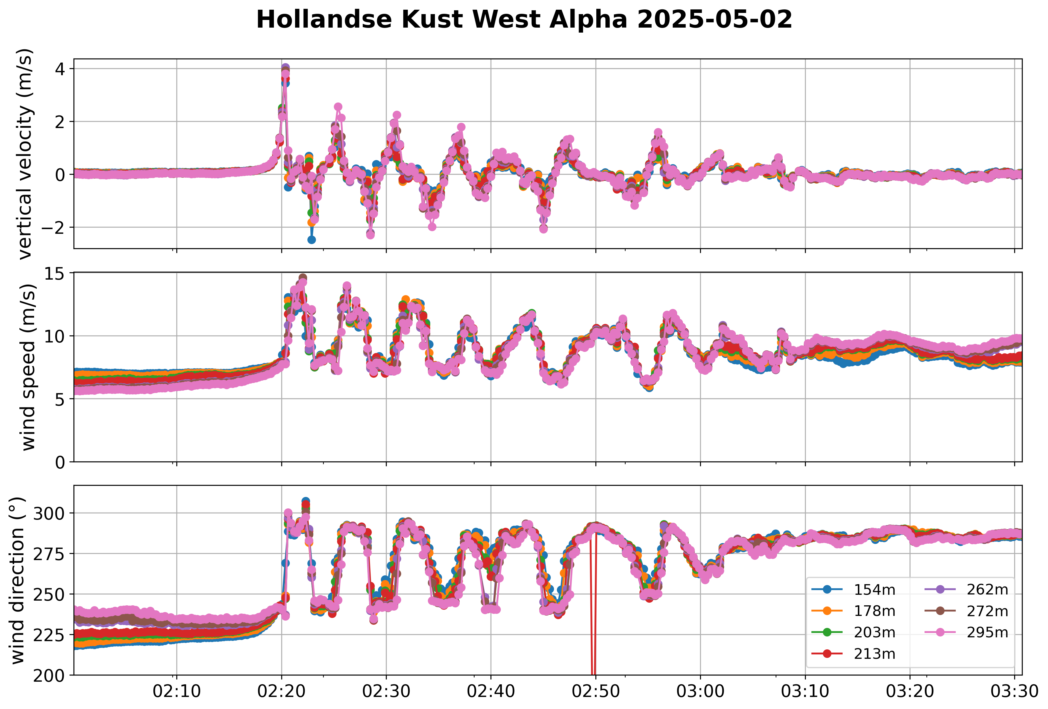
Wind direction ~ 225°
GW direction ~ 320°
Period: ~ 6 minutes
Wavelength: c*period ~ 10 m/s * 6 min.=3.6 km

Slide 11
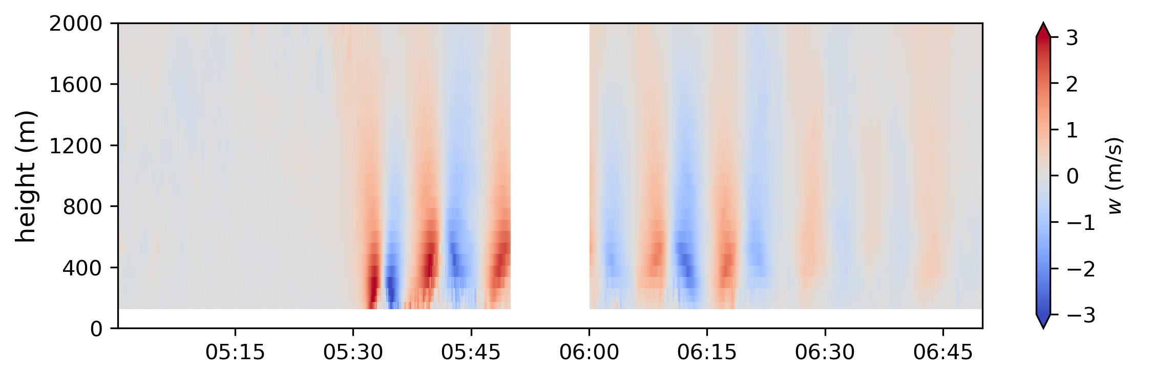
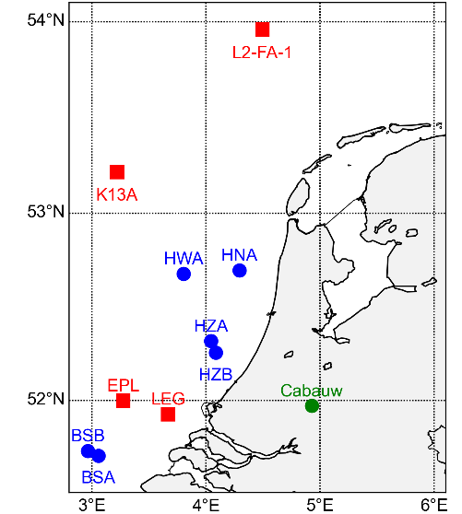
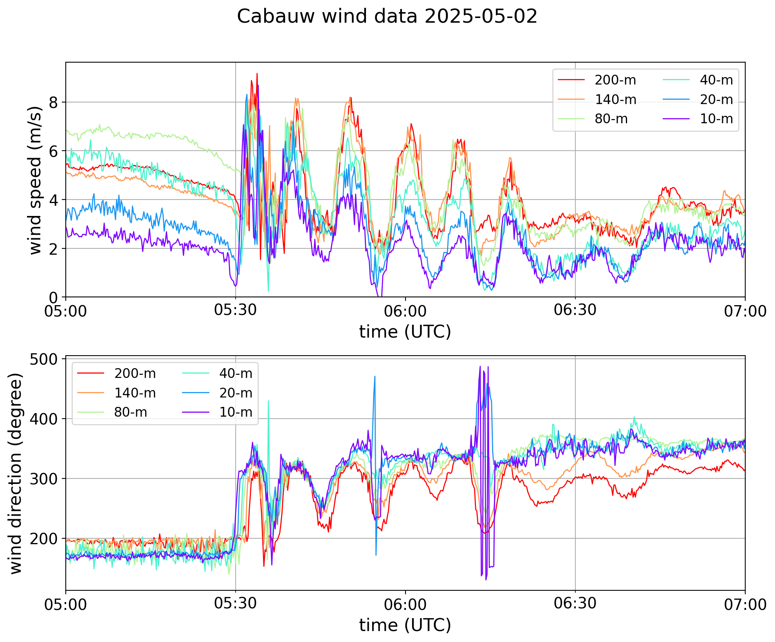
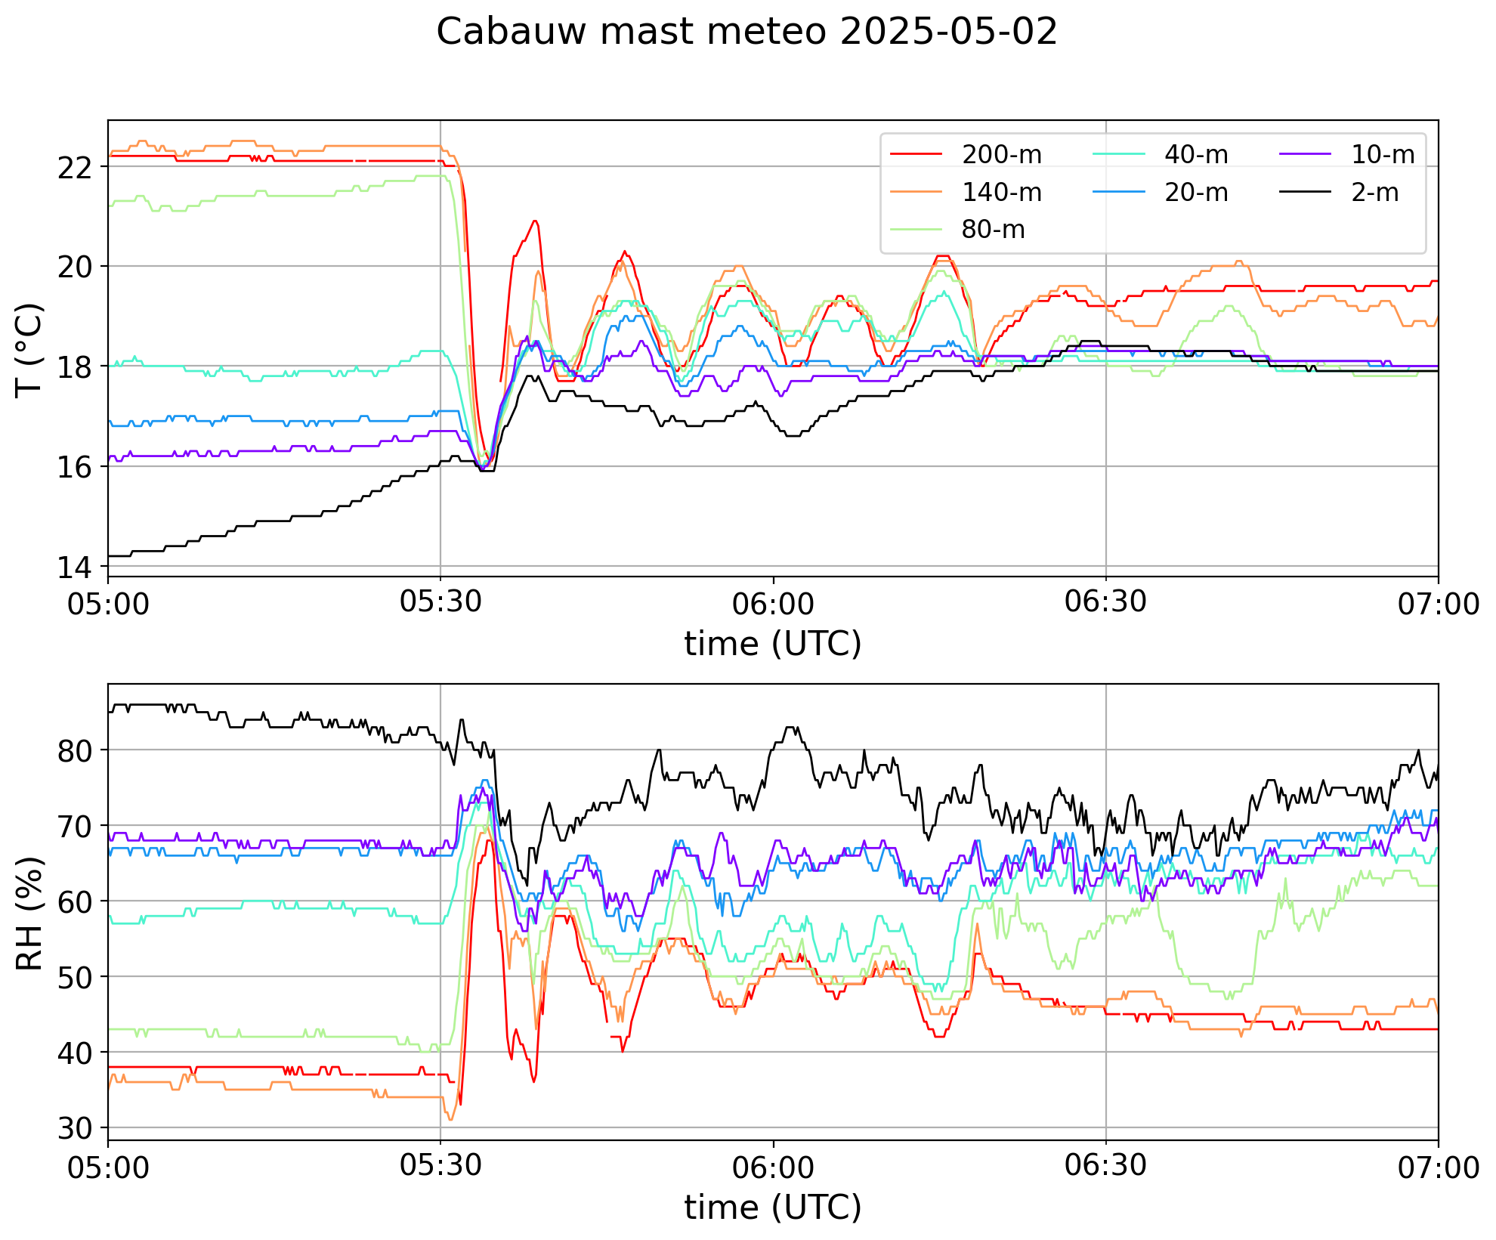
Cabauw

Slide 12

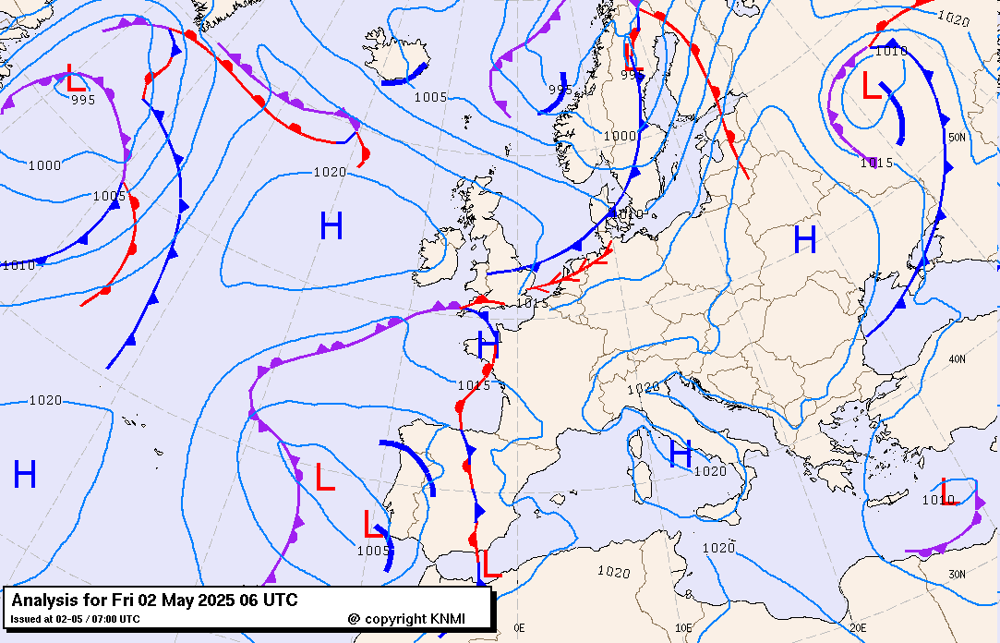
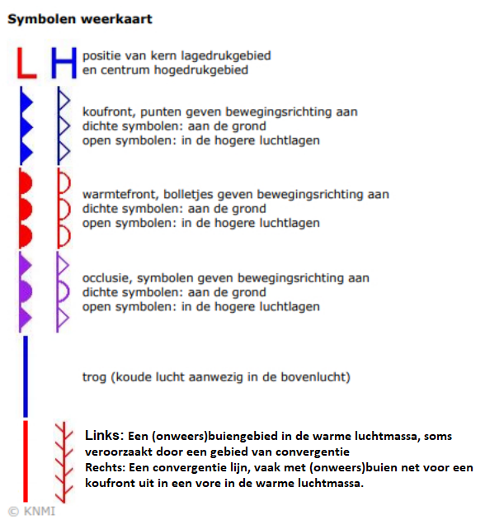
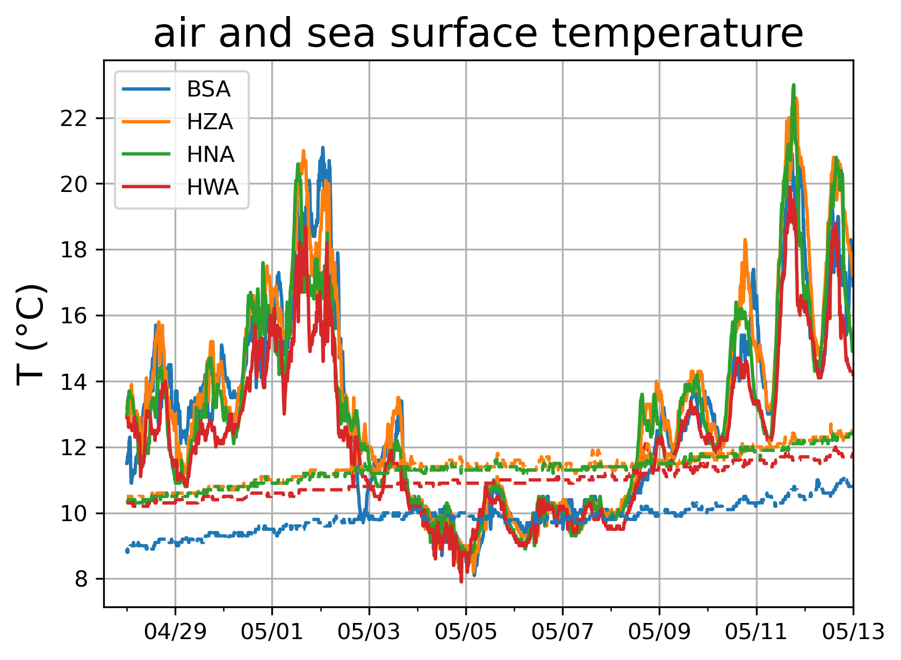
convergence
line
waterinfo.rws.nl

Slide 13

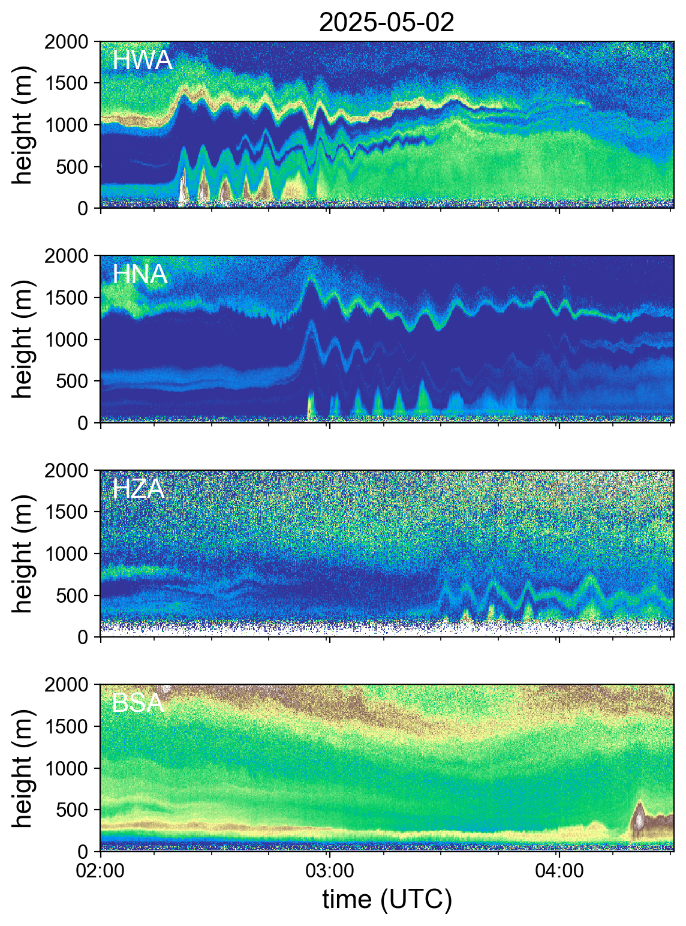
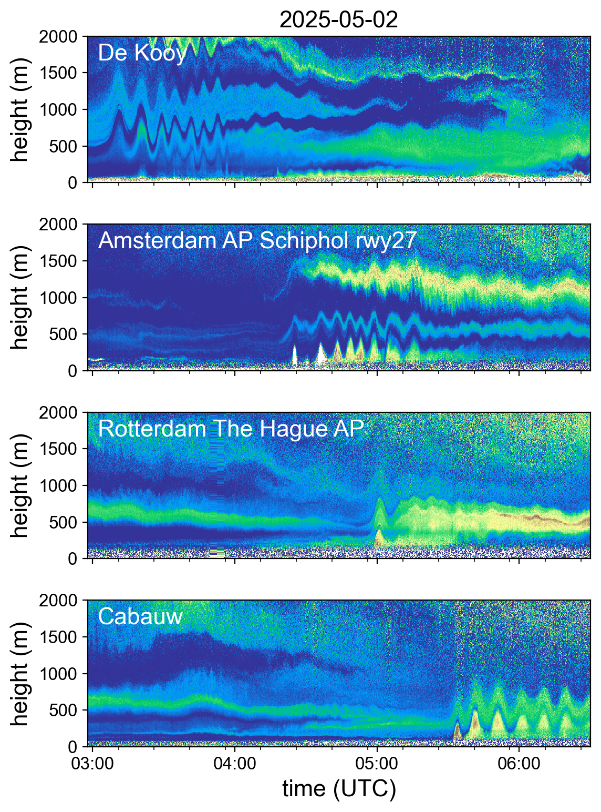
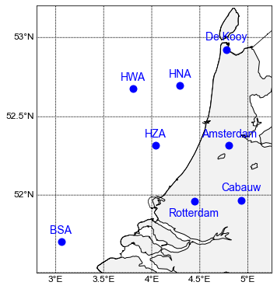
Automatic lidar ceilometer backscatter

Slide 14
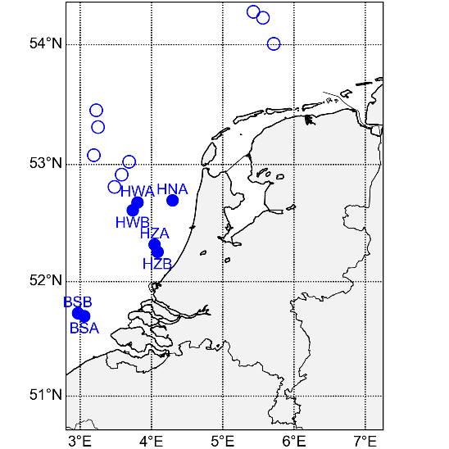


Conclusions
Gravity wave (GW) observations by short-range wind lidars
  Vertical velocity, raw data
  Lower part of ducted GW
  Intercomparison tower sonics-ZX300M at Cabauw
North Sea GW observations (within wind farms)
Period ~ minutes, duration ~ hour, wavelength ~ km
~30 cases since 2020, mostly spring/summer
Impact wind turbines on GW observations?
Strong modulation of wind speed and wind direction
Impact GWs on wind farm?
Long-range
Short-range

