Slide 1


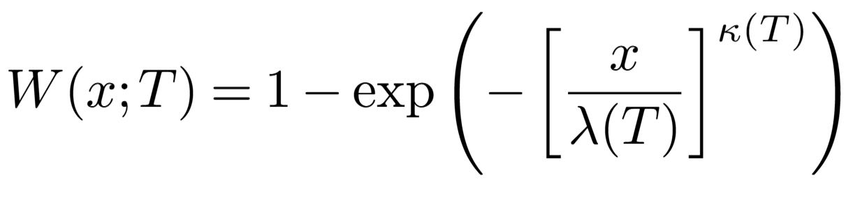
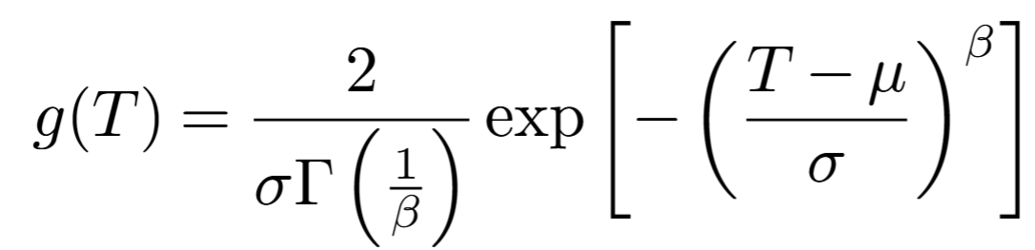
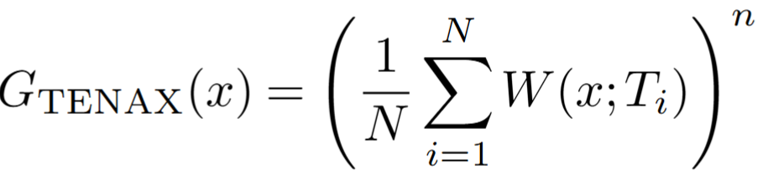
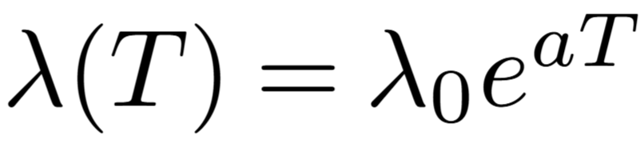
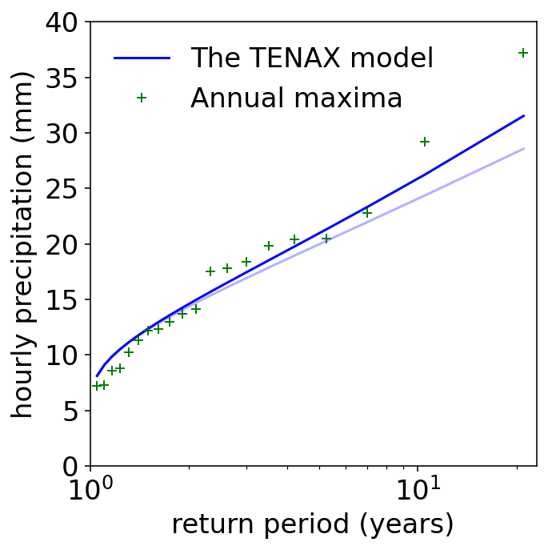
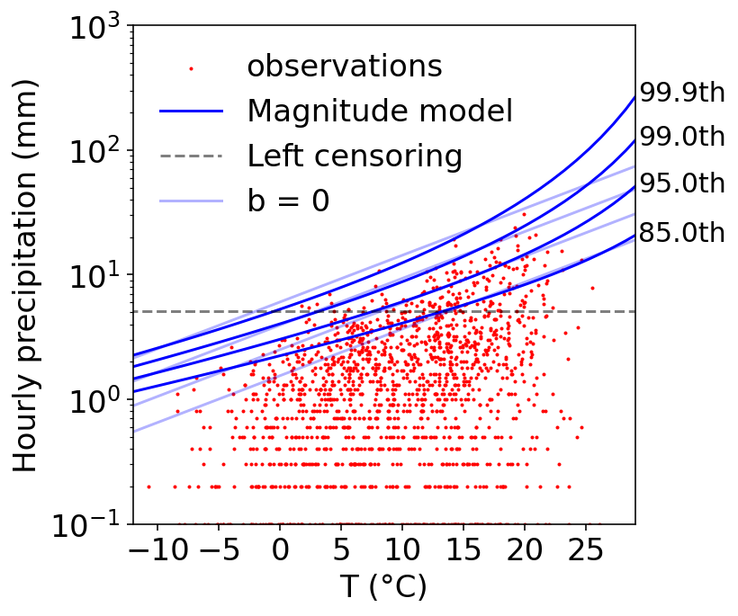
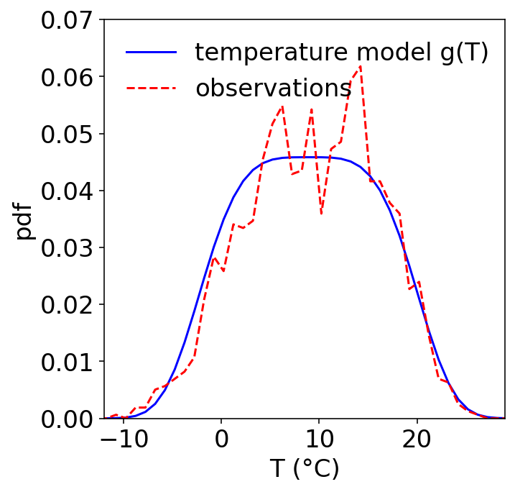


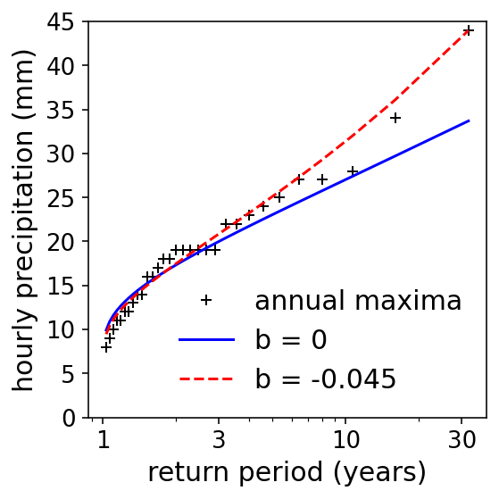
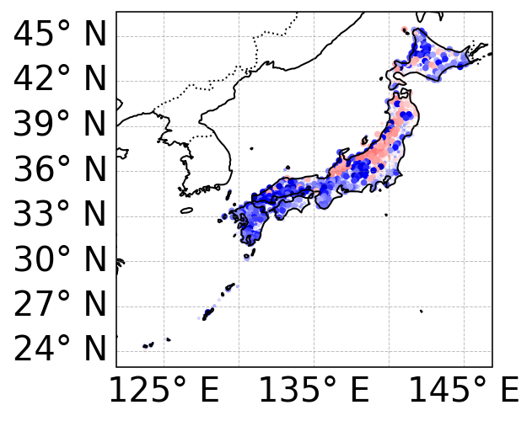
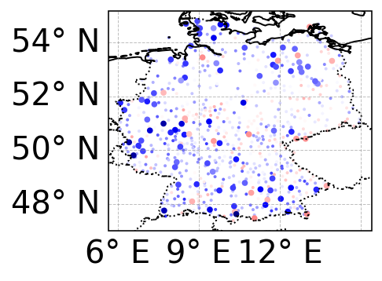
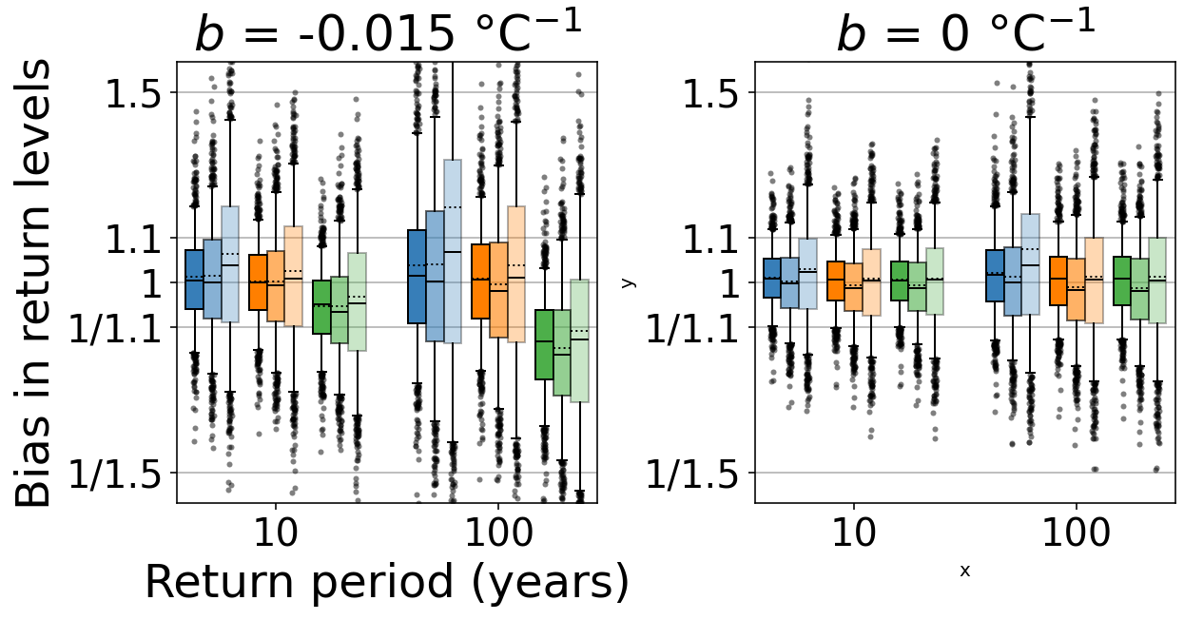
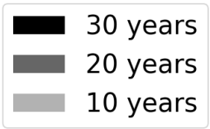
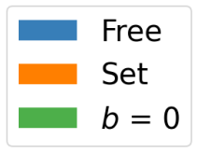
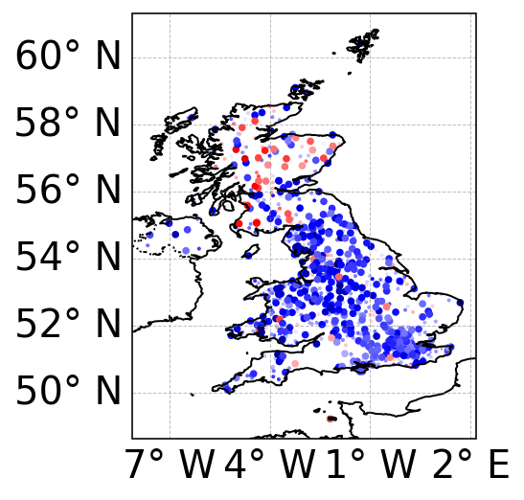
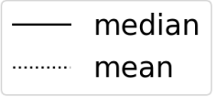
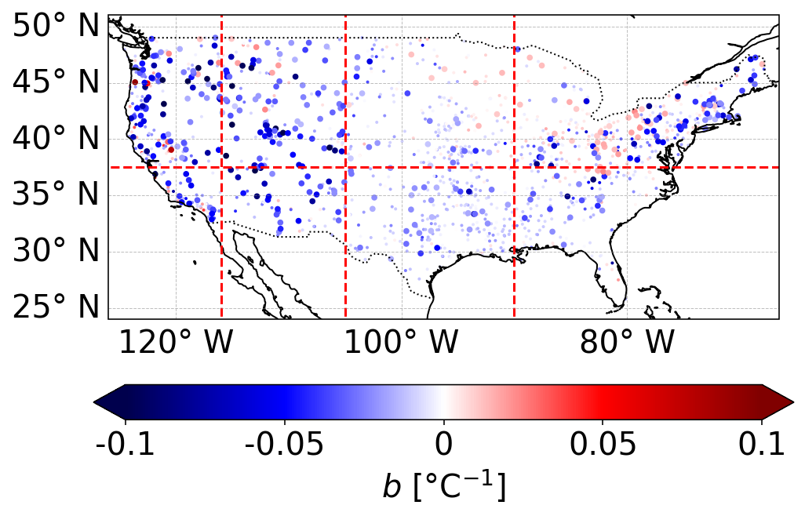
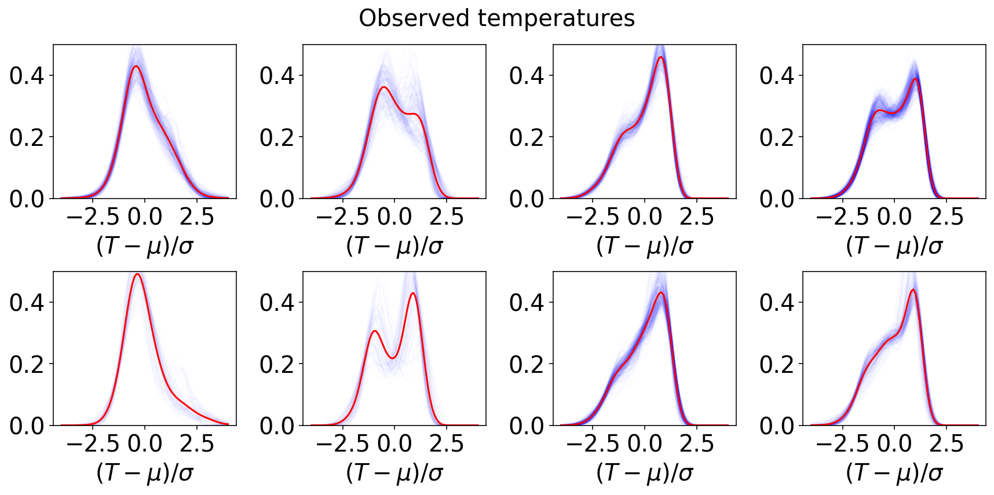
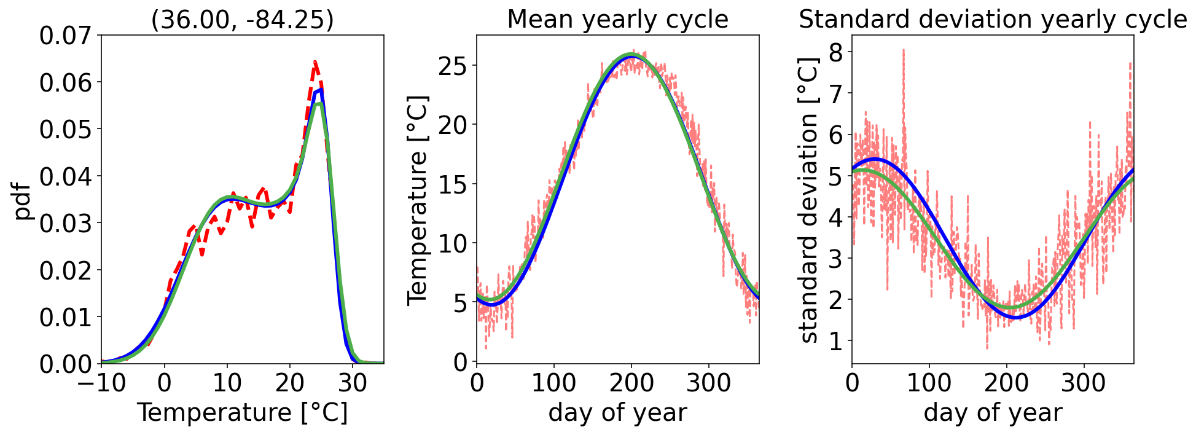
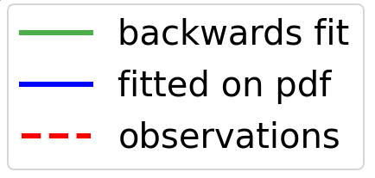
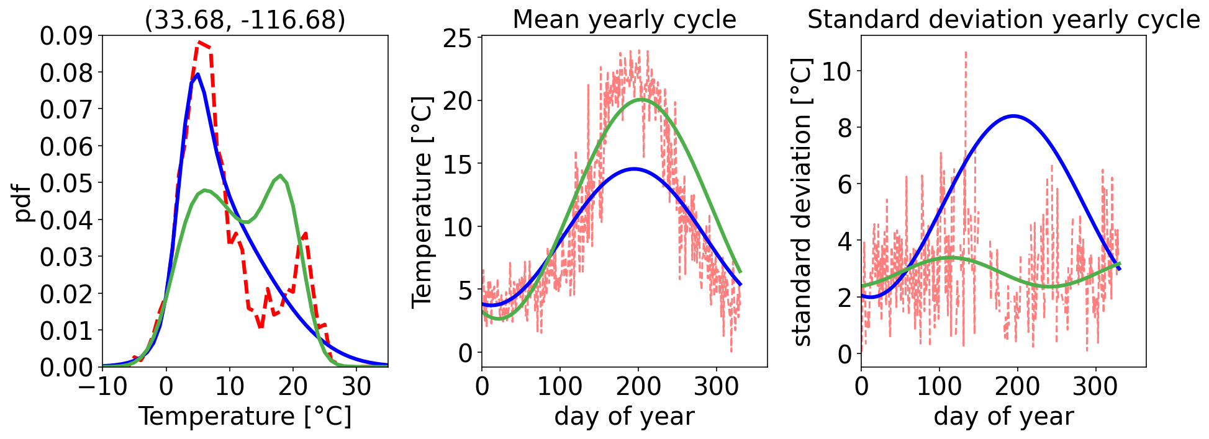
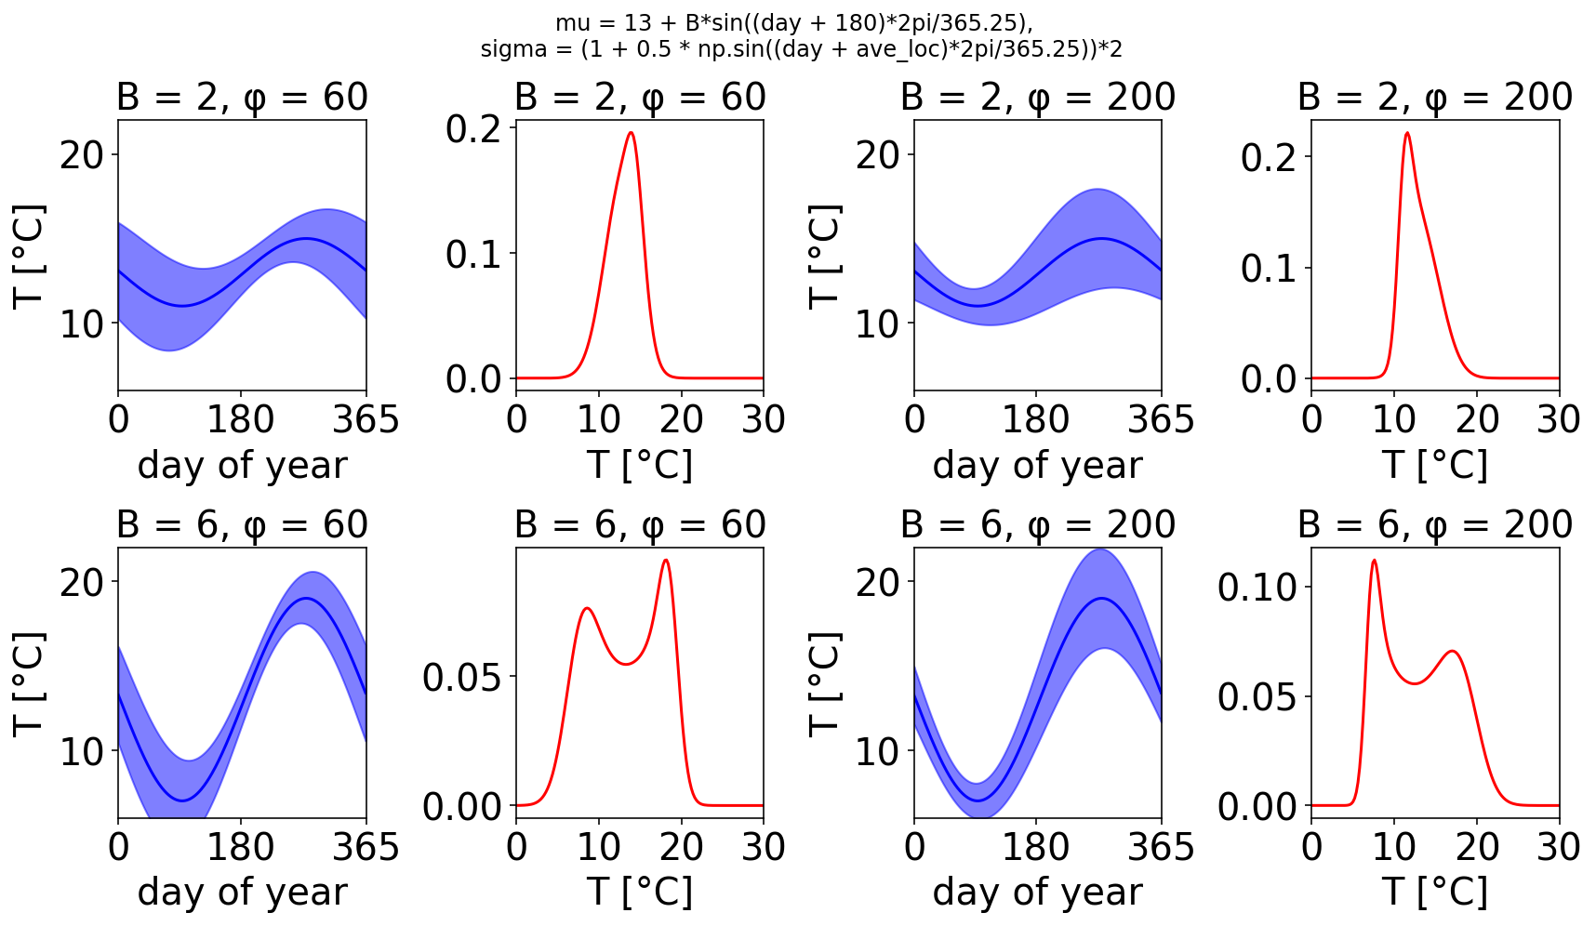


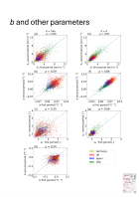
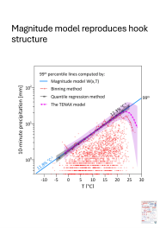
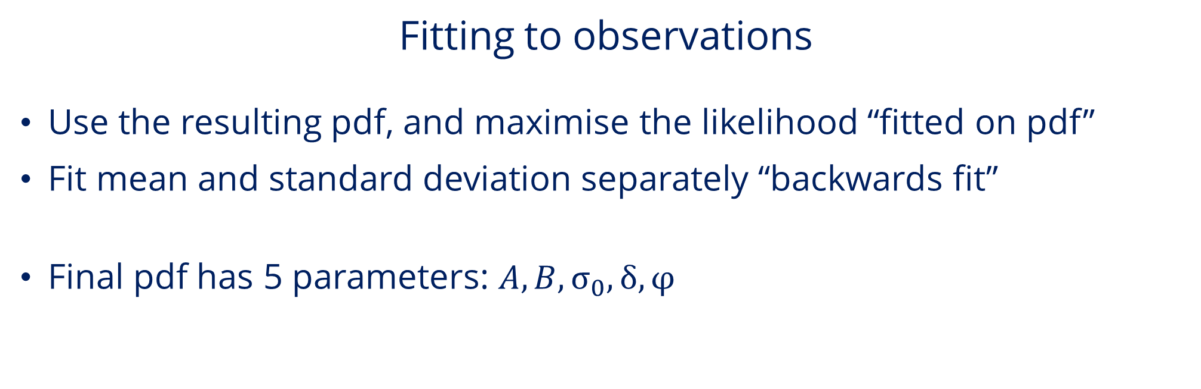
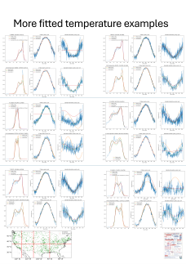

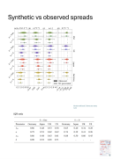
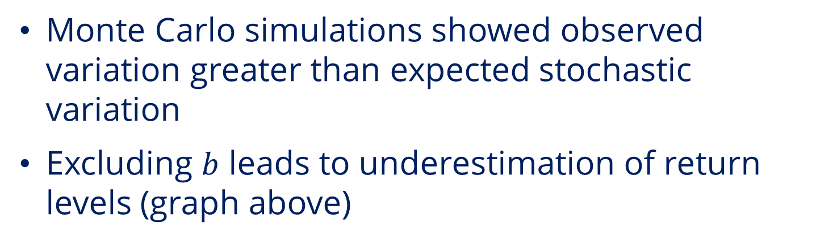

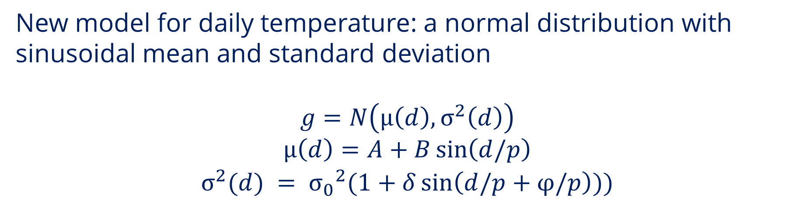

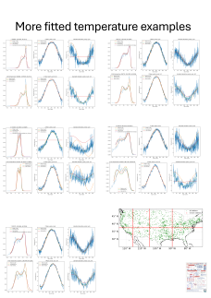
Changes in hourly rainfall return levels due to temperature shifts:
Parametrization of the TENAX model across different climates
Ella Thomas, Marco Borga, Petr Vohnicky, Nadav Peleg, and Francesco Marra
Methods
Background: the TENAX model
More equations
TENAX models sub-daily extreme precipitation, combining thermodynamics and statistics
Can shift the temperature model to produce predictions of return levels with climate change
Previously tested in the Alps with good results (Marra et al., 2024; Peleg et al., 2025)
How well does the model work in other regions?
Does the rate of increase with temperature depend on the percentile examined (magnitude model)?
How can we explain the shape of the temperature distribution?
Precipitation data taken from GSDR (Lewis et al., 2019), temperature data from ERA5-land (Muñoz-Sabater et al., 2021)
Precipitation events are independent, separated by at least 24 dry hours, and the maximum hourly precipitation in an event is used
Temperature is averaged in the 24 hours preceding the event
Models fitted by maximising likelihood
Left-censoring in magnitude model at 90th percentile. Values below threshold retained and treated as non-exceedances
Return levels calculated with $N=2∙{10}^{5}$
Clausius Clapeyron scaling
Magnitude model: non-stationary Weibull distribution, temperature as covariate
Temperature model: generalised normal distribution
First TENAX paper
(Marra et al.)
(Peleg et al.)
Temperature dependence in the shape parameter
Synthetic experiments
$$κ\left(T\right)=κ_{0}+bT$$
Larger points where $b$ significantly different from 0
$b$ usually negative – larger scaling at higher percentile
$b$ is significant (5%) in:
36% of stations in Japan
44% in the UK
14% in Germany
28% in the USA
a
b
c
d
Monte Carlo simulations showed observed variation greater than expected stochastic variation
Excluding $b$ leads to underestimation of return levels (graph above)
e
f
g
h
Temperature distribution
Shapes of observed distributions varied, rarely fit generalised normal
Fitting to observations
Use the resulting pdf, and maximise the likelihood “fitted on pdf”
Fit mean and standard deviation separately “backwards fit”
Final pdf has 5 parameters: $A, B, σ_{0},δ,φ$
a
b
c
d
e
f
g
h
New model for daily temperature: a normal distribution with sinusoidal mean and standard deviation
$$g=N\left(μ\left(d\right),σ^{2}\left(d\right)\right)$$
$$μ\left(d\right)=A+B\sin\left(d/p\right)$$
$$σ^{2}(d) = {σ_{0}}^{2}(1+δ\sin\left(d/p+φ/p\right)))$$
Interactive version
$$A = 13 ℃$$
$$p = 365.25 days$$
$$σ_{0}=2 ℃$$
$$δ=0.5$$
Few storm events during summer (gaps in the standard deviation)
Do we need a filter for the storms too?
Can we simplify and reduce the number of parameters?
Conclusions
Try TENAX with your data!
Python MATLAB
Temperature dependence in the shape parameter of the Weibull distribution, implying a larger scaling of precipitation extremes with temperature at higher percentiles
Parameter is important, but difficult to estimate and its inclusion increases uncertainties
Temperature distribution not always well represented by generalised normal distribution
Distribution constructed from a normal distribution with sinusoidal mean and standard deviation is promising
GSDR https://zenodo.org/records/8369987
ERA5-land
https://www.ecmwf.int/en/era5-land
Me
ella.thomas@unipd.it
ee23ert@leeds.ac.uk

Slide 2
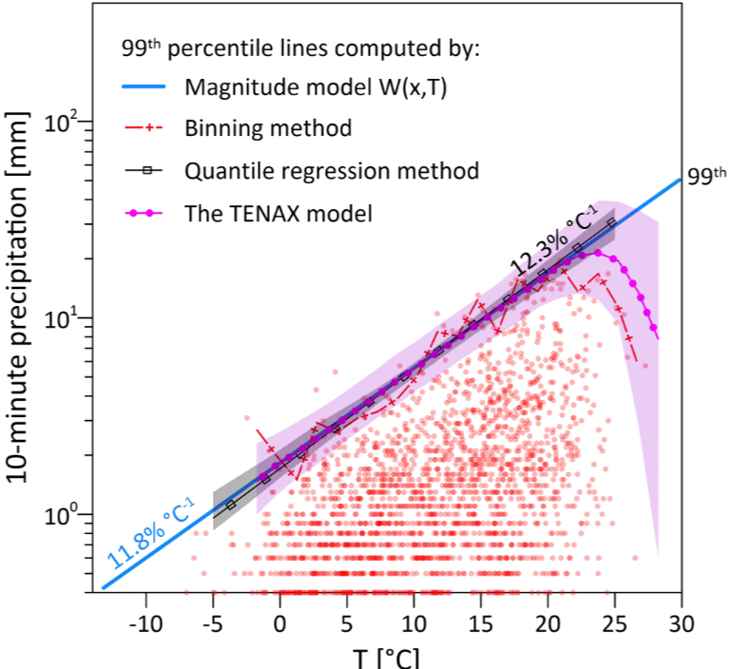
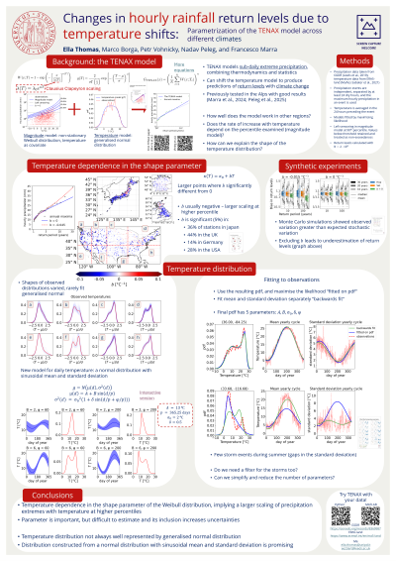
Magnitude model reproduces hook structure

Slide 3

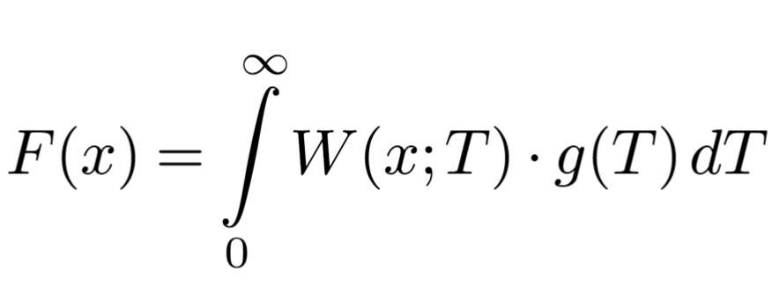

More equations

Slide 4
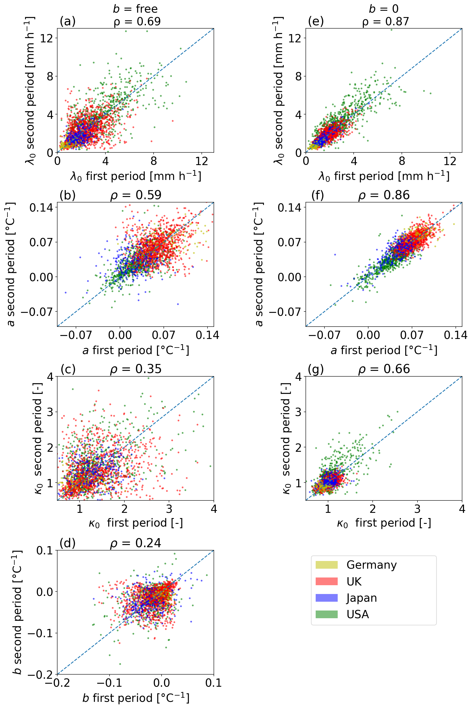
b and other parameters

Slide 5
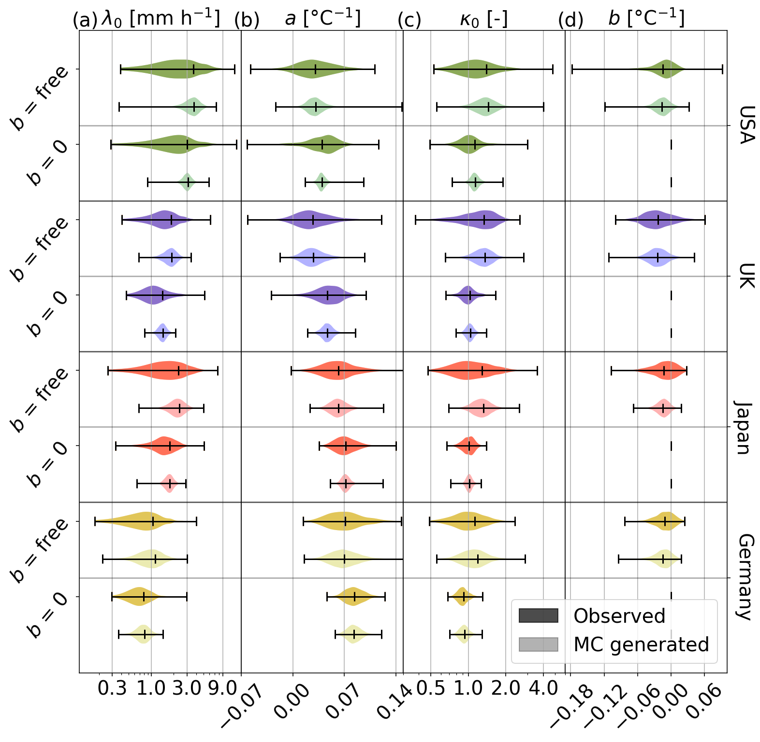
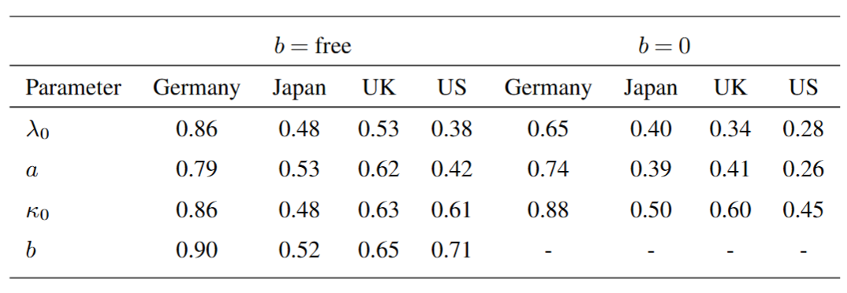
Synthetic vs observed spreads
Version without 5 times as many runs
IQR ratio

Slide 6

Synthetic vs observed spreads 2

Slide 7
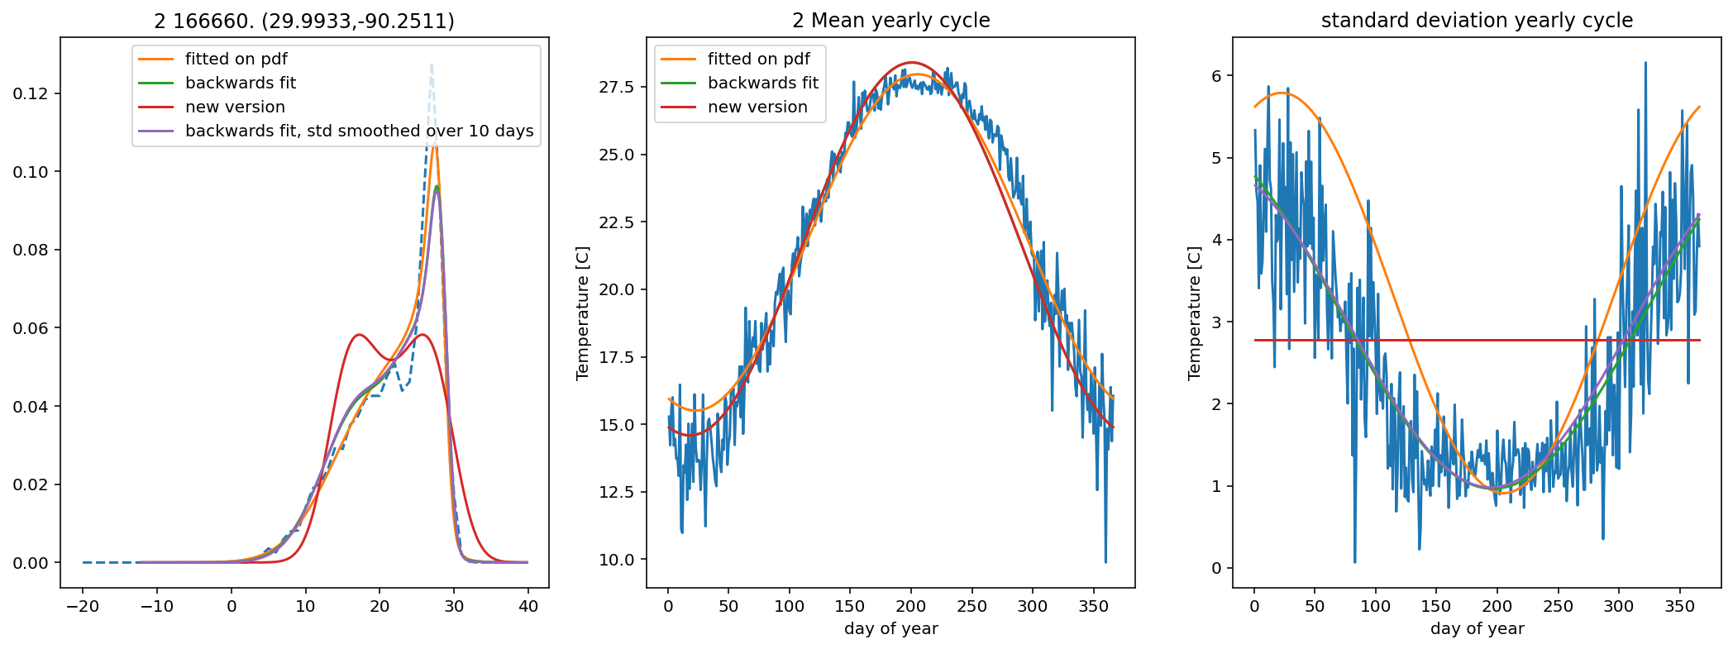
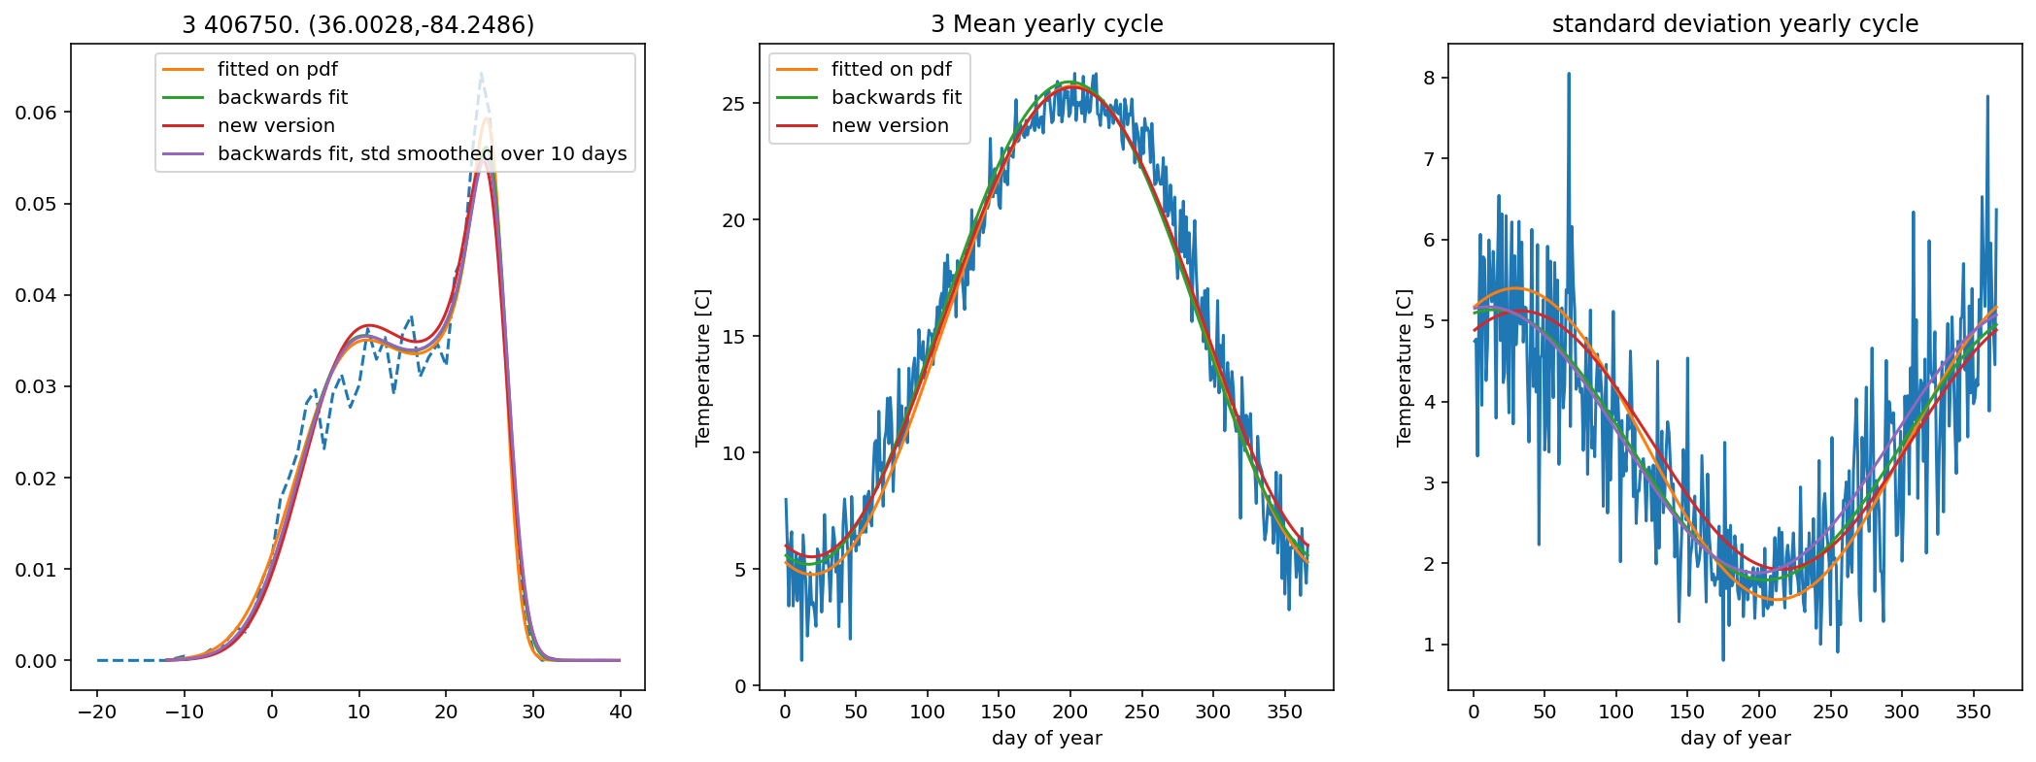
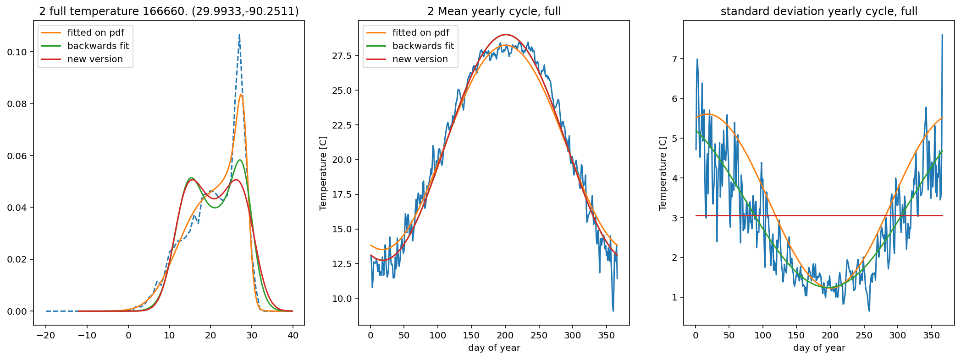
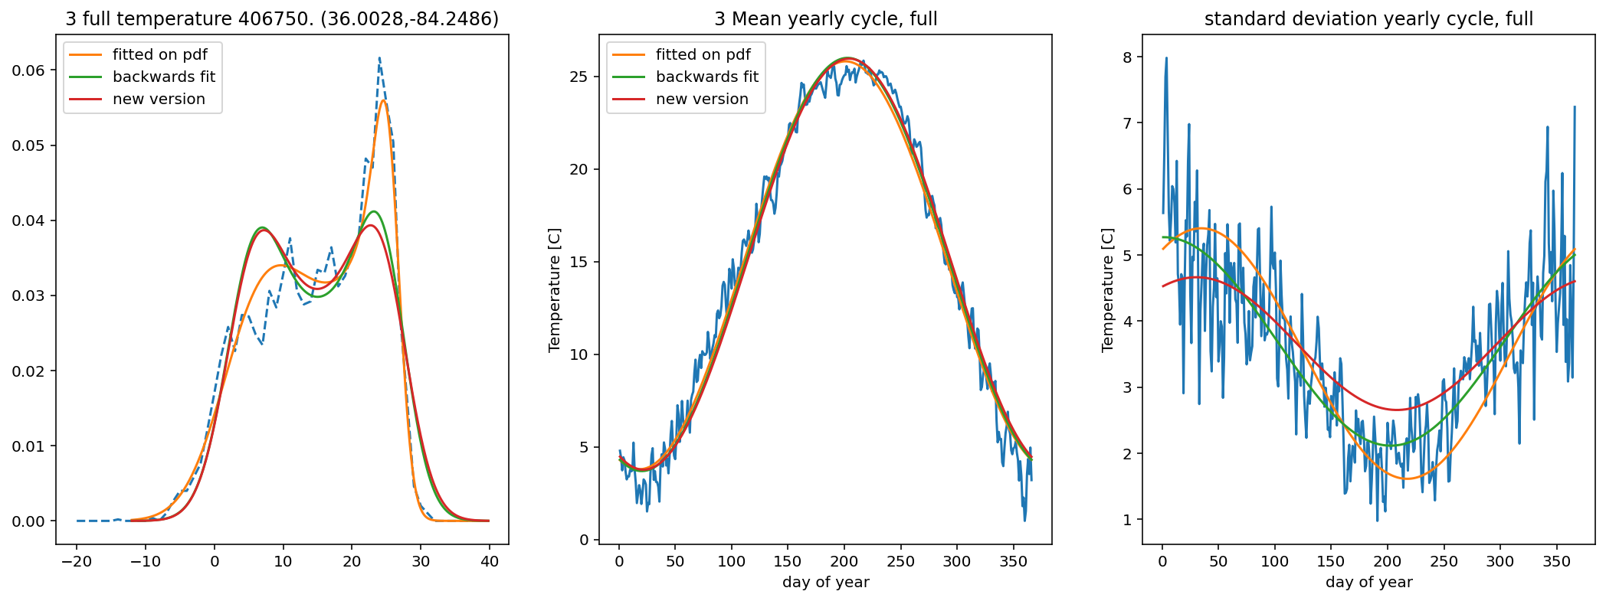
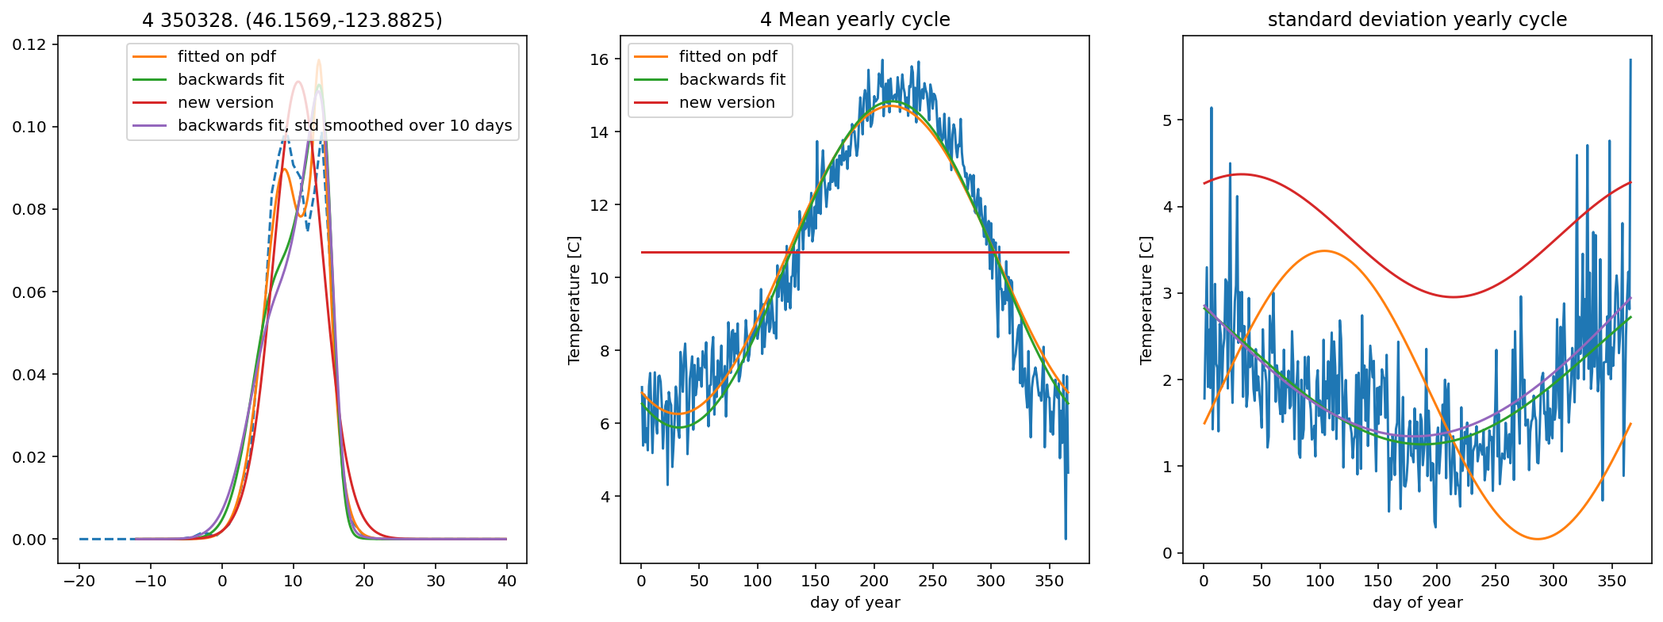
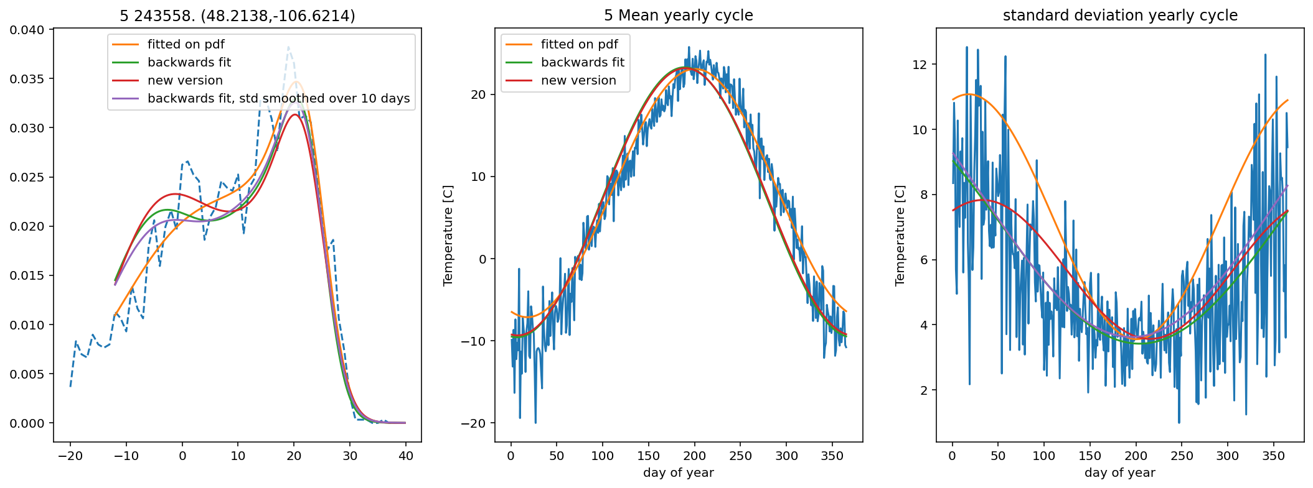
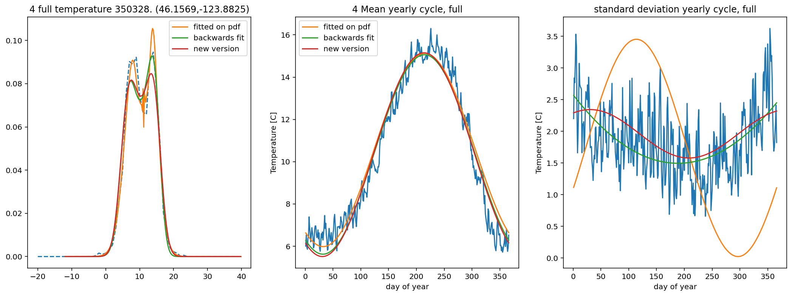
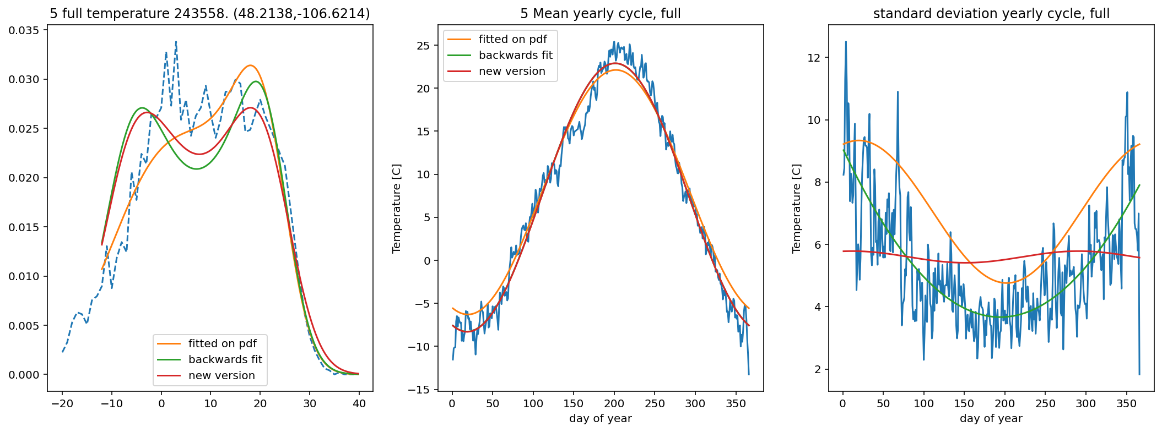
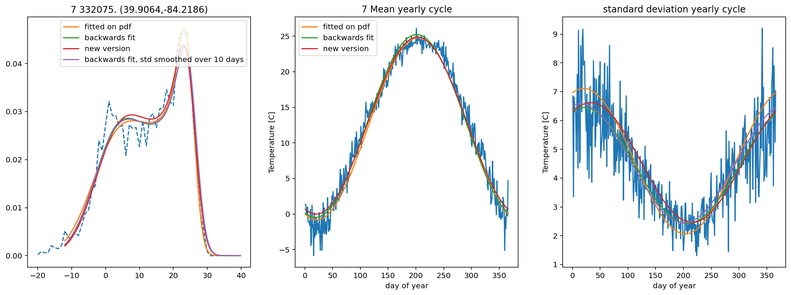
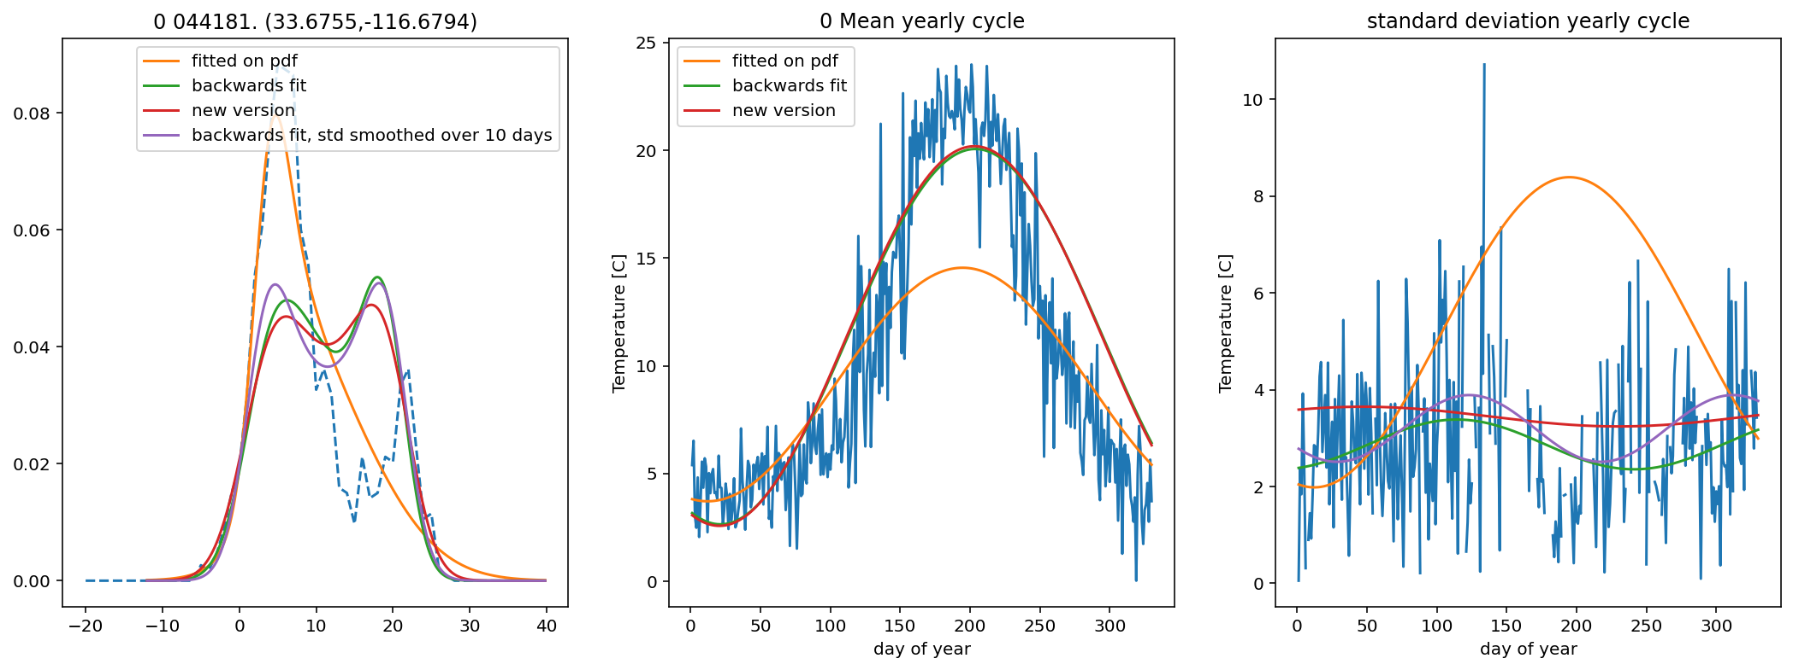
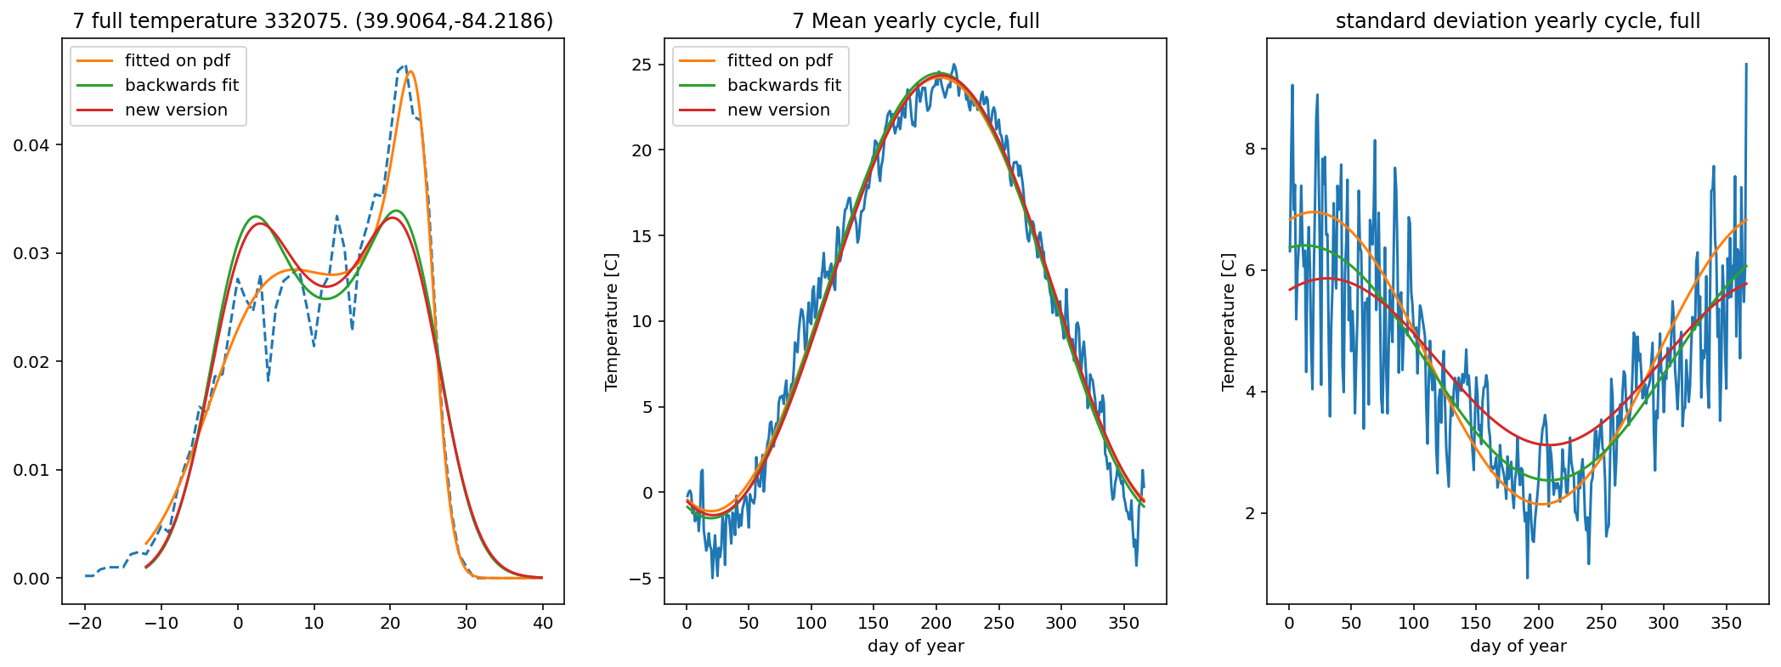
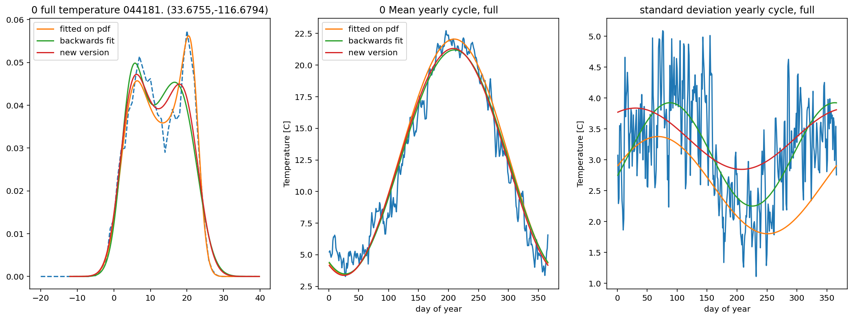

More fitted temperature examples

