Slide 1
Pan-European severe weather warnings by using deep learning and extrapolation techniques
Seppo Pulkkinen & Heikki Myllykoski
Finnish Meteorological Institute
9th September 2025

Slide 2


















Introduction
Project partners
European-wide forecasting of storm hazards and risks with focus on floods
Web platform and notification services for end-users
Products also disseminated via European Flood Awareness System (EFAS)
OPERA data provider
Stakeholders and end-users
Finnish civil protection
Spanish and Portuguese civil protection
Funding mechanism: EU / Knowledge for Action in Prevention & Preparedness (KAPP)
Meteorological agencies
Projects:
HAREN: February 2012 - June 2013
EDHIT: February 2014 - May 2015
ERICHA: February 2016 - 2017
SMUFF: January 2018 - December 2019
TAMIR: February 2020 - September 2022
EDERA: February 2023 - February 2025
INLINE: March 2025 -
International organizations
Environmental agencies

Slide 3
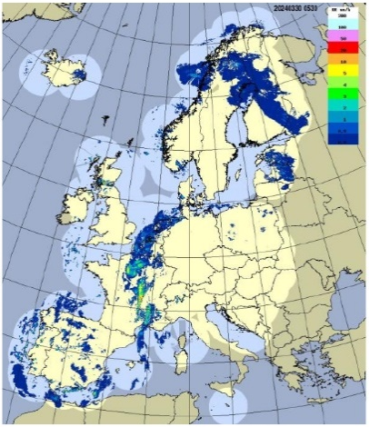
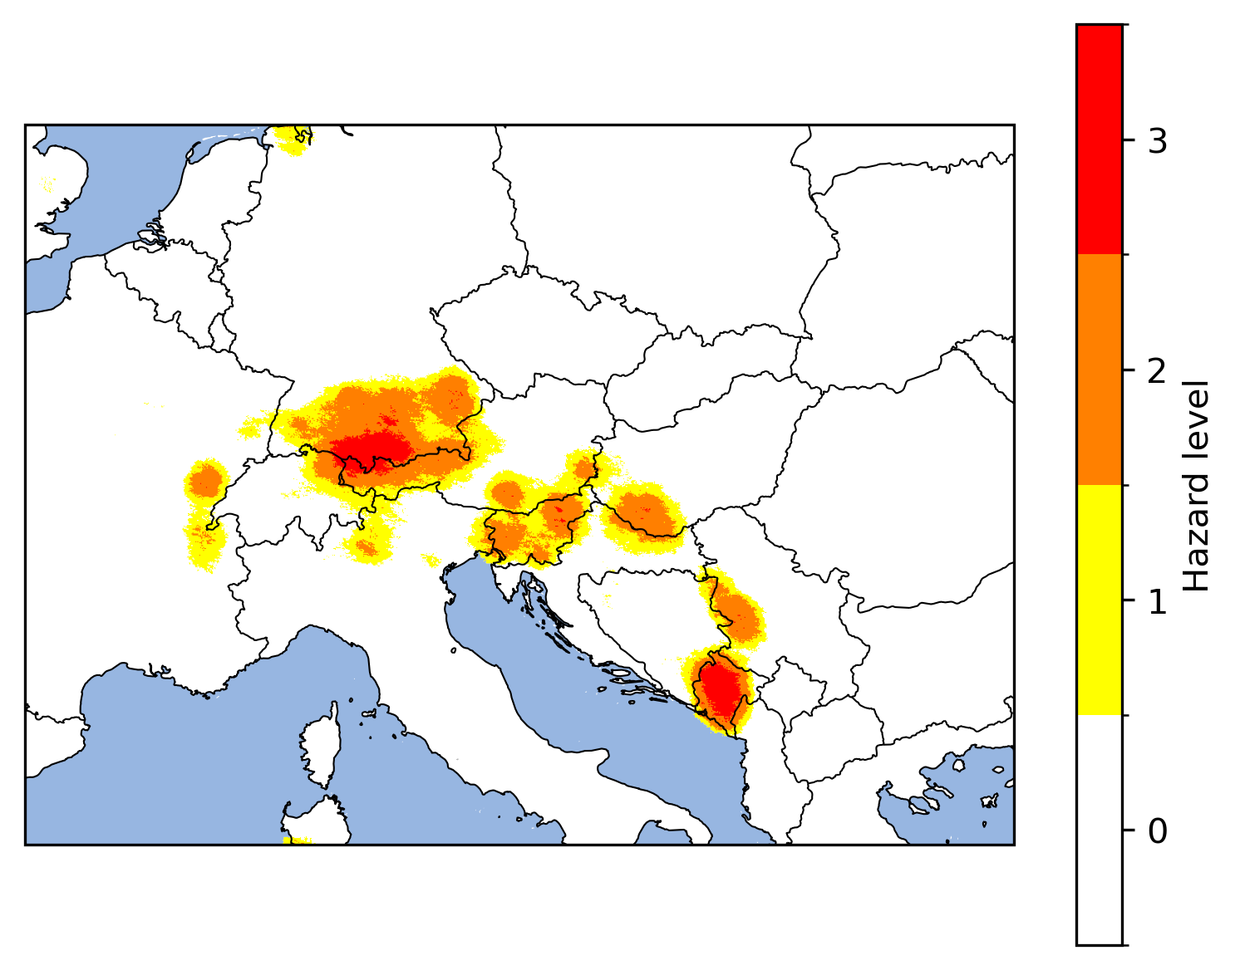
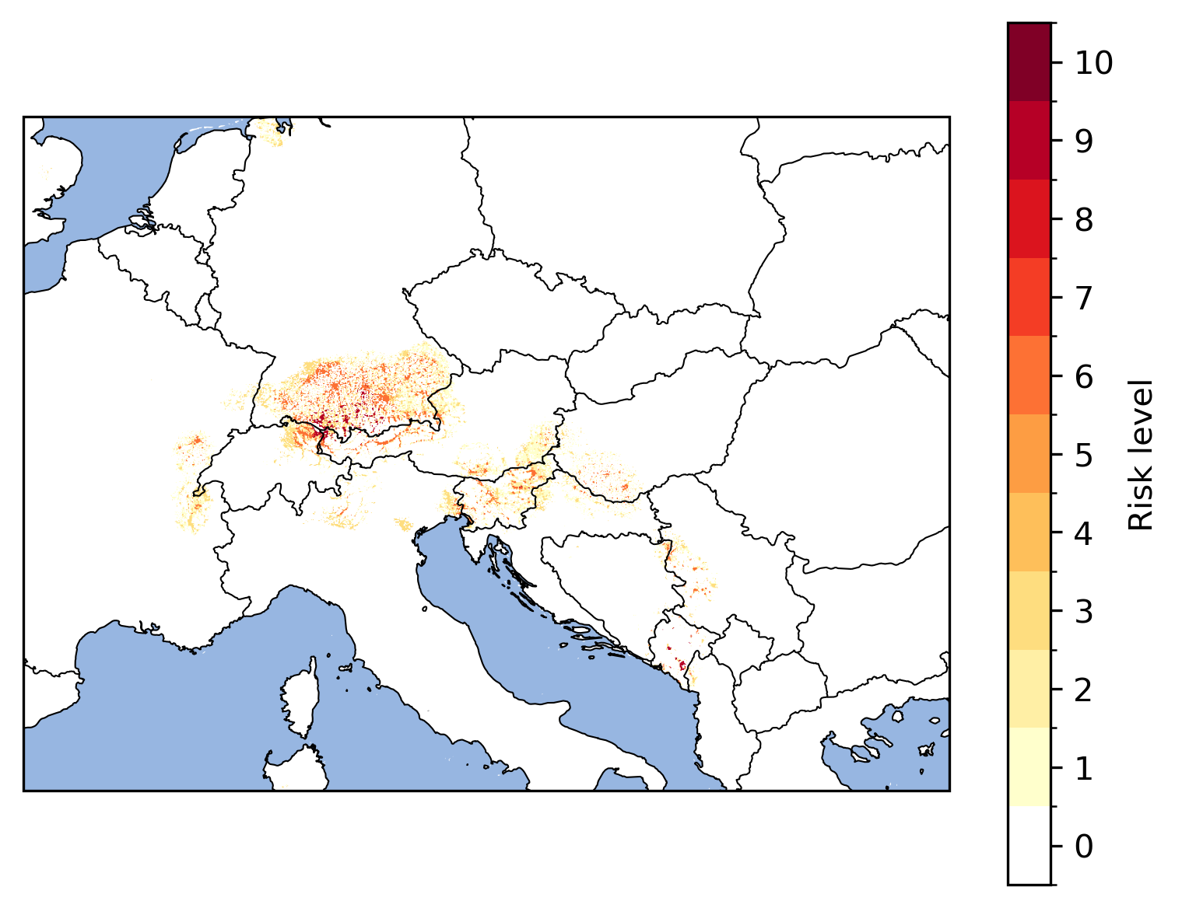
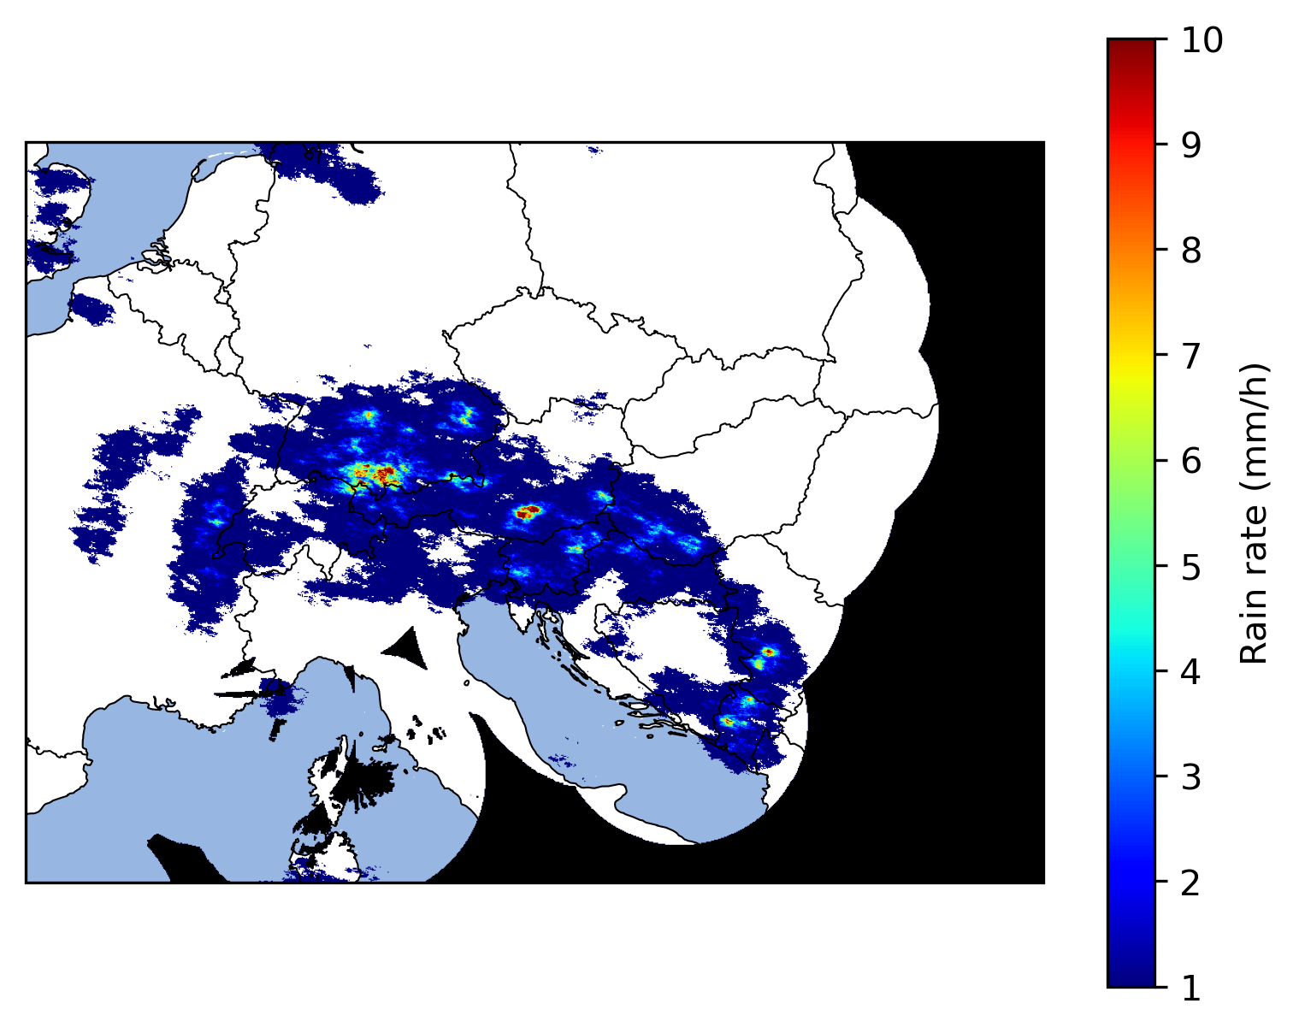
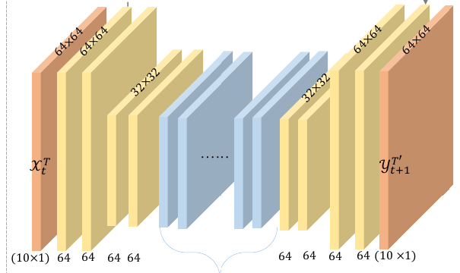
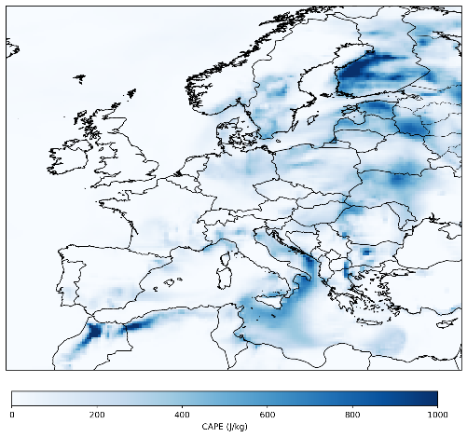
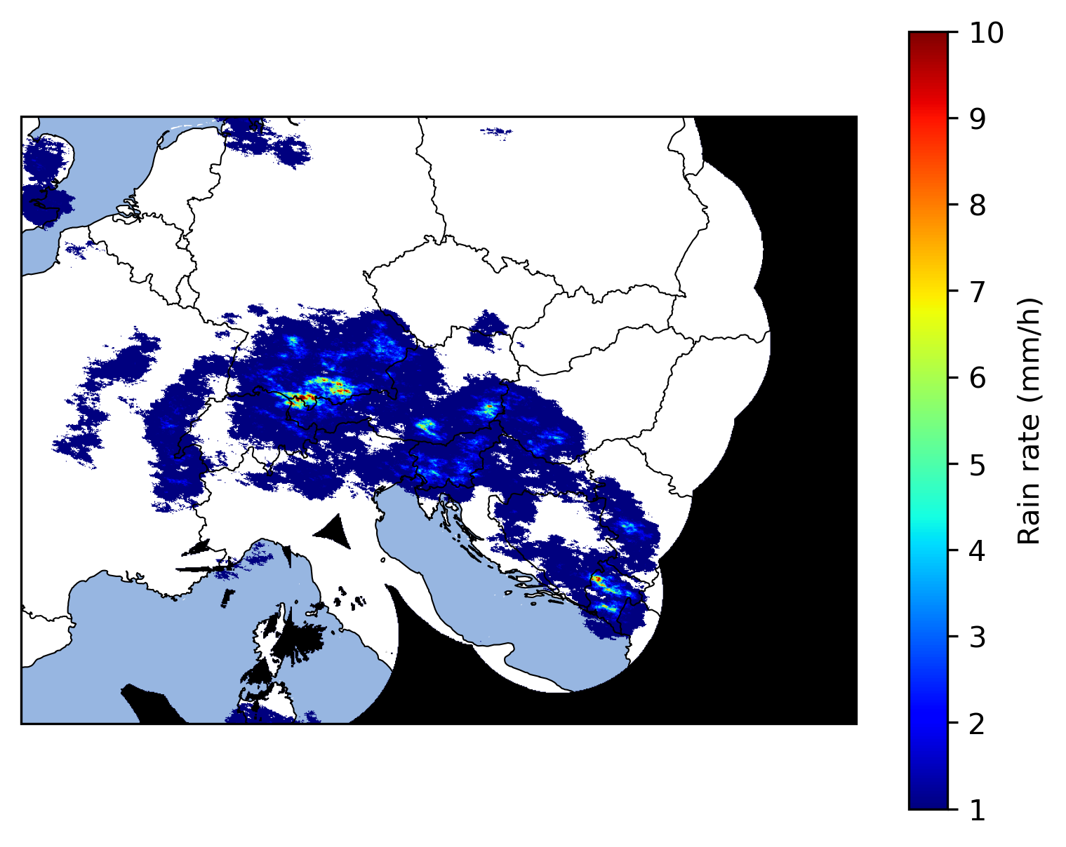
INLINE: Storm nowcast products
Precipitation hazard nowcasts: generated with 15-minute time step
Multi-hazard nowcasts: generated with one-hour time step
Spatial resolution: 2 km
Time range: 1-3 hours
Use pySTEPS (https://pysteps.github.io)
Combinations of thresholds for different hazard types
Multiple thresholds for different hazard levels
Input / output
Combine hazard nowcasts with exposure
1. Extrapolation + statistical models (pySTEPS)
Rain rate > y mm/h
Wind speed > x m/s
OPERA composites
Add stochastic perturbations to generate ensemble nowcasts
Real-time demonstration in web-based platform
Model fields
Estimate storm hazard probabilities from ensembles
Hazard nowcasts
Risk nowcasts
Wind u / v components
2. Convolutional neural network (SimVP)
CAPE
CIN
Training: ERA5
Production: ECMWF IFS forecasts
SimVP nowcasts are generated for lead times of 1 and 2 hours

Slide 4
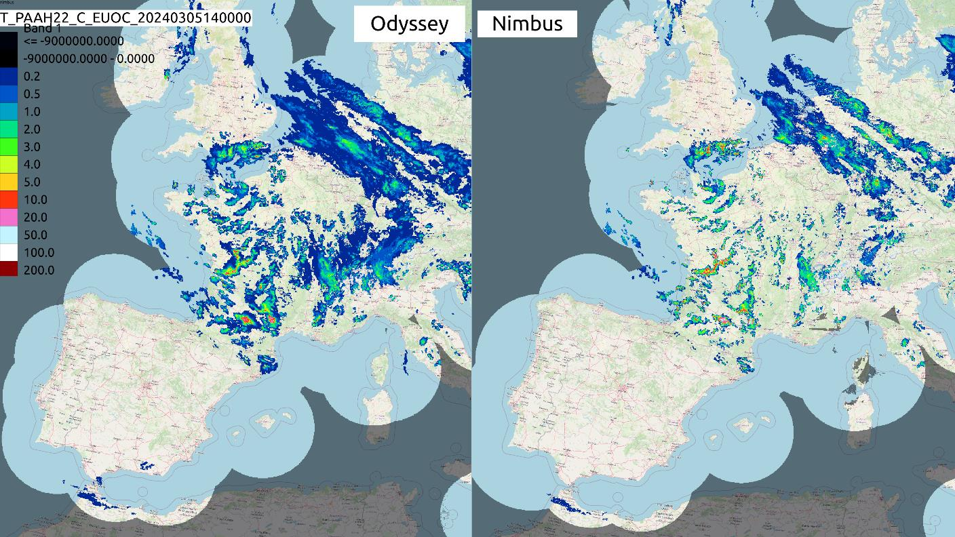
OPERA radar composites
Less averaging applied higher spatial resolution
Operational Program on the Exchange of Weather Radar Information (OPERA)
Pan-European radar data exchange maintained by EUMETNET
Products are being made publicly available in the RODEO project (https://rodeo-project.eu)
Product line | Subproducts | Spatial resolution | Update interval
CIRRUS | Max. reflectivity | 1 km | 5 minutes
NIMBUS | Rainfall rate Hourly rainfall accumulation | 2 km | 15 minutes
Best for high-resolution prediction of severe weather (e.g. lightning or hail)
Best for predicting rainfall

Slide 5
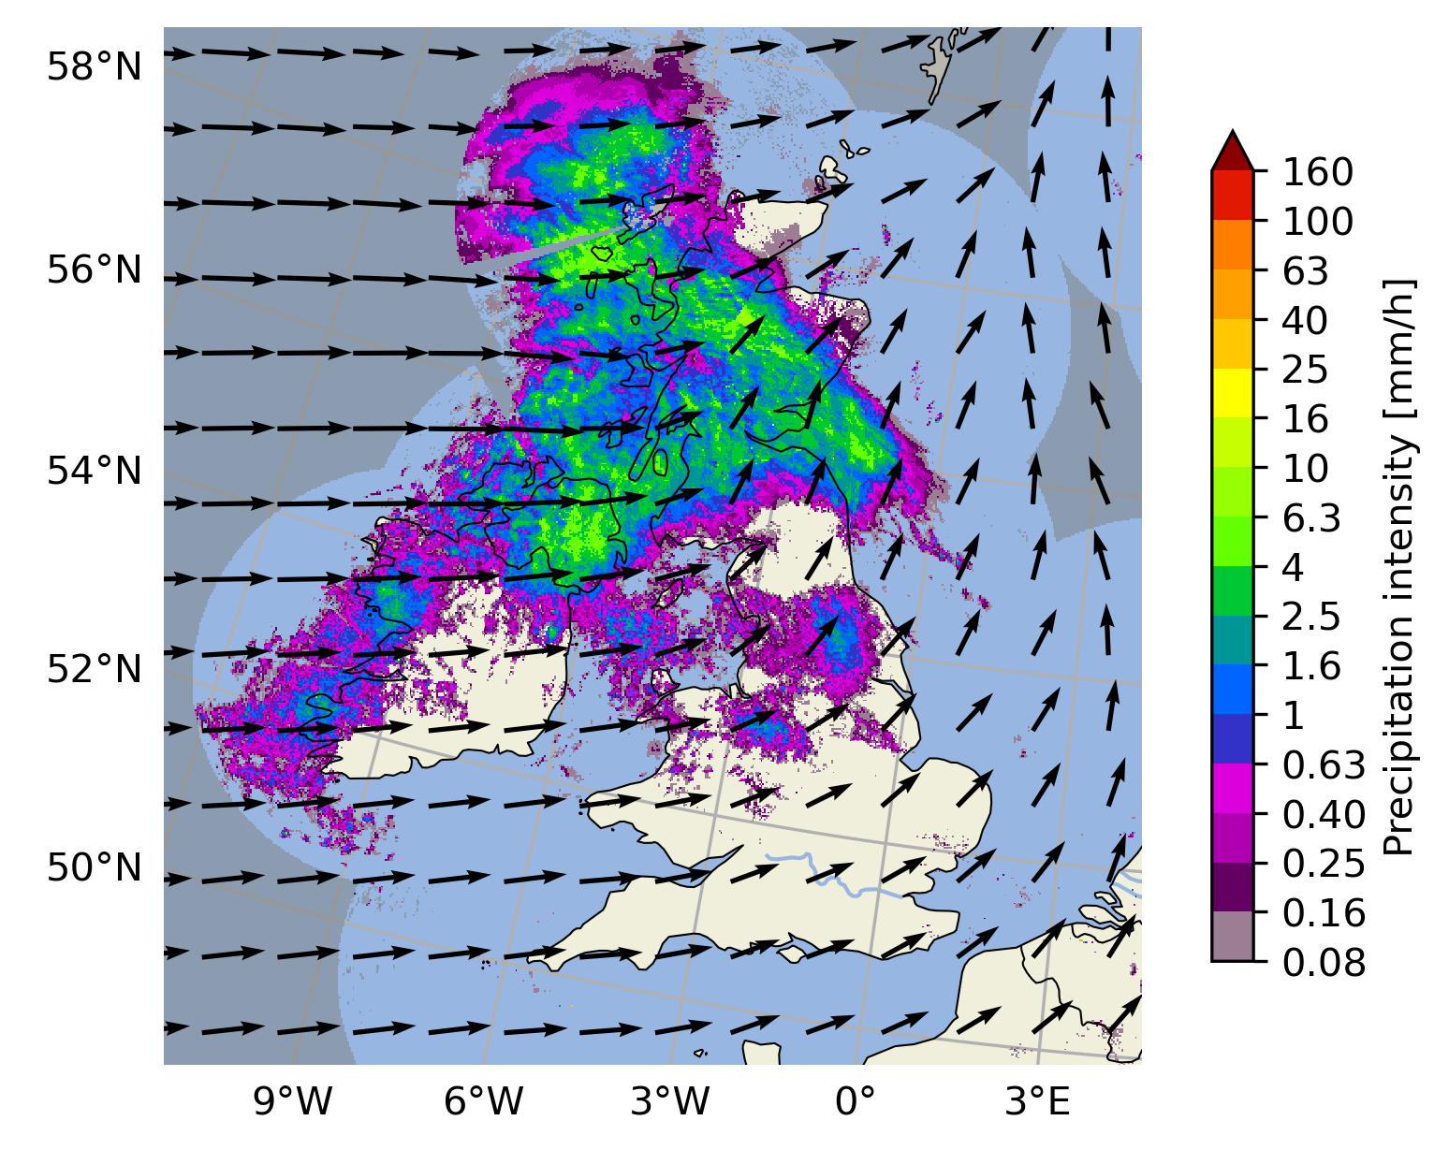
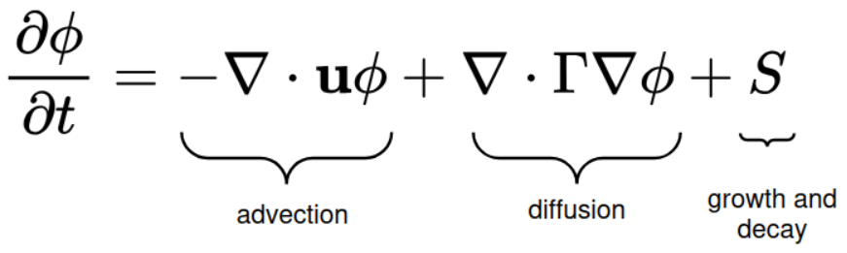
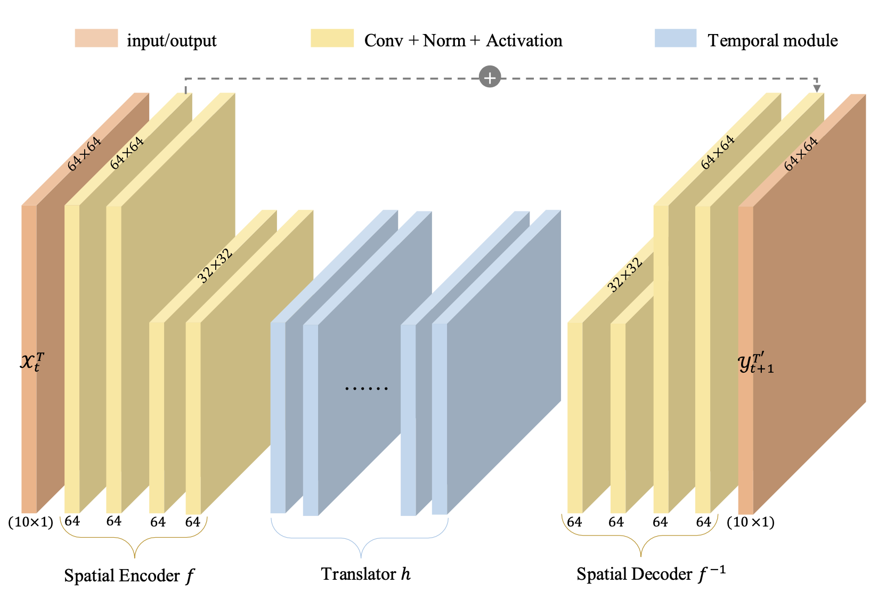
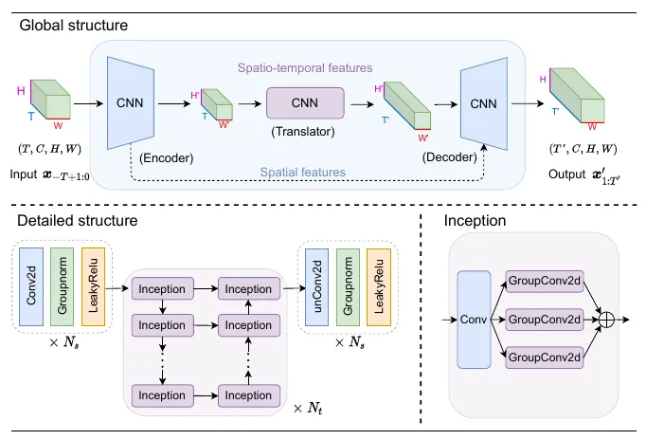
Nowcast models
pySTEPS (https://pysteps.github.io)
Persistence: no temporal evolution
Extrapolation: only advection
Extrapolation-DS: advection + diffusion + stochastic perturbations
STEPS: advection + cascade decomposition + autoregressive models + stochastic perturbations (Bowler et al. 2006)
LINDA: advection + diffusion + autoregressive models + stochastic perturbations (Pulkkinen et al. 2021)
Motion field estimated by optical flow + semi-Lagrangian advection
Convolutional neural network: SimVPv2 (Tan et al. 2025)

Slide 6
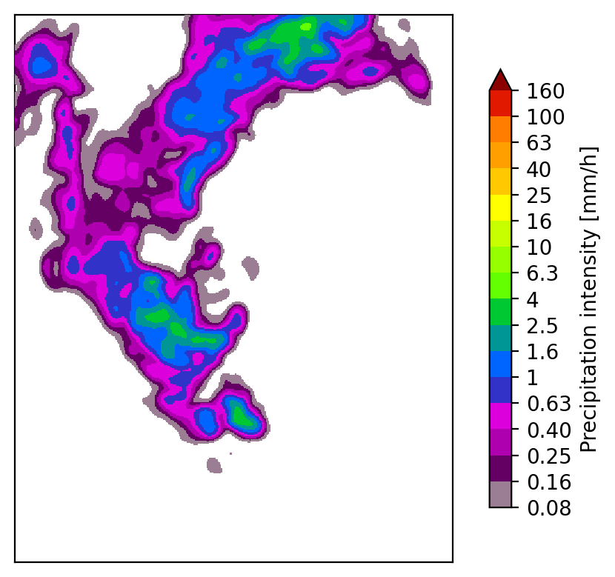
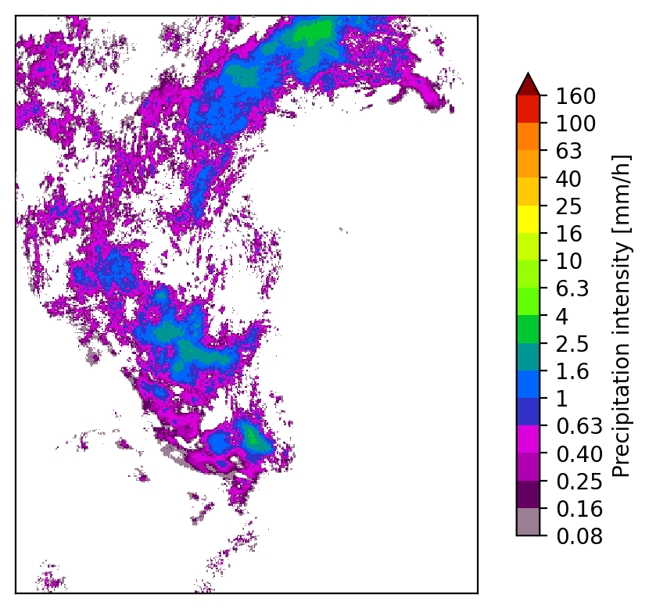
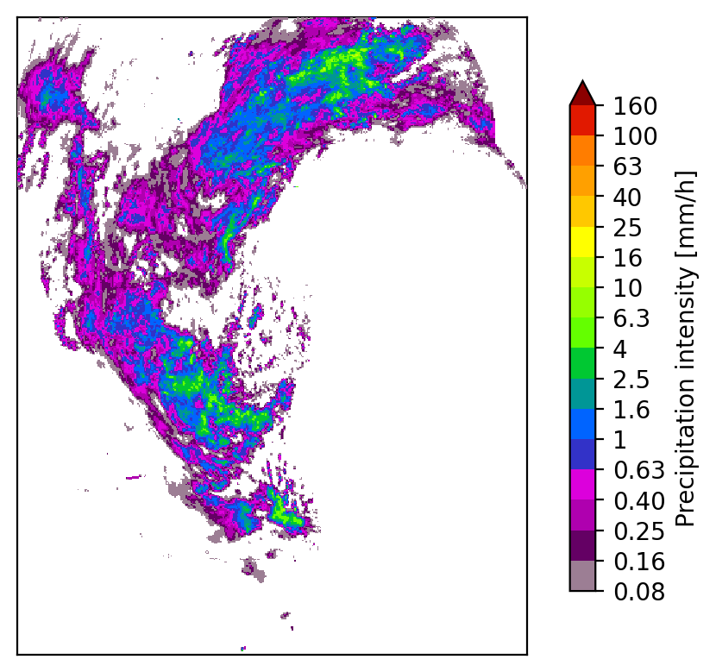
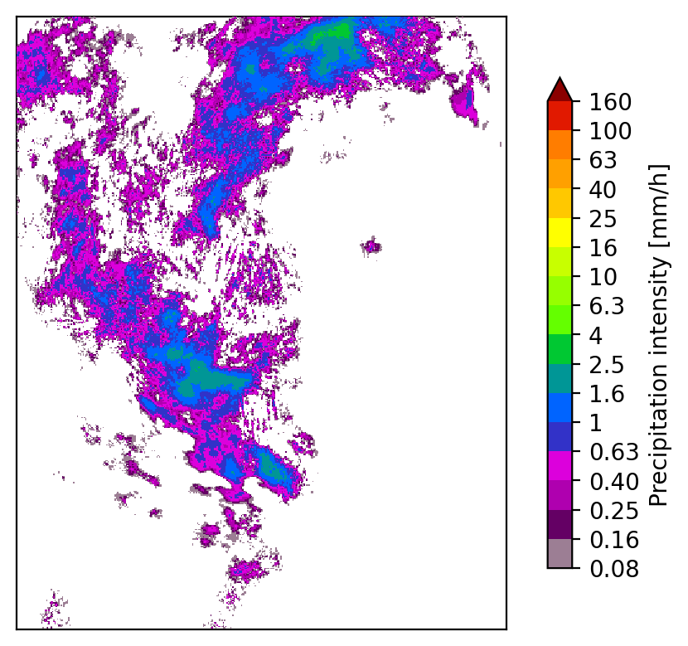
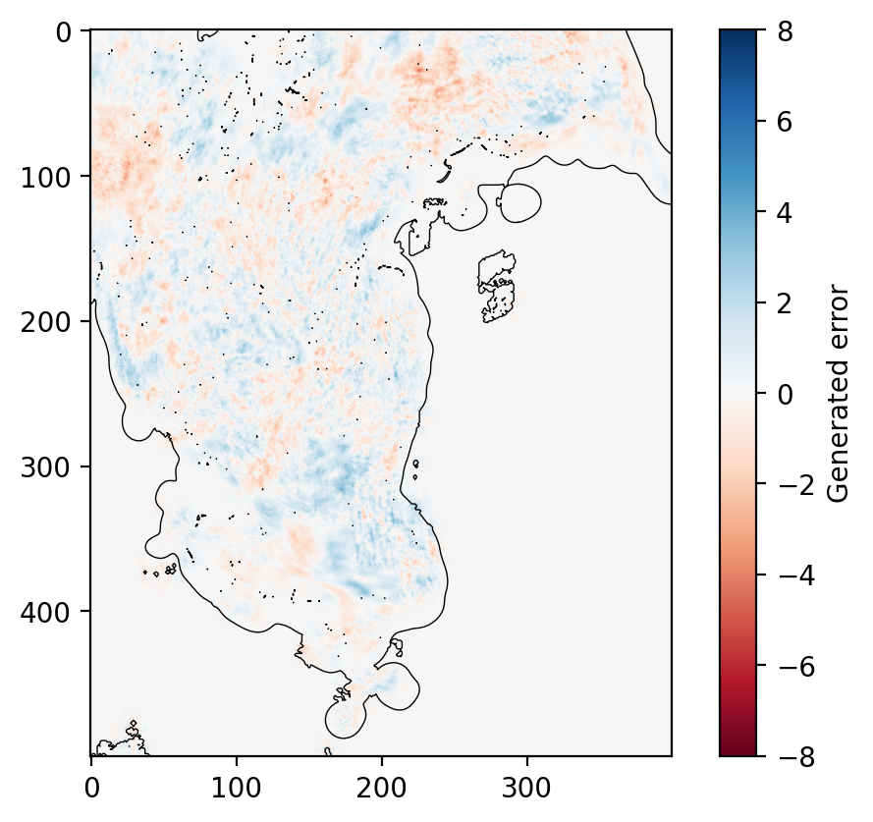
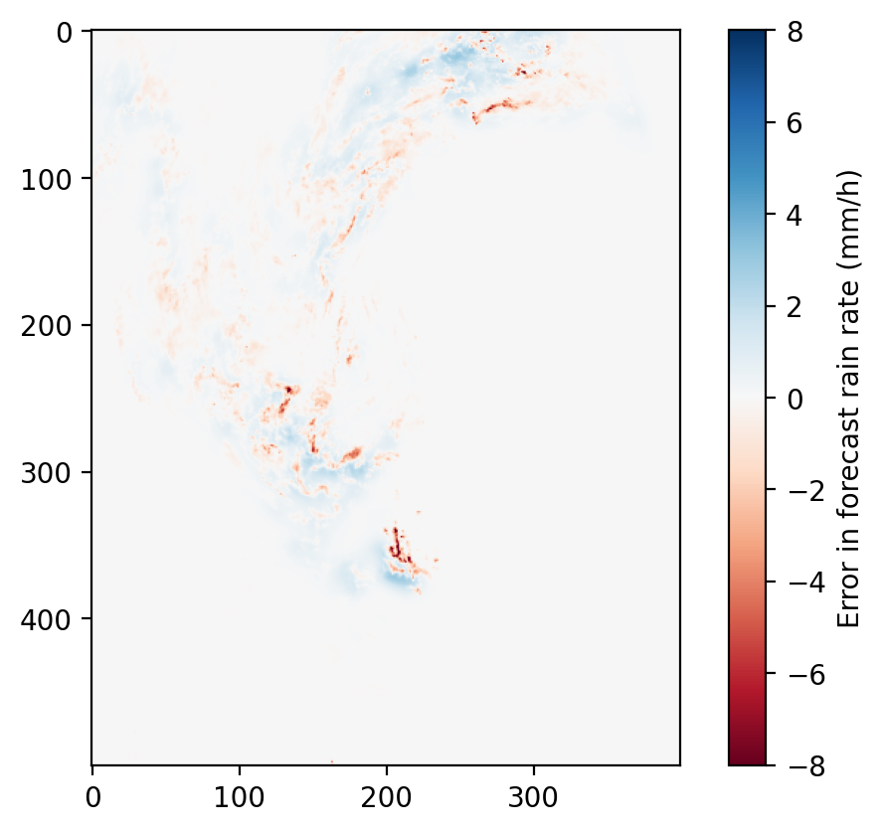
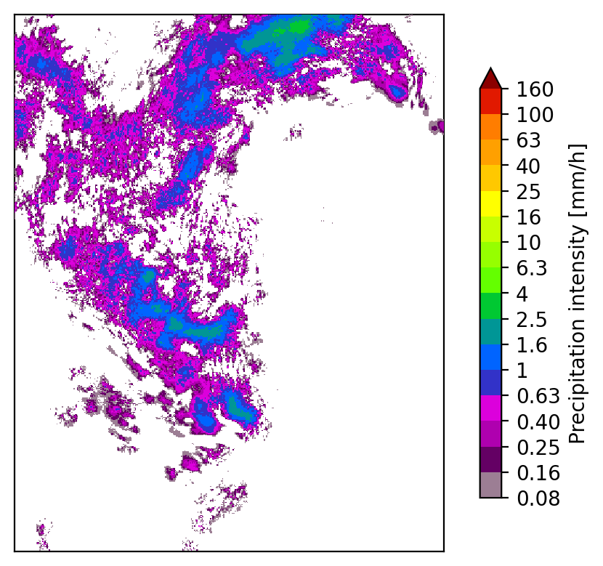
Ensemble generation
Repeat n times nowcast ensemble
LINDA methodology (Pulkkinen et al. 2021)
Observed
Generate stochastic perturbations to simulate nowcast errors
Generator parameters estimated by using past nowcast errors:
spatial autocorrelation function (exponential)
marginal distribution (lognormal)
Separate generator for each lead time
+
1h nowcast
Stochastically generated error field within rainy areas
Gaussian-filtered nowcast: suppress scales that are not predictable
nowcast errors
Methods implemented in pySTEPS (https://pysteps.github.io)

Slide 7
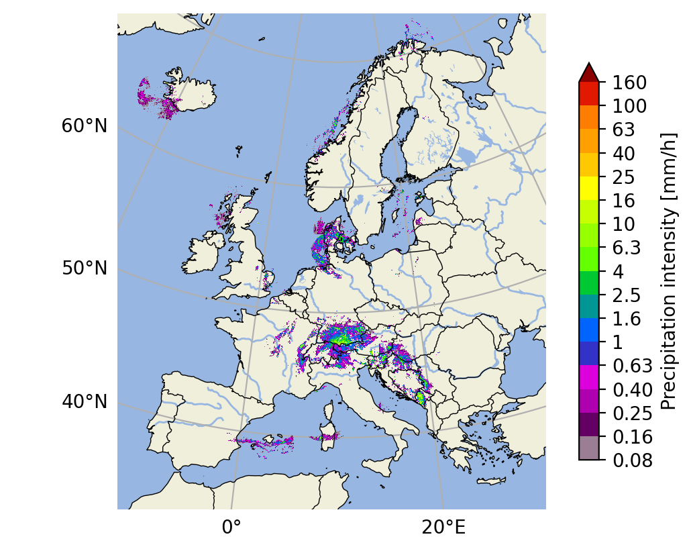
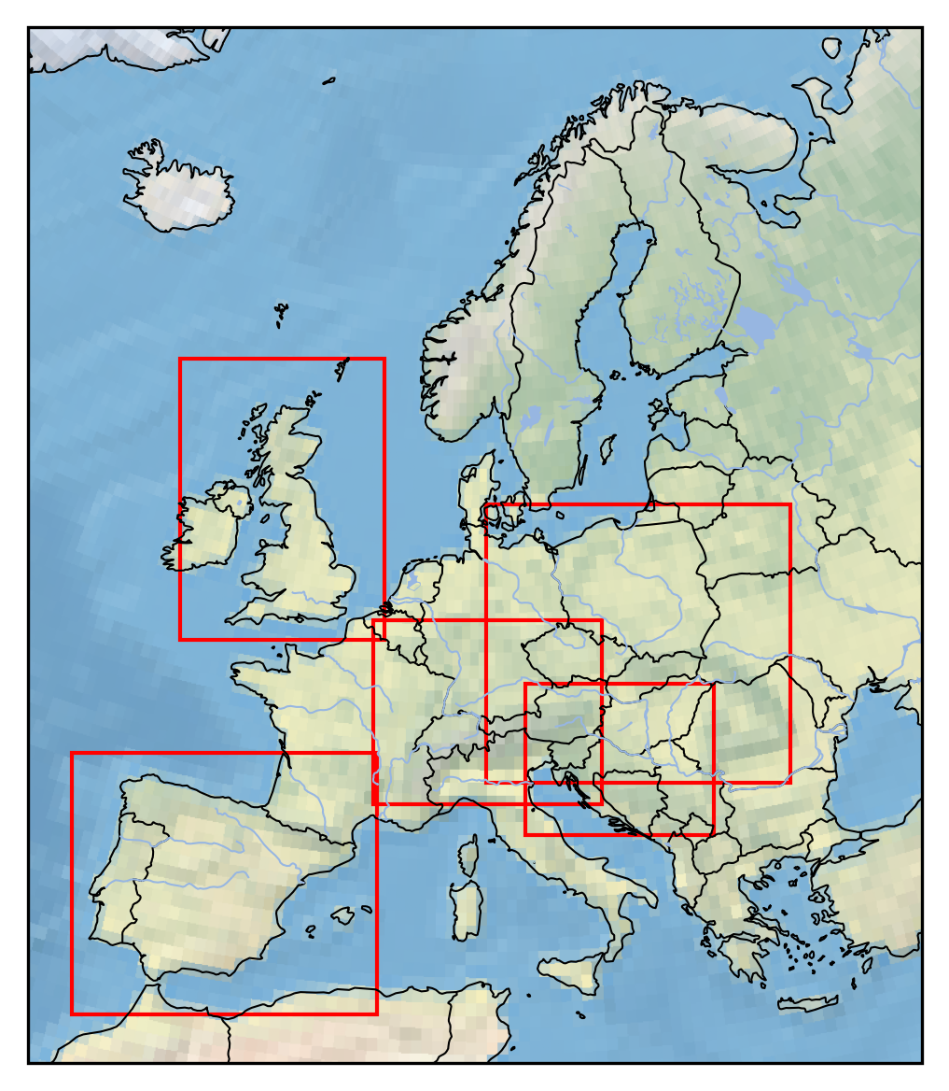
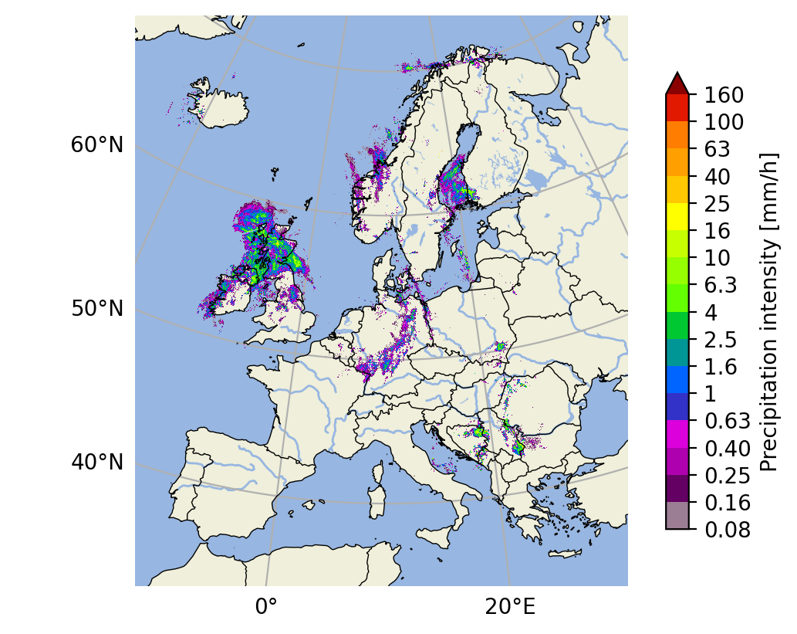
Selected events
2024-05-31 07:00 UTC
3.-4. Aug 2023: Severe rainfall and landslides in Slovenia
2.-3. Sep 2023: Heavy rainfall and flooding in Spain
31. May-4. June 2024: Extended period of heavy rainfall in South Germany
13.-16. Sep 2024: Storm “Boris”, Eastern Europe
4.-8. Aug 2025: Storm “Floris”, heavy rainfall and winds in the British isles
5
4
2025-08-04 03:00 UTC
3
1
2

Slide 8
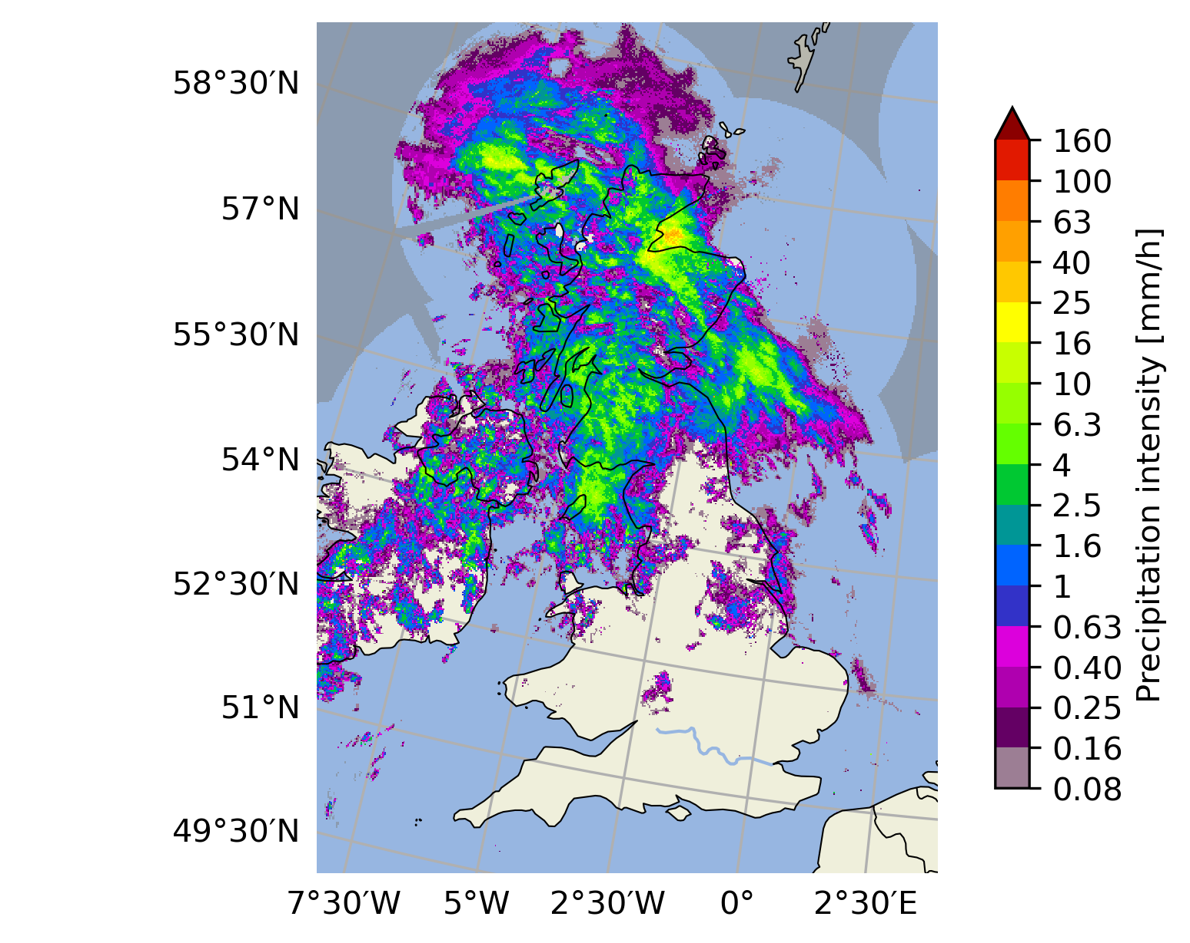
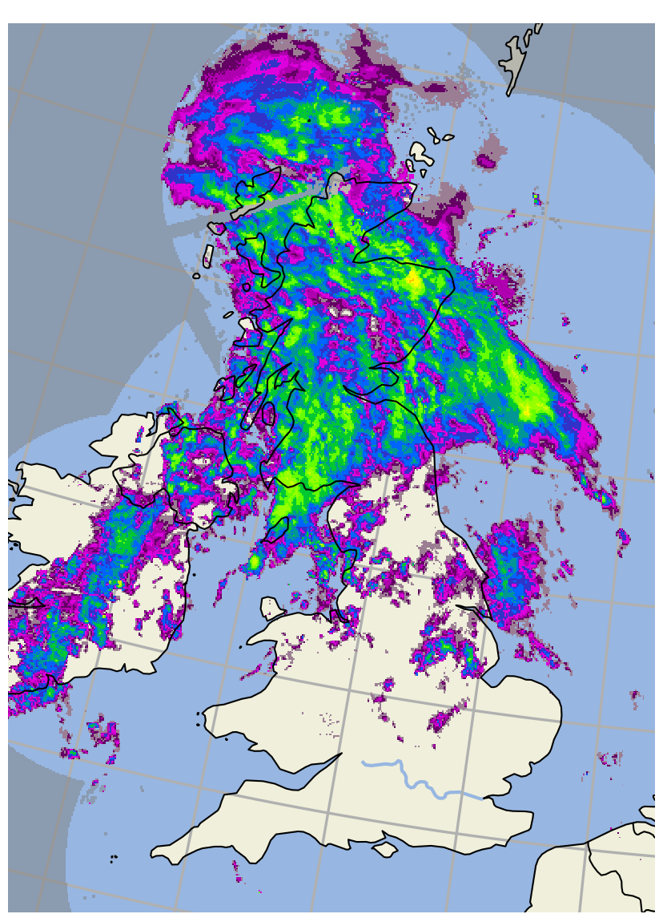
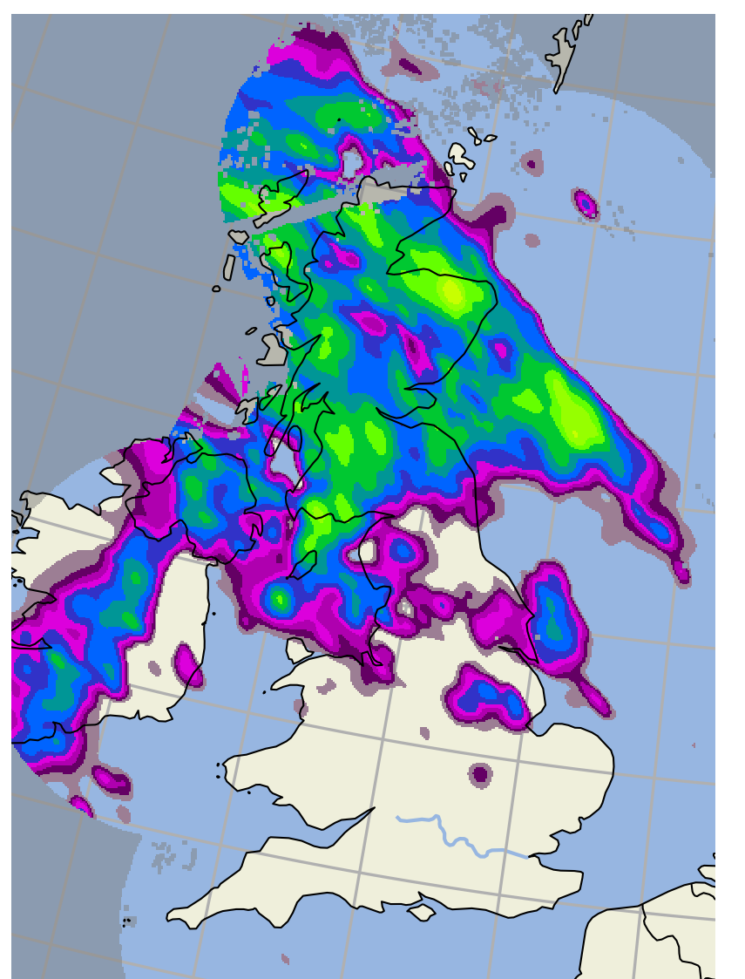
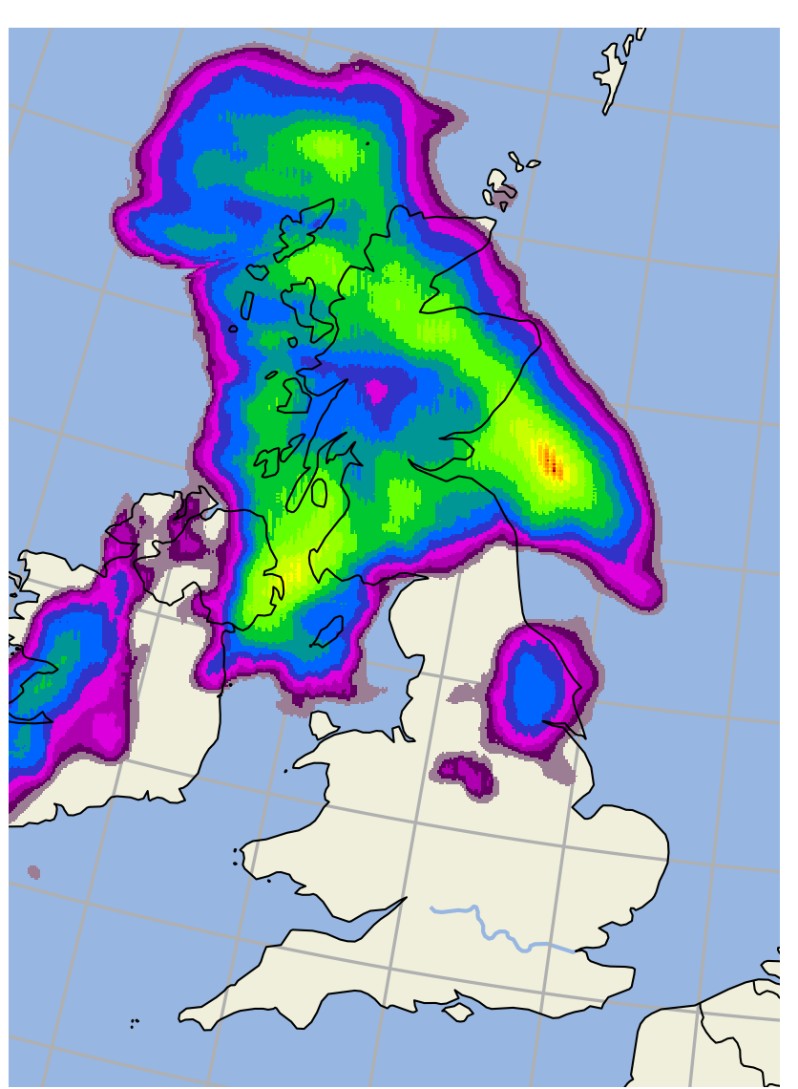
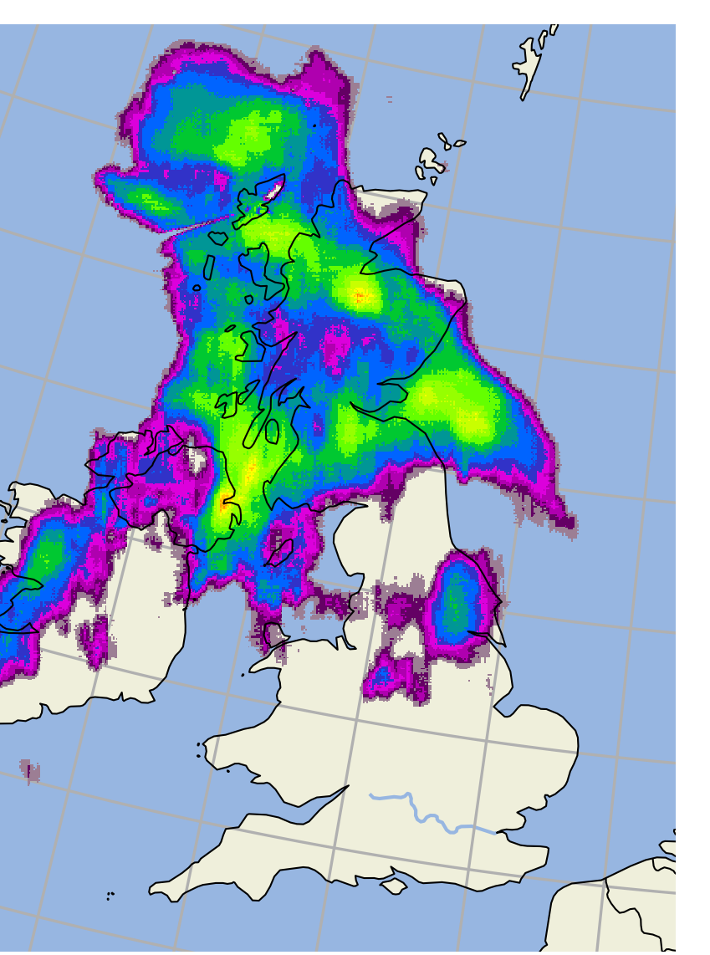
Visual comparison of nowcasts Lead time: 1 hour
Tradeoff
Minimize
forecast errors
Preserve spatial structure
Two SimVP configurations:
SimVP-S: single input/output channel: rain rate
SimVP-M: multiple input/output channels: rain rate, CAPE, CIN and wind u/v components
CDF of SimVP nowcasts matched to observations
Extrapolation
LINDA
Observed
Extrapolation nowcasts typically have large errors but they preserve spatial structure
Diffusion in LINDA removes small-scale variability, but overall structure is preserved
SimVP trained with MSE loss cannot preserve spatial structure but predicts high-intensity areas reasonably well
CDF / nowcast
1
CDF / observed
SimVP-S
SimVP-M
0
Rain rate (mm/h)
50

Slide 9
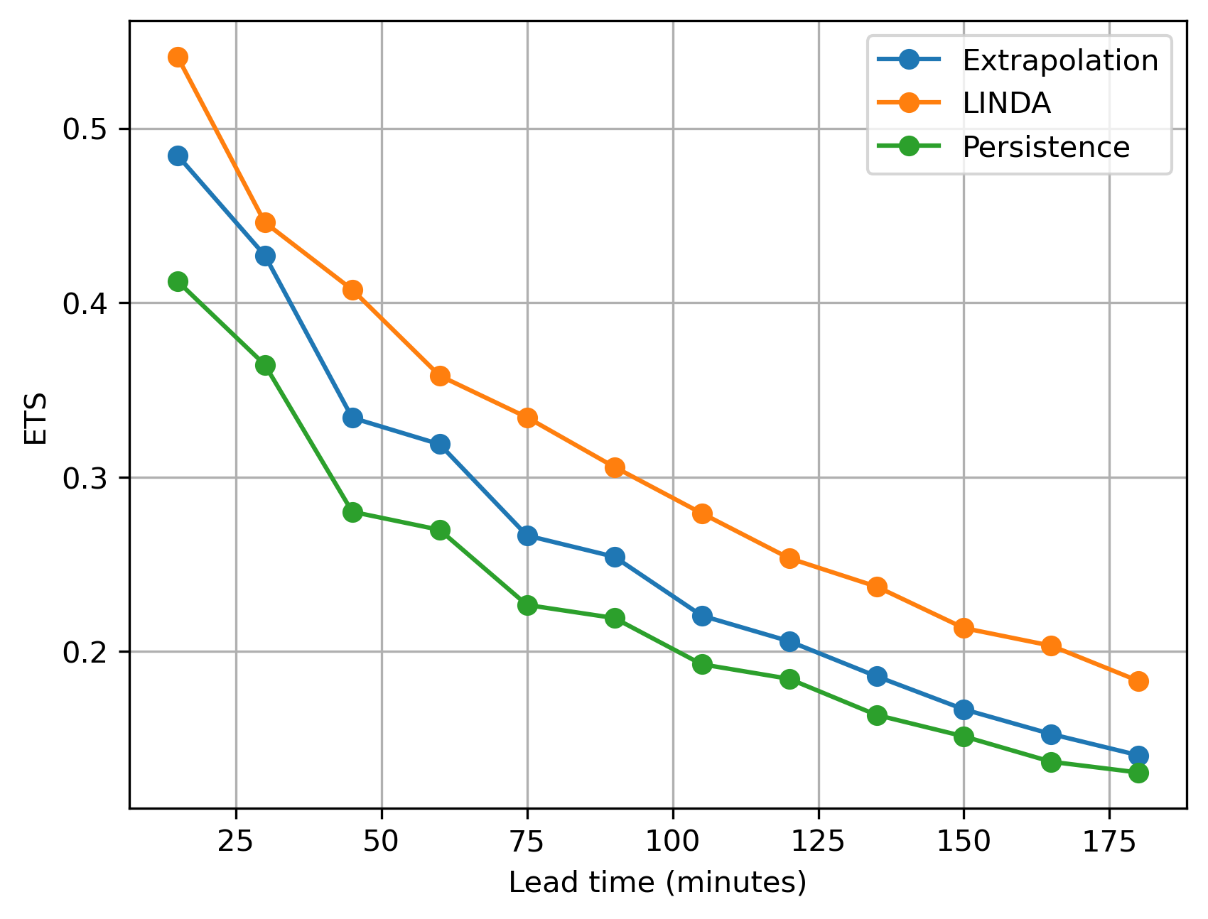
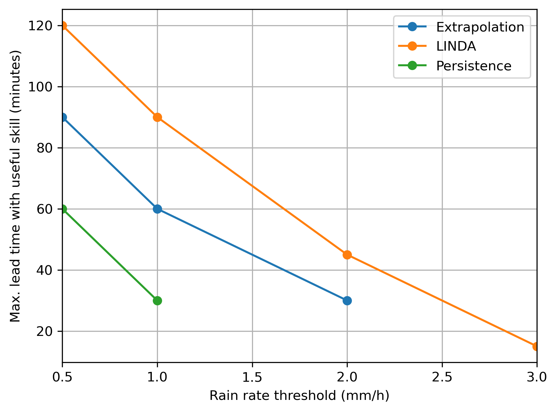
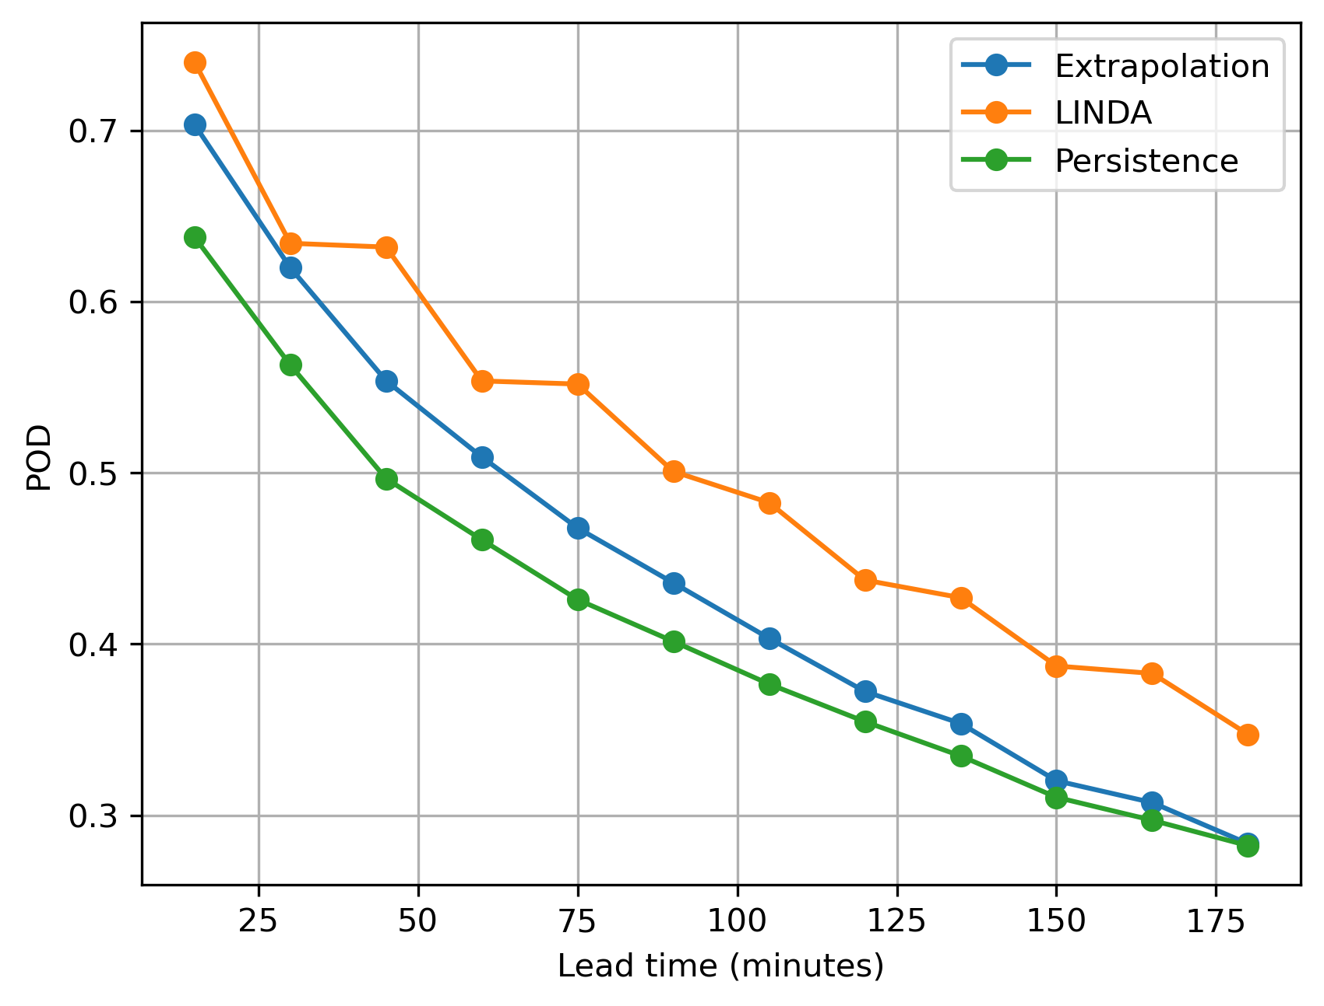
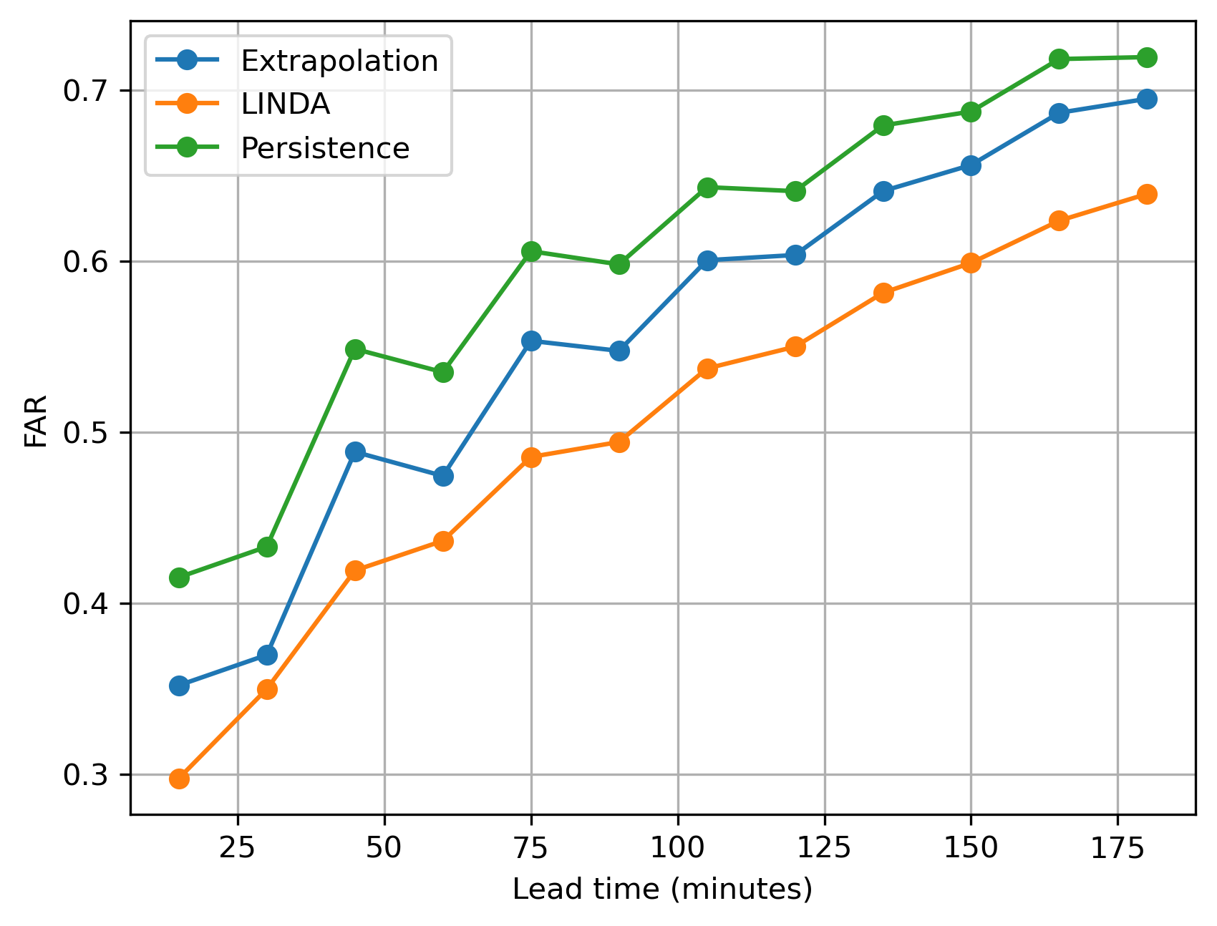
Categorical metrics
1 mm/h
Calculated in the 2 km scale of the input data by using observed radar composites as ground truth
LINDA has the best skill in three-hour time range for rain rates 0.5-3 mm/h
Maximum lead time where nowcasts have useful skill:
POD > 0.5 and FAR < 0.5
POD
FAR

Slide 10
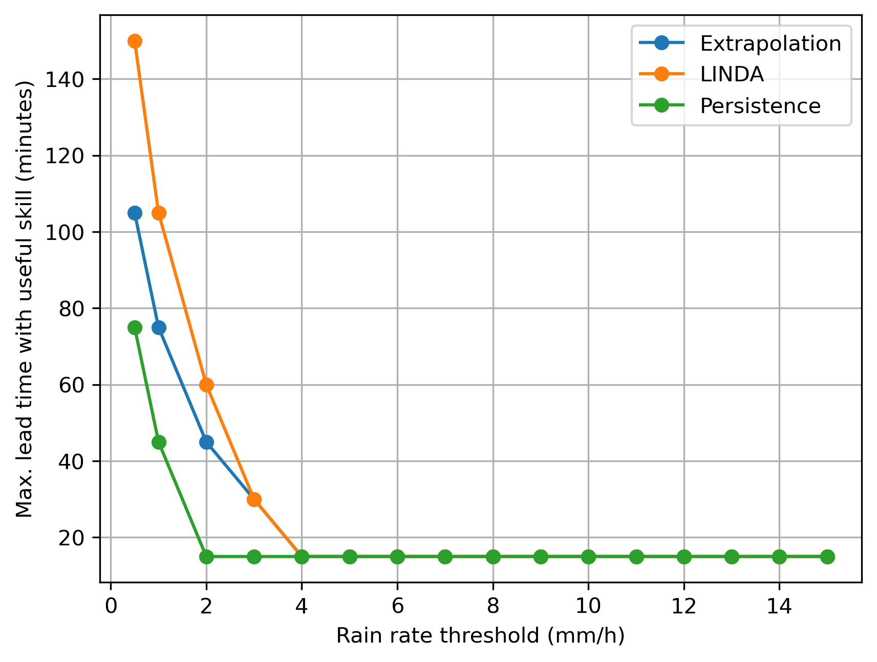
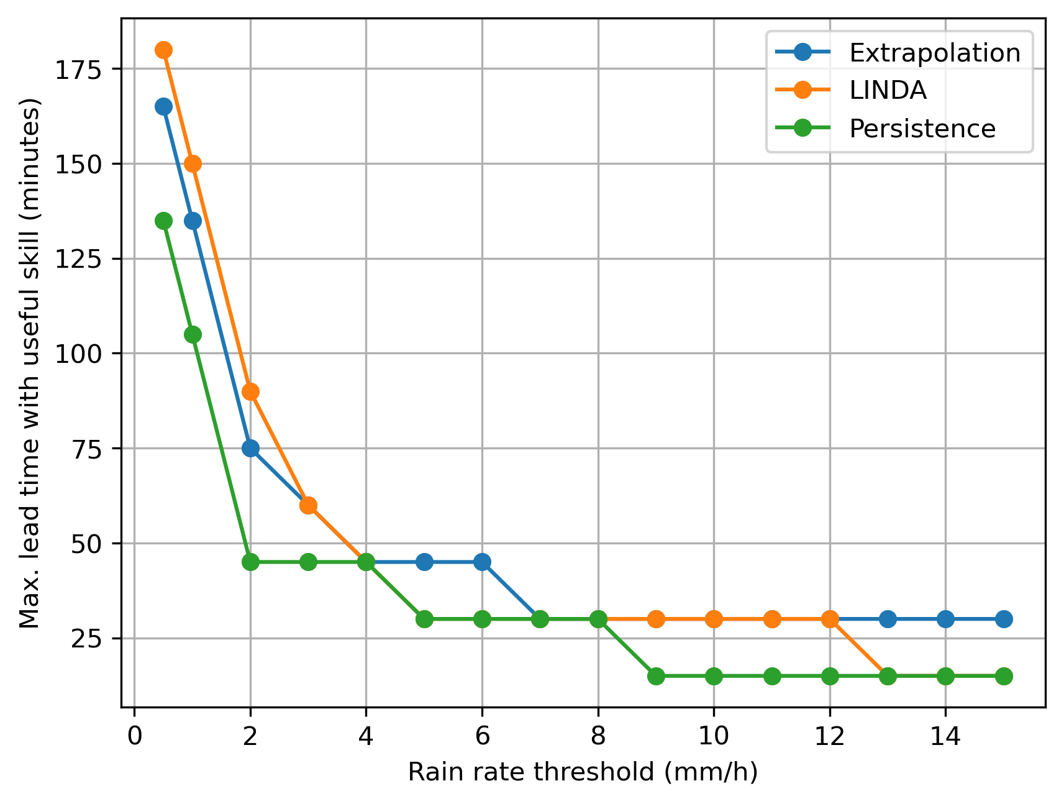
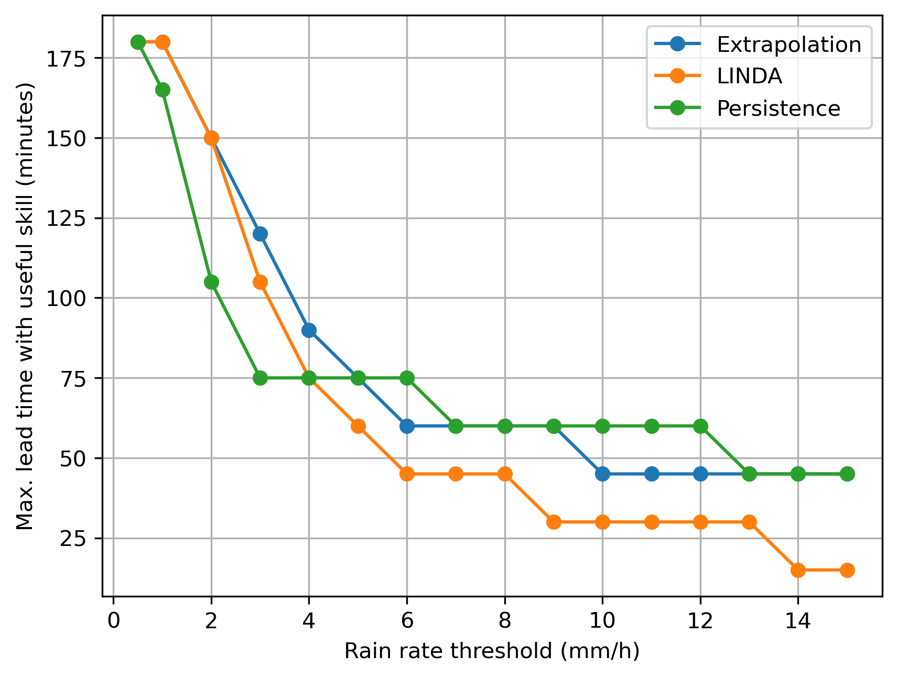
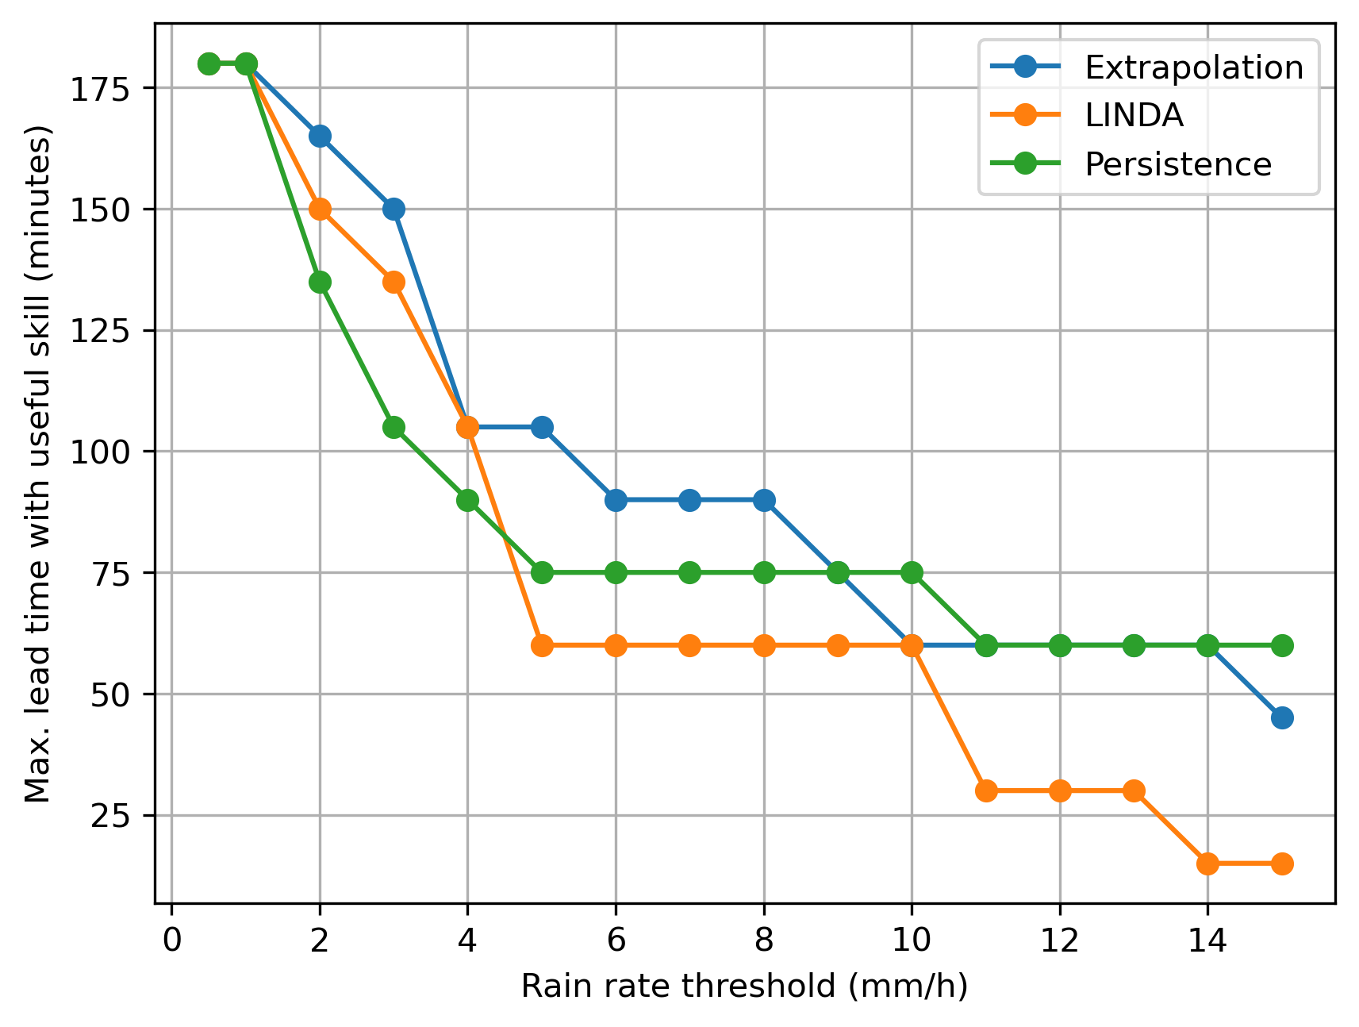
Multi-scale verification Fractions skill score (FSS)
Maximum lead time where nowcasts have useful skill: FSS > 0.5
2 km
10 km
In hydrological applications one is interested in a wide range of spatial scales
LINDA performs best in the smallest scales (< 10 km) relevant for predicting flash floods
Extrapolation has the best overall skill across different scales
40 km
60 km

Slide 11
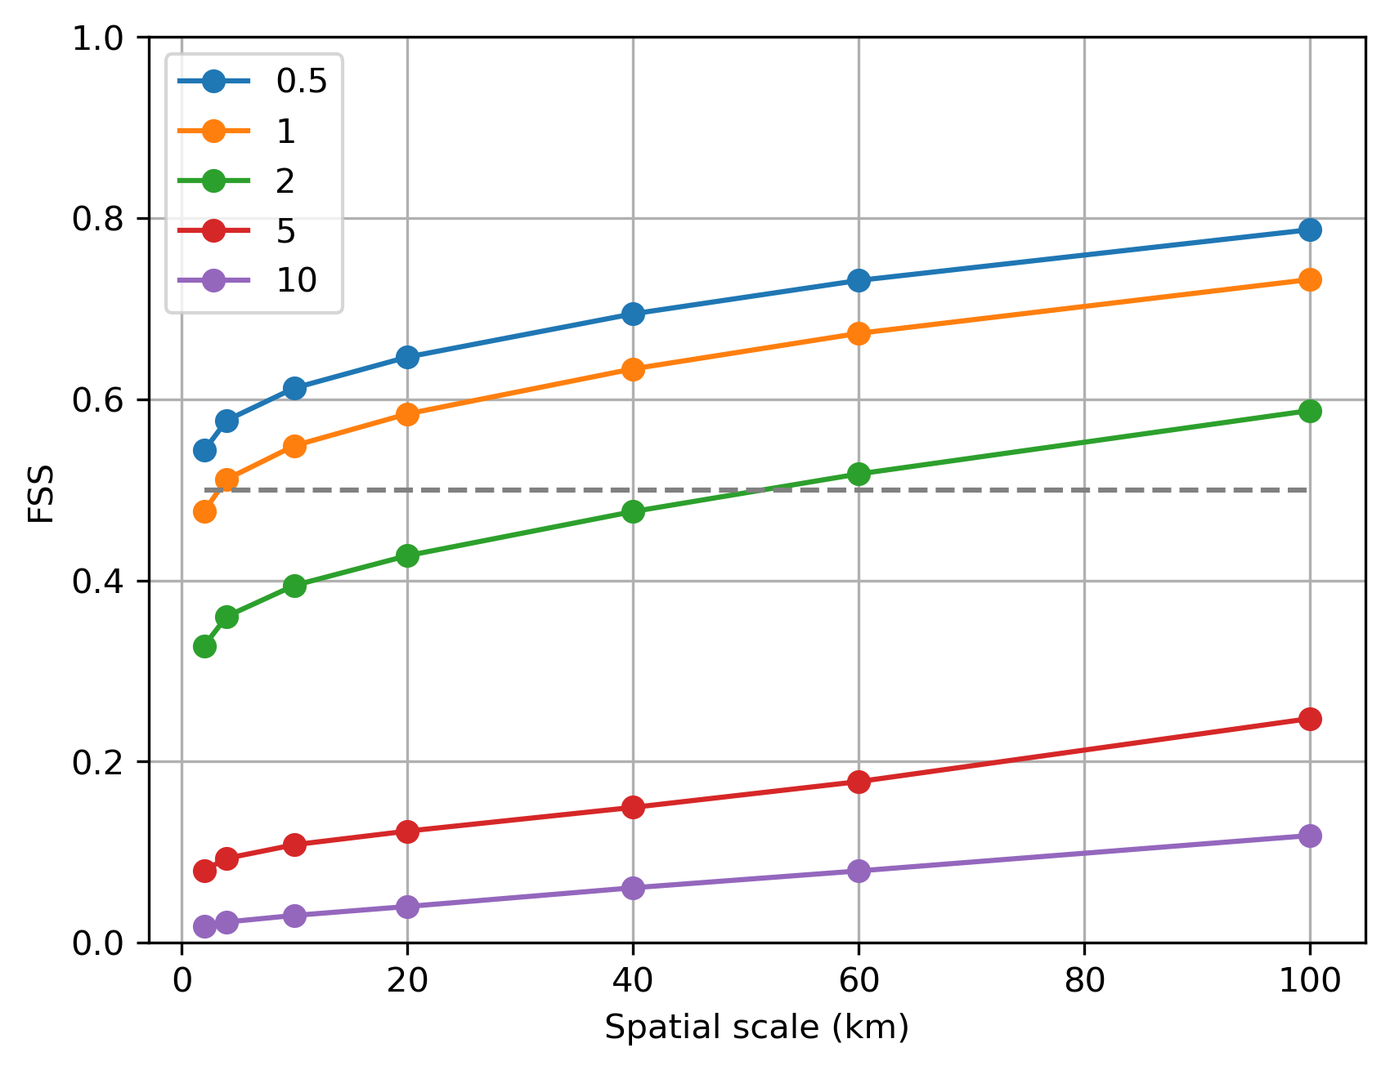
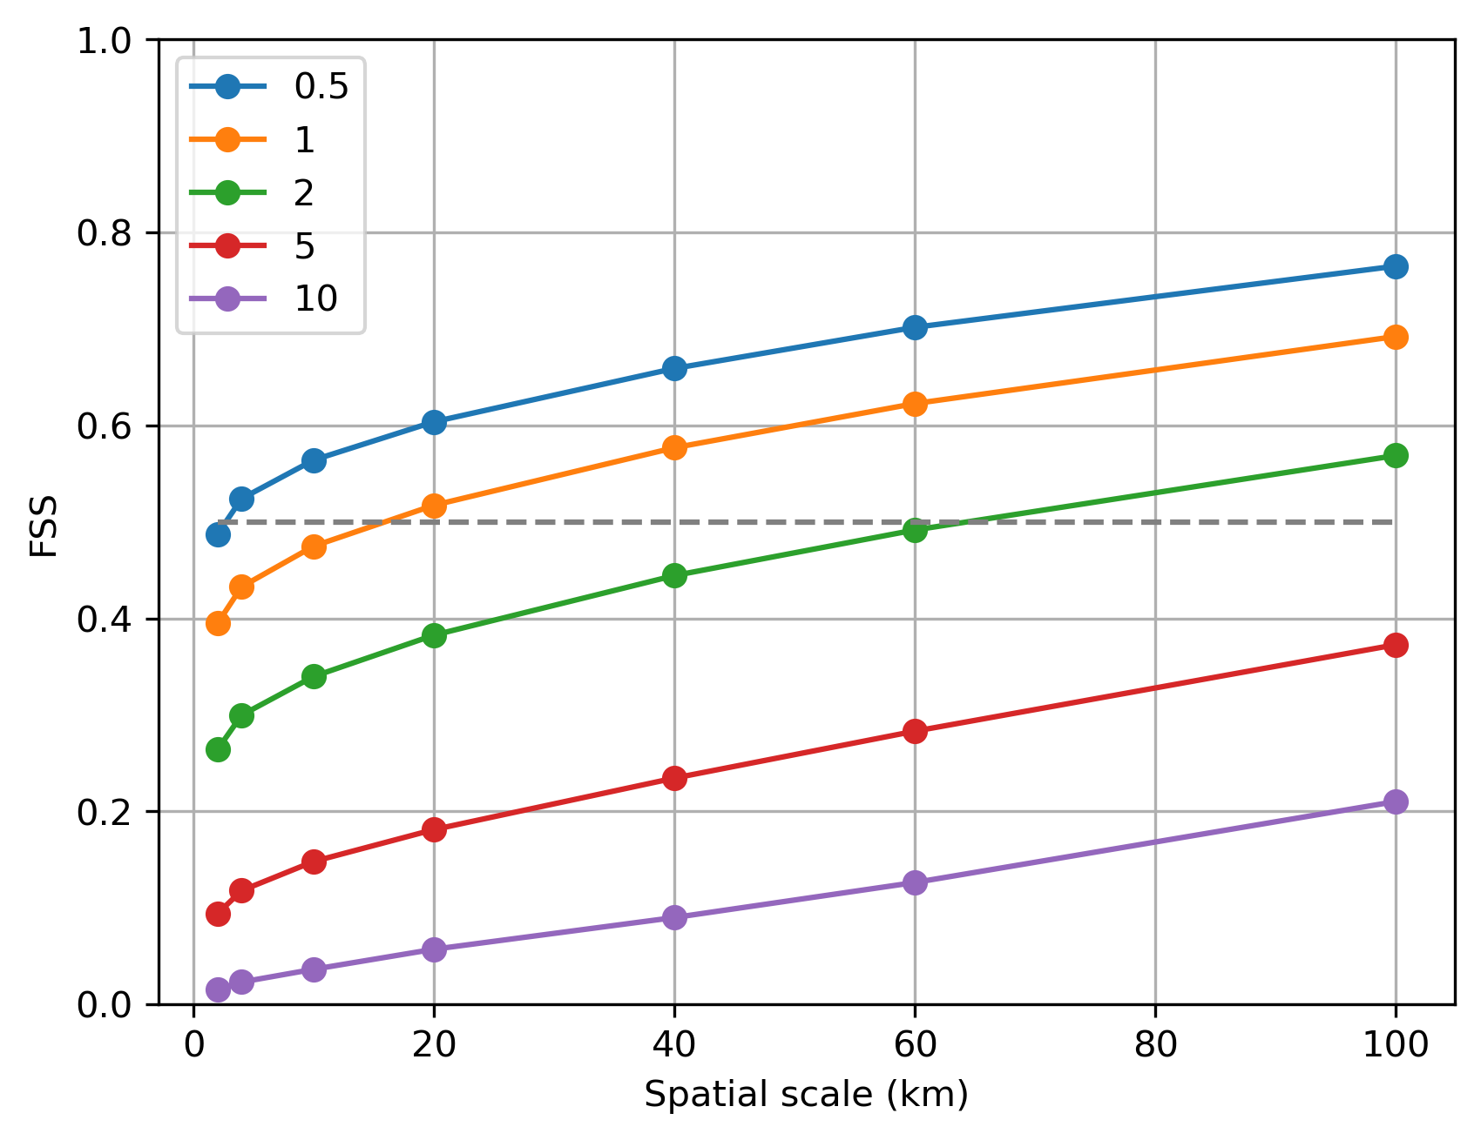
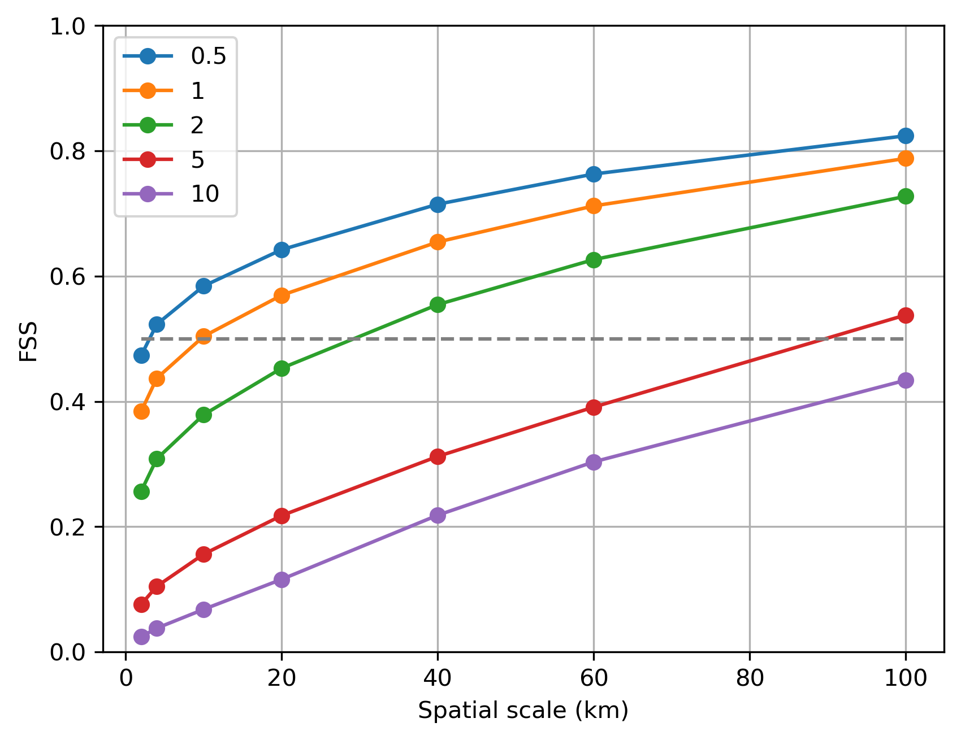
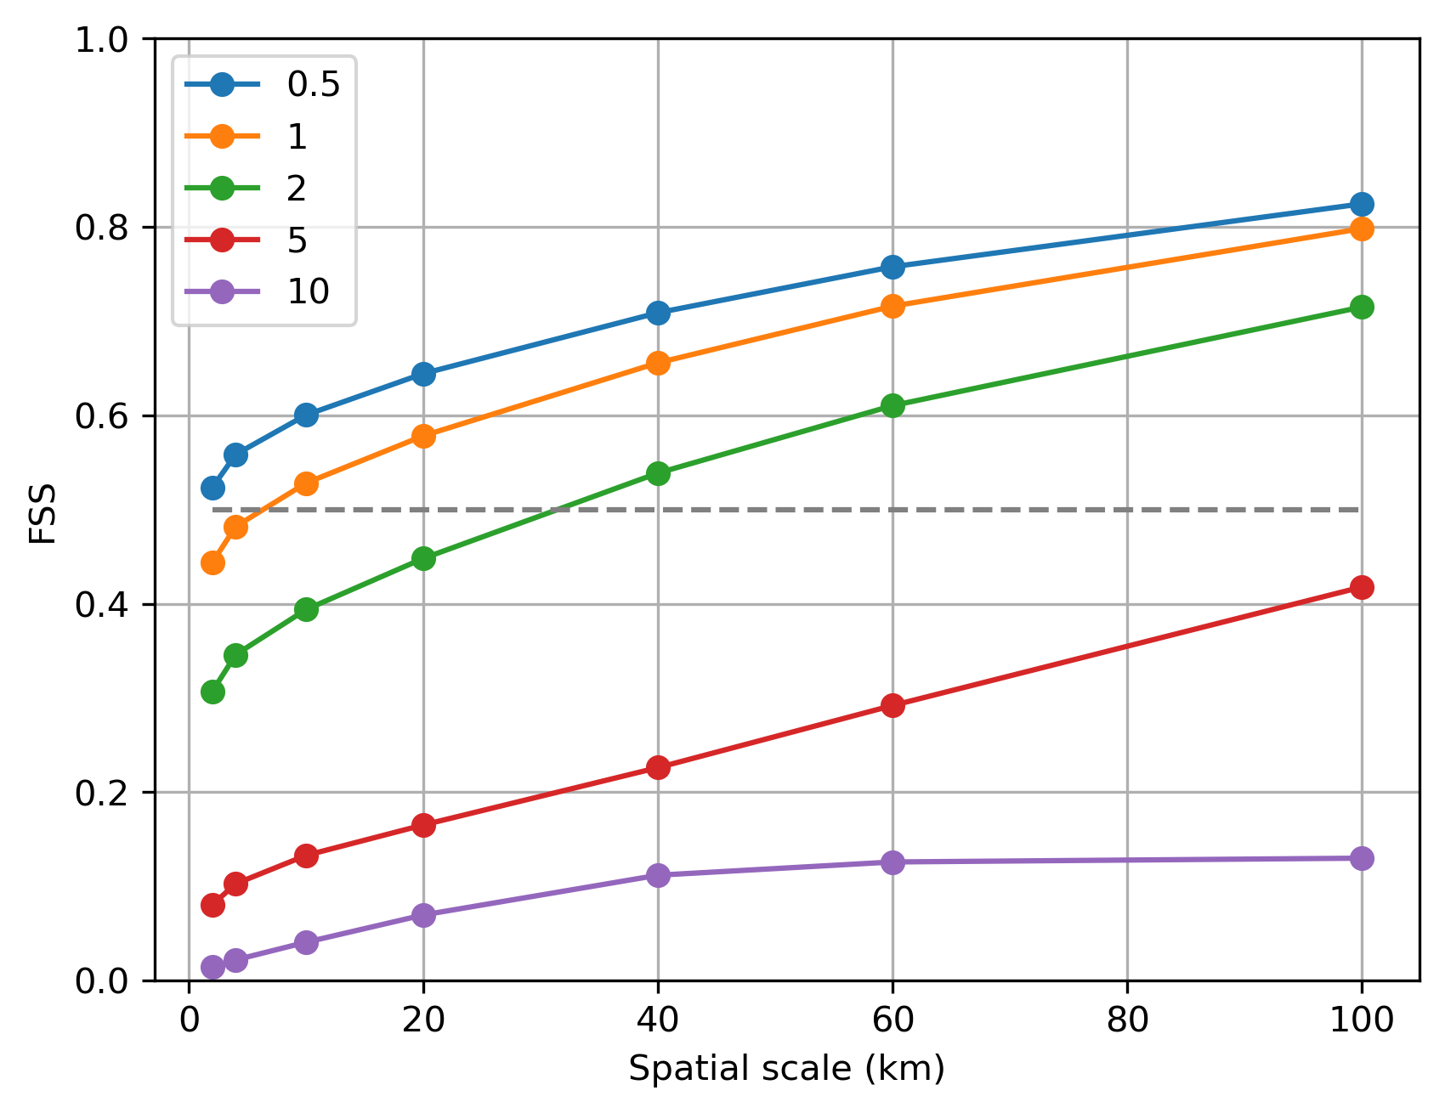
Comparison with SimVP FSS of two-hour nowcasts
SimVP-S
SimVP-S has the best skill in the smallest scales (< 5 km)
Extrapolation has the best skill above 20 km scale
Adding more input / output channels to SimVP reduces skill to predict precipitation
SimVP-M
Extrapolation
LINDA

Slide 12
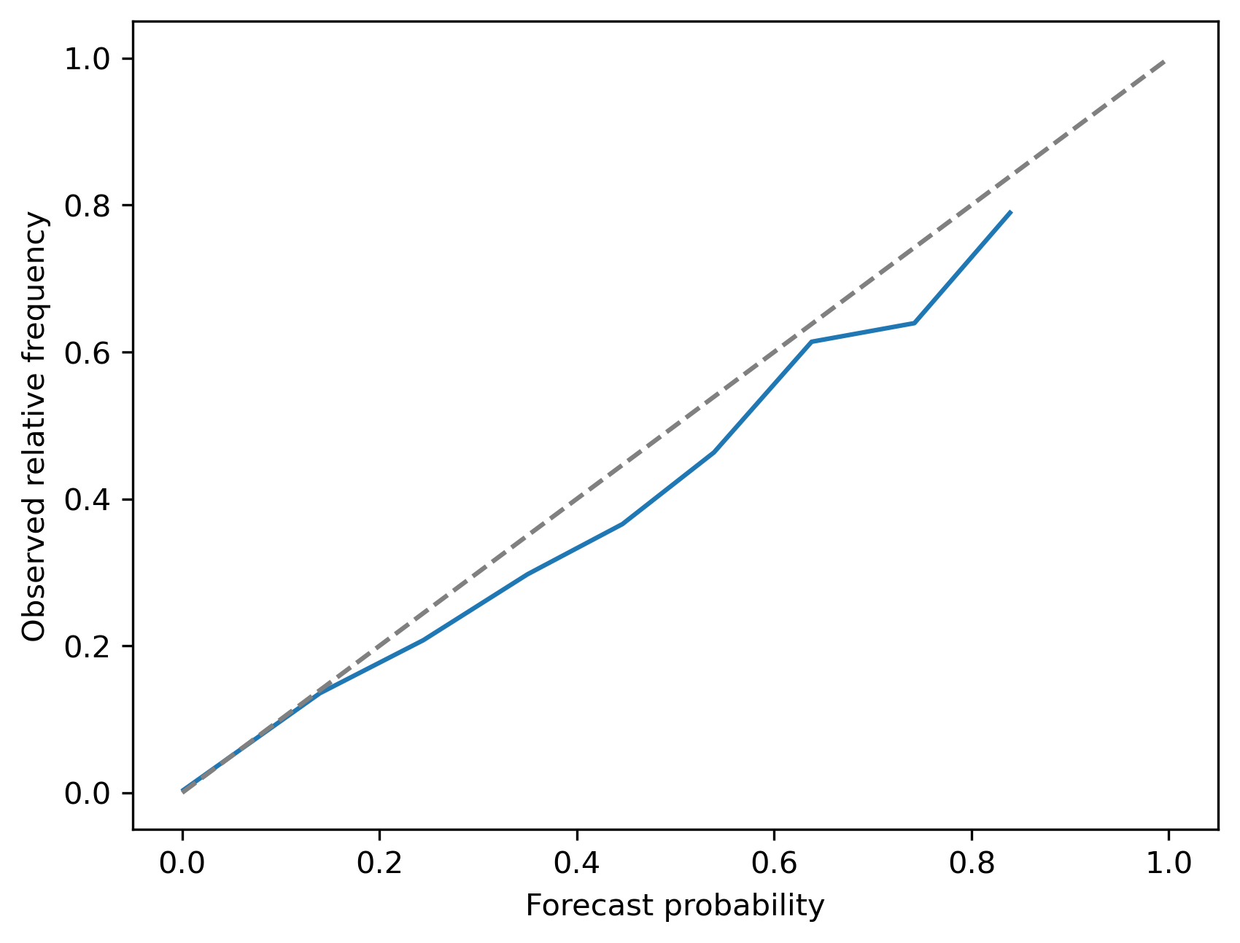
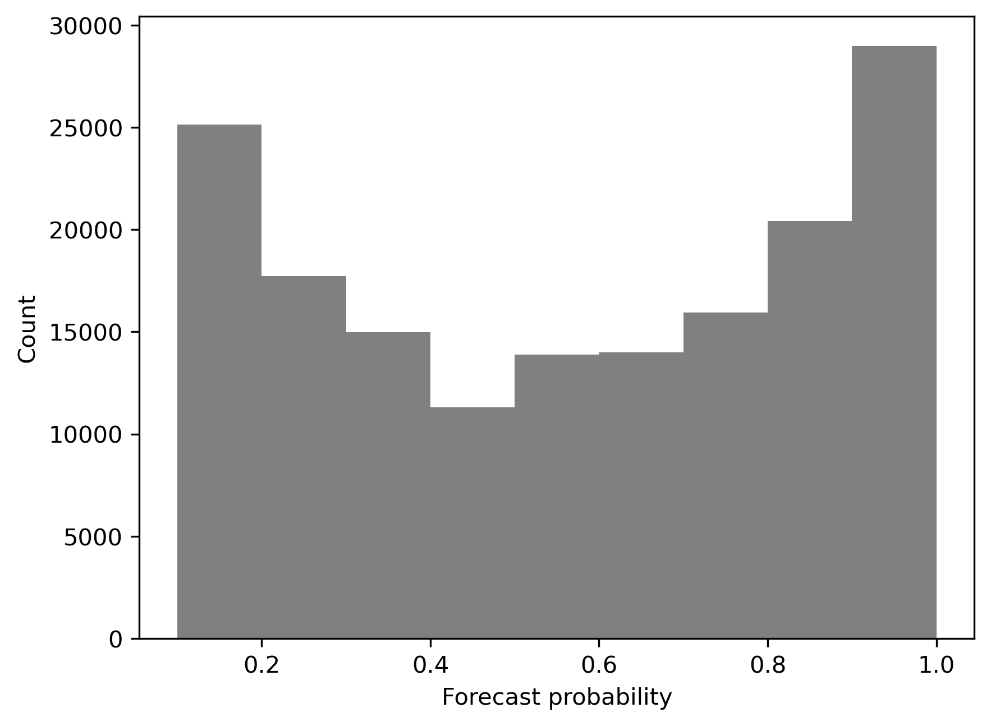
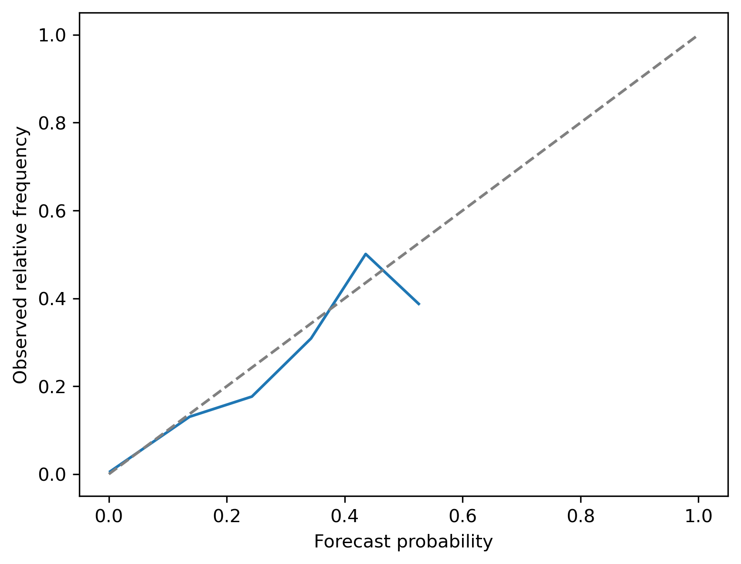
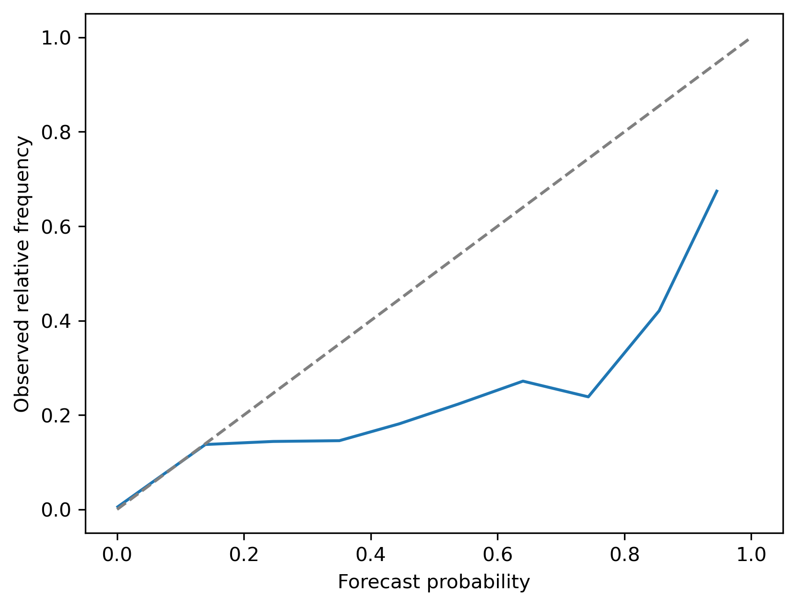
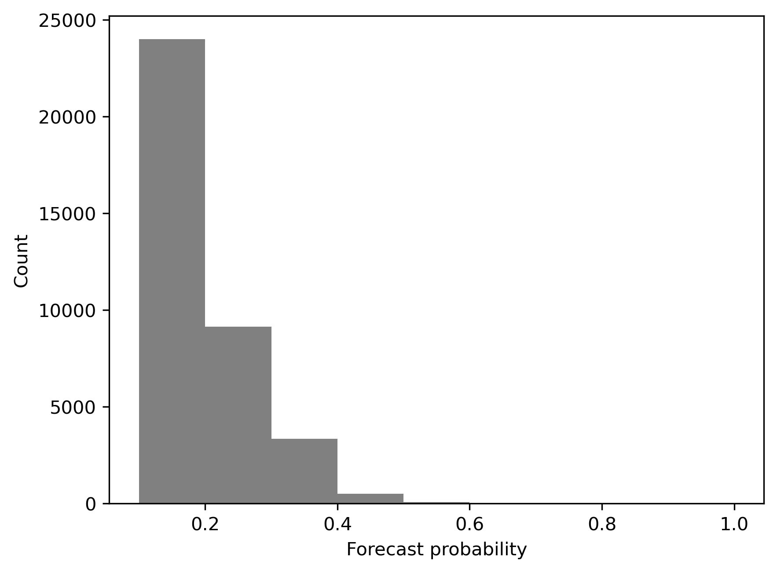
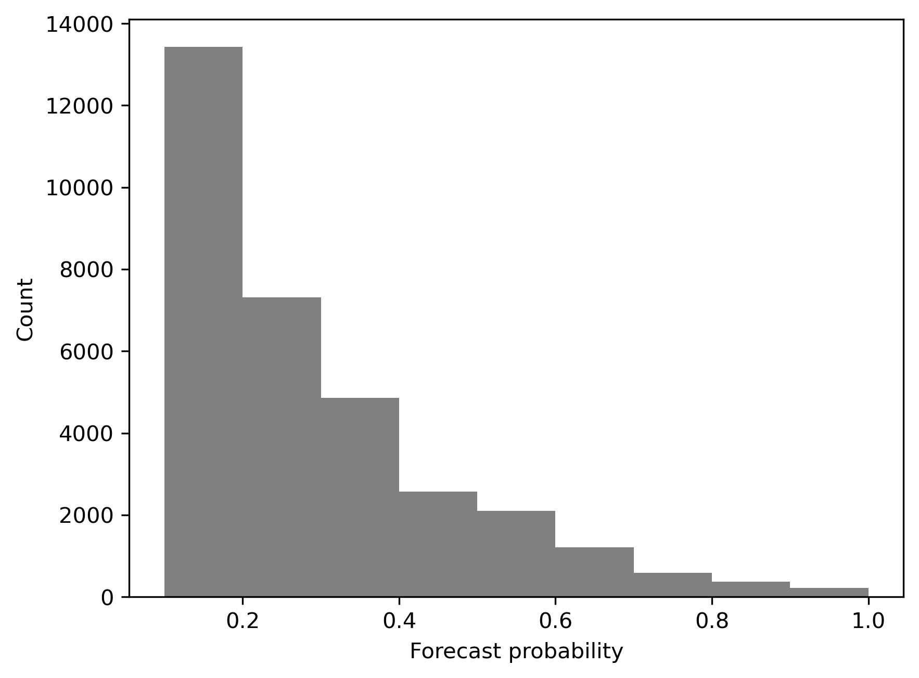
Probabilistic verification Reliability diagrams
Extrapolation-DS: 30 min nowcast, 5 mm/h
With increasing threshold and lead time:
LINDA predicts too large probabilities
the models become less confident about their predictions
Extrapolation-DS yields unbiased ensemble nowcasts
Extrapolation-DS: 1 h nowcast, 5 mm/h
LINDA: 1 h nowcast, 5 mm/h

Slide 13
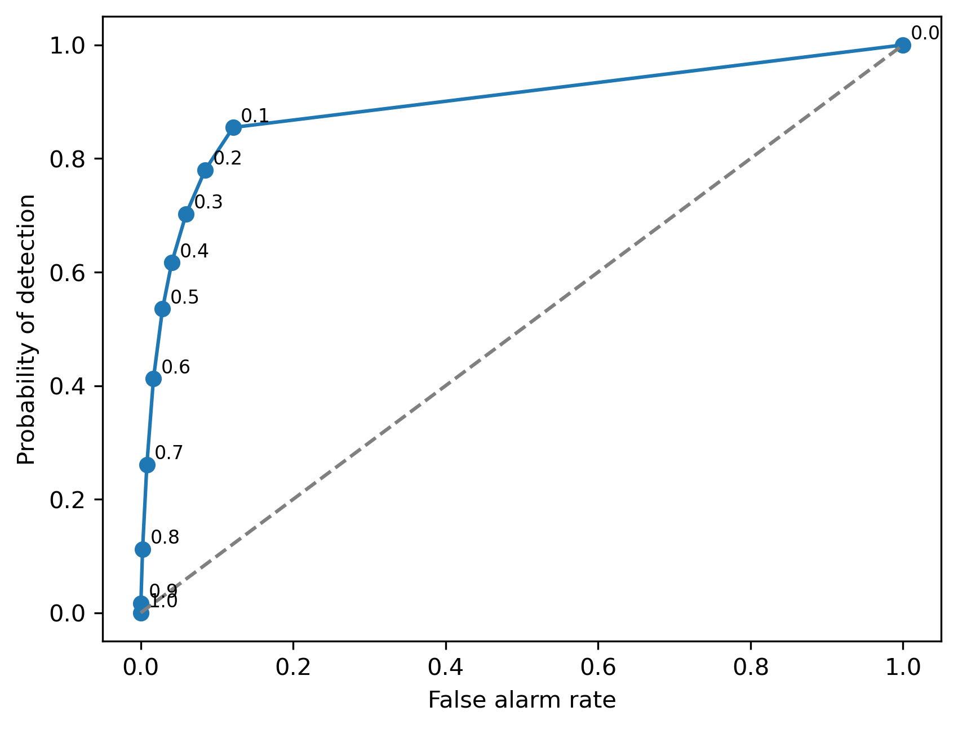
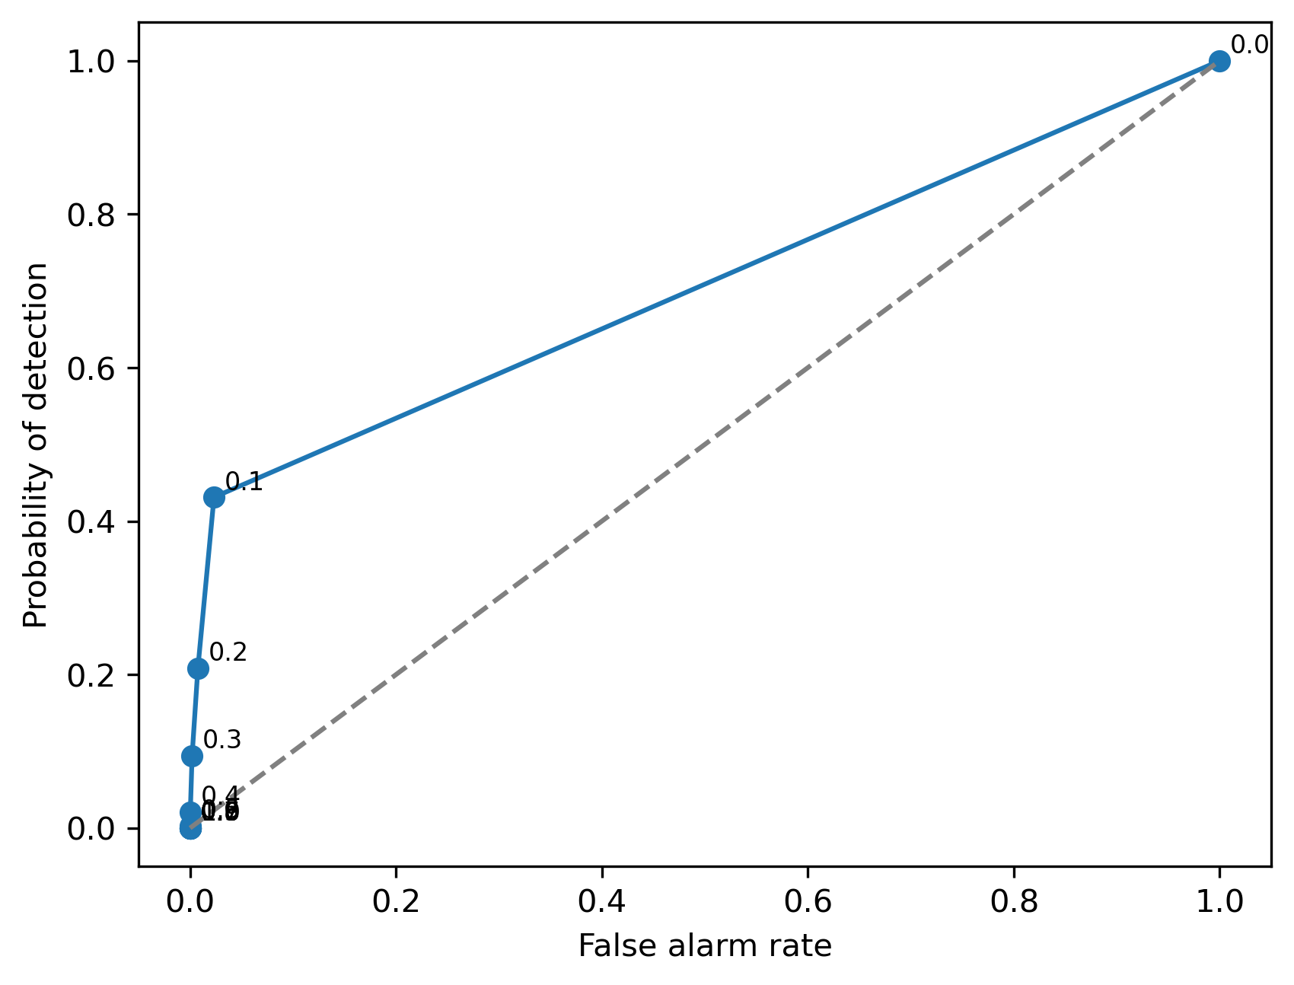
Probabilistic verification ROC curves
One-hour nowcasts: Extrapolation-DS
1 mm/h
Common pattern with all methods, where stochastic perturbations are added to deterministic nowcasts
ROC curves are shifted to the left side
The optimal decision thresholds correspond to small probabilities (< 0.15)
For a perfectly calibrated forecast the optimal threshold would be 0.5
5 mm/h

Slide 14
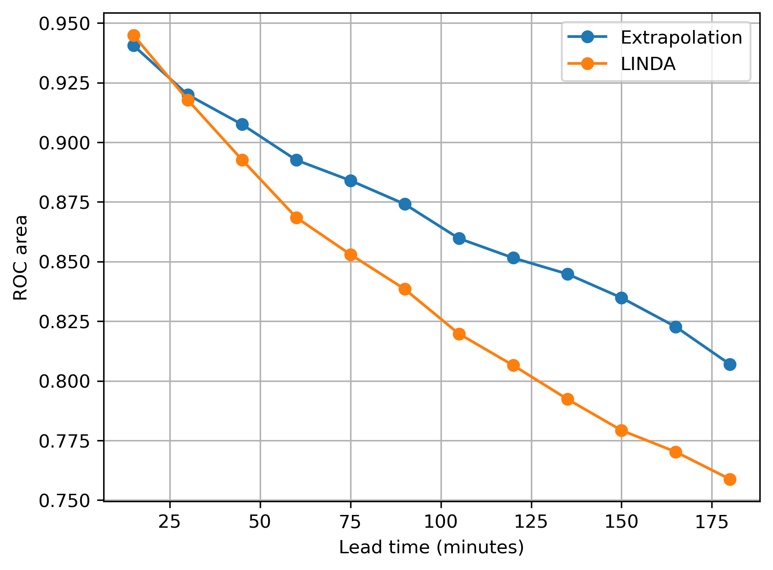
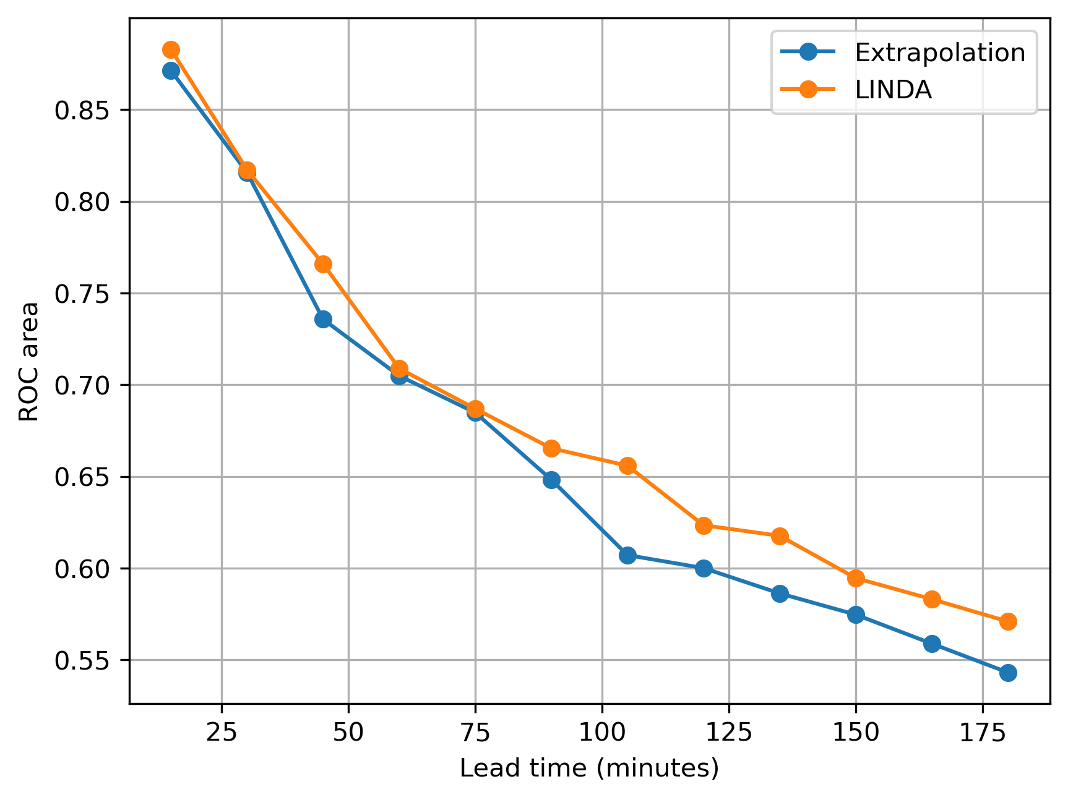
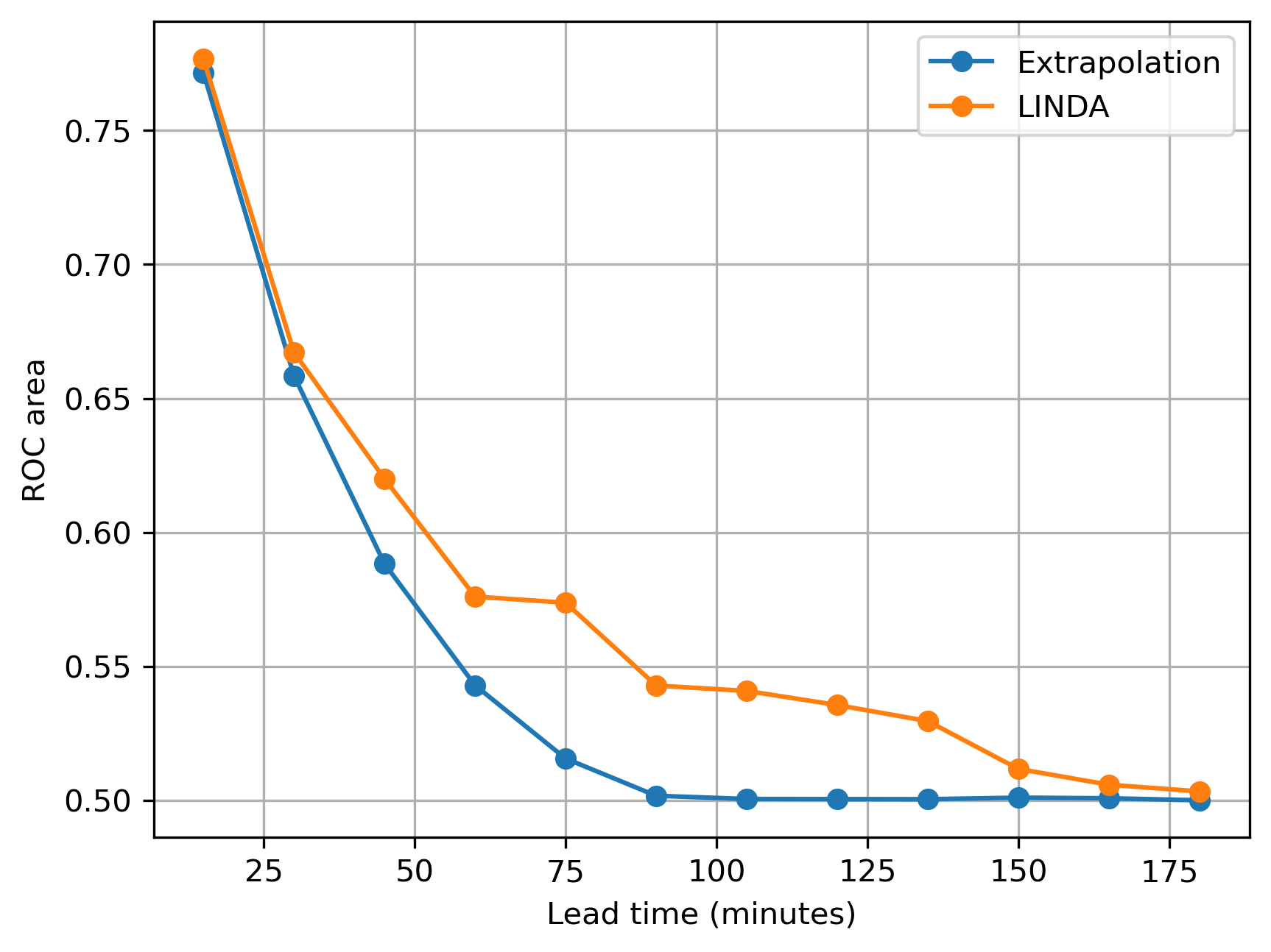
Probabilistic verification ROC area
Criterion: ROC area > 0.7
Extrapolation-DS outperforms LINDA for low rain rates
LINDA has better skill for predicting rain rates above 5 mm/h
Limits of useful probabilistic nowcasts in 2 km scale:
1 mm/h: > 3 hours
5 mm/h: ~1 hour
10 mm/h: < 30 minutes
1 mm/h
5 mm/h
10 mm/h

Slide 15


Examples of hazard and risk nowcasts
Method for assigning hazard classes:
Estimate exceedance probabilities of each class lower bound
Convert probabilities into 0/1 values by using the optimal thresholds from ROC curves
Take the maximum class index among those assigned to 1
Hazard classes
< 1 mm/h
1-2 mm/h
2-5 mm/h
Ensemble members generated by adding stochastic perturbations to precipitation nowcast
> 5 mm/h
Risk nowcast generated by using exposure levels from population density
risk = hazard * exposure

Slide 16




Multi-hazard forecasts
Hazard and risk forecasts from NWP-predicted wind speed
Maximum hazard level from precipitation and wind forecasts
Hazard classes
< 20 mm/h
20-30 mm/h
30-40 mm/h
> 40 mm/h

Slide 17
Summary
INLINE project: probabilistic forecasts of precipitation and wind impacts in Pan-European scale
Stochastic post-processing technique for generating forecast ensembles
Verification study to determine maximum time horizon of useful nowcasts for different rain rate thresholds and spatial scales
Methodology for translating ensemble forecasts into hazard and risk predictions
Simple extrapolation techniques remain competitive with deep learning in precipitation nowcasting

Slide 18
Additional Slides

Slide 19

OPERA radar composites Data quality
2024-09-13 04:30 – 10:30 UTC
Challenges include
Non-meteorological echoes
Missing data
Large variability in timing of radar measurements
Change of product line from Odyssey to NIMBUS
2023
2024
September
October
Challenging for machine learning models that need long archives of data with consistent quality

Slide 20

http://gebrada.upc.es/edera-platform
Product
selector
Notifications
Date & time selector
Products will be disseminated via a web-based platform maintained by UPC-CRAHI
Hazard and impact forecasts:
Flash floods
Convective phenomena: rainfall, wind gusts, lightning and hail
Access provided to project partners and stakeholders by UPC-CRAHI on request
Automatic e-mail notifications of hazardous weather sent to end-users

Slide 21



Categorical metrics Comparison with SimVP in 2 km scale
SimVP-S has the best forecast skill
Adding more input/output channels to SimVP degrades skill
SimVP-NP configurations without CDF matching perform poorly
All models perform poorly beyond one hour and 2 mm/h rain rate
0.5 mm/h
1 mm/h
2 mm/h

Slide 22




Verification of rainfall accumulation nowcasts
For hourly rainfall accumulations the limits of usable nowcasts can be extended to:
2 km / 3 mm: 30 minutes
10 km / 15 mm: 45 minutes
45 km / 15 mm: 1 hour
2 km
FSS > 0.5
10 km
POD > 0.5
FAR < 0.5
40 km

